Slide 1
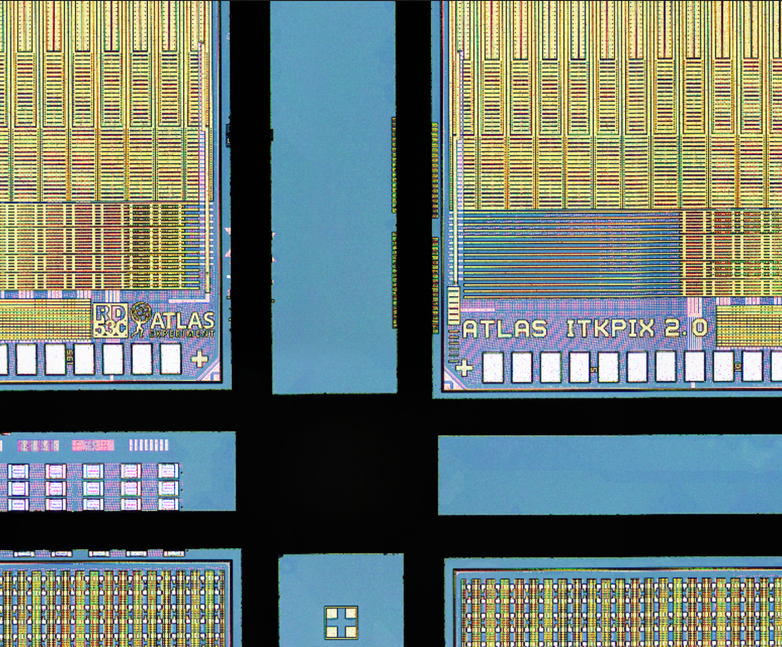
Testing the Limits of ITkPixV2
The ATLAS Inner Tracker Pixel Detector
Readout Chip
Luc Le Pottier, Timon Heim, Maurice Garcia-Sciveres, Maria Mironova, and Liam Foster
Lawrence Berkeley National Lab
November 17th, 2024
Diced ITkPixV2 Readout Chips (Maurice Garcia-Sciveres)

Slide 2
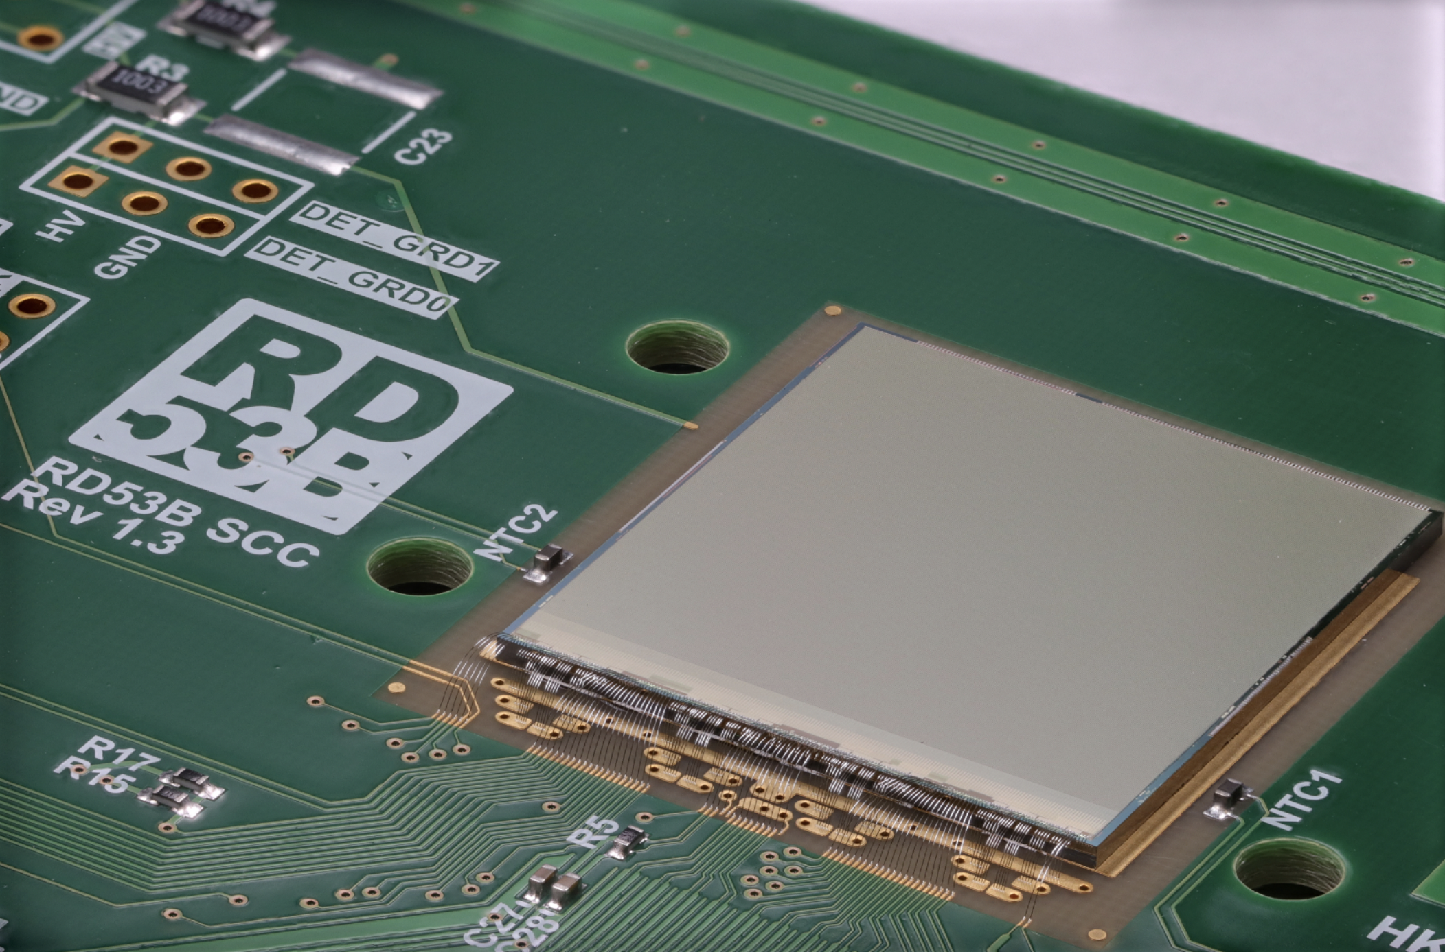
The ITkPixV2 Chip
Development
Final version of chip with a 10-year cycle by RD53 Collaboration, first proposed in 2013
Building block of ATLAS ITk Pixel Detector (see talk from Simone Monzani, 10:30am Monday)
Requirements
Major improvement over current pixel detector
Needs to accommodate a wide range of conditions: readout, hit rate, and trigger rate (+10x!)
 | Curent Pixel | ITKPixV2 | Difference
Chip Size | 2x2 cm² | 2x2 cm² | 0 %
Pixel Size | 50 x 250 µm² | 50 x 50 µm² | 5x less
Hit Rate | 0.4 GHz / cm² | 3 GHz / cm² | 7.5x higher
Trigger Rate | 0.1 MHz | 1 MHz | 10x higher
Trigger Latency | 6.4 µs | 12.8 µs | 2x longer
Surface Area | 1.9 m² | 13 m² | 7x larger
Radiation Tolerance | 300 MRad | 500 MRad | 1.6x higher
Current Draw | 20 µA/pixel | <8 µA/pixel | 2.5x lower
Min. Threshold | 1500e | 600e | 2.6x lower
Summarized ITkPixV2 Design Requirements

Slide 3
Triggering the Chip
ITkPixV2 hits are grouped into 25 nanosecond time snapshots (LHC bunch crossing collision rate, 40MHz)
To trigger at 1MHz on average, we only want 1/40th of all 25ns snapshots…
But, we don’t know which one it will be
The level 0 trigger needs 12.5 microseconds to decide which snapshot we need (latency = 12.5us)
Data of interest
1 microsecond (40 bunch crossings)
12.5 microseconds (trigger decision time)
Upshot: chip memory needs to store 12.5 microseconds of data at full rate! (500 slices of 25 nanoseconds)
To accommodate this: ITkPixV2 is >50% memory by transistor count
Next challenge: how do we read out all this data in time?

Slide 4
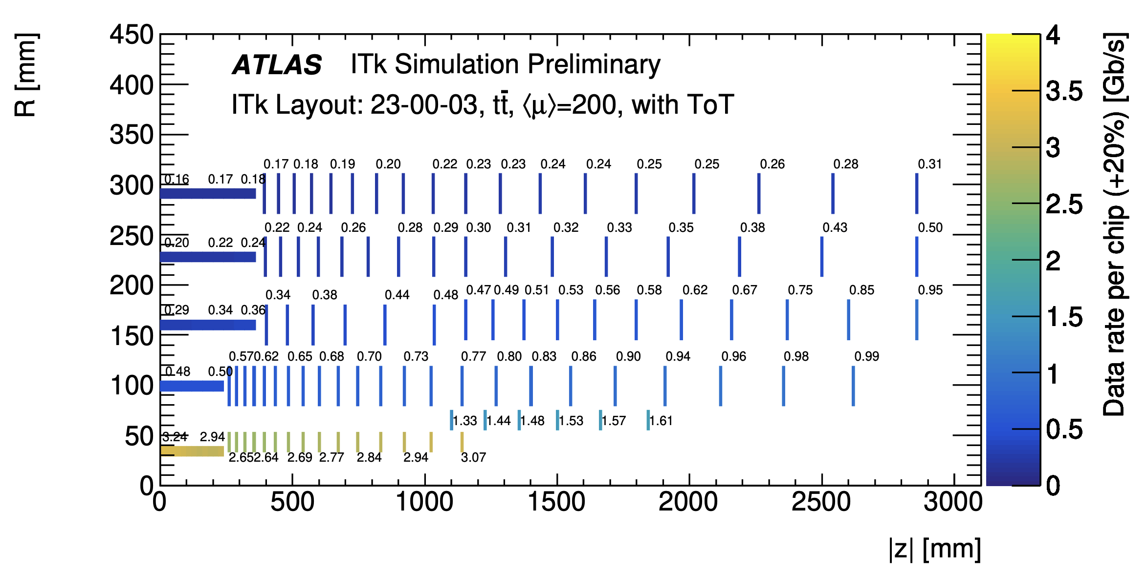
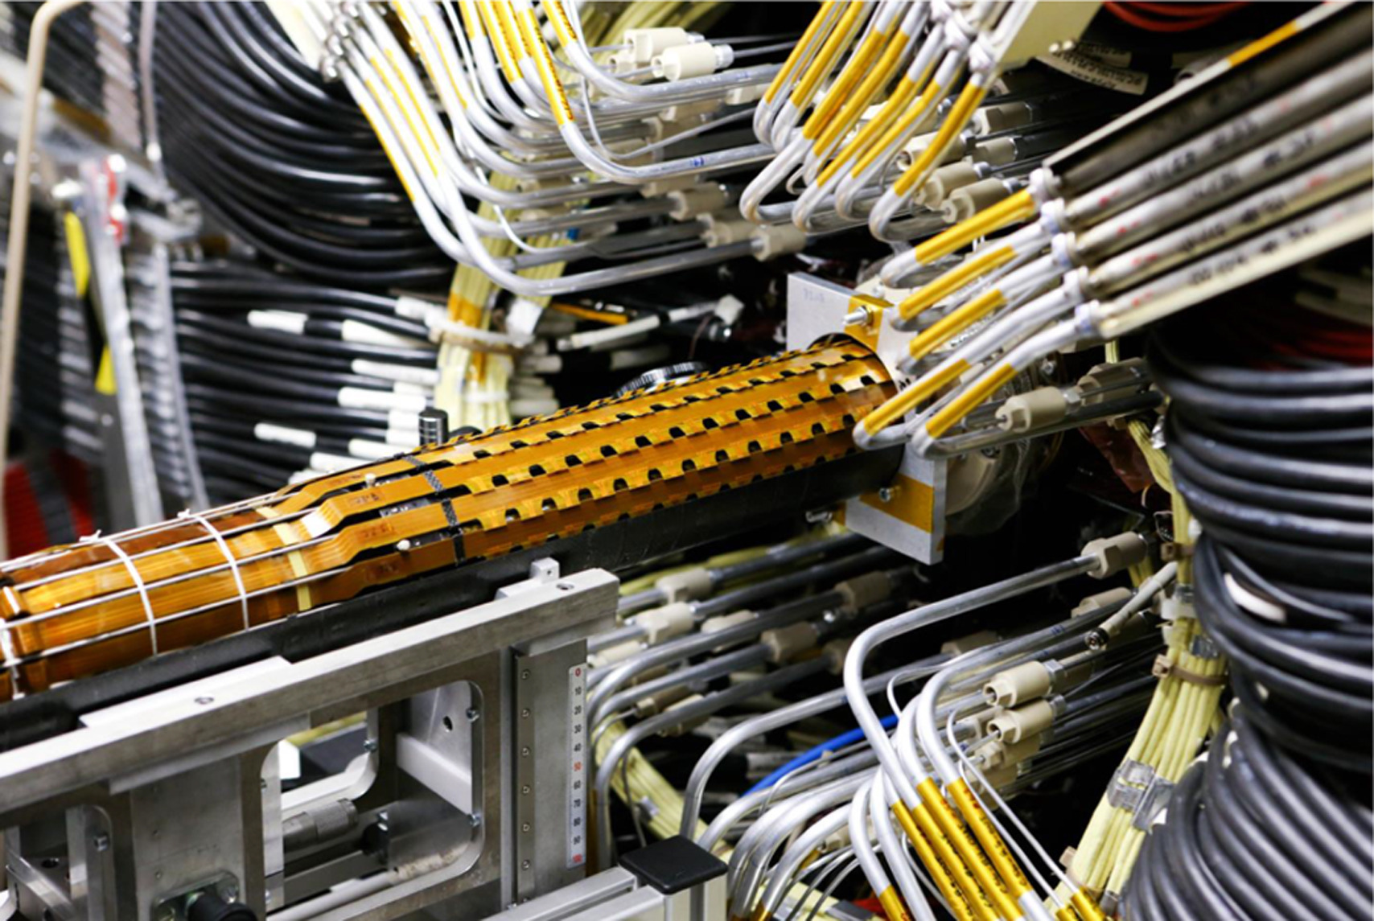
Data Readout
20x difference in readout rate between chips in inner/outer ITK
How do we handle this all with one chip?
4 readout channels per chip, called lanes: 1.28 Gbps each
Combine multiple chips onto one lane to minimize material
3.24 Gb/s needs 3-4 lanes!
190 Mb/s needs <1 lane!
Inner pixel system simulated data rates per chip (ATL-ITK-PUB-2022-001)
Ultimately, chip bandwidth is limited by output bandwidth: need to transmit over low-mass cables, with rad-hard drivers
Higher output bandwidth = more data = more physics
How to reduce need for output bandwidth?
Need to design a data compression scheme which works equally for both high and low hit rates
Current ATLAS IBL during insertion

Slide 5
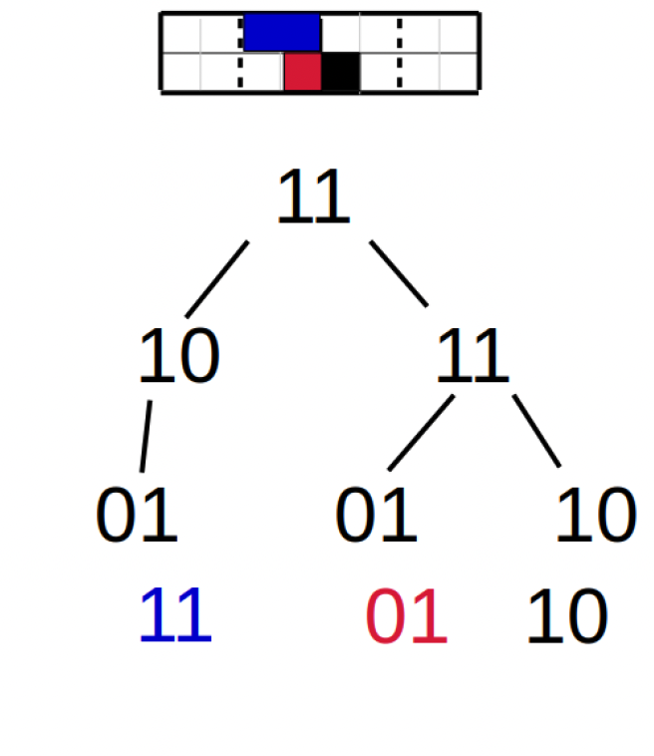
Encoding Data
What is the best way to compress such variable data?
Encoded output for three hits, two of them being in the same core column, spanning two 64 bit data blocks
Minimum ionizing particles typically form clusters…
We can drop addresses by identifying neighboring pixel hits (“islast” and “isneighbor”)
Binary tree encoding of hits in a quarter core helps for < 5 hits
01 -> 0 substitution everywhere helps as well
Great! But.. this data format is very complicated
An event with 50 hits could range in encoded size by 2-3x
Not byte aligned, so can not easily decode in FPGA
= 11 10 01 11 11 01 01 10 10 (18 bits)
= 11 10 0 11 11 0 0 10 10 (15 bits)
Making a data decoder which can run in real time is an extremely challenging task
RD53 Encoding Scheme for a four-hit event within a single quarter core

Slide 6
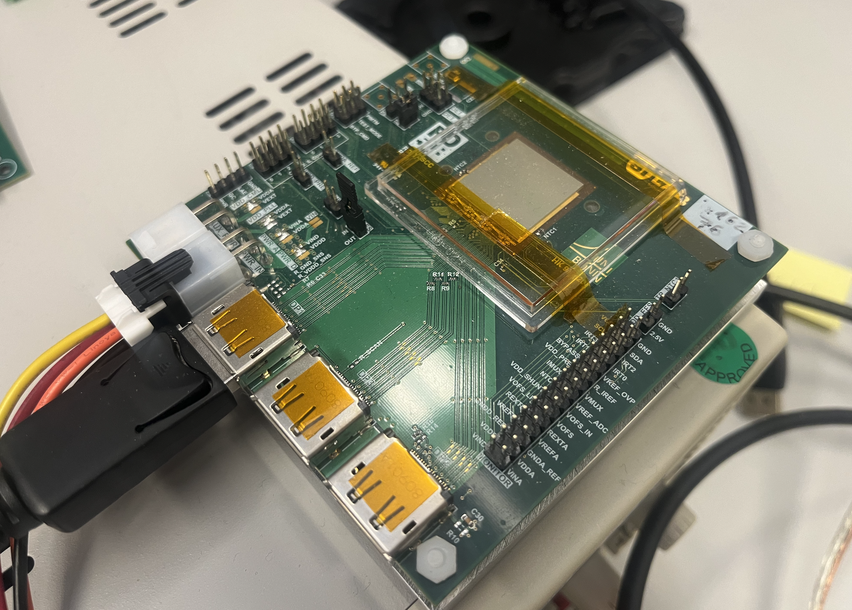
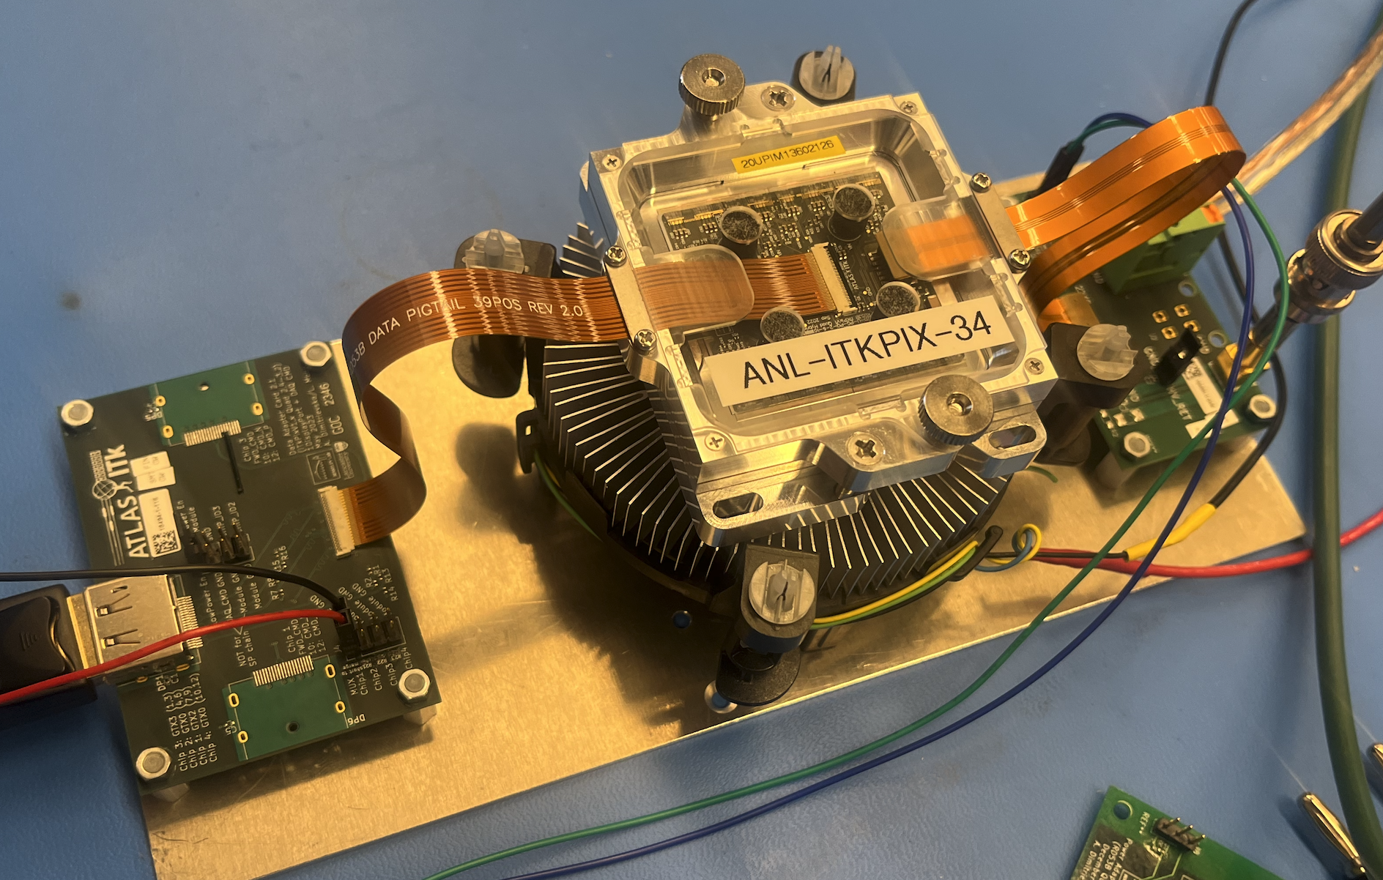
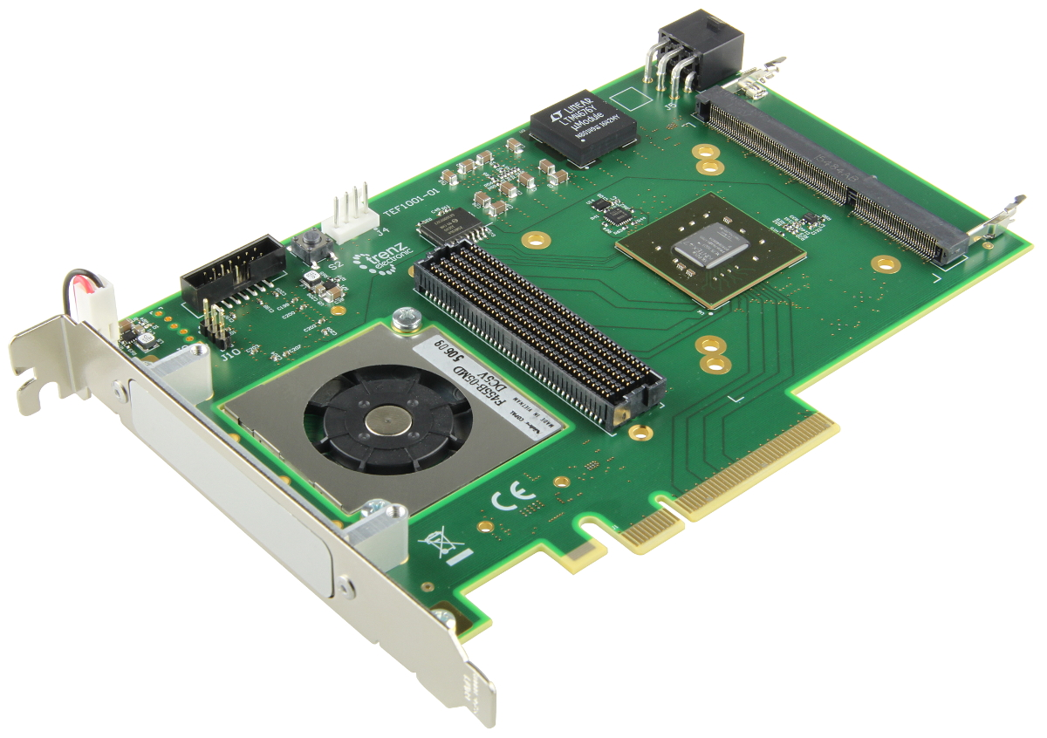
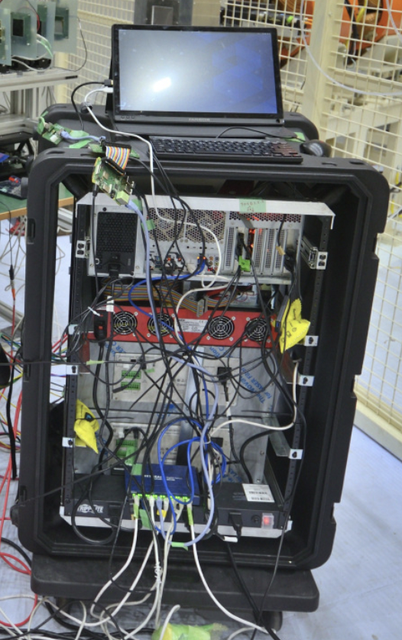
Benchtop Testing
Chip + sensor
We can already decode at rates needed for bench testing, using YARR readout firmware/SW
Single chip cards (SCCs) and triplet/quad modules (3x1 and 2x2 chip arrays), at all module testing sites worldwide
Readout PCB
ITkPixV2 Single chip card (SCC) being tested
ITkPixV2 Quad Module (center) with cooling, data readout card (left), and power (right)
Detector Frontends
Firmware: handles triggering, fast chip communication, and data routing to DAQ PC
Software: does all real-time data processing of encoded data, and provides high level control for detectors (tuning, scans)
Even in simple environments, things can go wrong: we must handle
Data transmission hiccups
Irregular chip output data from manufacturing and electrical issues (see: core columns)
Dead, noisy, or disconnected chip sections
FPGA + firmware
firmware
software
Readout PC + DAQ software

Slide 7
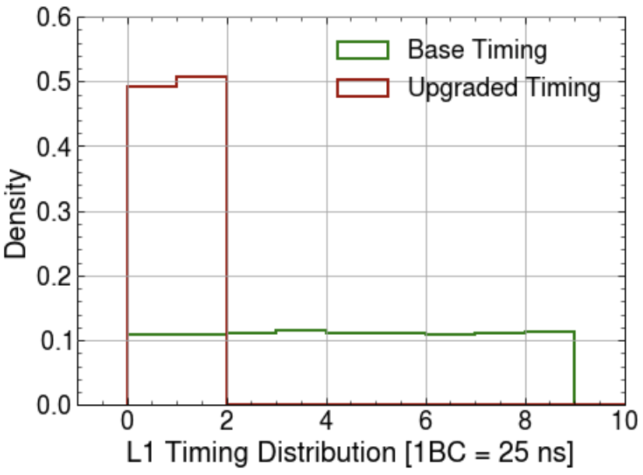
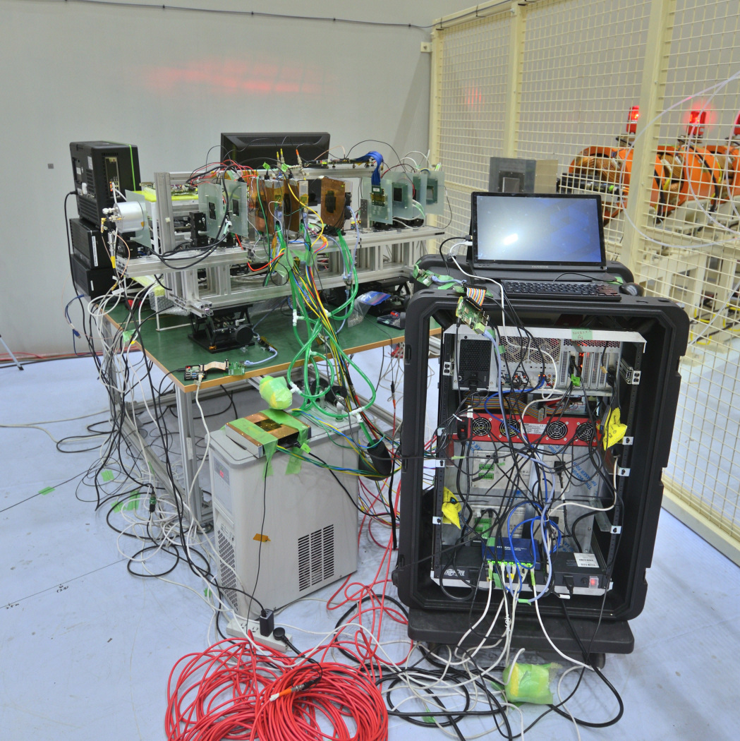
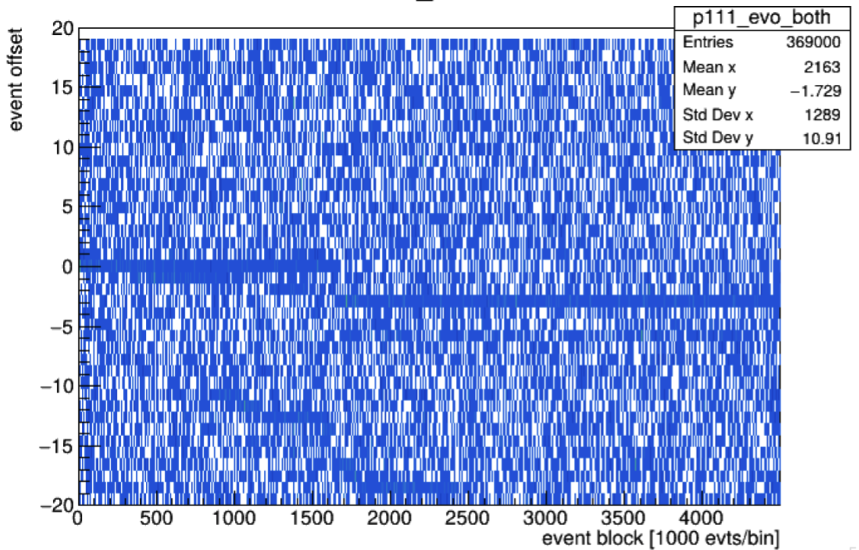
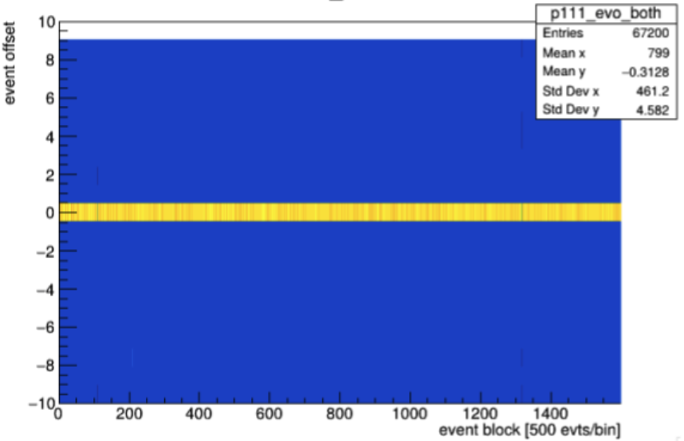
Test Beams
See results from collaborators!
poster from Md Arif Abdulla Samy on Thursday
KEK test beam with Koji Nakamura et al
A step up in output bandwidth, trigger rate, and hit rate!
10-100 KHz trigger rate (10-100 times lower than max)
~5 particles per chip for every trigger (60x lower than operation max)
Chip Trigger Timing [1BC = 25ns]
New readout challenges in these environments!
Firmware upgrades required to tighten chip timing distribution
Dropped events in telescope planes, caused by dropped events in chip, DAQ, and transmission lines: must be fixed
Before
After
Flat line means good synchronization!
Test beam at KEK, as part of the US-Japan program to construct a test beam made up of ITkPixV2 modules only
Synchronization Plot in time showing desync at around 100k collected events
Post-fix synchronization plot

Slide 8
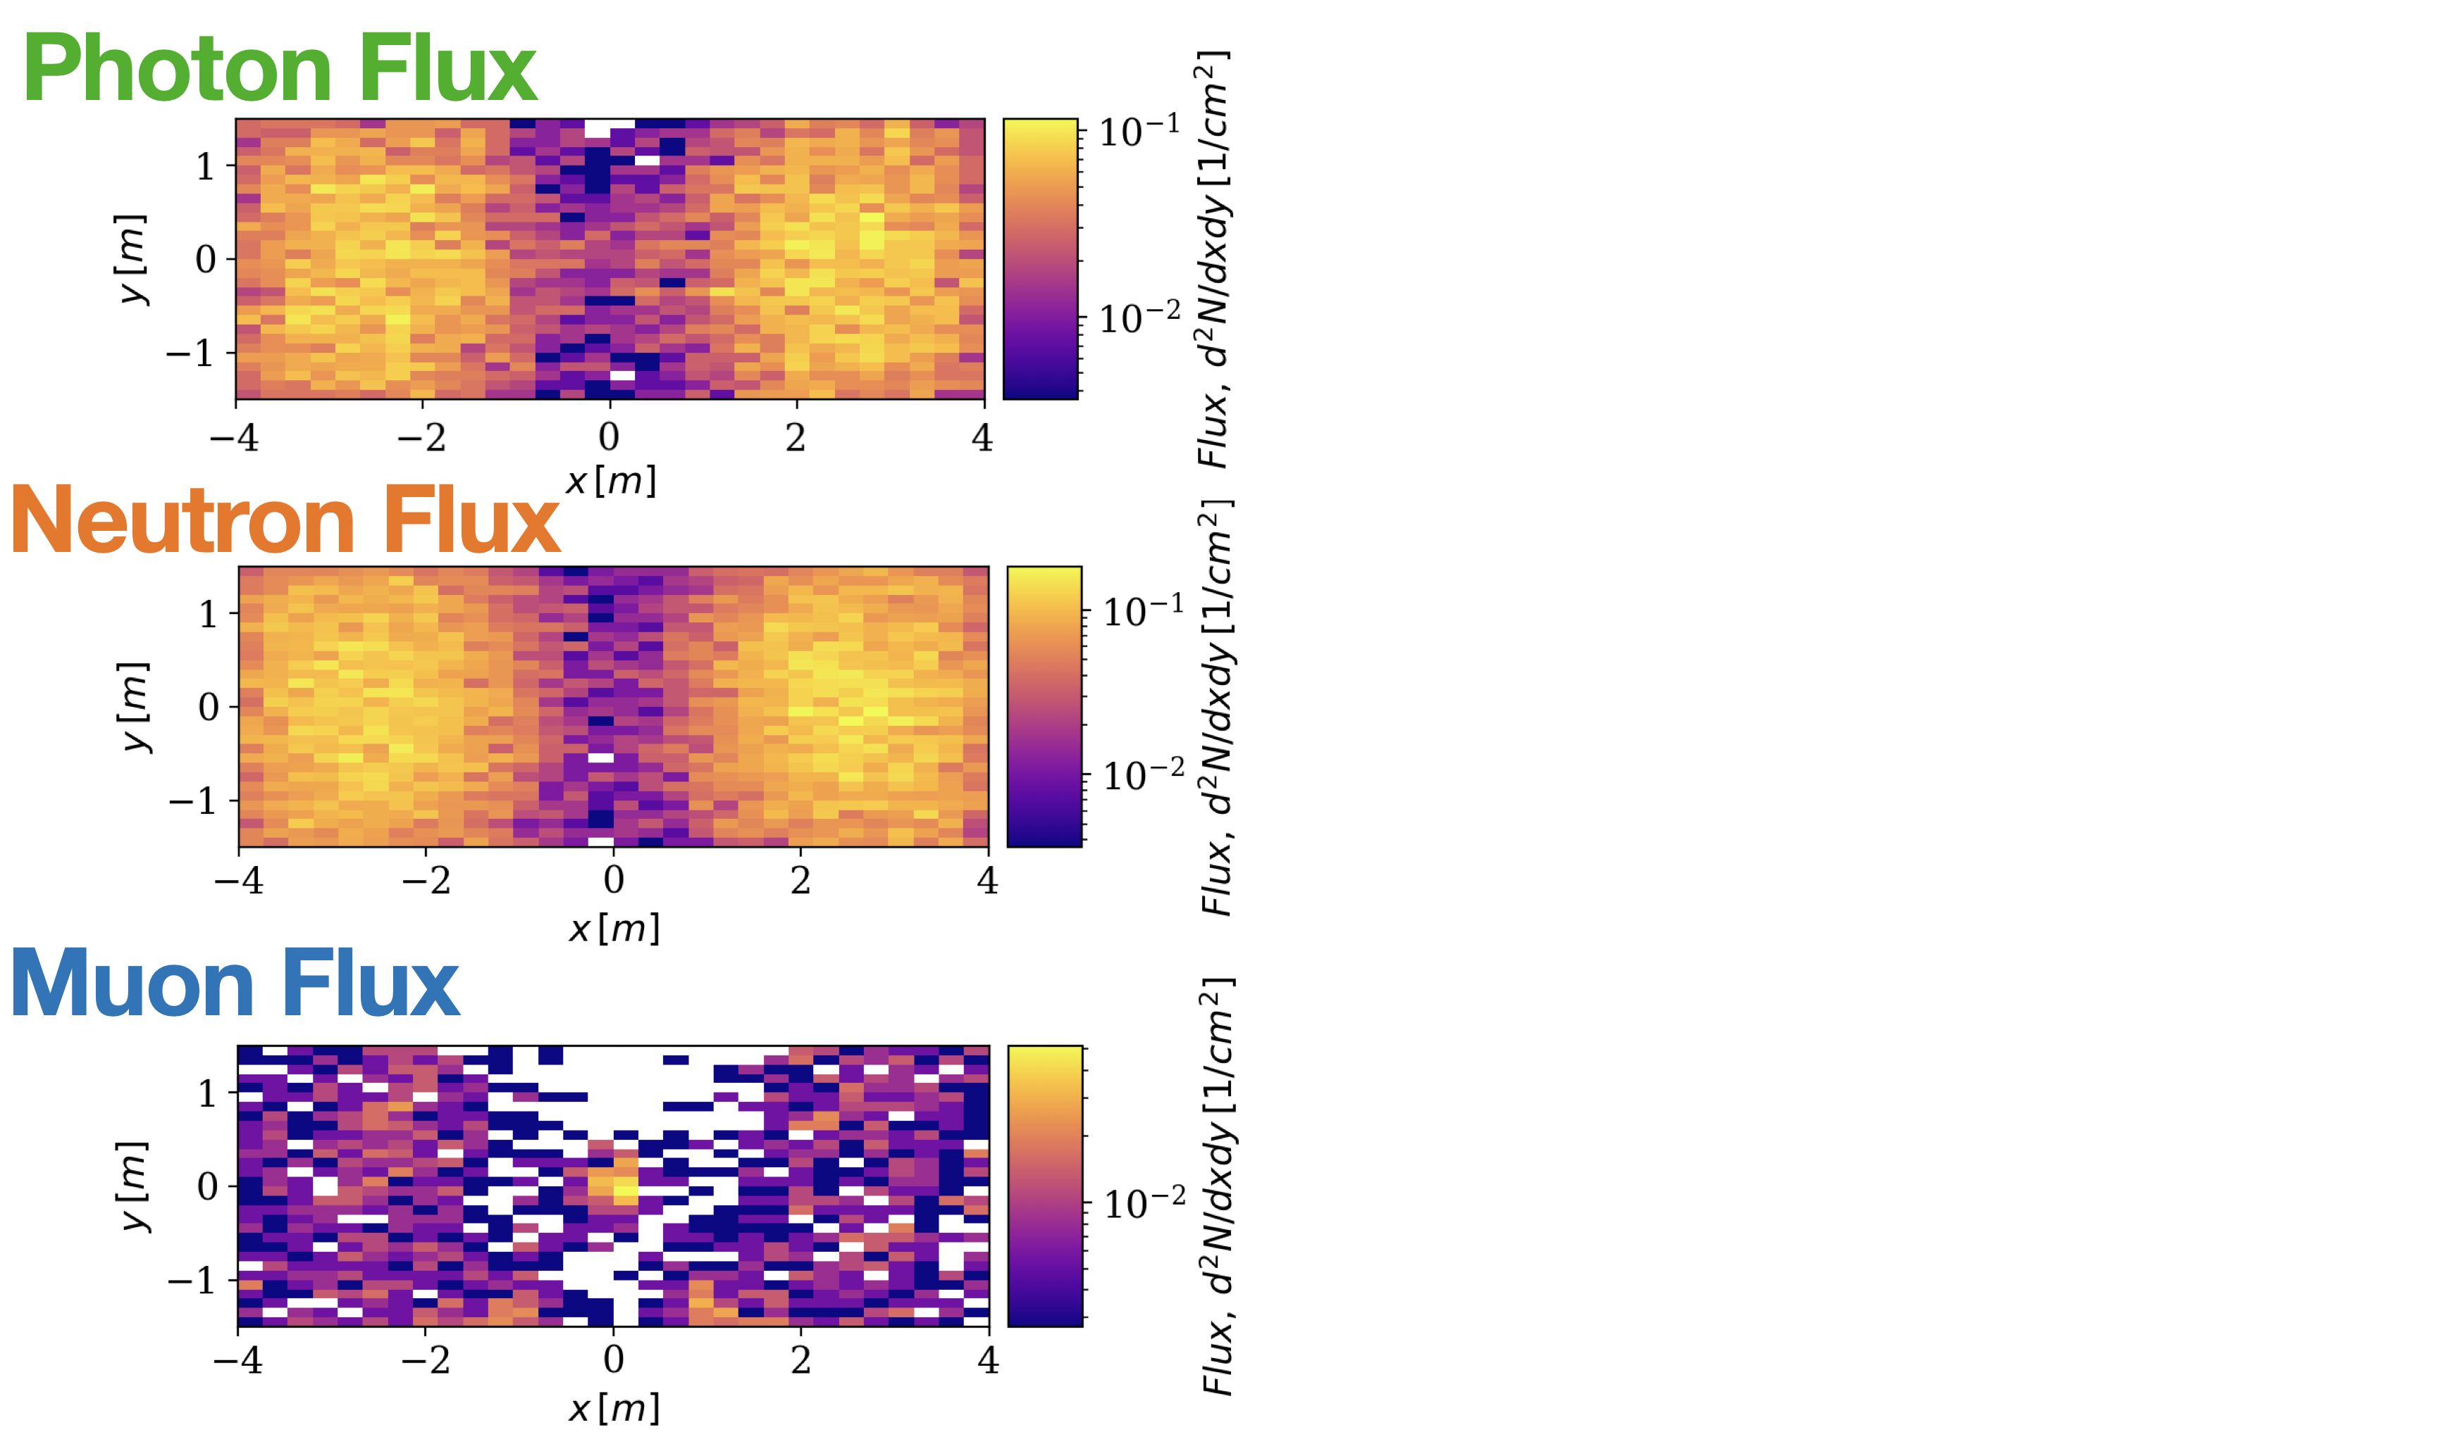
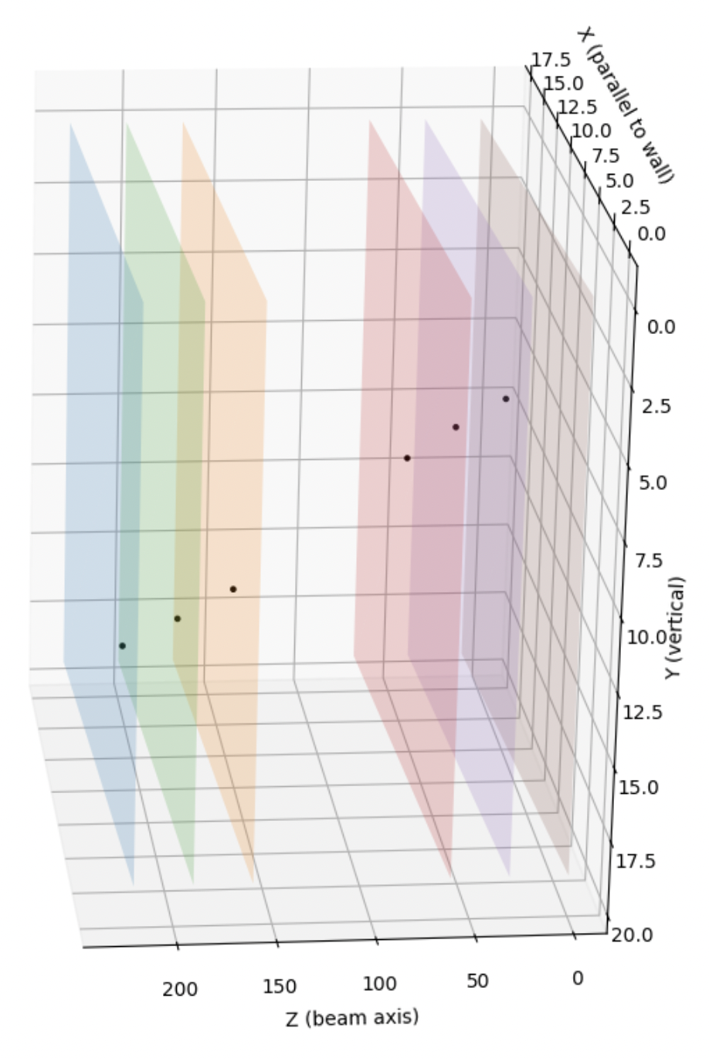
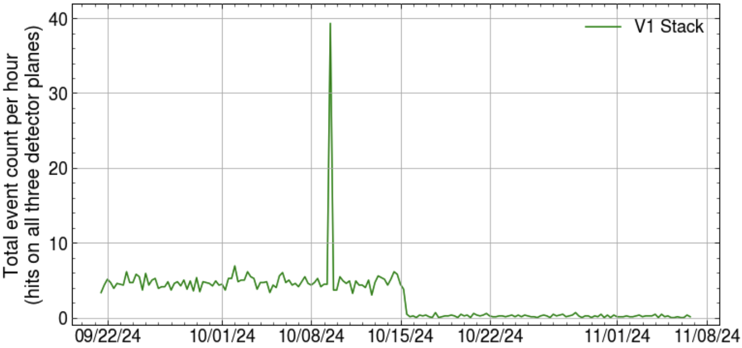
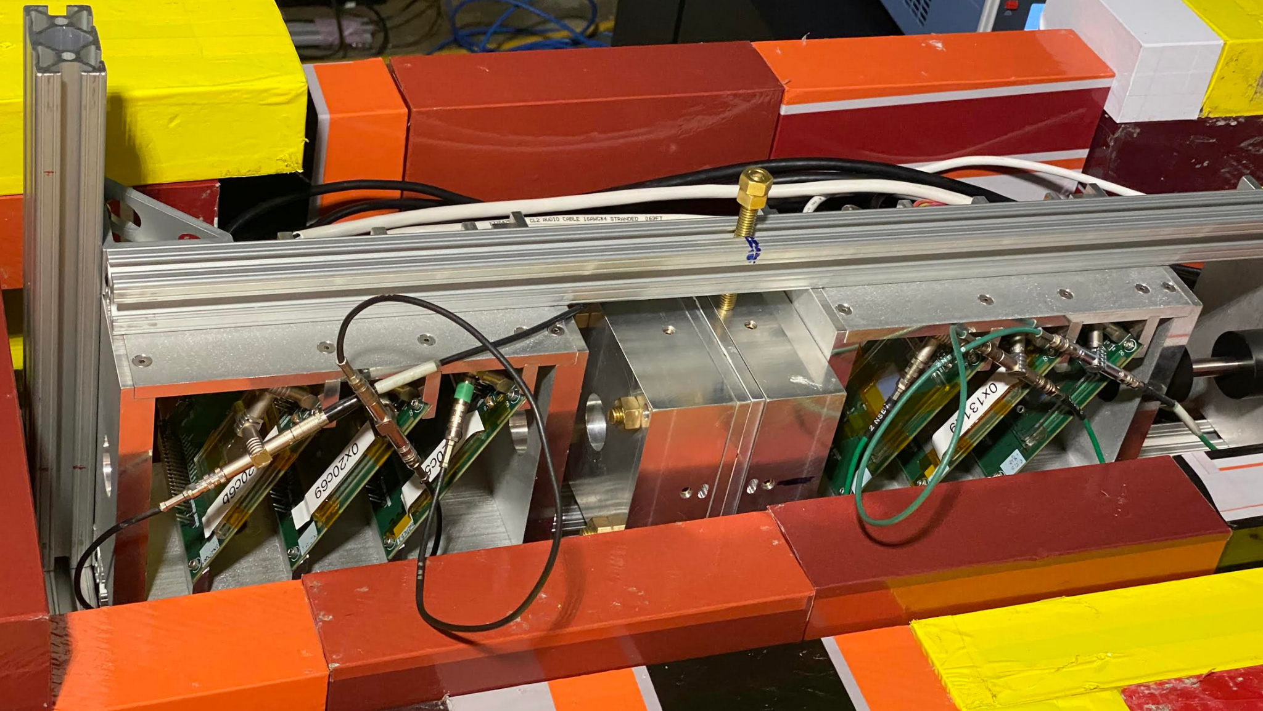
Test Beams
Simulated particle flux in BELLA target area
Other challenges at test beams…
Long term stability of detectors + DAQ
Local test bench for this: telescope after 10ft concrete beam dump at Berkeley Lab Laser Accelerator (BELLA)
Almost 2 months of continuous data taking with a 6-detector configuration
Momentary beam activity
Telescope in vertical orientation, mostly cosmic ray muon events (5-6 events per hour)
Telescope in horizontal orientation, mostly cosmic ray muon air showers (<1 event per hour)
Collected events passing through a whole telescope stack of 3 SCCs per hour, over a 1.5 month data collection period
BELLA beam telescope with 6 ITkPixV2 Single Chip Cards
Example muon event

Slide 9
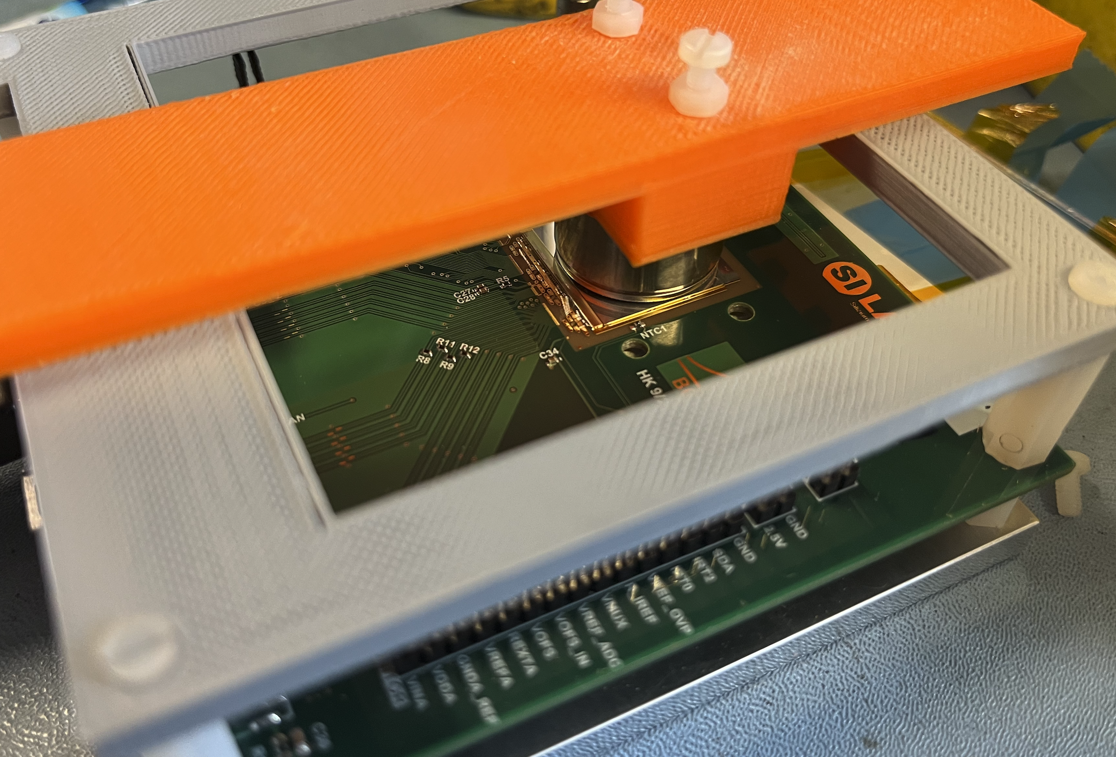
Approaching Full Rate
Despite overcoming huge DAQ challenges, tests in this talk so far have reached only
60x below the maximum hit rate of 3GHz/cm²
10x below maximum trigger rate of 1MHz
We can visualize full-rate with a Krypton-85 source, placed on a single chip card
Gaseous source with spherical container, means spherical radiation pattern
Collect the amount of data the chip would process in 1 second of operation, at the closest layer to the collision point
Ignoring single event upsets (SEUs), a significant challenge for the real detector
What does this look like?
Krypton-85 Source
ITkPixV2 Chip + micron 100um sensor
Source test setup, with Krypton-85 source placed directly above ITkPixV2 chip + sensor

Slide 10
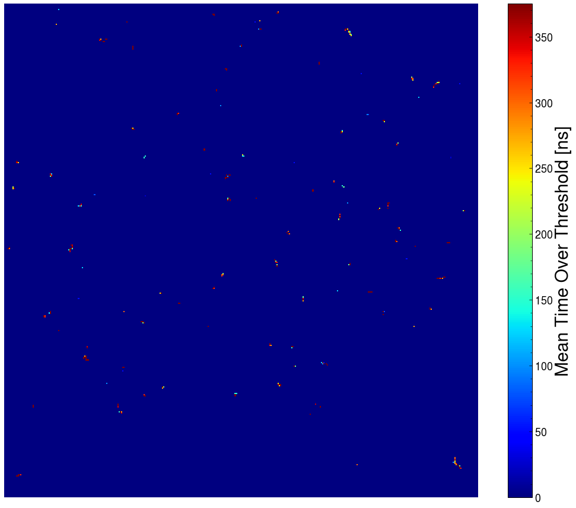
1 bunch crossing at full rate
313 hits
25 nanoseconds
2x2 cm sensor
Krypton-85 data

Slide 11
1 second
at full rate
12.6 billion hits
40MHz event rate
3.276 GHz/cm²
2x2 cm sensor
realtime
Krypton-85 data

Slide 12
too fast?

Slide 13
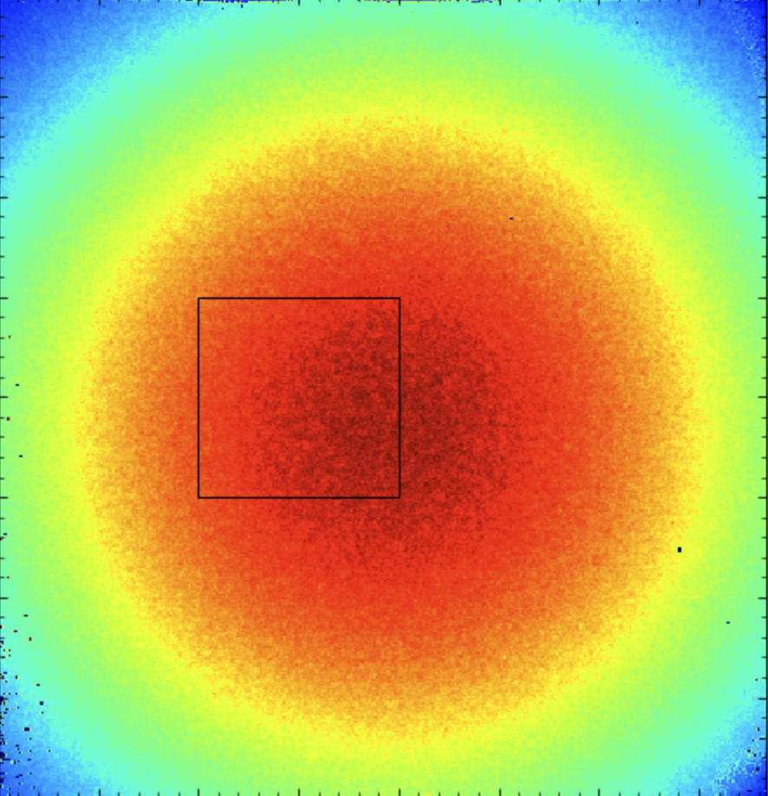
… then take a subset
100x100 pixel subregion
1/15th the area
1 millisecond
… and slow it down

Slide 14
Cumulative
Instantaneous
1 millisecond
850 thousand hits
1.5$μ$s per frame
3.4 GHz/cm^2

Slide 15
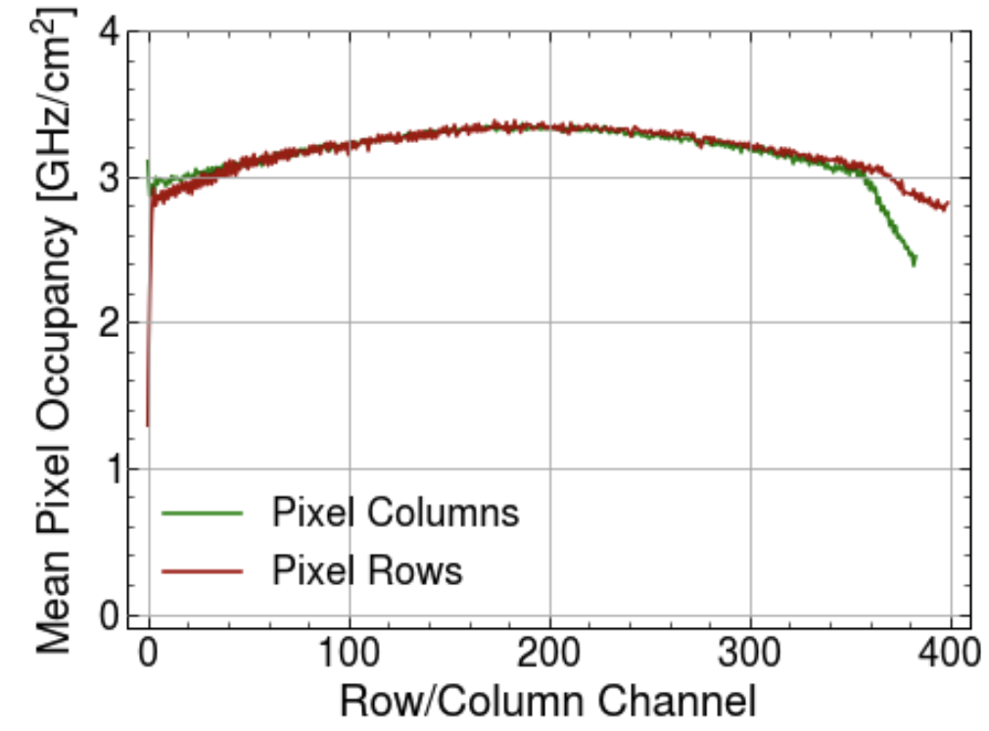
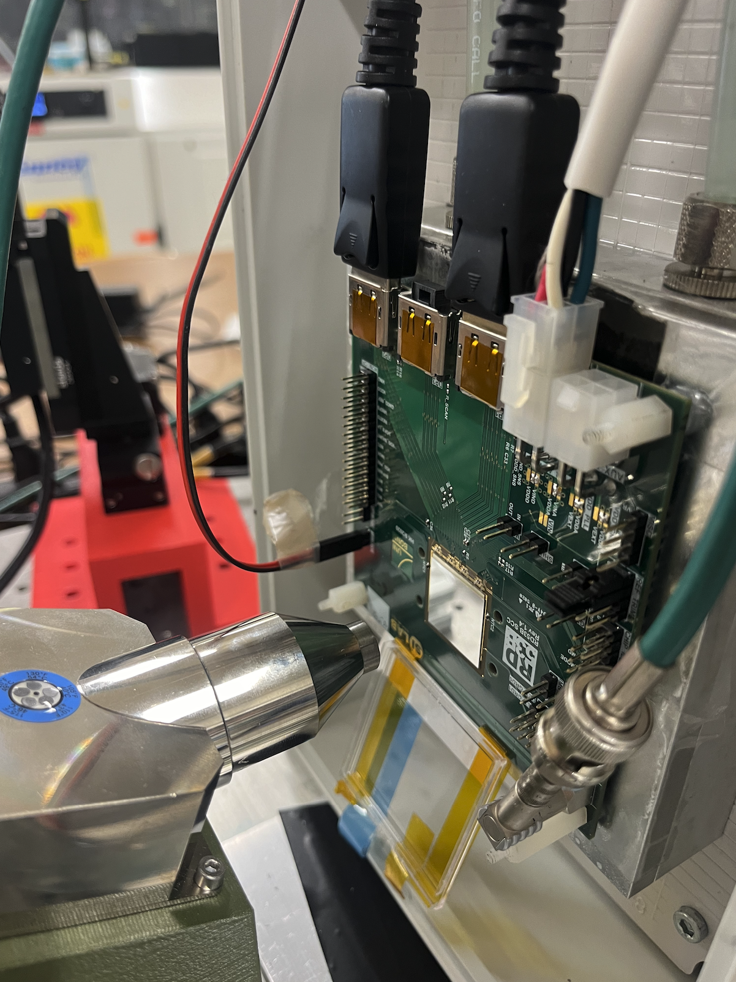
Testing at Full Rate
We need to validate our chip design
But, impossible to recreate the “real” environment in every way, without actually building ITK
How can we test at this extreme rate?
Isolate specific tests we want to do, and push the chip
Simple full-rate measurement:
Digital current consumption of the chip as a function of hit rate
Critical measurement for cooling budget of ITK: more current = more heat
Setup:
To reach ultra-high hit rates: use X-ray tube (Amptek mini-x2)
Make precision current, temperature, etc measurements during tests, triggering at 1MHz
Expectation: exactly linear relationship between hit rate and current
Mean hitrate for ~3GHz rate, showing close-to-uniform occupancy across the chip
X-ray tube aligned with chip high-rate studies
(For more on ITk cooling/mechanics: see Liam Cunningham’s talk on Monday)
Thank you to Jennifer Ott/Simone Mazza at
University of Hawaii/SCIPP for providing x-rays!

Slide 16
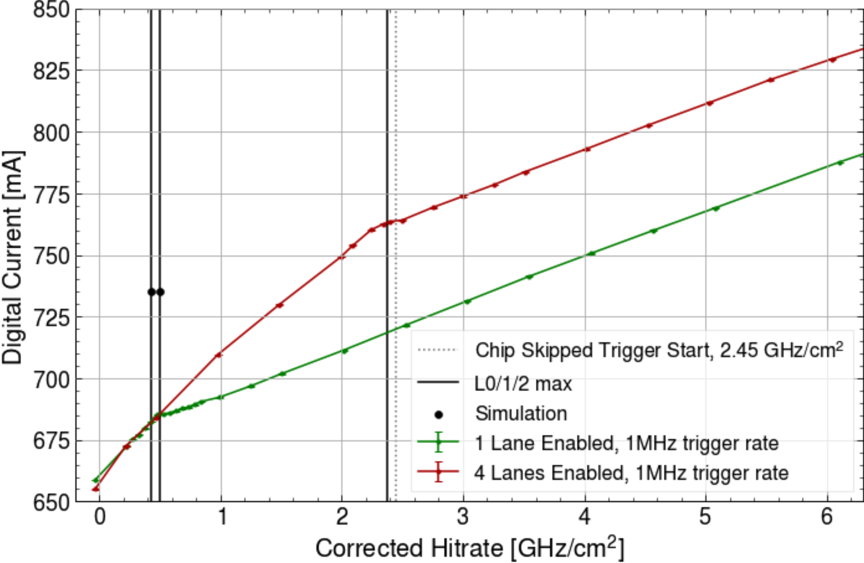
Digital Current Measurement
4-lane chip output bandwidth reached
As expected, slope is linear in hit rate
Can clearly see a “knee” at 0.45 GHz/cm²
Knee at 0.5GHz /cm² : 1 lane bandwidth limit of 1.28Gbps
Knee at 2.5GHz/cm²: 4 lane bandwidth limit of 5.12 Gbps
After this limit, lower slope: only seeing pixel matrix current (counting of hits, ToT)
1-lane chip output bandwidth reached
Digital current vs. hit rate for ITkPixV2 chip + 100um micron sensor
Why do we need to “correct” the hit rate?

Slide 17
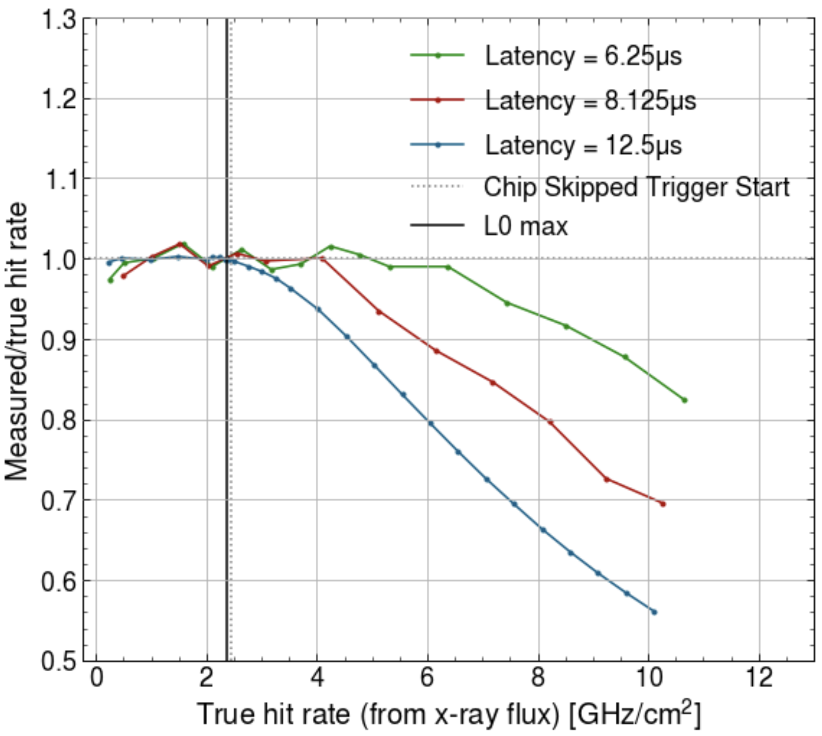
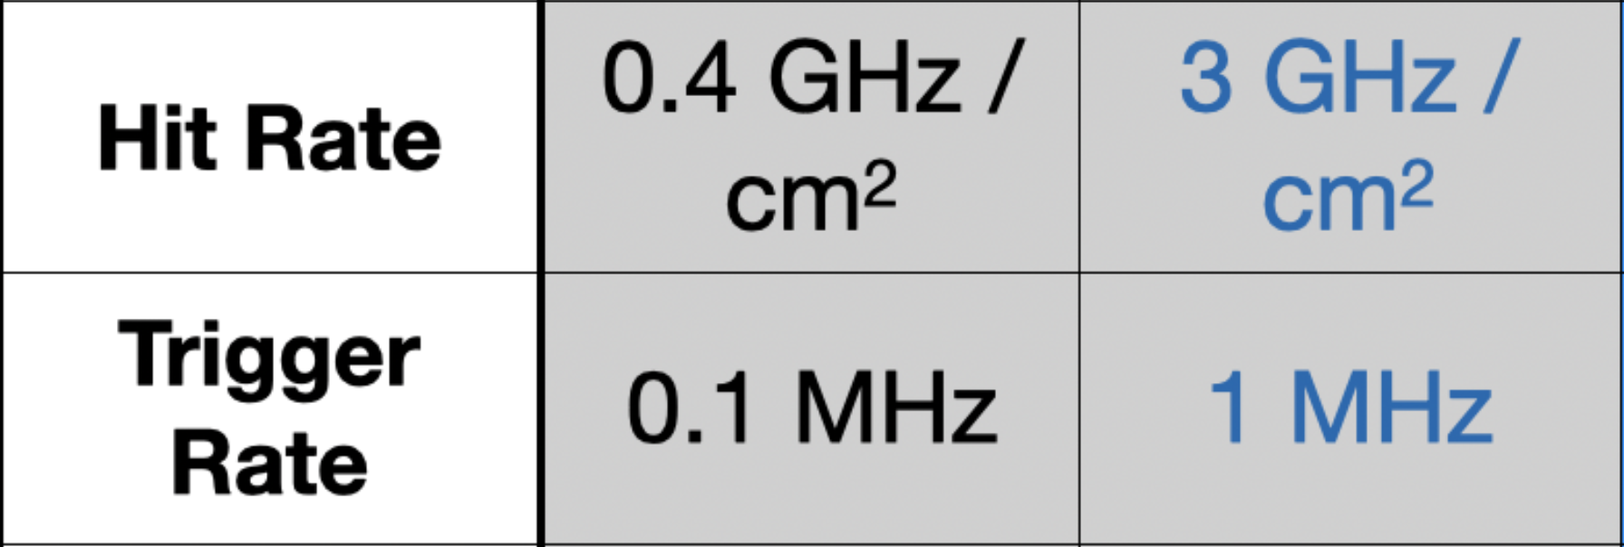
Latency and Pixel Hit Memory Overflow
Latency has a huge impact on the amount of lost hits!
Dropped hits are caused by memory overflow
Higher latency: hits have to stay in memory longer before they are read
Skipped Triggers
We start to see “skipped triggers” from the chip at only 2.45 GHz/cm²…
This is the point where the chip “can’t keep up” anymore with the combined trigger and hit rate: design spec is 99% efficiency @3GHz
But what about our design requirements?

Slide 18
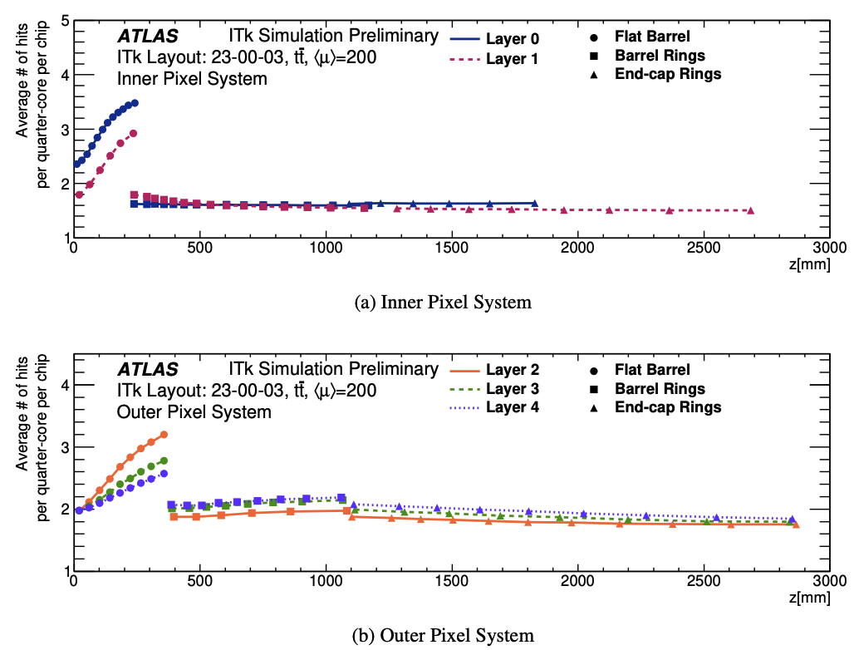
Maximum Rate
Short answer: we are ok
X-rays are typically single pixel hits, which compress less from our encoding than clusters (slide 5 and paper study)
In the real detector, we expect to see mostly clusters
This is the whole point of our chip encoding design!
X-rays provide the worst possible encoding case, at about 1.8 Gbps / GHz/cm² (clusters are closer to 1Gbps/GHz/cm² - see backup)
Chip from this test has a bandwidth limit at ~4.5 Gbps -> within safety factor!
Simulated number of hits on average per hit quarter core for (a) inner pixel system and (b) outer pixel system

Slide 19
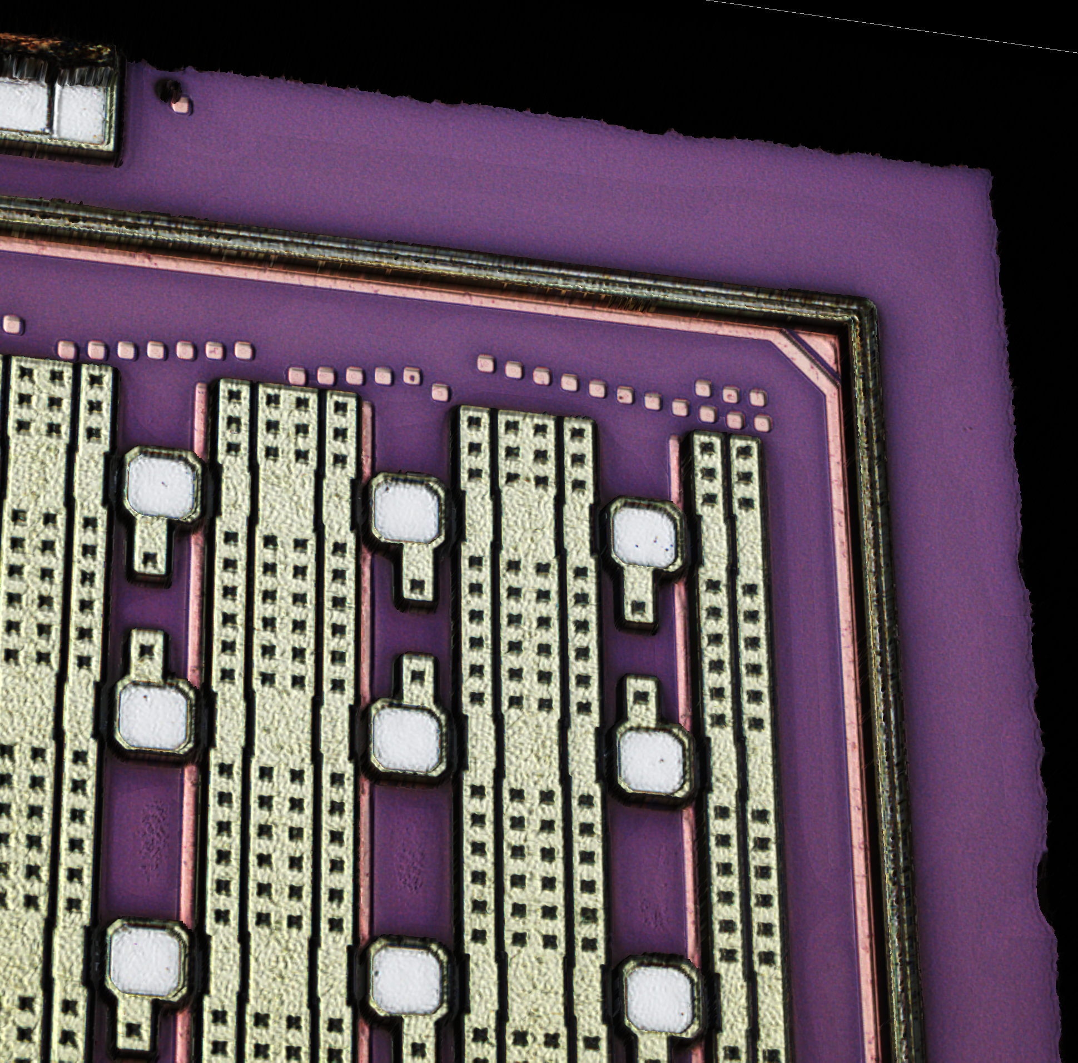
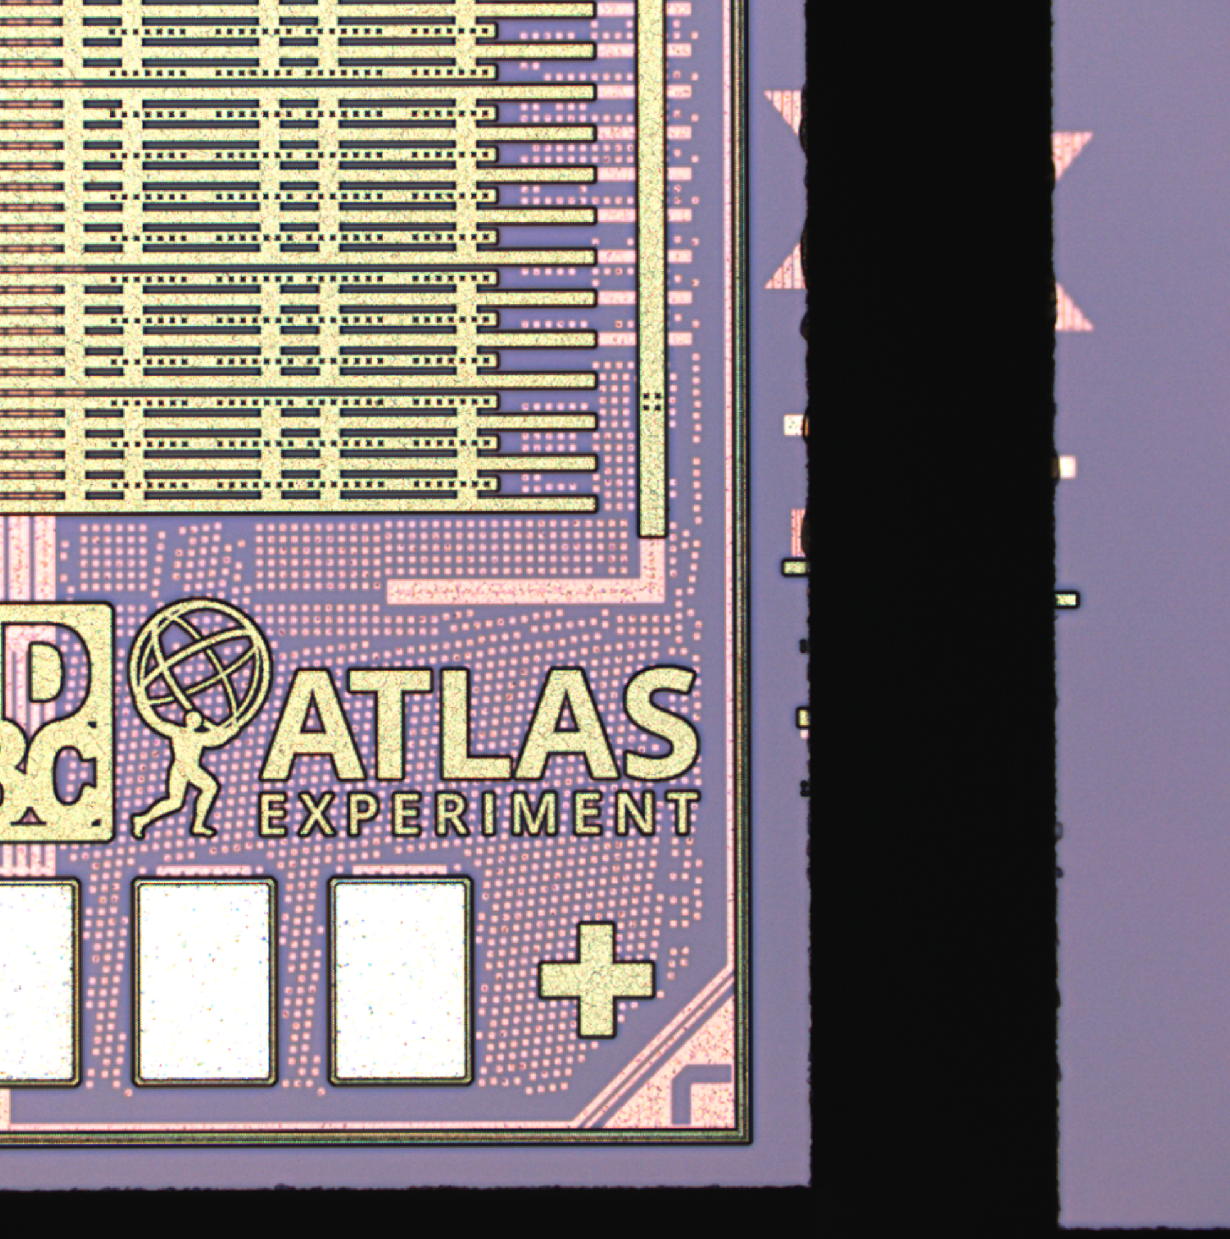
Take away
Measurements like these are critical:
Helps to verify our hardware
Builds our experience with how our detector will function during the HL-LHC
Diced wafer chip edge with pixel bonding pads and cut edge (credit to Maurice Garcia-Sciveres)
Diced wafer chip edge with wire bond pads (bottom left) and digital chip bottom (top left) (credit to Maurice Garcia-Sciveres)
Even simple measurements at our operational conditions are extremely complicated to make correctly! To truly measure everything at once, we need HL-LHC
Lots more work to do – but ITkPixV2 is working well so far

Slide 20
Questions

Slide 21
Backup

Slide 22
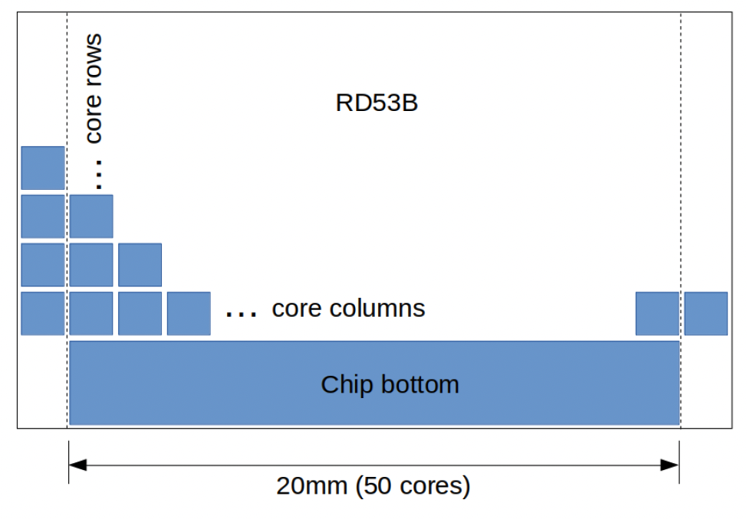
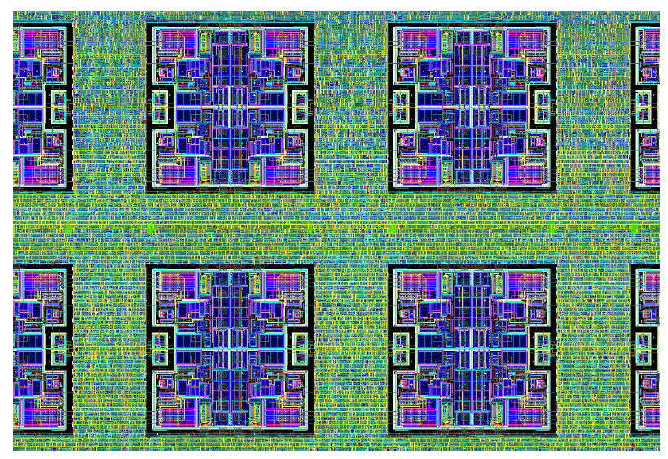
Chip Design
ATLAS consists of 48 core rows x 50 core columns, for 384 x 400 pixels
Each pixel core consists of 8x8 pixels, and contains four analog islands
Pixel matrix contains repeated pixel cores, interconnected for config and readout
Conceptual depiction of RD53C Chip Framework, from the ATLAS RD53C manual
Layout of four complete analog islands within chip digital logic, from the ATLAS RD53C manual

Slide 23
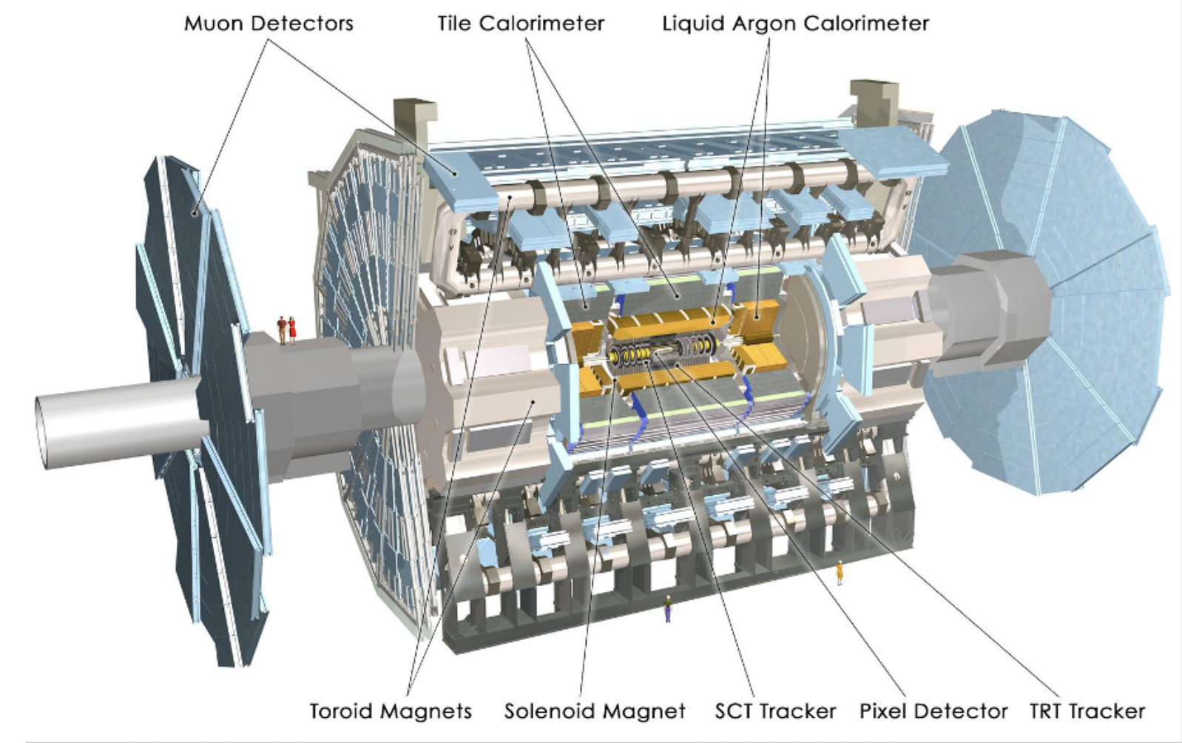
ITk Location
Part of the readout challenge is minimizing material from ITK’s location
Once installed, ITk and all cabling will need to be robust to operational conditions
Graphic from ATLAS-ITK-SLIDE-2024-008

Slide 24
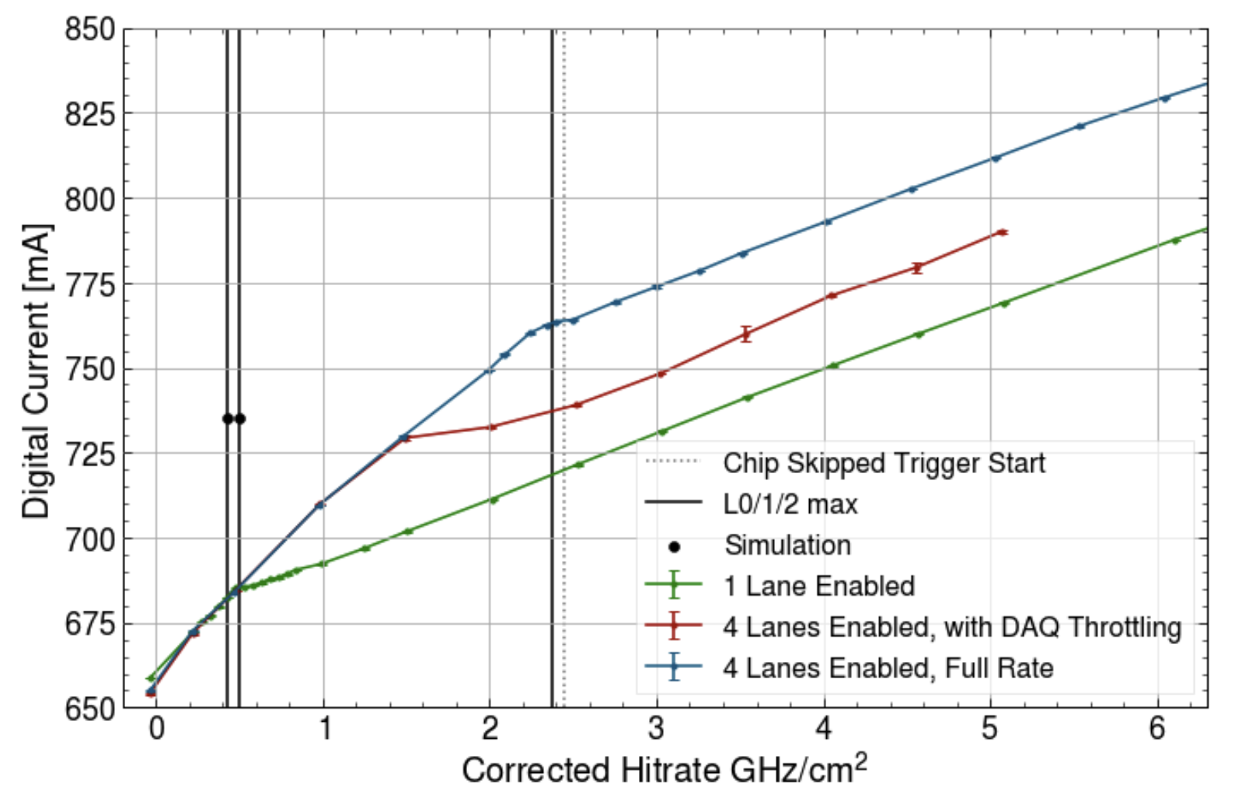
Knee FAQ
Why does current keep increasing after the “knees”?
The pixel matrix is still counting and processing hits, even though maximum output bandwidth is throttled
This means: the post-knee slope gives an estimate of the raw pixel current consumption
What does “corrected” hitrate mean?
The chip memory is finite, meaning it will fill faster and faster as the hit rate increases
At some point, new hits will begin to overwrite old hits before they can be read
Latency: controls how far back we look in chip memory, and should change our “correction factor”

Slide 25
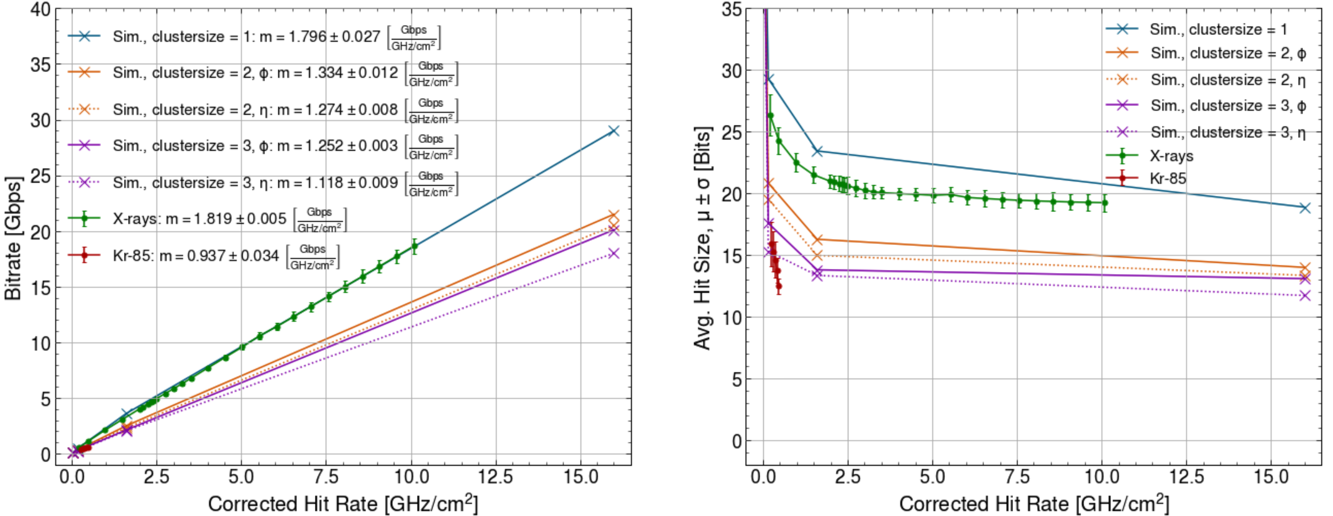
Bitrate vs. Hit rate
We can re-encode our raw data to obtain bitrate as a function of hitrate, using ITkPix encoder produced by Ondrej Kovanda for x-ray + krypton datasets. We can also plot simulated values from Rd53 testing meeting
Bitrate (left) and average hit size (right) as a function of hit rate for Krypton source, x-ray source, and simulation values for cluster sizes of 1, 2, and 3 pixels in both Eta and Phi directions.

Slide 26
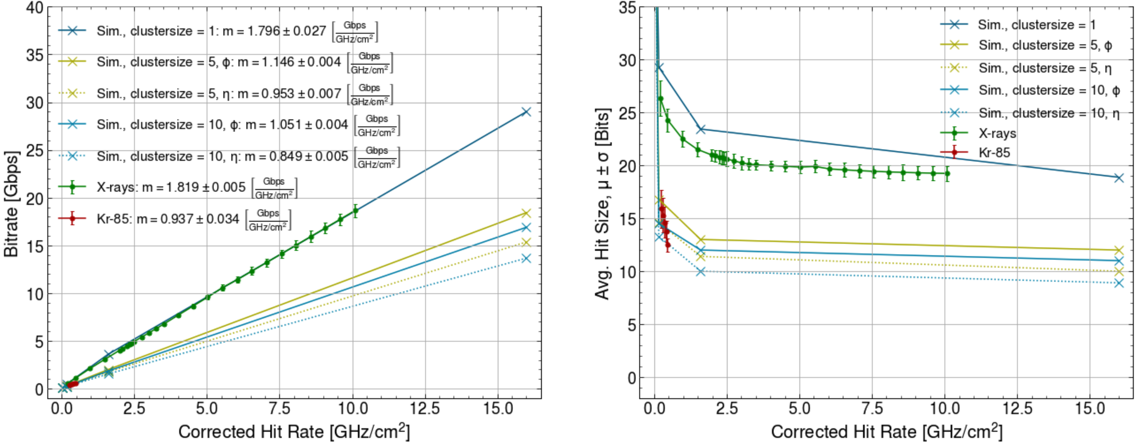
Bitrate vs. Hitrate
We can re-encode our raw data to obtain bitrate as a function of hitrate, using ITkPix encoder produced by Ondrej Kovanda for x-ray + krypton datasets. We can also plot simulated values from Rd53 testing meeting
Bitrate (left) and average hit size (right) as a function of hit rate for Krypton source, x-ray source, and simulation values for cluster sizes of 1, 5, and 10 pixels in both Eta and Phi directions.

Slide 27
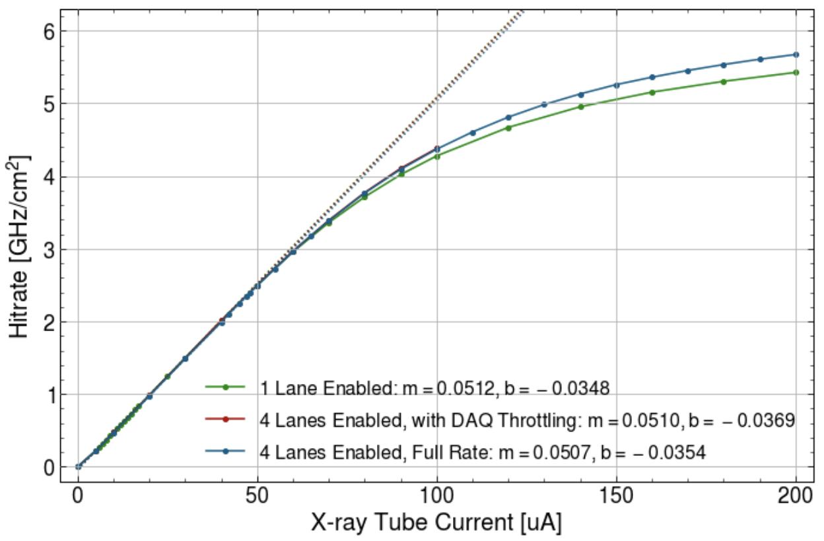
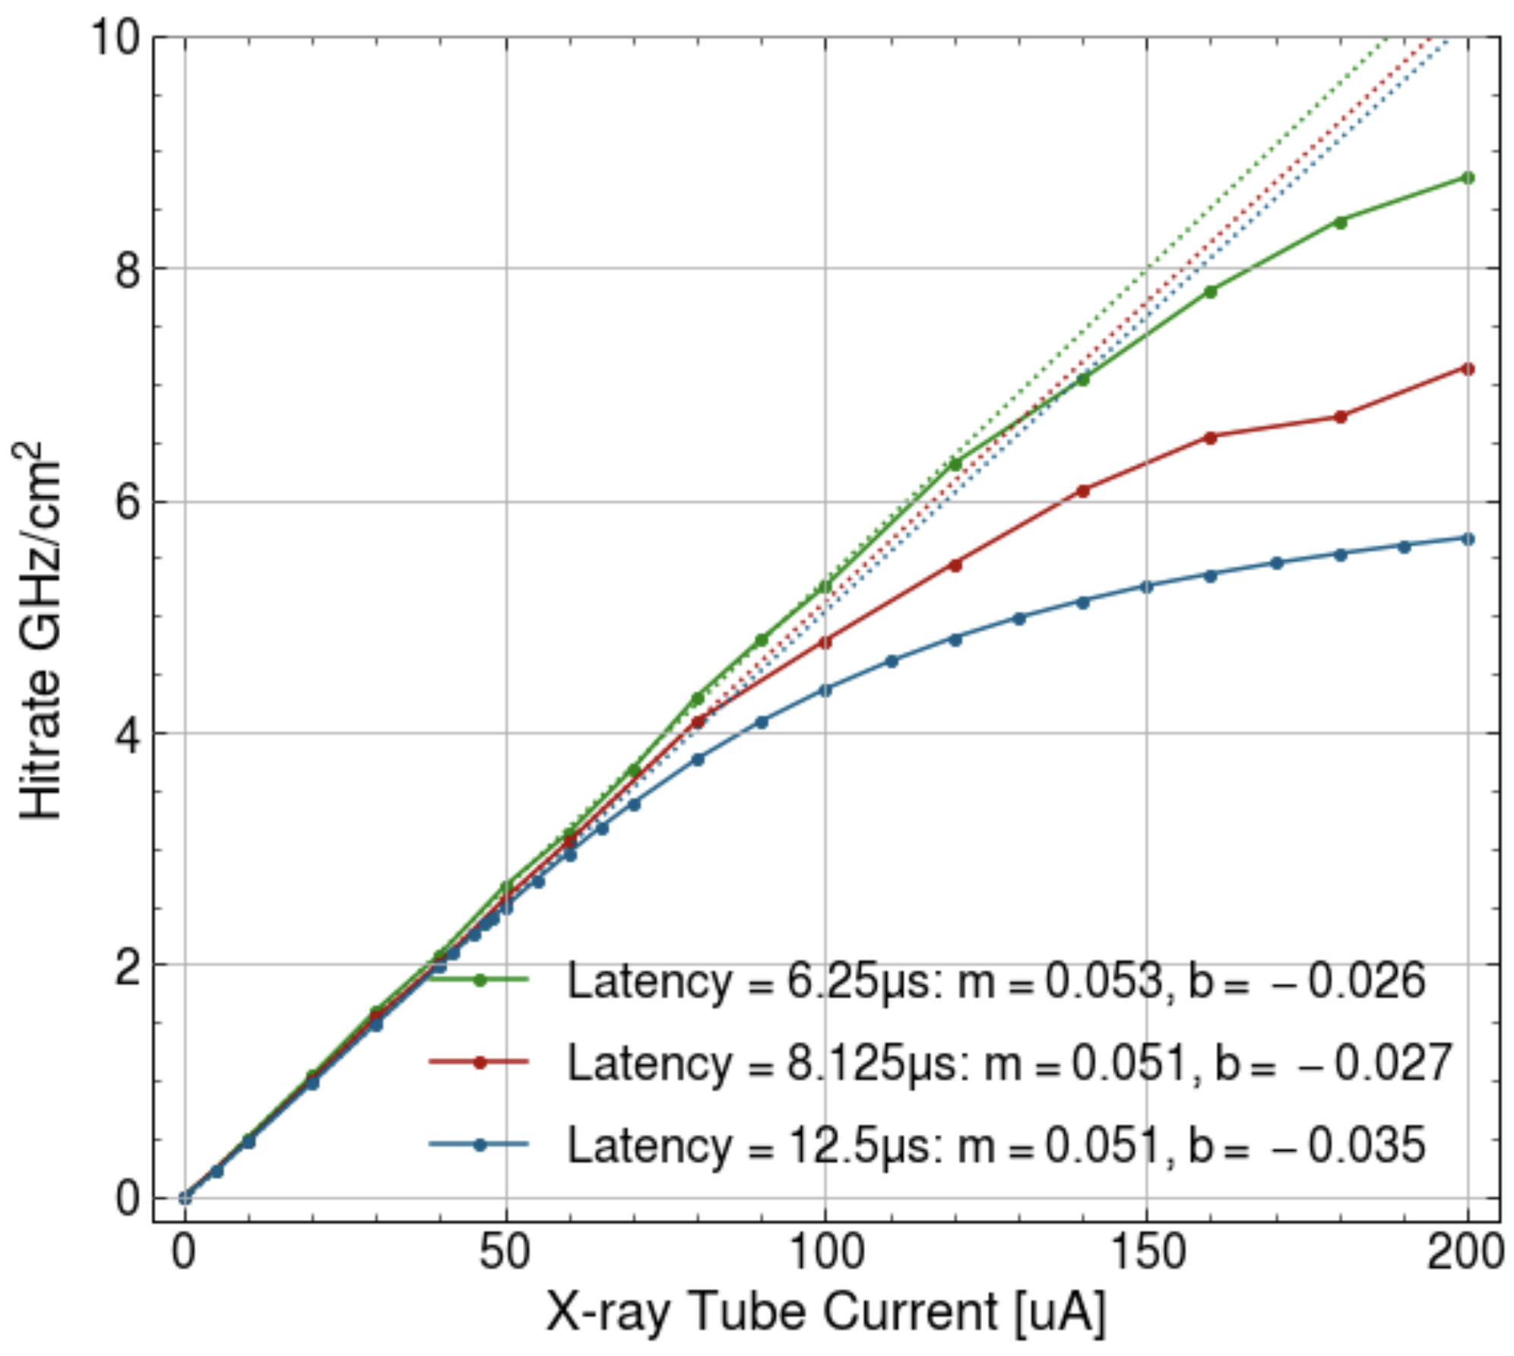
Hit Rate Correction Factors
Correction factors determined by linears fit to hit rate, from x-ray tube current, are shown below. Identical values for the same latency is expected, within stat. fluctuations
Hit rate as a function of X-ray tube current, with correction factor fits (dotted lines), for a variety of lane configurations (left) and a variety of latencies (right).

