Slide 1



Stefano Profumo
Santa Cruz Institute for Particle Physics
University of California, Santa Cruz
Astrophysical Evidence for Dark Matter and Implications for Direct Searches
3rd Berkeley Workshop on the Direct Detection of Dark Matter
LBL, December 5, 2016
Notes:
Good morning, and thanks for having me today.
I was asked to talk about: “…
Some, including me, might argue that the word “evidence” is a bit too ambitious to use here, so let me rephrase my title…

Slide 2
Stefano Profumo
Santa Cruz Institute for Particle Physics
University of California, Santa Cruz
Astrophysical Searches for Dark Matter and Implications for Direct Searches
3rd Berkeley Workshop on the Direct Detection of Dark Matter
LBL, December 5, 2016
Notes:
Good morning, and thanks for having me today.

Slide 3
As far as we know, there need not be
any connection between the visible and dark sector
gravity
“ordinary”
matter
[Standard Model]
dark
matter
weak int.?
“dark” force?
A portal is, however, theoretically plausible,
and phenomenologically well-motivated
Notes:
On the one hand, such “portal” exists in many well-defined and UV-complete models for particle dark matter; on the other hand, such a connection is motivated for instance by the paradigm of thermal relics as a natural explanation to the observed cosmological dark matter abundance

Slide 4
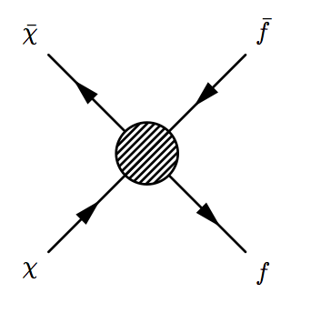
Dark Matter
Particles
Standard Model
(ordinary) Particles
Are connections between “direct detection” and
“astrophysical (indirect) searches” possible?
Notes:
schematically, one of the most likely possibilities is that dark matter particles pair-annihilate into SM particles, this
perhaps being the same mechanism that keeps the dark matter in thermal equilibrium in the early universe, and that sets its relic abundance

Slide 5
Three categories of possible “astrophysical evidences”
(i) very indirect: effects on cosmology, stars, planets,…
(ii) indirect: charged cosmic rays *
(iii) not-so indirect: photons, neutrinos **,***
*’s: possible “evidences”
On today’s menu:
what is the connection with direct detection?
Notes:
I like

Slide 6
In essentially all cases, there is some (bigger or smaller) degree of model-dependence in connecting astrophysical signals to the direct DM detection
e.g., for (i) (very indirect), suppose there is a conclusive CMB black-body spectral distortion, or additional relativistic degree at BBN: virtually impossible
Notes:
I like

Slide 7

…but even in the “very indirect” case,
connections with direct detection are possible
example: anomalous heat in “cold” planets (e.g. Uranus),
or in planets with “well-understood” and measured heat emission (e.g. Earth), from captured DM annihilation
capture probability ~ DM-N cross section x
planet column density
anomalous heat ~ planet geometric cross section x capture probability x DM density x DM velocity
Notes:
I like

Slide 8
Notice that the heat is independent of DM mass!
unfortunately, this is not quite true…
Evaporation (DM getting kicks that impart a velocity greater than the escape velocity) affects any DM particle lighter than ~10 GeV (~1 GeV in the Sun)
[GeV scale is “special”]
If anomalous heat (from cold planets, or from the Earth) is detected, large cross sections of DM off of ordinary matter, masses > 10 GeV …good news for “traditional” direct detection searches!
Notes:
I like

Slide 9
(ii) “indirect”: charged cosmic rays
Key complications: diffusion, energy losses, backgrounds
Promising avenue: search for low-background species
Antimatter cosmic rays: positrons, antiprotons, antinuclei
Notes:
I like

Slide 10
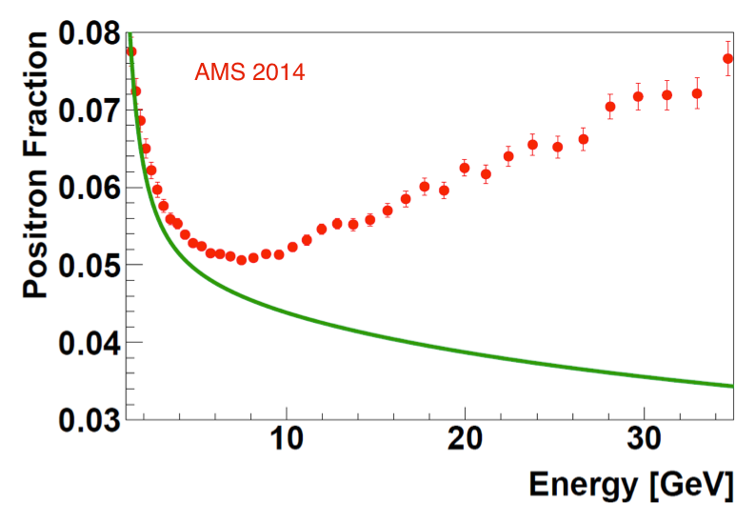
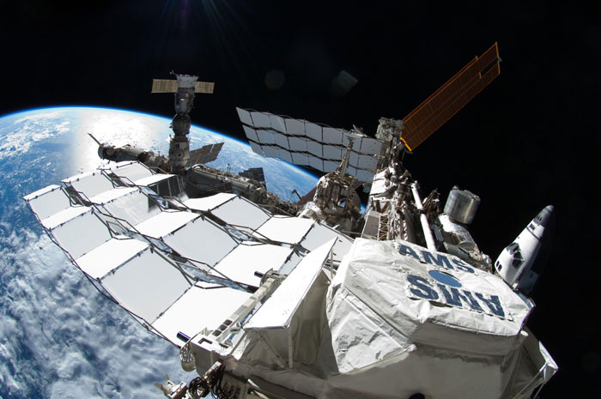
Quick summary of status
secondary
background
AMS “propaganda” plot
Notes:
I like

Slide 11
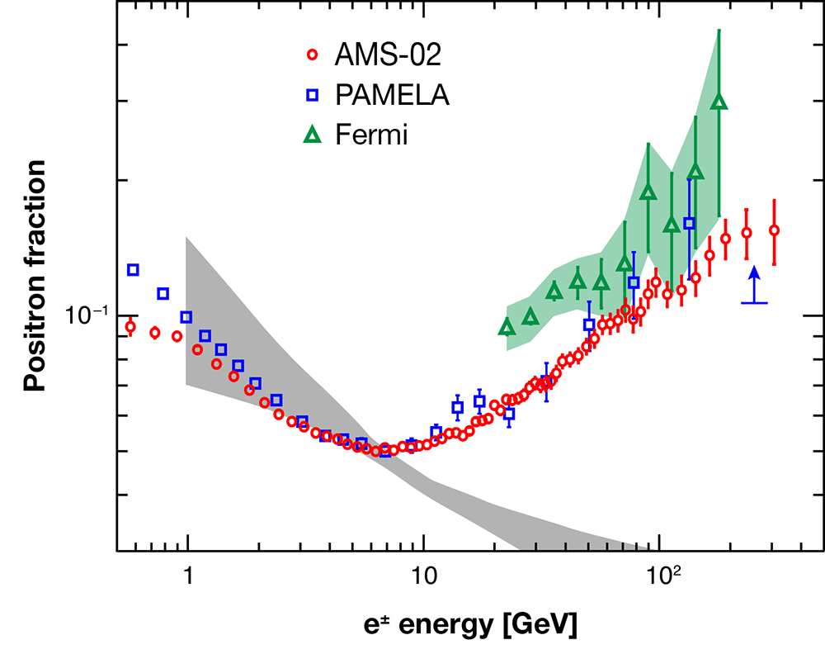
Quick summary of status
more serious
background band
conclusively an “excess” over secondary positron background
Notes:
I like

Slide 12
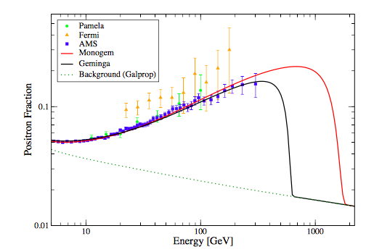
Quick summary of status
natural explanation: one (or more) nearby, young pulsars
Linden & Profumo
Notes:
I like

Slide 13
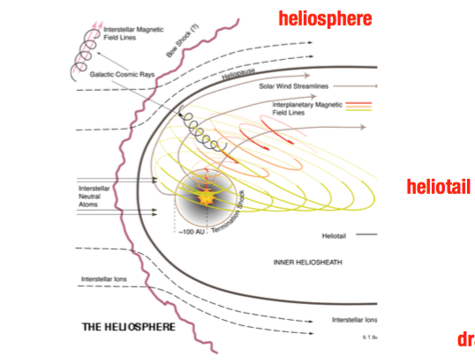
One possible way to disentangle PSR from DM: anisotropy
Complication: Larmor radius for heliospheric magnetic fields
B~ nT, is of the order of the solar system size

Slide 14


What about direct detection,
if positrons from dark matter?
(1) DM annihilates to quarks, no DD velocity suppression
B_{e}: astrophysical boost factor; S: Sommerfeld enhancement
(2) DM annihilates to unstable particles not contained
in normal matter (gauge or Higgs bosons, heavy leptons)
additional loop
suppression
also: possibly M → M_{W}
See e.g. 0809.2409 by Cirelli et al
Notes:
I like

Slide 15

(3) DM annihilates to electrons
tricky – must be sensitive to electrons, have very low energy threshold, kick off innermost electrons…
this is ~10 orders of magnitude larger than what needed to explain DAMA, which would be sensitive to such a signal
See e.g. 0809.2409 by Cirelli et al
Notes:
I like

Slide 16
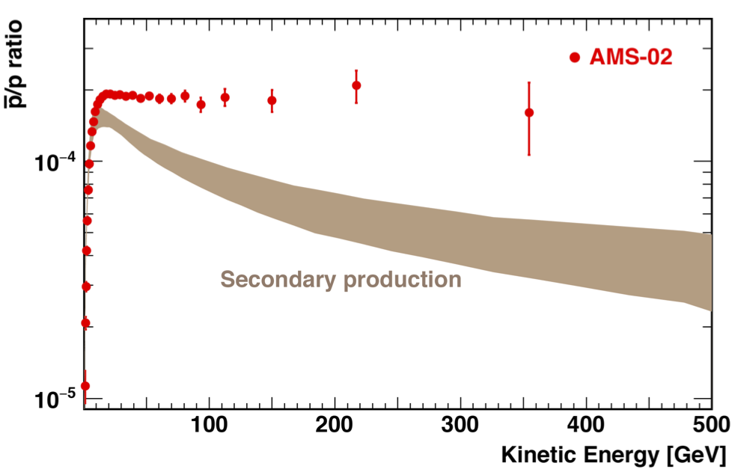
Summary of status: antiprotons
AMS propaganda plot
Resonaances: “experts unanimously agree that the brown smudge in the plot above is actually just s**t, rather than a range of predictions from the secondary production”
Notes:
I like

Slide 17
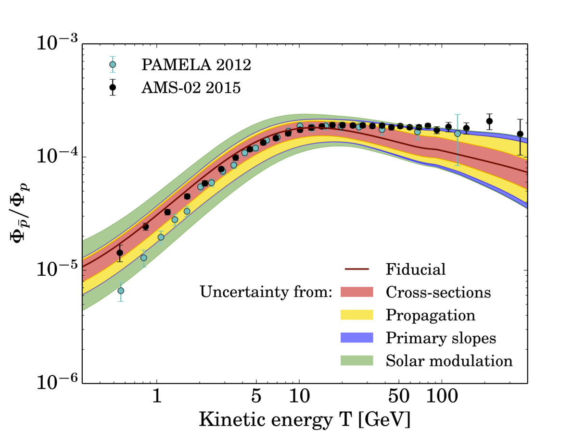
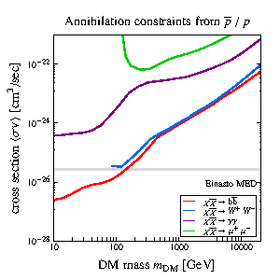
Summary of status: antiprotons
see eg. Resonaances blog
Notes:
I like

Slide 18
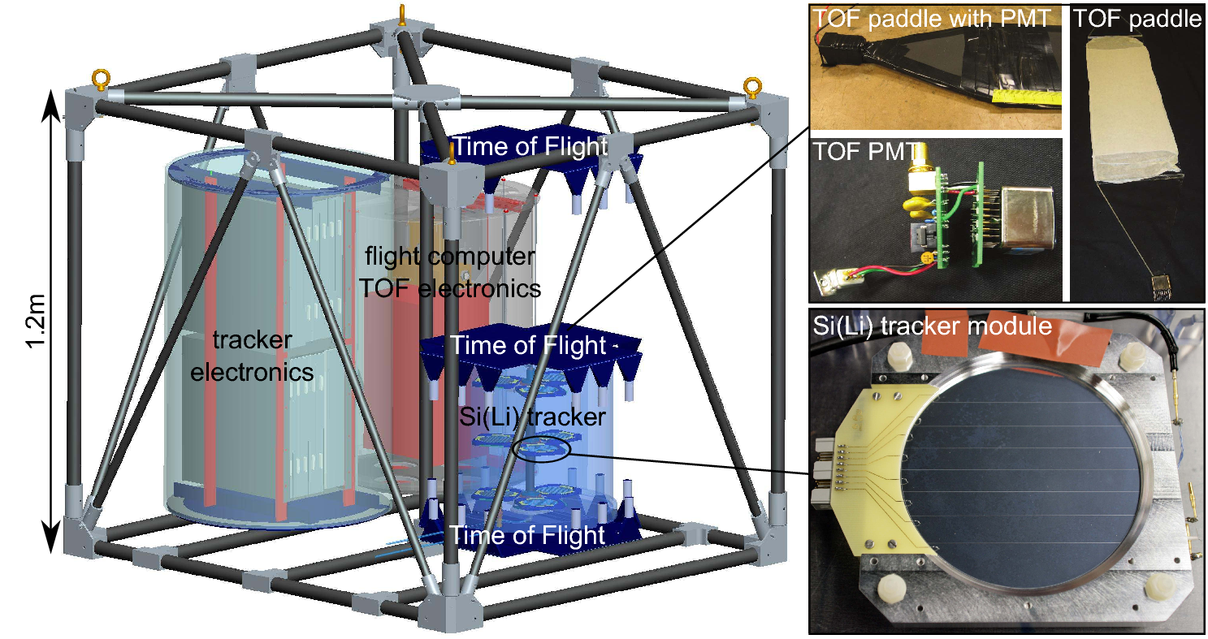
Other avenue: very rare antinuclei
no (secondary) background at all for A>2
at low energy, very low-background for antideuteron
Experiments in
progress (GAPS)
Notes:
I like

Slide 19
Should a signal be seen…
…implications for direct detection:
mass must be >2 GeV
large annihilation cross section, implying
relatively large DD cross sections (with caveats as above)
Notes:
I like

Slide 20
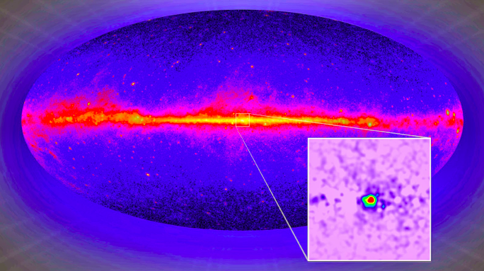
Gamma rays: not-so indirect!
long-standing signal from the Galactic center
associated dark matter particle: “Hooperon”
Notes:
I like

Slide 21
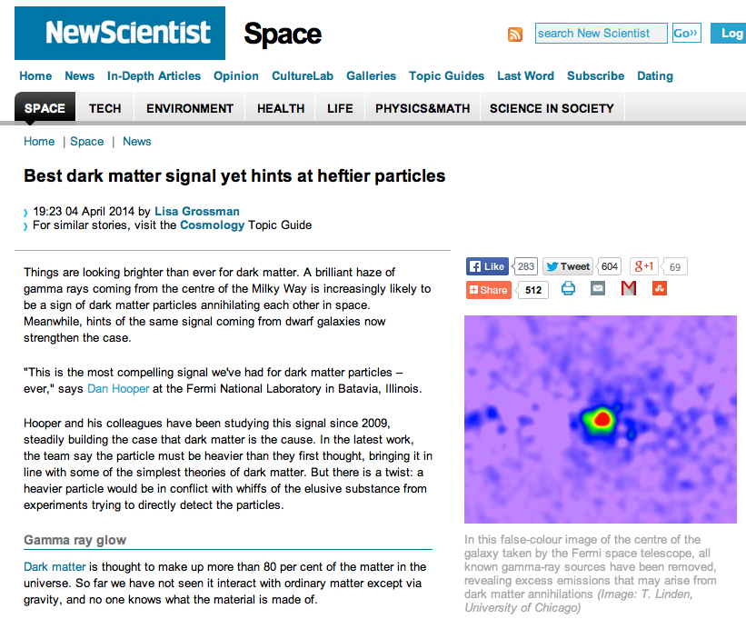
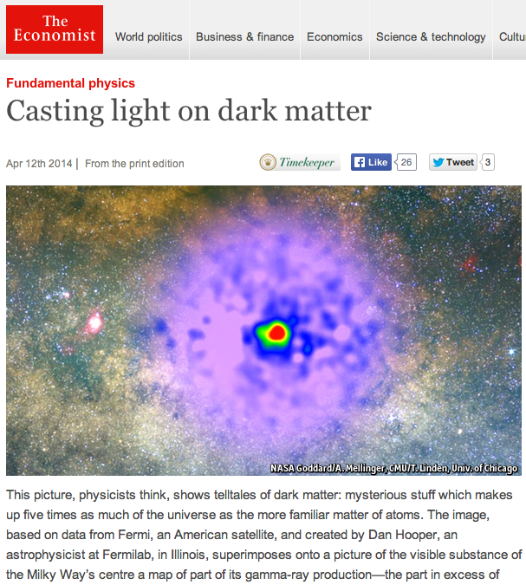
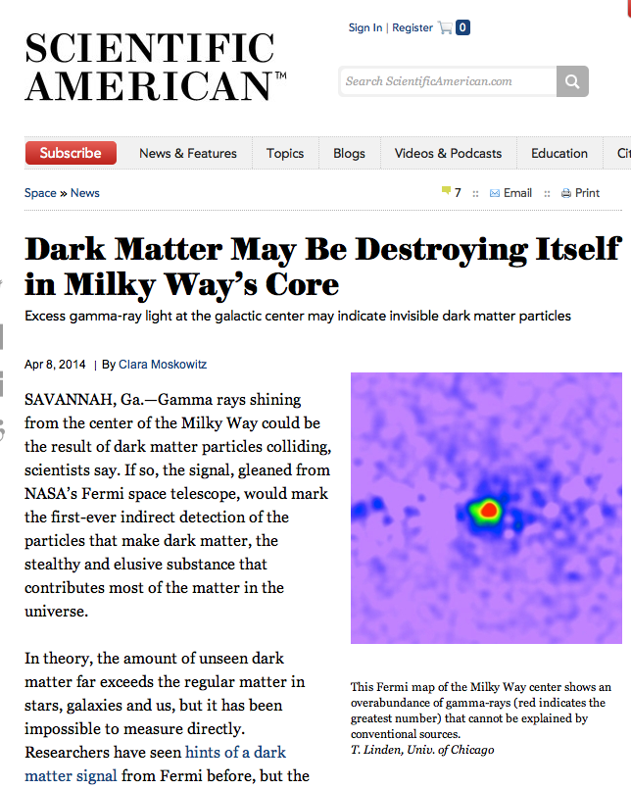

Slide 22
The Economist has the tendency
to get things right

Slide 23


Slide 24

May 7 2016 (!)

Slide 25
there are several reasons to believe that
the excess is, in fact, no excess at all
Two key reasons:
(1) not all sources of diffuse emission are accounted for
(2) diffuse gamma-ray background models are
primitive and inadequate
Notes:
I like

Slide 26
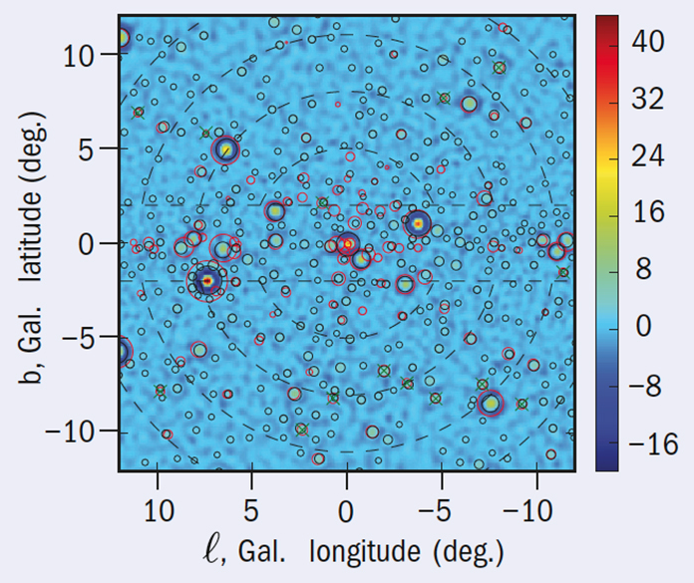
(1) not all sources of diffuse emission are accounted for
There is statistical evidence
that a large fraction
of the excess
resembles sub-threshold,
unresolved point sources
(possibly MSPs)
* Bartels et al, 2016, PRL 116 051102, ** Lee et al, 2016, PRL 116 051103
Notes:
I like

Slide 27
(2) diffuse gamma-ray background models are
primitive and inadequate;
2-D Gas Density Distribution
2-D Cosmic-Ray Propagation
Steady State
Simplistic Cosmic-ray source distribution
Every assumption costs a systematic effect
of the same order as the excess (~ few %)!
…but by far the biggest deal is item 4.
* Carlson, Linden, Profumo 1510.04698 (Phys.Rev.Lett.), 1603.06584 (PRD)
Notes:
I like

Slide 28
How to improve on this?
3-D Gas Density Distribution
3-D Cosmic-Ray Propagation
Cosmic Ray Bursts/Transients
Physically motivated Cosmic-ray
source distributions
* Carlson, Linden, Profumo 1510.04698 (Phys.Rev.Lett.), 1603.06584 (PRD)
Notes:
I like

Slide 29
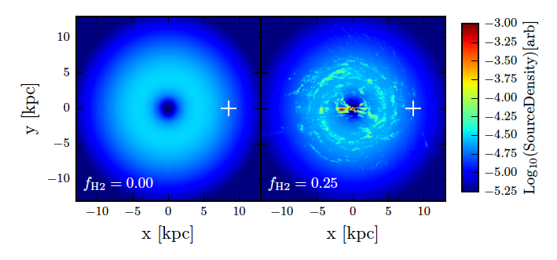
Physically motivated, 3D Cosmic Ray
source distributions
* Carlson, Linden, Profumo 1510.04698 (Phys.Rev.Lett.), 1603.06584 (PRD)

Slide 30
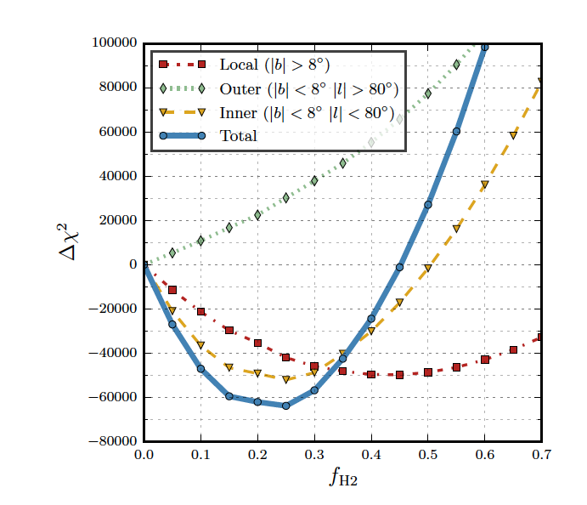
Good to push the (theory) envelope.
But do you get a better or worse fit to data?
* Carlson, Linden, Profumo 1510.04698 (Phys.Rev.Lett.), 1603.06584 (PRD)

Slide 31
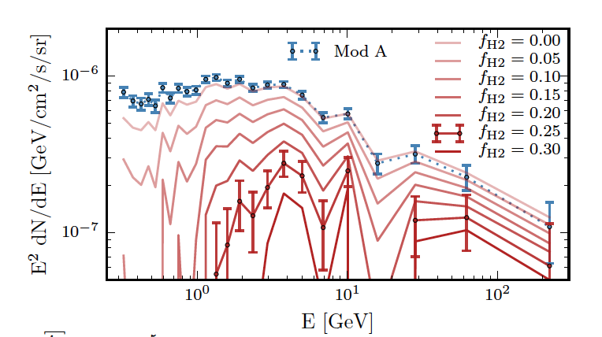
What do these improved models imply
for the Galactic Center “Excess”?
* Carlson, Linden, Profumo 1510.04698 (Phys.Rev.Lett.), 1603.06584 (PRD)

Slide 32
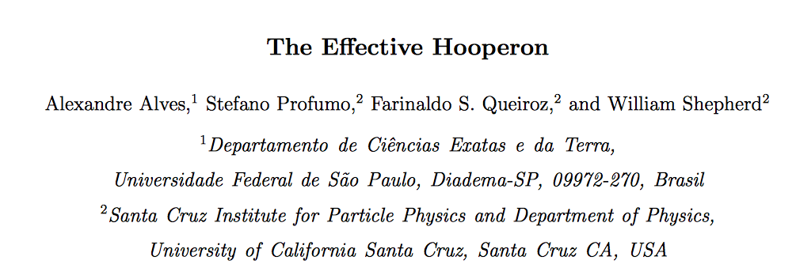
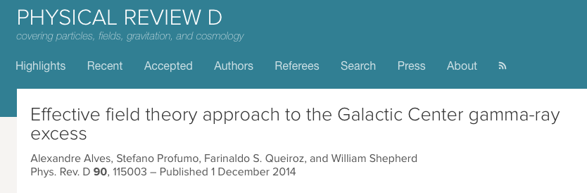
assuming there is a signal from dark matter,
one can use an “effective theory” approach to connect gamma-ray rates with direct detection rates
* Alves, Queiroz, Profumo and Shepherd, 14003.5027 (PRD)
Notes:
I like

Slide 33
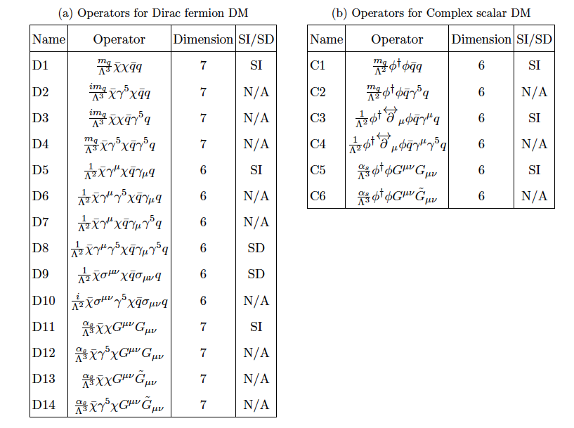
assuming there is a signal from dark matter,
one can use an “effective theory” approach to connect gamma-ray rates with direct detection rates
Notes:
I like

Slide 34
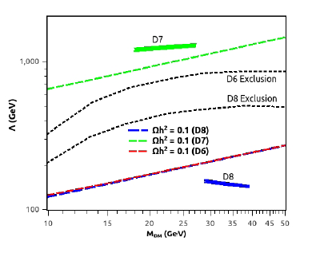
Example plot for three operators
GC signal
relic density
Collider constraints
Notes:
I like

Slide 35
key findings of the “Effective Hooperon”:
if direct detection cross section is not velocity-suppressed, it kills any effective operator that would explain the GC excess
in some cases, future DD can test models for the GC excess even if velocity-suppressed
if GC excess is explained by a single effective operator, LHC will test it
Notes:
I like

Slide 36
Beyond gamma rays: the X-ray signal
Associated DM particle: the “Bulbulion”
3.5 keV line detected from clusters of galaxies (Bulbul+ 2014, Boayrsky+ 2014)
3.5 keV line detected also from Galactic center (Jeltema+Profumo ‘14)
K XVIII line(s) compatible with all observations (Jeltema+Profumo, ‘14 ‘15)
Morphology incompatible with sterile neutrino decay (Carlson+ ‘15)
No signal from Draco dSph rules out sterile nu (Jeltema+Profumo ‘16)
Notes:
I like

Slide 37
decaying or annihilating dark matter not viable options
disregarding Occam’s razor K XVIII option, two possibilities:
axion-like particle conversion
cosmic-ray excitation of a two-state dark sector
ALP coversion is essentially not testable in the lab
(very large BxL ~ 10¹⁸ G cm )
Notes:
I like

Slide 38


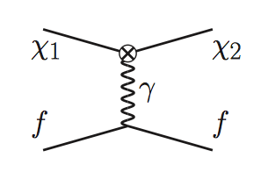
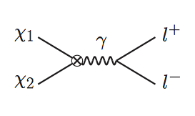
2. actually is fairly “exciting”…
Signal ∼ ρ_{DM} x ρ_{gas}
Good Thermal Relic!
D’Eramo, Hambleton, Profumo and Stefaniak, 1603.04859, PRD

Slide 39

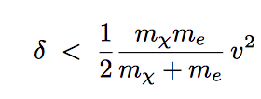
2. actually is fairly “exciting”…
effective interaction:
To have inelastic scattering
if m_{χ}<1 GeV, no way (μv²<<3.5 keV),
if m_{χ}>1 GeV, interesting…
D’Eramo, Hambleton, Profumo and Stefaniak, 1603.04859, PRD

Slide 40
Final not-so indirect option: neutrinos…
excruciatingly low fluxes from dark matter annihilation in GC, other galaxies
virtually background free target for >GeV neutrinos: Sun (or Earth)
Notes:
I like

Slide 41
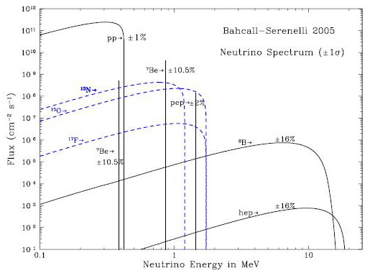
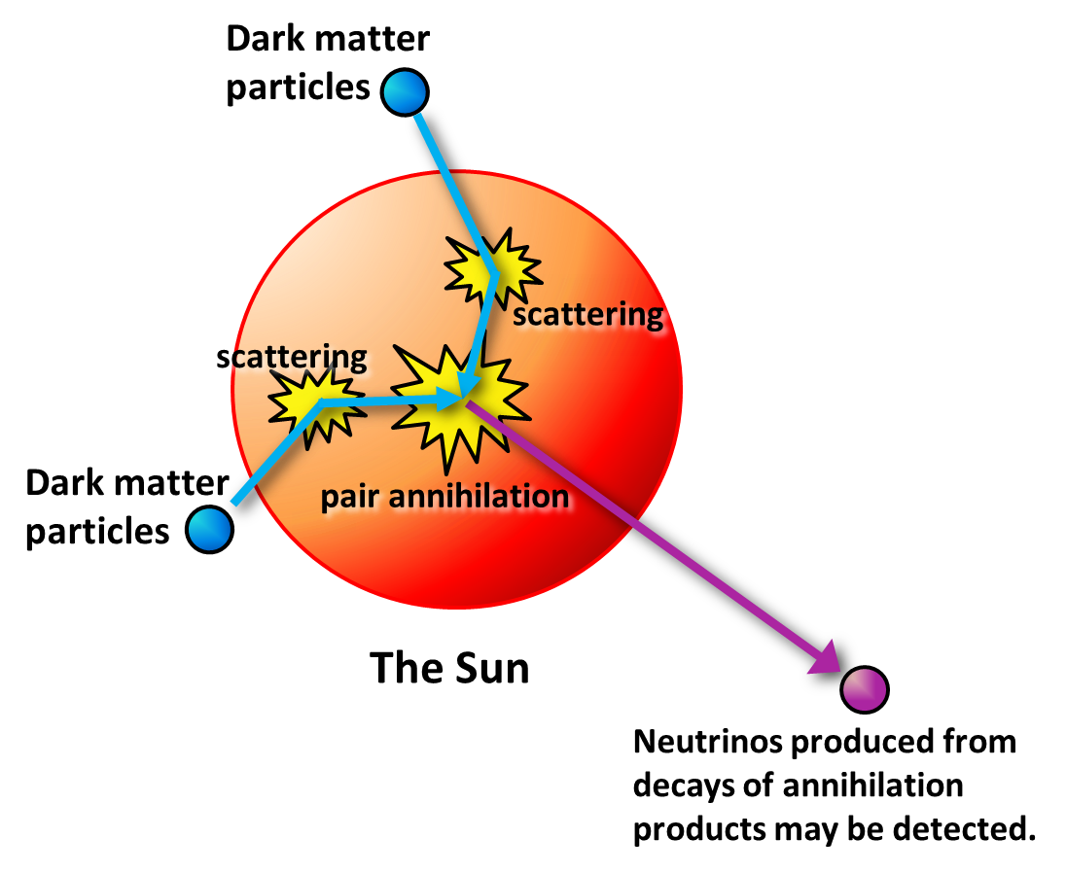
best target: Sun! Large, nearby, low-E neutrino emission

Slide 42



Estimate the process quantitatively!
First: capture rate

Slide 43







Number of accreted DM particles N
want to maximize argument of tanh!

Slide 44




So yes thermal DM is in equilibration (for “thermal” WIMPs as long as WIMP-nucleon cross section is larger than

Slide 45


With equilibration, flux of neutrinos
only depends on capture rate!
flux of neutrinos is then

Slide 46
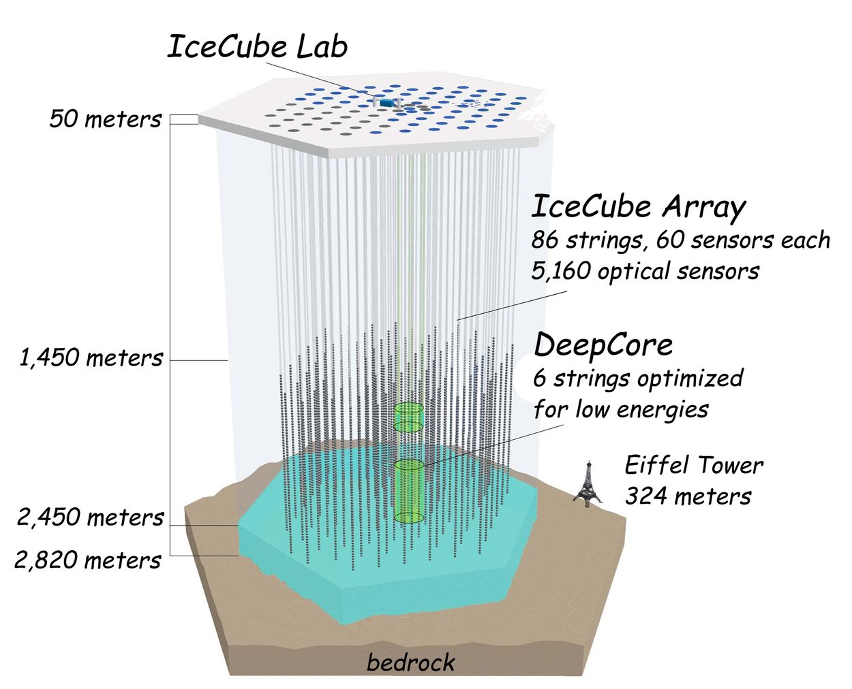
So far no anomalous events from Sun observed;
Earth less promising, also no signal so far
Opportunities with
lower-energy
threshold
sub-detectors
DeepCore, PINGU

Slide 47
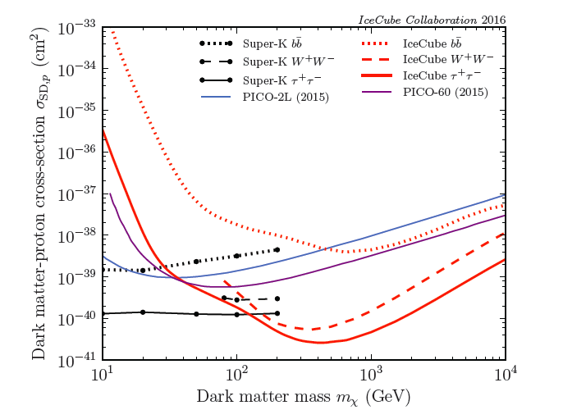

2016 IceCube results: ν from the Sun
Final states induce large model-dependence!
See 1601.00653
Notes:
I like

Slide 48
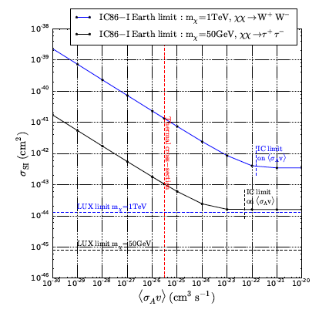
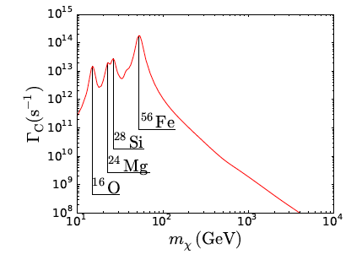
2016 IceCube results: ν from the Earth
Resonant capture for selected DM masses
Equilibration much harder to achieve; limits much weaker than SI DD
See 1609.01492
Notes:
I like

Slide 49
Conclusions
1. Drawing from astrophysical DM searches is possible,
but is generally highly model-dependent
2. Key exception: signals from DM accreted in
celestial bodies (planet heating, neutrinos from the Sun)
3. At present, there are no conclusive astrophysical “evidences” for dark matter
4. Direct detection can test models that provide explanation to selected “anomalies” (positron excess, GC excess, 3.5 keV line)
Notes:
I like

