Slide 1




Exclusive photoproduction of $J/ψ$ near threshold using NRQCD
Jyotirmoy Roy
Duke University
in collaboration with
Sarah Blask (Arizona), Sean Fleming (Arizona), Thomas Mehen (Duke),
Iain Stewart (MIT), Fanyi Zhao (MIT)
SCET 2025, Tucson, Arizona
11th March 2025

Slide 2
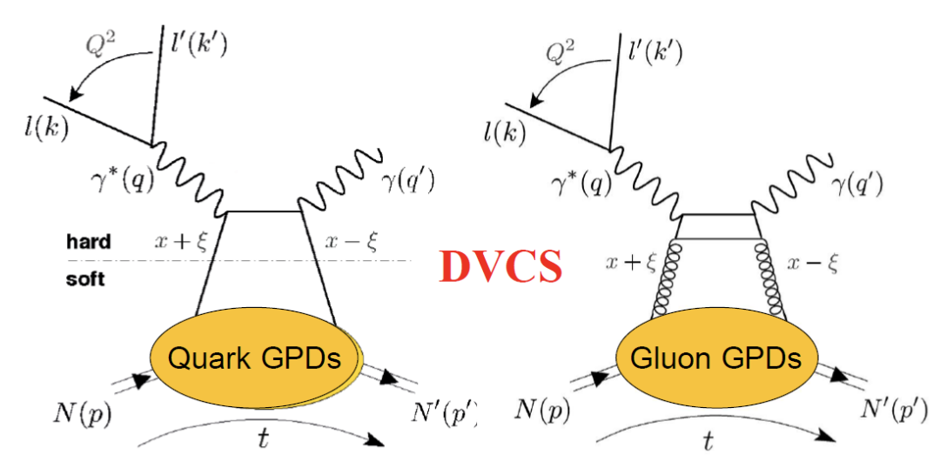
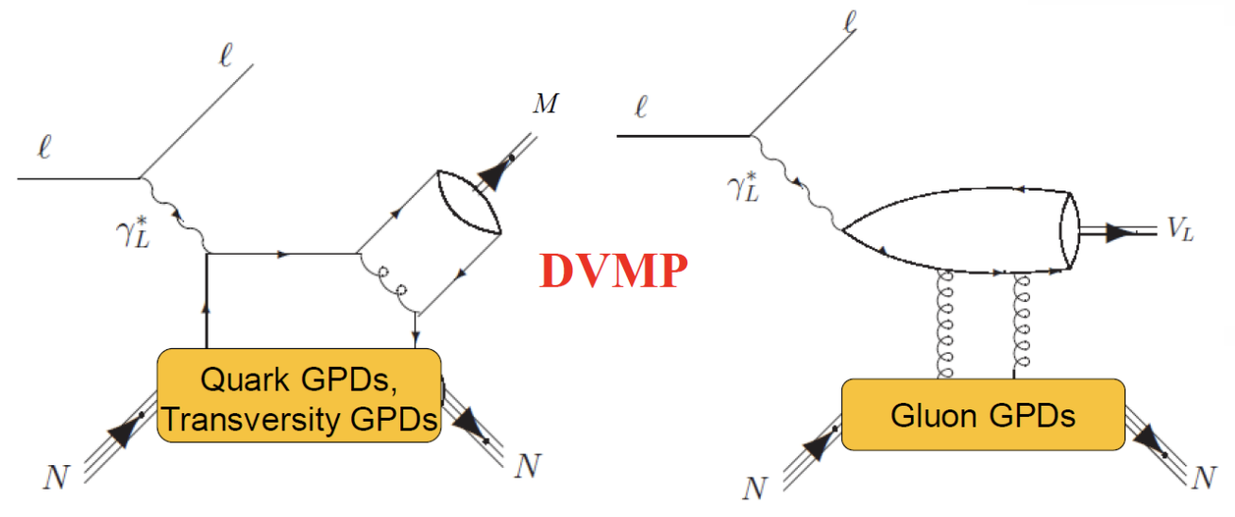
Exclusive processes
Courtesy: Hyon-Suk Jo, KPS Meeting
Exclusives like DVCS and DVMP can give access to new parton distributions.
Factorization theorems in terms of “Generalized Parton Distribution” at LP:
  DVCS using SCET [Bauer, Fleming, Rothstein and Stewart, hep-ph/0202088] and pQCD [Collins and Freund, hep-ph/9801262; Ji and Osborne, hep-ph/9801260]
  DVMP using pQCD [Collins, Frankfurt and Strikman, hep-ph/9611433]

Slide 3
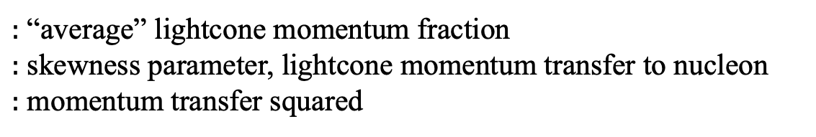
Generalized Parton Distribution
GPD correlator for quarks:
GPDs
$:$ “average” lightcone momentum fraction
$:$ skewness parameter, lightcone momentum transfer to nucleon
$:$ momentum transfer squared

Slide 4
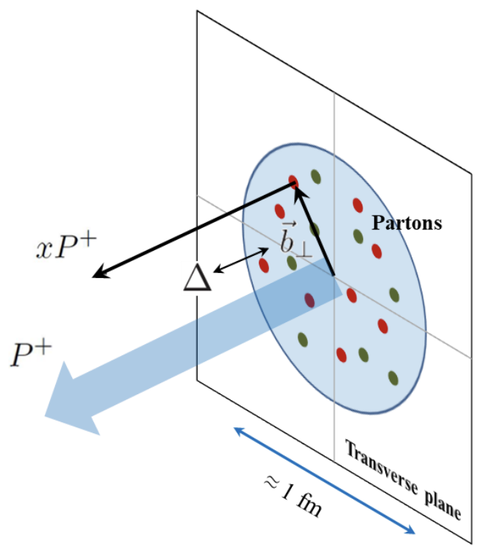
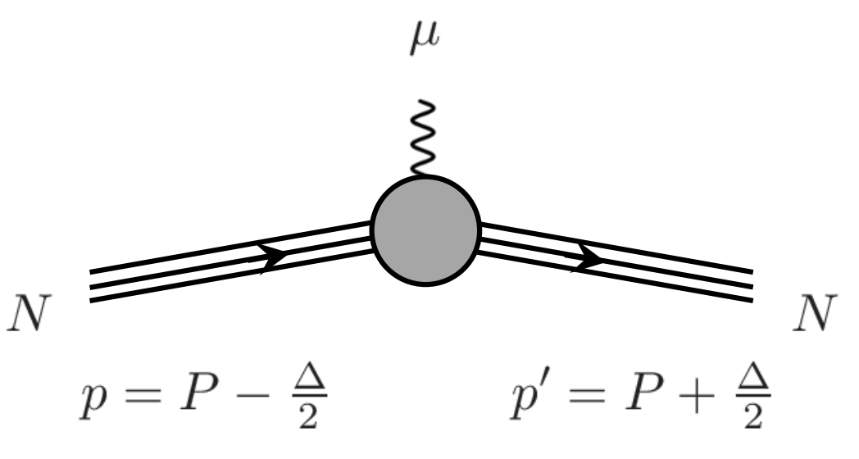
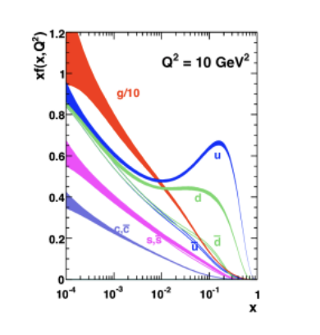
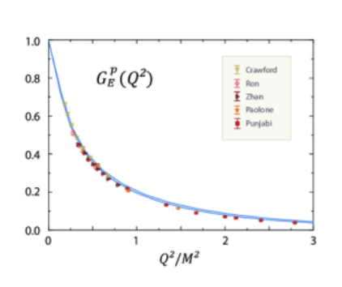
Generalized Parton Distribution
Courtesy: C. Lorce
GPDs
PDFs
FFs

Slide 5
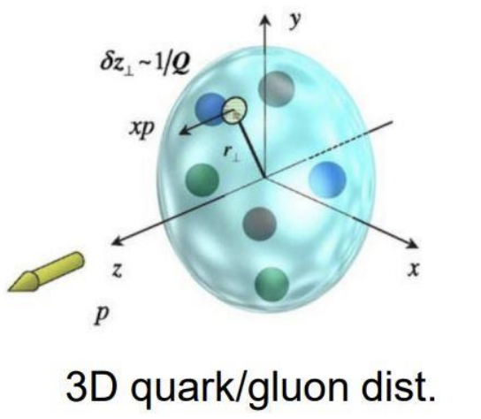
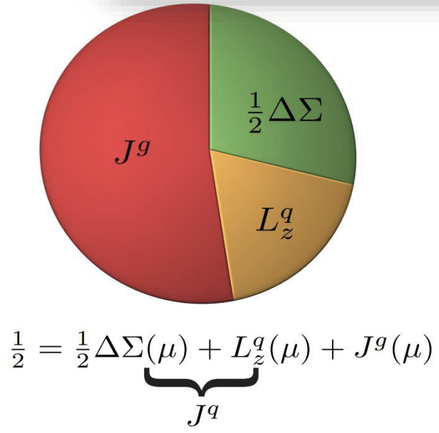
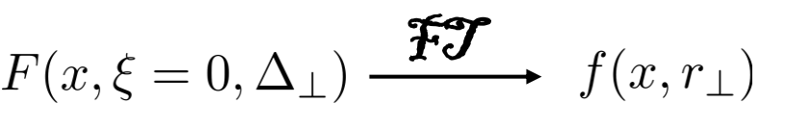
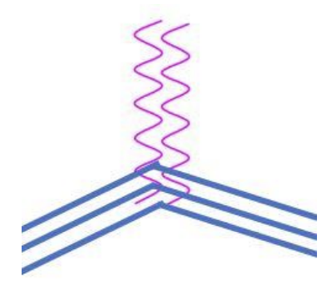
Motivations for GPD
Courtesy: S. Bhattacharya
3D Imaging [Burkardt, 0005108]
Spin sum rules [Ji, 9603249]
Mechanical properties inside of nucleon [Polyakov, Shuvaev, 0207153]
Gravitational Form Factors

Slide 6
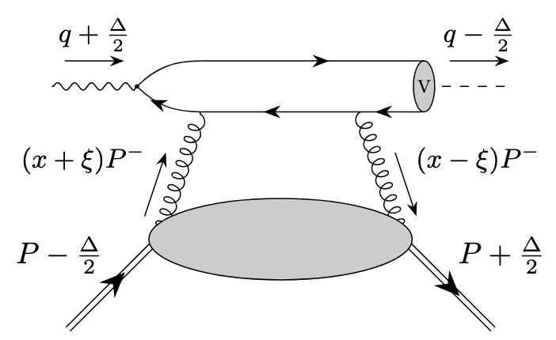
Exclusive photoproduction of HVM
Kinematics in the Ji frame:
Threshold region:
Contrast this with gapped hard scattering
and

Slide 7
Leading power factorization
In the collinear expansion amplitude factorizes into hard kernel, non-relativistic HVM wavefunction and gluon GPD [Ivanov et. al., hep-ph/0401131, Guo et. al., 2103.11506]
In the threshold region, since expand in
Validity of the expansion based on the fact

Slide 8
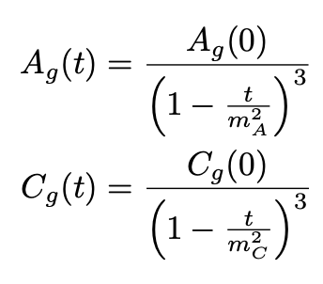
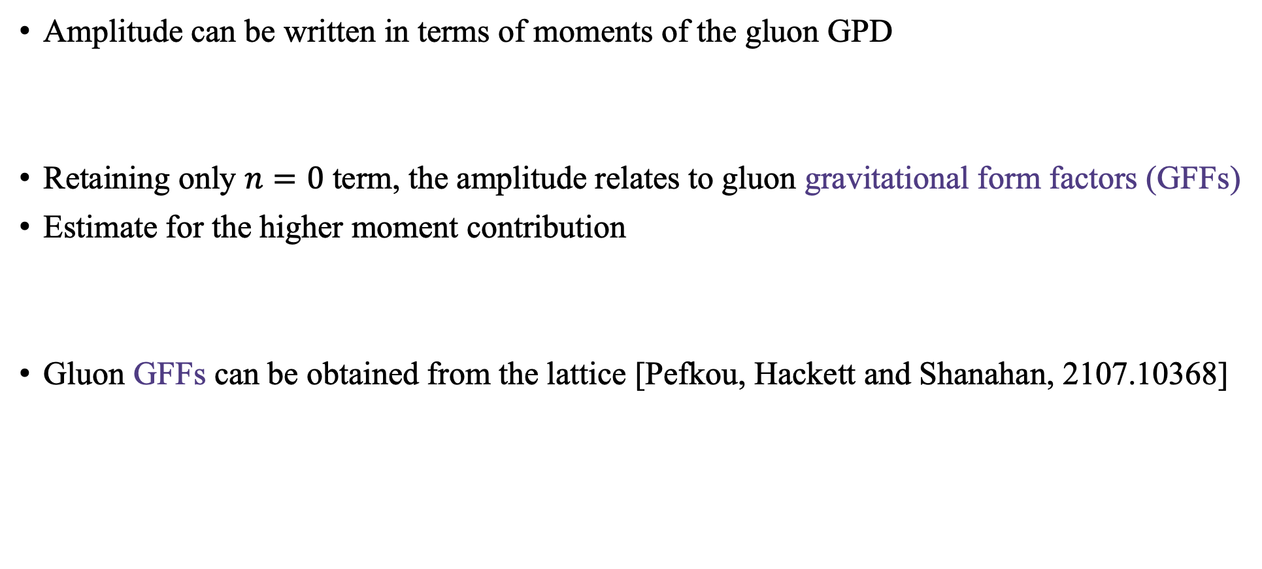
Leading power factorization
Amplitude can be written in terms of moments of the gluon GPD
Retaining only $n=0$ term, the amplitude relates to gluon gravitational form factors (GFFs)
Estimate for the higher moment contribution
Gluon GFFs can be obtained from the lattice [Pefkou, Hackett and Shanahan, 2107.10368]

Slide 9
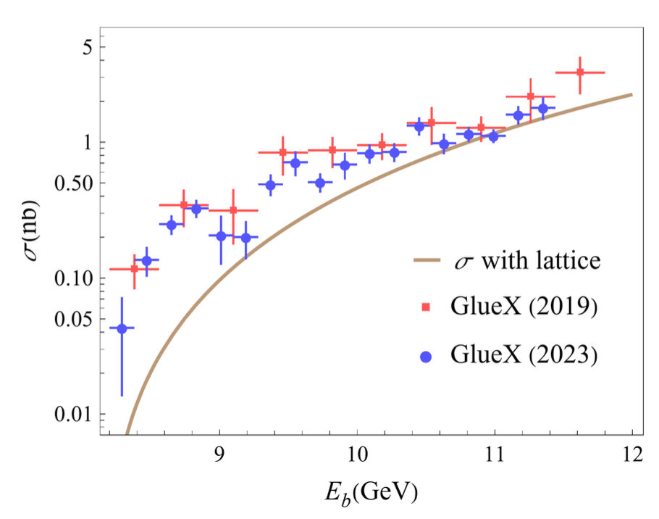
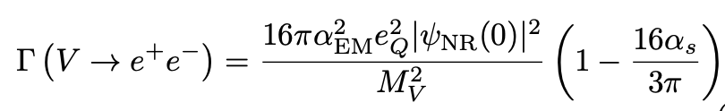


LP cross-section for $J/ψ$
Wavefunction from HVM to lepton decay [Eichten and Quigg,1904.11542]
Inclusion of effects from the relative motion of the heavy quarks inside quarkonium requires NRQCD
[Guo, Ji, Liu and Yang, 2305.06992]

Slide 10
Non-Relativistic QCD (NRQCD)
EFT for quarkonium – heavy quarks are non-relativistic fields
NRQCD factorization formalism [Bodwin, Braaten and Lepage, hep-ph/9407339]
LDME scales with :
Double expansion in and
short distance cross-section
non-perturbative long distance matrix element (LDME)

Slide 11
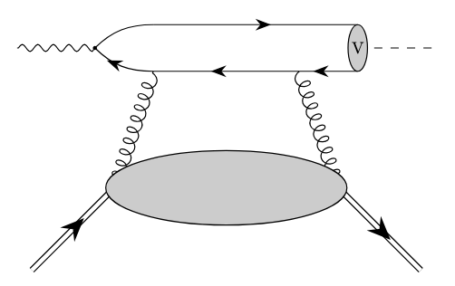
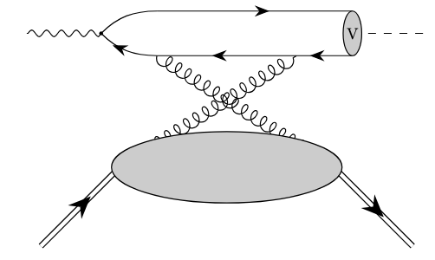
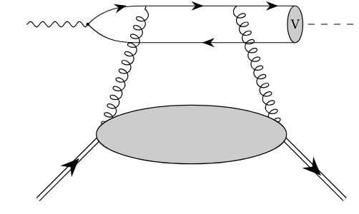
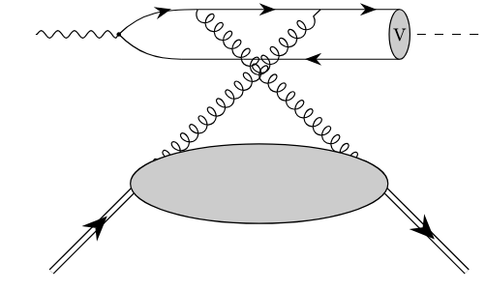
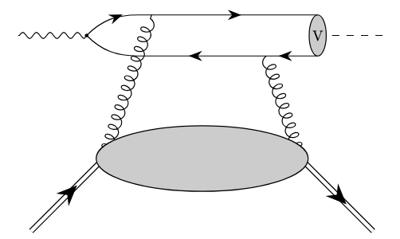
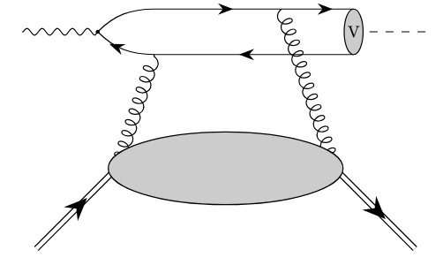
Hard matching coefficient
Six diagrams at LO

Slide 12
Hard matching coefficient
Expand in the relative momenta of the pair.
Amplitude expansion can be done using covariant projector method
Spin triplet, color singlet projector

Slide 13
Leading Power
Each term in the expansion can then be projected onto spin-singlet quarkonium states
E.g.: For Charmonium states
LP amplitude:
;

Slide 14

Relativistic corrections
Constitutes power correction relative to the LO LDMEs in each channel.
E.g.: Spin triplet, color singlet LDME
gets correction from
is expressed in terms of and matrix element , using Gremm-Kapustin relation (by using EOM to express spatial derivatives as time derivatives and hence NRQCD Hamiltonian) where

Slide 15

Relativistic corrections
Relativistic correction can be obtained from the second order term by projecting it onto the higher power LDME
Leading Power
$v^{2}$ correction

Slide 16
Endpoint Region & Singularities
LP hard kernel has simple poles at
Convolution integral calculated using Principal Value prescription
Relativistic corrections have double poles and leads to singularities which cannot be resolved by PV prescription

Slide 17
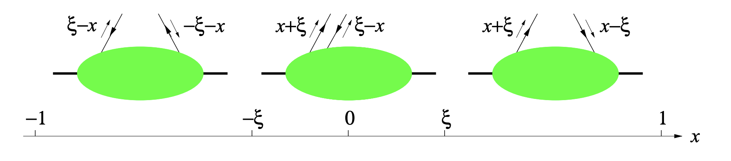
Endpoint Region & Singularities
corresponds to the transition point between DGLAP and ERBL region where one of the gluon goes soft. GPDs being analytic at makes the LP, PV integral not divergent.
Like other endpoint divergences cancellation may occur from the interplay of different kinematical regions.
For threshold region we avoid it since and . Expanding in and write the NLP amplitude in terms of GFFs
DGLAP
ERBL
DGLAP

Slide 18
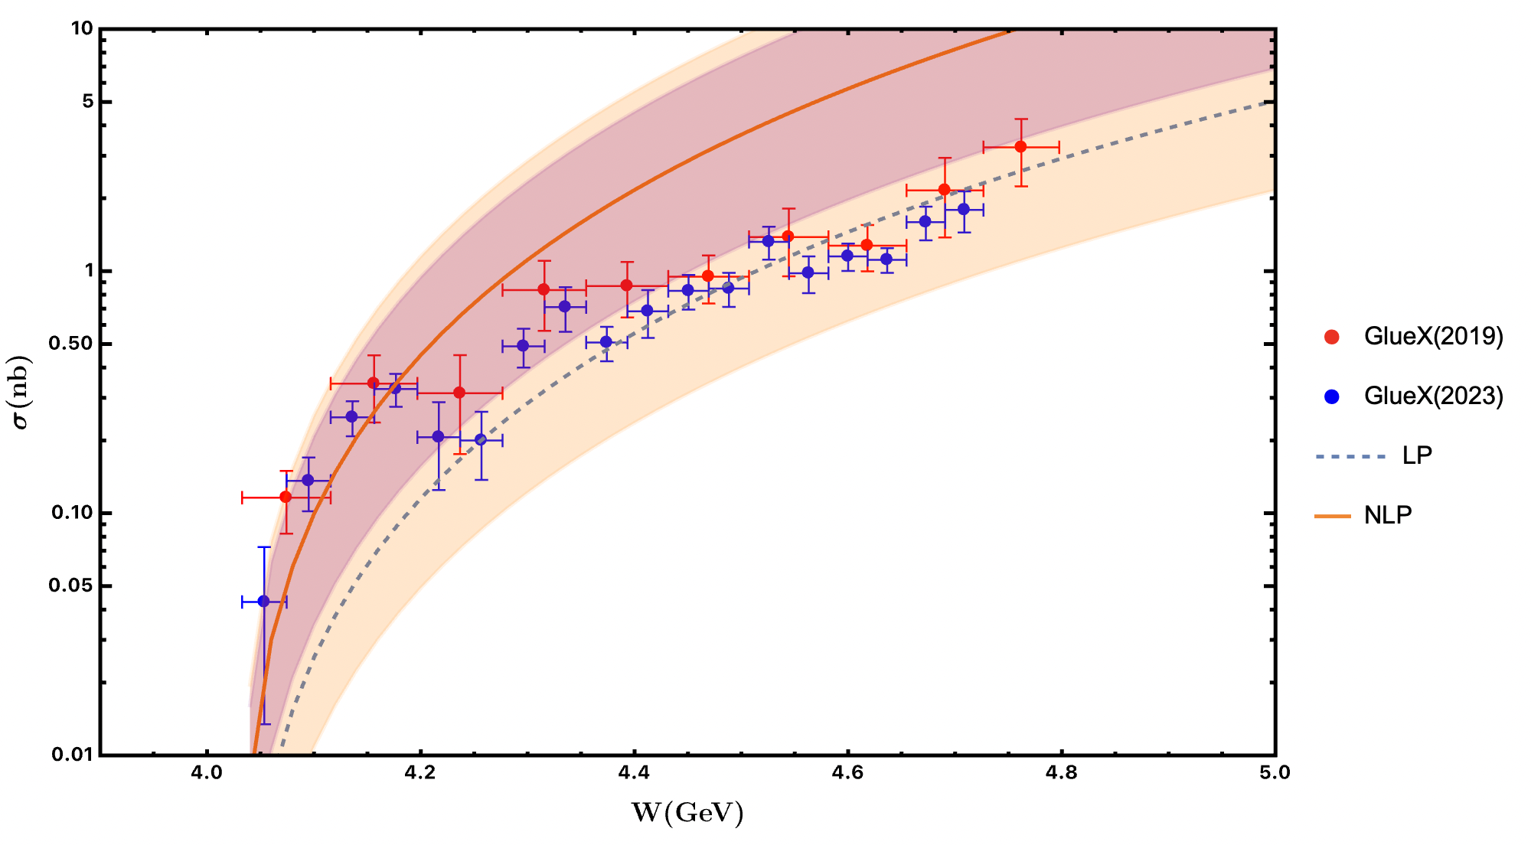
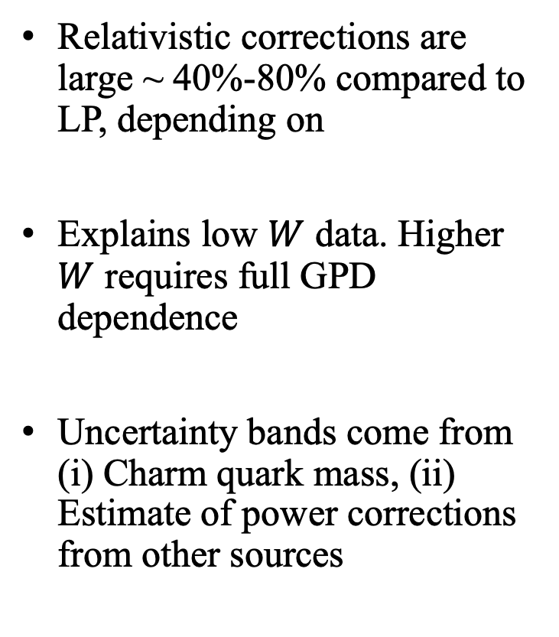

Relativistic corrections for $J/ψ$
[S. Blask, S. Fleming, T. Mehen, JR, I. Stewart, in preparation]
Relativistic corrections are large ~ 40%-80% compared to LP, depending on
Explains low $W$ data. Higher $W$ requires full GPD dependence
Uncertainty bands come from (i) Charm quark mass, (ii) Estimate of power corrections from other sources
Threshold region
Purple band: Power correction
Orange band: Power correction

Slide 19
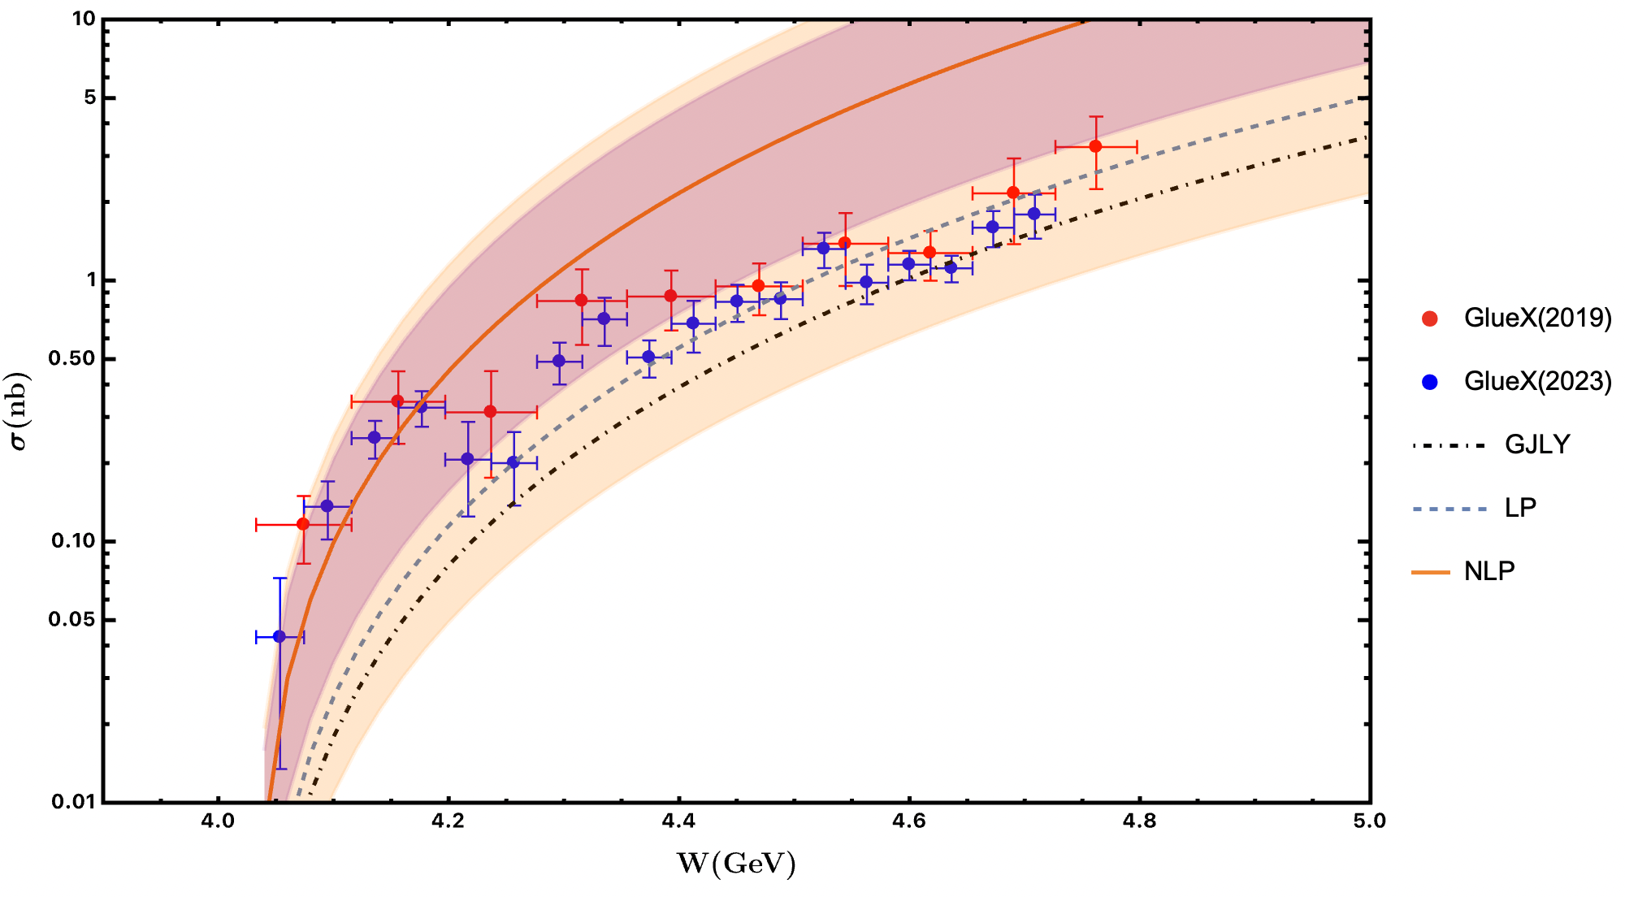
Sensitivity to charm quark mass
LP result from NRQCD differs from Guo et. al. result.
Important when considering relativistic correction since

Slide 20
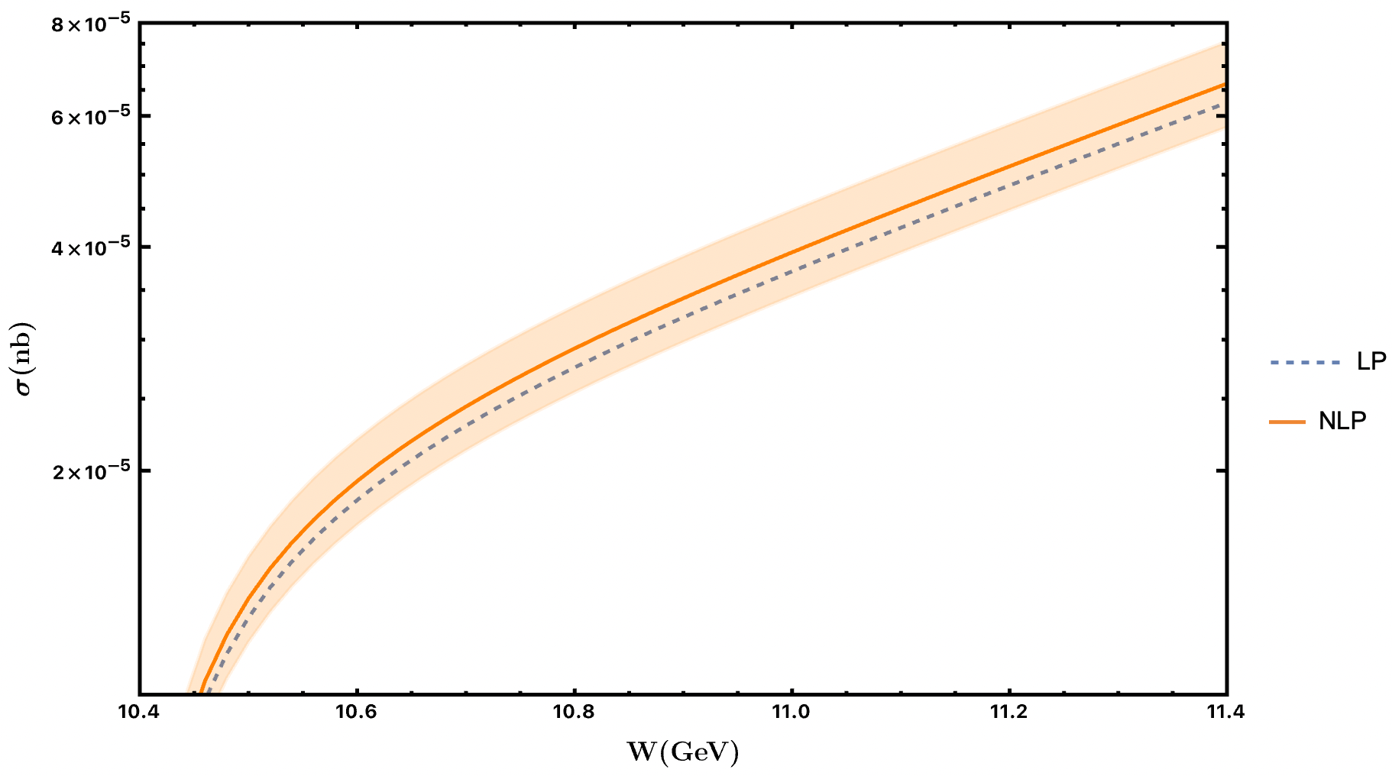

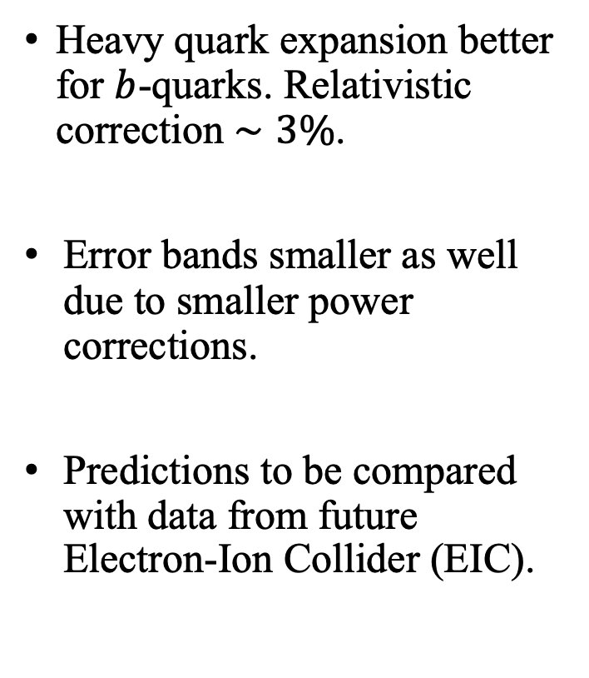
Relativistic corrections for $Υ$
Heavy quark expansion better for $b$-quarks. Relativistic correction $∼3\%$.
Error bands smaller as well due to smaller power corrections.
Predictions to be compared with data from future Electron-Ion Collider (EIC).

Slide 21
Outlook
Calculated the relativistic correction for exclusive photoproduction of HVM near threshold, which can be large.
Future work needs to include kinematical and subleading GPD power corrections.
Proper treatment of the singularities in the endpoint region using SCET.

Slide 22


Dedicated to the memory of
Tom Mehen and Fanyi Zhao

