Slide 1
-Slicing with multiple jets
Rudi Rahn
13-03-25, SCET25, Tucson
Based on [2005.12279],[2205.05104], [2412.05358] with
Yang-Ting Chien (Georgia State), Rong-Jun Fu, Ding Yu Shao (Fudan), Solange Schrijnder van Velzen, Wouter Waalewijn (Nikhef/UvA), Bin Wu (USC)

Slide 2
Outline
Slicing and jets
The Winner-Takes-All axis
Azimuthal vs radial decorrelation
Results

Slide 3
Slicing
How to access higher-order calculations?
Individually divergent, different phase spaces
Soft and collinear emissions difficult to observe
Split unobserved reals and add to virtuals
Find resolution variable, e.g. qT:
[Catani, Grazzini, ’07]

Slide 4
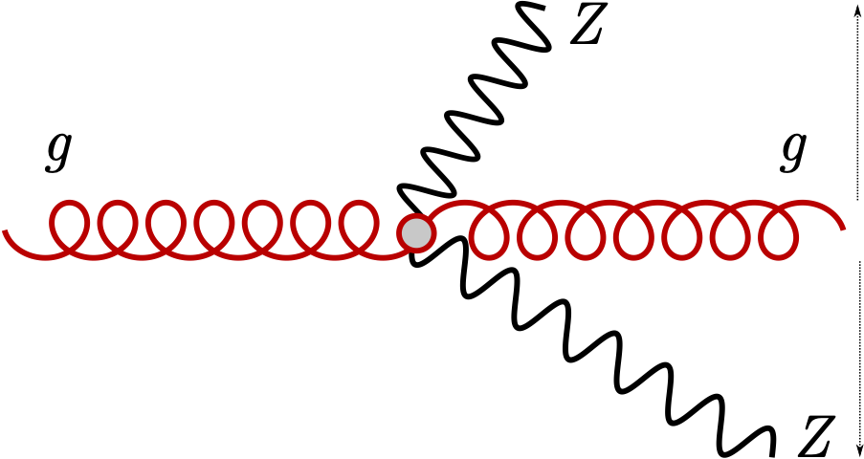
TRANSVERSE MOMENTUM CORRELATION
pp collisions: no control over longitudinal momenta, but final state momenta correlated

Slide 5
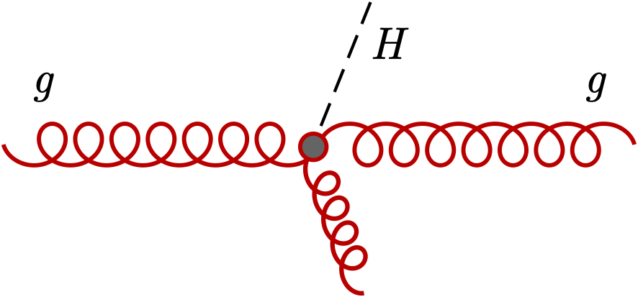
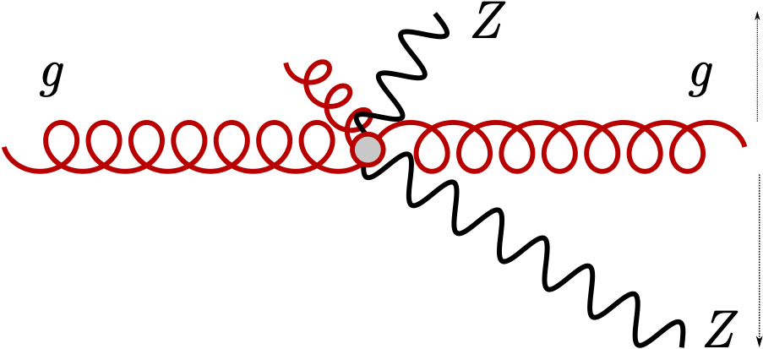
TRANSVERSE MOMENTUM DeCORRELATION
pp collisions: no control over longitudinal momenta, but final state momenta correlated
For small decorrelation: soft and collinear emissions

Slide 6
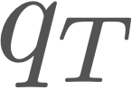
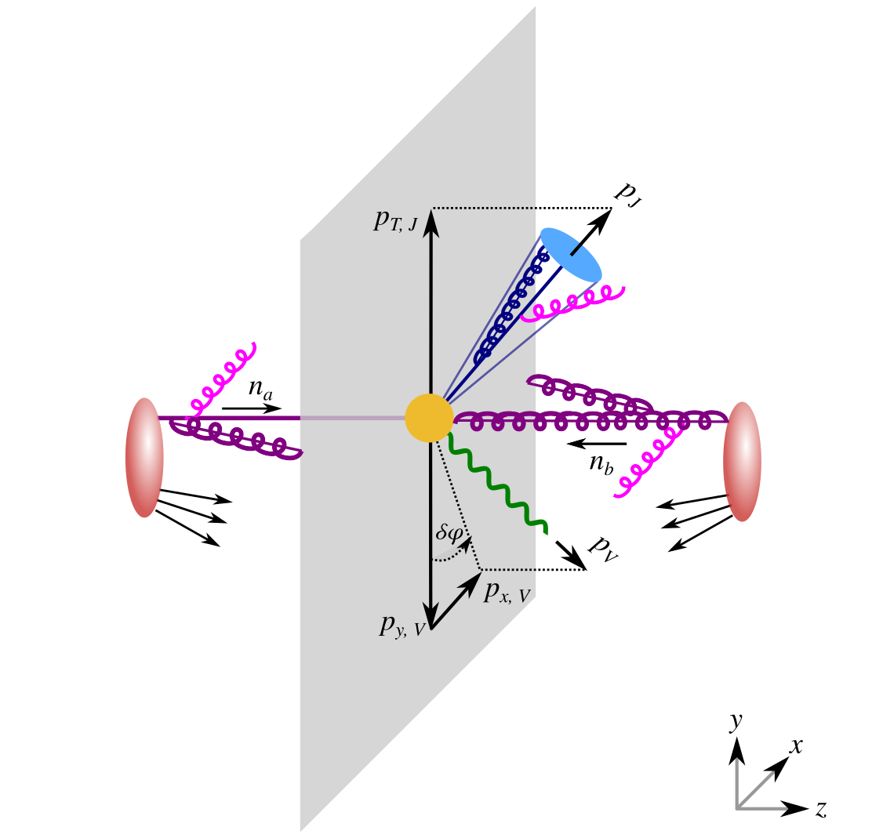
-decorrelation with jets
Laboratory: V+jet,
Leading partonic: planar
Soft/Collinear emissions:

Slide 7
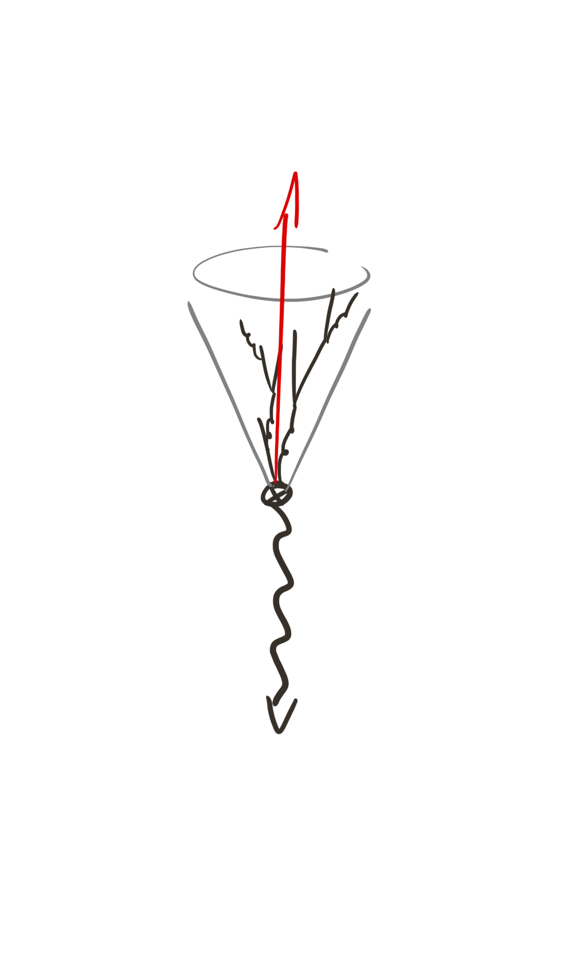
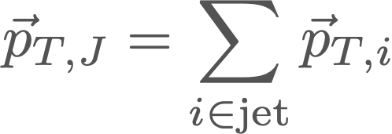
Standard Jet
Standard Jet axis:

Slide 8
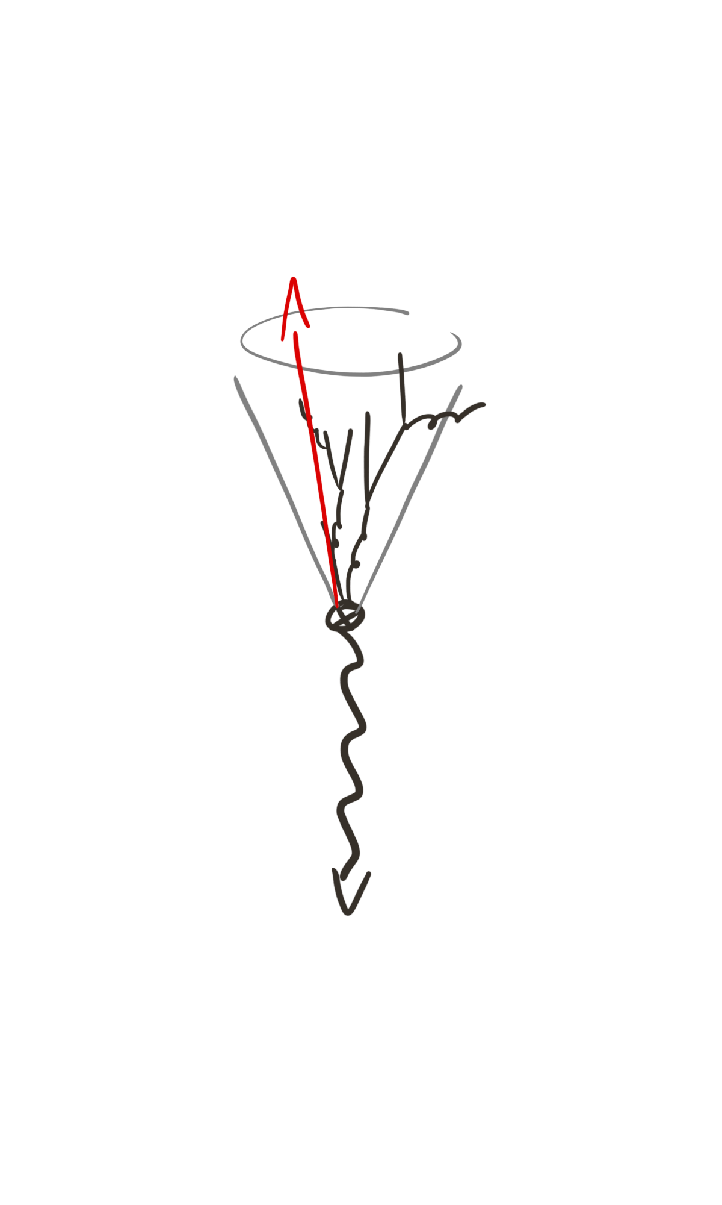
Standard Jet
Standard Jet axis:
Contribution to requires out-of-jet radiation
Non-global
( )
[Dasgupta, Salam, ’01]

Slide 9
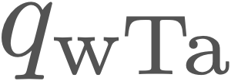
-slicing
-slicing vs. Jets: SJA blind to in-jet dynamics
N-jettiness
[Boughezal, Focke, Liu, Petriello, ’15]
[Gaunt, Stahlhofen, Tackmann, ’15]
(Kinematic dependence? Power corrections?)
[Bell, Dehnadi, Mohrmann, RR, ’23]
[Campbell, Ellis, Seth, ’22]
[Agarwal, Melnikov, Pedron, ’24]
kT-ness
[Buonocore, Grazzini, Haag, Rottoli, Savoini ’22]
(Higher orders?)
Use a different jet axis!

Slide 10
The Winner-Takes-All axis
[Salam, unpublished]
[Bertolini, Chan, Thaler, ’14]
Endpoint of a reclustering sequence, based on some distance measure
Clustering step: closest emission pair i,j with , & ,
if
{
if
NOT the “highest energetic particle”, clustering ensures IRC safety!

Slide 11
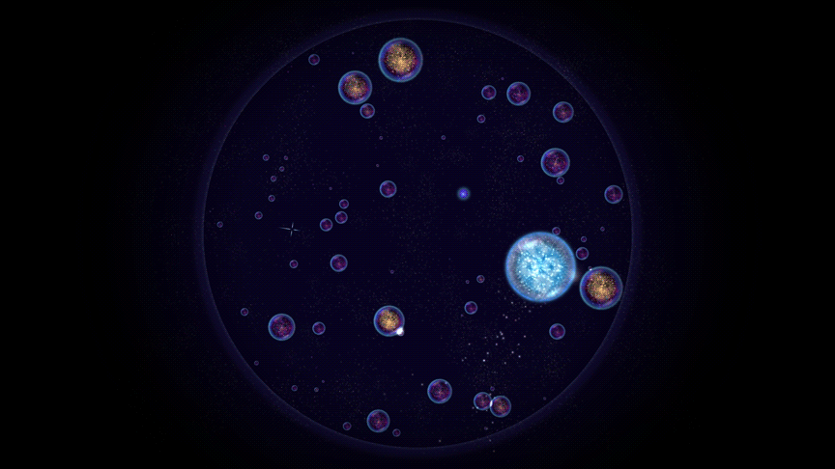
WTA for bacteria
Osmos
[Hemisphere Games, ’09]

Slide 12
The Winner-Takes-All axis
[Salam, unpublished]
[Bertolini, Chan, Thaler, ’14]
Powerful when combined with SCET:
Direction purely a collinear affair:
Soft subleading in magnitude:
No non-global logarithms*
[Larkoski, Neill, Thaler, ’14]

Slide 13
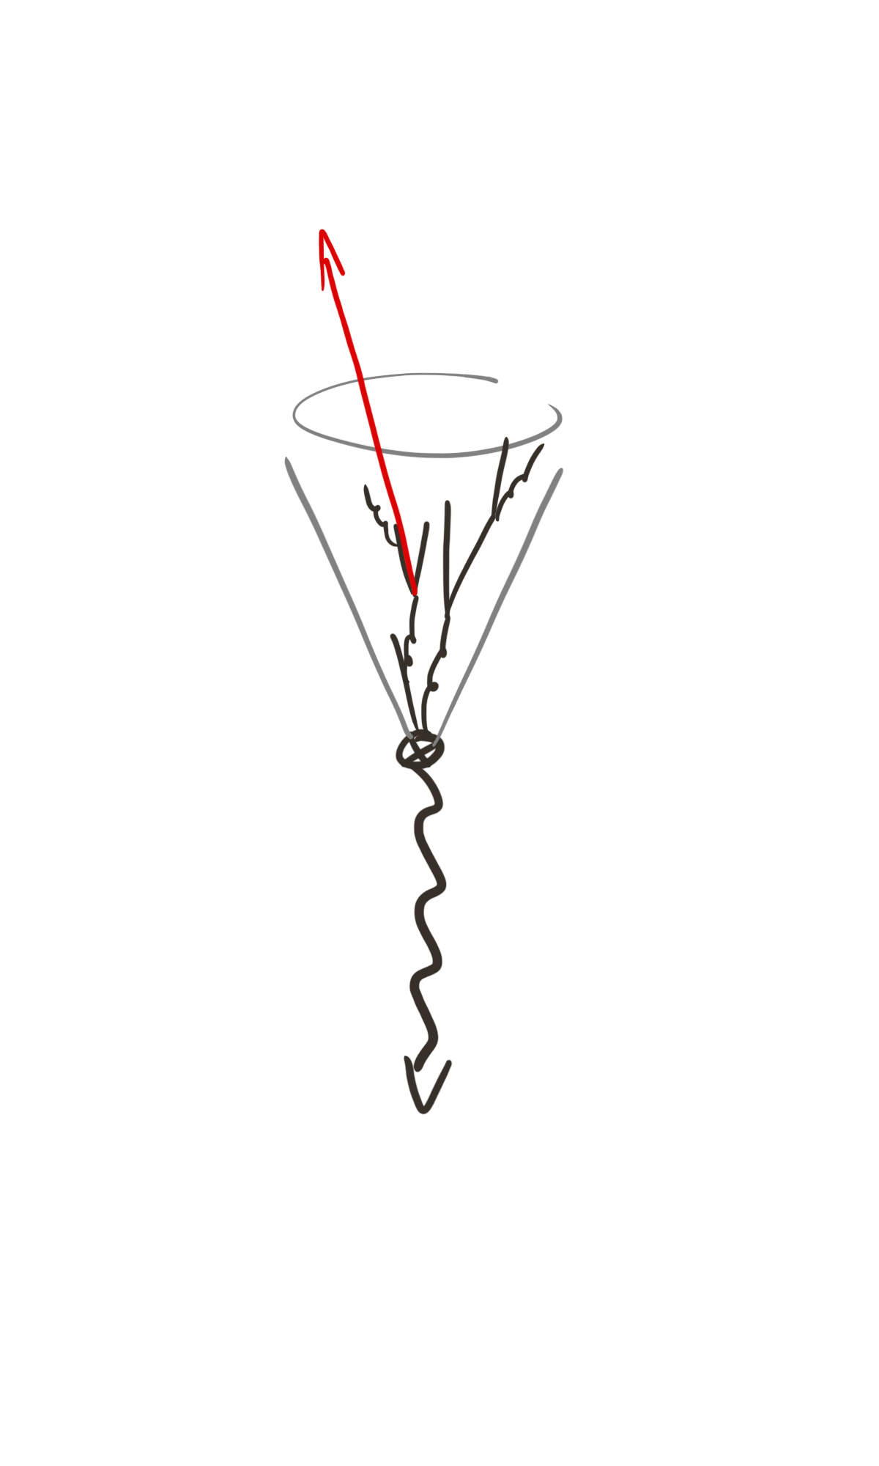
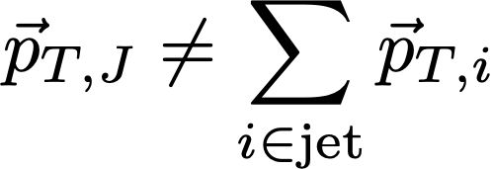
WTA axis in action
Even if all radiation is inside the jet:

Slide 14
WTA axis in action
Even if all radiation is inside the jet:
In- and out-of-jet soft radiation contribute through recoil
Only in-jet soft radiation contributes to : power suppressed

Slide 15
TransVerse momentum decorrelation
Two-component decorrelation:
Align y-axis with jet axis:
Azimuthal decorrelation
Radial decorrelation

Slide 16
Azimuthal decorrelation
From momentum conservation:
Factorisation is very simple:
TMD Beam function
TMD Soft function (+boost)
WTA jet function

Slide 17
Radial decorrelation
From momentum conservation:
“ ”

Slide 18
Radial decorrelation
From momentum conservation:
Are these the same?

Slide 19
Radial decorrelation
From momentum conservation:
Are these the same?
No!

Slide 20
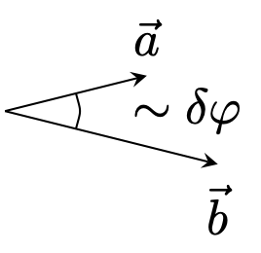
Radial decorrelation
From momentum conservation:
I) scalar sum vs. vector sum

Slide 21
Radial decorrelation
From momentum conservation:
I) scalar sum vs. vector sum
II) soft out-of-jet emissions
“ ”

Slide 22
Radial decorrelation
From momentum conservation:
I) scalar sum vs. vector sum
II) soft out-of-jet emissions
Complicated, and non-global

Slide 23
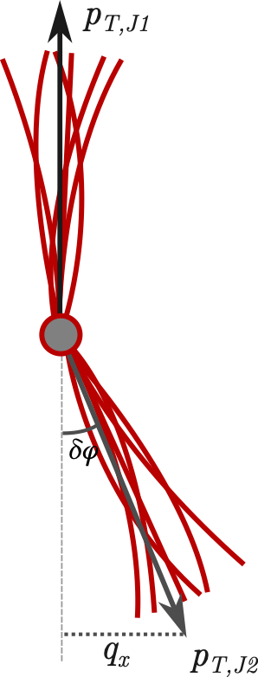
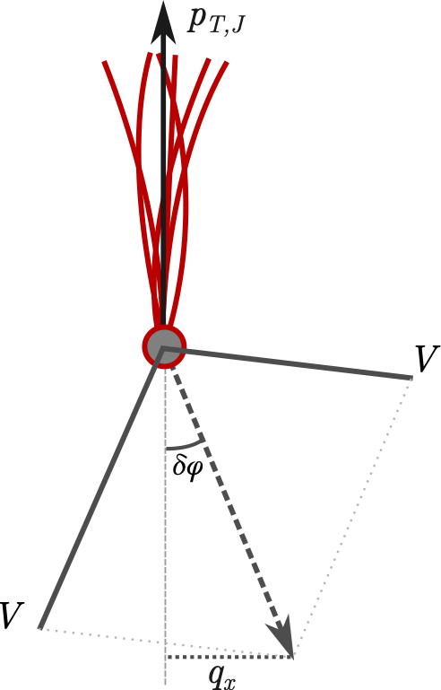
-Imbalance
Azimuthal decorrelation is much nicer than radial
Can we avoid using the radial decorrelation?
For planar Born processes azimuthal suffices:

Slide 24
Unresolved piece
Factorisation:
Involves:
Standard TMD beam function
Standard TMD soft function
WTA TMD jet function
Beyond NLO: linear polarisations in beam/jet

Slide 25
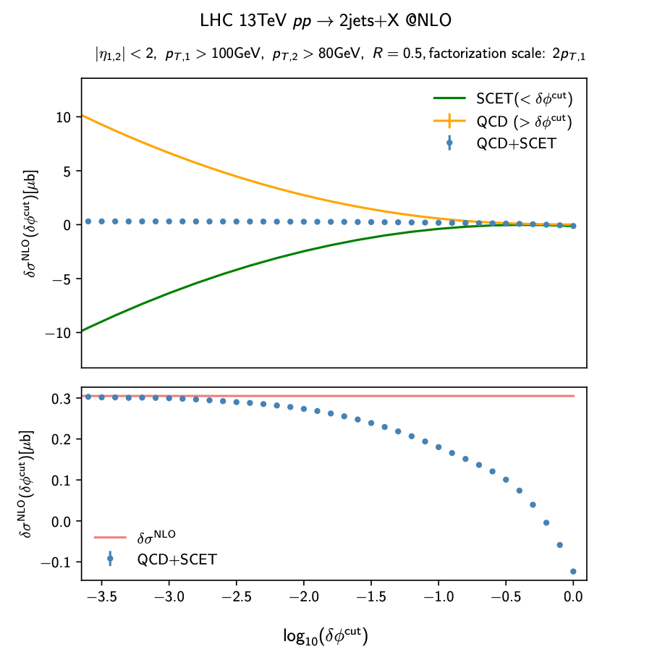
NLO Verification
Missing for NNLO: gluon jet function

Slide 26
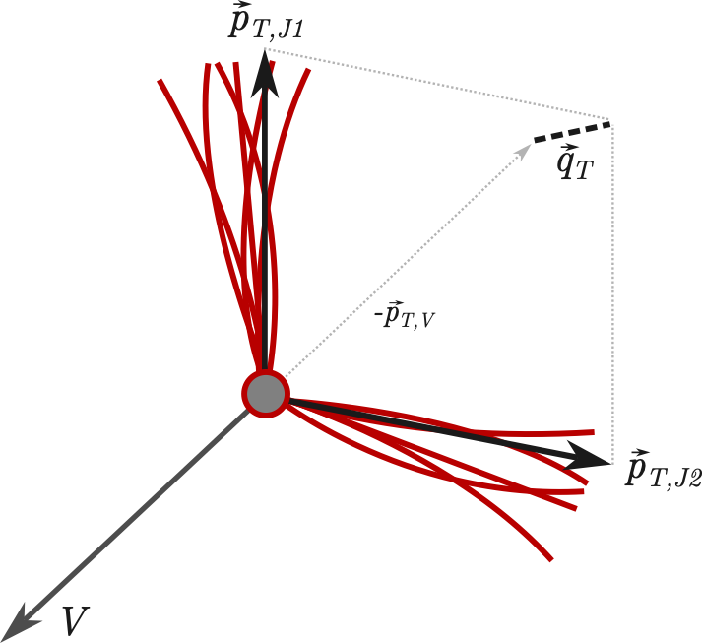
Non-planar cases
Radial decorrelation required
A priori SCET+ framework:
Complicated mode structure
Multiple hierarchies
But: suffices!
[Procura, Waalewijn, Zeune, ’15, ’18]

Slide 27
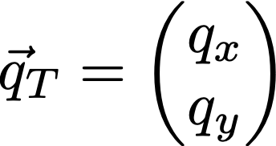
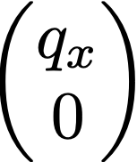
-dijet
Factorisation:
Involves:
Standard TMD beam function
Dedicated soft function
WTA TMD jet function
Soft function:
{
Outside jet:
Inside jet:

Slide 28
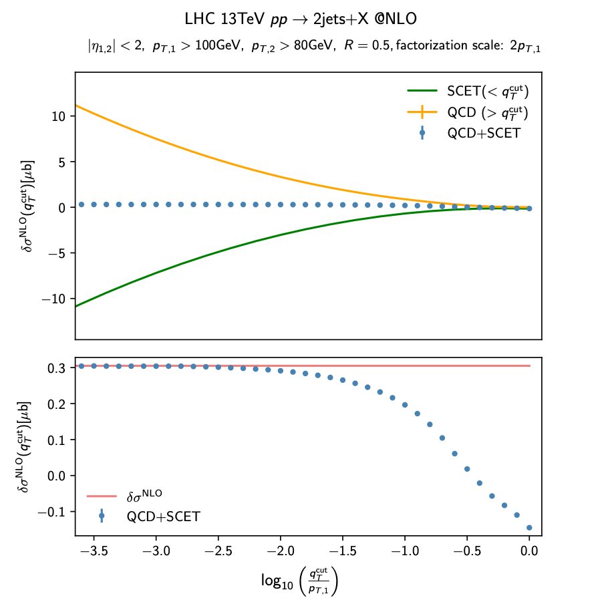
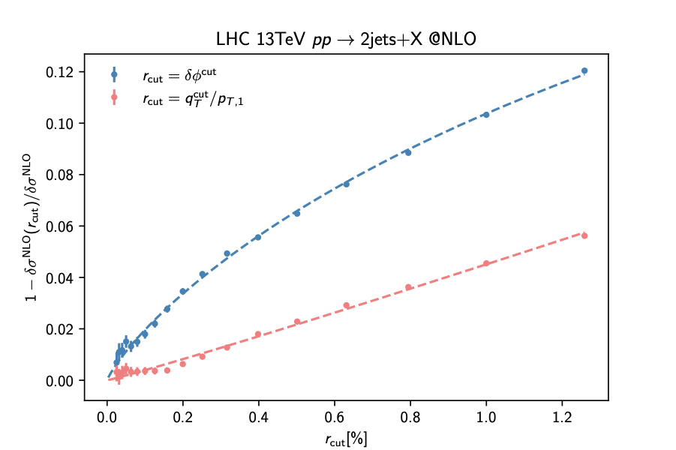
Compare
Full qT performs better

Slide 29
Multijet cases
x/y now means perpendicular/parallel to a jet
Jet function:
Soft function:
Outside jet:
{
Inside jet J:

Slide 30
Simplifications
Soft function can be refactorised
Purpose is not to resum, but to simplify
Global soft function only depends on dipoles
CS function only depends on dipole and jet kinematics
restored by including subleading terms

Slide 31
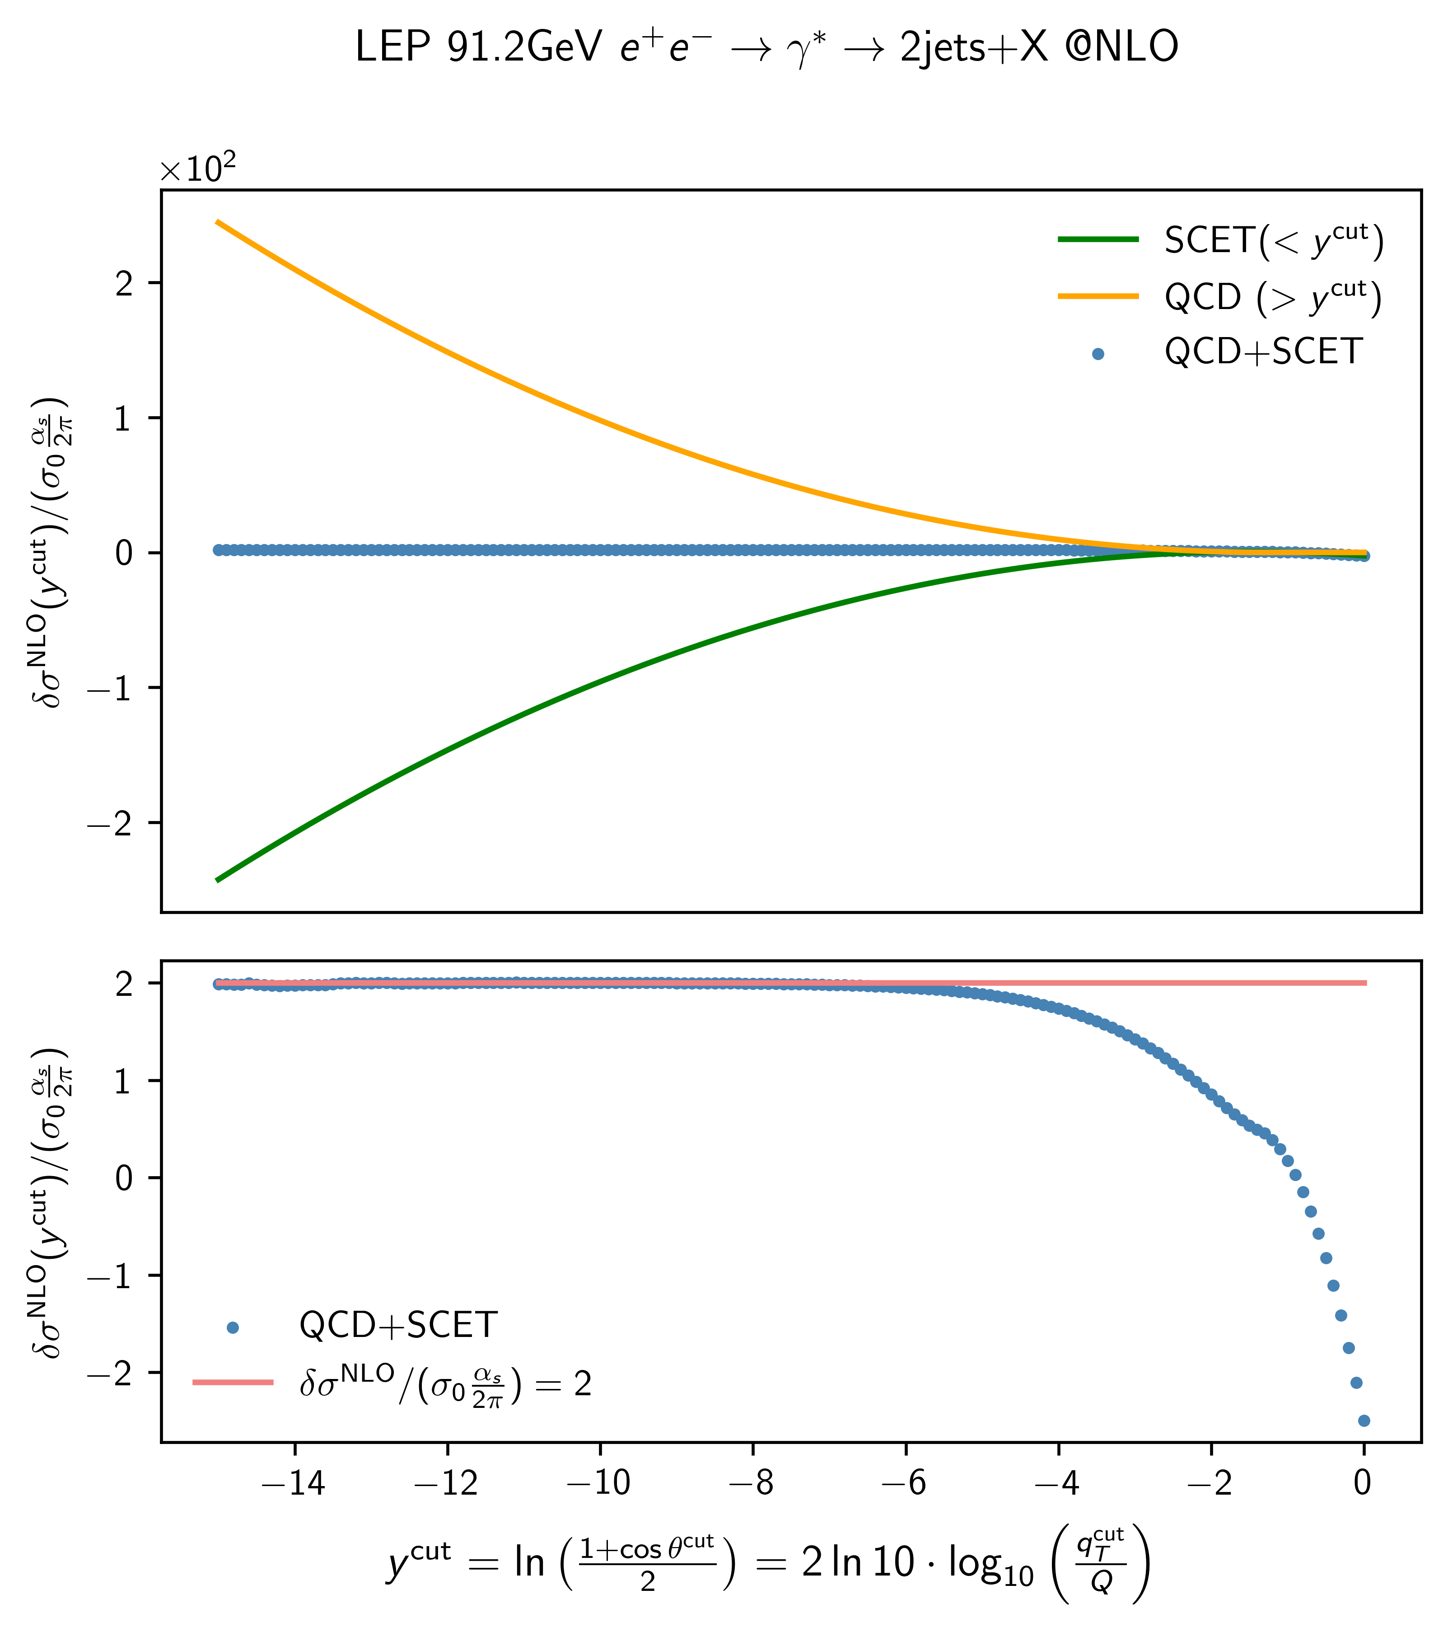
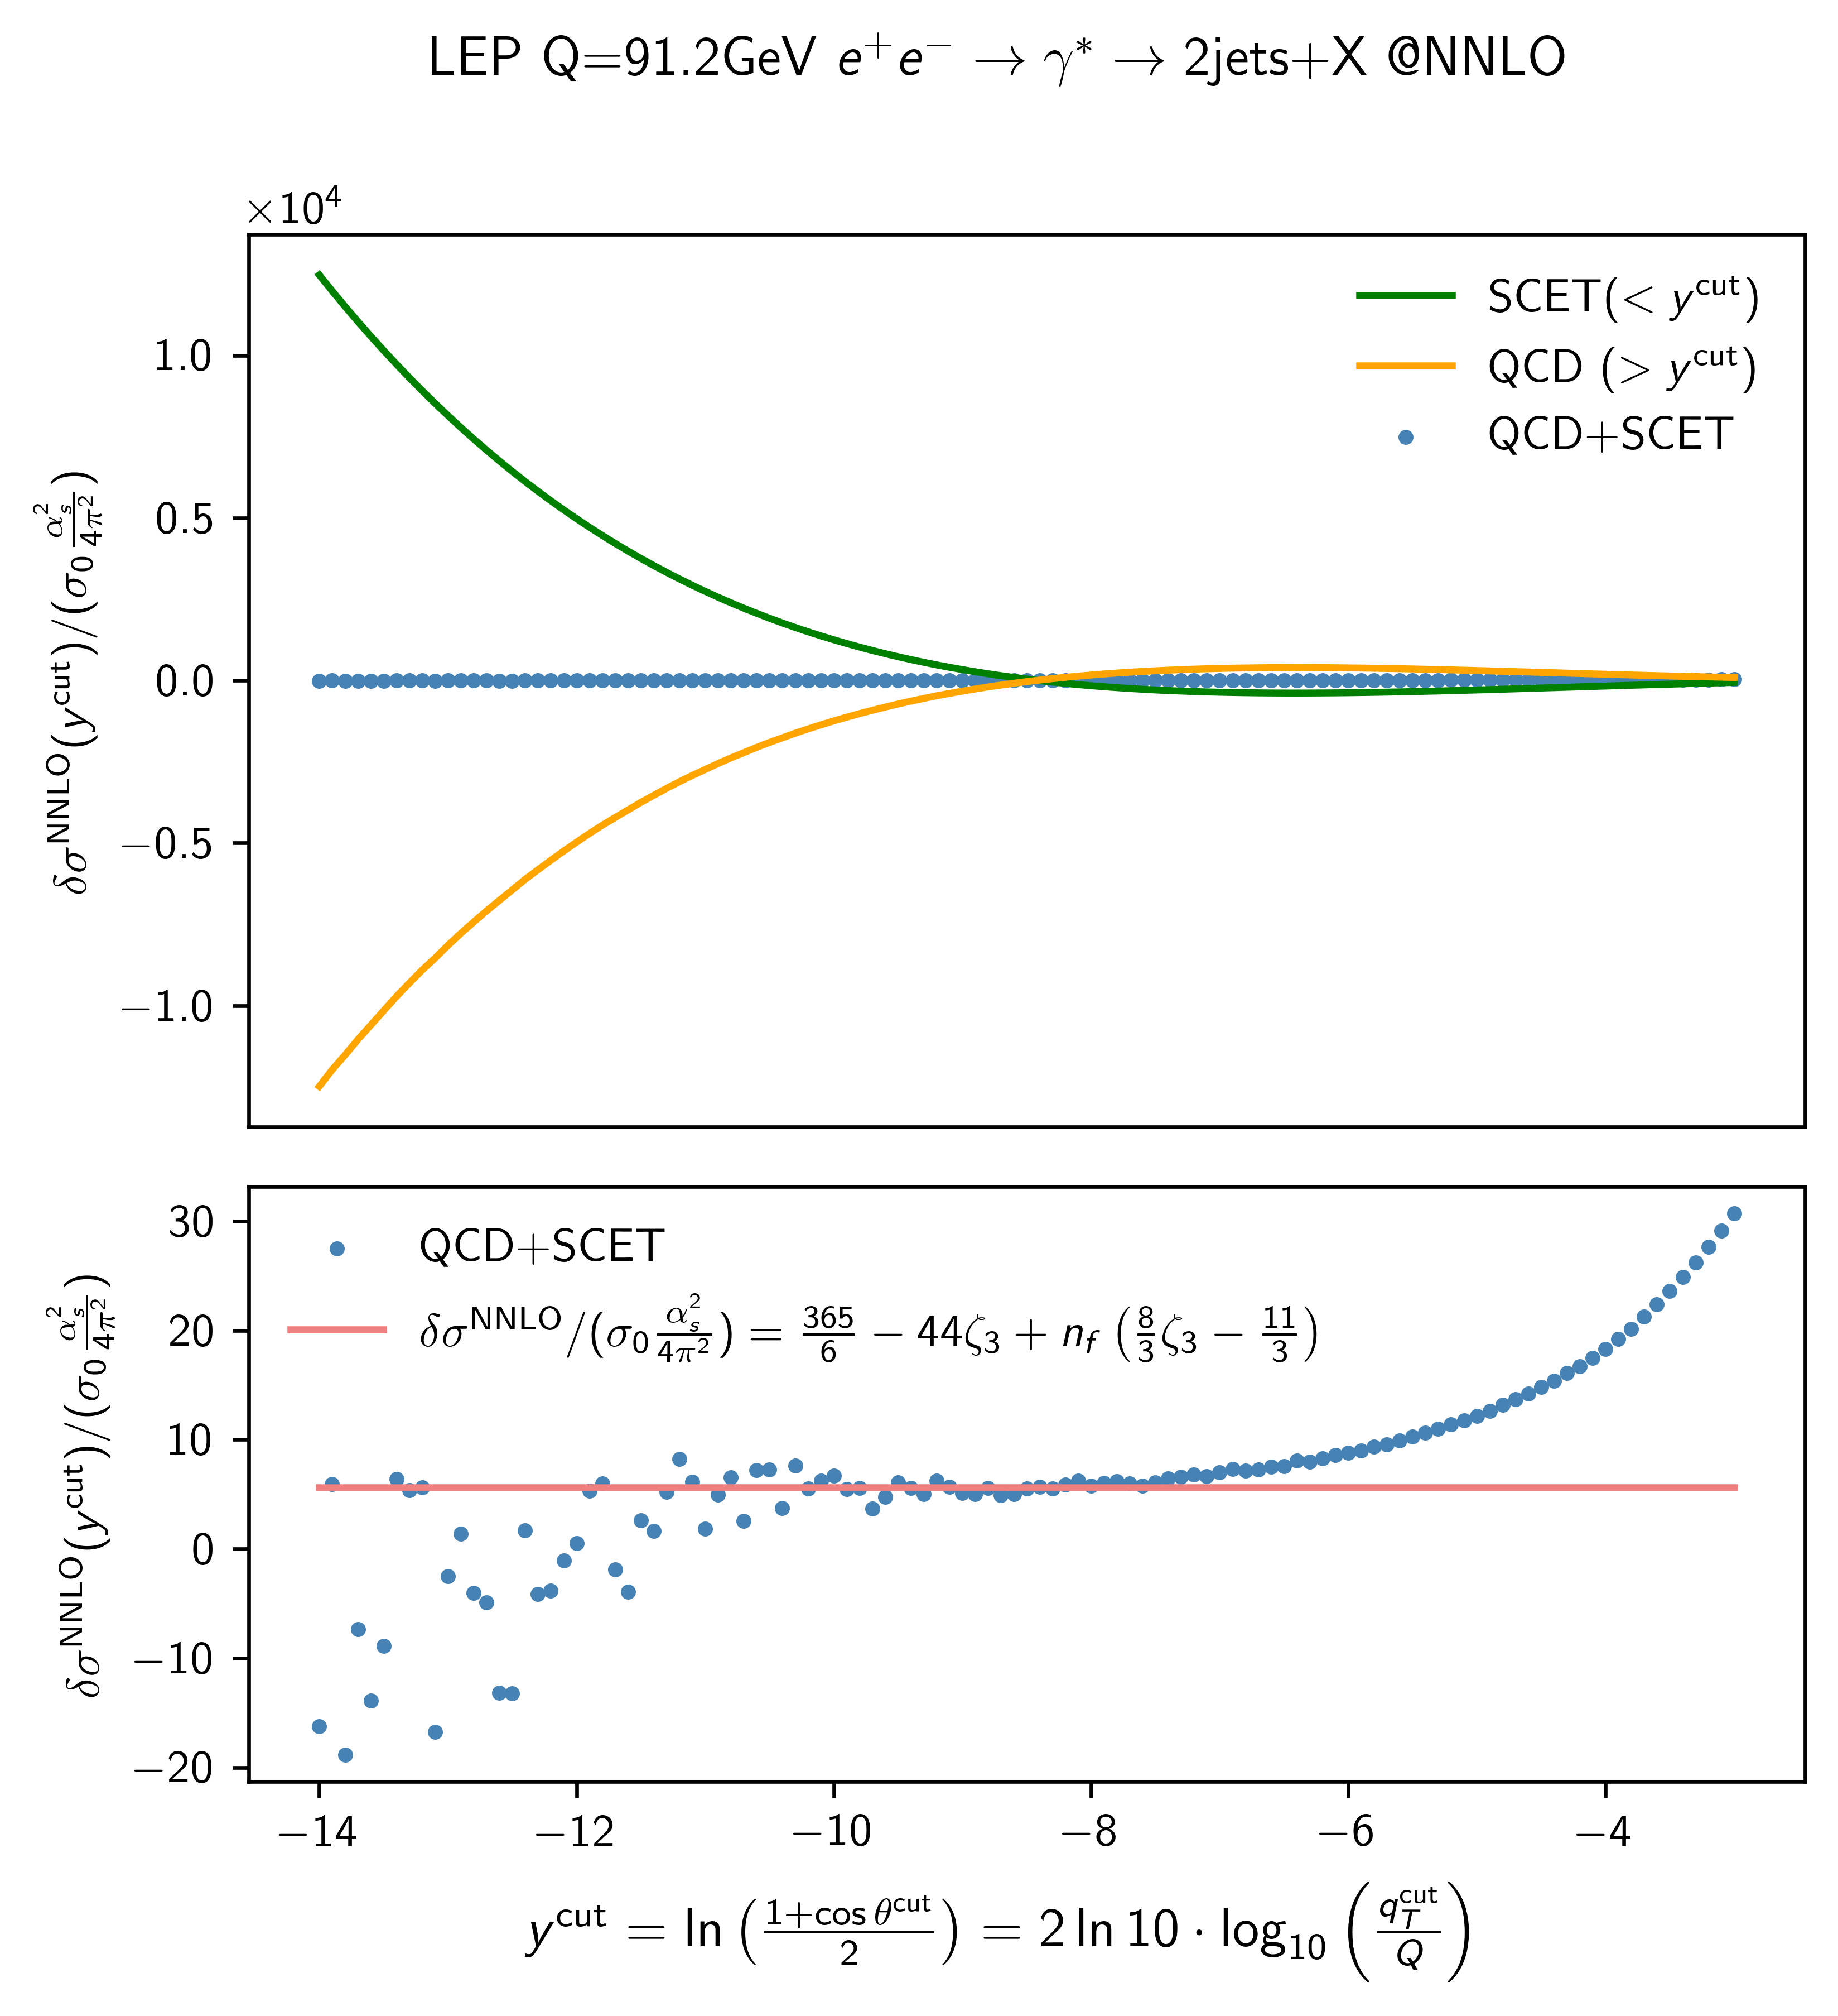
Lepton NNLO
No gluon jet function needed for lepton collisions

Slide 32
Conclusion
Azimuthal decorrelation is a really nice observable
Radial decorrelation isn’t
The WTA axis salvages qT-slicing for jets
Planar slicing is simple, non-planar less so

Slide 33
Thank you!

Slide 34
Dijet again
Modes inherited from azimuthal decorrelation
behaves like Standard Jet axis case!

Slide 35
Calculation
NNLL resummation
3-loop , 2-loop , 1-loop finite H,J,S,B
[Arnold, Reno, ’89]
[Becher, Lorentzen, Schwartz, ’12]
[Moch, Vermaseren, Vogt, ’04/’05]
[Becher, Neubert, ’09]
[Gehrmann, Luebbert, Yang, ’14]
[Echevarria, Scimemi, Vladimirov, ’16]
[Luebbert, Oredsson, Stahlhofen, ’16]
Most known, only minor recalculations:
S at NLO via boost (non-)invariance:
TMD jet function with -regulator and large jet radius
See also [Gao, Li, Moult, Zhu, ’19]
[Gutierrez-Reyes, Scimemi, Waalewijn, Zoppi, ’18/’19]
[Chiu, Jain, Neill, Rothstein, ’12]

Slide 36
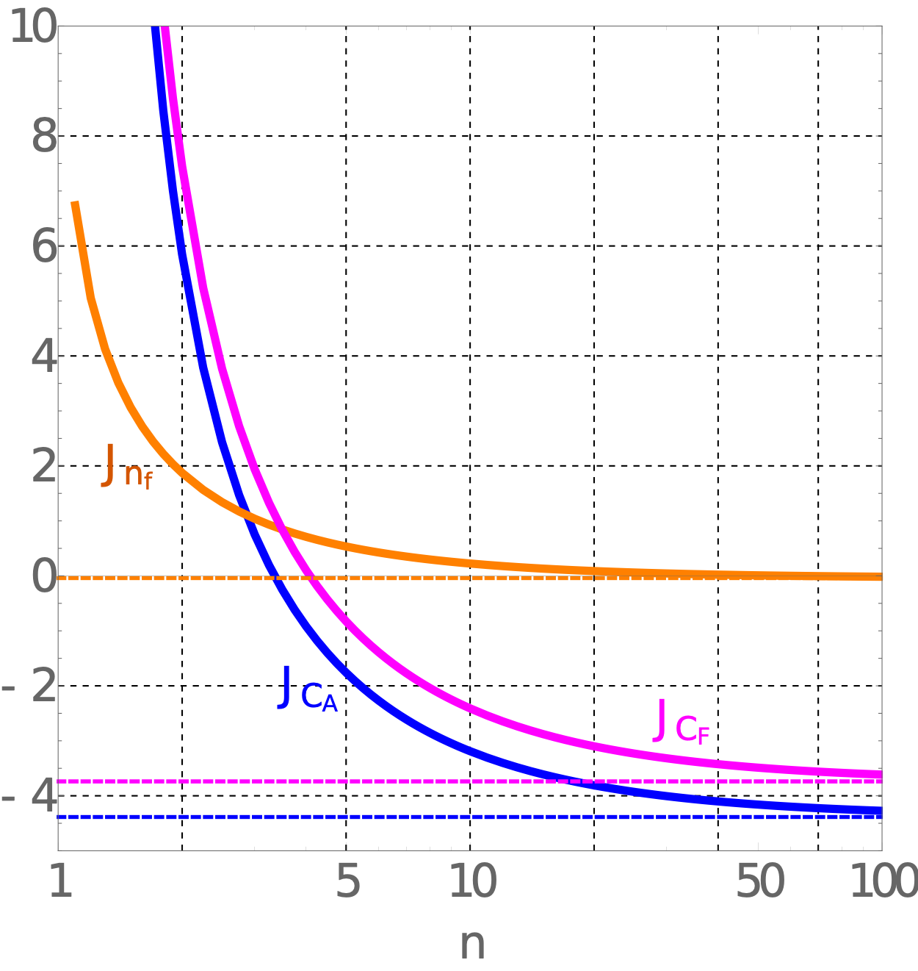
Backup Trivia
pT-weighted jet recombination:
Reproduces WTA as
Linear polarisation:
[Catani, Grazzini, ‘11]

