Slide 1
Regge Anomalous Dimensions and Unitarity
Michael Saavedra
Based on [2410.06283] with Ira Rothstein

Slide 2
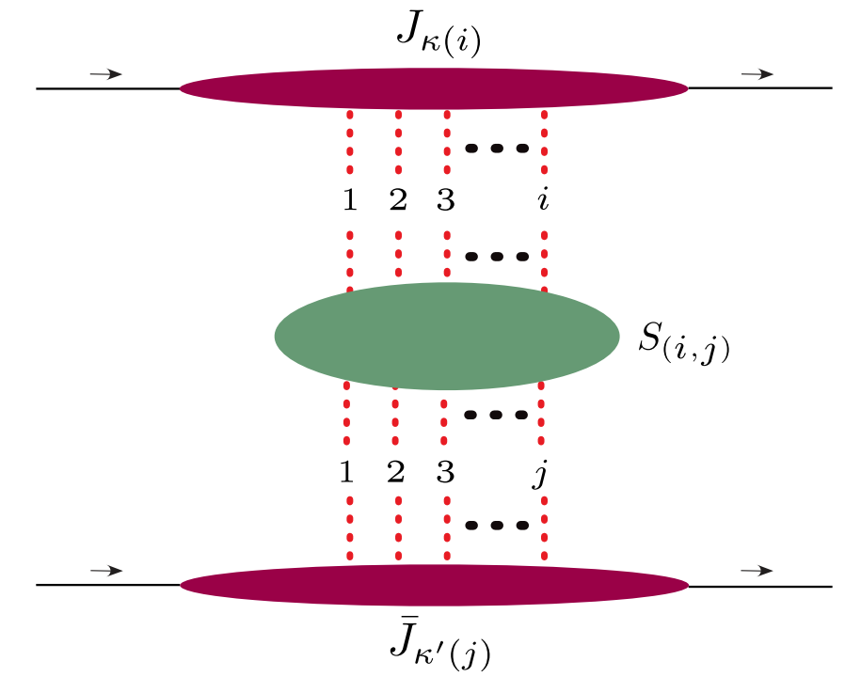
Glauber Factorization
[Rothstein, Stewart, 2016]
[Gao, Moult, Raman, Ridgway, Stewart, 2024]
Factorize amplitude into a sum of soft and collinear matrix elements:
Rapidity RG:
This is a mess…
Gluon Regge Trajectory
BFKL Equation

Slide 3
Hints of Structure
Amplitude simplifies in the planar limit
Each comes from different Glauber operators
Anomalous dimensions must reduce to Regge trajectory
How do we reproduce this in the EFT? Can we push beyond the planar limit?

Slide 4
Outline
Formalism: Complex boosts and signature
Regge trajectory from unitarity cuts
Generating relations between anomalous dimensions
BFKL from the Regge trajectory

Slide 5
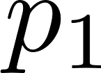
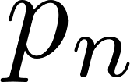
EFT Form Factors
EFT form factor
[Caron-Huot, Wilhelm, 2016]
[Rothstein, MS, 2024]

Slide 6
Forward Amplitude?
These formulas rely on all large scales being time-like:
Forward scattering has two large scales, and
is forced to be space-like by momentum conservation
It is not obvious we can use the formalism for scattering amplitudes

Slide 7
Signature
Crossing highly constrains analytic structure in the high-energy limit
We can decompose amplitude into a crossing-symmetric (even) and crossing antisymmetric (odd) piece:
All dependence captured in :
are real

Slide 8
Signature Pt. II: Complex Boosts
Complex boost conjugates :
Boost takes signed amplitudes to their complex conjugates:
Only odd-signature is amenable to unitarity

Slide 9
Glauber Factorization
Signed amplitude from Glaubers:
Complex boosts give anomalous dimensions:

Slide 10
Formula for Regge Trajectory
Use the vanishing of transitions:
Formula for the Regge trajectory:
Builds up phase and subtracts out non-Regge ‘s

Slide 11
Formula for Regge Trajectory
Reproduces known results at one and two loops:
Equivalent to the relations found in [Moult, Raman, Ridgway, Stewart, 2022]

Slide 12
Bonus Relations at two loops
Let’s look at the real part at two loops:
Use the one loop relation
The two Glauber RRG is fixed to be multiplicative!

Slide 13
Bootstrapping
It turns out we can say more:
Leads to an ansatz for :
Compare with :
Matches with BFKL Kernel!

Slide 14
Relations in the Even Sector
We can get similar formulas for the even signature amplitude.
At three loops:

Slide 15
Conclusions
Using amplitudes with signature, we can generalize the complex boost formalism to study Glauber anomalous dimensions
This gives a useful formula for the Regge trajectory in terms of unitarity cuts
This leads to constraints on and relations between anomalous dimensions of different operators

