Slide 1
In-Sensor Spectral Machine Vision
Dehui Zhang
Professor Ali Javey Research Group
January 21, 2025

Slide 2
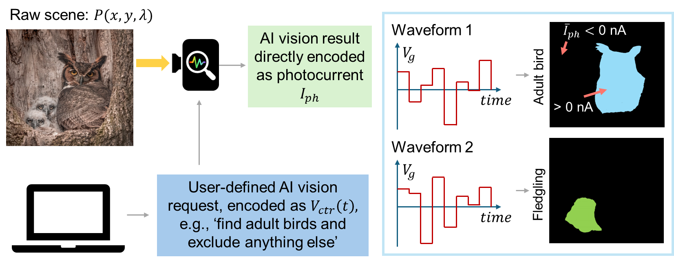
In-Sensor Spectral Machine Vision
What it is?

Slide 3
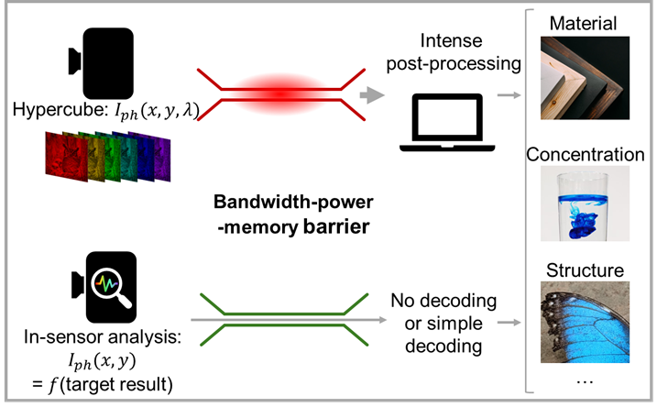
In-Sensor Spectral Machine Vision
Why in sensor?
1000*1000 pixels
*300 bands*60fps…

Slide 4
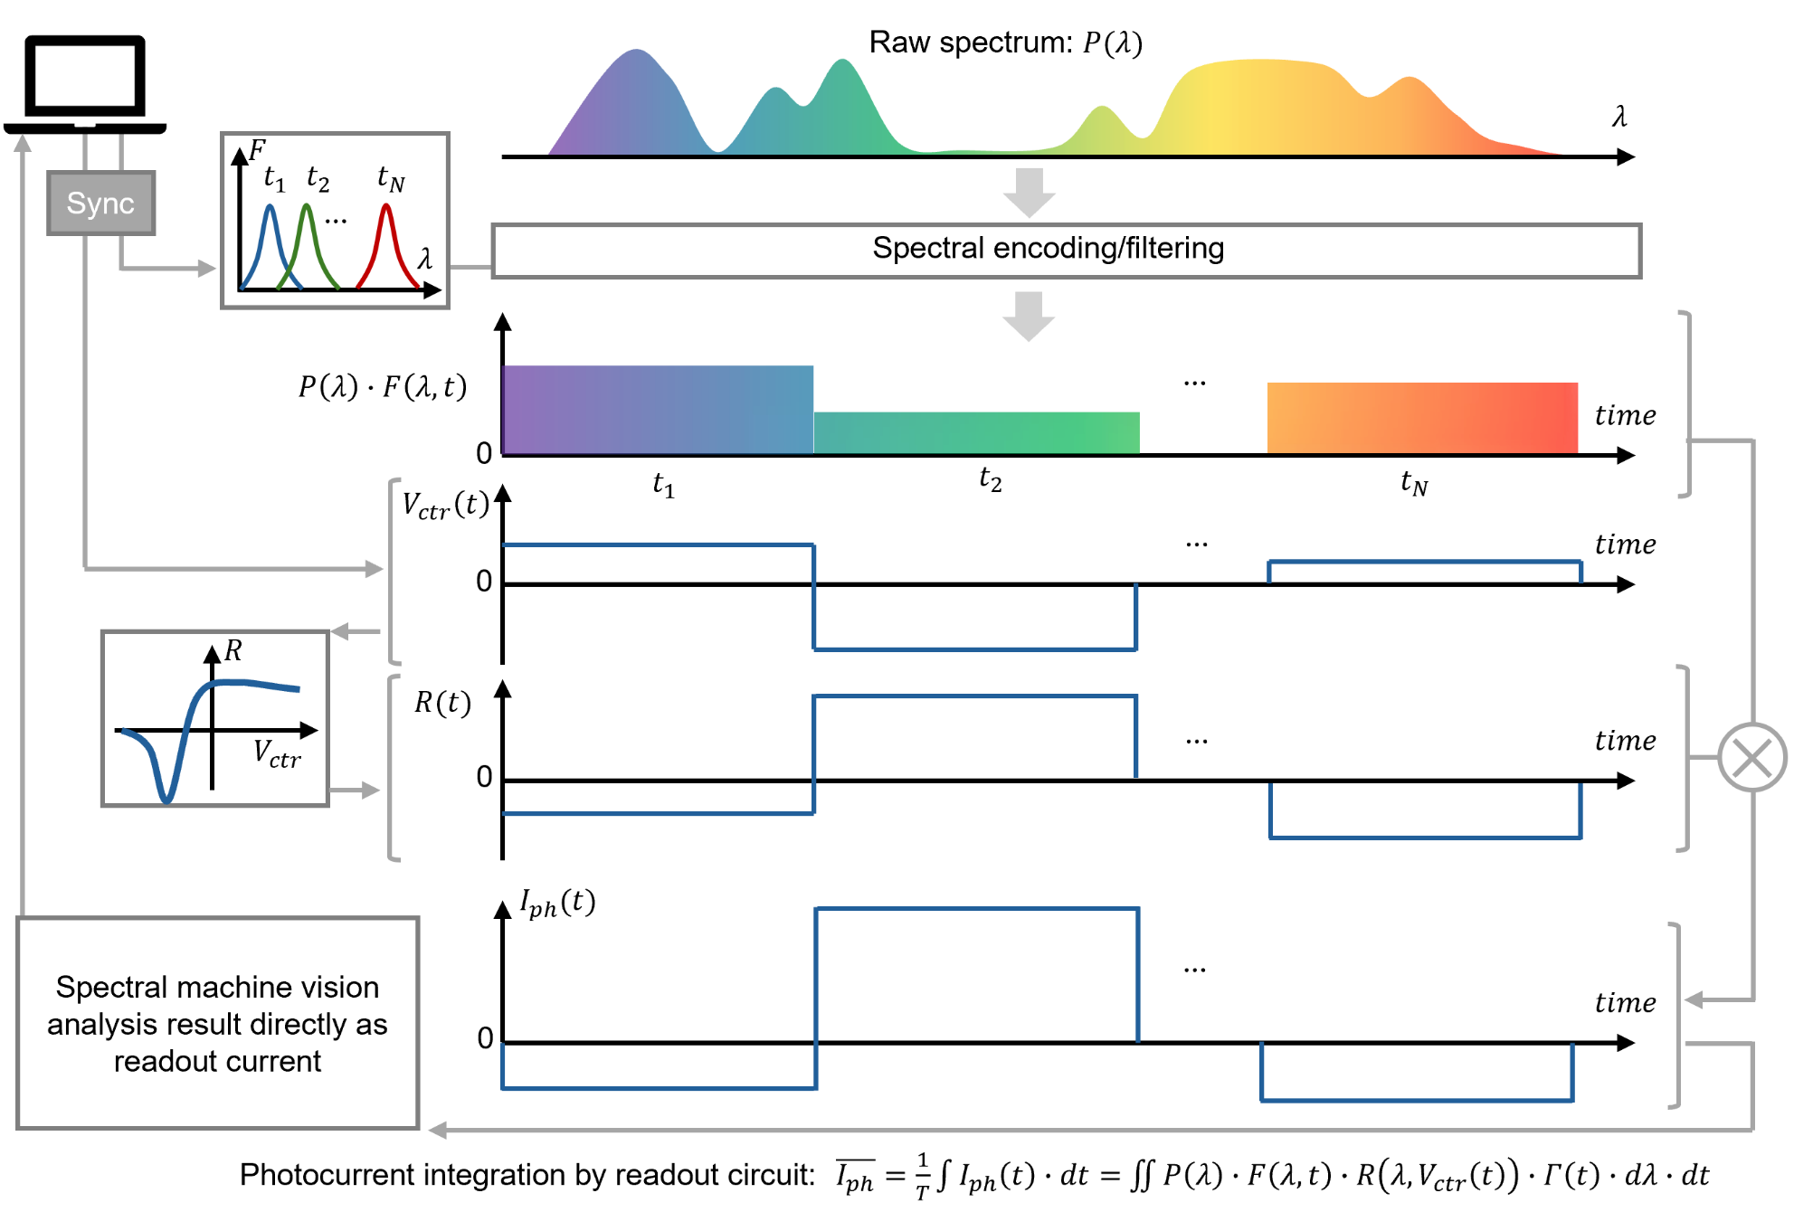
System Architecture
How?
Multiplication.
Addition.

Slide 5
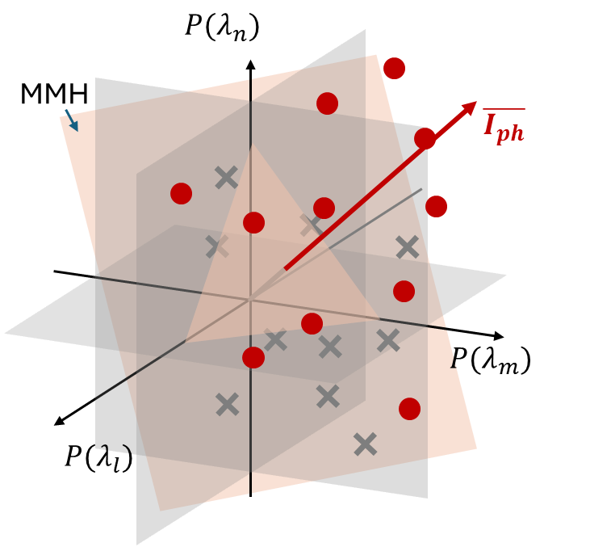
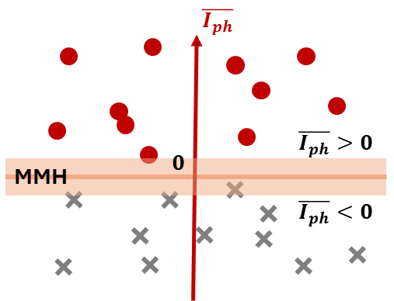
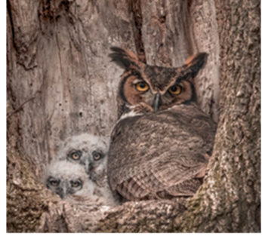
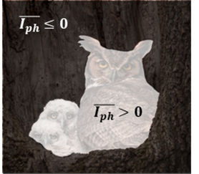

Spectral Kernel Machine
$\overline{I_{ph}}=\frac{1}{T}\int{I_{ph}\left(t\right)∙dt}= \iint{P\left(λ\right)∙F\left(λ,t\right)∙R\left(λ,V_{ctr}\left(t\right)\right)∙Γ\left(t\right)∙dλ∙dt}$
$z=sgn\left(\overline{I_{ph}}\right)=\operatorname{sgn}\left(\sum_{i=1}^{N}{w_{i}z_{i}k\left(P, S_{i}\right)}\right), with k\left(P, S_{i}\right)=\int{P\left(λ\right)∙S_{i}\left(λ\right)∙dλ}$
Our device naturally follows the kernel machine learning algorithm.

Slide 6
Tunable Bipolar Photodiode
Electrically tunable.
Bipolar
Low dark current and noise.
-
+
+
-
G1
G2
G1
G2
+
-
-
+
E

Slide 7
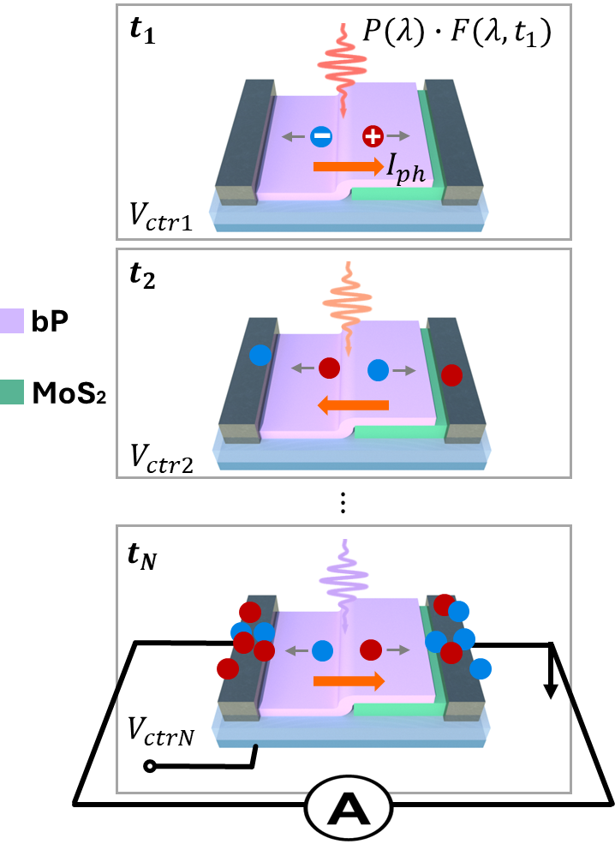
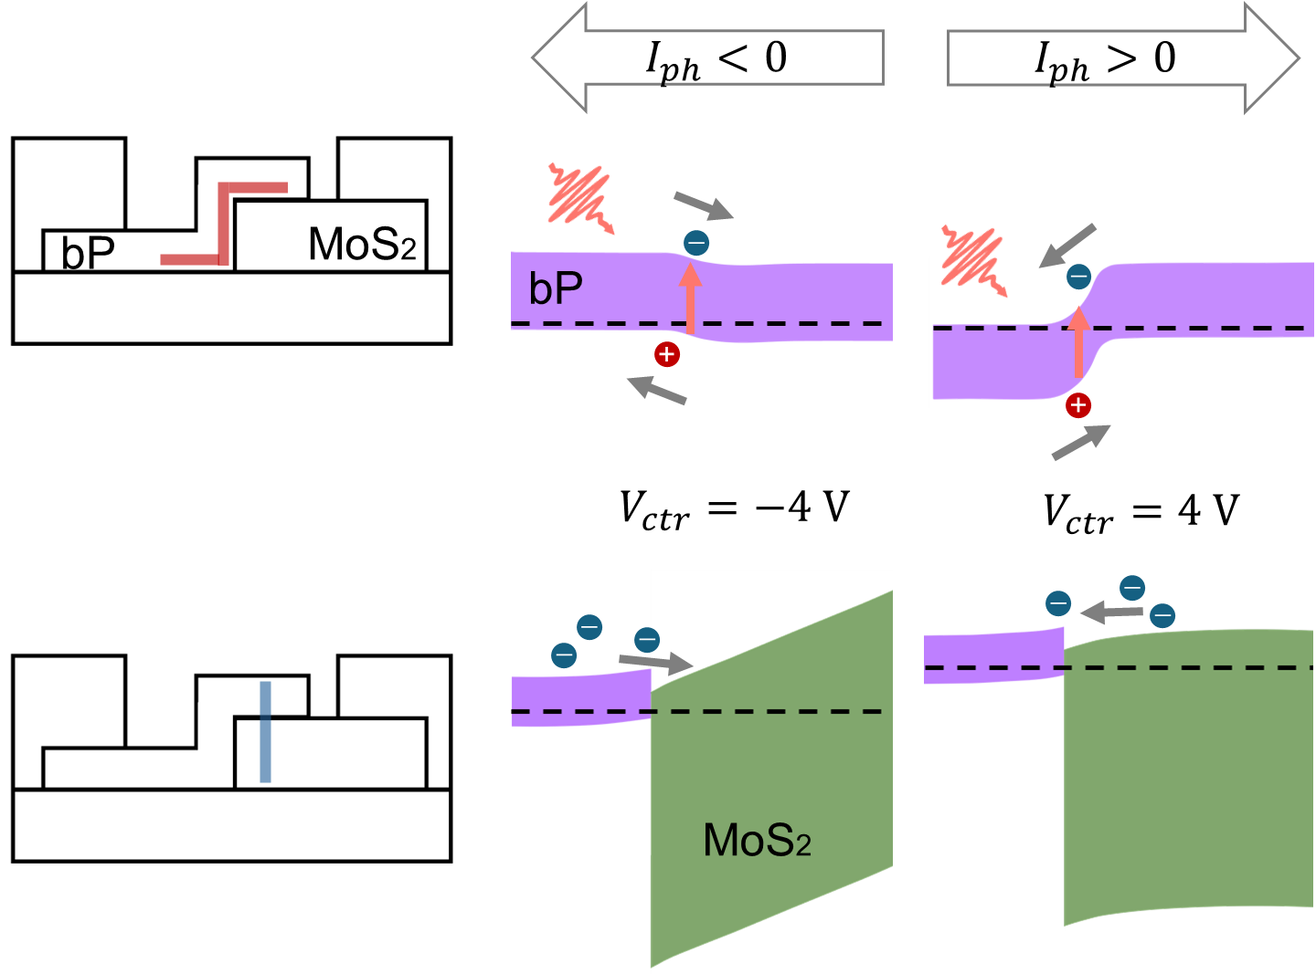
Tunable Bipolar Photodiode
Electrically tunable.
Bipolar
Low dark current and noise.

Slide 8
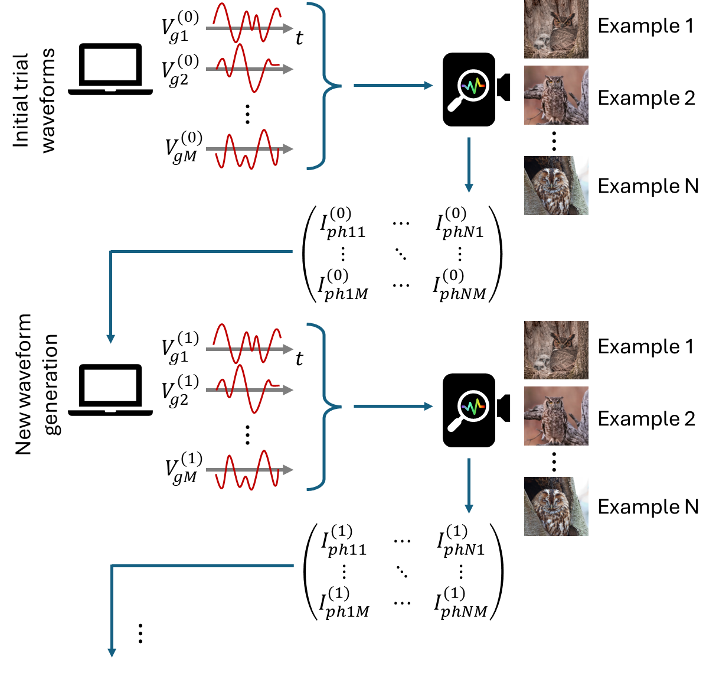
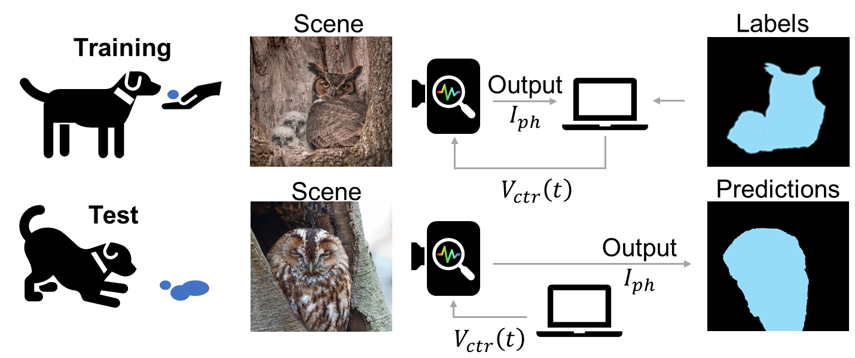
Training
Sniff-and-seek sensing.
Genetic training algorithm.

Slide 9
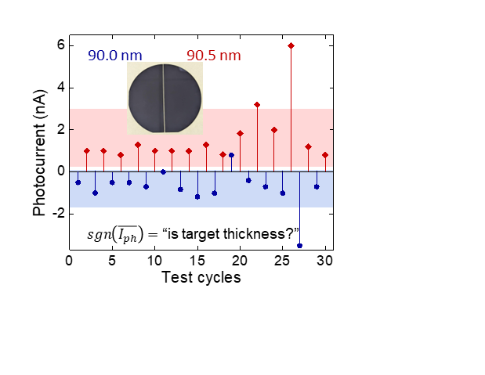

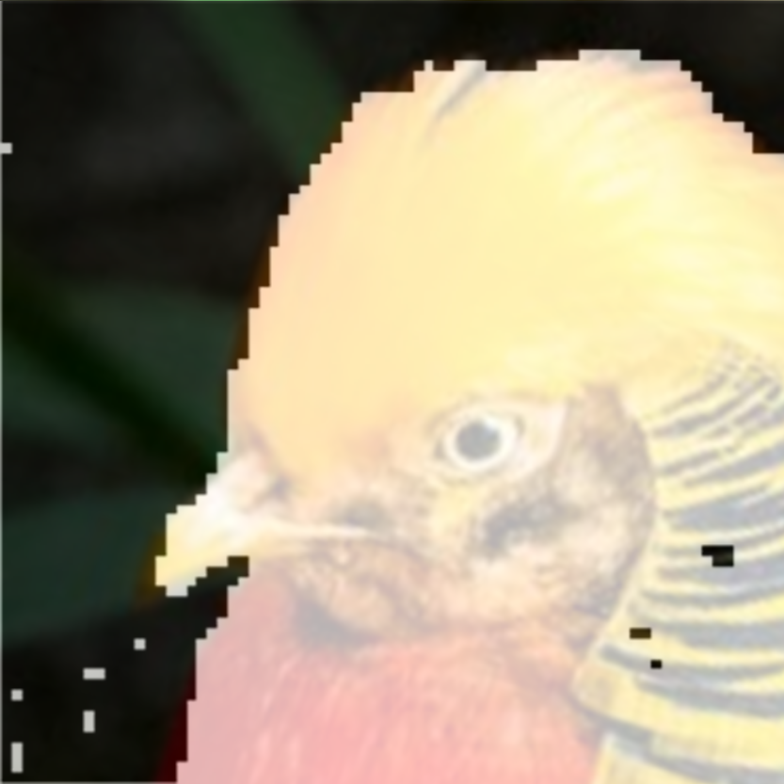
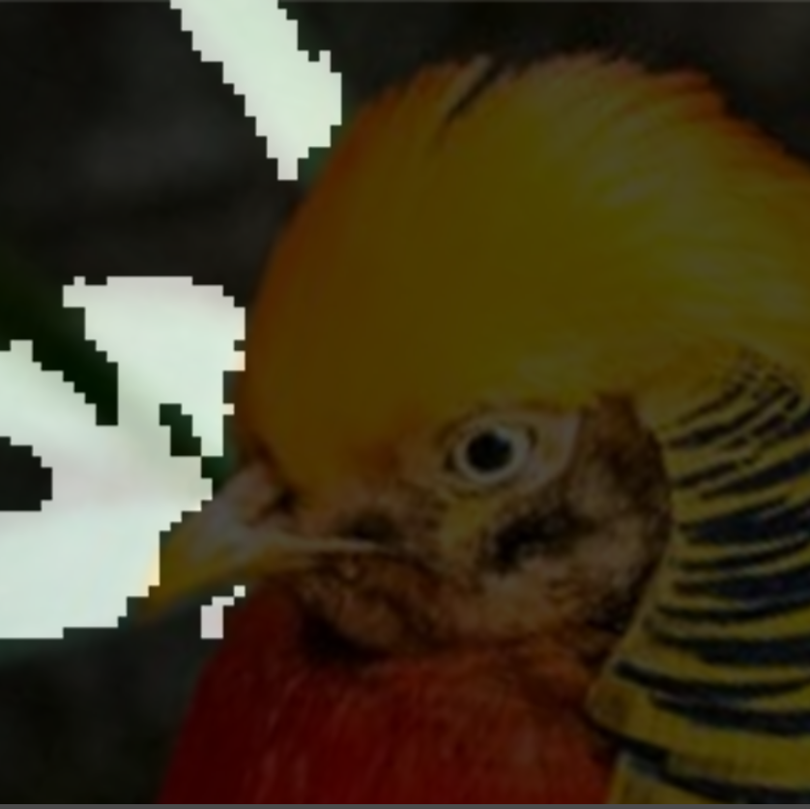
Visible Demo
Thin film metrology
Object-wise imaging
Token = ‘identify birds’
Token = ‘identify leaves’

Slide 10
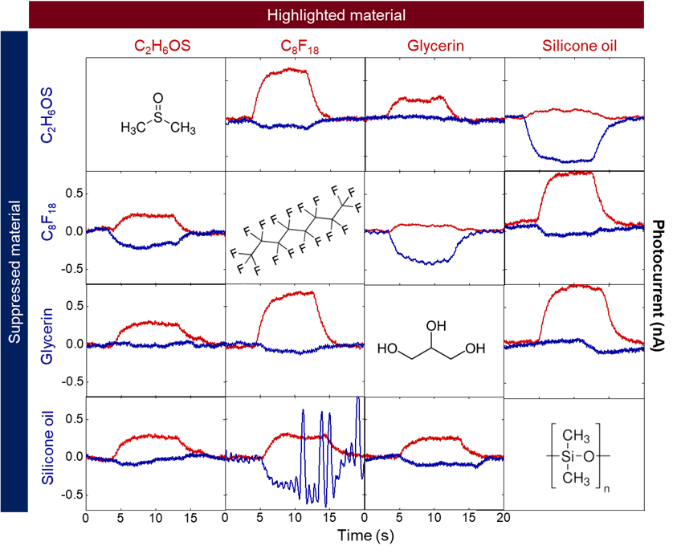
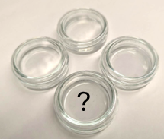
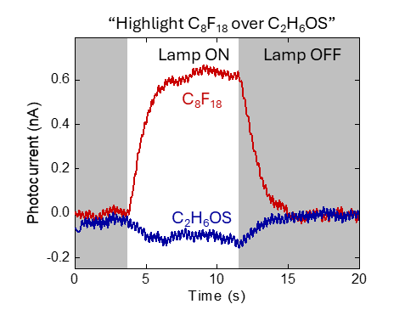
NIR-MIR Demonstration
Identification of visibly transparent liquid chemicals.

Slide 11
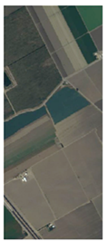
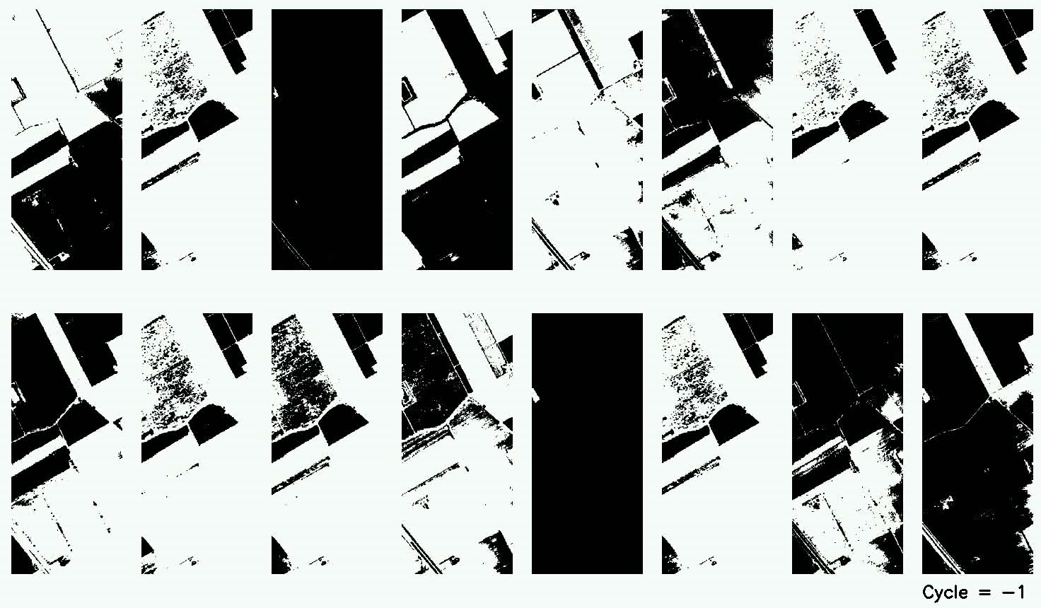
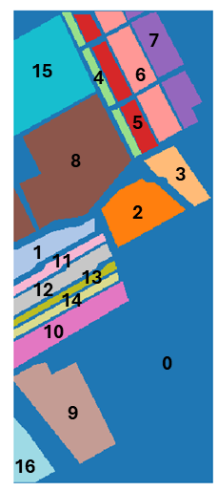
Towards Scalable Field Applications
Simulation on sniff-and-seek sensing on Salinas hyperspectral dataset of crop fields.

Slide 12
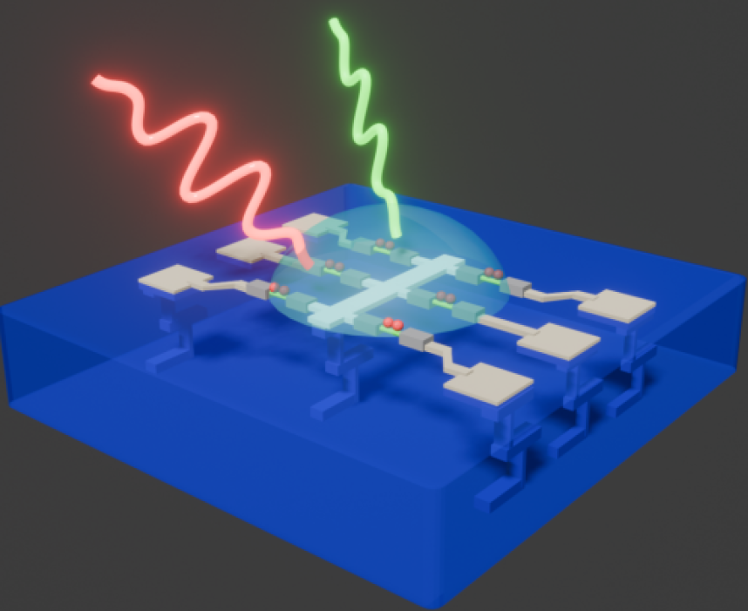
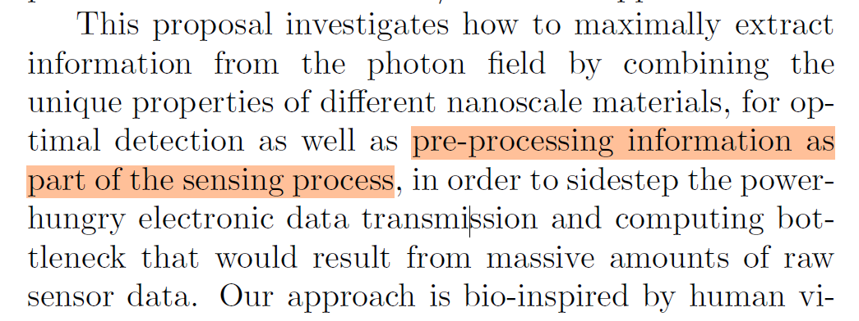
Scientific Questions at Nanoscale
A good fit to the program.
Squeeze the spectral encoding to the sensor with novel materials and novel device physics.
Extend to other optical degrees of freedom such as polarization or quantum states.
Materials: CNT, TMDCs, Te, Si, perovskites…
Optics: dye filters, metamaterial, QDs, Resonators…
Scalability…

Slide 13

Questions

