Slide 1
TMD Lithographic Synthesis
Towards CMOS compatible Integration
Tevye Kuykendall 1/21/2024

Slide 2
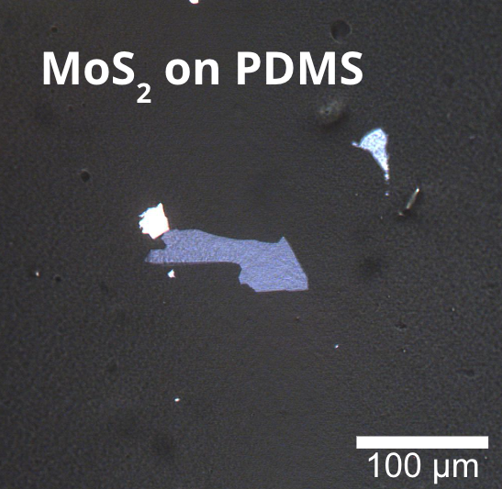
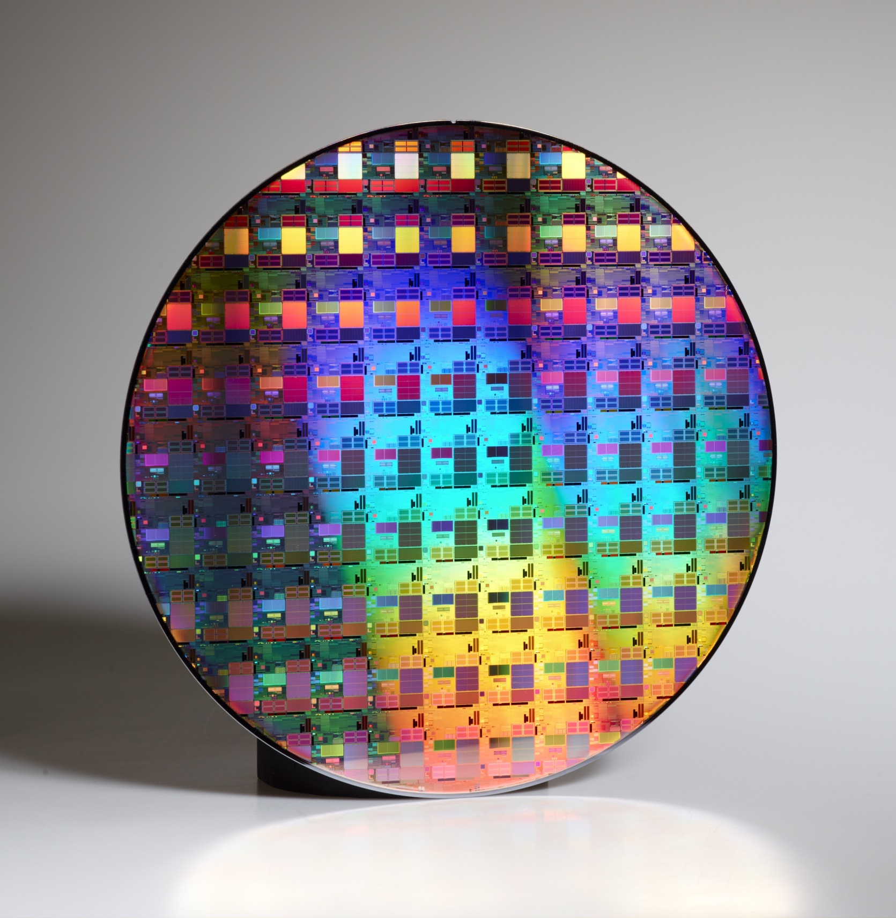
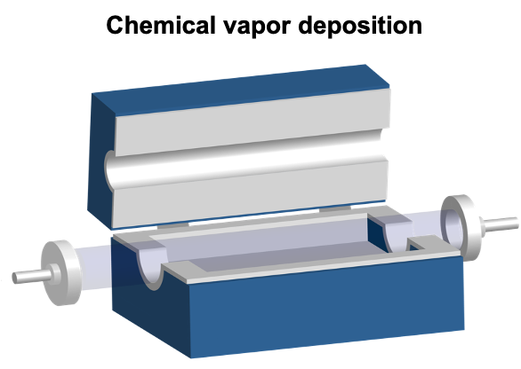
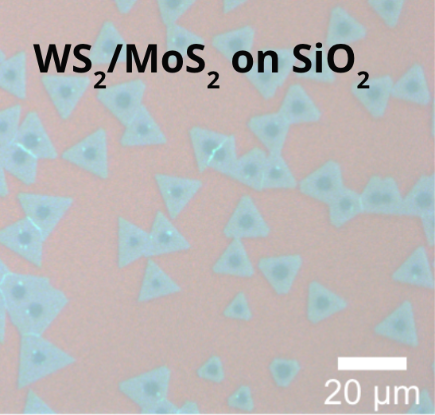
Traditional synthesis of 2D Materials:
Transition Metal Dichalcogenides (TMDs)
Exfoliation & Transfer
Transition Metal Dichalcogenides
Wafer-Scale
Fabrication
Easy to learn and high quality materials. Not reproducible.
?
Chemical Synthesis (e.g. CVD)
MX₂
M = Transition Metal
X = Chalcogen
Reproducible materials. Non-trivial to define location and shape of materials.

Slide 3
Lithographically Defined Synthesis of Transition Metal Dichalcogenides (TMDs)
A. Lateral Conversion: Microfabrication & Synthesis
H₂
H₂X
H₂
B. Optical Microscopy (WS₂)

Slide 4
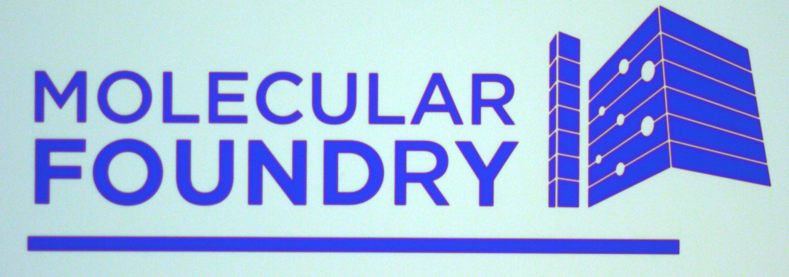
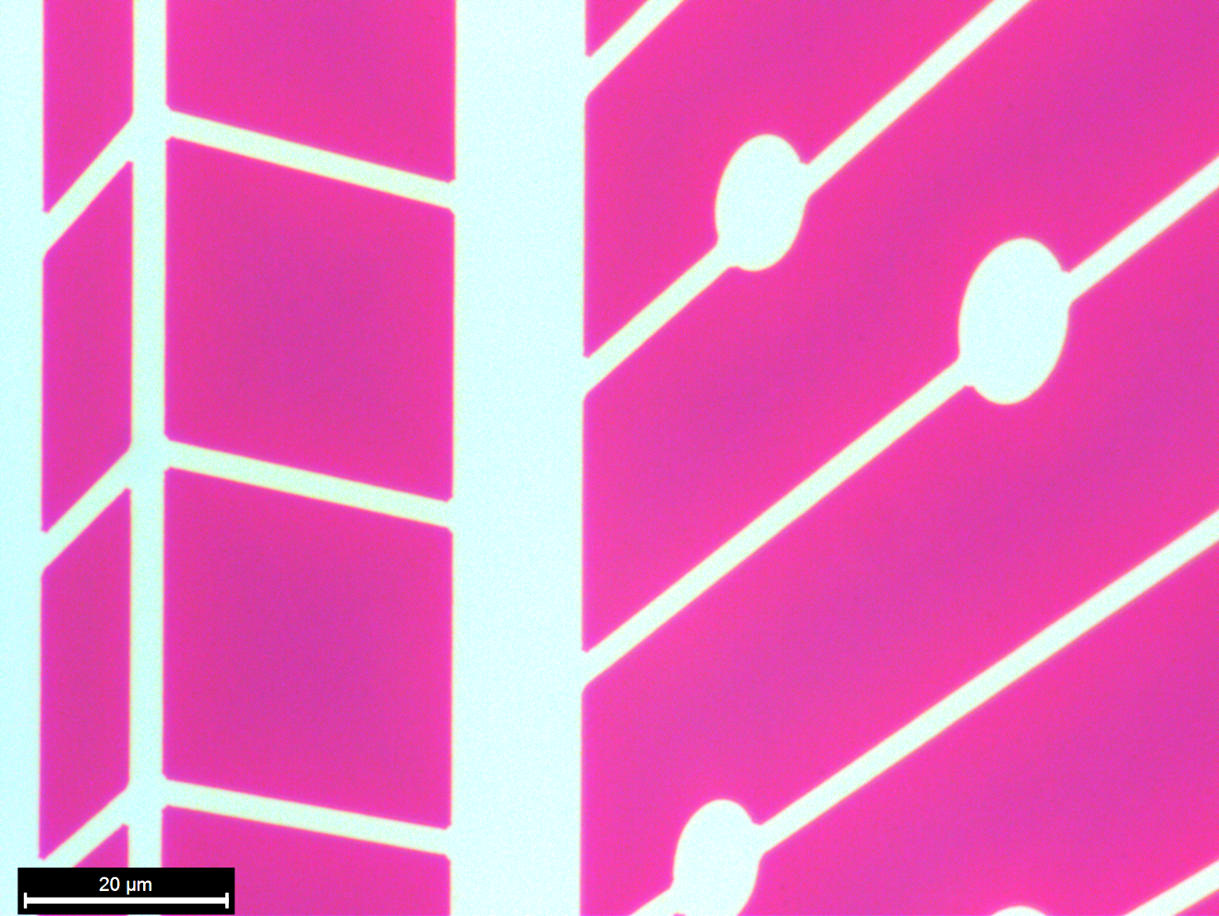
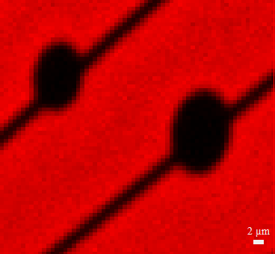
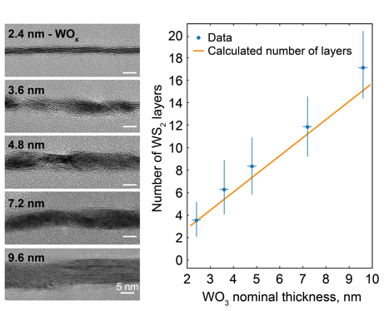
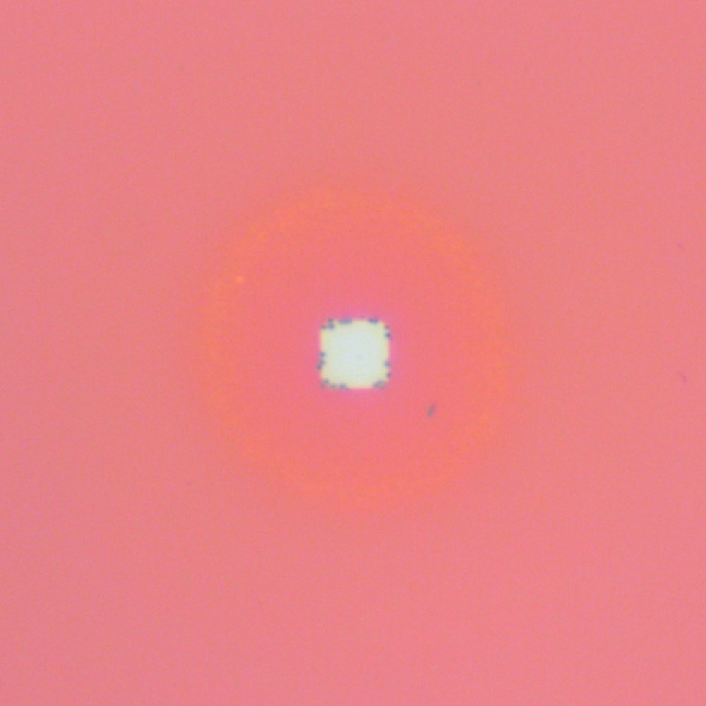
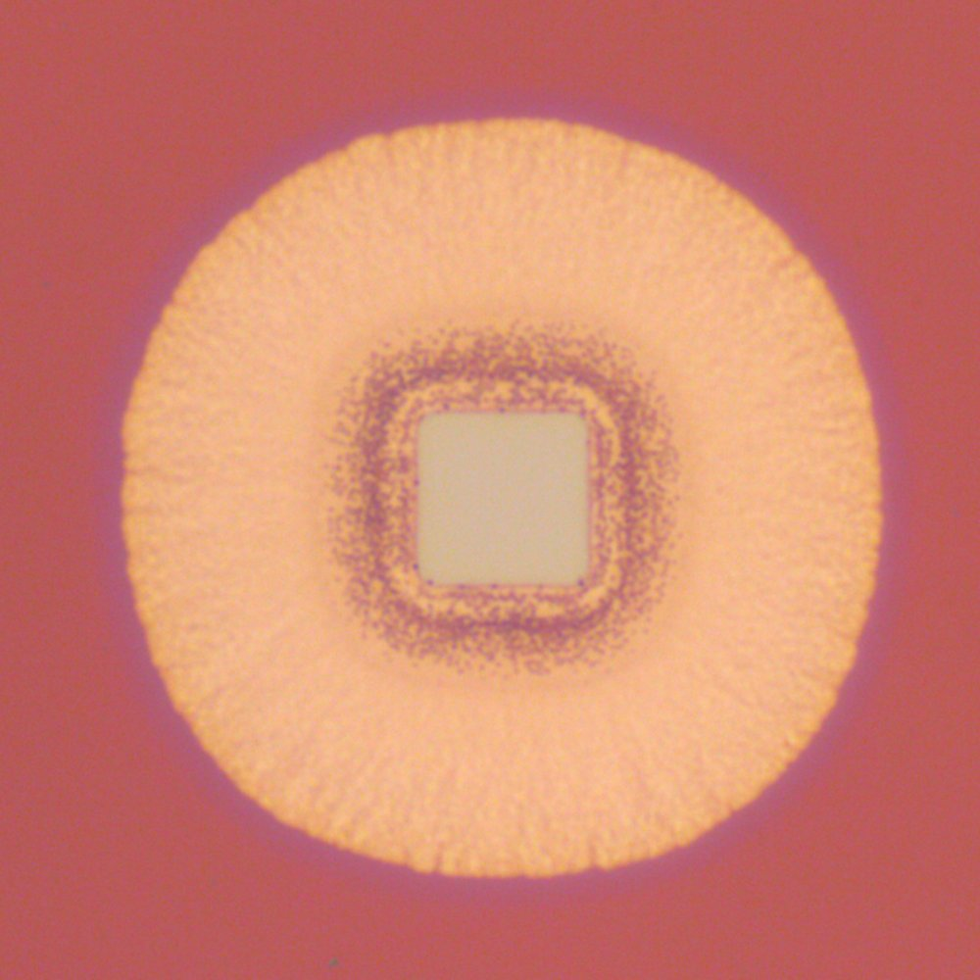
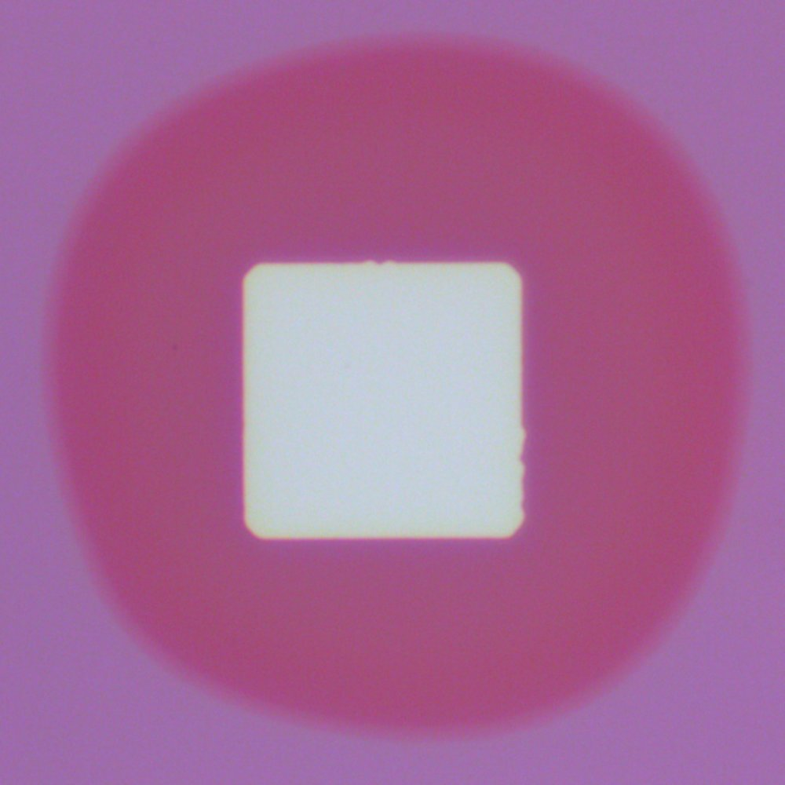
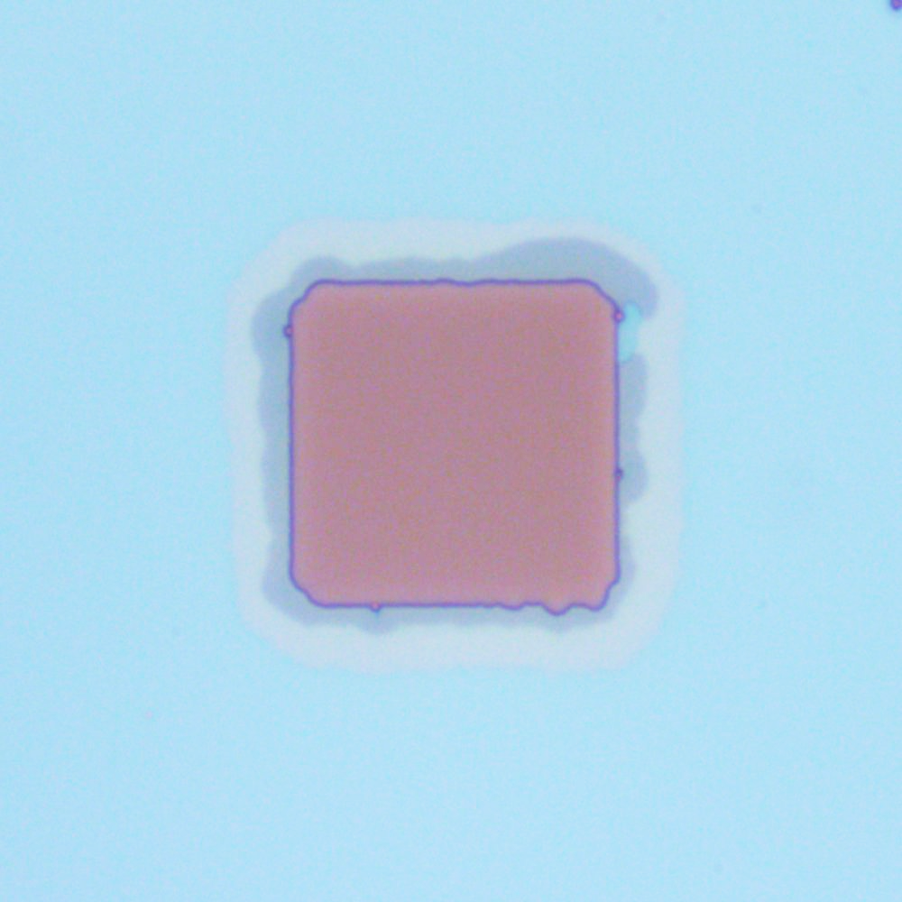
Lithographically Defined Synthesis of TMDs (cont.)
Wafer Scalable
Cross-Sectional HRTEM
Sulfides
1 mm
(H₂S)
SiO₂
WS₂
MoS₂
WS₂
10 µm
Cross-Sectional TEM of Various WO_{x} Thickness
Selenides
(H₂Se)
WS₂ Raman Map
WSe₂
MoSe₂
Tellurides
(Tellurium powder)
WTe₂
Pt_{x}Te_{y}
MoTe₂
GaTe
Etched
area
Fully Converted
WS₂
20µm

Slide 5
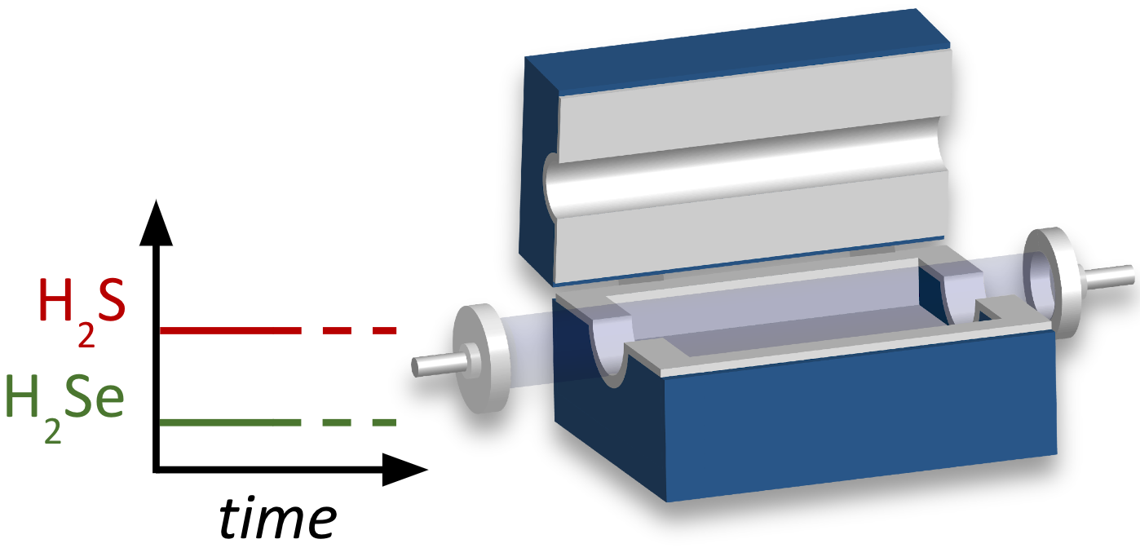
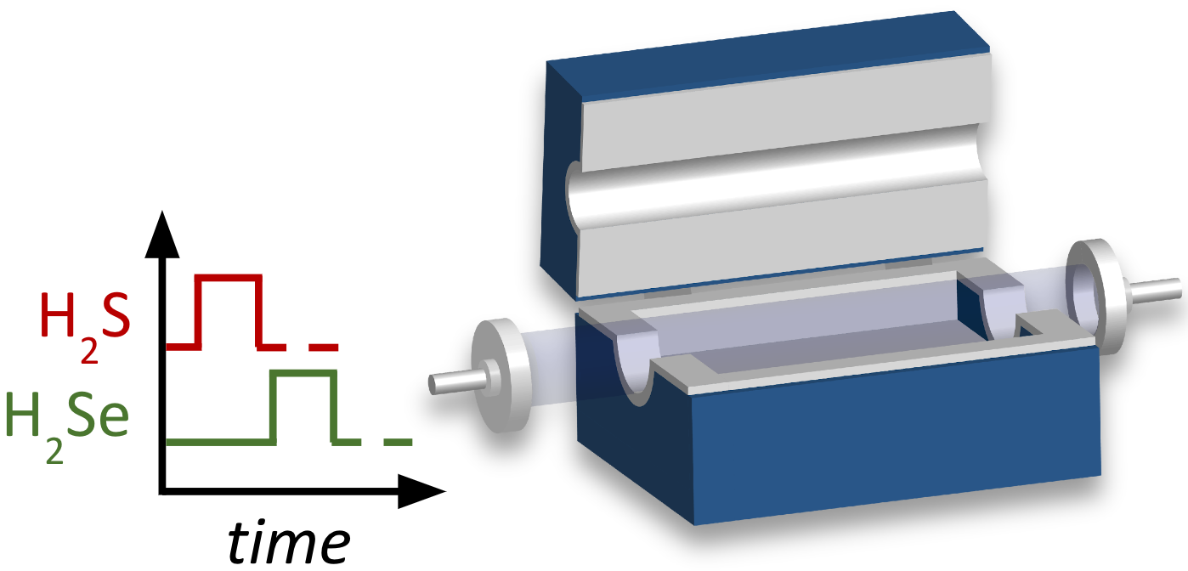
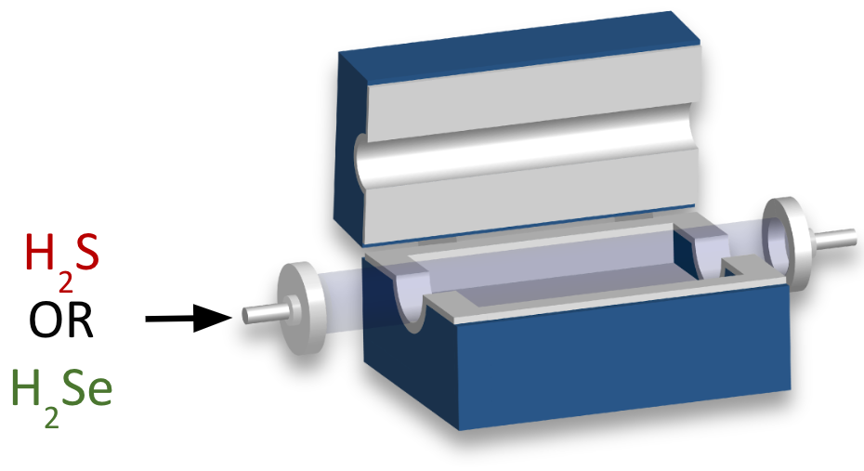
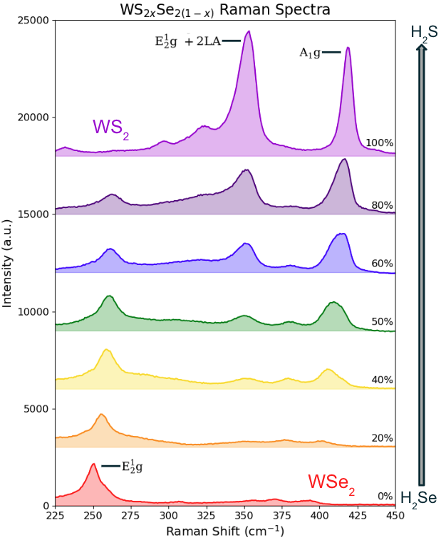
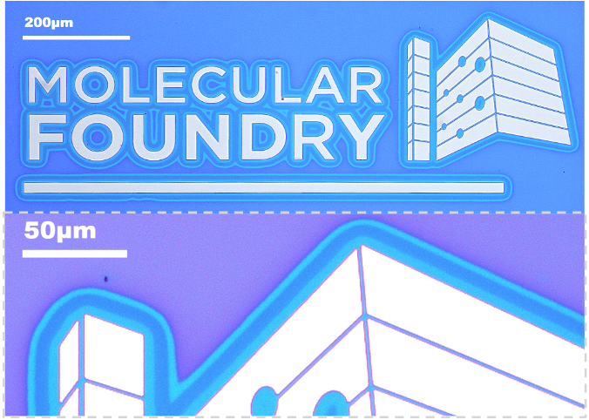
Lithographically Defined TMD Alloys & Heterostructures
Alloys
Lateral Heterostructures
Vertical Heterostructures
WS₂ - WSe₂ (Optical Microscopy)
Cross-Sectional HRTEM
WS₂
SiO₂
WS₂
SiO₂
WS₂
SiO₂
Raman Spectroscopy Line Scan
WS₂
W
WS₂
WSe₂
WS₂

Slide 6
Lower growth temperature for CMOS compatibility?

Slide 7
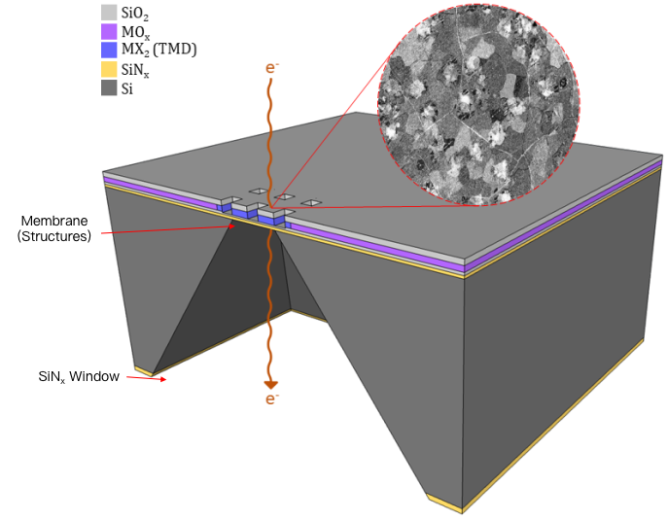
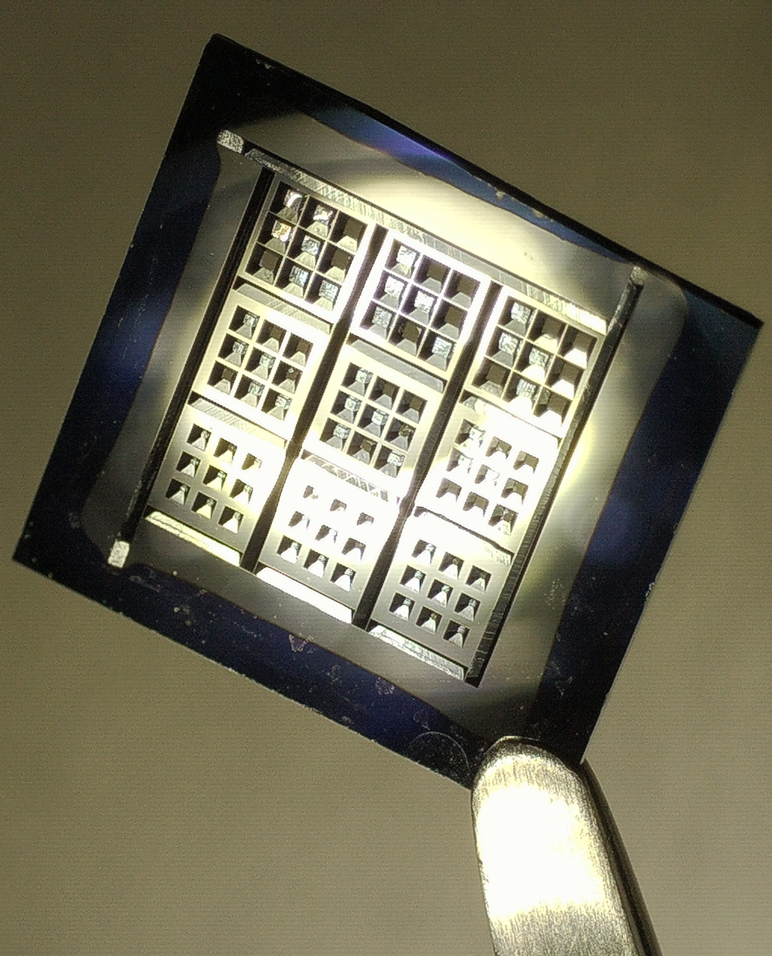
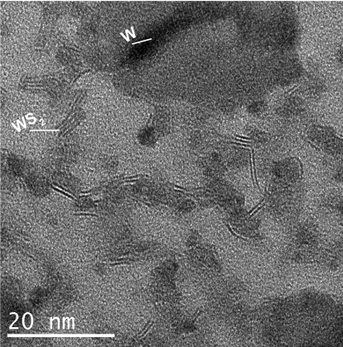
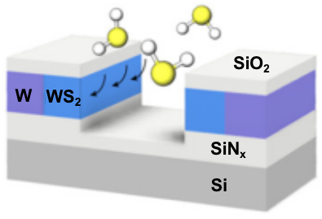
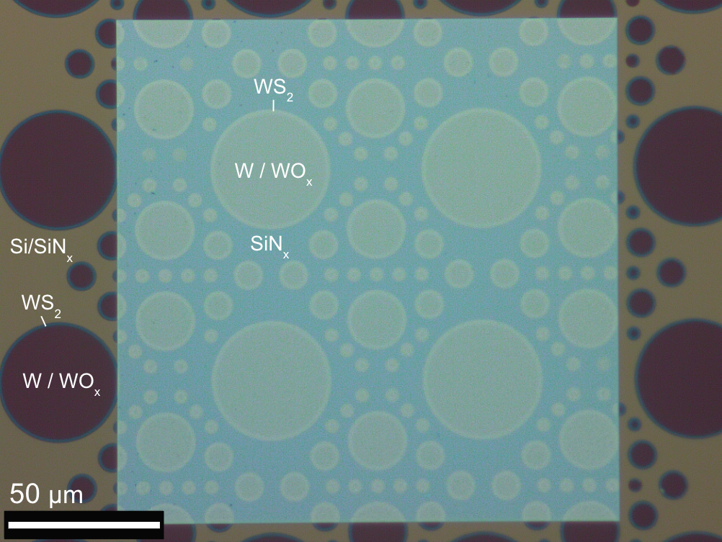
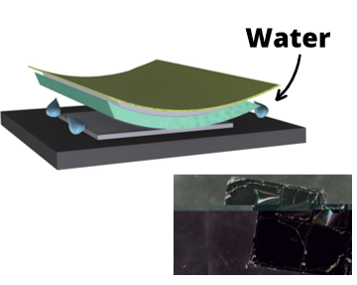
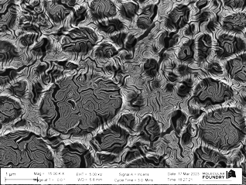
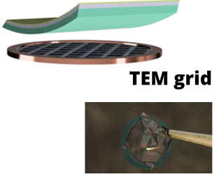
TEM to Study the Effect of Reduction and Growth Temperature
A. SiN_{x} Membranes
Bottom
Top
Top
Membrane
A. BCP patterning and liquid exfoliation transfer

Slide 8
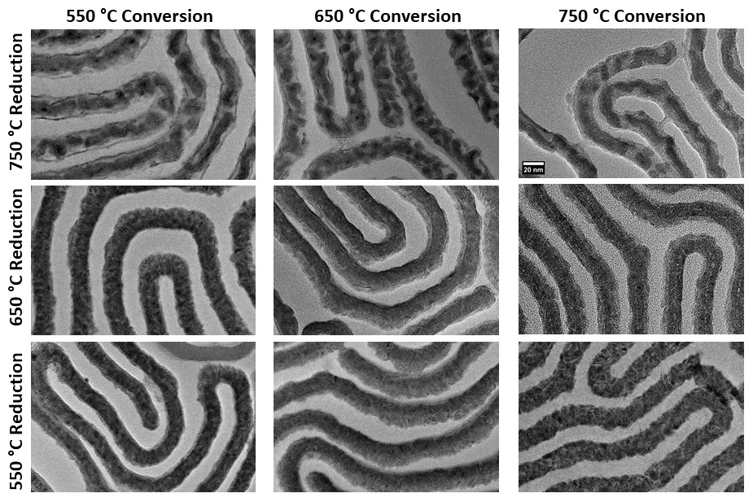
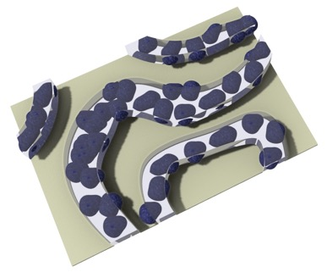
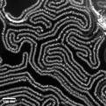
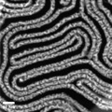
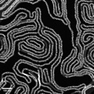
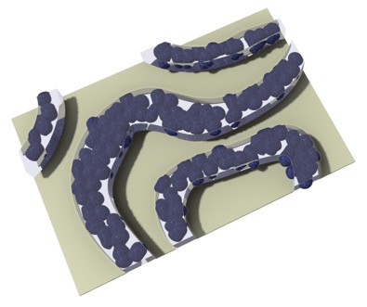
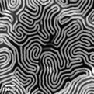
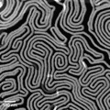
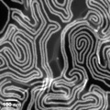
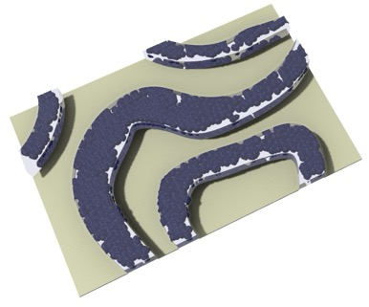
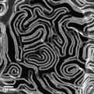
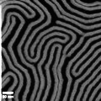
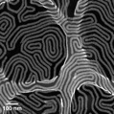
Morphology trends
Grain size:
$$15.06 ±1.50 nm$$
Grain Size
Grain size:
9$.89 ±2.11 nm$
Crystallinity
Ref. *Marco D'Alessandro Master’s Thesis | 8
Notes:
As you recall form the introduction - Reduction / conversion two step process, so a systematic study on the combination of them tells us morphology info. Interested to see how it behaves at low T to possibly integrate in CMOS tech which requires T around 400C maximum.
Here we have info on the impact of synthesis temperatures on the material. We can see from these images that higher T of reduction are associated to larger grain size and especially at 750 we have a coarsening of the metal producing large but discontinuous grains. Instead, at lower T the grains appear to be much smaller and also more continuous creating a more homogeneous material. This also affect the transfer resulting in a removal of the material improved.
Figure 3. TEM images of BCP patterned, laterally converted WS₂, transferred to lacy carbon membranes. This shows the effect of H₂ reduction, and H₂S conversion on the morphology of the resulting WS₂. The main images are bright-field, while the insets are dark-field. The illustrations on the left show the general trend in average grain size, and emphasize that the WS₂ grain size was primarily determined by the reduction step of the synthesis.

Slide 9
Morphology trends
Grain size:
$$15.06 ±1.50 nm$$
Lower temperature conversion leads to lower quality TMD and gives limited conversion below 400C
Grain Size
Grain size:
9$.89 ±2.11 nm$
Crystallinity
Ref. *Marco D'Alessandro Master’s Thesis | 9
Notes:
As you recall form the introduction - Reduction / conversion two step process, so a systematic study on the combination of them tells us morphology info. Interested to see how it behaves at low T to possibly integrate in CMOS tech which requires T around 400C maximum.
Here we have info on the impact of synthesis temperatures on the material. We can see from these images that higher T of reduction are associated to larger grain size and especially at 750 we have a coarsening of the metal producing large but discontinuous grains. Instead, at lower T the grains appear to be much smaller and also more continuous creating a more homogeneous material. This also affect the transfer resulting in a removal of the material improved.
Figure 3. TEM images of BCP patterned, laterally converted WS₂, transferred to lacy carbon membranes. This shows the effect of H₂ reduction, and H₂S conversion on the morphology of the resulting WS₂. The main images are bright-field, while the insets are dark-field. The illustrations on the left show the general trend in average grain size, and emphasize that the WS₂ grain size was primarily determined by the reduction step of the synthesis.

Slide 10
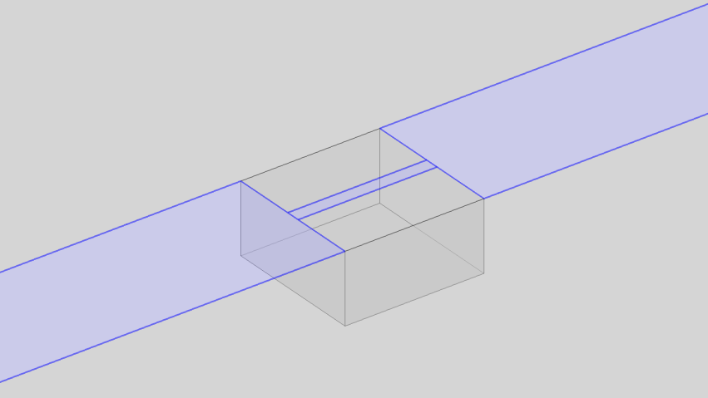
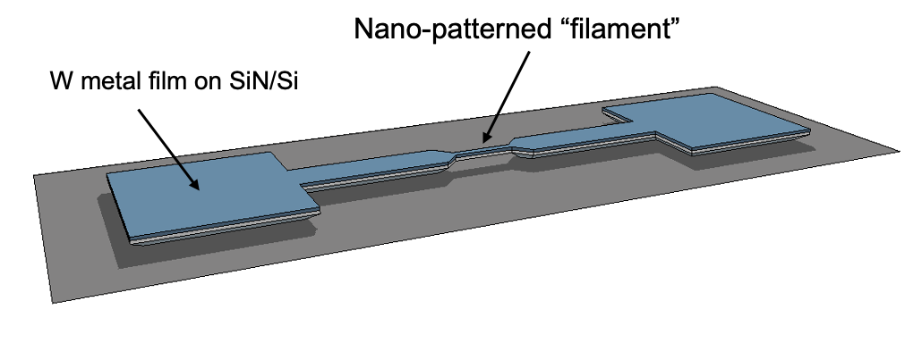
Locally-Heated Chemical Conversion
Local conversion:
Precise patterning of TMD
Transfer-free method
High local growth temperature
Low substrate temperature
Device arrays allow parallel synthesis and automated characterization for application of AI/ML optimization
Simulated suspended heater
W
Si
c)
0.1V
Filament width (μm)
0.2
0.5
1.0
Temperature, (ºC)

Slide 11
Outline of Experimental Plan
Non-suspended device arrays for experimental design:
Establish proof of concept, conversion and characterization.
Establishing fab processes for patterning (deposition/etching) tungsten filaments with ~50-100nm wire width.
Chip carrier and device bonding for in-situ electrical testing
Building/integrating electrical measurement hardware/software
Tungsten filament conversion to WS₂ using standard furnace heating to test characterization workflow (Eg. Raman, SEM, etc).
Test first filament conversions (W -> WS₂) using ohmic heating.
Establish data workflow for large device array, “combinatorial” approach: Integrate with scope foundry for automation of Raman and SEM data collection.
Suspended devices

Slide 12
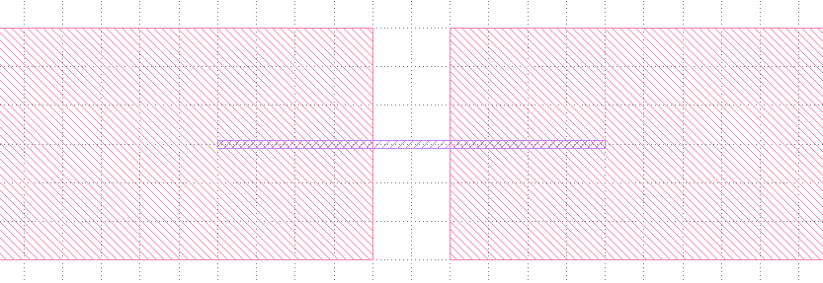
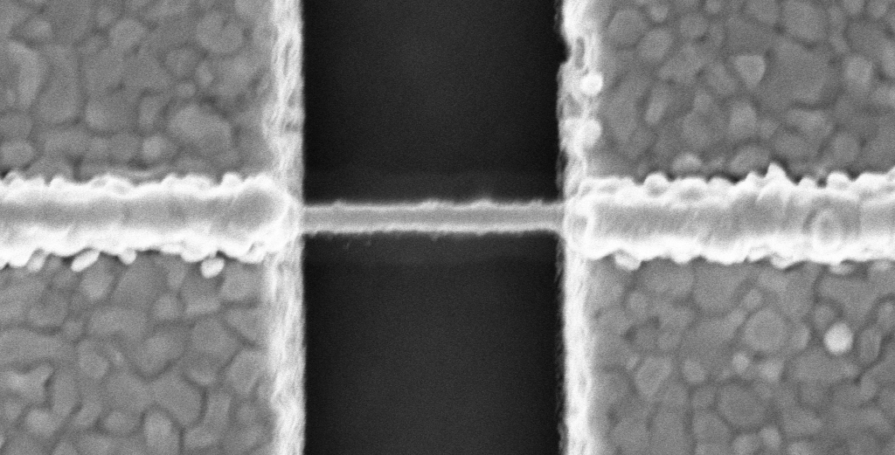
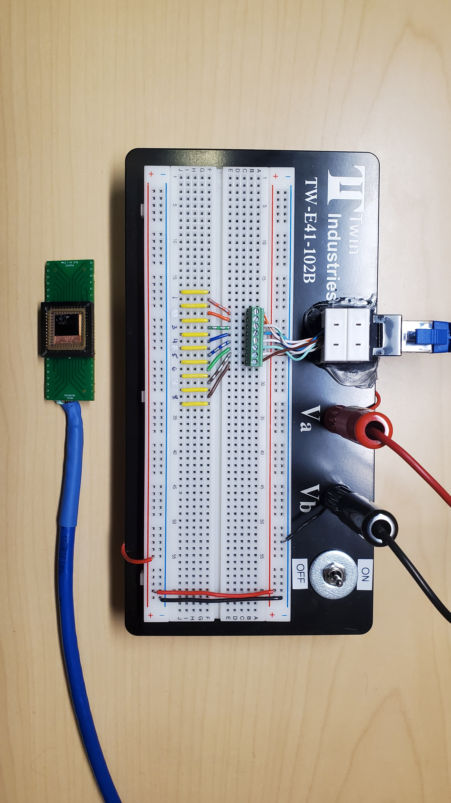
500-1000nm
Contact
50, 100, 200nm
Tungsten NW
2μm
5nm Ti / 250nm Au
50nm
50nm W
500nm

Slide 13
Outline of Experimental Plan
Suspended devices
Provides improved thermal isolation of filaments. Less heating of CMOS, and enables higher conversion temperatures due to reduced conductive heat loss to substrate.
A) Suspended devices on LPCVD SiN
Establishing fab processes for patterning suspended filaments with ~50-100nm wire width on LPCVD SiN bridge.
Testing, proof of concept, debugging.
Device design for in-operando thermal measurement architecture.
Prototyping and testing on non-CMOS architecture.
Reduction of nanoribbon device dimensions using BCP
B) Suspended devices on SiO2, SiN or other CMOS compatible bridge material
Device design and integration on CMOS chips with thermal management.

