Slide 1

CNT device fabrication and testing @ Sandia
Gaurang R. Bhatt
1/21/2025, LBL Meeting

Slide 2
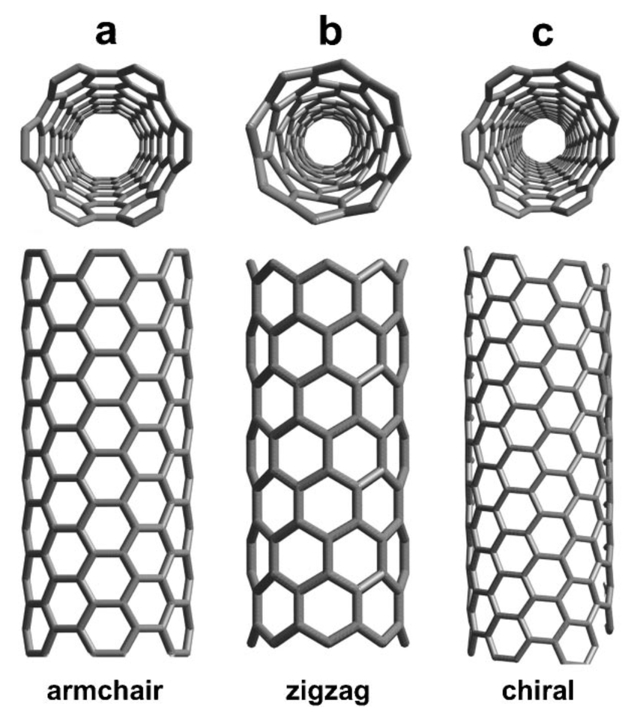

CNT-FETs - Refresher
$$I_{DS}$$
CNT
Source
Drain
Si
Gate
Notes:
Contacts – Ti/Pd..

Slide 3
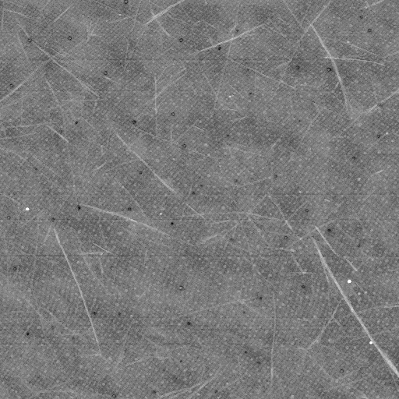
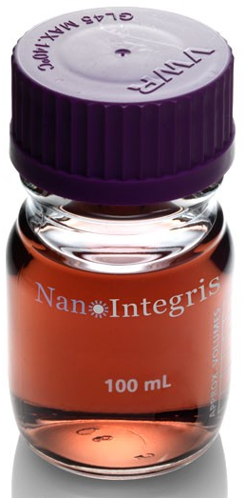
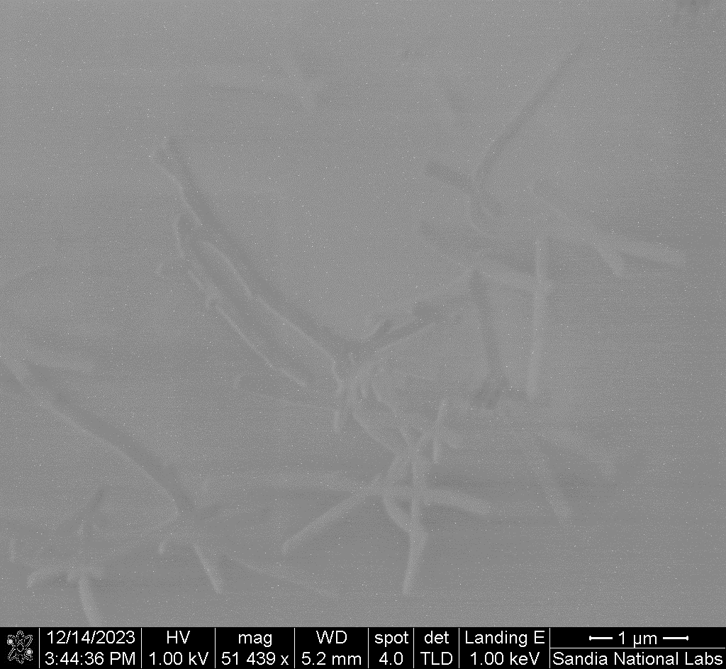

Deposition of CNTs
AFM
SEM
2% solution of CNT in toluene is spin coated
Average density 3-5 tubes/μm²
$$2 μm$$

Slide 4
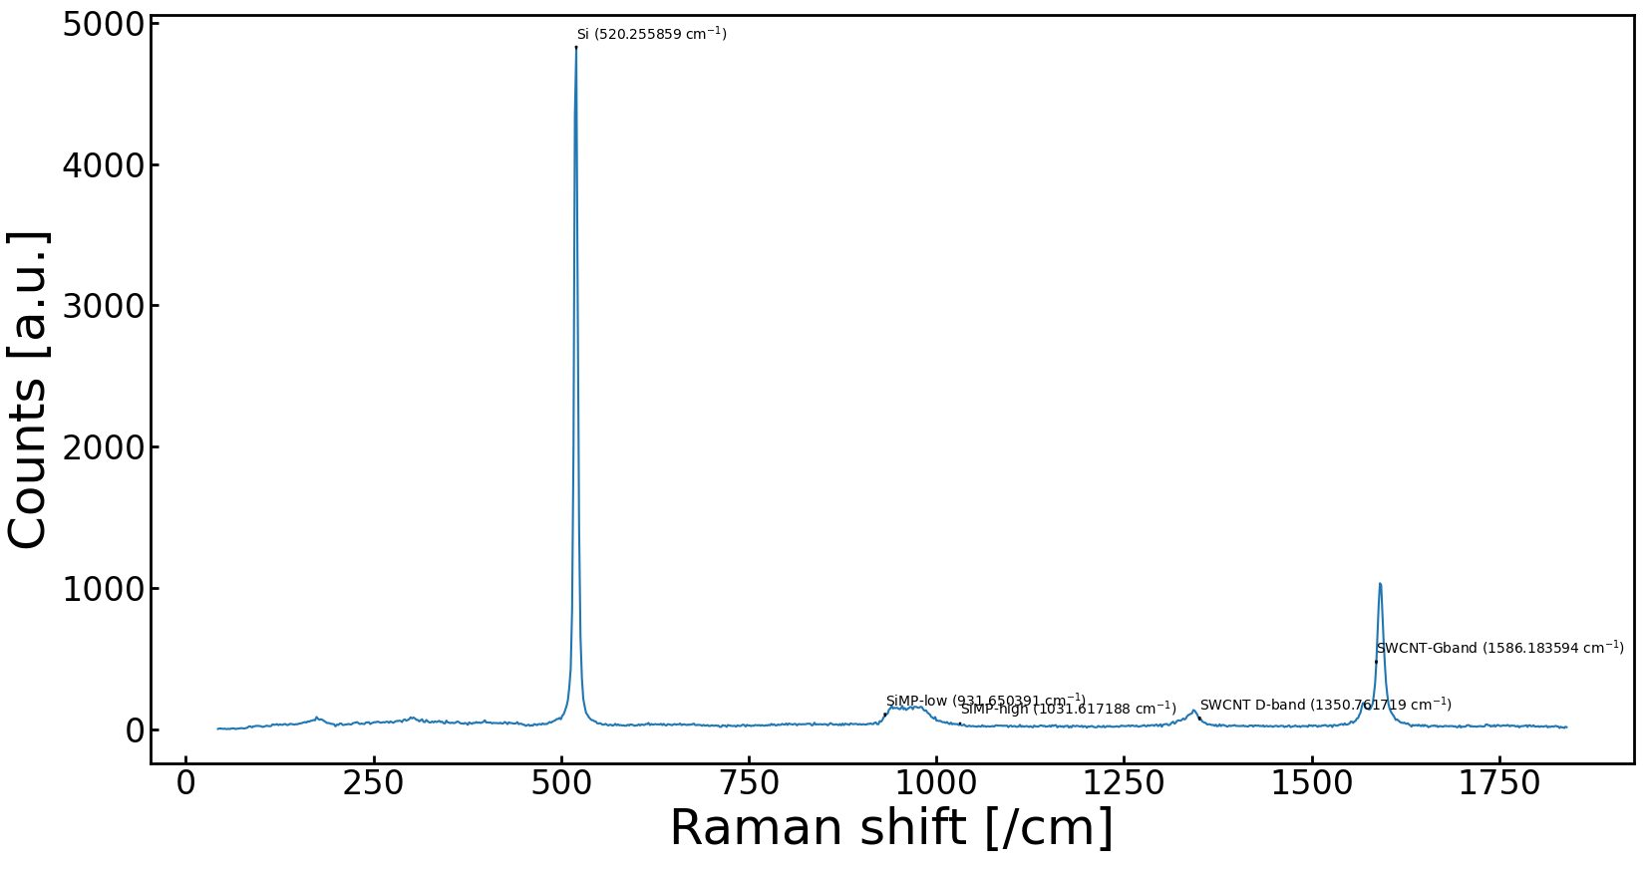
Raman
Silicon
SWCNT
Silicon-MP
SWCNT

Slide 5
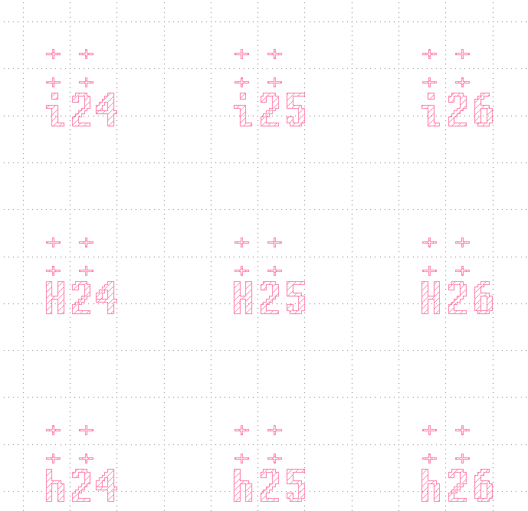
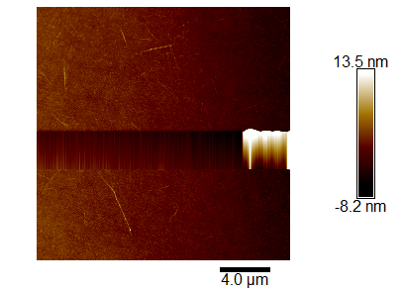
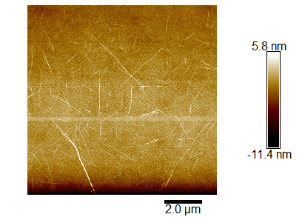
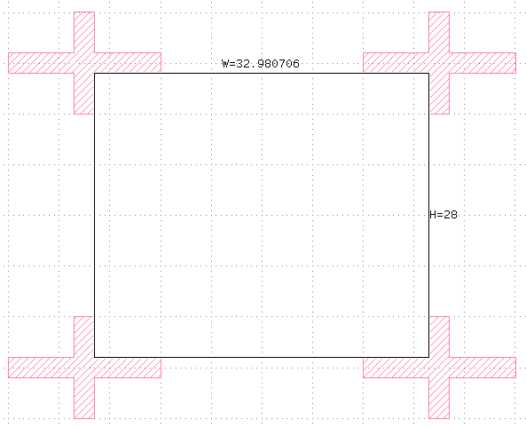
Locating CNTs for making single-CNT FETs
CNT

Slide 6
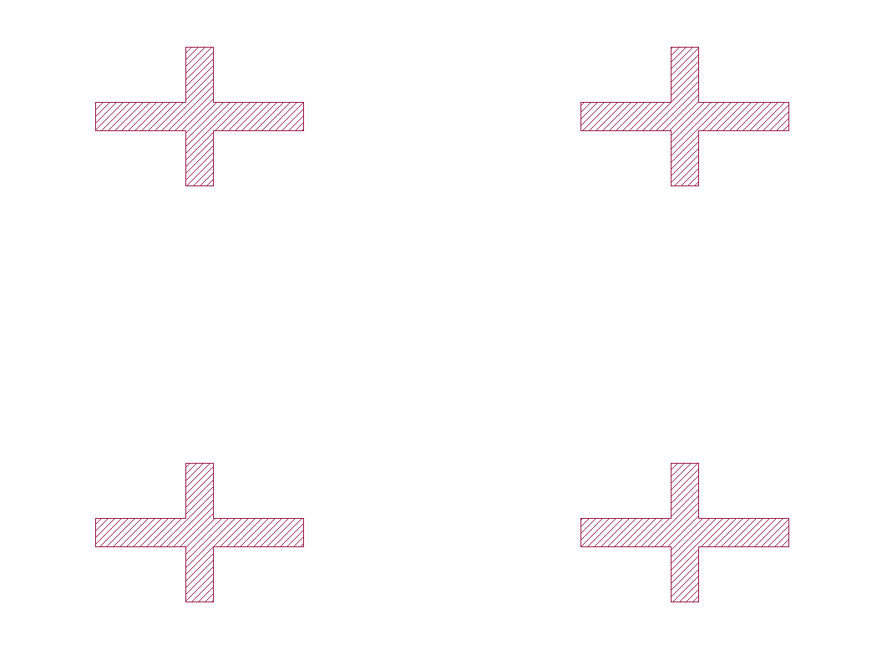
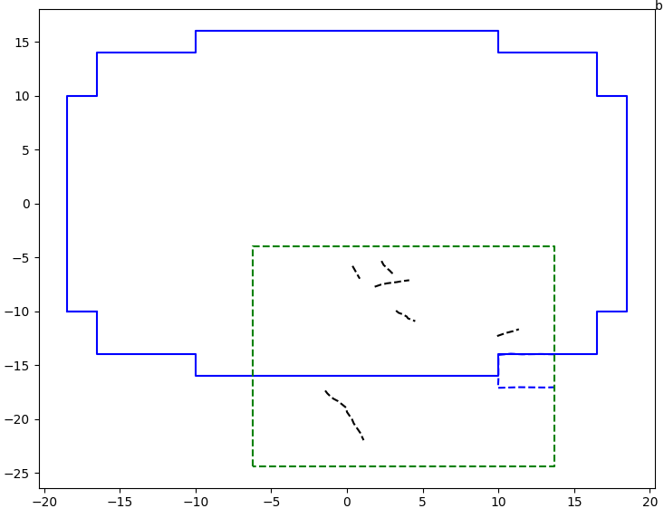
CAD preparation and locating CNTs: AFM image overlaid on CAD sub-field
CAD sub-field boundary
AFM frame from Slide 9

Slide 7
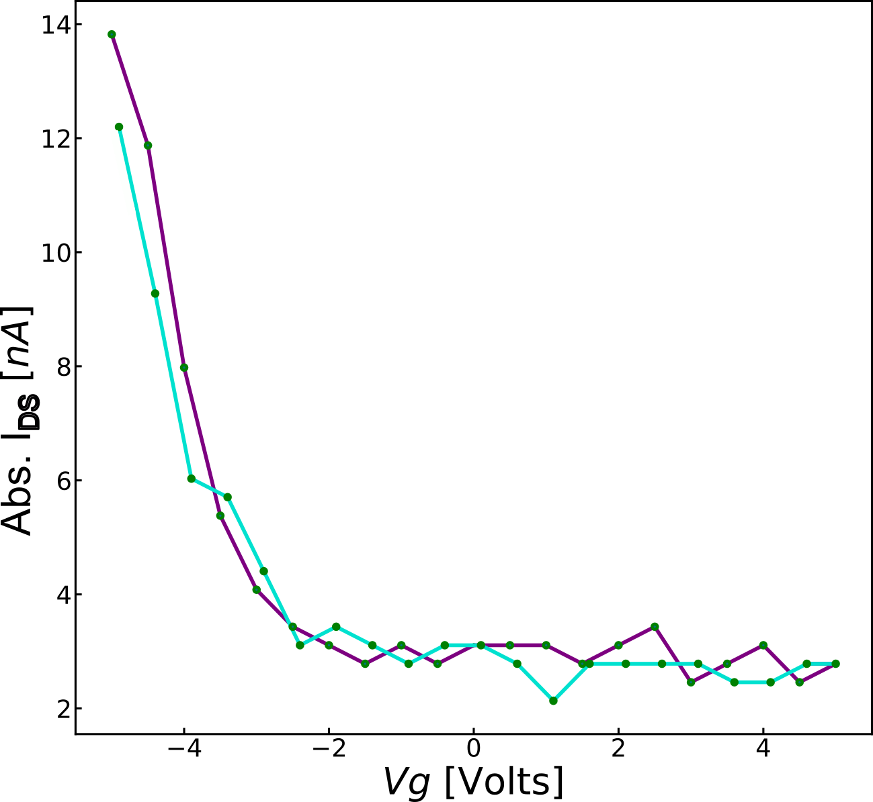
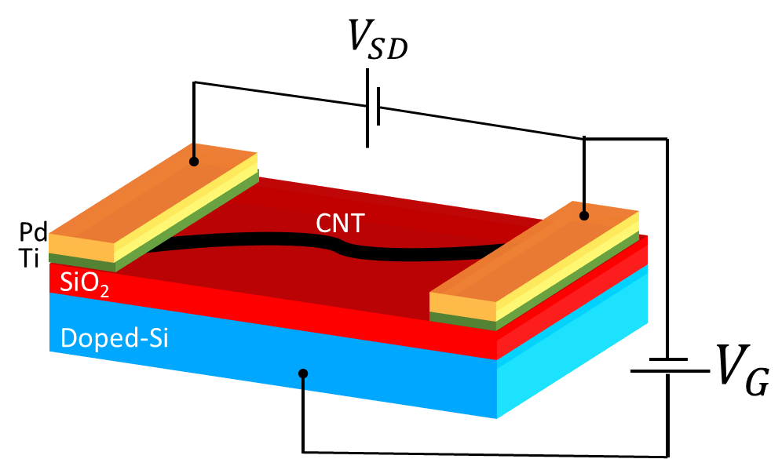

Testing single CNT-FETs
Channel length = 100 nm
$$V_{DS}=100 mV$$
Notes:
Low current
Contacts or surfactant residue are the suspected issues.

Slide 8
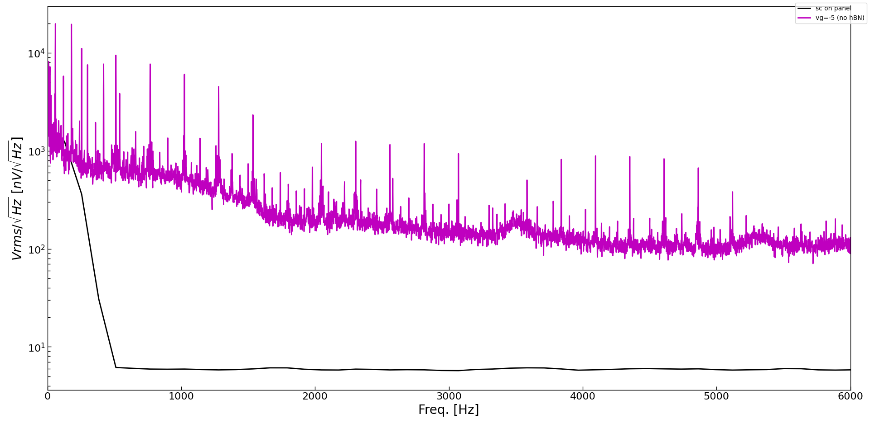
FET noise measurement
Vg = -5 V
Instrument noise floor
Notes:
300 k ohm!

Slide 9
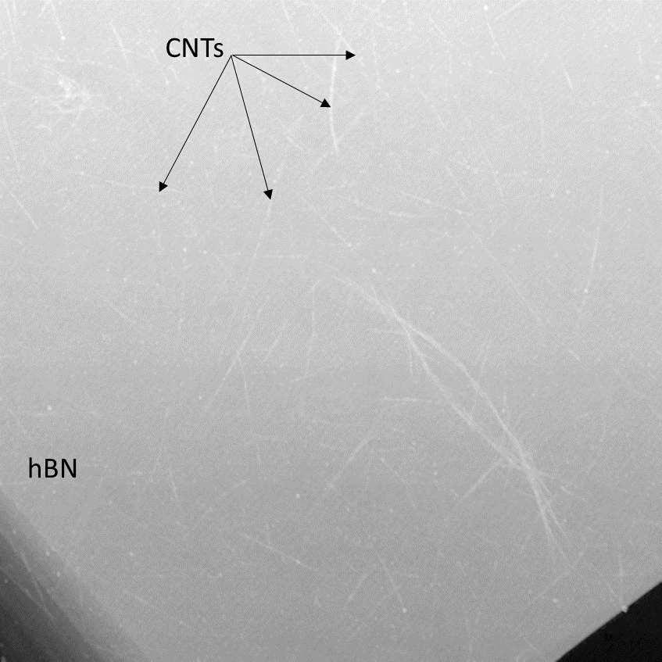
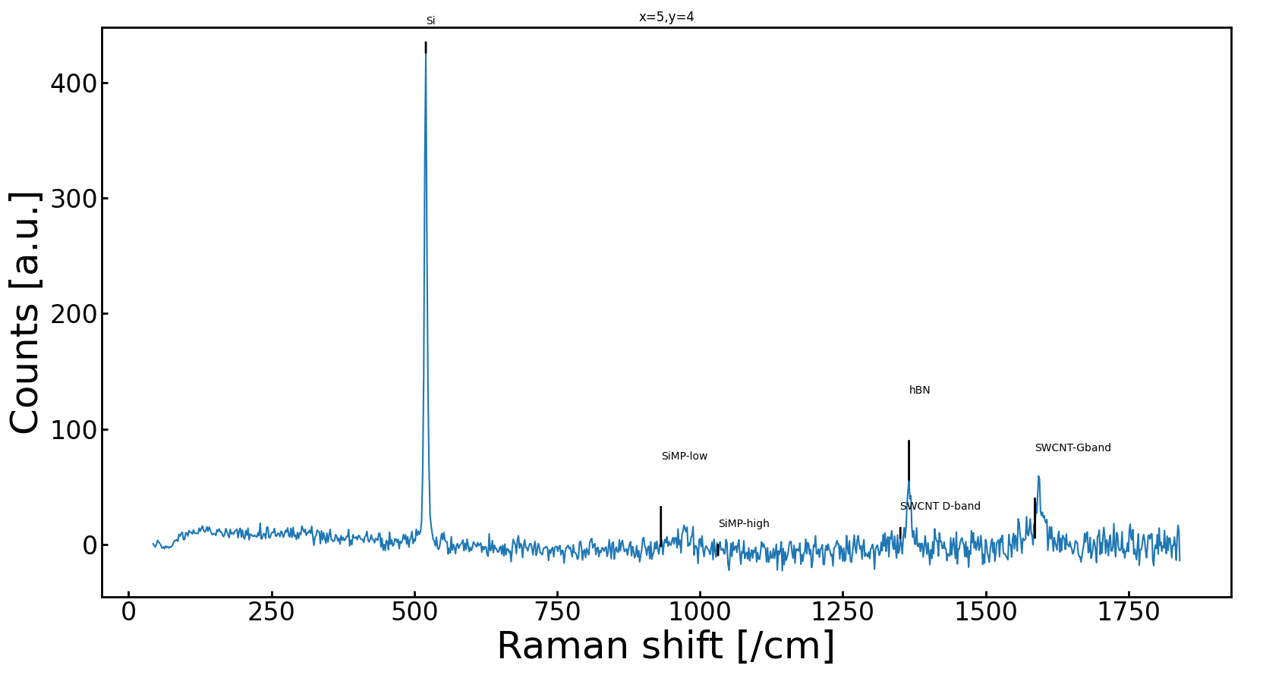
CNTs on hBN

Slide 10

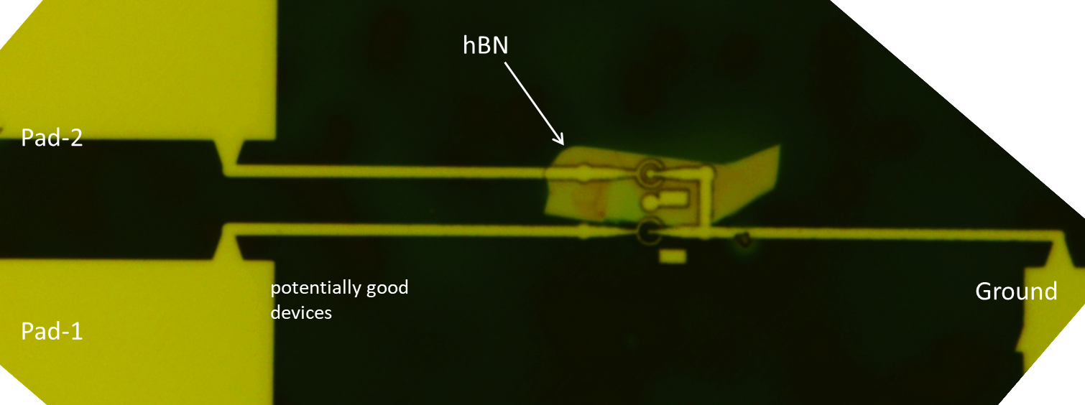
CNT-FETs on hBN
Notes:
Contacts are worse.. Metal not sticking on hBN

Slide 11
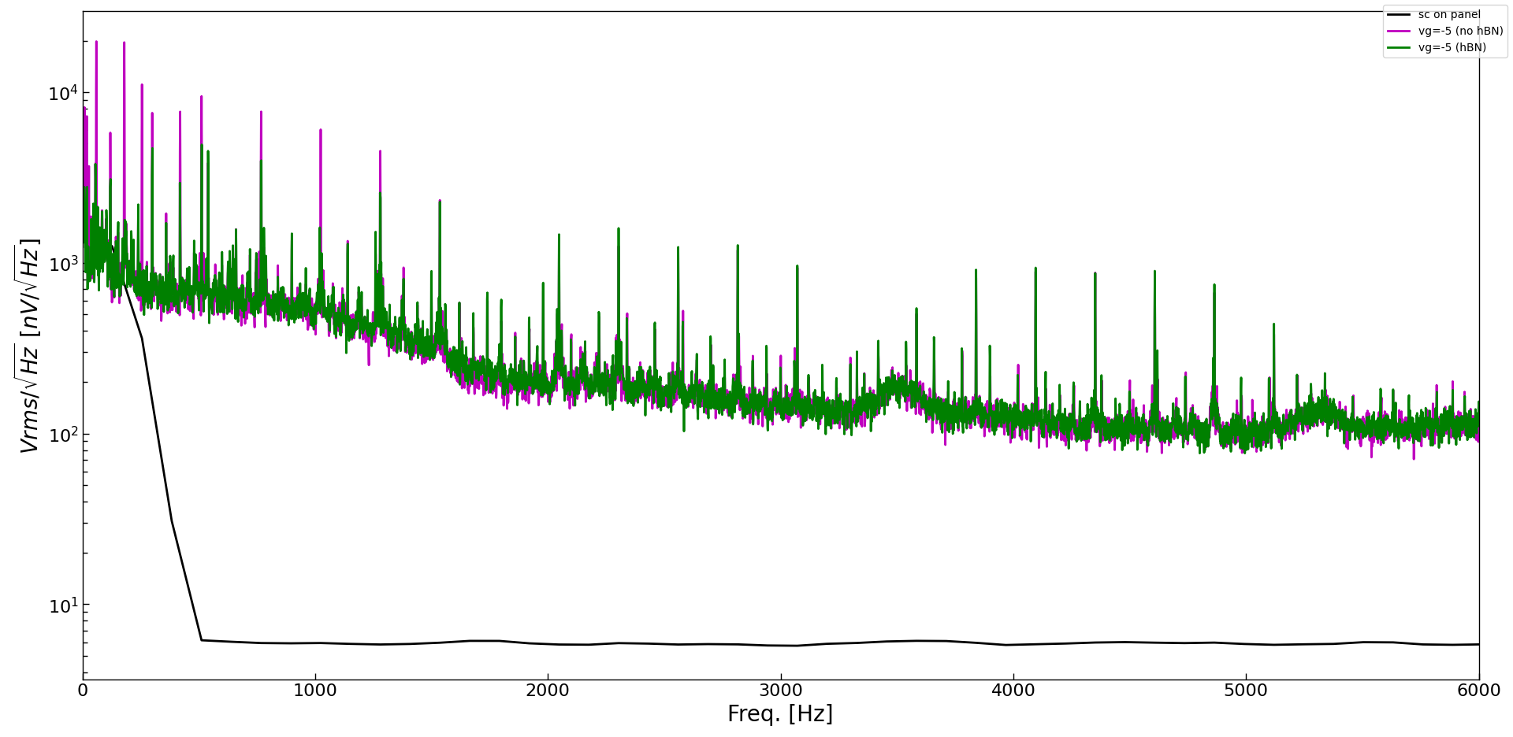
Low noise FETs – WIP/Future plan
no-hBN, Vg = -5 V
hBN, Vg = -5 V
Instrument noise floor

Slide 12
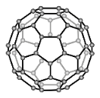

Low noise photon detectors – WIP/Future plans
CNTs are poor absorbers of light by themselves.
Using QD/patterned TMDC to absorb light while CNT-FET provides a channel/mechanism for generated current
Light absorbing molecule/atom
$$I_{DS}$$
Source
Drain
Si
Gate

Slide 13
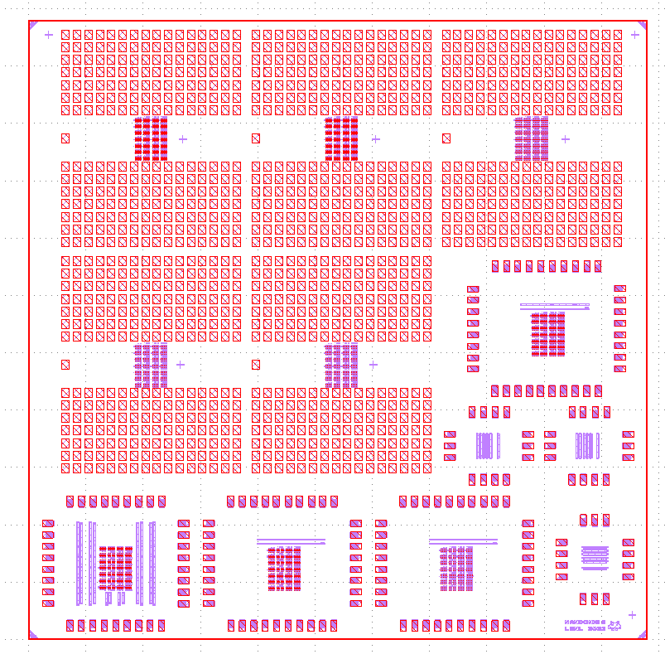
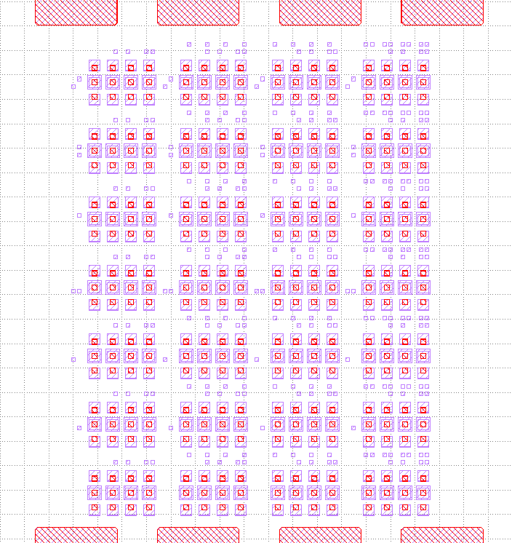
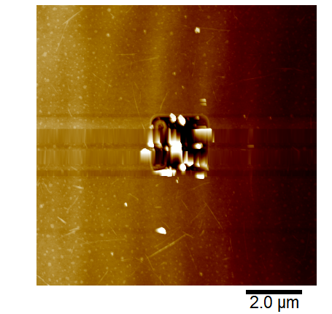
Slits
Integration with CMOS-WIP/Future plans
CNTs

Slide 14
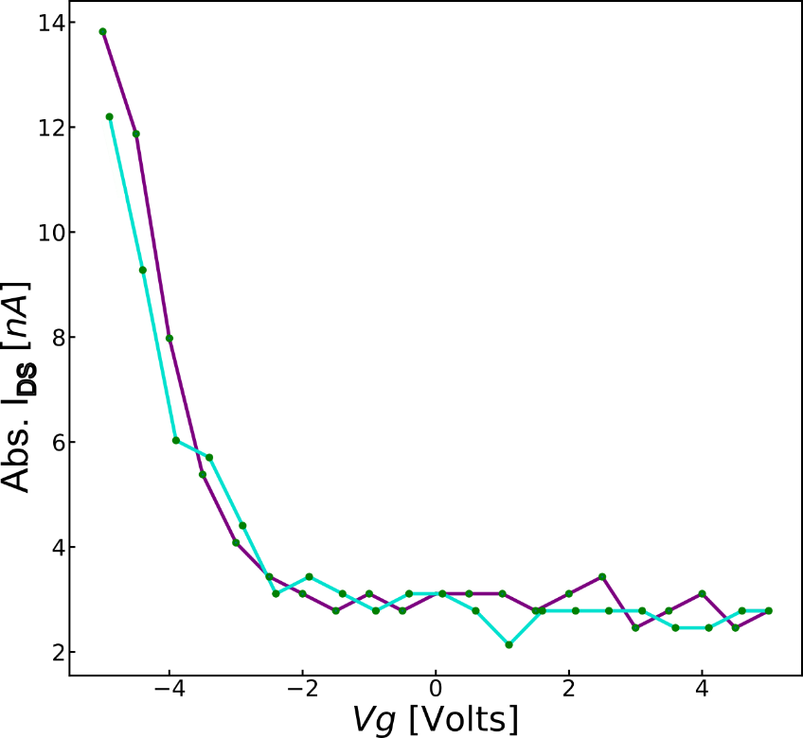
Single SWCNT-FETs
Summary
Low noise photon detectors
Integration with CMOS
Spin-on quantum dots
Patterned TMDC as light absorbers
CNTs

