Slide 1
CXRO Nanofabrication Capabilities for device Post-processing plus CNT on trenches
Weilun Chao and Mi-Young Im

Slide 2
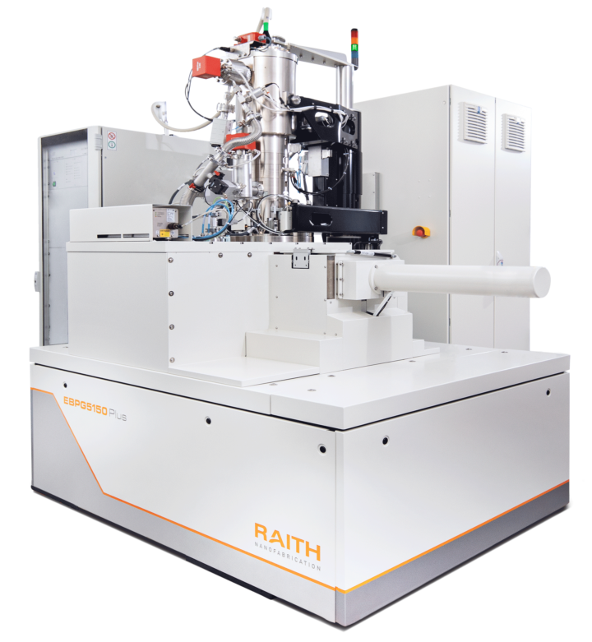
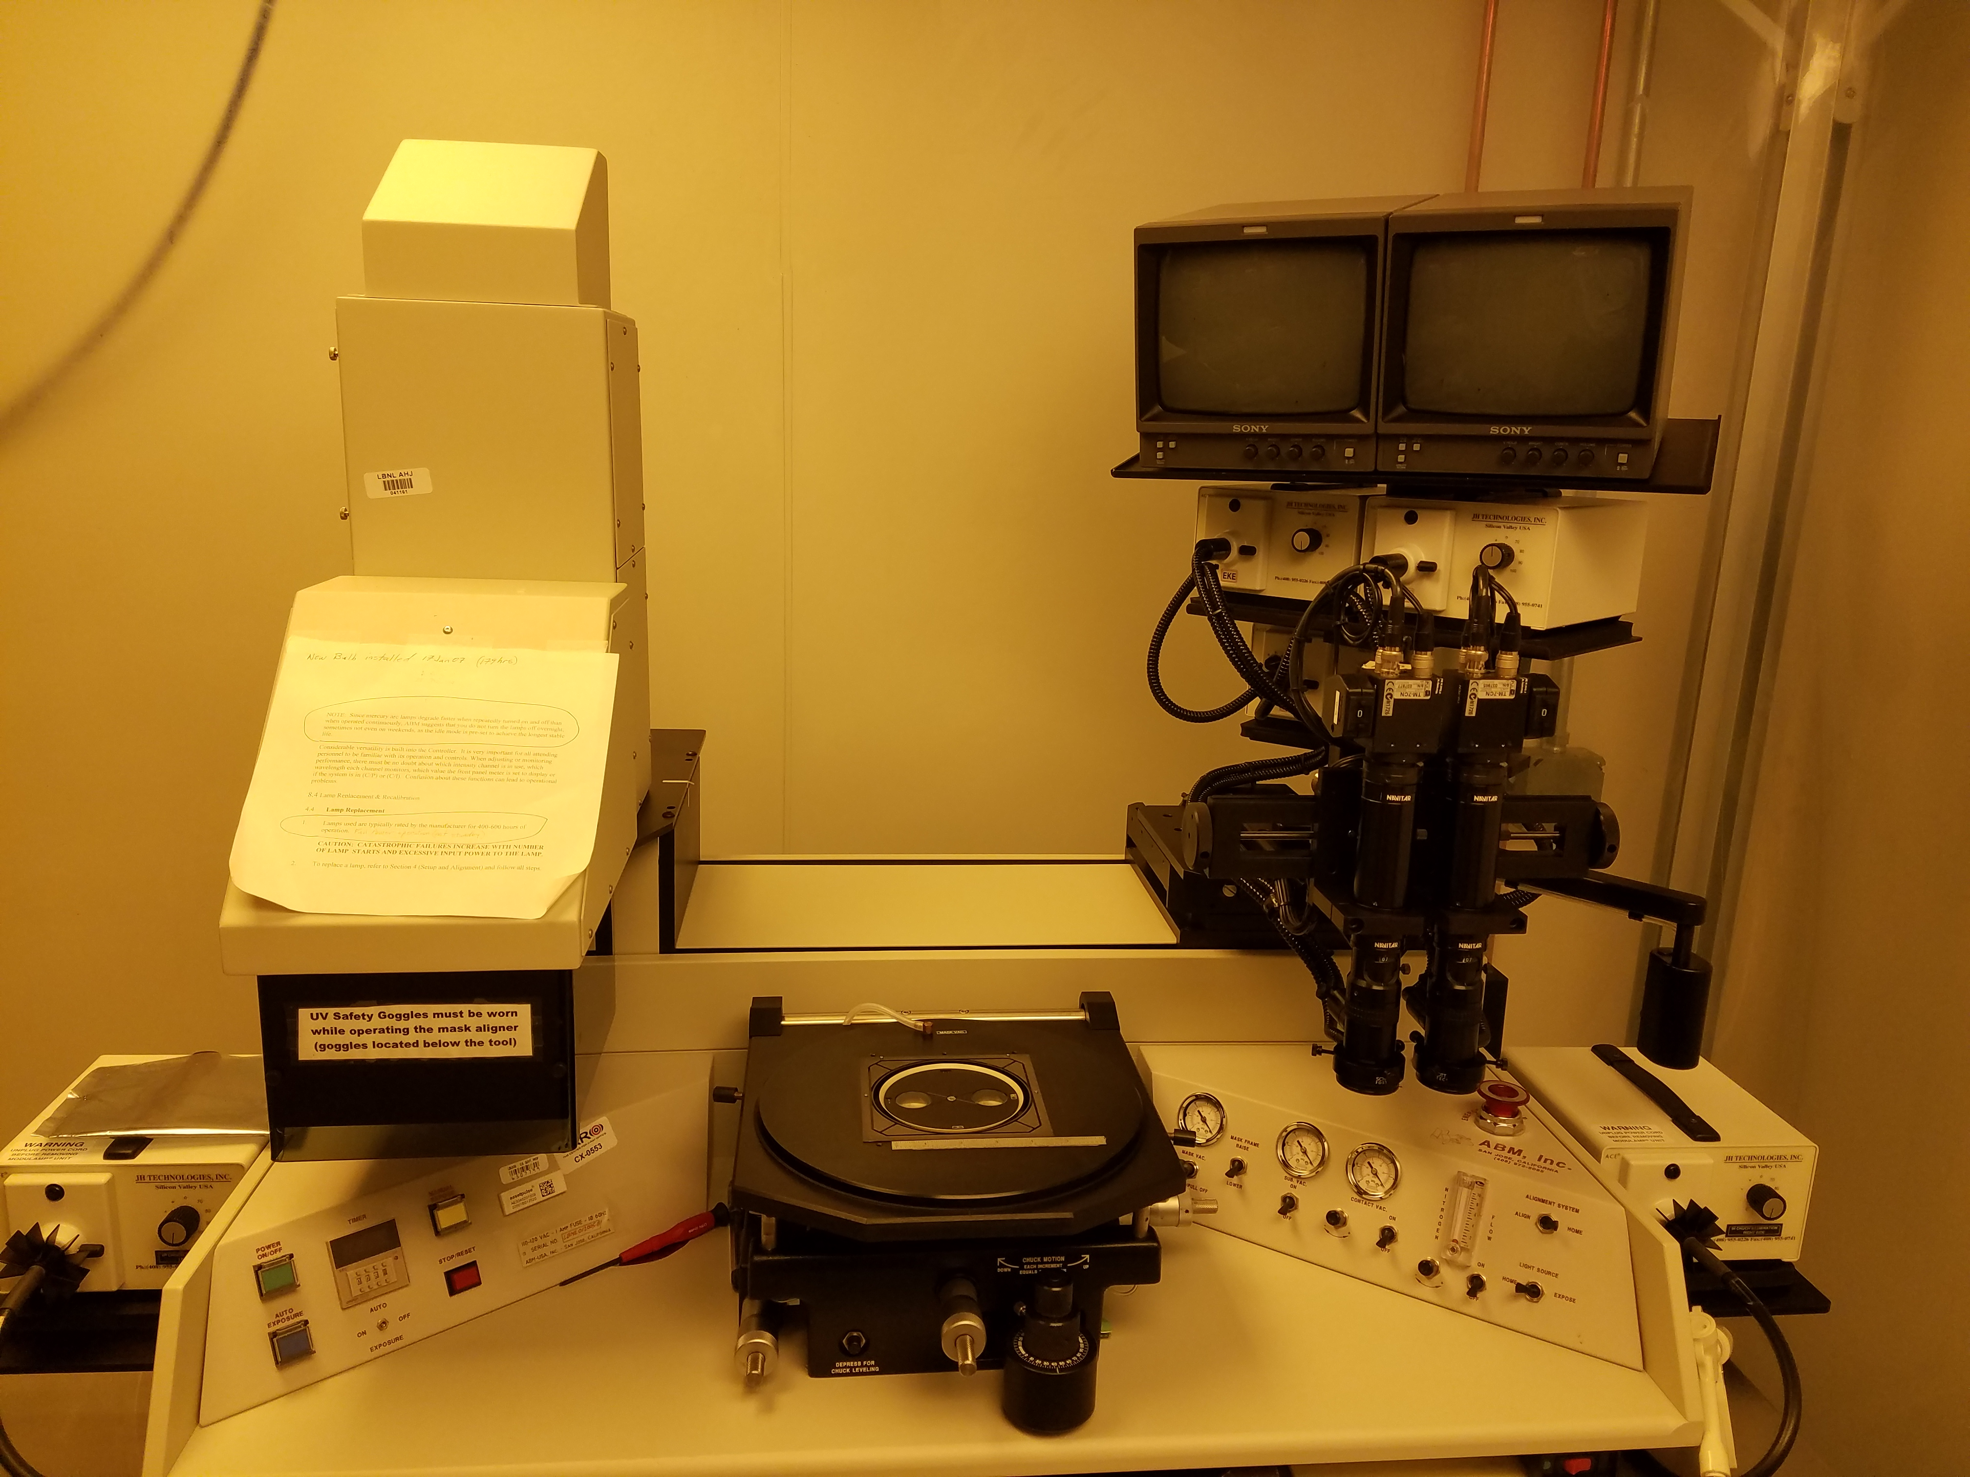
Lithography capabilities
Fully automated 100keV electron beam lithography system (MF)
Contact mask aligner photolithography
Resolution better than 10nm
Exposure mode in serial (slow)
Piece or wafer substrates
Can do alignment with proper registration marks
Resolution around 1-2 microns
Exposure mode in parallel (fast)
More suitable for wafer substrates
Can do alignment with proper registration marks

Slide 3
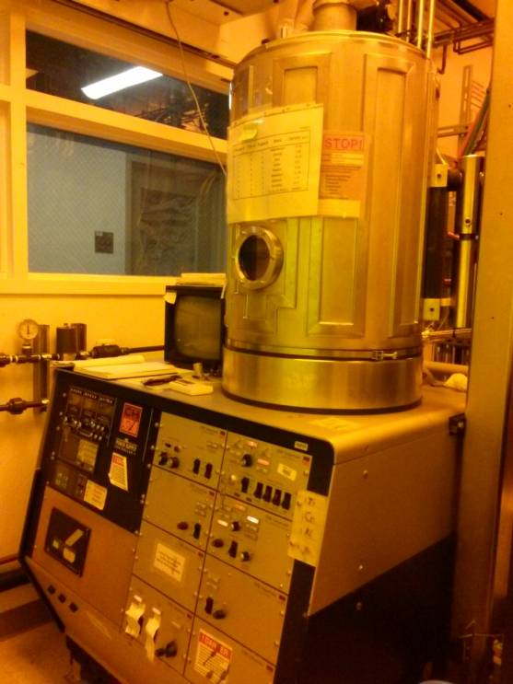
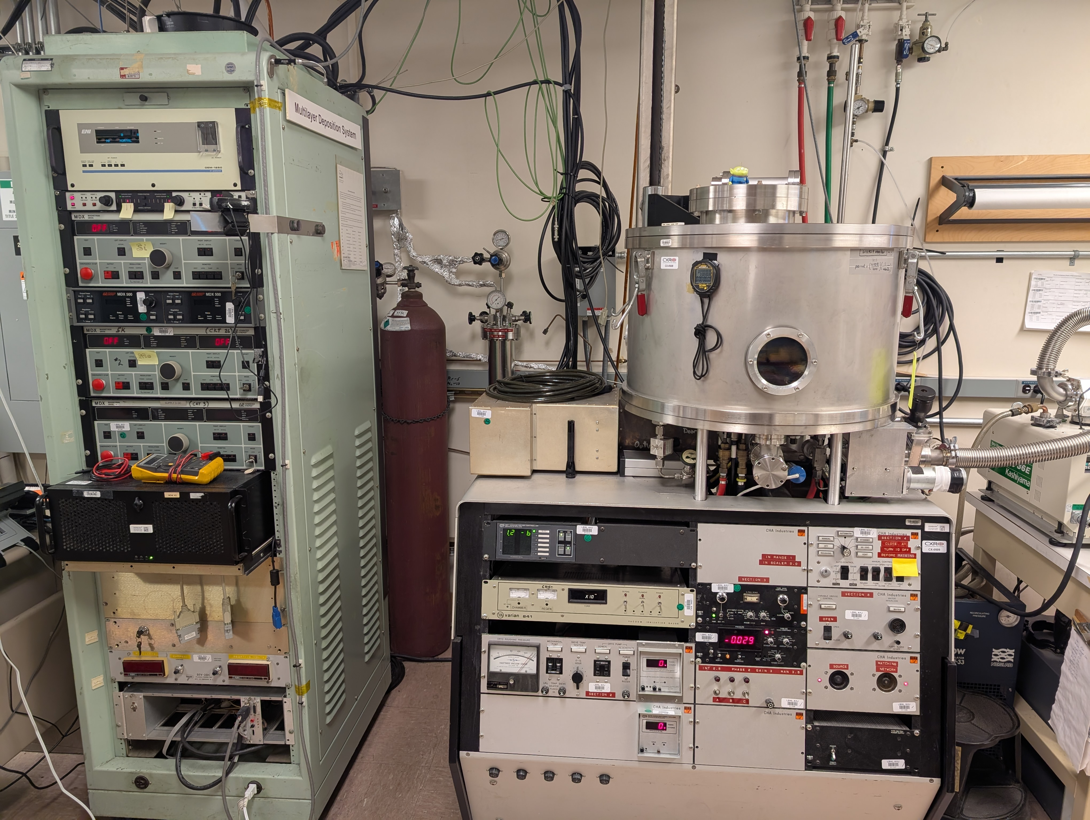
Processing capabilities
Electron beam evaporator
Magnetron sputtering
Material choice: Pd, Ti, Pt, Ni, Cr, Au, Cu, Ru, …
Thickness control ~ 1-3nm
Conformal coating of various semi-metal/ metals
Thickness control in angstrom
Molecular Foundry: PECVD and ALD of various oxides and nitrides

Slide 4
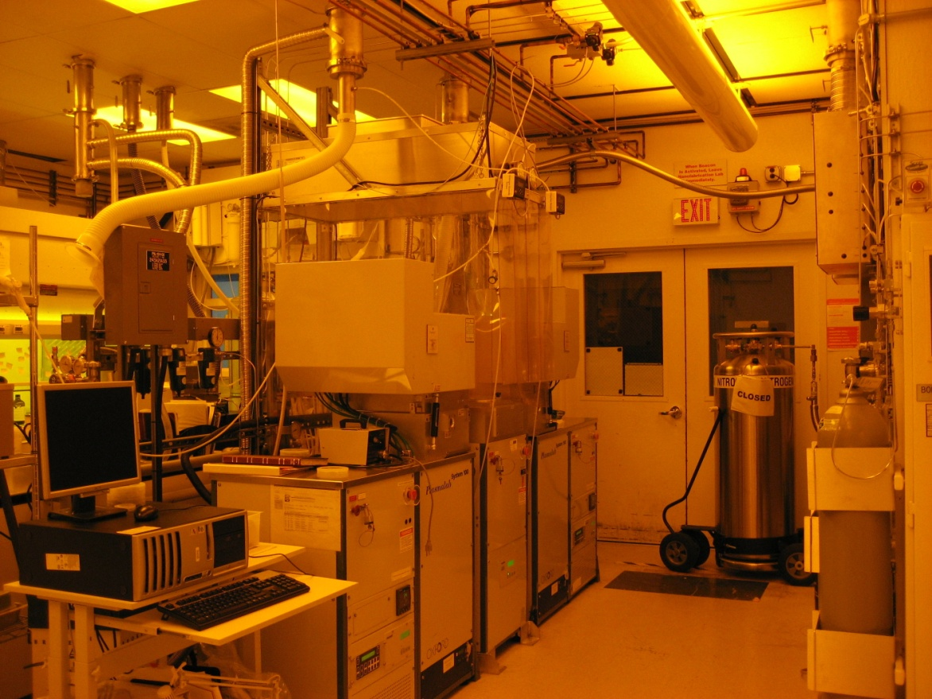
Processing capabilities
High density plasma etcher
Dual chamber for separate fluorine and chlorine plasma etching
Can etch Si, SiN, SiOx, Mo, Ru, Cr
Cryo-etching possible
Designed for nanoscale pattern transfer

Slide 5
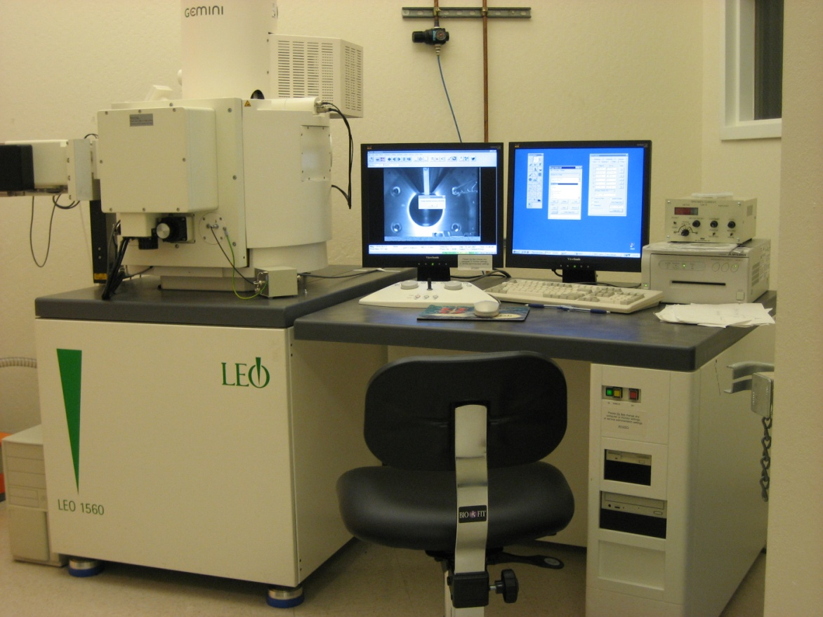
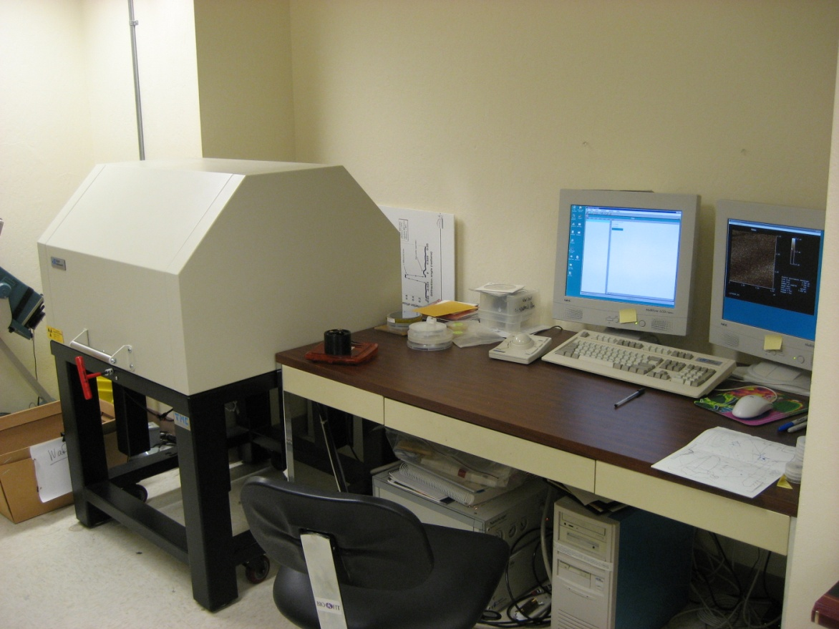
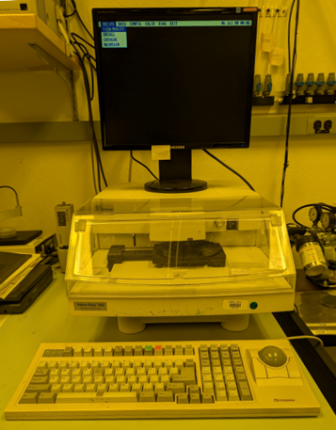
Metrology capabilities
SEM
AFM
Profilometer

Slide 6
Metrology capabilities
SEM
AFM
Profilometer

Slide 7

Making electrical contact with CNT
S
D
G

Slide 9
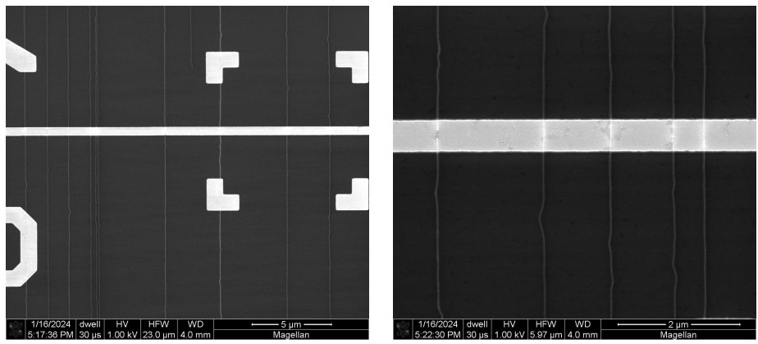
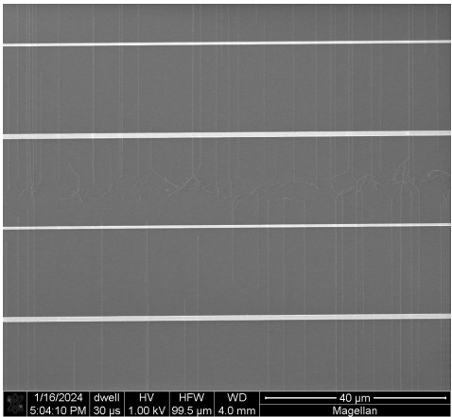
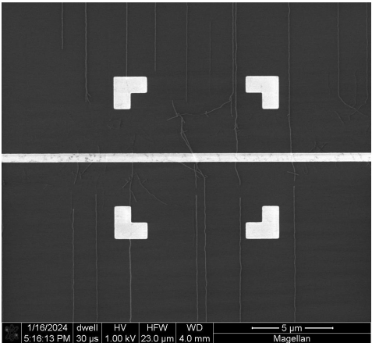
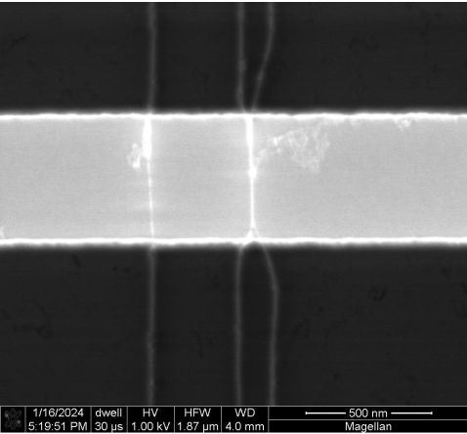

Slide 10
Pd/Pt
pad
Pd/Pt
pad

Slide 11
Thank You

