Slide 1

CMOS design for heterogeneous integration and future plans
Aikaterini Papadopoulou
Nanoscale hybrids Collaboration meeting

Slide 2
Outline
Overview of past chip designs
Work plan

Slide 3
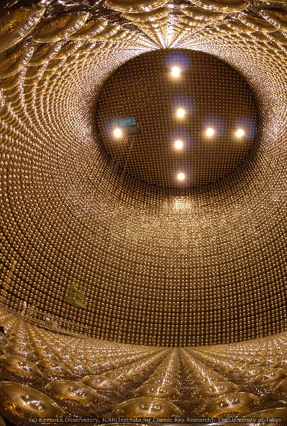
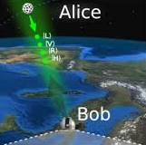
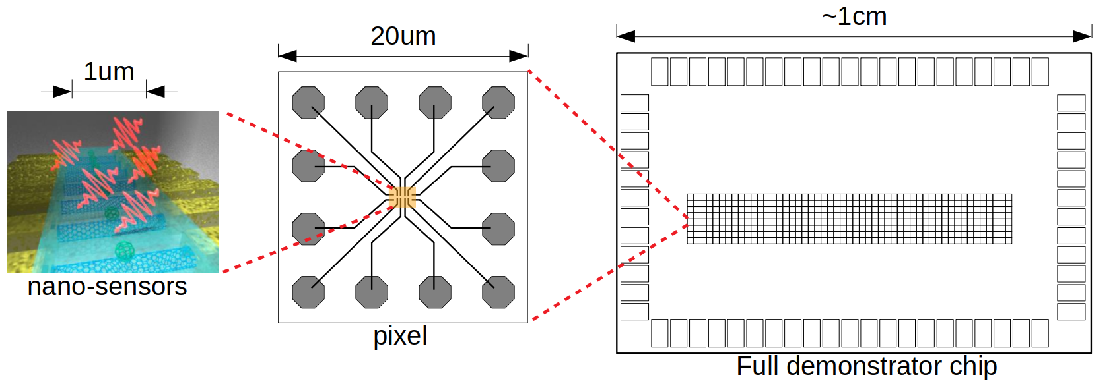
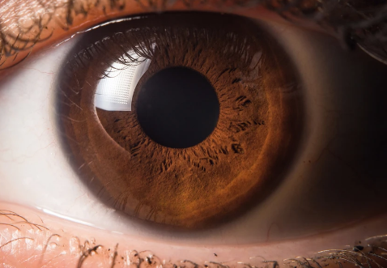
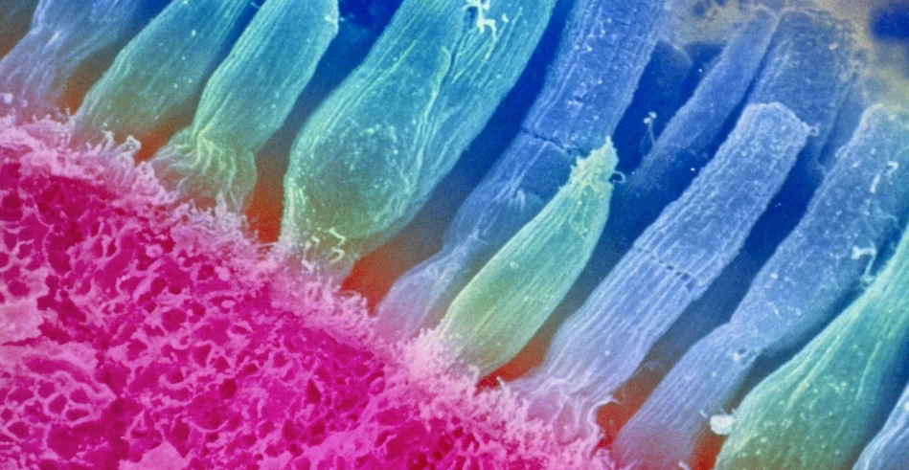
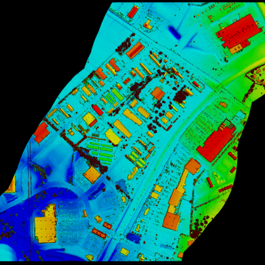
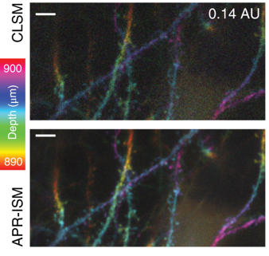
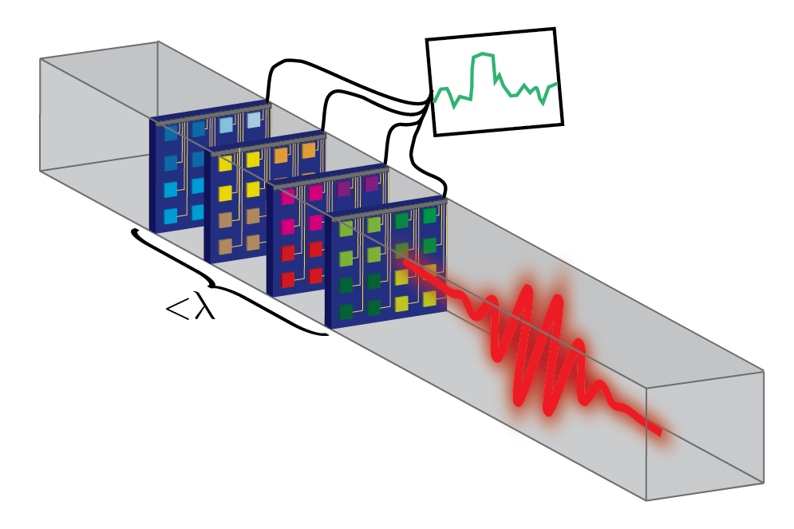
1. Envisioned device
Description
Goal
Applications
A bio-inspired approach to imaging using color-sensitive receptors
A monolithic demonstrator pixel imager for
color-resolved single photon detection
Every photon is absorbed by one nanosensor or another depending on the color
MICROELECTRONICS CO-DESIGN RESEARCH 3-YR AWARD
FOA: LAB 21-2491
Cosmology
Quantum key distribution/ secure communications
Single photon LIDAR
Biological imaging
Subwavelength nanosensors
Notes:
Interdisciplinary effort - > good fit for Microelectronics Co-design research

Slide 4
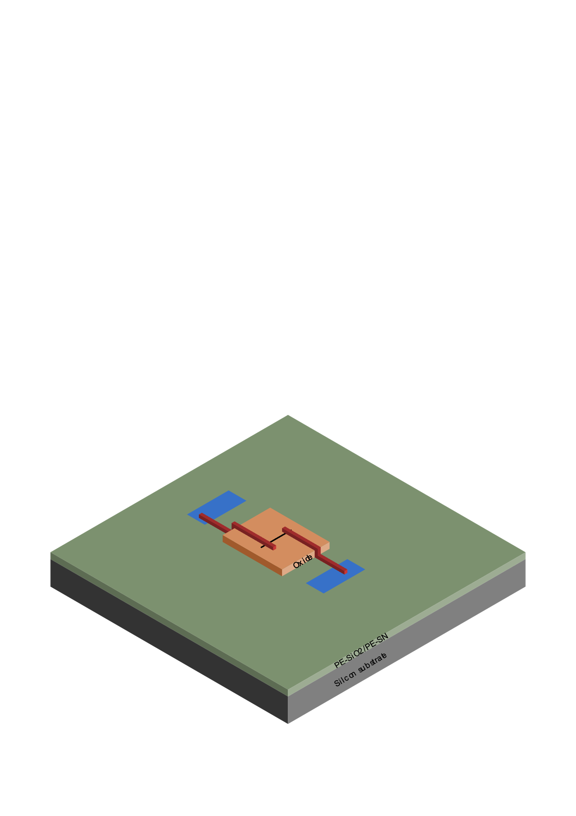
1. Envisioned device
3. Oxide deposition
2. Planarization
4. CNT deposition
1. Silicon fabrication
5. Pd deposition

Slide 5
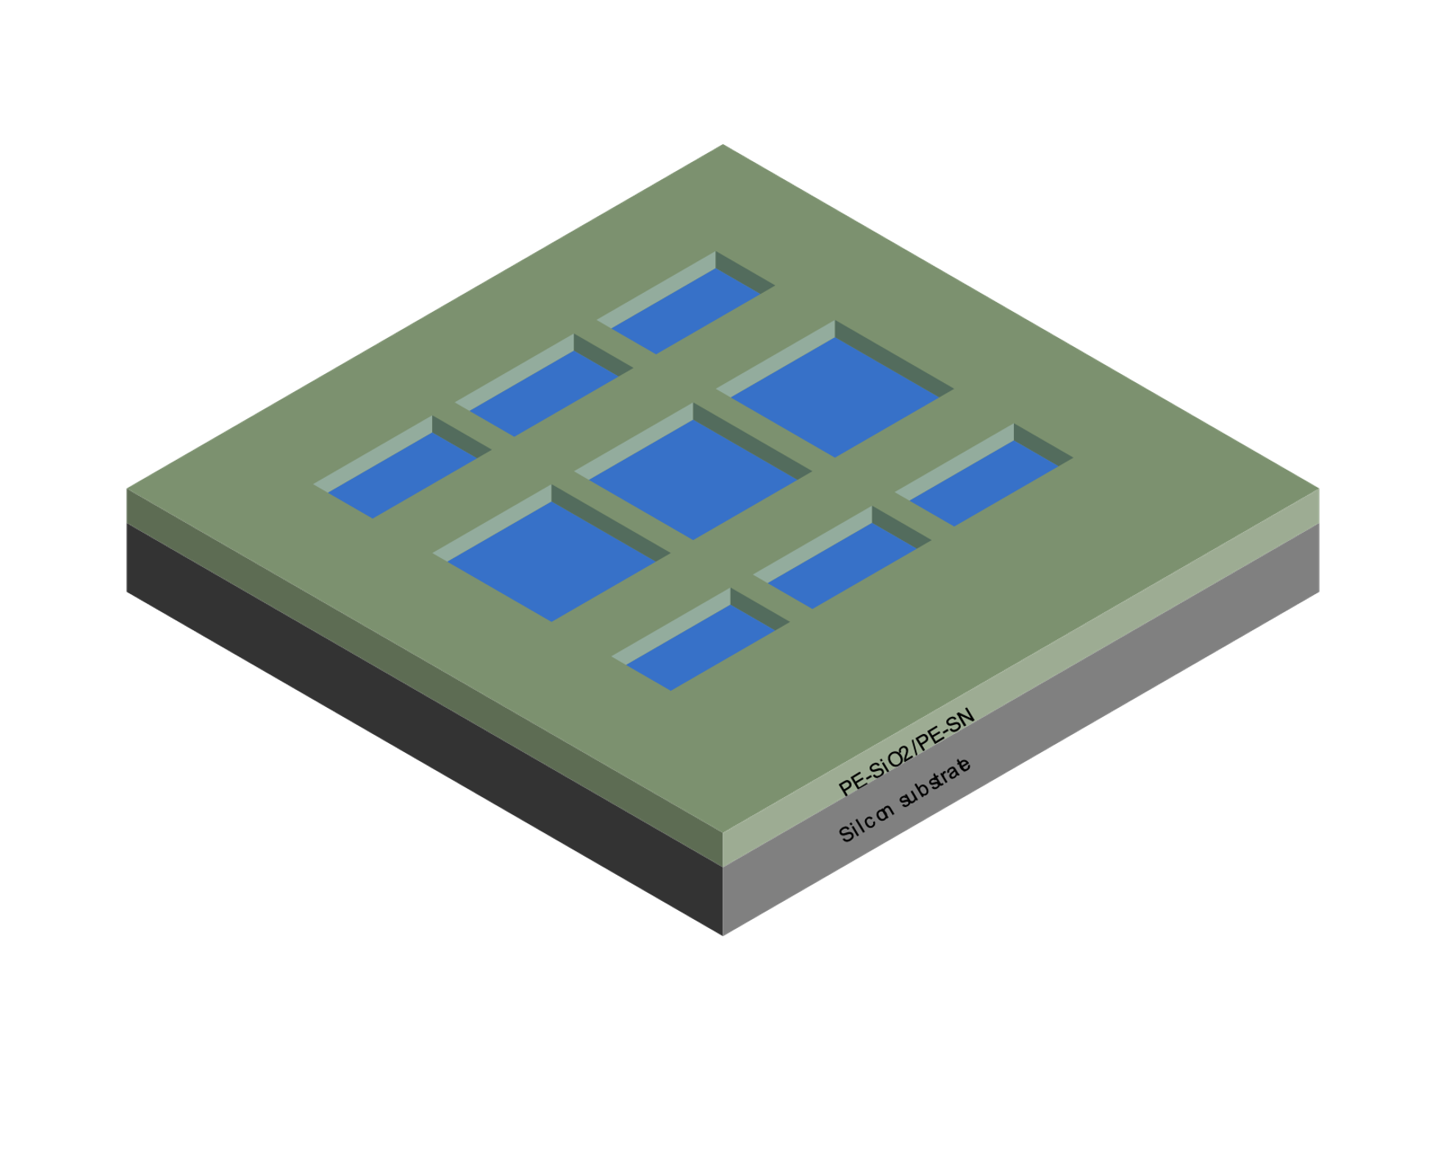

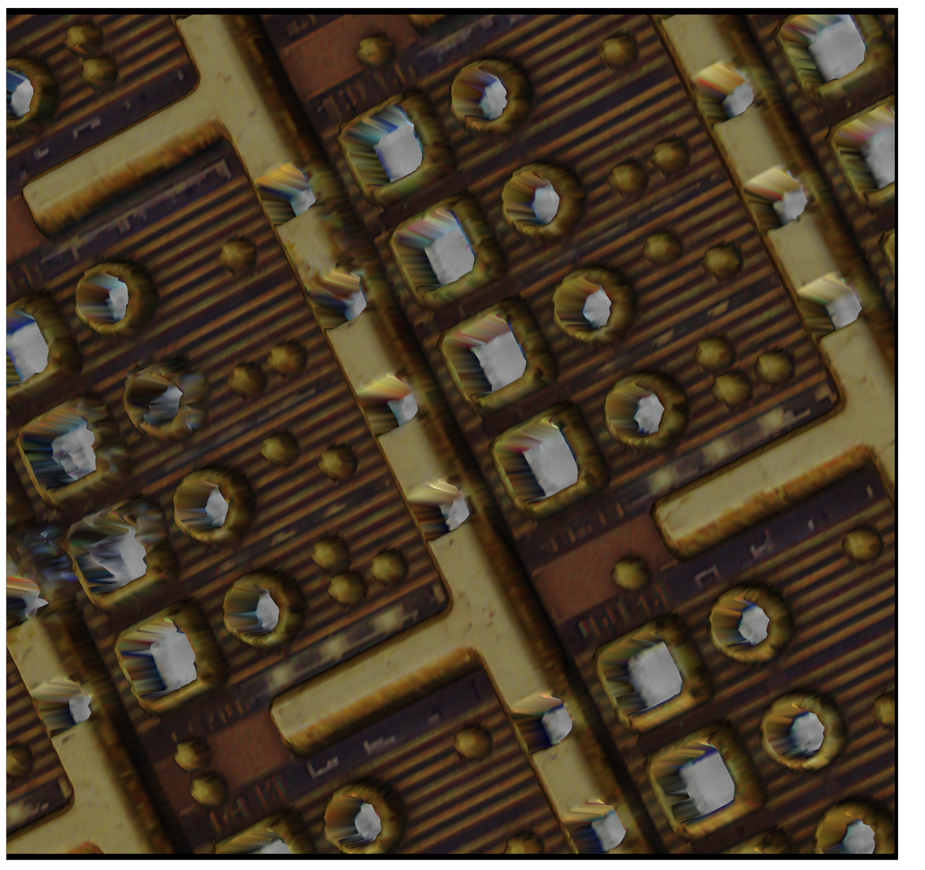
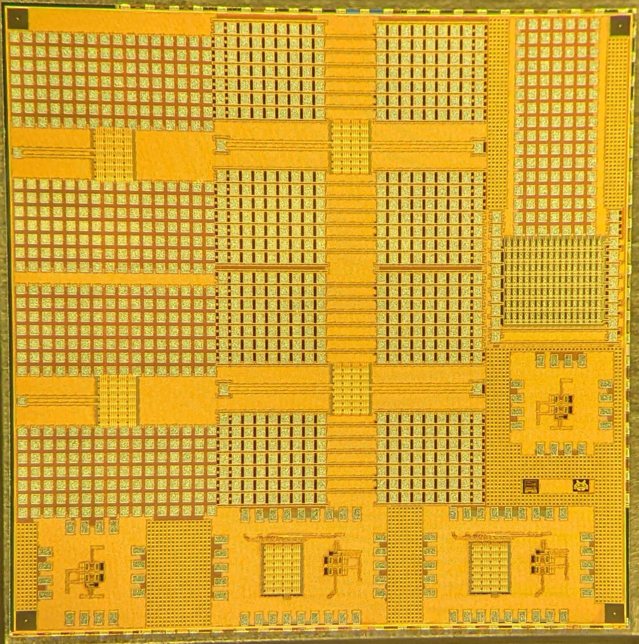
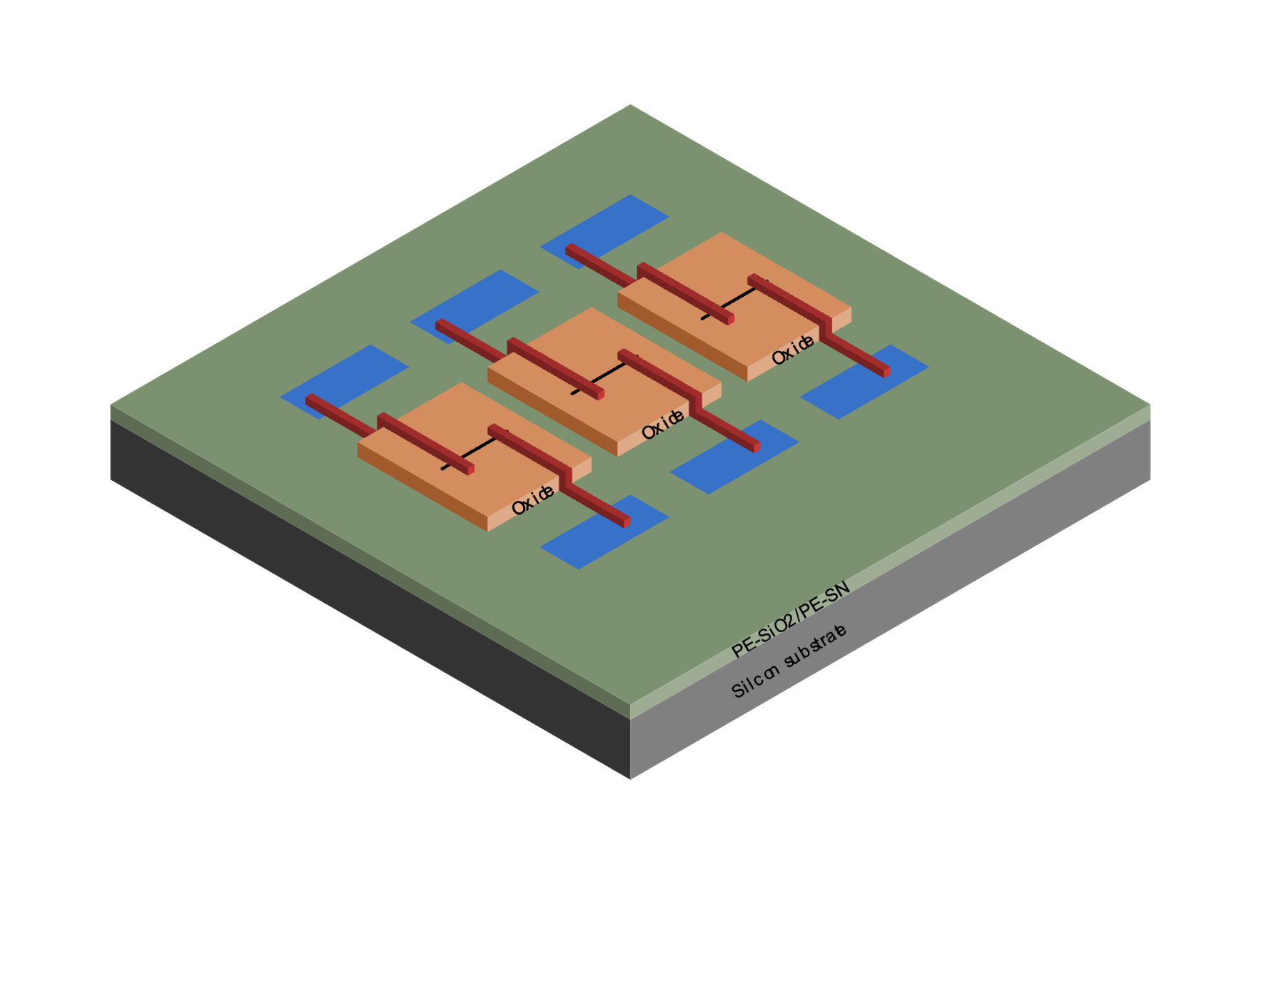
2. Passive array design
drain
gate
source
Top metal with passivation opening
Top metal without passivation opening
Test structures including ~90,000 sites for carbon-nanotube deposition designed in TSMC 180nm MPW
- Include padded-out terminals for standalone device testing, identification patterns, alignment marks

Slide 6
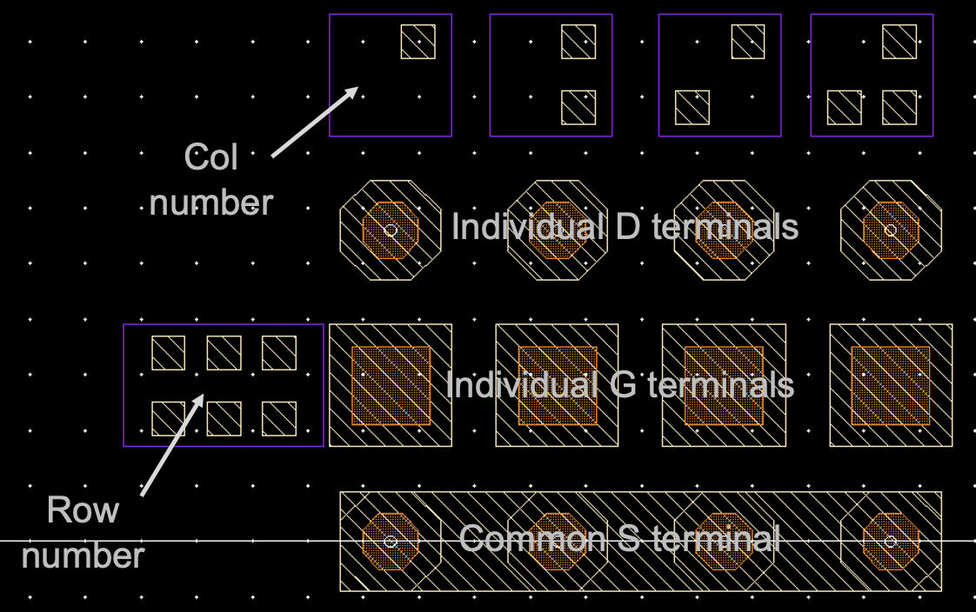
2. Passive array design comments
- How was the shape and geometry chosen?
- How was this used in the end?
- How to revise geometry?

Slide 7
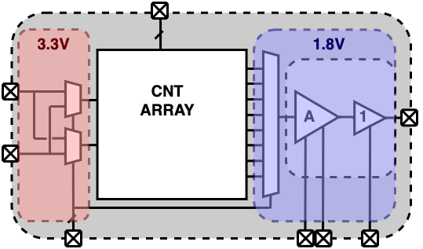
3. Readout electronics
Block diagram of integrated readout IC
Designed in TSMC 180nm MPW
Includes standalone and integrated AFE with fixed-gain amplifier & output buffer. Specs based on past papers.
Standalone design successfully tested
Dies used for first development of post-processing steps
Simulation and measurement results of standalone amplifier

Slide 8
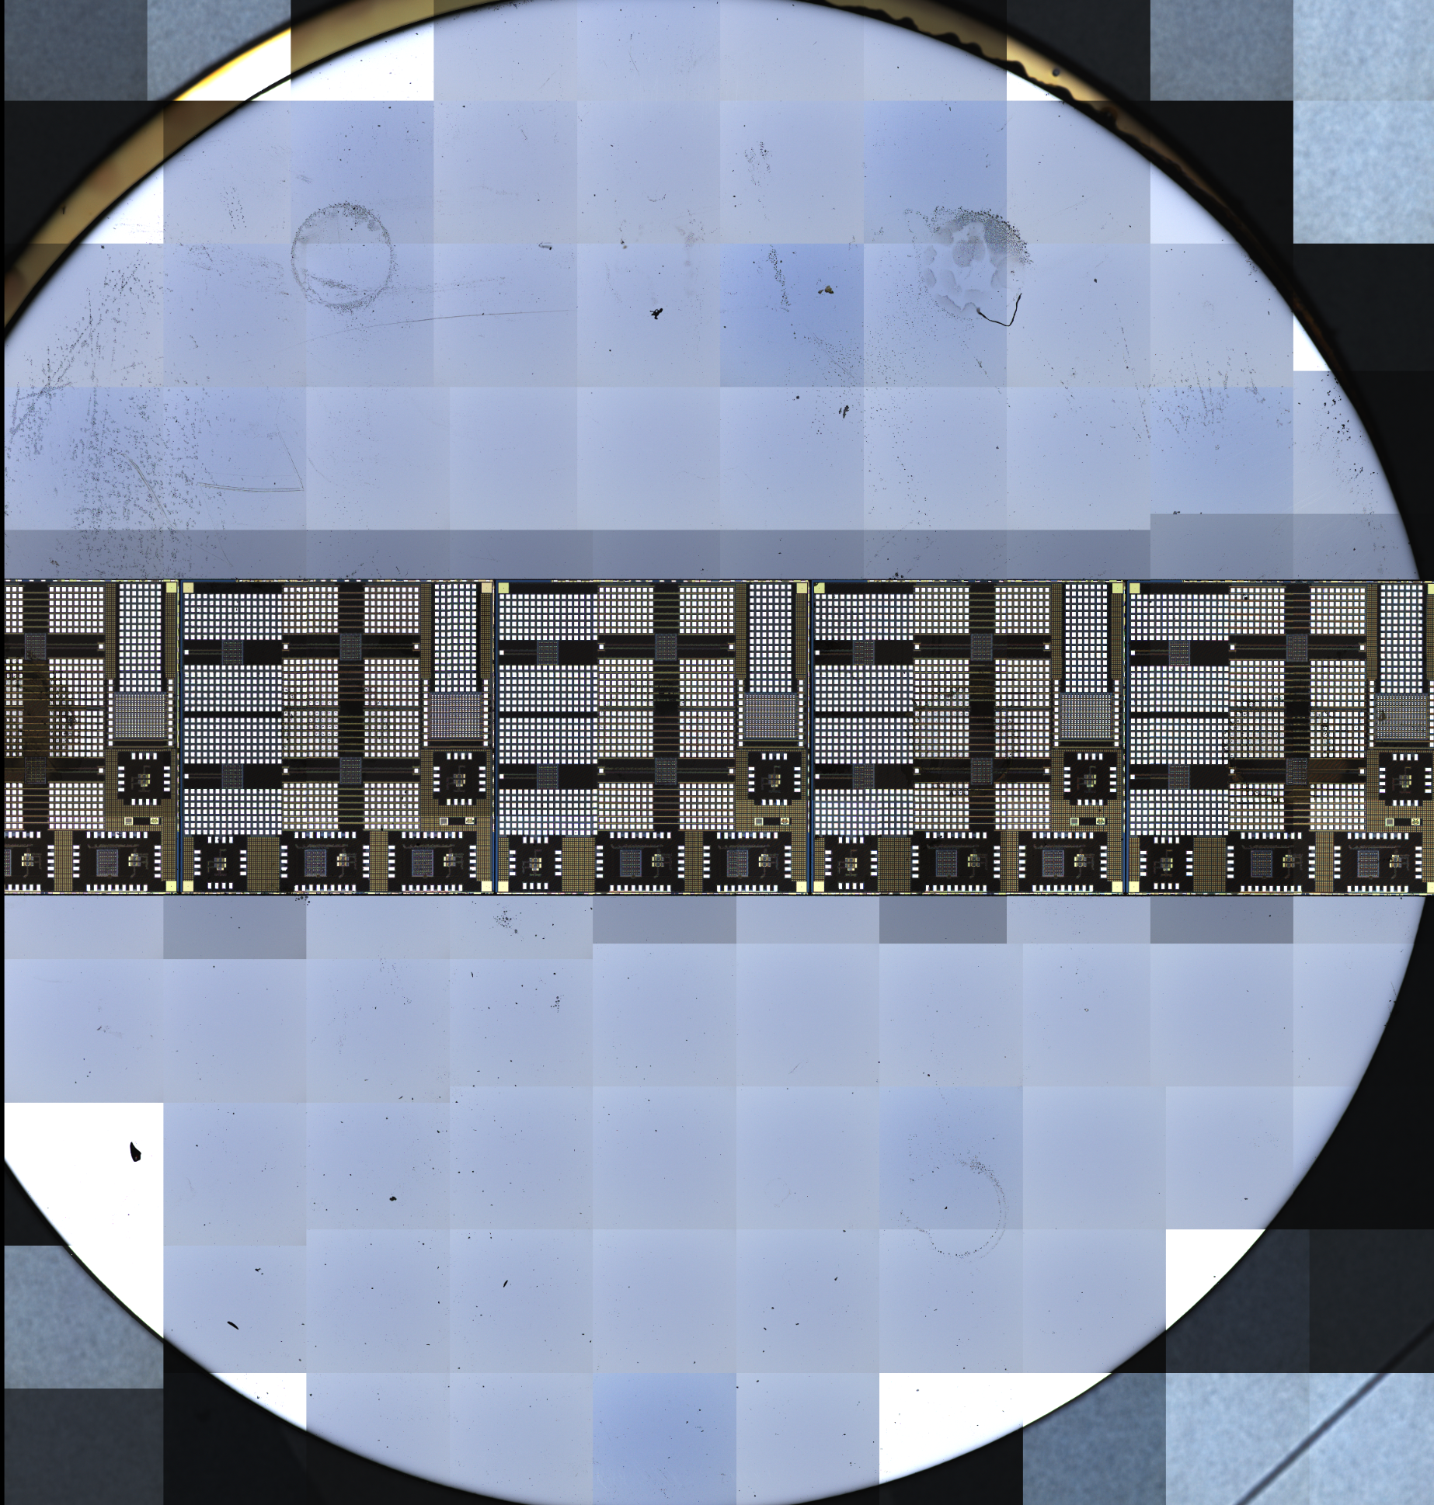
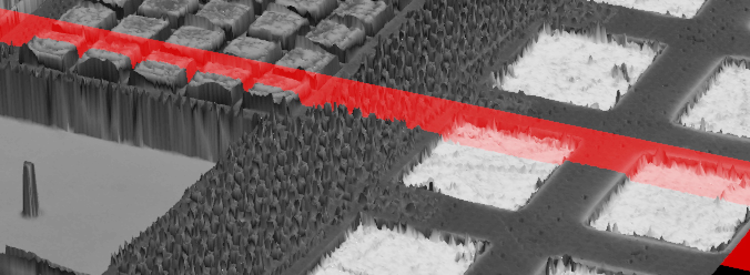
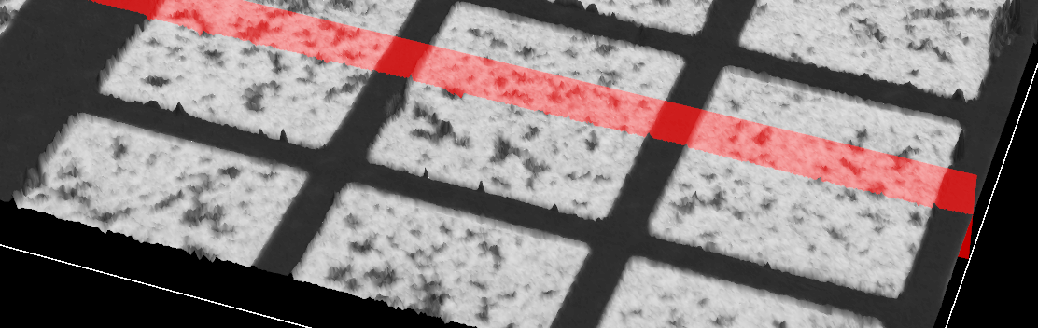
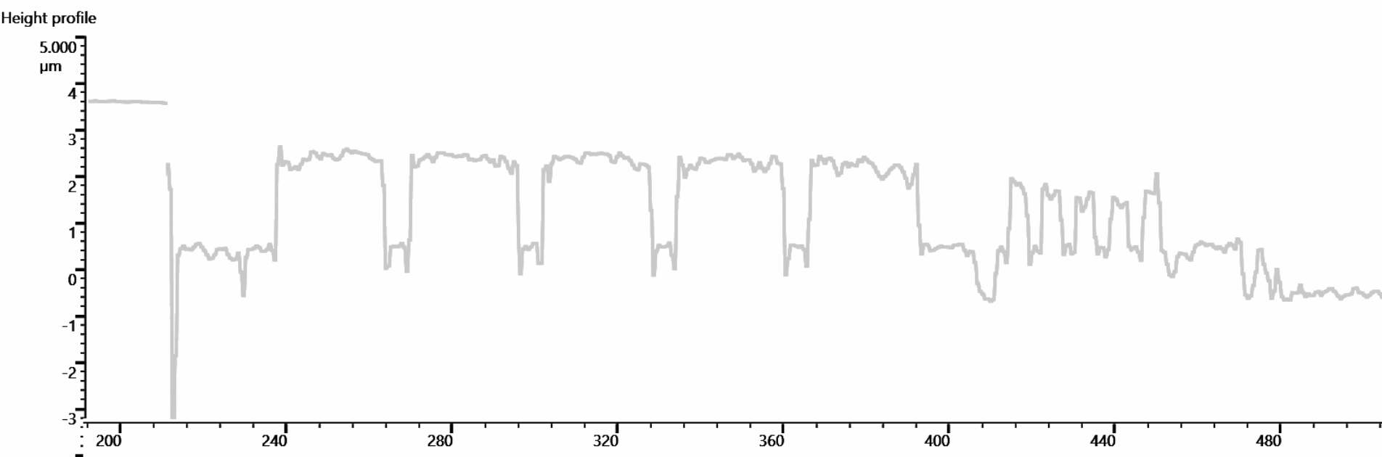
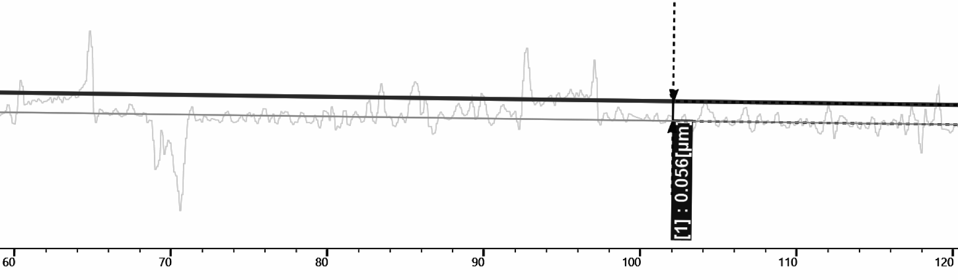
4. Initial attempts in post-processing
Dies embedded in a 1” wafer for precision polishing
Height profile showing 3um topography before polishing
Chips polished to 50nm
flatness
Post-processing requirements:
Controlled nanomaterials deposition requires a planar surface:
<10nm roughness
CNT diameter approximately 20nm
Desired gate oxide thickness under CNT approximately 20nm

Slide 9
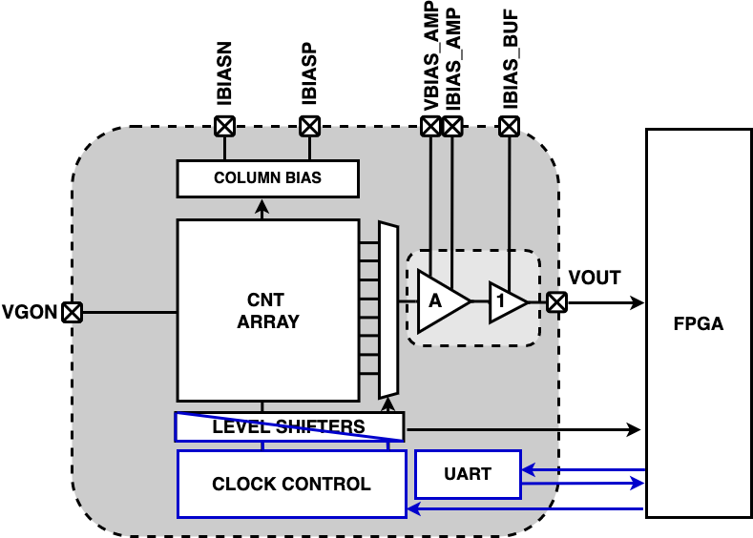
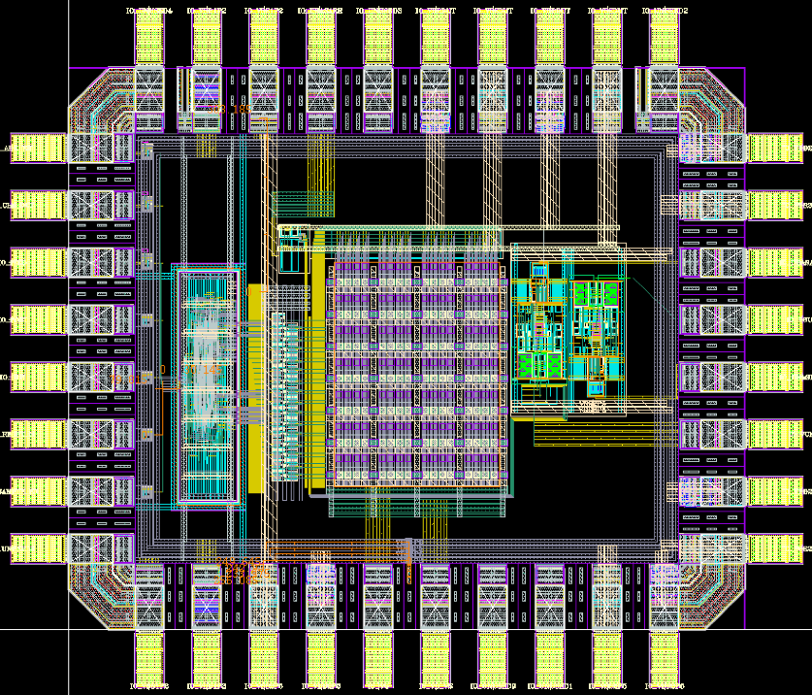
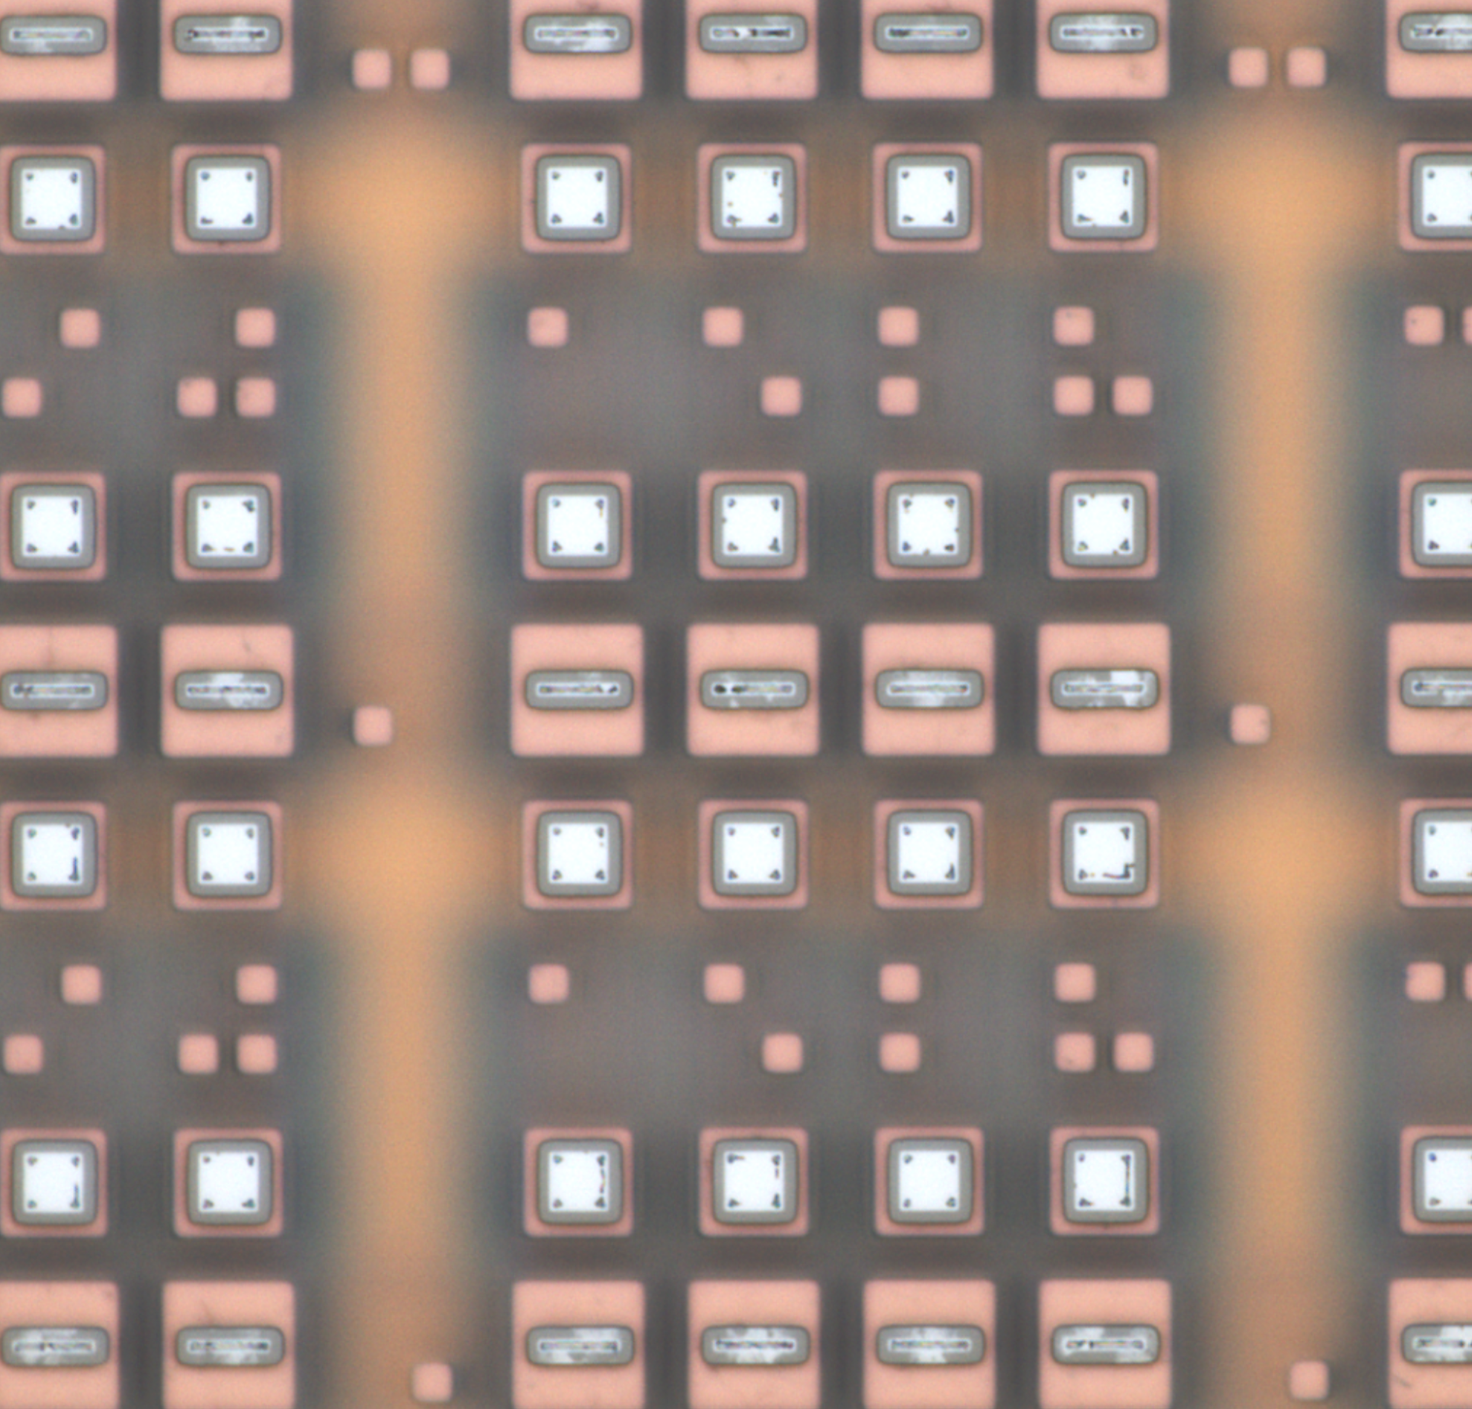
5. TSMC 130nm full wafers
Migrate to TSMC 130nm in order to
demonstrate operation of a full
mini pixel array
Improved readout with higher bandwidth, programmable gain, higher input range, on-chip device biasing
Digital control and clock programmability for pixel array readout
Digital communication
interface
New pad geometry

Slide 10



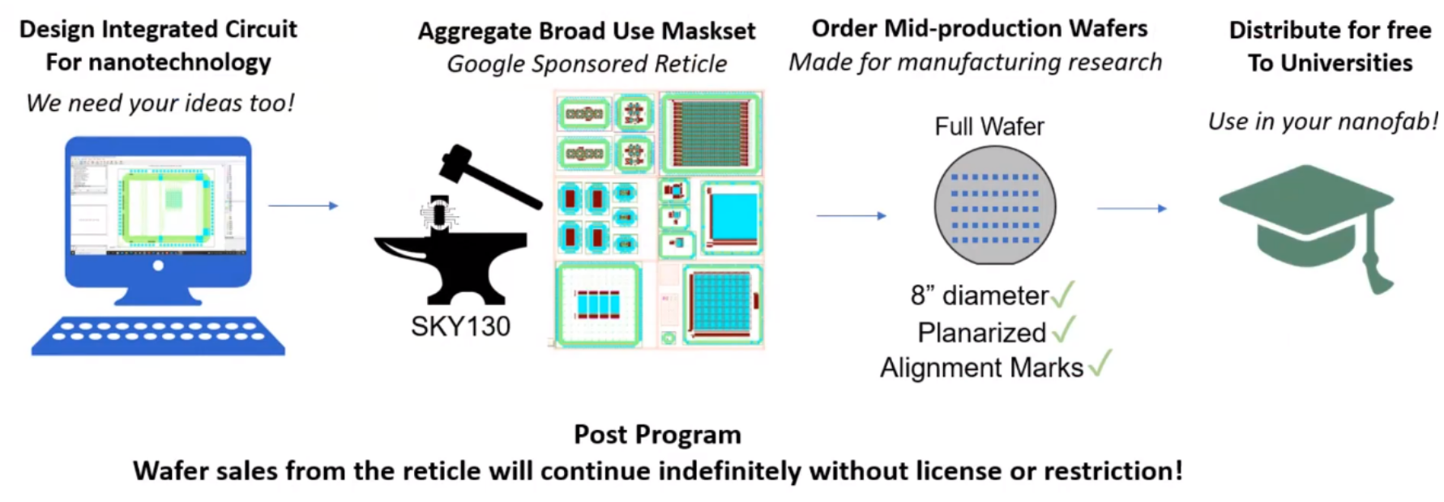
6. SkyWater 130nm full wafers
Nanotechnology Accelerator
Program
+
+
Wafer-level run with excellent 1nm planarity, and small 0.4um feature size
Design submitted in June 2023, including devices arrays and several variations of readout amplifiers

Slide 11
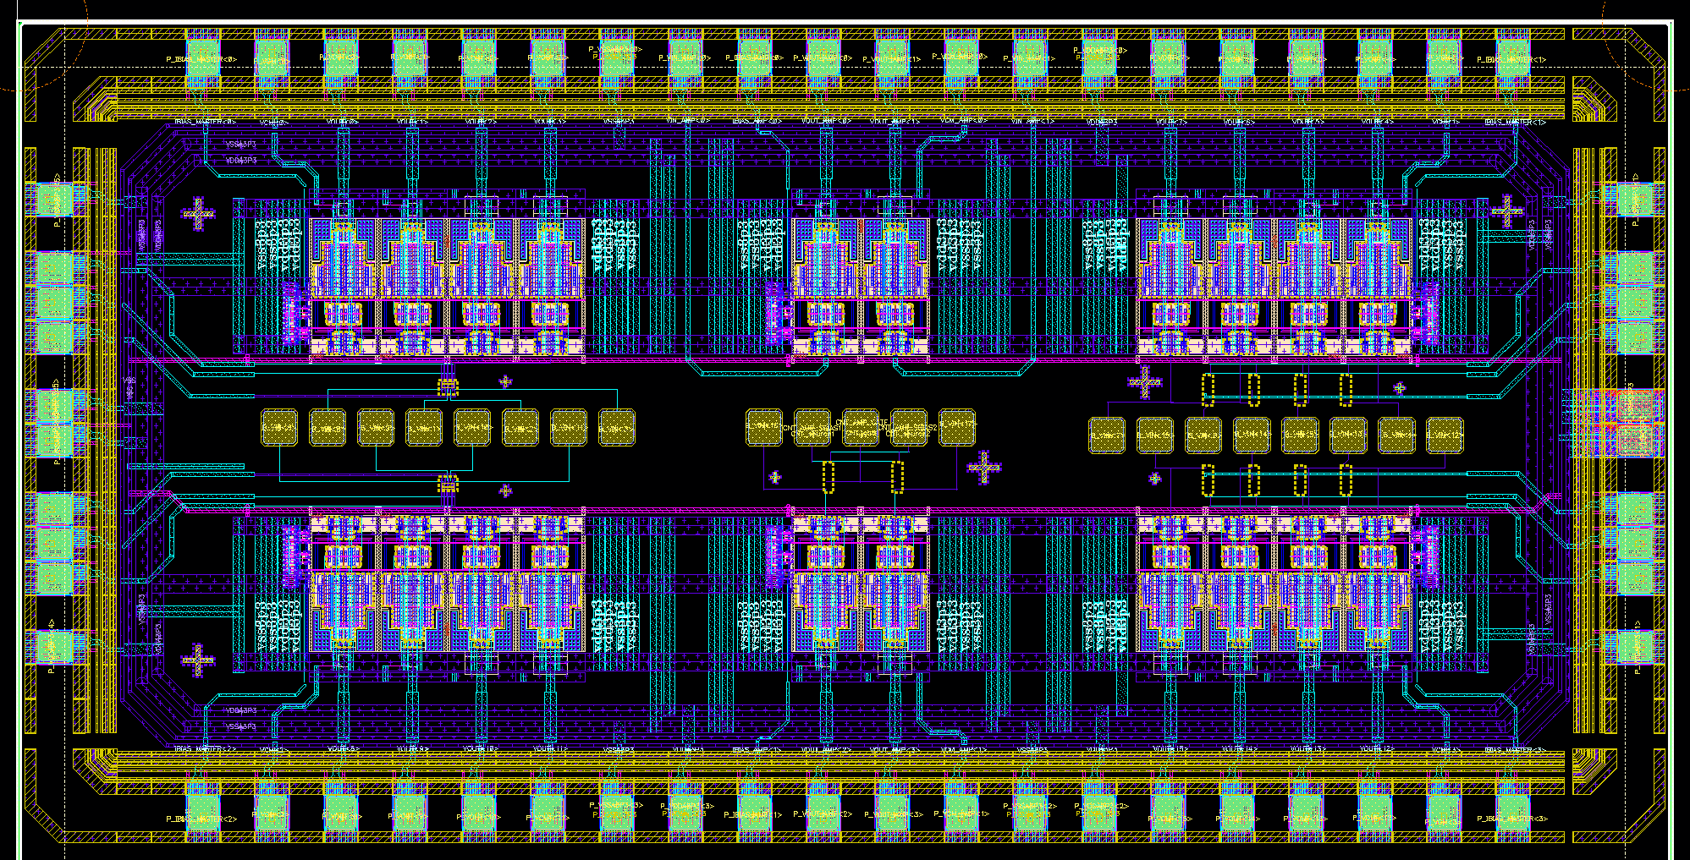
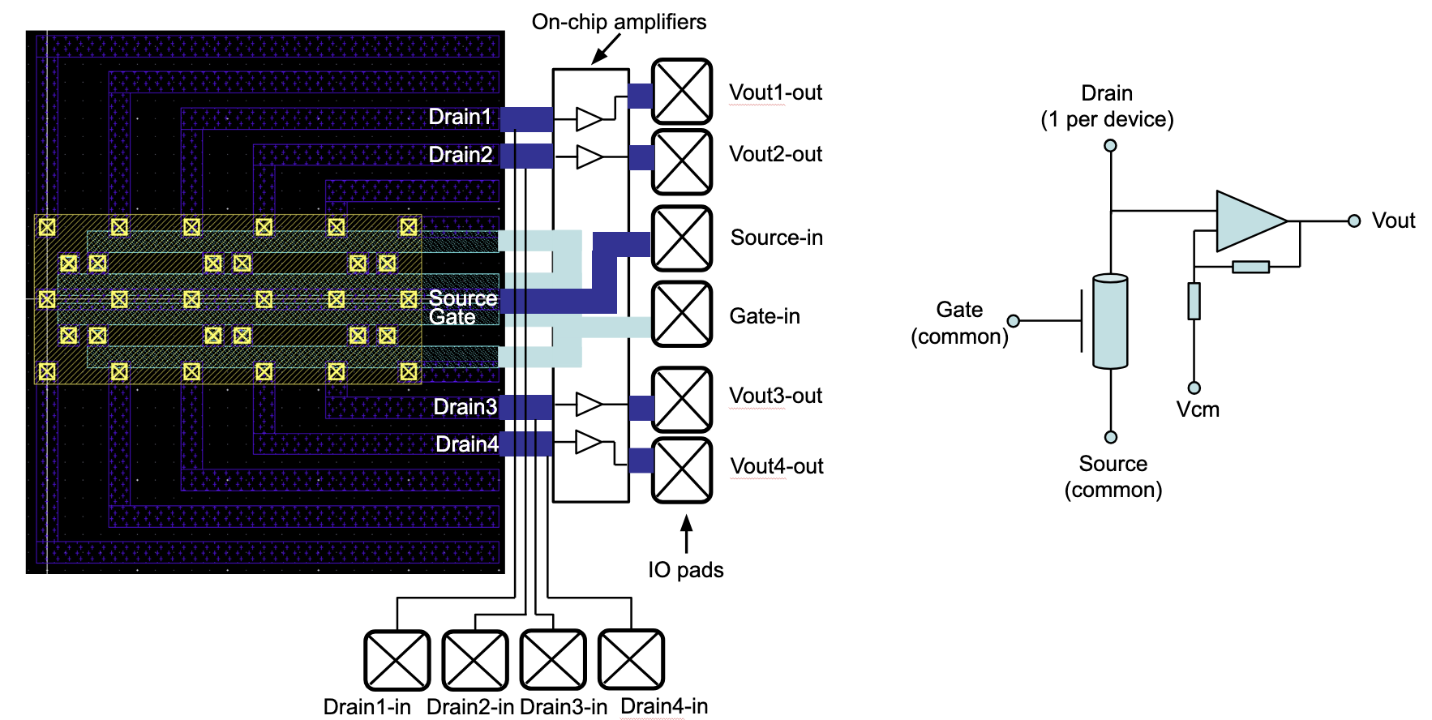
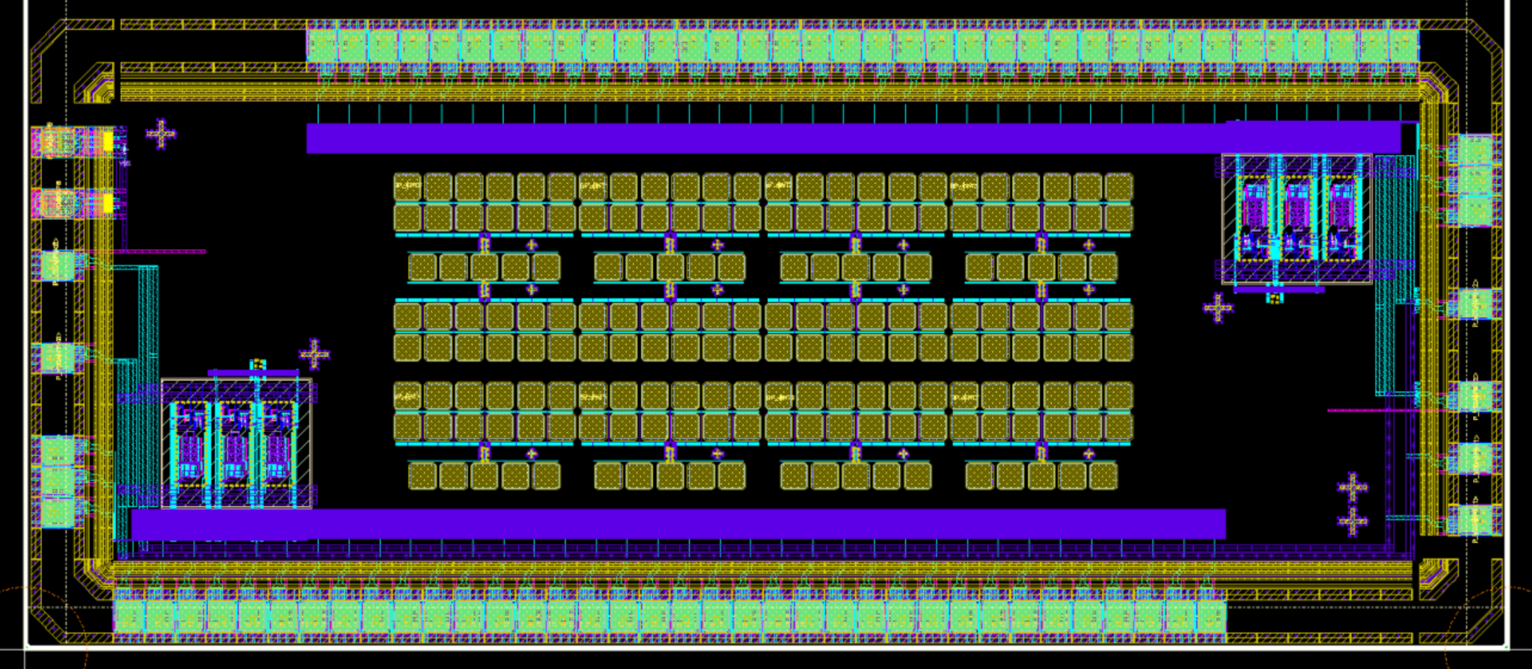
6. SkyWater 130nm new pad architectures
New tiny pad structures:
- allow structure to fit into 25um AFM field
- allow space around gate for hBN flakes
Experimental amplifiers

Slide 12
7. Work plans: preparation - accumulate feedback
- What have we learned from post-processing, oxide deposition, patterning etc.
- Feedback on shapes and geometries
- Feedback on placement

Slide 13
7. Work plans: preparation - modeling
No circuit design in first year
Get a model ready. Many levels of accuracy can be discussed:
- IV curves from simulation -> Verilog-A LUT models
- IV curves from measurement -> Verilog-A LUT models
- IV data – Silvaco UTMOST software
- If further interest – compact model tuning and development (photoresponse not modeled by any of existing models)

Slide 14
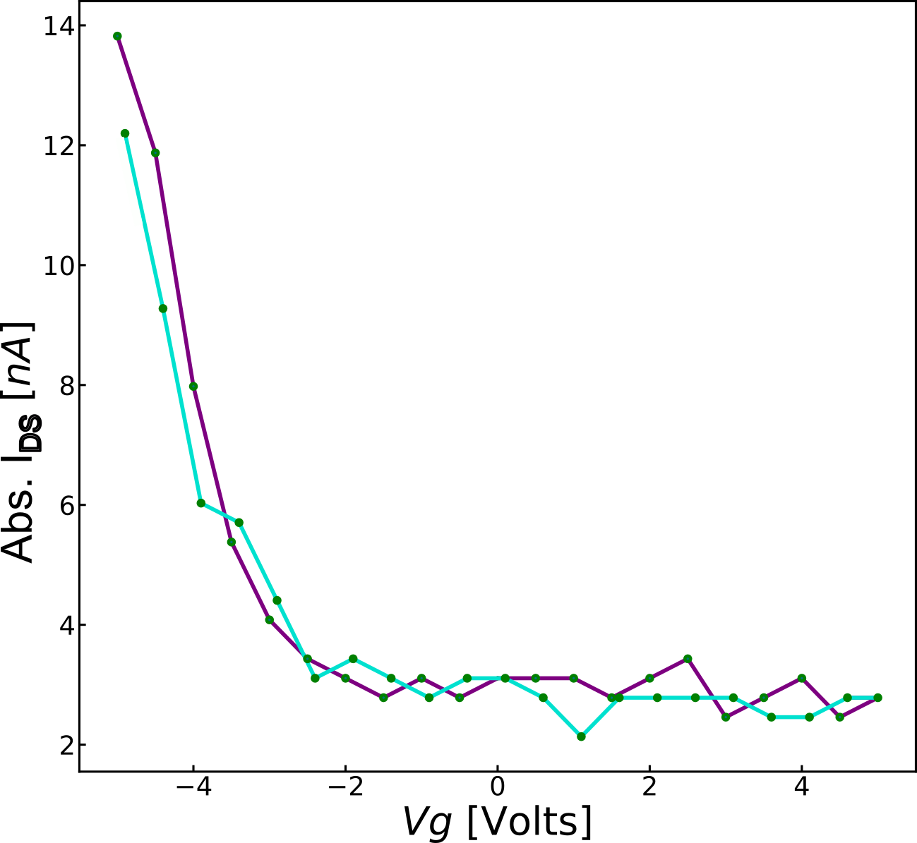
Work plans: preparation - characterization
Most important:
1. Device testing and characterization
2. Chip testing and characterization

