Slide 1
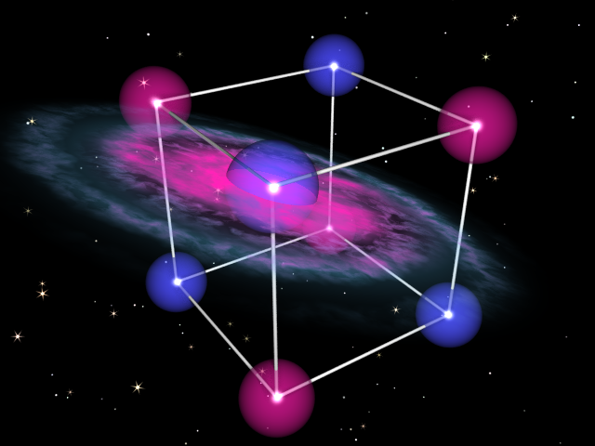
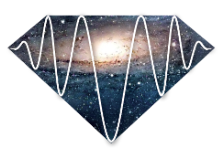



Cosmic Axion Spin Precession Experiment (CASPEr)
Alex Sushkov

Slide 2
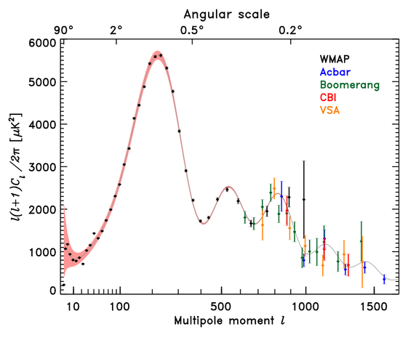
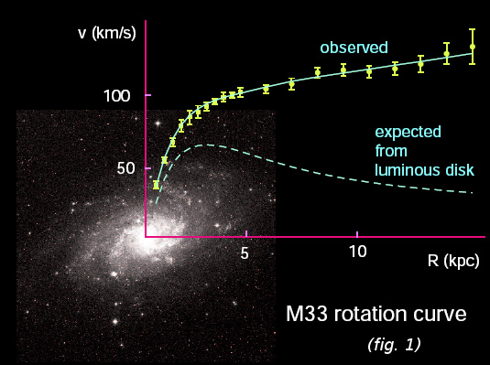
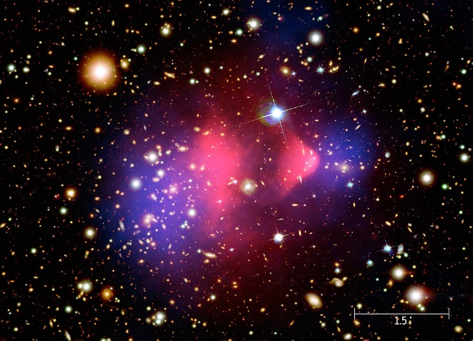
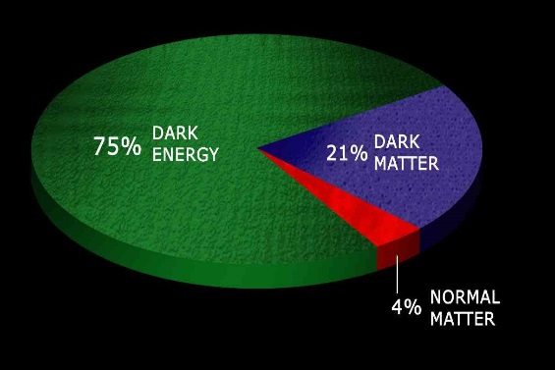

Evidence for dark matter
galaxy rotation curves
CMB angular power spectrum
galaxy clusters: Bullet cluster
+ gravitational lensing
+ structure formation
+ …
approximately 21% of energy in the Universe is in the form of dark matter:

Slide 3
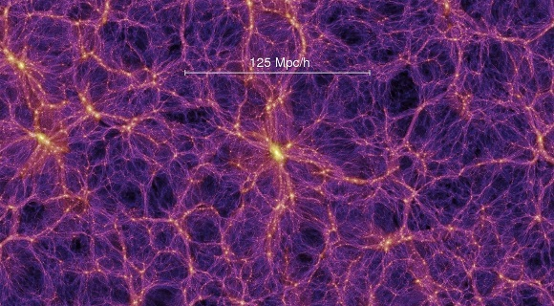
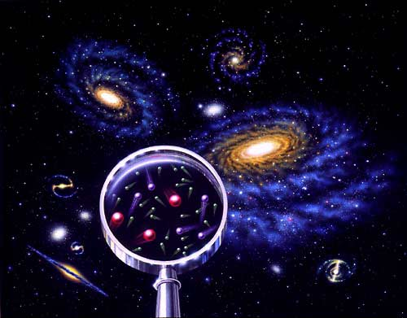
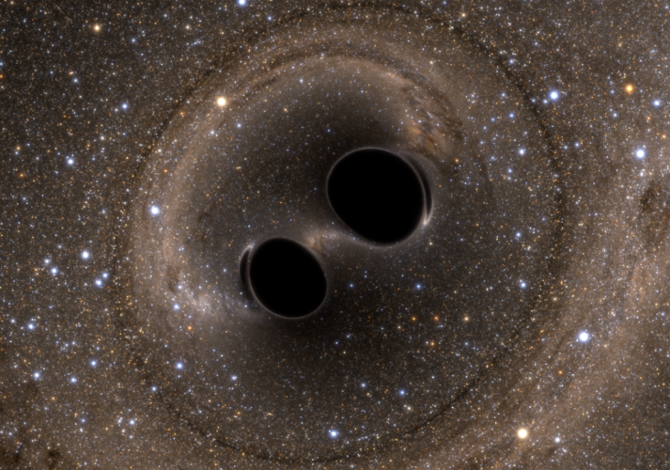
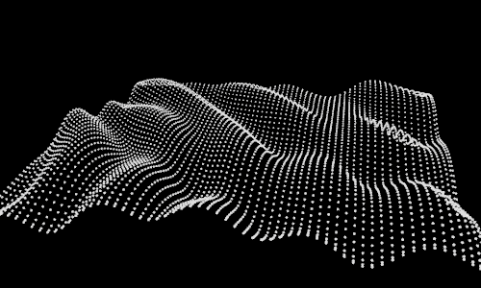
Some of the candidates for dark matter
dark matter
Weakly Interacting Massive Particles (WIMPs):
mass ~ 100 GeV
Light candidates
(eg: axions, dark photons)
mass ~ µeV
Massive black holes
(LIGO)

Slide 4
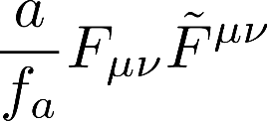
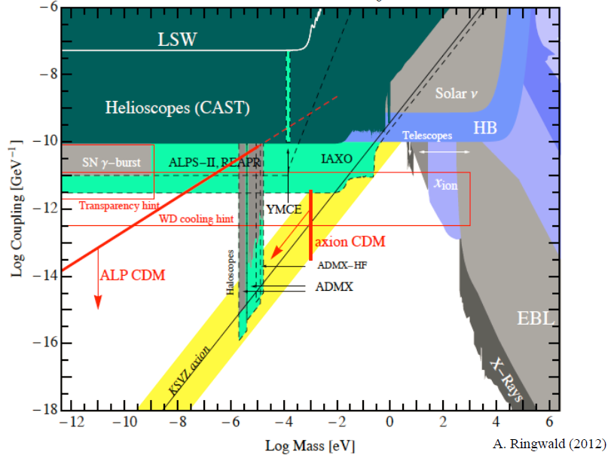
Axions
Pseudoscalar light field: spin = 0, odd under parity
Proposed to solve the strong CP problem of Quantum Chromodynamics
[PRL 38, 1440 (1977)]
Axion-like particles (ALPs) arise very naturally in string theories, symmetries broken at GUT (10¹⁶ GeV) or Planck (10¹⁹ GeV) scales
Possible couplings to standard model particles:
axion field amplitude
coupling to photons
→ Primakoff effect
existing axion searches:
ADMX, CAST, IAXO, …
(sensitivity all the way down to the QCD axion coupling!)

Slide 5
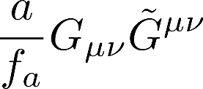
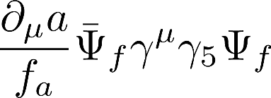


Axions
Pseudoscalar light field: spin = 0, odd under parity
Proposed to solve the strong CP problem of Quantum Chromodynamics
[PRL 38, 1440 (1977)]
Axion-like particles (ALPs) arise very naturally in string theories, symmetries broken at GUT (10¹⁶ GeV) or Planck (10¹⁹ GeV) scales
Possible couplings to standard model particles:
axion field amplitude
coupling to photons
coupling to gluons
coupling to fermions
→ Primakoff effect
→ creates nucleon EDM
(electric dipole moment)
this is why axions were invented
→ creates axion “wind”
→ spin to axion “wind” coupling:
→ spin to axion coupling:
existing axion searches:
ADMX, CAST, IAXO, …
(sensitivity all the way down to the QCD axion coupling!)
CASPEr-electric
CASPEr-wind
[Phys. Rev. X 4, 021030 (2014)]
[Phys. Rev. Lett. 115, 201301 (2015)]
CASPEr (Cosmic axion spin precession experiments) will search for experimental signatures of these couplings

Slide 6
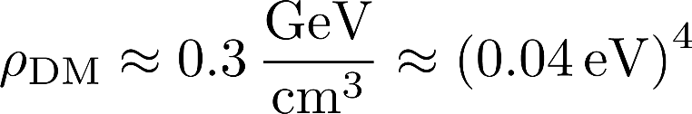





Axion coupling to spin
spin to axion coupling:
axion (or ALP) field
spin
effective electric field
dark matter energy density:
large number of particles per de Bloglie wavelength
ALP mass range:
ALP dark matter acts as a classical field:
ALP Compton frequency
coupling constant
spin to axion coupling:
effective interaction:
spin “feels” an effective magnetic field:
[D. Budker, P.Graham, et al., Phys. Rev. X 4, 021030 (2014)]

Slide 7
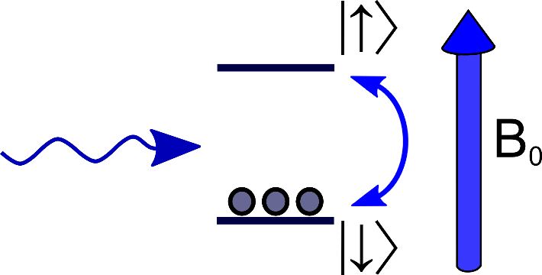



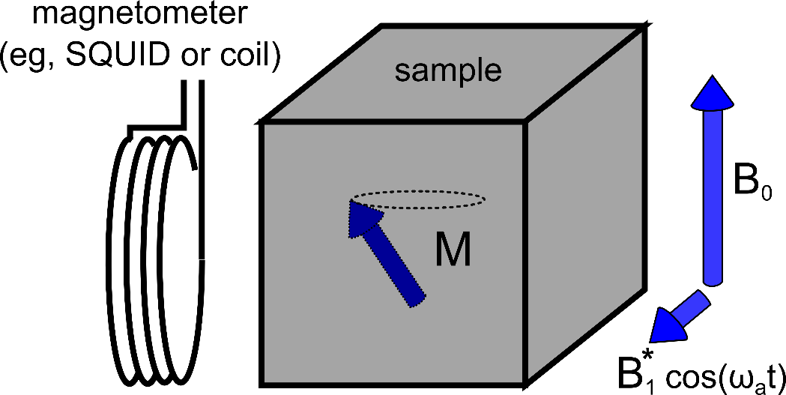
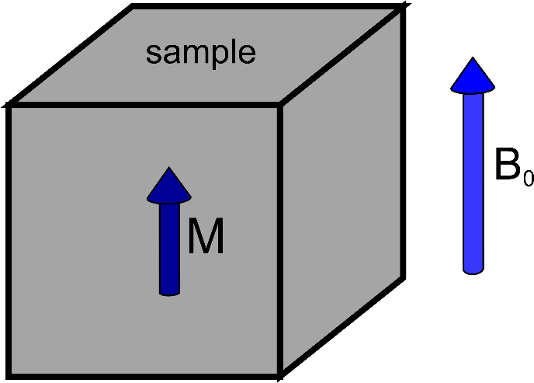
Experimental search for axion coupling to spin
effective interaction:
search for this effective magnetic field using magnetic resonance
1) placing a spin-1/2 into an external magnetic field splits the spin states by
2) spin polarization (thermal or optical) in a cm³ sample
3) resonance:
axion-spin interaction can now flip spins!
sample magnetization tilts and precesses
4) a magnetometer next to the sample detects the magnetic field created by this precessing magnetization
basically an NMR experiment
[D. Budker, P.Graham, et al., Phys. Rev. X 4, 021030 (2014)]

Slide 8
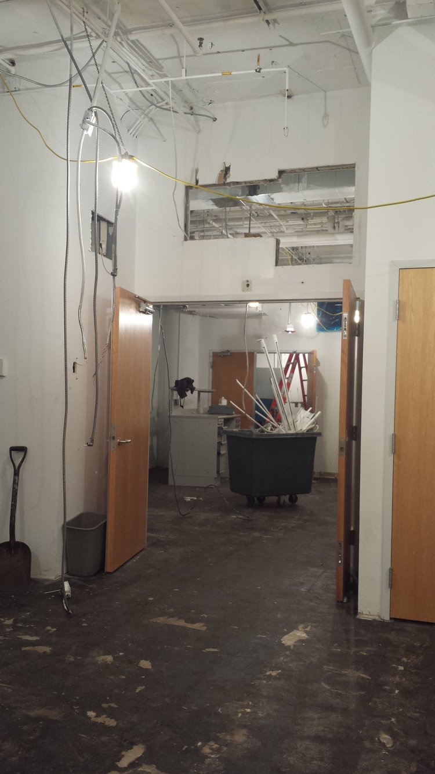
A lab-scale search
February 2016

Slide 9
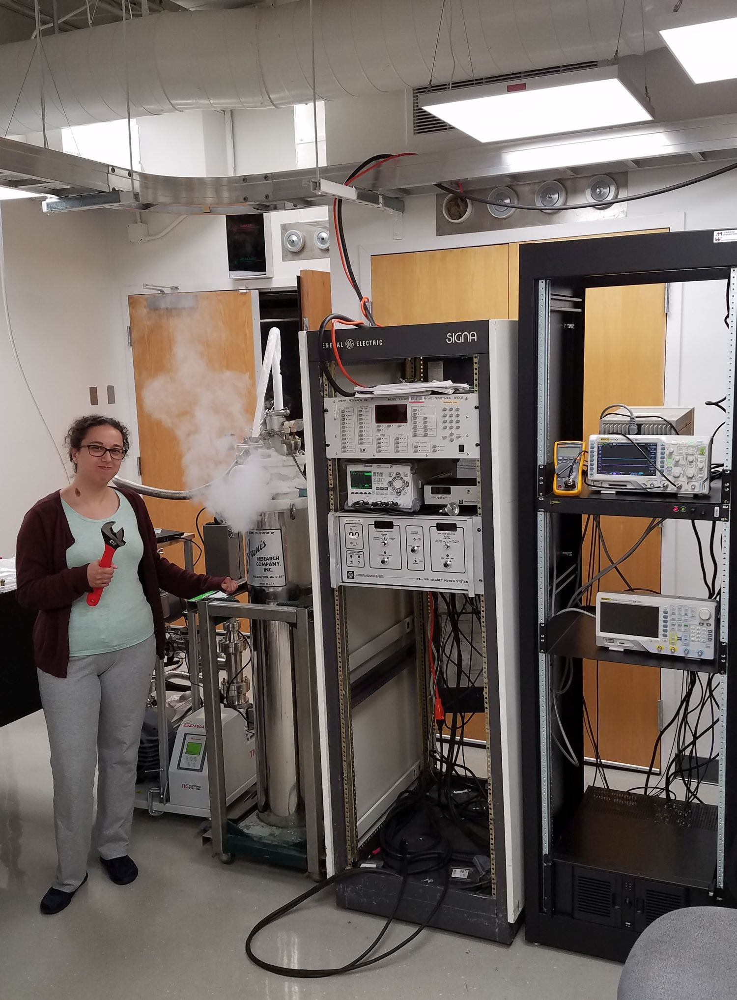
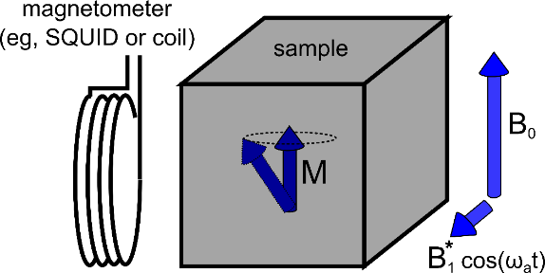
A lab-scale search
November 2016

Slide 10


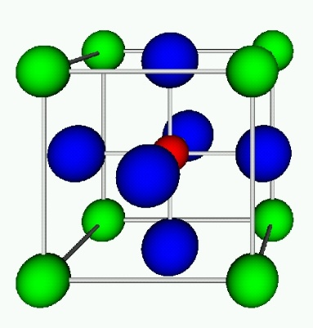
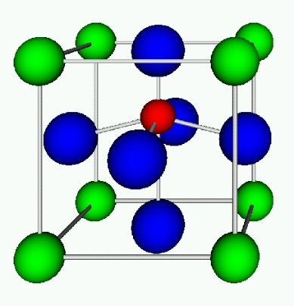



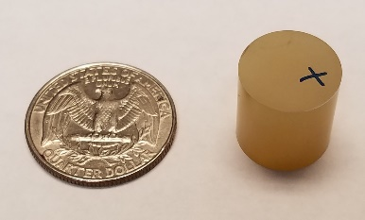



Sample material
effective interaction:
1) maximize
2) maximize spin density
3) optimize spin coherence time
1) use a ferroelectric solid where nuclear spin are subject to effective electric fields
similar to a polar molecule:
ACME [Science 343, 269 (2013)]
2) nuclear spin density:
Prof. Luo (Shanghai)
3) nuclear spin coherence time:
materials:
[D. Budker, P.Graham, et al., Phys. Rev. X 4, 021030 (2014)]

Slide 11
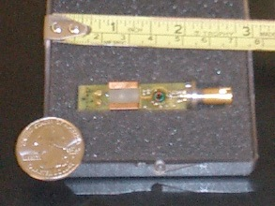
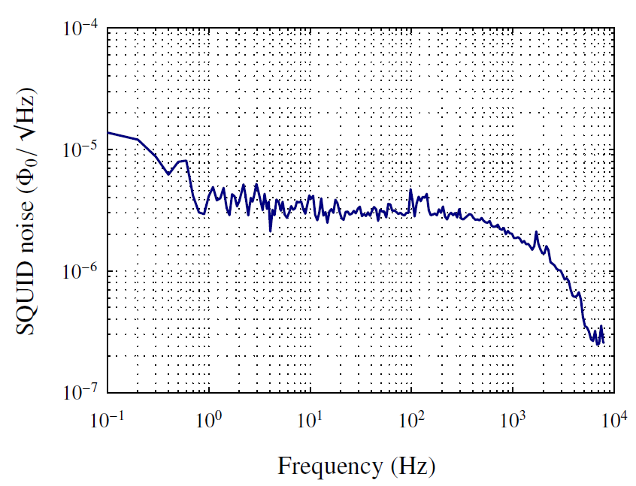
Magnetometry
effective interaction:
inductive (Faraday) detection:
SQUID:

Slide 12
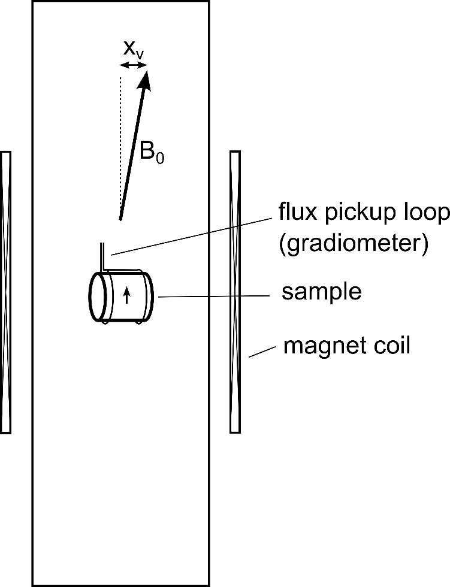
Systematics
superconducting magnetic shield
effective interaction:
main systematic: vibrations
vibrations of the magnetometer pickup loop with respect to the applied magnetic field will show up as oscillating signals mimicking the axion signature
vibrational frequencies ≈ kHz
far from axion search frequencies
small B₀ → searching for axions at small mass (low frequency, close to vibration peaks), but signal due to vibrations is small
large B₀ → larger signal due to vibrations, but searching for axions at large mass (high frequency, far from vibration peaks)

Slide 13
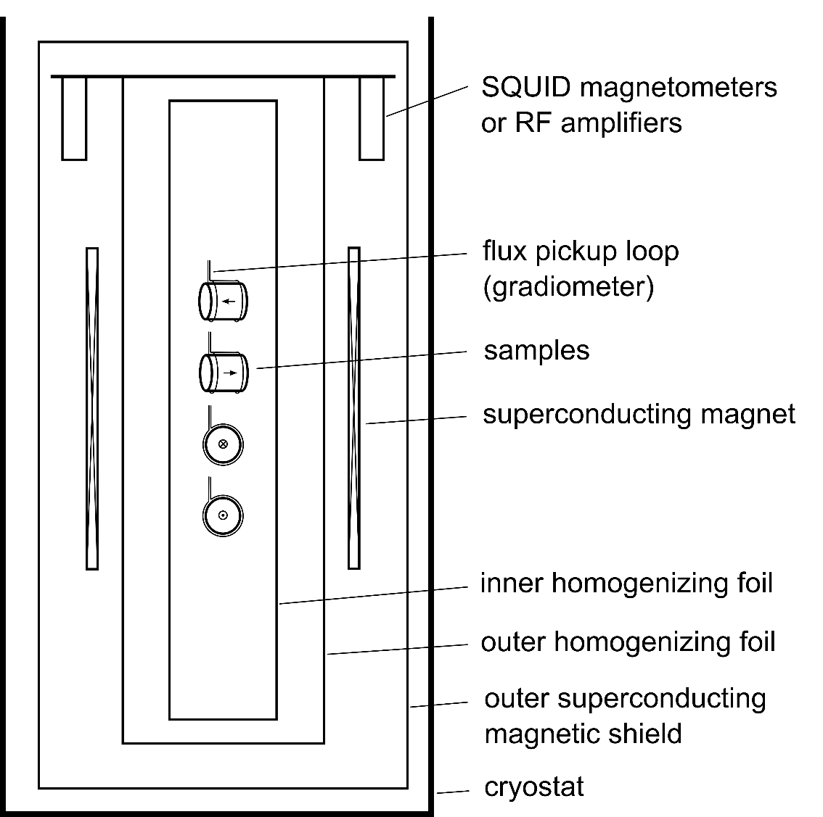
Systematics
superconducting magnetic shield
effective interaction:
in order to reject systematics, we have several samples:
axions will couple identically (in-phase)
if we have a detection, axion Compton frequency (inverse mass) must be the same in independent experiments

Slide 14
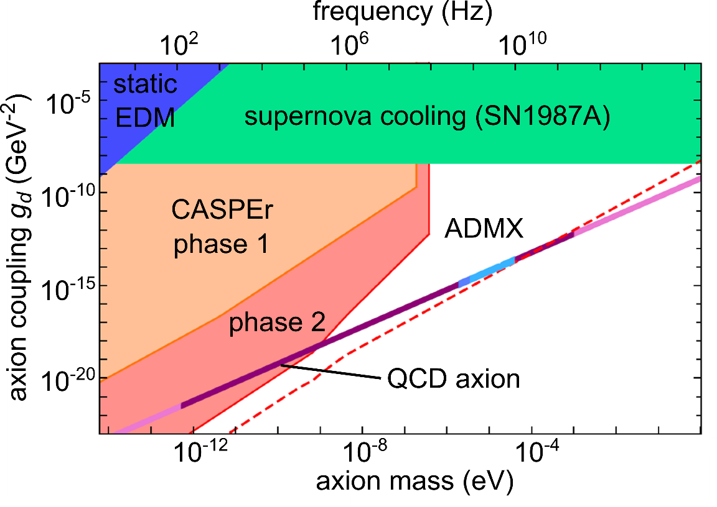
The experimental reach of CASPEr
phase 1,
existing technology:
thermal spin polarization,
1 cm sample size,
T₂ = 1 ms
phase 2,
ongoing R&D:
optical spin polarization,
10 cm sample size,
T₂ = 1 s
search in a wide range of masses and couplings, with potential to reach QCD axion
[D. Budker, P.Graham, et al., Phys. Rev. X 4, 021030 (2014)]

Slide 15




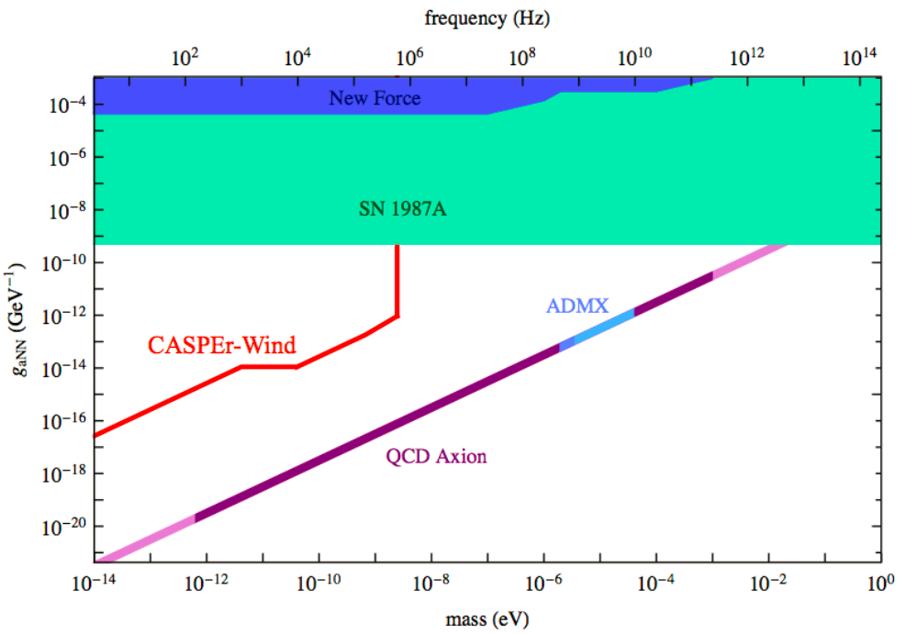
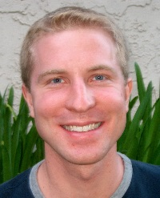

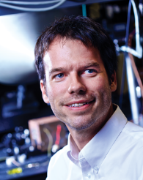
Our collaboration
Deniz Aybas (Boston University)
Arne Wickenbrock (Mainz)
John Blanchard (Mainz)
Samer Afach (Mainz)
Nathan Leefer (Mainz)
Surjeet Rajendran (UC Berkeley),
Peter Graham (Stanford)
Dmitry Budker (UC Berkeley & Mainz)
Alex Sushkov (Boston University)
Derek Kimball (CSUEB)
Boston University:
CASPEr-electric using spins in solids
Mainz:
CASPEr-wind using liquid Xenon
Stanford, Berkeley, CSUEB:

Slide 16
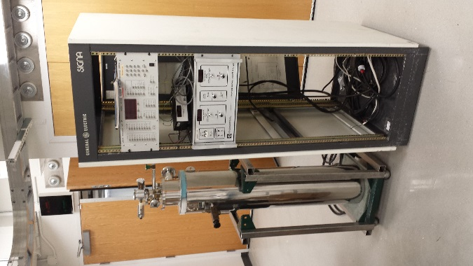
Thank you
[D. Budker, P.Graham, et al., Phys. Rev. X 4, 021030 (2014)]

