Slide 1
Atomic Clocks and Interferometers for Dark Matter
Sub-eV 2016
Jason Hogan
Stanford University
December 9, 2016

Slide 2
Ultralight scalar dark matter
Ultralight dilaton DM acts as a background field (high occupation number)
Can cause small (but coherent) oscillations in Standard Model parameters
+ …
Electron
coupling
Photon
coupling
e.g., QCD
DM scalar field
Fundamental “constants”:

Slide 3


Observing DM with atomic clocks
DM coupling causes time-varying atomic energy levels:
Measurement strategies
Two species clock comparison
Differential acceleration (EP tests)
“Clock gradiometer” (GW detector)

Slide 4
Two species clock comparison
Asimina Arvanitaki, Junwu Huang, and Ken Van Tilburg, PRD 91, 015015 (2015)
Energy level shift depends on species
Compare clocks with frequency comb
Electron coupling
Photon coupling

Slide 5

Differential Acceleration – EP tests
Scalar field varies in space
Force points in the direction of the local gradient in the field:
Force is oscillatory and equivalence-principle violating
Example: Coupling to electron mass
Vector coupling (e.g., B-L) has similar phenomenology
P. Graham et al., PRD 93, 075029 (2016)

Slide 6
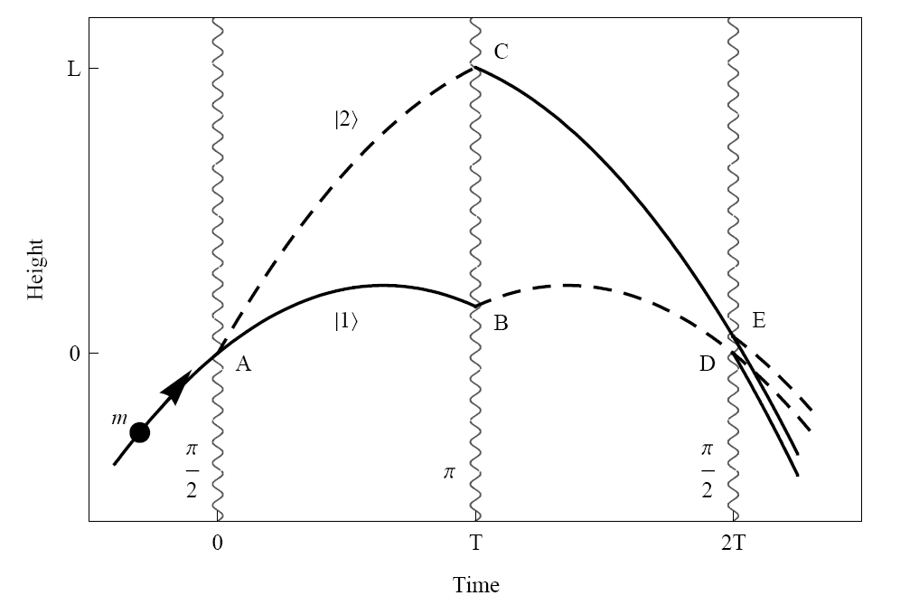
Light Pulse Atom Interferometry
Long duration
Large wavepacket separation

Slide 7
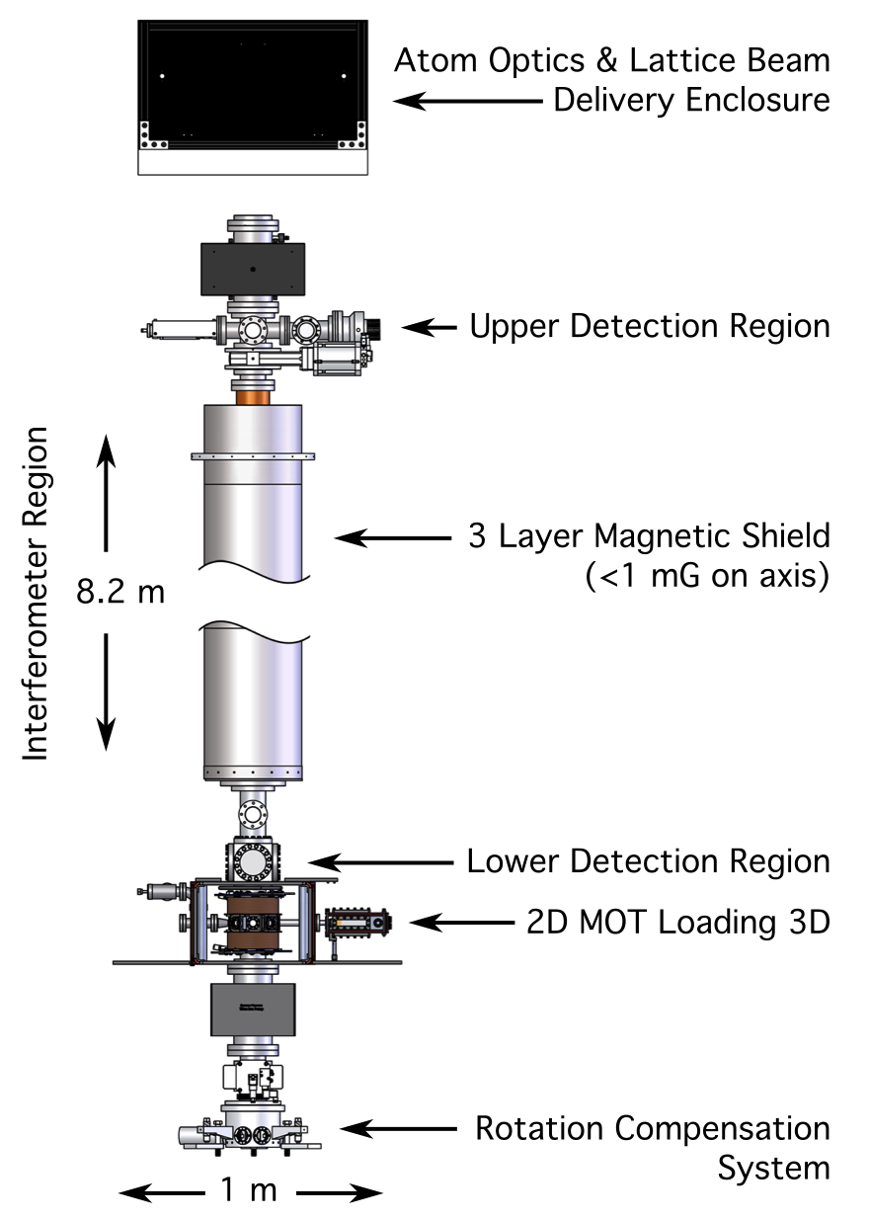
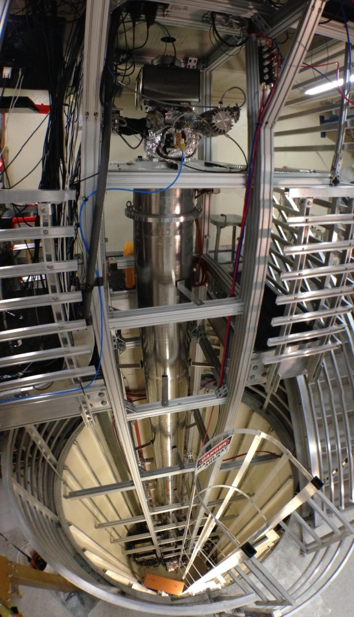
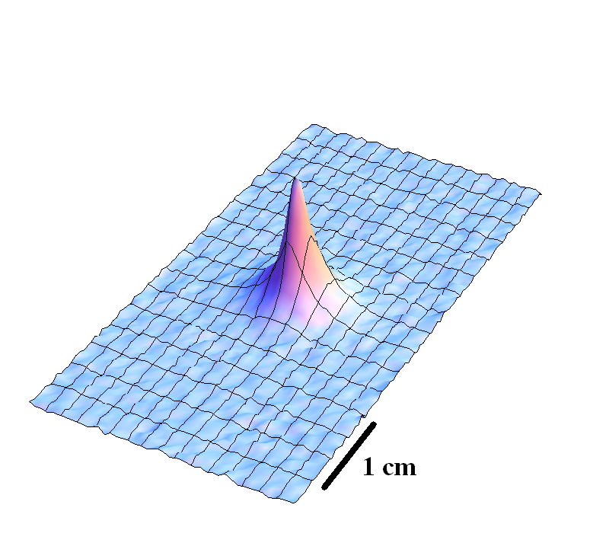
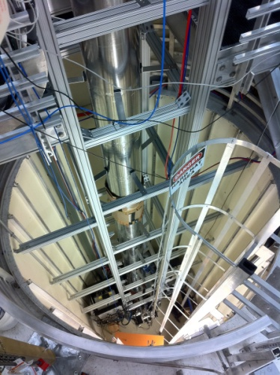
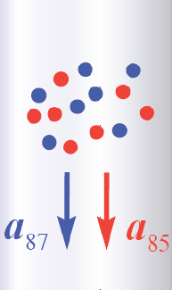
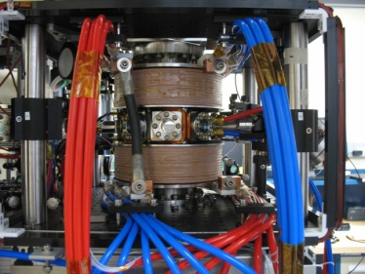
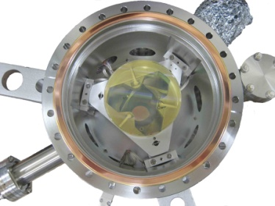
10 meter scale atomic fountain
< 3 nK

Slide 8
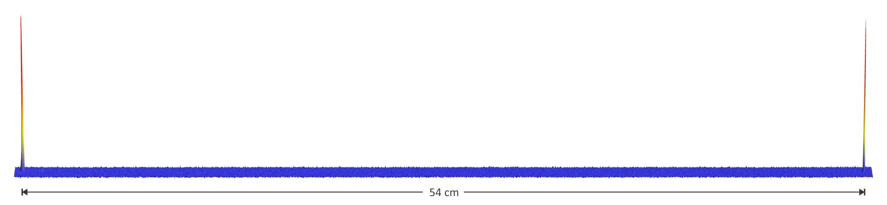
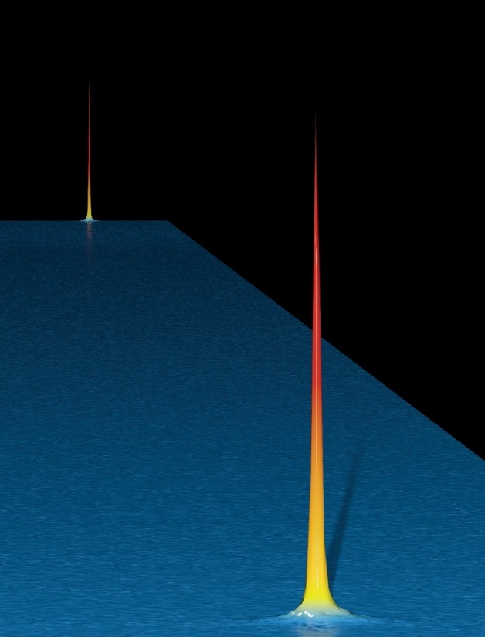
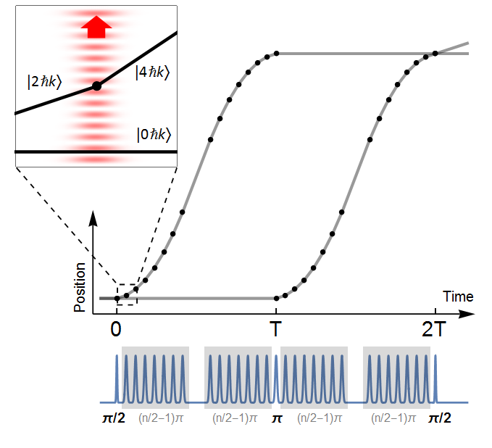
Large momentum transfer demonstration
54 cm
Multiple pulses to transfer momentum
Bragg atom optics
Long duration (>2 s)
Pulse sequence
Kovachy et al., Nature 2015

Slide 9
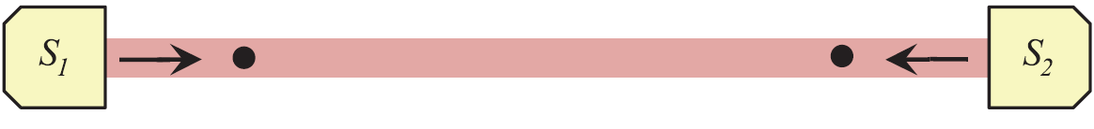
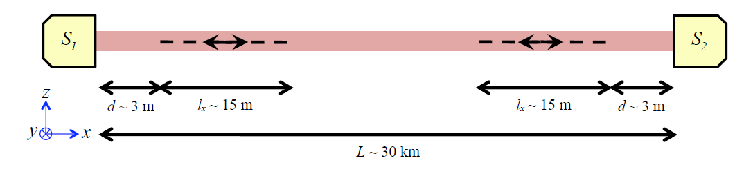
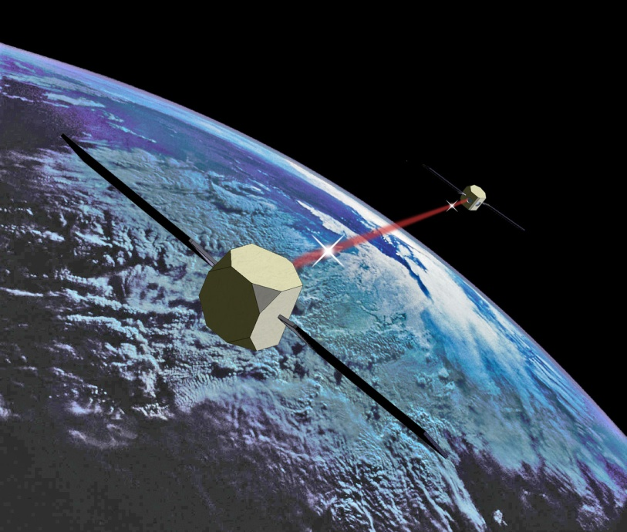
Gradiometer configuration
Laser
Laser
Atoms
Common interferometer laser beam
Atoms
Measurement baseline
Terrestrial
Space
(Vertical mine shaft)

Slide 10
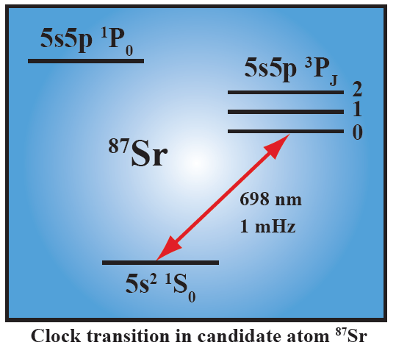
Differential atomic clock
Excited state phase evolution:

Slide 11
Differential atomic clock
Excited state phase evolution:

Slide 12
Differential atomic clock
Excited state phase evolution:
Two ways for phase to vary:
Dark matter
Gravitational wave
Each interferometer measures the change over time T
Laser noise is common-mode suppressed in the gradiometer

Slide 13
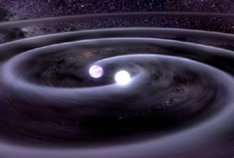

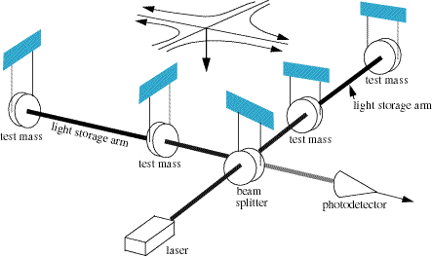
Gravitational Wave Detection
frequency
L (1 + h sin(ωt ))
strain
Laser interferometers suppress laser noise by comparing multiple baselines
Atom interferometer only requires single baseline
Compare to LISA (2 vs. 3 spacecraft)
Laser interferometer GW detector

Slide 14
Resonant Detection Mode
Resonant interferometer sequences for enhanced, narrow band response
L = 4 × 10⁷ meters
AI sensitivity
Optimized sensitivity near 1 Hz
Includes constraints on total pulses and source lifetime
Graham, et al., PRD 94, 104022 (2016)

Slide 15
GW Sensitivity
L = 4 × 10⁷ meters

Slide 16
Scalar dark matter sensitivity
GW detector is also sensitive to scalar dark matter
Single photon GW detector as delayed clock comparison
Coupling to electrons
Coupling to photons
Arvanitaki, et al., arXiv:1606.04541 [hep-ph] (2016)

Slide 17
Gradiometer Demonstration (Rb)
Gradiometer response to 84 kg lead test mass
10 ћk
30 ћk
Gradiometer interference fringes

Slide 18
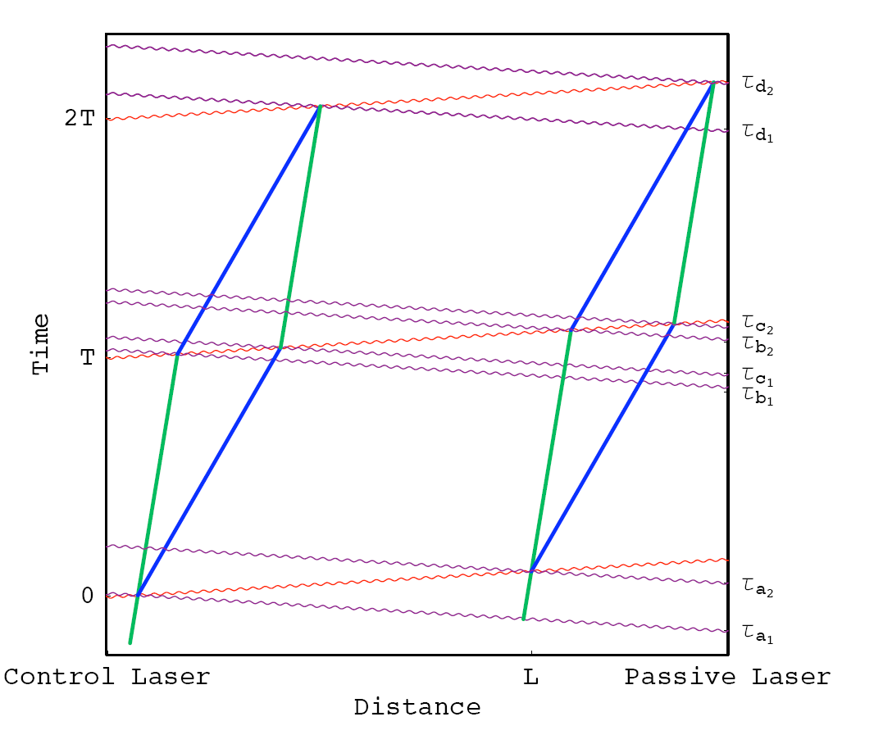
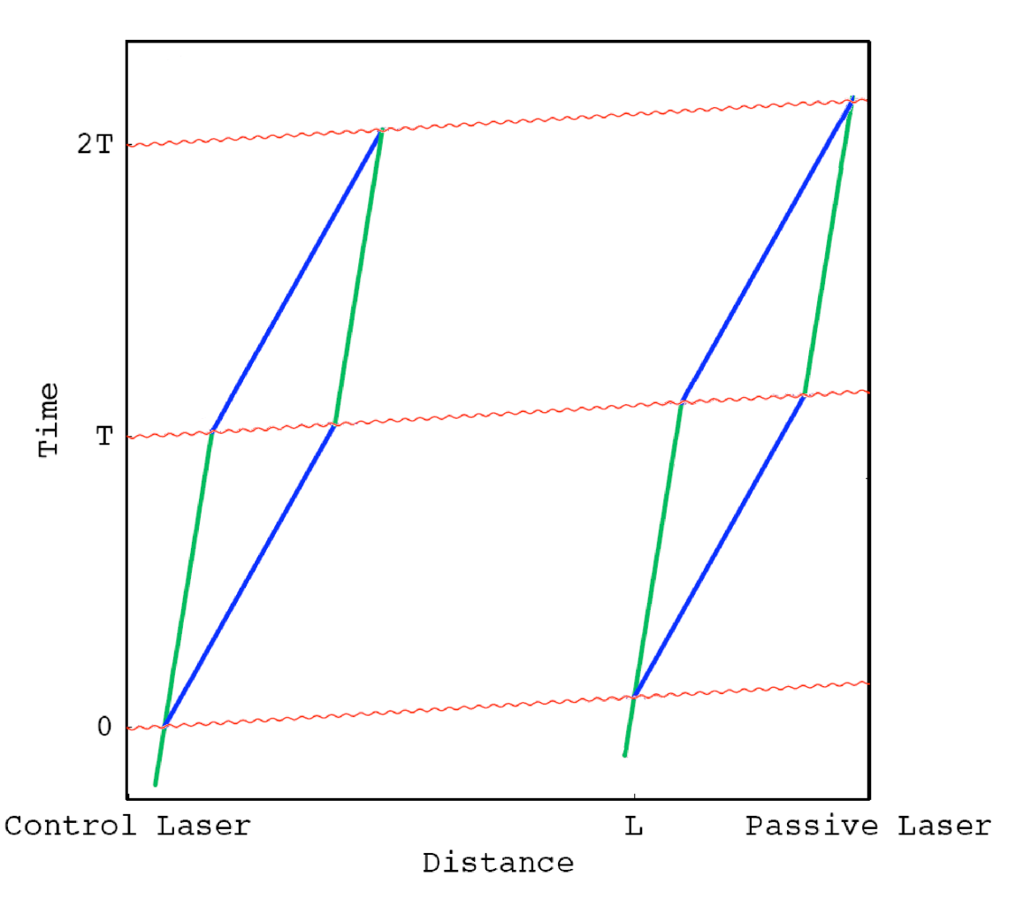
Two-photon vs. single photon transitions
2-photon transitions
1-photon transitions
Sr
Rb
Sr
Graham, et al., PRD 78, 042003, (2008).
Yu, et al., GRG 43, 1943, (2011).

Slide 19
Two-photon laser frequency noise
Consider a laser frequency error dw that varies at the GW frequency
Phase error:
GW Signal:
(and even harder with LMT)

Slide 20
Single photon atom interferometry
Sr gradiometer demonstration experiment
Laser
Laser
Proof of concept experiment
New tower with Sr atoms
AI on the the clock transition
Compare two Sr interferometers

Slide 21
Collaborators
Rb Atom Interferometry
Mark Kasevich
Tim Kovachy
Chris Overstreet
Peter Asenbaum
Daniel Brown
Sr Atom Interferometry
TJ Wilkason
Hunter Swan
Jan Rudolph
Theory:
Peter Graham
Savas Dimopoulos
Surjeet Rajendran
Asimina Arvanitaki
Ken Van Tilburg
TJ Wilkason

