Slide 1
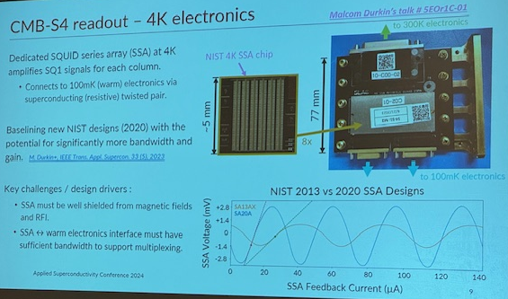
Applied superconductivity conference recap
Very big conference.
Ranging from magnet for MRI, superconducting power transmission for trains, particle collider magnets, superconducting sensors (TES, MKID), quantum devices
TES workshop → CMB-S4 special session
Organized by
Shannon Duff (NIST)
Kaja Rotermund (LBNL)
+ more
Many contributions from NIST, but there were participants from across the US, Europe, Asia
Overview science talk (Clarence Chang)
Detector talk (Aritoki Suzuki)
Questions: How to test so many detectors
Readout talk (Shawn Henderson)
Questions: What to do if no solution for flex cable comes up
Module talk (Matt Young)
Questions: What are magnetic field requirements for the module design?

Slide 2
Material R&D
Qubit, cosmic ray and radioactivity study/mitigation with GEANT-4 CMP simulation
Film material (Nb, Ta, Al, Au encapsulation) vs substrate (Si, sapphire) study for background noise
Low Tc low Stress IrPt for DM search
XRD study of low Tc film. Stress vs Tc
a-Si achieves 1e-4 tandat 300 GHz
Detector R&D
CCAT MKID
CPW based bandpass filter for CMB experiment in China
Lenslet coupled detector for CMB experiment in China
TES weak link modeling, how u-strip structure increases G
Vapor HF to make a superconducting bridge across CPW
Readout R&D
Differential TDM
Hybrid u-mux to increase mux count by xfew
SQUID resonance study
LiteBIRD SQUID development by adding inductance and resistance to JJ
2-stage SQUID improvement by splitting 1 SQUID into two stages to lower input inductance
Parametric Amplifiers
Flexible silicon as interconnect cable
MEM based RF switches

Slide 3
Material R&D
Qubit, cosmic ray and radioactivity study/mitigation with GEANT-4 CMP simulation
Film material (Nb, Ta, Al, Au encapsulation) vs substrate (Si, sapphire) study for background noise

Slide 4
Material R&D
Low Tc low Stress IrPt for DM search
XRD study of low Tc film. Stress vs Tc

Slide 5
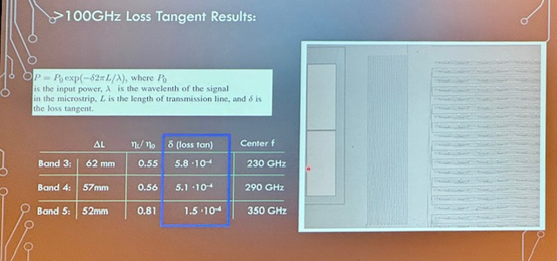
Material R&D
a-Si achieves 1e-4 tand at 300 GHz

Slide 6
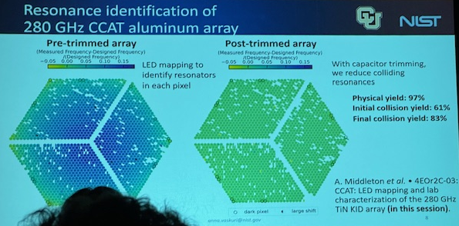
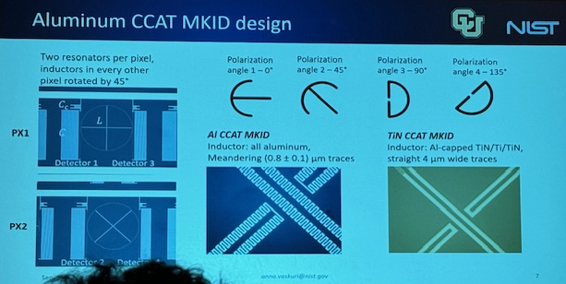
Detector R&D
CCAT MKID

Slide 7
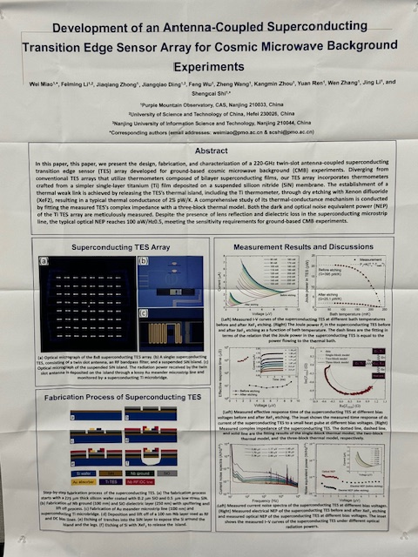
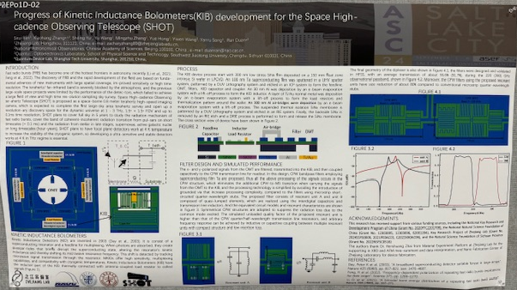
Detector R&D
CPW based bandpass filter for CMB experiment in China
Lenslet coupled detector for CMB experiment in China

Slide 8
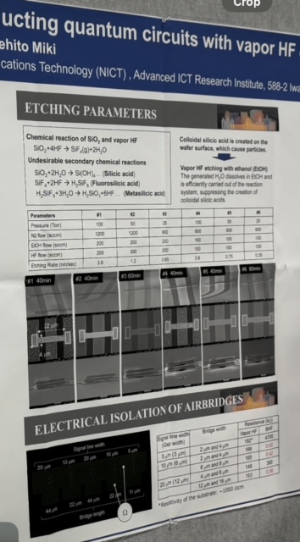
Detector R&D
TES weak link modeling, how u-strip structure increases G
Vapor HF to make a superconducting bridge across CPW

Slide 9
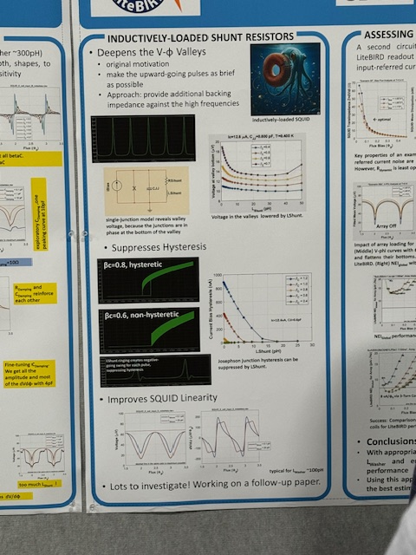
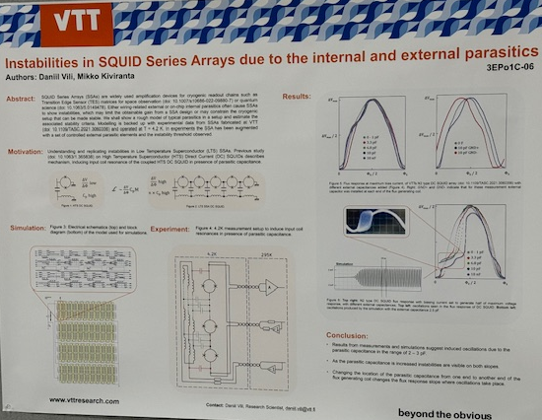
Readout R&D
SQUID resonance study
LiteBIRD SQUID development by adding inductance and resistance to JJ
2-stage SQUID improvement by splitting 1 SQUID into two stages to lower input inductance

Slide 10
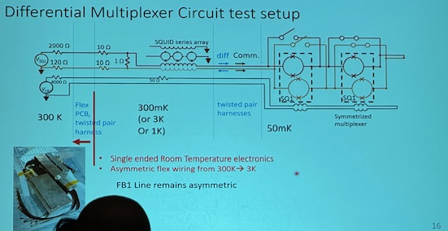
Readout R&D
Differential TDM
Hybrid u-mux to increase mux count by factor of a few

Slide 11
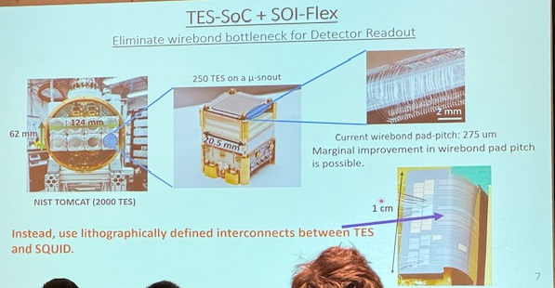
Readout R&D
Flexible silicon as interconnect cable

Slide 12
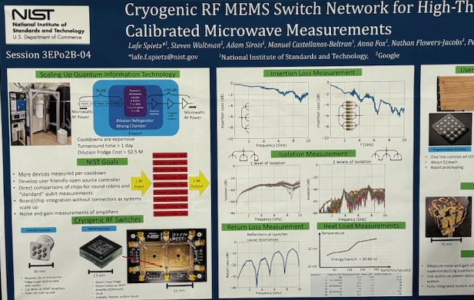
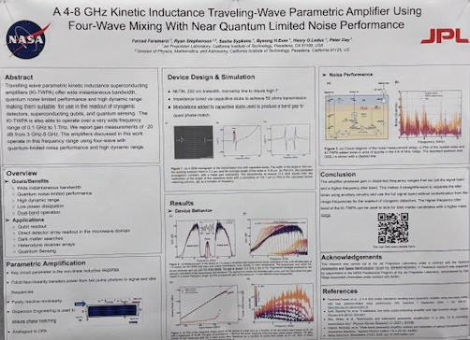
Readout R&D
RF MEMs Switch
Parametric Amplifier

