Slide 1
Accelerator Technology and Applied Physics (ATAP) Division Perspectives
Jens Osterhoff
Thanks to Cameron Geddes, Qing Ji, Jean-Luc Vay for providing slides!

Slide 2
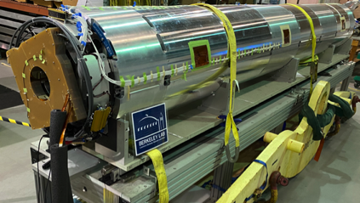
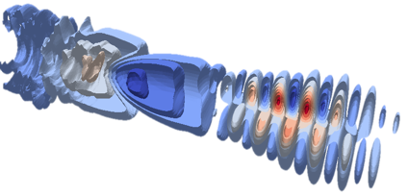
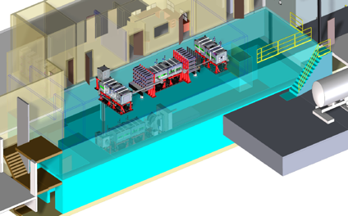
Extend the reach of High Energy Physics by
developing new accelerator, magnet and enabling capabilities
Advance accelerator & collider performance by addressing key limits
  High field superconducting magnets
  Precision controls and RF for efficiency and performance
Pioneer a new generation of accelerators to transform cost and capability
  Plasma accelerators at high gradient
  Ultrafast lasers at high average power
  Collider technology for wakefields, high field protons and muons
Simulate at exascale to understand and control accelerator science
Distinguished staff leading their field and developing the next generation
Lead initiatives – kBELLA, precision kHz laser towards future colliders, Exascale simulation, high field magnet development

Slide 3
Organization Connects Accelerator Capabilities Across the Division
HEP - Centered Programs

Slide 4
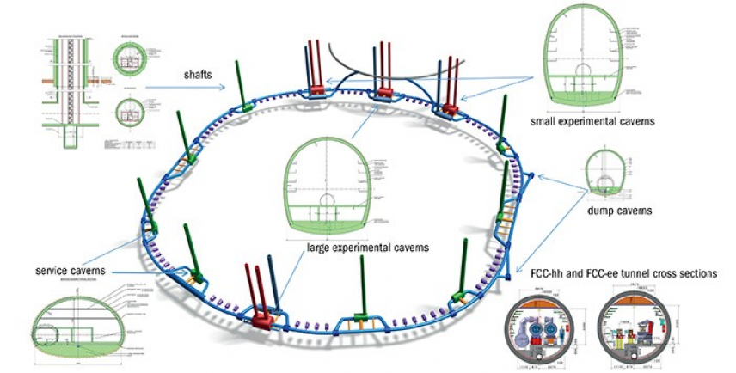
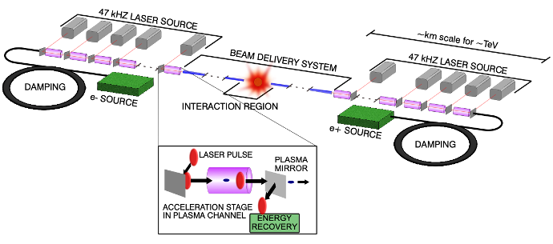
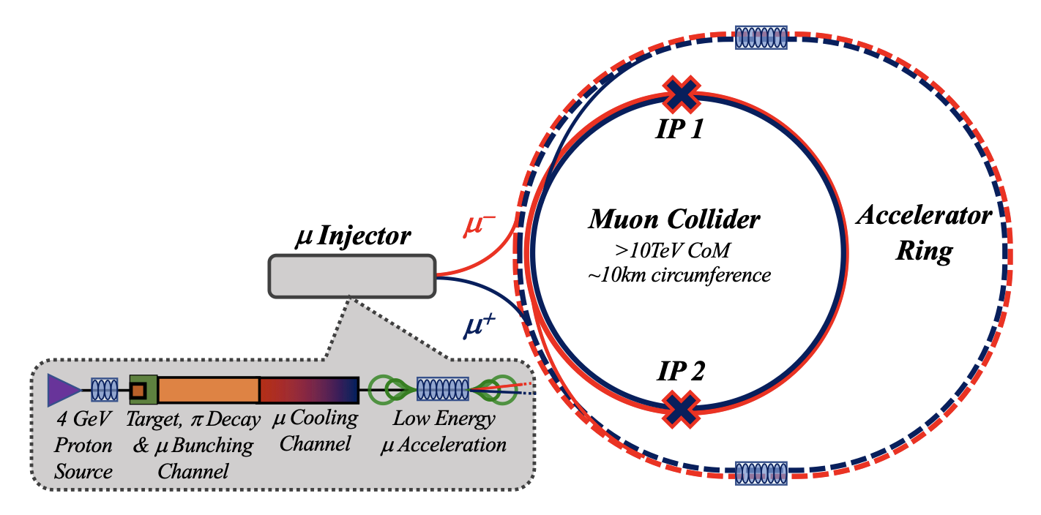
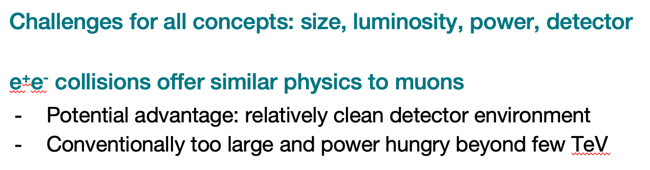
10 TeV pCM technology must be developed, no concept ready
Proton collider
Muon collider
Linear wakefield lepton collider
Key needs: high field magnets, detectors
Key needs: targets, cooling
Key needs: efficiency, staging, drivers
“All options for a 10 TeV pCM collider are new technologies under development and R&D is required before we can embark on building a new collider”
P5 Report (2023), p. 17
Notes:
Image sources:
FCC image from Wikipedia: https://en.wikipedia.org/wiki/Future_Circular_Collider#/media/File:Rough_approximations_of_the_LHC_layout_and_one_possible_layout_for_the_FCC.png
Muon Collider figure from https://arxiv.org/abs/2303.08533 Figure 1
Where is wakefield collider picture coming from? Carlo’s community snowmass paper?

Slide 5
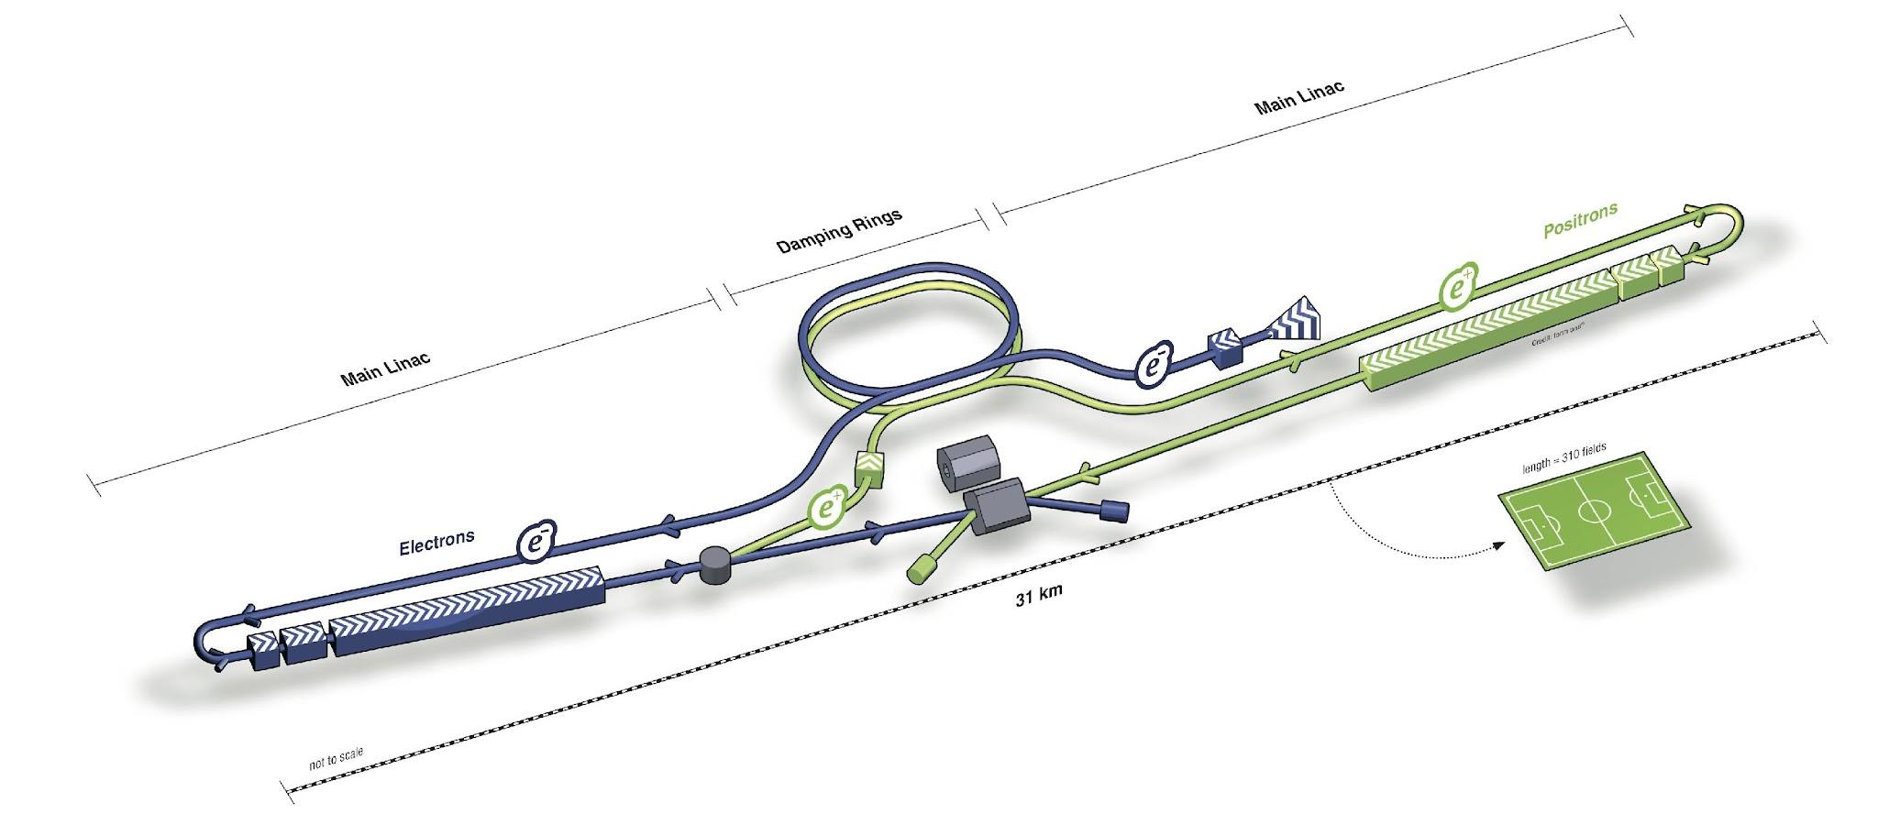
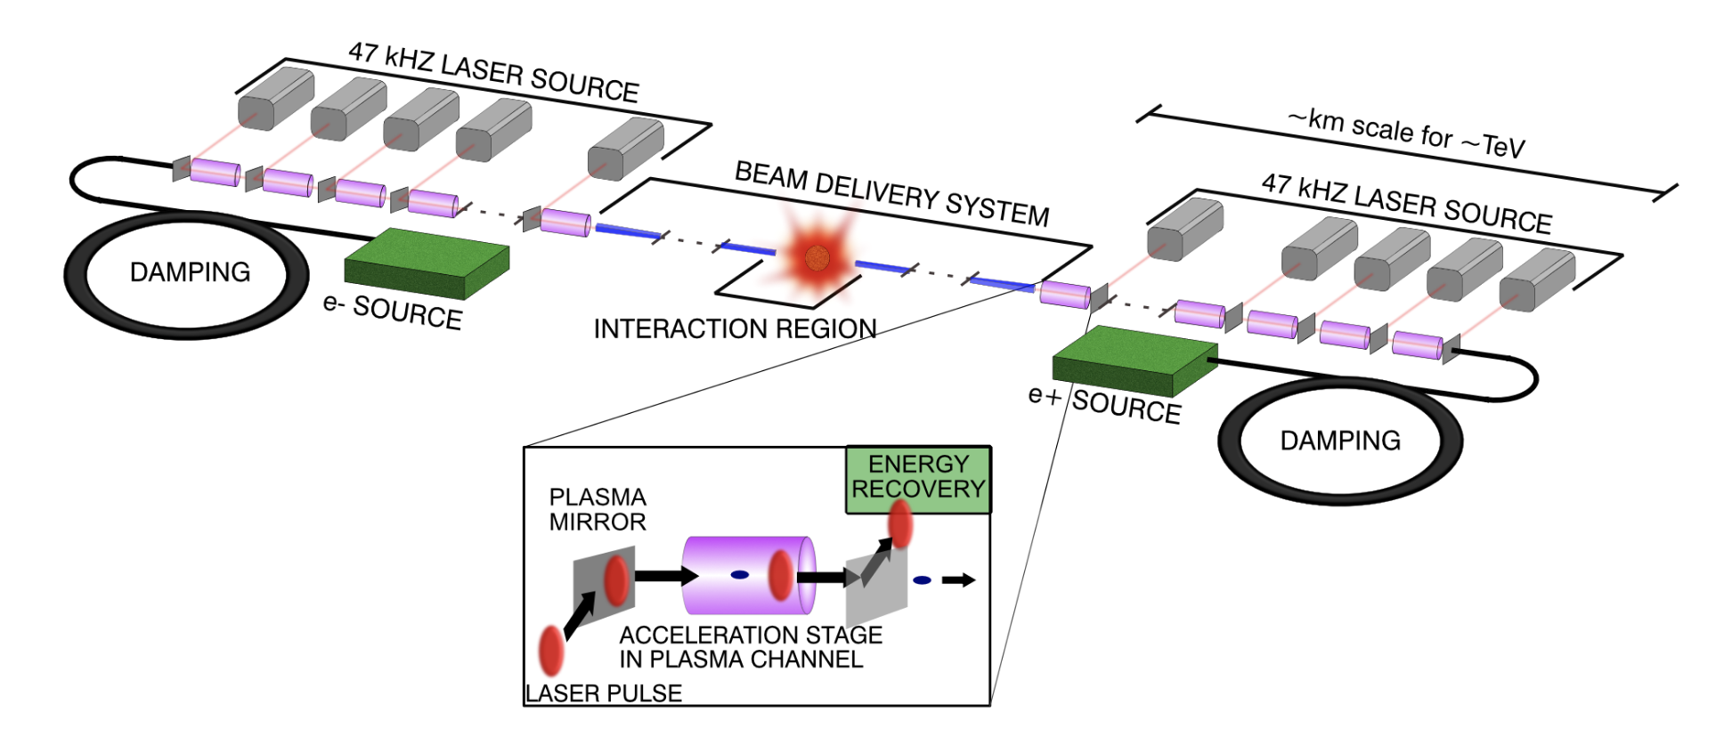
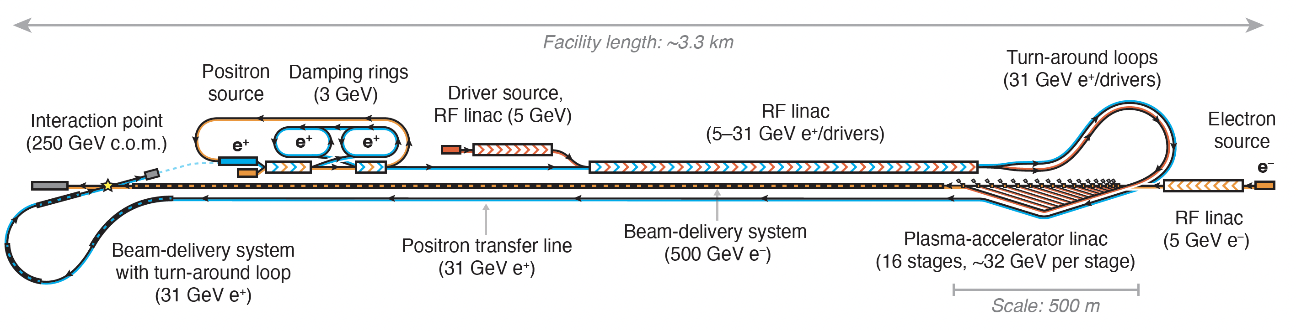
Wakefield accelerator (> 1 GV/m) goals for particle physics
Reduce the size of future colliders
Reduce the cost of future colliders
Reduce the environmental impact of future colliders
ILC / 500 GeV / 31 km
HALHF / 250 GeV / 3.3 km
Wakefield Collider / 15 TeV / 6.6 km* *for the linac, not including BDS
Foster, D’Arcy, and Lindstrøm, NJP 25, 093037 (2023)
C.B. Schroeder et al., JINST 18 T06001 (2023)

Slide 6
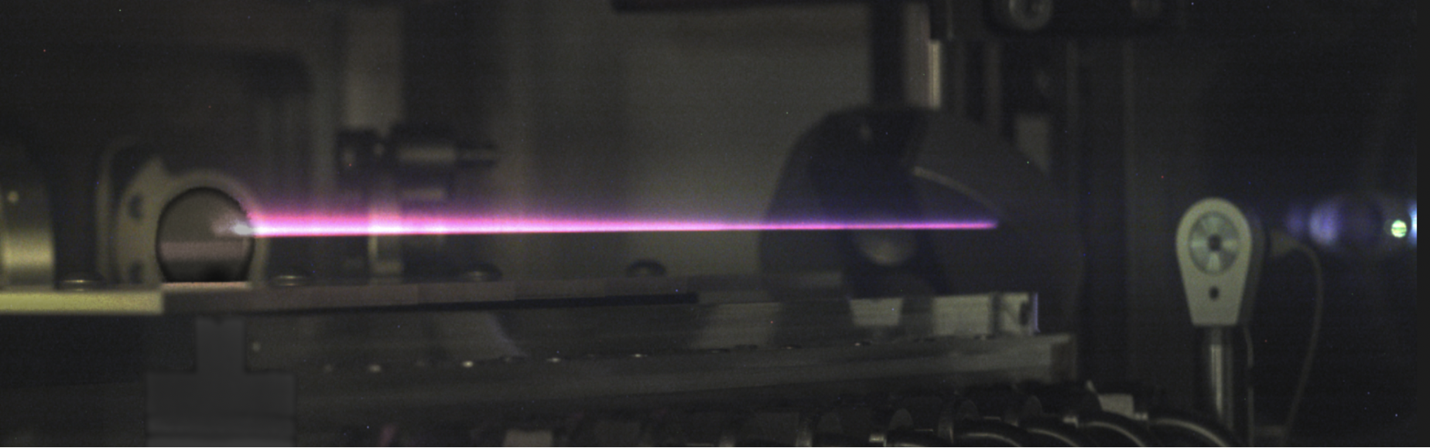
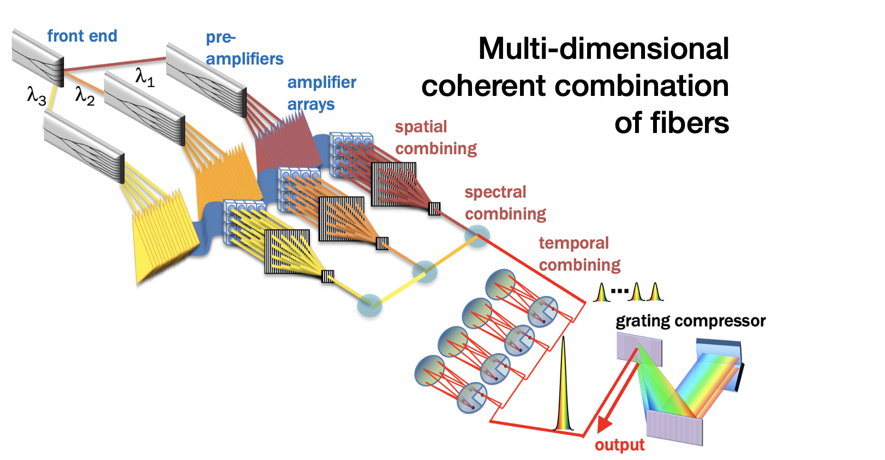

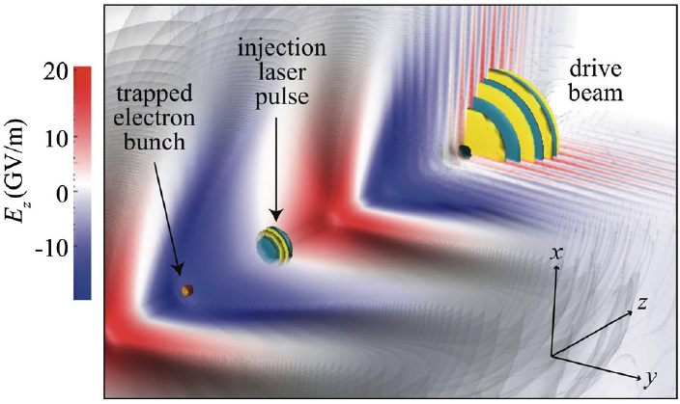
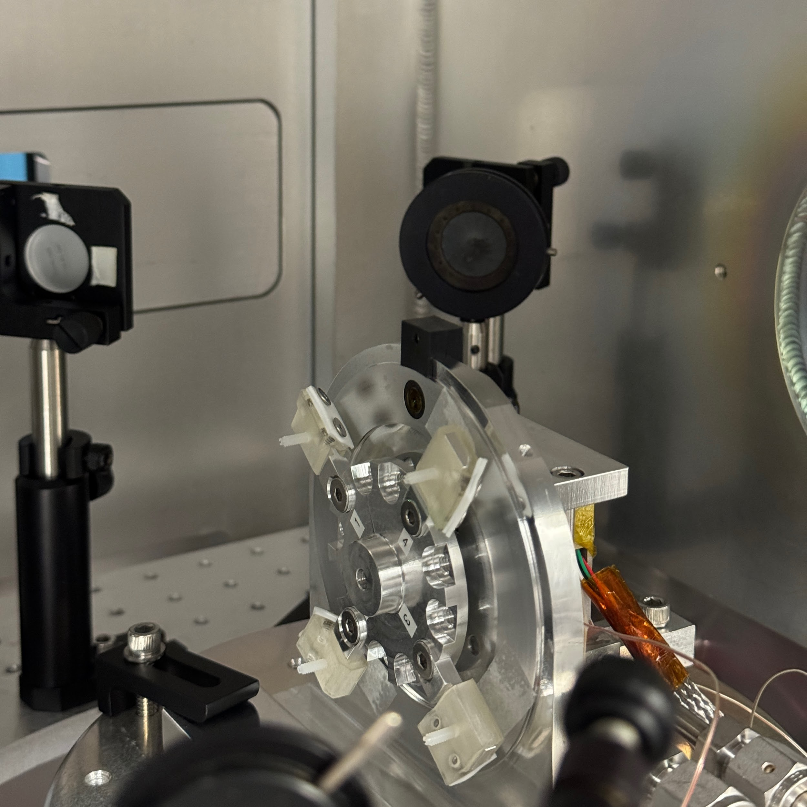
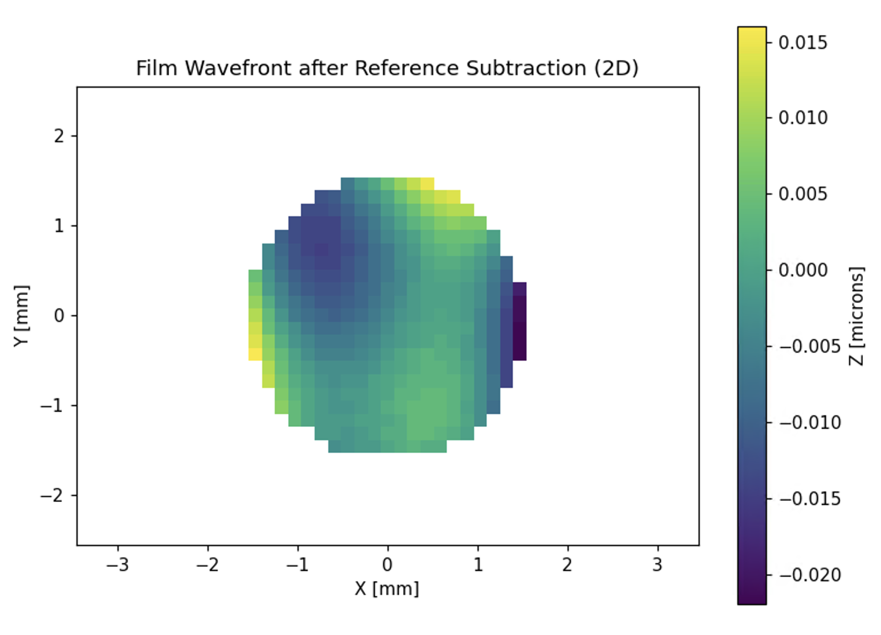
BELLA made substantial experimental and technical progress on subsystems
10 GeV stages & multi-GeV staging
High-rep. rate laser driver technology
Beam stability and
high-brightness electron sources
Plasma mirrors for laser coupling
C.B. Schroeder et al., PRAB 17, 101301 (2014)
Notes:
- Be brief!

Slide 7
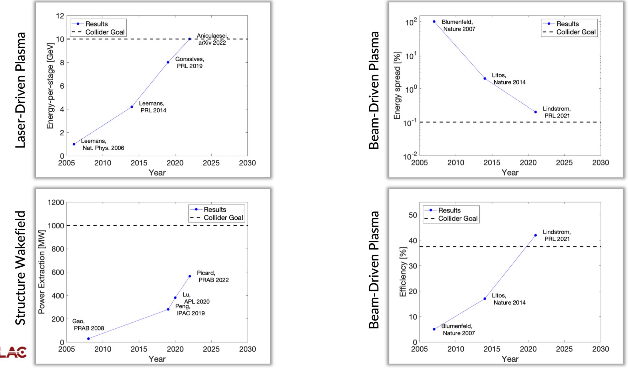
Wakefield accelerator stages are approaching and exceeding
select individual parameters for a future multi-TeV collider
Next steps/challenges:
precision stage combining brightness, efficiency, alignment, stability
coupling multiple such stages with high efficiency, tolerances
positrons, spin transport
compact BDS
high average power
and wall-plug efficiency
→ test facilities
are needed (incl. kBELLA)
Recent results at
UT, LBNL, CSU
Laser-driven plasma
Beam-driven plasma
“In order to make a confident, informed decision on the path forward—a decision that we hope to make within the next 20 years—one or more of these technologies must reach technical maturity, allowing us to reliably estimate both cost and technical risk”
P5 draft (2023), p. 85
Structure Wakefield
Beam-driven plasma
Material courtesy of Spencer Gessner (SLAC)

Slide 8
Community derived multi-TeV conceptual collider design during Snowmass
    Acceleration to TeVs conceptually possible
    Collider system design considerations driven by interaction point physics
    Minimizing linac length (gradient > GV/m)
    Plasma density, Beamstrahlung limit bunch charge,
    luminosity requires kHz+ repetition rate
    Maximizing energy efficiency (luminosity/power)
    Energy recovery considered
Conceptual parameter set
Laser: 6.5 J energy per pulse, λ = 1.0 µm, 130 fs pulse length, 47 kHz rep. rate,
50% wall-to-laser efficiency
Plasma: n₀ = 10¹⁷ cm⁻³, 1.7 m stage length, 5 GeV gain per stage
Bunch: 200 pC, 8.5 µm length
Working toward full self-consistency
Design based on advanced component simulations and scaling laws
C.B. Schroeder et al., JINST 18 T06001 (2023)
Notes:
Transition from P5 to: “during the Snowmass process, leading up to P5, community derived conceptual design and parameter set based on …”

Slide 9

New initiative to orchestrate the community
for an end-to-end 10 TeV pCM wakefield collider design
“Wakefield concepts for a collider are in the early stages of development. A critical next step is the delivery of an end-to-end design concept, including cost scales, with self-consistent parameters throughout.”
P5 (2023), p. 85
  Goal: end-to-end design concept including sub-systems (detectors, beam delivery system), cost estimates,
  self-consistent parameters, based on strong physics case
  LBNL is co-leading 10 TeV wakefield collider initiative
    Started US wakefield accelerator community organization, reach out to additional labs and universities at AAC in July
    (biweekly meetings; since Jan 2024)
    Established links to worldwide activities
    through ICFA ANA, ALEGRO, and HALHF
    Intensified integration with particle physics incl. detectors,
    together develop case for lepton and 𝛾/𝛾 colliders at 10 TeV
    (monthly cross-divisional meetings at LBNL + LDRD seed funding;
    two monthly meeting series between LBNL, SLAC (, ANL) on physics at IP)
Notes:
Expand upon Snowmass community white paper (JINST 2023) into community-wide end-to-end design effort

Slide 10
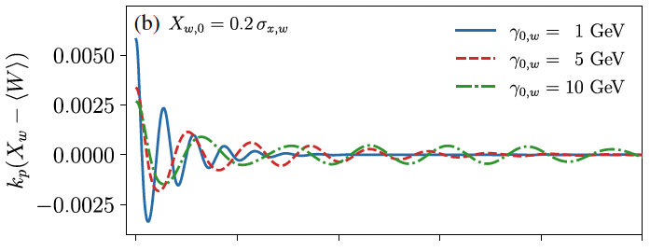
BELLA (Berkeley Lab Laser Accelerator) Center
updated from last year
Plasma based wakefield accelerator development
Multi-GeV Laser-Plasma Accelerator (LPA) stages
Combination of stages with high gradient
High brightness beam generation
New concepts for compact accelerators
Beam Test Facilities Council, broad collaborations
10 TeV pCM collider design work guides R&D
Multi-institution collaboration preparing for collider R&D
Flagship facility in US for laser-plasma acceleration
Highest rep rated PW laser in US; 8 GeV record
    New 2nd beamline (2BL) for 10 GeV, staging…
    Hundred-TW lasers: prototype novel concepts
In context of $B class international investment
Leveraging multi-agency applications for HEP
High-rep rate, high average power laser drivers
kHz tests indicate stabilization for colliders, applications
kBELLA Joule-class GeV kHz demonstrator proposed
Self-stabilization of positron beams in plasma columns
S. Diederichs et al., Phys. Rev. Accel. Beams 25, 091304 (2022)
Synergies with other offices/agencies :
NNSA: mono-E MeV Xrays (test operating)
BES: compact FEL (recent lasing), injectors
DARPA: compact particle sources
ARDAP, DARPA: high average power lasers
FES: LaserNetUS user access, plasma sci.

Slide 11

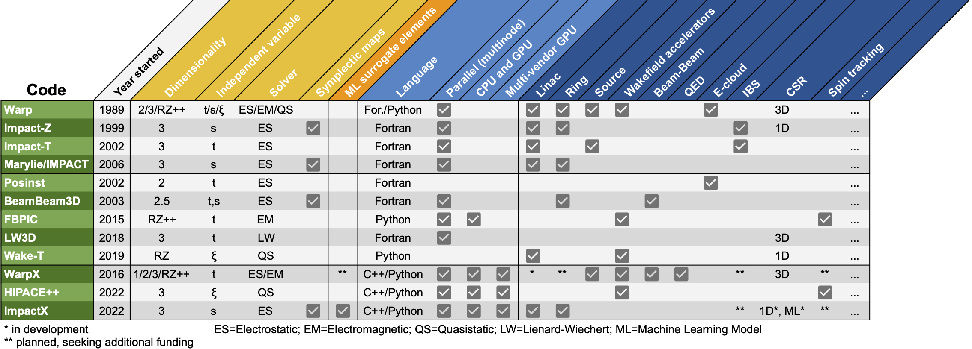










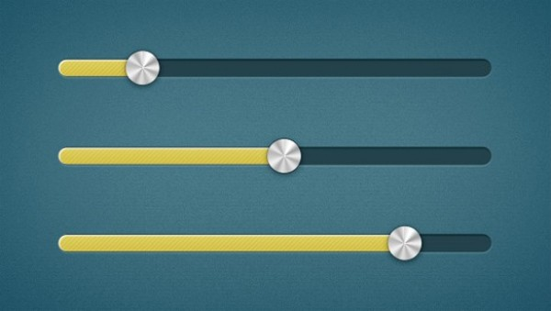

AMP leads BLAST: an open-source simulation toolkit
for end-to-end modeling of colliders
blast.lbl.gov
standards & workflows
Data
Input
Lasers
Optimize
General purpose
(legacy)
Specialized
New
integrated
all types of colliders: Higgs factory, 10 TeV parton, muon, plasma-based, …
Quasistatic
Fast
&
as
accurate
as
possible
Reduced models
ML
surrogates
Full
PIC
First principles
Accurate
&
as
fast
as
possible
tunability from fast modeling to detailed physics studies for collider design.
Speed
Idealized beam
profiles
Experimental
beam profiles
Fidelity
Reduced physics
Full physics
1D-1V
3D-3V
E.g., for a plasma-based collider:
ML surrogate⇒Wake-T⇒HiPACE++⇒WarpX
Low resolution
High resolution

Slide 12
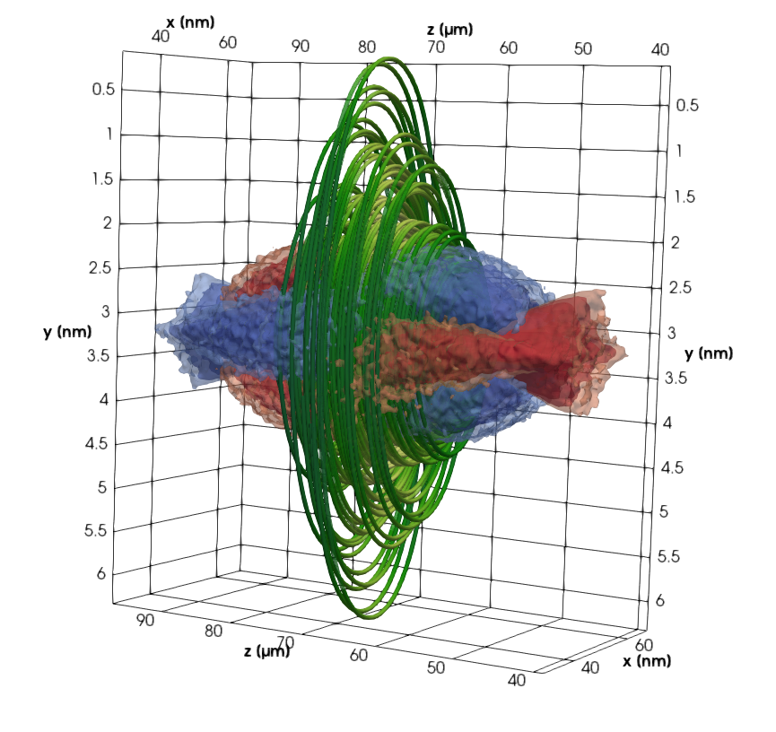
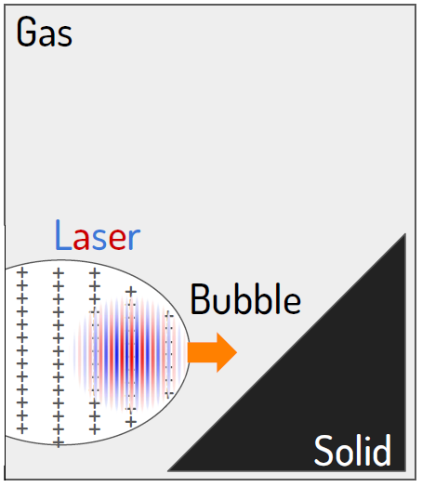
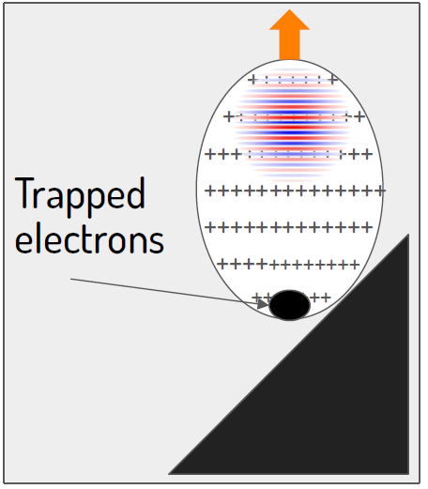
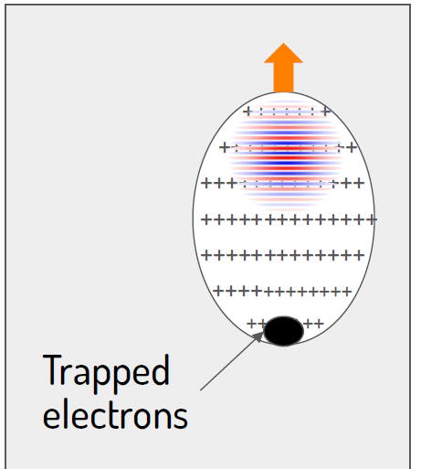
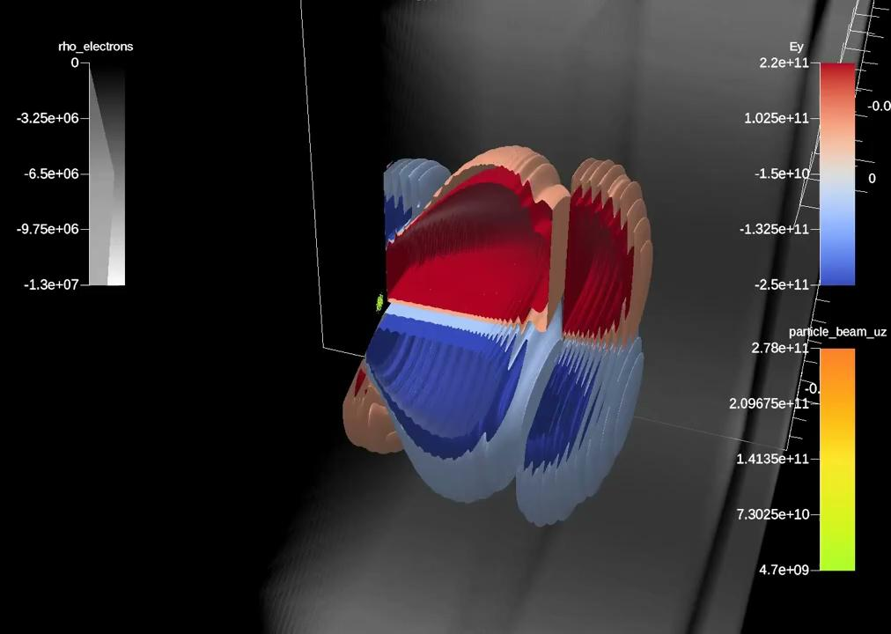

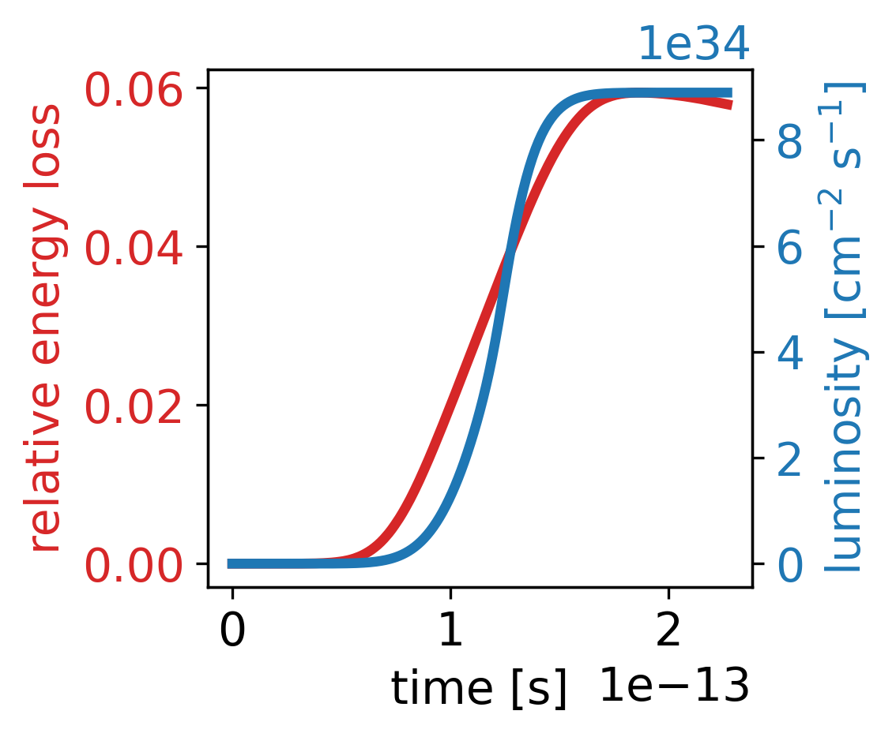
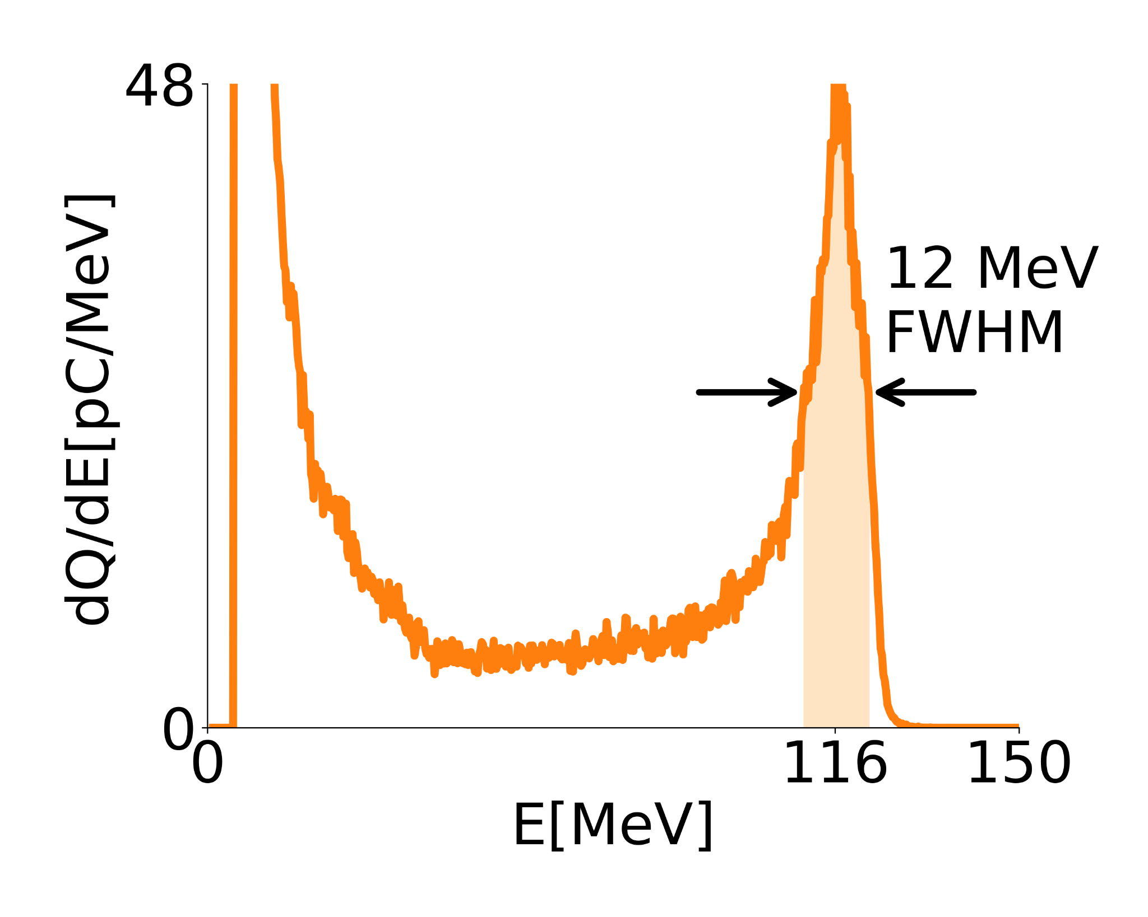
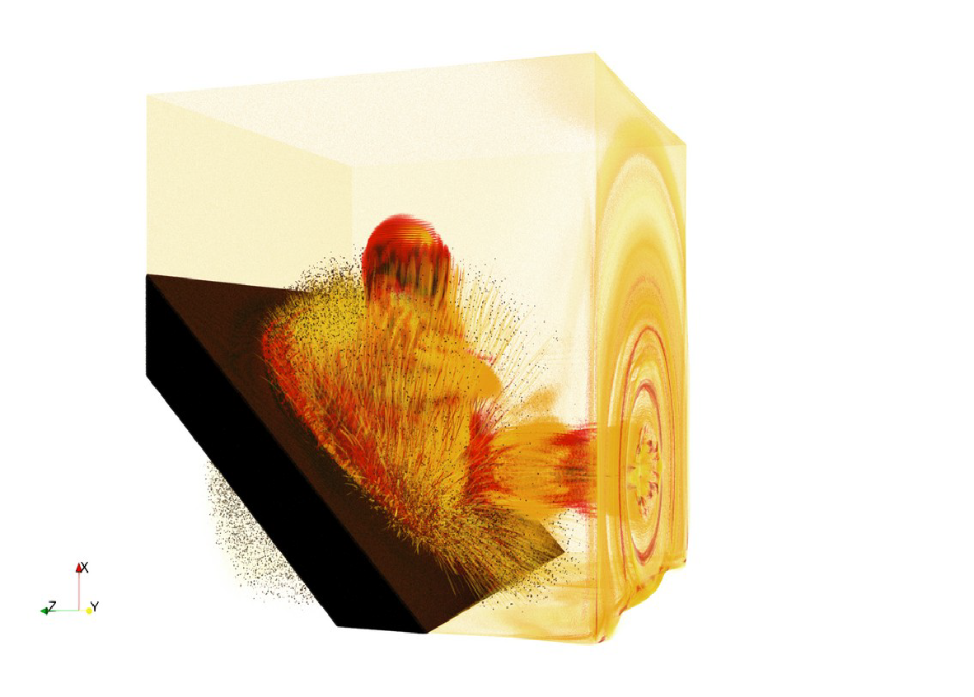
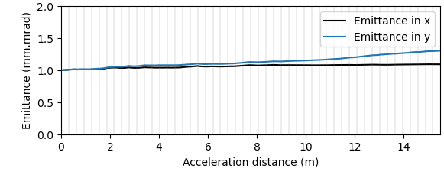
BLAST Codes Cover Plasma-Based Collider
Modeling from Source to Interaction Point
…
…
Generation
Acceleration & Transport
Interaction Point
Two-stage injection+acceleration
w/ plasma mirror
50 Multi-GeV LPA Stages in 3D
10 TeV COM e–e⁺
Ascent VTK-m In Situ Visualization of the first 15 stages:
1
2
3
preliminary!
1st stage
Interaction with the plasma mirror
2nd stage
0.5 nC (peak)
1.7 nC (total)
1
10
stage number
WarpX can now simulate flat, spherical, round and asymmetric beams in linear colliders:
ILC, C³, wakefield, HALHF, …
Next are more QED physics & circular colliders: FCC-ee, Muons
20
30
40
50
WarpX also studies: flat ILC beams @250 GeV COM, spherical, round and asymmetric beams …
Relative energy spread:
flat at 0.005% after few stages
P5 Report: Exploring the Quantum Universe (2023)
J-L Vay et al., ISAV20 Keynote (2020) & PoP 28.2, 023105 (2021)
L Fedeli, A Huebl et al., SC22, ACM Gordon Bell Prize for WarpX (2022)
WarpX ECP MS FY23.1 & FY23.2 (2023); T Barklow et al., JINST (2023)
A Ferran Pousa et al., IPAC23, TUPA093 & PRAB (2023); CB Schroeder et al., JINST (2023)
1 fC
On the fly focusing lens tuning using e- beam Twiss parameters enables emittance preservation.

Slide 13
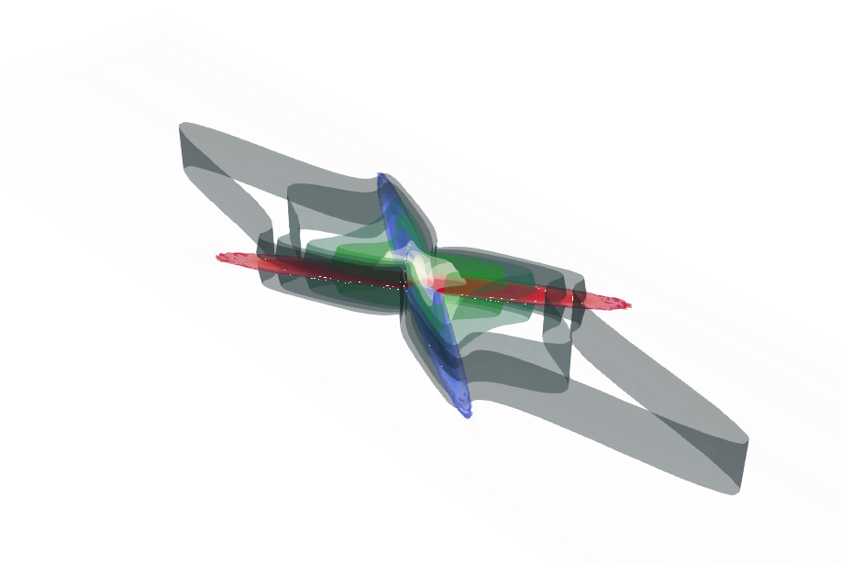
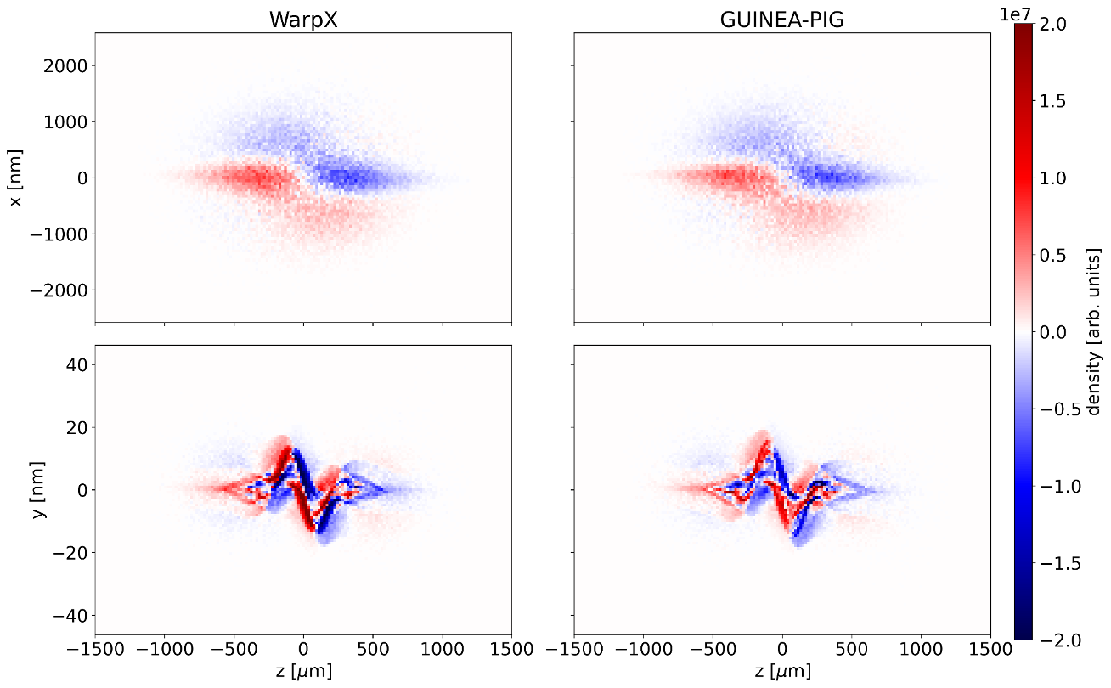
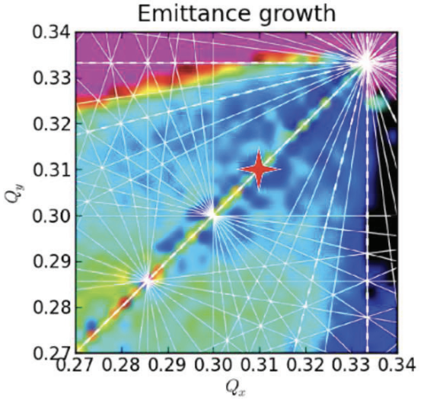

AMP Activities in Modeling of RF-Based Colliders
Past & ongoing activities:
BeamBeam3D applied to beam-beam studies of: EIC, (HL) LHC, SuperKEKb, RHIC, Tevatron
Warp(+ICOOL) applied to muon cooling for Muon Collider and e-cloud studies for SPS, ILC
AMP staff member (Rob Ryne) L2 on theory and modeling in former US Muon Collider program
WarpX applied to model beam-beam interaction for the ILC
Potential future activities:
Fully strong-strong beam-beam modeling for FCC-ee using BeamBeam3D & WarpX
Integration of WarpX and XSuite for complete ring + beam-beam interaction modeling of FCC-ee
Self-consistent modeling of beam transport + cooling for muon collider using WarpX
Potential modeling of damping ring and/or injection linacs for FCC-ee using ImpactX
Potential modeling of electron cloud for FCC-ee using WarpX
LHC
FCC-ee
Emittance growth due to beam-beam effects as a function of working point tune
BeamBeam3D
WarpX

Slide 14
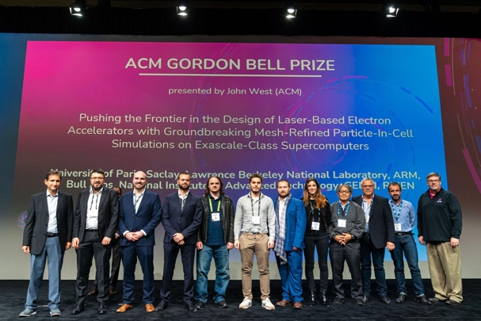
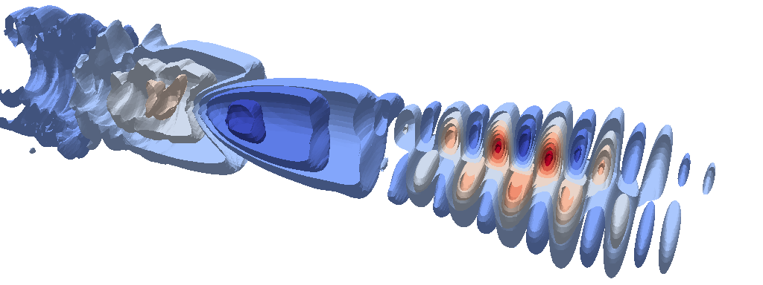
The Accelerator Modeling Program (AMP)
HEP beam & accelerator theory and modeling
Applications across beams & accelerators: linacs, rings, injectors, advanced concepts (plasma,dielectric),
IP & BDS physics - Higgs factories and 10 TeV pCM
ILC DR, Electron cloud; FNAL space charge & IOTA NL dyn.
Beam dynamics across collider designs: CSR, microbunching, space charge and beam halo, nonlinear dynamics, collisional effects, electron cloud effects, sources and injectors
High-performance computing
Lead SciDAC-HEP Collaboration for Advanced Modeling of Particle Accel. CAMPA [LBNL+FNAL+UCLA+SLAC+ORNL+ANL]
Beam, pLasma & Accelerator Simulation Toolkit (BLAST) State-of-the-art codes ImpactX, WarpX, BeamBeam3D, FBPIC,... [LBNL+LLNL+SLAC+CEA+DESY+CERN+Avalanche, TAE, Zap]
openPIMD & PICMI standards [LBNL, SLAC, FNAL, ORNL, UCLA, LLNL, Cornell, HZDR, CASUS, iOQ Jena, UH, EuroXFEL, others]
Led Exascale Computing Project application WarpX [LBNL+LLNL+ORNL+SLAC]
First-of-a-kind mesh refined modeling of novel concept of plasma injection on largest supercomputers wins 2022 ACM Gordon Bell Prize
Synergies with other offices/agencies:
FES: laser-ion acceleration, Fusion, HEDS;
BES: light sources; NP: Electron-Ion Collider;
ASCR: high-performance computing, QIS
DARPA: compact sources

Slide 15
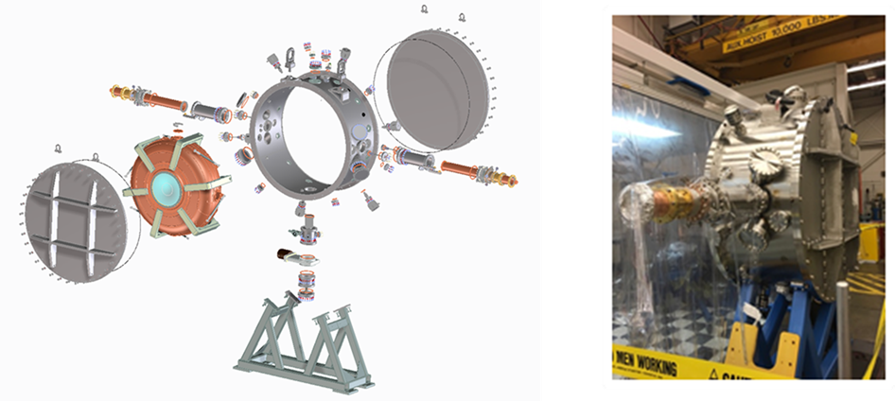
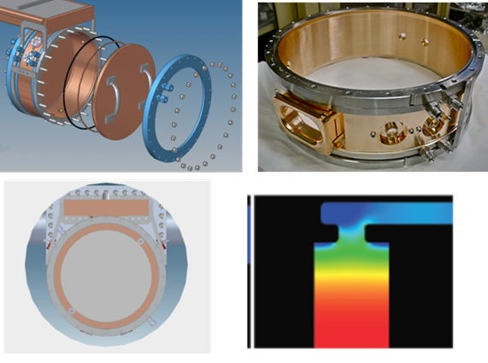
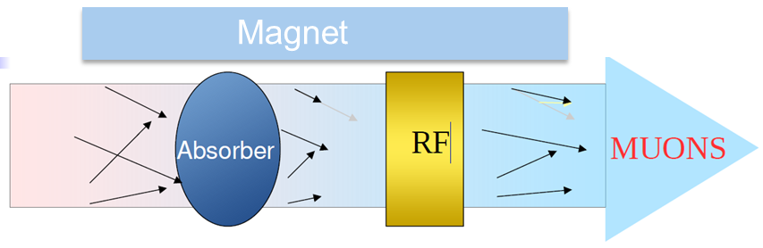
BACI has been actively involved in developing the normal conduction radio-frequency cavity (NCRF) for the ionization cooling for the MuC
Ionization cooling is the key step to achieve the required luminosity for the MuC with a proton-driven muon source.
The NCRF cavity in the ionization channel requires high gradient acceleration in a strong magnetic field. Overcoming the RF breakdown in strong magnetic field is the major challenge.
BACI has led the design and the production of the 201 MHz RF module for the Muon Ionization cooling Experiment (MICE).
BACI has made major contribution to the development of the 805 MHz Muon Accelerator Program (MAP) modular cavity.
Ionization cooling scheme
MICE 201 MHz cavity
MAP 805 MHz modular cavity

Slide 16
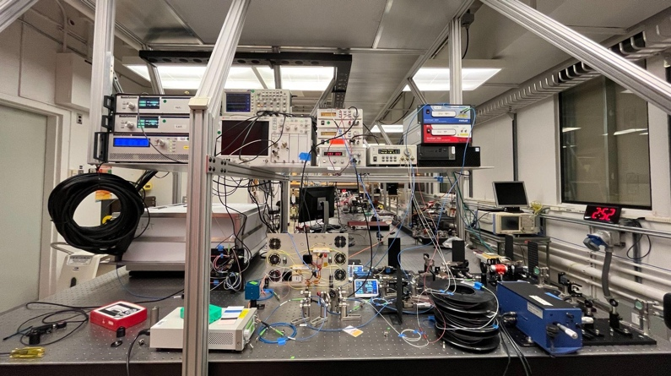
Berkeley Accelerator Controls and Instrumentation Program
Technology leadership enabling projects
Precision low-level RF controls enabling complex systems
LLRF system for PIP-II at Fermilab. Upgrade for AWA at ANL;
ML-FPGA feedback–LLRF, high-Q, lasers, magnets, colliders
Open source superconducting qubit control system
Cross-SC: LLRF system for LCLS-II (+HE) injector and SC linac, SNS power upgrade and ALS-U; future ACE upgrades
CW normal conducting RF design, engineering, integration
PIP-II RFQ and LCLS-II (+HE) injector
HiRES beamline R&D testbed enables controls, applications
Cavities, beam diagnostics joint with other divisions
Muon collider RF and cooling expertise & planning
Ready for ionization cooling, NCRF R&D, modeling...
Fiber laser technology and controls
High energy/high repetition rate laser path for accelerators
Highest energy fiber laser, under construction (joint with BELLA)
Precision controls testbed supporting accelerator systems
New laser lab for 200mJ ultrafast fiber laser,
showing broadband front end (joint w/BELLA)
Synergies with other offices/agencies :
NP, BES: controls, advanced RF for EIC
NNSA: LANSCE modernization
BES: light source injector, UED
ASCR: QIS
ARDAP, DARPA: high average power lasers & feedback controls

Slide 17
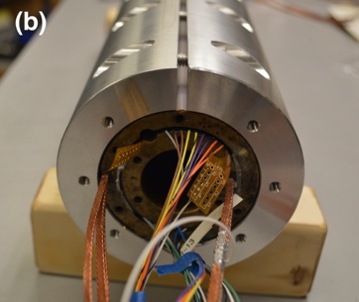
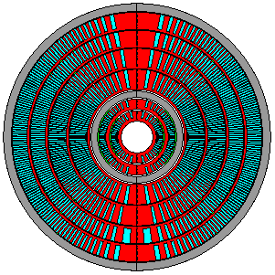
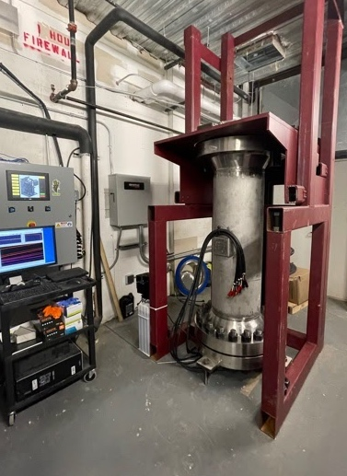
Superconducting Magnet Program and
US Magnet Development Program
The US Magnet Development Program
High field superconducting magnet technology, driving accelerator performance
Superconducting Magnet Program (ATAP) and Berkeley Center for Magnet Technology (ATAP+ Eng)
Advanced structure+highest performing superconductors
Design, fabricate, and deliver specialty magnets including Higgs factory IR magnets
Critical to proton and muon paths to 10 TeV pCM
HL-LHC AUP: delivering Nb3Sn magnets
Cabling complete, assembling magnets
US MDP: LBNL (lead), FNAL, BNL, ASC/NHMFL
Strong, established multi-lab integrated team
Roadmap update 2020 (next ‘24) - focused on delivery
Important US strength
Reference for other DOE-SC offices & internationally
Similar program - strongly funded – initiated in Europe
Bi2212 insert coils being developed
Preparing for high-field hybrid flagship
3 coils at FSU, ready for reaction in Renegade furnace
Synergies with other offices/agencies:
FES: HTS magnets, diagnostics, quench protection
NP: accelerator magnets, ECR sources
BES: Light source magnetics
ARDAP: Bi2212, gantries

