Slide 1
Going Beyond the Standard Model
A Celebration of Lawrence Hall and Hitoshi Murayama

Slide 2
Topic?
Sorry not to be there
Hate giving talks on zoom
Cannot tell reaction
Or if people laugh at jokes…
But did check on talk titles to see what is expected
Turns out they were all the same title
TBA
But this is an opportunity to reflect on the honorees
Nonetheless, like most such talks, it will also be about the speaker: Me

Slide 3
In fairness
I thought I’d reflect a bit on some of the papers we did back in the day
It is interesting at this time to reflect on where we’ve been and where we are going
Here “we” refers to papers Lawrence wrote with me
No papers with Hitoshi…
However

Slide 4
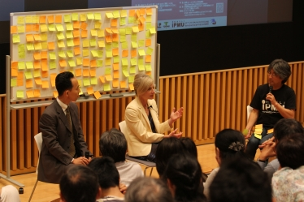
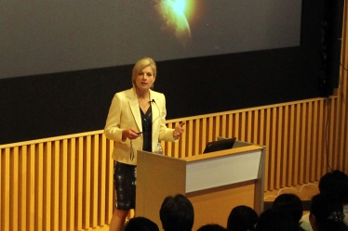
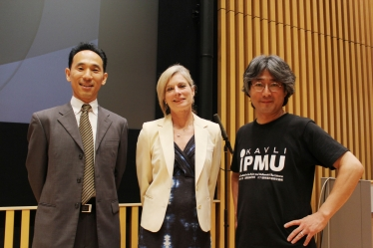
However web search
http://www.ipmu.jp/ja/2016-dinosaurs
left: Shinji Mukokyama, Lisa Randall, and Hitoshi Murayama address questions from the audience during their Q & A session
left: Shinji Mukhoyama, Lisa Randall, and Hitoshi Murayama at the Kavli IPMU public science lecture held on June 19
Related links

Slide 6
Also
Want to congratulate Hitoshi for celebrating with someone a decade older
Makes you seem youthful!
(And Lawrence seem sage…)

Slide 7
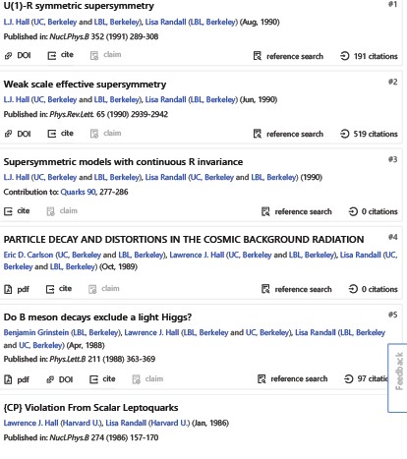
L J RandALL papers with L J HALL

Slide 8
So many didn’t fit on one page
Probably Lawrence doesn’t remember
But I do…
One of my first particle physics papers
Howard was working on mooses
I thought very nice for more advanced students
I wanted something a bit more down to earth
So I talked to Lawrence
Had an idea how to solve strong CP in supersymmetric theories

Slide 9
Two problems for me
First, I was second year student
Didn’t know supersymmetry yet
So I spent the weekend learning supersymmetry
The second problem was when I did understand
It didn’t really work
But we wrote paper anyway
And had follow up with model I designed w/o SUSY!
Explain idea and problem

Slide 10
SUSY Soft Breaking and CP
Key insight is nonrenormalization theorem
Θ doesn’t get renormalized in a susy theory
Spontaneously break CP through scalar masses
Our model had scalars: Φ,N,H
First gets vev breaking CP spontneously
Puts phase into N matrix (N heavy enough to suppress CP violation)
Interact with quarks via H
We actually did a GUT model but that was a side addition
Or so we thought

Slide 11
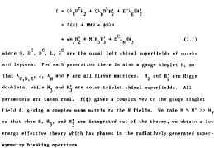
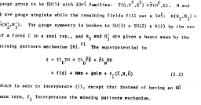
Model (nongut and GUT)

Slide 13
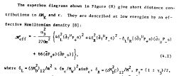
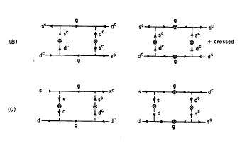

Slide 14
BUT

Slide 15
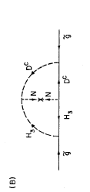
Nonrenormalization doesn’t apply to gaugino mass
That’s what I realized after my weekend learning SUSY
Two-loop diagram the problem
Generates phase in gaugino mass
Lawrence was undeterred
Basically didn’t rewrite paper

Slide 16
LJH Gets Credit Here!

Slide 17
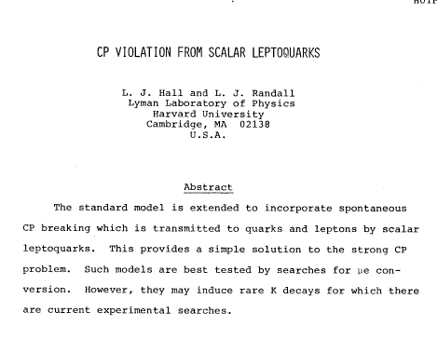
LJR Faced the Reality
SUSY didn’t actually help
Introduced problematic gluino
Keep essence of model but get rid of all the superpartners
Keep key of getting CP violation via box diagram

Slide 18
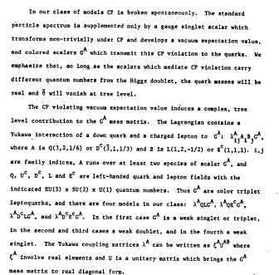
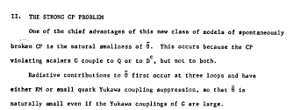

Slide 19
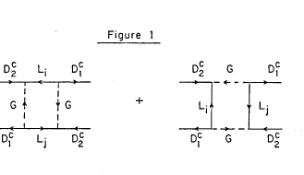
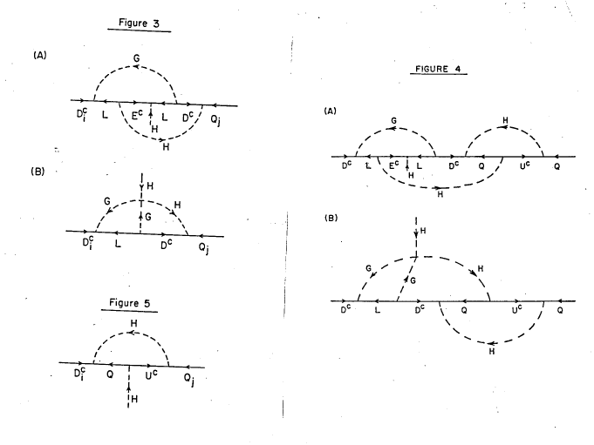
Weak cp violn
Strong cp violn

Slide 20
To summarize, I realized you are better off without SUSY
I made a model with the good stuff
Used a leptoquark
Describe model
But here is where you see one difference
I made the model but I didn’t believe it enough to make detailed predictions
So Lawrence became my student (he didn’t’ know I thought of it like that…)
And did the detailed calculations
I did check them!

Slide 21
Lawrence really is an optimist
His enthusiasm is infectious
But I could never believe it was worth knowing details until some evidence
Started working on gravity waves for real when they were discovered
Lawrence believes in his models
I believe in the ideas behind them

Slide 22
Another joint paper
I can’t really remember. I think this was a clever accommodation of the following paper with U(1)R symmetric SUSY
They came out about same time
But maybe not

Slide 23
Idea?
Test weak scale symmetry
Not just SUSY breakign through supergravity
Minimal low-energy supergravity model
Instead impose necessary constraints (mild)
Minimal particle content consistent with observations and susy
R-parity
No quadratic divergences
Prohibit dimension-four susy breaking operators
With singlets also dimension-three constrained
GIM mechanism

Slide 24
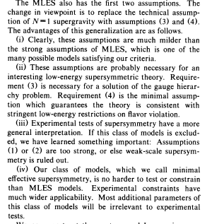

Slide 25
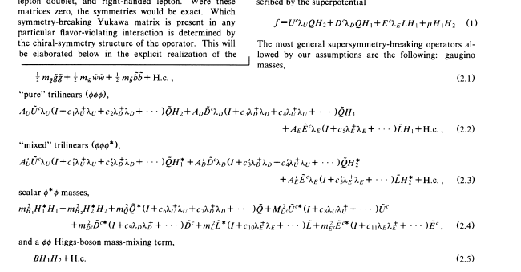
Lagrangian

Slide 26
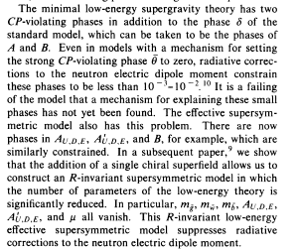
Proof we were working on other idea at same time

Slide 27
Another Example of elevating “dumb” idea
Again was trying to study CP violation
Wanted to find a symmetry to get rid of the strong CP problem
In the end (meaning a weekend of torturing/challenging myself) trying to find a symmetry
Convinced myself only one option:
Eliminate gaugino mass operator altogether
Only way to use symmetry

Slide 28
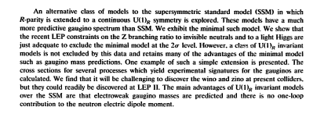
I kind of thought it was kind of funny
Lawrence elevated it into a principle

Slide 29
For gluino mass

Slide 30
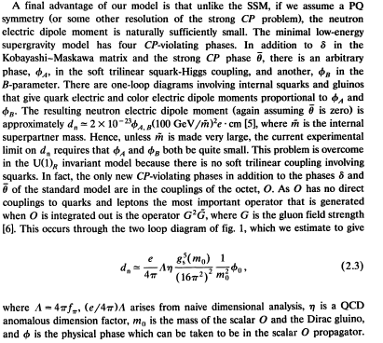
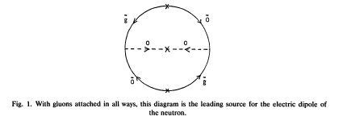

Slide 31
Rest of talk
Some of these models probably ruled out now
Worth checking them
Maybe some extensions?
Rest of talk also not recent research
Though now lots of cool stuff on cosmology of warped dimensions and dark matter
But I am challenged by zoom talks and time…
So I’ll stick to theme—physics of flavor
Because I think we should not ignore these models
Have very nice features
Show generic type of prediction
Old work but ripe for revisiting
Let me know if interested!

Slide 32
Some very nice features of warped geometries for flavor
Assume bulk fields corresponding to every light fermion
Hierarchies are easy to achieve
Heavy fields localized in IR (near Higgs)
Light fields localized in UV
Moreover, warped geometry lends itself to exponential ratios of masses
Light fermion couplings to gauge KK modes in duce FCNCs but unlike flat case there is an RS-GIM mechanism due to approximate flatness of KK gauge boson wavefunctions in UV and a hierarchy in fermion wavefunctions in IR
Essentially models flow to NMFV (mixing with third generation)
Because the wave function (for L and R bulk fields) determine masses, angles are necessarily correlated (in right way) with masses
This is even more powerful in that when masses are nearly degenerate, there is a mechanism to have o(1) mixing angles
Relies on bulk masses being smallish comparable or smaller than AdS scale
In that case no reason to expect an exponential hierarchy

Slide 33
More nice features
Will see the possibility of exponent and not an exponent depending on relation mass to AdS scale provides a beautiful explanation for neutrino vs quark masses
Another nice feature (more related to work we have just seen) is it is natural to incorporate a GIM-like mechanism
We will see that bulk masses can be degenerate or determined by 5d Yukawas
MFV like
Notice not MFV like 4d since 5d masses are not 4d masses
But bulk masses:
When r is nonzero
CP violn only in up sector
Need to show true when we fit to masses which we did with r~.3
Reduces flavor violations
Even though Yukawas are generic (structureless)

Slide 34
CP?
Neutron EDM only at two loops here
All three generations must participate
Can also do models specifically addressing CP
This model was fine back in day
We now have constraints on up sector
Not sure will survive but will be interesting to see
Can always raise IR scale…

Slide 35
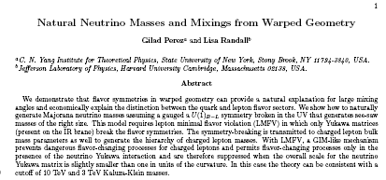

Slide 36
Basic Ideas
Again anarchic 5d Yukawas
Gauged lepton number to prevent larger Majorana neutrinomasses in IR
RH masses are large however (localized in UV)
Hence see-saw
Key idea however is to have smaller splittings in bulk neutrino masses vs quarks
About 1% for neutrinos, 1% for quarks
Recall size of space “30” in appropriate units
Difference between exponential hierarchy and absence thereof

Slide 37
Other key idea
How to get large mixing angles and small flavor-changing
Again LMFV: only 5d Yukawas break flavor symmetry
Notice mixing angle large because neutrino masses not very different

Slide 38
Model

Slide 39
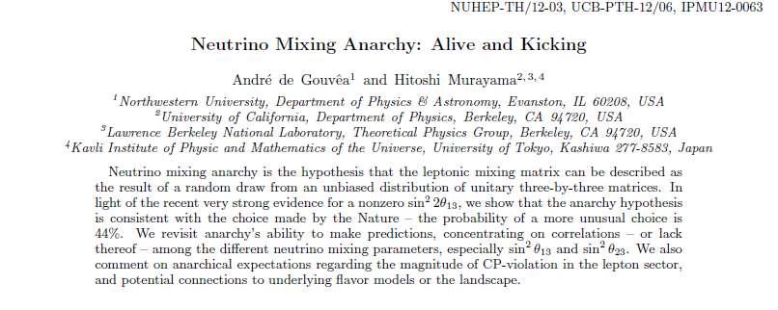
“Soft” Predictions
13 mixing angle should not be small
23 and 12 shouldn’t be nice geometric factor
Simply O(1) angles
General for anarchic models

Slide 40
Conclude
How far we’ve come and how little
Still facing similar problems to address
Old ideas shouldn’t necessarily be abandoned
Still don’t know answers and they provide a good scaffold
But I’ll end by quoting LJH from our first paper
“However, a great deal of care and cunning is required”

