Slide 1
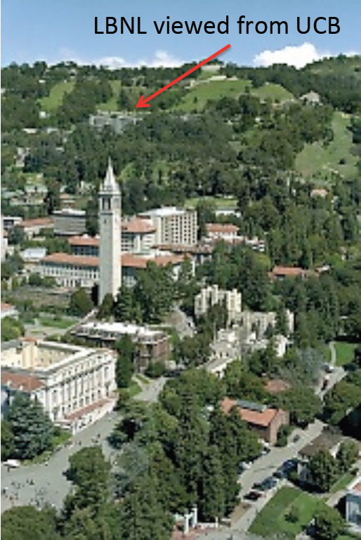
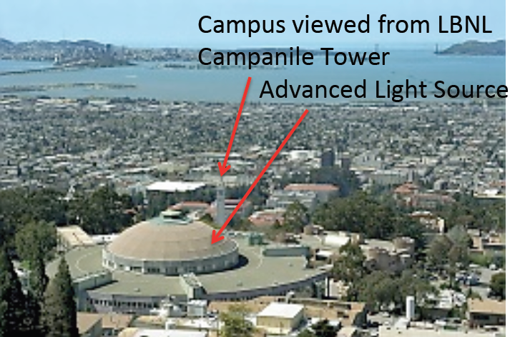
Welcome to Berkeley Lab!
Just up hill from the UCB Physics Dept.
Tony Spadafora
Division Deputy, Physics Division

Slide 2
VISITOR SAFETY AT THE LAWRENCE BERKELEY NATIONAL LABORATORY

Slide 3
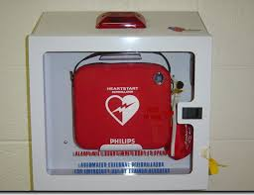
General Information
DOE Facility
Call 911 from a Lab phone in an emergency
Due to construction the speed limit is 15 mph
Do not attempt to touch any wild animals onsite
No smoking, except outside at designated locations
Defibrillator located various places on-site

Slide 4



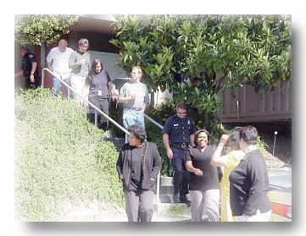
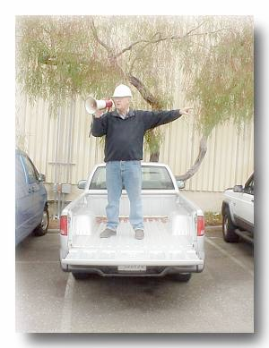
Earthquake Response
Drop down on the floor.
Cover under a sturdy desk, table or other furniture.
Hold on to furniture if it isn’t bolted to the floor and be prepared to move with it.
Evacuate to assembly area (usually in parking lot) when shaking stops. Take personal items.
Follow Directions from the Building Emergency Team.

Slide 5
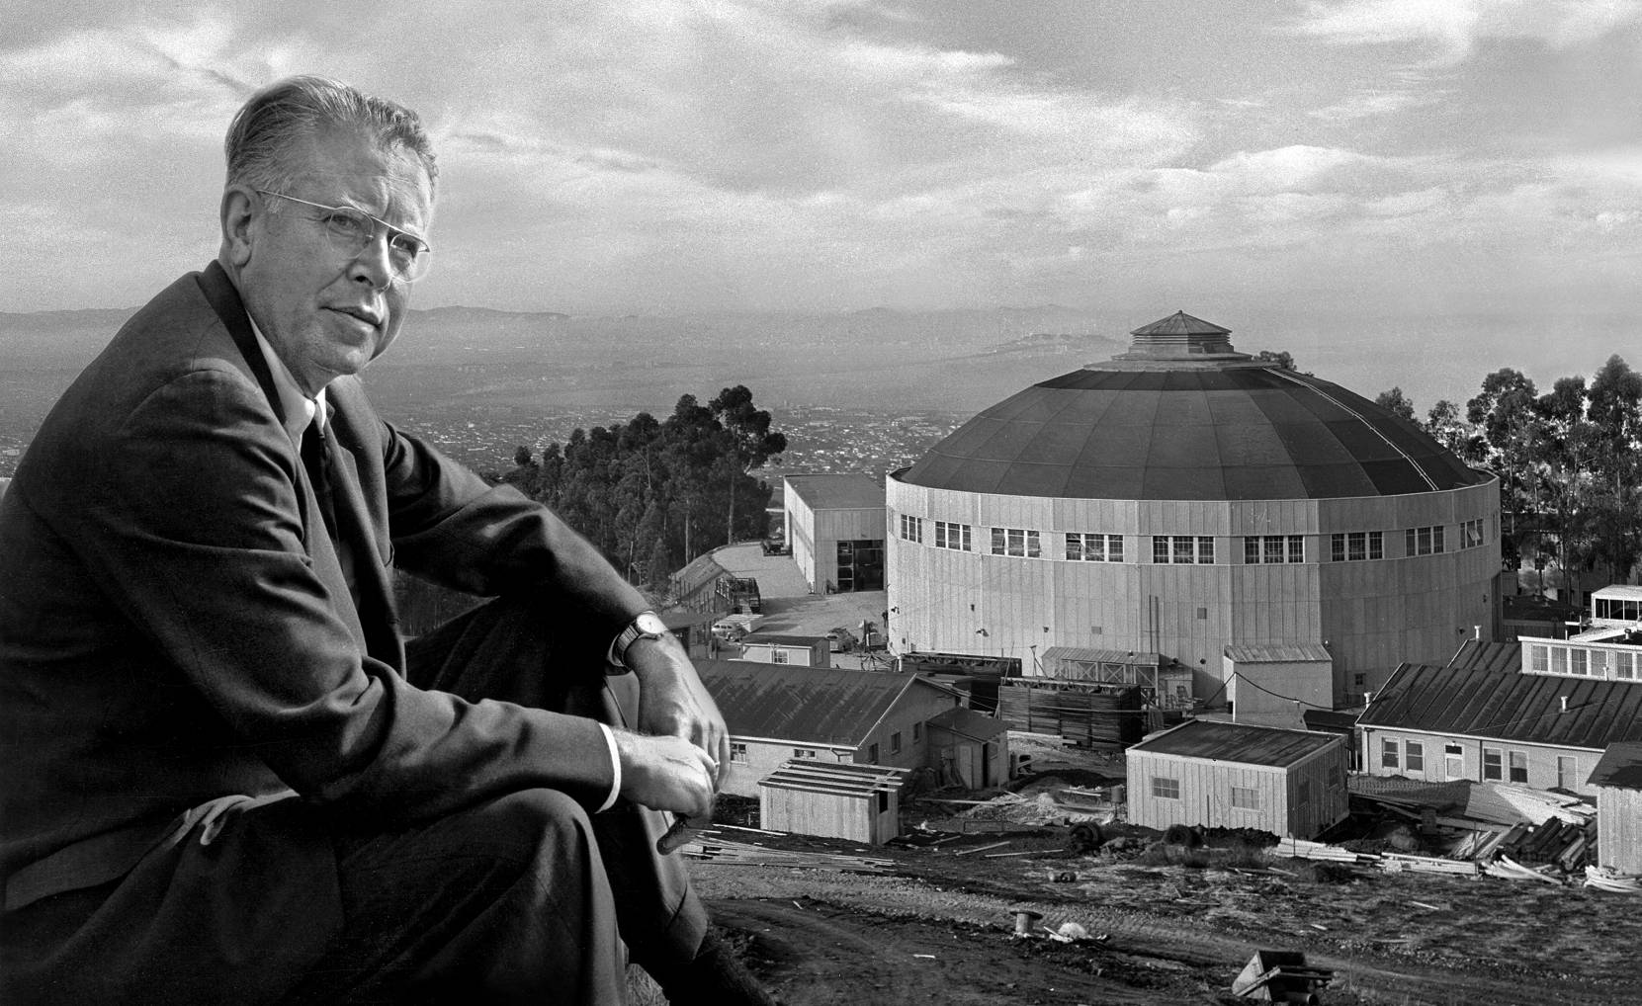
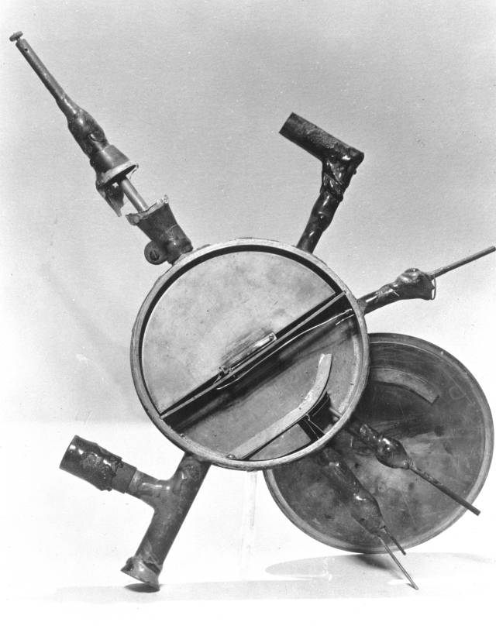
LBNL was established
Established in 1931
E. O Lawrence and the 184” cyclotron (circa 1940).
The small seed from
which Big Science grew.

Slide 6
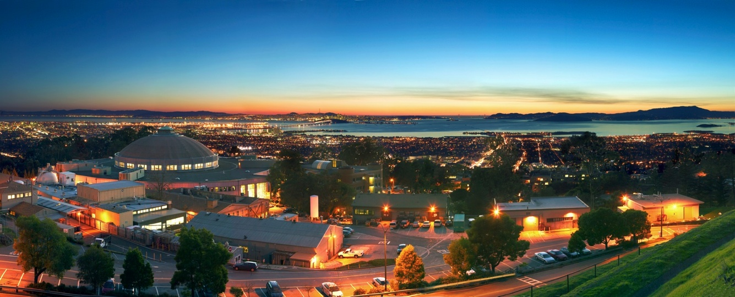
Today Berkeley Lab is home to 17 scientific
divisions organized in five research areas

Slide 7
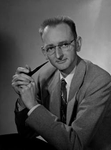
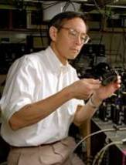
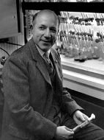
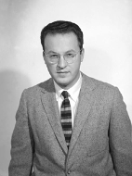
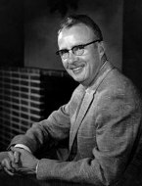
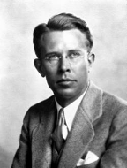
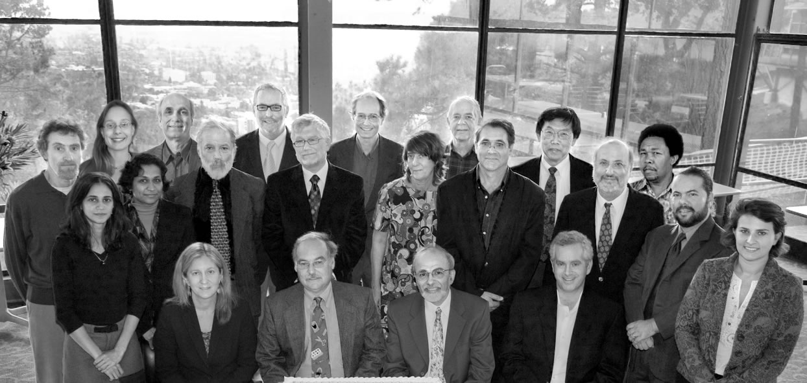
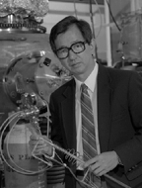
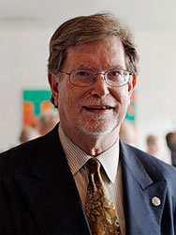
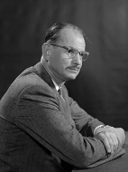
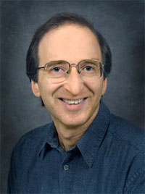
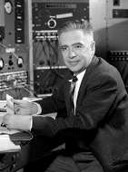
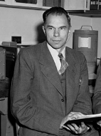
Thirteen Nobel Laureates
Owen Chamberlain
Steven Chu
Melvin Calvin
Donald A. Glaser
Luis W. Alvarez
Ernest Orlando
Lawrence
Intergovernmental Panel on Climate Change (IPCC)
Yuan T. Lee
George F. Smoot
Edwin M. McMillan
Saul Perlmutter
Emilio G. Segrè
Glenn T. Seaborg

Slide 8
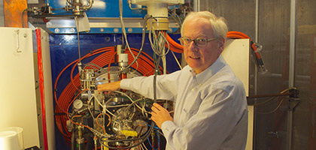
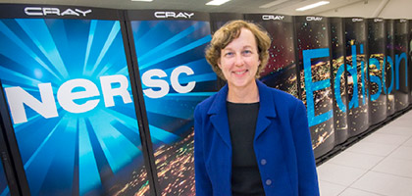
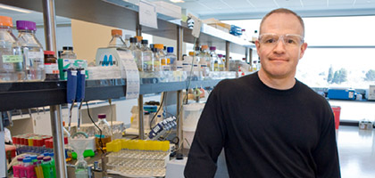
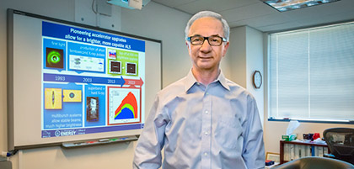
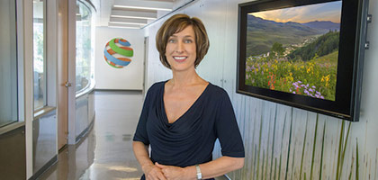
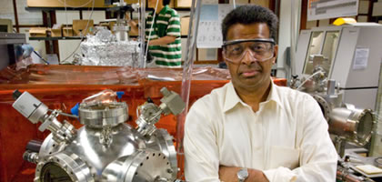
Berkeley Lab Research Areas
Physical Sciences
Computing Sciences
Energy Sciences
Biosciences
Energy Technologies
Earth and Environmental Sciences

Slide 9
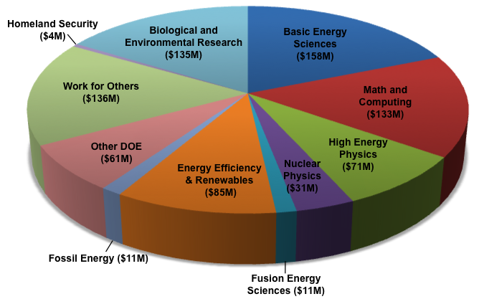
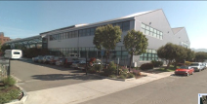
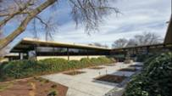
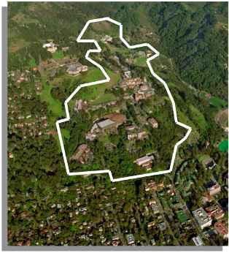
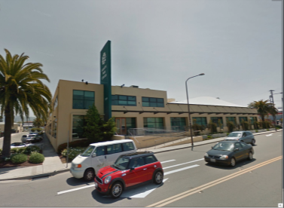
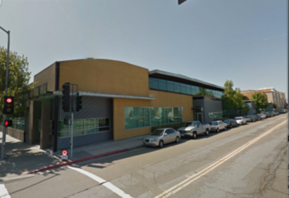
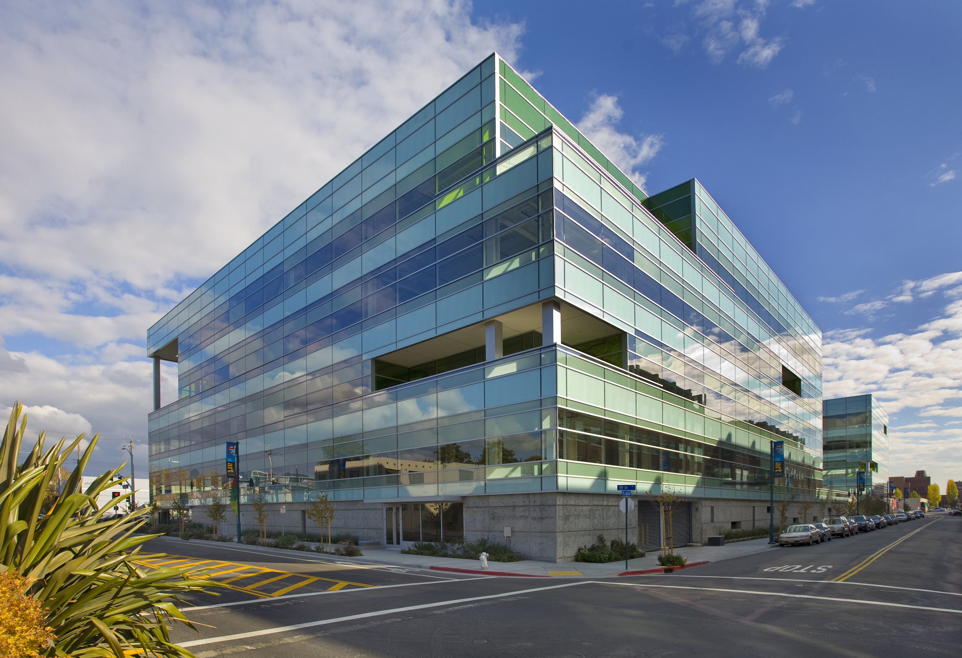
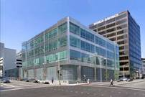
LBNL at a Glance
Current Funding ~ $750M
West Berkeley
Walnut Creek
Life Sciences
Genomics
JCAP
OCFO
Main Site
Berkeley Hills
West Berkeley
Emeryville
Employees | 3,232
Joint Faculty | 253
Postdoctoral | 500
Graduate | 318
Undergraduate | 132
Visiting Scientists | 1,674
Biofuels
Supercomputing
Emeryville
Downtown Oakland

Slide 10
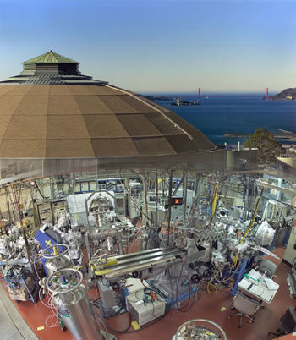
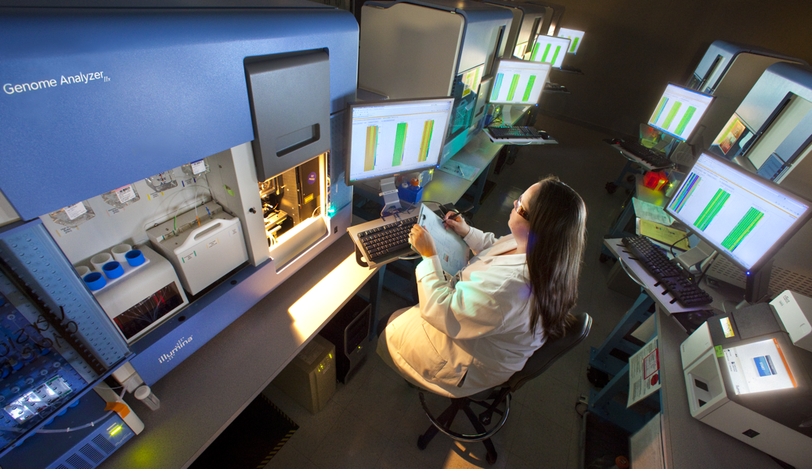
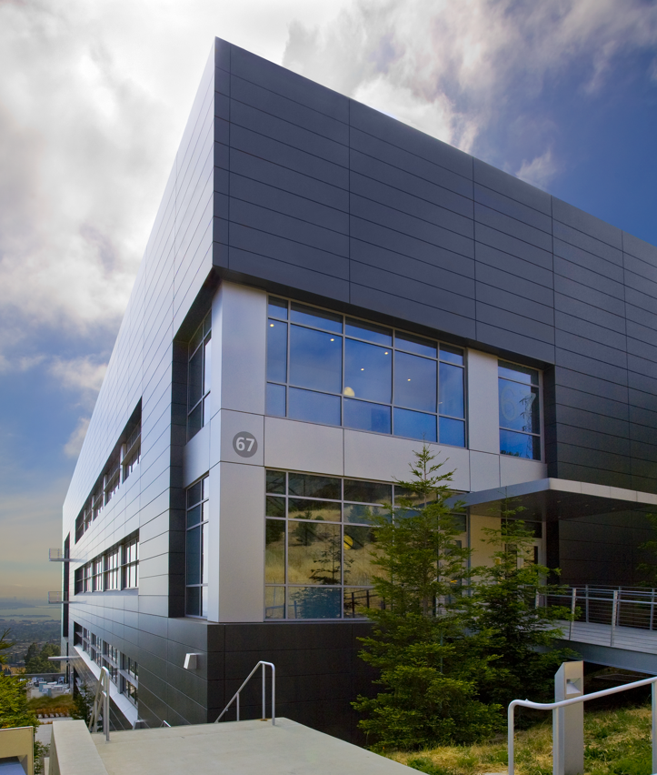
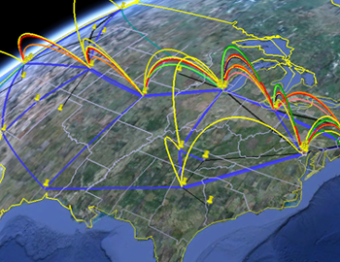
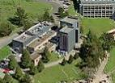
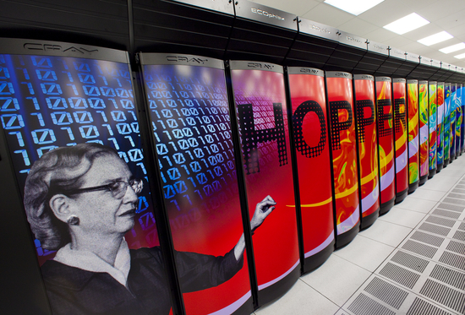
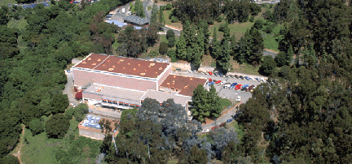
World-Class User Facilities at
Berkeley Lab Today
Advanced Light Source
Molecular Foundry
Joint Genomics Center
National Center for
Electron Microscopy
(NCEM)
National Energy Research
Scientific Computing Center
(NERSC)
88” Cyclotron
Energy Sciences Network (ESNet)

Slide 11
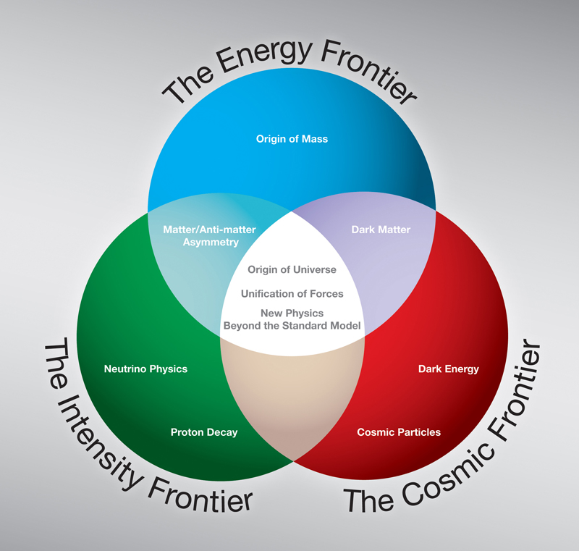
LBNL Physics Division Program
Addressing Big Questions in Particle Physics & Cosmology:
  Energy Frontier:
    What is the origin of matter?
    Is there new physics waiting to be discovered at LHC ?
  Cosmic Frontier:
    What is Dark Matter?
    What is Dark Energy?
  Intensity Frontier:
    Understanding neutrino oscillations
    Looking for rare decays: muon to electron conversion
ATLAS
ATLAS @ LHC
BigBOSS
Supernovae
BOSS
LUX
Daya Bay
Mu2e
LBNE
Dark Energy
Dark Matter
Neutrino Experiments
Rare Decays
Notes:
17 Sr. Scientists; 9 staff scientists (5 PDG); 15 faculty scientists (not including string theorists); 2 Division Fellows; 3 Project Scientists; 23 postdocs + Chamberlain fellows; 30 students including theory

Slide 12
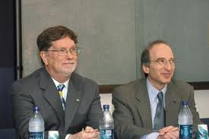
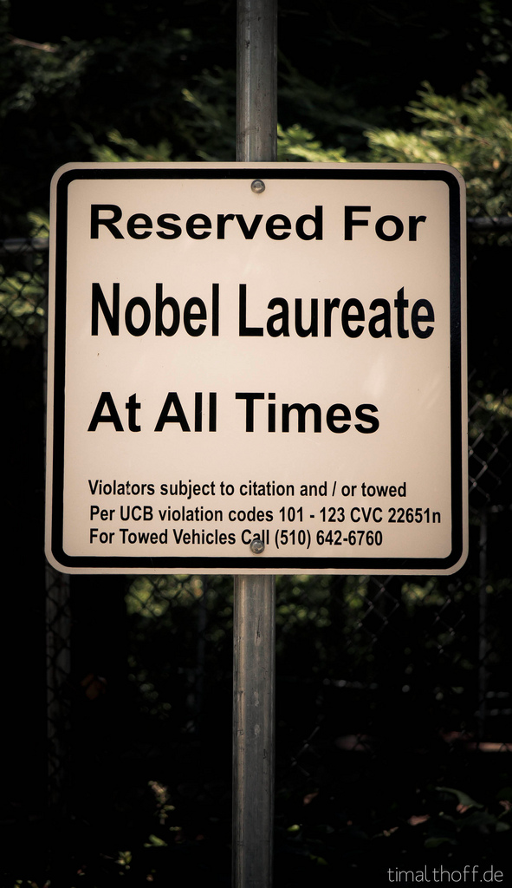
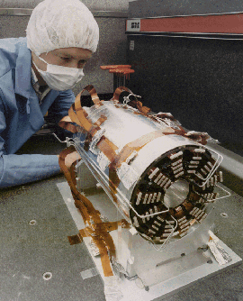
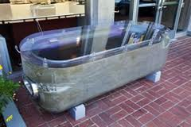
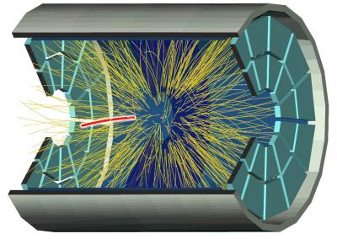
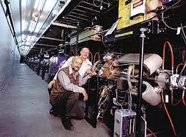
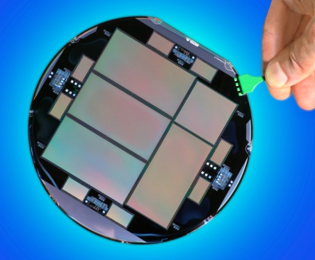
Tradition of Innovation
  Responsible for many “game-changers”: TPC detector, silicon vertex detectors/SVX readout, asymmetric B Factory, pixel detectors, COBE, Type Ia SNe, red-sensitive CCDs,……
  Innovations that enable science…

Slide 13








LBNL PHYSICS DIVISION
ATLAS | Neutrinos: Daya Bay and DUNE | Mu2e
SNe, BOSS, DESI CMB | Dark Matter: LUX LZ | Detector R&D
Theory

Slide 14


Slide 15


