Slide 1

Overview of the Cosmology program
Simone Ferraro
Lawrence Berkeley National Lab
(sferraro@lbl.gov)
Physics Grad Open House
March 15, 2024

Slide 2
The cosmology group at LBNL
Over 20 Senior Members. Lots of possible projects and research supervisors.
Very broad program, from data analysis/modeling/theory to instrumentation, simulations, data management etc.
Leading major experiments such as DESI and CMB-S4
Very close connection to campus and to BCCP (joint seminars, meetings, weakly pizza, speaker’s dinners etc.)
Campus + LBL → one of the largest and broadest cosmology groups
+

Slide 3
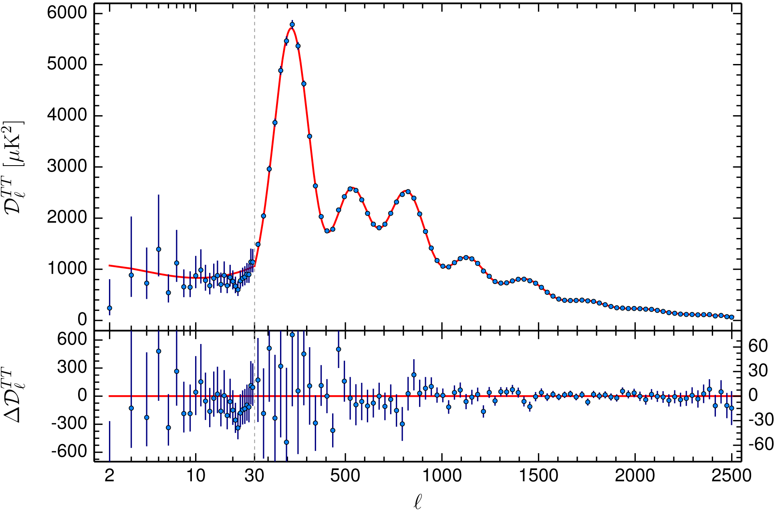
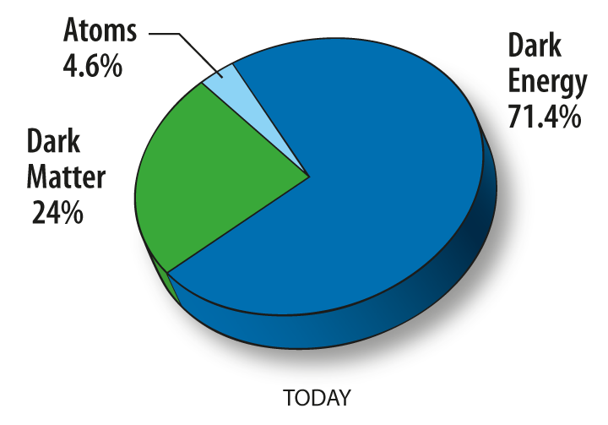
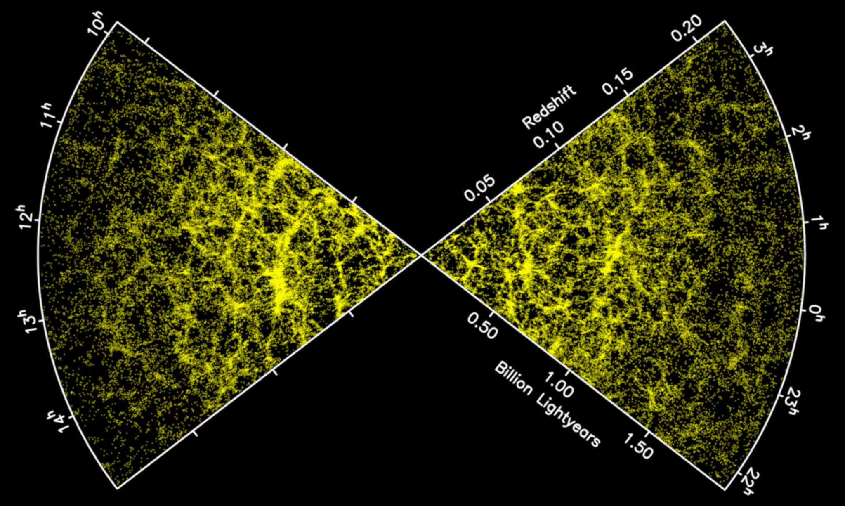
A simple yet strange Universe
But the model is based on…
Dark Matter (?)
Dark Energy (?)
Inflation (?)
Neutrinos and other light particles (?)
The primary goal of the Cosmology Group program is to understand these “ingredients”!
Planck, BOSS
Notes:
Say that I will talk about inflation

Slide 4
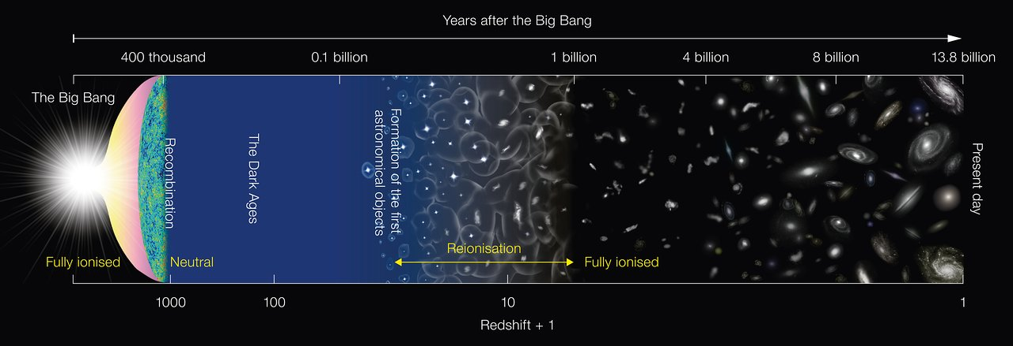
Brief history of the Universe & our program
Credit: ESA
CMB-S4
Simons Observatory
DESI-2/Spec-S5
LIM (mm and 21cm)
DESI
supernovae
21cm / LuSEE

Slide 5
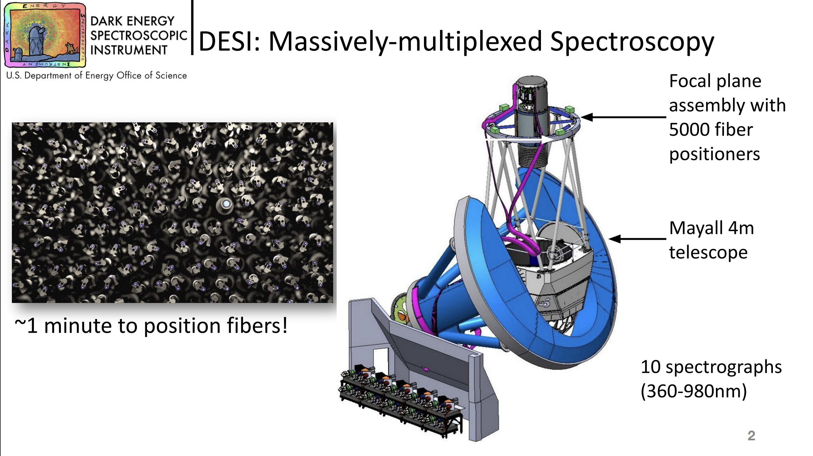

Slide 6
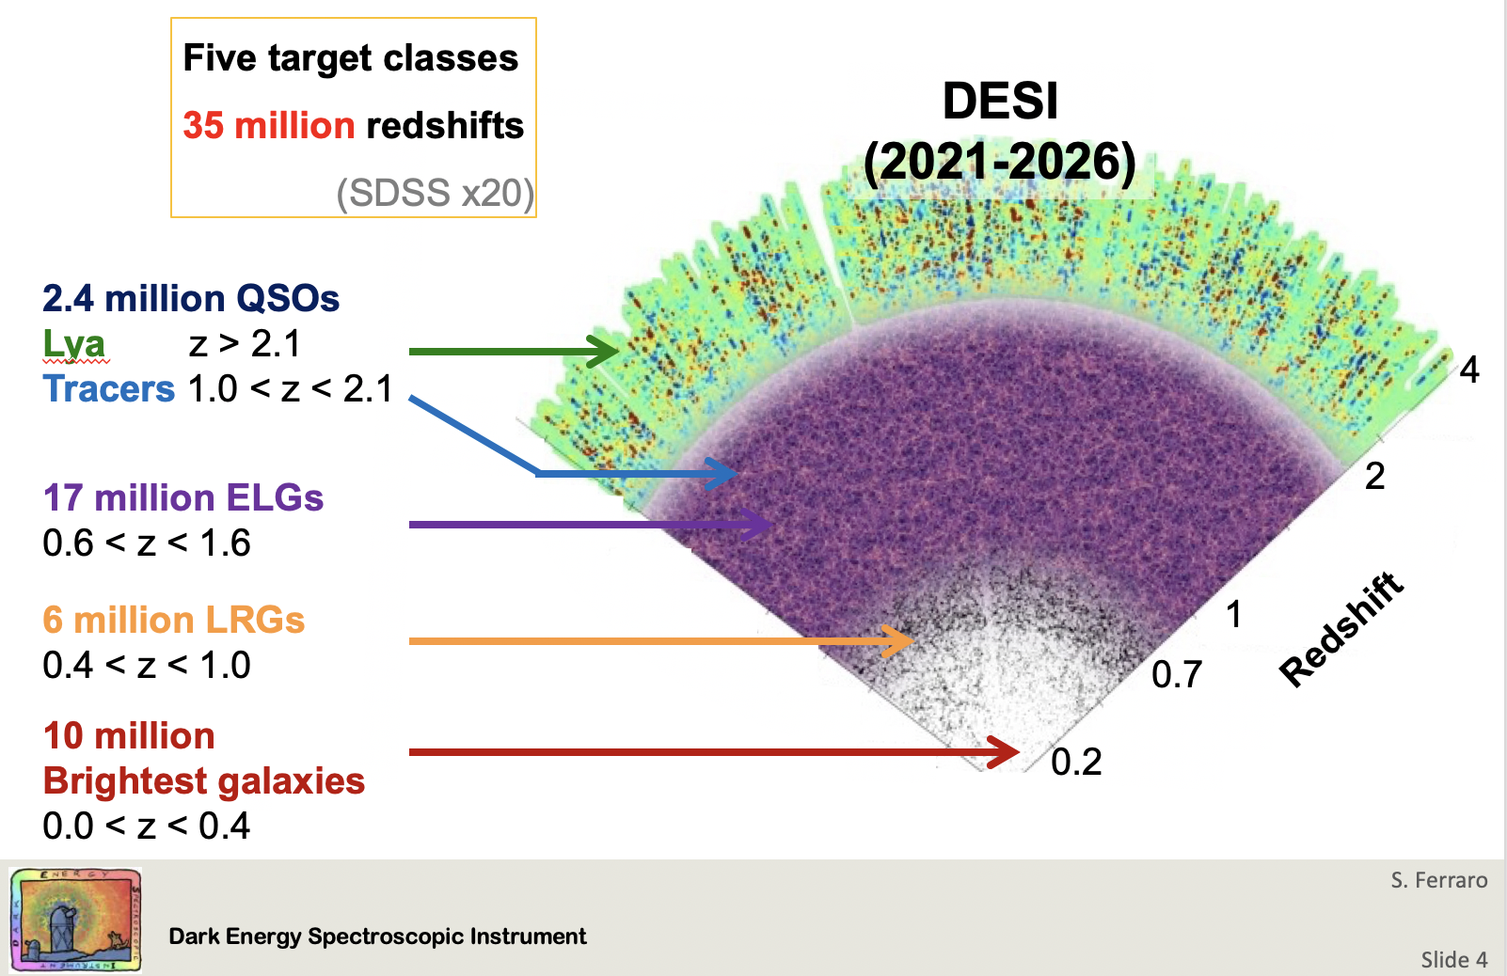
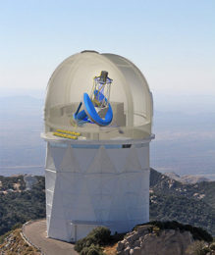
DESI
Dark Energy Spectroscopic Instrument: Massively multiplexed spectroscopic survey with 5000 robotic fibers, over ~14,000 sq. deg
40
Almost done collecting 3 years of data
Analysis of Year 1 data ongoing. Stay tuned!
Major LBNL contributions in almost all aspects
Great alignment with campus/BCCP interests

Slide 7
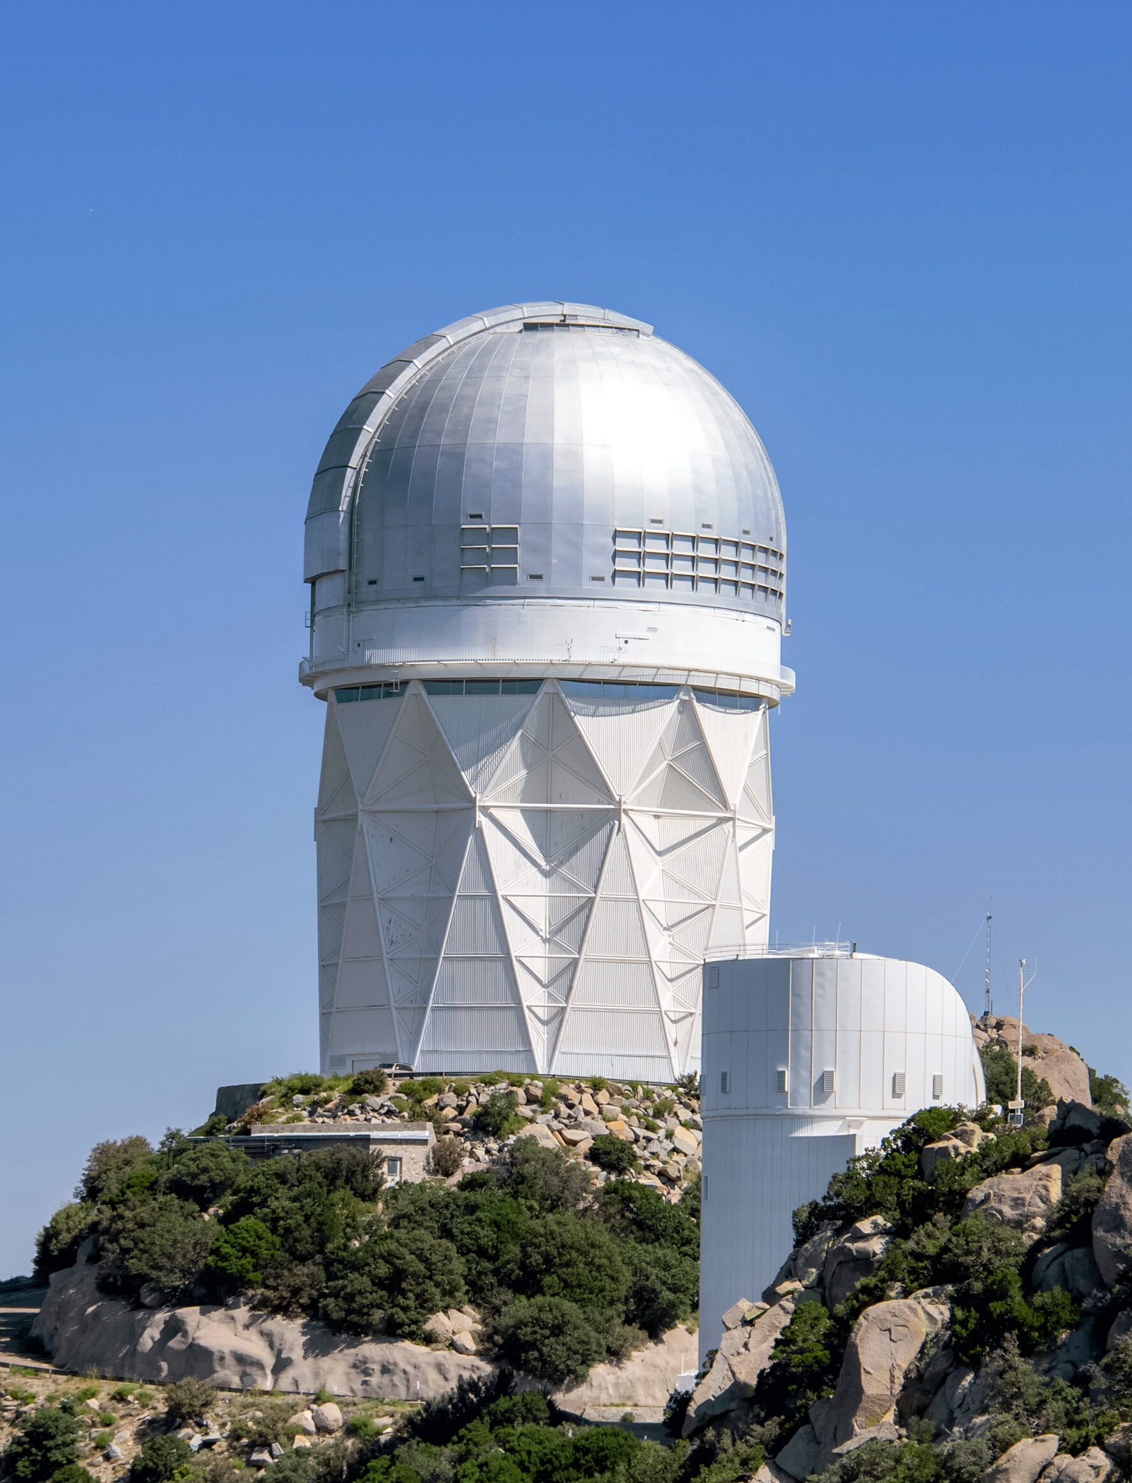
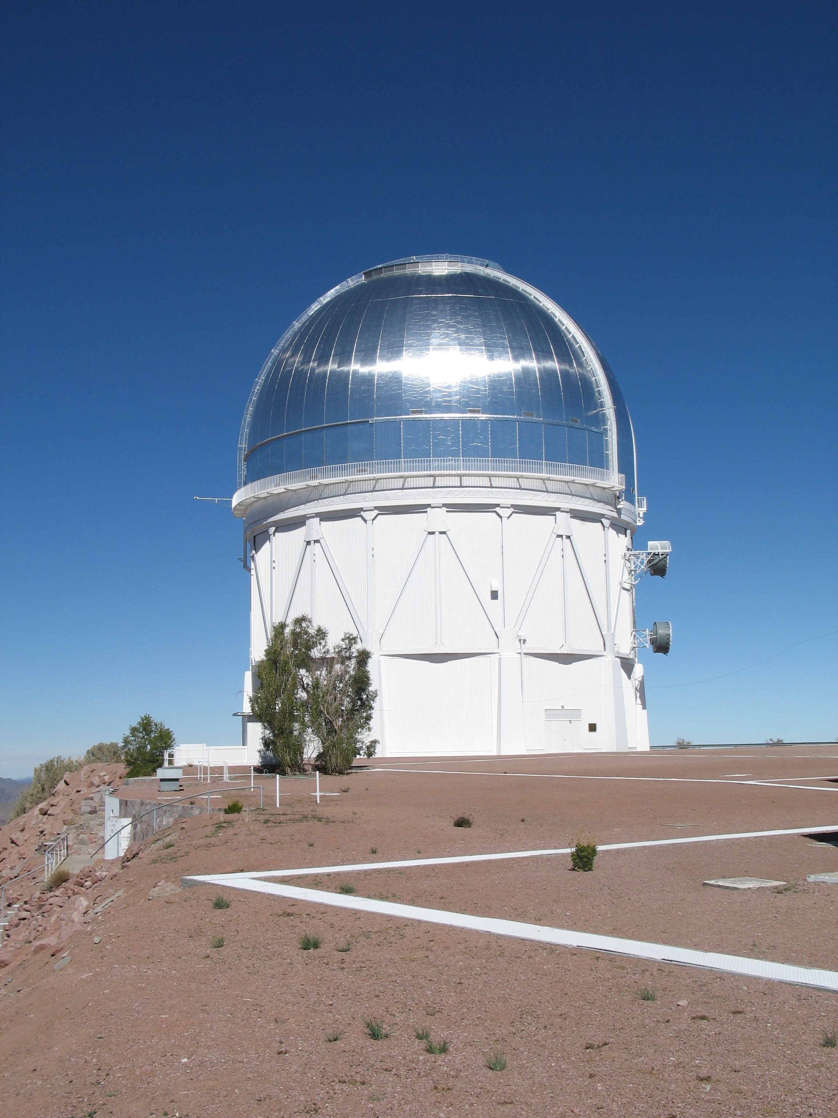
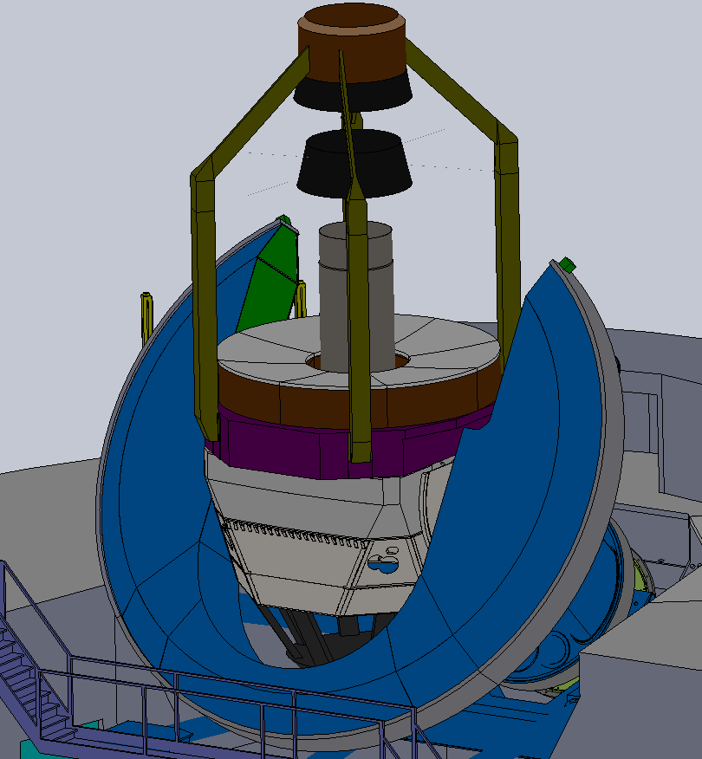
DESI is so successful that we are proposing DESI x 10 (Stage-5 spectroscopy!) two 6 meter telescopes with 26,000 fibers!

Slide 8
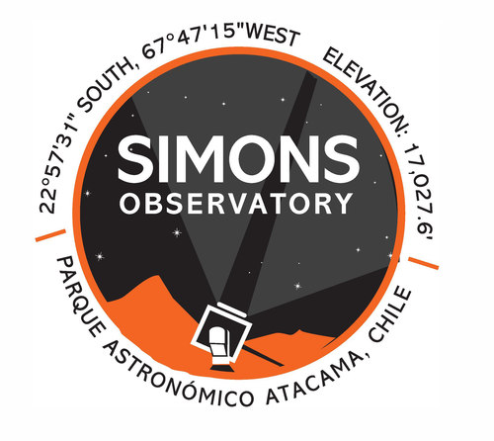
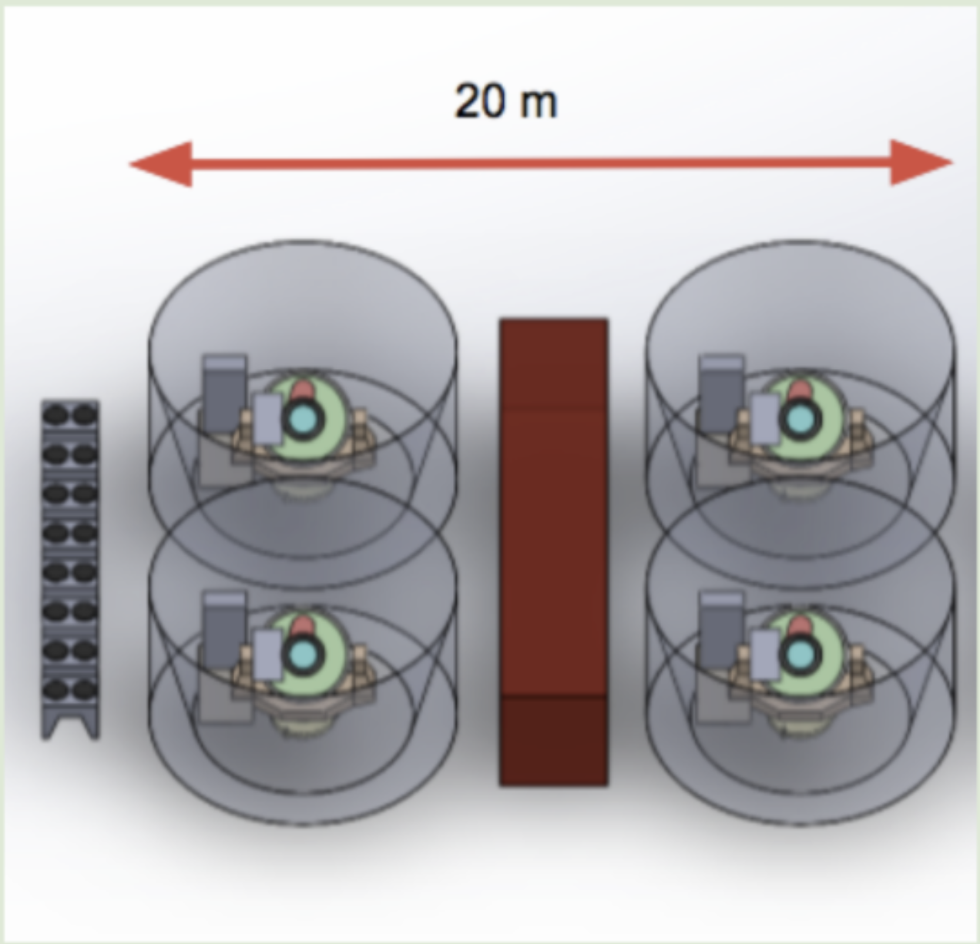
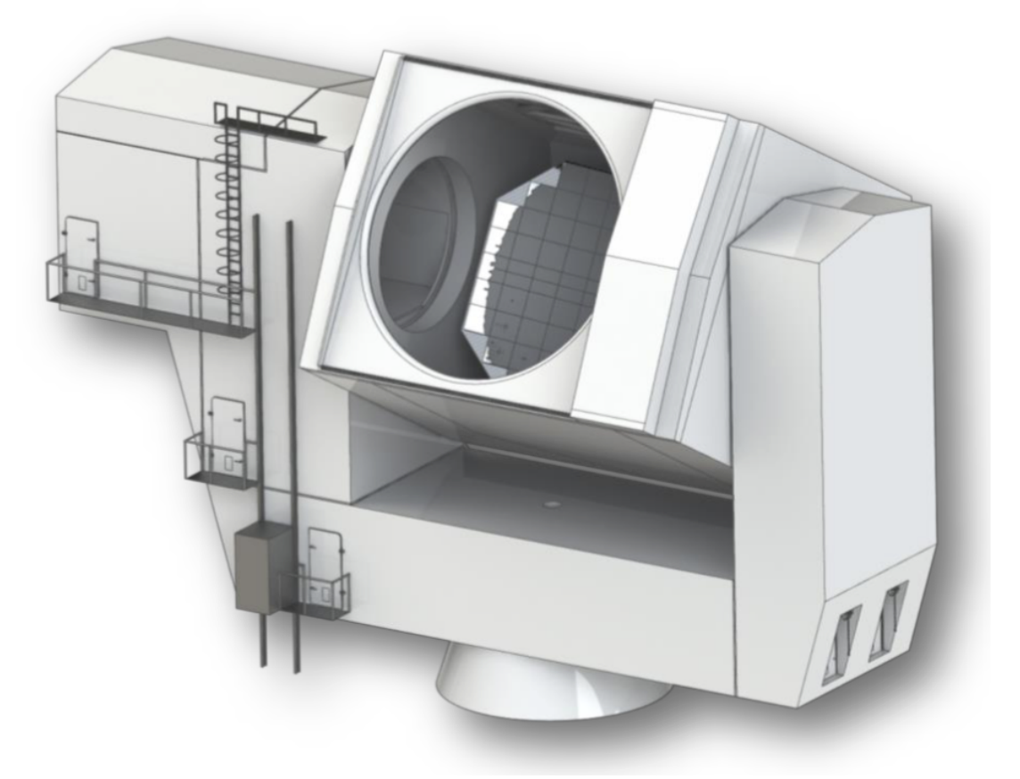
The CMB landscape – 2024-2030?
Large Aperture Telescope
one 6 meter in diameter
Small Aperture Telescopes
42 cm refractors
Large frequency coverage (30 – 270 GHz)
10 Countries
40+ institutions
Funded
6-year program
First light in 2024!
Notes:
Stress LEADER!!
100M dollar experiment. Spent a lot of my time optimizing science returns.
Frequency coverage is key for foregrounds removal

Slide 9
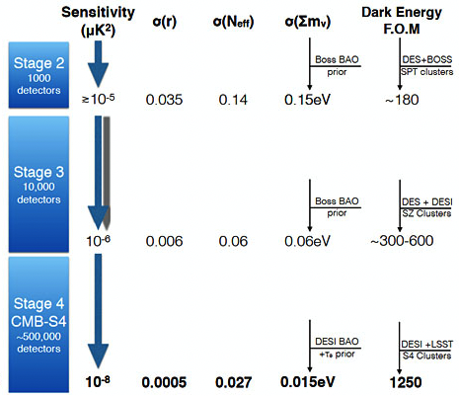
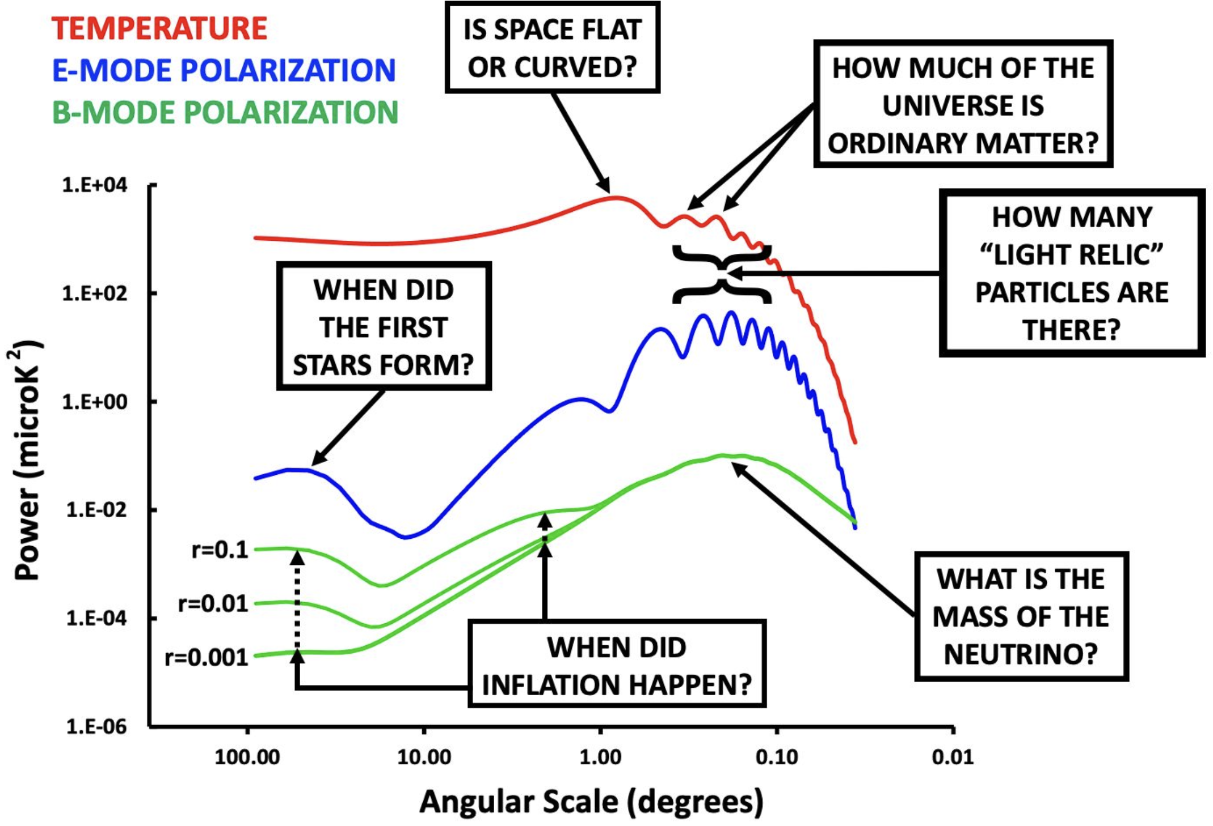
CMB-S4 (2032? – 10 year survey)

Slide 11
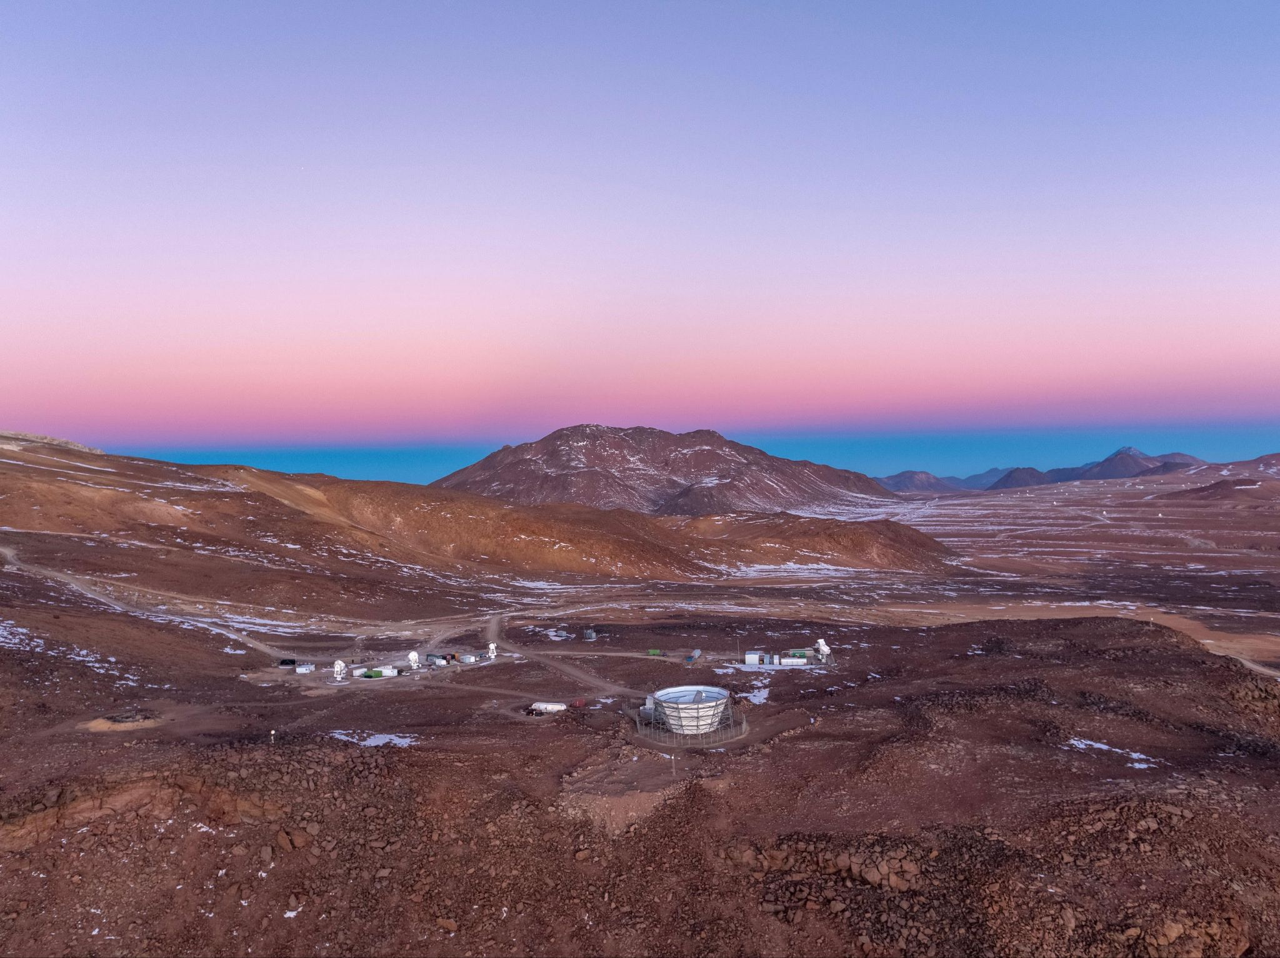
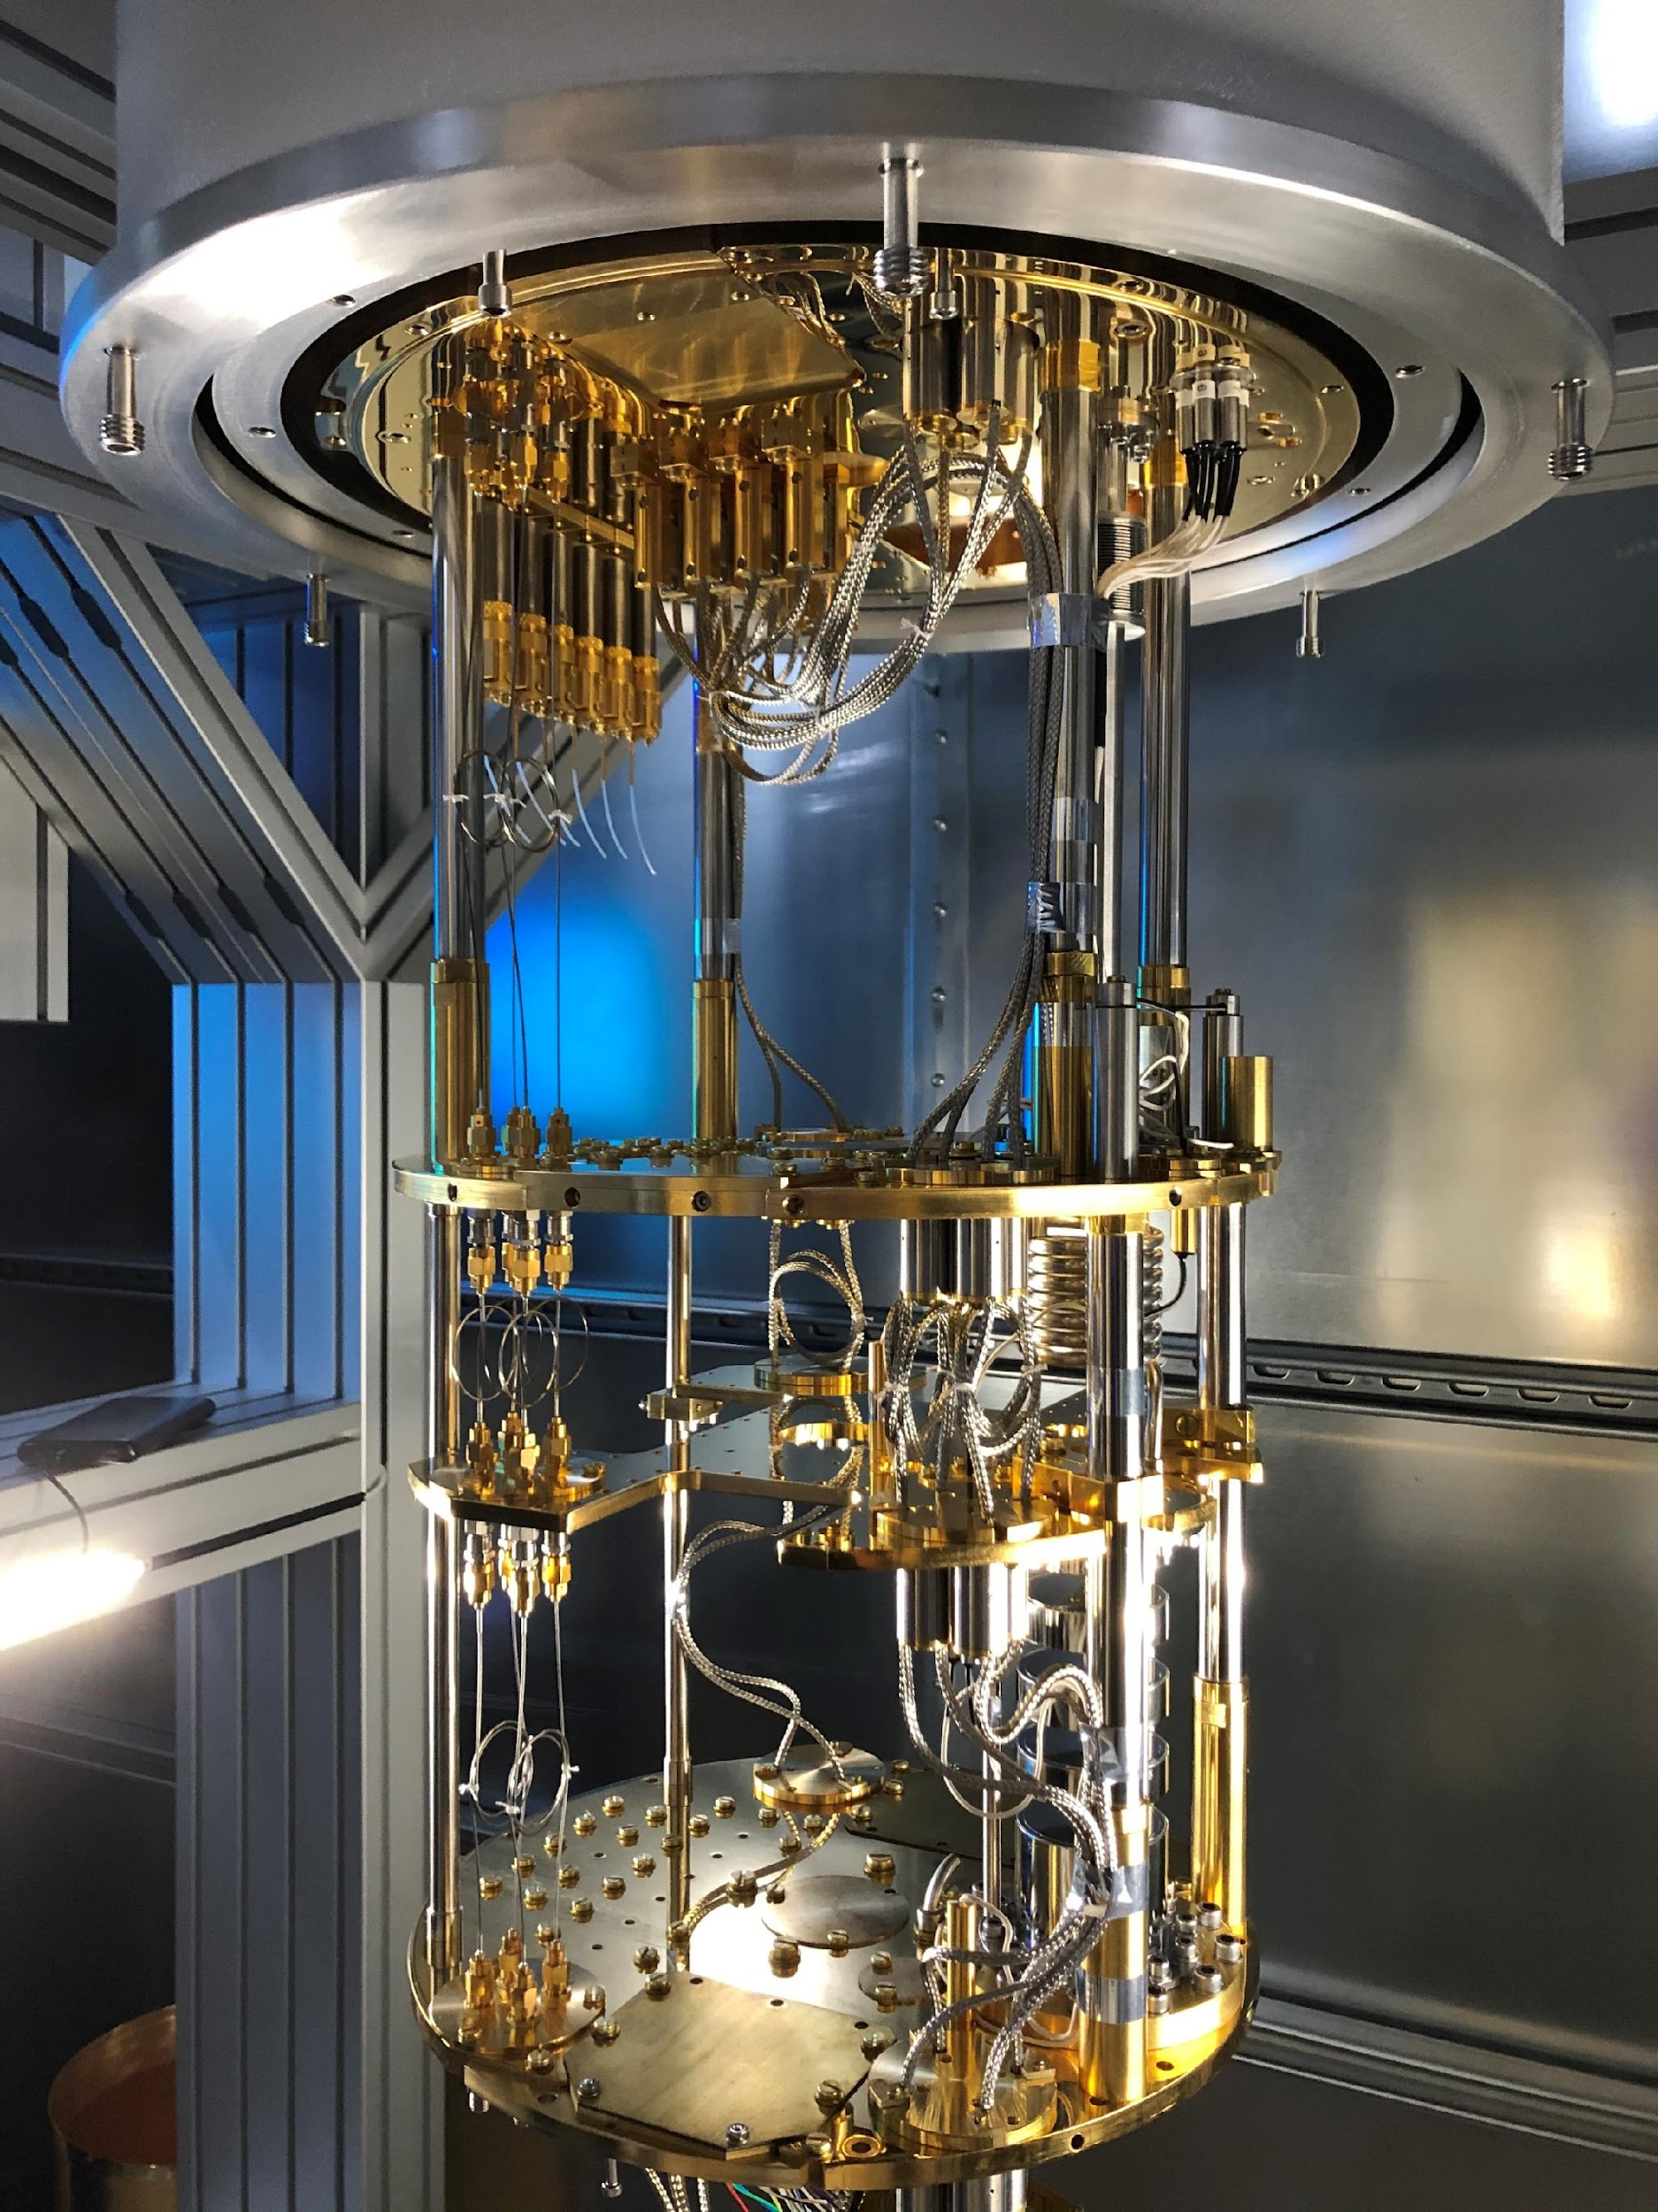
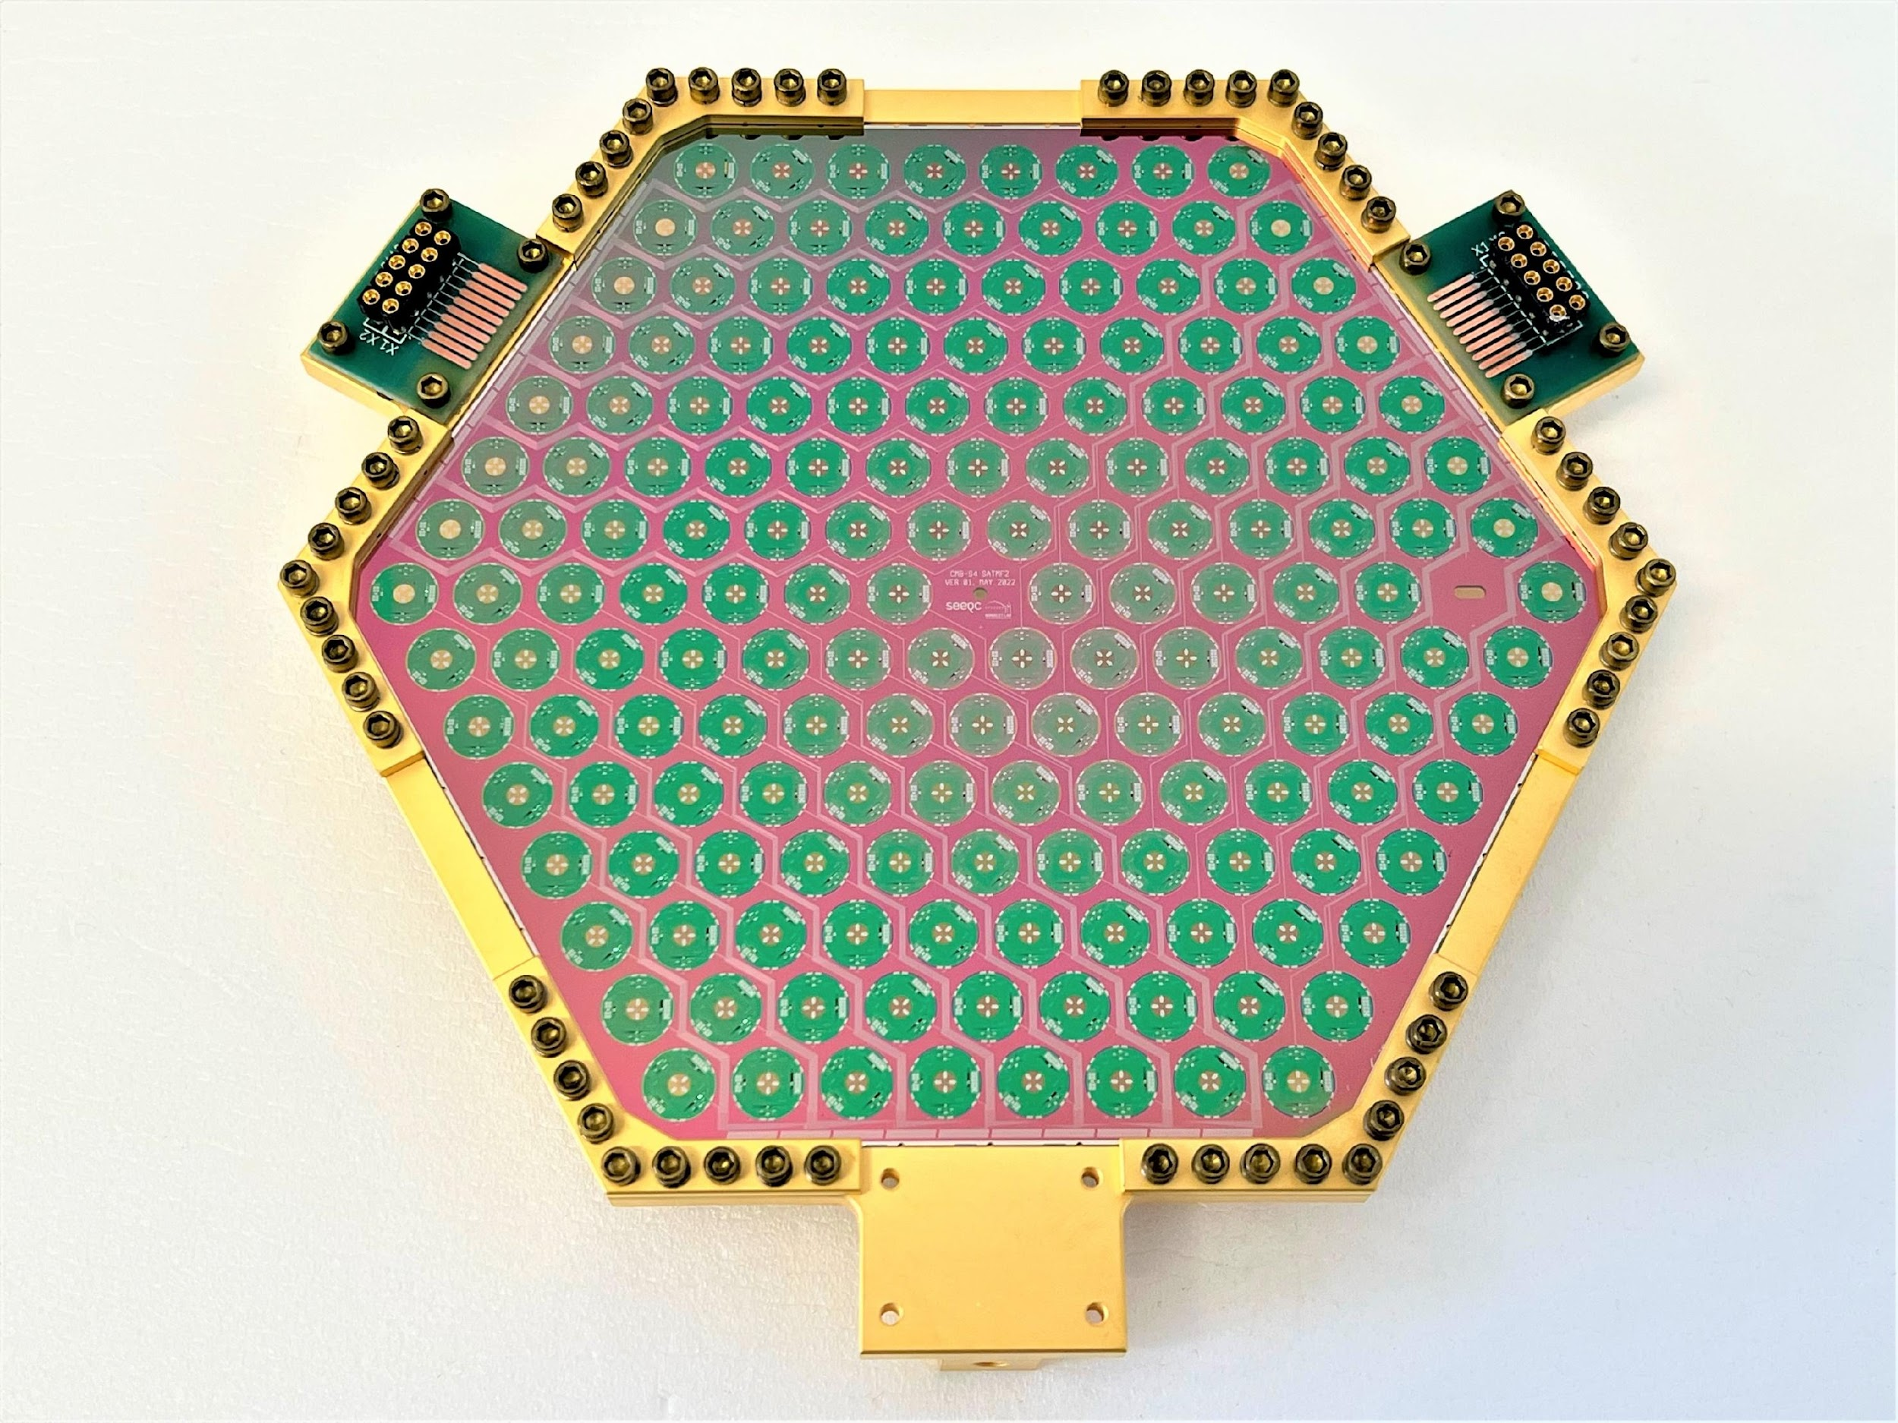
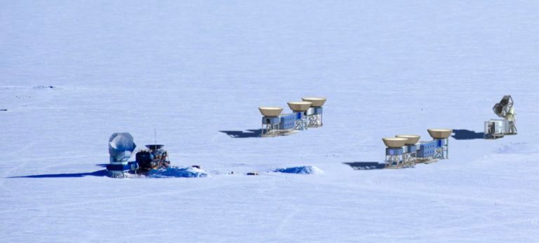
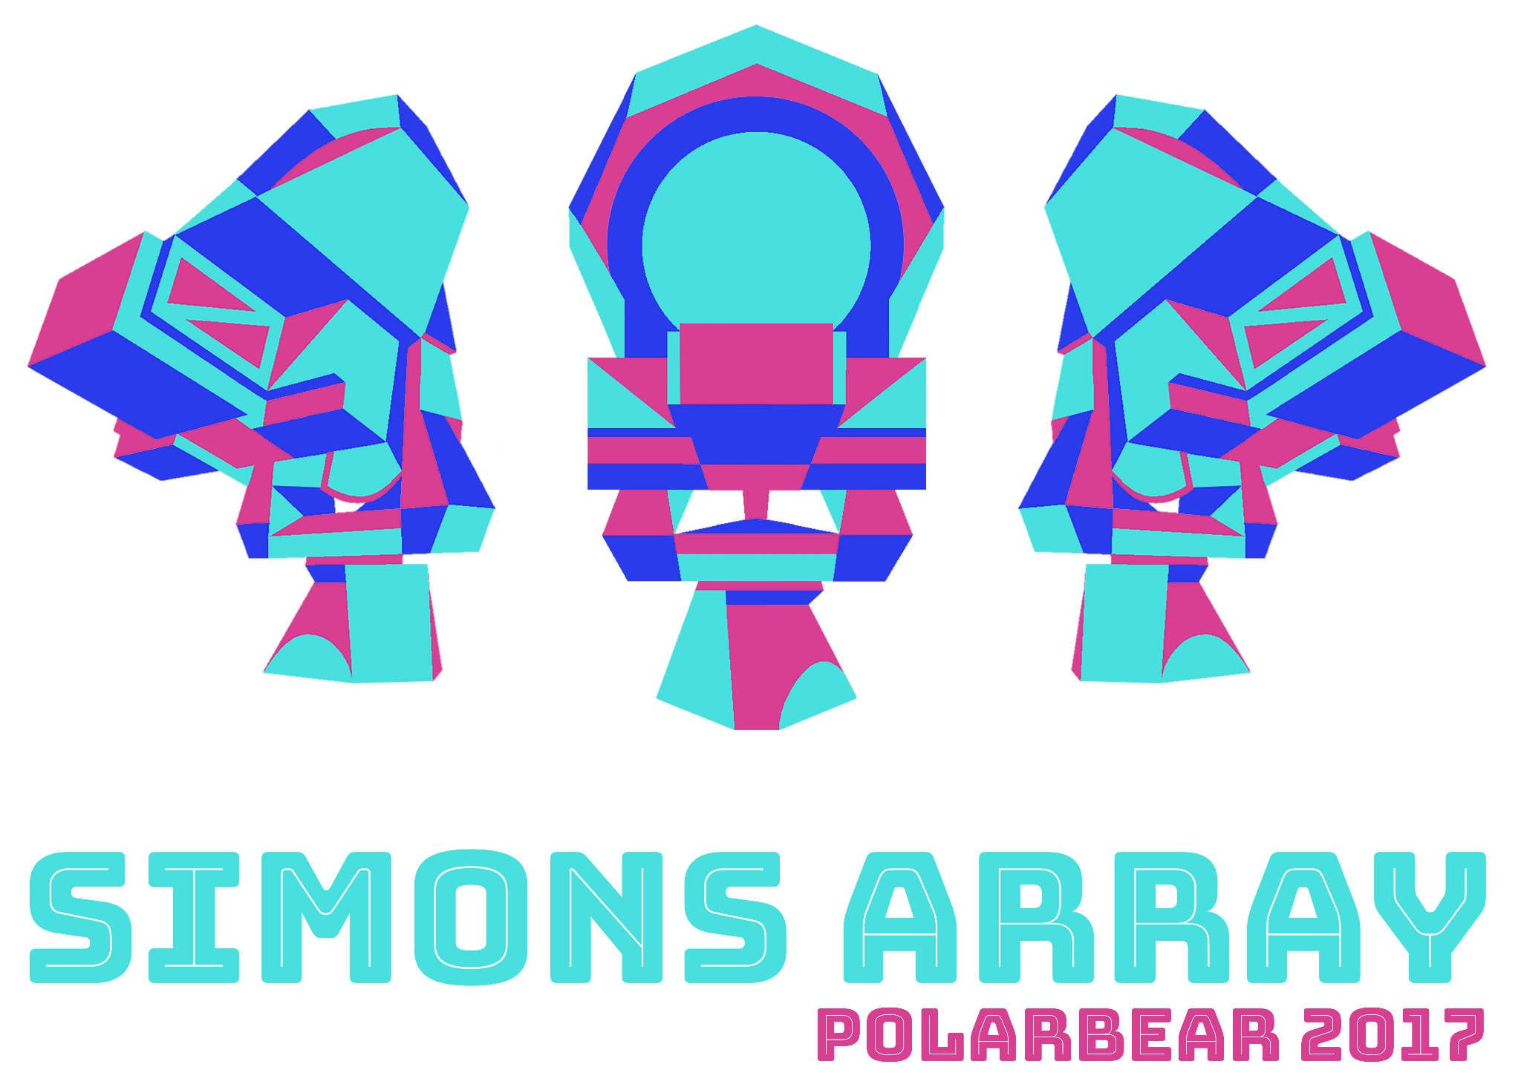
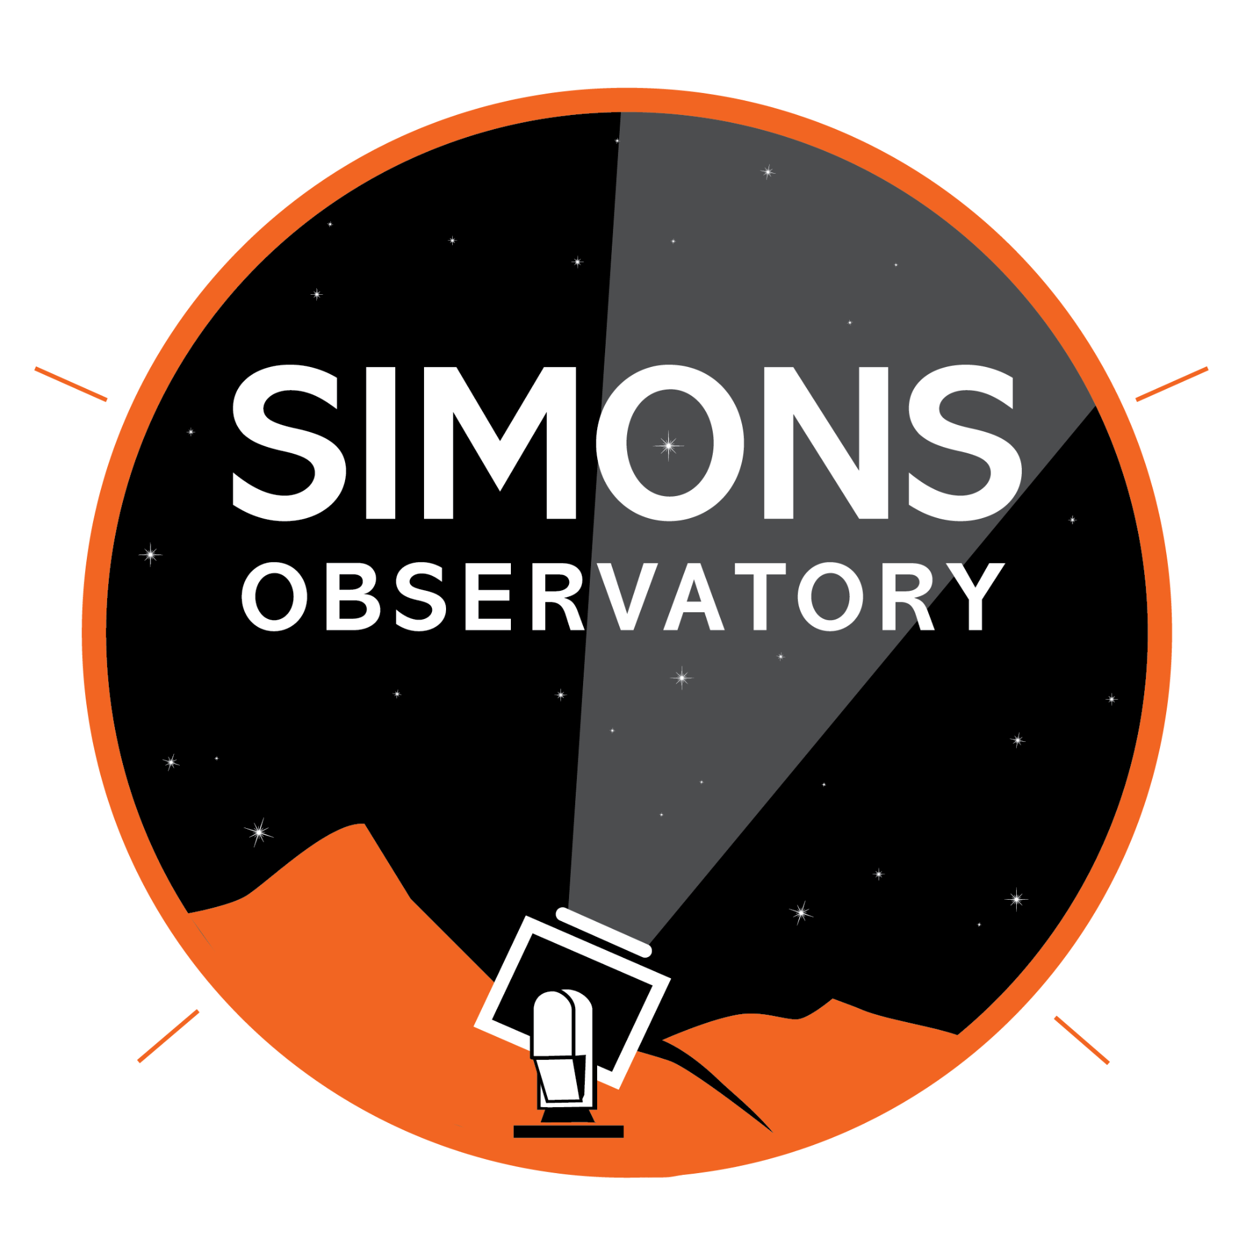
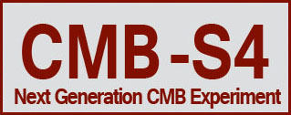

CMB Instrumentation
telescope site in the Chilean Atacama desert
prototype sensor array for CMB-S4
telescope site at the geographic South Pole
Exciting CMB instrumentation program at LBNL
  Superconducting detector & readout development
  Cryogenic receiver development, integration, and testing
  Data analysis
Contact
  John Groh
  Akito Kusaka
  Adrian Lee
  Aritoki Suzuki
one of several 100 mK testing systems @ LBNL

Slide 12
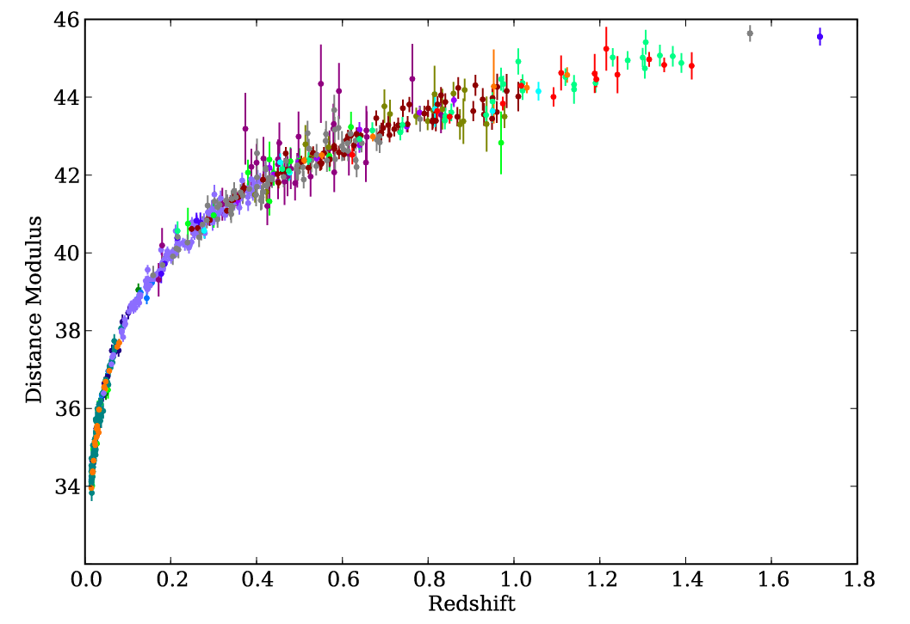
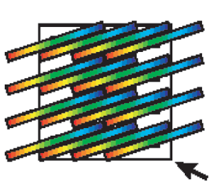
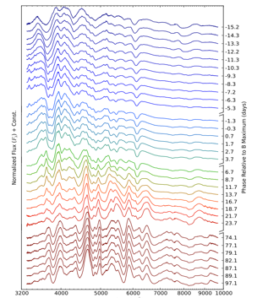
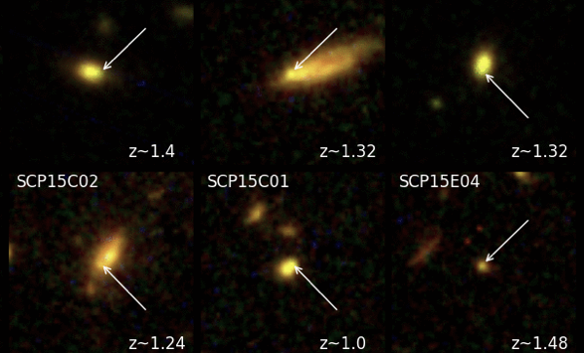
5 We are determining SI-traceable flux calibration to tie together SNe at all redshifts.
Studying Dark Energy & Gravity with Supernovae
Saul Perlmutter, Greg Aldering, Alex Kim + Peter Nugent, Rob Knop in C³
High-z
4 At high z, we are currently measuring time-variability of Dark Energy using HST supernova searches and follow-up. We are also developing spectral reduction techniques for the Roman Space Telescope instruments, and propose an ambitious new space telescope to follow SNe and LIGO gravitational wave triggers.
Mid-z
3 At mid-to-high z, we are designing and building the instruments and software pipelines to follow the triggers from LSST (in Chile) and Roman Space Telescope (in space).
2 DESI is making the definitive measurement of the nearby galaxy density field. We are using this and nearby supernovae to measure the growth of structure, and thereby measure how gravity behaves on cosmological scales.
Low-z
1 At low redshifts, we are using Machine Learning with the comprehensive observations of 300 SNe from our Nearby SN Factory to make possible the next generation of Dark Energy measurements.

Slide 15
R&D efforts
LuSEE-Night
antenna
LIM
detector & readout
CMB
detector & readout
Spectroscopy
CCDs
positioners
spectrographs
Supernovae

