Slide 1
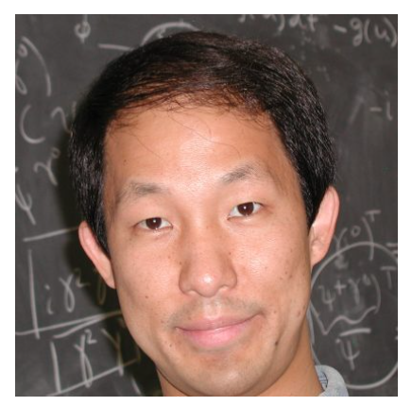
CDM Blue isocurvature in LSS
May 07, 2024
Sai Chaitanya Tadepalli
with
Prof. Daniel Chung Prof. Moritz Muenchmeyer

Slide 2
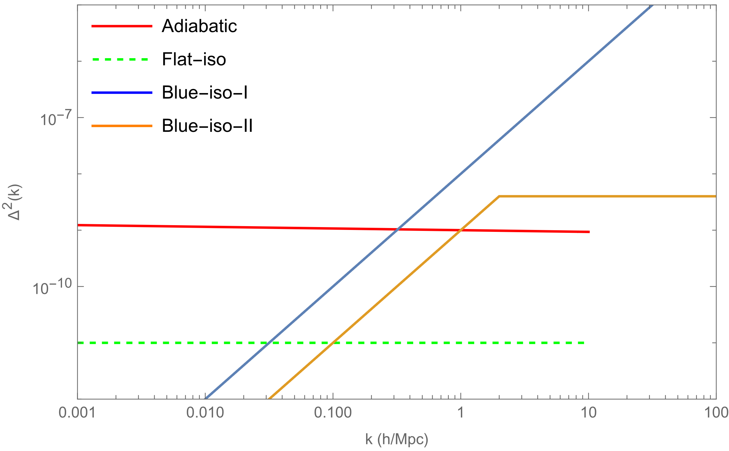
Primordial blue-tilted isocurvature (generated during inflation)
Constrained to be less than 2% on large (CMB) scales at k~0.1/Mpc. [1807.06211]
2-sigma hint found in 1711.06736, 1707.09354 and slight support in 1807.06211 from combined Planck+BOSS-DR12 data analysis
for uncorrelated CDM iso with 1.5<niso<3.5
[1807.06211]

Slide 3
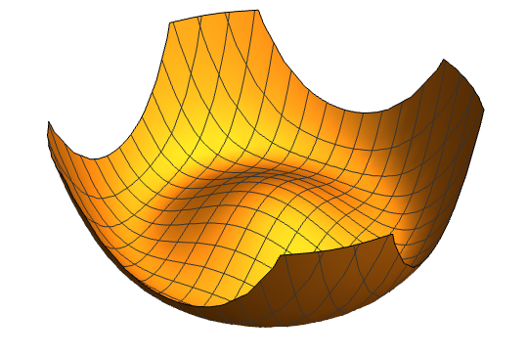
Generate blue-tilted spectra via non-equilibrium radial field
Kasuya+Kawasaki:2009
Dynamical non-equilb mass
Massless axion
1501.05618

Slide 4
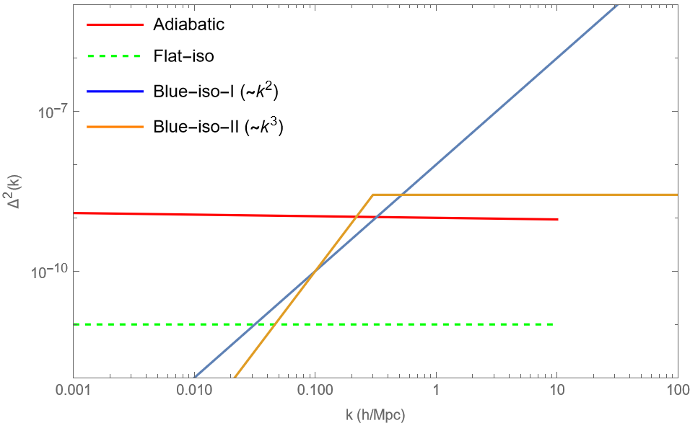
Primordial blue-tilted isocurvature from non-equilibrium physics during inflation
Large (niso > 2.5) blue-tilted isocurvature power spectrum from massive (m>H) spectator fields during inflation must have cutoff.
The cutoff scale naturally lies in the range around <~ 1h/Mpc
CDM isocurvature spectra with a cutoff <~ O(0.5)h/Mpc evade most constraints on small scales and hence are well-suited for LSS surveys

Slide 5
We will try to answer this in the context of Euclid and MegaMapper within EFTofLSS and biased tracer formalisms

Slide 6
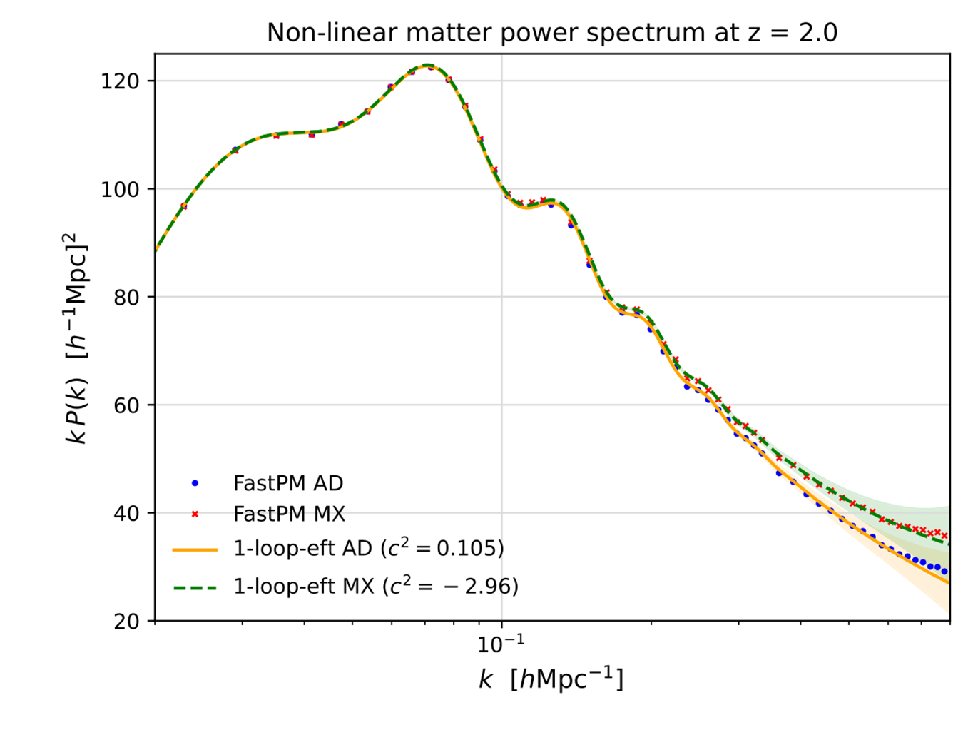
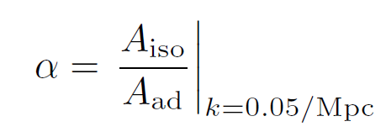

Slide 7
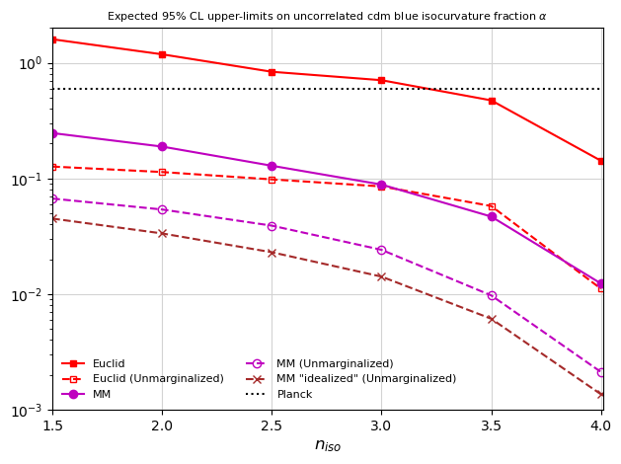
Estimates
Sai+2023
Planck
MM
Euclid
Additional factor of 2-3 improvement from RSD
Further improvement from strong priors on bias parameters
Factor of ~10 improvement expected from Stage5 surveys

Slide 8
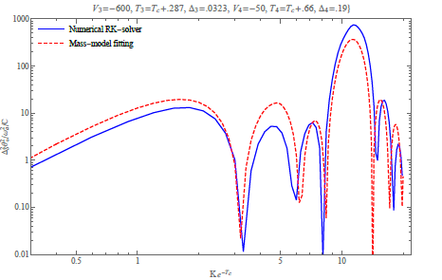
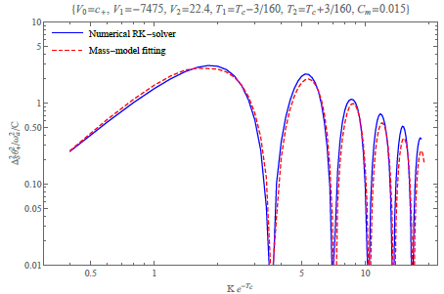
Interesting science case…
“niso” can offer insights into the presence of spectator DM fields and their mass scales.
niso > 2.4 can imply time-dependent mass during inflation. [1509.0585]
Axionic blue iso can relax the constraint on parametric region
Can give large peaked power on small scales or oscillatory signals.
NG signal?
Indication from c^2(z) EFT parameter?

Slide 10
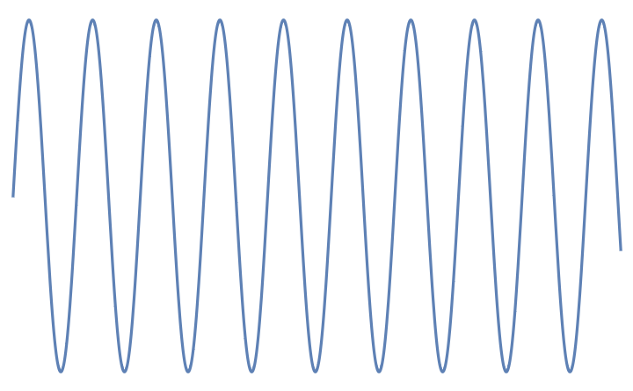
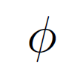
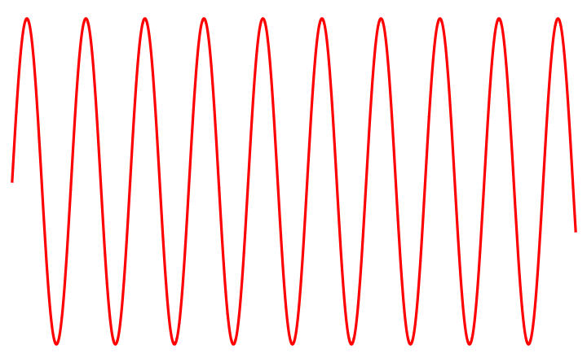
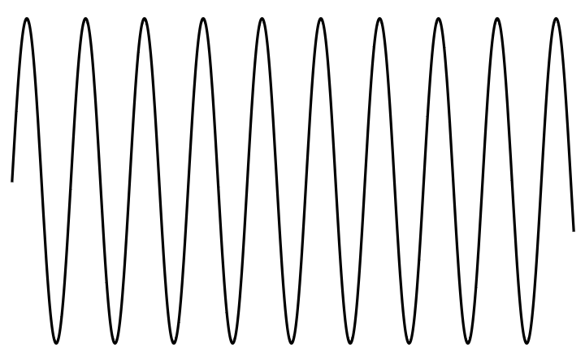
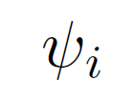
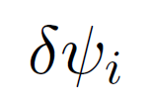
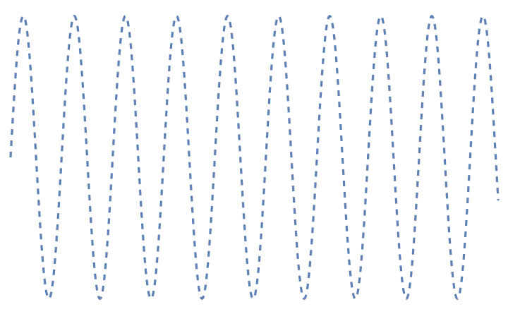

Slide 11
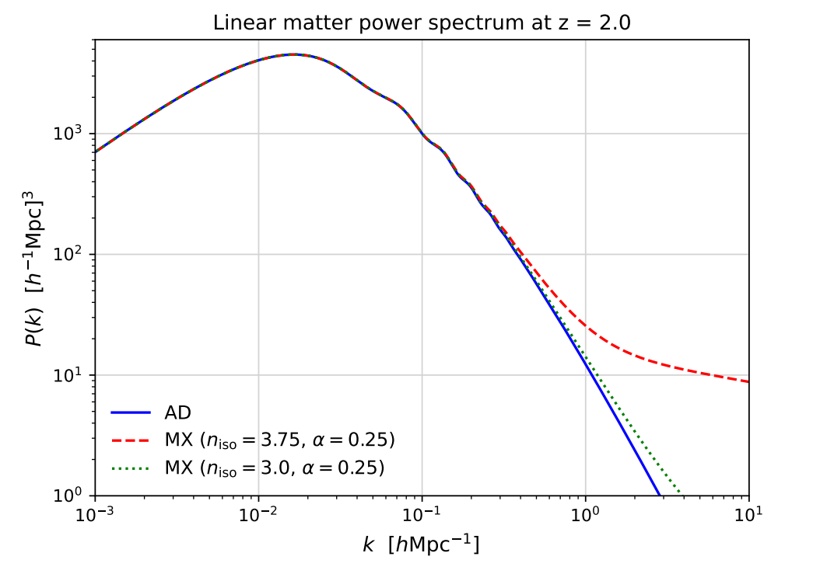

Slide 12
Talking points
Introduce isocurvature
CMB limits, flat isocurvature (not so interesting)
Blue iso- spectator (axion) – can be far more interesting
Requires more linear modes, hence higher redshift, require lower shot noise,
Final money plot: show comparison b/w Planck, Euclid and MM
Degeneracies (Laplacian bias, massive neutrinos, CC signals)

