Slide 1
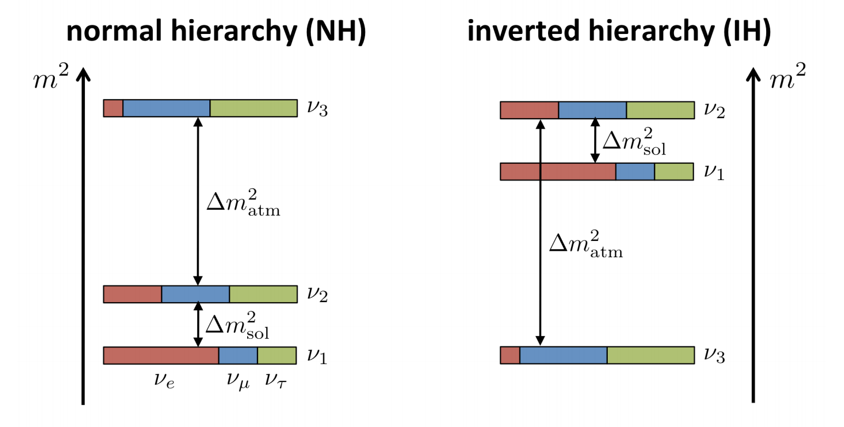
Neutrinos and cosmology
Simone Ferraro (LBNL & UC Berkeley)
sferraro@lbl.gov
290e seminar - UC Berkeley

Slide 2
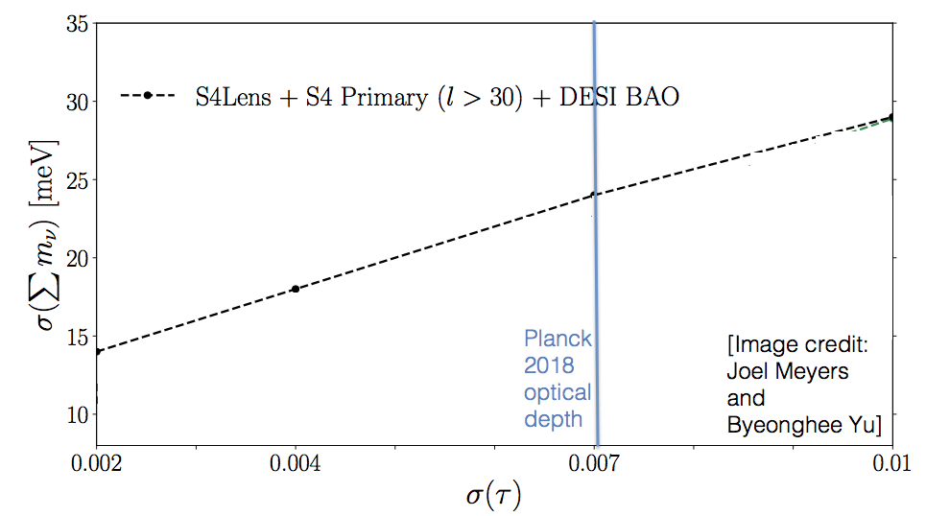
Goal: understand this plot!

Slide 3
References:
Massive neutrinos and cosmology (https://arxiv.org/abs/astro-ph/0603494)
Status of neutrino properties and future prospects - Cosmological and astrophysical constraints (https://arxiv.org/abs/1712.07109)
Bauman’s cosmology lecture notes (http://cosmology.amsterdam/education/cosmology/)
Phases of New Physics in the CMB (https://arxiv.org/abs/1508.06342)
Measuring neutrino masses from the Cosmic Frontier (Sailer, Ferraro, White, 2024 in prep)
Lots of ongoing work at LBL and UCB with DESI and CMB.

Slide 4
Outline
A brief history of the Universe
Cosmological neutrinos
Observables: CMB, Large Scale Structure
Current status of neutrino cosmology
Future experiments
Number of neutrino species and other light relics

Slide 5
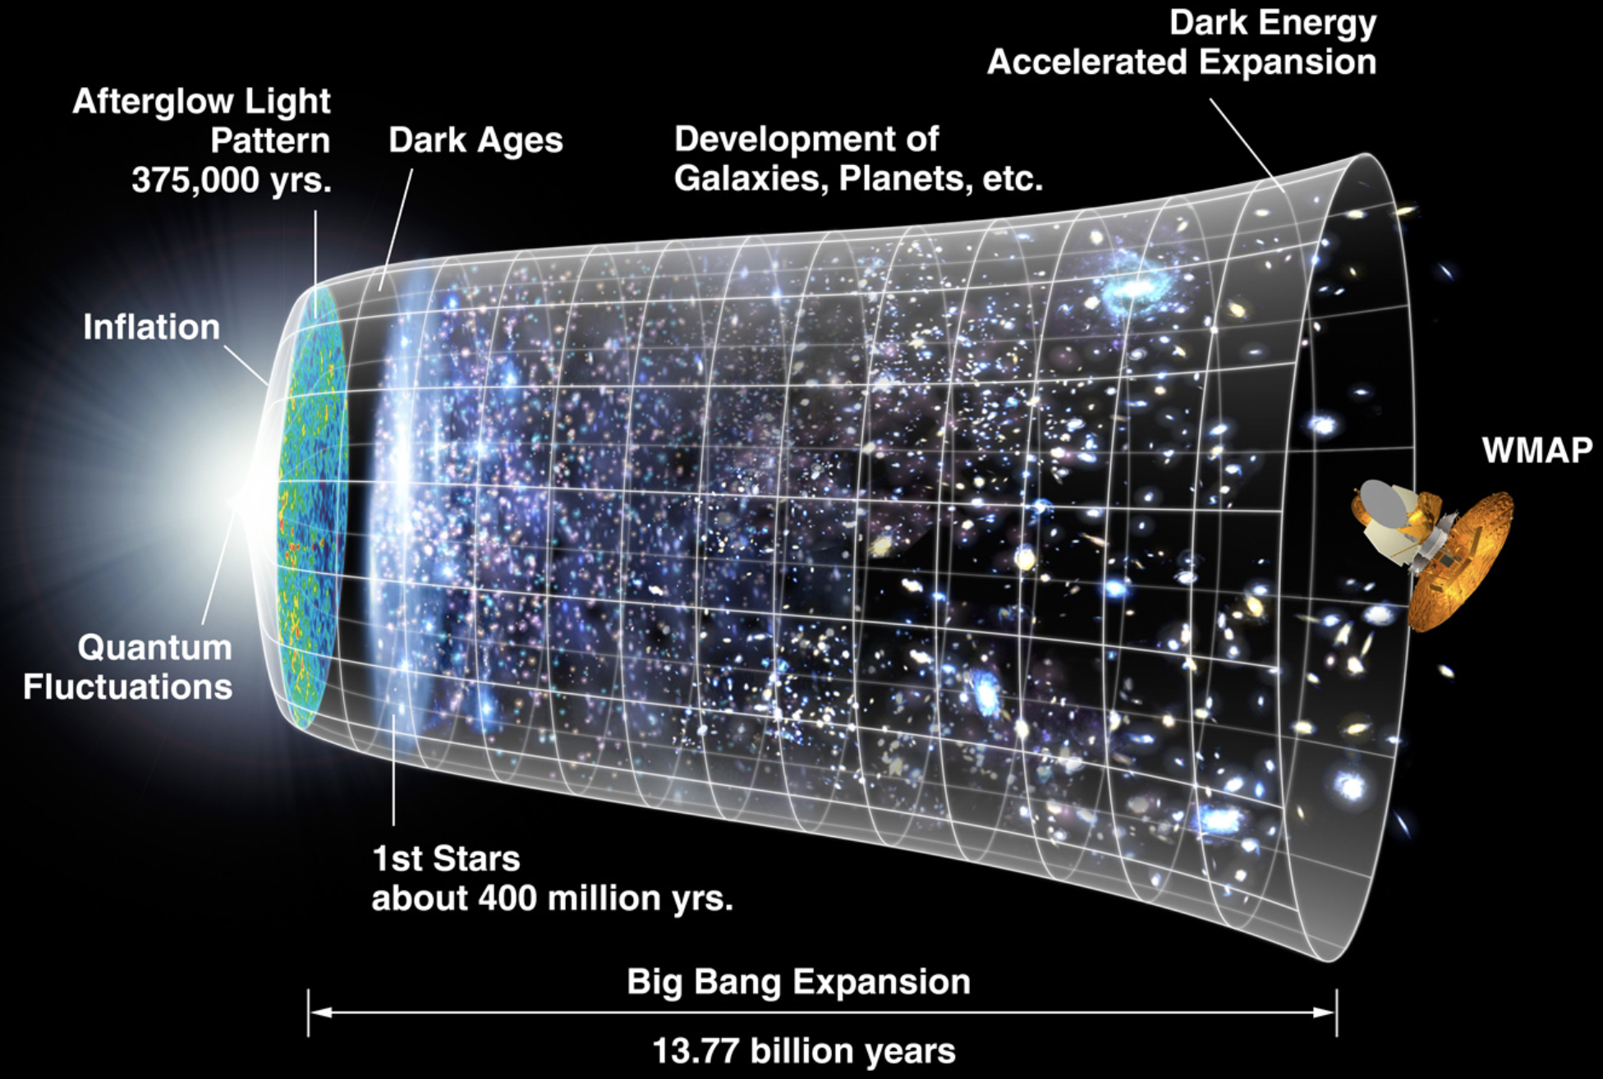
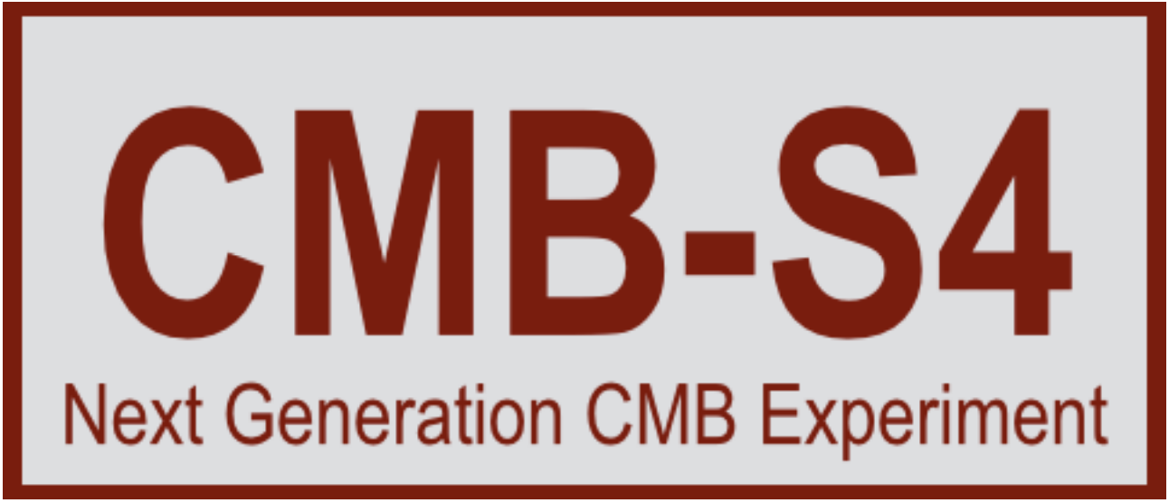
A brief history of the Universe
94% of photons
travel from the CMB to us
without scattering*
6% scatter with matter
*path slightly deflected
by gravitational lensing
Notes:
While a small percentage of photons -> extremely large amount of information.
Only now are experiments beginning to probe this rich regime

Slide 6
Neutrinos have mass!

Slide 7
Cosmic neutrinos?

Slide 8
E. Bernardini

Slide 9
E. Bernardini

Slide 10
E. Bernardini

Slide 11
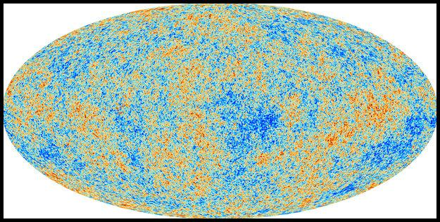
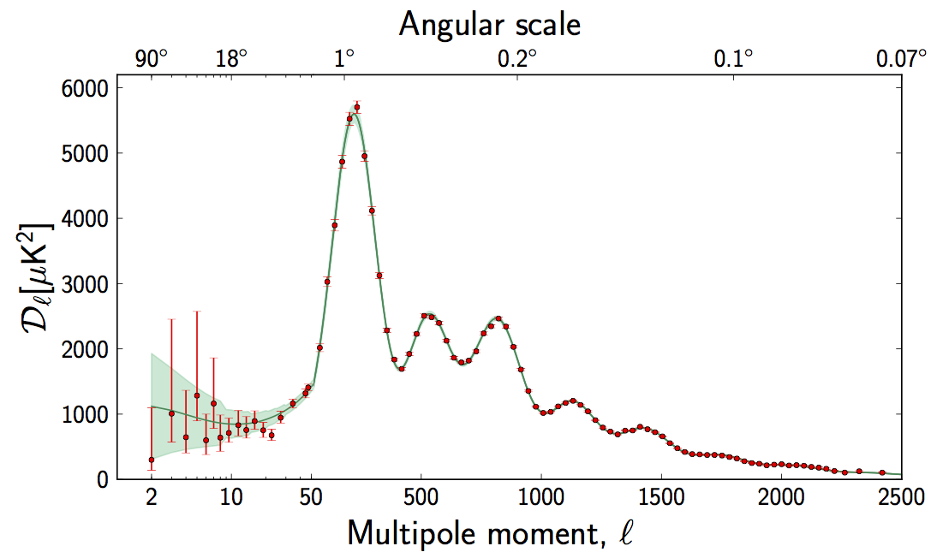
Cosmic microwave background (CMB)
Planck Satellite (2018)
“primary fluctuations”
Effect of neutrinos detected
at high significance (~20σ)
But not a good probe of
neutrino mass. Why?

Slide 12
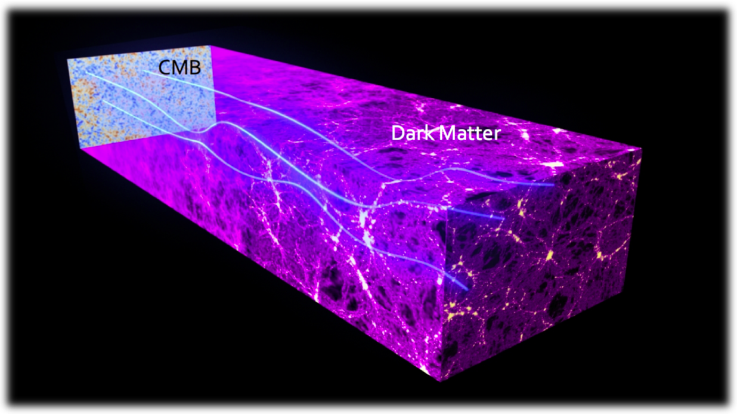
CMB lensing
Paths of CMB photons deflected by matter → create statistical anisotropy

Slide 13
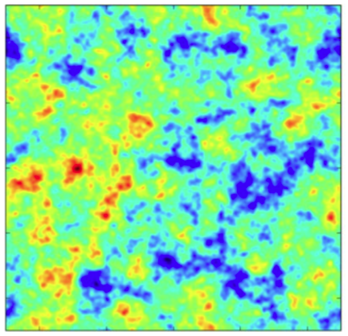
CMB lensing
Paths of CMB photons deflected by matter → create statistical anisotropy

Slide 14
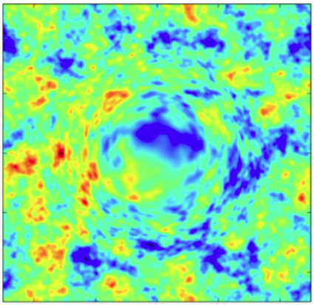
CMB lensing
Paths of CMB photons deflected by matter → create statistical anisotropy

Slide 15
E. Bernardini

Slide 16
E. Bernardini

Slide 17
E. Bernardini

Slide 18
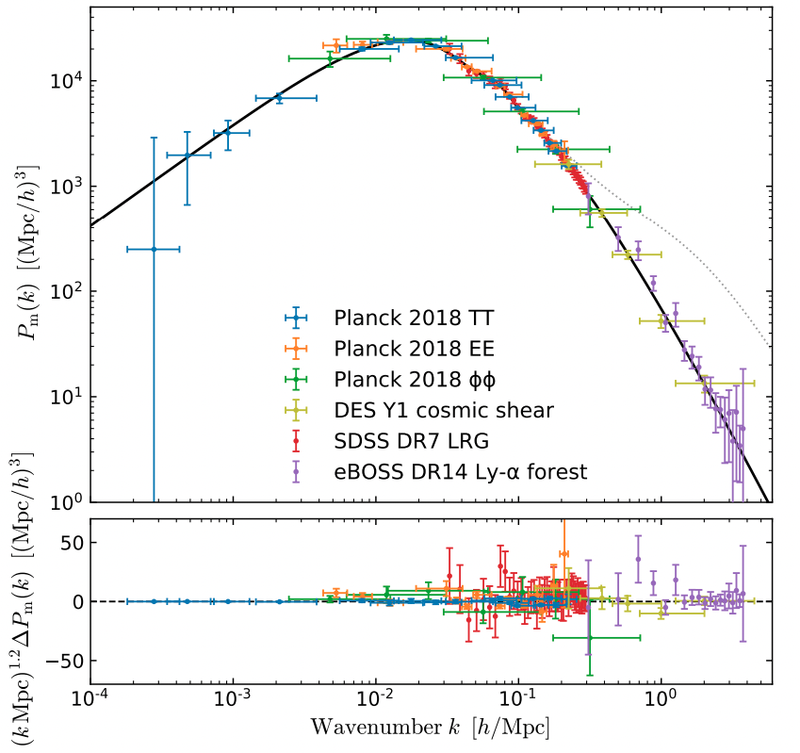
Most modern version:
galaxies &
lensing
primary
CMB
Ly-a forest
arXiv:1905.08103

Slide 19
= 0.5%
→ 4% suppression minimum!

Slide 20
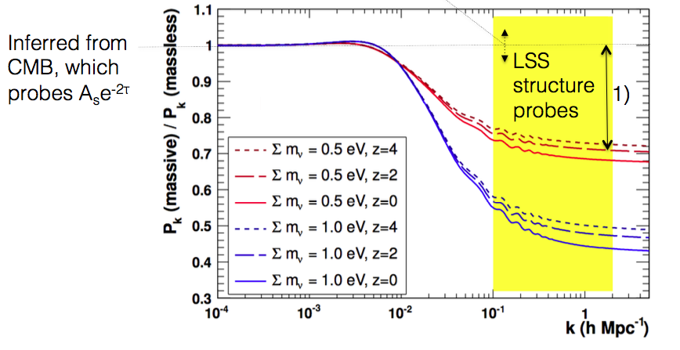
Neutrino mass
Compare CMB to LSS amplitudes and look for a suppression!
CMB
probes this
range

Slide 21
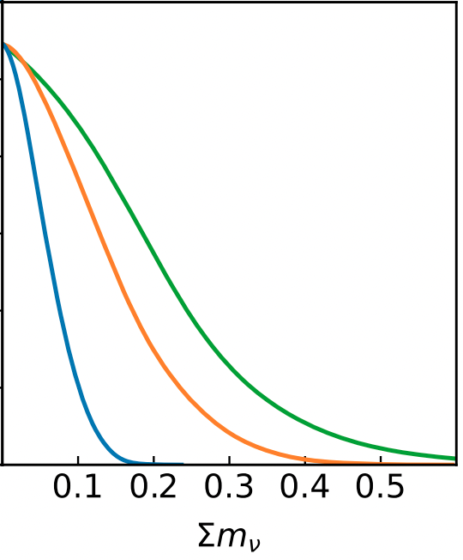

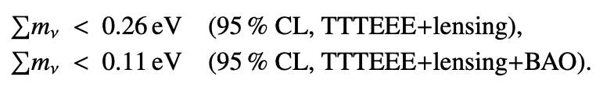

Latest constraints
Currently best constraint!
(conservative)
Putting pressure on the inverted
hierarchy!
We are not that far from the
minimum mass allowed
probability
arXiv:2309.10034

Slide 22
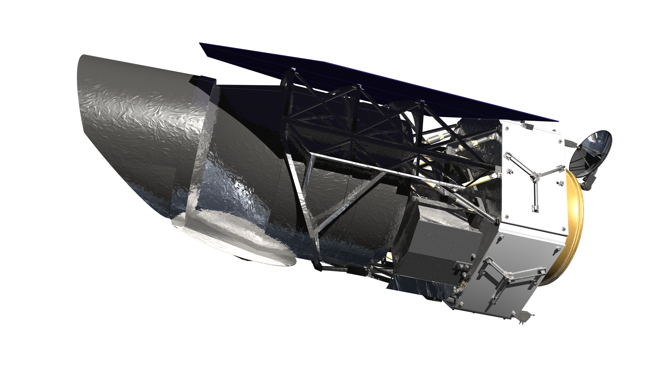
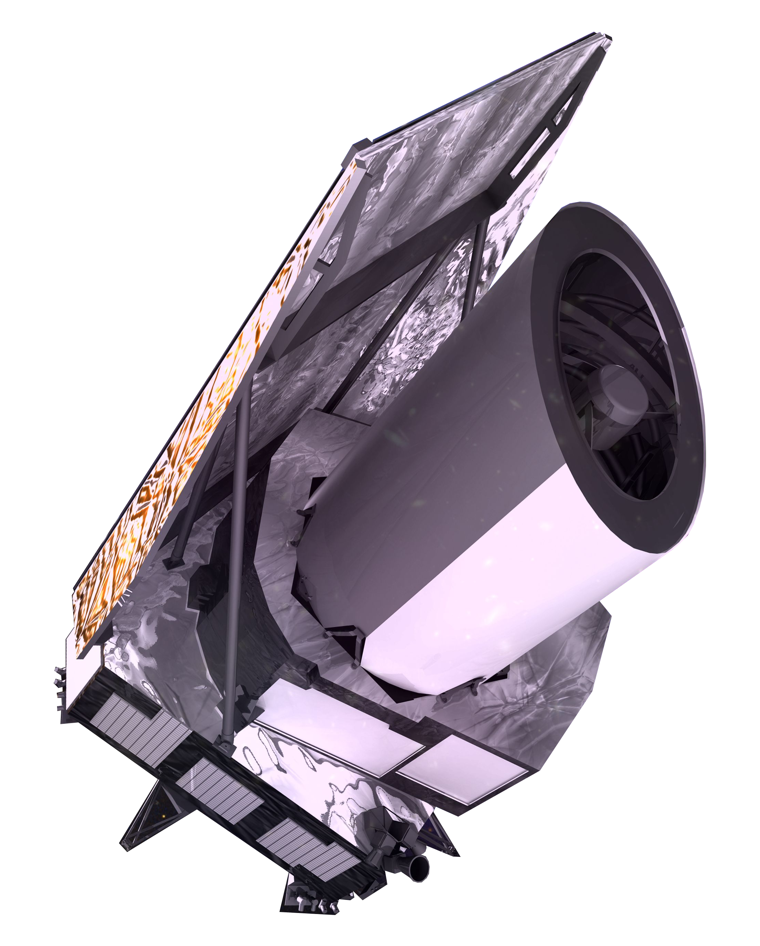
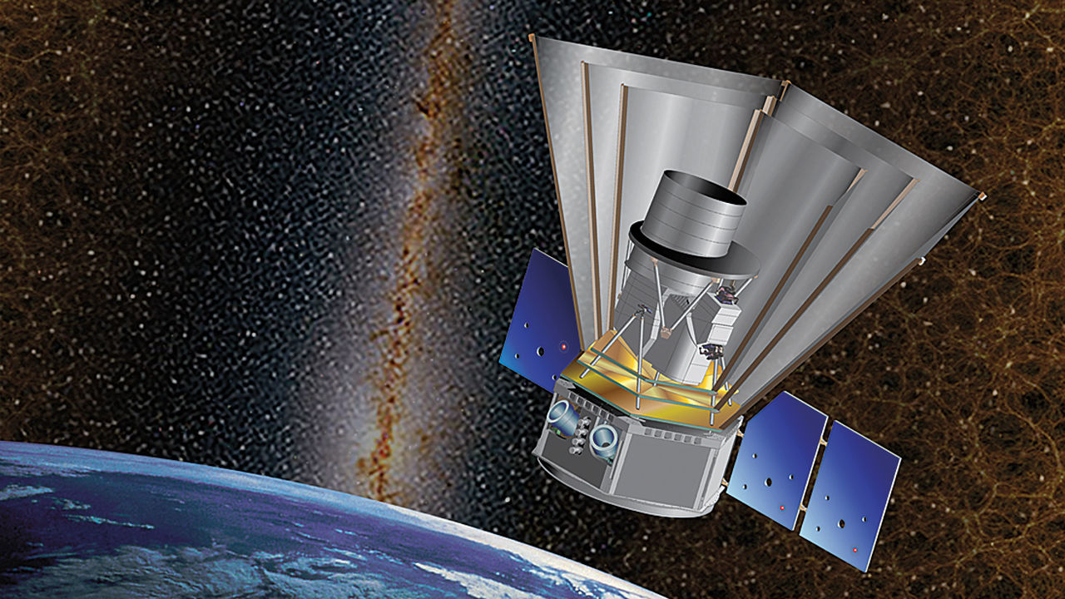
What’s next? Large scale structure
Roman Space Telescope
LSST
/Rubin Observatory
DESI
EUCLID
SPHEREx
+ 4-MOST, HSC/PFS, HETDEX,
MSE, …
Also: 21cm (Chime, HIRAX)
Notes:
Add timelines

Slide 23
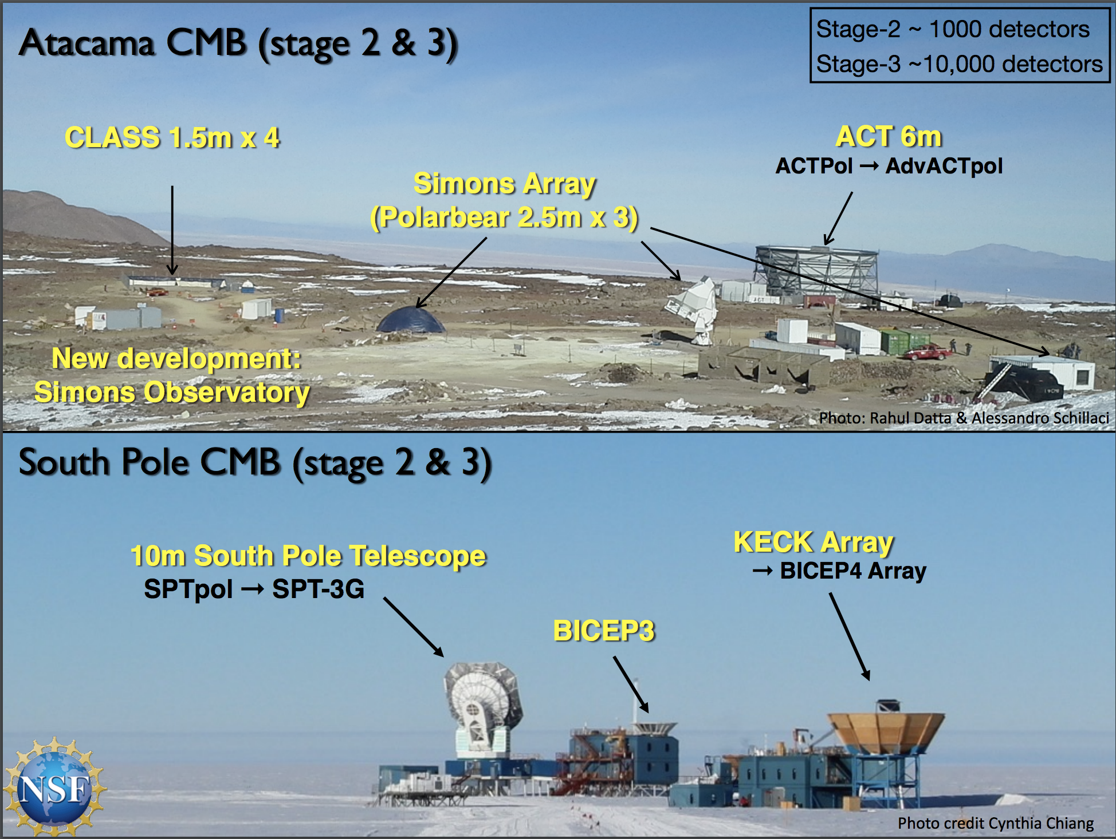
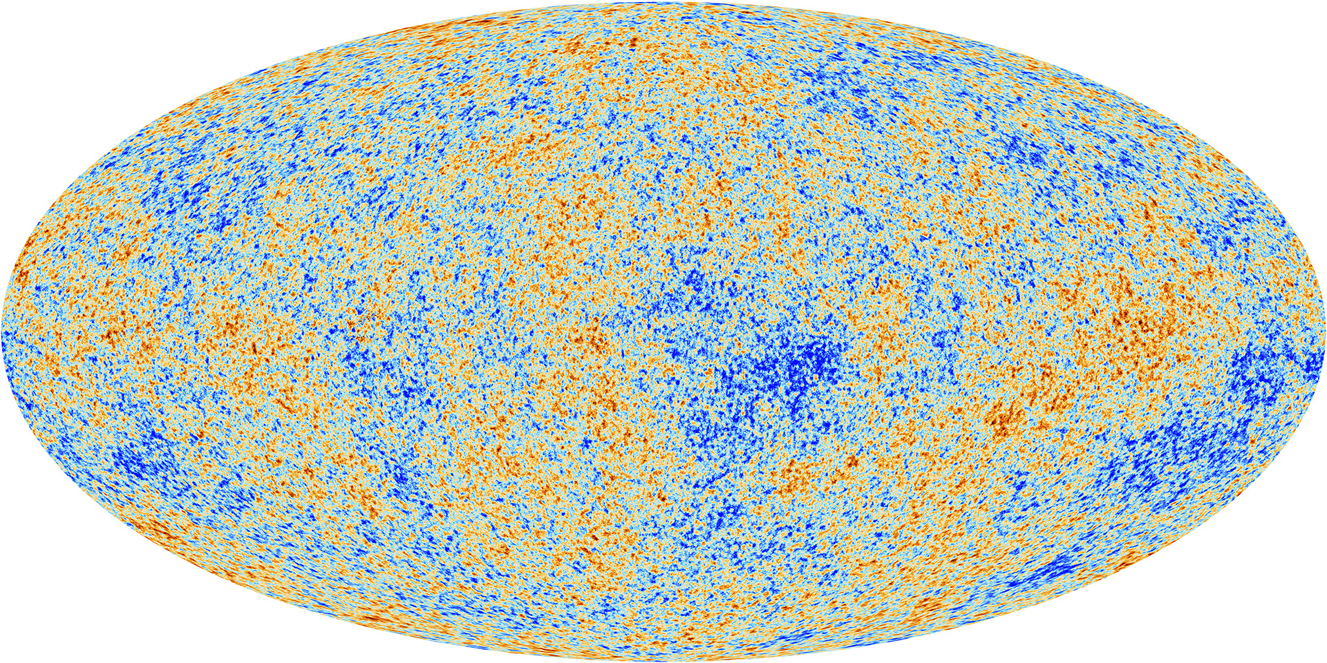
The CMB landscape – state of the art
SPACE
GROUND
Planck satellite
+ BALLOON experiments
Notes:
Say I am part of the ADVACT collaboration!

Slide 24

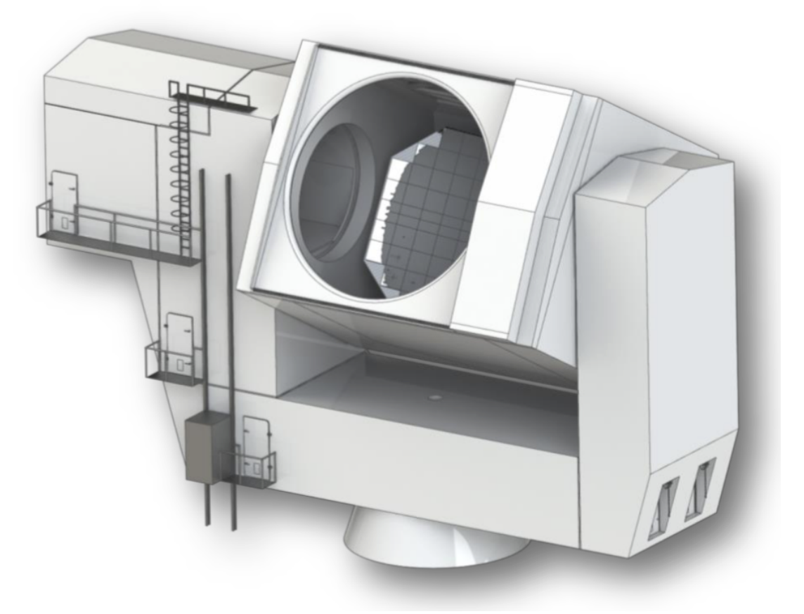
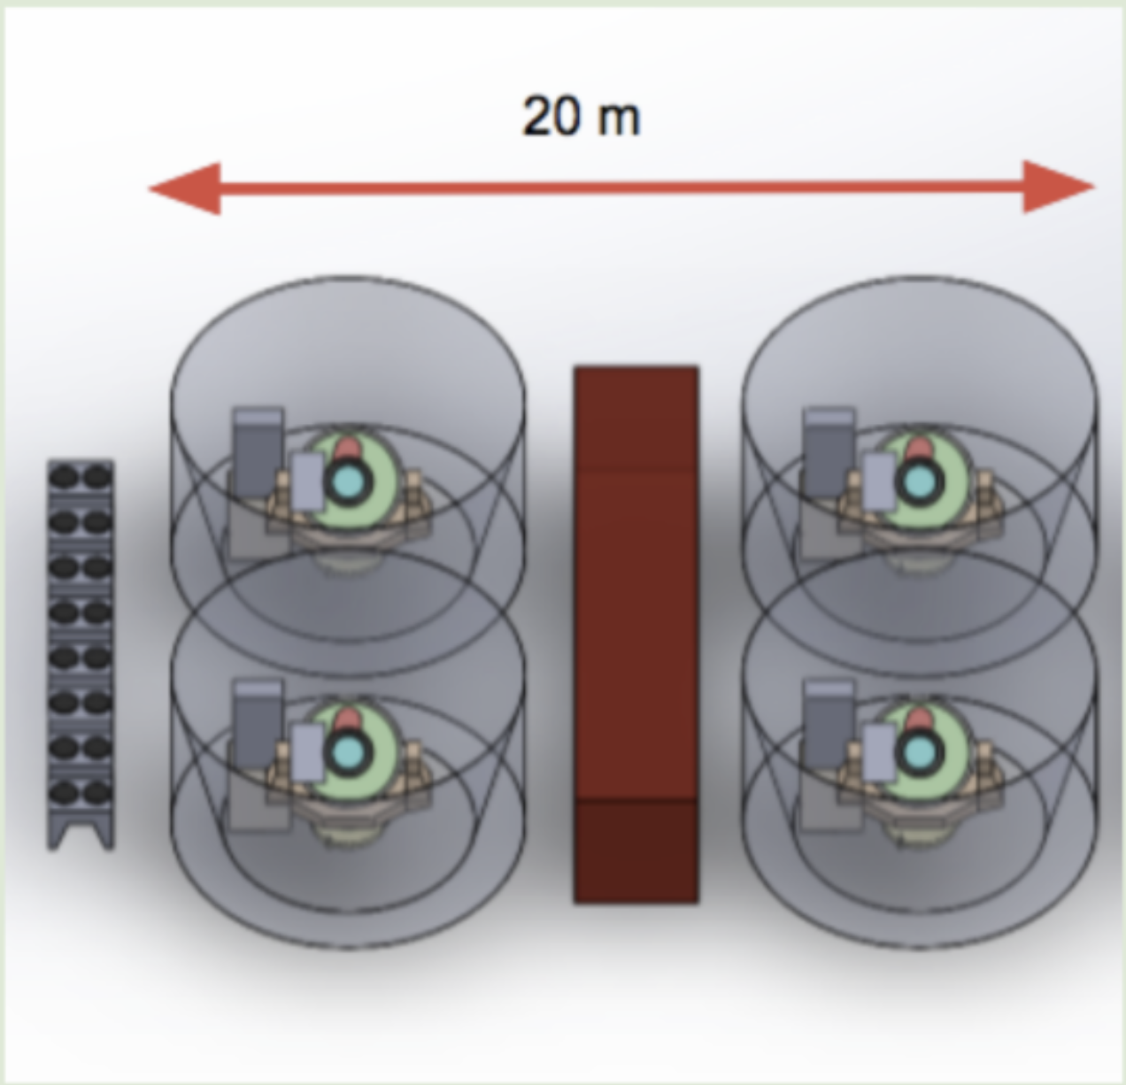

The CMB landscape – early 2020s
Large Aperture Telescope
one 6 meter in diameter
Small Aperture Telescopes
~eight 42 cm refractors
10 Countries
40+ institutions
Key LBL participation
Large frequency coverage (30 – 270 GHz)
Fully funded
6-year program
First light in 2024!
Followed by
(LBL lead Lab)
Notes:
Stress LEADER!!
100M dollar experiment. Spent a lot of my time optimizing science returns.
Frequency coverage is key for foregrounds removal

Slide 25
Can we improve?
Future surveys will measure the amplitude on the sky to better than 0.5% (both CMB and LSS)
We are looking for a 4% suppression (or larger)
So, no problem??
Reionization is the limiting factor in getting measuring the amplitude from CMB!

Slide 26
CMB and reionization
~94% of photons
travel from the CMB to us
without scattering*
~6% scatter with matter
Optical depth 𝜏 =
fraction of CMB
photons that
scatter with matter
CMB actually measures

Slide 27
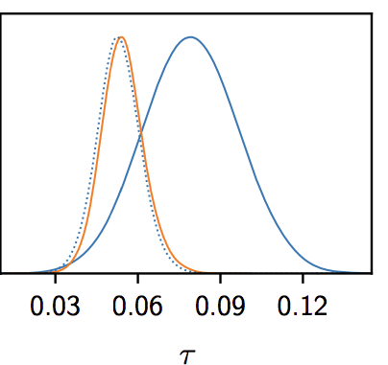


Current best measurements
Planck 2018
Amplitude
known to 1.5%
Not limited by surveys, but by
knowledge of 𝜏!

Slide 28
Better 𝜏 measurements?
Measure from the large-scale polarization of the CMB. Not accessible by the ground → need to go to space!
Current proposed missions: LiteBird (UCB/LBL + Jaxa), CORE (ESA), PICO (NASA)
New ideas?

Slide 29
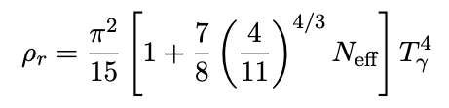

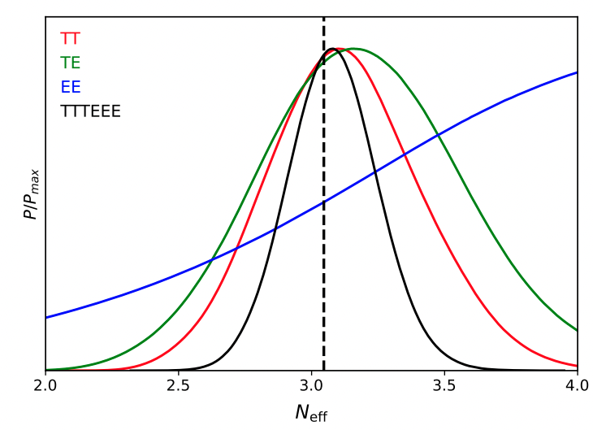


Light relics
Consider other (beyond Standard Model) light particles that are relativistic at CMB (eg sterile neutrino?):
In the Standard Model:
From the CMB:
Completely a gravitational
measurement!
Goal for CMB-S4:
arXiv:2309.10034

Slide 30
Thanks!
Interested in exploring fundamental Physics in cosmology?
We have openings at LBNL! Please email me: sferraro@lbl.gov and check out sferraro.lbl.gov

Slide 31
BACKUP

Slide 32
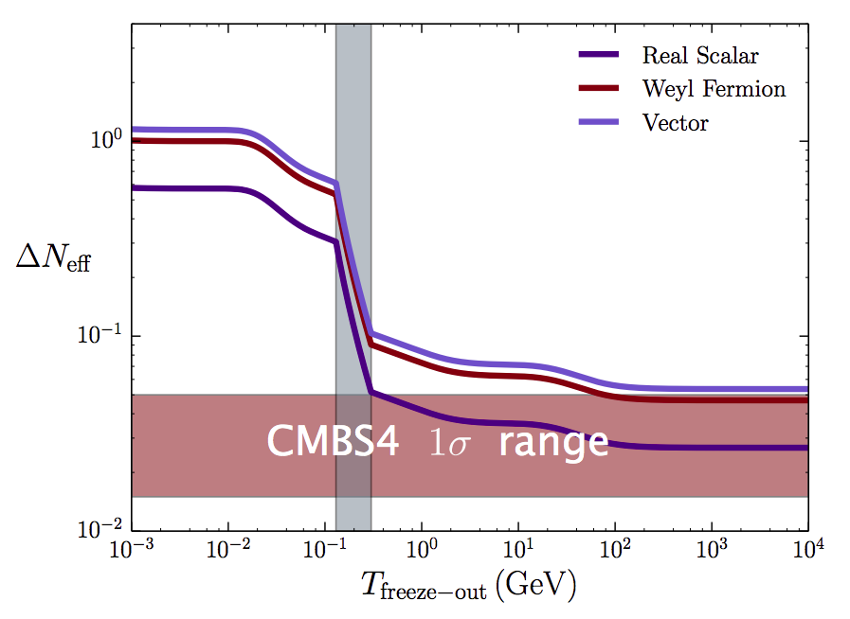
Light relics
Each phase transition/annihilation conserve entropy

