Slide 1
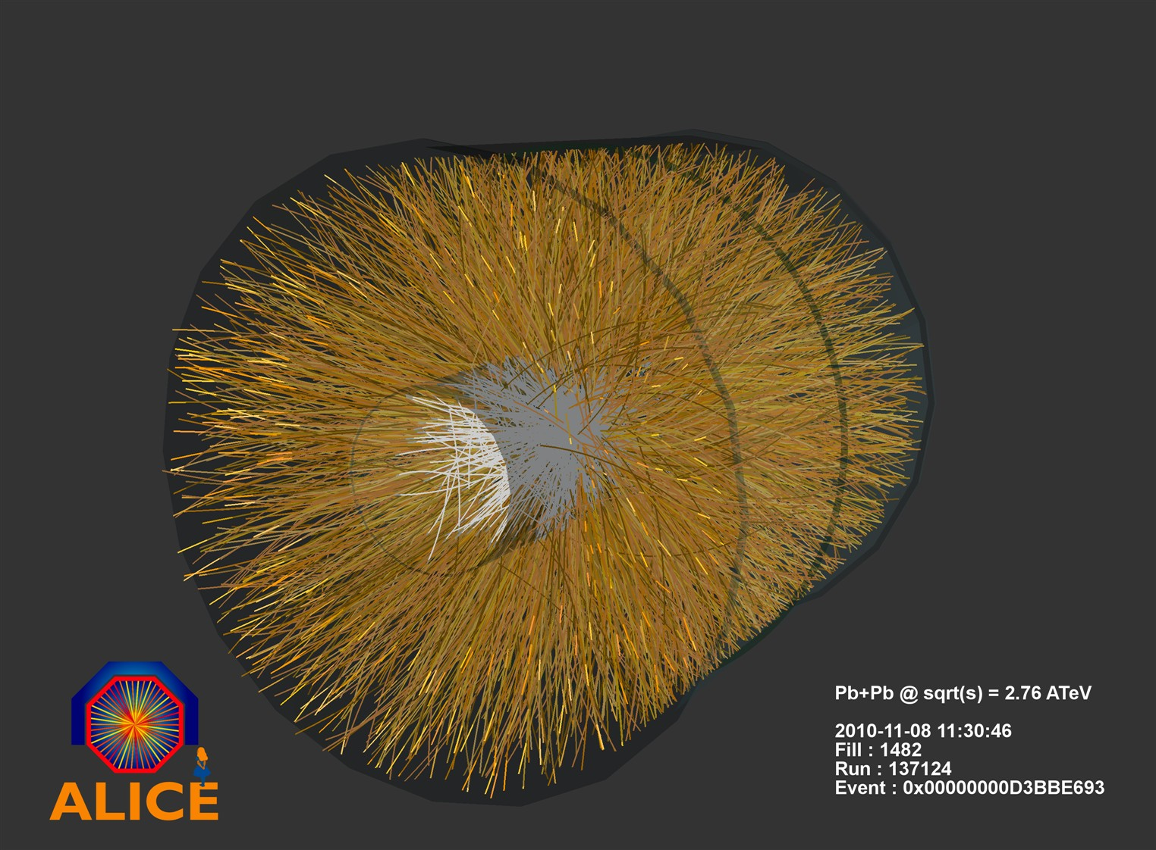
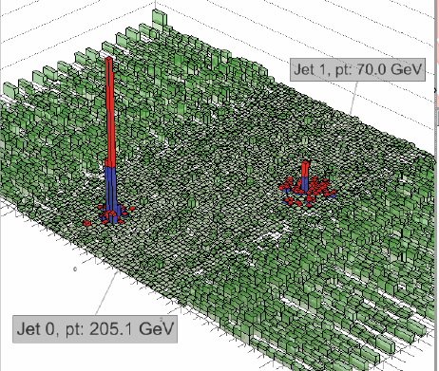
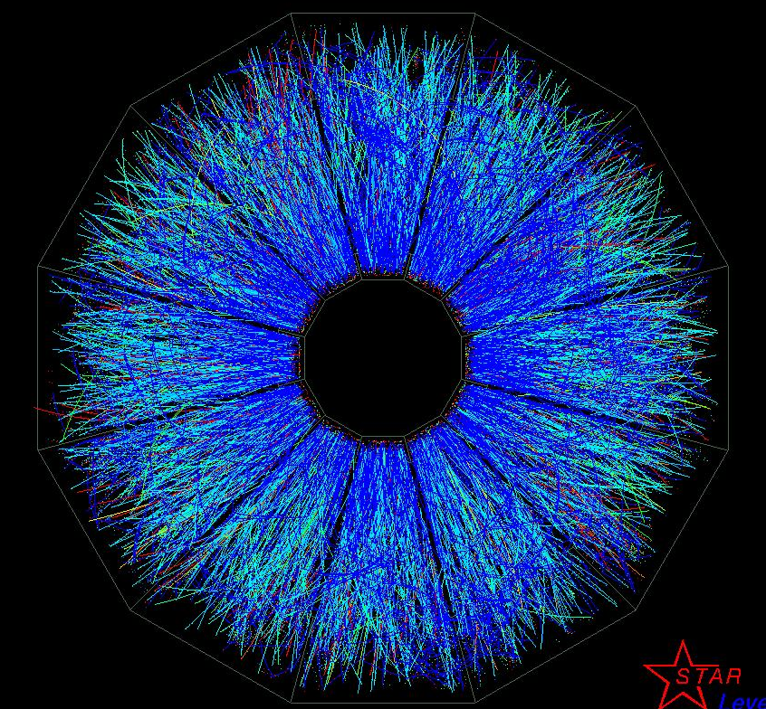
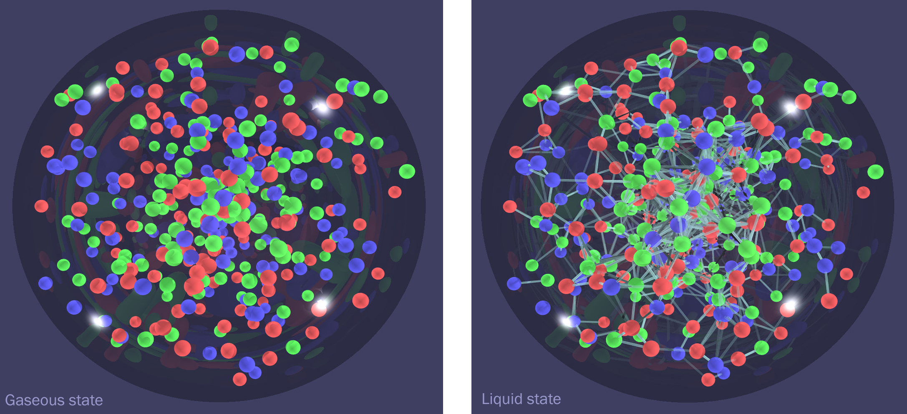
Hot QCD
Barbara Jacak
UC Berkeley
Feb. 17, 2016

Slide 2
outline
Why hot QCD
How – and what - we measure
Controlling the collision
Collective behavior in QCD
Parton interactions with quark gluon plasma
Color screening in quark gluon plasm

Slide 3
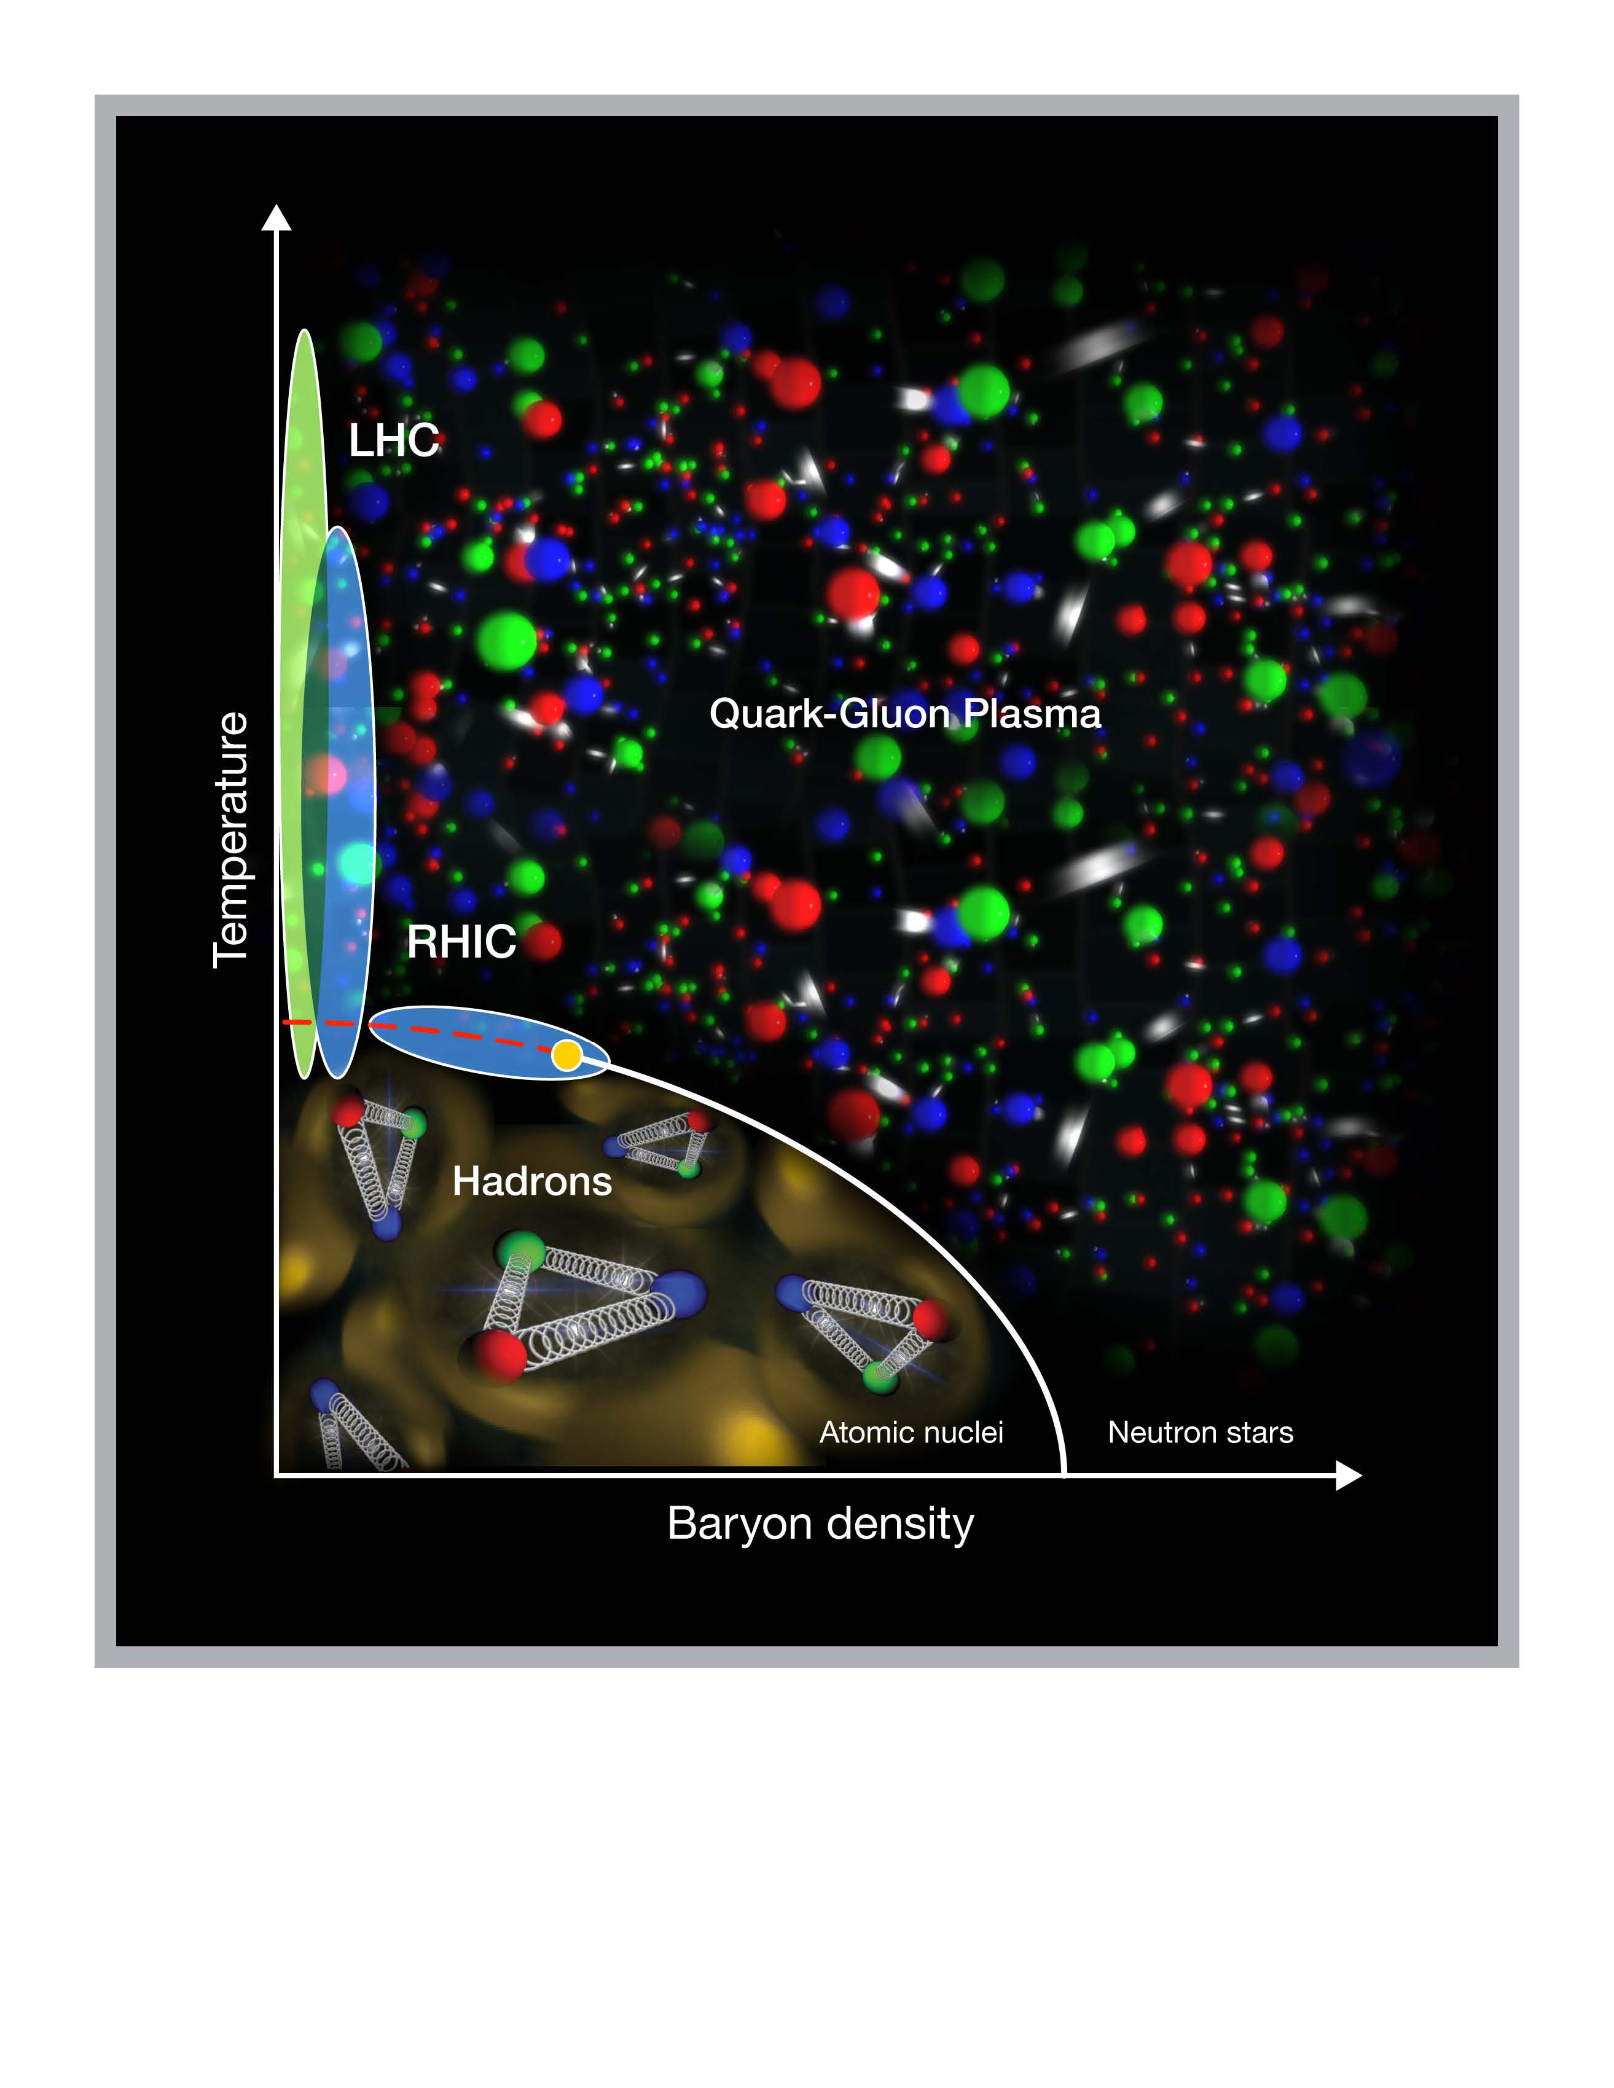
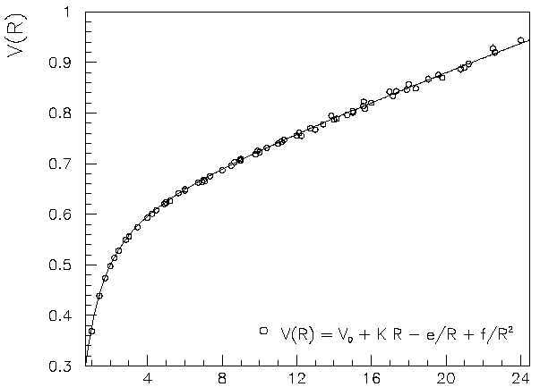
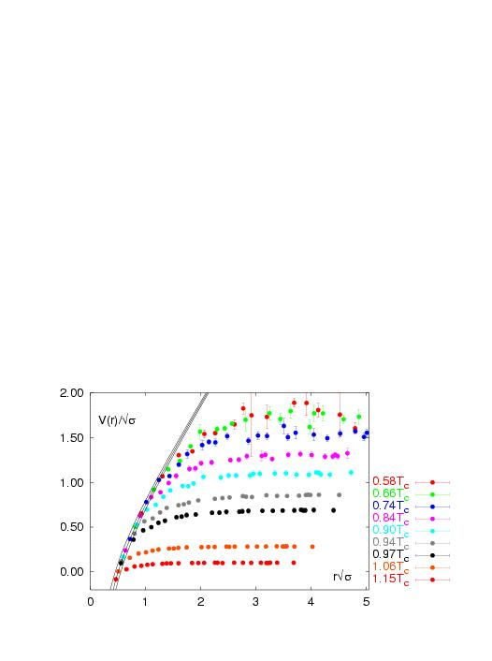
Hot, dense QCD matter
asymptotic freedom
At high temperature/density
screening by produced colored particles
Expect phase transition to
deconfined quark gluon plasma
Lattice QCD → T_{c} ~ 150 MeV

Slide 4
heavy ion collision & diagnostics
time
ε, pressure builds up
Hard scattered q,g
(short wavelength)
probes of plasma
formed
π, K, p, n, φ, Λ, Δ, Ξ, Ω, d,
Hot QGP
Hadrons qqq baryons & qq mesons
reflect (thermal) properties when inelastic collisions stop
thermal radiation (γ, γ∗→ e⁺e⁻, μ+μ−)
not possible to measure as a function of time
nature integrates over the entire collision history

Slide 5
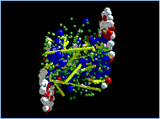
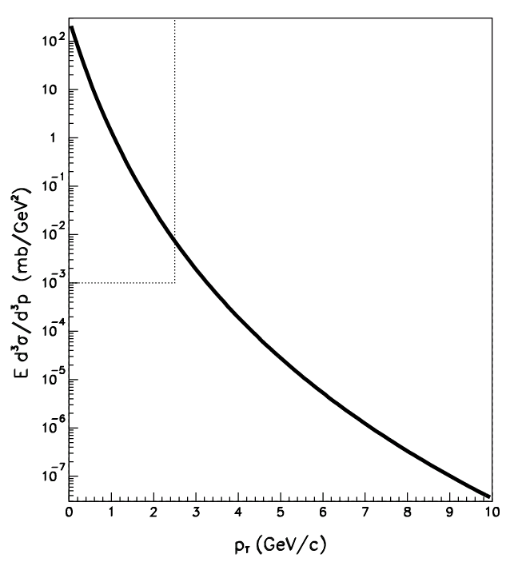
study plasma with radiated
& “probe” particles
as a function of transverse momentum
  90° is where the action is (max T, ρ)
  p_{L} between the two beams: midrapidity
p_{T} < 1.5 GeV/c
  “thermal” particles π,K,p, etc.
  radiated from bulk medium
  “internal” plasma probes
p_{T} > 3 GeV/c
  “large E_{tot}” (p_{T} or M >>T)
  set scale other than T(plasma)
  autogenerated “external” probe
  describe by perturbative QCD
control probe: photons
  EM, not strong interaction
  produced in Au+Au by QCD
  Compton scattering
# scales as N_{part}
# scales as N_{coll}

Slide 6
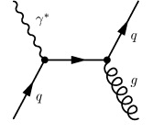
Some cool observables
Compare p+A to p+p for gluon distribution in A
  Use QCD Compton scattering
  What to measure to study
  thermalization (pre-equilib)?
Penetrating probes
  γ or e⁺e⁻ emitted during thermalization?
Lasting probes (which may survive later stages)
  Correlations and fluctuations among groups of particles
  Pre-equilibrium flow?

Slide 7
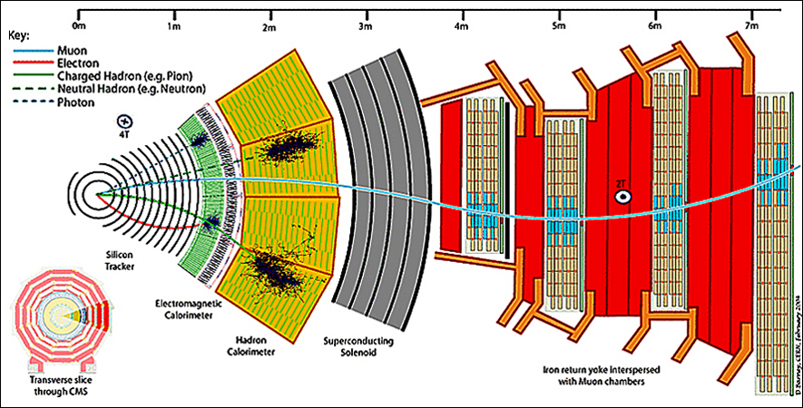
How to measure all this stuff?
+ dE/dx & Time-of-flight: hadron ID + Cherenkov & TRD: electron ID
High granularity to handle high multiplicity

Slide 8
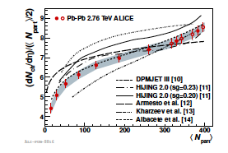
Handling high multiplicities
1700 particles per unit η
Challenge for Si: # of space points
Challenge for TPC: space charge
Trick: reconstruct collision vertex & use it in track reconstruction
Luminosity = frequency*n₁*n₂/(4πσ_{x}σ_{y})
higher Z -> lower n
@RHIC <L> in Au+Au /pp ~ 1/600
Just how tough is this?
For p+p collisions, value is about 4 particles per unit η
But, luminosity is much higher!
Pileup in high luminosity p+p = 150 events/crossing (dN/dη ~ 600)
but these are from different vertices!!
Pile-up rate in ATLAS in 2015?
ATLAS handles a similar tracking problem (it can do HI collisions!)

Slide 9
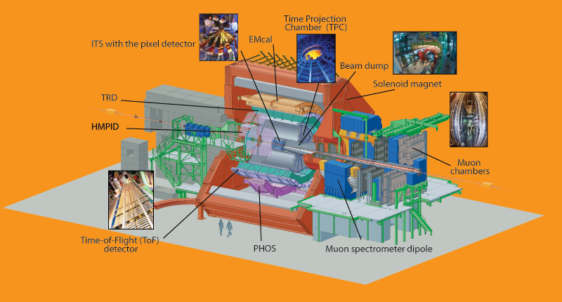
PID in ALICE

Slide 10
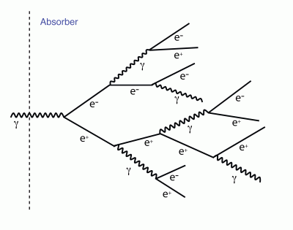
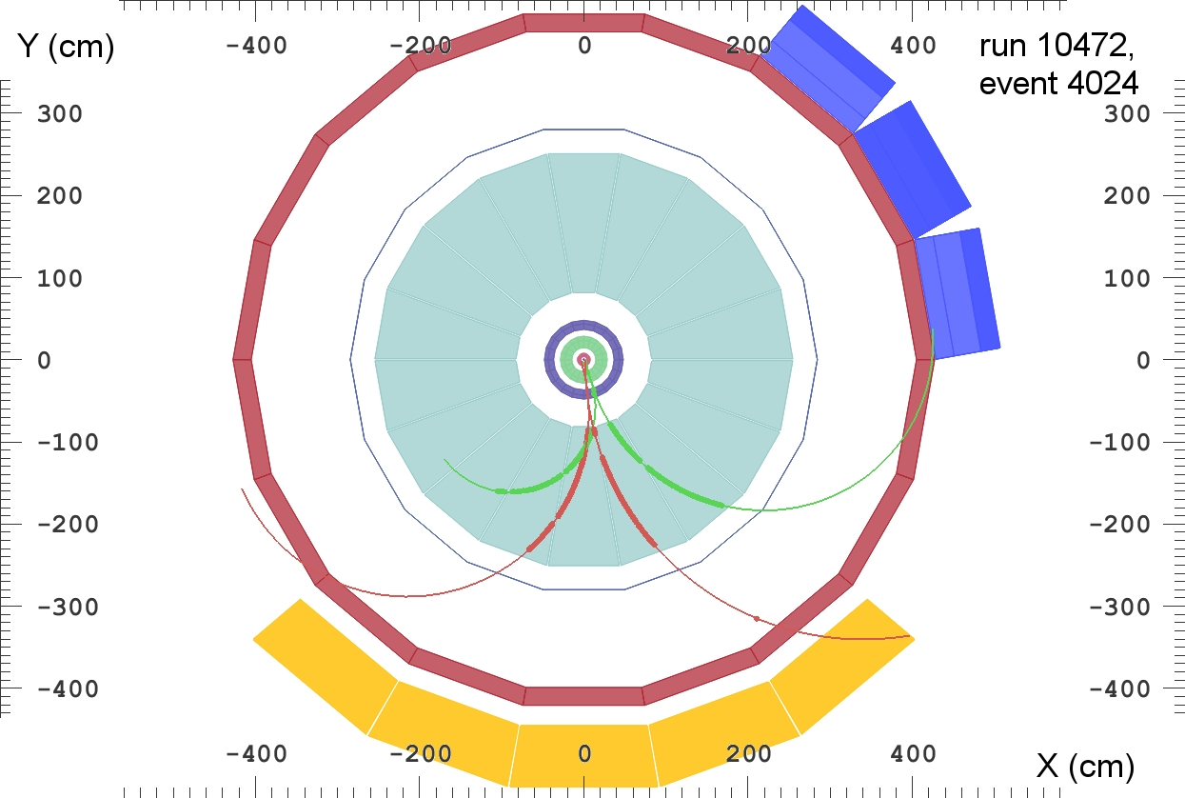
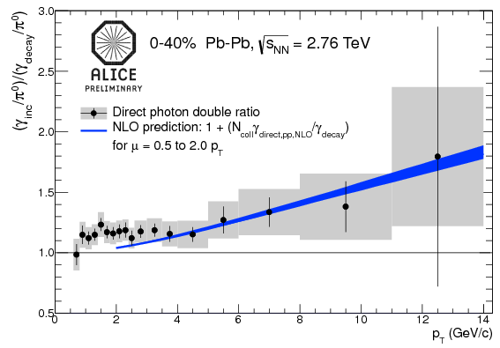
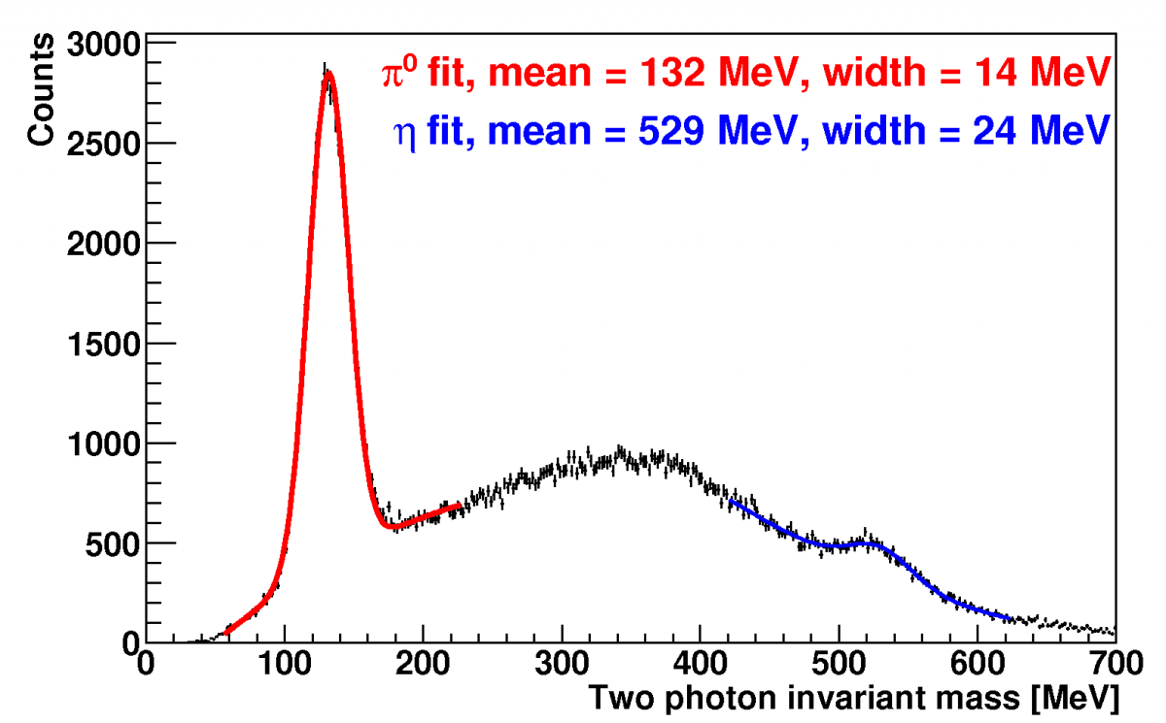
Measuring photons
Two ways to measure photons
Big backgrounds
conversions
calorimetry

Slide 11
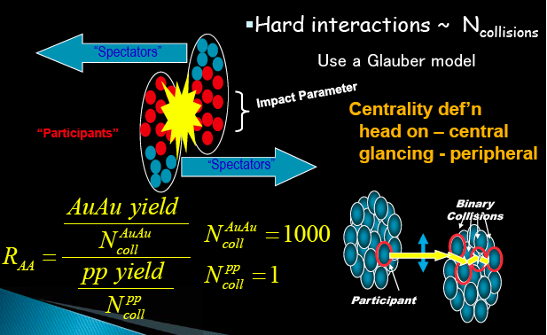
Geometry of heavy ion collisions
ameter = b
Use Glauber model of nucleons in nuclei
calculate # of participant nucleons N_{part}
# of binary NN collisions N_{coll}

Slide 12
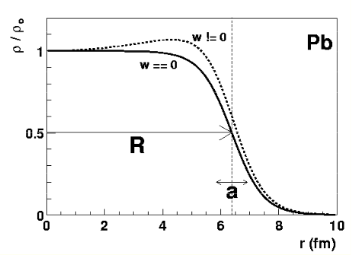

Glauber model: calculate probabilities
Nucleus B
Nucleus A
b_{B}
z_{B}
b
b_{A}
z_{A}
Woods-Saxon nuclear density profile:
volume element in B: db_{B}dz_{B}
volume element in A: db_{A}dz_{A}
Probability of finding a nucleon in volume element A =
ρ_{A}(b_{A},z_{A}) db_{A}dz_{A} (ρ_{A} is nuclear density * nucleons in A)

Slide 13


Probability of n interactions
Thickness function in nucleus A:
s measures transverse overlap – given by b and nucleus R
Thickness function for A+B:
Probability of n interactions is given by binomial distribution:
Number of nucleon-nucleon collisions:

Slide 14
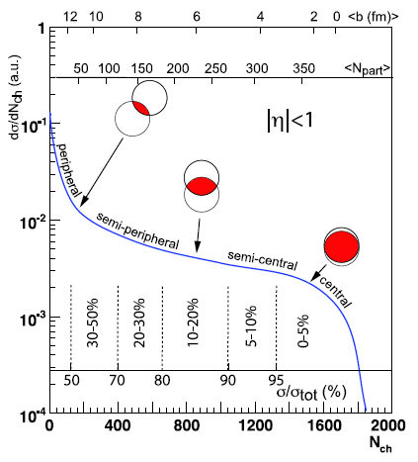
Collision centrality

Slide 15
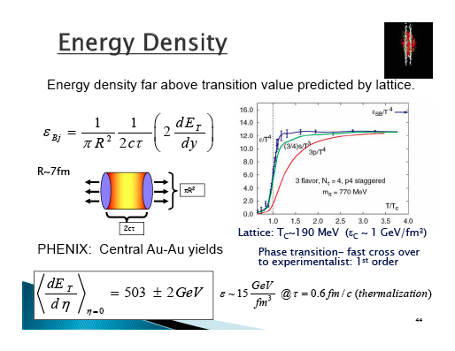

Slide 16
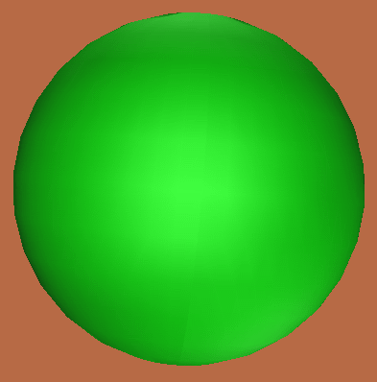
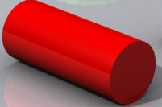
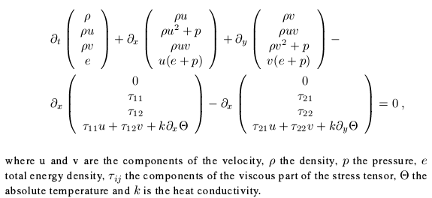
Does the matter exhibit collectivity?
Look for collective flow via velocity boosts
  Model expansion of the system with fluid dynamics
Nuclear theorists have found solutions for 3-D viscous hydro!

Slide 17
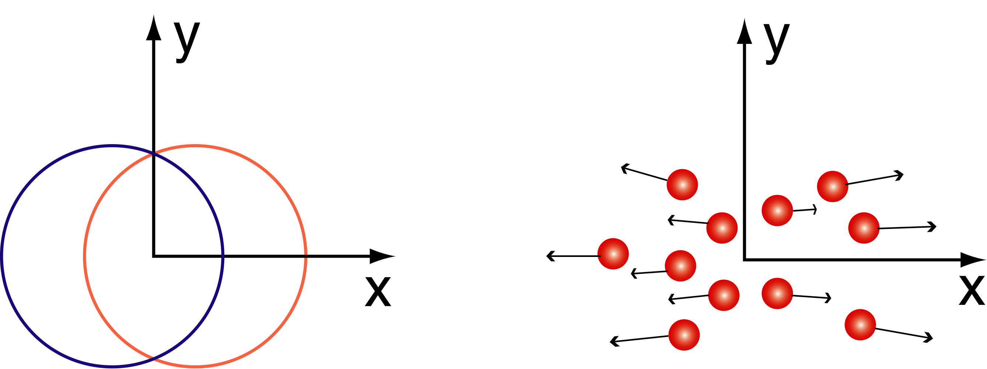
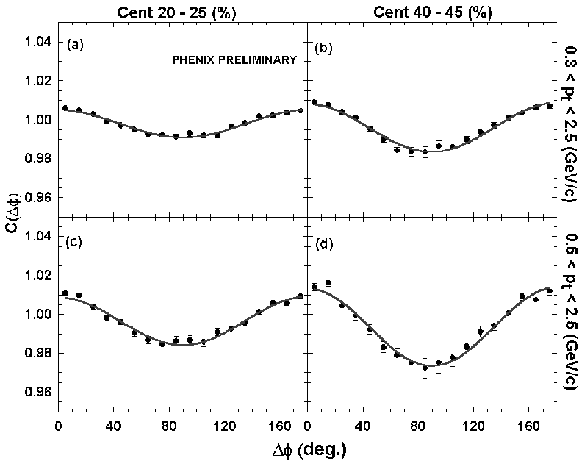
Collective motion & elliptic flow (v₂)
Almond shape overlap region in coordinate space
z
y
x
momentum space
dN/dφ ~ 1 + 2 v₂(p_{T}) cos (2φ) + …
hydrodynamics works!

Slide 18
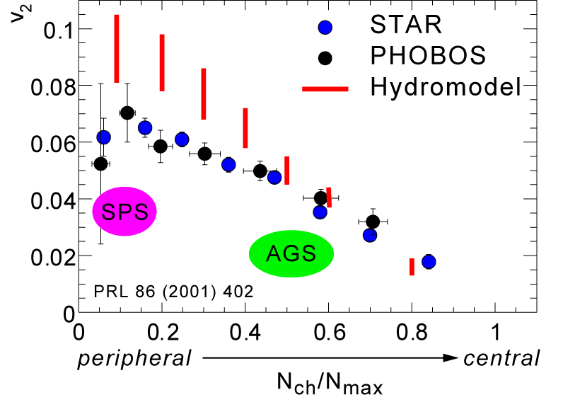
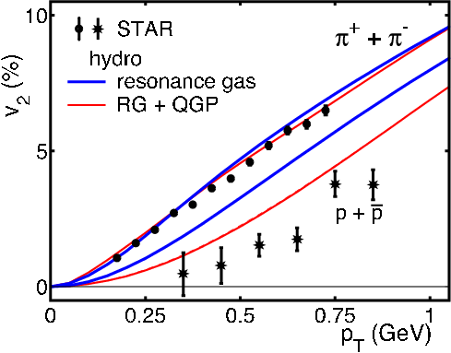
Surprise: matter flows like a liquid
huge pressure buildup
large anisotropy →
it all happens fast
efficient equilibration
mechanism??
Kolb, et al
Hydrodynamics reproduces
elliptic flow of q-q and 3q states
Mass dependence requires
soft EOS, NOT gas of hadrons
only works with low viscosity/entropy
“perfect” liquid (D. Teaney, PRC68, 2003)

Slide 19
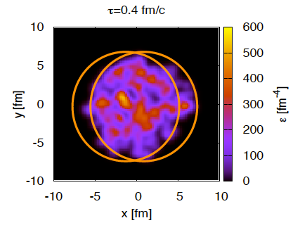
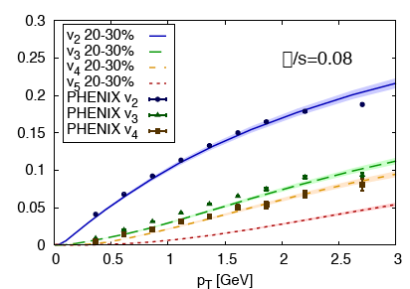
Fluctuations matter!
Nucleons move around inside the nucleus
-> locations of NN scattering fluctuate
-> apparent symmetry effects yielding only even harmonics not realistic
η/s=0.08
Reproduce with hydro
IF include fluctuating initial conditions
Provides a tool to better pin down the viscosity/entropy ratio
arXiv:1109.6289

Slide 20
Hydro including event-by-event fluctuations
Use the same Glauber model
MC to allow nucleon positions to fluctuate
  Generate an ensemble of hydro calculations with different initial states
Woods-Saxon nuclear density profile:

Slide 21
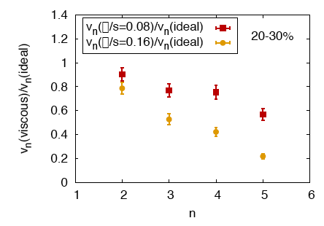
Higher moments more sensitive to viscosity
v_{n}(η/s=0.08)/v_{n}(ideal)
v_{n}(η/s=0.16)/v_{n}(ideal)
arXiv:1109.6289
Longitudinal expansion at v ~ c
“freezes in” small shape
  perturbations
  e.g. triangular fluctuations (v₃)
Viscosity is like friction!

Slide 22
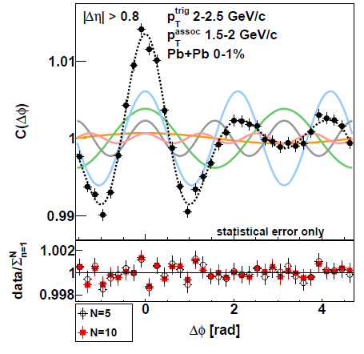
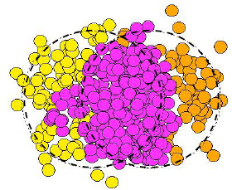
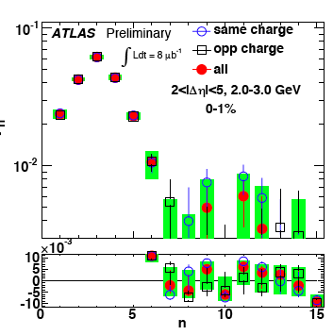
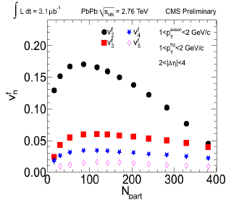
LHC data
ALICE
v₃
v₂

Slide 23
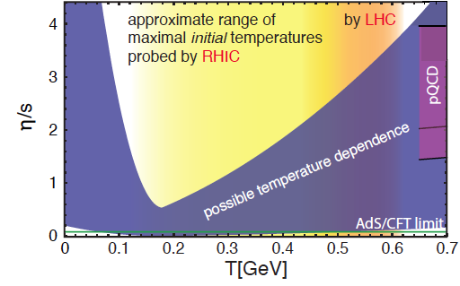
Shear viscosity depends on temperature

Slide 24
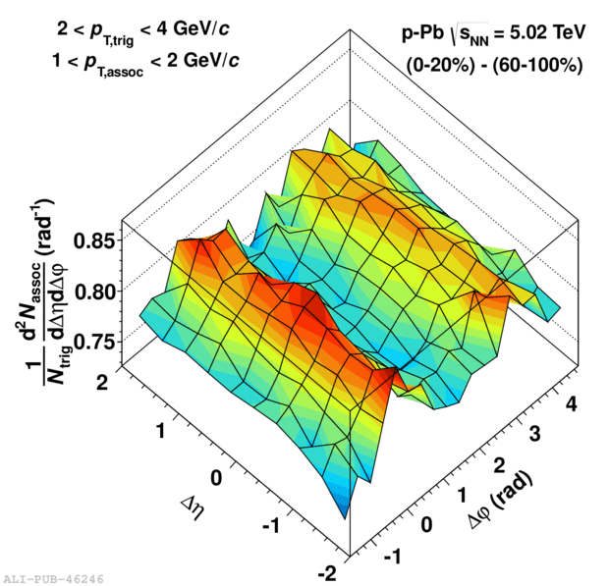
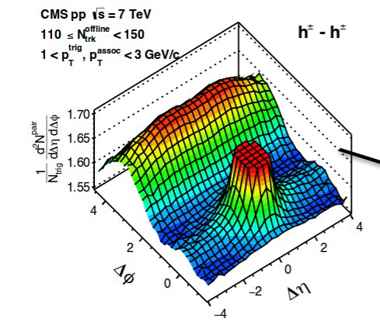
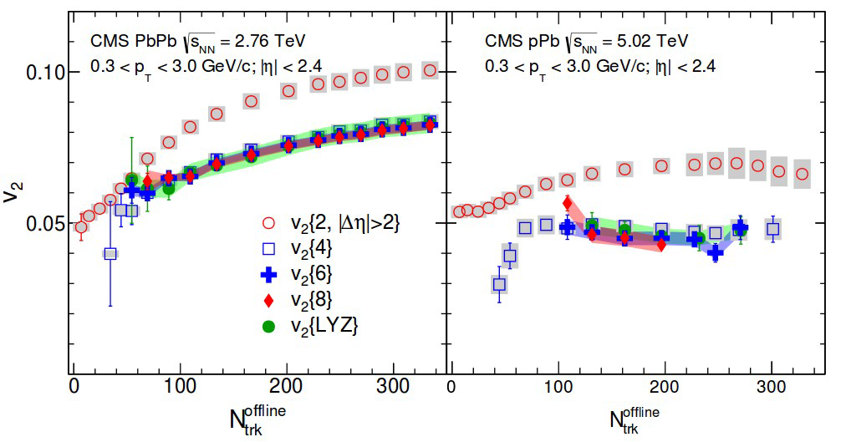
Collective flow in small systems?
p+Pb
p+p
Significant v_{N} (n=2 to 5) with
“familiar” ordering + shape in p_{T}
Multi-particle correlations
(v2{4}≈v2{6}≈v2{8}≈v2{LYZ})
What is going on?
  Hydrodynamics in small(ish) systems? Correlations between particles produced in initial state? Radial flow an artefact of constant temperature freezeout surface?

Slide 25
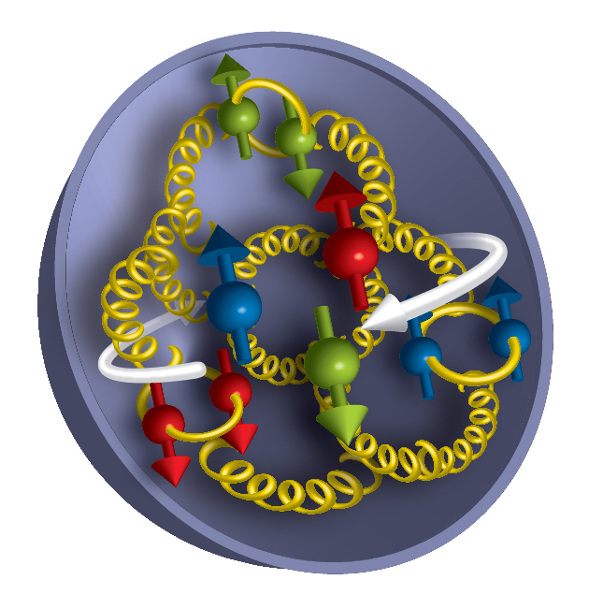
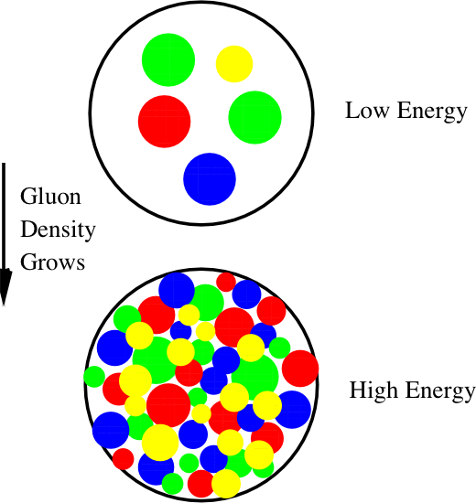
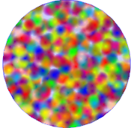

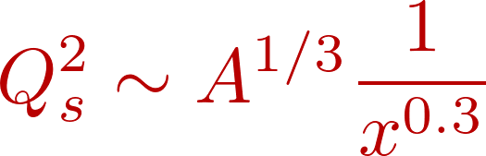
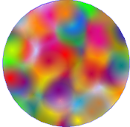
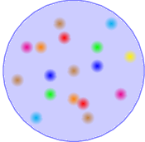
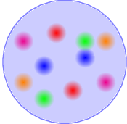






Hot, dense gluonic matter is surprising
Are cold dense gluons wierd too?
    Look deep in a nucleus: gluons are numerous
    At high density
    what then?
This is our initial state in heavy ion collisions!
Saturation
Smaller gluon momentum➔
1/Q_{S}²
BFKL
DGLAP
Increasing probe energy ➔
+
?
Probe with e+A

Slide 26
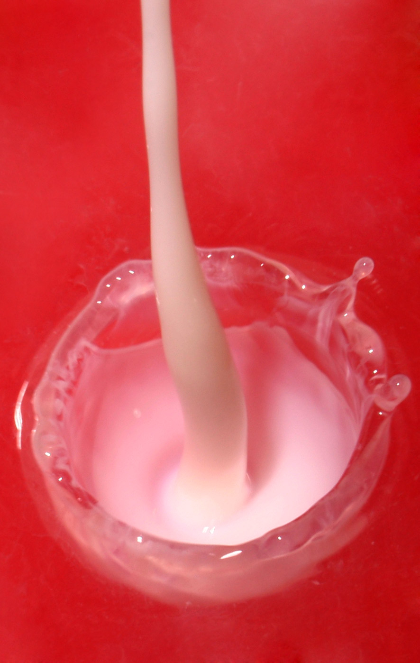
Surprise: viscosity/entropy is small
Viscosity: inability to transport momentum & sustain a wave
low η → large σ, transports disturbances
Viscosity/entropy near 1/4π limit from quantum mechanics!
∴ liquid at RHIC is “perfect”
Example: milk. Liquids with higher viscosities will not splash as high when poured at the same velocity.
Good momentum transport: neighboring fluid elements “talk” to each other
→ QGP is strongly coupled
Should be opaque:
e.g. q,g collide with “clumps”
of gluons, not individuals

Slide 27
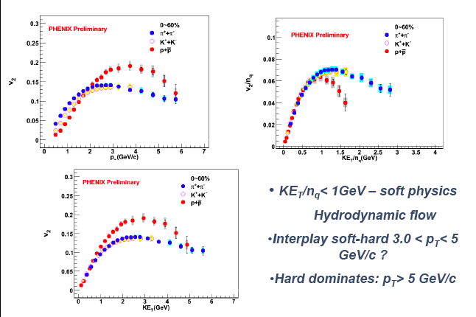
p_{T} dependence of v₂
It’s the quarks that flow!

Slide 28
Do fast quarks & gluons escape the plasma?
They feel the strong interaction, so they
should interact

Slide 29
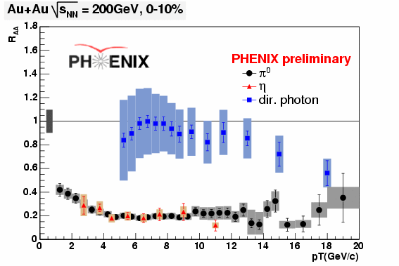
colored objects lose energy, photons don’t
Nuclear modification factor:
VERY opaque! Lots of gluon radiation (bremsstrahlung)

Slide 30
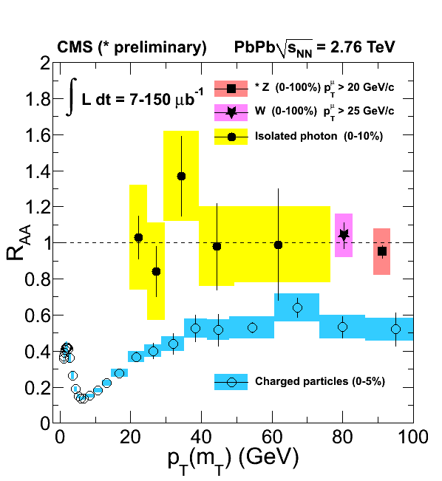

Energy loss even by very energetic q & g
LHC experiments reach to 300 GeV!

Slide 31
Energy loss depends on medium density
In dilute medium
  Independent processes: bremsstrahlung & scattering
  Calculate probabilities and add them up
  Independent radiations follow Bethe-Heitler
In dense medium
  Mean free path is short: λ = σ/ρ
  Formation time of radiated gluon: τ = ω/k_{T}²
  Transverse momentum of radiated gluon: k_{T}²=nμ²
  # of collisions n=L/λ, μ=typical p_{T} transfer in 1 scattering
  λ,μ are properties of the medium, combine to q= √μ²/λ
Coherence in the dense medium!
  Next scattering takes place faster than gluon formation
  Add amplitudes for all multiple scatterings
  In QCD this increases the energy loss!
  some evidence for coherence already in cold matter!
<

Slide 32



Fit R_{AA} at different √s
arXiv:1312.5003
JET collaboration fit all data with multiple calculations
minimize χ2 for best fit to strong coupling parameter or q
<
AMY
model
Put together all the calculations

Slide 33

Interactions with plasma?
radiation (bremsstrahlung)
collisional energy loss
In plasma: interactions among charges of multiple particles
charge is spread, screened in characteristic (Debye) length, λ_{D}
also the case for strong, rather than EM force … Effect on collisions?
AdS/CFT says QGP is a strongly interacting field, model as ∞ strong
  Interact with this QGP as with a tiny black hole
  No particles to hit, none can survive inside. Eloss ➔ collective excitations
Δ
S. Gubser

Slide 34
Back to QCD…

Slide 35


Slide 36


coherent limit
Subsequent splittings drive color de-coherence of 1st generation emitted gluons & softer leading partons

Slide 37
How this is calculated
There is a great paper comparing vacuum DGLAP evolution to an in-medium cascade (BDMPS), which depends on q.
See Blaizot and Mehtar-Tani:
http://arxiv.org/pdf/1501.03443v1.pdf
In medium cascade results in energy flow to x~0 due to multiple branchings. DGLAP has an infrared cutoff. DGLAP branching time is constant, while in BDMPS it decreases along the cascade. This allows transport of energy to very soft gluons in a finite amount of time. Result looks a lot like wave turbulence
A good topic for a (somewhat technical) QCD talk!
<

Slide 38

Jet asymmetry

Slide 39


Where does the lost energy go?
We don’t know yet!
Medium enhances gluon radiation/splitting:
  extra gluons at small
  angles (in/near jet cone)
  radiated gluons thermalize in medium (i.e. they’re gone!)
  remain correlated with leading
  parton, but broaden/change jet

Slide 40


Jet Fragmentation function
D(z) = 1/N_{jet} dN(z)/dz; z = p_{had}/p_{jet}
Measure: count partners per trigger as fraction of trigger momentum
z_{T} = p_{Ta}/p_{Tt} ~ z for γ trigger
ξ = ln(1/z_{T})
Modification factor similar to R_{AA}:
FFn experimental challenge:
measure the parton p
Use trigger γ or jet

Slide 41

Modified in AA vs. p+p

Slide 42


PHENIX: FFn via γ-h correlation
γ: parton energy, h: fragmentation fn.
“Extra” soft particles at larger angles near the away side jet
Au+Au/
p+p
Provide constraints on gluon splitting
Perturbative?
PRL 111, 032301 (2013)

Slide 43

G. Roland

Slide 44
A jet is a partonic probe
It’s not a photon…
It can lose energy before the hard scattering
It can lose energy after the hard scattering
It can experience multiple scattering
These may not be independent!
These are not just “background”
Higher-twist physics is interesting, not well understood,
as well as relevant to parton-plasma interaction !
Should measure γ-h correlations in cold nuclear matter!
this is underway in p+A!

Slide 45

Change the probe! pA vs. eA
Hadron-Hadron
T. Ullrich
Electron-Hadron (DIS)
p
p/A
p/A
  More direct information on the response of a nuclear medium to gluon probe
  Probe has structure as complex as the “target”
  Soft color interactions before the collision can alter the nuclear wave function and destroy universality of parton properties (break factorization)
    Point-like probe
    Dominated by single photon exchange ⇒ no direct color interaction ⇒ preserve the properties of partons in the nuclear wave function
    High precision & access to partonic kinematics
    Nuclei always “cold” nuclear matter (CNM)
Notes:
x = \frac{2 m_T}{\sqrt{s}} \sinh y
x_{\color{red}1} &=& \frac{Q}{\sqrt{s}} \ e^{\color{red}y} \\
x_{\color{red}2} &=& \frac{Q}{\sqrt{s}} \ e^{\color{red}-y}

Slide 46
Heavy quark probes of QGP

Slide 47


Charm quarks also lose energy and flow!
Charm quarks diffusing through strongly coupled QGP
Collisions drive energy loss and push charm along with the bulk

Slide 48




Upgrade ALICE for heavy quark probes in Run3
Silicon detector arrays around beam pipe
  Tag displaced vertex to separate c,b
  Reconstruct D & B mesons from their decay hadrons
MAPS technology used for STAR at RHIC
ALICE
build now
for Run3
(2020)

Slide 49


Flow and suppression as for light quarks

Slide 50


Is there a relevant screening length?
Plasma: interactions among charges of multiple particles
  spreads charge into characteristic (Debye) length, λ_{D}
  particles inside Debye sphere screen each other
Strongly coupled plasmas: few (~1-2) particles in Debye sphere
  Partial screening -> liquid-like properties
  sometimes even crystals!
Test QGP screening with heavy quark bound states
c + c and b + b : J/ψ & Υ
  Do they survive?
  All? None? Some? Which size?

Slide 51





Color screening in quark gluon plasma
q-qbar potential in vacuum:
screened:
Screening length in EM plasma:
in (ideal) QGP, particle density so:
For α_{s} ~ 0.2, find:

Slide 52

J/ψ vs. system size, √s
Low p_{T}
No clear suppression pattern with √s, T!
Why more suppression at y=2?
Late break-up?
Final state coalescence of qq?
J/ψ R_{AA} ~same from 17.5-200 GeV!
2.76 TeV direct J/ψ lower at mid-y, inclusive above at forward y

Slide 53
Lose some and gain some
QGP screens primordial c-cbar and b-bbar
  Melting depends on binding energy (i.e. size of bound state)
  Look at J/ψ vs. ψ’ vs. Υ states
quarks find one another when system cools to T~150 MeV
  coalesce to form the hadrons we observe
Occasionally a c can find a cbar
  “regeneration” or “coalescence”
  Probability increases with c-cbar pairs
  Increases with beam energy
  Confuses measurements of melting
Measure energy & quark mass dependence to sort out
  b’s are rare, so Υ is a good screening probe
Initial state affects c&b production – so must measure p+A!
J/Ψ

Slide 54

Suppression pattern ingredients
arXiv:1010.1246
Color screening
Final state coalescence
Initial state effects
  Shadowing or saturation of
  incoming gluon distribution
  Initial state energy loss
  (calibrate with p+A or e+A)
Final state effects
  Breakup of quarkonia due
  to co-moving hadrons
  (calibrate with A &
  centrality dependence)

Slide 55
d+Au -> J/ψ from PHENIX
Au
Forward + y
d-going
Backward - y
Au-going
d
8/13/12
Au

Slide 56

Shadowing, breakup & Cronin effect
PRC87, 034911 (2013)
J/ψ
p_{T} broadens (multiple scattering) w/N_{coll}; effect stronger at y=0
J/ψ suppressed to higher p_{T} @ mid & forward y (lower x in Au);
R_{dA}>1 at high p_{T} backward (Cronin effect in Au nucleus )
p_{T}, y, centrality dependence was not reproduced by the models

Slide 57
but
d+Au -> J/ψ
Arleo, et al 1304.090
coherent parton energy loss and p_{T} broadening from multiple scattering in the nucleus is consistent with data!
ˆq₀ = 0.075 GeV²/fm
Dynamics of the probe & structure of the medium mix!!

Slide 58


b-bar bound states at the LHC
Many c-cbar at LHC: coalescence important. Use b-bar probe
ϒ (2S,3S)
suppressed

Slide 59



Probe nucleons & nuclei with electrons
How many gluons are there?
        Measure e+p, e+A ➔ e
How are they distributed?
    In space? In momentum?
    Measure e+p, e+A ➔ e + hadrons, e + γ or J/ψ
How are they correlated inside nucleus?
        Measure e+p, e+A ➔
        e + ≥ 2 hadrons
What’s gluon range inside a nucleus?
      Measure hadron production
In vacuum
In nucleus

Slide 60


EIC kinematic reach
An electron-ion collider
probe structure directly
Enhance Q_{S} with A, not energy

Slide 61

Electron-ion collider

Slide 62
backup slides

Slide 63
Questions
Can we create quark gluon plasma in the lab?
thermodynamic properties (equilibrium)
  T, P, ρ
  Equation Of State (relation btwn T, P, V, energy density)
  v_{sound}, static screening length
transport properties (non-equilibrium)*
  particle number, energy, momentum, charge
  diffusion sound viscosity conductivity
In plasma: interactions among charges of multiple particles
charge is spread, screened in characteristic (Debye) length, λ_{D}
also the case for strong, rather than EM force
  *measuring these is new for nuclear/particle physics!

Slide 64


Stochastic cooling keeps bunches tight
Coulomb interactions among highly charged ions blow up the beam bunches
Measure and send correcting kick to outliers (at each go-round)
Huge increase in beam lifetime and luminosity!

Slide 65
Mechanism for fast thermalization?
Must be thermalized in < 1 fm/c!
  Otherwise v₂ smaller than in the data
Can this be achieved with gg, qg, and qq binary scatterings?
  NO!
  Making this picture yield sufficient v₂, requires boosting the pQCD parton-parton cross sections by a factor of ~50!
Mechanism not known yet. Perhaps start out with correlated gluonic matter at small x?

Slide 66



Elliptic flow scales with number of quarks
transverse KE
implication: valence quarks, not hadrons, are relevant
pressure builds early, dressed quarks are born of flowing field

Slide 67

Eccentricity:

Slide 68

Calculating transport in QGP
weak coupling limit ∞ strong coupling limit
perturbative QCD not easy! Try a pure field…
kinetic theory, cascades gravity ↔ supersym 4-d
interaction of particles (AdS/CFT)
2→3,3→2,n→2…

Slide 69


minimum η at phase boundary?
strongly coupled dusty plasma
B. Liu and J. Goree,
cond-mat/0502009
quark gluon plasma
Csernai, Kapusta & McLerran
PRL97, 152303 (2006)
minimum observed in other strongly coupled systems –
kinetic part of η decreases with Γ while potential part increases

Slide 70


Slide 71


Dense gluonic matter (d+Au, forward y): large effects observed
arXiv:1010.1246
arXiv:1105.5112
Di-hadron suppression at low x
pocket formula (for 2➔2):
Shadowing/absorption stronger than linear w/nuclear thickness
trend as, e.g. in CGC …

Slide 72


More jet probes = more insight
Hadrons
  Single high p_{T} hadrons (leading jet fragments)
  di-hadron correlations
Reconstructed jets (depend on reco algorithm, compare to theory)
  Single jets
  <di-jets> or jet-h correlations
Gamma-jet correlations (photon tags jet energy)
  γ-h correlations
  <γ-reconstructed jet>
Construct the variables: R_{AA}, I_{AA}, A_{J}, q-hat
  Nuclear modification:
  Jet asymmetry:
Jet transport coefficient: q= μ²/λ; μ= <p_{T} transfer> in 1 scattering
<

