Slide 1
Jets in Monte Carlo
Tucker Hwang
290E Seminar

Slide 2
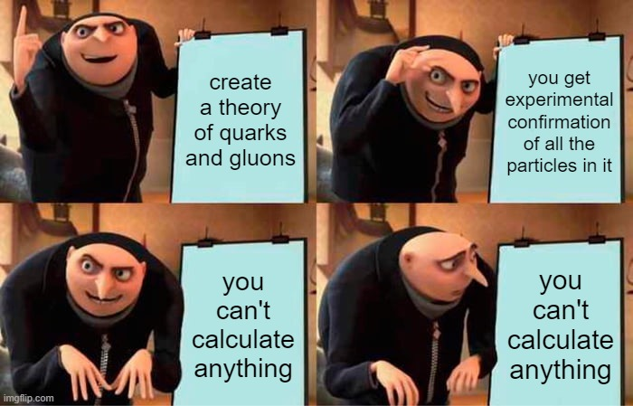
Overview
Overview of Monte Carlo
MC and jets
Jet showering
Jet hadronization
Jets and QGP: quenching

Slide 3
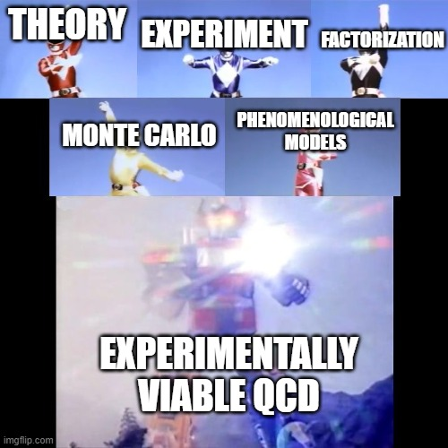
Monte Carlo event generators (MCEG)
Theory-based prediction for exclusive final state in different stages
Impossible exact solution: factorization in descending order of Q²
Hard scattering
Parton shower
Hadronization

Slide 4
Hard scattering
Tree-level matrix element generator
Automation based on
Diagrams: AMEGIC, CompHEP, MadGraph
Recursion: Comix, HELAC, O’Mega
Alpha algorithm: ALPGEN
Separated from parton showering MC via LHEF e.g. HERWIG++, PYTHIA

Slide 5
Matrix element generators
State of the art: automated LO, “tree-level” ME
Bleeding edge: automated NLO?
BlackHat + SHERPA: specialized one-loop correction + general LO
MadLoop: fully automated NLO for pp → X + (0-2)j, limited by CPU
But number of Feynman diagrams scale as n!...

Slide 6
Parton showering
Given hard parton from initial scattering, determine evolution to energy scale Λ_{QCD}
Divergence at zero energy or opening angle: soft and collinear form dominant contributions
Strongly ordered emission: larger angles for earlier emissions
Resummation of LL contributions to all orders

Slide 7
Hmm…
Matrix element
Parton shower
Hard emissions
Higher multiplicity, higher complexity
Soft and collinear emissions
Sudakov suppressed at low p_{T}
Valid for high multiplicity

Slide 8
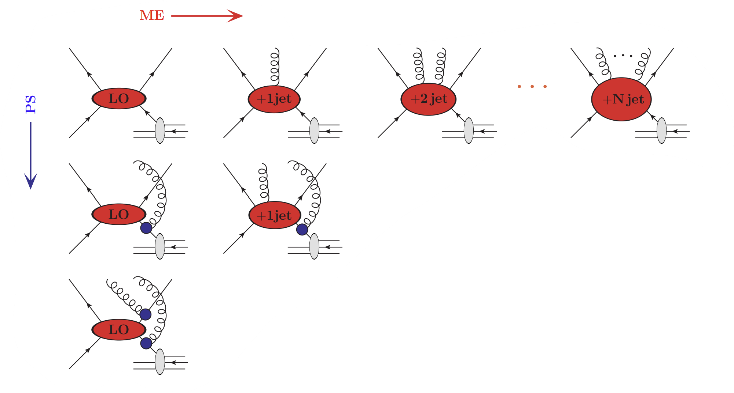
ME + PS
POWHEG, MC@NLO, KrKNLO
Main issue: how to avoid overcounting?
e.g. first emission is in both NLO and PS
Defining ME/PS boundary, no-emission (Sudakov) weights:
Truncated shower (SHERPA, HERWIG++)
CKKW-L (ARIADNE)
MLM (ALPGEN)
CKKW (SHERPA)
Mixed (MadGraph, HELAC)

Slide 9
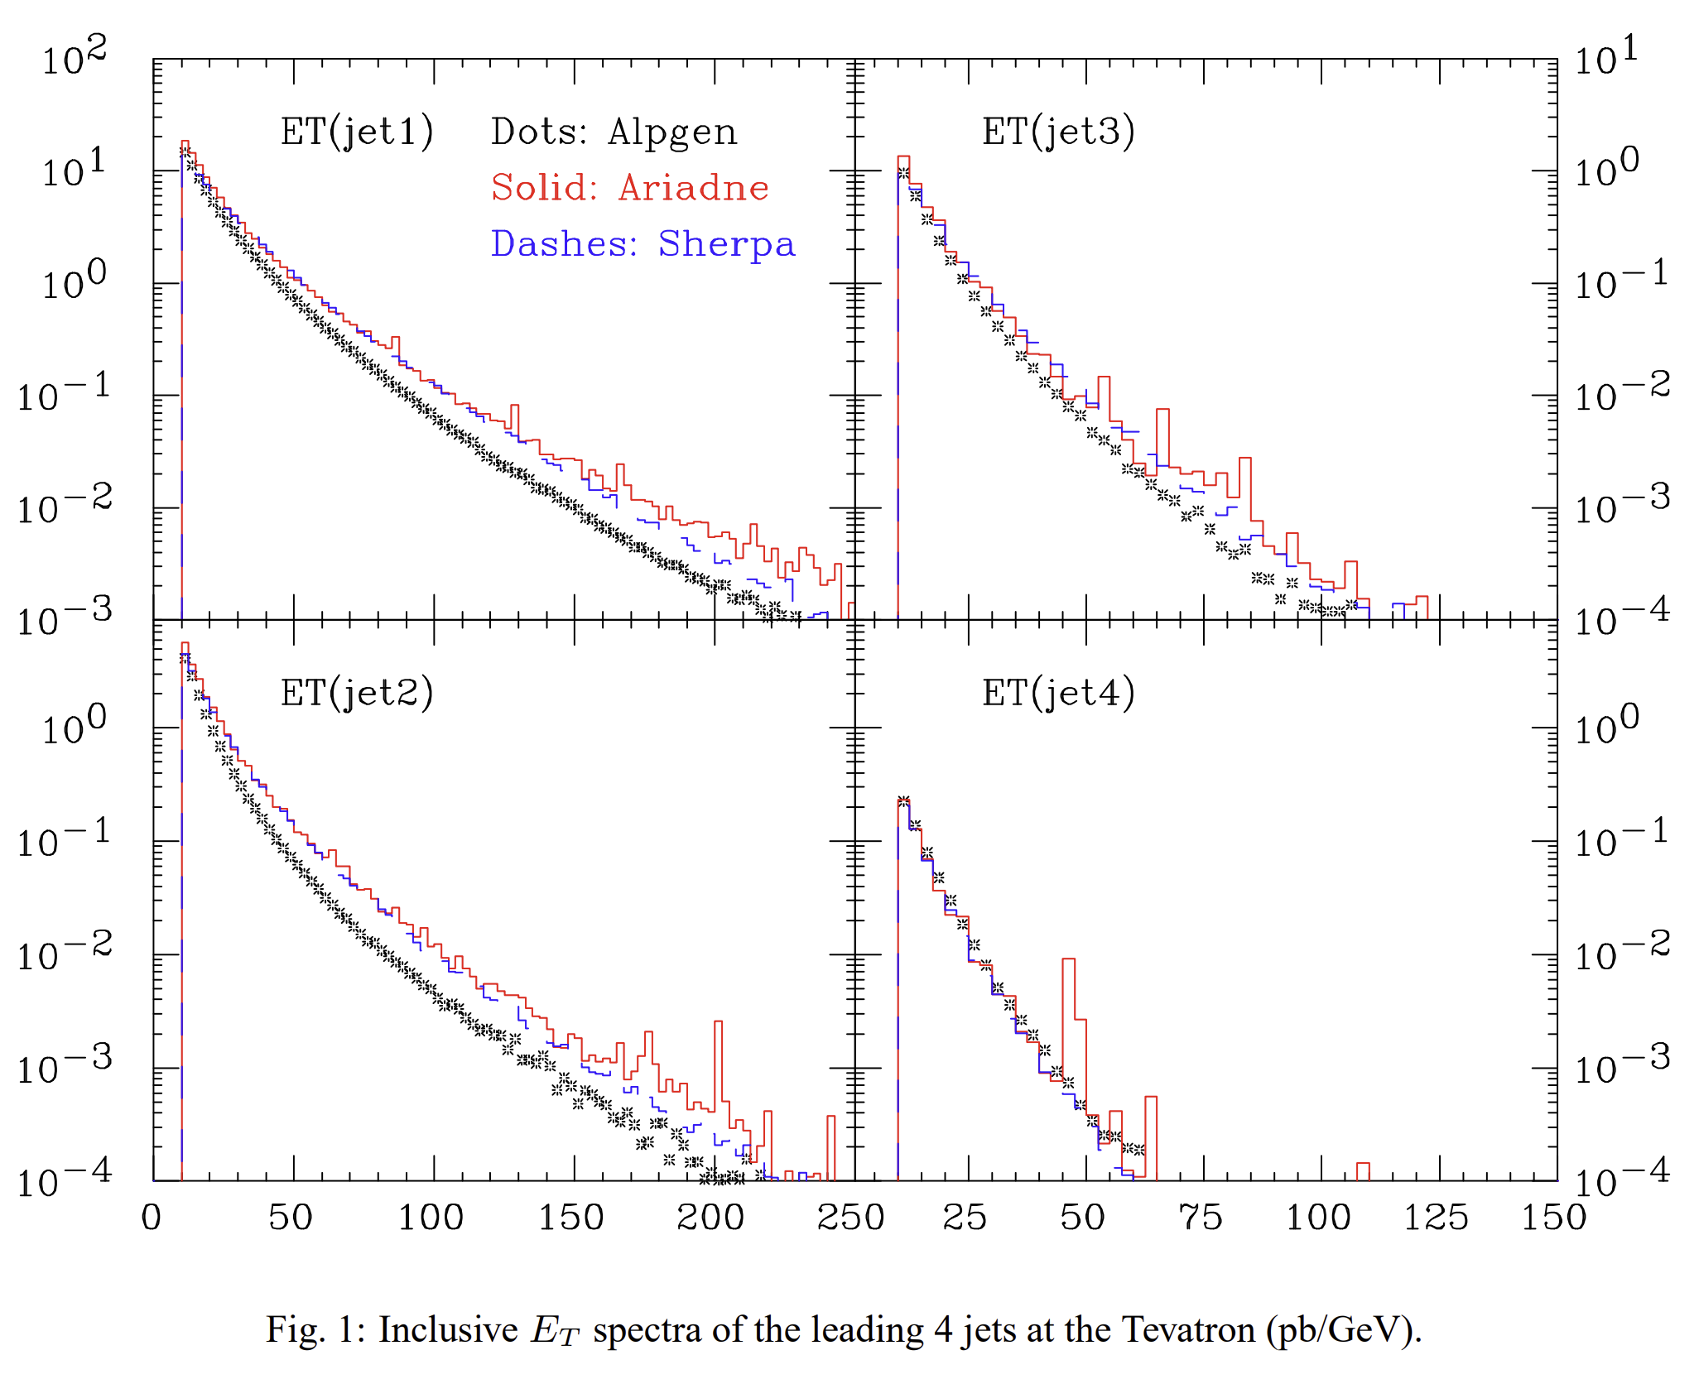
ME + PS
POWHEG, MC@NLO, KrKNLO
Main issue: how to avoid overcounting?
e.g. first emission is in both NLO and PS
Defining ME/PS boundary, no-emission (Sudakov) weights:
Truncated shower (SHERPA, HERWIG++)
CKKW-L (ARIADNE)
MLM (ALPGEN)
CKKW (SHERPA)
Mixed (MadGraph, HELAC)

Slide 10
Hadronization
Truncate shower at some scale ~ 1 GeV
Independent fragmentation: u:d:s = 43:43:14
Input from PEP, PETRA, LEP data fits
Iterate until all momentum is used up
Energy/flavor not exactly conserved
$$f\left(z\right)=1−a+a\left(b+1\right){\left(1−z\right)}^{b}$$
$$f\left(z\right)=\frac{z{(1−z)}^{2}}{{(1−z)}^{2}+εz}$$

Slide 11
String and cluster fragmentation
String fragmentation
QCD “string” breaking: qq pair from tunneling, k=1 Gev/fm
$$f\left(z\right)\sim \frac{1}{z}{(1−z)}^{a}e^{−\frac{b(m_{h}^{2}+p_{⊥}^{2})}{z}}$$
Good physical motivation, very successful in comparison to data
Universal!
Cluster hadronization
Post-shower: color singlet pairs are close in phase space
Combine closest-in-phase-space partners
NP gluon splitting g → qq

Slide 12
Jets in QGP
Modifications in showering process
Interactions with QGP: vacuum-like splittings, medium-induced gluon radiation
Medium response: constituents in medium correlated to jet
Shower (modification) is multi-scale and evolves in space and time: very complicated!
Analytical (P and NP) approaches
MC approaches – factorization!

Slide 13
Choose your fighter:
Analytical approach
MC approach
First principles ☺
Parton level ☺
Clear interpretation of results ☺
Observable-unique 😐
Theory-data comparison might be difficult ☹
Factorization ☺
Broader set of observables ☺
Full jet shower + medium response ☺
Theoretical model limitations 😐
More assumptions to go beyond analytic approach ☹

Slide 14
Jets in QCD matter
PS modification
Key ingredient: a MC model (e.g. jet quenching)
But how do I…
… model my shower?
… induce energy loss via medium?
… induce energy loss via collisions?
… recoil my medium?
… evolve my medium?
… hadronize the resulting shower?
etc.

Slide 15
Energy loss
Medium-induced
Single-gluon perturbatively calculable in eikonal approximation: BDMPS-ASW, AMY, Higher-Twist, GLV
Agree well, but extrapolations might not…
Model → full jet shower is hard ☹ Two categories:
Dynamic/fully dynamic models
Afterburners

Slide 16
Medium-induced energy loss
Fully dynamic modeling
Afterburners
Incorporate gluon radiation into the shower itself as it progresses
Q-PYTHIA, MATTER, JEWEL
Additional term in splitting probability
Some small correction to Sudakov form factor
P_{emission} = P_{vacuum} + P_{QGP}
End-of-the-line modification
MARTINI, PyQUEN, Co-LBT, Hybrid
MARTINI: AMY rate equations on truncated shower
PyQUEN: momentum rescaling over full medium length pre-hadronization

Slide 17
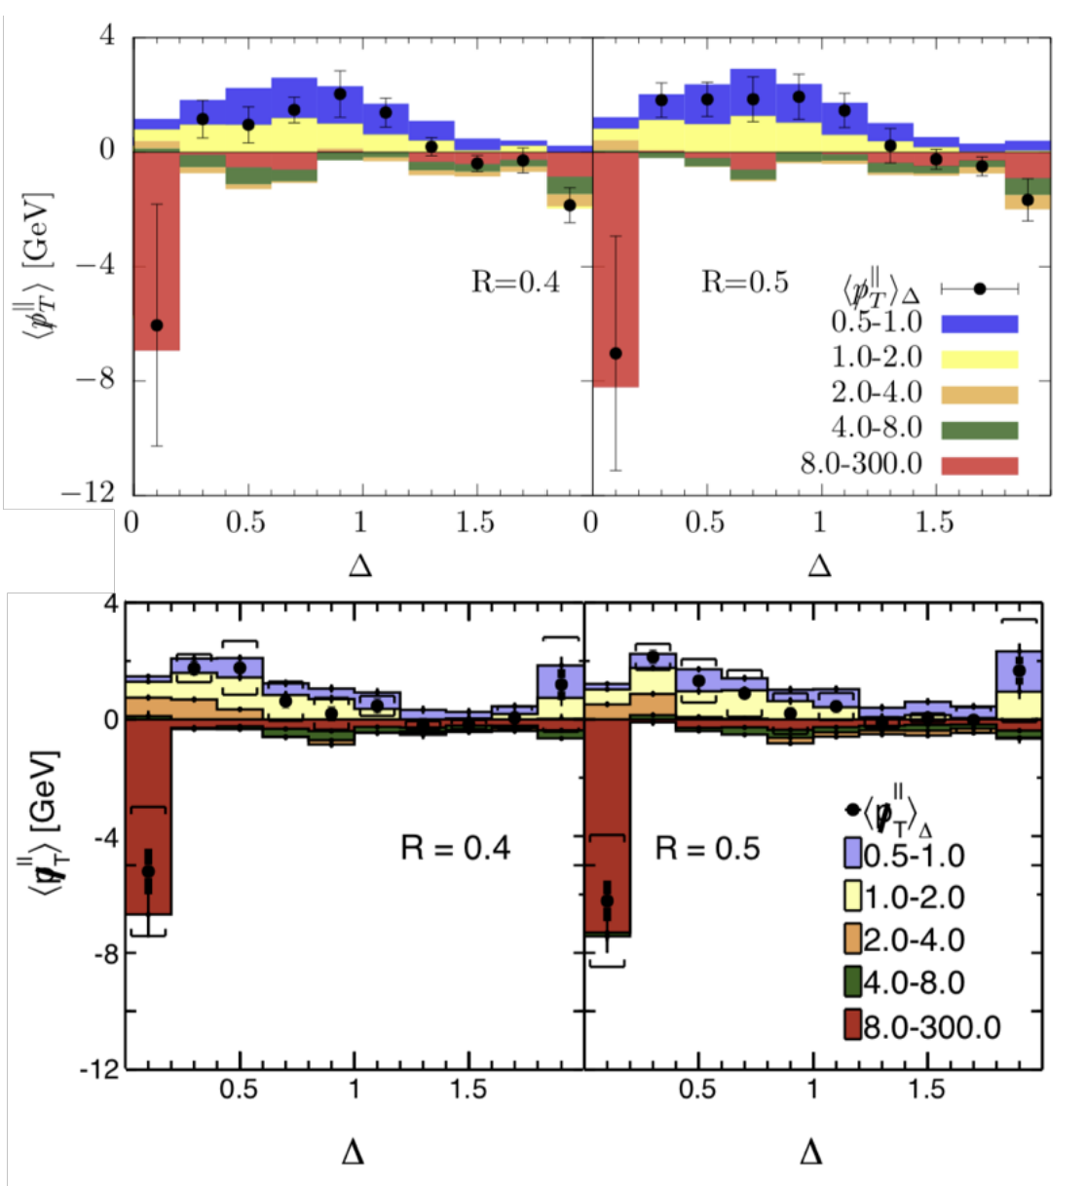
Medium-induced energy loss
Fully dynamic modeling
Afterburners
Incorporate gluon radiation into the shower itself as it progresses
Q-PYTHIA, MATTER, JEWEL
Additional term in splitting probability
Some small correction to Sudakov form factor
P_{emission} = P_{vacuum} + P_{QGP}
End-of-the-line modification
MARTINI, PyQUEN, Co-LBT, Hybrid
MARTINI: AMY rate equations on truncated shower
PyQUEN: momentum rescaling over full medium length pre-hadronization

Slide 18
What have I skipped?
Lots and lots of theory ☺
Parton distribution functions
QGP evolution, elastic energy loss
MC validation through data
Advances in computation, numerical methods

Slide 19
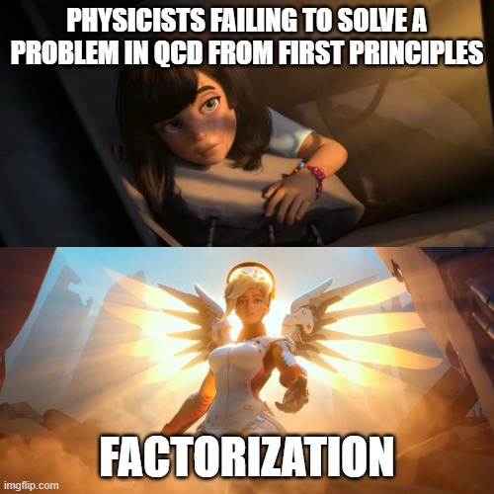
Summary
Factorization
Hard scattering/shower
ME, NLO fully automated
ME/NLO + PS standard(ish)
Current difficulties in overcounting
Improvements in computation
Hadronization
Cluster or string now standard
Jets in QCD matter
Dynamic/afterburner types

