Slide 1
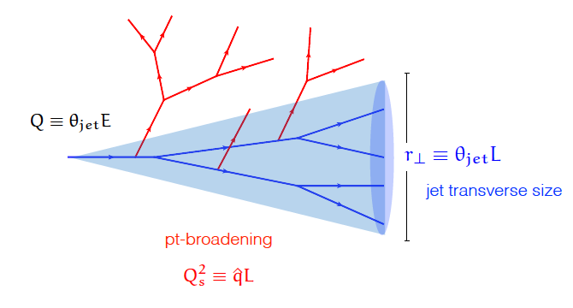
Fun with Jets
(in both pp and Pb+Pb collisions)
Barbara Jacak & Marjorie Shapiro
August 30, 2023

Slide 2
outline
What is a jet?
  Some definitions and some history
Jet finding
  Algorithms
  Jet “fragmentation” process
Hadronization
Jet structure
Heavy quark jets
Energy loss in quark gluon plasma
Jet substructure observables

Slide 3
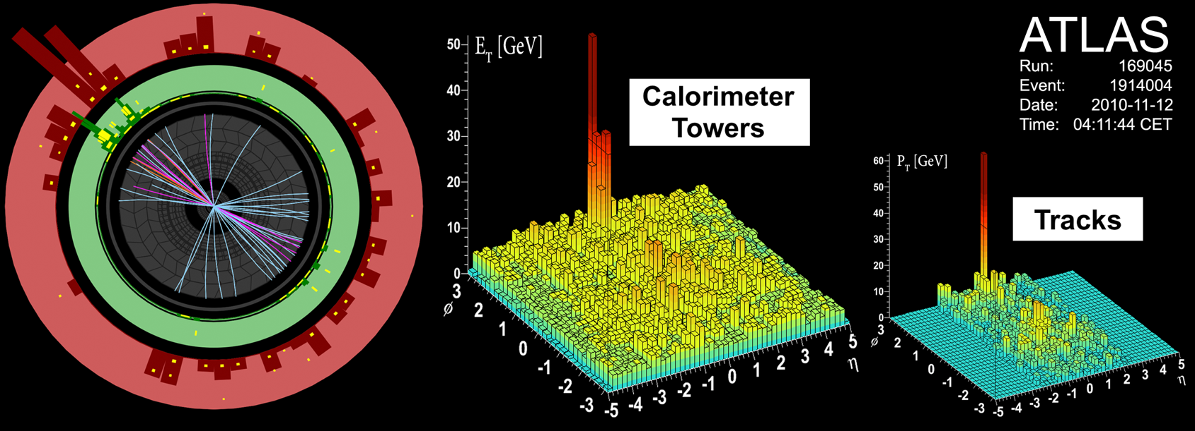
What, actually, IS a jet??
No such object! (despite the cartoons)
We define a “jet”
by choosing algorithm and size scale
Which hadrons belong to the same jet?
  In Pb+Pb: many particles from other than the hard parton
  In p+p the underlying event is smaller, but not zero
Reconstruct jets from all hadrons, or charged ones only

Slide 4
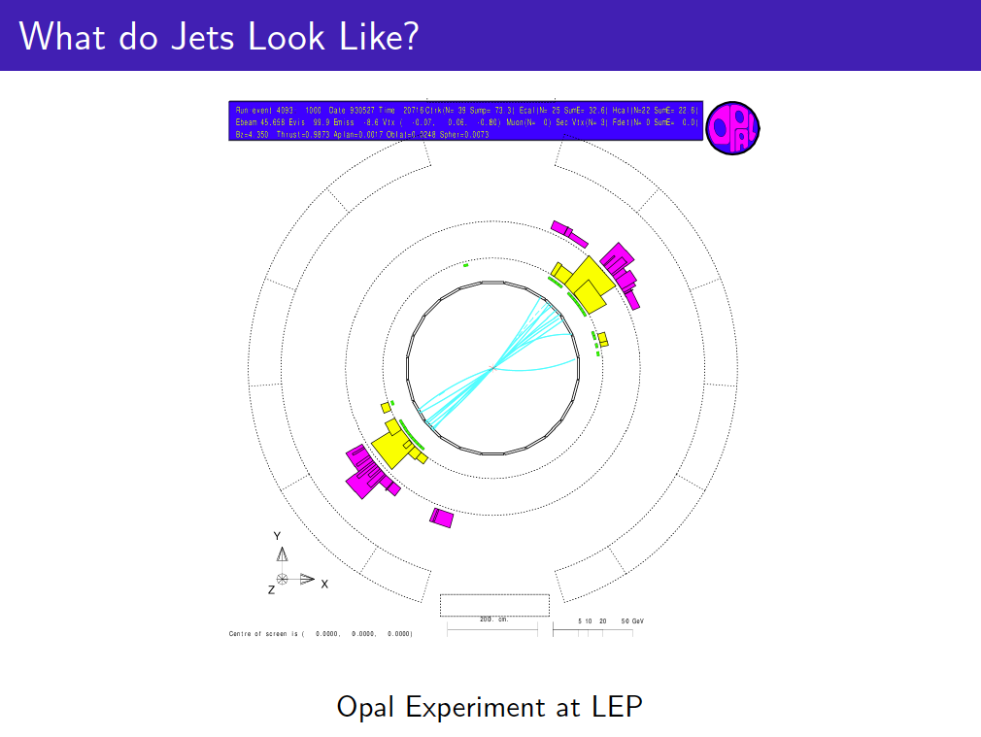
A bit of history
e+e-➞ 2 jets

Slide 5
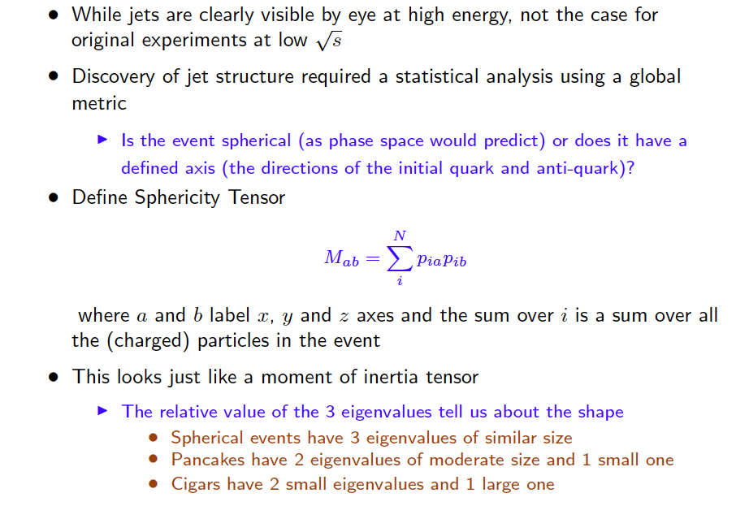
Discovery of jets in e+e- collisions

Slide 6
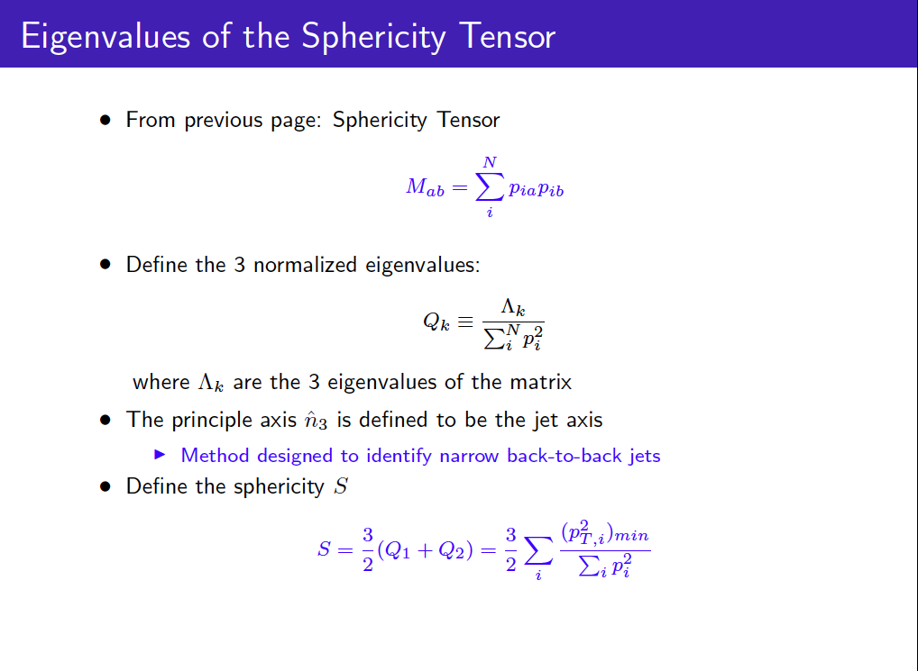

Slide 7
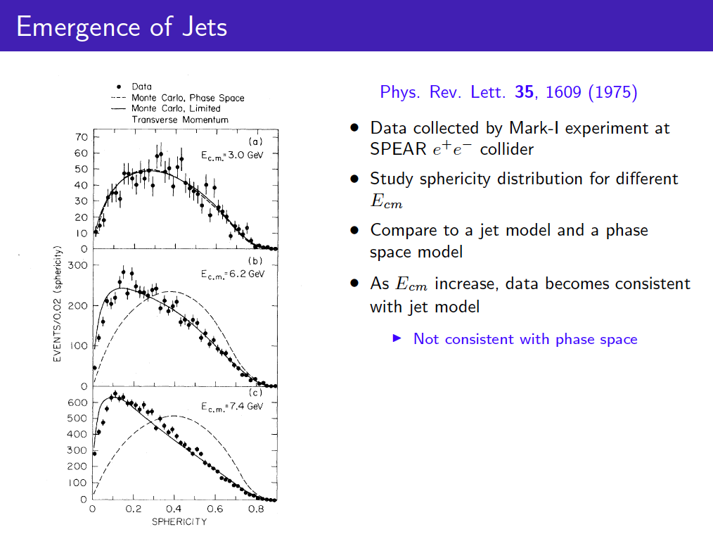

Slide 8
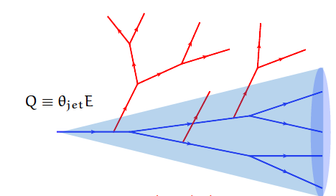
Quarks & gluons in hadron collisions
Produced by hard scattering among incoming q, g
  Scatter out of the beam direction
The partons produce a “shower” of secondary partons
  Radiate gluons (just as in bremsstrahlung)
  Gluons can split into two
  Partons can collide with q, g in any medium they encounter (e.g. underlying event in pp, or QGP)
Shower particles also evolve, creating a cascade
  Especially in the presence of large, dense medium
At the end, hadrons form from all of the produced partons

Slide 9
Finding jets inside collision events

Slide 10
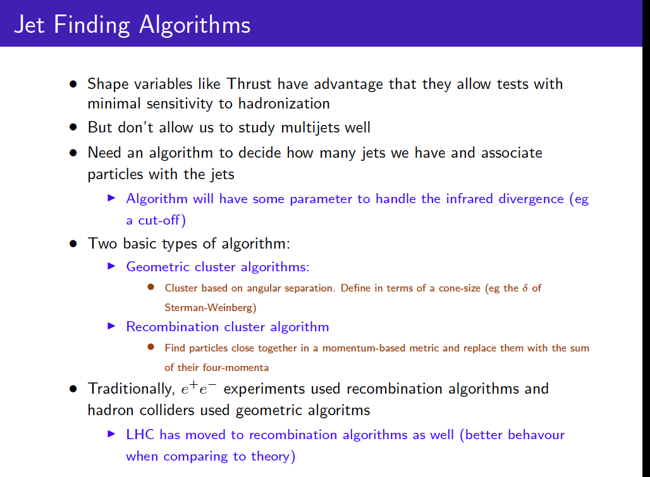

Slide 11
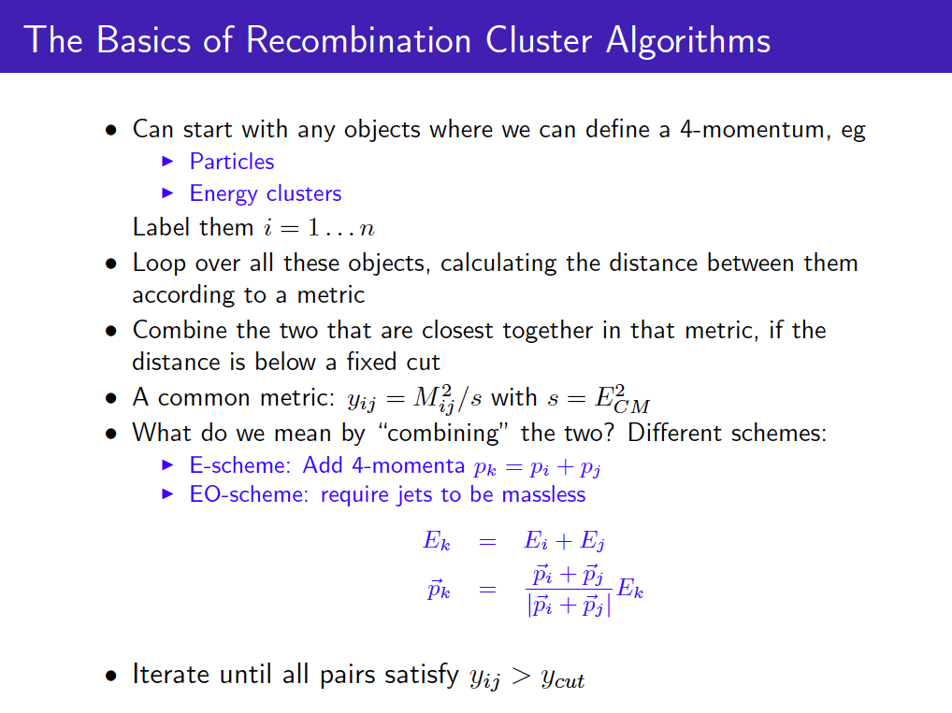

Slide 12
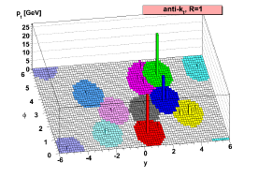
Jet algorithm of choice: “anti-k_{T}”
arXiv:1802.1189
Seed is hardest hadron or calorimeter tower
Calculate distance to other particles:
Clusters softer particles with harder ones, until no more remain within distance of 2R
and
Typically, use R ~ 0.4 to allow statistical subtraction of the underlying event. But this misses some of the parton’s energy.
R = 1.0 is better. Feasible in e+A
Theorists can do this at the parton level, so jets are calculable with perturbation theory

Slide 13
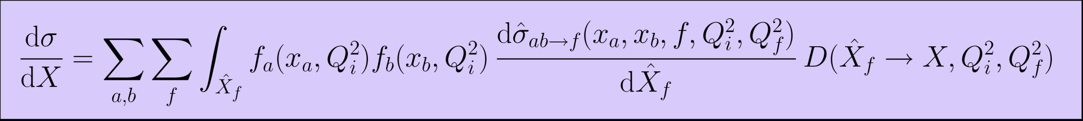
Jet spectrum
PRC101, 034911 (2020)
Power law shape:
Due to distribution of partons inside nucleons
f_{a} and f_{b}
+ combinatorics of finding partons of similar momentum fraction x_{a}~x_{b}
We will come back to the fragmentation function D

Slide 14
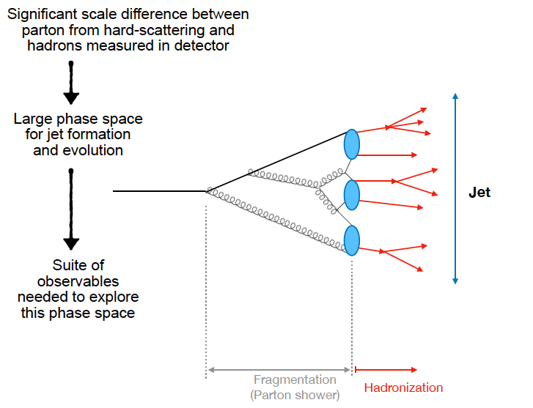
Under the hood: parton shower evolution
Calculable in pQCD
Not calculable in pQCD
Rey Cruz Torres

Slide 15
Perturbative QCD calculation
Coupling constant runs with momentum transfer, becomes small
Expand interaction cross section in powers of α_{s}

Slide 16
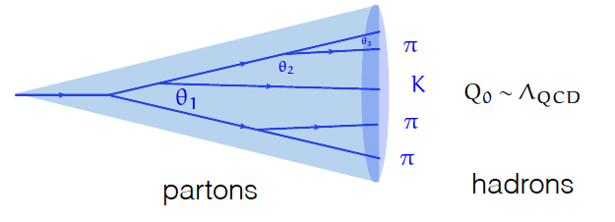
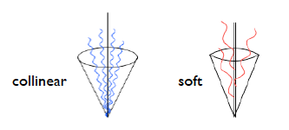
How nature makes a jet
  q,g undergo probabilistic cascade of g emissions
  Total color charge & flavor are conserved
  Successive branchings are ordered in angle
  Color coherence suppresses large angle soft radiation
High energy q, g fragment mostly outside the overlap region
Parton collisions inside medium (e.g. QGP) radiate extra gluons. These produce secondary showers
Lower energy jets start to fragment in medium – can rearrange particles or add stuff from medium

Slide 17
3 problems in connecting data & QCD
Measure hadrons but QCD calculates quarks and gluons
    Hadronization is non-perturbative and so intractable
Singularities
Particles from underlying event

Slide 18
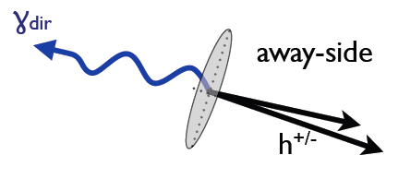
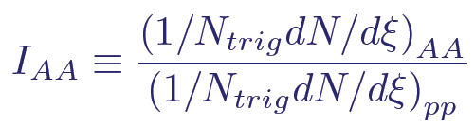
Jet Fragmentation function
D(z) = 1/N_{jet} dN(z)/dz; z = p_{had}/p_{jet}
Count jet fragments as fraction of the jet’s momentum
z_{T} = p_{Ta}/p_{Tγ} ~ z for γ trigger
ξ = ln(1/z_{T})
Modification in nuclear collisions:

Slide 19
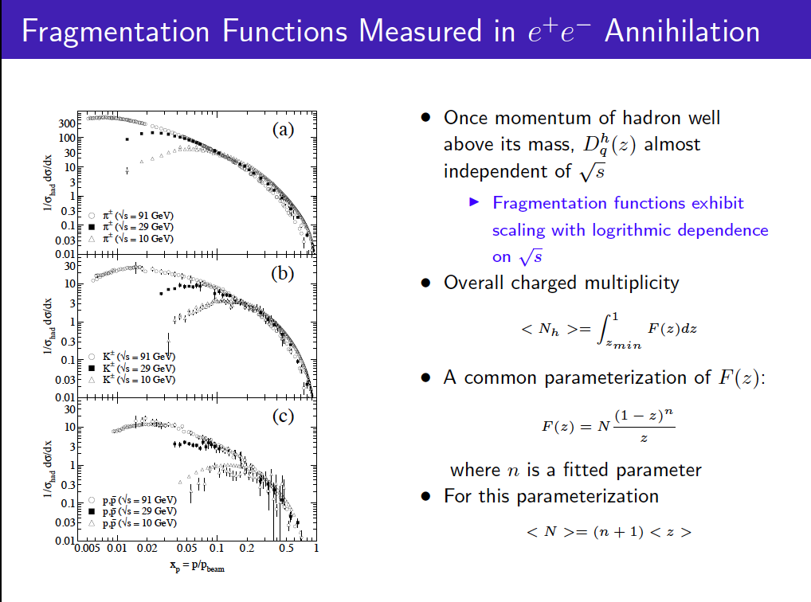
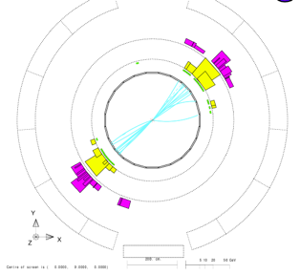

Slide 20
Big fly in the ointment: hadronization

Slide 21
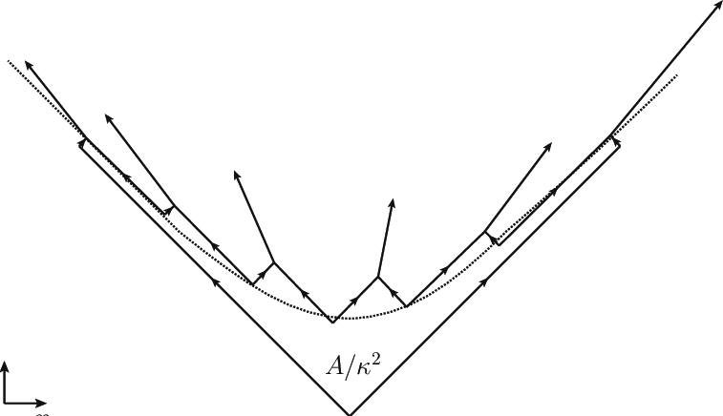
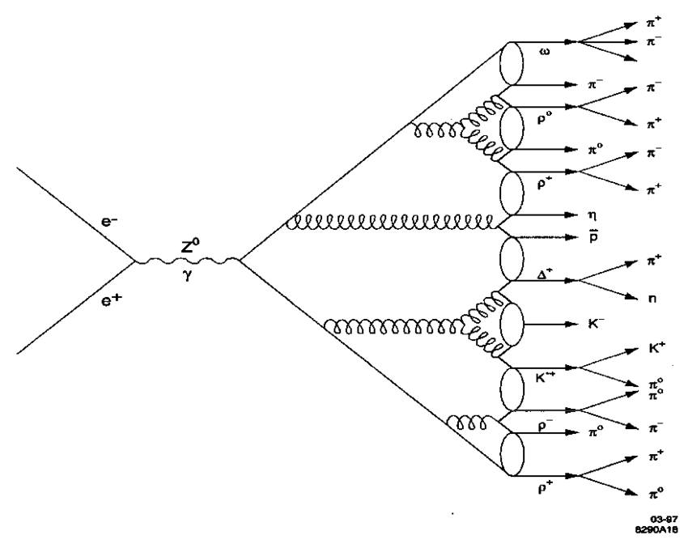
How do the partons become hadrons?
String breaking (e.g. Pythia)
String carries flavor correlations
Partons tunnel out of the string
Cluster hadronization (e.g. Herwig)
Cluster locally connected partons
After the shower is finished
Coalescence or Statistical Hadronization?
Connect partons which end up close by in phase space

Slide 22
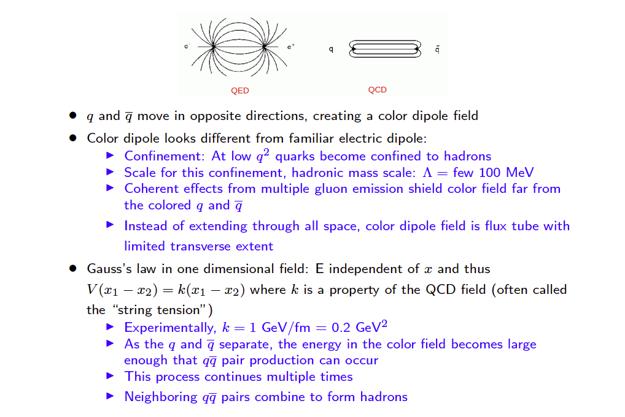
String breaking

Slide 23
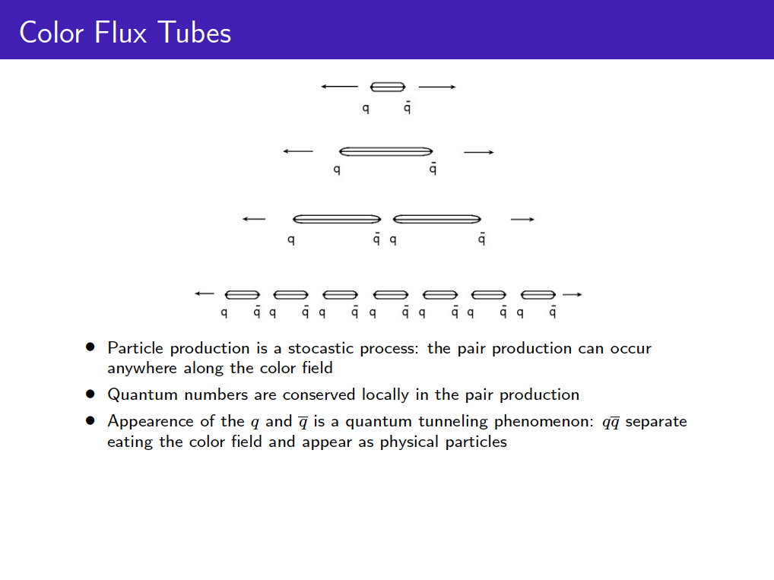

Slide 24
Tune string parameters to reproduce data
Pythia Monash tune for LHC
Stefan Prestel
  From linear confinement:
  @ end of shower, color-connected partons form string pieces w/ quark endpoints; gluons = transverse kinks
  String junctions are asymmetric color tensor carrying baryon number
  Strings break by tunneling;
  “string tension” = energy
arXiv: 1404.5630

Slide 25
Cluster hadronization
Non-perturbative splitting follows pQCD shower
Cluster color-connected partons together
heavy clusters fission
randomly fill shower & beam remnant mass distribution
Color-connections more local than in string breaking
Clusters decay into hadrons
  ensure sufficient cluster mass for hadron masses
  draw flavor k from vacuum

Slide 26
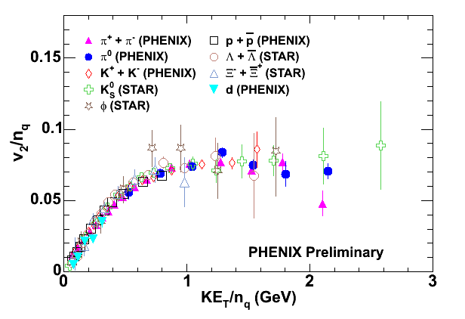
Coalescence in quark gluon plasma
valence quarks, not hadrons, are present when collective flow develops
Recombination from thermal distribution:
Fries, Mueller, Nonaka & Bass, PRC68, 044902 (2003)
Fries, J. Phys. G32, S151 (2006)
transverse KE
dressed quarks are born of flowing field
hadronize by (simple) coalescence of co-moving quarks
quarks (miraculously?) dressed by gluons

Slide 27
What to do with these disparate pictures?
Each can describe the data
  In different conditions
Non-perturbative nature of the problem means
  No answer from first-principles
  Dynamical process, so hard to reproduce in lattice QCD
  Hadronization depends on underlying event, too
Experimentalists measure
  Theorists describe by a “non-perturbative function”
  i.e. fit something to the data…
  But that makes it difficult to tease out the underlying physics

Slide 28
Jet structure

Slide 29
Look at (calculable) parton splittings
Lund Plane
Find substructure observables that avoid singularities
  e.g. jet axis, z_{g}, 𝛉_{g}, jet mass, angularities, n-sub jettiness, energy-energy correlators, etc.
Groom away softest particles to remove underlying event and minimize hadronization effects, using combination of momentum & angle

Slide 30
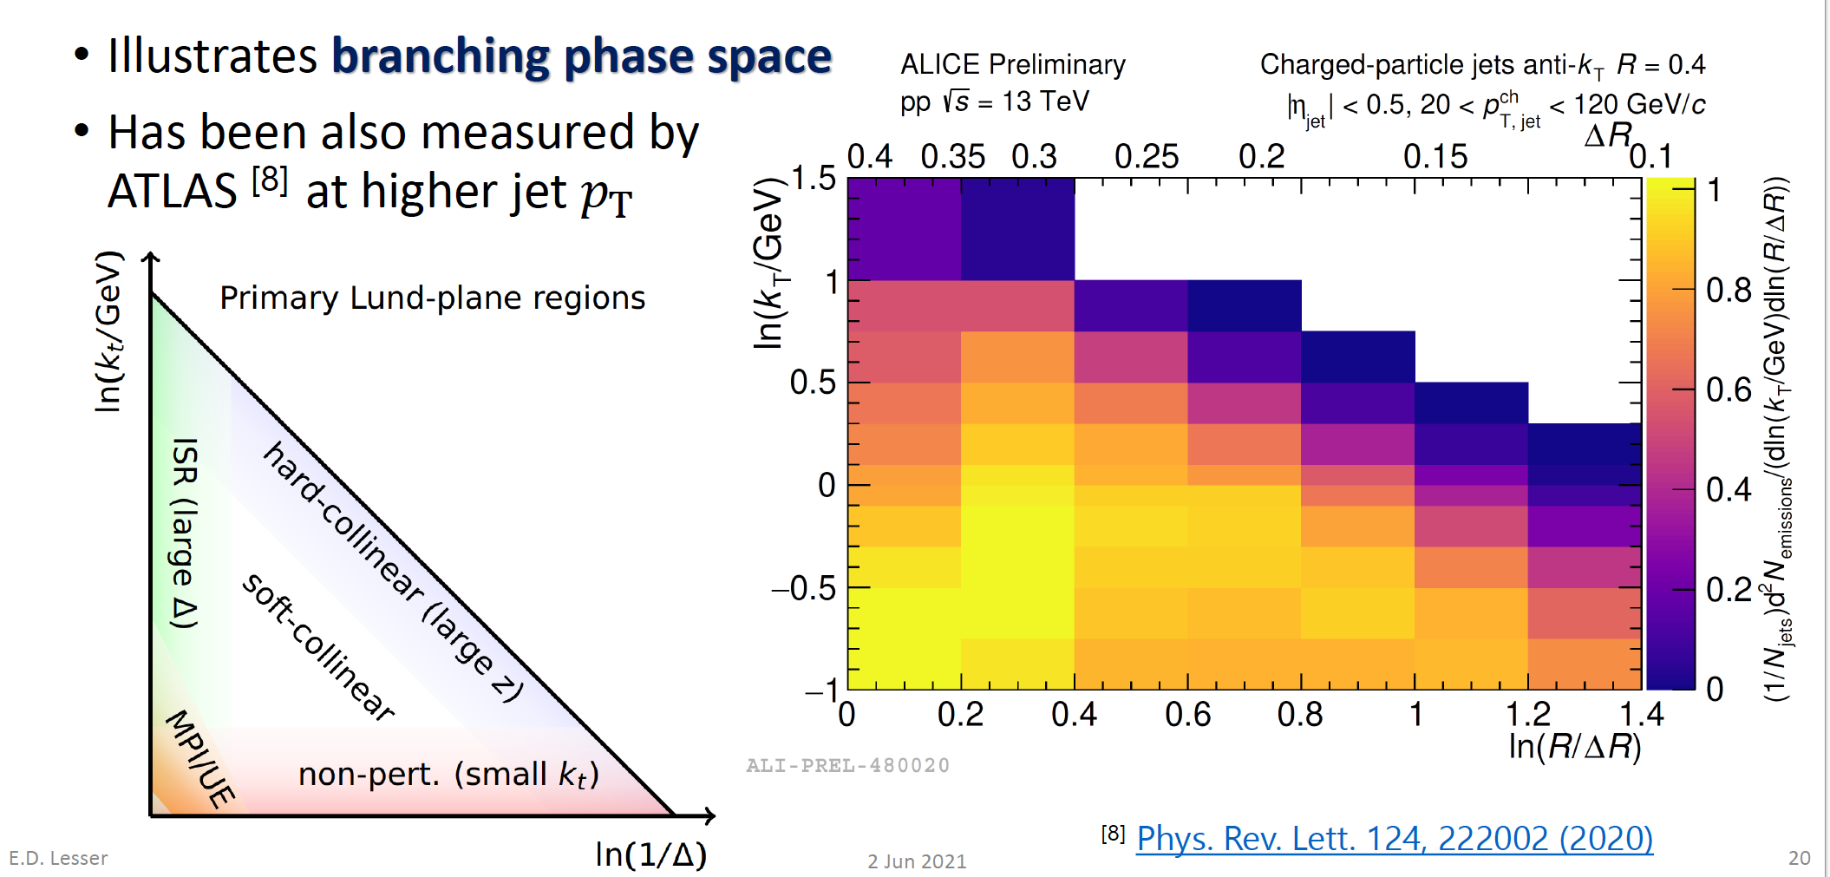
Lund Plane in pp data

Slide 31
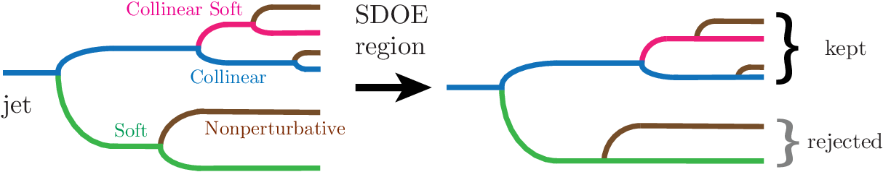



Grooming jets
Collect particles into subjets
Use “soft drop” algorithm to remove soft subjets
Removes soft radiation & non perturbative effects
  Allow access to perturbative splittings
  Also grooms away remaining underlying event
:
typically, z_{cut} ~ 0.1-0.2 , β=0 or 1

Slide 32
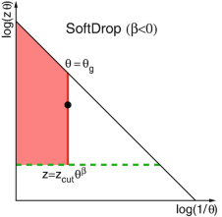
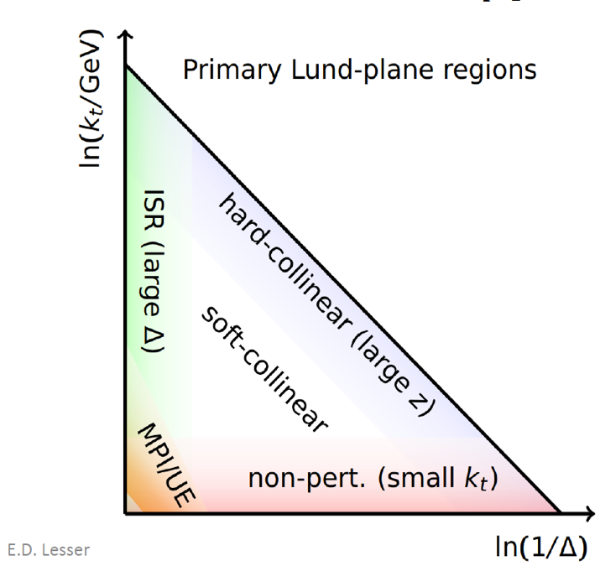
Grooming effect on Lund Plane
Cutting away low z and low ΔR particles makes holes in the Lund Plane
Allows looking at jet splittings in IR safe region and comparing to pQCD calculations

Slide 33
Heavy quark initiated jets

Slide 34

Preeti Dhankher

Slide 35
Reconstructing D jets
Preeti Dhankher
Reconstruct D⁰ meson from K & π
Find charged jet around the D
Calculate angularity
Correct for D efficiency & background
Unfold for energy resolution and missing neutral particles

Slide 36

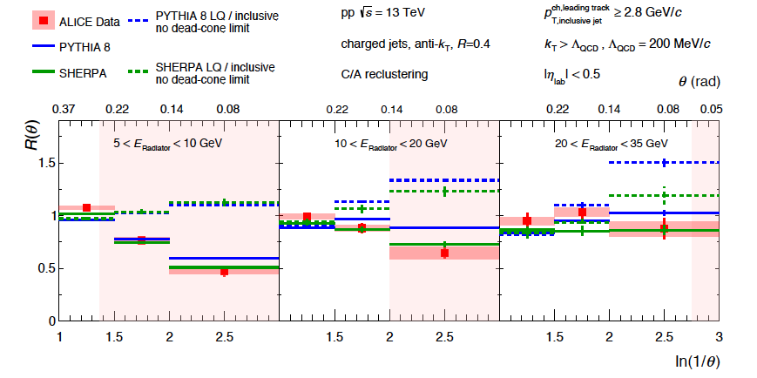

Can we see the dead cone?
Soft gluon radiation spectrum
Large M suppresses small angle radiation (phase space effect)
Known as “dead cone effect”
Dokshitzer, et al. J.Phys.G17,1602 (1991)
Dokshitzer & Kharzeev, PL B519, 199 (2001)
ALICE D-tagged vs. inclusive jets in p+p
θ_{g}
HF/ inclusive
Yes!
arXiv:2106.05713

Slide 37
B-jets
Important for Higgs studies
Under study at Berkeley
  We will hear more during the student talks

Slide 38
Jet energy and shape modification in quark gluon plasma

Slide 39

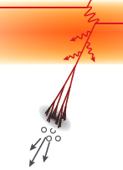
Where does the lost energy go?
Several possibilities
  extra gluons at small
  angles (in/near jet cone)
  radiated gluons thermalize in medium (i.e. they’re gone!)
  remain correlated with leading
  parton, but broaden/change jet

Slide 40
Look inside and around the jet
Precise measurement of energy loss by tagging with a photon or vector boson (which do not interact with the plasma)
Longitudinally: jet fragmentation function
Also transverse to the jet axis: jet substructure observables

Slide 41
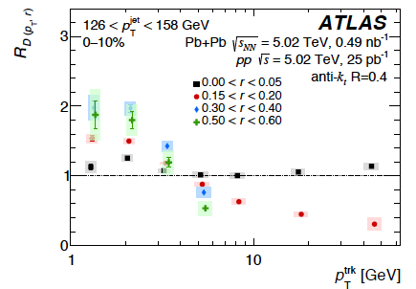
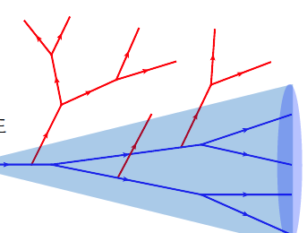
p_{T} vs. r of jet fragments
arXiv: 1908.05264
See also: CMS
arXiv: 1803.00042
Pb+Pb/ p+p
r
Excess soft hadrons at large jet radius
Narrowing of high p_{T} particle distribution
Energy loss (and medium response?)

Slide 42
Energy unbalanced in γ, Z – tagged jets
With photon or Z, you know the initial parton energy
Plasma reduces the jet’s energy. Jet and boson p_{T} no longer balance

Slide 43
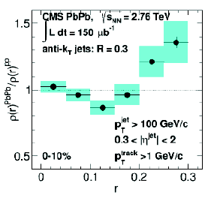
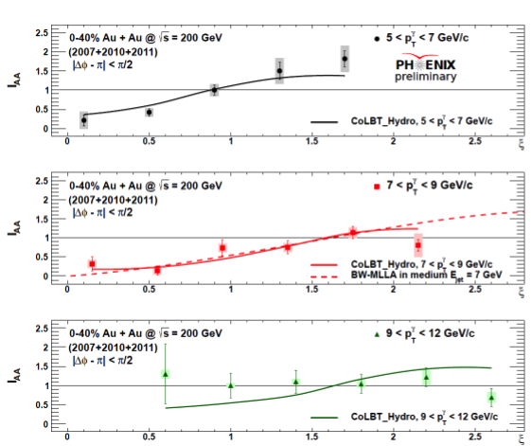
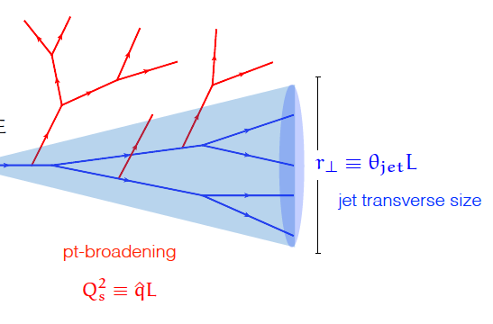
γ-jet data: jets get wider & softer in plasma
Pb+Pb/p+p:
Extra low momentum
particles; high momenta
suppressed
Pb+Pb/
p+p:
Jets are wider in
Pb+Pb
Medium induced radiation!

Slide 44
Jet substructure observables

Slide 45
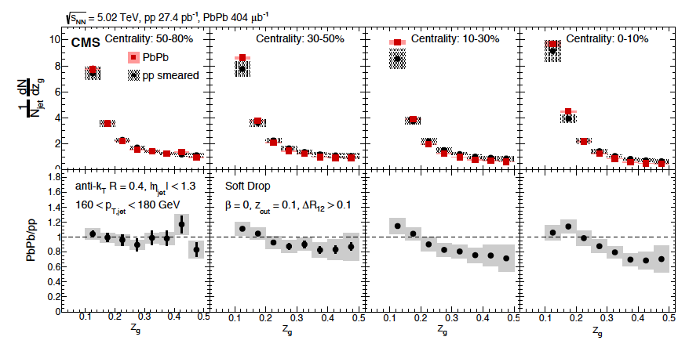
  Early gluon splitting
Recluster & groom jet
Use 2 leading clusters
Useful to quantify energy, p_{T} transport.
See significant dependence on jet E, grooming.

Slide 46
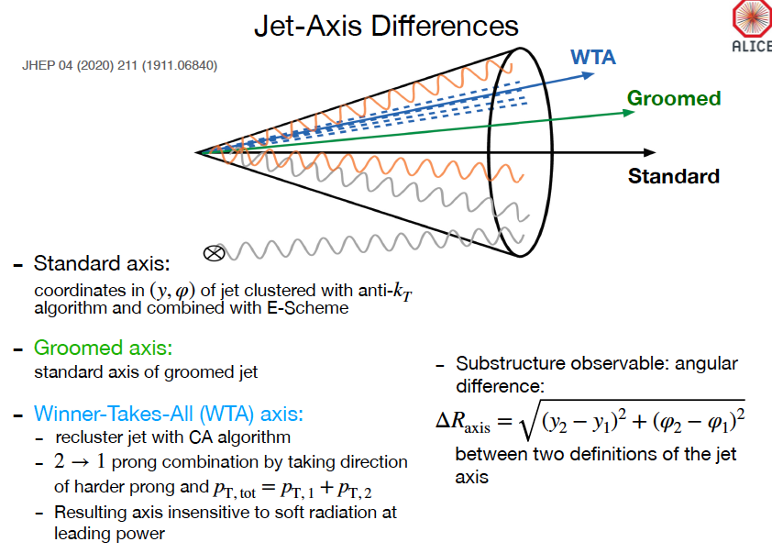
Rey Cruz Torres
How aligned is hardest fragment with the jet axis?

Slide 47
Why measure this observable?
Axis difference can be calculated perturbatively
Especially if jets are groomed to remove the soft particles at large angles.

Slide 48

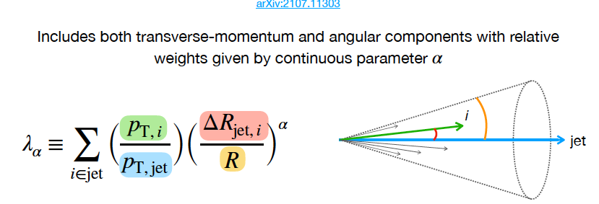
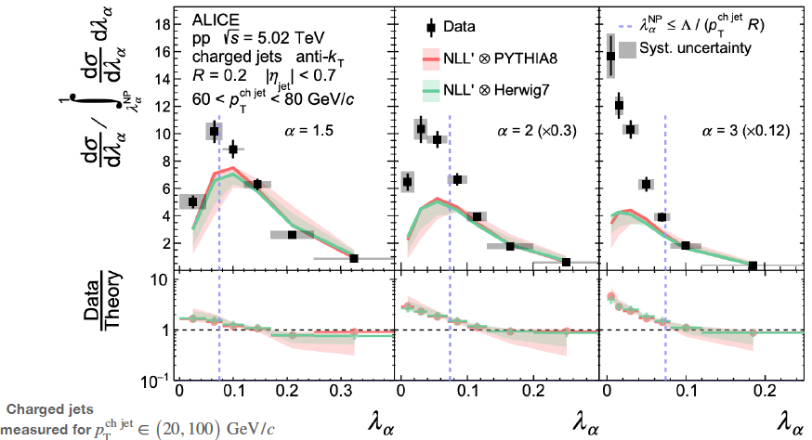
Combine p_{T} & θ: Angularity
Ezra Lesser, Preeti Dhankher
(shape) Calculable in pQCD
data, model agree
Let’s groom away the soft stuff

Slide 49
Groomed jets well described by NLL QCD
Ezra Lesser

Slide 50
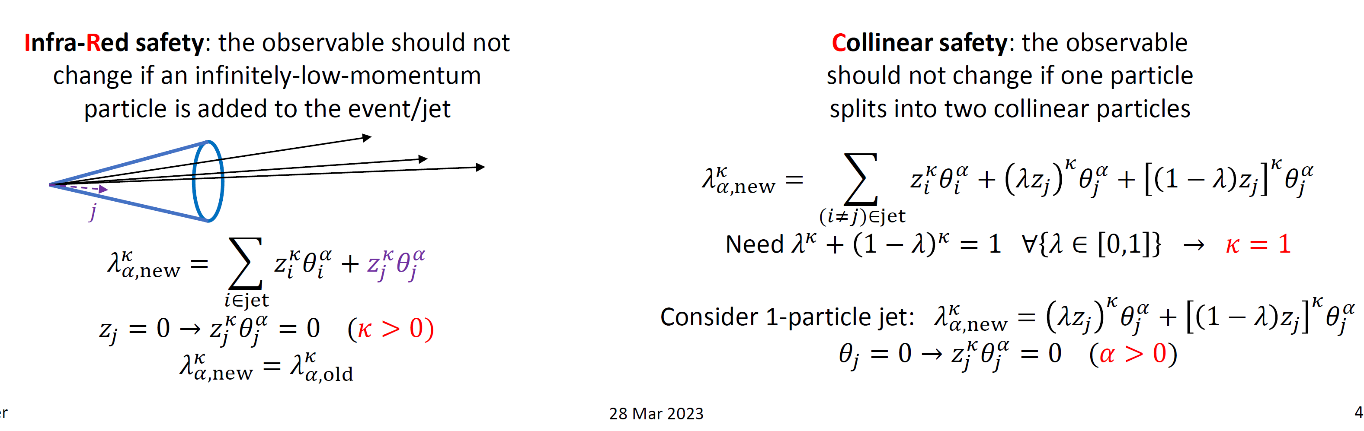
Why is angularity safe for pQCD?
Ezra Lesser

Slide 51
Explore with jet energy-energy correlators

Slide 52
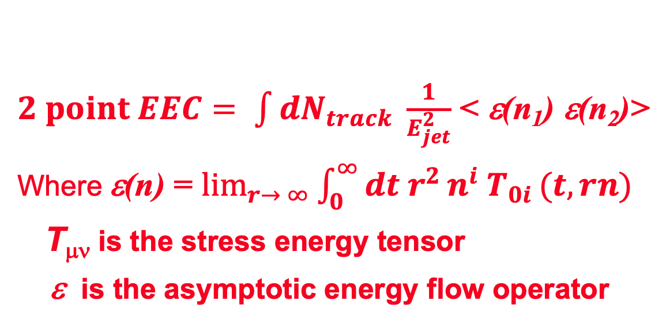
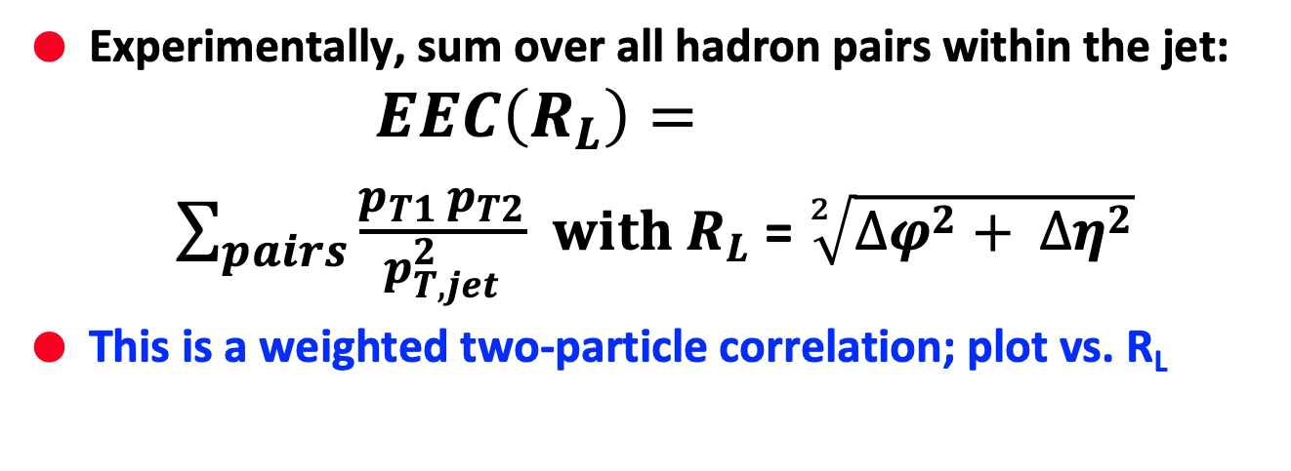
Energy-energy correlator definition
$2 point EEC= \int{dN_{track} \frac{1}{E_{jet}^{2}}}$ < ε(n₁) ε(n₂)>
Where ε(n) = $\lim_{r→ ∞}{\int_{0}^{∞}{dt{ r}^{2}}}n^{i} T_{0i }(t,rn)$
T_{μν} is the stress energy tensor
ε is the asymptotic energy flow operator
Experimentally, sum over all hadron pairs within the jet:
$$EEC\left(R_{L}\right)=$$
$\sum_{pairs}{\frac{p_{T1 }p_{T2}}{p_{T,jet}^{2}}}$ $with R_{L}$ = $\sqrt[2]{{∆φ}^{2}+ {∆η}^{2}}$
This is a weighted two-particle correlation; plot vs. R_{L}

Slide 53
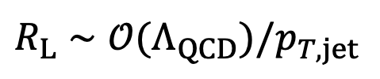
Quark-gluon region calculable
Kyle Lee, Bianca Mecaj, Ian Moult; arXiv:2205.03414
dσ/dR_{L}
When the virtuality approaches 𝓞(ΛQCD), EEC undergo transition into confinement region
$$R_{L}∼𝒪(Λ_{QCD})/p_{T,jet}$$

Slide 54
Separate pQCD, hadronization & hadron gas
Deviation between data and NLL: non-perturbative onset
Agreement between data and free hadron scaling: hadron gas phase
Transition region physics – stay tuned!

Slide 55
Compare data to models Pythia & Herwig
Herwig (hadronization via clusters) agrees better with the data
But data are somewhat broader than Herwig. Longer time needed to form hadrons?

Slide 56
Backup

Slide 57
Jet axis

Slide 58
Does grooming change the jet axis?
arXiv:2211.08928
arXiv:2303.13347
Not much!
Results in pp are well reproduced by Pythia & Herwig

Slide 59
In Pb+Pb

Slide 60
Evolution of jet axis difference
Jets narrow in PbPb
Larger effect in softer jets
Quark jets start out narrower. Are the gluon jets more modified?
C: relative probability to emit a gluon

Slide 61
Medium resolution length

Slide 62
Interactions appear to be incoherent

Slide 63
Look at the parton splittings

Slide 64
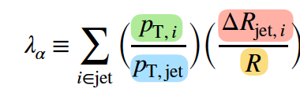
In Pb+Pb
Ezra Lesser
Recall:
Jets narrow in PbPb
Quark jets are narrower. Are the gluon jets more modified?
Models depend on QGP evolution too!
Angularity in groomed Pb+Pb jets: large λ depleted, small λ enhanced.
Expect this if jets narrow in QGP

Slide 65
Compare D jet with light parton jets
Preeti Dhankher
D jets are narrower (smaller angularity)
Increasing α (weight of angular term) decreases the difference
Comparison dominated by jet core
Observation is exactly what we would expect from dead cone:
  Fewer & harder jet fragments

Slide 66
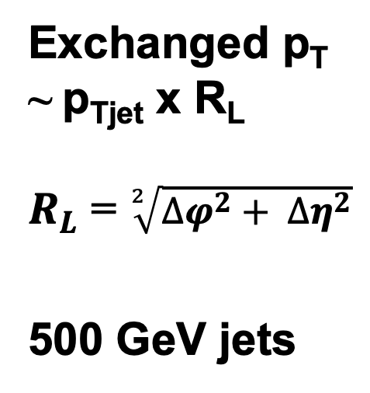
Separates pQCD & non-perturbative regions
Komiske, Moult, Thaler, Zhu. arXiv:2201.07800
Exchanged p_{T} ~ p_{Tjet} x R_{L}
$R_{L}$ = $\sqrt[2]{{∆φ}^{2}+ {∆η}^{2}}$
500 GeV jets
At large R_{L}: universal scaling w/ perturbative quark and gluon interactions
At small R_{L}: for uniformly distributed hadrons
R_{L} dσ/dR_{L} ∼ R_{L}²
Transition region = correlator at hadronization

Slide 67
Check for scaling
Recall p_{T}*R_{L} is order of Λ_{QCD}
Common shape for all jet energies – transition region is universal
HWHM = 1.8 ± 0.2 GeV/c

Slide 69
backup slides

Slide 70
Impact of the initial state

Slide 71
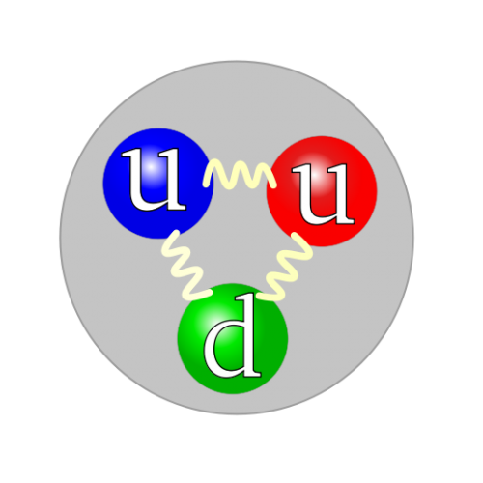
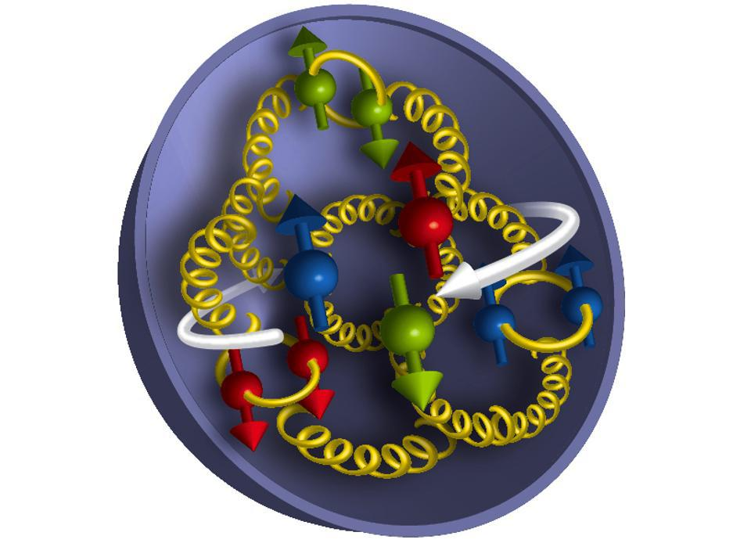
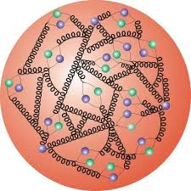
Inside nucleons and nuclei
Discovery at RHIC:
  Spin of the nucleon is spread out among the quarks and gluons!
  quarks & gluons in polarized proton also polarized
Implications:
  Cold nuclear matter also strongly interacting when density of quarks and gluons is large
Initial state of colliding Pb nuclei already has many-body interactions

Slide 72
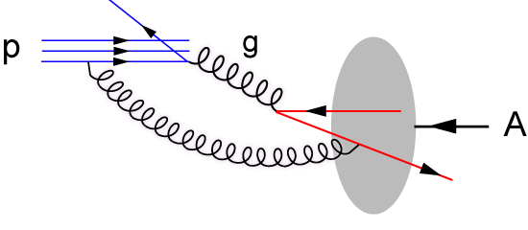
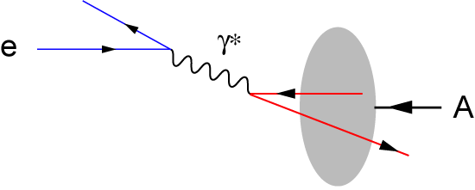
Probe cold, dense matter: Collide e + A
Hadron-Hadron
Electron beam: deep inelastic scattering
p
p/A
p/A
  Probe is a gluon
  Probe has structure!
  Dynamics of the probe mixed up with structure of the nucleus
  RHIC & LHC
  Point-like probe
  No strong interaction before high momentum transfer process
  Control probe kinematics by measuring scattered electron
  Electron-Ion Collider
We’ll also find out: will there be hydrodynamic flow if we excite a hot spot with a point particle??!

Slide 73
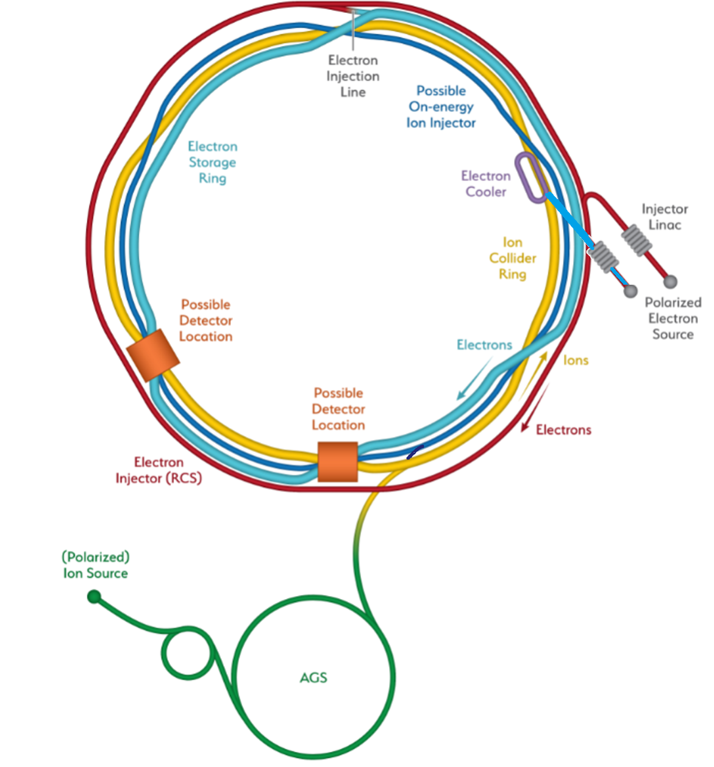


Electron-ion collider at Brookhaven
  Scatter electrons from nuclei!
e
e’, $ν$
$γ,$Z,W
p/A
q
p remnant
√s = 30 to 140 GeV
  Add electrons to the ions at RHIC
Hadron Storage Ring
Electron Storage Ring
Electron Injector Synchrotron
Possible on-energy Hadron
injector ring
Hadron injector complex

Slide 74




See quarks & gluons with electron beam?
Deep inelastic scattering
scatter virtual γ off the q charge
“See” gluons when quark distributions don’t scale with energy transfer from the electron
Seeing gluons more directly:
  in p+p: QCD Compton scattering
  in e+p: γ + g -> cc
  photon-gluon fusion
q
γ
g
q
-

Slide 75













    Deep in a nucleus: gluons are numerous
    At high density, what?
    gluon # saturates?
Saturation
Smaller gluon momentum➔
1/Q_{S}²
BFKL
DGLAP
Increasing probe energy ➔
+
?

Slide 76



Nuclear PDF’s
Inside nucleus: densities modified
  q, g from different nucleons interact
arXiv:1708.01527
Inclusive DIS off nuclear beams

Slide 77


Slide 78


Deep inelastic scattering off dense QCD matter at low-x
Probe nucleon or nucleus at x=10⁻² with 5-15 GeV jets
Y. Song, M. Arratia
100

Slide 79


Electron tags original jet energy, angle
e+p, DIS; Pythia 8. Require W² > 4 GeV²,
electron
momentum
struck parton
reconstructed jet
Youqi Song, M. Arratia
⬅ electron direction
proton/ion ➔ direction
Rest of the event is very clean (we can find these jets!)
How much energy is lost to the cold, dense matter?

Slide 80

Jet’s fate in cold, dense QCD matter
Energy & angle balance
  via lepton-jet correlations
  compare energy loss to
  hot, denser QCD matter
Jet broadening?
Jet substructure
  Energy flow/shower development
  Quantum # correlation in jets
  Hadron formation in jets
  Jet angularities

Slide 81


Figure it out at EIC
Hadron yields
And correlations

Slide 82
2 hadronization pictures
Cluster hadronization
  Based on idea of “pre-confinement”
  @ end of shower, all gluons split into q-qbar pairs
  Color-connected quark pairs form clusters
  Large cluster fission into smaller clusters
  Small clusters decay isotropically into 2 hadrons
String hadronization
  Based on ideas of linear confinement
  @ end of shower, color-connected partons form string pieces w/ quark endpoints; gluons transverse kinks.
  String junctions are asymmetric color tensor carrying baryon number
  Strings break by tunneling; “tension” = energy
Small strings clusters
  Both Pythia and Herwig tuned to reproduce data well

Slide 83
Same message from LHC
Is coalescence in phase space the whole story?

Slide 84

Results from ALICE
Correct for detector and reconstruction effects
Peak shifts to lower R_{L} for higher p_{T} jets
Width is related to the time required for hadrons to form

Slide 85
Connect observations to QCD
Y. Mehtar-Tani: 1602.01047
Blaizot, et al, PRL114, 222002 (2015)
Can’t see a single quark or gluon in the detector
Partons radiate gluons, which collect into final state hadrons
(which we call “fragmentation”)
The hadrons are co-moving and boosted by quark’s momentum
We detect them as jets of hadrons

