Slide 1
SoftReset Documentation
-- HongjiangCai
Instrumentation meeting
Aug 18, 2023

Slide 2
Agenda
Why we need soft reset?
How is soft reset achieved?
How to use soft reset with executable?
How to use soft reset with inline code?
How to add soft reset to other modules in the future?

Slide 3
Why soft reset
After running some YARR software side scan/app/test, the FW can stuck at some weird state. To perform another scan/app/test, we need to reset the FW but the only way was to reboot the host.
For busy logic in BRAM, some scan/app/test can cause the busy counter to be misaligned, we need to reset the counter before doing a scan.

Slide 4
How is soft reset achieved on FW
In control register module, when it receive a write to soft reset register, it set target’s soft reset signal high for 8 cycles.
These soft reset signal then goes into corresponding modules and reset internal signals just like rebooting host.

Slide 5
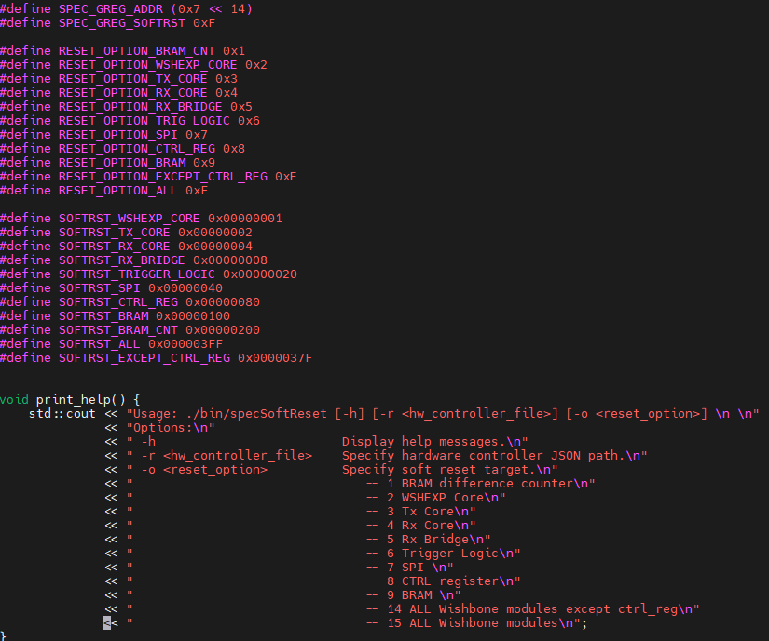
How to do soft reset with executable
After building YARR SW, there will be a executable under ./bin called specSoftReset
-h option will show the help
-r option is used to get the correct specCom Id
-o option let user choose which module to reset
Example: ./bin/specSoftReset -r configs/controller/specCfg-rd53b-16x1.json -o 14

Slide 6
How to do soft reset with in line code
To add soft reset in your own software side application, you need to include “specCom.h” and find correct specNum
Then, use writeSingle function in SpecCom you can write the data with SoftResetTarget into the SoftResetRegister on FW
For specNum, you can find it in controller config file with ScanHelper.h
Soft Reset Register Addr
Soft Reset Target
Each bit in write data represents a reset signal for modules in FW.
If you want to reset multiple modules, you can ‘OR’ the definitions to create your own target list.
E.g. SOFTRST_TX_CORE | SOFTRST_RX_CORE
will reset both wb_Tx_core and wb_Rx_core

Slide 7
How add new soft reset
SW side
Currently, we only used 10 bits in the soft reset register. User can add their own soft reset in the future.
FW side
Example:
new_module
port map{
...
rst_i => not rst_n_s,
...
}
new_module
port map{
...
rst_i => (not rst_n_s) or soft_rst_reg(10),
...
}

Slide 8
How add new soft reset
What you need to add:
SW side
definition of bit in register representing the module.
FW side
logics marked red.
app.vhd
new_module.vhd
rst_i
ctrl_reg.vhd
or
Host
soft_rst_reg(10)
32
soft_rst_reg
= soft_rst_reg(10)
new module’s rst

