Slide 1
Visitor Safety at Lawrence Berkeley Lab

Slide 2
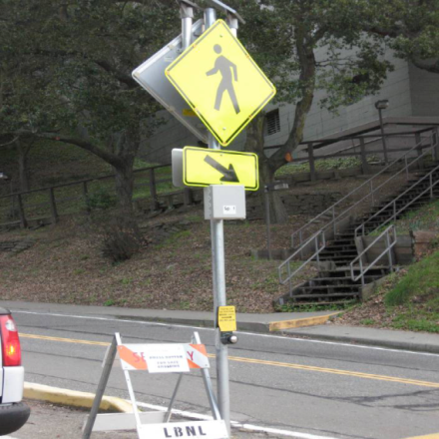
Traffic at the Lab
Traffic Safety
Speed limit is 15 mph
Follow traffic and parking signs
Obey all traffic control personnel and security officers
Bicyclists must wear helmets and obey traffic rules and signs
Pedestrian Safety
Stay on the sidewalk
Cross at crosswalks

Slide 3
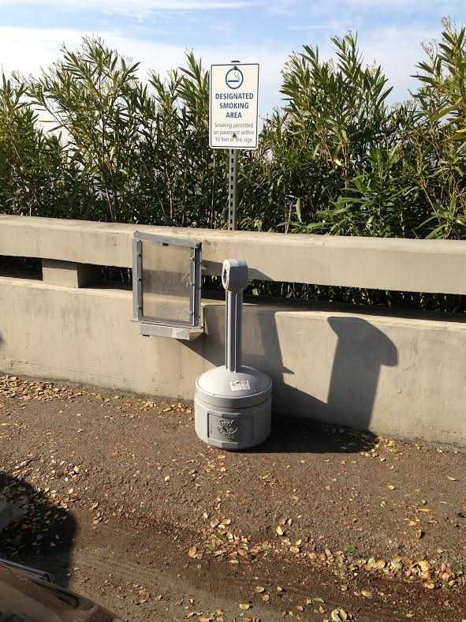
Smoking Policy
For those adults who choose to smoke, the Lab has provided ash cans in a few places throughout the site
Outside away from doors/windows
Away from dry brush
Use the ashcan

Slide 4
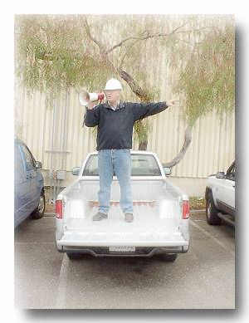
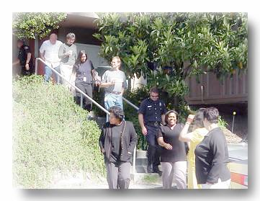
Earthquake Response
Drop down on the floor.
Cover under a sturdy desk, table or other furniture. In an auditorium, cover your head with your arms and get between rows of chairs.
Hold on and be prepared to move with the furniture
Evacuate to the assembly area (usually in parking lot).
Follow Directions from the building emergency team.

Slide 5
Questions?

