Slide 1
Frequently Asked Questions
About LArTPC Reconstruction and Wire-Cell

Slide 2
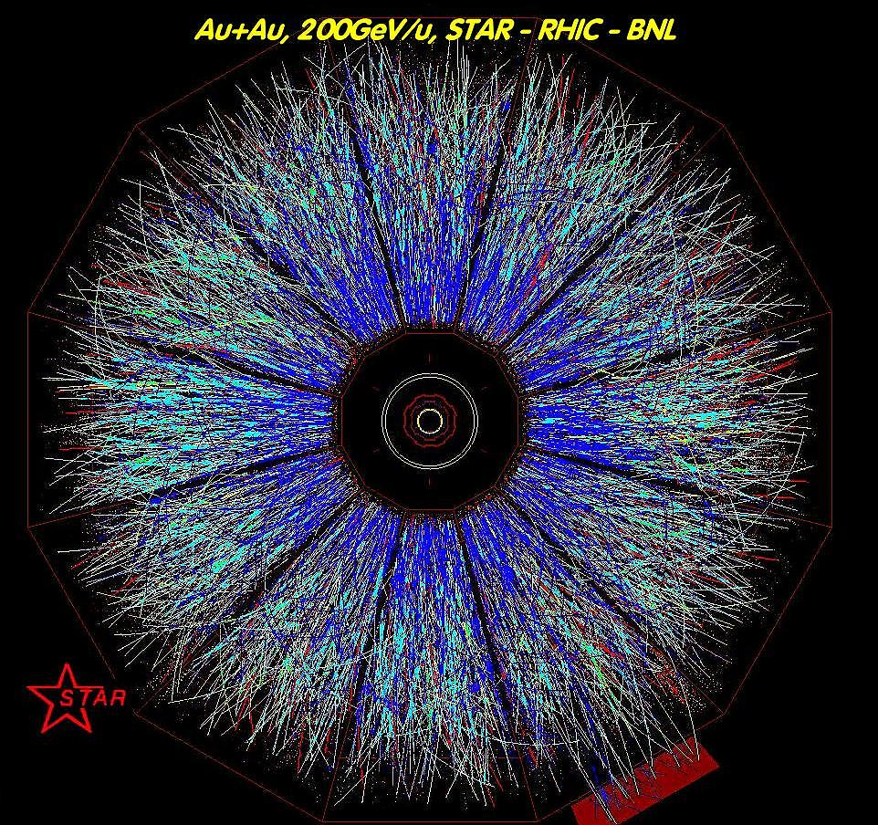
TPC reconstruction is not new. What's the main differences between gas TPC collider experiment and LArTPC neutrino experiment that cause extra difficulties?
Why can they reconstruct thousands of tracks while you are struggling with reconstructing a few?

Slide 3
There are two main differences that makes event reconstruction in LArTPC neutrino experiment more difficult
1. Event topology
2. Wire vs. Pixel readout

Slide 4
Event Topology
Gas-TPC, Collider
LArTPC, Neutrino
Interaction (mainly) only happens at the colliding vertex
Many auxiliary detectors (arranged typically in onion-shape)
vertex detector, muon detector, TOF, EM/hadron calorimeter, etc.
Magnetic field to help determine particle momentum and predict particle trajectory
Association of tracks is relatively simple.
Shower reconstruction is not as important
Main challenge is the high multiplicity of tracks.
Neutrino scattering can happen anywhere in the detector
tracks and showers coming out at all directions.
Both are our signals
Secondary interactions are common due to high density
Very few auxiliary detectors
No magnetic field
Correctly reconstructing and associating the tracks and showers are the main challenges in LArTPC.

Slide 5
(continue)
2. Wire vs. Pixel:
Collider TPC typically use pad readout, which provide one 2-D image vs. time. A 3-D image can be directly obtained without ambiguity.
In large LArTPC, driven by cost/power consideration, most experiments adopt wire readout, which provides only a few 1-D views vs. time. It is therefore a mathematically ill-posed reconstruction problem leading to degenerate solutions.
The worst-case ambiguity is caused by parallel tracks: ionizing electrons from those tracks will arrive at the wire planes around the same time, causing many wires being hit simultaneously.
The ambiguity is further amplified by the wrapping wires (e.g. in DUNE), where a single U or V wire views two opposite drift volumes.
N^2 vs m*N
(Hardware TPC optimization underway)

Slide 6
What's the main differences between NOvA/MINERvA type detector and LArTPC?
Why are you still struggling with automated LArTPC reconstruction while they have already done full automated full-chain analysis with a much worse resolution detector?

Slide 7
NOvA

Slide 8
NOvA

Slide 9
NOvA

Slide 10
NOvA

Slide 11
MINERvA

Slide 12
MINERvA

Slide 13
Human Expectation
NOvA / MINERvA / MINOS
~40-60% efficiency probably OK
LArTPC
The expected standard is much higher
Superior resolution of the detector
Must achieve >80% efficiency with high purity to reach physics goals in time
Critical criteria when making technical decisions between WC and LArTPC
Must do more than simple CCQE, CC-inclusive type analysis
Basically want to reconstruct what we see.
Intentionally smearing the fine image to use the existing reconstruction tools is possible but would only be a fallback/ complementary option.
Won’t meet the expected performance
Given the ambiguity of parallel tracks, the topology would still be different from NOvA/MINERvA even if we smear the image.

Slide 14
Topology
NOvA / MINERvA / MINOS
Most LArTPC
beam is near perpendicular to the view planes.
The resulting lepton tracks are therefore mostly perpendicular to the view planes too.
The hit multiplicity on each view plane is low and can be reconstructed with little ambiguity even without pad readout.
beam is near parallel to the view planes
Many tracks are therefore parallel to the view planes Both are our signals
leading to large degeneracies due to the wire readout.

Slide 15
Timing
NOvA / MINERvA / MINOS
LArTPC
Scintillator detectors, the timing scale is ~ns.
The cosmic muon background rejection is therefore easier
Scintillator signals directly tells the position of the tracks
Electron drift time is slow ~ms.
Need to be coupled with high efficiency scintillator detectors to efficiently reject cosmic muon background.
Flash matching is needed to reconstruct the position of tracks from optical detectors and match the TPC measurements

Slide 16
(continue)
Hardware
So far the quality of the electronics in LArTPC has not reached the level of those in scintillator detectors (NOvA/MINERvA) which typically have >99% good channels
Maturity
LArTPC is still a young technology and so is the reconstruction.

Slide 17
Have you explored existing 3D pattern-recognition techniques to avoid re-inventing the wheels?
Within HEP, there is no 3D pattern recognition exactly matching our needs due to the difficulties in topologies and ambiguities mentioned above. The solution space is large with many “corner cases”. More methods can be invented by human scanners on the fly.
“No wheels exist yet”
We are actively seeking and re-use concepts and codes where we can (e.g. Hough transformation, etc.). However there surely are still many methods that we are not aware of yet. We are eager to discuss the applicable ideas with experts from all fields.
We are eager to collaborate with existing efforts (e.g. LArSoft, Pandora, etc.) to improve all areas of the reconstruction (clustering, fine tracking, PID, etc).

Slide 18
I heard machine-learning/deep-learning can solve everything, why don't you go that direction?
We are indeed exploring these fields. We need more experts to help us.
We as physicists would like to better understand the problems first typically caused by underlining physics and detector properties, in order to provide better features to the different machine learnings.
One of the ideas is to feed database of hand-scan operation/commands/solutions into the reinforcement learning. We would like to develop tools (e.g. Bee 2.0) to do that.
Another idea is to feed raw waveforms to deep learning

Slide 19
Why do you still advocate for hand-scan techniques in the modern era?
Convenient hand-scan tools are important to ensure the correctness of the reconstruction.
A 3-D hand-scan tool is required to fully understand the topology of the events.
There are many "corner cases" where existing heuristics fail, but are likely to be identified by hand scan.
Such scan results can be fed back to the reconstruction to improve the results.
Such scan results also be fed back to machine for reinforcement learning.
We are considering “semi-automated” hand-scanning:
Automated high-signal-efficiency high-background-rejection pre-selection
Hand-scan to improve the automated reconstruction efficiency and bias, and feed back to automated reconstruction
We would like to develop tools (e.g. Bee 2.0) to do that
Depending on the automated results, hand scan may be required in the end.

Slide 20
What exactly are the CPU bottle-necks?
Solving for “blobs” which attempts to remove a trial blob and re-compute the chi^2. This has explosive combinatorics. Current MCMC can still be slow depending on topology.
Large number of channels -> N^2 number of cells
How to improve speed?
Better algorithms
Optimization
Parallel
GPU

Slide 21
More Questions?
We would like to put these FAQs on our website so everyone can look and learn

