Slide 1
Thoughts on TPC Optimization
Xin Qian
BNL

Slide 2
Outline
Detector Parameters
TPC angle
Wire pitch
Wire angle
Wire pattern
Wire plane gap
Basic reconstruction
Charge resolution
Position resolution
Image reconstruction quality
High level physics
Particle identification
Resolution

Slide 3
Gain and Shaping Time Optimization for Cold Electronics

Slide 4
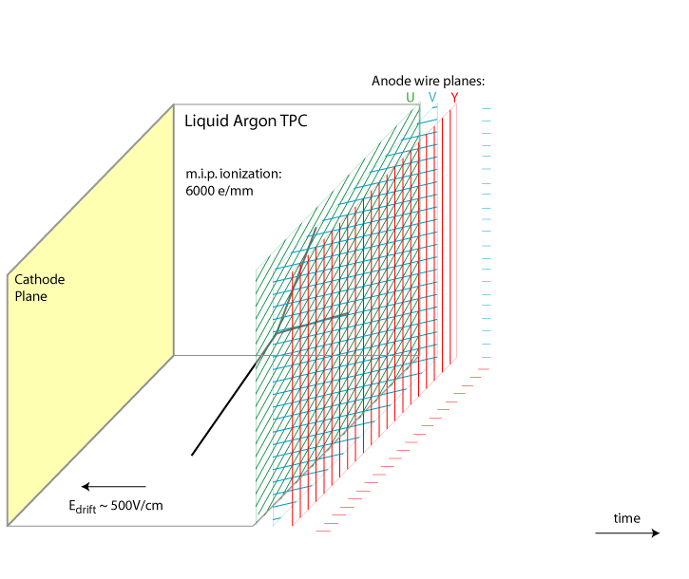
Overview of Signal Processing
Number of ionized electrons
V. Radeka
Field Response
Signal on Wire Plane
Electronics Response
Signal to be digitized by ADC
(Deconvolution)
High-level tracking …
time
TPC signal consists of time and charge information from induction and collection planes
Same amount charge was seen by all the wire planes

Slide 5
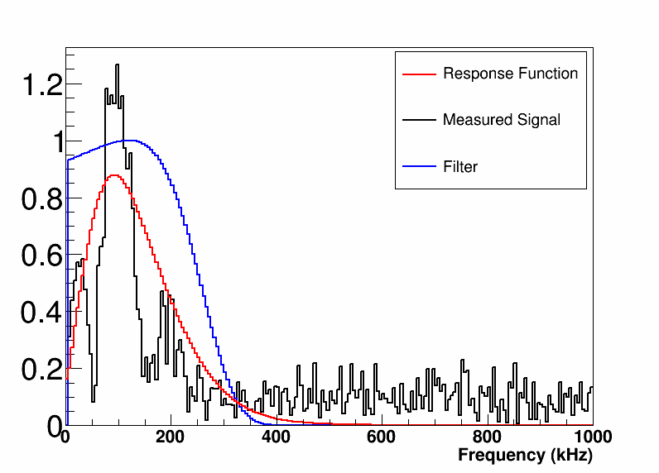
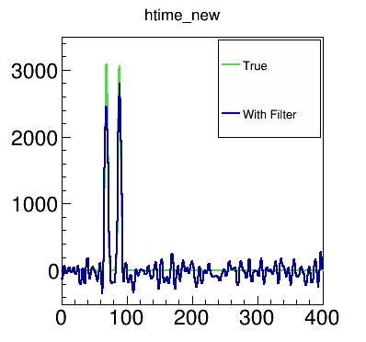
Deconvolution
Frequency Content
Time domain
Fourier transformation
Deconvoluted Signals
Frequency domain
The goal of deconvolution is to help extract charge and time information from TPC signals
Back to time domain
Anti-Fourier transformation
Time Domain
Bruce Baller developed during Argoneut
Notes:
Explain
1. What is filter like in the frequency domain?
2.Why filter is necessary (e.g. plot results w and w.o. filter )
3. Why we need a zero at zero frequency?

Slide 6
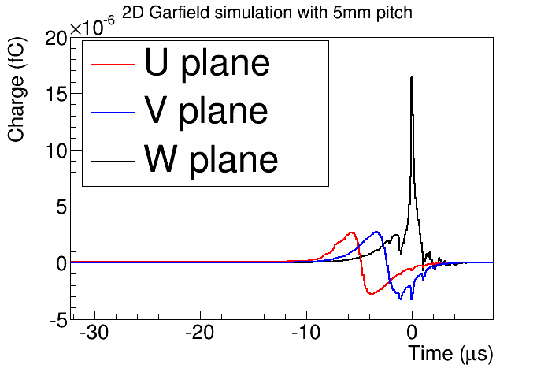
Field and Electronics Response
Leon, SLAC
Charge vs. Time averaged for a single electron
Difference between simulation and data (bigger signal in LongBo arXiv:1504:00398)
Cold electronics:
4 shaping time (0.5, 1.0, 2.0, 3.0 us)
4 gain (4.7, 7.8, 14, 25 mV/fC)

Slide 7
Discussion about Noise
There are two components of noise
Electronic noise (ENC)
The signal to noise ratio does not depend on the gain
Longer shaping time has smaller noise
Longer shaping time has slightly worse two-peak separation
Digitization noise due to 12-bit ADC
At 3 ms and 4.7 mV/fC, the electronic noise at collection plane is expected to be 0.58 ADC
1/sqrt(12.) ~ 0.29 ADC
11.7 ENOB → 1.23/sqrt(12.) ~ 0.36
12-bit ADC is enough so that “digitization noise” << “electronic noise”

Slide 8
Discussion about Gain and Shaping Time
The choice of gain will not affect the signal to noise ratio
Higher gain could lead to more chances of overflow
Also need to take into account the zero-suppression algorithm
Longer shaping time would
Increase the size of signal
higher chance to overflow
Reduce noise, thus increase signal/noise ratio
Slightly worse two-peak separation (difference between 2.5 and 3 us)
Also less digitization time (Nyquist: T_{shaping} >= 2 T_{digitization})
Less data

Slide 9
Optimization of Field Response Functions

Slide 10
Gap between Wire Plane, Bias Voltage, and Grid Plane
The raw signal (digits) consists of both signal and (electronic) noise
An ideal deconvolution will recover signal completely → number of electrons reached
The deconvolution on the electronic noise will thus determine the signal to noise ratio
Change in the gap distance and bias voltage will change → response function R → signal to noise ratio
To be worked out

Slide 11
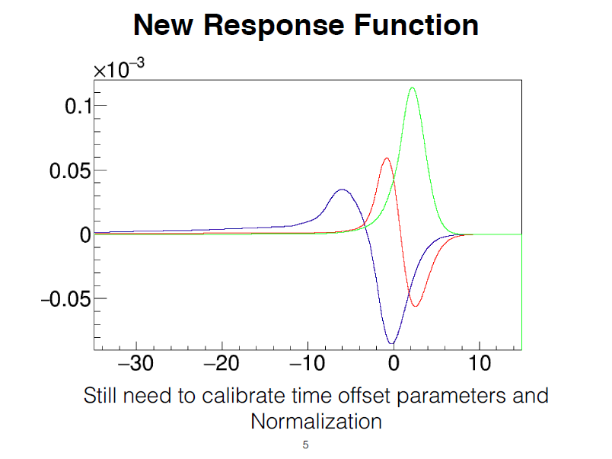
MicroBooNE Case
In MicroBooNE, the second induction plane has the worst signal to noise ratio
Jyoti Joshi

Slide 12
Some Questions
Preliminary results for 1D deconvolution
What’s the impact of dynamic induced charge?
Data validation

Slide 13
TPC Angle(I)
LArTPC
Liquid Scintillator
High density (Z ~ 18)
Event are more compact
Parallel wire readout w.r.t. the beam direction
More ambiguities
Slow detector response (~ms)
Challenges in rejecting cosmics for detector on surface
Ultra-high resolution
A layer ~ 3.5% X₀ (14 cm R.L.)
Higher physics requirement
~ 80% efficiency
Low density (Z ~ 6)
Perpendicular wire readout w.r.t. the beam direction
Fast detector response (~10 ns)
High resolution
A layer ~ 0.15 X₀ (44 cm)
~35% efficiency in NOνA

Slide 14
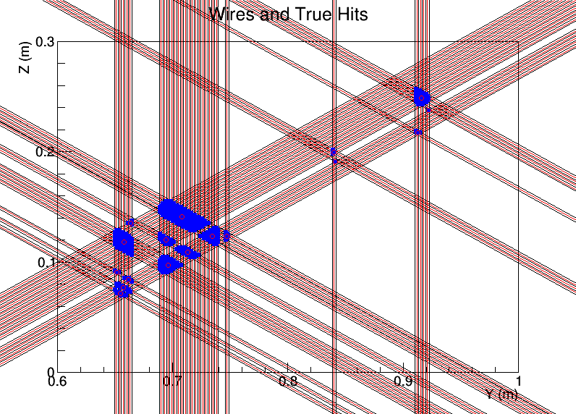
TPC Angle (II)
In a neutrino event, because of incident neutrino energy, the entire event is more boosted toward forward region
Due to nucleon response, the lepton tends to going more forward in the center-of-mass frame
TPC with wire readout has more trouble to reconstruct “tracks” which are parallel to the wire plane → charges arrive at various wire-plane at same time → ambiguity to figure out the proper correlation
http://www.phy.bnl.gov/wire-cell/ bee/set/4/event/2/

Slide 15
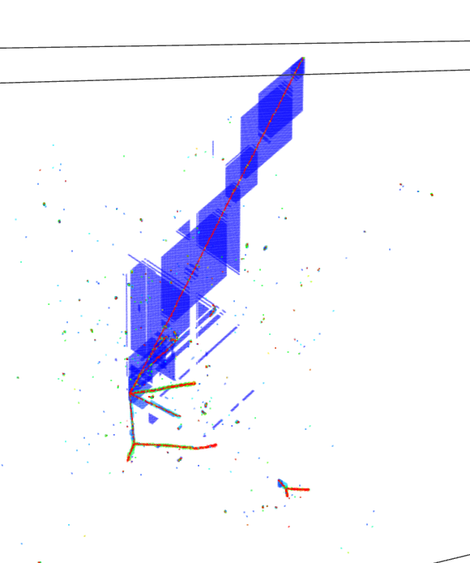
Detector Angle
http://www.phy.bnl.gov/wire-cell/bee/set/7515fe16-d163-4df8-ad87-09f7c809dc7e/event/0/
Same events (rotate 0-19 degrees)
Event 0 → 0 degrees
Event 10 → 10 degrees
Event 19 → 19 degrees

Slide 16
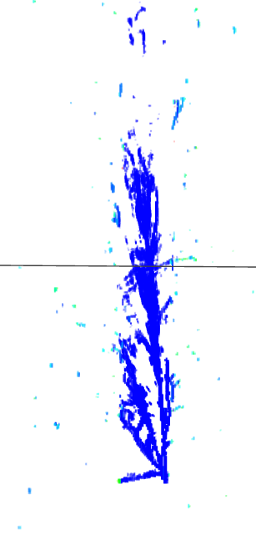
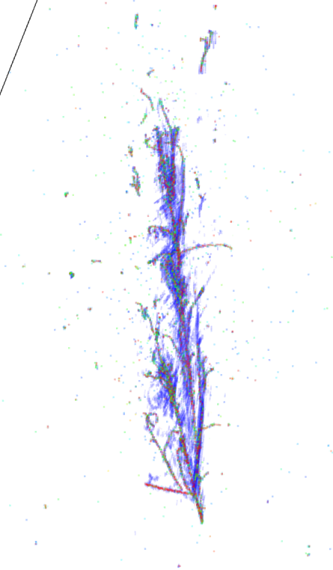
One can click the web-site to look at events in 3D and rotate to get a better understanding.
0 degrees
10 degrees
10 degrees (truth)

Slide 17
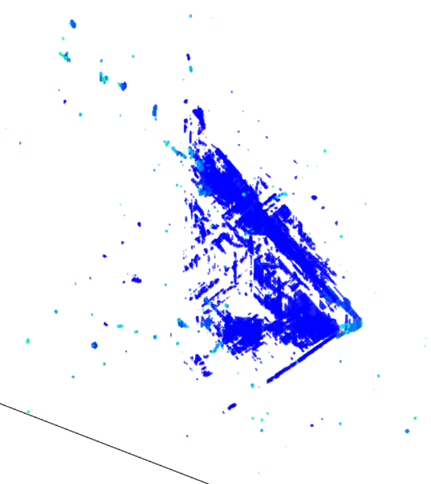
10 degrees
19 degrees
http://www.phy.bnl.gov/wire-cell/bee/set/6/event/8/
MC truth: one electron, one neutral pion, and one positve pion

Slide 18
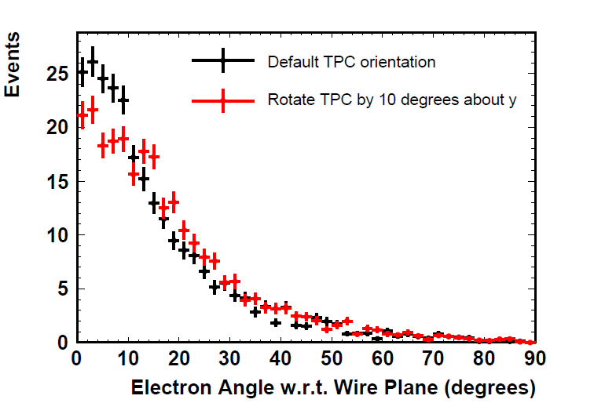
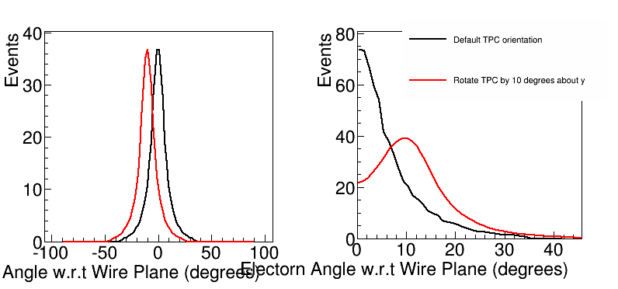
First Look at the TPC Orientation
Generated by GENIE
Look at the electron angle for two configurations: default vs. 10 degrees rotation
Integrated over all the energy, oscillation added
~ 20 % effect at the 0 degrees with rotating 10º
Effect is expected to be strongly energy-dependent
Right plot shows the expected distribution at Argoneut (5-6 GeV) energy

Slide 19
Questions
How to evaluate which angle is good enoug?
Is perpendicular wire-readout completely hopeless?
Can we add in intended distortion in electric field?
How to calibrate its effect?

Slide 20
Wire Pitch’s impact on Charge
For a electron drift at different locations within a wire pitch
Field response has a strong dependence on the location of electron
Deconvolution was performed with average field response
Large wire pitch → smaller (electronic) noise to signal ratio → smaller resolution
Large wire pitch → larger spread at response function → larger resolution

Slide 21
Questions
What’s the expected charge resolution and its dependence on the wire pitch?
How important is dynamic induced charge effect?
How to calibrate the 2D response function?

Slide 22
About Wrapping (Wire Angle)
Wire angle would impact the wire wrapping scheme
What’s the problem of wire wrapping?
The wrapping of wire would lead to more crossings of wires → the wires originally won’t cross can cross with wrapping → the crossing of wires will introduce ambiguities
The amount of ambiguities strongly depends on the event activity
For a simple track, it is not a problem
For multiple tracks, more difficult
For showers, much more difficult
For shower + track + crossing APA → extremely difficult
Wire-cell imaging step is an ideal tool to study this (use both charge and time to do reconstruction)
u2
v3
True Hits
v2
u1
H1
v1
At fixed time
H2
H4
Fake Hits
H5
H3
H6

Slide 23
Wire Pitch/Angle on Position Resolution
Along the drift direction, the digitization length is 0.5 us * 1.6 mm/us → 0.8 mm @ 500 V/cm
Average diffusion σ=0.9 mm for 2.5 m drift distance
Signal shaping time 2 us → 2 us / 2.45 * 1.6 ~ σ=1.3 mm
For wire plane, the digitization length is related to the wire pitch (3 ~ 5 mm)
For a continuous track, not a problem to calculate dE/dx
For the end points of track, the resolution in “dx” is about “0.3 * L”
Perpendicular to vertical wire: L = wire pitch
Parallel to vertical wire: L ~ (wire pitch)/sin(theta)
Consequences in short tracks (PID, angle, energy through range …)
Gap identification (i.e. for e/gamma separation)
Likely need “2 * L” to identify a gap
θ

Slide 24
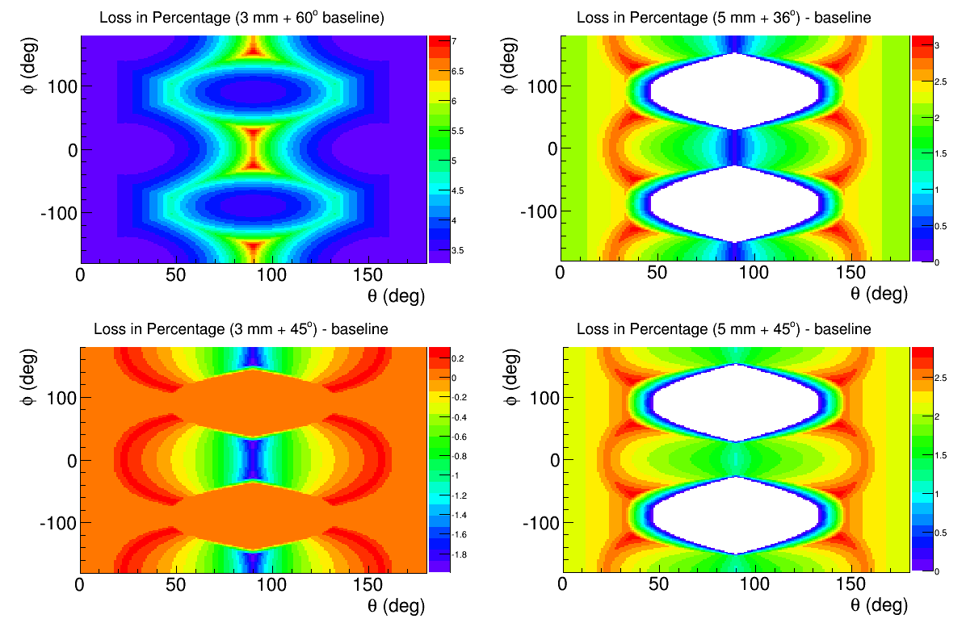
More about Gap Identification
Radiation length ~ 14 cm → for high-energy photon, the mean free path 9/7 * 14 ~ 18 cm
Assumption
Along the drift direction: 4 us for two-peak separation
Perpendicular to drift direction → 2 * L
Observations:
3 mm→ 5 mm, gap identification efficiency is reduced by about 2.x% ~ (1-exp(-4/180))
~60% more background
36 → 45 degrees, the impact of gap identification efficiency is one order smaller
Also varied pitch for different planes (Maxim)

Slide 25
Discussions
For bigger wire pitch, the gap identification efficiency will be reduced without a doubt
3 mm → 5 mm wire pitch leads to about 2.2 % reduction in efficiency
But this number corresponds to ~60% more background
There are three weapons to differentiate electron from gamma:
Gap identification
dE/dx (initial track is about 3 cm long, what’s the impact of wire pitch?)
Shower topology (i.e. gamma is always from neutral pion decay, thus multiple gammas)
The real question is “which wire pitch is good enough to reject background?”
Also engineering considerations
Will small wire pitch leads to more chance of wire touching and high noise?

Slide 26
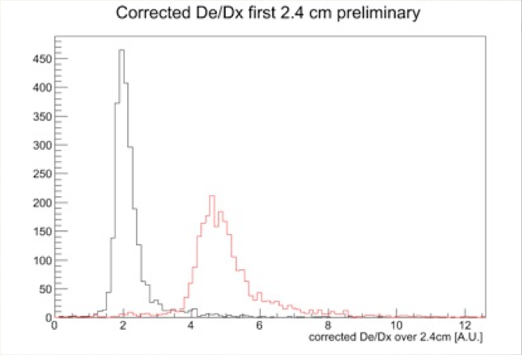
These two would explain the shape of dE/dx plot
Compton Scattering
I calculated 5 cm mean free path based on moller scattering cross section, cross checked with MC

Slide 27
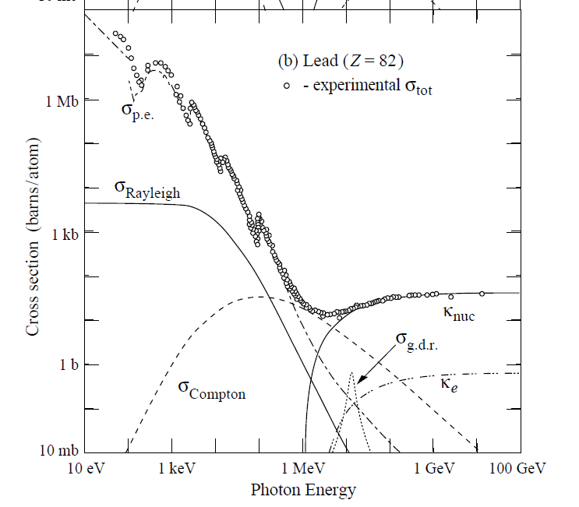
e/gamma separation dE/dx
Compton ~ Z
Pair production ~ Z^2
Compton scattering could lead to confusion of dE/dx

Slide 28
Summary
From reconstruction point of view, the priority (from high to low) is
TPC angle (5-10 degrees from the beam direction)
Within this range, larger angle is better
When will be enough (i.e. increment is modest)?
Wire Pitch (gap identification, dE/dx)
3 mm is better
Will 5 mm be enough?
Wire Angle (reduce ambiguity, position resolution)
To be studied
Wire gap and bias voltage (charge resolution)
To be studied

