Slide 1
Lessons Learned from Real Data
Xin Qian
BNL

Slide 2
Outline
Space Charge effect for LArTPCs on surface
Field Response Calibration
How to deal with noises and dead channels

Slide 3
Space Charge
It is possible that the electric field in LArTPC is distorted
One possible source is the ion space charge
Ion’s velocity is about five orders of magnitude slower than the ionization electron
Ions take several minutes to move from APA to CPA
For LArTPCs on surface, cosmic muons leads to significant amount of space charge inside the TPC active volume→ distort electric field
Magnitude: (Drift distance)³ and (E-field)^{-1.7}

Slide 4
Simulation:
M. Mooney

Slide 5
Impact of Space Charge
Clear effect of space charge with the laser data

Slide 6
Impact of Space Charge (I)
Space charge leads to a distortion of electric field
According to Maxwell equation, electric field line can not cross each other
Due to the high density of LAr, ionization electron basically drift along the electric field line
With the distortion of the electric field line, the unique feature of LArTPC (the foundation of wire-cell) stays the same
Same amount of charge are observed by all three planes for point charge arrived at anode plane

Slide 7
Impact of Space Charge (II)
With the standard position reconstruction (assuming no space charge effect), a distorted 3D image will be reconstructed
The correction of space charge must be 3D point (x,y,z)_{rec} to 3D point (x,y,z)_{corr}, once the space charge effect is calibrated
Wire-Cell imaging step, producing (x,y,z)_{rec} directly, fits well with space charge correction
Can be done before the pattern recognition

Slide 8
Notes
The Space Charge Distortion in MicroBooNE qualitatively agrees with expectation
Need quantitative evaluations
The space charge leads to curved tracks, which effectively reduce the number of long cosmic muons travelling parallel to the wire planes
For some MC events, Wire-Cell has memory issues due to this kind of long parallel tracks
For real Data, memory is more relaxed (also due to dead channel)

Slide 9
Outline
Space Charge effect for LArTPCs on surface
Field Response Calibration
How to deal with dead channels

Slide 10
Strategy Comparison (Xin’s View)
Traditional 2D Reconstruction
Wire-Cell 3D Tomography
Start with 2D (time + wire)
2D pattern recognition
Particle track information
Matching 2D patterns into 3D objects
Time information (start/end of clusters)
Some charge information to remove ambiguities in matching
3D track-like objects for both tracks and showers
MC truth are needed to evaluate efficiency
Start with 2D (at fixed time)
2D image reconstruction
Explicit Time + Charge information
Some connectivity information can be used
3D image reconstruction
Straight forward
3D Pattern recognition
Tracks
Showers
Imaging vs. recognized pattern can be used to evaluate efficiency

Slide 11
Discussion
Wire-Cell explicitly uses the match of time and charge information from all three planes
Very high requirement to the deconvoluted signal from all three planes
Performance are thus sensitive to the quality of the deconvoluted signal
We can use this feature to calibrate the overall response function

Slide 12
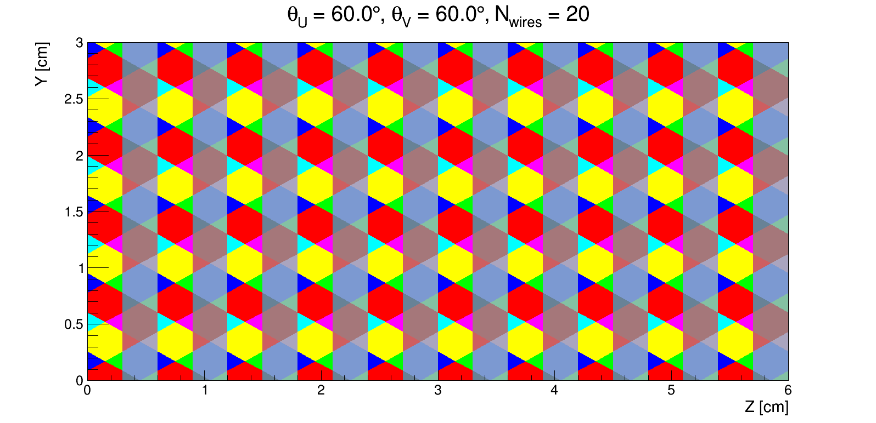
Tiling
Wire: wire +- pitch/2
Cell: overlap of three wires (each in U, V, and W)
Tiling: form cells from wires
W: measured charge in a wire
C: expected charge in a cell
G: a matrix containing geometry information connecting wire and cell
Mike Mooney CellMaker

Slide 13
Discussion
Cells are made from the fired wires at the same time slice
If there are time offsets among signals from fired wires, the number of cells created should be reduced
Therefore, we can use this metric (number of cells created) to calibrate the time offset

Slide 14
Solving
C: charge in each (merged) cell
G: Geometry matrix connecting cells and wires
W: charge in each single wire
B: Geometry matrix connecting merged wires and single wires
V_{BW}: Covariance matrix describing uncertainty in wire charge

Slide 15
Discussion
For each merged wire, after fit we have two values:
Measured charge
Expected charge from the sum of merged cells
The expected charge is calculated based on the unique feature of TPC
Same amount of charge is observed by every wire plane by point charge arriving at the APA

Slide 16
Outline
Space Charge effect for LArTPCs on surface
Field Response Calibration
How to deal with noises and dead channels

Slide 17
About 10% unusable channels

Slide 18
Impact to Wire-Cell
Naively, with 10% unusable channels, the volume efficiency with all three wire planes can be estimated as
0.9 * 0.9 *0.9 ~ 73%
One can increase the efficiency by requiring only two out of three planes
However, there are a lot of ghosts produced in the process

Slide 19
Two planes

Slide 20
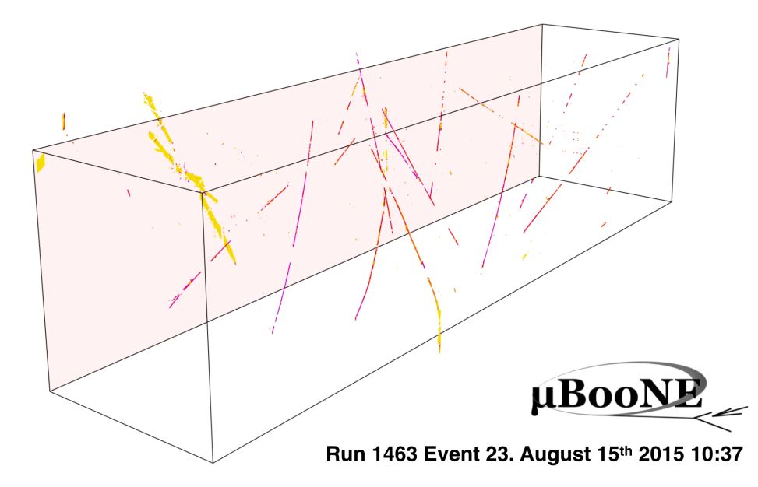
Three planes

Slide 21
Strategy Comparison (Xin’s View)
Traditional 2D Reconstruction
Wire-Cell 3D Tomography
Start with 2D (time + wire)
2D pattern recognition
Particle track information
Matching 2D patterns into 3D objects
Time information (start/end of clusters)
Some charge information to remove ambiguities in matching
3D track-like objects for both tracks and showers
MC truth are needed to evaluate efficiency
Start with 2D (at fixed time)
2D image reconstruction
Explicit Time + Charge information
Some connectivity information can be used
3D image reconstruction
Straight forward
3D Pattern recognition
Tracks
Showers
Imaging vs. recognized pattern can be used to evaluate efficiency

Slide 22
Discussion
How to deal with unusable channels is a challenge to all reconstructions methods
I believe that Wire-Cell suffers more
Wire-Cell has high requirement on charge/time matching among three planes
While two-plane tiling has high efficiency, it also introduces lots of ghosts
A disambiguity algorithm was introduced
However, this disambiguity algorithm also kills good signal
Probably need two-pass reconstruction (one to remove cosmics, one to deal with neutrinos)

Slide 23
Summary
Wire-Cell tomographic reconstruction fits well with the position correction due to distorted field
Space charge by positive ions
Wire-Cell has stringent requirement on the time/charge match among different planes
This can be used to calibrate the overall response function
Wire-Cell suffers more from the unusable channels
Challenges to be resolved

