Slide 1
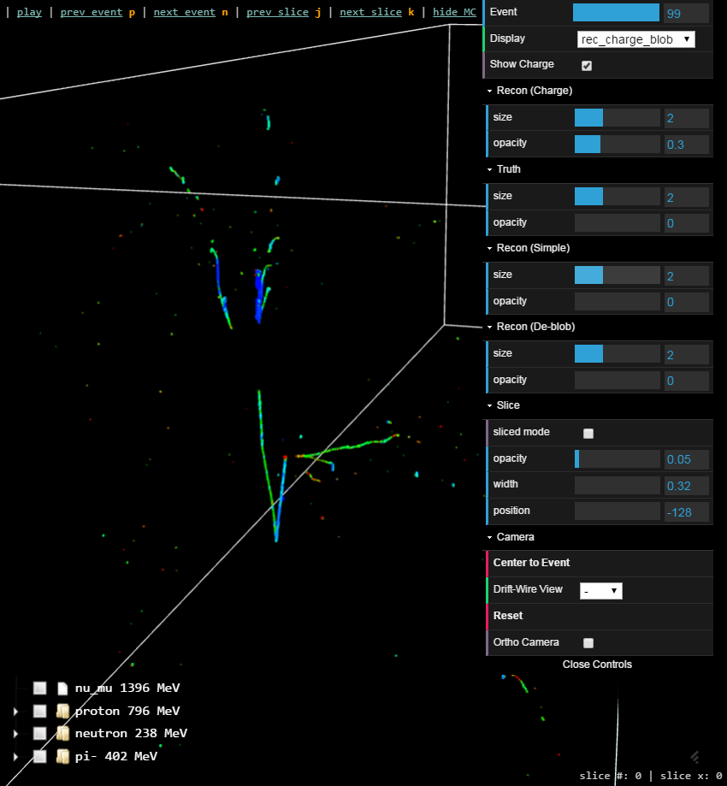
Visualization with Bee
Chao Zhang
BNL

Slide 2
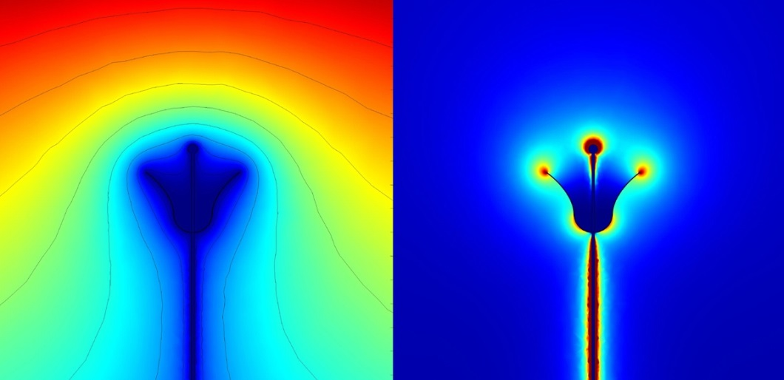
Why the Name “Bee”?
Bees are known to make cells
https://en.wikipedia.org/wiki/Honeycomb
Bees sense electric fields by building up electric charges as they rapidly flap their wings.
http://www.nature.com/news/bumblebees-sense-electric-fields-in-flowers-1.12480
A flower's electric field (right, with associated electric potential on the left) helps bumblebees predict where to find the most nectar.

Slide 3
Outline
Why do we need an event display and why use WebGL (20’’)
Demo of Bee (20’’)
Software Implementation (10’’)

Slide 4
Existing LArTPC Event Displays
 | LArSoft | LArLite | Argo | VENu | RED | Bee
Current developer | T.Usher et. al | C.Adams | N.Tagg | A.McLean et. al | C.Zhang | C.Zhang
Experiment | All | uBooNE | uBooNE | uBooNE | DUNE-35t | All
Viewer | 2D / 3D | 2D | 2D / 3D | 3D | 2D / 3D | 2D / 3D
GUI | ROOT | PyQT | Canvas / WebGL | Unity3D | ROOT / EVE | WebGL
Focus | Analysis | Analysis | Online- monitor | Public | Analysis | Analysis
Platform | Linux/Mac | Linux/Mac | All | All | Linux/Mac | All
Data | LArSoft | LArSoft | LArSoft | Derived. | Derived. ROOT TTree | Derived. JSON
Not a complete list. There could be a lot more and perhaps even more in the future.

Slide 5
Why Do We Even Need An Event Display
Many experiments work well without dedicated event displays. Many displays only exist for the purpose of online/offline monitoring
In LArTPC, ability to hand-scan an event in 3-D is essential in order to fully understand the topology of the events - not just for public show-off
Gain intuitions of the complexity of LArTPC event topologies
Ensure the correctness of the reconstruction.
Help to develop new reconstruction techniques
Evaluate and compare different reconstruction performances
Learn the “corner cases” where reconstruction fails
Gain inspirations, teach machines, …

Slide 6
What’s an ideal hand-scan tool?
Easy to install even for non-experts
cross-platform
User-friendly even for non-experts
Consistent, predictable, elegant UI
Fast, responsive, interactive 3D
Rich functionality for experts and non-experts
“Event database” for easy access to data
Tools to interact with the database
Supportive Services:
Documentation, maintenance, feedback, …

Slide 7
What’s an ideal hand-scan tool?
Easy to install even for non-experts
cross-platform
User-friendly even for non-experts
Consistent and elegant UI
Fast and Responsive
Rich functionality for experts and non-experts
“Event database” for easy access to data
Tools to interact with the database
Supportive Services:
Documentation, maintenance, feedback, …
Does such a thing exist?
Is that too much to ask for?

Slide 8
Web Application + WebGL
Easy to install: only need a modern web browser; works even on mobile platforms
User-friendly: many beautiful web UI frameworks working consistently on all platforms
Interactive 3-D: WebGL / JavaScript
Fast and Responsive: asynchronous JavaScript
Interact with “event database”: many popular MVC web frameworks for agile development
Supportive Services: need man-power and experts! Gentle learning curve but broad area.

Slide 9
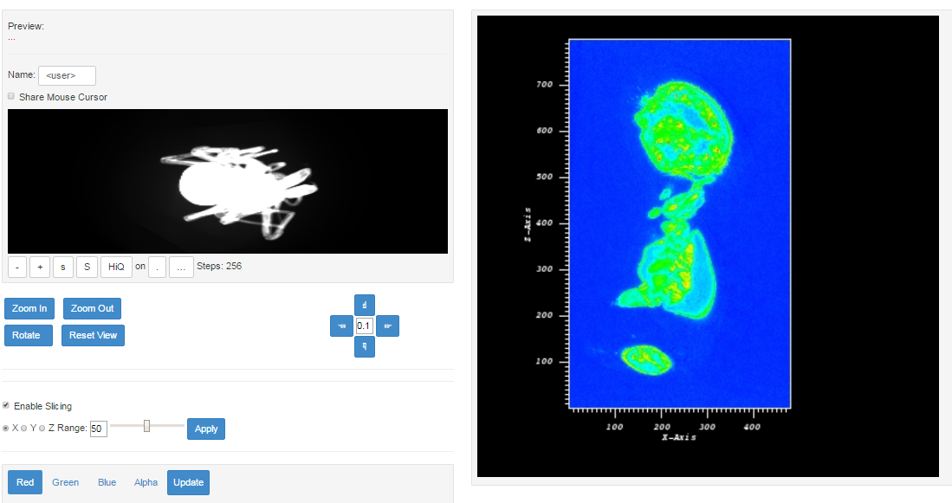
An Inspiration Coming from LBNL
In March, Craig showed me a spider demo using data from ALS X-ray micro-tomography
http://portal.nersc.gov/project/als/visit_client/visitclient.php?dataset=20130713_185717_Chilarchaea_quellon_F_9053427_IKI_-imgrec-20130714_192637.h5&root=1

Slide 10
WebGL Demo:
WebGL implementation through Three.js
Many examples at: http://threejs.org/examples/
A Water Cerenkov Detector showing the propagation of millions of photons: http://www.phy.bnl.gov/~chao/wbls/demo/
Notice how fast and smooth WebGL renders large amount of objects in a browser
WebGL runs everywhere with a modern browser (Chrome, Firefox, Safari, IE11+, etc. http://caniuse.com/#feat=webgl)

Slide 11
Bee Demo
http://www.phy.bnl.gov/wire-cell/bee/
Basic Operations
Move around
2-D projections
Compare different algorithms
Compare with MC truth
“Sliced mode”
Hotkeys
Event sets
Upload your own event sets
Doc: http://bnlif.github.io/wire-cell-docs/viz/bee/

Slide 12
Some example events
numu-cc: http://www.phy.bnl.gov/wire-cell/bee/set/7/event/0/
nue-cc: http://www.phy.bnl.gov/wire-cell/bee/set/6/event/2/
numu-nc: http://www.phy.bnl.gov/wire-cell/bee/set/8/event/27/
nc-pi0: http://www.phy.bnl.gov/wire-cell/bee/set/8/event/11/
cosmic+nu: http://www.phy.bnl.gov/wire-cell/bee/set/17/event/0/
Algorithms comparison: http://www.phy.bnl.gov/wire-cell/bee/set/4/event/2/

Slide 13
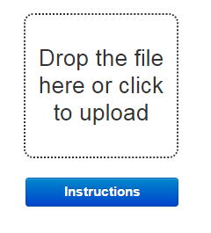
Upload Your Own Files
Documentation about user uploads can be found at http://bnlif.github.io/wire-cell-docs/viz/uploads/
We already showed how to upload Wire-Cell files
For LArSoft files:
lar -c celltree_protodune.fcl your_reco_file.root
Then drag and drop the bee/bee_upload.zip file to the dropzone
It will show the “pmtrackdc“ Space Points by default
To add more algorithm, see next slide
bee_upload.zip

Slide 14
.fcl File
physics:
{
analyzers:
{
WireCell:
{
module_type : "CellTree"
saveRaw : false
saveCalib : false
saveSimChannel : false
saveMC : true
saveJSON : true
RawDigitLabel : "daq"
CalibLabel : "caldata"
SpacePointLabels: ["trackkalmanhit", "pandoraCosmicKHit", "pandoraCosmic", "pandoraNu", "pandoraNuKHit“, “pmtrackdc"]
mcOption : "all"
outFile : "celltree.root"
}
}
analysis: [ WireCell ]
end_paths: [ analysis ]
}
To customize, copy the $LARRECO_DIR/job/celltree_protodune.fcl file to your working directory and modify the red lines as shown in the right (for LArSoft)

Slide 15
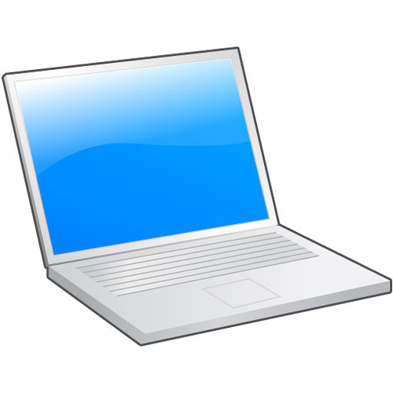
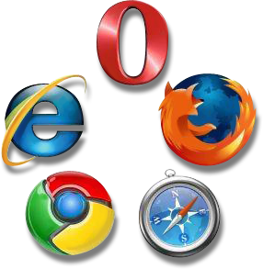
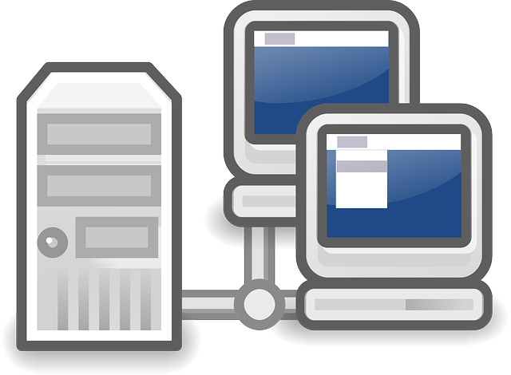
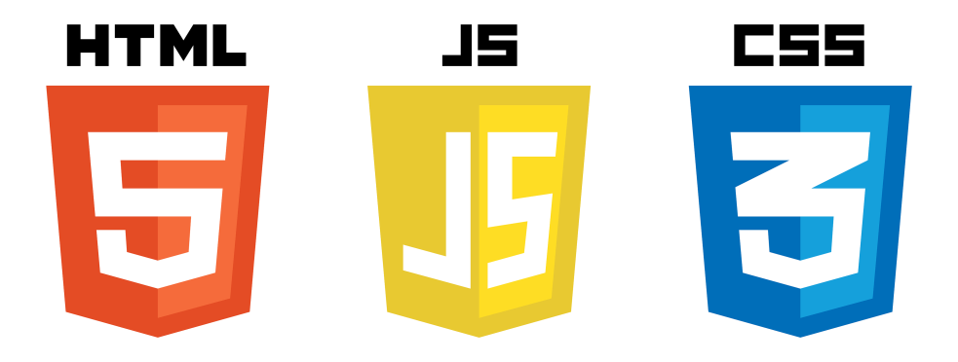
Software Implementation

Slide 16
Software Implementation

Slide 17
Software Implementation
No-server implementation
Possible, implemented in earlier versions of Bee
Limitations as the app grows
But shows the “essential” part of the software is in-fact “front-end” programming
Something unfamiliar for most physicists
Everyone should learn JavaScript!

Slide 18
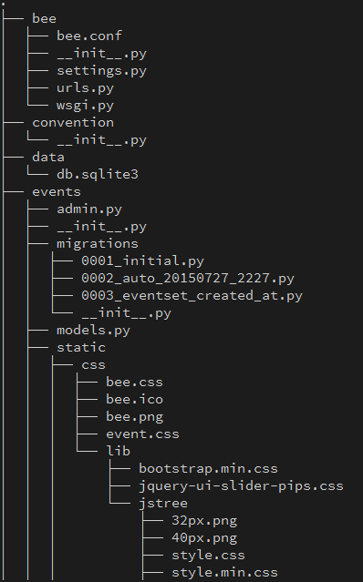
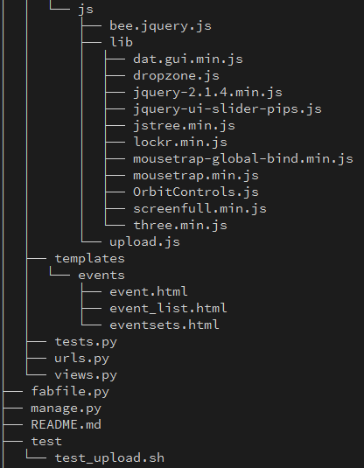
Bee Code Base
https://github.com/WireCell/wire-cell-bee

Slide 19
Server Side
Env: virtualenv + pip
Django
URL Routing
Interact with database (SQLite)
ORM models
CRUD
APIs (not RESTful yet)
Simple templating
Core UI moved to front-end for responsive behavior

Slide 20
Client Side
Env: Chrome Developer Tools
So far not using any JavaScript Frameworks
Too many choices: Backbone, Angular, React, …
Evolving too fast: often obsolete within a few years
Plain JS + Essential libraries
three.js: WebGL implementation
JQuery: DOM operation, AJAX, promise, …
DAT.GUI: simple GUI
Lockr: local storage
Many other utilities: dropzone, jstree, mousetrap, …

Slide 21
Summary
Bee is a web application utilizing WebGL to implement 3D interactive visualization
Bee is still in its early stage, but has many of the core functionalities implemented and usable
Bee still has many desired features to be implemented, but need help
User feedbacks are essential
Anyone interested is welcome to contribute.
Bee 2.0 (see Wed. talk)

