Slide 1
Berkeley Lab HEP Program P5 town-hall February 23, 2023

Slide 2
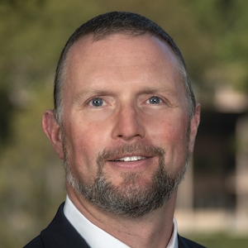
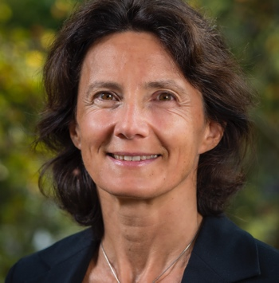
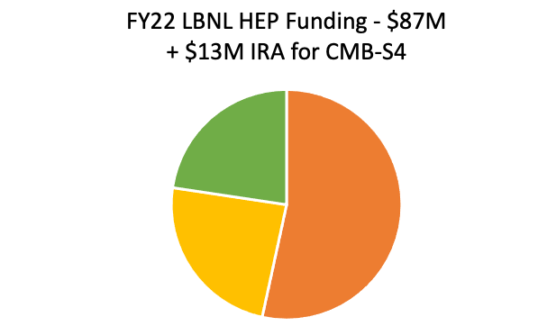
Berkeley Lab HEP Program Snapshot
LBNL is a large (>$1B) multi-purpose DOE lab
HEP at LBNL at the core of two divisions: Physics and Accelerator Technology and Applied Physics, ~250 employees in all
Award winning staff – 9 Nobel prizes in physics
Fully matrixed Engineering division
Strong connections with
NERSC, ESNet, Computing Sciences Area
Materials Science, Molecular Foundry
Nearby UC Berkeley, many joint faculty and students
Accelerator Division
Cameron Geddes
Physics Division
Nathalie Palanque-Delabrouille
Projects
LHC, ATLAS,
CMB-S4
Research
Cosmic (Dark Energy,
Dark Matter, CMB),
Energy (ATLAS),
Intensity (DUNE, Mu2e), Theory (+AI/ML, QIS, PDG),
Instrumentation (R&D,
microelectronics)
Accelerator
Operations
ATLAS, DESI, LZ
BELLA Center
UCB/LBL theory group: world-leading
center for theoretical work on
elementary particle phenomenology
Notes:
Multi-purpose: HEP (8%), Adv Scientific Computing (25%), Basic Energy Sciences (25%), Biological Env Research (18%), Energy Efficiency & renewable En. (15%)
BES: Basic Energy Sciences (molecular foundry), FES:

Slide 3
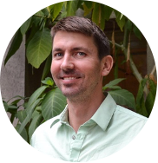
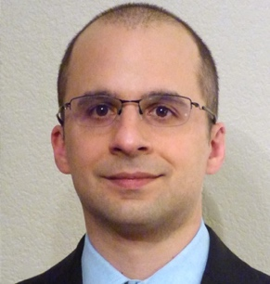
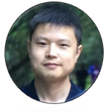
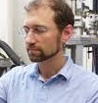
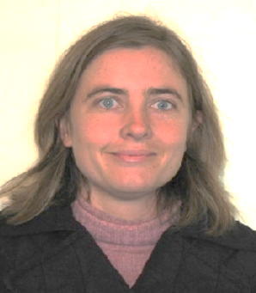
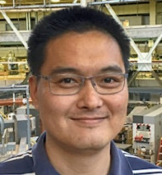
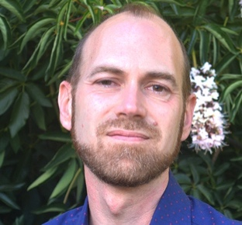
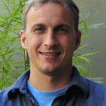
Outstanding Young Scientists – Our Most Important Asset
14 recent DOE HEP + BES Accelerator Early Career Awards
3 of past 9 recipients of the APS Primakoff Award for early career physicists

Slide 4
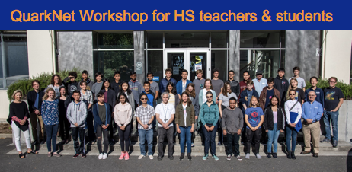
IDEA: Inclusion, Diversity, Equity and Accountability
IDEA@Berkeley Lab: Fostering a diverse workforce – diverse in experiences, perspectives, and backgrounds – and a culture of inclusion are key to attracting and engaging the brightest minds and advancing our record of scientific excellence and groundbreaking innovations
Physical Sciences Area Mentoring Program
Launched in 2021, expanded in 2022 to include admin, technical staff
50 to 70 Mentor/Mentee pairings every year
Division activities: Quarknet, US Particle Accelerator School, SAGE, Snowmass white paper, IDEA events & seminars, APS divisional IDEA groups
Teaching for a diverse next generation
Teaching for a diverse next generation

Slide 5
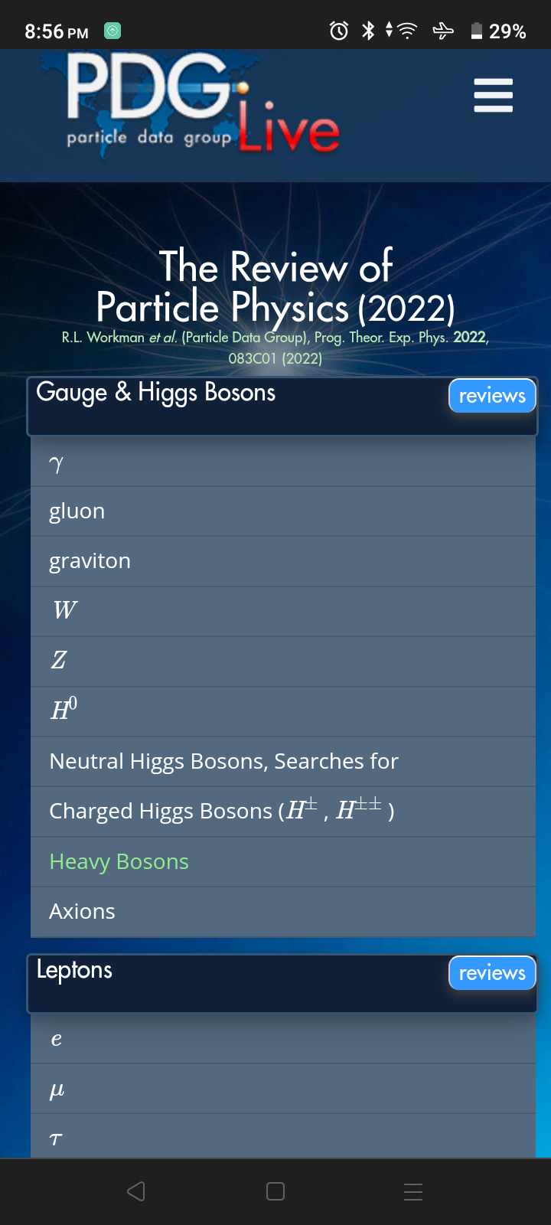
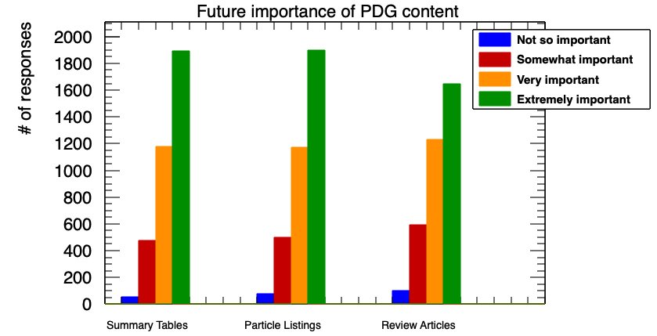
Serving the community: the Particle Data Group
PDG is a science legend, recognized by SC as an authoritative data resource
In the process to make PDG data machine-readable
PDG is vital to HEP community & related areas (particles, cosmology, astroparticle physics) but more largely too (academia)
For researchers
For students
For teaching and outreach
PDG user survey (2022) demonstrates extremely strong interest from community in all of PDG’s content
Tables
Listings
Reviews

Slide 6
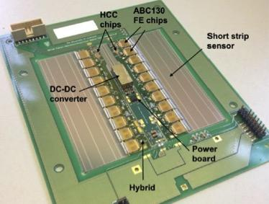
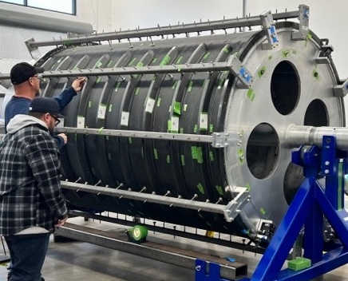
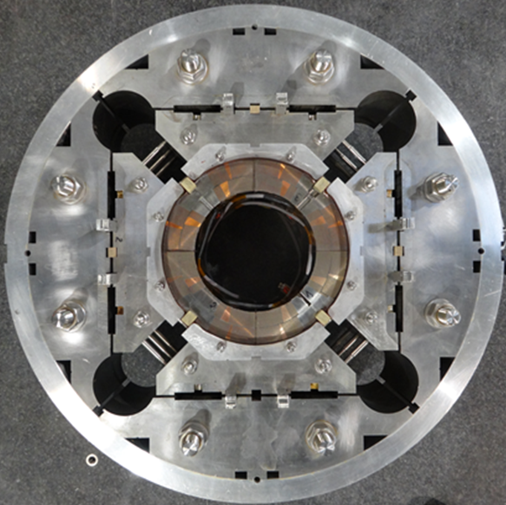
Energy Frontier: Collider projects and accelerators
ATLAS
Higgs physics, precision measurements, BSM physics
Benefits from growing AI/ML cross-cutting activity
HL-LHC
Detector upgrade: Lead roles on all three WBS of ITk tracker
Pixels: Leadership role in ASIC development
Strips: Selected stave concept originated & demonstrated at LBNL
Global Mechanics: Lead design & construction of carbon-fiber structures (first carbon shells recently delivered)
Accelerator Upgrade Project: HL-LHC magnets
Lead cable assembly and magnet facility
Drives increased luminosity for future runs
Leadership: pixel readout
LBNL design: Silicon Strip
Precision assembly, state of art cabling

Slide 7
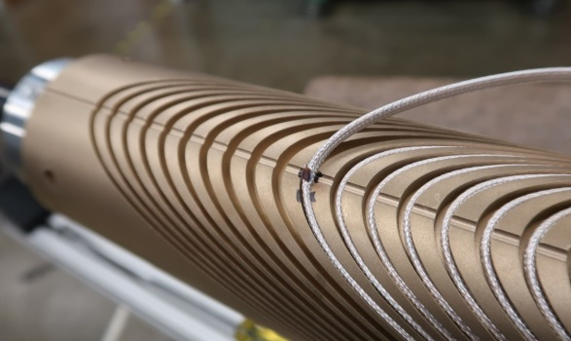
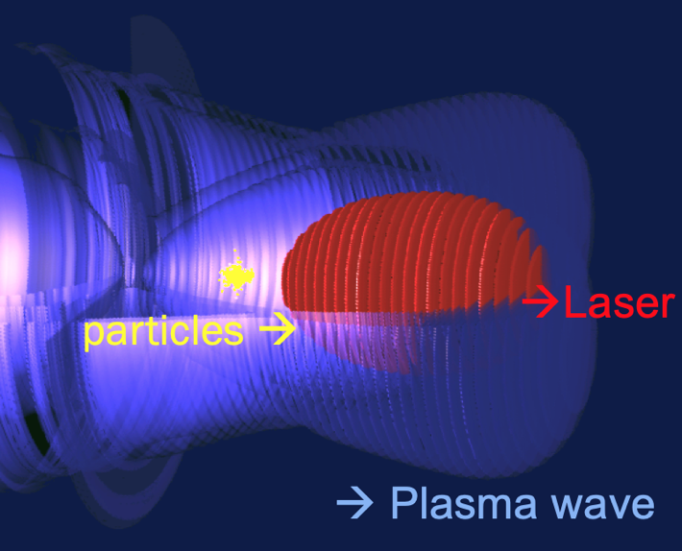
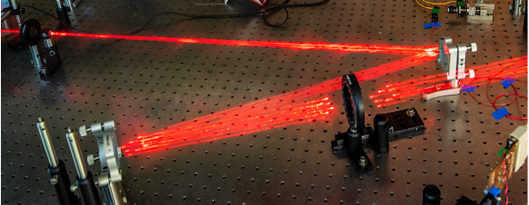
Energy Frontier: Collider projects and accelerators
Accelerator modeling program – Exascale and SciDAC
GordonBell Prize for WarpX; Post-Exascale funding critical for sustainability
Lead lab for US Magnet Development Program
High-temperature superconducting and hybrid magnets towards ≥ 20T
Key to future circular colliders, as well as light sources, fusion etc.
Bella center
Laser plasma acceleration (towards 10 TeV/parton scale)
kBella → kHz regime for future colliders
Mid-scale project
LArPix ASIC
bonded to sensor
Stress management for high field
Laser-driven plasma waves
kHz laser technology for colliders
kBELLA & fiber combination

Slide 8
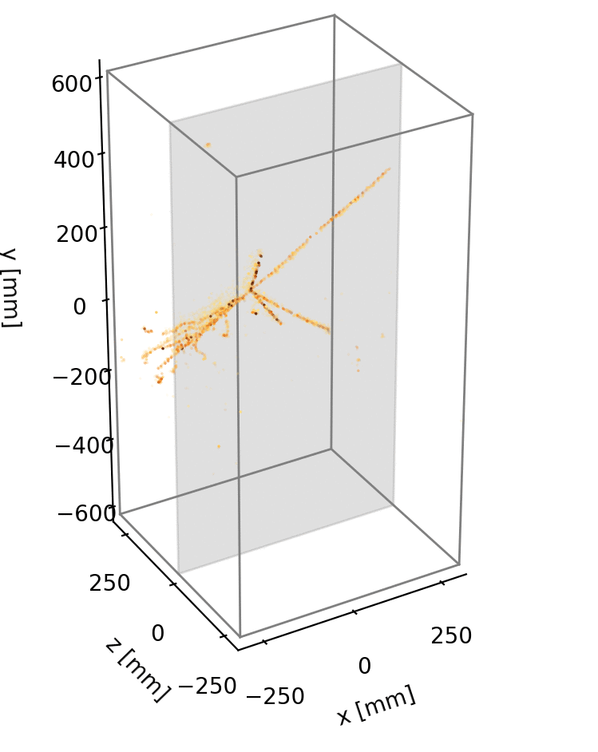
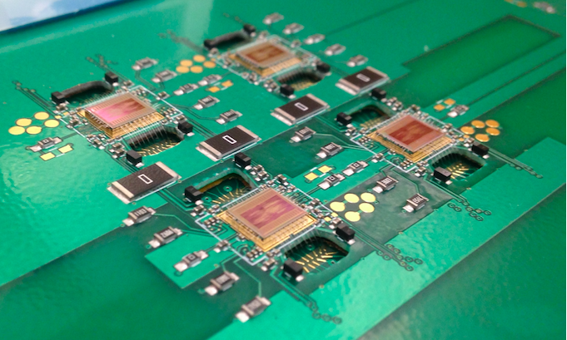
Contributions to the Intensity Frontier
DUNE
Leadership on Far Detector #1 and #2 Vertical Drift read-out electronics
Leadership of Near Detector LAr TPC (ND-LAr)
Successful demonstration of ton-scale demonstrator modules with >80k LArPix readout channels; LArPix was designed, fabricated & demonstrated at LBNL
Coordinating production of 4 modules for ArgonCube 2x2 demonstrator to be operated in NuMI neutrino beam
LArPix ASIC
bonded to sensor
Cryogenic pixelated readout ASIC (LArPix)
Cosmic Ray Shower imaged with LArPix

Slide 9
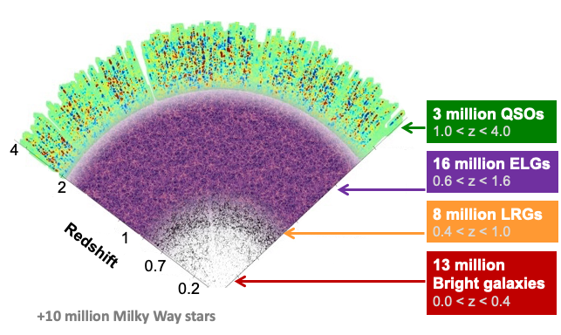
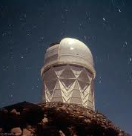
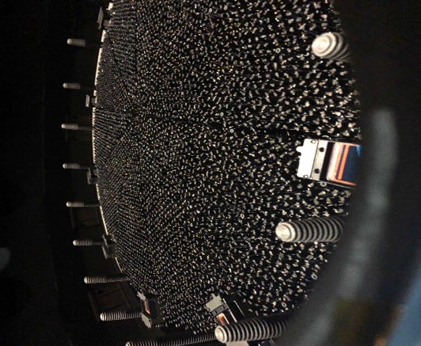
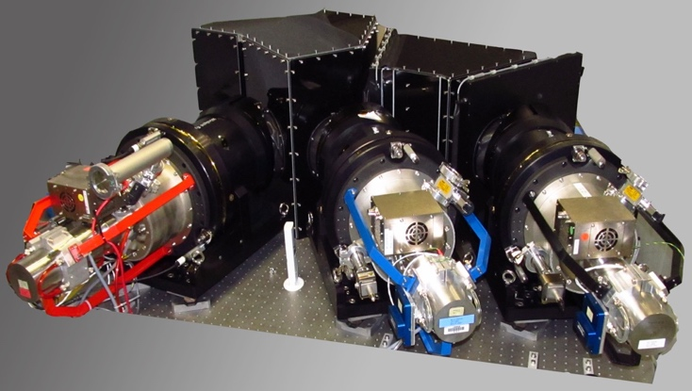
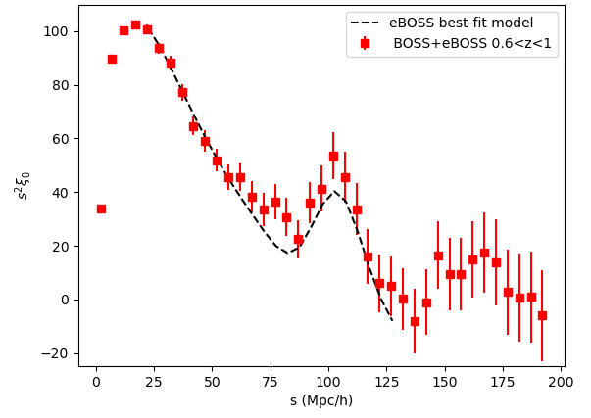
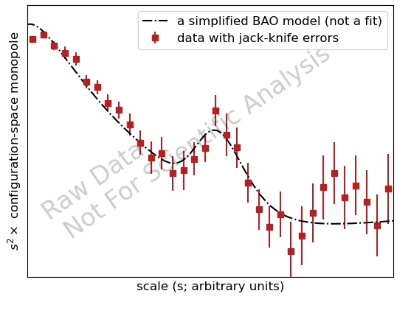
DESI: Dark Energy Spectroscopic Instrument
40 million
galaxies & quasars
Largest-ever 3D map of the Universe from 40M sources, charting the Universe expansion history over 12 billion years to study Dark Energy
DESI received the DOE Project Management Excellence Award (delivery on schedule and under budget)
Led by LBNL, collaboration of over 1000 scientists from 70 institutions
First Stage IV Dark Energy experiment taking data
Preparing near-term DESI-II to address early dark energy, and long-term Stage-5 spectroscopic instrument to probe inflation & primordial features
New cage and ring arriving
at Kitt Peak National Observatory
Kitt Peak Observatory
NSF’s Mayall telescope
Ten 3-arm spectrographs
6-year eBOSS
2-month DESI
BAO
BAO
Amplitude
Focal Plane with 5000
robotic fiber positioners
Scale
Scale

Slide 10
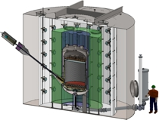
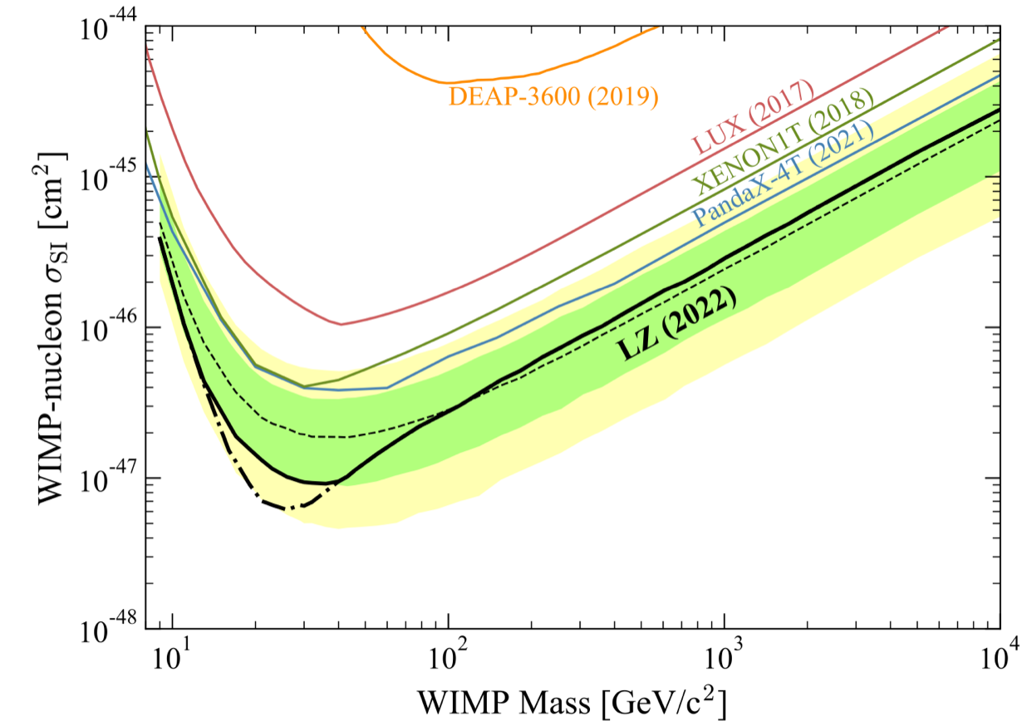
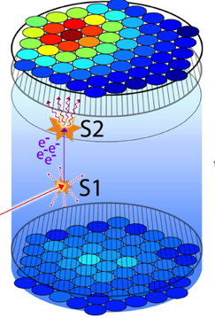
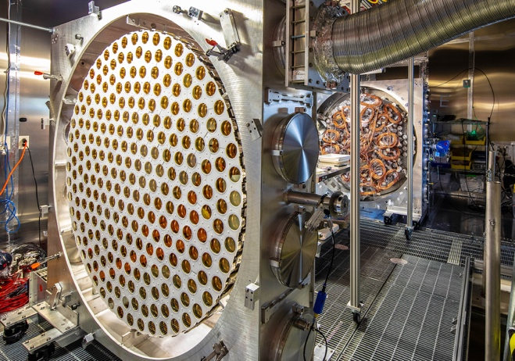
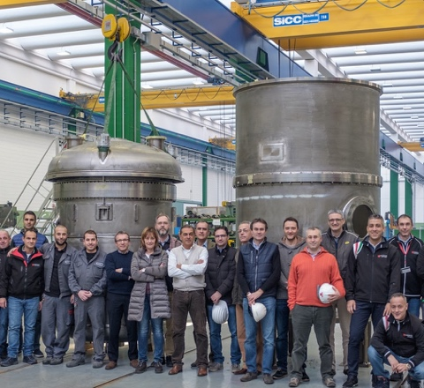
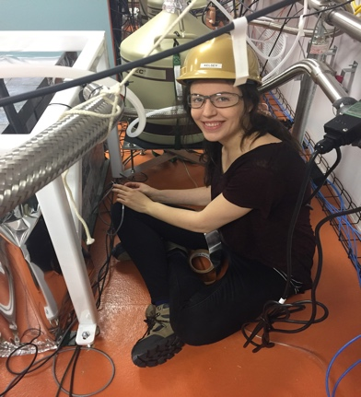
LZ: Dark Matter Experiment
LZ: 10 tonnes of liquid xenon viewed by sensitive light and charge sensors to detect minute energy deposits from Dark Matter
Located 1 mile underground at the Sanford Underground Research Facility
Led by LBNL, over 250 collaborators from 37 institutions; delivered on time and budget despite pandemic
First data run yielded world-leading constraints on WIMPS
Year-long Science Run 2 in progress
Cross-section
PMT
Arrays
Inner and outer cryostats complete
Work on low background assay
Mass

Slide 11
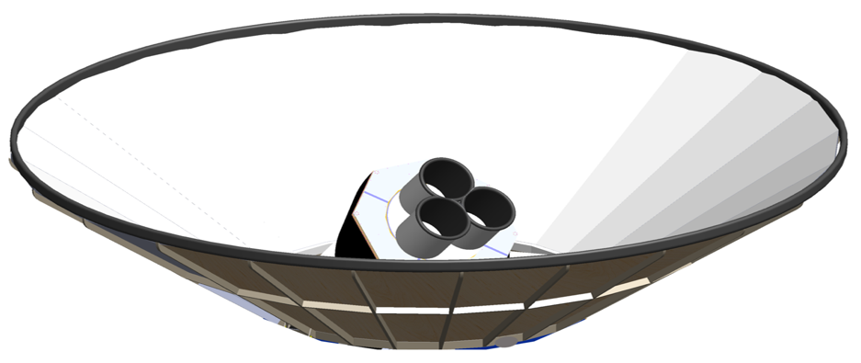
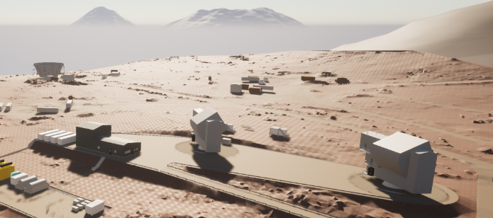
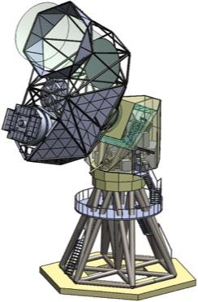
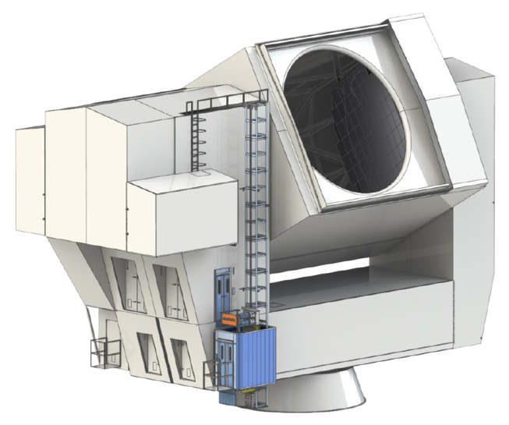
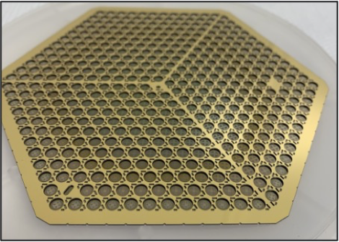
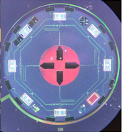
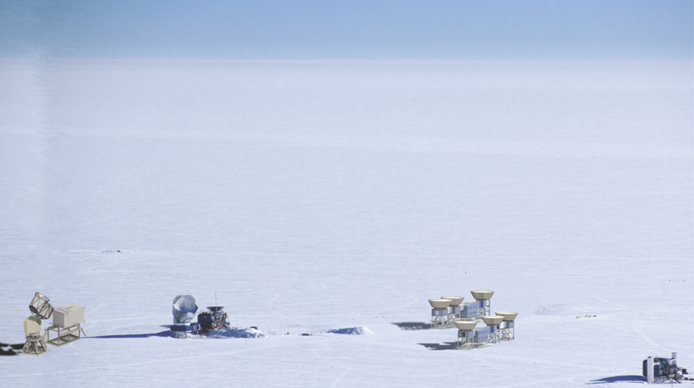
CMB-S4 experiment
CMB-S4 will measure the relic radiation from the early Universe to characterize the content and evolution of the Universe
Array of small & large telescopes with ~ 500,000 superconducting microwave detectors, deployed in Chile and the South Pole
LBNL is lead lab of CMB-S4, with >400 collaborators from >100 institutions
Recommended by the HEPAP 2014 P5 report, very strong endorsement from Astro2020 and snowmass 2022 - Planned as a joint DOE/NSF project
Growing interest from foreign partners
South Pole Small Telescope
Chile site
South Pole site
Detector pixel
2 polarizations
Chile
Large Telescope
South Pole
Large Telescope
Detector wafer

Slide 12
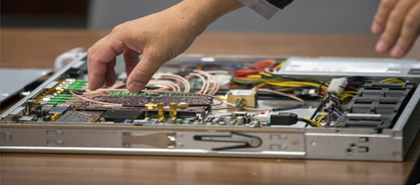
AI/ML and QIS Initiatives
Cross-cutting Physical Sciences AI/ML group
HEP-specific but project-independent team of experts to complement project-specific experts
QIS initiative integrates Physics and ATAP expertise, connections to Quantum System Accelerator center
Quantum sensor development, quantum computing, networking, qubits and controls
Leverages related programs with ASCR and FES
QuantISED Quest
Quantum
fields
Skipper CCD QuantiSED
QIS
Alpha
Advanced Qubit controls
Table-top gravity
Single photo-electron
read-out
Best-measured
constant
Low-mass Dark Matter;
Detect single phonon at 0 dark count;
Solving QCD on quantum computers

Slide 13
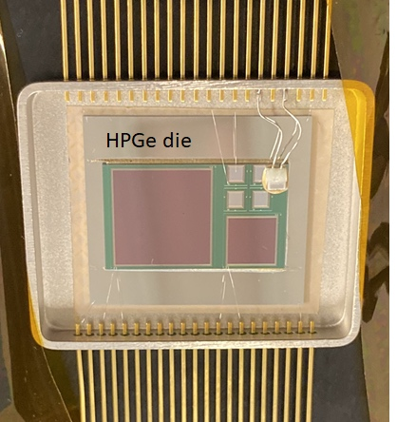
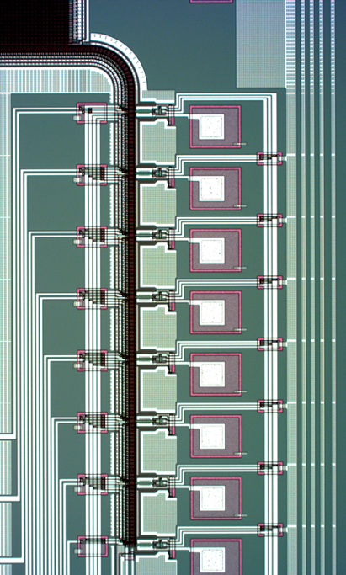
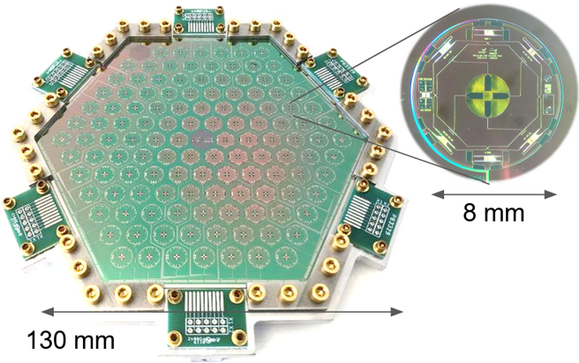
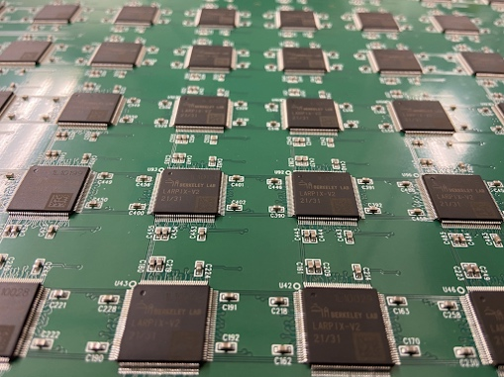
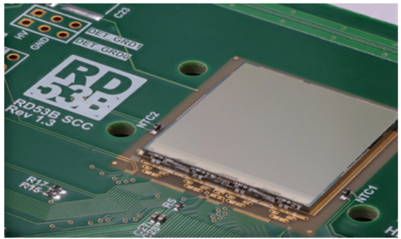
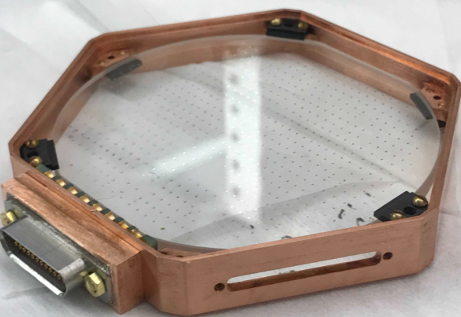
LBNL: a long tradition of innovation
Cosmic Frontier
Ge CCDs, skipper CCDs
CMB polarization detectors
Intensity Frontier
Pixellated readout for DUNE
Hydra I/O to bypass chip failure
Beam physics for high intensity
Technology transfer to industry
Energy Frontier
HL-LHC ATLAS & AUP upgrade
Magnets and accelerators
RD53 pixel readout chip
R&D on 28 nm for next generation
QIS
Quantum sensing
Qubit control

Slide 14
Summary
LBNL HEP leads a broad program of discovery science to address the most compelling questions in fundamental physics
Across the Energy, Intensity, Theory and Cosmic frontiers; significant AI/ML and QIS efforts
Strengths in advanced accelerators, superconducting magnets, detectors, electronics, computing
HEP benefits from the scientifically rich environment and resources at LBNL
Outstanding staff, training the next generation
We are advancing the next generation of experiments
All our projects benefit from our matrixed engineering division and our historical stewardship in HEP-wide instrumentation & theory
Strong contributions to ATLAS and DUNE, with unique and enabling contributions
Leading DESI and LZ: P5 experiments in Dark Energy and Dark Matter, both taking data
Leading CMB-S4: CD-0, working with NSF and DOE to define the path to CD-1
Extending the reach of colliders via superconducting magnets, exascale simulation and controls
BELLA: leading in plasma accelerators towards future collider, kBELLA shovel ready

