Slide 1
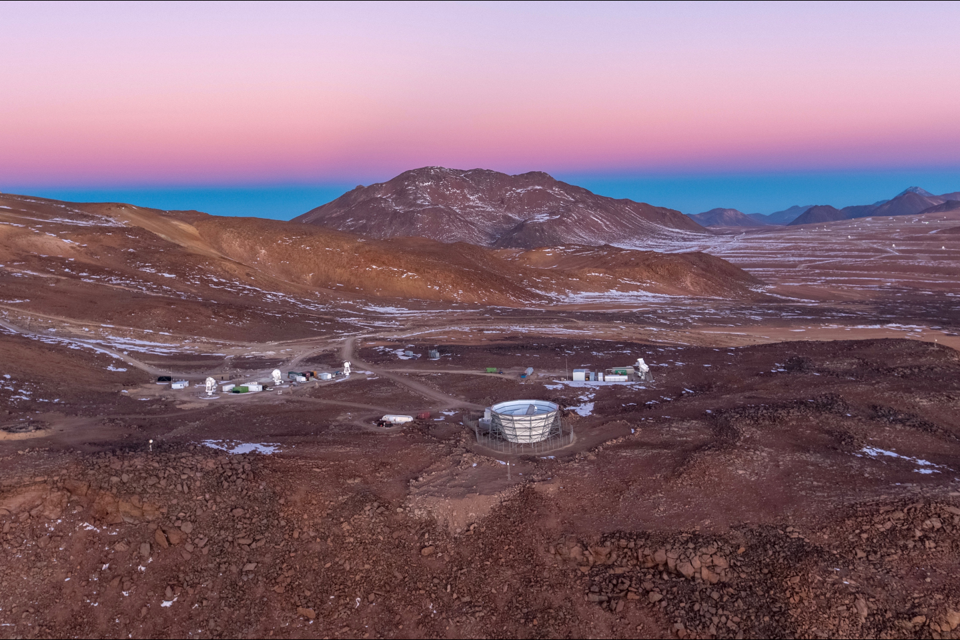
Simons Observatory
Adrian Lee
University of California, Berkeley
Lawrence Berkeley National Laboratory

Slide 2
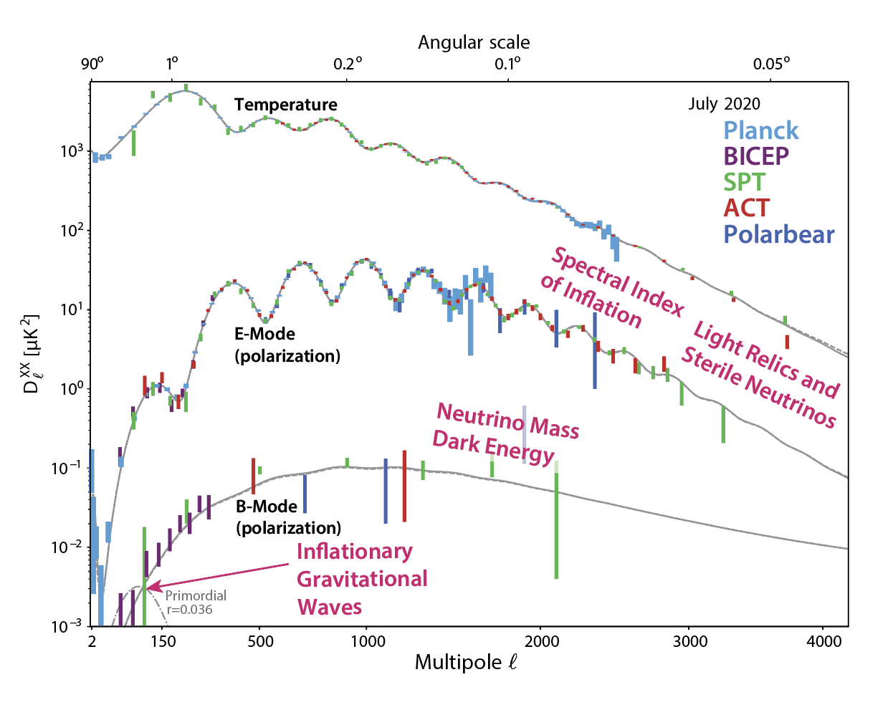

Slide 3
Inflation->Primordial grav waves->Bmodes

Slide 4
Massive Neutrinos/Early Dark Energy->reduced structure formation->reduced lensing

Slide 5
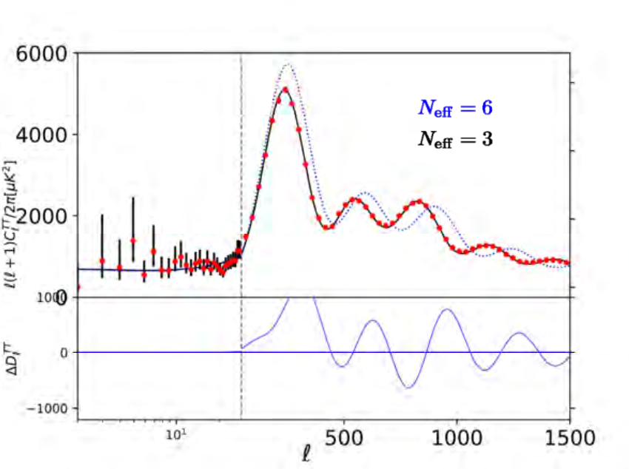
Relativistic Species->faster propagation->phase shift of peaks
G. Barenboim

Slide 7
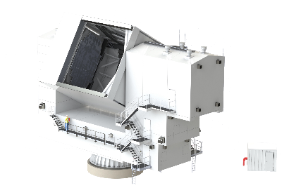
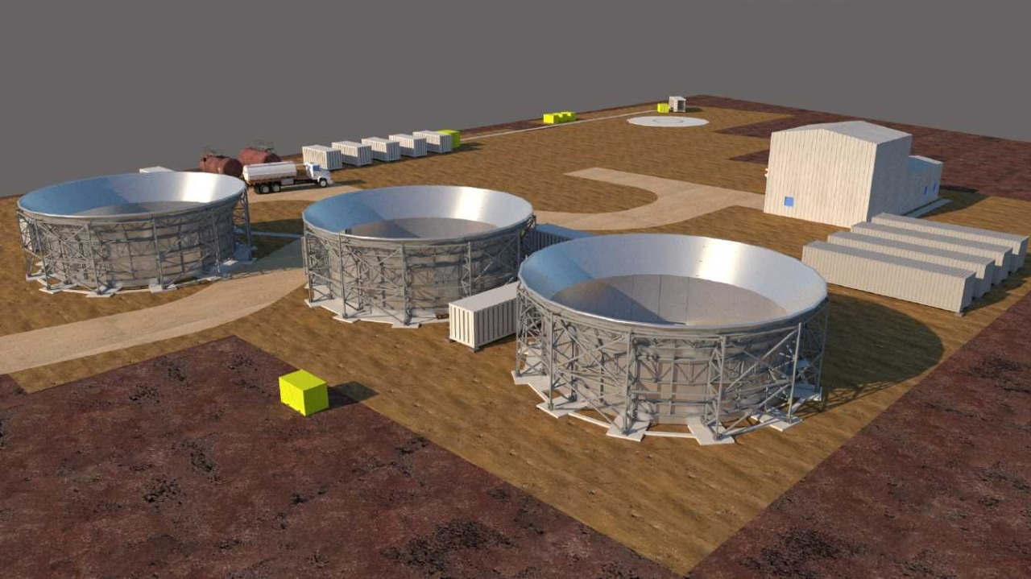
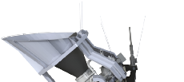
The Simons Observatory
Large Aperture Telescope (LAT)
Advanced Simons Observatory: Commissioning
High bay and Control Room
Power Generation
Small Aperture Telescopes (SAT)
Located at 5200 meters in Northern Chile

Slide 8
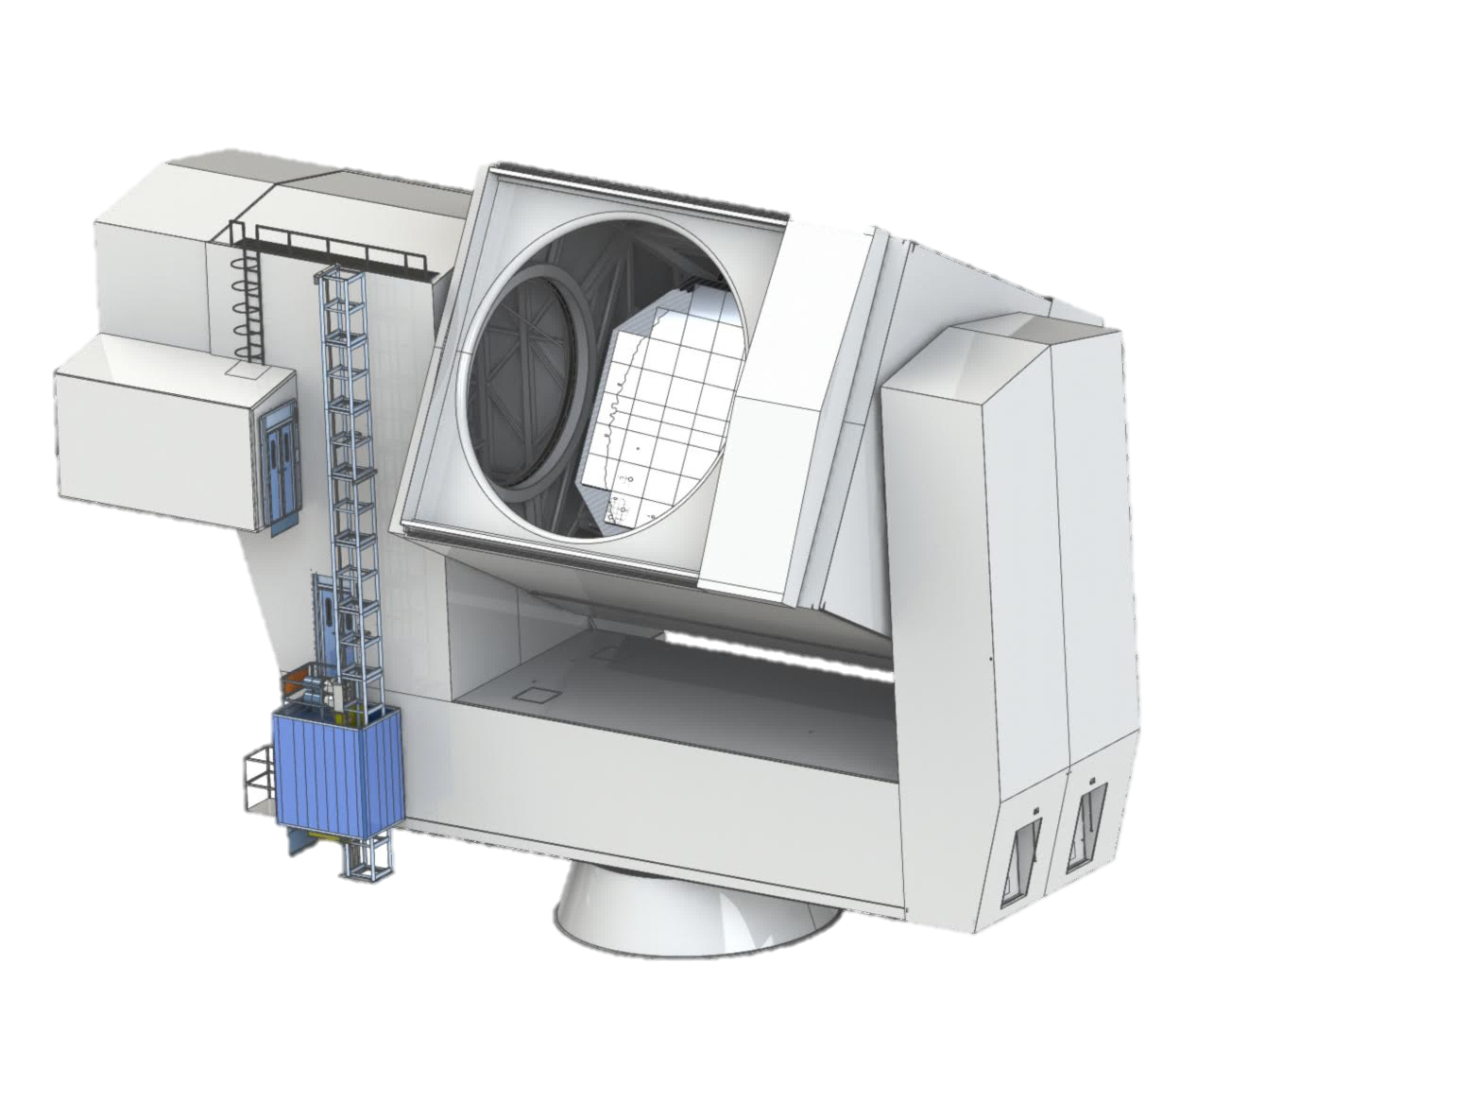
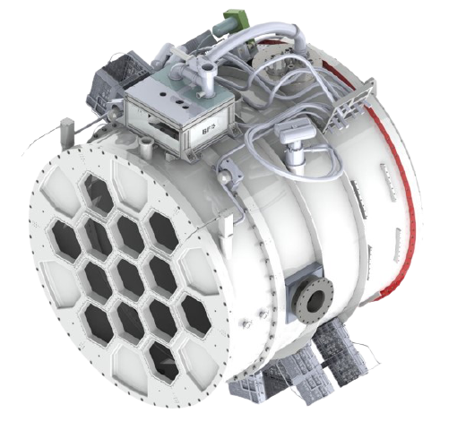
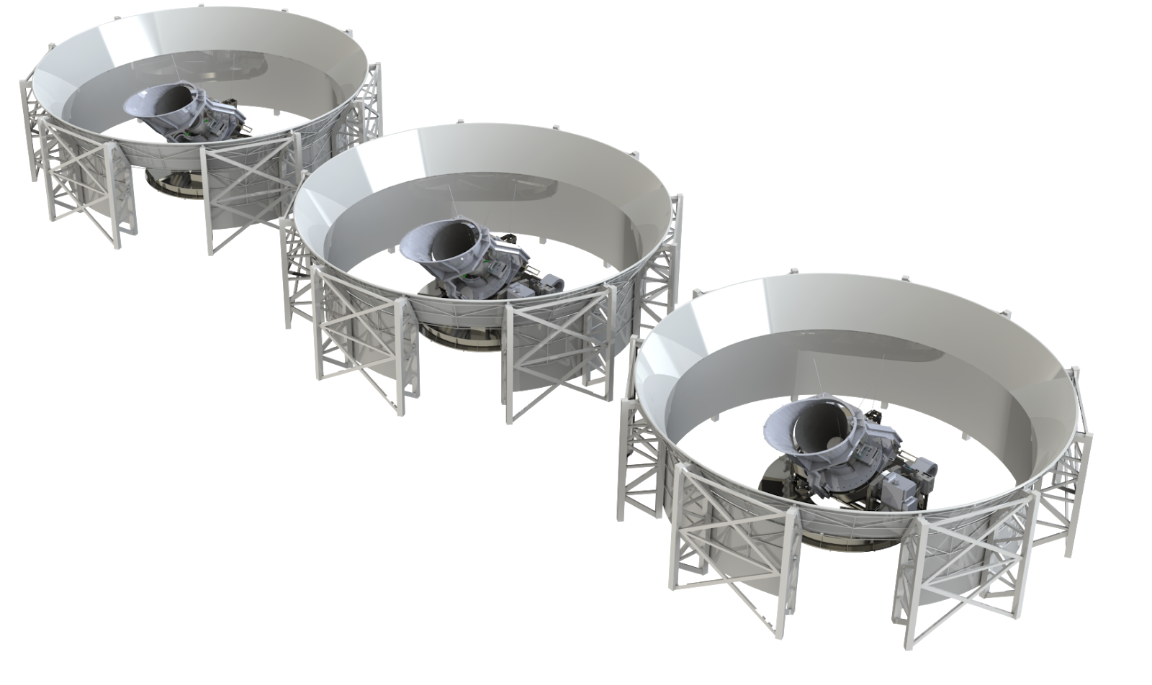
Expansion: UK, Japan, and NSF funds*
*proposed
#optics tube
7/13
#optics tube
13/13
Doubling of SAT and LAT mapping speeds
~60,000 -> ~120,000 detectors
2023〜
2026〜

Slide 9
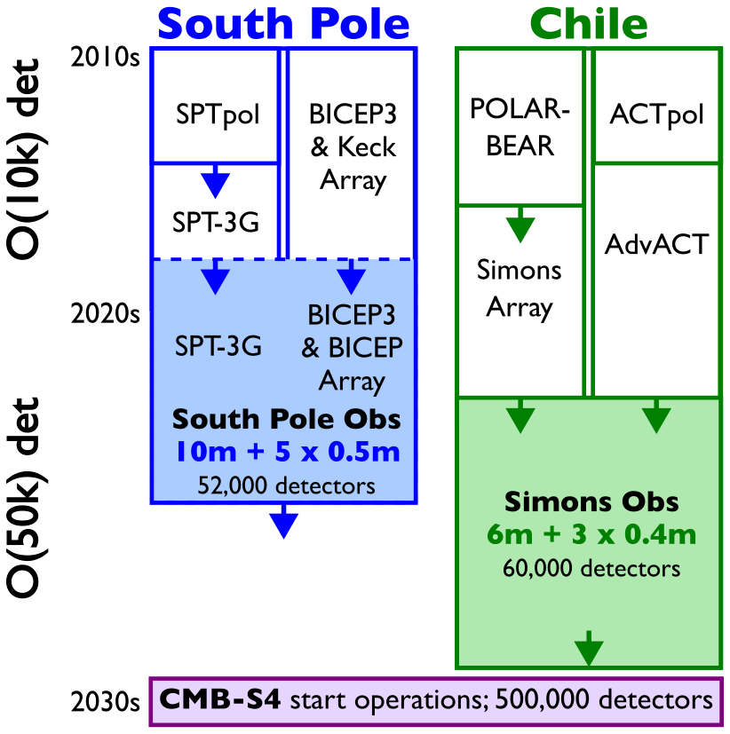
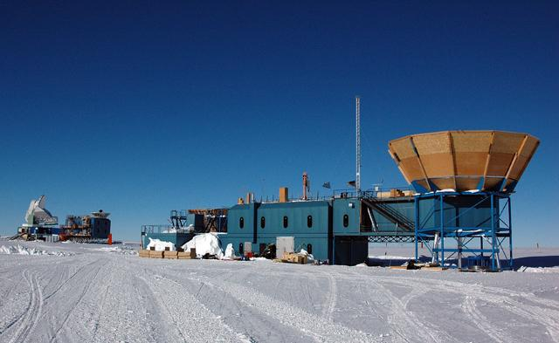
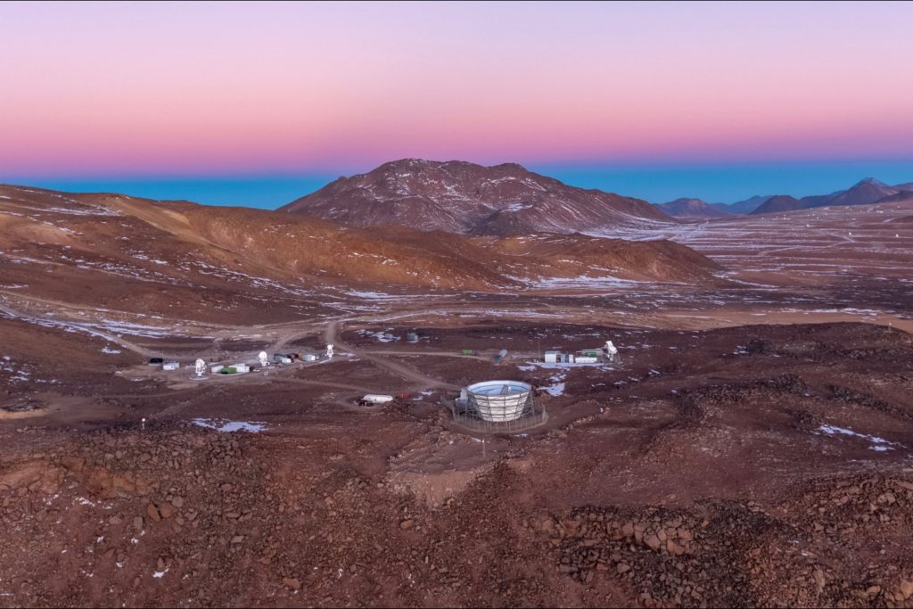
O(10k) det
O(100k) det
6m + 6 x 0.4
120,000 detectors
Notes:
ACTION: Suggest moving this to after slide 9! To explain why it is 120,000 detectors.

Slide 10
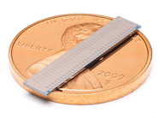
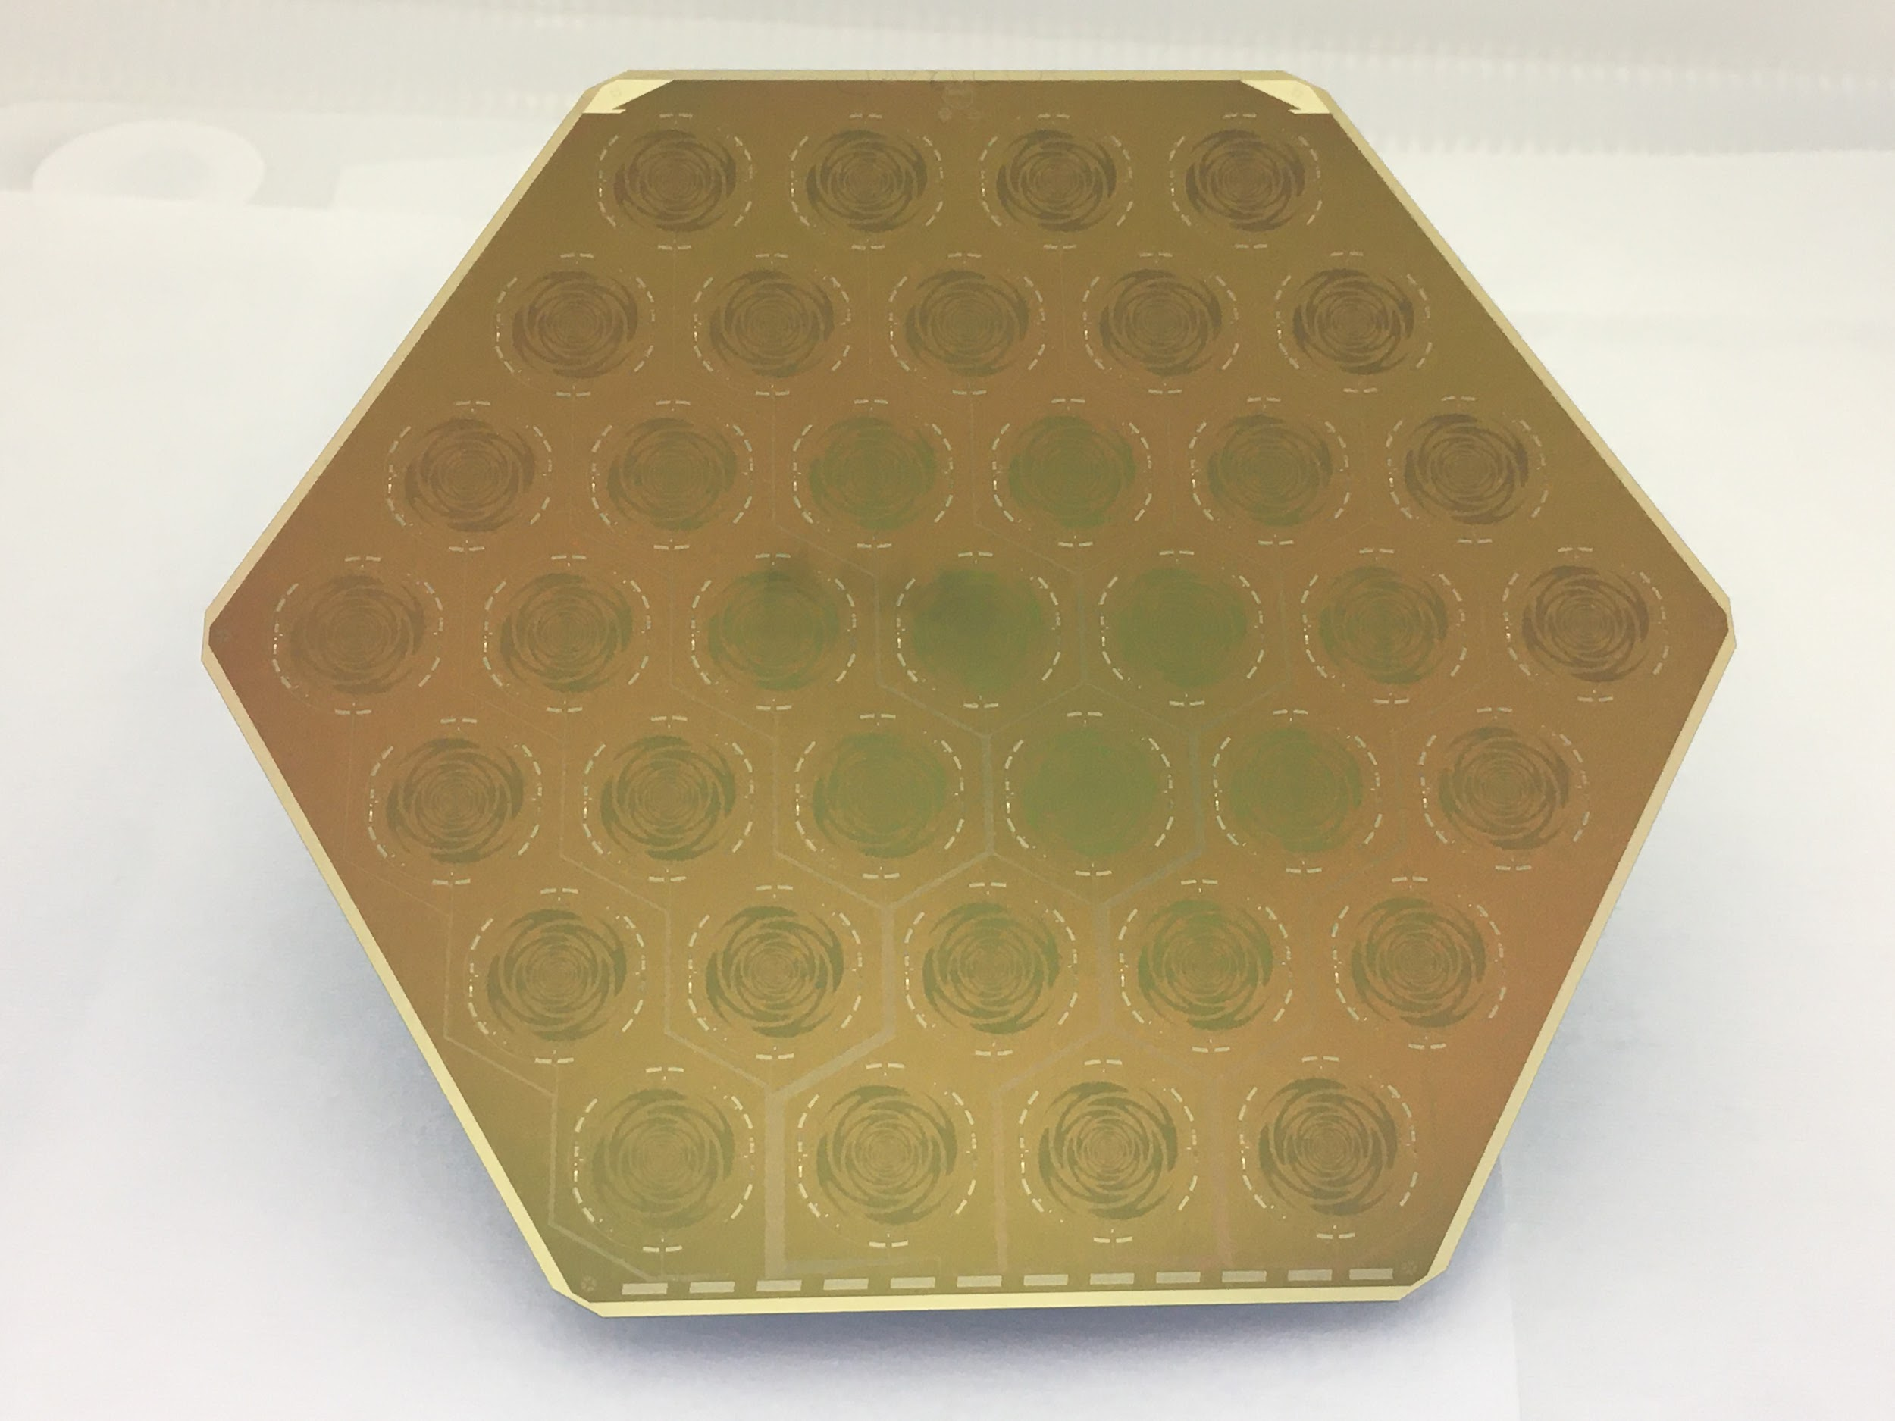
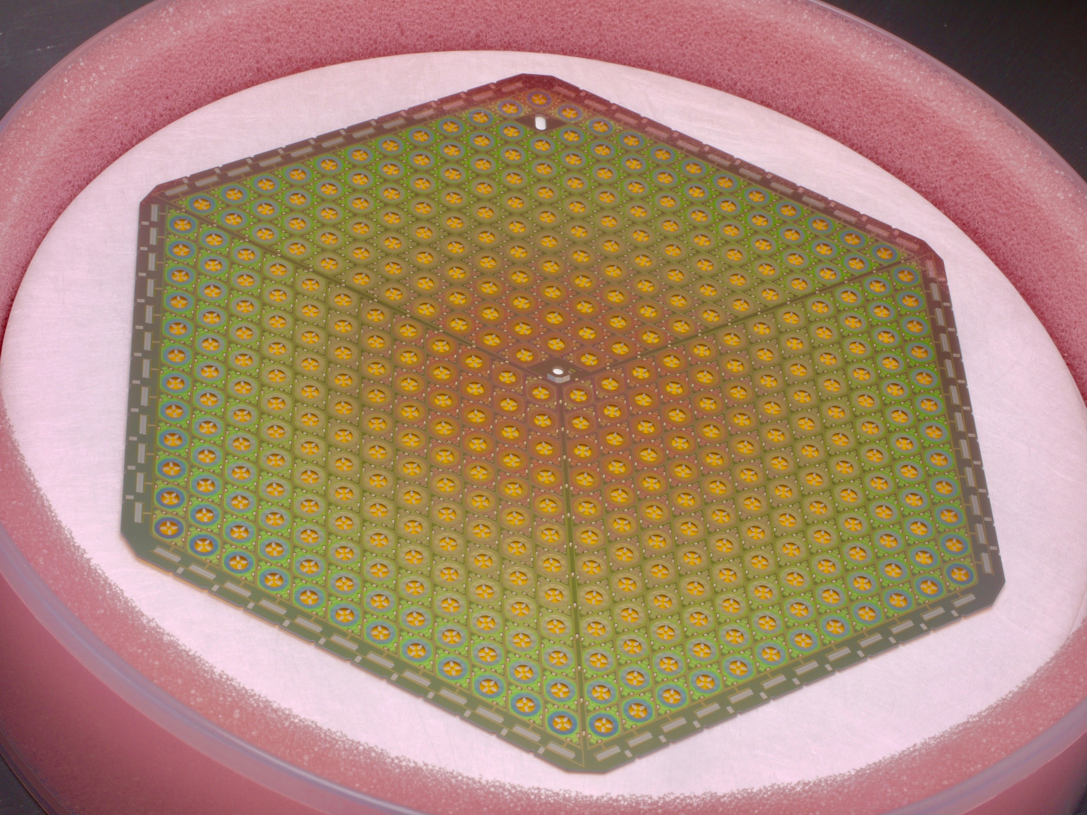
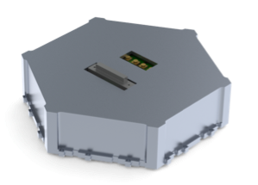
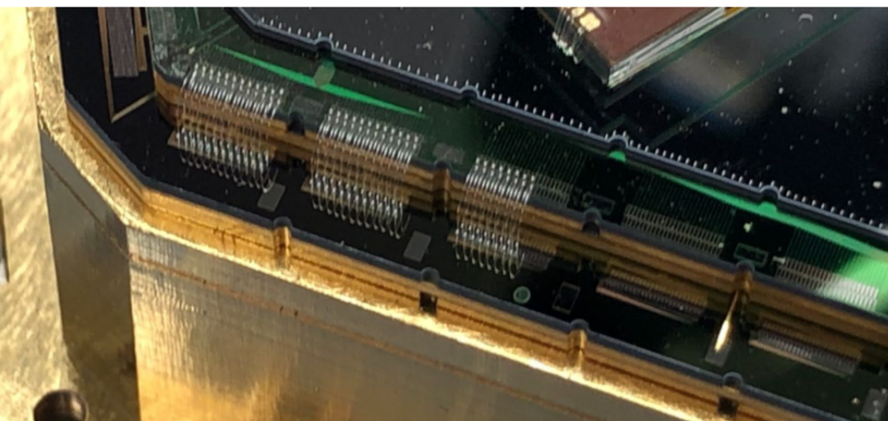
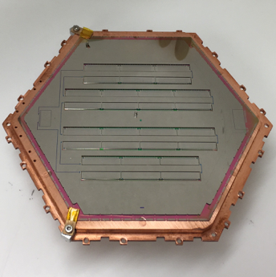
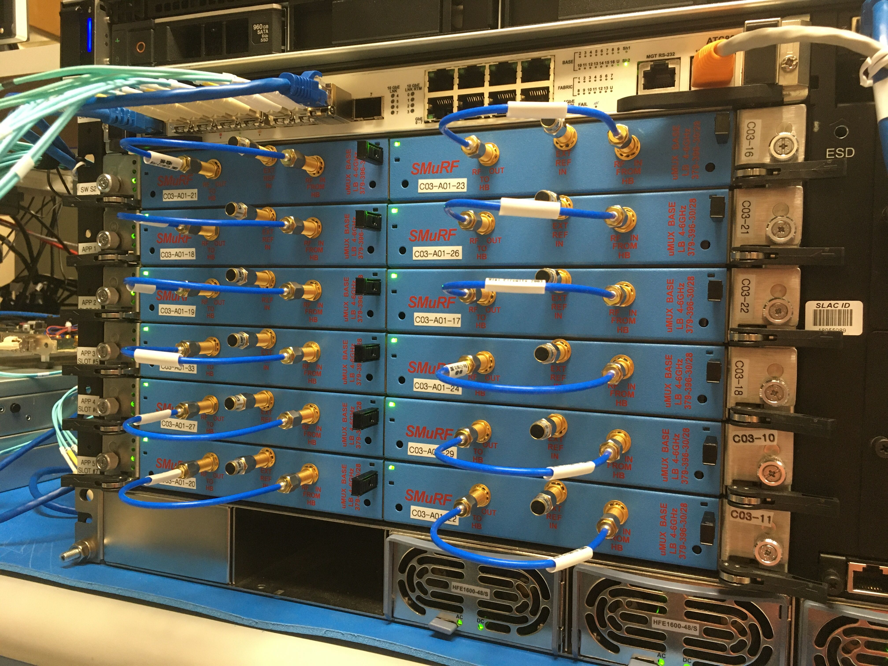
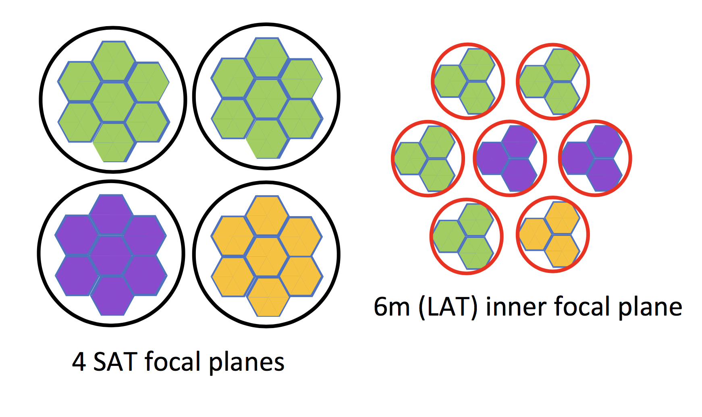
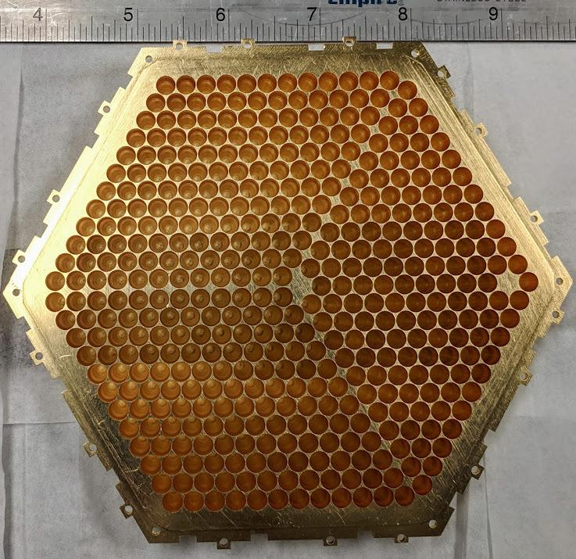
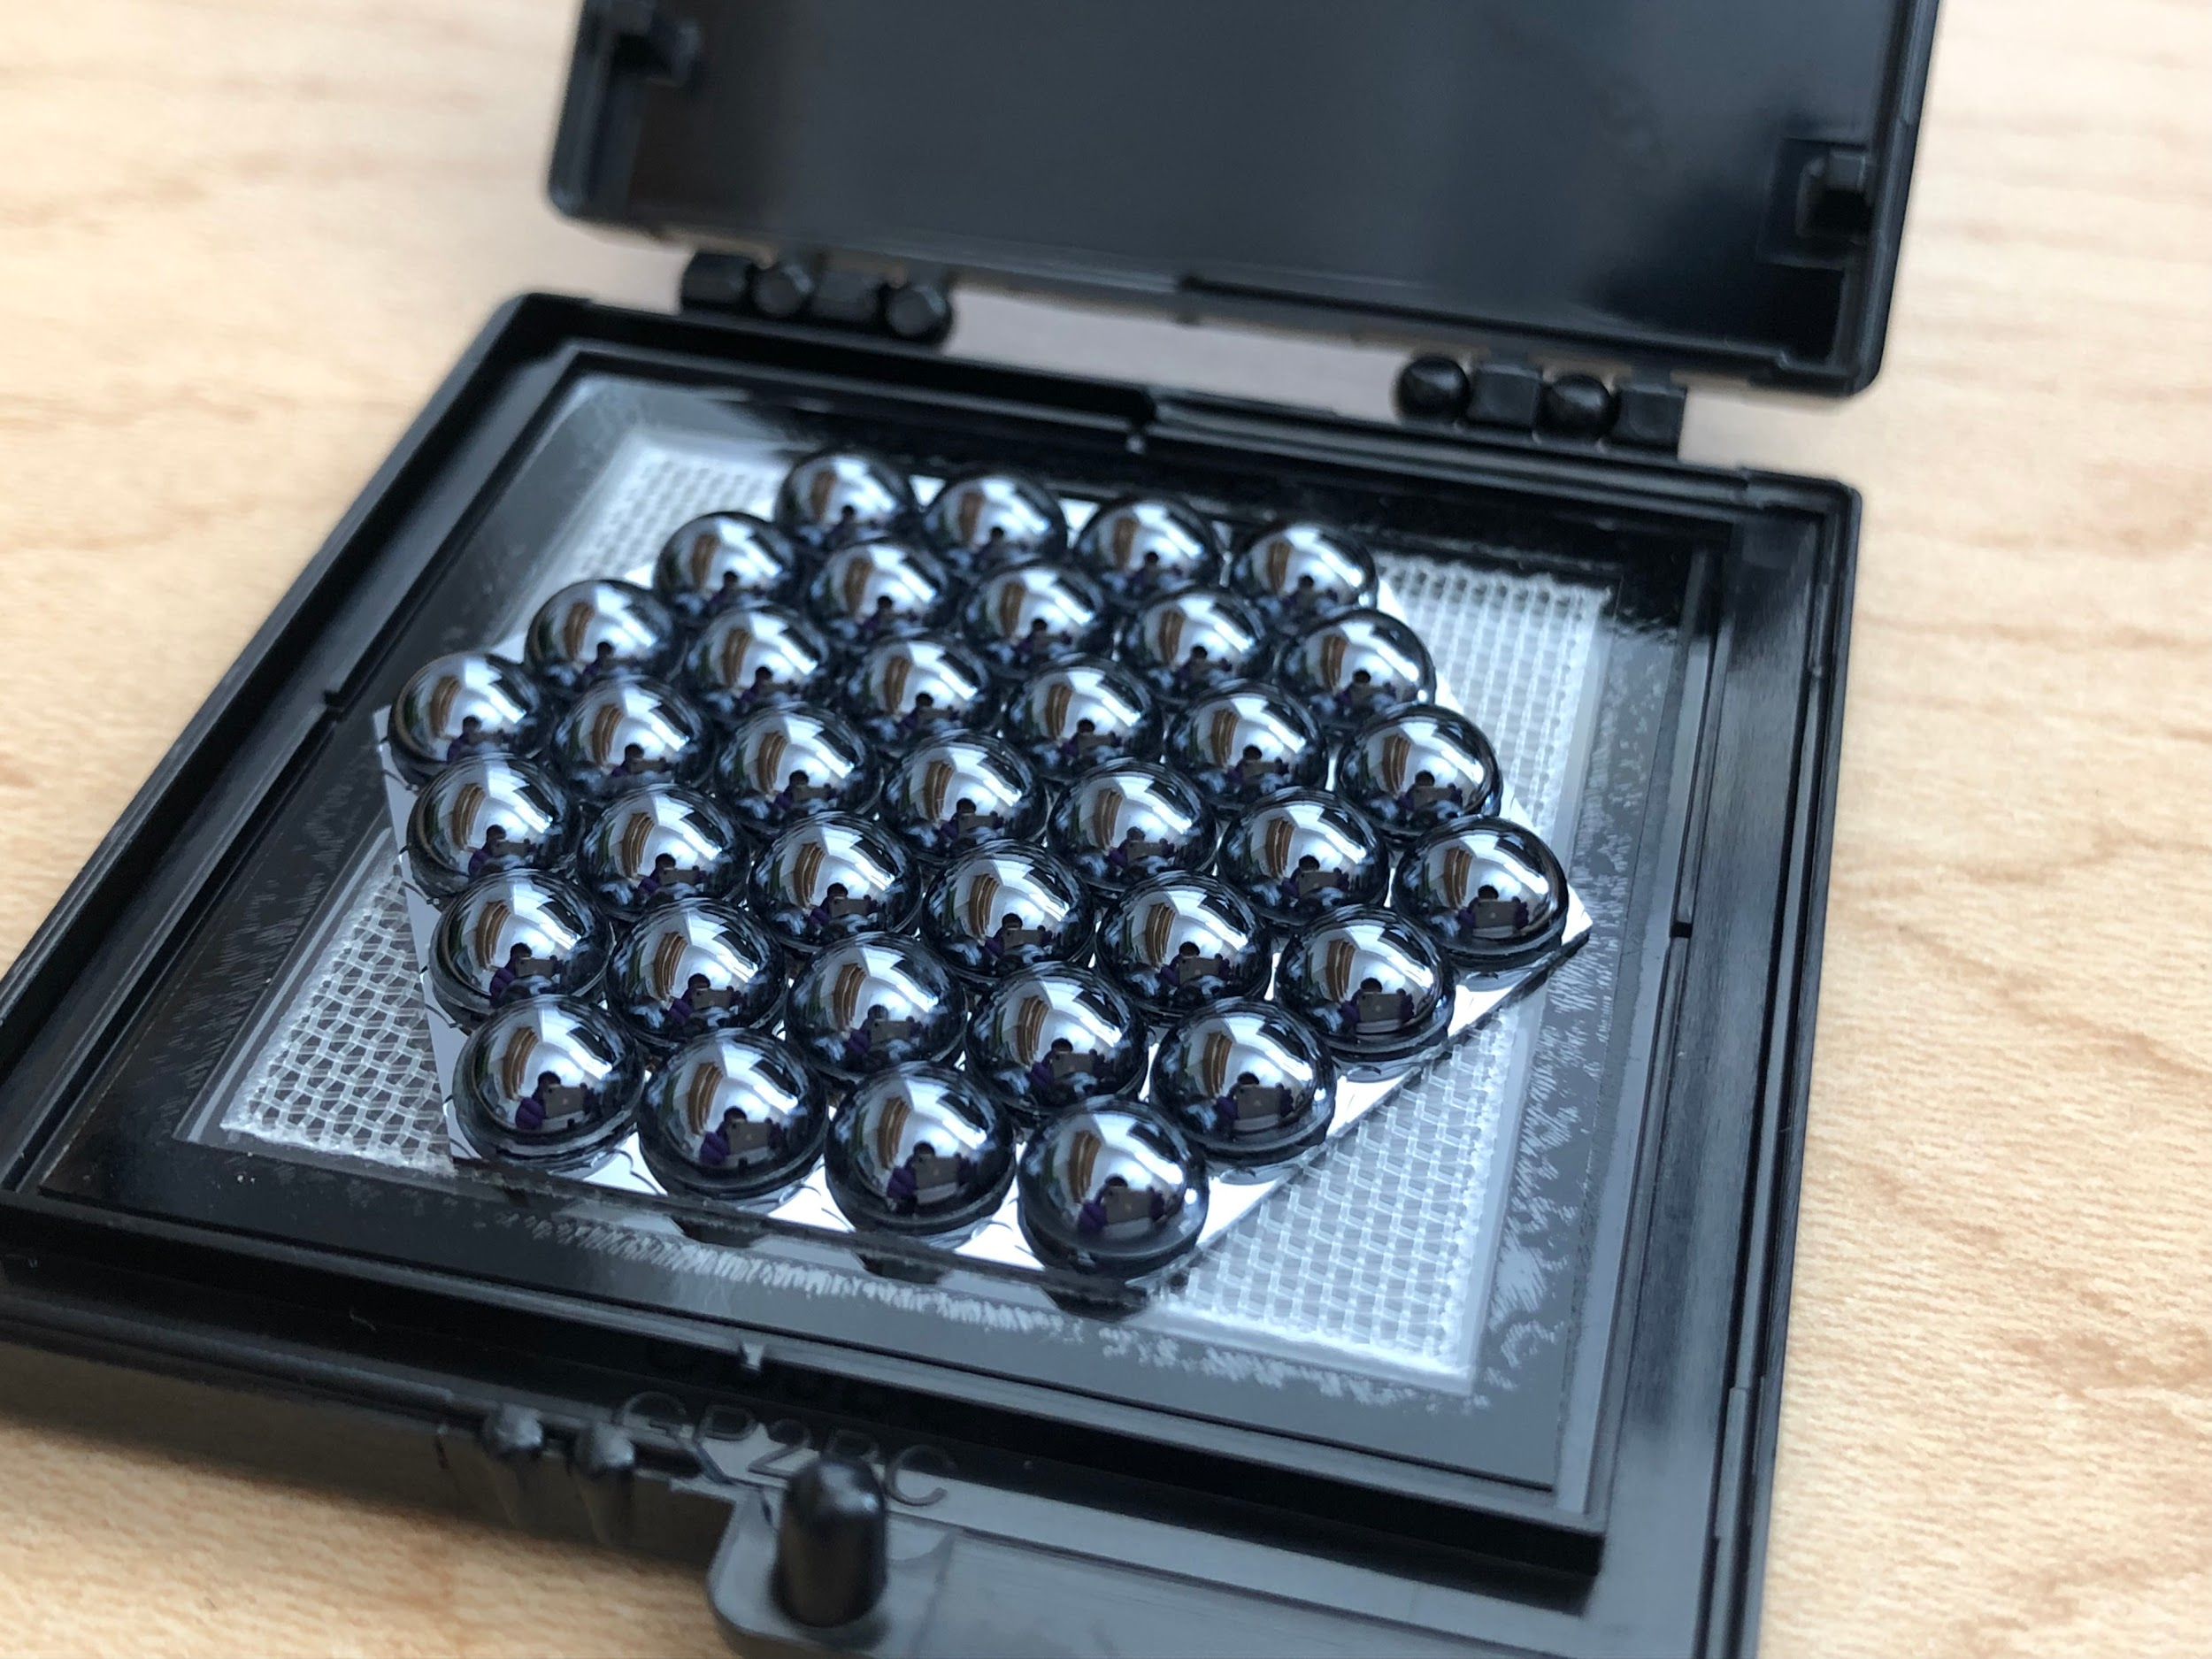
Simons Observatory Readout and Detectors (Simons Foundation Scope Alone)
Readout: SO is using microwave SQUID multiplexing (umux) readout with a 1000x multiplexing factor in collaboration with SLAC (warm electronics) and NIST (cold).
Detectors: SO will use dual-polarization, dichroic TES bolometer detectors spanning 27 - 270 GHz. Each mid-frequency (MF) and high-frequency (HF) array contains ~1700 detectors, with >60,000 detectors total.
Focal plane design: the universal focal-plane modules, common to both the SATs and LATR, contain the cold readout, detectors, and optical coupling (MF/UHF: horns, LF: lenslets).
150
mm
150
mm
universal focal plane (UFM) module
focal plane module detail showing side of horn array, detector stack, and readout.
uMux readout channels (left) and NIST uMUX chip with 66 channels (right)
SO MF detector array (left) and LF array (right)
Prototype SO cold readout module with 1848 readout channels (left). SMuRF warm electronics with 12,000 tones (right).
Horn array (left) and lenslet (right) optical coupling for the MF and UFM detector arrays and LF detector array, respectively.
UFM distribution in the four SATs and LATR.
Notes:
NOTE: add a comment here that this is for SO Nominal, perhaps adding it is based on publications, and then citing them. Don’t mention plans for SO UK detectors on the slide since this level of detail is not ready.

Slide 11
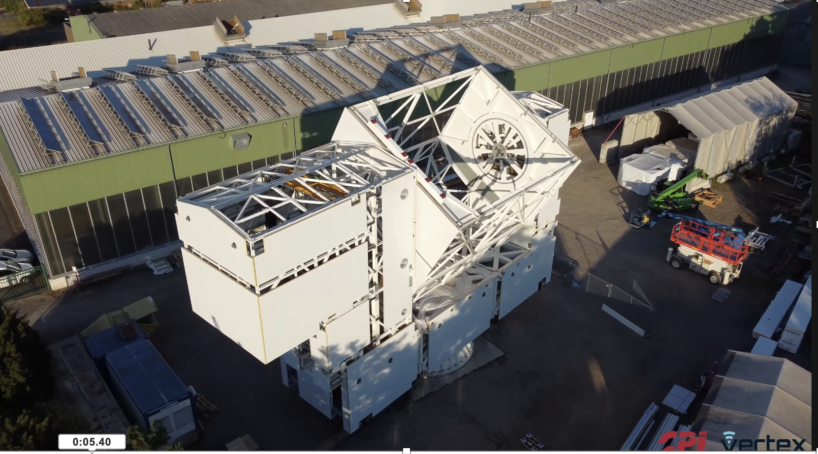
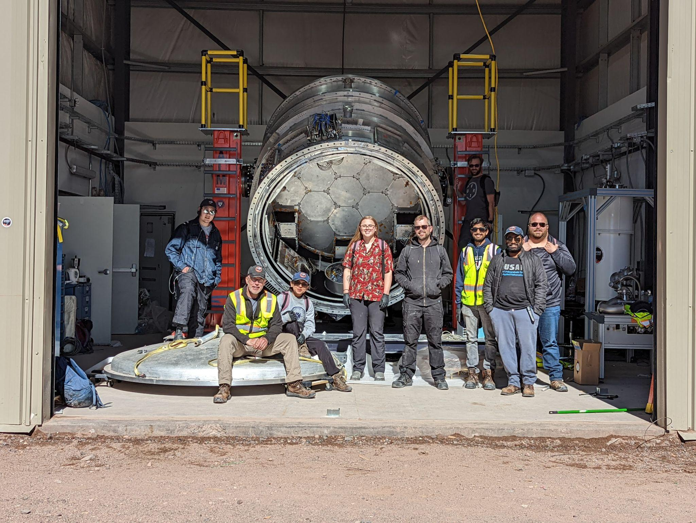
SOLAT and LATR
Link to watch directly on youtube:
https://www.youtube.com/watch?v=HOOjVkWMdKc&t=1s
LAT in Germany – now, arriving in Chile
LATR being assembled in Chile

Slide 12
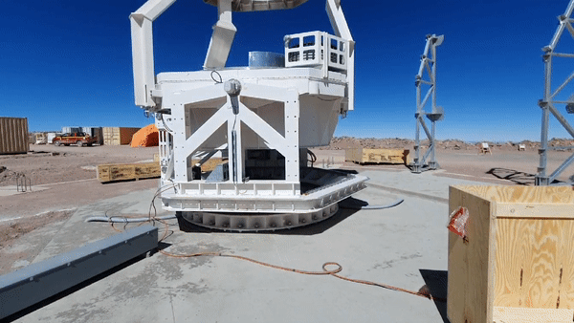
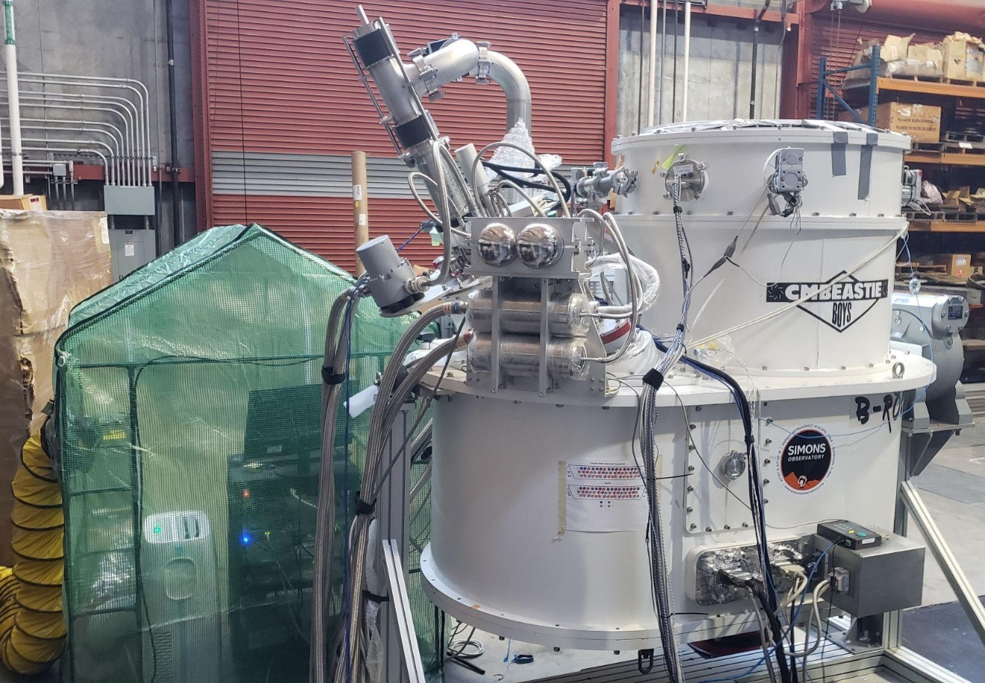
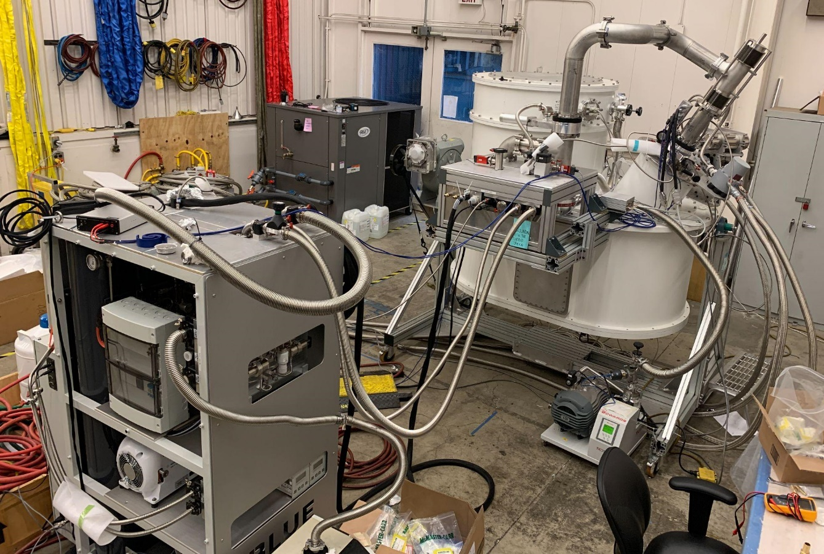
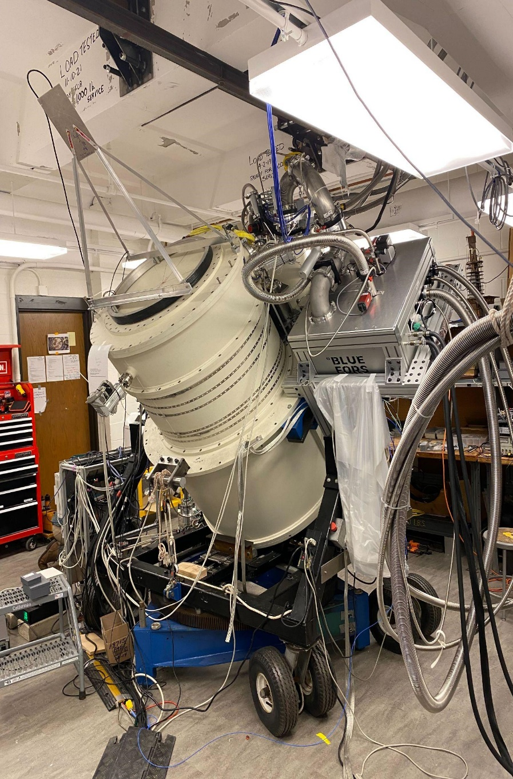
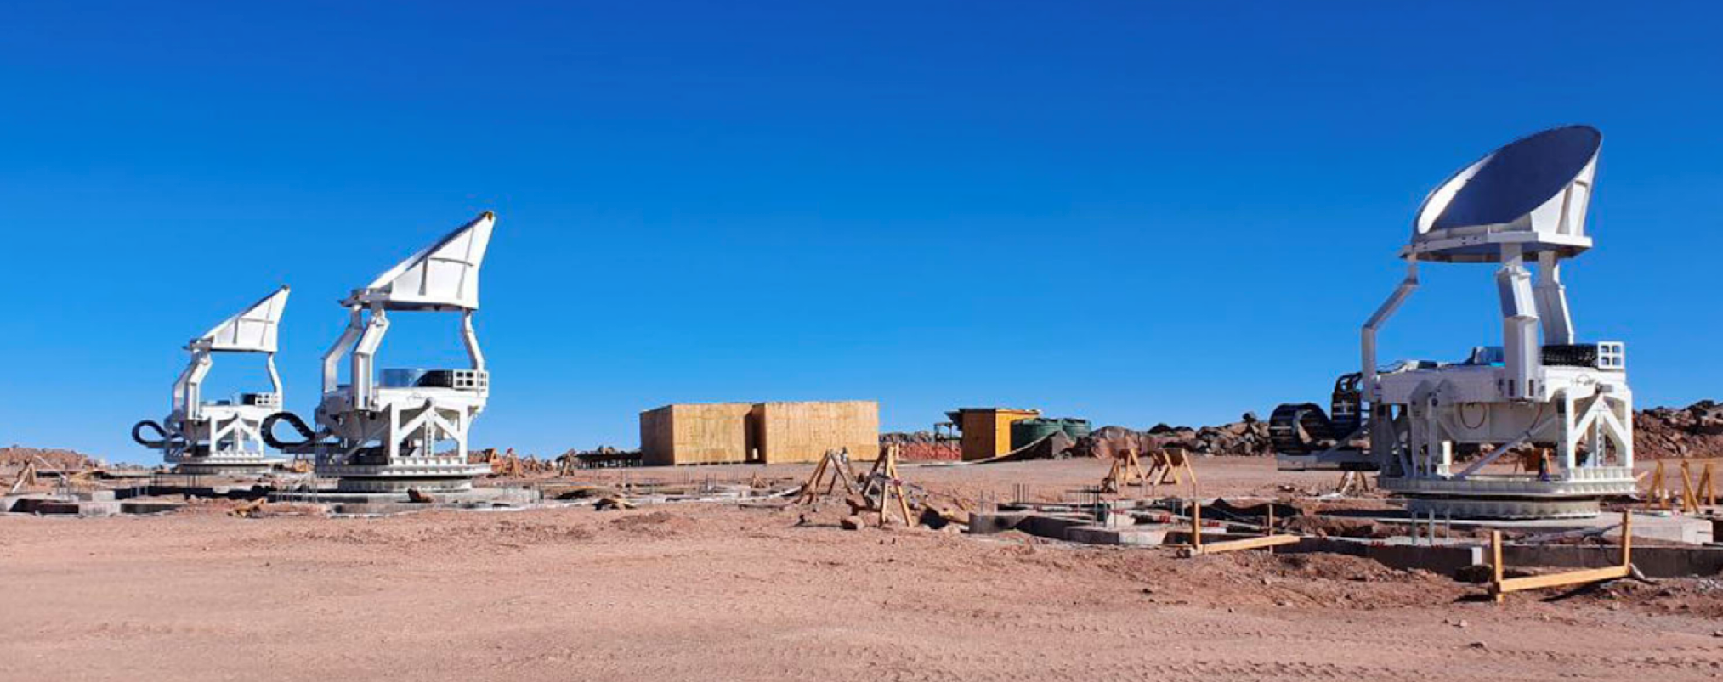
Small Aperture Telescopes (SATs)
SAT MF-1 @ UCSD
SAT UHF @ LBNL
SAT MF-2 (TSAT) @ Princeton
Deployment of SATs in 2023

Slide 13
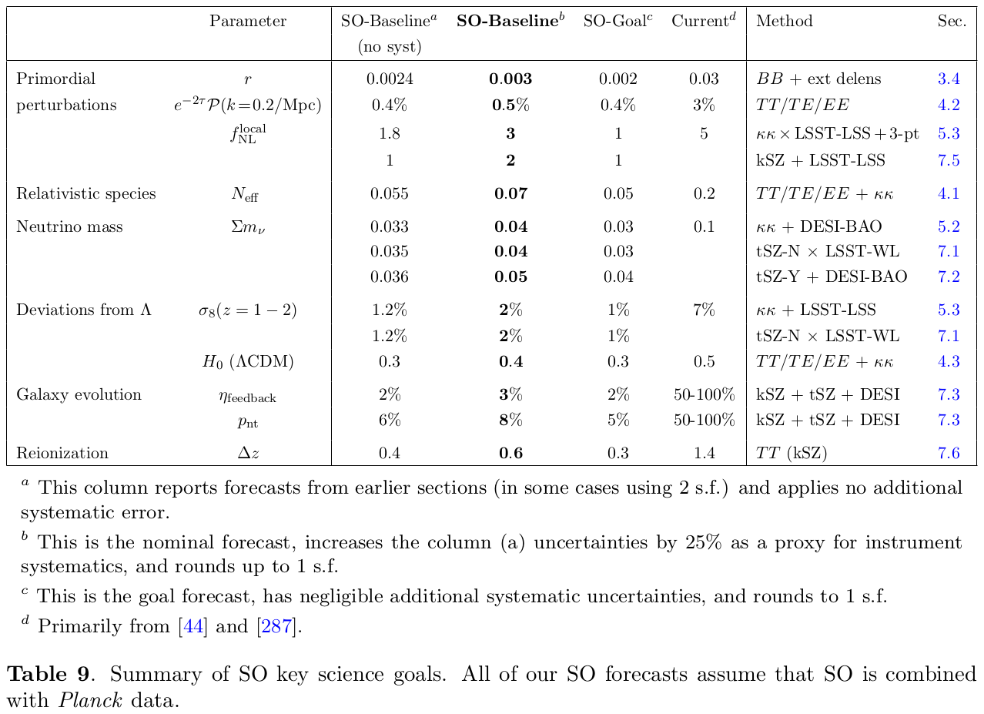
SO Science Goals
(2018-19)
From: The Simons Observatory: science goals and
forecasts
SO Collaboration, JCAP02 (2019) 056
https://ui.adsabs.harvard.edu/abs/2019JCAP...02..056A/abstract
[44] BICEP2 and Planck collaborations, Joint Analysis of BICEP2/Keck Array and Planck Data, Phys. Rev. Lett. 114 (2015) 101301
[287] Planck collaboration, Planck 2018 results. VI. Cosmological parameters
Forecasts including SO:UK, SO:JP, and ASO additions forthcoming:
2x mapping speed and longer observation period
Notes:
C

Slide 14
SO and CMB-S4
A first MOU between SO and CMB-S4 (Nov 2021) described collaboration on:
Chile site infrastructure
Instrumentation
Algorithms and pipeline tools
Techniques for large high-sensitivity CMB surveys
Since the MOU was established, there has been an ongoing discussion of using the SO Large-Aperture Telescope in CMB-S4.
SO and CMB-S4 teams have large overlap
Technology flow between SO and S4: A significant contribution to CMB-S4
Chile LAT design/verification
Chile LAT receiver: Verification of design foundations
Manufacturing/Verification of horn-coupled detector arrays
Dilution refrigerator: Test of concept
Notes:
Discussion on use of SO instrumentation including the Large-Aperture Telescope in CMB-S4 is ongoing.

Slide 15
Backup

Slide 16
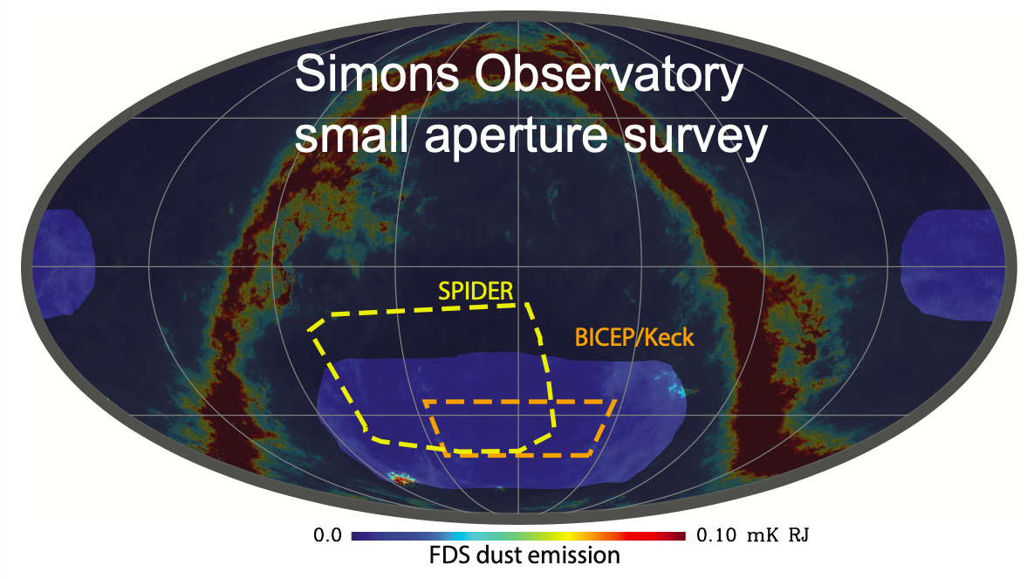
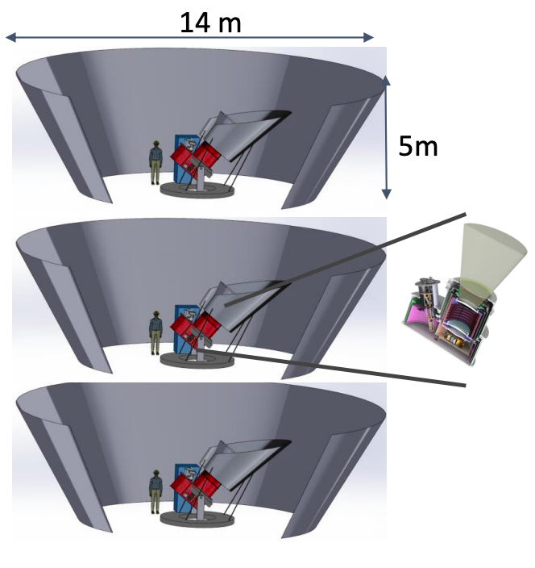
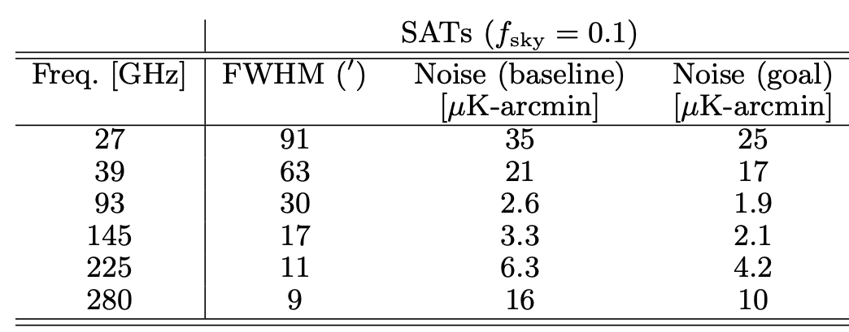
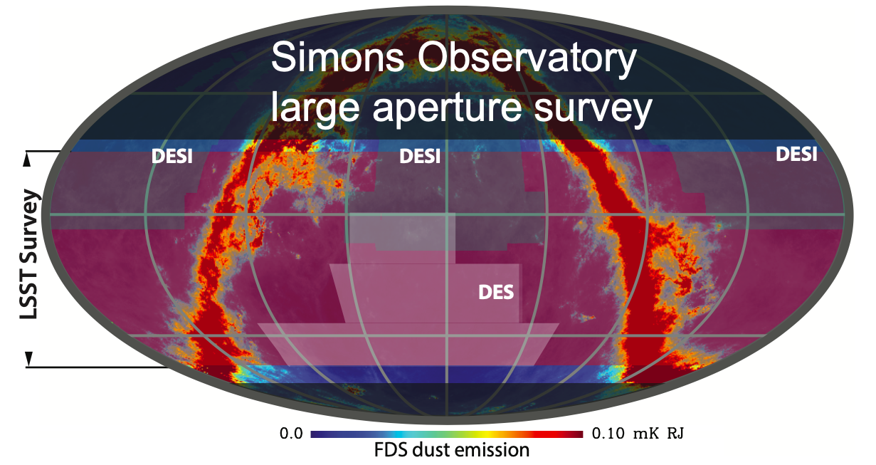
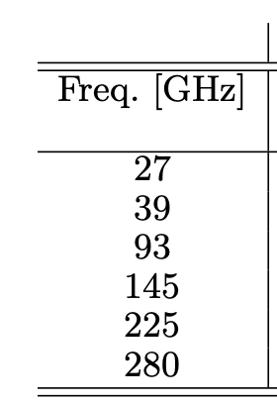
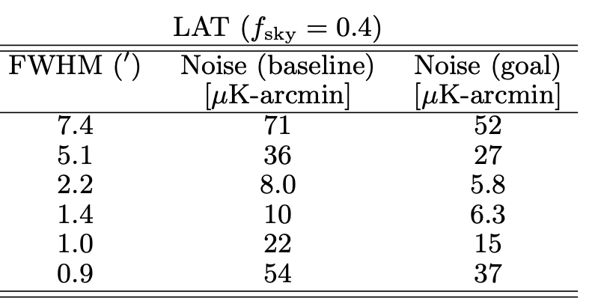
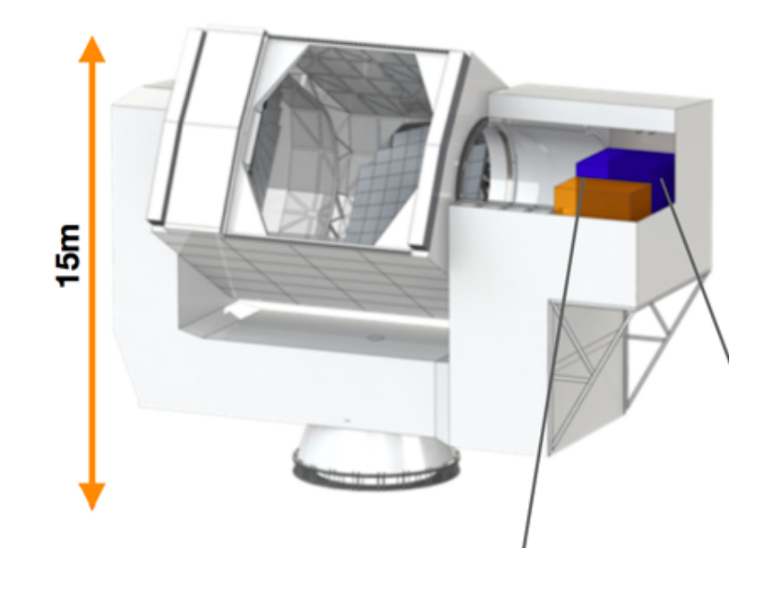
SO Surveys
} 2 𝝻k-arcmin
} 6 𝝻k-arcmin
From June, 2020 SO+LSS Zoomference

Slide 17
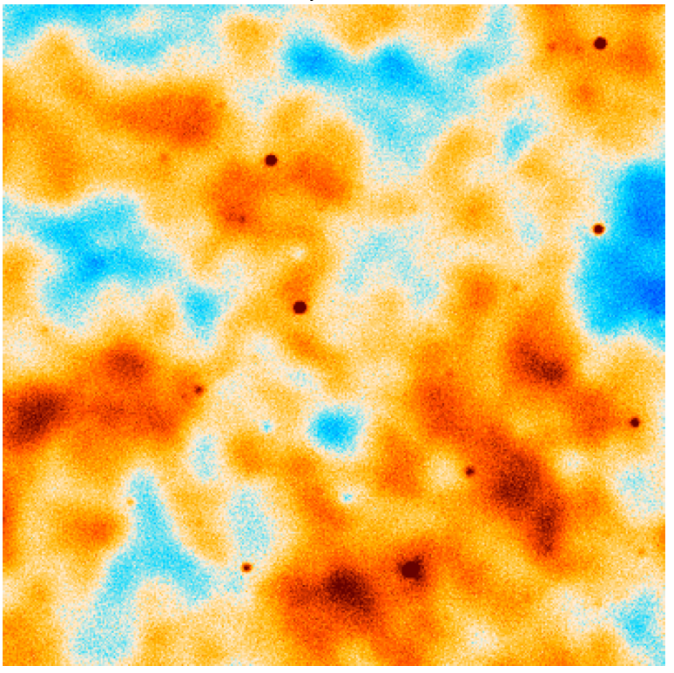
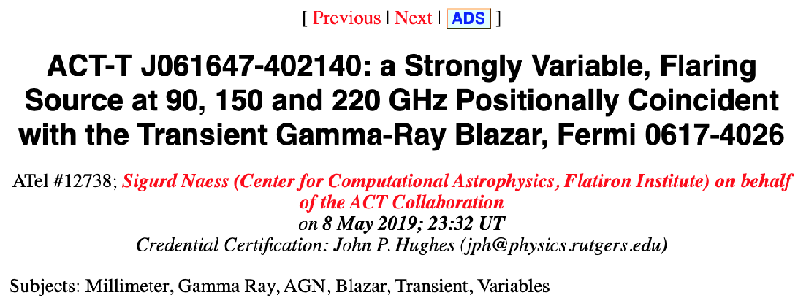
SO: New Opportunities in mm-Transient Science
Variable Active Galactic Nuclei: track thousands daily/weekly/monthly at 1-10 mm.
Potential of mm transients: e.g. orphan afterglows of Gamma Ray Bursts
Potential follow-up of Rubin Observatory optical transients
In addition to wealth of CMB science (early and late-time signals), 30k high-z dusty galaxies, 20k clusters and Galactic science

Slide 18
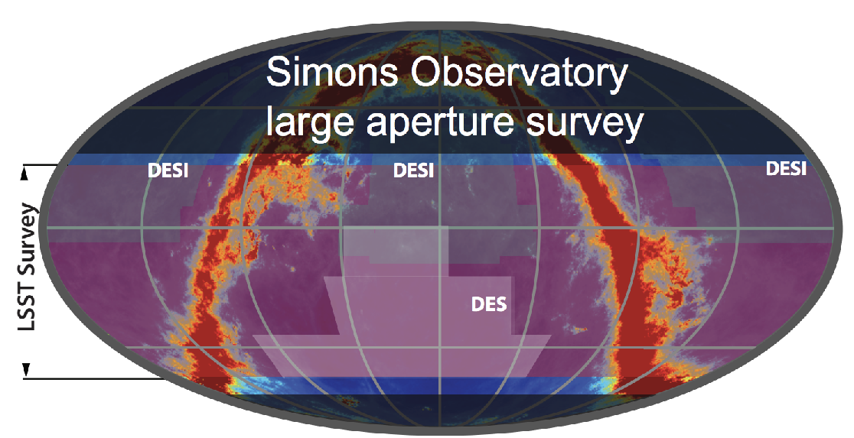
SO Synergy with Optical Surveys
SO’s 2023-28 observing timeline overlaps with Rubin Observatory, DESI, Euclid
CMB and optical surveys both measure large-scale matter and baryon distribution.
Better together!
Growth of cosmic structure, constraints on baryonic feedback, calibrating systematic effects…
ACT and SO are community oriented.
Regular planned releases of maps, catalogs, likelihoods on NASA LAMBDA and/or other platforms
Code, notebooks and tutorials: to read and manipulate maps, and to train students

Slide 19
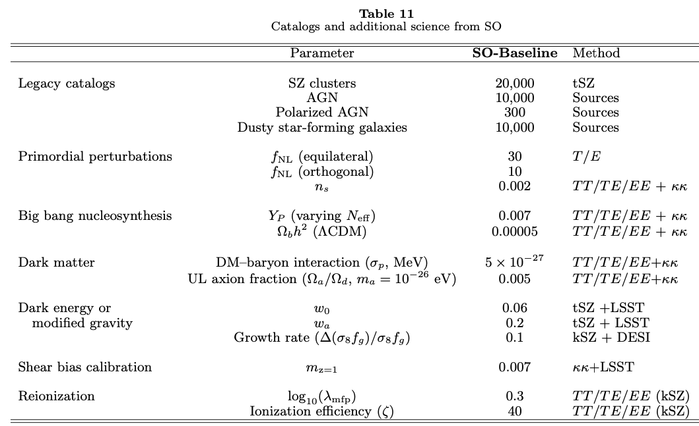
Additional Goals and Data Combinations
SO Collaboration (2019)

