Slide 1
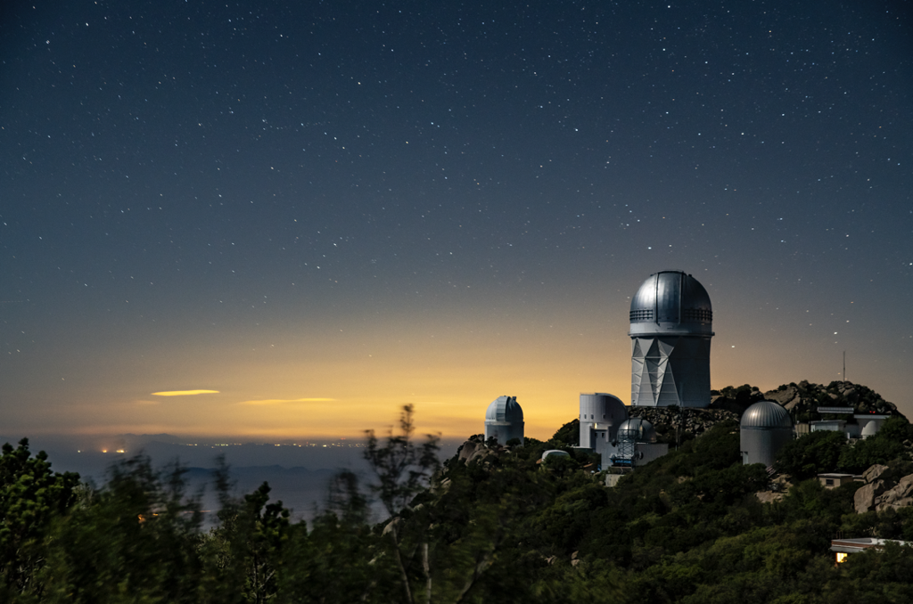
✭ z=1.226
✭ z=0.103
✭ z=2.475
✭ z=2.477
The Opportunities of Stage-5 Spectroscopy
Probing both epochs of accelerated expansion
David Schlegel, Lawrence Berkeley Lab
DESI Co-Project Scientist, Snowmass CF6 co-convener
✭ z=0.775
✭ z=3.381
✭ z=0.989
✭ z=0.461
✭ z=1.591
✭ z=1.013
✭ z=1.204
P5 Cosmic Frontier Town Hall
February 22, 2023

Slide 2
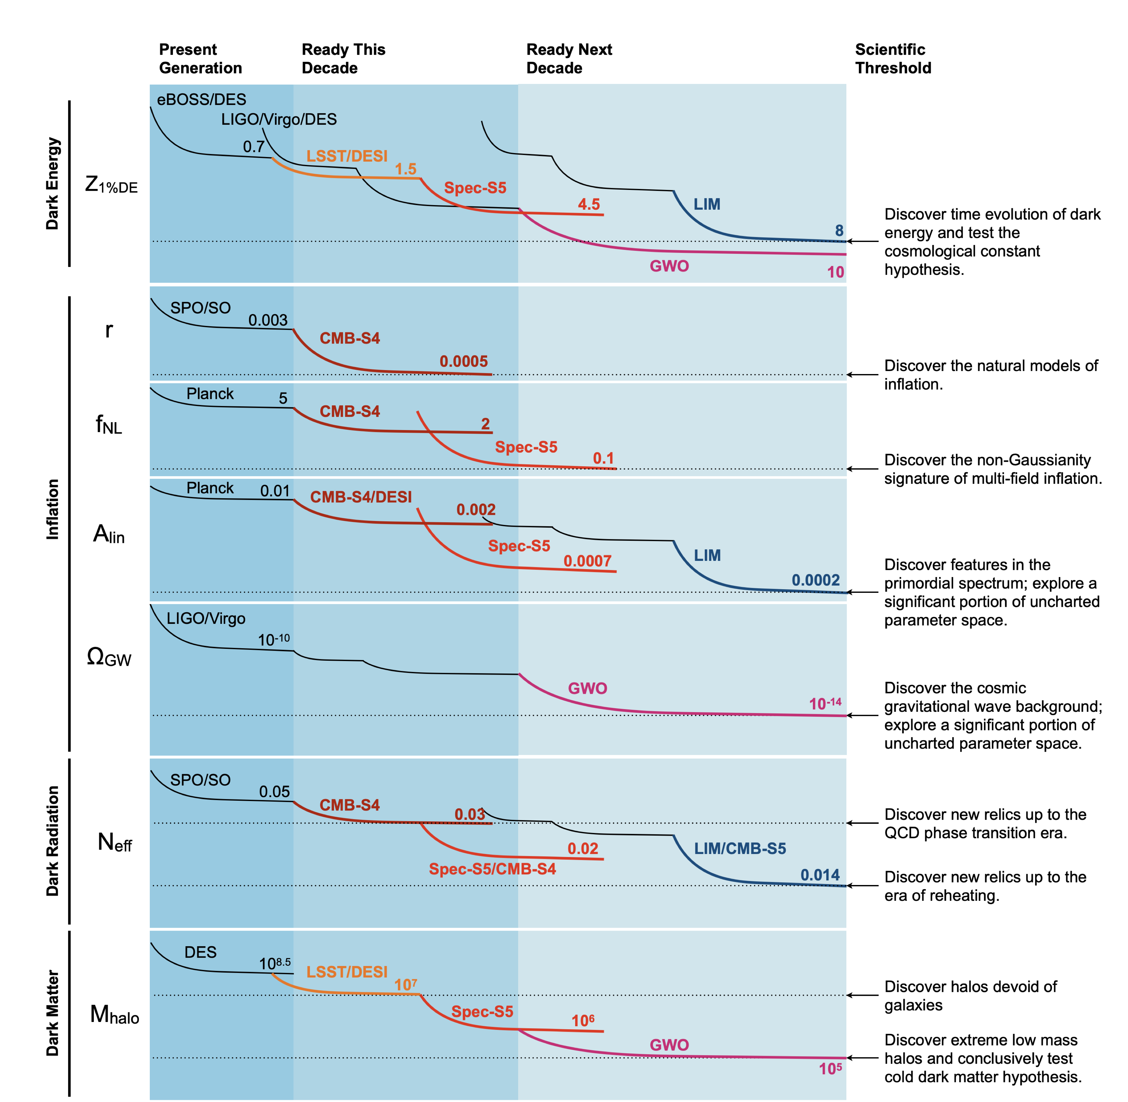
Stage 5 Spectroscopy will probe both epochs of accelerated expansion
Dark Energy
Inflation
Primordial feature amplitudes
Ref: Snowmass Cosmic Frontier Report https://arxiv.org/abs/2211.09978

Slide 3
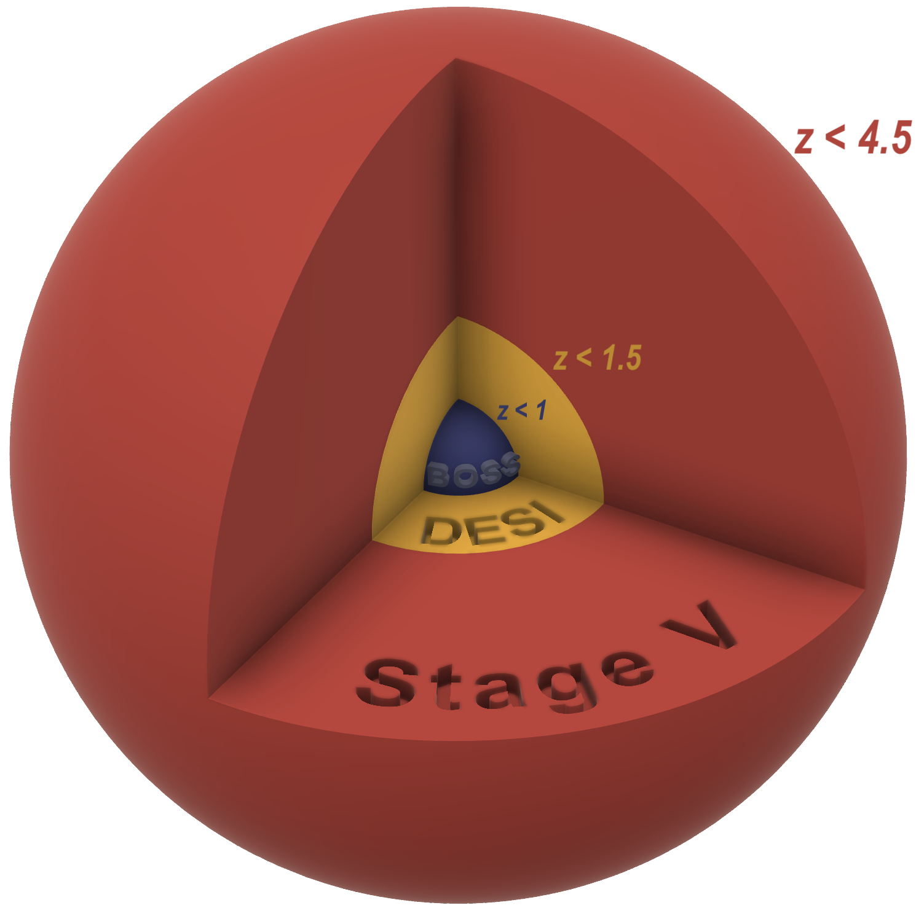
What is the Stage 5 Spectroscopic experiment?
Newly-developed technologies to build the largest 3-dimensional galaxy map,
10X linear modes to be mapped by DESI + Rubin + CMB-S4
AA
Credit: D. Kirkby
Credit: Aragon, Subbarao, Szalay for the SDSS collaboration

Slide 4
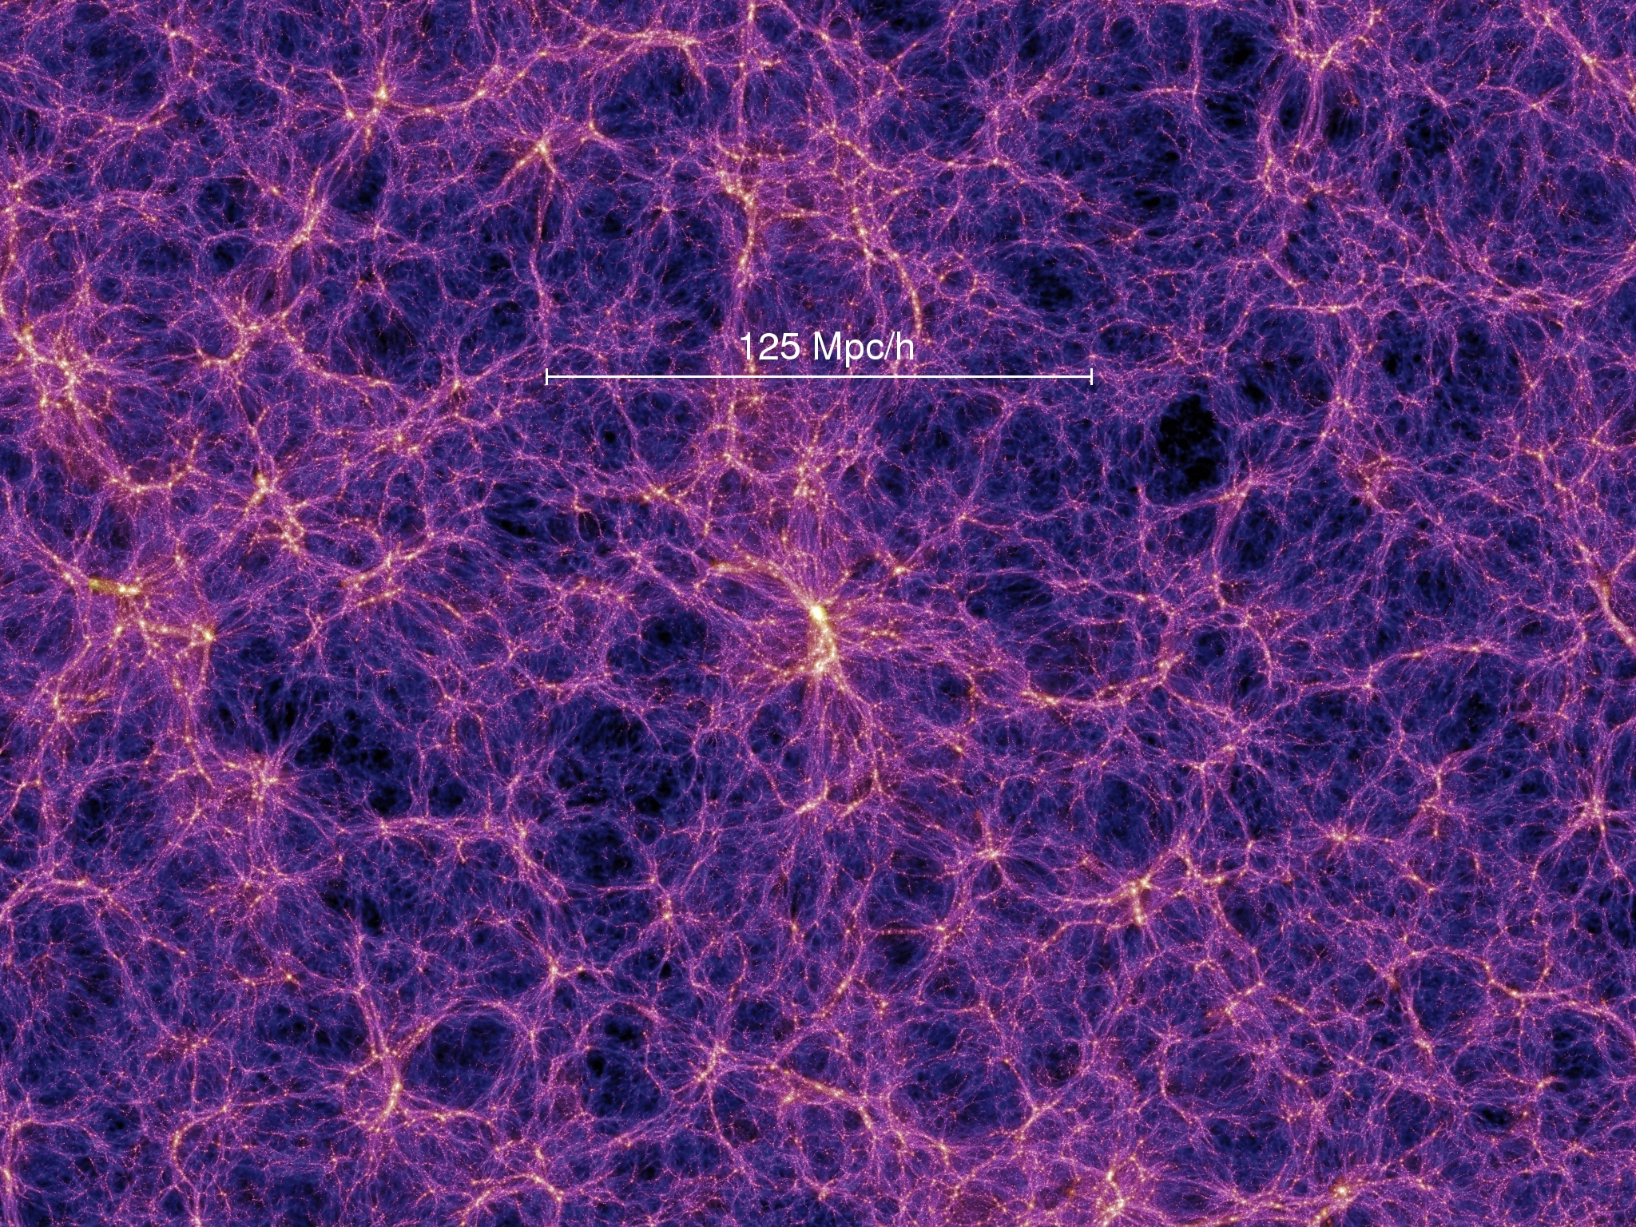
Stage 5 Spectroscopy reaches 10X the “Primordial Figure of Merit”
by mapping 10X more linear modes than DESI
These are the quantum fluctuations imprinted on galaxy maps
Experimental signal-to-noise scale as √number of modes
non-linear mode
Credits: Millenium simulation, IllustrisTNG

Slide 5
What is a Stage 5 Spectroscopic experiment?
Dark Energy Task Force (DETF) in 2005 advised DOE, NSF, NASA on the future of Dark Energy research
Four stages of spectroscopic experiments:
Stage 1 & 2: SDSS — confirms Dark Energy
Stage 3 SDSS/BOSS + eBOSS — precision Dark Energy at low redshift
Stage 4: DESI — precision Dark Energy z=0->3
Stage 5 Spectroscopy moves us beyond the horizon of DETF,
addressing Dark Energy, primordial physics, neutrino mass, light relics, dark matter
—> All of this is physics beyond the standard model
AA

Slide 6
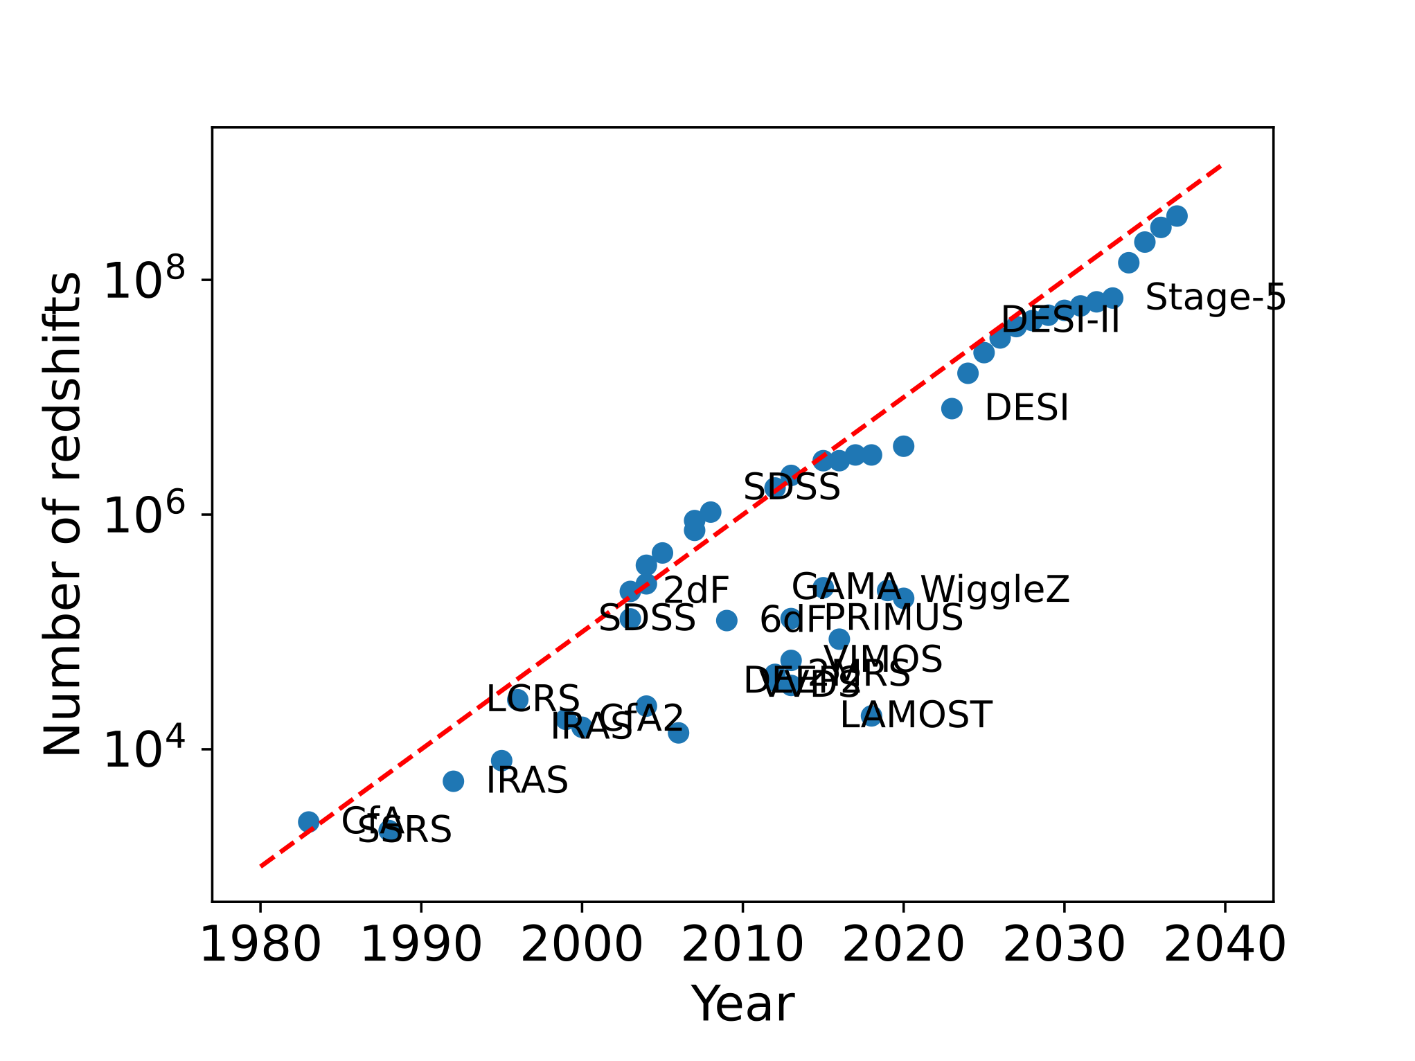
Stage 5 requires mapping the more distant universe at 2 < z < 6
— Larger volume
linear modes well-correlated with init. cond., less affected by late-time astrophysics
— Larger redshift range
degeneracy breaking, measures early->late Dark Energy
Courtesy: P. McDonald

Slide 7
Stage 5 Spectroscopy extends to more volume + smaller scales than DESI
Primordial physics
Inflation non-gaussianity
BAO scale “wiggles”
Neutrino masses + light relics
Based on Sailer, Castorina, Ferraro & White (2022)

Slide 8
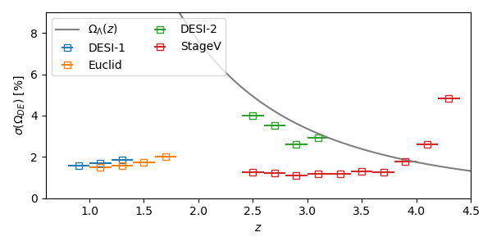
Stage 5 Spectroscopy : “Late” epoch of accelerated expansion
— direct, sub-percent Dark Energy density measurements to z=4 (matter-dominated era)
— indirect 1% expansion measurements to z~10⁵
— search for extra relativistic species
— modified gravity + Dark Matter interactions
LCDM prediction
of Dark Energy
DESI-II
Stage 5
Based on Sailer, Castorina, Ferraro & White (2022)

Slide 9
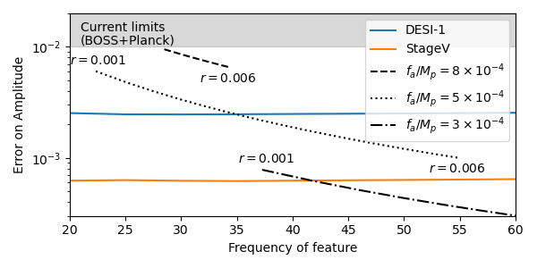
Stage 5 Spectroscopy: “Early” epoch of accelerated expansion
— probe the inflationary potential with primordial non-gaussianity
Primordial Figure-of-Merit increases from 0.9 (DESI) to 10 (Stage 5)
— inflationary features — 10X more sensitive than Stage 4 (DESI,CMB-S4)
— tests of parity-violating physics
BOSS
DESI
Stage 5
Courtesy Dan Green, Eva Silverstein, Martin White
Inflaton potential of the form sin(ɸ/f), ɸ=inflaton, f=energy scale

Slide 10
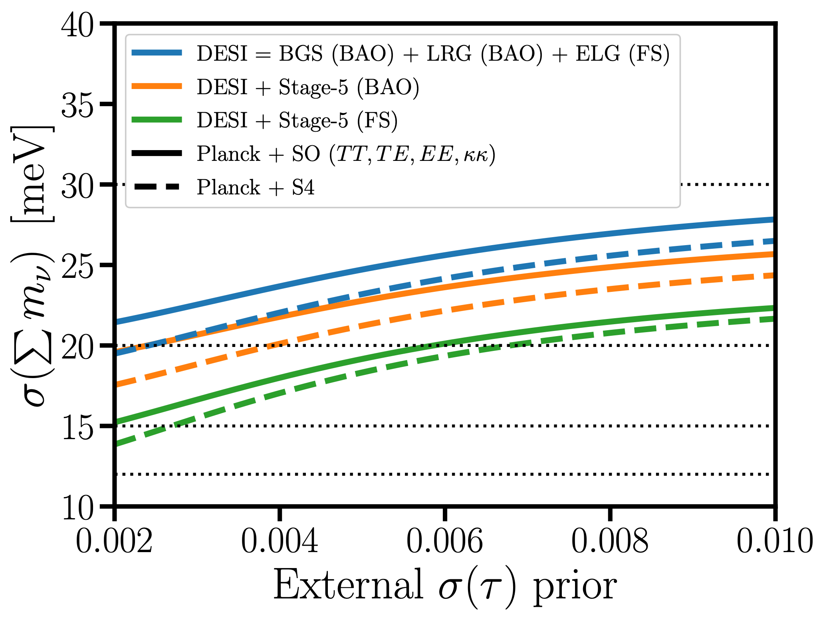
Stage 5 Spectroscopy: neutrino masses + light relics
— Current constraints from Planck (CMB) + BOSS (Stage 3 spectroscopy)
— Massive neutrinos (∑mν) to 15-25 meV (dependent upon LiteBIRD τ)
— Light relics (ΔNeff) to 0.024 (with BBN prior, otherwise 0.08)
Based on Sailer, Castorina, Ferraro & White (2022)

Slide 11
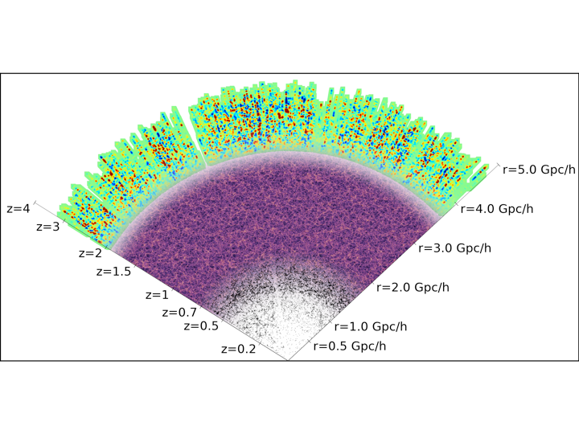
The Universe (+Rubin Observatory) kindly provides compact galaxies at all redshifts
At z > 2, we have Lyman Alpha Emitters (LAEs) and Lyman Break Galaxies (LBGs)

Slide 12
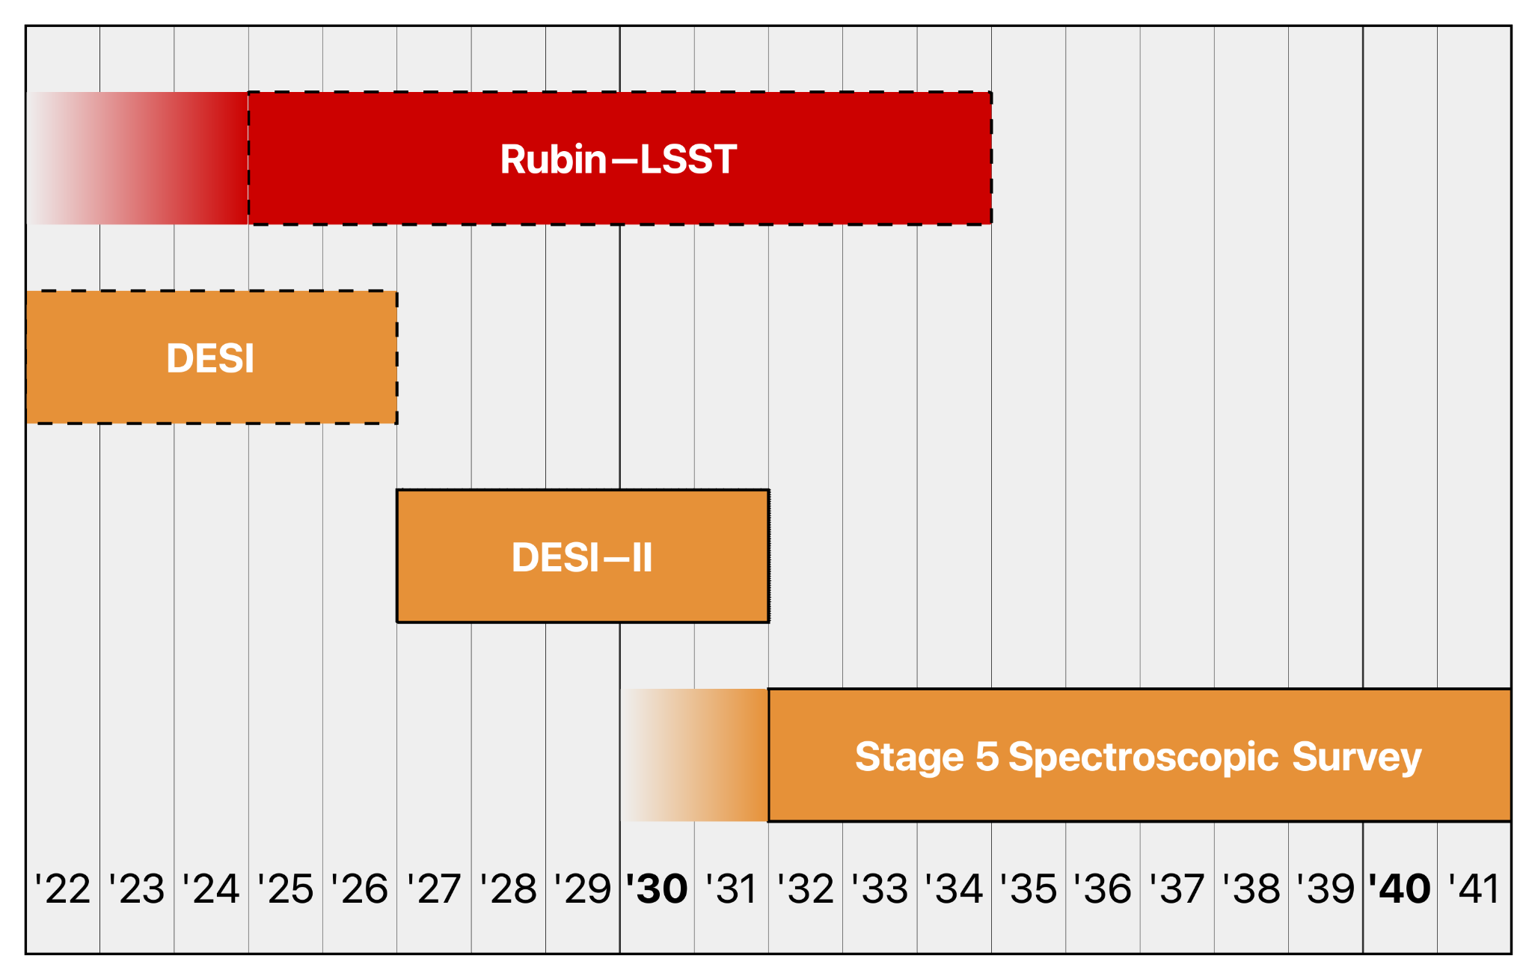
Stage V Spectroscopy Timeline advocated in the Snowmass reports
Rubin imaging will provide the target-selection incl. >30M LBG and >50M LAE galaxies
Target selection
Year —>
Adapted from Snowmass CF6 report

Slide 13
Stage 5 Spectroscopic Survey implementation options
Operate DESI for ~100 years
(not actually proposed)
Option A: DESI-Upgrade in the north+south (twin 4-m telescopes)
Upgrade DESI in Arizona from 5,000 ➔14,000 fiber robots
DESI spectrographs
Upgrade the detectors + electronics to low-noise Skipper CCDs
Replicate at the twin telescope in Chile
Operate both telescopes for ~10 years
Option B: MegaMapper (6.5-m telescope)
New or re-purpose existing 6.5-m primary mirror
New wide-field optical corrector
DESI spectrographs
Operate for ~5 years
Larger-aperture telescope (SpecTel/WST, MSE)
Facility + instrument would be shared with other astronomy projects
Uncosted
AA

Slide 14
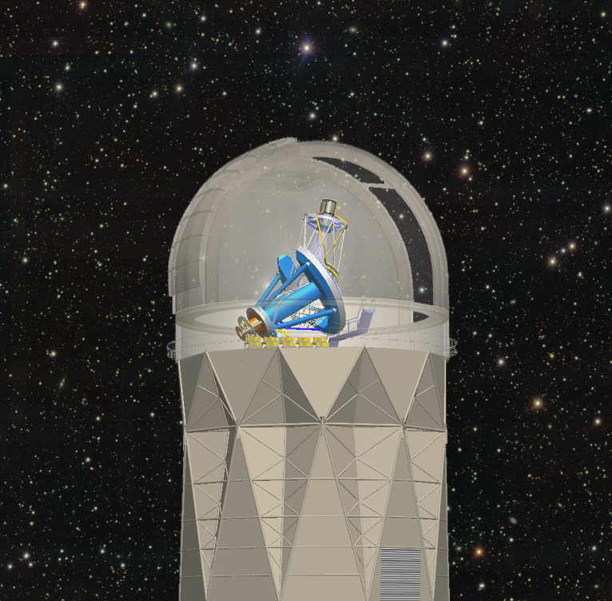
R&D for Stage 5 Spectroscopic Survey is well-underway
What upgrades from DESI?
robots — smaller, higher-density robot army
fibers — higher fiber density
CCDs & FEEs — low-read-noise (Skipper) detectors
Heritage from DESI
targeting
spectrographs
telescope operations
instrument operations
data systems
analysis pipelines
the collaboration!
AA

Slide 15
Robot army for DESI

Slide 16
R&D for Stage 5 robot army converging on the “Trillium” design
3X packing density compared to DESI for any of the Stage 5 implementations
Precision (~5 micron) pointing
optical fiber tip
Stage 5 robots
DESI robot

Slide 17
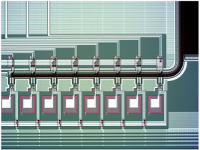
R&D for Stage 5 detectors to use “Skipper” CCDs
increases signal-to-noise for faint galaxies with ~few photons per spectral resolution
Dark matter experiments developed Skipper (non-destructive-read) amplifiers
Astronomical Skipper CCDs use many Skipper amplifiers for fast readout
First “astronomical Skipper” CCDs to be deployed by FNAL this year
16 Skipper amplifiers
(on one corner of the CCD)

Slide 18
Stage 5 Spectroscopy exploring site alternatives
Partnership will partly depend upon telescope platform
NSF NOIRLab is the partner for DESI — partner at Kitt Peak & Cerro Tololo for Options A or B
Carnegie Observatories — partner at Las Campanas for Option B
DESI site
Kitt Peak, AZ
(NSF NOIRLab)
Las Campanas, Chile
(Carnegie Observatories)
Cerro Tololo, Chile
(NSF NOIRLab)

Slide 19
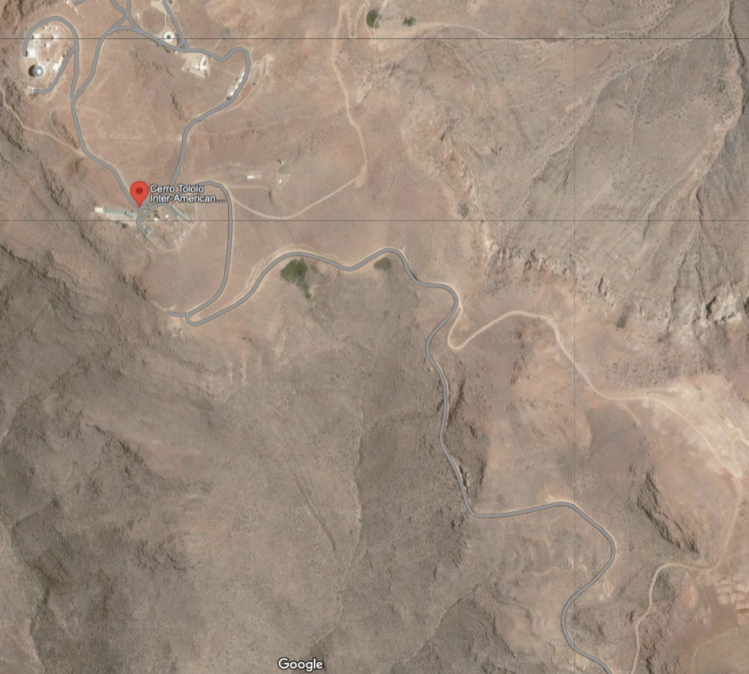
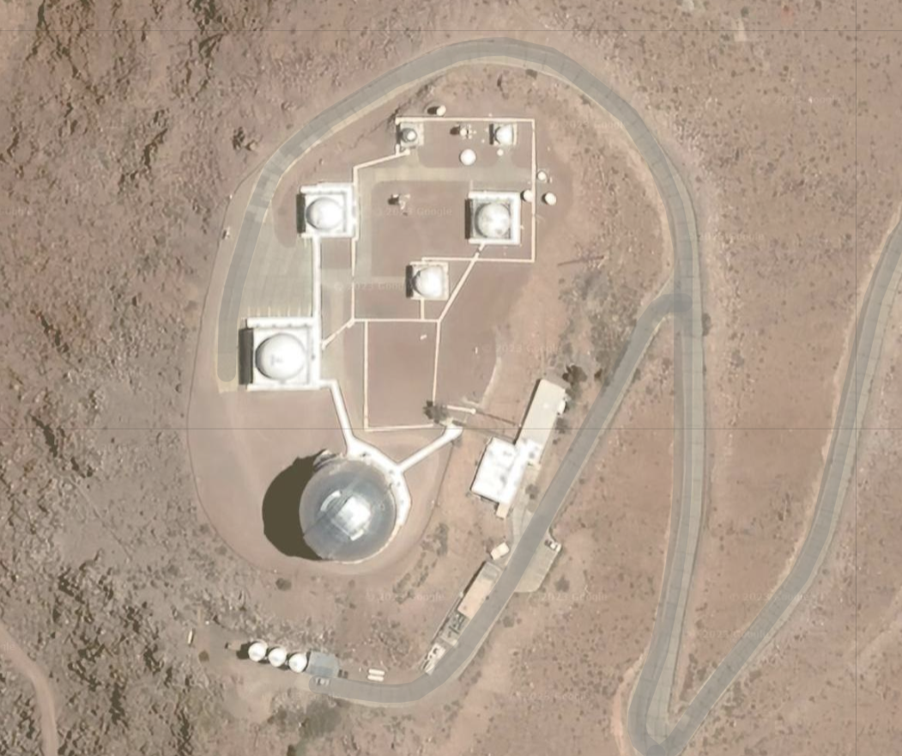
Potential sites for Stage 5 Spectroscopy options A or B at or near Cerro Tololo
0.9m telescope
Cerro “Walker”
Blanco
Courtesy: Arjun Dey (NSF NOIRLab)

Slide 20
Potential sites for Stage 5 Spectroscopy Option B at or near Las Campanas
Courtesy: Juna Kollmeier (Carnegie Observatories & CITA)

Slide 21
SDSS & DESI collaborations have developed expertise across many institutions
Aix-Marseille University Regional Participation Group
Centre de Physique des Particules de Marseille (CCPM)
Laboratoire d’Astrophysique de Marseille (LAM)
Observatoire des Sciences de l’Univers – Institut Pythéas
Argonne National Laboratory
Barcelona-Madrid Regional Participation Group
Institut de Física d’Altes Energies
Institut de Ciències de l’Espai (ICE-CSIC, IEEC)
Centro de Investigaciones Energéticas, Madioambientales y Tecnológicas
Instituto de Física Teórica (IFT, UAM)
Brookhaven National Laboratory
Boston University
Carnegie Mellon University
CEA-IRFU, Saclay
China Participation Group
National Astronomical Observatories, Chinese Academy of Sciences
Peking University
Tsinghua University
Cornell University
Durham University
École Polytechnique Fédérale de Lausanne
Eidgenössische Technische Hochschule, Zürich
Fermi National Accelerator Laboratory
Granada-Madrid-Tenerife Regional Participation Group
Universidad Autónoma de Madrid (Campus de Excelencia Internacional CIE/UAM + CSIC)
Instituto de Astrofísica de Andalucía
Instituto de Astrofísica de Canarias
Harvard University
Kansas State University
Korea Astronomy and Space Science Institute
Korea Institute for Advanced Study
Lawrence Berkeley National Laboratory
Laboratoire de Physique Nucléaire et de Hautes Energies
Laboratório Interinstitucional de e-Astronomia (LIneA)
Ludwig Maximilians University
Max Planck Institute
Mexico Regional Participation Group
Universidad Nacional Autónoma de México (UNAM-Instituto de Física, UNAM-Instituto de Astronomía,
UNAM-Instituto de Ciencias Nucleares)
Universidad de Guanajuato (División de Ciencias e Ingenierías)
Instituto Nacional de Investigaciones Nucleares (ININ)
Centro de Investigación y de Estudios Avanzados del Instituto Politécnico Nacional (CINVESTAV)
National Optical-Infrared Astronomy Research Laboratory (NSF NOIRLab)
National Taiwan University
New York University
Ohio University
Perimeter Institute
Shanghai Jiao Tong University
Siena College
SLAC National Accelerator Laboratory
Southern Methodist University
Swinburne University
The Ohio State University
Universidad de los Andes
University of Arizona
University of Barcelona
University of California, Berkeley
University of California, Irvine
University of California, Santa Cruz
University College London
University of Edinburgh
University of Florida
University of Michigan at Ann Arbor
University of Pennsylvania
University of Pittsburgh
University of Portsmouth
University of Queensland
University of Rochester
University of Toronto
University of Utah
University of Waterloo
University of Wyoming
University of Zurich
UK Regional Participation Group
The Royal Observatory, Edinburgh
University of Cambridge
University of Saint Andrews
University of Warwick
Yale University

Slide 22
Stage 5 collaboration would build upon DESI incl. international partners
LAM + CPPM (France): Spectrographs
LPNHE (France): Calibration systems
CEA (France): Cryo systems
Fermilab (U.S.): Telescope top-end + lens cell
w/ UCL (U.K.): Telescope optics
AAO, USTC, Spain: Fiber positioner R&D
Efforts managed + coordinated by LBNL as the lead lab

Slide 23
Stage 5 costing
DESI management estimates based upon DESI construction 2016-2021
with 35% (labor) or 46% (materials) escalation to FY23 dollars
DESI partners have (enthusiastically!) expressed interest in Stage 5
Option A: Twin DESI north+south
$145M for Arizona site upgrade
$175M for Chile site upgrade (including new wide-field corrector)
$320M total w/out contingency
Option B: MegaMapper instrument on a 6.5-m telescope platform
Would require a contributed telescope
$340M for instrument+corrector w/out contingency
Operations costs would scale from DESI at $11M/year,
plus continued DOE grant support for ~40 US university PIs

Slide 24
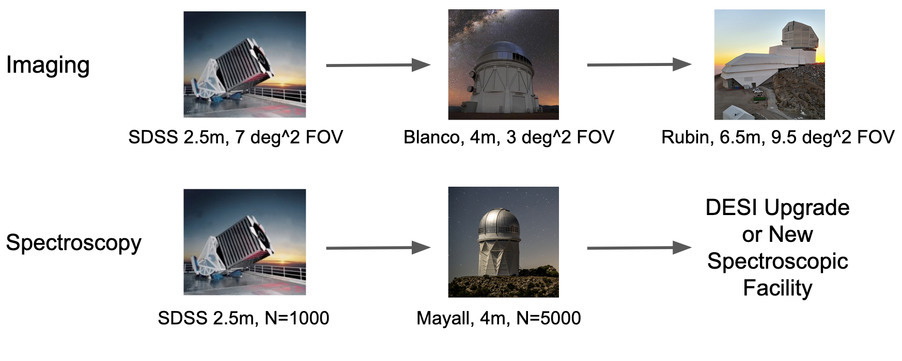
Summary: The Opportunites of Stage 5 Spectroscopy
Next-generation will probe both epochs of accelerated expansion
Direct Dark Energy density measurements to z=4
Primordial Figure-of-Merit increases from 0.9 (DESI) to 10 (Stage 5)
Snowmass report: “CMB-S4 and Spec-S5 are ready to be immediately implemented”
instrument continues iterative upgrades from DESI, increasing capability by 10X
BOSS, DES, DESI collaborations have built the analysis tools
Continues broad participation in the US HEP community & international participation
Snowmass CF6 report

