Slide 1
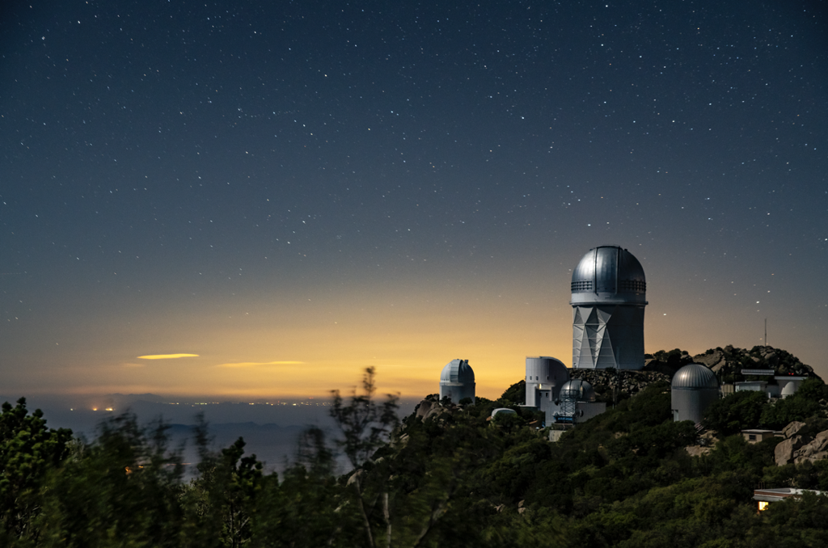
DESI and DESI-II
Kyle Dawson, University of Utah
DESI co-Spokesperson
P5 Cosmic Frontier Town Hall
February 22, 2023
Lawrence Berkeley National Laboratory

Slide 2
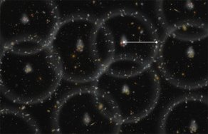
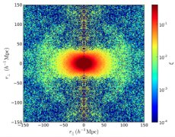
Cosmology with Spectroscopic Surveys
DESI survey covers over 14,000 deg² in 5 years!
Artist Rendition of BAO
Baryon Acoustic Oscillations (BAO)
Preferred scale in clustering of matter and galaxies
Direct expansion measurement
Redshift Space Distortions (RSD)
Anisotropy in clustering due to peculiar velocities induced by gravitational collapse
Growth of structure
Stage-IV Dark Energy Experiment
Expansion history and growth of structure to probe accelerating expansion
10X improvement to w₀w_{a} posterior area compared to Stage-II measurements
RSD as measured in galaxy clustering

Slide 3
Staging Spectroscopic Surveys
DESI survey covers over 14,000 deg² in 5 years!
Dark Energy Spectroscopic Instrument (DESI; primarily z<1.5)
Dark Energy with Baryon Acoustic Oscillations (BAO) and Redshift Space Distortions (RSD)
DESI-II (primarily z>2)
As powerful as DESI, but at z>2
Early dark energy and growth of structure in matter-dominated regime
Synergies with other Cosmic Frontier experiments
Spec-S5
Primordial physics (more constraining than the CMB in important areas)
|
|
|
|
|
|
|
|
|
Current Operations

Slide 4
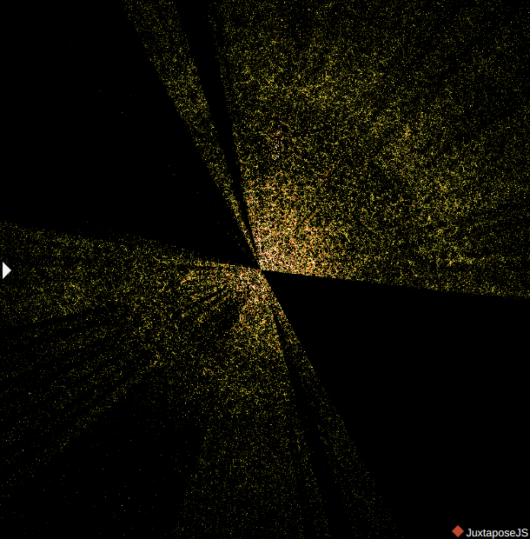
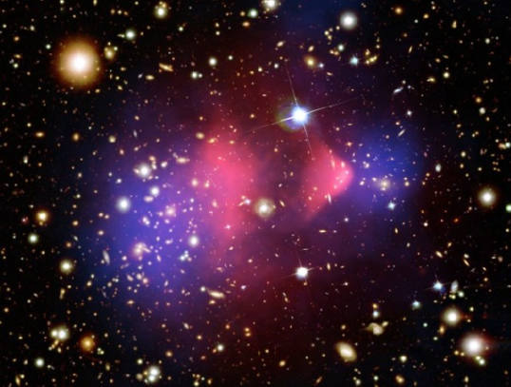
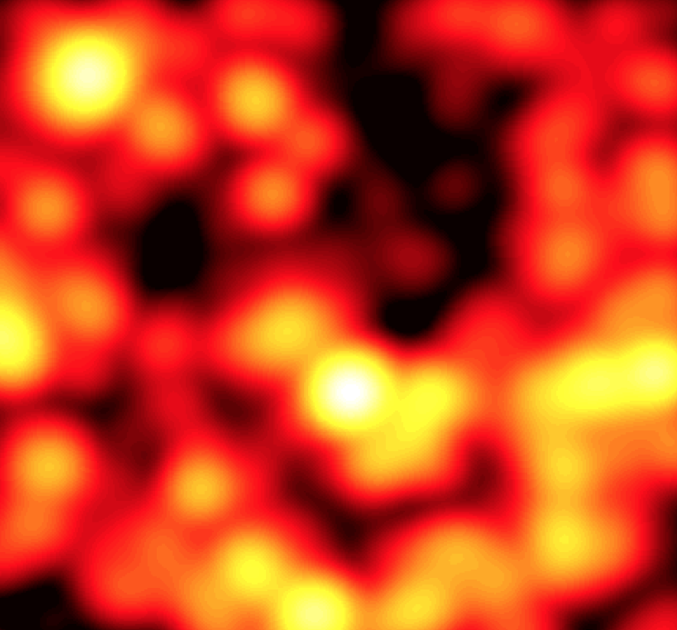
DESI
DESI survey covers over 14,000 deg² in 5 years!
Size (Mpc)
adapted from CF6 Report
Inflation (Primordial structure)
Early Dark Energy
CMB-S4
Dark Energy
Inflation (Primordial Gravitational Waves)
10³
DESI/LSST
BAO scale and larger
10²
Acoustic Peak, Hubble constant
Modified
Gravity
Neutrinos, hot dark matter, rate of structure growth
New relativistic energy
(new particles, new phase transitions)
Astro. probes of Dark Matter
10⁻³
Size of a galaxy cluster
redshift
z~0
z~6
z~1100
Galaxies emitting in optical wavelengths and spatially resolved.
Galaxies and gas emission at redder wavelengths and spatially dense.
Hot dense state. Detectable relics include CMB, gravitational waves and neutrinos.

Slide 5
DESI-II and Spec-S5
DESI survey covers over 14,000 deg² in 5 years!
Size (Mpc)
adapted from CF6 Report
Inflation (Primordial structure)
Early Dark Energy
CMB-S4
Dark Energy
Inflation (Primordial Gravitational Waves)
10³
DESI/LSST
BAO scale and larger
10²
Acoustic Peak, Hubble constant
Modified
Gravity
Neutrinos, hot dark matter, rate of structure growth
New relativistic energy
(new particles, new phase transitions)
Astro. probes of Dark Matter
10⁻³
Size of a galaxy cluster
redshift
z~0
z~6
z~1100
Galaxies emitting in optical wavelengths and spatially resolved.
Galaxies and gas emission at redder wavelengths and spatially dense.
Hot dense state. Detectable relics include CMB, gravitational waves and neutrinos.

Slide 6
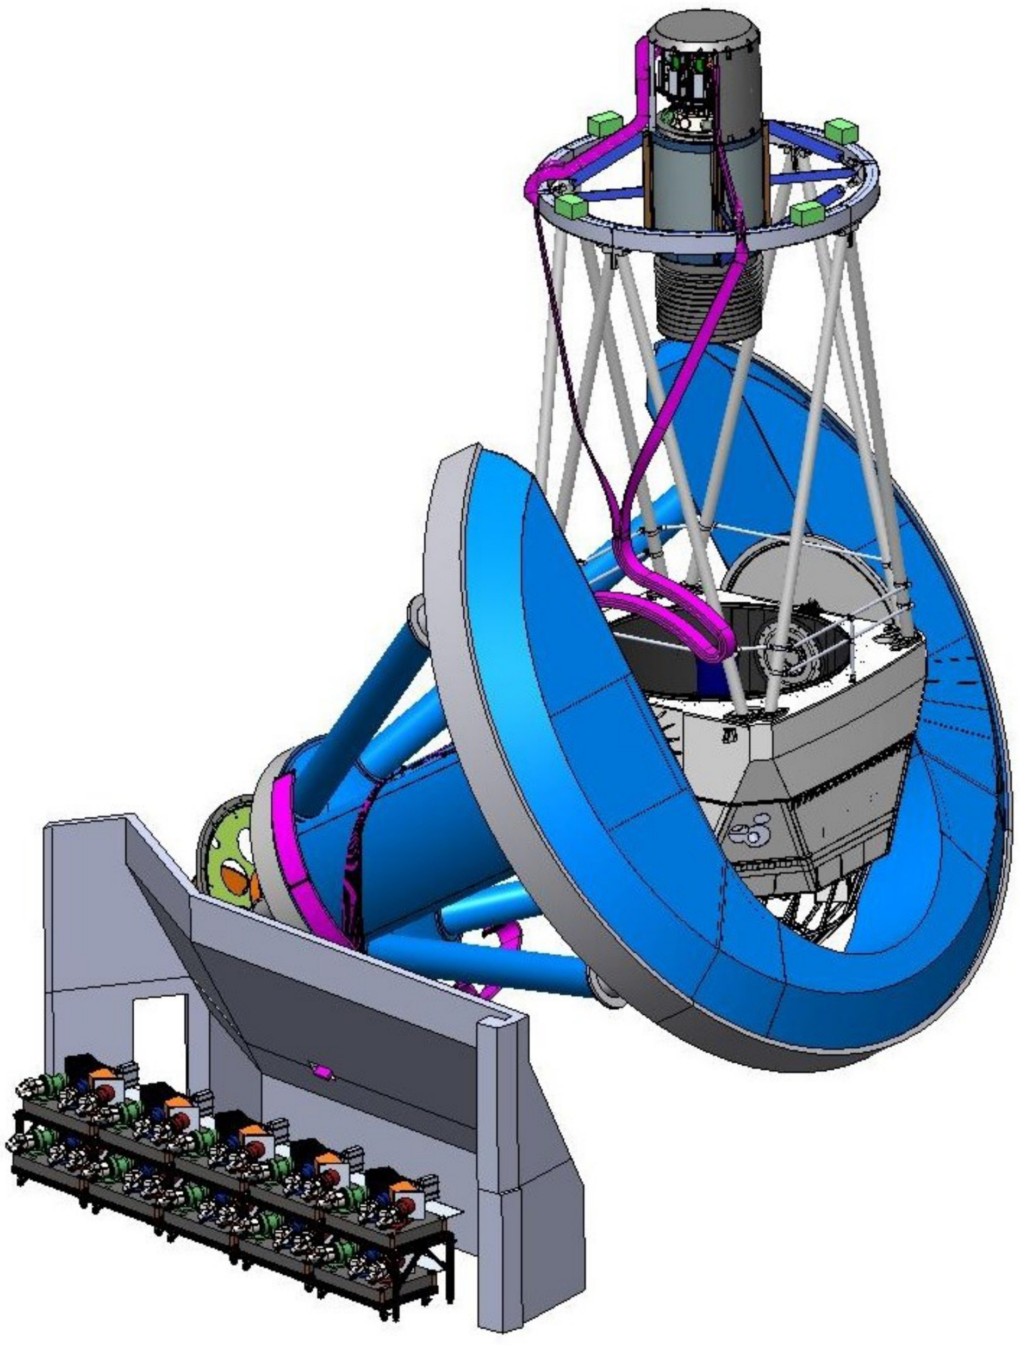
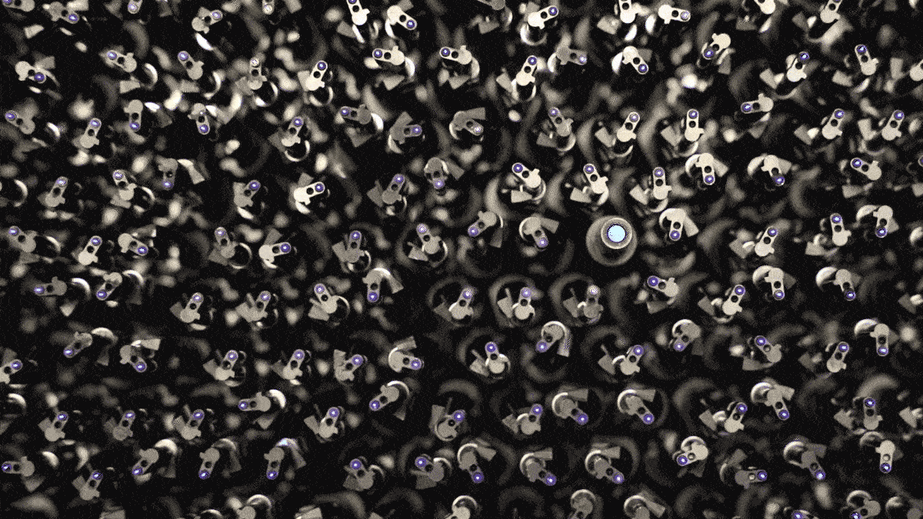
DESI: Massively-multiplexed Spectroscopy
Focal plane assembly with 5000 fiber positioners
DESI survey covers over 14,000 deg² in 5 years!
Mayall 4m telescope
Robotic fiber positioners!
10 spectrographs (360-980nm)

Slide 7
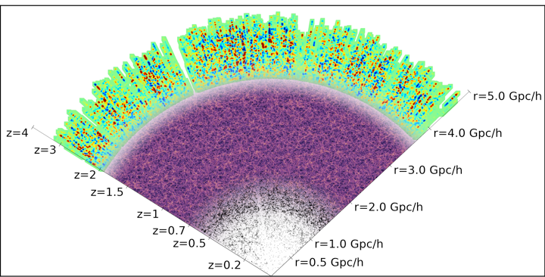
Uninterrupted Galaxy and Quasars from 0<z<3.5
3 million quasars + Ly-α forest (1 < z < 3.5)
DESI survey covers over 14,000 deg² in 5 years!
16 million Emission Line Galaxies
(0.6 < z < 1.6)
8 million Luminous Red Galaxies
(0.4 < z < 1.1)
13 million Bright Galaxies
(0.0 < z < 0.4)
40M extragalactic redshifts plus 10M Milky Way stars

Slide 8
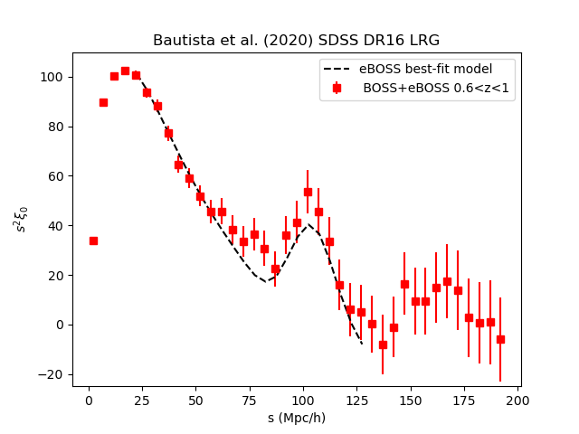
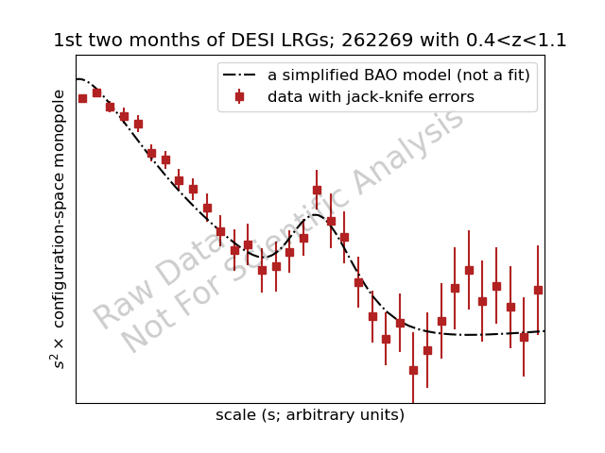
Two Months of DESI
(e)BOSS: 2-3M extragalactic redshifts
Two Months: Competitive with all of Stage-III
One year: More than 14M extragalactic redshifts
Notes:
The spherically-averaged correlation function is displayed utilizing an arbitrary binning in redshift-space separation. The error-bars are determined from 60 jack-knife realizations that include the de-biasing factors of Mohammad & Percival (2021). The measurements are compared to a (pre-reconstruction) BAO model with BAO signal strength consistent with the expectations of a Lambda-CDM concordance model (i.e., similar, but not matching, that applied to the final eBOSS results in Alam et al. 2020). The early DESI data appears consistent with the expected BAO strength in all cases.

Slide 9
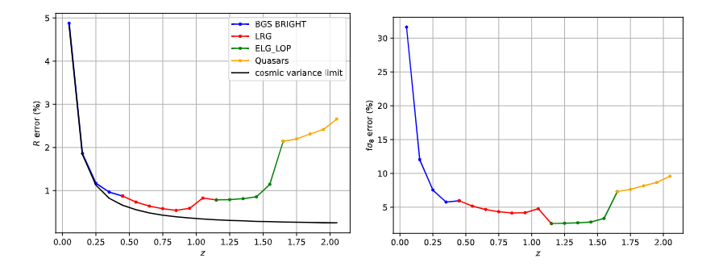
Forecasts from DESI Main Samples
Nearly all BAO information available in 14,000 sq deg survey (Cosmic Variance limit)
DESI is and will remain the most competitive instrument for wide-field spectroscopic surveys on the planet!
Baryon Acoustic Oscillations Redshift Space Distortions

Slide 10
DESI
Recommended project by P5 in 2014
First science observations in 2020
~1200 person collaboration
280+ grad students
69 Institutional members
39 International partners
Expects to meet mission goals (demonstrated by survey validation data):
Measure the isotropic cosmic distance scale R(z) from the BAO method to 0.28% precision aggregated over the redshift bin 0.0 < z < 1.1
Measure the isotropic cosmic distance scale R(z) from the BAO method to 0.39% precision in the redshift bin 1.1 < z < 1.9.
Measure the Hubble parameter at 1.9 < z < 3.7 from the BAO method to 1.05%.
Constructed on schedule and within budget

Slide 11
Beyond the Main DESI Samples
Snowmass: “Continue operation of DESI (via a new DESI-II program) to constrain dark energy in new domains and as a step towards a Stage V spectroscopic facility (Spec-S5).”
Provide new insights into the high redshift Universe
Strengthen synergies with other Cosmic Frontier facilities
Provide a bridge to a Stage V experiment.
Pilot Surveys
Explore capabilities of DESI spectrograph beyond core BAO/RSD program
>100,000 spectra collected in Rubin Deep Drilling fields
z>2 galaxies for primordial physics
host galaxies for supernova cosmology
faint galaxies for photometric redshift calibration
z<1 galaxies for galaxy-galaxy lensing science
dwarf galaxies for dark matter

Slide 12
Wide reaching DESI-II program
Confirmed by pilot surveys
Dark Time: dedicated LSS survey at z>2 for early dark energy
Dark Time: spare fibers for faint Rubin source galaxies
Gray Time: time-series observations of Rubin deep drilling fields
Gray Time: z<1 galaxies to characterize Rubin lens population
Bright Time: stellar spectroscopy to probe Milky Way dark matter
Designed for broad BSM discovery potential while being sensitive to existing tensions.
Snowmass: “New data from other facilities will be needed as a complement to unlock the full constraining power of LSST, including follow-up observations of strong gravitational lenses, supernovae, and gravitational wave standard sirens, as well as measurements of spectroscopic redshifts for deep training samples of objects to enable precision photometric redshift measurements.”

Slide 13
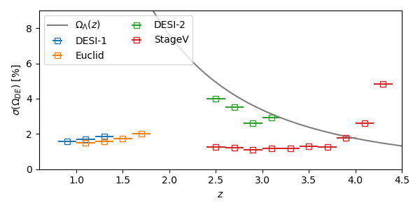
DESI-II Science: Early Dark Energy
Baryon Acoustic Oscillations
5000 square degrees
sub-percent precision distance measurements at z>2
Measurement of dark energy deep in matter-dominated regime

Slide 14
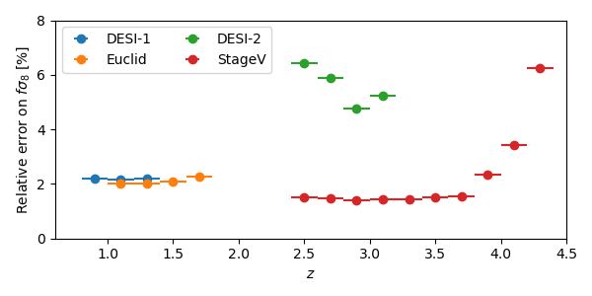
DESI-II Science: Growth of Structure
Sigma8 tension: Redshift Space Distortions
Identical to BAO sample
Independent measurements in growth-dominated regime
Test “low redshift low sigma8” and “CMB lensing average sigma8” at z>2
Stepping stone to Spec-S5 for BAO and RSD measurements

Slide 15
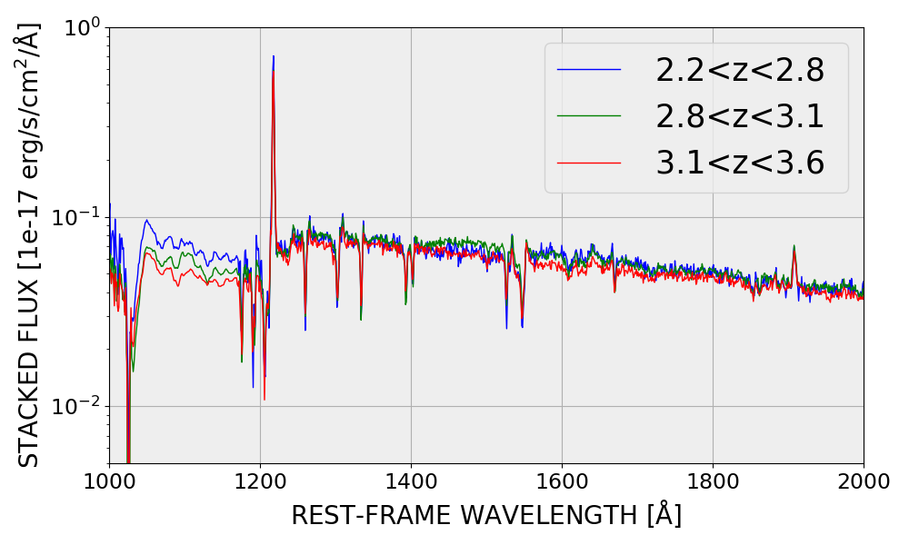
Capabilities: LSS at z>2
DESI at z>2
Snowmass2021 Cosmic Frontier White Paper: Cosmology and Fundamental Physics from the three-dimensional Large Scale Structure
Pilot studies prove we can measure redshifts of faint, distant galaxies
Can match volume of current DESI program in entirely new redshift range
Composite DESI Spectra: based on preliminary target selection algorithm

Slide 16
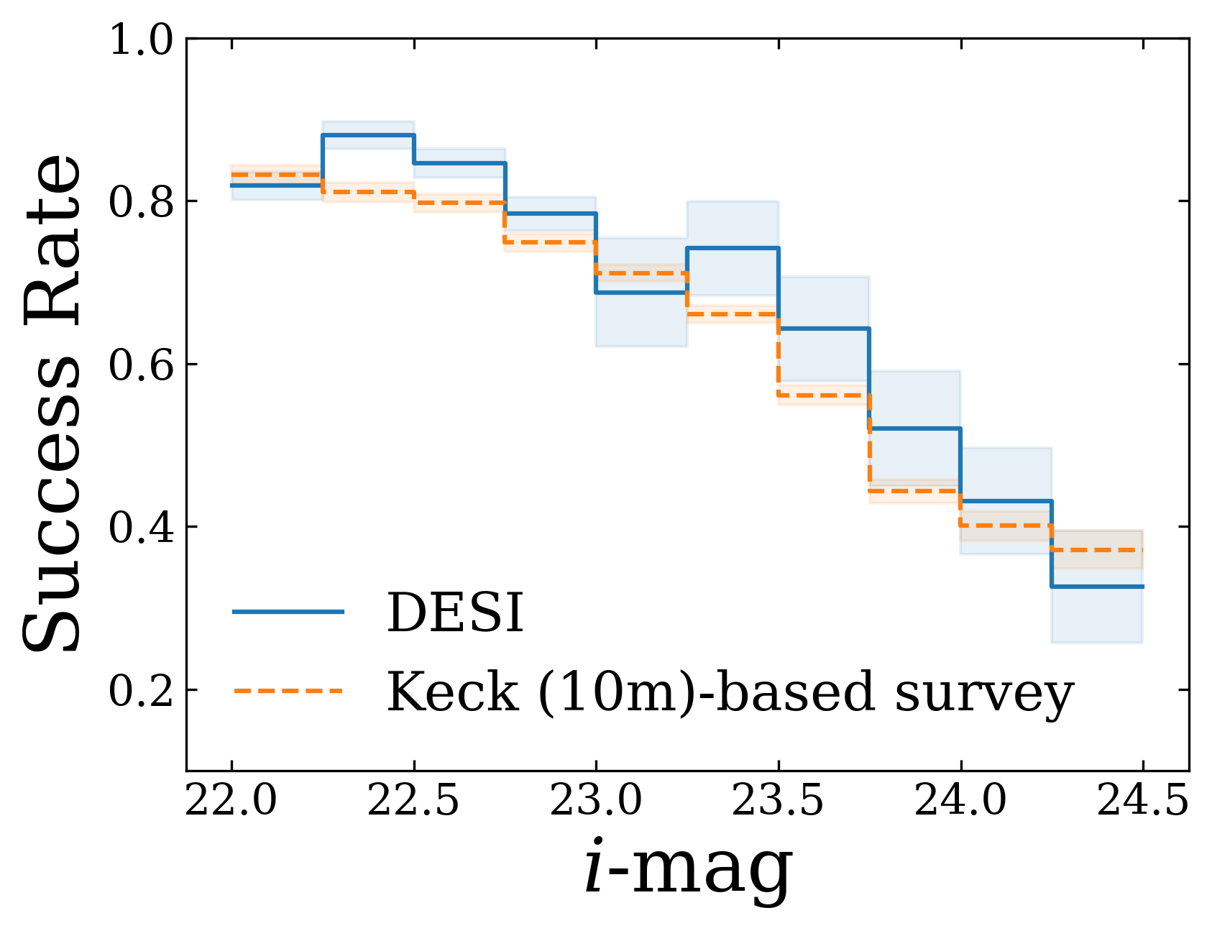
Capabilities: Supporting Rubin Cosmology
99% redshift completeness for z<1 galaxies
order of magnitude increase in surface density relative to DESI
Galaxies at 22<i<24.5
Comparable to 10m class telescopes in only 50% more observing time
40 times more galaxies per exposure
Characterize lens and source populations for cosmic shear and lensing studies

Slide 17
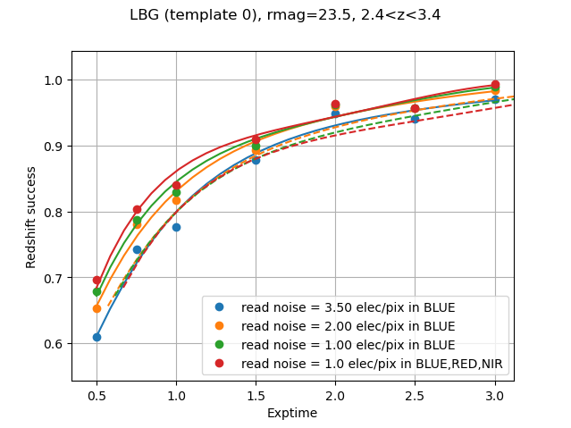
DESI-II: Pathway to Better Performance
R&D: up to 50% improvement in survey speed possible
Implement for DESI-II
Early deployment of Spec-S5 technologies
Single electron counting CCDs (Skipper CCDs)
Developed by Berkeley Lab & Fermilab for dark matter detectors
read noise <1 electron
Upgraded gratings
Facility improvements
Improved mirror cooling

Slide 18
DESI-II Cost Estimates
Operations and minor hardware upgrades
$11M/yr are the current operating costs of DESI
includes cost of operating and maintaining the Mayall 4m telescope
includes cost of operating and maintaining the DESI instrument
includes cost of the lead observers (night-shift operators)
includes cost of the nightly data reductions/QA and nightly selection of targets
includes cost of the major data releases, calibrations, redshift catalogs
Expect this level of operating costs to continue into DESI-II
Cost of hardware upgrades: approximately $5M
new skipper-CCDs
new blue channel gratings
improved mirror cooling
While DESI-II does not require these upgrades, together they greatly improve the survey speed and are needed improvements for Spec-S5.

Slide 19
Summary
DESI
Order of magnitude increase over preceding spectroscopic samples
Sub-percent distance and growth measurements to z<2
Lyman-alpha forest distance measurements at z>2
DESI capabilities
Tens of millions of galaxies accessible with current instrument
Even more powerful with modest upgrades
Wide reaching DESI-II program
Dark Time: dedicated LSS survey at z>2 for primordial physics
Dark Time: spare fibers for faint Rubin source galaxies
Gray Time: time-series observations of Rubin deep drilling fields
Gray Time: z<1 galaxies to characterize Rubin lens population
Bright Time: stellar spectroscopy to probe Milky Way dark matter
Snowmass: “Continue operation of DESI (via a new DESI-II program) to constrain dark energy in new domains and as a step towards a Stage V spectroscopic facility (Spec-S5).”

Slide 21
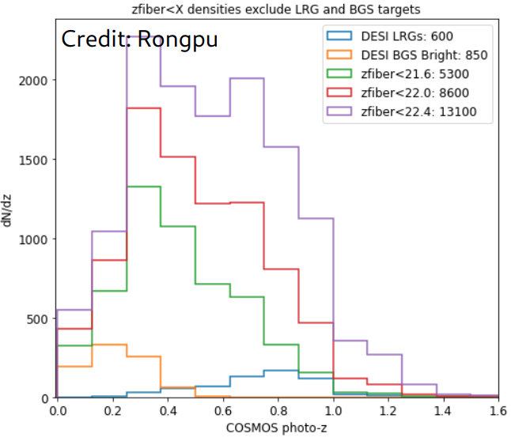
Capabilities: Supporting Rubin Cosmology
99% redshift completeness for z<1 galaxies
z_fib<21.6
5300 per sqdeg
Characterize low-mass end of halo-mass function for galaxy-galaxy lensing studies

Slide 22
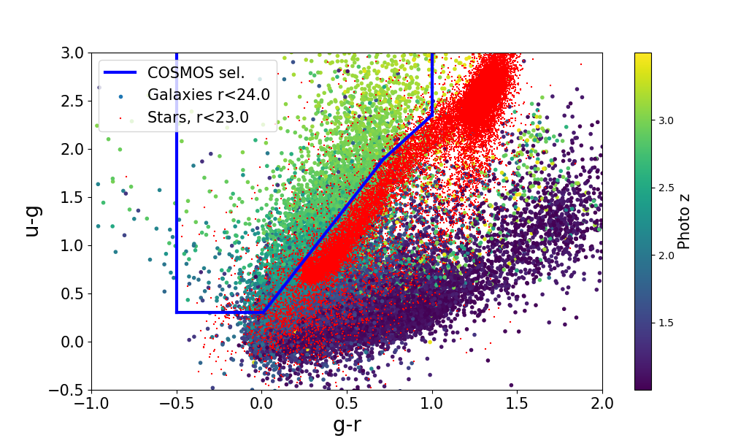
Target Selection: LSS at z>2
Select galaxy targets in the redshift range(s) that we want: 2.0<z<3.5.
UNIONS deep imaging: targets at high declination
Rubin ugriz: targets in LSST-DESC overlap
DECam medium band filters: emission line galaxies for efficient redshift classification
Densities well matched to DESI focal plane for BAO and RSD

