Slide 1
The Vera C. Rubin Observatory and the
LSST Dark Energy Science Collaboration (DESC):
Promise for Fundamental Physics
with the LSST Survey and Beyond
Christopher Stubbs
Harvard University
stubbs@physics.harvard.edu

Slide 2
Talk Outline
Rubin Observatory and DESC: structure and relationship
Fundamental physics goals
A look ahead to operations and analysis phase
Some early thoughts about evolution and extensions
What we need in order to succeed

Slide 3
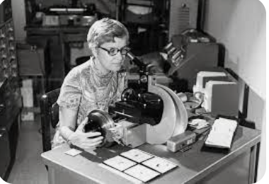
The Vera C. Rubin Observatory
Largest new US investment in ground-based optical/IR facility
System comprises an 8.4 meter telescope, the largest digital camera ever constructed, and an analysis and information distribution pipeline
Jointly supported by NSF & DOE
Strong international participation
No proprietary data period- levels the playing field across partners
Construction now nearing completion
Operations phase expected to begin late 2024

Slide 4
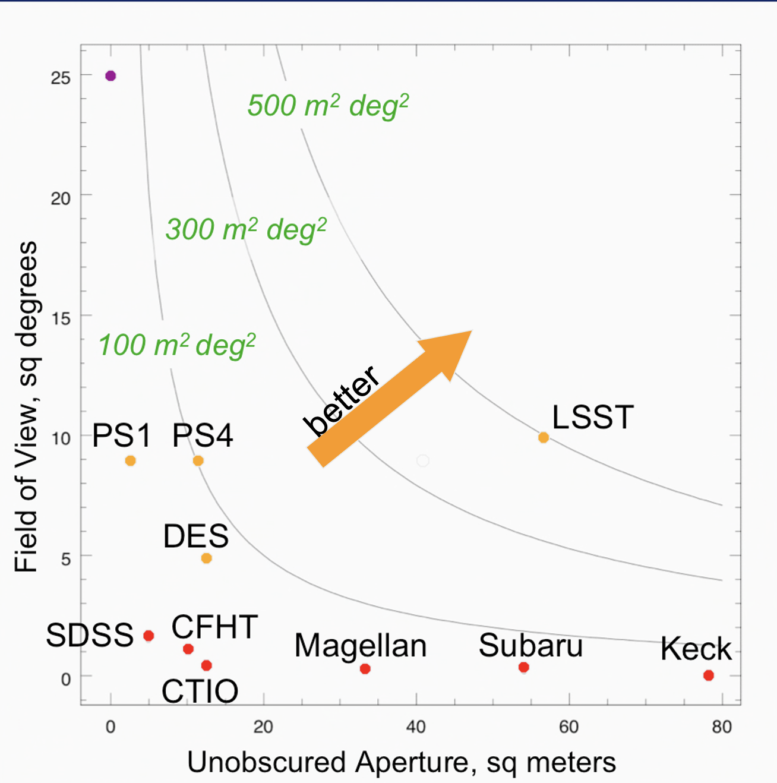
Unprecedented Aperture X Field of View
Etendue = AΩ product is figure of merit for surveys
Rubin (aka LSST) combines those features
Baseline plan is 10-year time-lapse imaging of entire Southern sky Images are co-added to detect faint objects
3-d mass map from weak lensing of galaxies
evolution of large scale structure: DM vs DE
streams of stars in MW and external galaxies
Images are subtracted in real time to detect transients, allowing dark energy and dark matter probes through distances & redshifts of type Ia supernovae
optical ID of sources of gravitational waves
time delays in strong lensing systems
Engineered to control systematics and achieve precision
Rubin

Slide 5
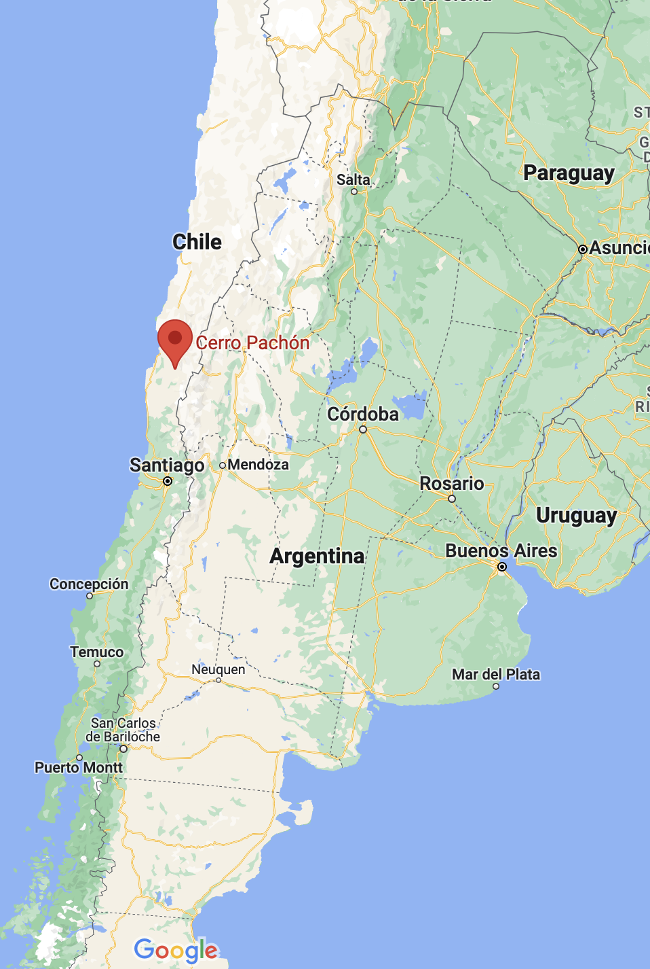
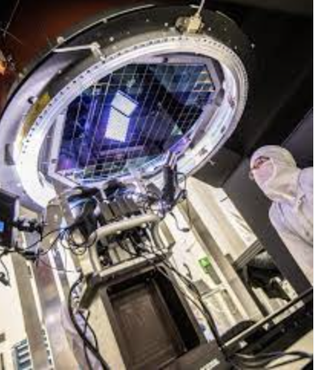
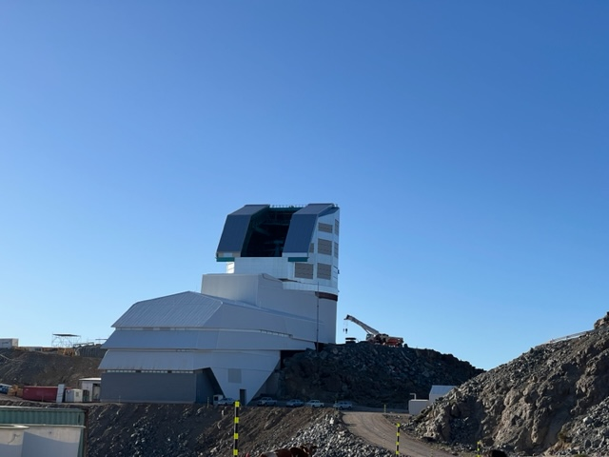
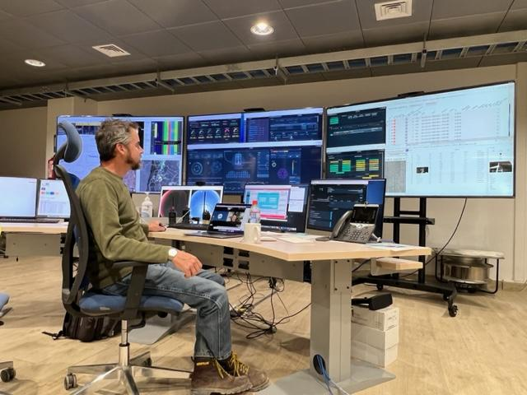
Rubin Observatory is coming to life
Feb 14, 2023
Big Glass + Big Silicon + Big Data

Slide 6
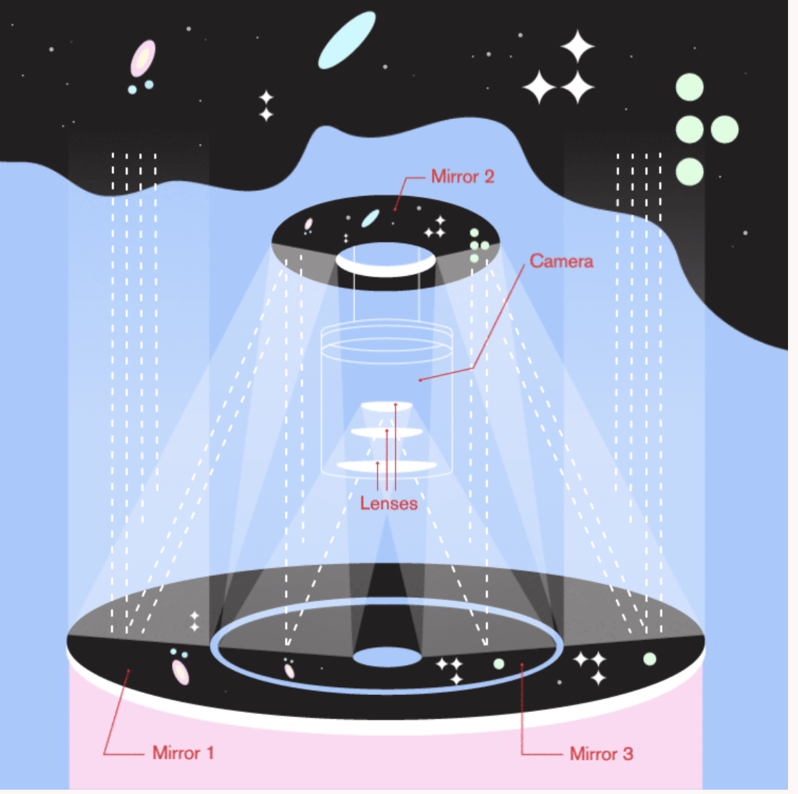
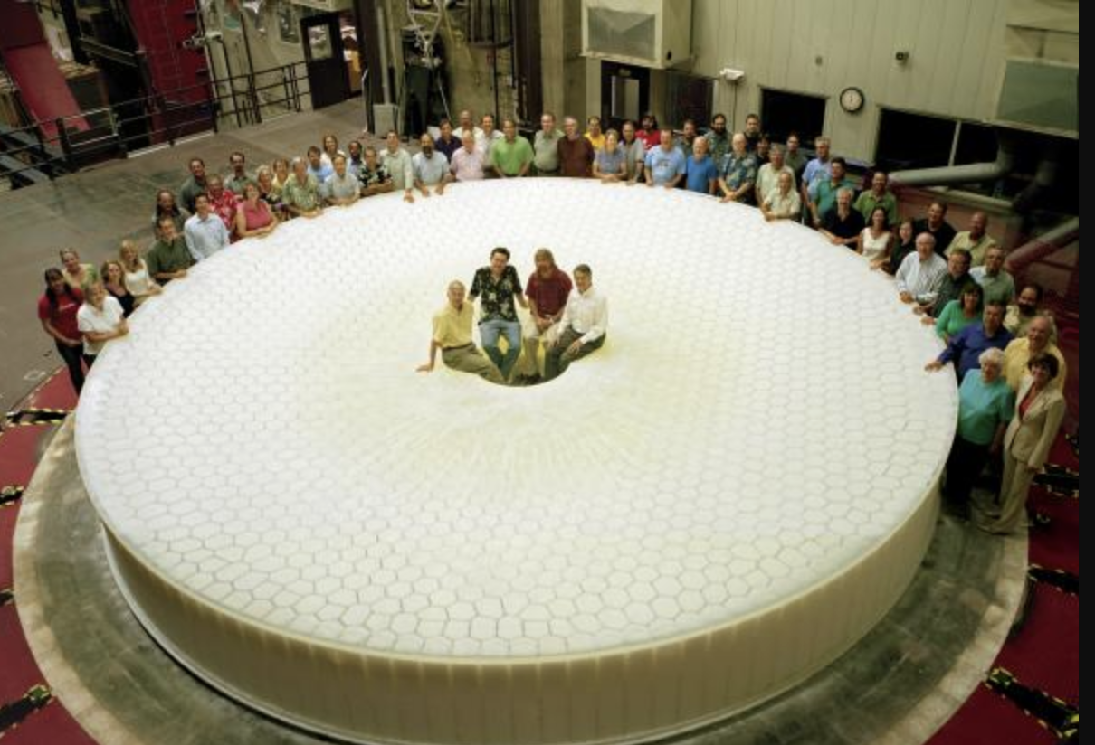
Big Glass f/1.2 beam feeds 3.5 deg FOV
Active control of mirror figure

Slide 7
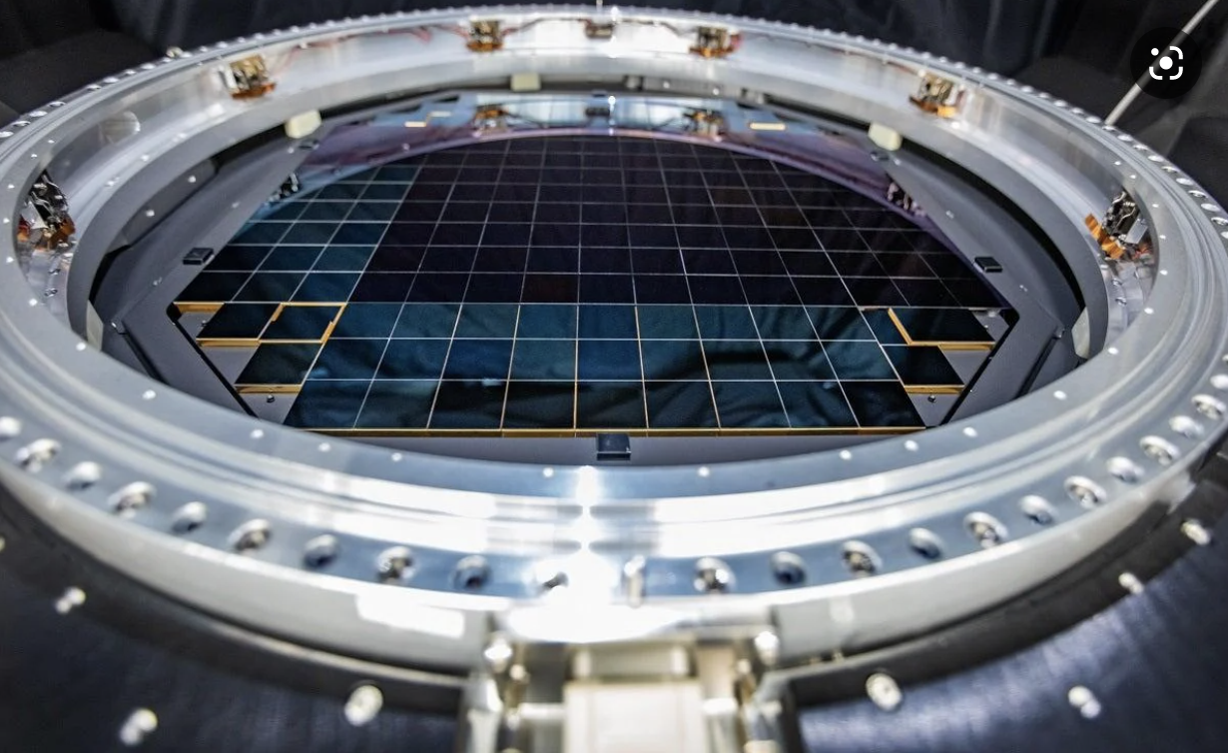
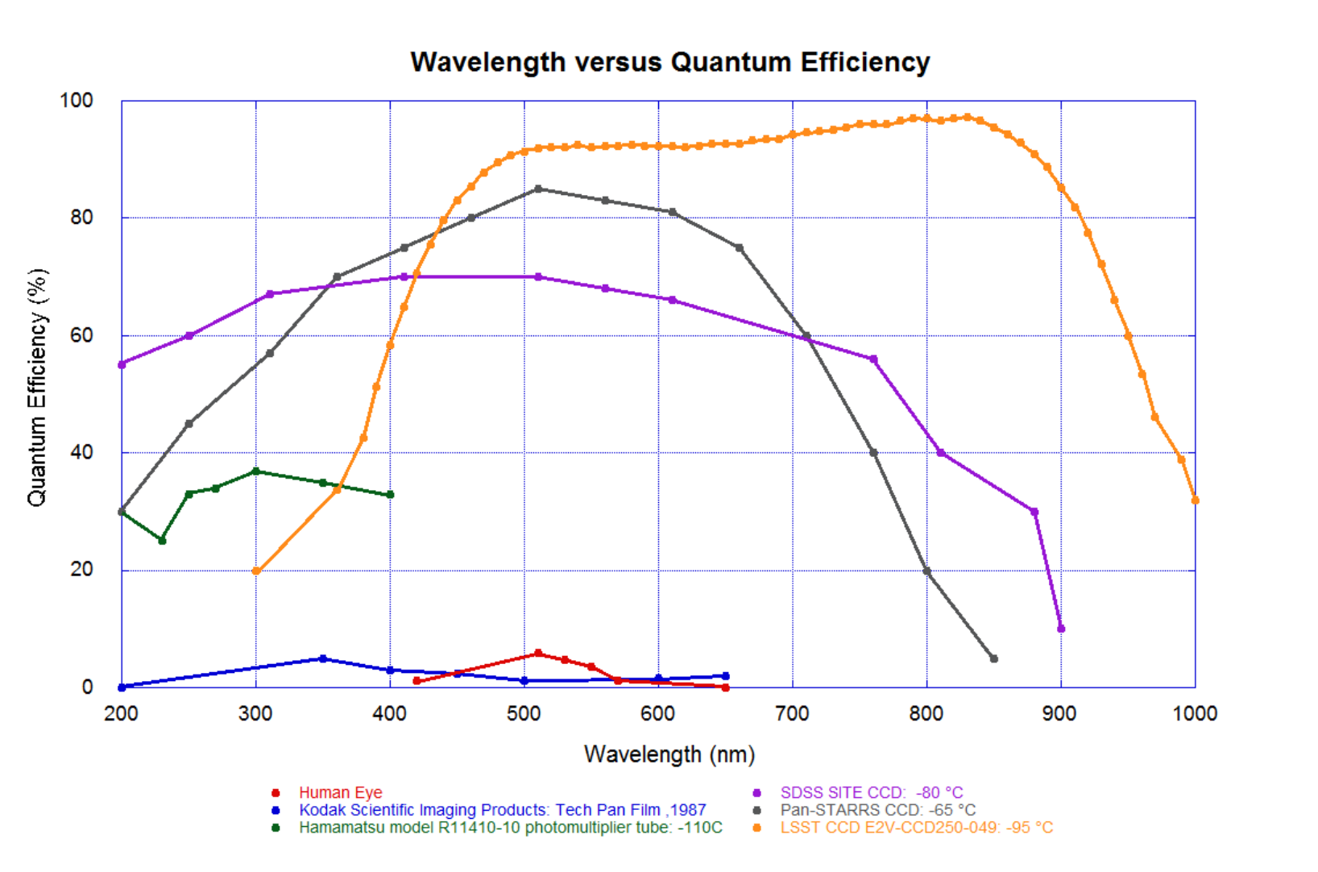
3.5 Gigapixel camera 10 micron pixels 100 microns thick enhanced NIR sensitivity 2 second readout Noise limited by sky background 6 optical passbands
Big Silicon

Slide 8
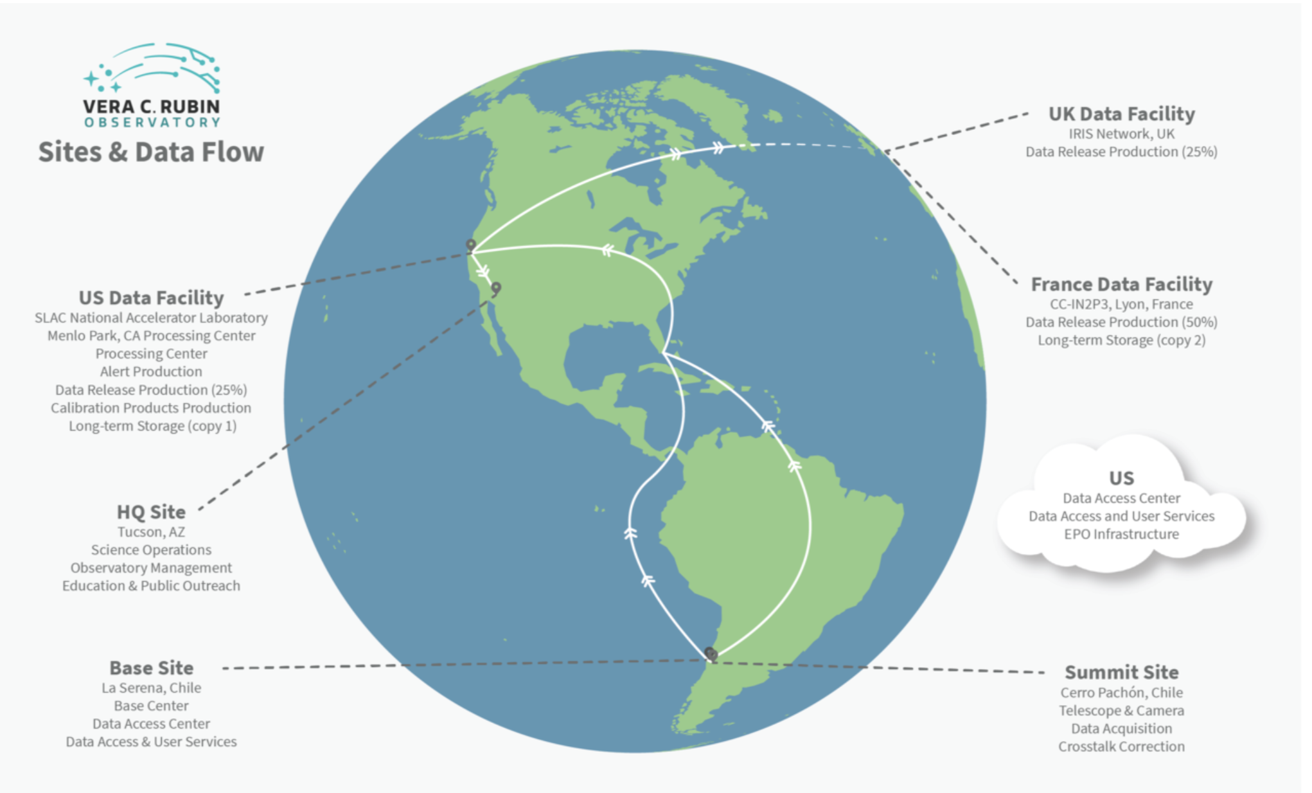
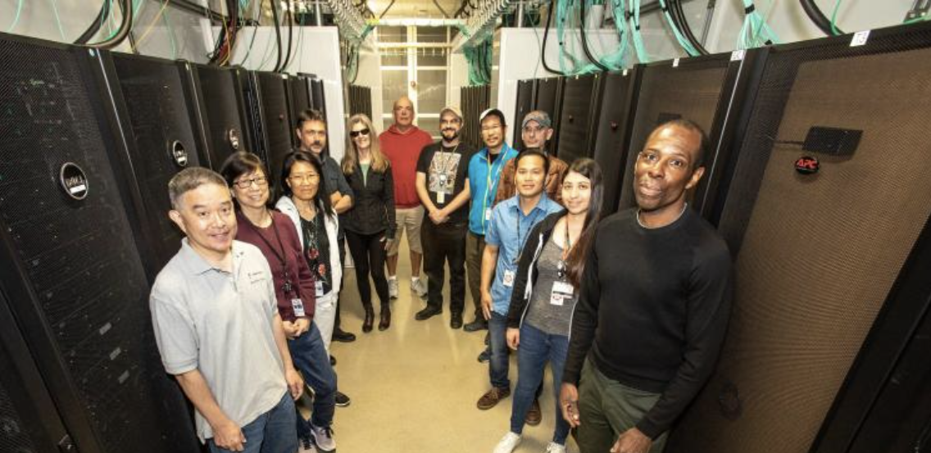
Big Data
Immediate transfer of images to US, 20 TB/night
Generation & dissemination of alerts within 60 sec
User access includes education and public outreach aspects
All Rubin software in public domain, open-source
Data processing at the Rubin Data Facilities in the US (SLAC), France (CC-IN2P3) and UK (IRIS)

Slide 9
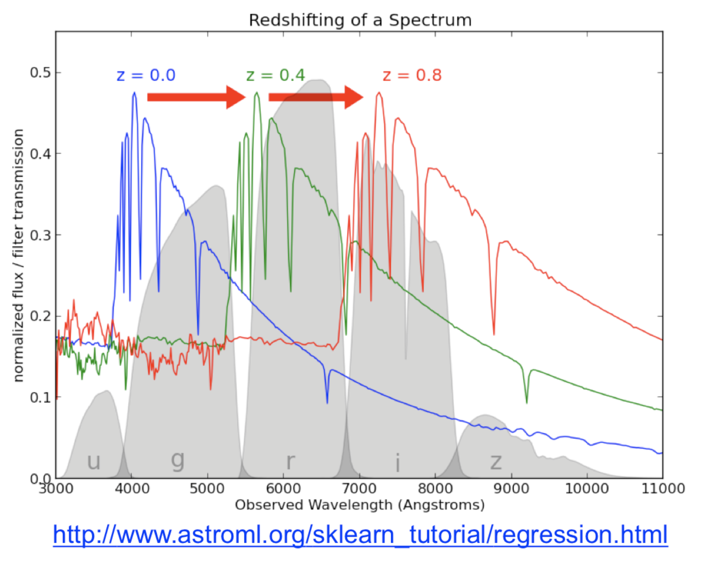
Six Optical Passbands provide 3-d mapping
Broadband fluxes (aka colors) provide ‘photometric redshifts’. Snowmass 2021 report stresses importance of spectroscopic training sets. Not as precise as spectroscopic redshifts, but many more objects measured; roughly 10⁵ useful galaxies measured per Rubin FOV.
Allows for 3-d gravitational lensing tomography.
Multiple bands also essential for precise distance determination of type Ia supernovae and for galaxy cluster detection. Additional (and narrower) filters increase redshift precision.

Slide 10
LSST is an incisive probe of Fundamental Physics
The most robust evidence for physics beyond the standard model comes from astrophysical observations
Non-baryonic Dark Matter
Dark Energy, in particular equation of state parameter w(z)
Inflation
Observations (as opposed to experiments) are particularly prone to systematic uncertainties. We need multiple, independent, probes of this new physics: Rubin’s Legacy Survey of Space and Time (LSST) will deliver this.
Rubin will make essential contributions to our understanding of Dark Matter and Dark Energy. It was designed to do so.
Joint analyses with other data sets is stronger than any of them alone

Slide 11
Testing the “Standard Model”, ΛCDM
Tests of the isotropy of cosmic expansion and its acceleration
Modified gravity constraints on length scales from Milky Way to cosmological
Dark matter constraints from refined lensing measurements of halos of both galaxies and clusters
Improved neutrino mass constraints
Census of satellite galaxies in the local group, which is a current tension in CDM
Refined distance indicators and maps of large scale structure
Identification and characterization of sources of gravitational waves, allowing secure determination of their redshifts and use as a new cosmological probe
Assessing the emerging tensions in H_{o} and S₈ from near-field and far-field cosmology measurements.
Discoveries and evolution of this science will guide evolution of Rubin system

Slide 12
The Rubin Observatory and the LSST Dark Energy Science Collaboration (DESC)
Observatory
DESC
Carry out high-precision and high-accuracy cosmological analysis of LSST data, with simulation, re-processing, and analysis pipelines
Construction of System
Carry out the LSST survey, deliver high-quality processed images, catalogs to the science community
Highlights of important Rubin-DESC connections
Observing strategy: DESC white papers led to shift in survey footprint
LSST DESC simulated data underpin the Rubin Data Preview 0
More than 100 DESC scientists are involved in commissioning, providing input on calibration, measurement algorithms, V&V, …

Slide 13
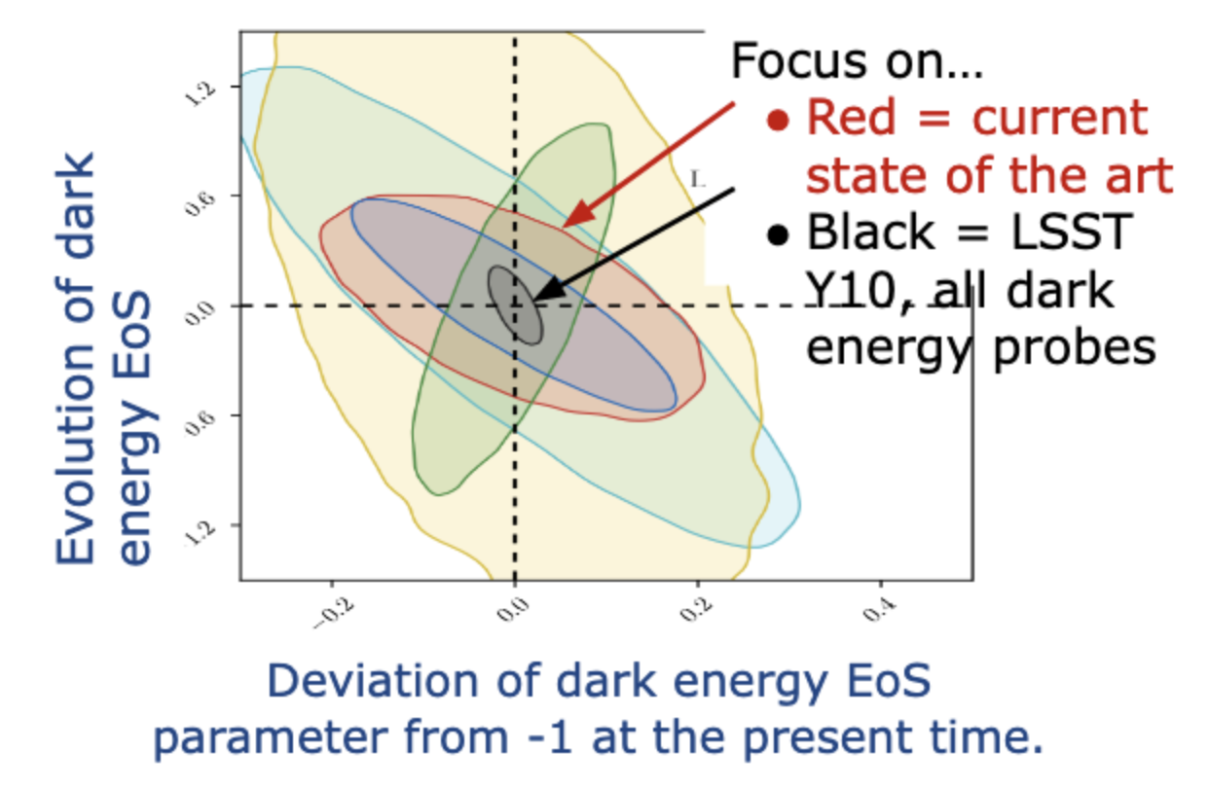
Dark Energy Science Collaboration
Scientific aim: explore the physics of the Dark Universe
Dark Energy, Dark Matter, inflation
Multiple complementary probes from Rubin alone
Large international collaboration with more than 1,000 members
50% US based, 50% international
France (IN2P3) and UK (STFC) are strong partners
Over half are early career researchers
Strong DEIB component
DESC Science Requirements Document defines success as %-level precision in DE parameters
R. Mandelbaum, T. Eifler, R. Hlozek, T. Collett, E. Gawiser, D. Scolnic et al., arXiv:1809.01669
Forecast 68% confidence level constraints on (w₀ ,w_{a} ) for individual probes and for their combination.
DESC Operations supports the development of mission-critical software

Slide 14
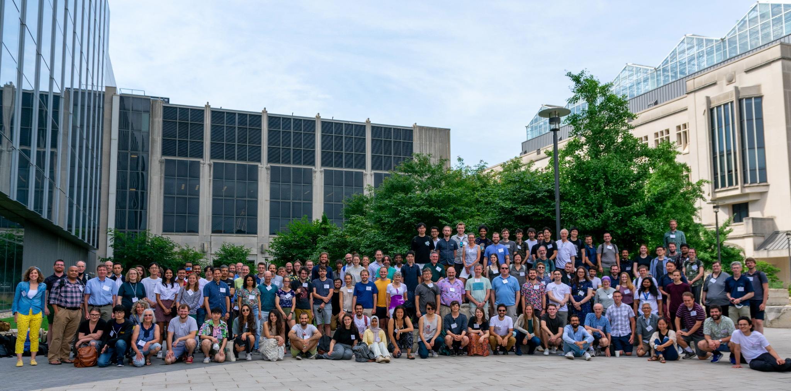
DESC Collaboration Meeting, August 2022
Hybrid Collaboration Meeting in Chicago, more than 300 participants
Notes:
Not sure if this is needed?

Slide 15
DESC Primary Science Goals
LSST DESC is planning to carry out full cosmology analyses (dark energy, dark matter, neutrinos, inflation, …)
Goal #1: Cosmological constraints from Rubin-only data from shear and clustering (3x2pt), clusters of galaxies and supernovae
Goal #2: Consistency checks between different Rubin DESC probes
Goal #3: Cosmological constraints and tensions from Rubin + External Data Sets
Goal #4: Be prepared for serendipity
Goal #5: Assess possibly needed changes in observing strategy, processing for upcoming data releases in the earlier years

Slide 16
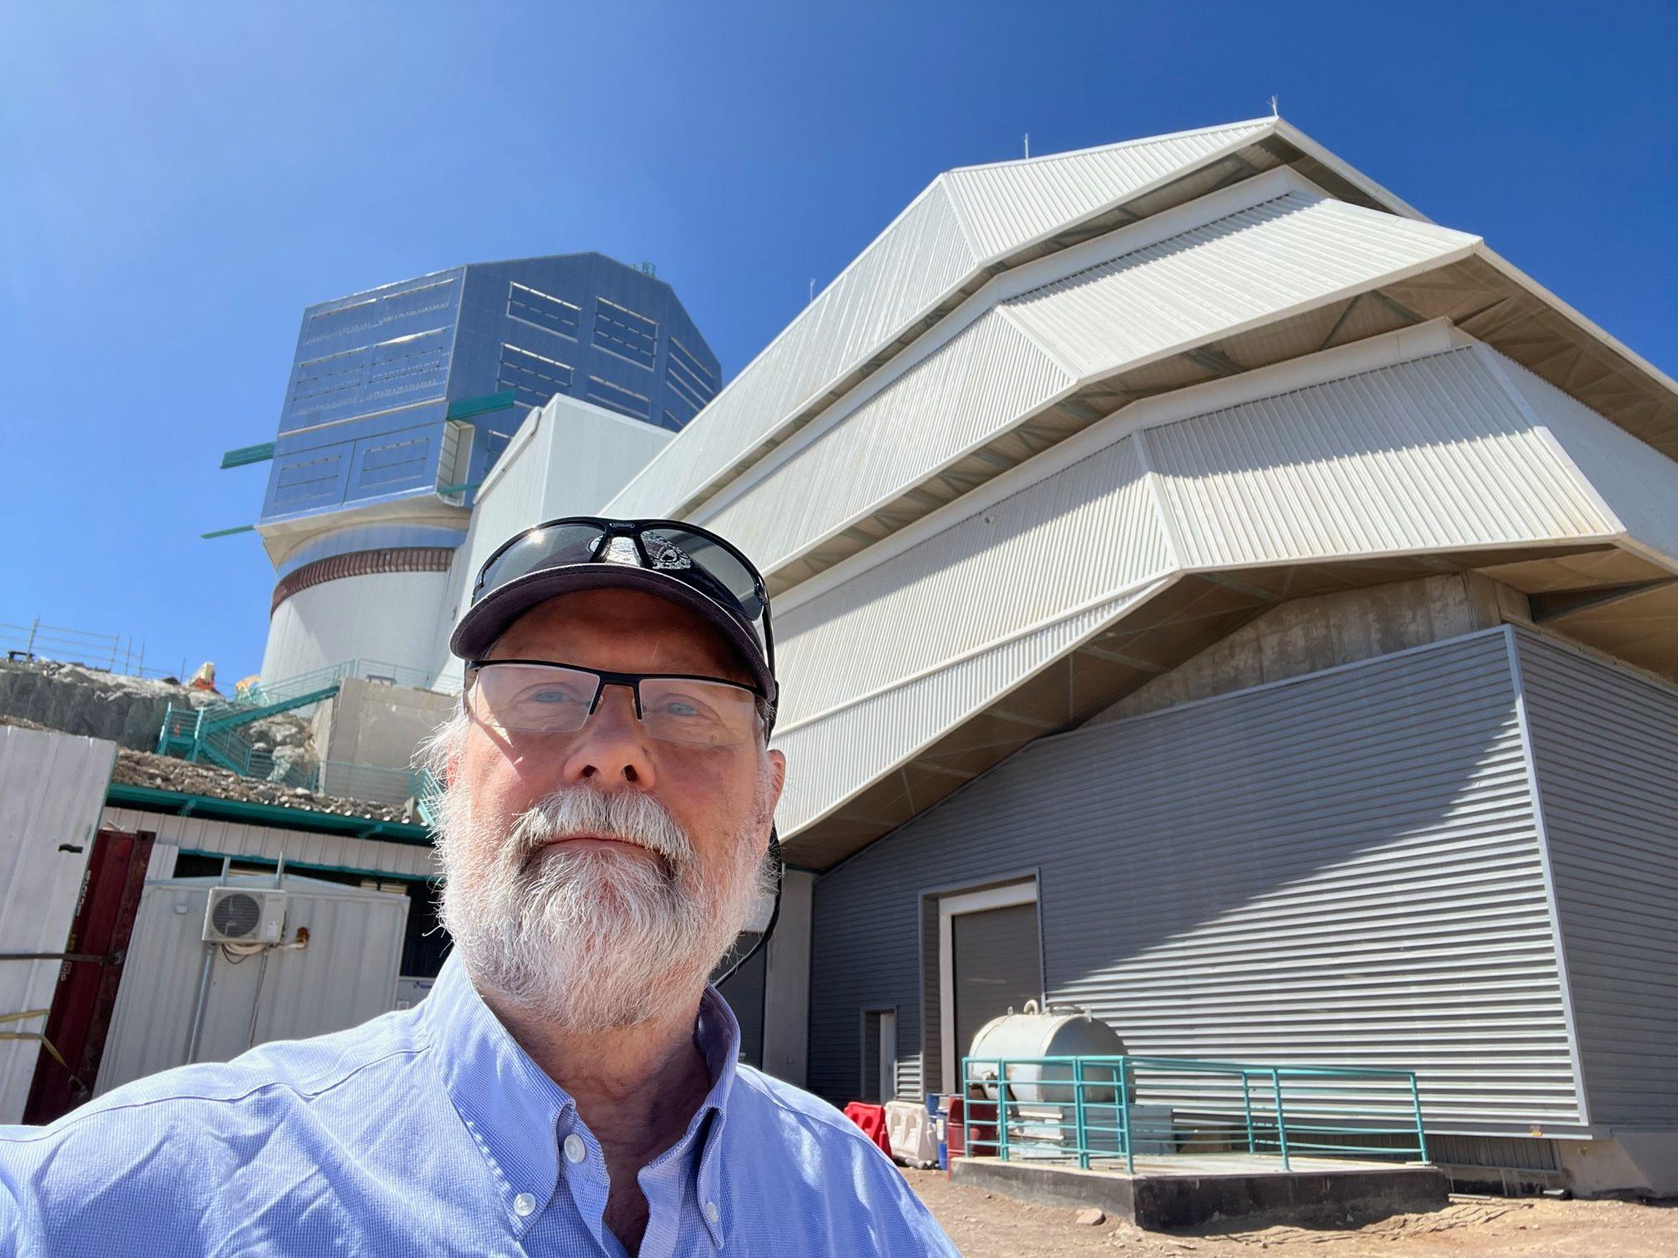
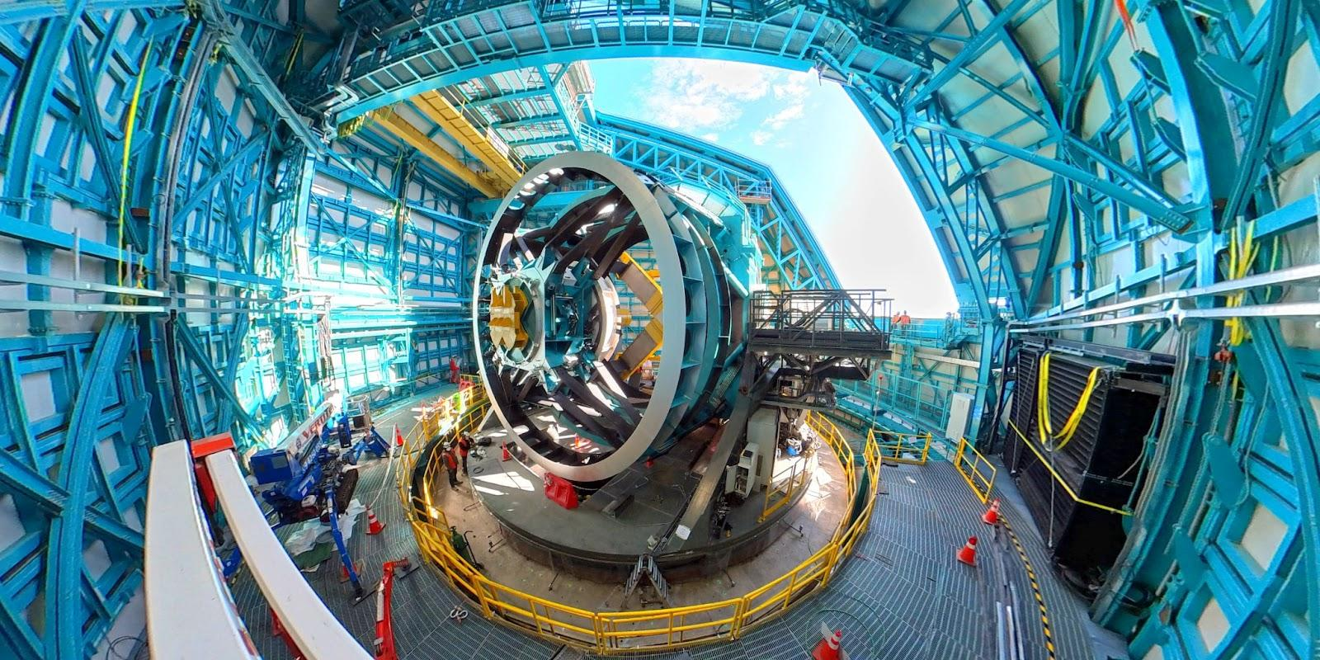
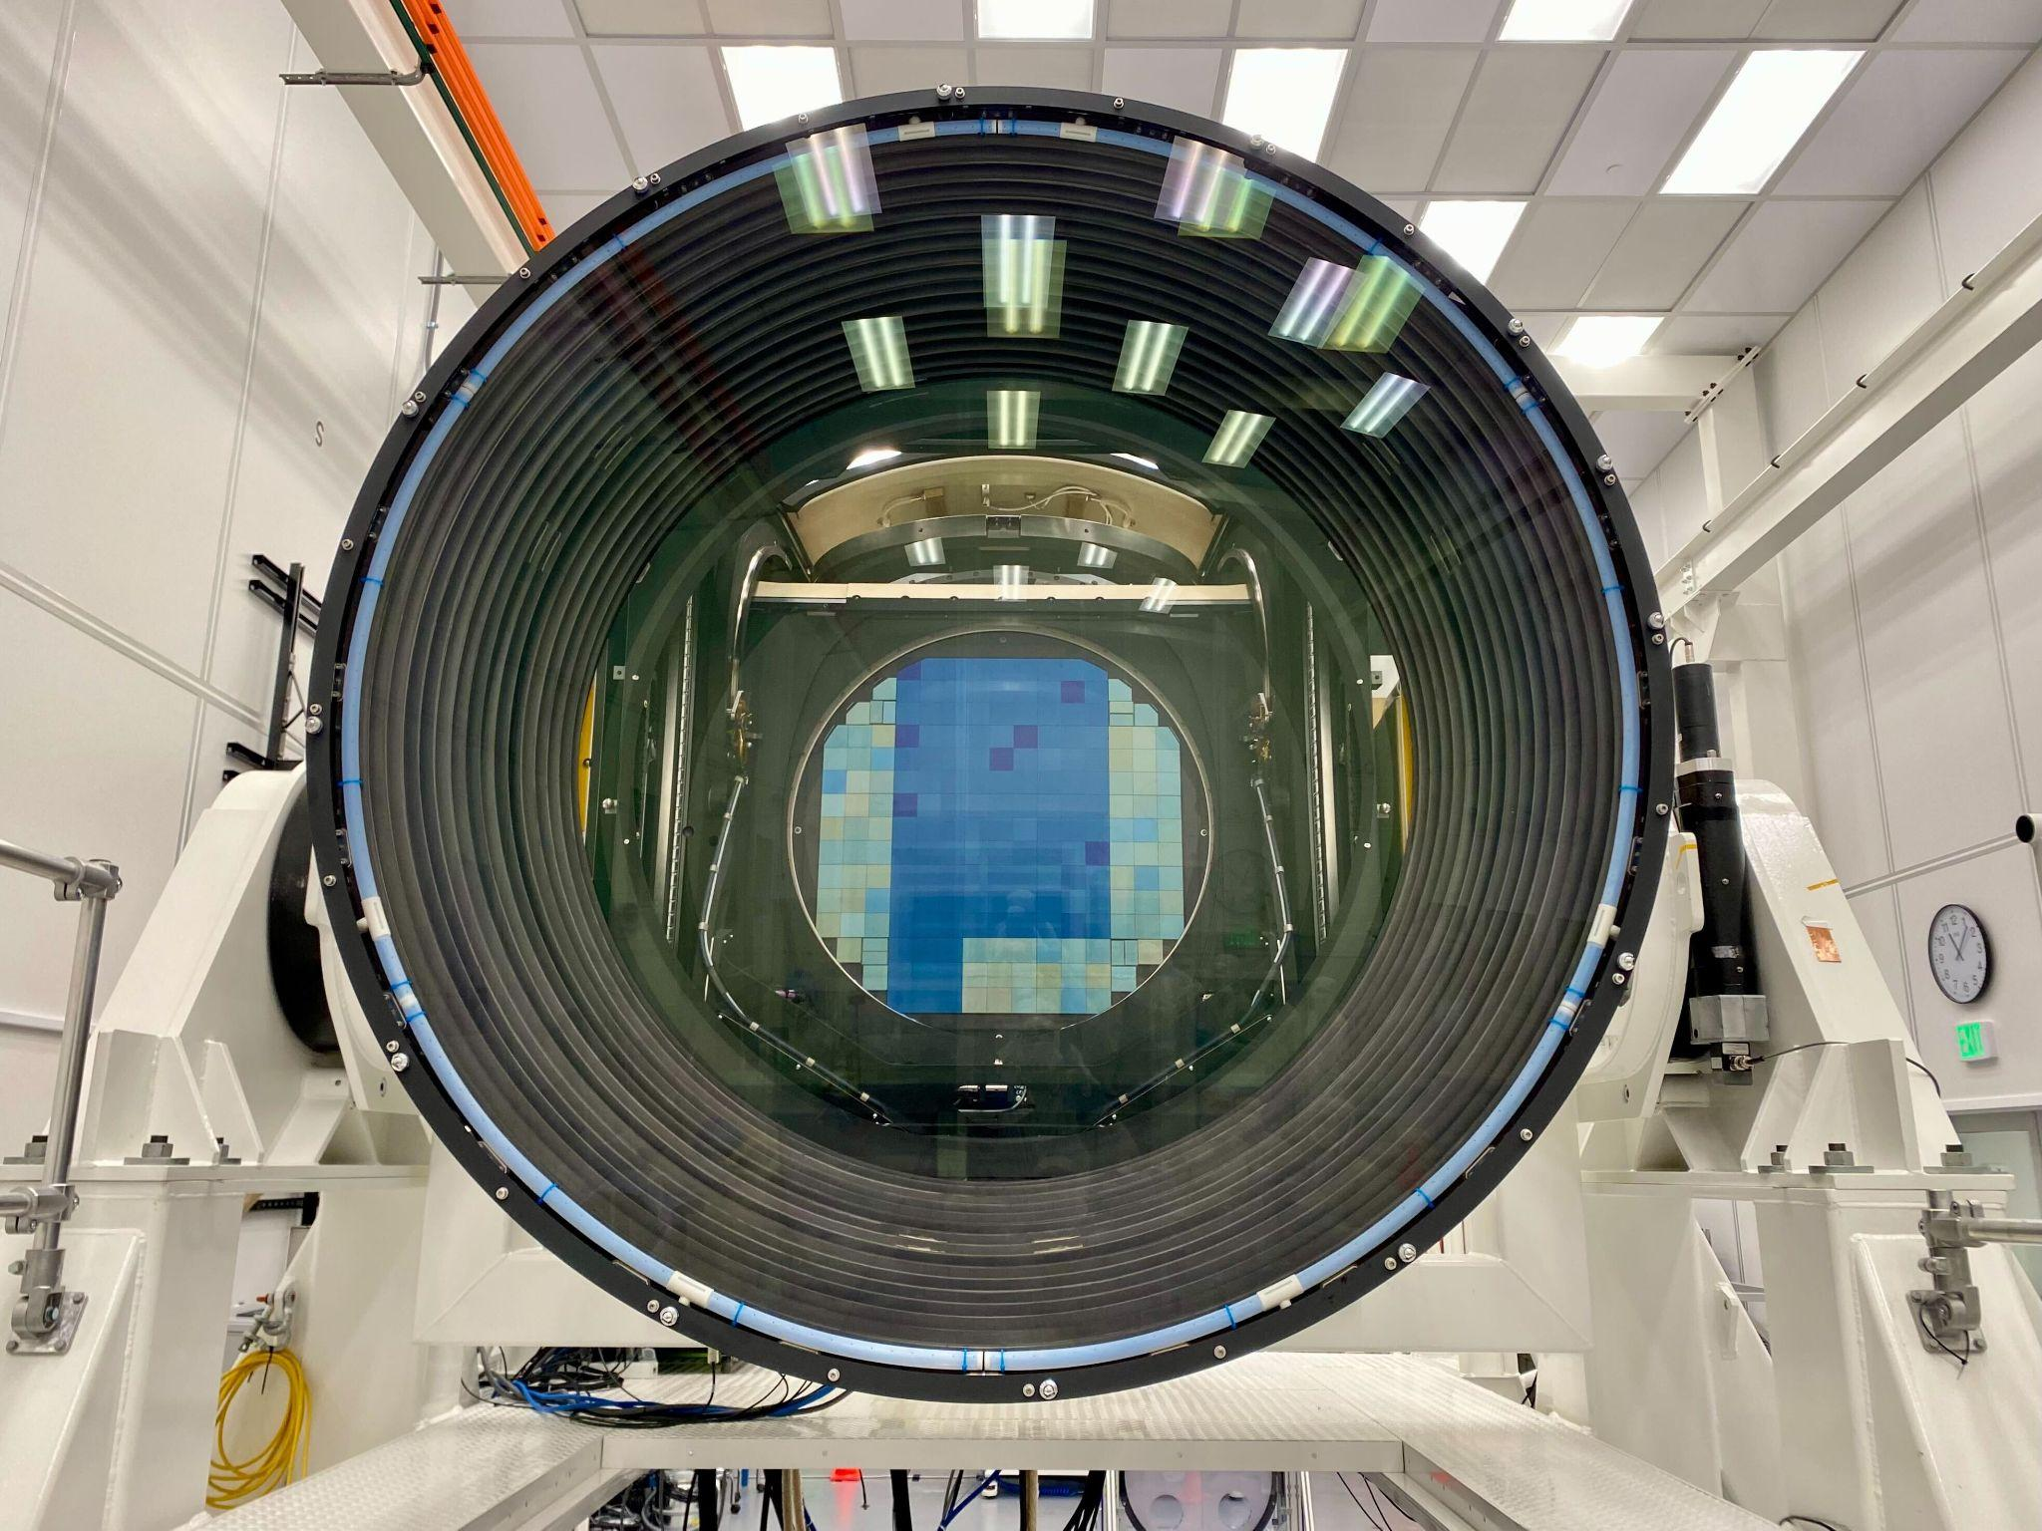
Commissioning is joint DESC + project effort
System integration is well under way
Commissioning includes strong DESC and international in-kind contributions
System “First Light” Summer 2024
Legacy Survey of Space and Time (LSST) projected to begin ~end of calendar 2024
See ls.st/dates for live
schedule

Slide 17
Augmented/complementary data: leverage
The ten-year LSST survey is designed to address primary science goals. High leverage gained from adding:
Host galaxy redshifts for LSST supernovae; to reap full benefits we need both SN distances & redshifts
Infrared SN data points to constrain host galaxy and Milky Way extinction due to ‘dust’ attenuation
Identification and light curves for gravitational wave optical counterparts
Spectroscopy and/or photometric redshifts breaks degeneracy between redshifts and chirp mass
Re-reduction of the archived data using better tools, algorithms, and fusion with other data sets (CMB-S4…)
Enhanced spectroscopic training sets for photometric redshift determination.
References: Astro2020 Decadal Survey White Papers, examples & links provided in backup slide.
“Rubin Observatory after LSST” Snowmass 2021 White Paper

Slide 18
Discoveries drive progress, agility paramount
We should be prepared for one or more of the following:
Indications of Dark Energy inconsistent with cosmological constant (w=-1, w’=0)
Anisotropy of Dark Energy properties
Inconsistencies in cosmological parameter constraints- H_{o} and/or S₈ tensions increase
Evidence for new physics arising from stellar astrophysics anomalies
…..?
Evolution of Rubin system, in response to science demands, could include one or more of the following:
1. Observations in additional passbands (emission line galaxies & better photo-z’s for structure mapping)
2. New instrument(s) to take advantage of high AΩ optics . Fiber-fed spectrograph w re-use of camera?
3. Complementary observing strategies (e.g. femto-lensing search for PBHs?)
4. Entirely different science mission (asteroids?, satellite traffic management?)
References: Proceedings from next-phase workshop at ANL, Snowmass white paper on "Rubin Observatory After LSST."

Slide 19
Preparing for Rubin’s Next Generation Surveys
LSST will run for 10 years, 2025-2034 inclusive, with annual data releases and one post-survey data release.
What Rubin does after the LSST depends on what we find, and how the science context evolves.
NOIRLab and SLAC will facilitate a series of community workshops to drive and digest the needed investigations of possible new technical capabilities
Efforts need to begin soon. Significant technical efforts will take of order 10 yr to make ready for deployment on the timescale of 2036
See Snowmass white paper on "Rubin Observatory After LSST.", Snowmass white paper on "Rubin Observatory After LSST."

Slide 20
Needs for the coming decade…
Specific goals for the 2024-2034 timeframe include:
Finalize construction and commissioning, transition into operations
Successful system operations, data analysis, and dissemination
Enable science across a range of topics, however DESC focus is fundamental physics
Look ahead and plan for evolution and extensions.
This effort receives critical science, operations, and computing support from DOE HEP, the NSF, and international partners.
Stable support is crucial to ensure the vitality of our research program and to deepen our understanding of the physics of the dark Universe. Our success will depend on the continuation of this support for both labs and universities.
The LSST data will enable multiple probes of the dark sector, and the Rubin system is a foundational platform for further investigations

Slide 21
Back-up slides

Slide 22
Why focus on precision and systematic uncertainties?
Dark Energy discovery data 1998 | ~20 distant SNe | 10% precision
ESSENCE and CFHTLS surveys, 2008 | 200 SNe | 3% precision
DES, 2020 | 2000 SNe | 1% precision
Rubin | >20,000 SNe | < 1% precision

Slide 23
Links to Astro-2020 decadal survey white papers
Joint Gravitational Wave and Electromagnetic Astronomy with LIGO and LSST in the 2020's
Gravitational probes of ultra-light axions
Partnering space and ground observatories - Synergies in cosmology from LSST and WFIRST
The Most Powerful Lenses in the Universe: Quasar Microlensing as a Probe of the Lensing Galaxy
Single-object Imaging and Spectroscopy to Enhance Dark Energy Science from LSST
Wide-field Multi-object Spectroscopy to Enhance Dark Energy Science from LSST
Deep Multi-object Spectroscopy to Enhance Dark Energy Science from LSST
LSST Narrowband Filters
Dark Matter Science in the Era of LSST
Testing Gravity Using Type Ia Supernovae Discovered by Next-Generation Wide-Field Imaging Surveys

