Slide 1
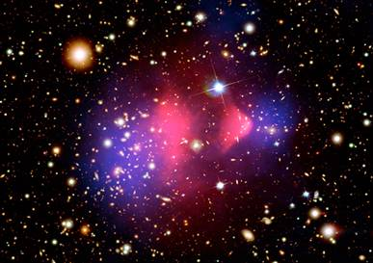
Exploring the Unexplored: Searching for 10meV-6GeV Dark Matter with Solid State Detectors
Matt Pyle
UC Berkeley
P5 2/22/23

Slide 2
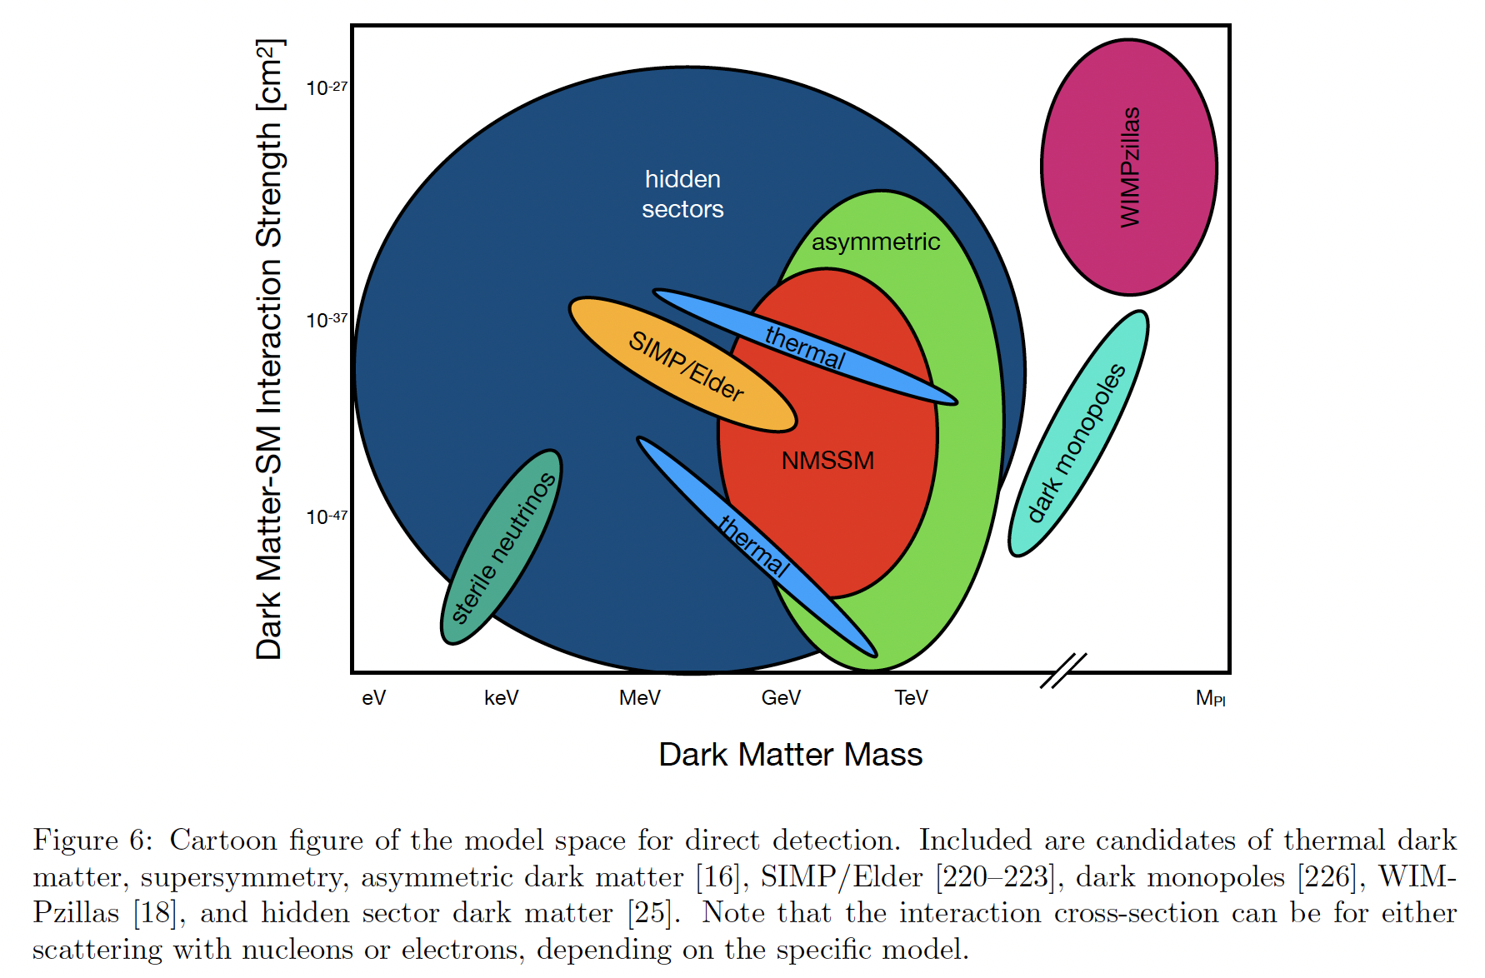
Well motivated theoretical models throughout 10meV<M_{DM}<6GeV
This Talk
2203.08297
Cosmic Visions 1707.04591, NIDM BRN, and SNOWMASS 2203.08297

Slide 3
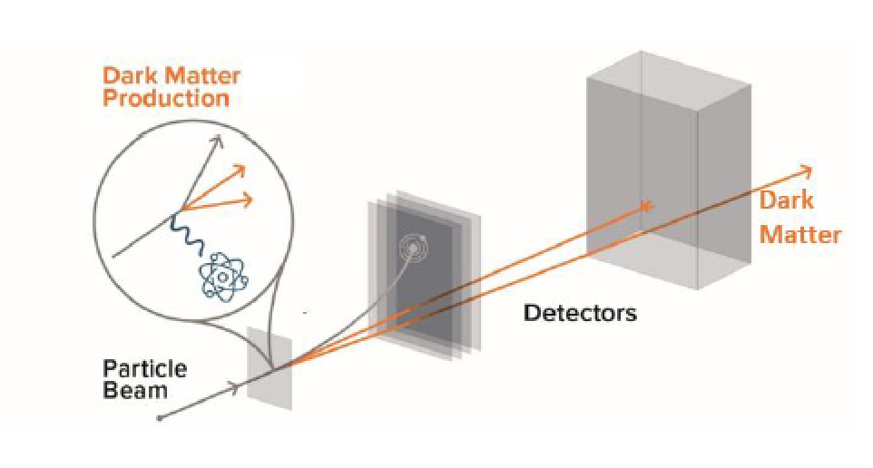
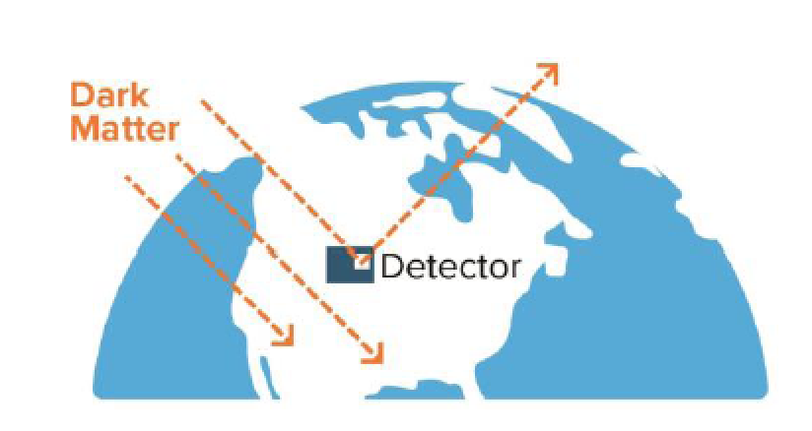
Detection Strategies
Production at Accelerators
Direct Detection of Galactic Dark Matter
BRN: Dark Matter Small Projects New Initiatives

Slide 4
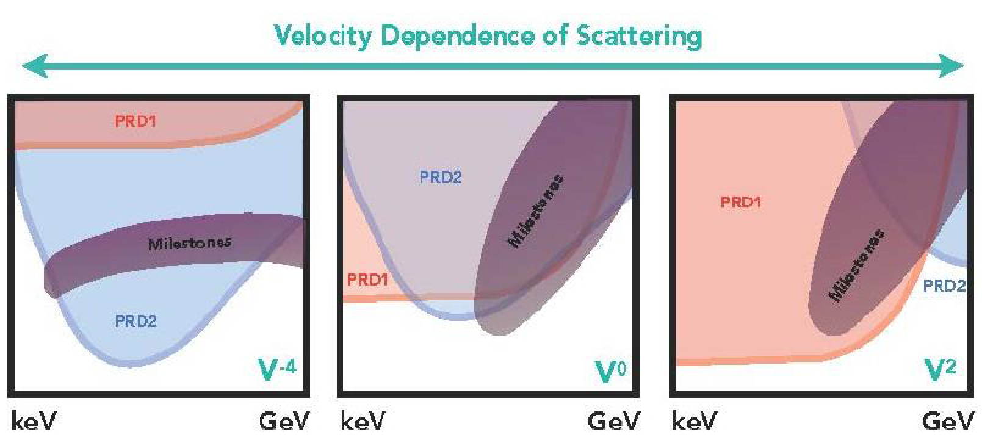
Complementarity with Accelerators
Accelerators
Direct
Detection
Direct
Detection
Accelerators
Interaction Strength
Accelerators
DD
BRN: Dark Matter Small Projects New Initiatives

Slide 5
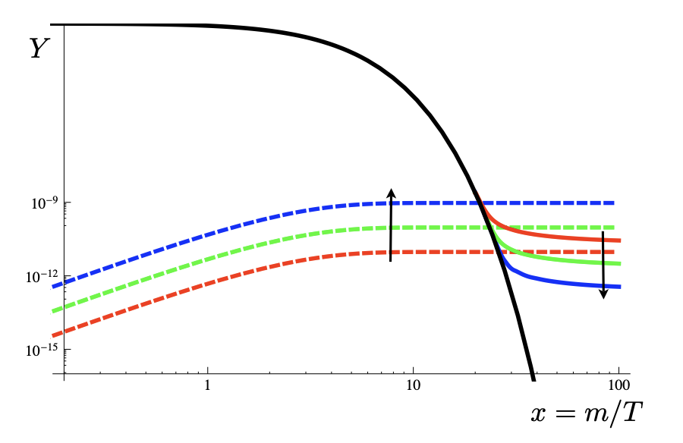
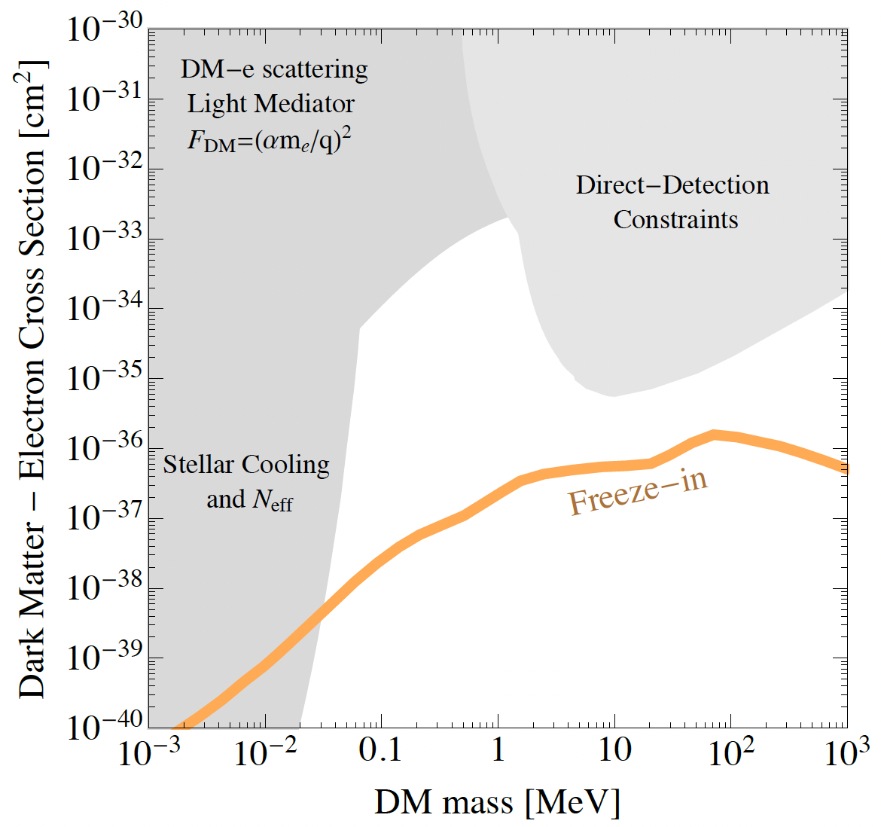
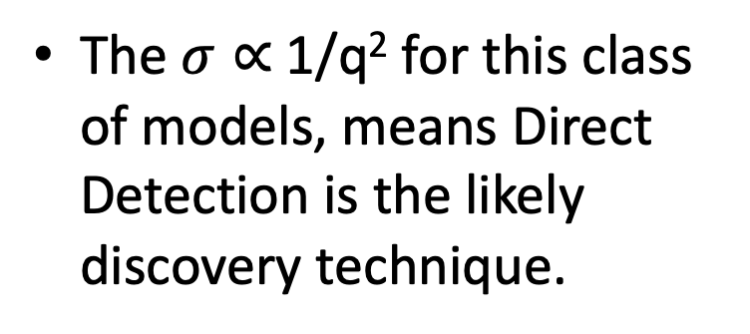
Freeze-In Dark Matter
Dark sector couplings are so small that DM never comes fully into thermal equilibrium
Dark Matter Comoving Number Density
0911.1120
Mass/Temperature (time ->)
The $σ∝$1/q² for this class of models, means Direct Detection is the likely discovery technique.
2203.08297

Slide 6
Light Mass DM Direct Detection
Design Drivers

Slide 7
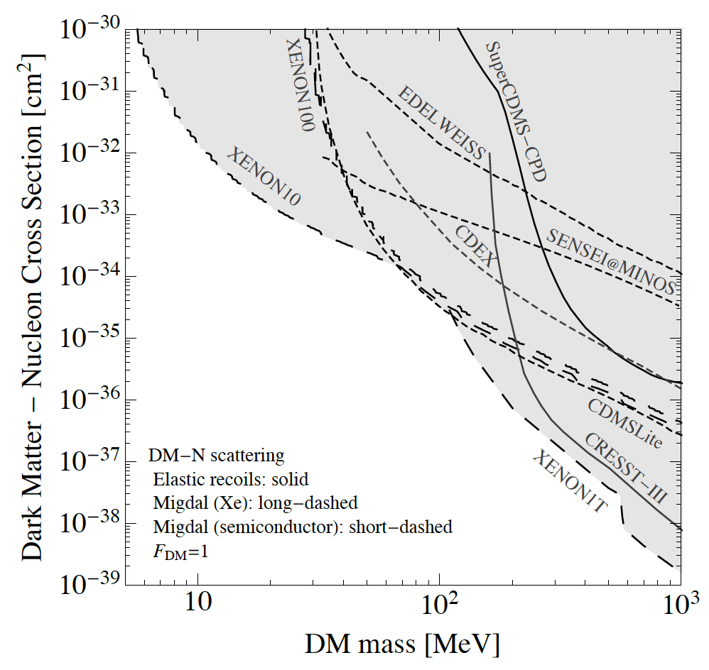
Light Mass DM: Nuclear Recoil Direct Detection Constraints
?
There are basically no Direct Detection constraints. Why?
Typical Neutrino cross section
2203.08297

Slide 8
Light Mass DM Design Drivers: Exposure
?
Interaction Rate scales with 1/M_{DM}
Light Mass Dark Matter Search experiments are tabletop and have small project cost scales: <10M

Slide 9
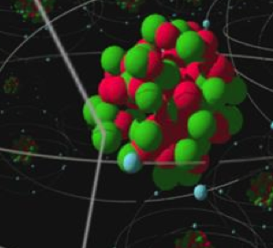
Kinematics: 2 Body Elastic Nuclear Scattering
DM
When M_{n}>> M_{DM}
Transfer of DM kinetic energy to nucleus is really inefficient for elastic 2 Body Scatters when M_{n} >> M_{DM}

Slide 10
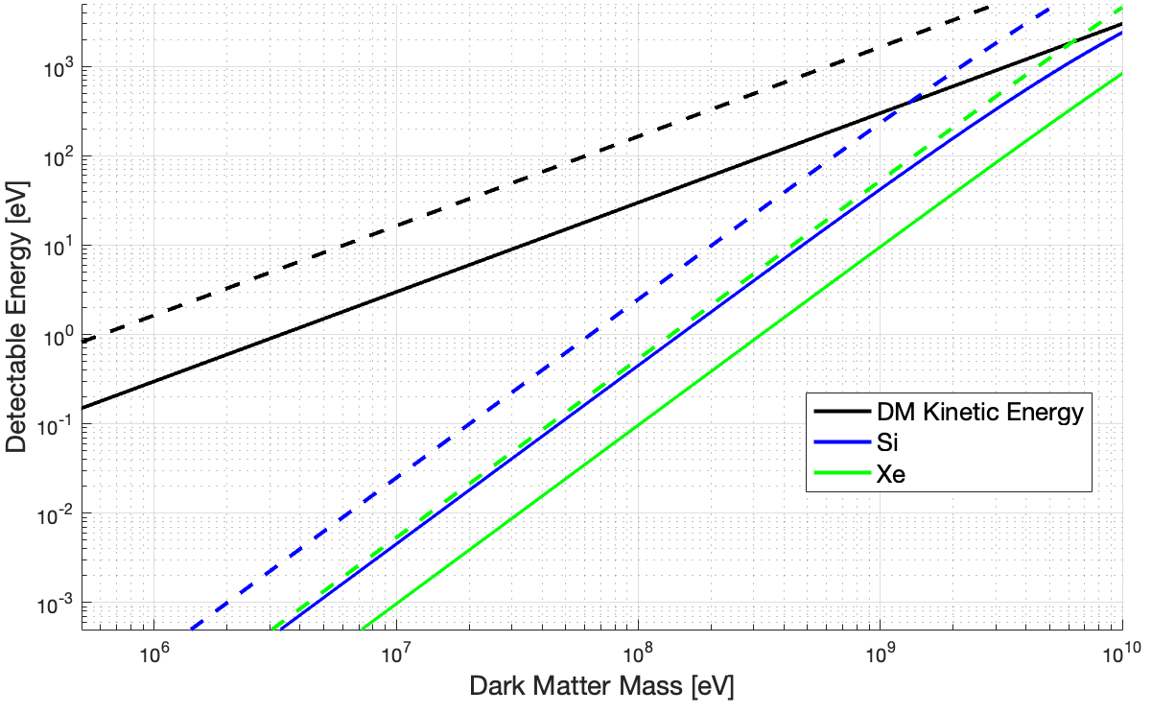
Light Mass Dark Matter: Elastic Nuclear Scattering
<v> -
V_{esc} --
1 meV
Design Driver #1: Energy Sensitivity

Slide 11
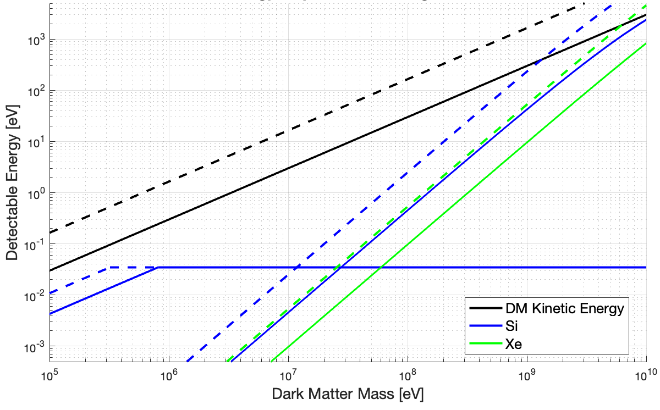
DM- Coherent Vibrational Interactions
Multiphonon
Regime
2205.02250
<v> -
V_{esc} --
Coherent Vibrational Excitations in Si
Single Phonon Regime
For DM interactions with small momentum and energy transfers, we need to start thinking about DM interactions producing coherent crystal excitations!

Slide 12
Ionization Production in eV Scale Nuclear Recoils
NR Ionization >> ER ionization
Xenon
?
Si
?
No Ionization expected from elastic nuclear recoils for
M_{DM} < O(200MeV) in Si
M_{DM} < O(GeV) in Xe
<v> -
V_{esc} --
𝛳=180

Slide 13
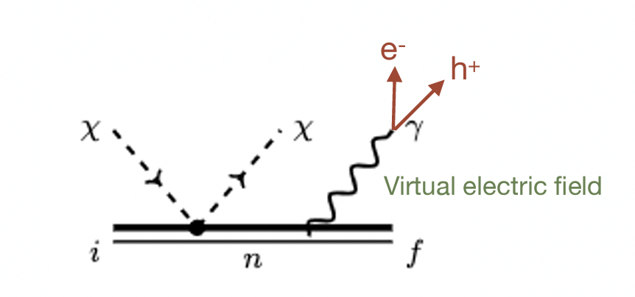
Midgal Ionization
Si
Xe
Search for DM using NR interactions that share momentum and energy between nucleus and e⁻
Knapen

Slide 14
Midgal Ionization: Signal Suppression
x10⁶ Penalty in Signal
Knapen
Midgal, like all processes with off-shell particles, will have significantly suppressed signal rates
x10⁶ greater exposure needed if exposure limited
x10⁶ less backgrounds needed if background limited

Slide 15
Nucleonic Interactions: Current Status
2g near surface
10g surface
Even now, small prototype solidstate detectors offer competitive reach because of these signal advantages
1 ton
underground
23.6g
underground

Slide 16
Nucleonic Interactions: Future
Design Driver #2: Backgrounds
Midgal Ionization Detectors must decrease backgrounds
Solid State Phonon Detectors must increase sensitivity and decrease backgrounds
Backgrounds
Energy Sensitivity
Backgrounds

Slide 17
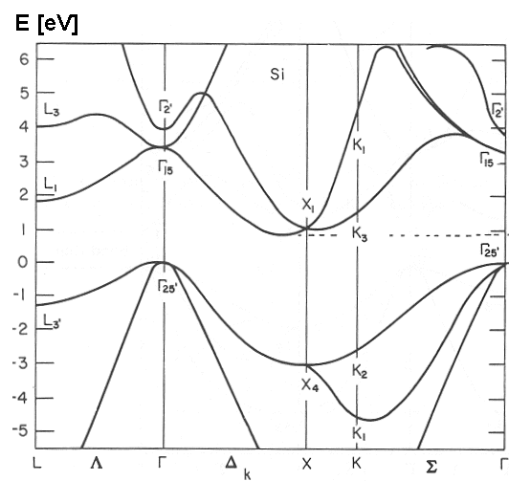
Inelastic e⁻ Recoils in Semiconductors
Band Diagram for Si
Crystal e- Momentum and Energy Scales Match MeV DM perfectly
Energy [eV]
DM
Momentum
4.5x10⁻¹⁰ m
3 keV/c

Slide 18
Smaller Excitation Energies are Better
Xe 1e-
x10³ Gain in Signal
Si 1e-
1707.04591
1 kgyr
No Backgrounds
?
What about using even lower bandgap materials?

Slide 19
Electronic Interactions: Current Status and Future
Backgrounds
Future sensitivity improvements depend solely on background mitigation (Design Driver #2)

Slide 20
Light Mass DM Design Driver Summary
0. Absorbers with small energy excitations
1.Sensitivity to Excitations
2. Backgrounds

Slide 21
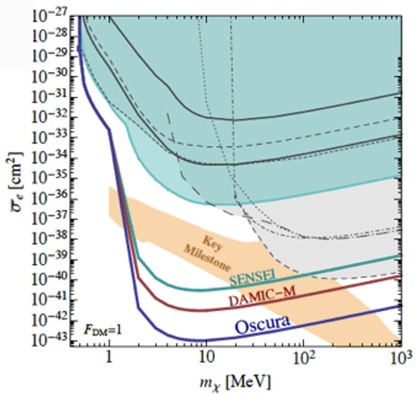
OSCURA: 10kg Si Skipper CCDs
Current Status: DOE NIDM Pre-project Phase
OSCURA Cost:
Pre-Project: 4M
Project: 10M
Timescale:
100g SENSEI SNOLAB:
now – FY26
1kg DAMIC-M: FY24-FY29
10kg OSCURA: First Science FY26
Estimated Sensitivity Curves
x10⁷ planned improvement in DM sensitivity!

Slide 22
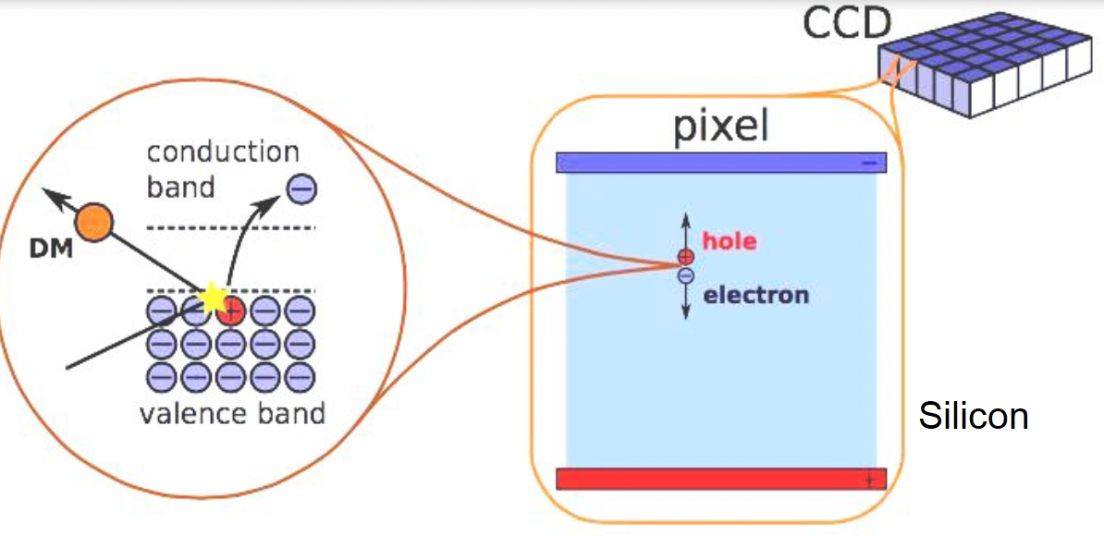
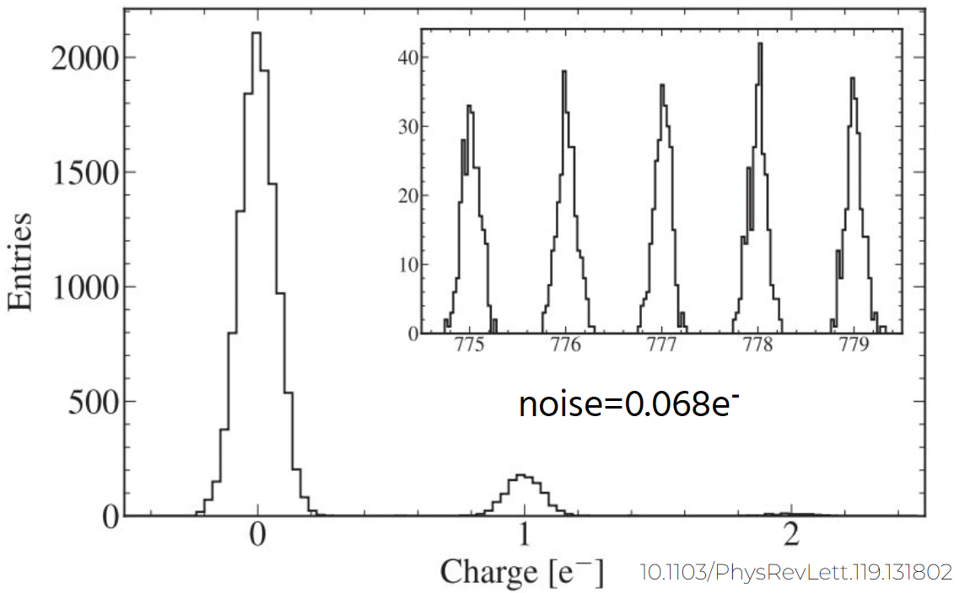
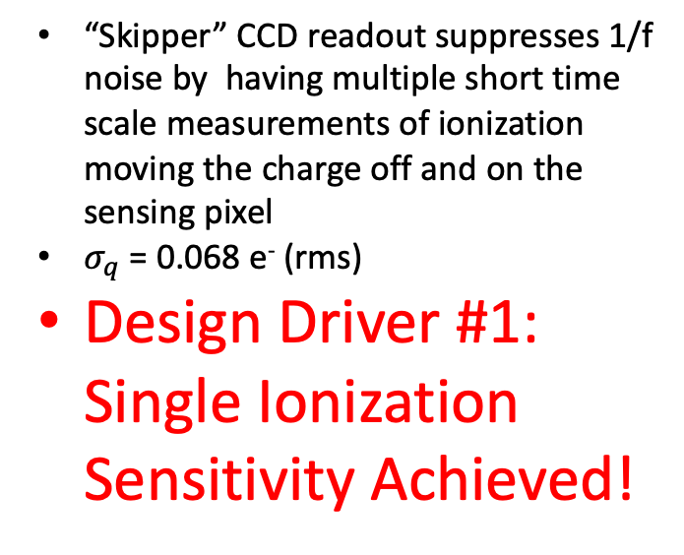
OSCURA: Skipper CCD
SENSEI
Pixel = 15um x15um x675um
5.5Mpixels per 2g device
“Skipper” CCD readout suppresses 1/f noise by having multiple short time scale measurements of ionization moving the charge off and on the sensing pixel
$σ_{q}$ = 0.068 e⁻ (rms)
Design Driver #1: Single Ionization Sensitivity Achieved!
2004.11378

Slide 23
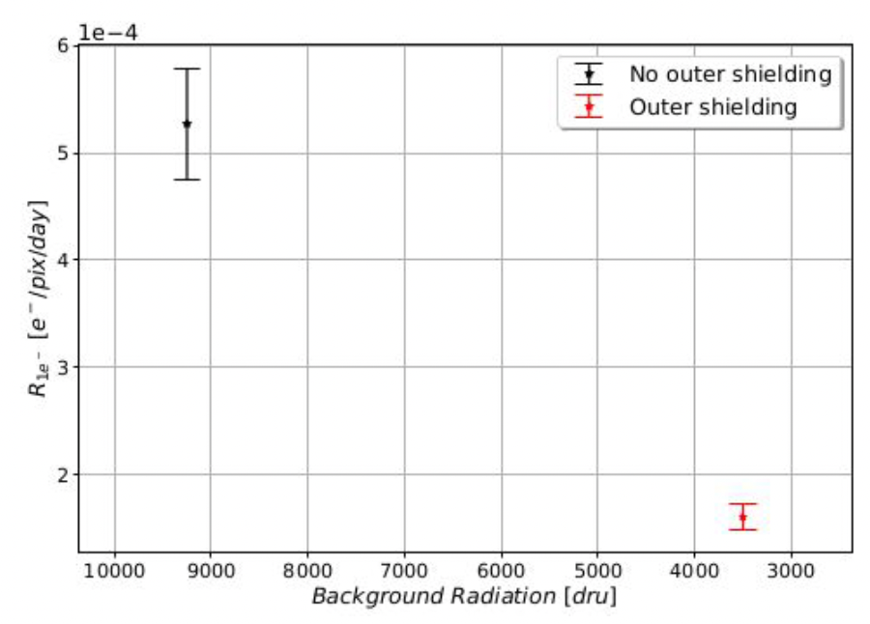
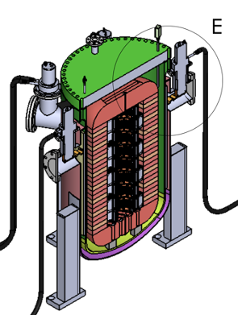
OSCURA: Backgrounds
SENSEI @MINOS: 3500 evt/(keVkgd) shielding
Single e- background rate seen to strongly correlate with background radiation
2011.13939 predicts backgrounds around this level from near gap photon secondaries from high energy backgrounds
2004.11378
OSCURA solution: Better shielding!
  SENSEI SNOLAB: 5 evt/(keVkgd)
  DAMIC M 0.1 evt/(keVkgd)
  OSCURA 0.01 evt/(keVkgd) (the world’s best cryostat)
Design Driver #2: Plan in place to suppress backgrounds by x10⁷
Estrada

Slide 24
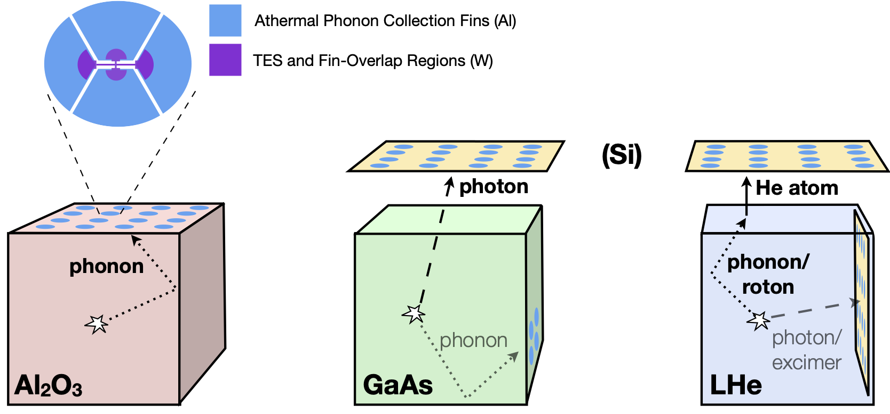
TESSERACT
/SiO₂
Multiple Targets with Complementary DM Science readout by identical athermal phonon sensor technology
Status | Cost | Timescale
DOE NIDM Pre-project (Delayed 2 years due to funding) | R&D: 2.8M Project: 9.2M (mostly cryostats) | Early Science before FY25 Pre-Project ends FY25 Project complete FY28

Slide 25
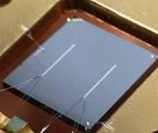
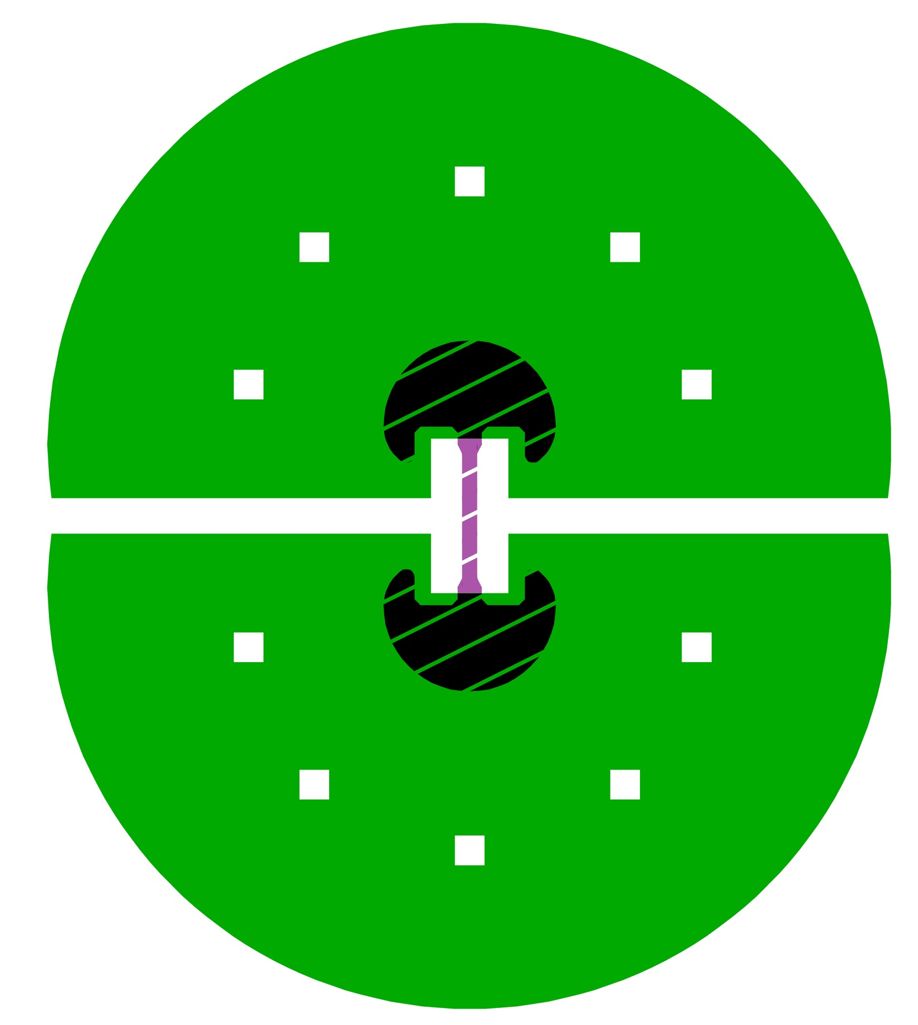
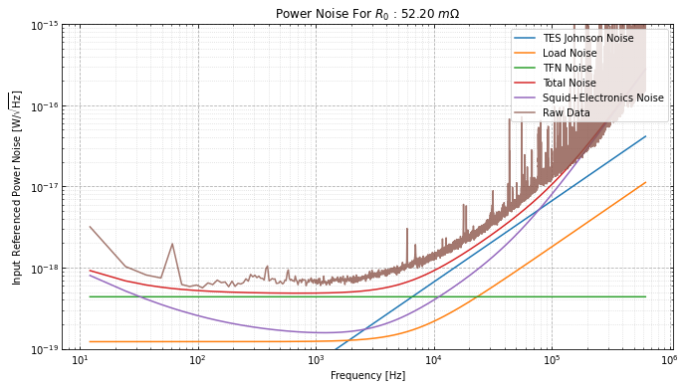
TESSERACT: Energy Sensitivity
Energy Sensitivity Plan:
Lower Tc: 60mK -> 15mK
  x4³ sensitivity improvement
  Done
Decrease IR and EMI backgrounds by x4⁶
  Ongoing
Design Driver #1: Plan and Significant Progress
S_{ptot} = 6x10⁻¹⁹ W/rtHz:
𝛔_{E} = 20 meV (assuming 100% collection)

Slide 26
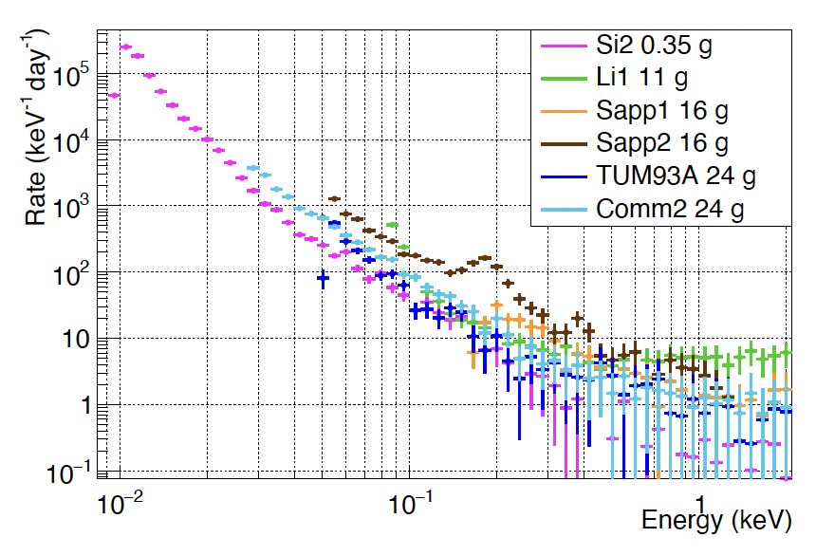
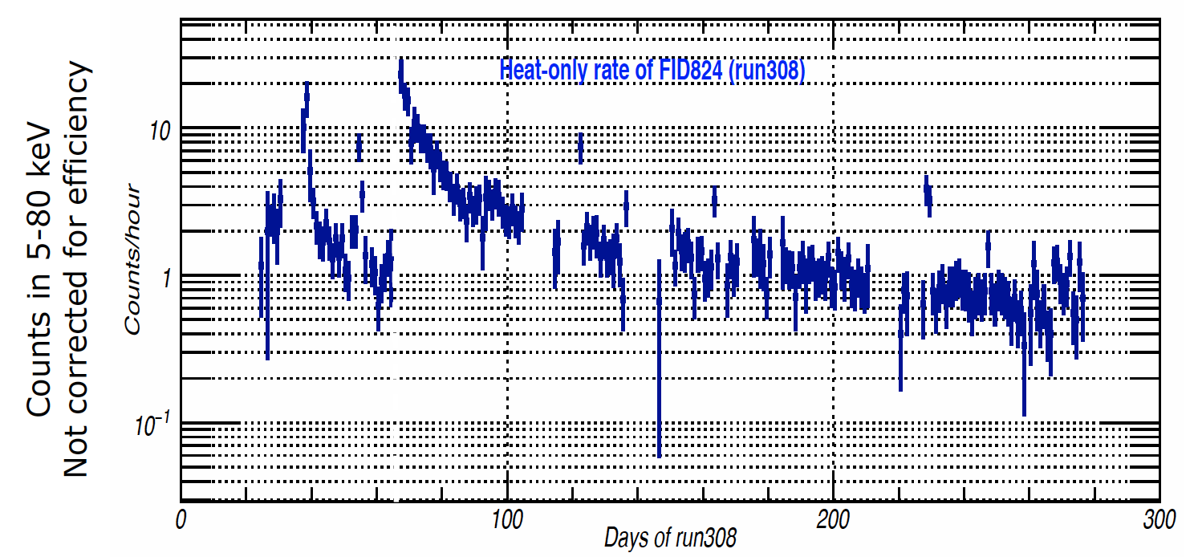
Phonon Detector Backgrounds
Mysterious monotonically increasing background rate at low energies
CRESST Background Studies
2207.09375
?
Expected Radiogenic Backgrounds
EDELWEISS Low Energy Excess
Background varies with time/time since cooldown
Background produces no ionization
Scales with surface or sensor area
Warm up to 11K and 19K due to fridge issues
E. Queguiner
Thesis

Slide 27
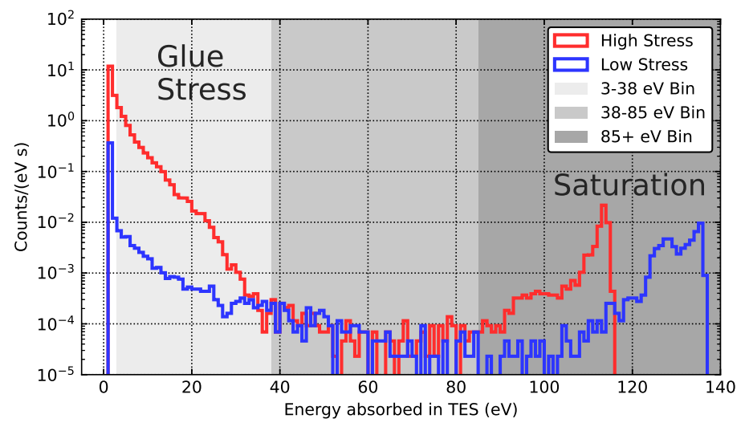
Stress Induced Microfractures?
Detector
Detector
Detector under stress due to thermal contraction,manufacturing, etc.
Detector relaxes releasing phonon energy
Evidence: Using glue with high thermal contraction stress can increase low energy event rate by x10²
Mitigation Plan: Decrease residual stress everywhere in detector
2208.02790
arXiv:physics/0504151

Slide 28
Discriminating between DM Signals and Backgrounds

Slide 29
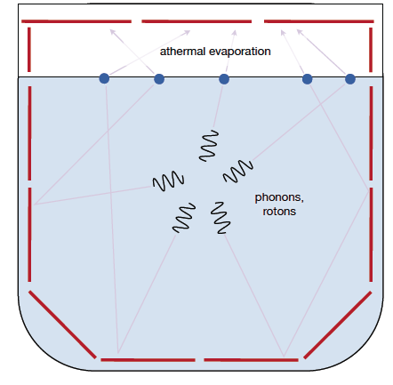
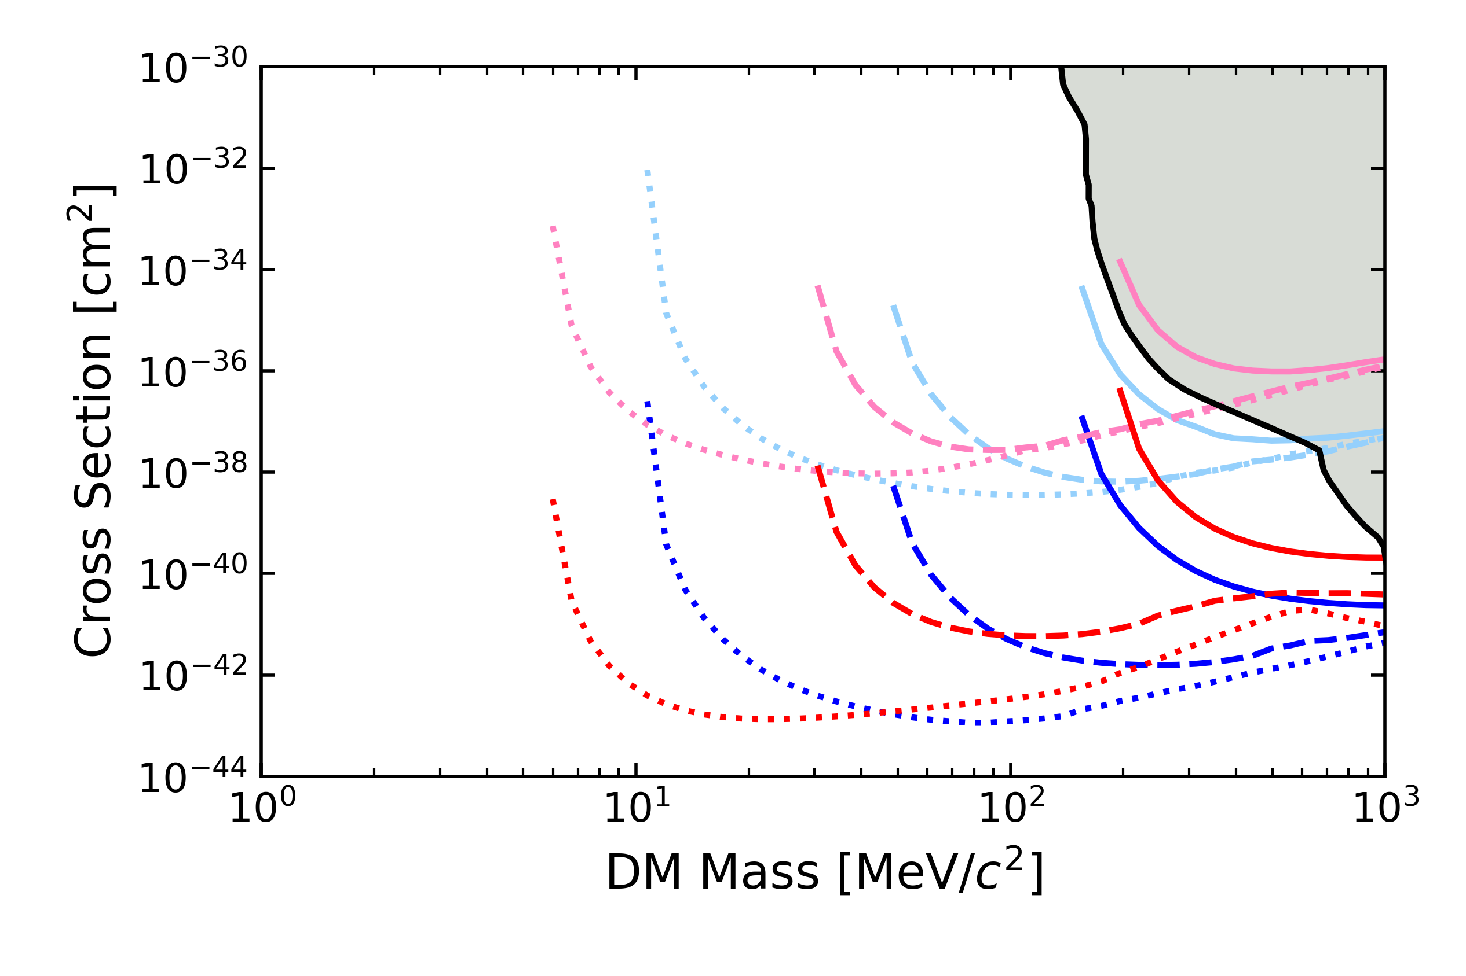
TESSERACT Discrimination: Superfluid Helium
Superfluid Helium: it’s a liquid … no stress microfractures
Multiple Pixel Coincidence for He DM events discriminates DM from pixel microfractures
Pulse Shape Discrimination: Helium is slow!
Al₂O₃
He
Design Driver #2:
Mitigation plan
Discrimination plan
Surface
Required
Goal
Stretch
Goal
Underground

Slide 30
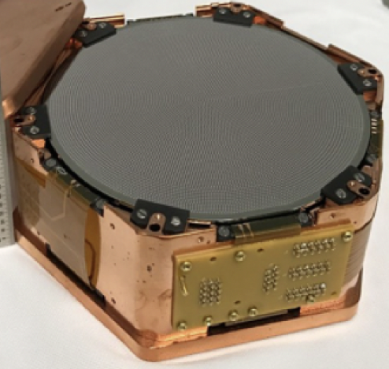
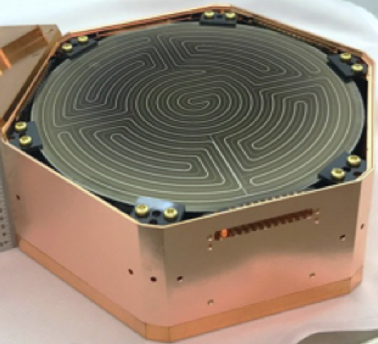
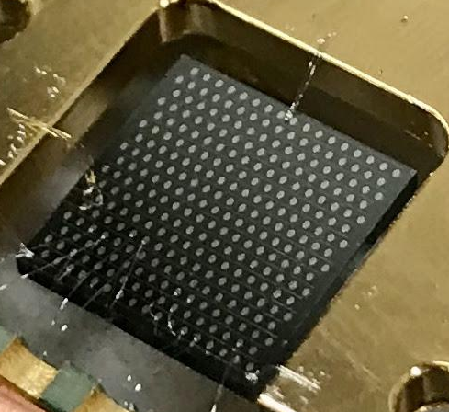
SuperCDMS Upgrades G2+
Small Volume iZIP
259cm³ -> 11cm³
Phonon Only iZIP
259cm³ -> 11cm³
Next Generation HV
0V 1cm³
All concepts discussed in 2203.08463
Status | Cost | Timescale
Concept Development | Cryostat exists <10M R&D + Project | Early Science upgrade prototypes @ CUTE FY25 Full Deployment in SNOLAB cryostat in FY29

Slide 31

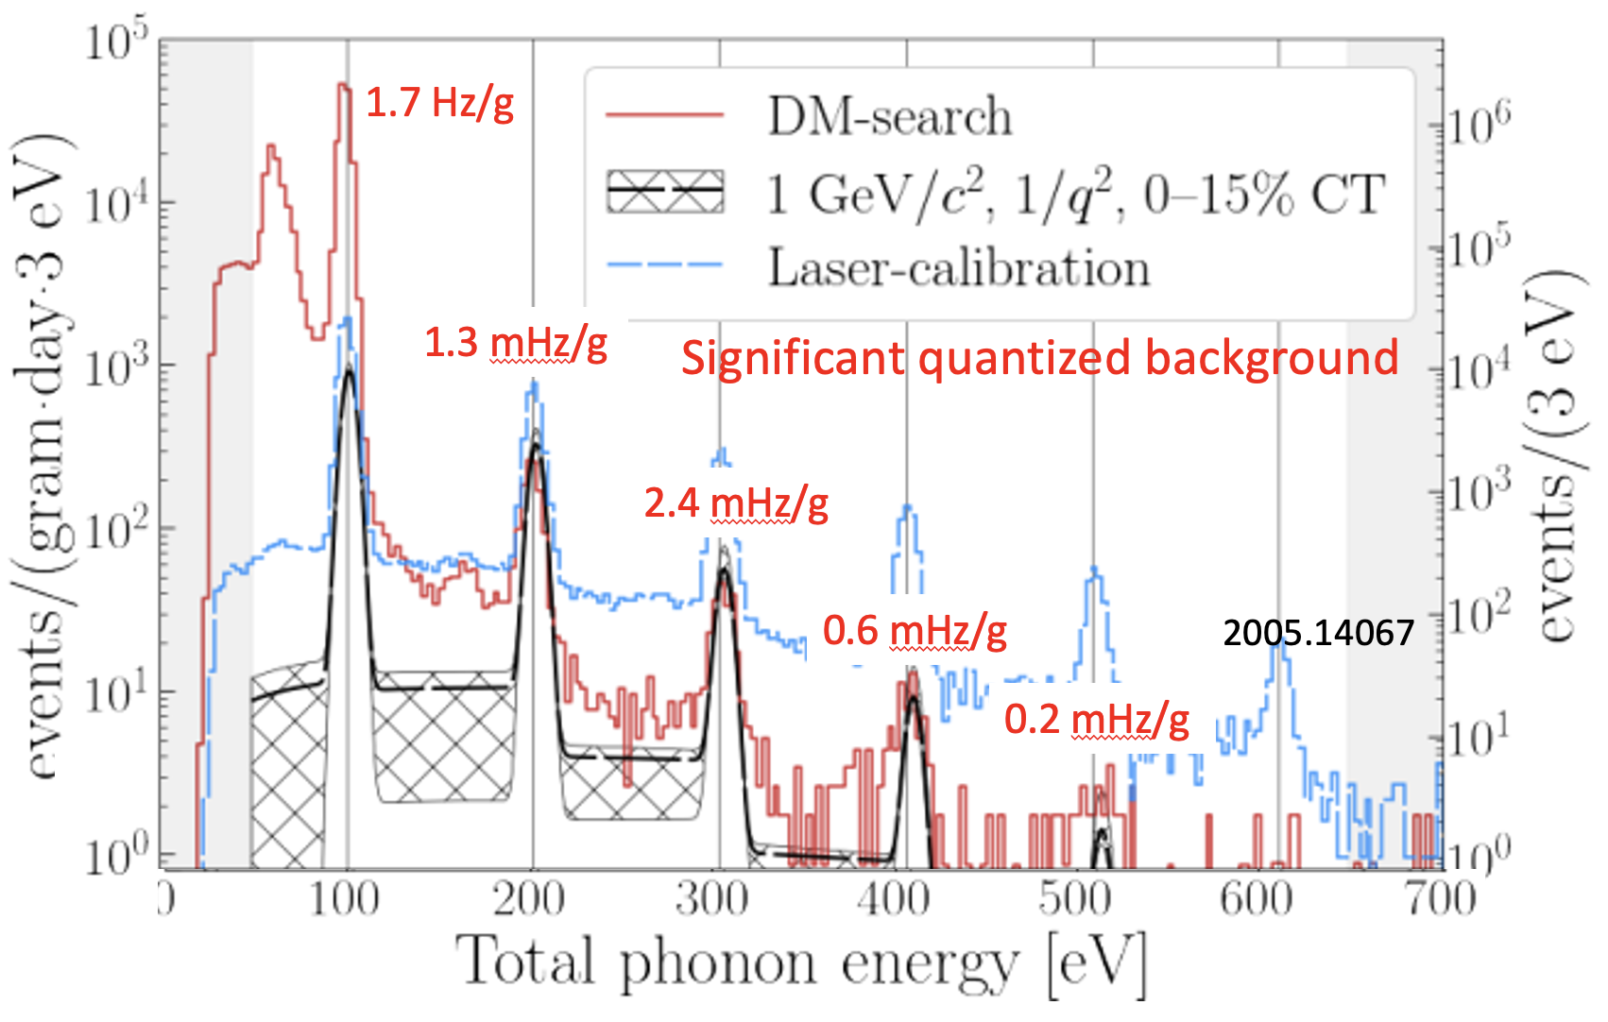
SuperCDMS G2: Excitation Sensitivity
Drifting charges release kinetic energy via NTL Phonon Production
Luke Phonons
ΔV
Recoil Phonons
HVeV Run 2
Design Driver #1:
Single charge sensitivity achieved
Brute phonon sensitivity - plan
Direct charge -plan

Slide 32
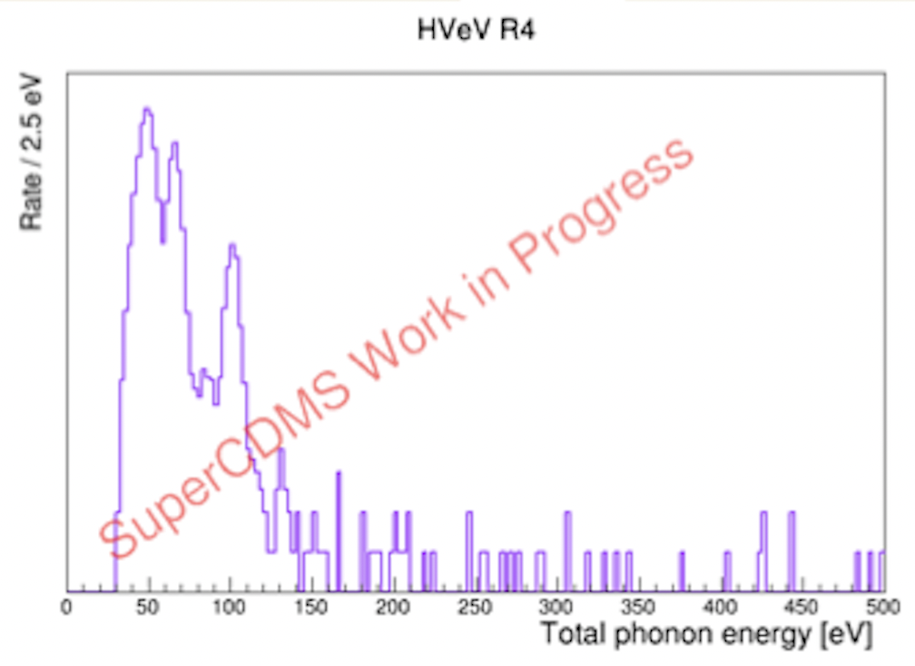
SuperCDMS G2+: HV Backgrounds
HVeV Run 2 Published
500V
Run 2 >= 2e⁻/h⁺ quantized backgrounds dominated by scintillation production in FR4 support structure
Run 4: Primarily limited by 0QLEE just like all phonon detectors
Design Driver #2 (Backgrounds):
  Mitigate 0QLEE
  Go to 500V to separate 2 e-/h+ from 0QLEE

Slide 33
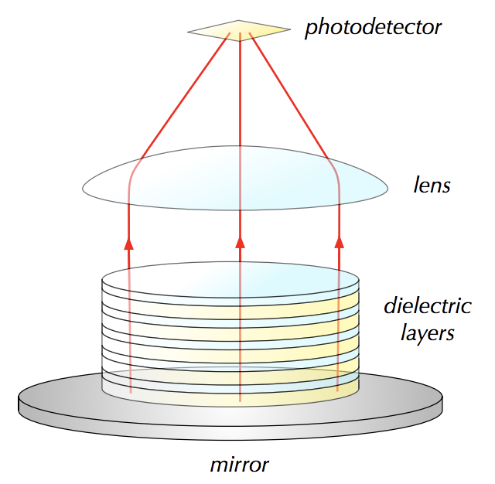
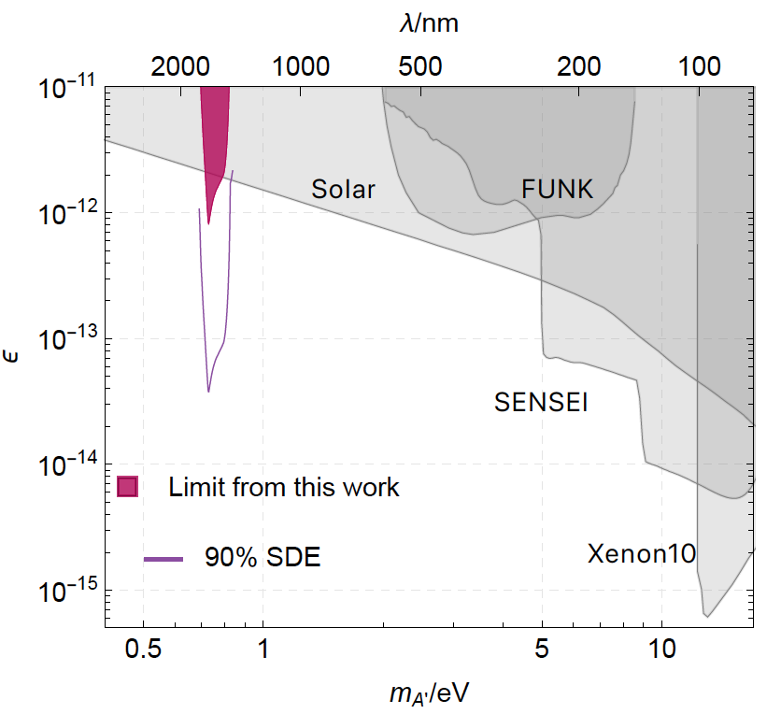
LAMPOST:Optical/IR Haloscope
Not currently funded by DOE
1709.05354,1803.11455,2110.01582
4 Momentum matching via multilayer stack
Can do axions and dark photons
1803.11455
Design Driver #1: Single Photon Sensitivity seen in SNSPDs, TES, MKIDs
Design Driver #2:
  Singles rate in SNSPDs is 6x10-6 Hz

Slide 34
… and so much more
NIDM funded | New Ideas
TESSERACT: GaAs | Implementation of new Quantum Sensing Technologies
TESSERACT: Polar | SNSPD readout of scintillating crystals
 | Small gap semiconductor detectors
 | SuperCDMS 0V 1cm³, iZIP, and piZIP concepts
 | Liquid Noble TPCs optimized for low leakage
 | Scintillating Bubble Chamber
 | …
Quantum Sensor
It’s an exciting time!

Slide 35
Conclusions I
Light Mass DM Design Drivers
  0. Small excitation energies: motivation for solid state
  Excitation Sensitivity: motivation for integration of quantum sensing
  Backgrounds: lots of viable plans to decrease by many orders of magnitude

Slide 36
Conclusions II
High Science/$: O(1M) R&D, <10M project
Lots of excitement and new ideas … field is changing so fast
New Initiatives in Dark Matter Program
  Absolutely critical, but underfunding has hampered the program
  Lots of exciting, viable new concepts could really succeed and warrant a significant expansion of the program in $ and cadence (only NIDM and G2 funding calls in the last decade)
  NIDM should be structured to expect failure.
    more pre-project/R&D awards, fewer project awards
  R&D/science boundary is fuzzy. World leading results can occur with 1g detectors at surface. NIDM pre-projects
    should have science funding
    expectation of real science from successful prototypes

Slide 37
Backup

Slide 38
Motivation

Slide 39
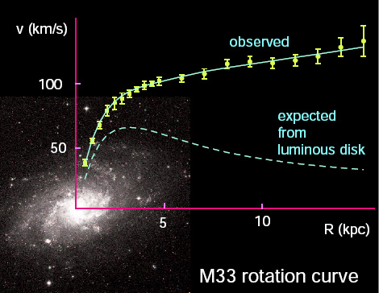
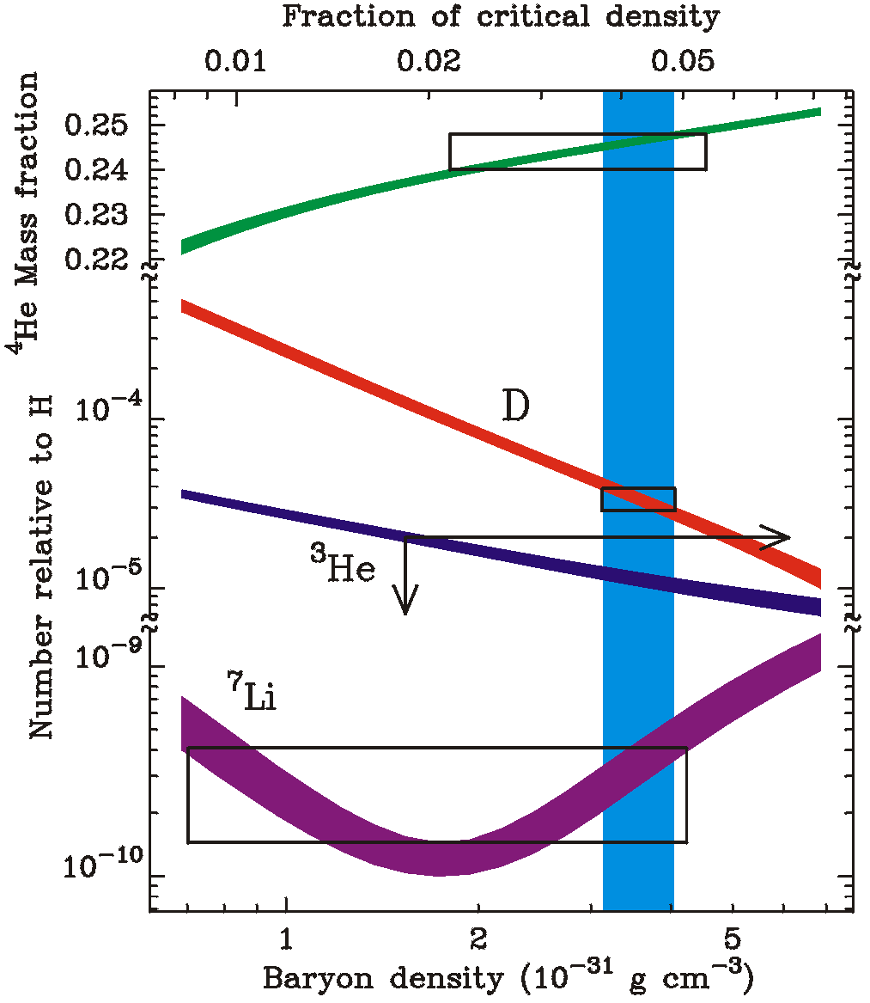
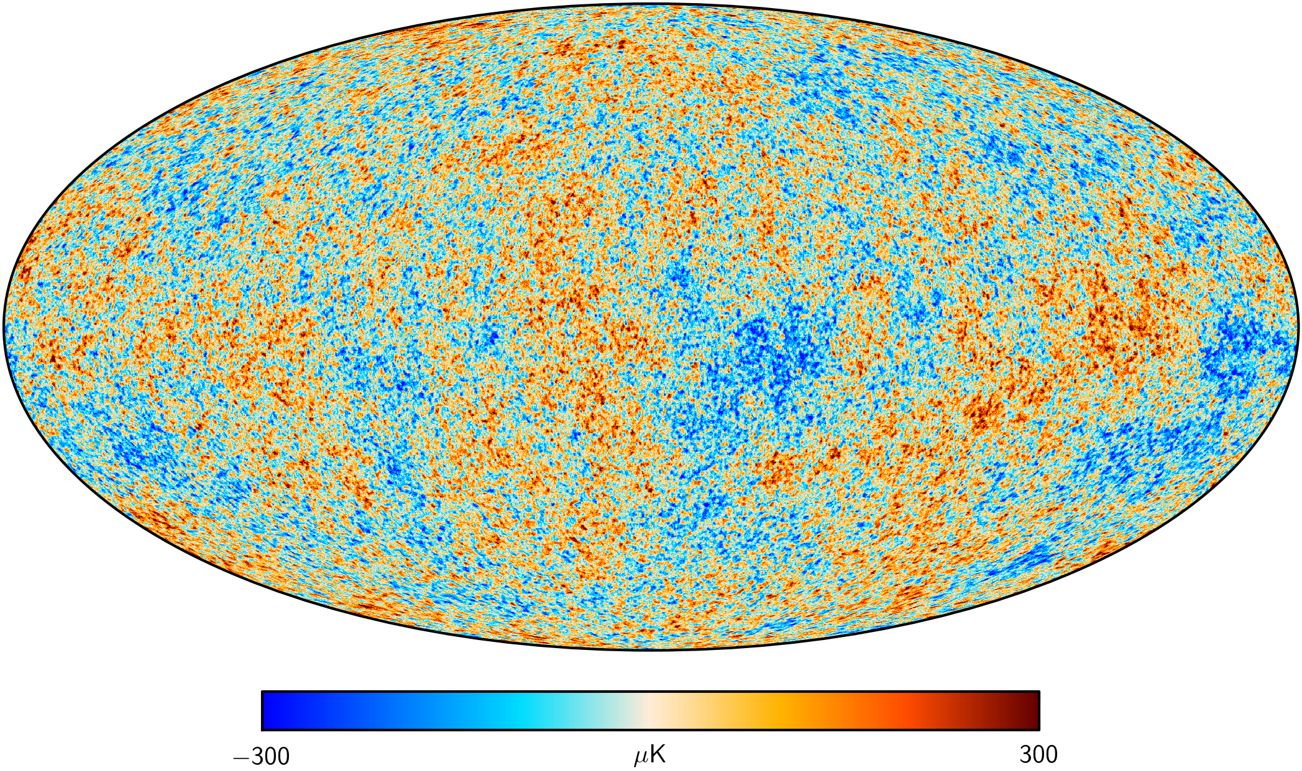
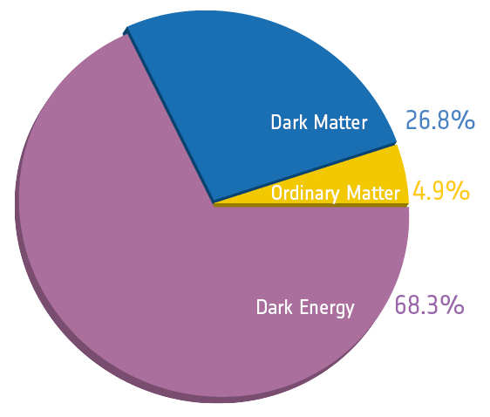
Observational Evidence for Dark Matter
Notes:
Main Idea: 1 slide showing all the observational evidence for dark matter

Slide 40
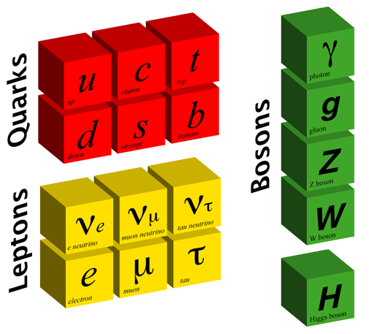

Dark Matter & Particle Physics
What are its properties?
  mass
  Is it charged under a new force(s)?
  How was it generated?
Can this knowledge help us understand the laws of physics at high energies?
Dark Sector
Visible Sector
?
?
Quarks
Portal
Bosons
?
?
?
Leptons
?
?
?
US Cosmic Visions: New Ideas in Dark Matter: 1707.04591

Slide 41
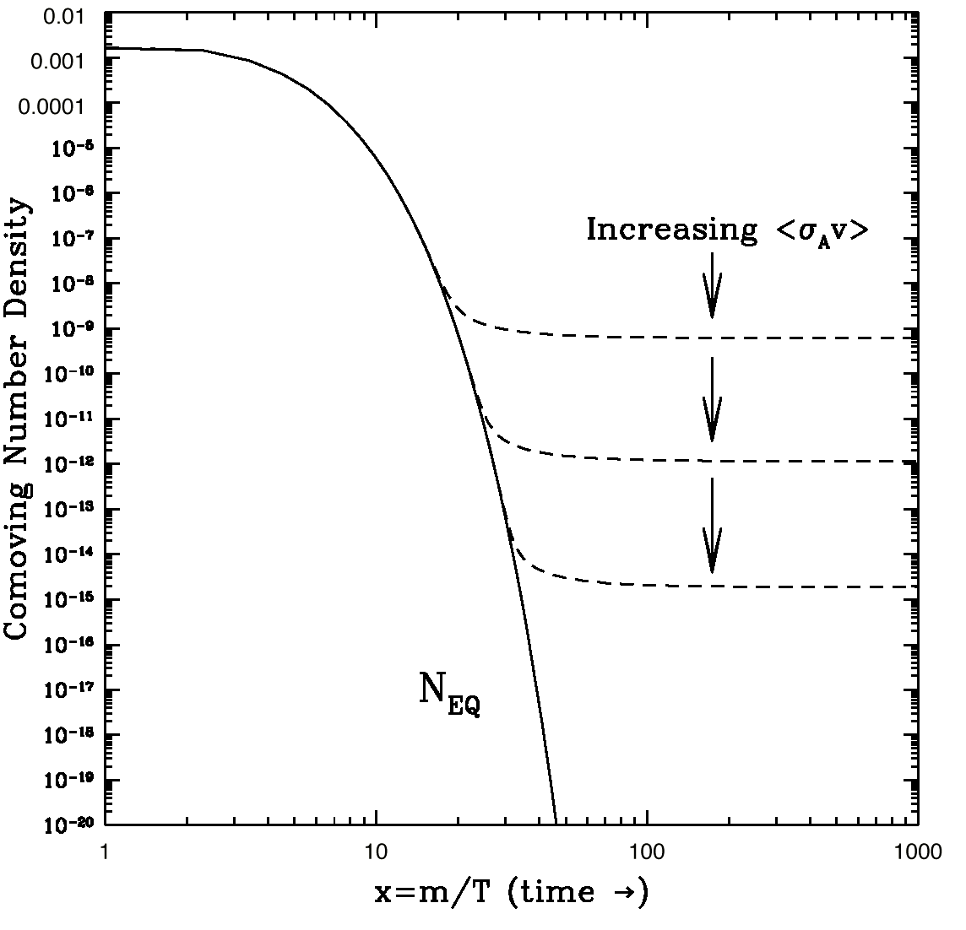
Past 35 years: A Focus on WIMPs *
keV
10 GeV
10¹⁹ GeV
10⁻²² eV
WIMPS
Relic DM density suggests weak-scale cross sections
New physics (and particles) at the weak scale could solve the hierarchy problem
* With the exception of ADMX (an experiment before its time)
Notes:
Main idea: 10 years ago the majority of the experimental community was searching for WIMPs
DM Constraints:
10^-22 eV: size of the galaxy
< 100 eV: Fermions are degenerate
< 3 keV: warm DM limit
WIMPs: 10GeV < M < 100TeV (above 100TeV WIMP won’t freeze out)
Hiearchy problem:
- Why do different forces have such enormously different strengths
- Why is the Higgs mass so much lighter than the plank scale

Slide 42
Backgrounds

Slide 43
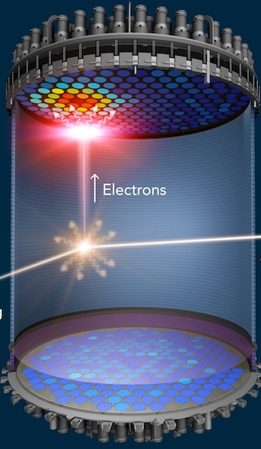
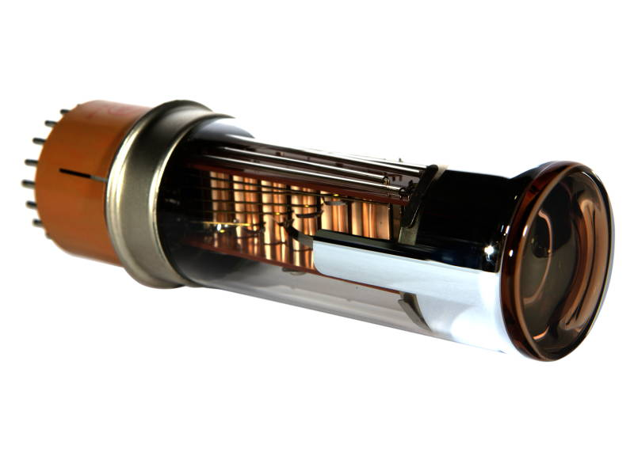
Problem #2: Detector Backgrounds in TPCs / PMTs
PMT, TPCs, SiPMs, SuperCDMS HV
all have dark currents / dark counts …
E
LZ
Hope: If we just get rid of the E-field …
1110.3056

Slide 44
TESSERACT

Slide 45
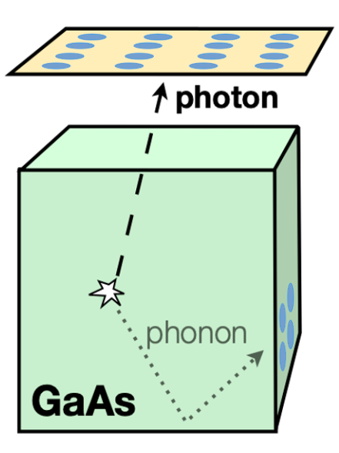
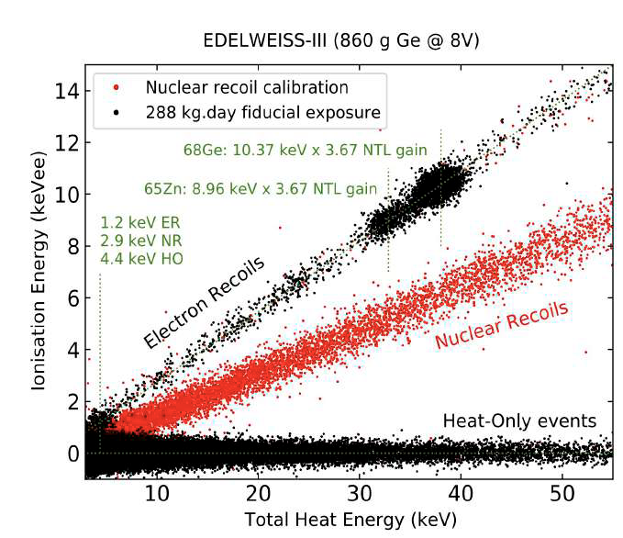
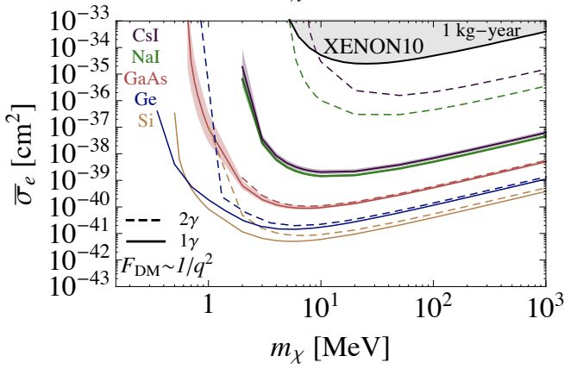
TESSERACT Discrimination: GaAs
To discriminate zero charge phonon only events in GaAs ER DM detector, one can require photon+phonon coincidence
Design Driver #2 (Backgrounds)
  Mitigation Plan
  Discrimination Plan
Scattering via Light Dark Photon

Slide 46
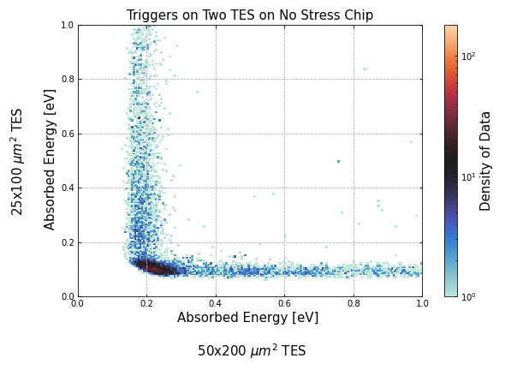
TESSERACT Discrimination: Polar Crystal
DM
Film OQLEE
Dark Matter
1
Energy Channel 2
2
DM
Film 0QLEE
Energy Channel 1
If stress is occurring in phonon sensor films, energy will preferentially deposited in a single channel
Design Driver 2 (Backgrounds)
  Plan to mitigate
  Plan to discriminate

Slide 47
NRDM Search Sensitivity @ Surface
Al₂O₃
He
Surface
Stretch
Goal
Goal
Required
Underground
Achieving pre-project energy threshold goals leads to world leading science @ surface

Slide 48
Nearly everything the same
Having multiple targets with complementary DM science (NRDM, ERDM, Absorption) and orthogonal risks doesn’t increase cost (time & money) significantly since almost everything is identical (phonon sensor development, wiring, electronics, DAQ, data handling, processing, and analysis software) except the substrate.

Slide 49
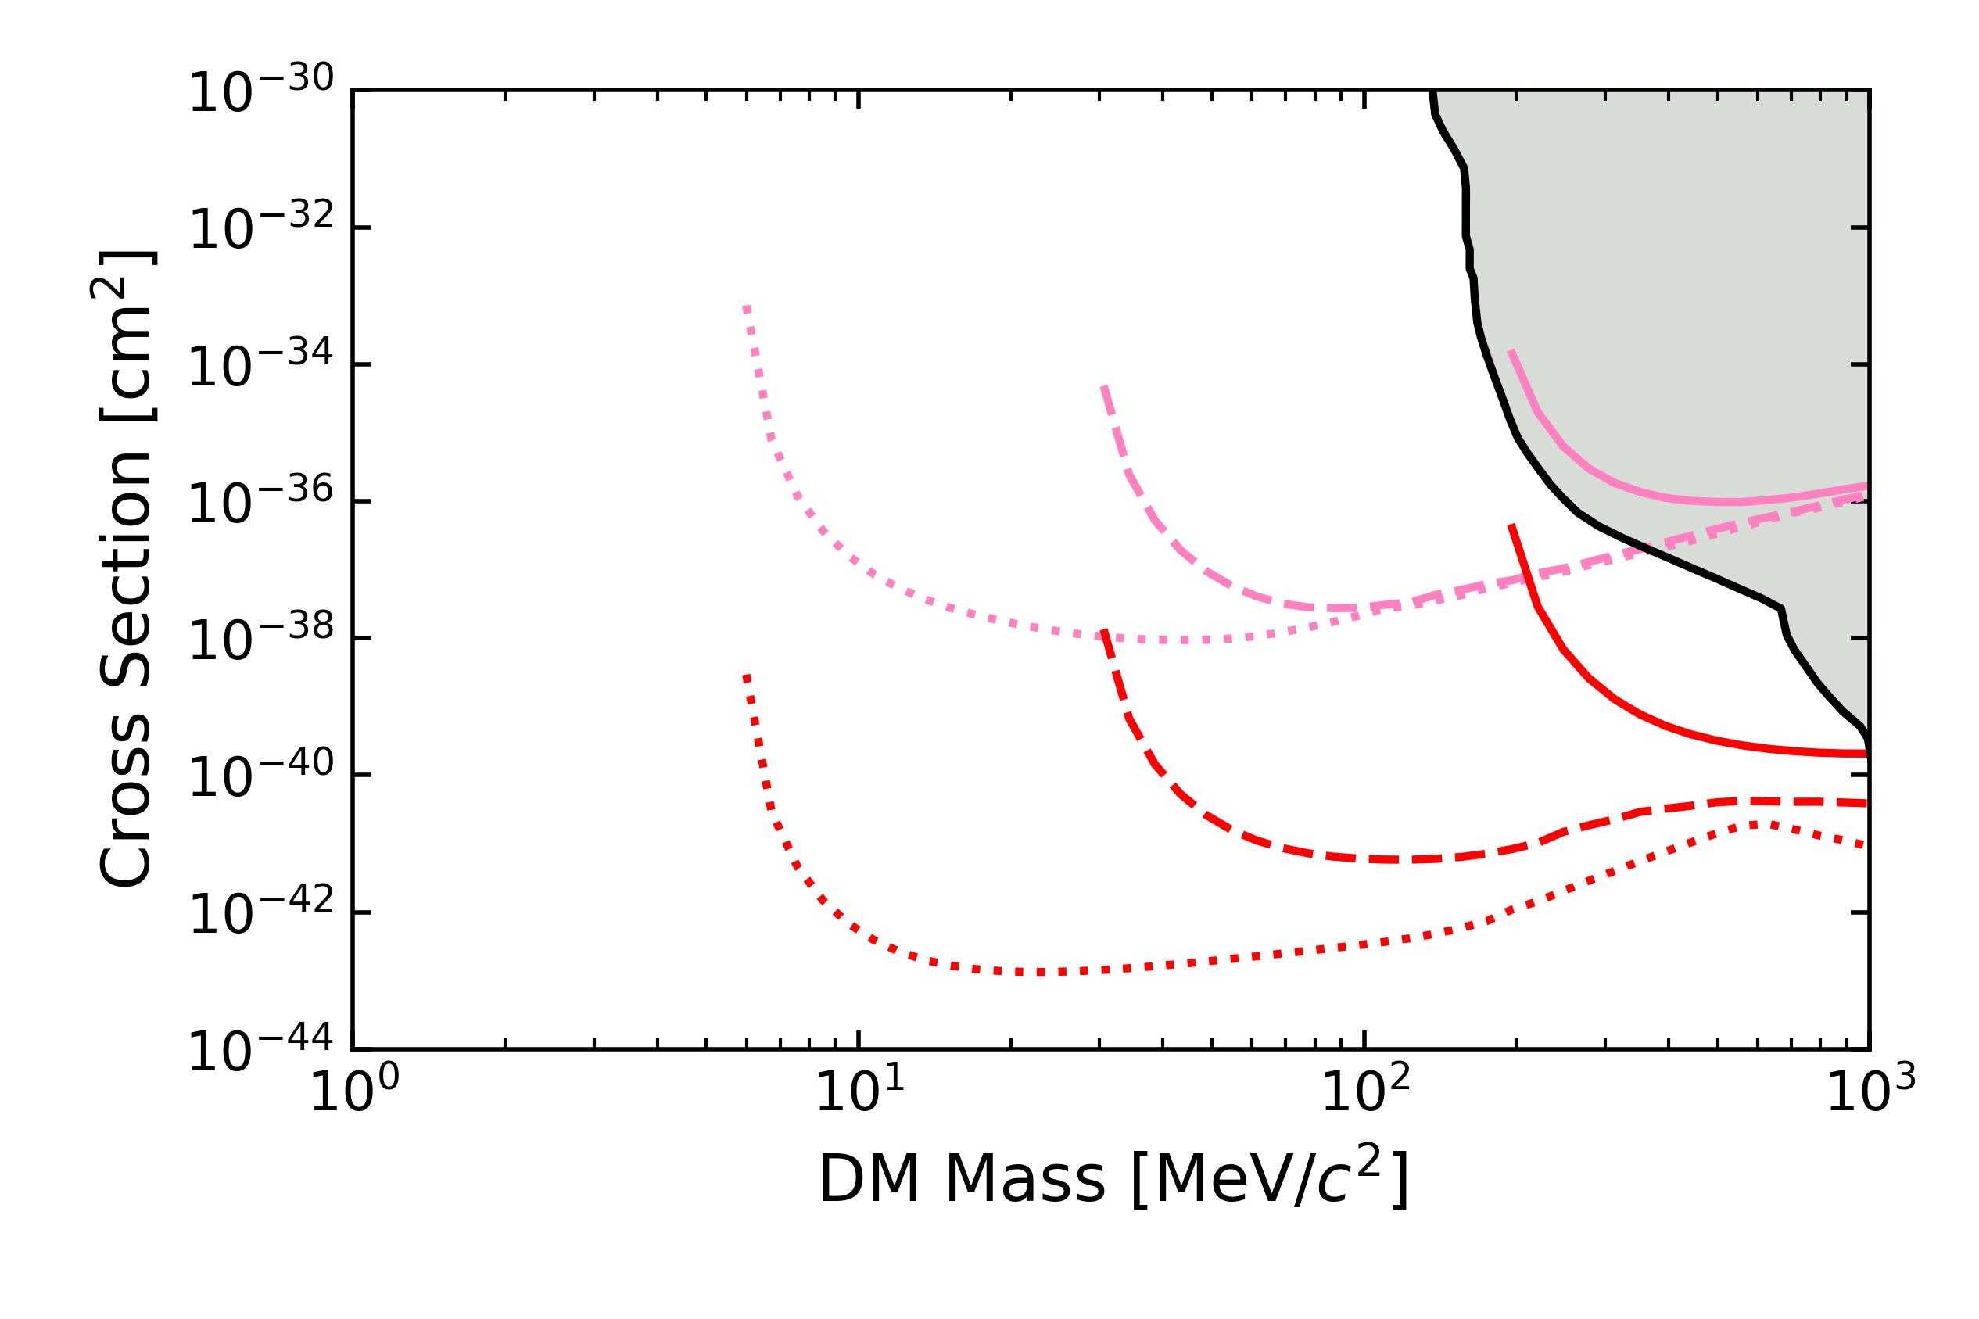
1) HeRALD:Helium Roton Apparatus for Light Dark matter
Surface
Required
Goal
Underground
Stretch
 | Required Threshold | Goal Threshold | Stretch Goal Threshold
Si 4cmx4cm | 6.7eV | 900 meV | 12 meV
He | 21 eV | 570 meV | 24meV
#1 Design Driver for Light Mass Dark Matter Searches: Energy Sensitivity

Slide 50
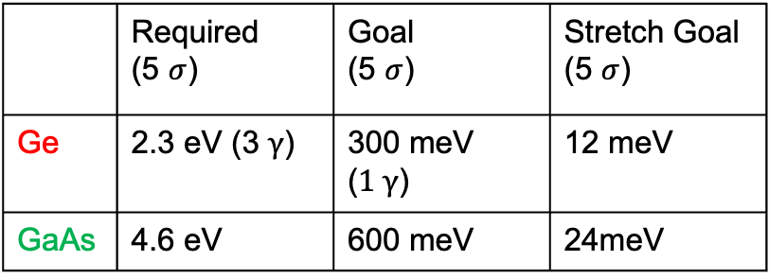
2) SPICE: GaAs ERDM
“CRESST for ERDM”
Scattering via Light Dark Photon
Ge
1kgyr
No Backgrounds
1607.01009
 | Required (5 $σ$) | Goal (5 $σ$) | Stretch Goal (5 $σ$)
Ge | 2.3 eV (3 $γ$) | 300 meV ($1 γ$) | 12 meV
GaAs | 4.6 eV | 600 meV | 24meV
~35meV
Optical
~600meV
900meV
ERDM
NR
GaAs
1meV 10meV 100meV 1eV 10eV

Slide 51



3) SPICE: Sub-ev Polar Interactions Cryogenic Experiment
Scattering via Light Dark Photon
In ionic crystals, optical phonons are oscillating electric dipoles! Couple strongly to dark photons!
Required
Stretch
Goal
1kgyr
No Backgrounds
1910.10716
/SiO₂
60meV
149meV
 | Required Threshold (5 $σ$) | Goal Threshold (5 $σ$) | Stretch Goal Threshold (5 $σ$)
SiO₂ | 3.5eV | 350 meV | 20meV
Al₂O₃ | 3.5eV | 350 meV | 20meV
Optical
Phonon/ER
SiO₂
Al₂O₃
60meV
90meV
NR
10meV 100meV 1eV 10eV 100eV

Slide 52
SuperCDMS

Slide 53


SuperCDMS G2+ iZIP: Backgrounds
To discriminate zero charge phonon only events from nuclear recoils, one needs to independently measure ionization and phonon energy
Improve ionization sensitivity with improved HEMT charge amplifier and smaller detector [$σ_{q}$ =50eVee, 17 eVee]
2203.08463
2 towers Ge 10cm iZIP
6 towers Si 10cm iZIP
Design Driver #2 (Backgrounds)
  Mitigation Plan
  Discrimination Plan

