Slide 1
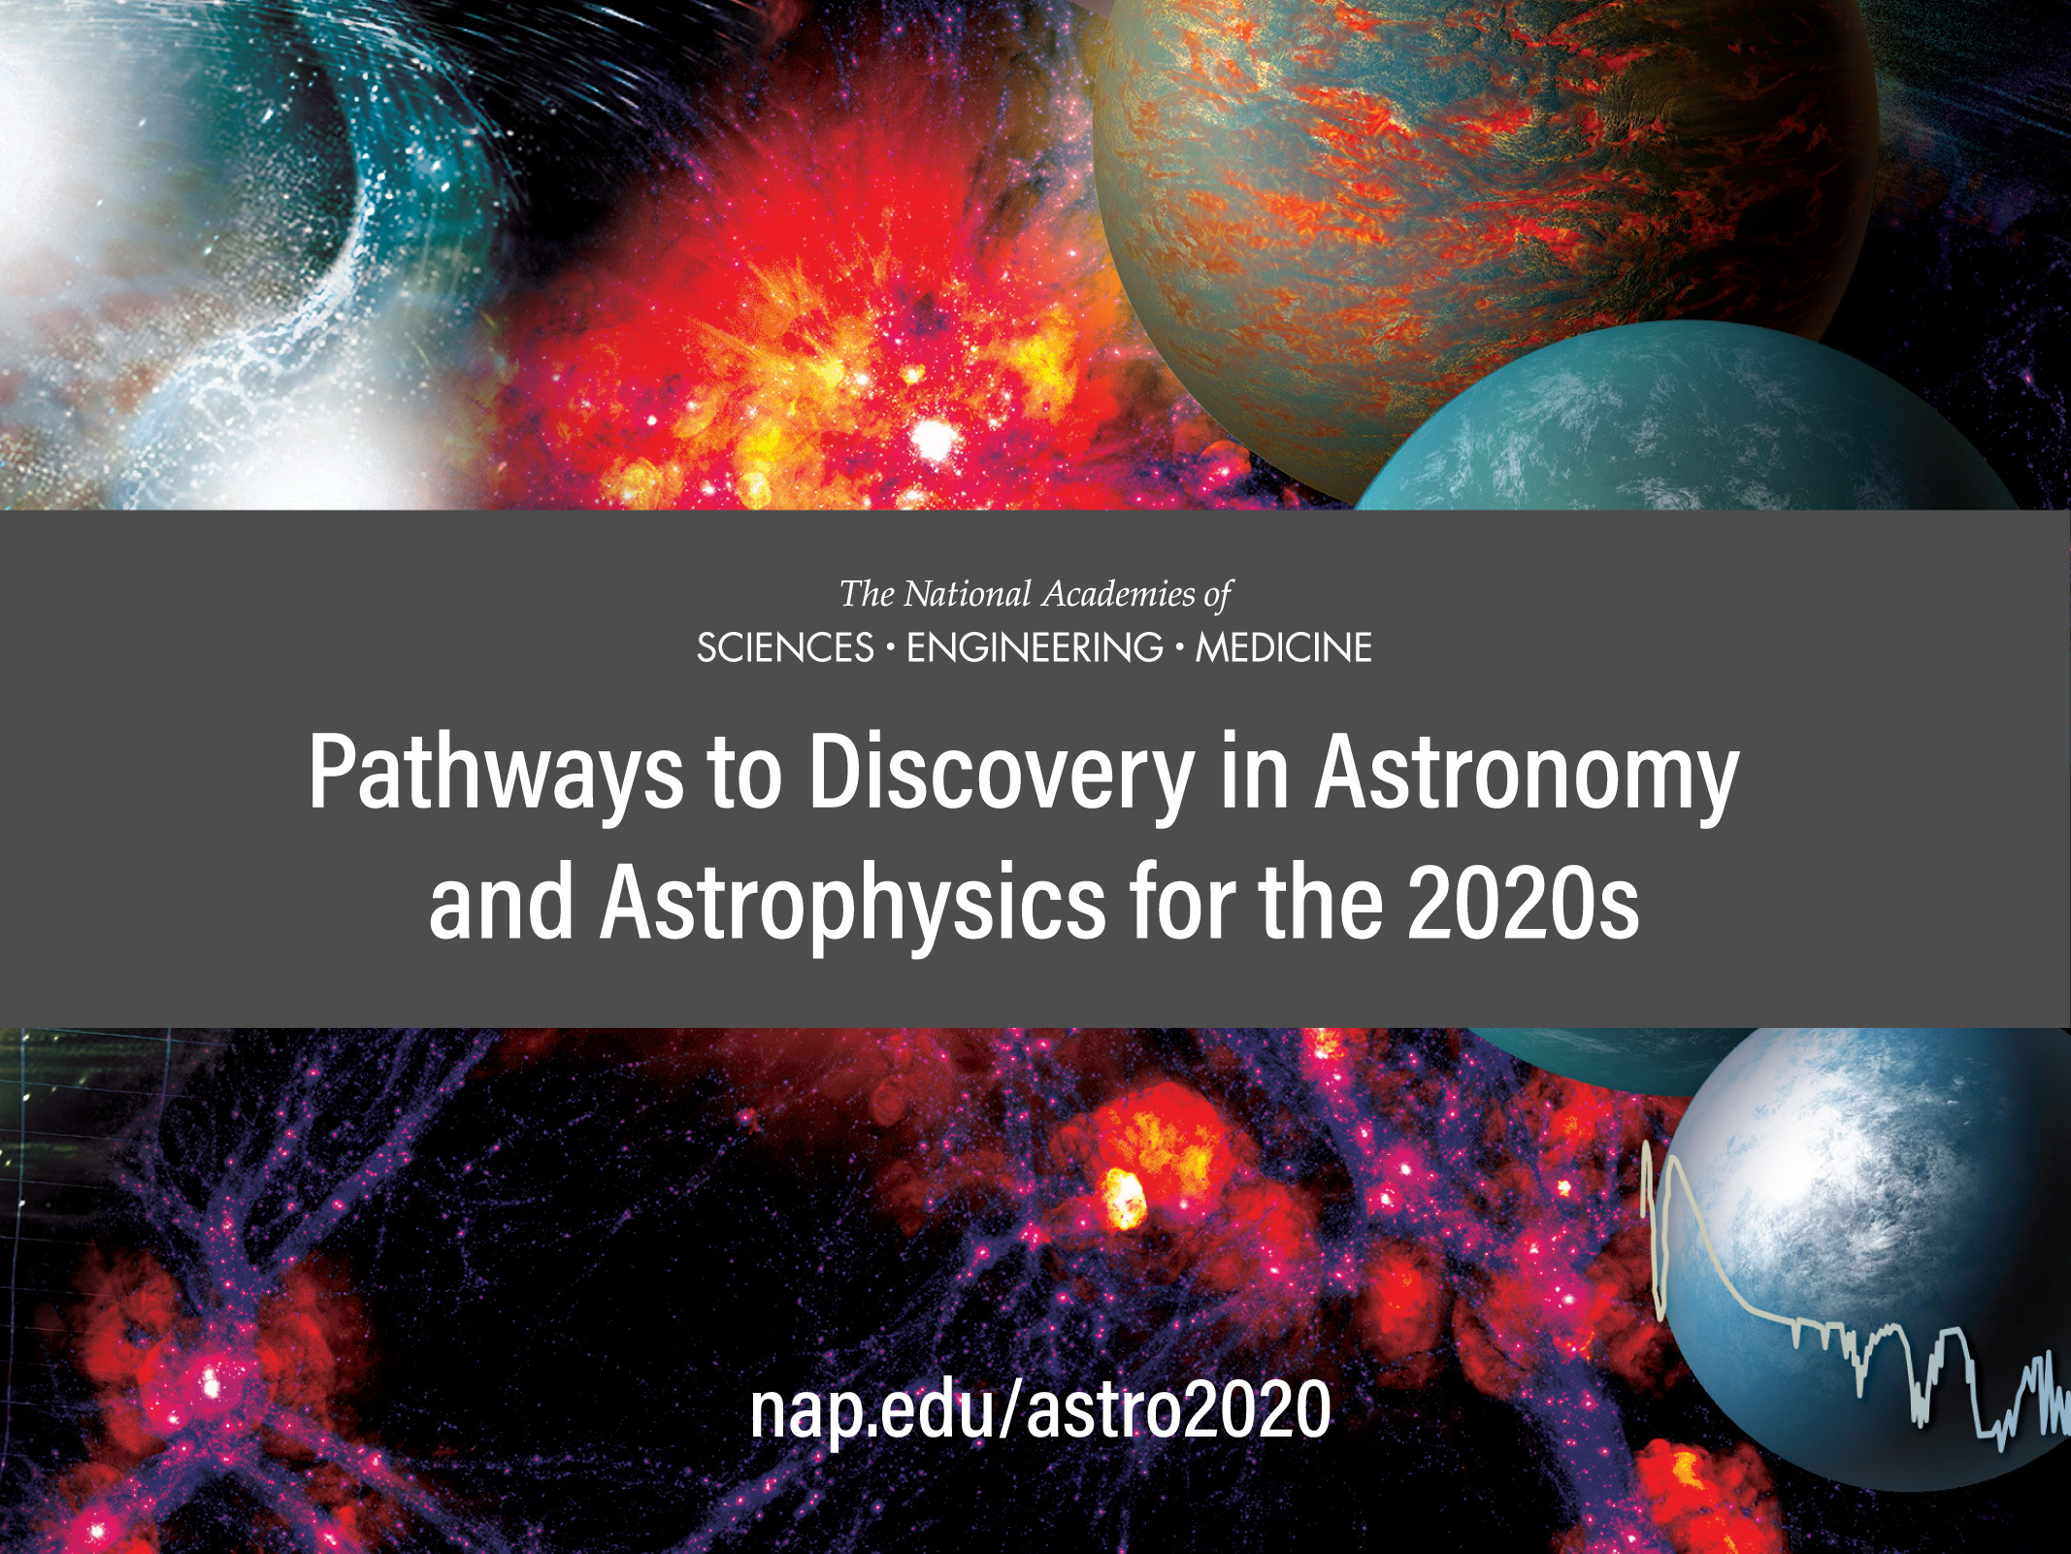
Report cover goes here

Slide 2
Approach
NASA, NSF, and DOE provided budget guidance, bounded by ambitious and conservative scenarios
The agencies urged the survey to develop an “ambitious”, “aspirational”, and “inspirational” plan
But a plan also needs to be realistic, responsible, achievable, sustainable
The Survey’s Approach:
Propose an ambitious program, but with decision rules, decision points, and contingencies
Emphasize phased development of many projects to lower risks and provide flexibility to agencies
Present a strategy, with details of implementation resting with agencies and their advisory committees
Notes:
Fiona

Slide 3
Astro2020 Process
community science white papers
(573)
community APC
white papers
(294)
Science Panels (6)
Program Panels (6)
SoPSI Panel
frontier questions
discovery areas
project assessments
(science, technical, cost, risk)
assess health of profession, provide actionable advice
Steering Committee
assimilate panel reports, address cross-cutting areas
integrate science program, identify key strategic questions, prioritized investment strategy within budget guidelines
Notes:
Fiona

Slide 4
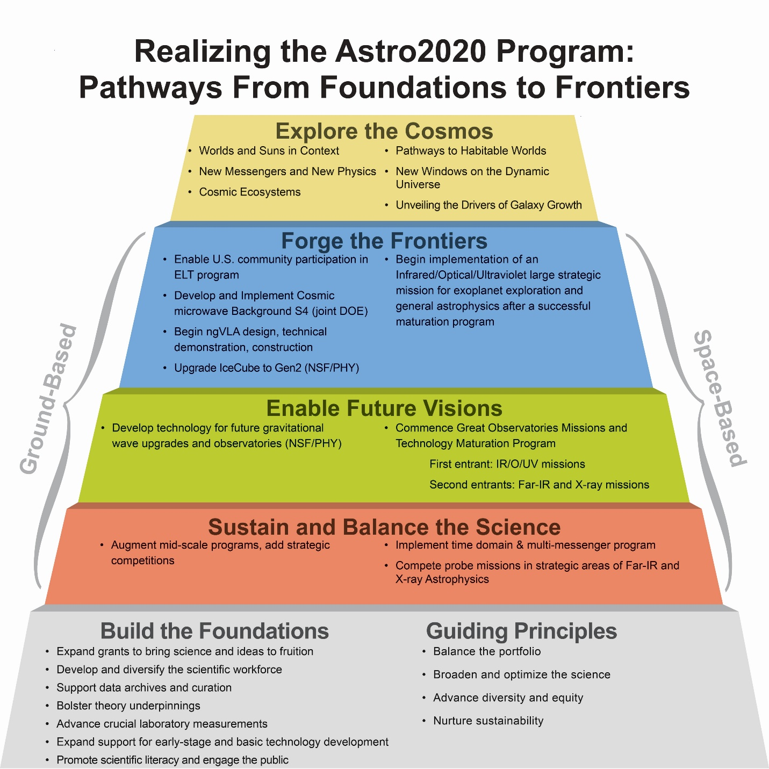
Notes:
Fiona

Slide 5
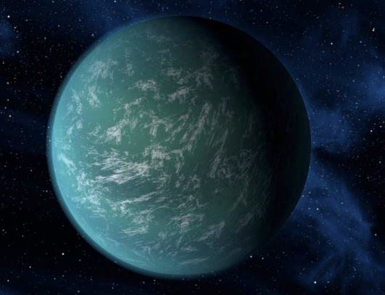
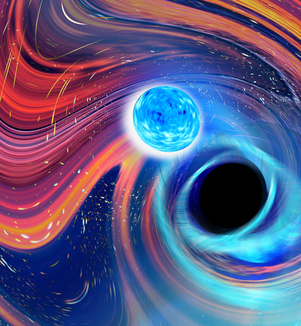
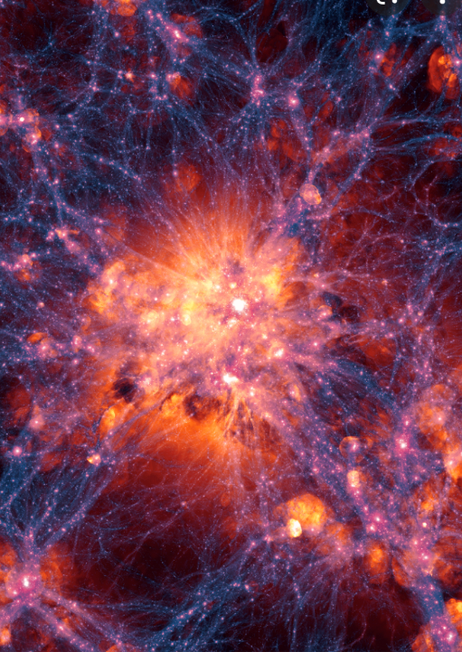
Science Themes and Priority Areas
  Science Themes
  Worlds and suns in context
  New messengers and new physics
  Cosmic ecosystems
  Priority Areas
  Pathways to habitable worlds
  New windows on the dynamic universe
  Unveiling the drivers of galaxy growth
Notes:
Rob

Slide 6
Ground Medium/Large Program Overview
Enabling and Realizing Major Observatories
MREFC Observatories
Federal Investment in U.S. ELTs for community access
CMB-S4 (~equal share NSF/DOE)
ngVLA Studies and Prototyping
Review
ngVLA Construction
2022
2032
Sustaining Programs
Enhancements to Astronomy Mid-scale Programs
Endorsements for Programs in NSF/PHYS
Technology Development for Future Gravitational Wave Observatories
The IceCube-Generation 2 High Energy Neutrino Observatory
Notes:
Rob

Slide 7
The Cosmic Microwave Background Stage 4 Observatory
CMB-S4 builds on the foundation of decades of CMB measurements to take a major leap, pushing CMB science to the next level
Scientific goals
  B-mode CMB polarization signatures of primordial gravitational waves and inflation
  Maps 50% sky, every other day from 0.1- 1 cm with unprecedented sensitivity
  Broad science including systematic time domain science
CMB-S4 consists of a systematically planned suite of facilities in Antarctica and Chile designed to sample a wide range of independent frequencies, and probe a combination of large and small angular scales
Notes:
Rob

Slide 8
The Cosmic Microwave Background Stage 4 Observatory
Key Attributes
  Balanced program between DOE (60%) and NSF (40%) for all phases
    Brings wide range of technical and scientific expertise to bear from community and national labs
  Total design, development and construction cost: $660M
  First observations could begin by 2030
Recommendation: The NSF and DOE should jointly pursue the design and implementation of the next generation ground-based cosmic microwave background experiment (CMB-S4).
i
Because of its great potential to advance general astrophysics and open discovery space, it is essential that CMB-S4 produce transient alerts, as well as calibrated maps in all bands and on all angular scales that are openly usable and accessible on as rapid a cadence as practical
Notes:
Rob

Slide 9
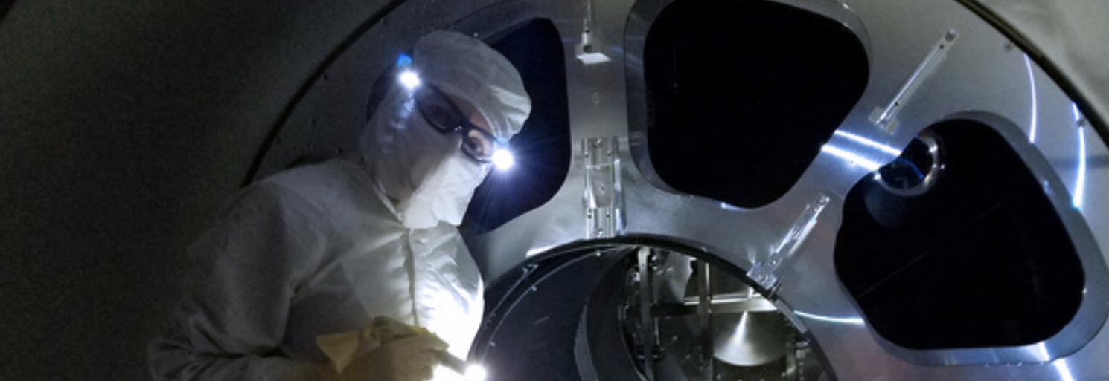
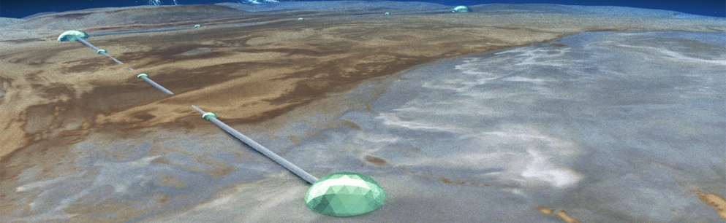
Technology Development for Future Ground-based Gravitational Wave Observatories
Gravitational wave detection is one of the most exciting and expanding scientific frontiers impacting central questions in astronomy
  Directly relevant to two Astro2020 priority areas: New Windows on the Dynamic Universe, Hidden Drivers of Galaxy Formation
More advanced detectors in the current LIGO facility (beyond A+) and planning for future generation facilities such as Cosmic Explorer are essential
Conclusion: … Continuous technology development will be needed this decade for next generation detectors like Cosmic Explorer. These developments will also be of benefit to the astrophysical reach of current facilities.
Notes:
Fiona

Slide 10
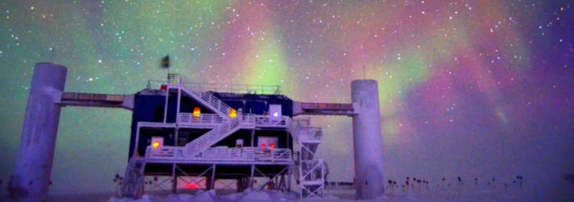
IceCube-Generation 2 Neutrino Observatory
IceCube at South Pole detects 100 TeV – 10 PeV cosmic neutrinos
Upgrade to Generation-2 observatory will add detector elements and a radio array to increase sensitivity (5x), detection rate (10x), and energy range (to 1000 PeV)
  resolve diffuse (currently) cosmic neutrino background
  localize, identify individual astrophysical sources
  coordinated multi-messenger observations
Conclusion: The IceCube-Generation 2 neutrino observatory would provide significantly enhanced capabilities for detecting high-energy neutrinos, including the ability to resolve the bright, hard-spectrum TeV-PeV neutrino background into discrete sources. Its capabilities are important for achieving key scientific objectives of this survey
Notes:
Fiona

Slide 11
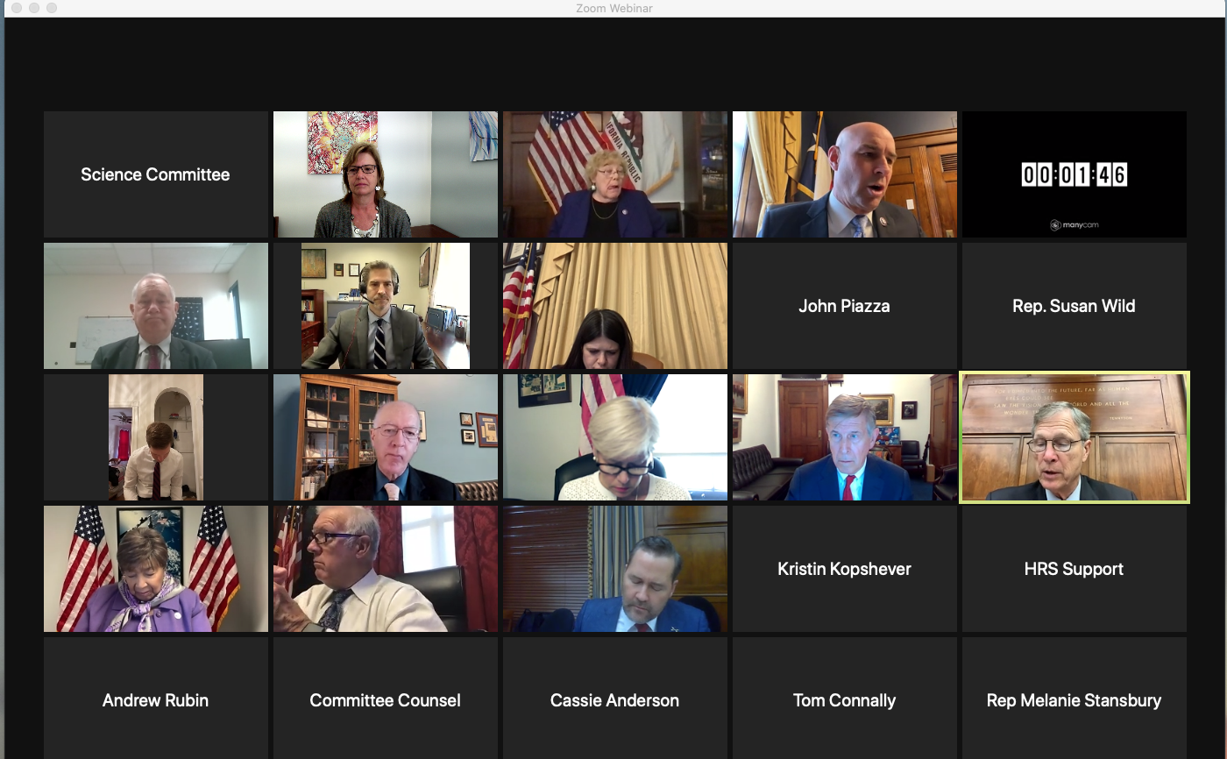
House Science, Space and Technology Committee Dec 1, 2021
  Subcommittee on Space and Aeronautics
  Subcommittee on Research and Technology

Slide 12
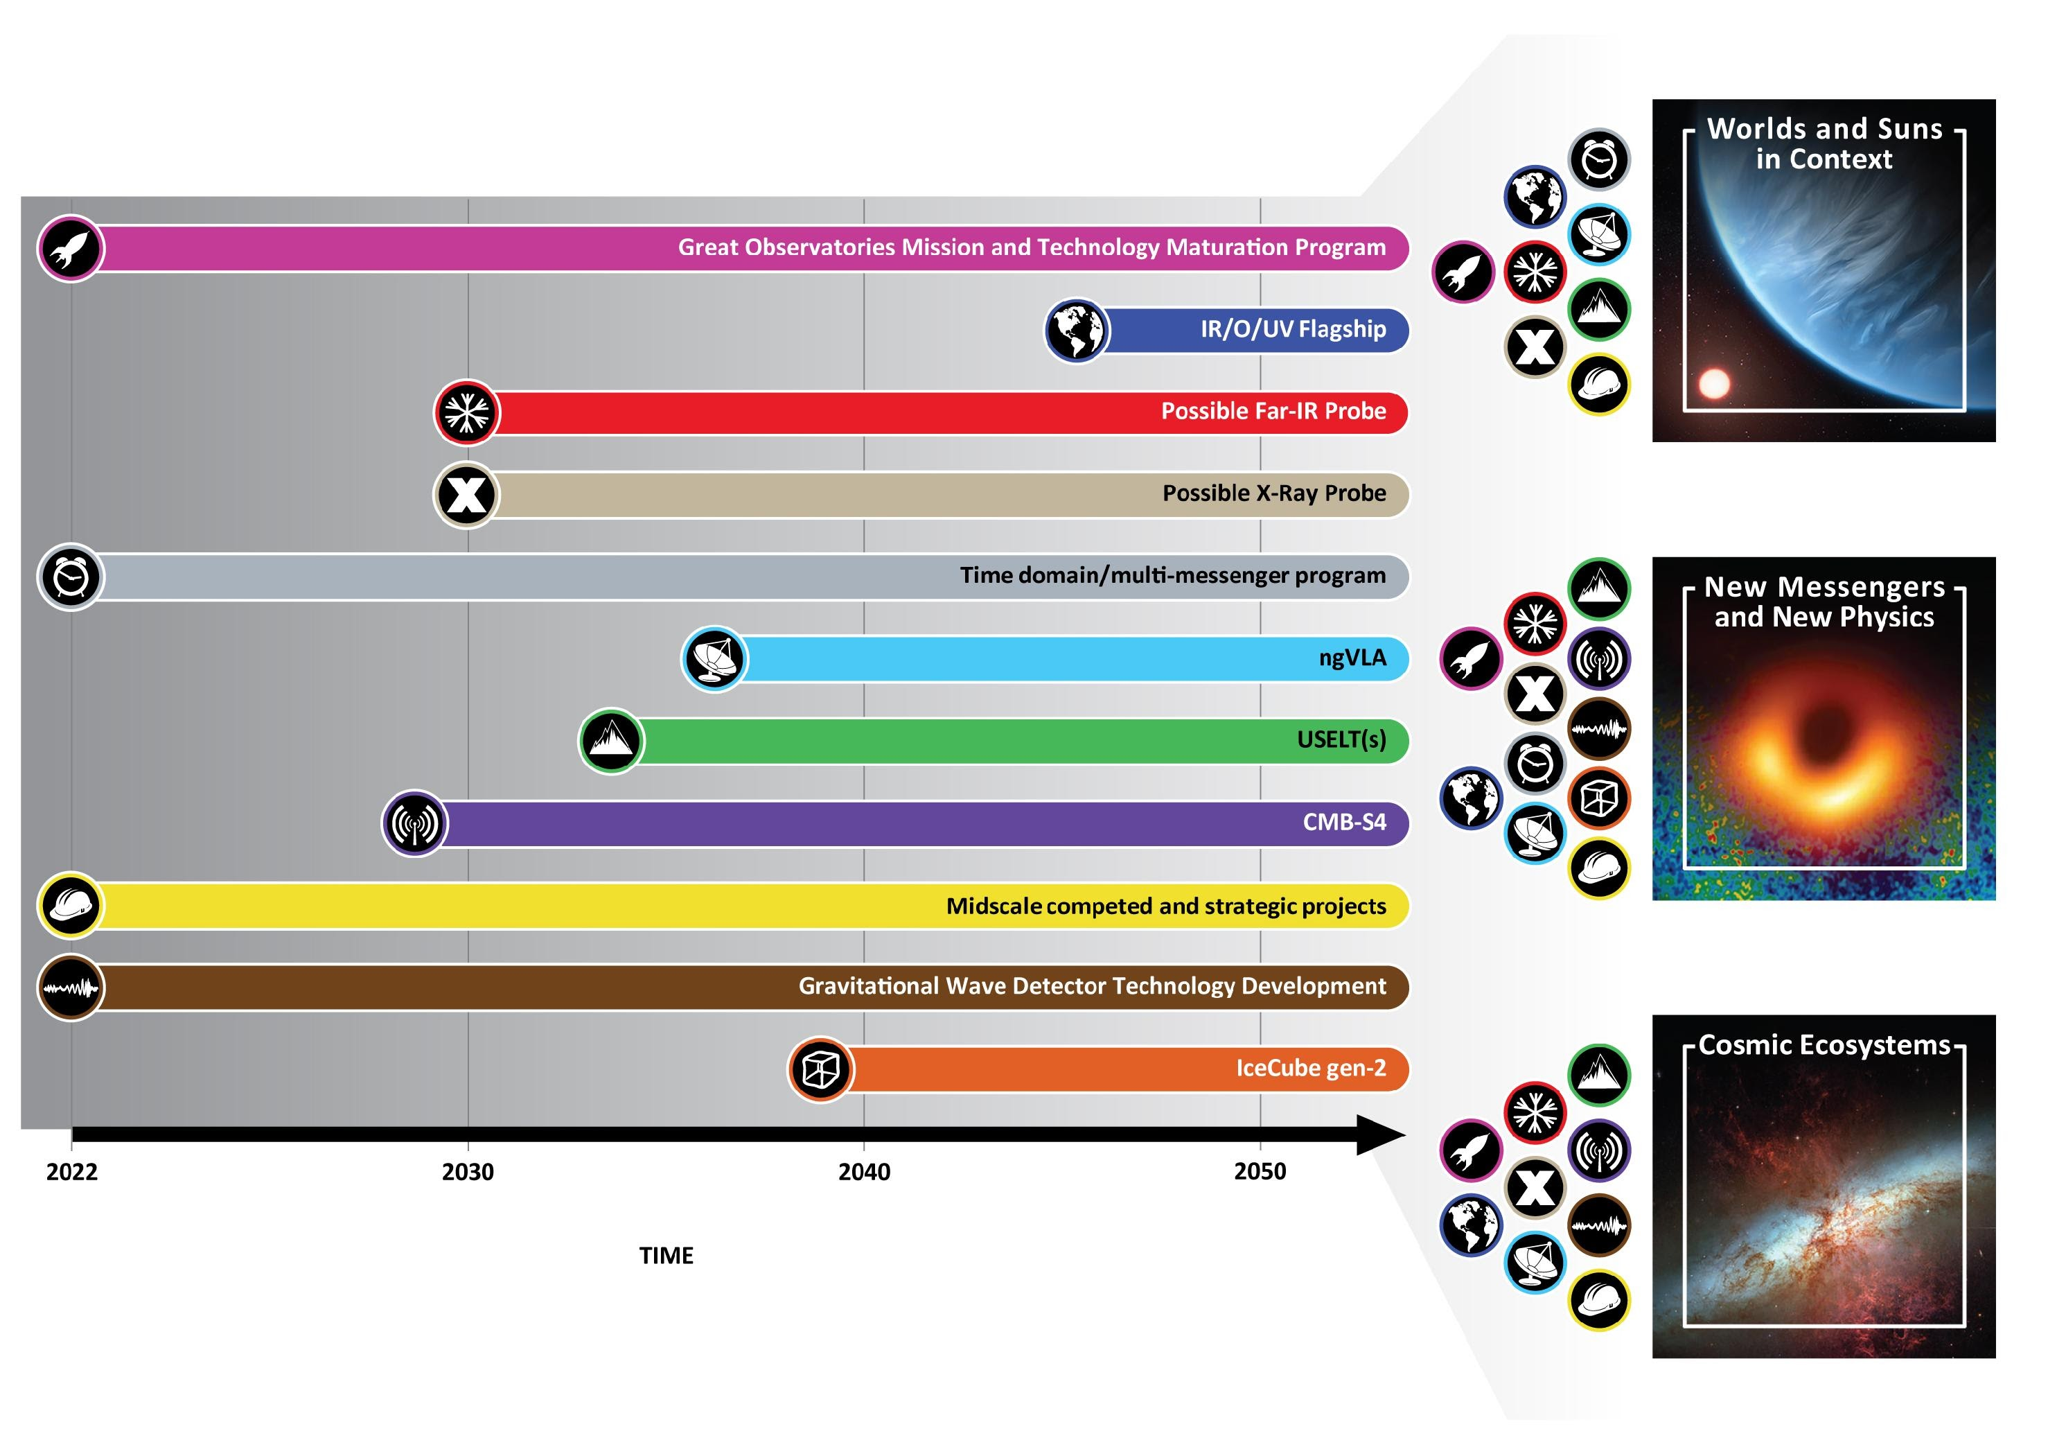
nap.edu/astro2020
www.nap.edu/26141

Slide 13
Backup Slides

Slide 14
The Profession and its Societal Impacts
“The pursuit of science, and scientific excellence, is inseparable from the humans who animate it.”
-- Panel on the State of the Profession and Societal Impacts
Guiding principles: diversity, equitable access, benefits to the nation and the world, sustainability and accountability
Astro2020 report includes 10 recommendations in this area
  Here we provide a brief synopsis: see the full report for additional discussions of education, career paths and pipelines, public outreach and engagement, climate change, and benefits to the nation
Notes:
Fiona

Slide 15
The Profession and its Societal Impacts
Areas of key recommendations for the state of the profession
  Collecting demographic data to understand equity in funding
  Diversity of the profession
    Improving diversity of project and mission teams
    Investing in and sustaining workforce diversity ”bridge” programs
    Undergraduate and graduate traineeship programs
  Professional policies related to harassment and discrimination
  Community relations
  Dark skies and protecting the radio frequency spectrum
Notes:
Fiona

