Slide 1
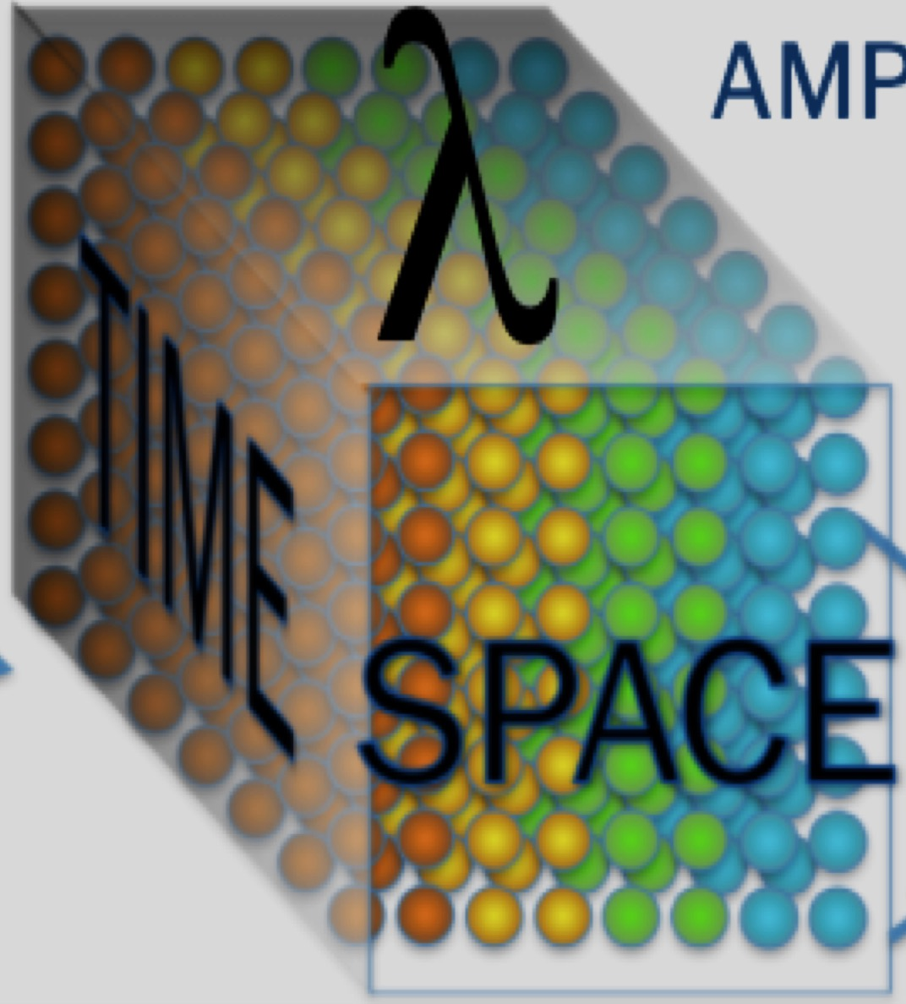
Advanced controls for coherent addition of femtosecond laser pulses
Russell Wilcox, Qiang Du, Dan Wang, Tong Zhou, Siyun Chen, Lauren Cooper

Slide 2
Outline
Motivation
Principles of interferometer and phase detector
Pattern recognition for phase control
Femtosecond pulse diffractive combination
Conclusions and future work

Slide 3
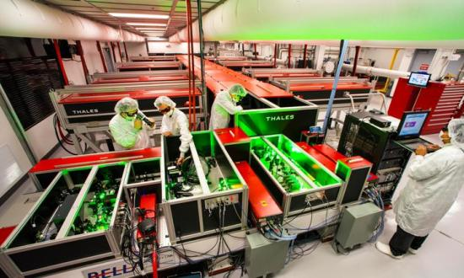
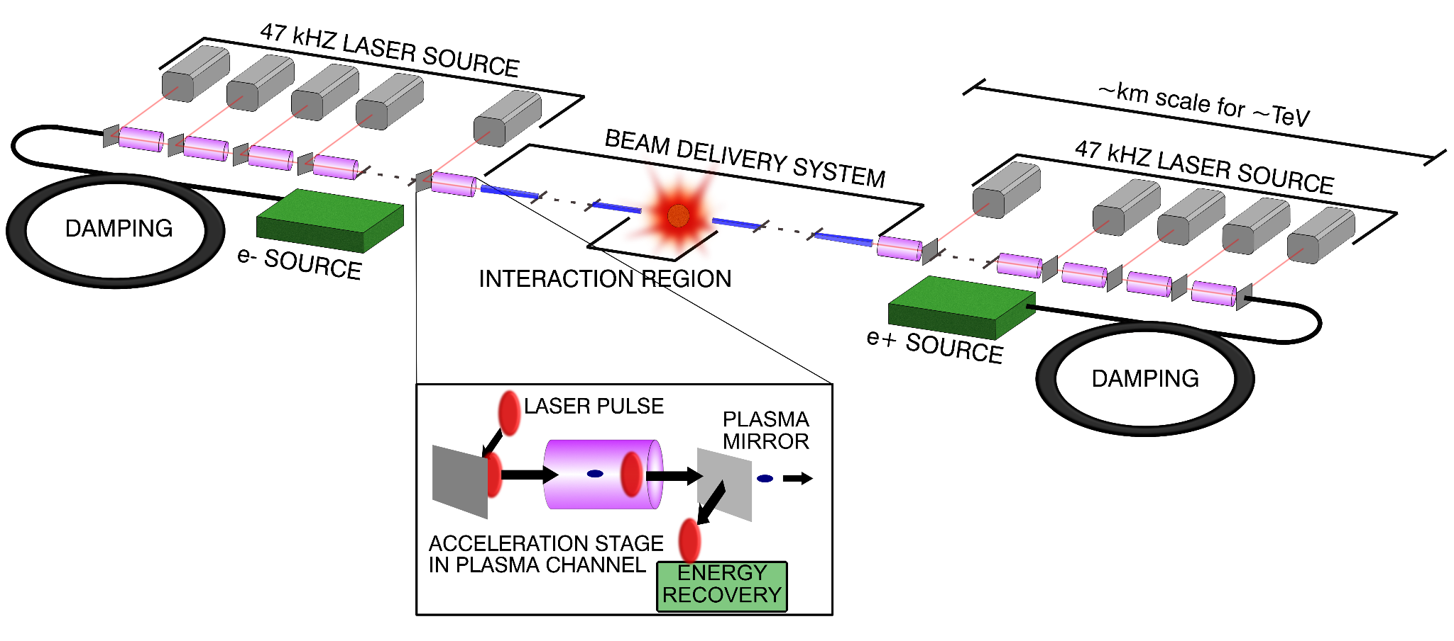
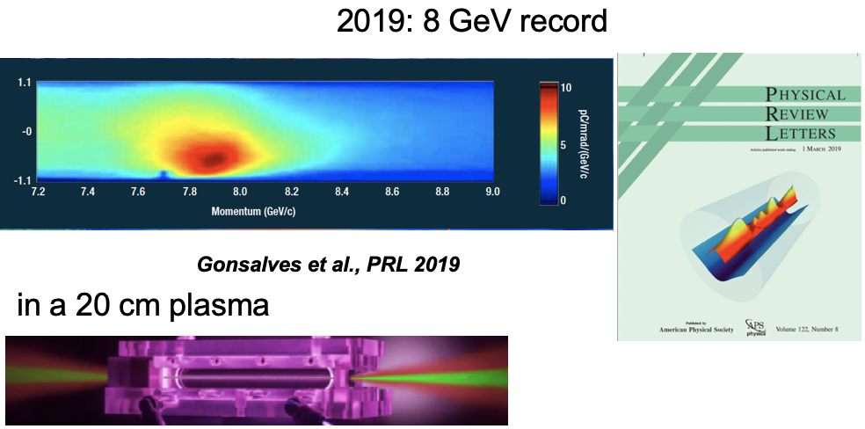
Accelerators need high power pulsed lasers
From 1Hz...
...to 50kHz
Leemans & Esarey,
Physics Today (2009)
Planned milestones:
Laser parameter | Funded, ongoing | k-BELLA | Hi rep-rate driver | Collider driver
Energy | 0.2 J | 3J | 3J | 6J
Pulse duration | 30fs | 30fs | 30fs | 100fs
Rep-rate | 5 kHz | 1kHz | 10kHz | 50kHz
Average power | 1kW | 3kW | 30kW | 300kW
Higher experimental data rate
Faster feedback to control error sources
These lasers don’t exist, need a completely new laser technology

Slide 4
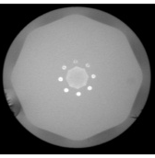
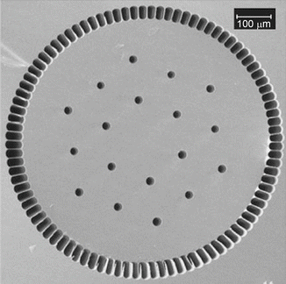
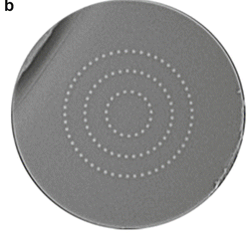
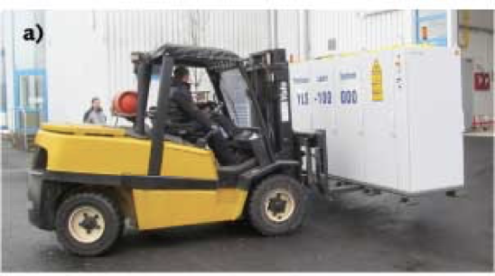
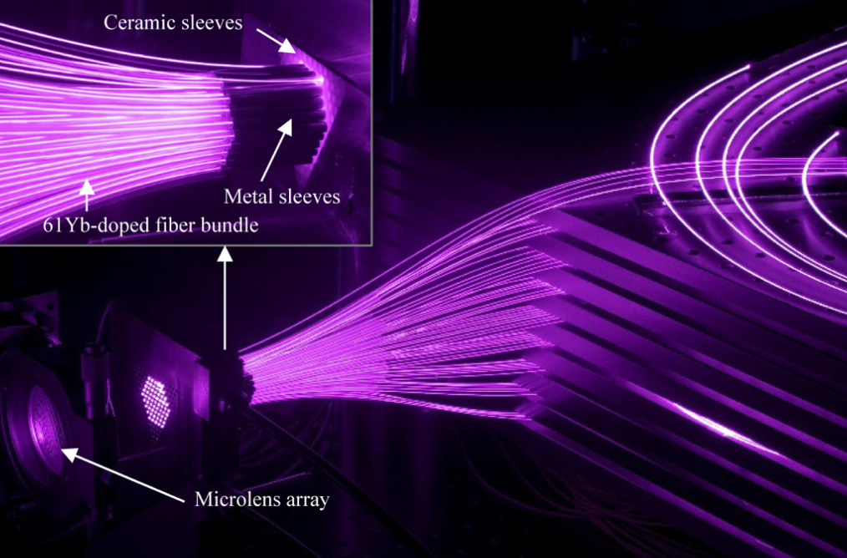
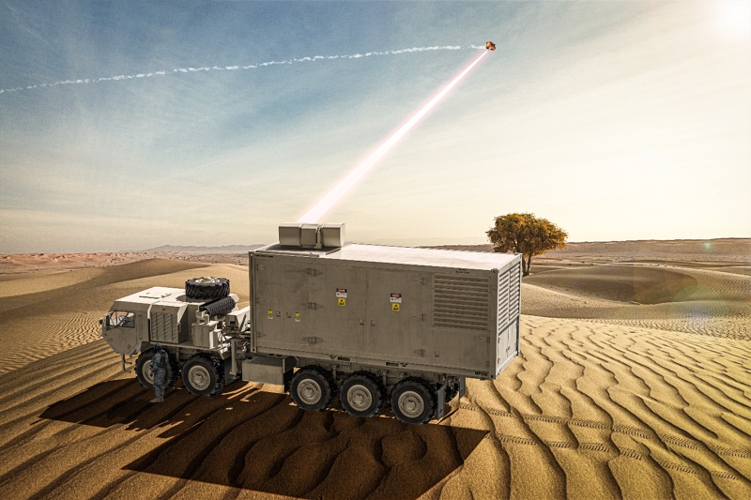
Fiber lasers have high power, limited energy
Light guided by high index core
Add laser ions, pump light; it’s an amplifier
Core is small
  Max diameter ~100um
Advantages:
  Average power
  Efficiency
  Bandwidth
  Beam quality
  Reliability
Limited energy due to
  Damage
  Nonlinearity
  Small volume
120 kW
45% WPE
300 kW
1kW, 250fs
Beam combination can increase output energy

Slide 5
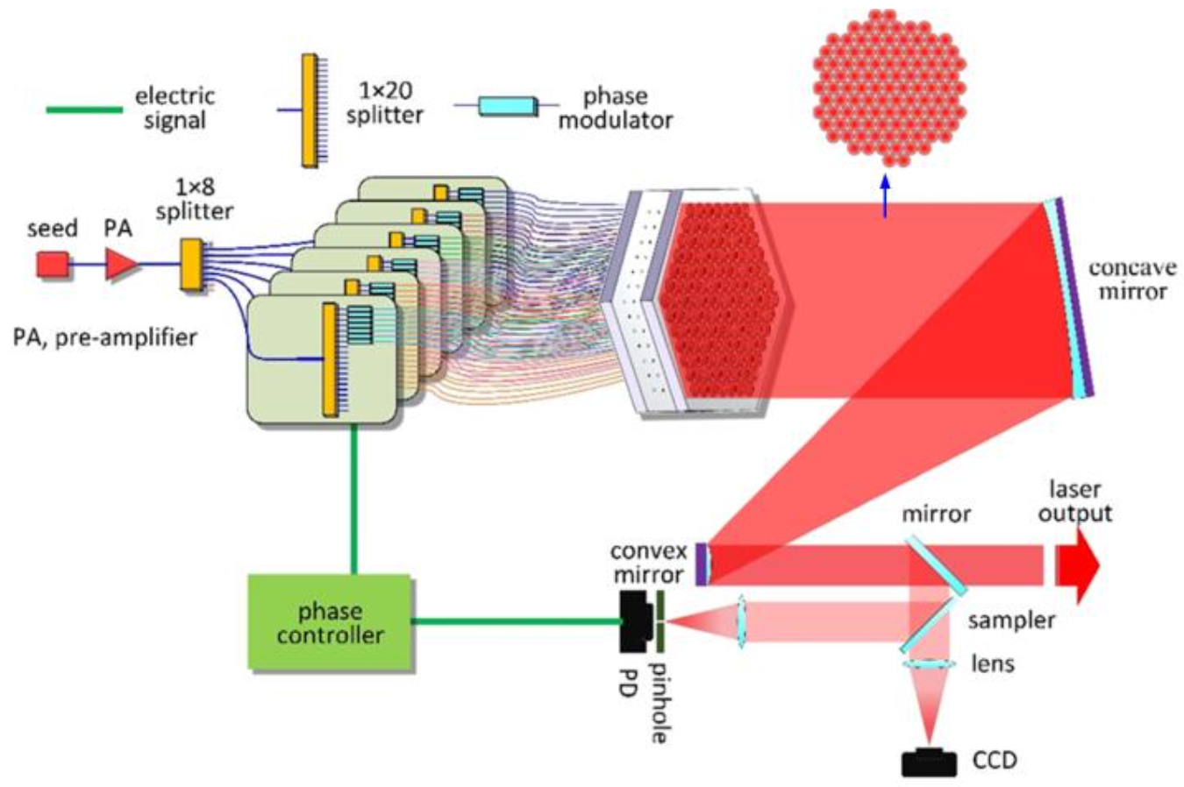
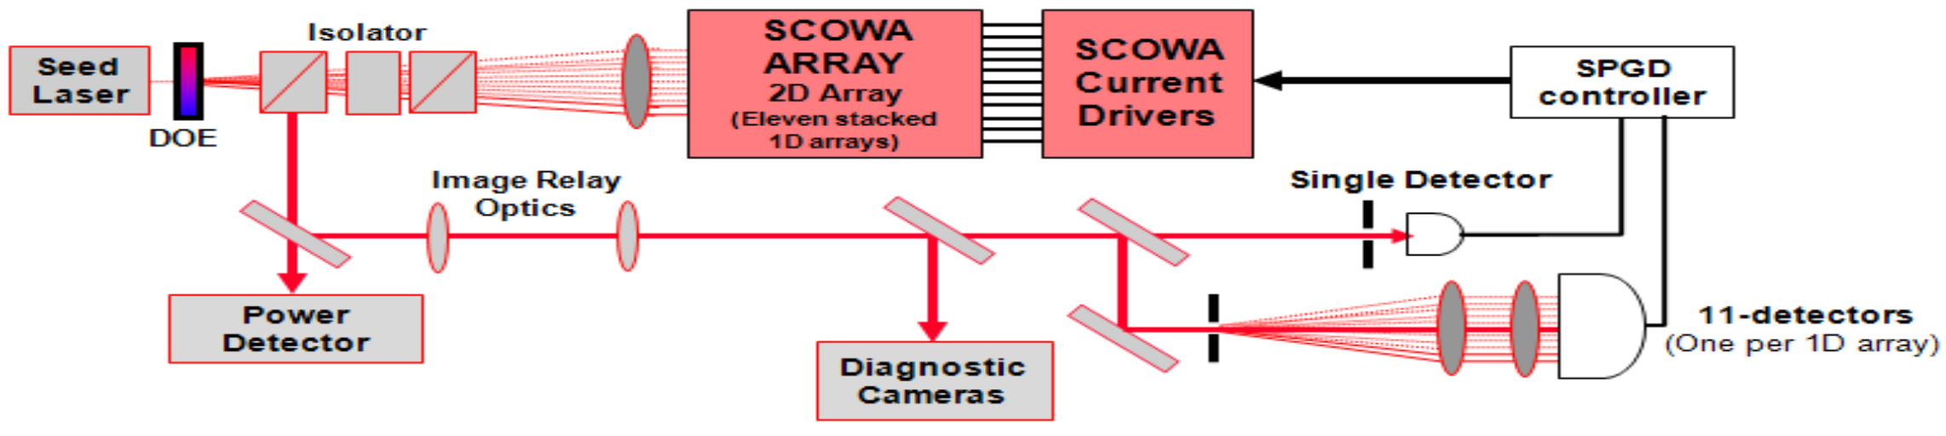
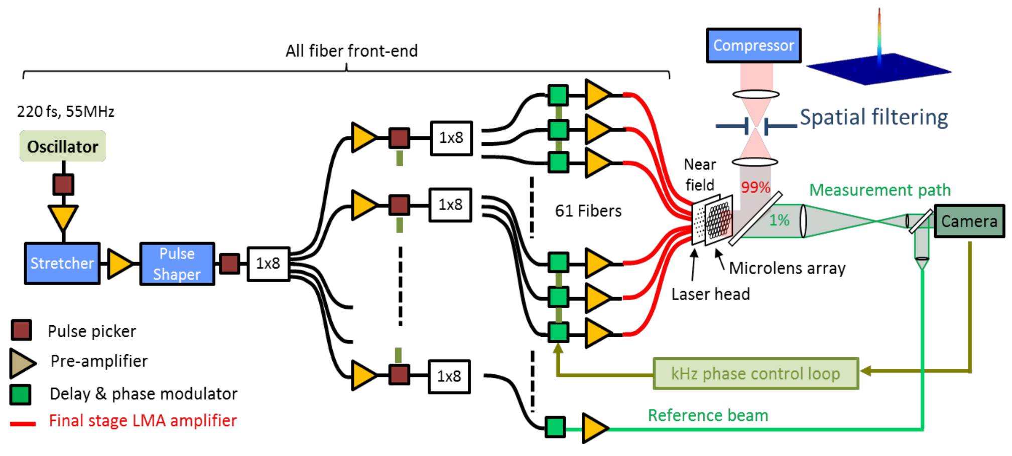
Various groups have combined ~100 beams
Redmond et al, CLEO 2011. 200 beams
Chang et al, ASSL 2020 107 beams
tiled, spectral,
Du et al, Opt. Exp. 2021, 81 beams
Our beam combiner will be a ~100-arm Mach-Zehnder interferometer
Fsaifes et al, Phot. West 2020, 60 beams

Slide 6
Mach-Zehnder interferometer
LASER
equal
phase
beam
splitter
mirror
additional pi
phase shift
on reflection
beam
splitter
mirror
fields add
path length
adjustment
fields cancel

Slide 7
Add amplifiers, it’s a combiner
LASER
beam
splitter
mirror
laser
amplifier
beam
splitter
twice the output of one amplifier
mirror
path length
control
D
feedback
electronics

Slide 8
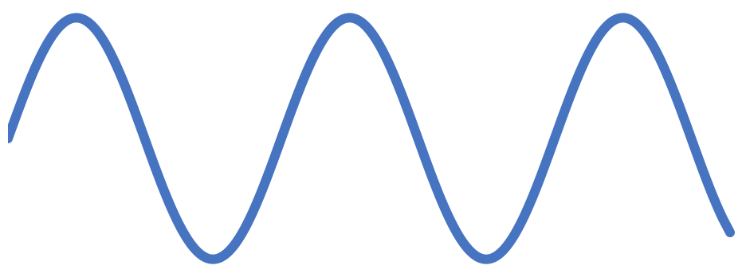



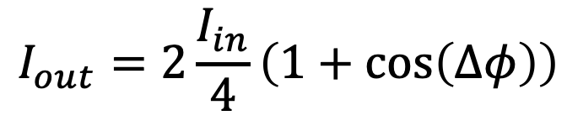

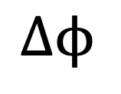





Detecting phase from intensity
interference term
LASER
$$I_{out}=2\frac{I_{in}}{4}\left(1+\cos\left(Δφ\right)\right)$$
$$I_{in}$$
$$\frac{I_{in}}{2}$$
$$\frac{I_{in}}{2}$$
$$\frac{I_{in}}{4}$$
$$\frac{I_{in}}{4}$$
0 to 2
$$I_{in}$$
$$I_{out}$$
detected power
$$\frac{I_{in}}{4}$$
$$\frac{I_{in}}{4}$$
-∏
0
+∏
$$Δϕ$$

Slide 9
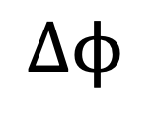
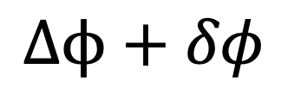
Dithering to disambiguate retrieved phase
?
detected power
detected power
-∏
0
+∏
-∏
0
+∏
$$Δϕ$$
$$Δϕ+δφ$$
“dither”

Slide 10
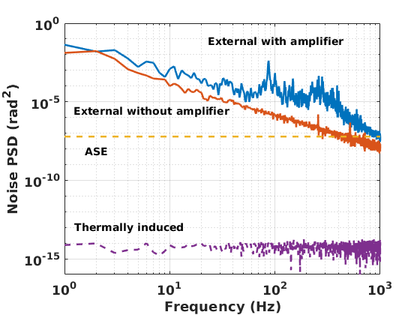
At low rep-rate, control bandwidth is limited
repetition rate,
highest sampling frequency
need to suppress noise
below this frequency
Want to derive phase error
and control as fast as possible!

Slide 11
Clever dither schemes for many beams
LOCSET
Dither each beam at a different frequency
Detect output, pick out each frequency with a filter, feed back to each beam
Advantage: lots of information
Scaling problem:
  For N beams, need N frequencies within narrow bandwidth
  Narrow bandwidth filter is slow to change (time/bandwidth product is constant)
SPGD
Add random dither value to all beams
Did that increase combined power?
    No: dither in different direction
    Yes: dither in same direction
Return to 2
Advantage: simple detection
Scaling problem:
  Single sensor, information bottleneck
  Number of iterations to optimize N beams scales as 10xN
  At optimal phase, sensitivity becomes zero; has to stabilize away from optimal
  Always dithering, noisy
Locking of optical coherence via single detector electronic frequency tagging
Stochastic parallel gradient descent

Slide 12



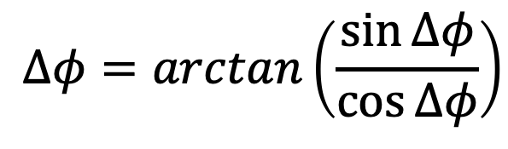

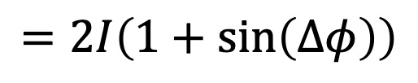
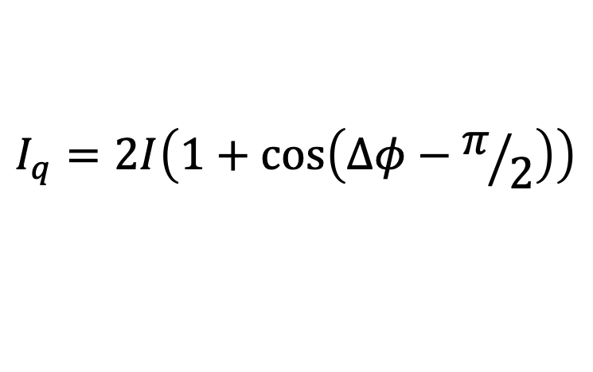
Obtain phase using two interferometers
$$Δϕ$$
D
I_{in}
$$I_{i}=2I\left(1+\cos\left(Δφ\right)\right)$$
“in-phase”
$$\frac{π}{2}$$
$$Δφ=\arctan\left(\frac{\sin{Δφ}}{\cos{Δφ}}\right)$$
D
“quadrature”
sine
$$Δϕ$$
$$I_{q}=2I\left(1+\cos\left(Δφ−π/2\right)\right)$$
$$=2I\left(1+\sin\left(Δφ\right)\right)$$
cosine
No dithering, stable output, immediate data

Slide 13
Quadrature phase concept is not new
phase = 0 on one side
phase = pi/2 on other side
Quarter rotation between left and right sides.
Can start from any position, go forward or backward.

Slide 14
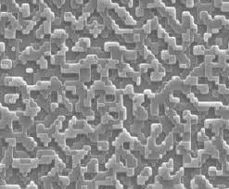
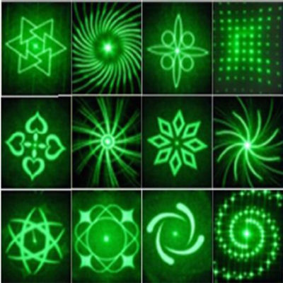
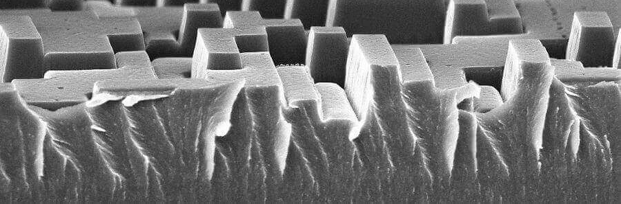
Diffractive splitter/combiner
LASER
Coherent light source
Surface relief on transparent substrate.
Calculated to diffract coherent light toward an arbitrary spot pattern.
Arbitrary spot pattern
(input to calculation)
Diffractive optical element (DOE) can split light into any pattern of rays
Also works in reverse

Slide 15
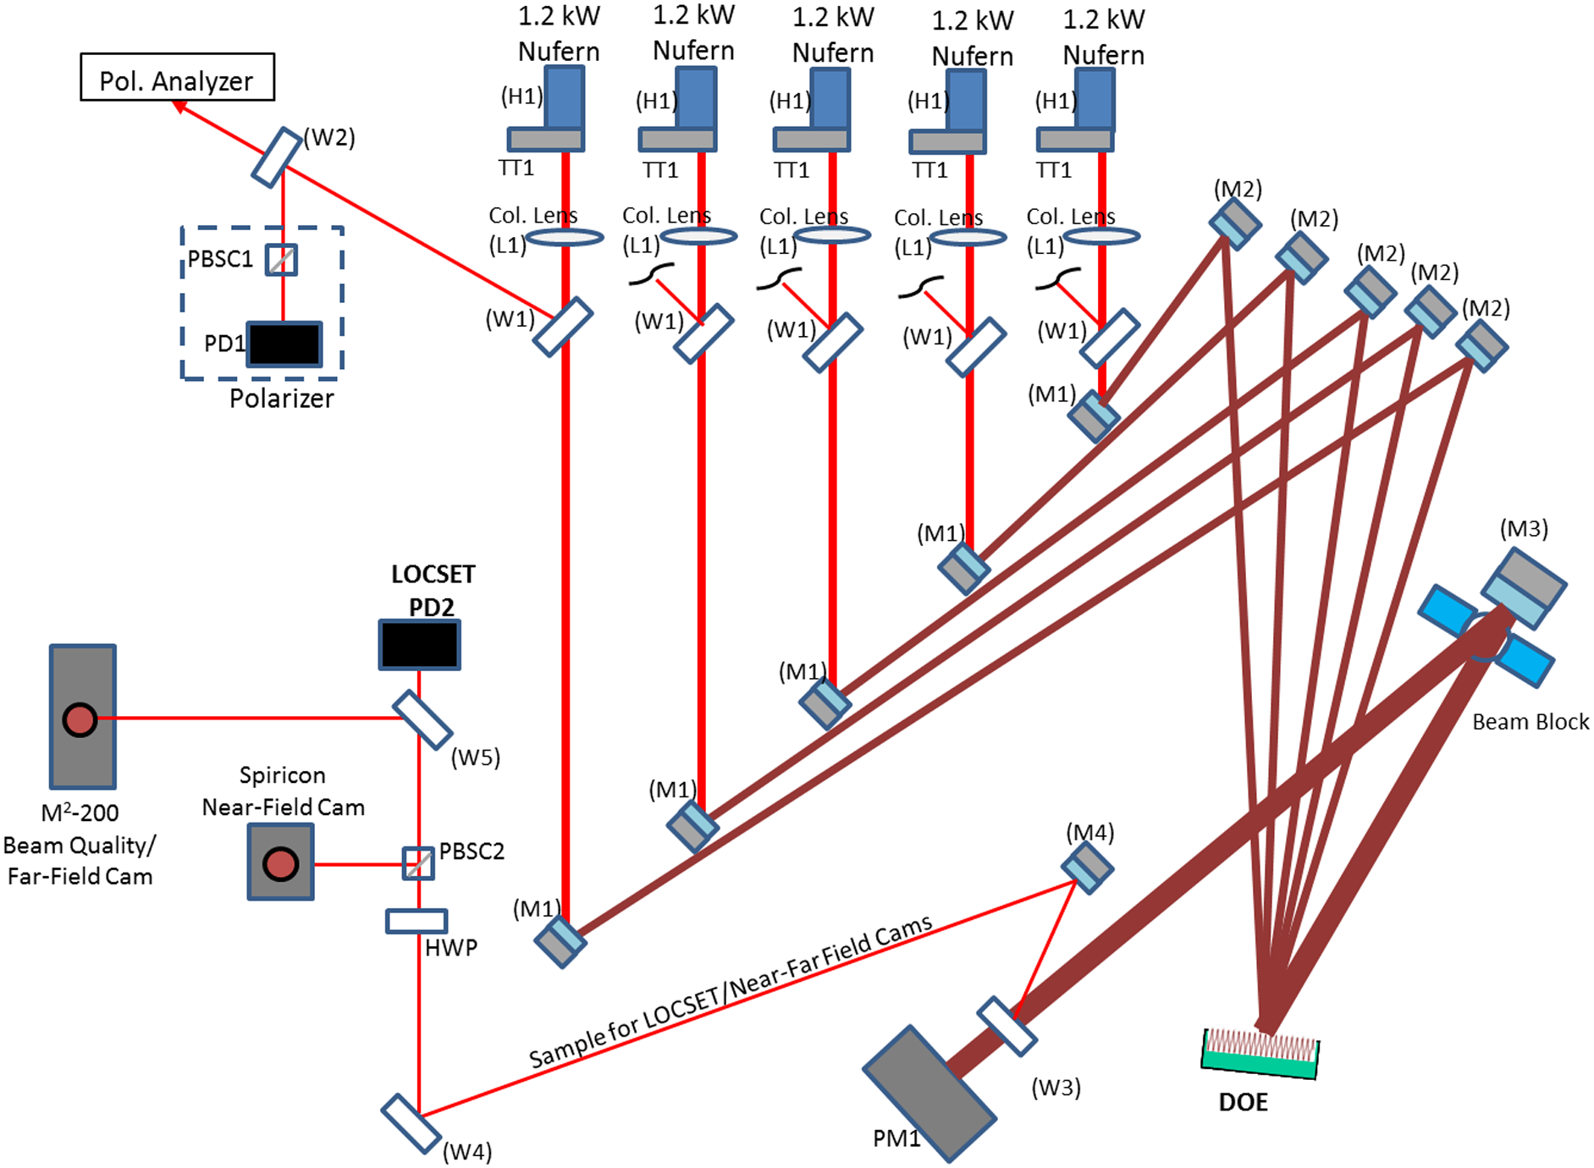
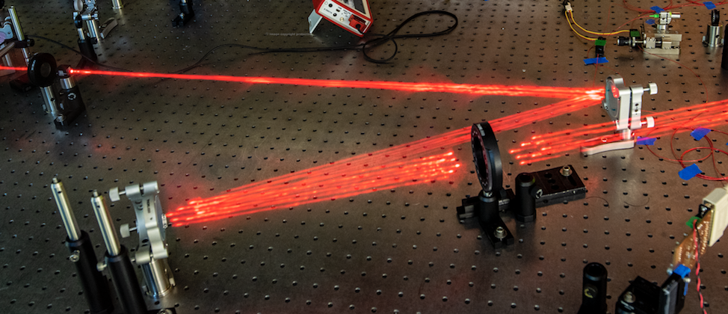
We will use DOE combiner for hi-power beams
Splitter operated in reverse
Many beams into one element
High 90s splitting efficiency
High power (multi-kW)
DOE
5kW, 5 beams CW
Flores et al, Opt. Eng. 55, 096101 (2016)
Our 3x3 setup

Slide 16
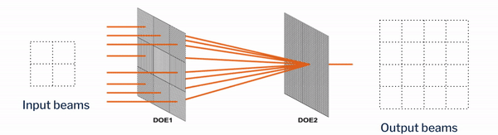
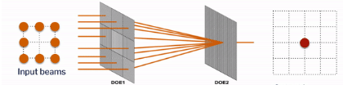
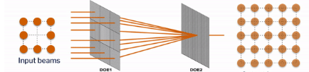
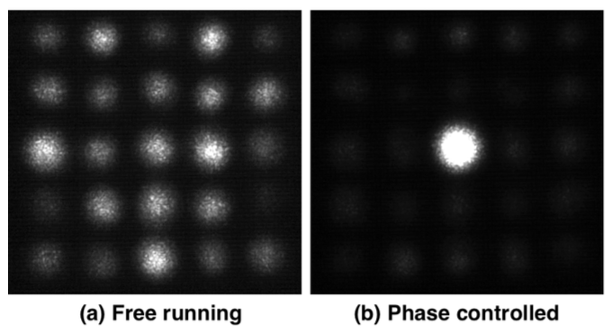
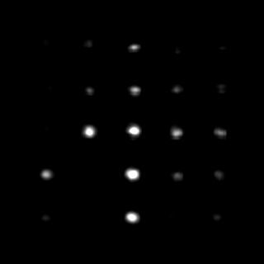
Side beams form an interference pattern
Side beams fluctuate in intensity as phases drift
Enough info to identify phase errors
Combined and side beams scale together
  With N inputs, (2N – 1) side beams (in each direction)
  Information thus scales with N, helping feedback rate
side beams are still there

Slide 17
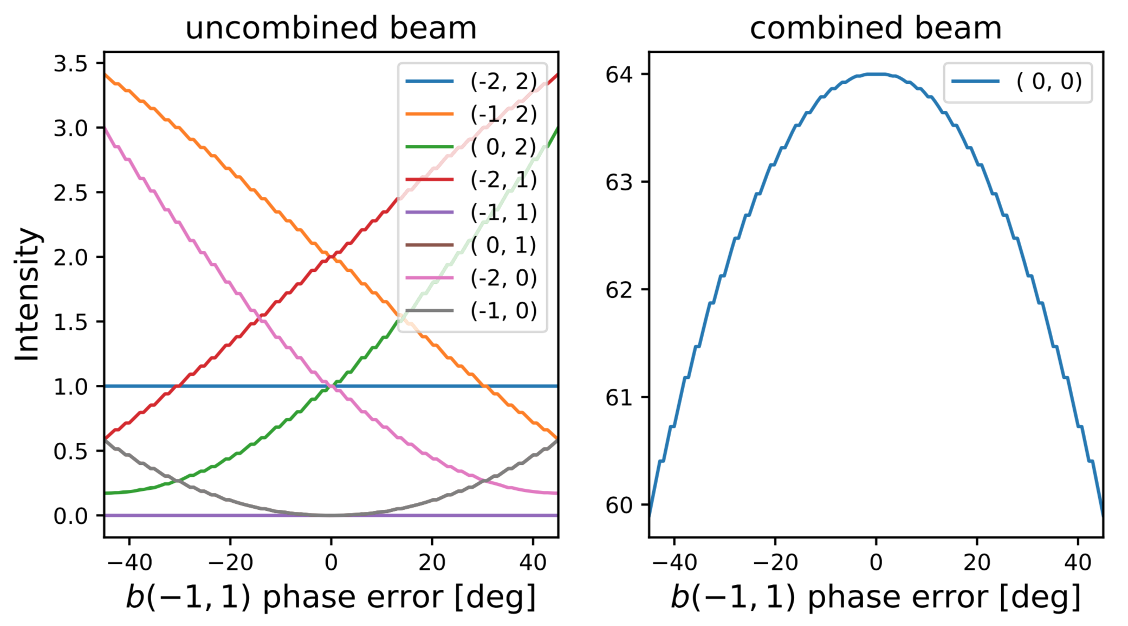
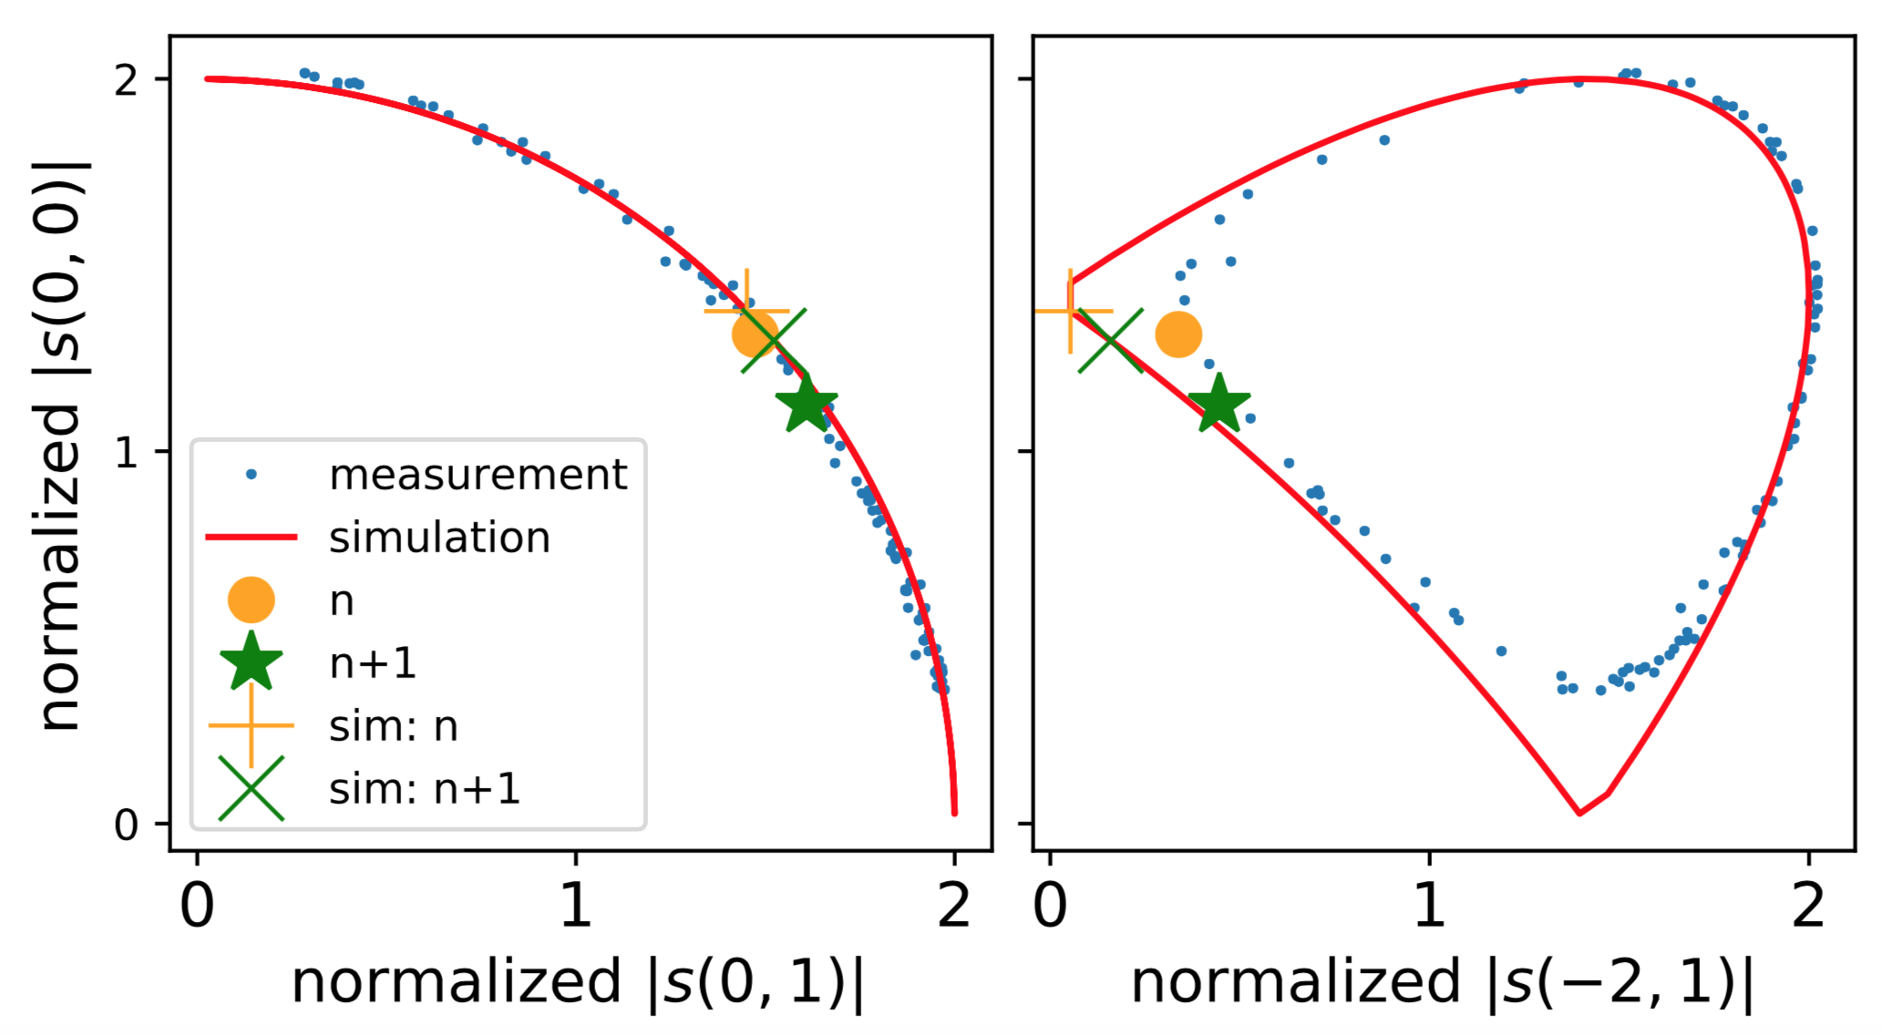
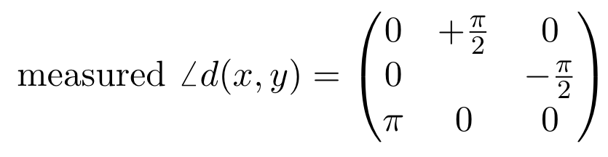
Some side beams give which-way info
00
01
02
01
02
10
12
20
21
22
21
22
correlations reveal quadrature phase!
“phase function” or “phase state”

Slide 18
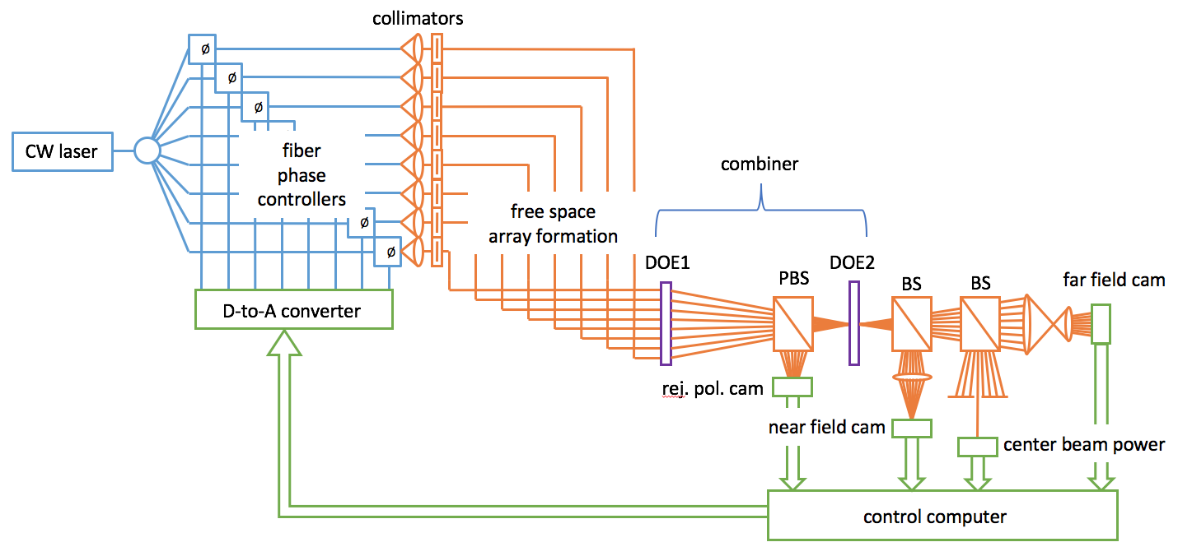
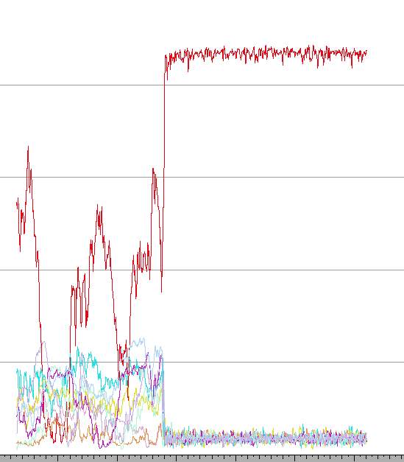
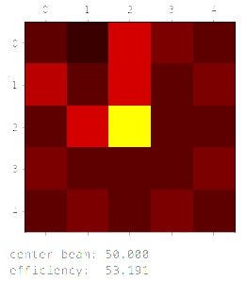
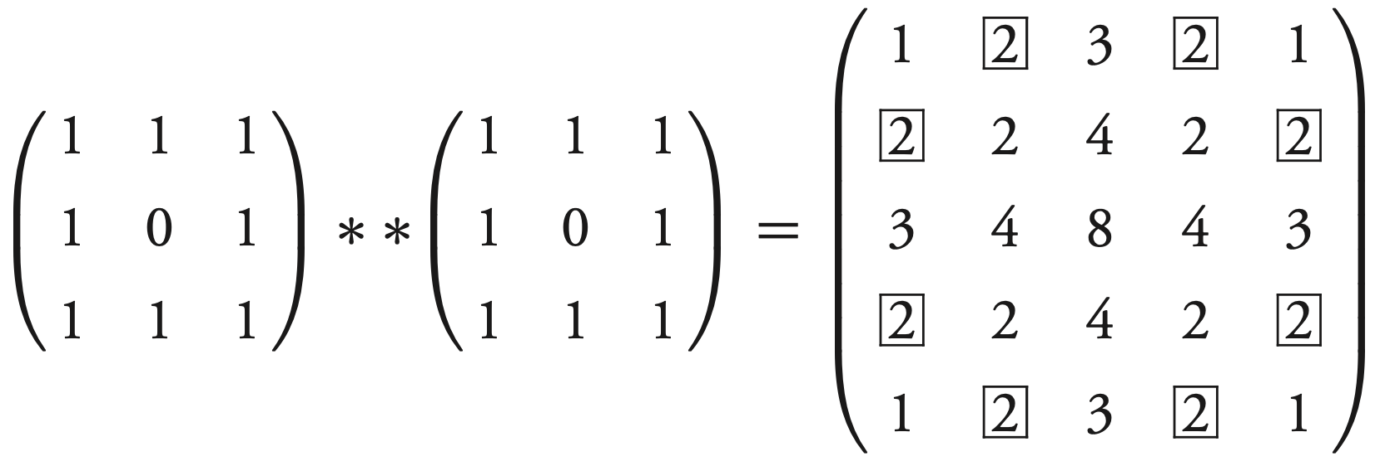
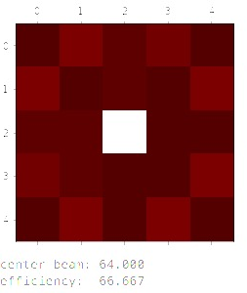
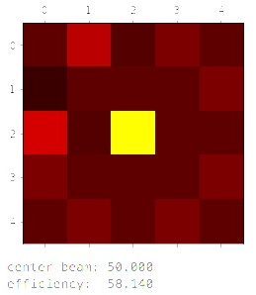


Control based on quadrature subset works
unlocked
locked
intensity, a.u.
0.2% RMS stability
93% of theoretical efficiency
side beams with only 2 contributors:
$$+\frac{π}{2}$$
0 10 20 30 40 50 60 70
time, seconds
$$−\frac{π}{2}$$
Does this simple case scale to 100?
Du et al, Opt. Lett. 44, 4554 (2019)

Slide 19
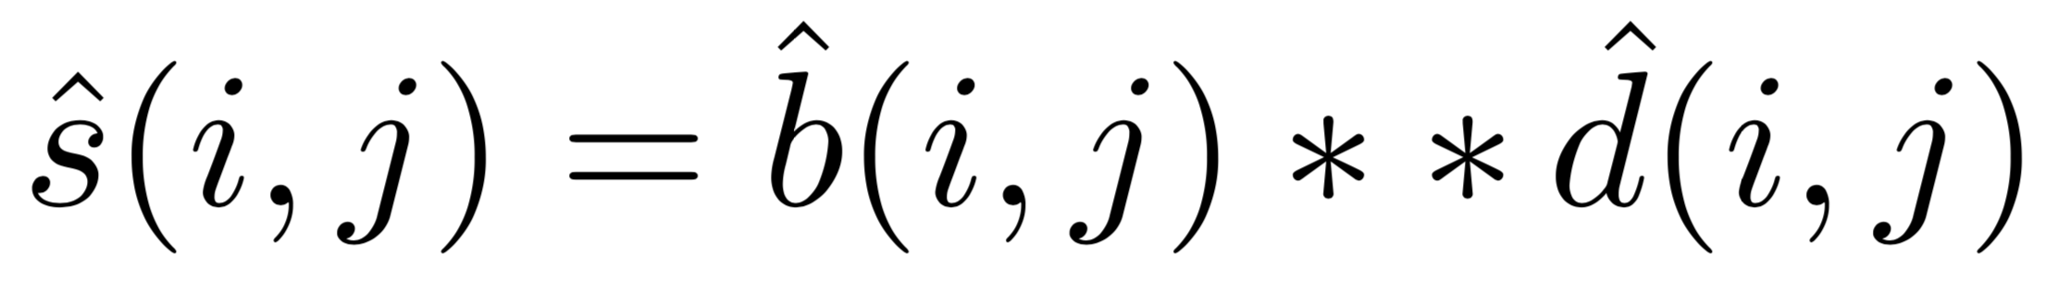
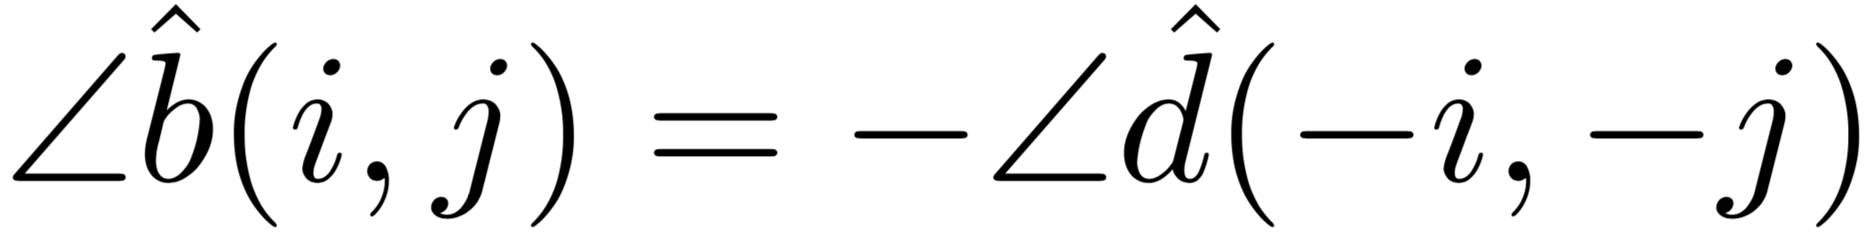
General representation of DOE combination
Complex valued matrix convolution:
Main plus side beams result from input beams convolved with DOE function
Phases drift, amplitudes not so much.
Efficient combination when:
input beam phases equal DOE phase function,
but in reverse, because it’s combining, not splitting

Slide 20
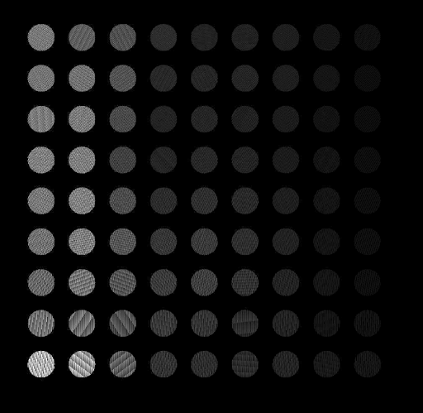
Measuring the phase function of a large DOE
SLM pixel values:
For measuring larger DOE phase function
SLM “programmable hologram” makes beam array easy
SLM controls all degrees of freedom of each beam
  Except polarization
Phase is controlled by shifting grating lines
Du et al, Opt. Exp. 29, 5407 (2021)

Slide 21
Deriving the 9x9 DOE phase function
Note symmetry
  Invariant when rotated 180 about out-of-plane axis, like letter “S”
  Same asymmetric function in x and y?
Scan relative phase of two beams in x, two in y
Find all the power curves
Find phases with respect to scan phase
Yields the full DOE phase function

Slide 22
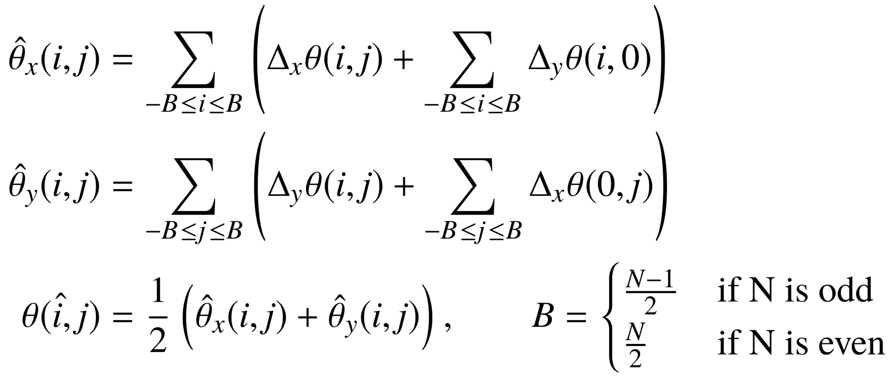
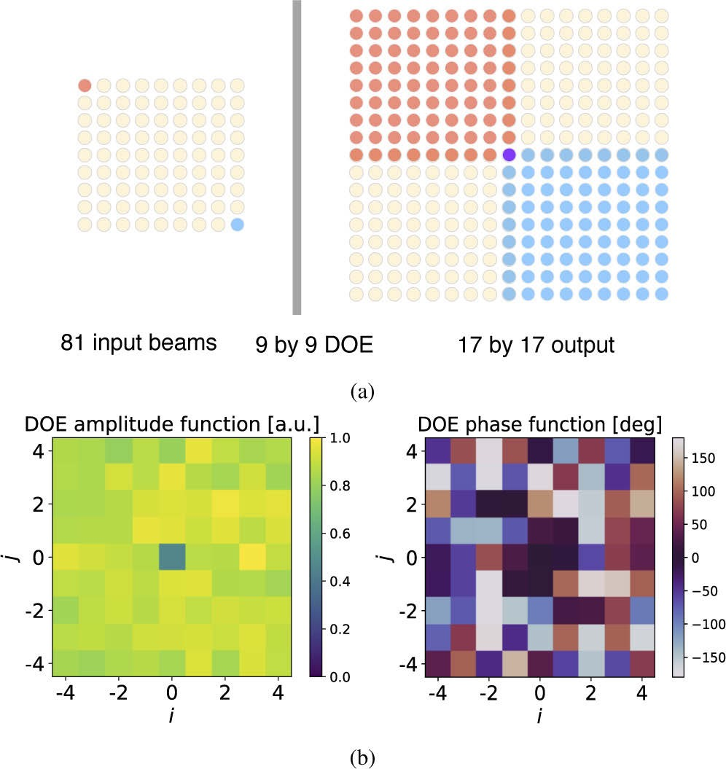
Measured 9x9 phase and power function
We will input this to the DOE
Note symmetry of phase function is “S-like”
  With a minus sign
Same symmetry as in interference patterns

Slide 23
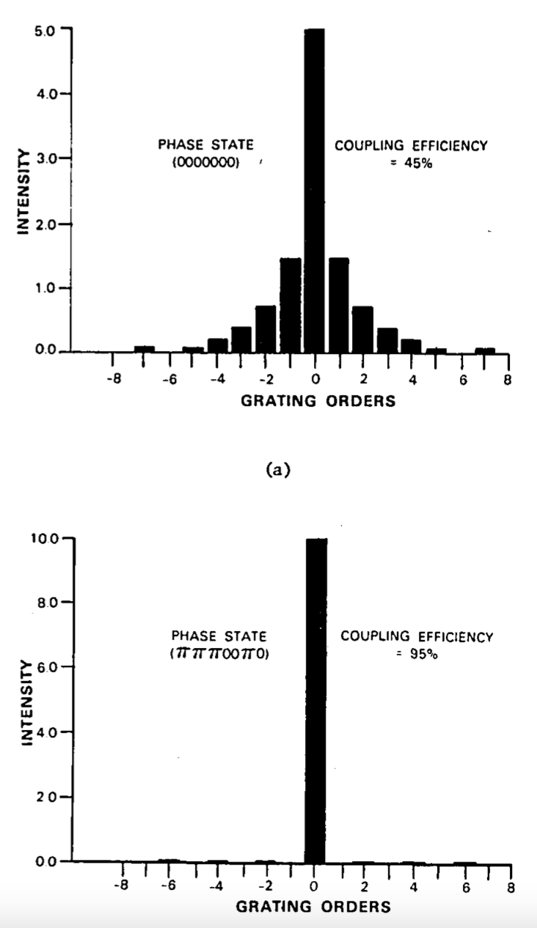
Why the phase function is (a)symmetric
DOE phase function matched with its compliment, amounts to autocorrelation
Want autocorrelation to yield narrow spike (combined beam)
Such a function tends to be asymmetric, random-looking
  Thus, probably useful “quadrature-like” phase shifts always available for control! (This was a potential issue.)
Calculation of DOE finds the same optimal function for x and y
This results in “S” type symmetry of 2D pattern
Leger et al, Appl. Opt. 26, 4391 (1987)

Slide 24
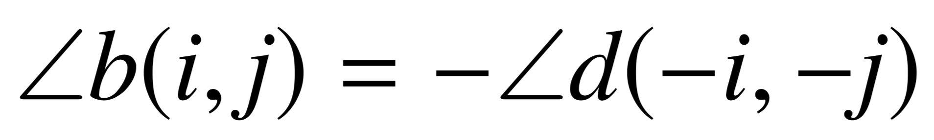
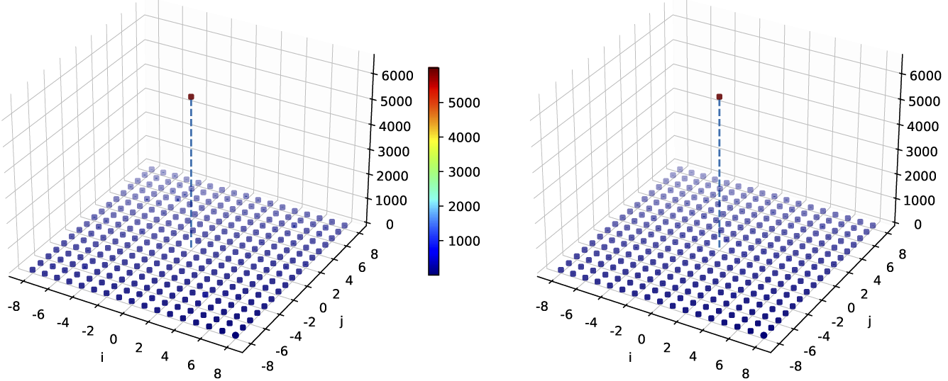
Input compliment of phase function to combine
Min. contrast 20dB
Realistic 15x15 DOE model
Min. contrast 18dB
Ideal 9x9 DOE model
Experimental
Simulated
60.4% eff, DOE is 72%
not optimized
Works in forward direction, but can’t be reversed to find phase errors for stabilization
In real laser, phases are unstable, so perfect inverse phase function is unavailable
  Need to actively control a complex array of beams

Slide 25
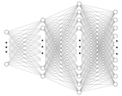


A machine can find patterns in complex data
Phase Controller
Laser System
Sensor
Phase Error
Measurement
Phase Errors (input lasers)
SPGD or Phase retrieval
Intensity Pattern (from camera)
SPGD or Phase retrieval
Neural Network (NN)
Wang et al, Opt. Exp. 29, 5694 (2021)

Slide 26
Phase error training range has to be < ± π/2
Predictions of phase from trained NN:
trained on full range
trained on limited range
Trained outside ±π/2, it gets confused by non-unique correlations
  Maybe less-than-optimal phase shifts available
Works fine when trained in limited range

Slide 27

Examples of ambiguous patterns
Two patterns can have nearly identical side beam powers, completely different phases
Maybe restricting the training range can avoid this

Slide 28
Small training range still works
0 π 2π 3π
Anywhere in phase space, better-than-even chance NN guesses the right direction to go next
Phase state random walks, but with a bias toward training range
Inside training range, one step to optimal
Maybe recognizing pattern similarities is enough

Slide 29
How to initially put training range near optimal
dither
range
accuracy
180 160 140 120 100 80 60 40 20
Use the SPGD algorithm to stay near optimal, while exploring a little
No special phase-mapping knowledge needed for this to work
Dither process provides a set of input errors to learn
Du et al, Opt. Exp. 30, 12639 (2022)

Slide 30







Prediction accuracy usually accumulates
Results: full perturbation range
Simulation:
Wrong predictions
delay convergence
phase difference from optimal

Slide 31

Faster than SPGD at same sample rate
81 beam combiner simulation
SPGD steps scales as 10 x N
  10 x 81 ≈ 800
  OK if reprate >> error frequency
    For us, reprate ≈ error frequency
Pattern recognition scheme scales as √N
  Average to converge:
    8 beams: 5 steps
    81 beams: 40 steps
Better efficiency, stability (no dither)

Slide 32



How to train on an unstable system?
Even with highly stable SLM setup, phases and powers drift:
drift over 24 hours, with same programmed inputs
pattern difference
The NN will have to be trained on real combiners with constantly changing parameters
Need a training scheme robust against drift

Slide 33

Differential learning/control is robust vs. noise
NN (X) = Y
NN training:
NN operation:
dither
input
combiner
correction
combiner
Current
Before
+
X
+
Y
X
Y
After
Target
Pattern
Space
Phase Space
Pattern
Space
Phase Space
NN
NN
X = pattern before + pattern after dither
Y = dither
X = current pattern + target pattern
Y = correction
Wang et al, IEEE JQE 58, 6100309 (2022)

Slide 34


NN trained differentially is efficient, stable
Measured.gif
0.4% RMS over >30min
Combining efficiency: 78.1%
DOE splitting efficiency: 82.1%
Ratio: 0.95
Power
Du et al, Opt. Exp. 30, 12639 (2022)
Control variables

Slide 35

AI found the same important beams we did
8 input beams
3 by 3 DOE
5 by 5 interference pattern
Assigning humans the stabilization task:
“These eight beams should give enough information” (based on physics).
Stabilization worked.
Assigning AI the stabilization task:
“These eight beams are more informative than the others” (based on experience).
Stabilization worked.
Could AI be used to find important parts of complex data before they are understood?

Slide 36



Control concept extends to temporal combining
Pattern
data
Combined output
Phase
stabilizer
Input pulses
Similar problem: patterns due to interference
Patterns are temporal (pulse trains), recognizable by NN
Stabilizes round trip phase in energy storage cavities
Wang et al, IEEE JQE 58, 6100309 (2022)

Slide 37

With short pulses, need to cancel pulse front tilt
$$θPFT$$
Angular dispersion (pulse front tilt) causes loss
  Compensate using second grating
Spatial and temporal dispersion still present
  Minimize by small diffraction angles
DOE
30fs is 10um
Zhou et al, Opt. Lett. 42, 4422 (2017)
DOE1
(integrated grating array)
DOE2
(diffractive splitter in reverse)
R. Wilcox, U.S. Patent 10,444,526

Slide 38


Calculation/modeling of loss mechanisms
100fs pulses after
4:1 combination
combined beam
without angle
compensator
with angle
compensator
Efficiency loss due to spatial dispersion:
According to theory, for small angles, dispersion and loss are low
Efficiency loss due to temporal dispersion:

Slide 39


4:1 experiment: high efficiency, low dispersion
Phase stabilized by SPGD
$$combining efficiency= \frac{combined beam power}{all output power}$$
120fs FWHM
$$splitting efficiency= \frac{\sum{far field beam powers}}{all output power}$$
Measured combining efficiency: 83.4%
Measured splitting efficiency (max combining efficiency): 84.7%
Dividing, we obtain 98% of theoretical efficiency
Zhou et al, Opt. Lett. 42, 4422 (2017)

Slide 40



8:1 experiment: high efficiency, low dispersion
Phase stabilized by SPGD
120fs FWHM
Measured combining efficiency: 89.5%
Measured splitting efficiency (max combining efficiency): 90.7%
Dividing, we obtain 98% of theoretical efficiency
Zhou et al, Opt. Lett. 43, 3269 (2018)

Slide 41




Multidimensional coherent combination
spectral
splitter
stretchers and
pre-amplifiers
Beam, pulse, and spectral combination
Achieves high energy, ultrafast pulses
High reprate and power, because fiber
oscillator
power
amplifiers
λ₁
λ₂
spatial
combiners
λ₃
spectral
combiners
…
temporal
stackers
pulse compressor
output

Slide 42






New laser will combine in space, time, spectrum
Schedule
Lab space
Block diagram
Current funding ~$8M
Modulators
Layout
Beam
combiners
Amplifiers
Hardware designs

Slide 43



Recent experimental support
SPECTRAL COMBINATION
TEMPORAL COMBINATION
Bandwidth to support 50fs
3 spectral bands combine to 40fs pulse
Siyun Chen, LBNL
Lauren Cooper, UM
A
AMPLIFICATION
G
F
E
Active and passive fiber drawn
for commercially produced fiber amp
D
B
C
Don Sipes, Optical Engines
Arto Nieminen, nLight

Slide 44
Conclusions and future work
We have stabilized large numbers of beams using advanced algorithms
This enables high-energy fiber laser designs
Ongoing work will make error correction faster
We are currently building a fiber laser with beam combination (27 beams), temporal combination (81 pulses), and spectral combination (3 bands)
  Target ~200mJ energy in ~40fs
  This will be a stepping stone toward high reprate accelerator drivers

