Slide 1
The 45th meeting of the US-Japan Joint Committee on High Energy Physics,
May 22-23, 2023, University of Hawaii
A collaboration framework to advance high temperature superconducting magnets for accelerator facilities
Tengming Shen (US PI), Lawrence Berkeley National Laboratory
Mukesh Dhakarwal (KEK) for Toru Ogitsu (Japan PI), KEK
With Xiaorong Wang (US CO-PI), Lawrence Berkeley National Laboratory, Ramesh Gupta, (US CO-PI), Brookhaven National Laboratory, and Naoyuki Amemiya (Japan CO-PI, Kyoto University).

Slide 2
Who we are?
Members of the US Magnet Development Program
Peter Hosemann
Kyoto Uni: Naoyuki Amemiya, Yusuke Sogabe, Guangwei Xu, Mao Shigemasa
KEK: Toru Ogitsu, Tatsushi Nakamoto, Michinaka Sugano, Masami Iio, Kento Suzuki, Mukesh Dhakarwal
BNL: Ramesh Gupta, Piyush Joshi, Mithlesh Kumar
LBNL: Chris Reis, Laura Garcia Fajardo, Tengming Shen, Xiaorong Wang
Early Career Scientists
Graduate students

Slide 3
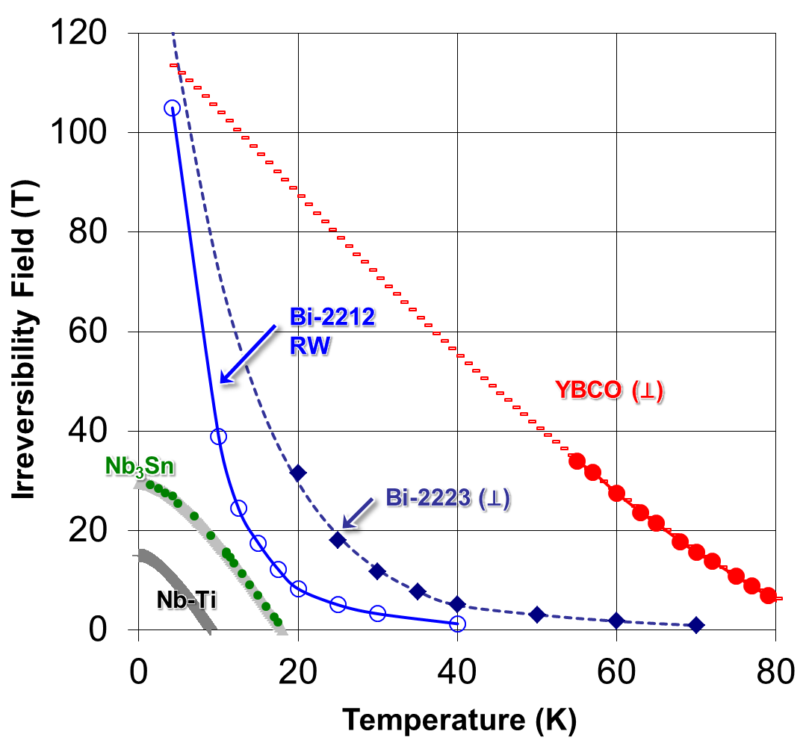
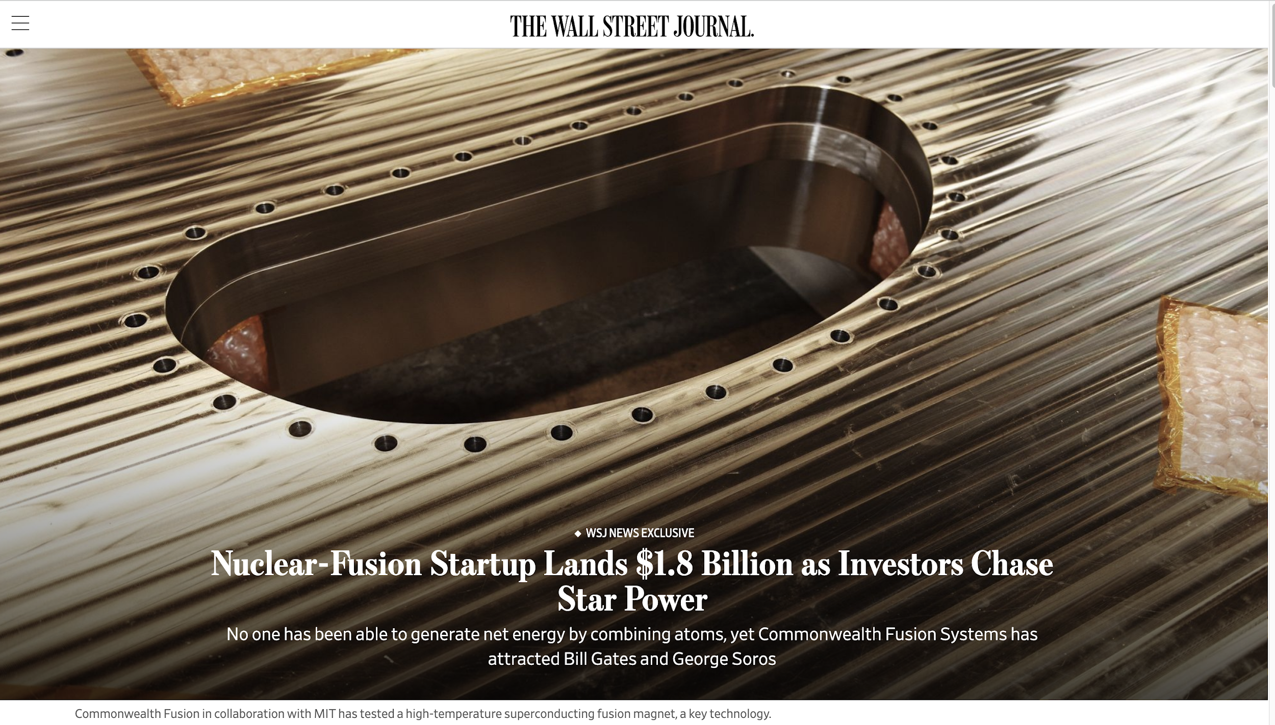
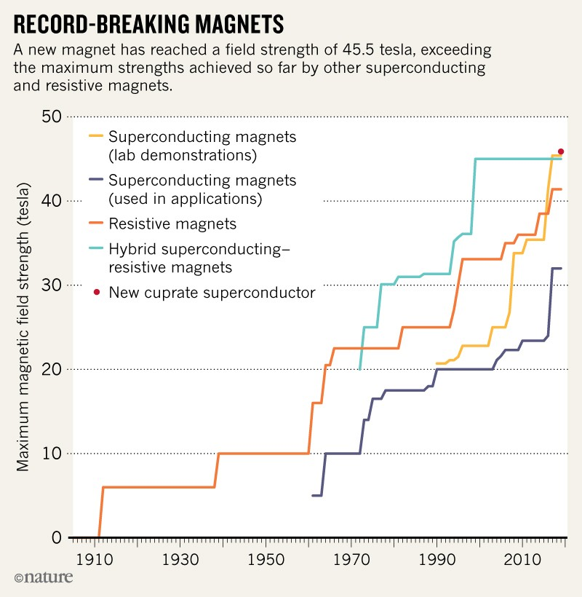
Why study HTS magnets?
(courtesy of D. Larbalestier, NHMFL)
High field frontier – enable frontier accelerator, fusion, and scientific facilities.
High temperature frontier – reduce the reliance on liquid He supply
Instruments 2020, 4(4), 30;
https://doi.org/10.3390/instruments4040030

Slide 4
Our tasks
Task 1: HTS magnet technologies for high-radiation environment
KEK, LBNL - Ceramic insulation, gamma-ray radiated epoxy resin composites, and neutron irradiation of REBCO tapes
Task 2: Stability, quench protection, and magnet safety
Kyoto Uni., LBNL, BNL – quench modeling, experiments with single tapes and REBCO wires/cables.
Task 3: Measuring and modeling AC loss and field quality of HTS accelerator magnets
Kyoto Uni., LBNL, KEK, BNL – magnets from C0 to C2, from modeling to experiments
Task 4: HTS/LTS high field hybrid accelerator dipole technology
KEK – racetrack coils fab; BNL – test of KEK racetrack coils in 10 T background fields.
The current funding: 07/01/2021 - 06/30/2024; Will submit a renewal proposal in Dec 2023.

Slide 5
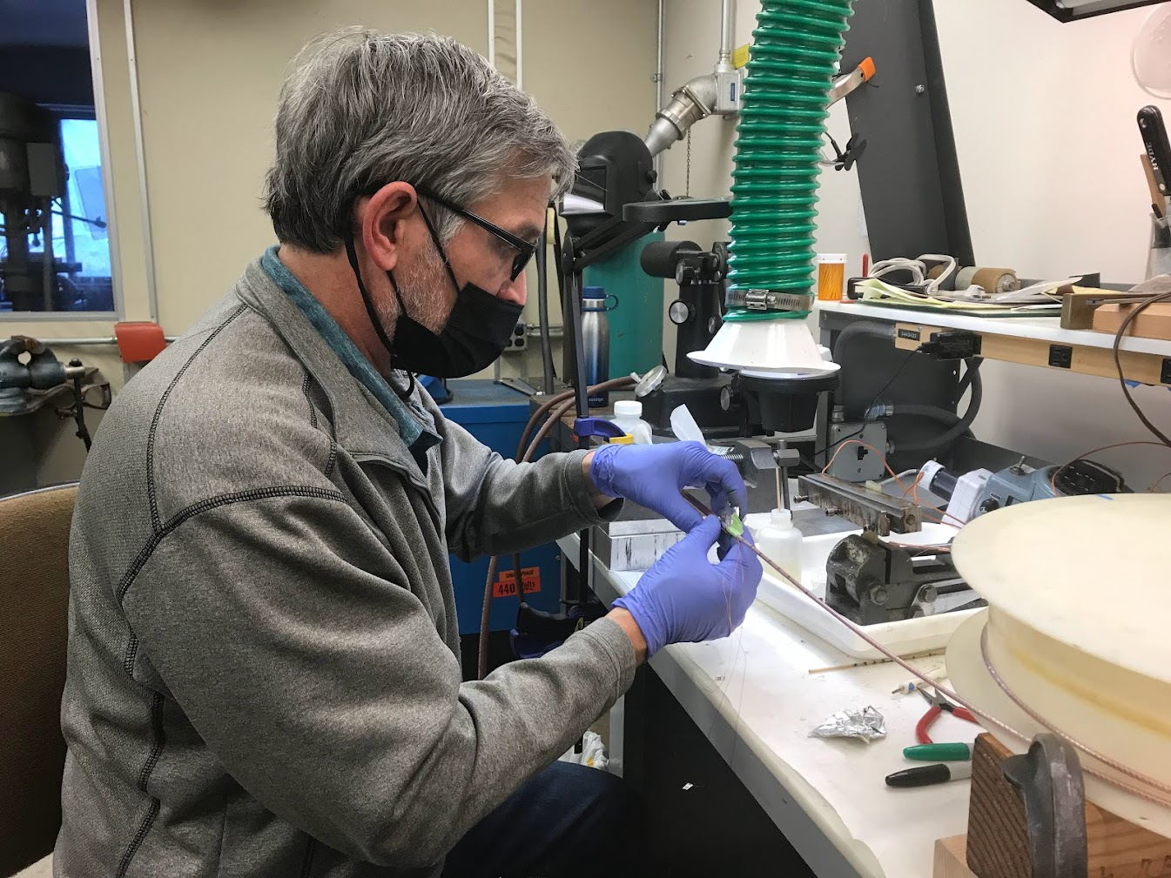
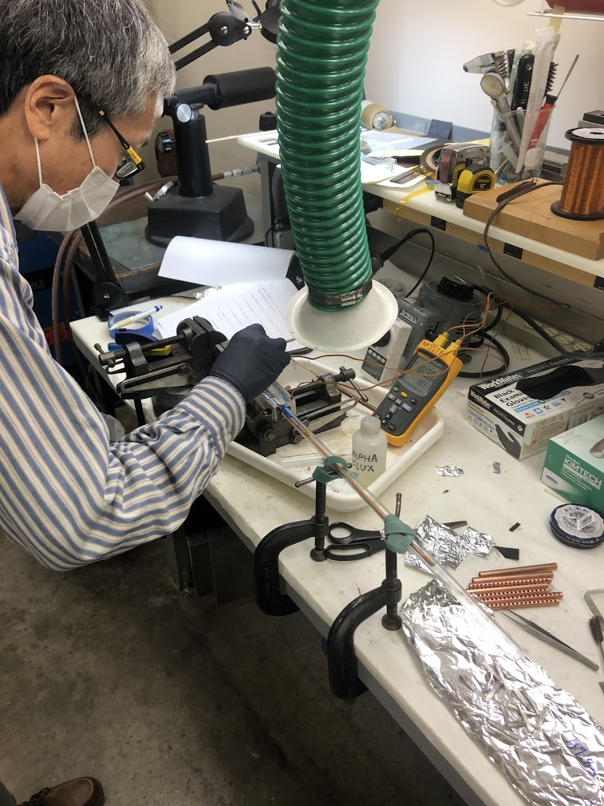
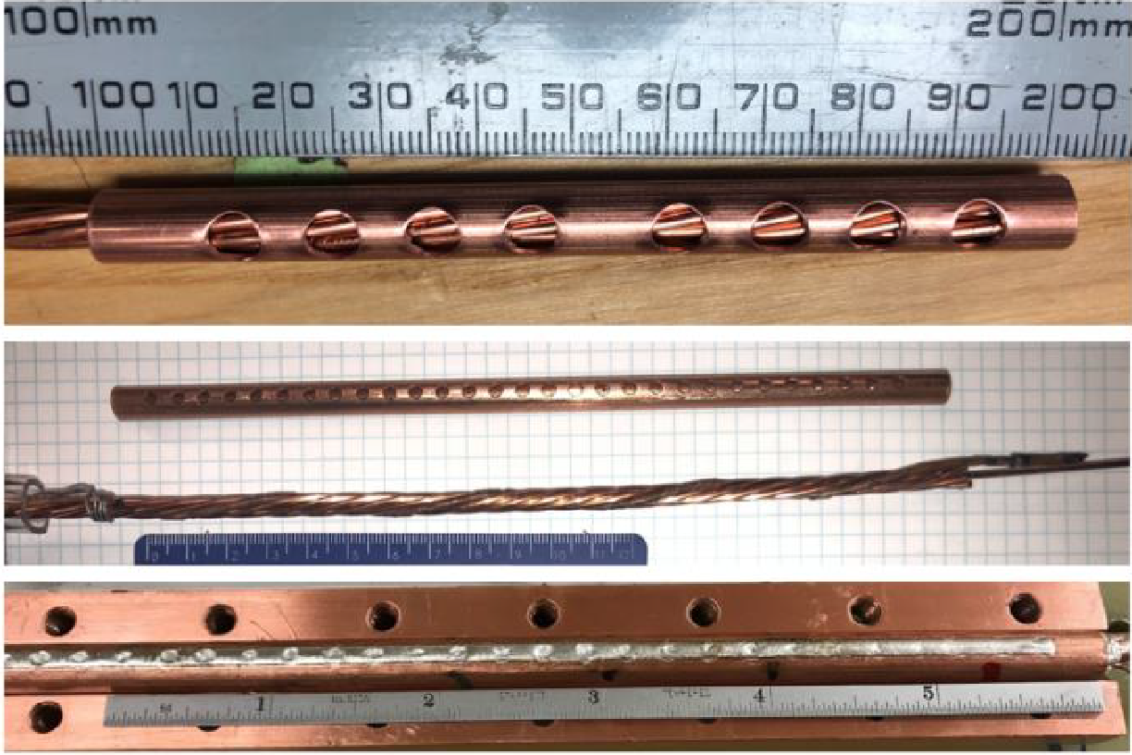
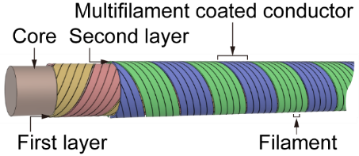
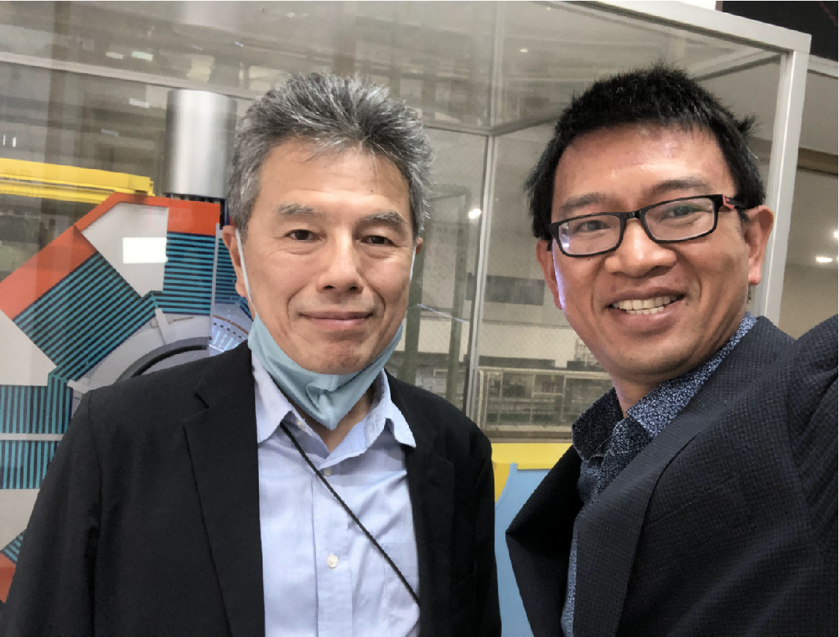
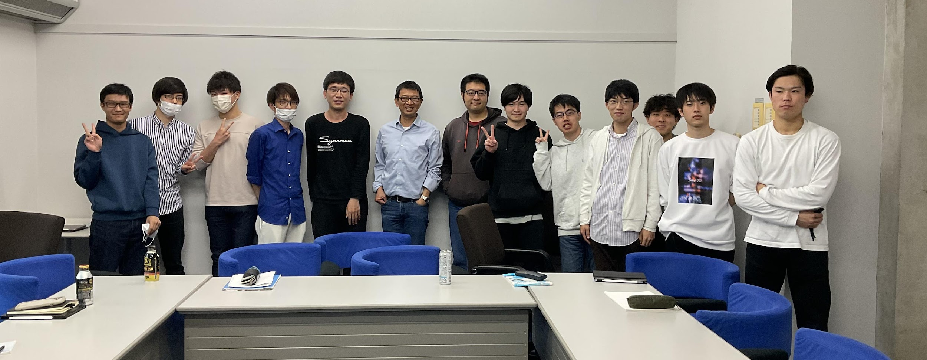
Exchanges
Prof. Amemiya, Sept 2022, learned how to fabricate a terminal/joint with LBNL’s flute design with Hugh Higley, applied to his SCSC cable design,
And provided improvement.
Ogitsu and Shen in front of BELLE-II
April 16, 2023
Lecture (T. Shen) to Kyoto Uni. Students, April 21, 2023

Slide 6
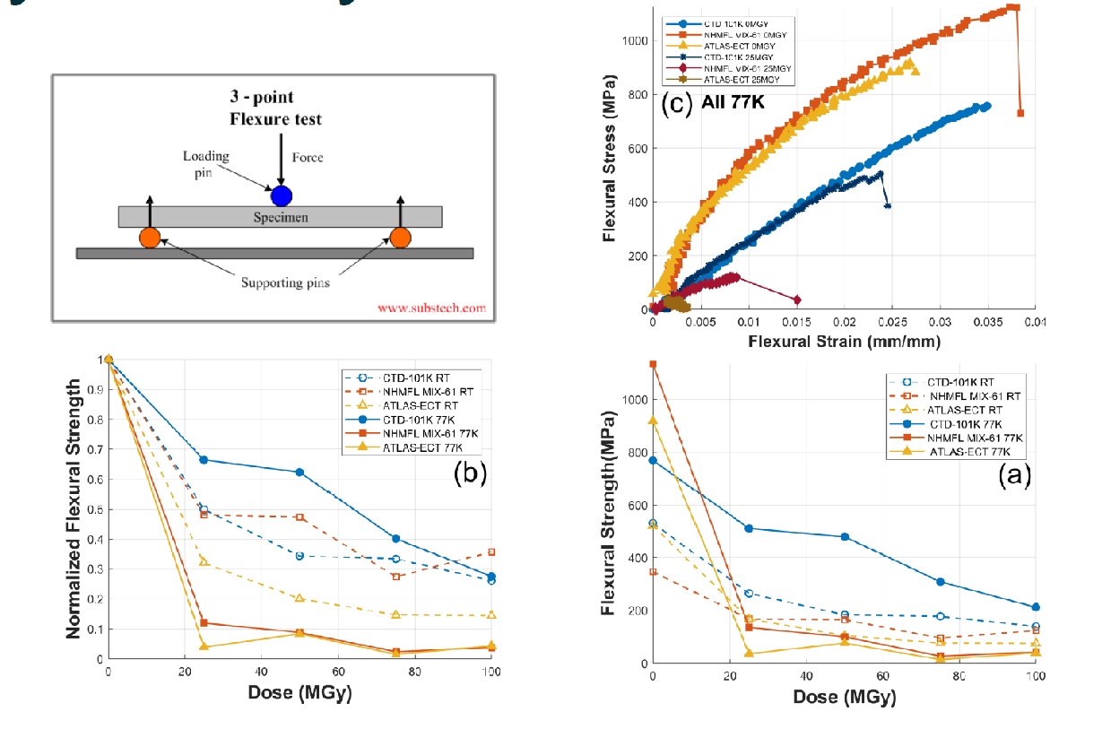
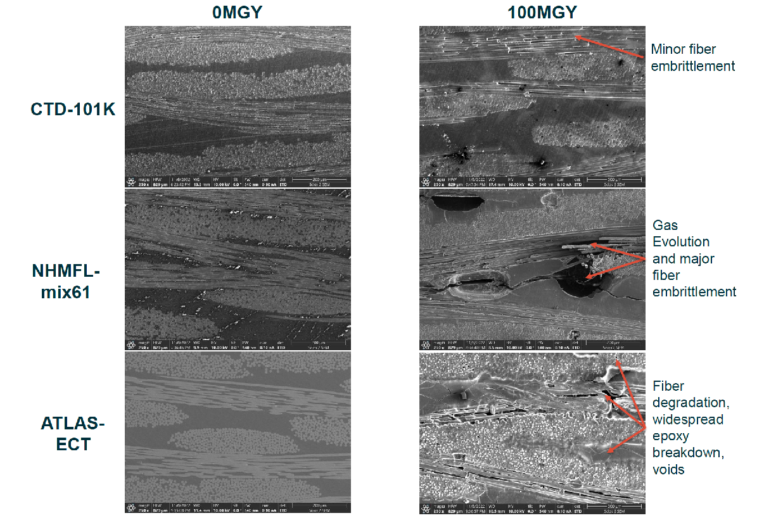
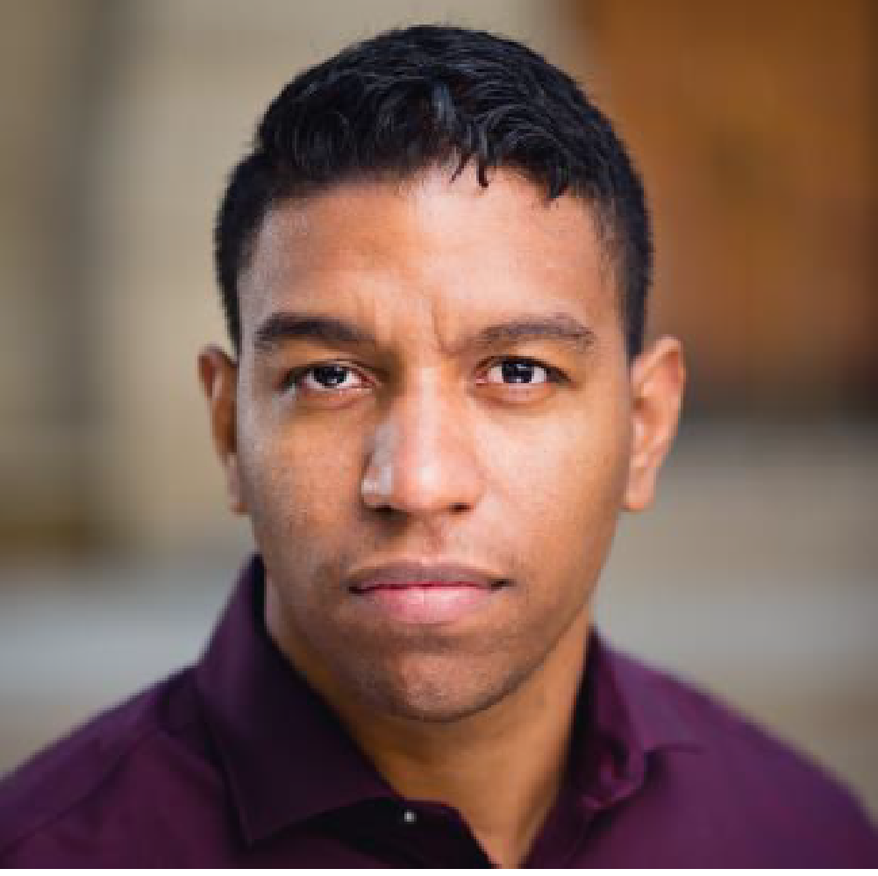
Task 1. Gamma ray radiation of epoxy resin composites and test
Epoxy resins are widely used in superconducting magnets.
Selected for high-Lumi LHC
and AUP Nb₃Sn Quads
10.1109/TASC.2019.2898124
By Chris Reis, LBNL, UCB, published with IEEE Trans. Appl. Supercond.

Slide 7
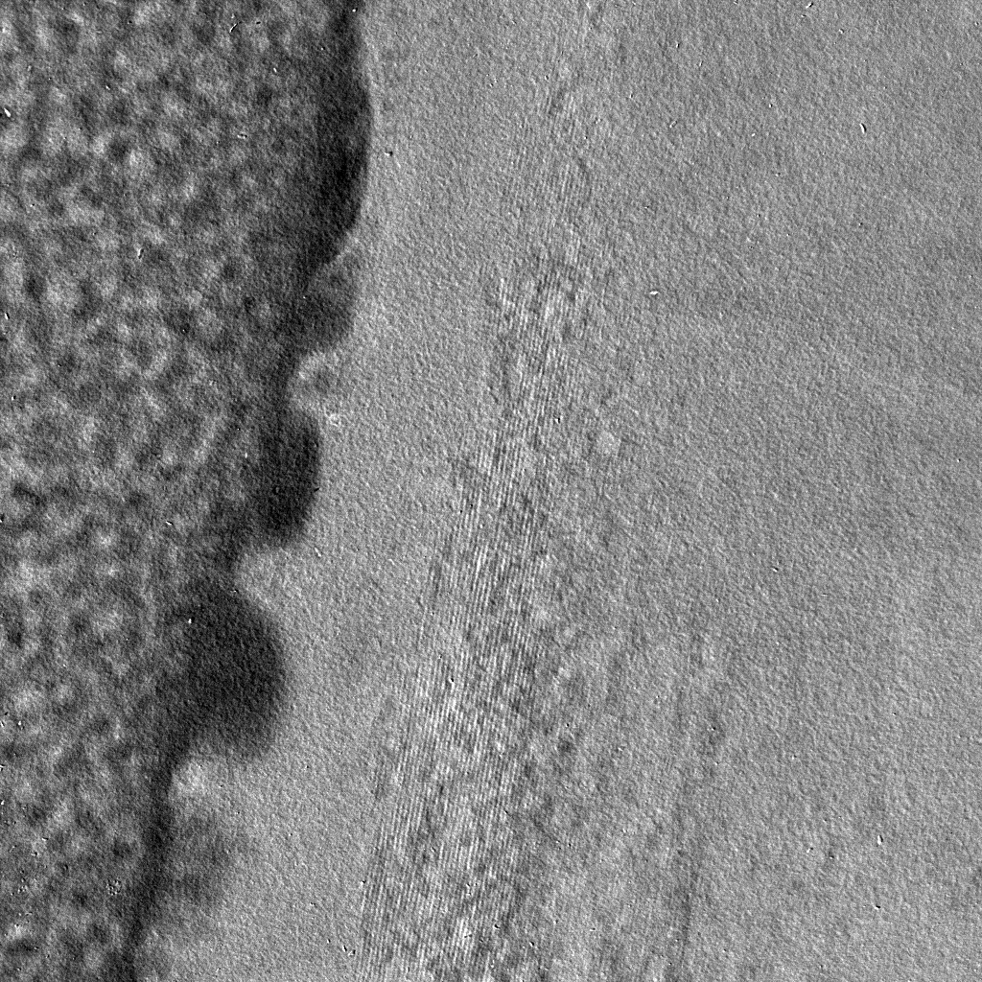
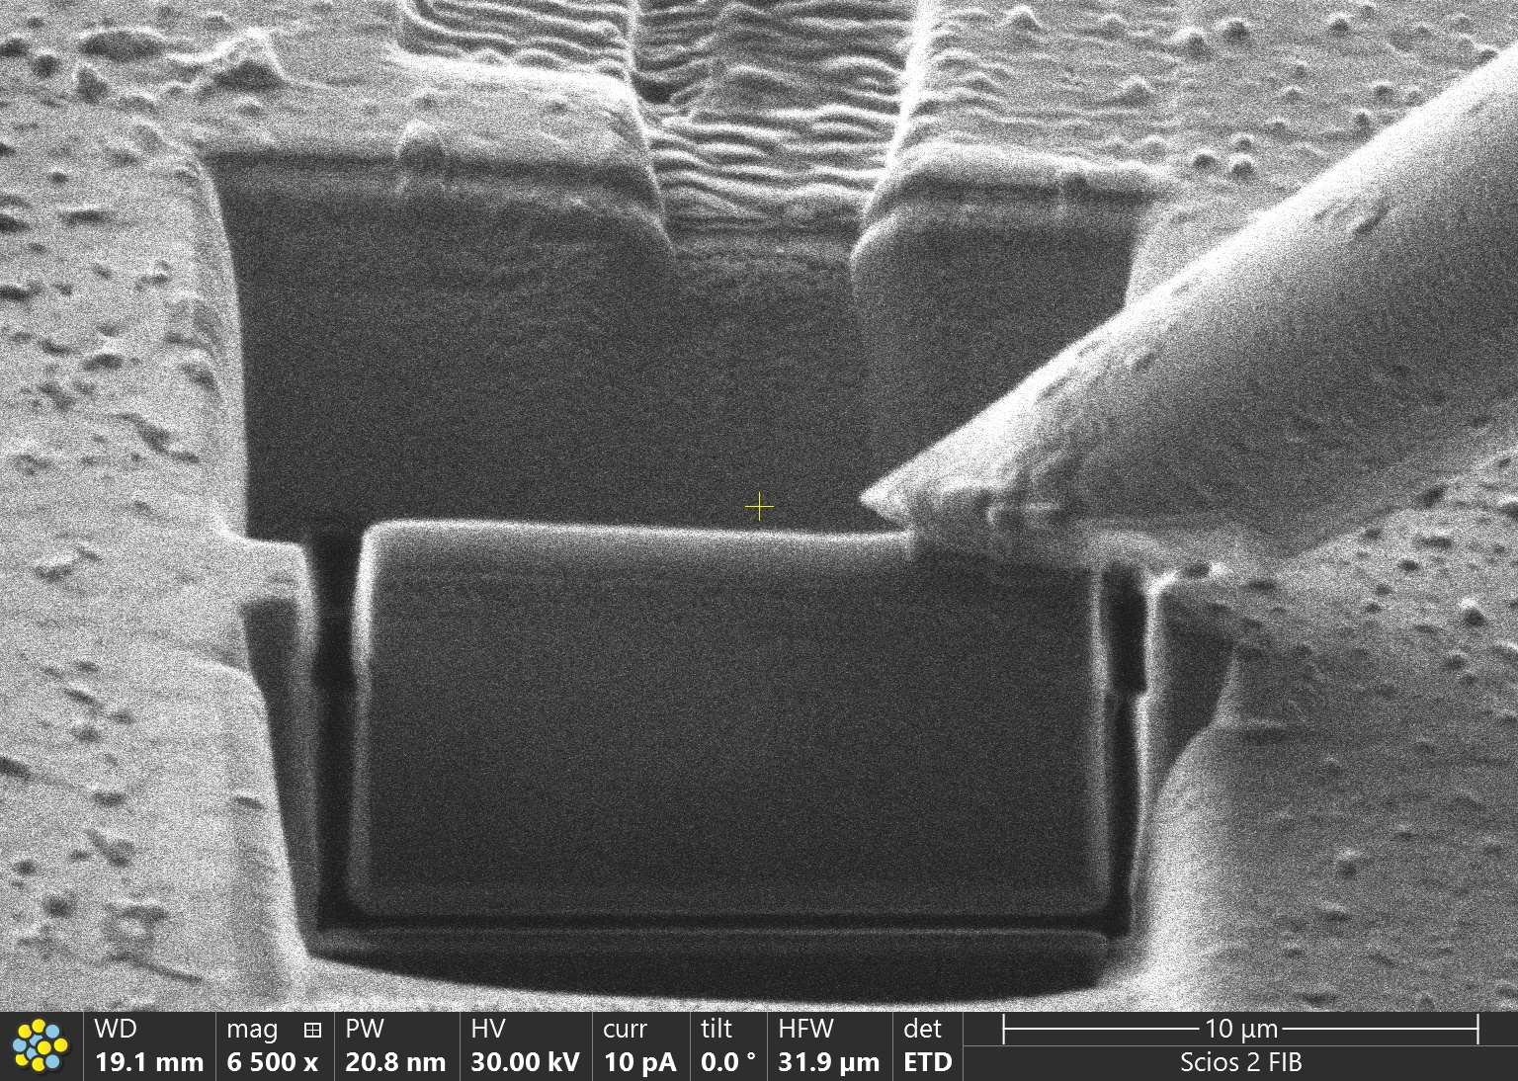
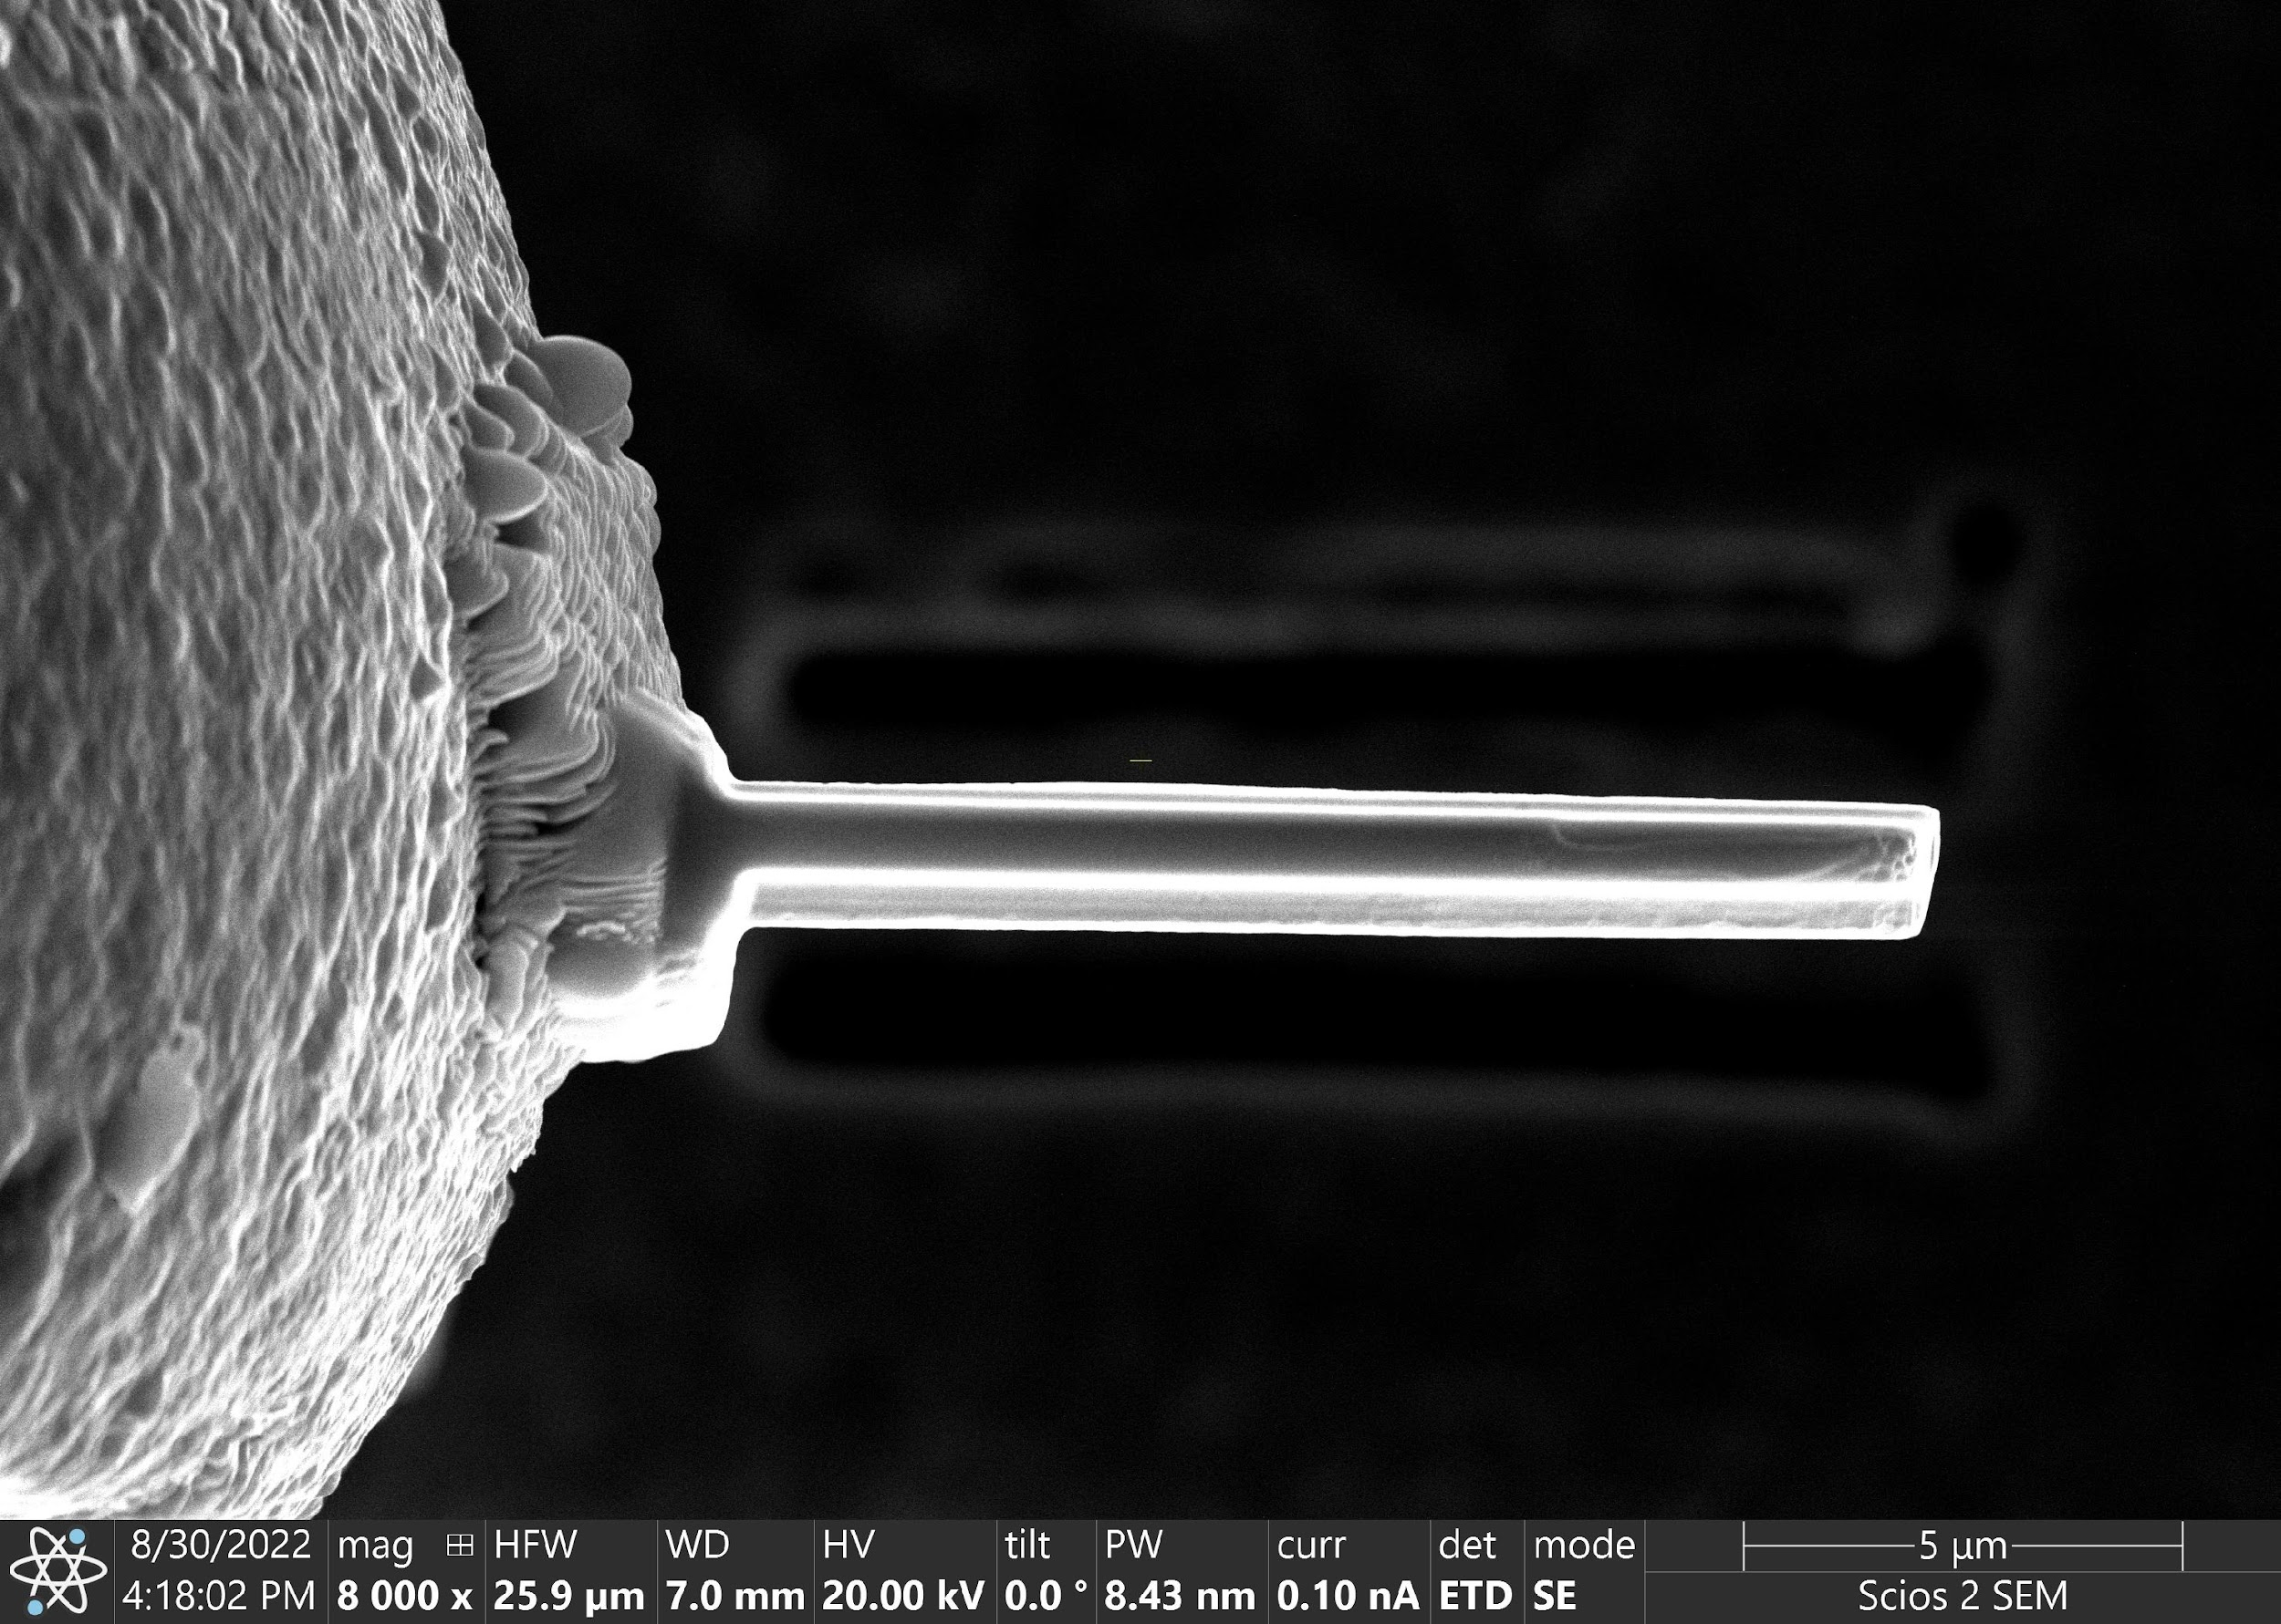
Task 2. Neutron irradiation of REBCO tapes made possible by unique facilities @ BR2 and Tohoku Uni.
HR-TEM of REBCO
at NCEM, LBNL
Sample prep + FIB-SEM @ UCB
Helium ion implantation at LBNL/UC Berkeley
Masami IIO, KEK

Slide 8
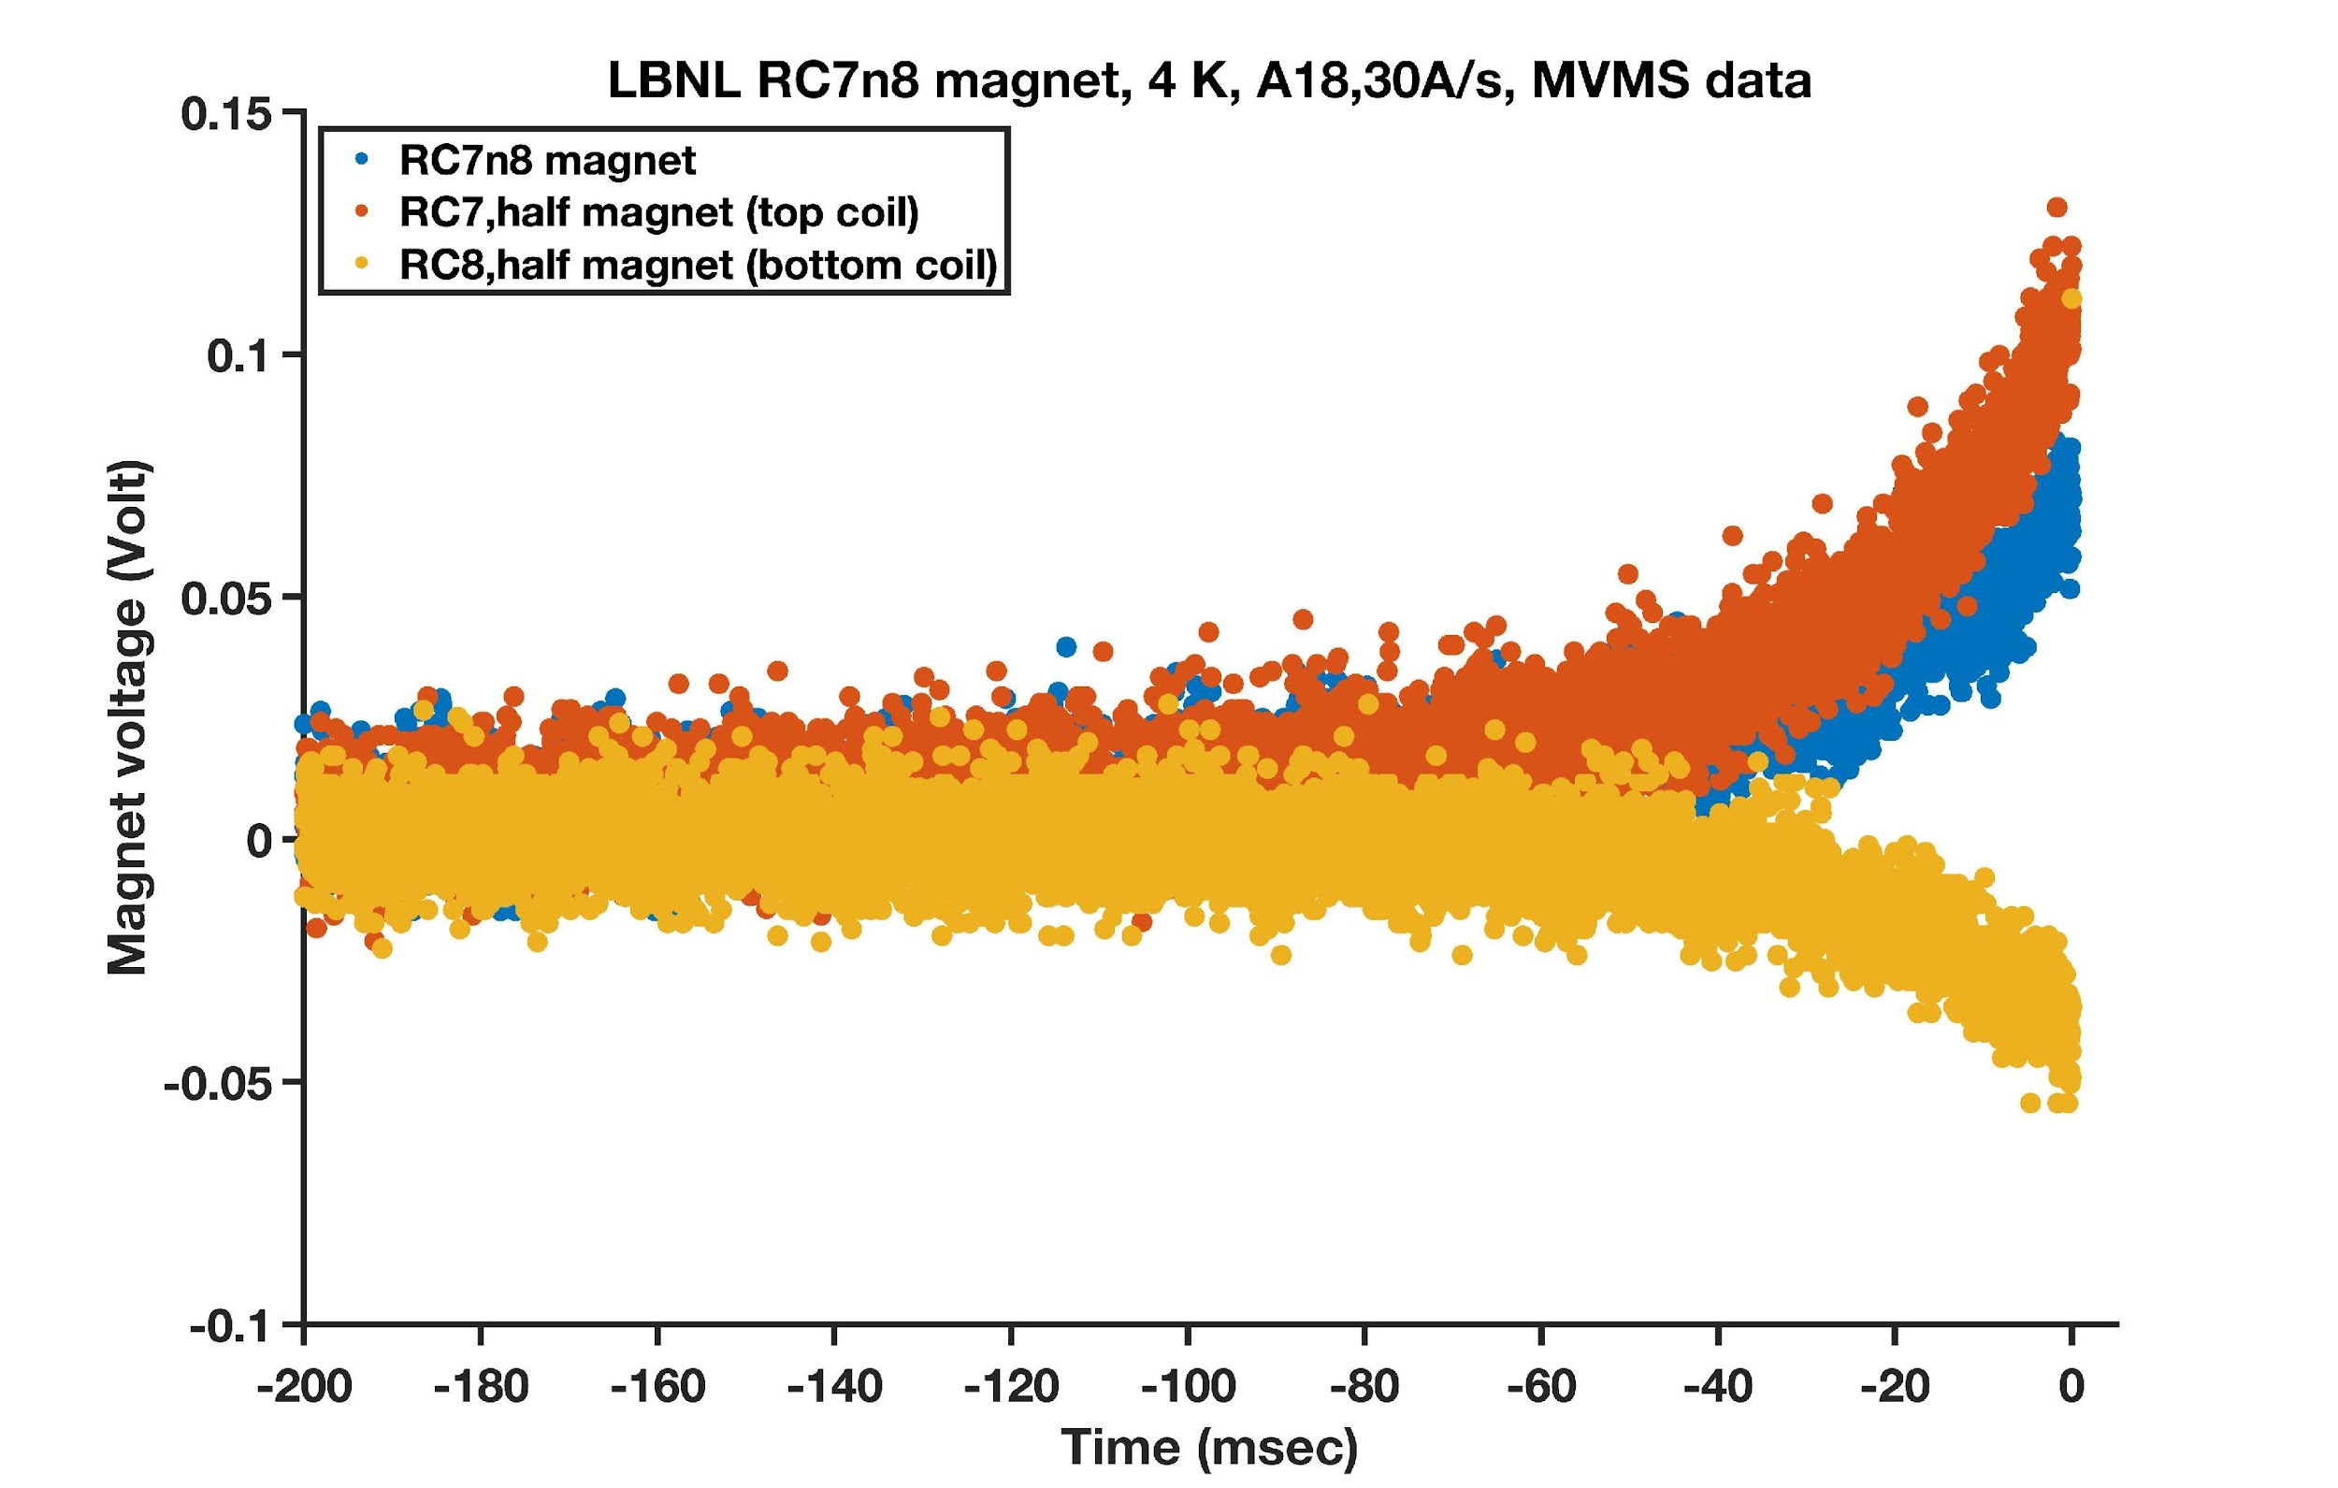
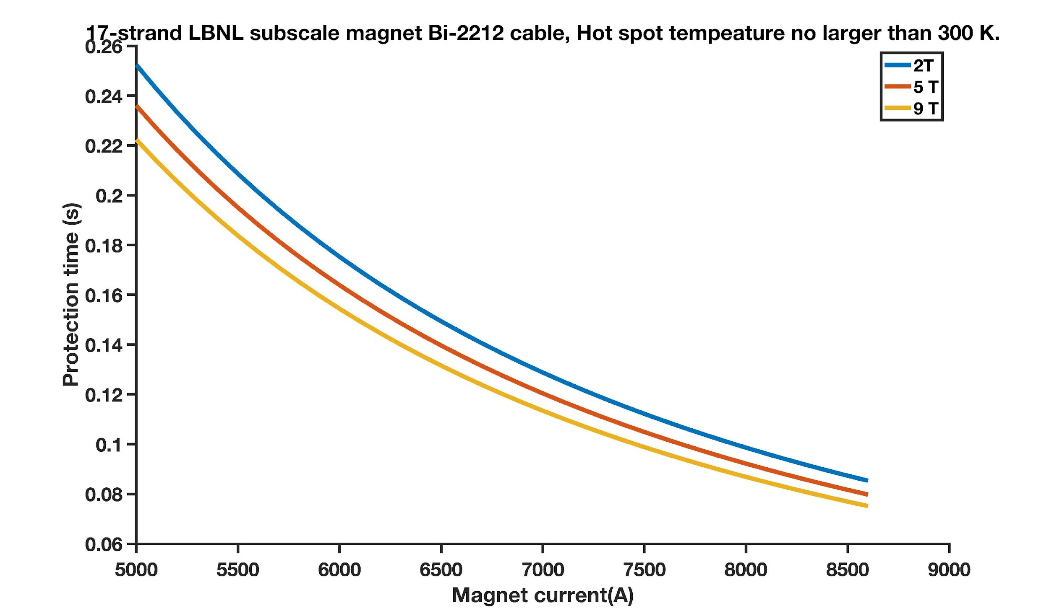
Task 2. Improving quench detection for HTS magnets
Known and existing: cRIO + FPGA/PXI, LBNL MTF
developed for LTS magnets
MIITS/time budget:
MIITS/time budget:
Detection
Protection
Detection
Protection
Magnet voltage (Volt)
RC7n8, 4.7 T, 5700 A,
Wire J_{E}=680 A/mm²
t < 180 ms for limit
temperature < 300 K
Extraction at
t = 0 s.
Protection time (s)
Time (ms)
Used to protect all MDP-LBNL Bi-2212 magnets.
RMS noises in 10⁻² V.
Quench detection at 50 – 100 mV.
Magnet current (A)

Slide 9
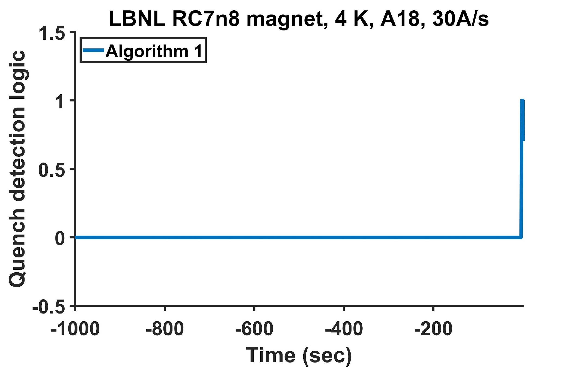
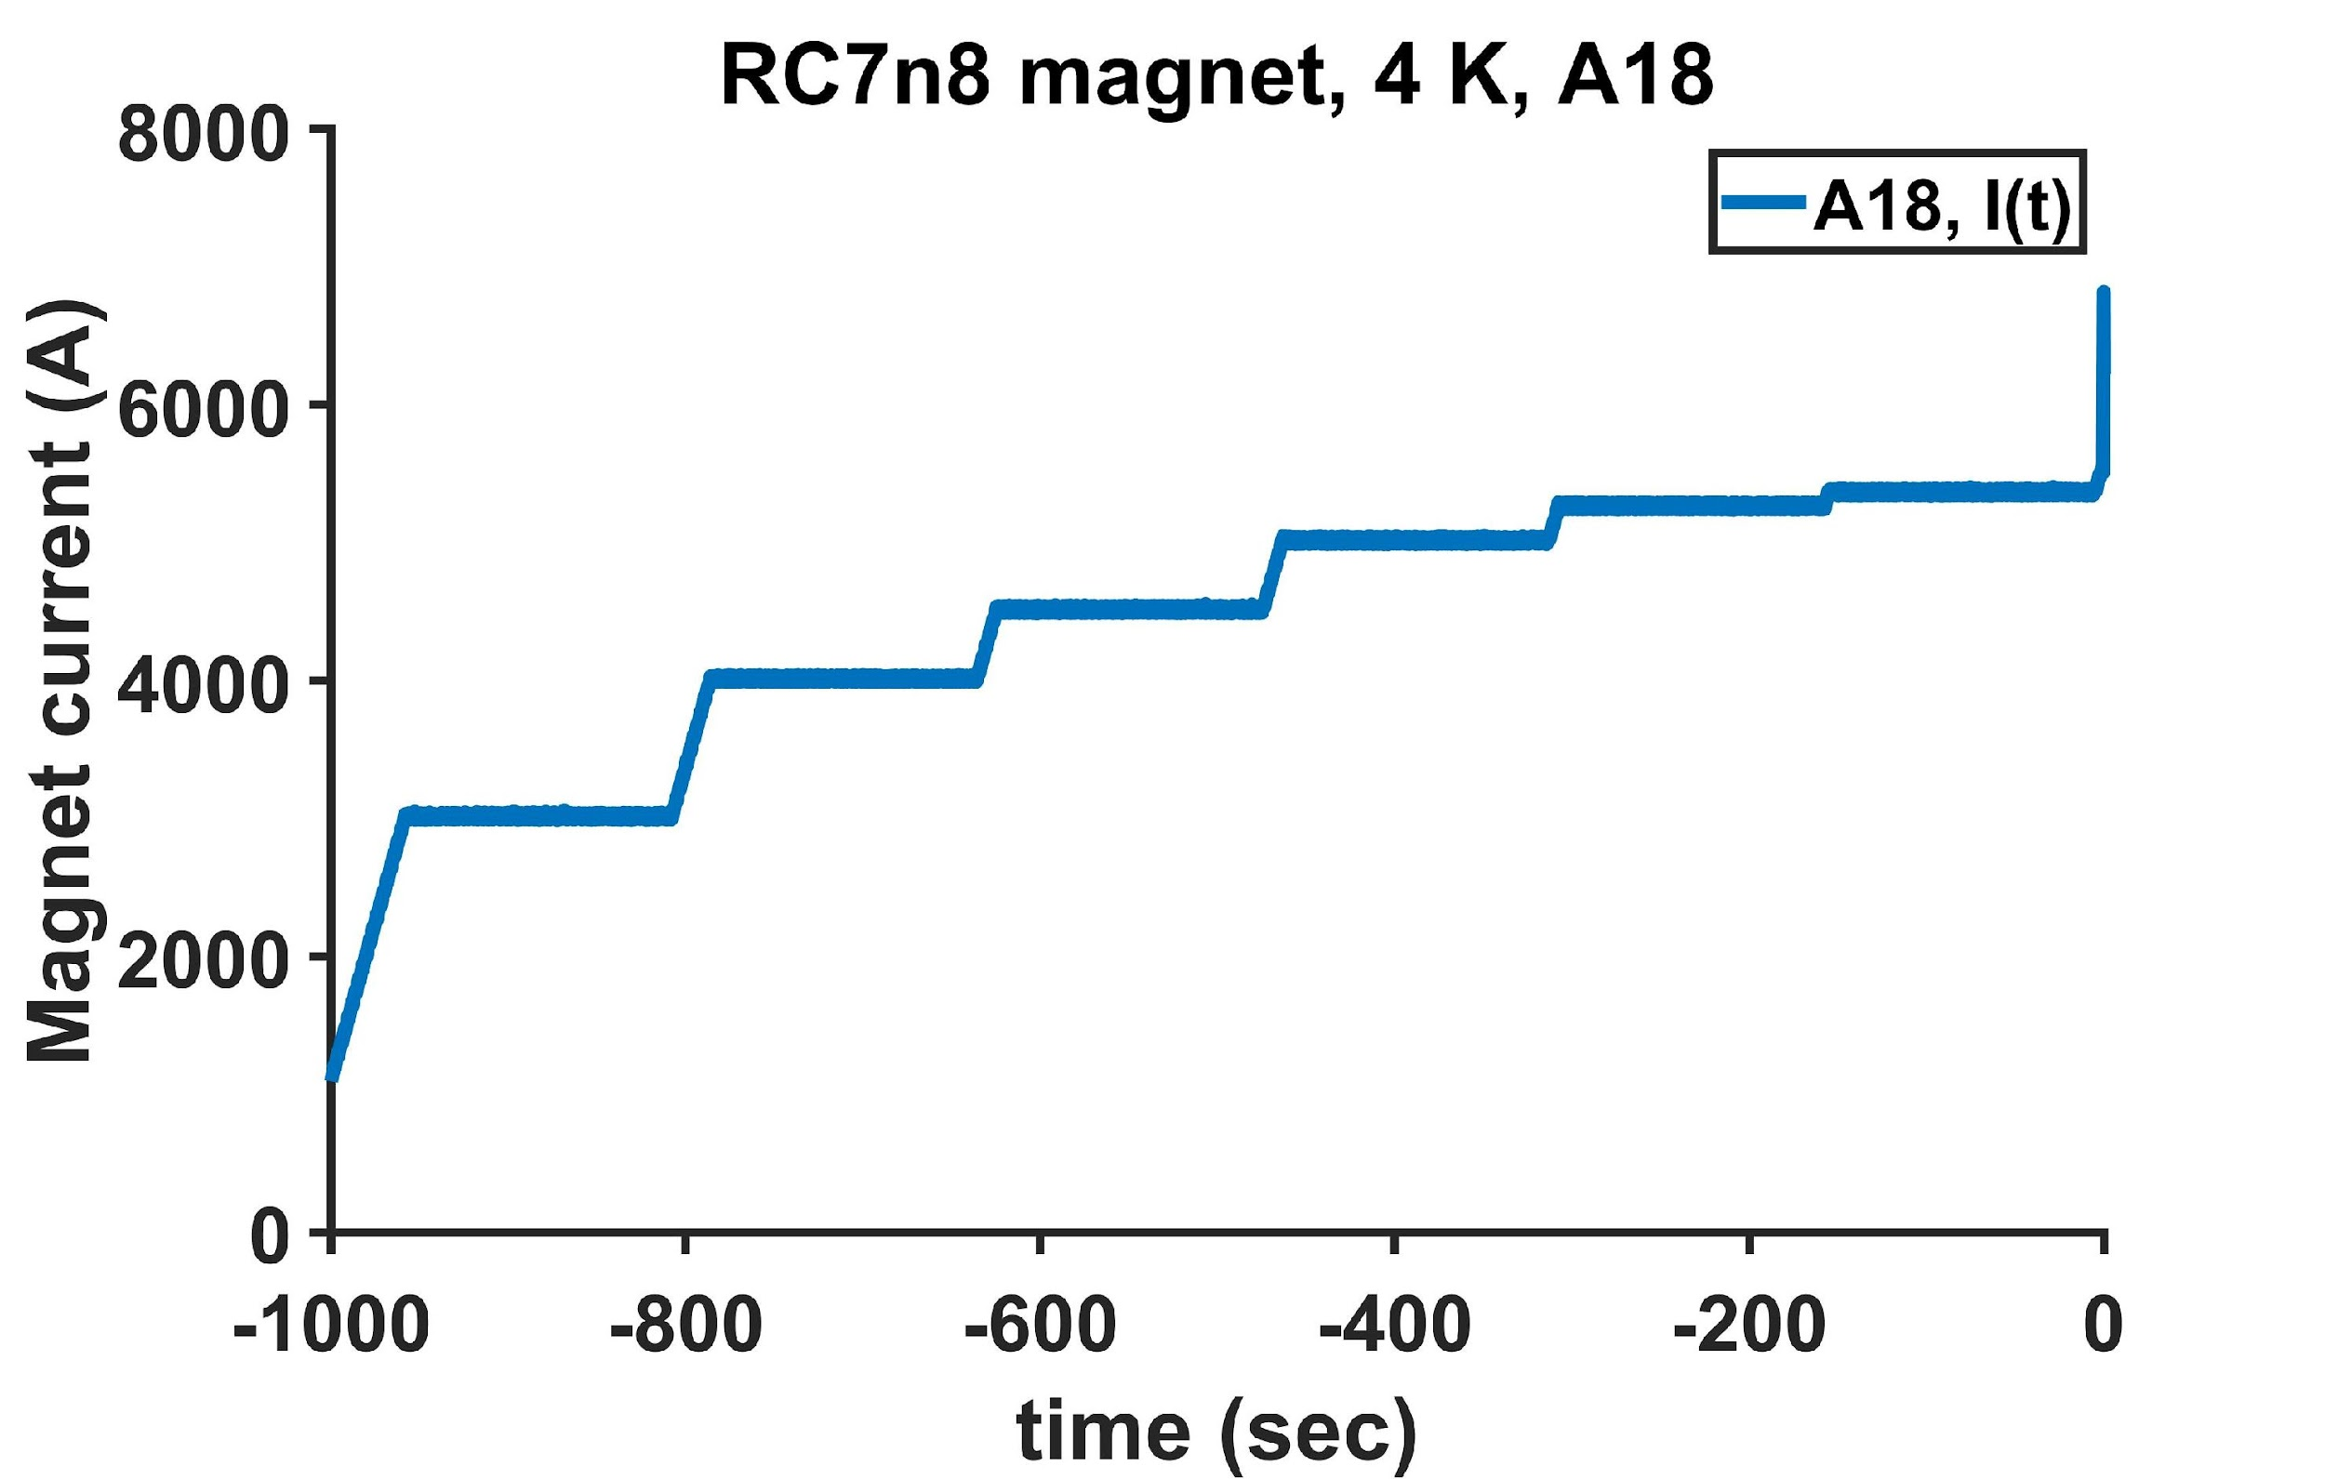
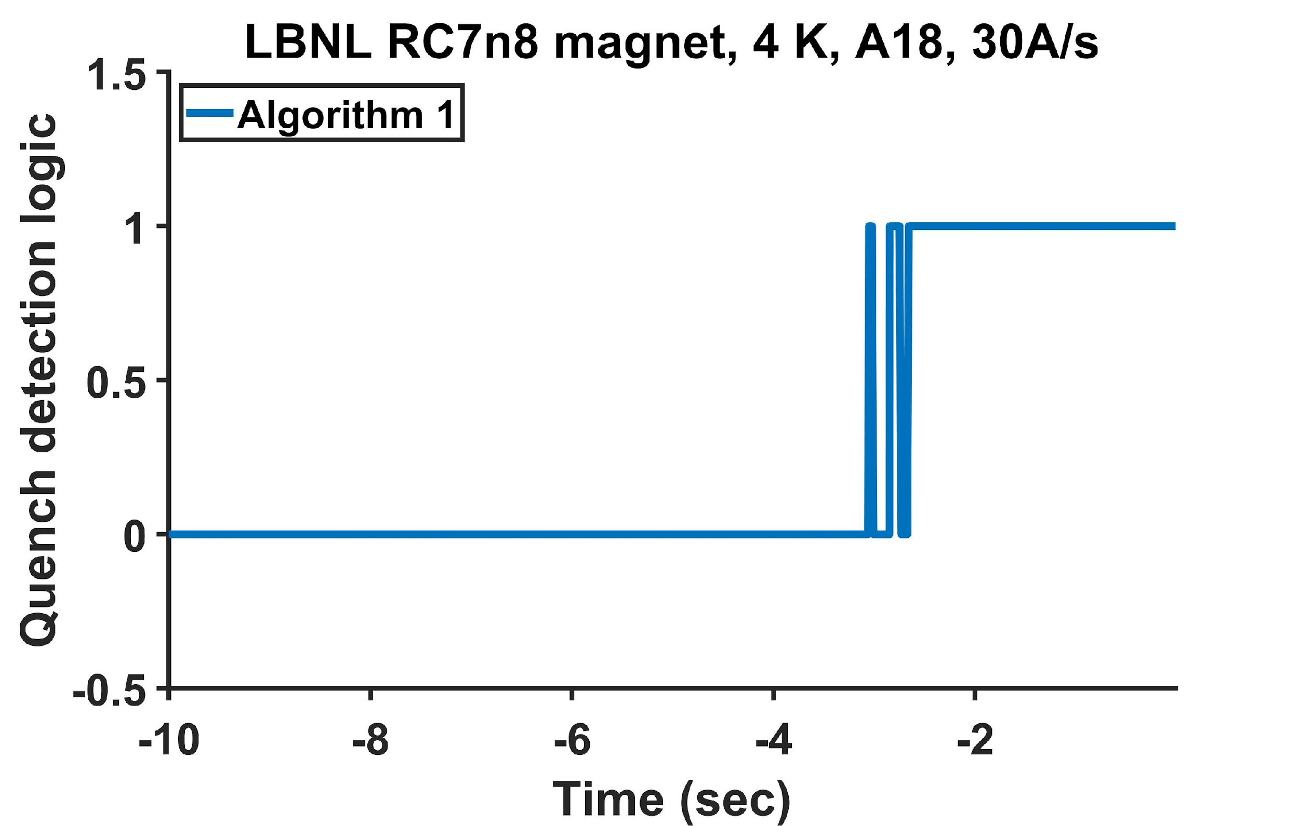
Task 2. Improving quench detection for HTS magnets – quench detection made 2.6 s ahead of the state of the art method – hugely important for safety of HTS magnets
No false detection from
-1000 s to -3.096 s
Staircase run with 30A/s ramp rate
Time = 0 s
SCR opened
No false detection to -3.096 s
No ambiguity after -2.652s

Slide 10
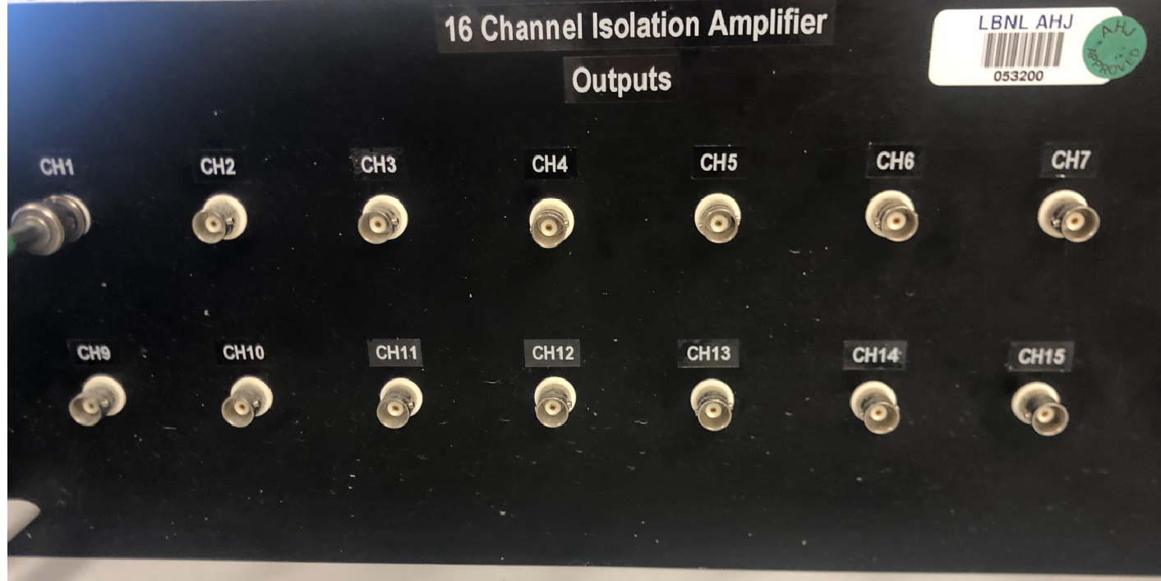
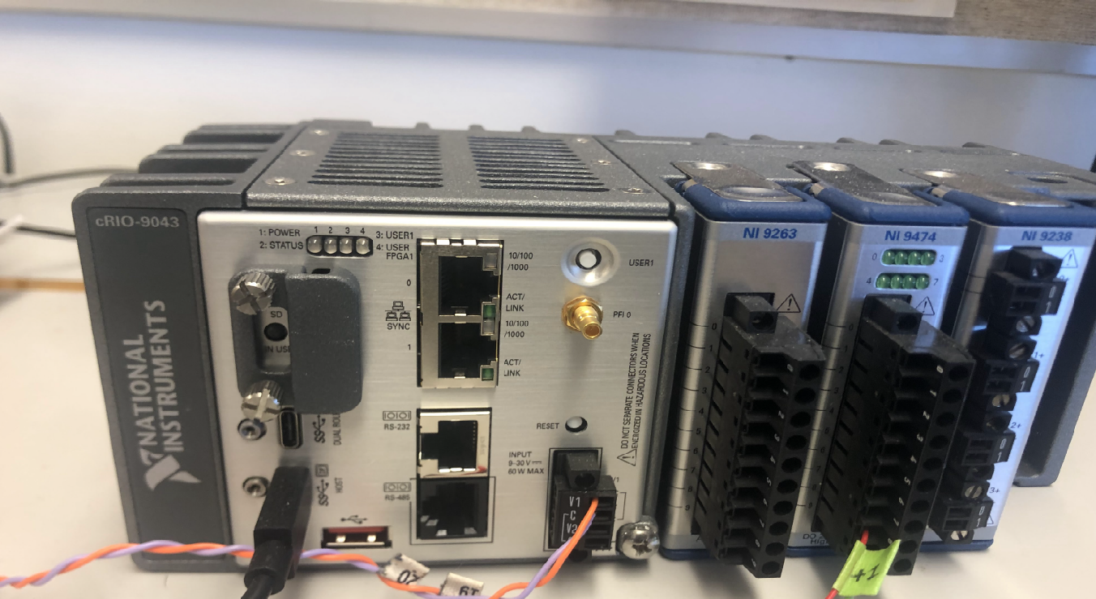
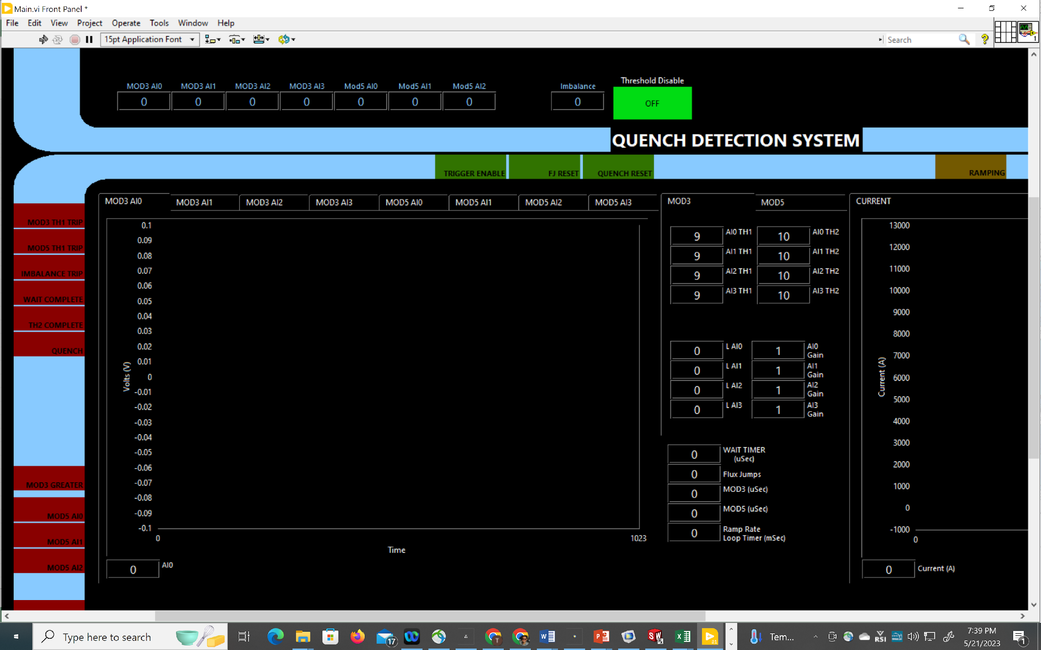
Able to have quench detection 2.5 seconds ahead, why it is exciting, and why this collaboration is interested and qualified to perform this work.
NEW LBNL QDS algorithm
Fast (discrimination at every 1 ms)
Work with all magnet operating scenarios
Implementable with FPGA.
To be applied, tested, and enhanced by US-Japan HTS magnets
- Test of KEK magnets at BNL
- KEK (CT0)
Currently also investigate machine learning for autonomous learning and anomaly detection (with Dan Wang, LBNL)
Front-end electronics
cRIO-FPGA
LabVIEW FPGA
User VI

Slide 11
Our tasks
Task 1: HTS magnet technologies for high-radiation environment
KEK, LBNL - Ceramic insulation, gamma-ray radiated epoxy resin composites, and neutron irradiation of REBCO tapes
Task 2: Stability, quench protection, and magnet safety
Kyoto Uni., LBNL, BNL – quench modeling, experiments with single tapes and REBCO wires/cables.
Task 3: Measuring and modeling AC loss and field quality of HTS accelerator magnets
Kyoto Uni., LBNL, KEK, BNL – magnets from C0 to C2, from modeling to experiments
Task 4: HTS/LTS high field hybrid accelerator dipole technology
KEK – racetrack coils fab; BNL – test of KEK racetrack coils in 10 T background fields.

Slide 12
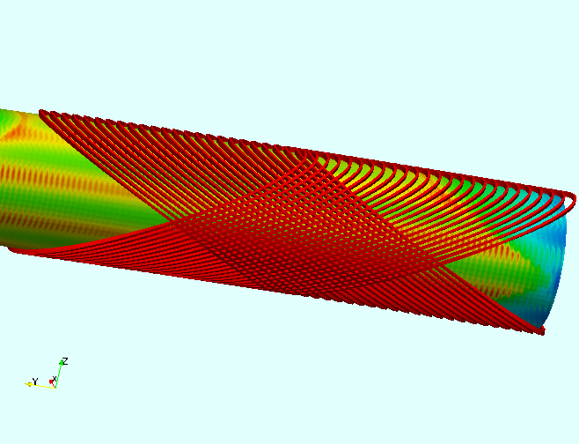
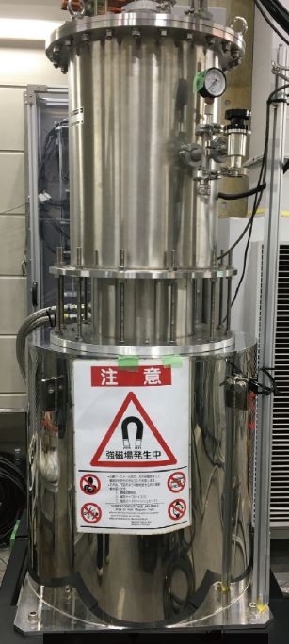
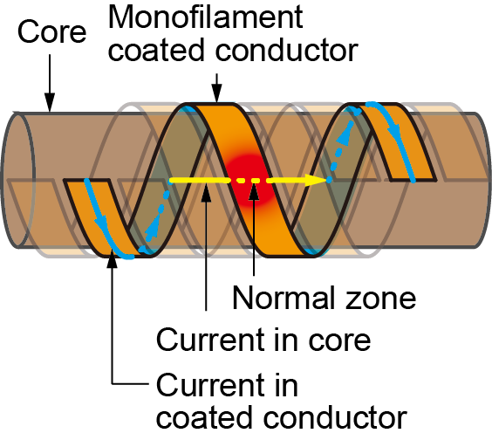
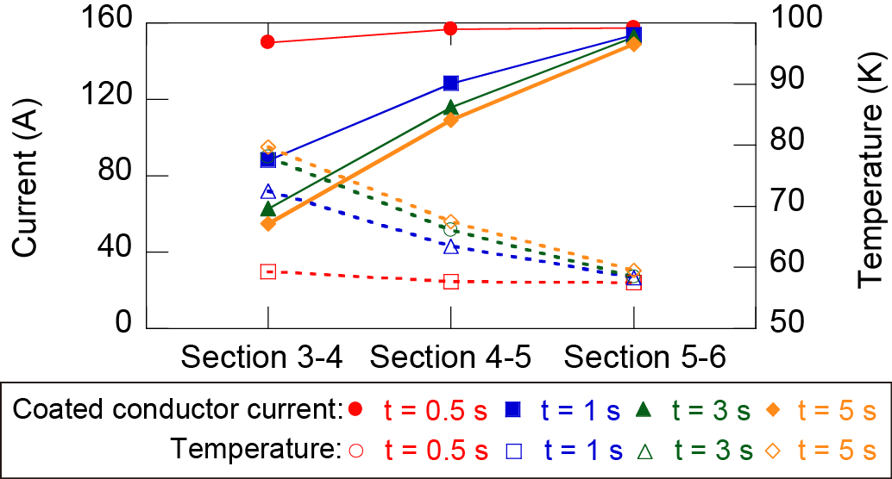
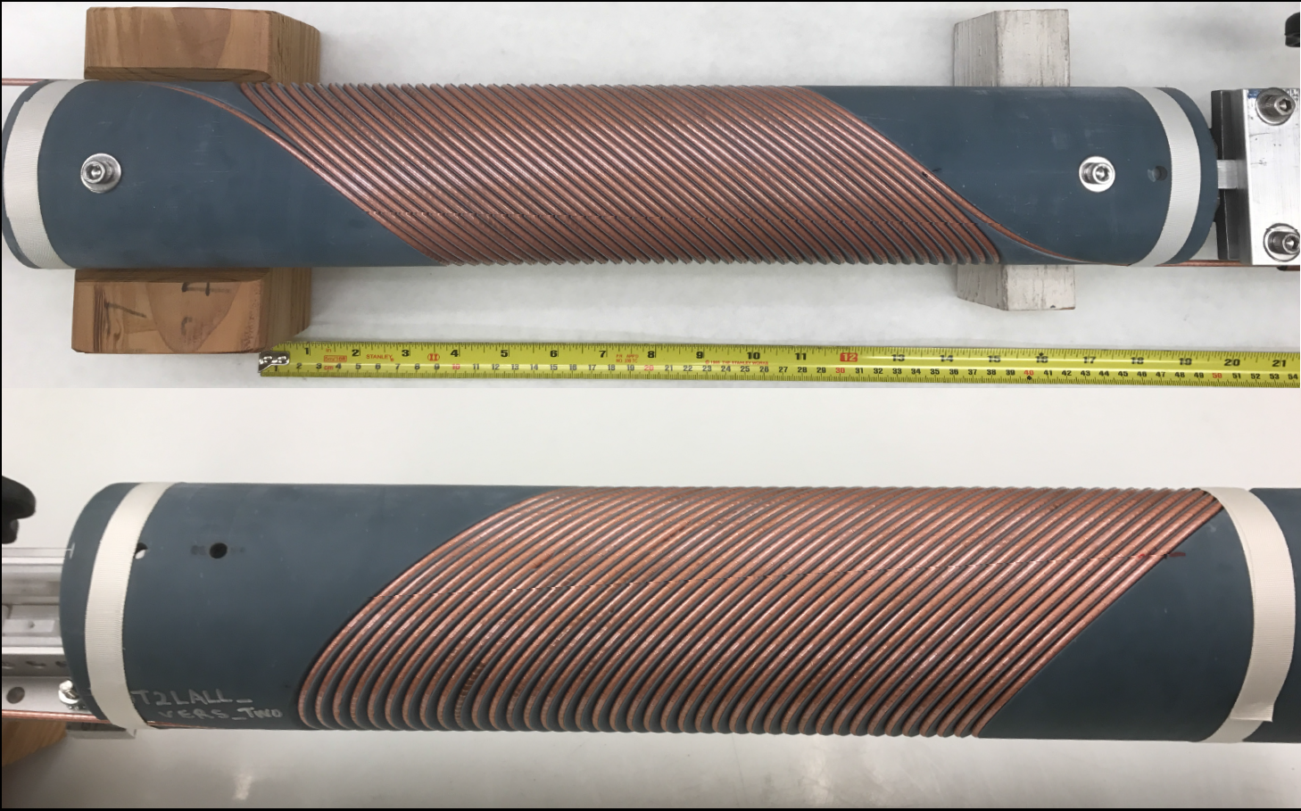
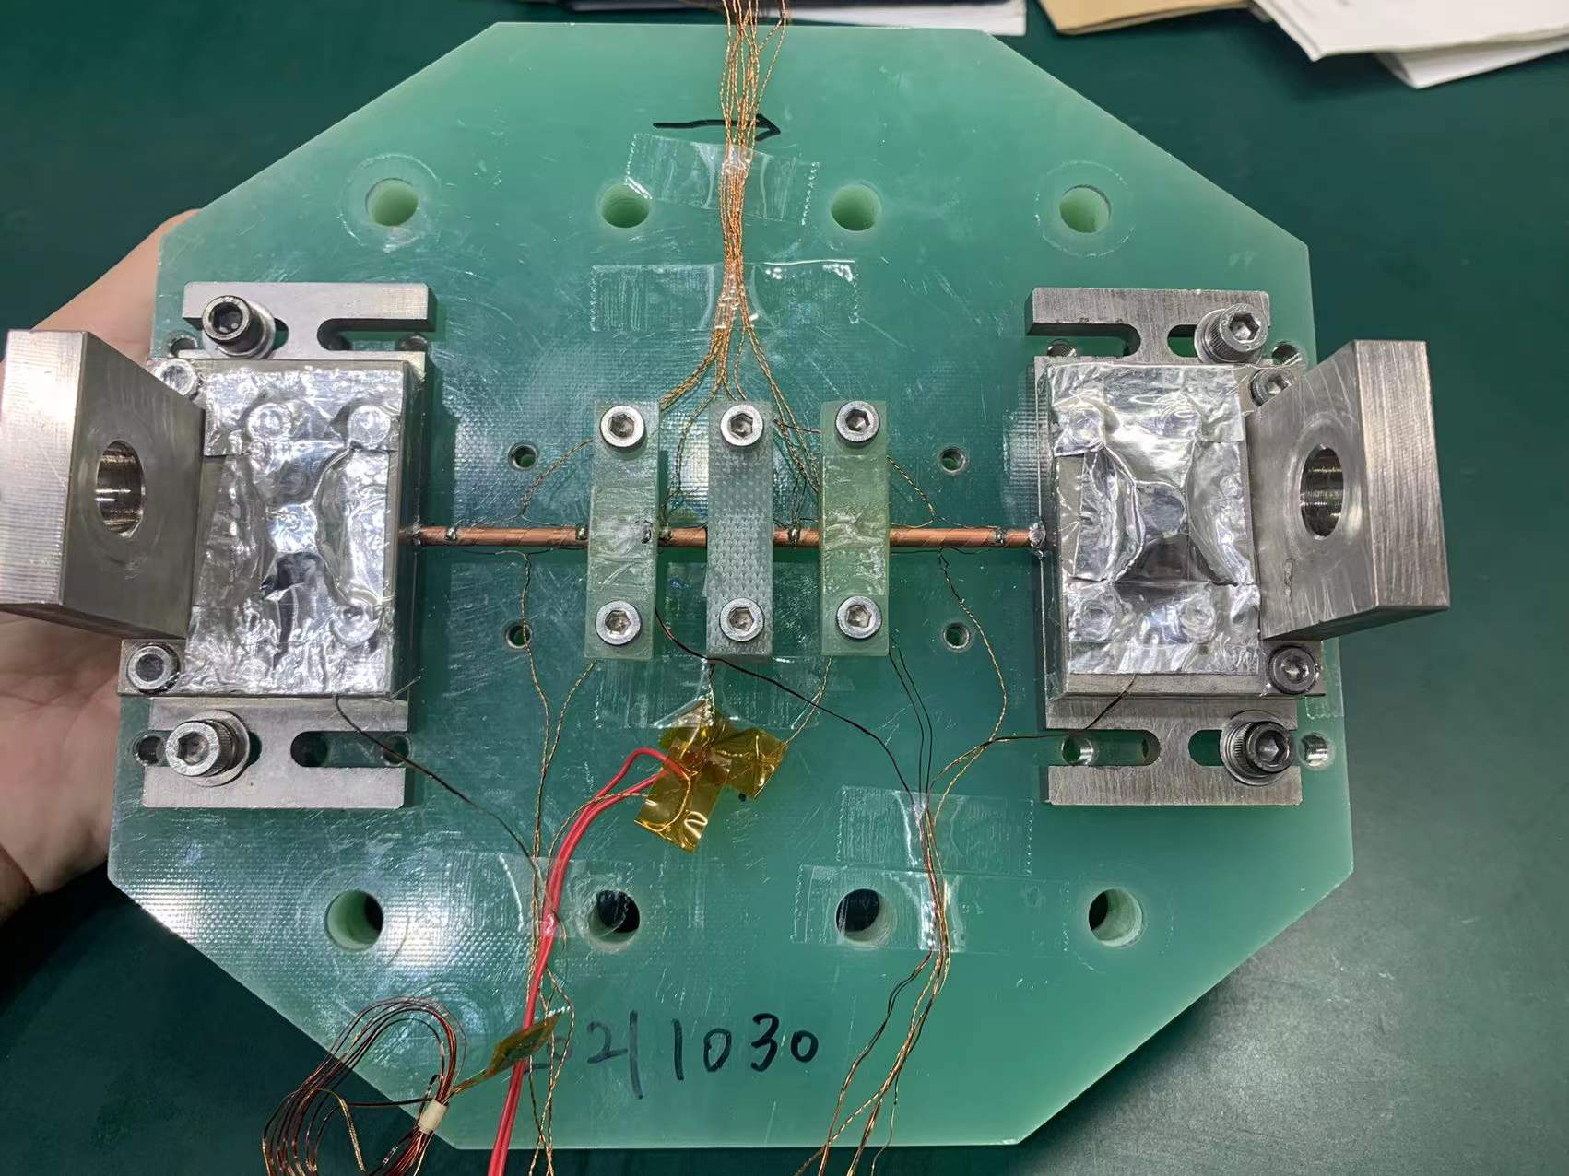
Task 3. Kyoto Uni.: Effect of current-sharing on AC loss of CORC-like conductors and field quality
Dipole field
current
REBCO CORC Canted cosine theta dipole magnet demo
C0, C1, and C2 have been constructed (Wang et al.,
10.1088/1361-6668/ab0eba; /10.1088/1361-6668/abc2a5
C3, 6-layer, 5 T CCT dipole magnet is ongoing.
Test by Guangwei Xu, Kyoto Uni.. REBCO CORC CCT by Xiaorong Wang, LBNL, with ACT

Slide 13
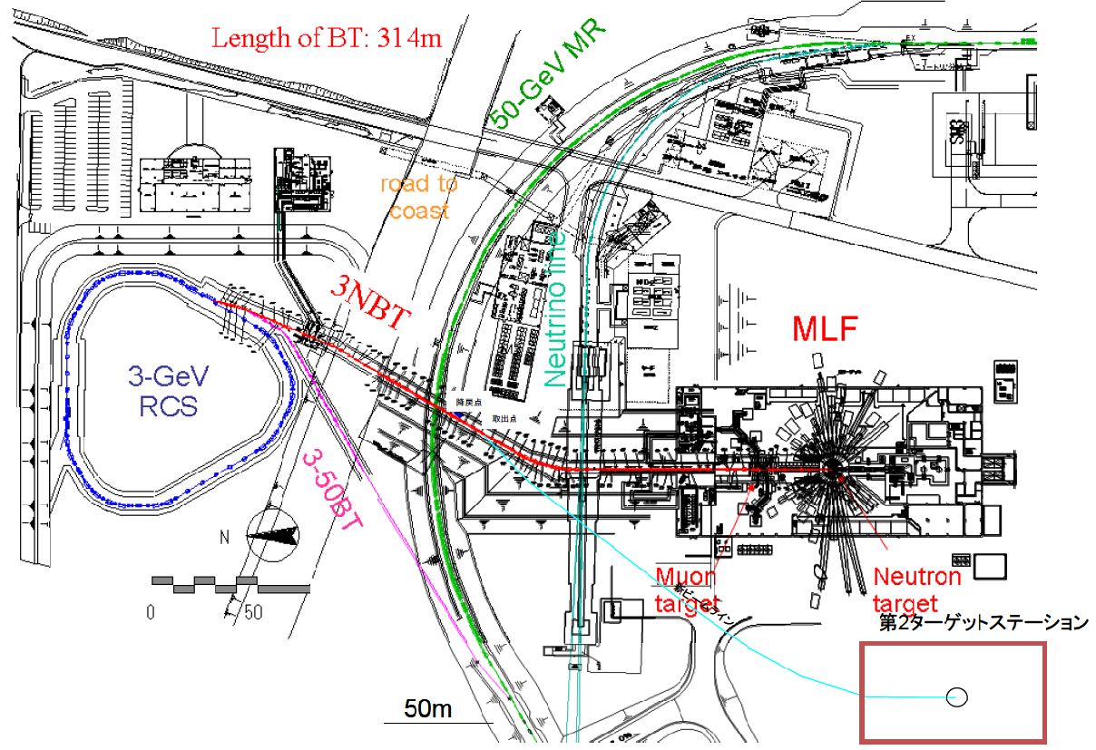
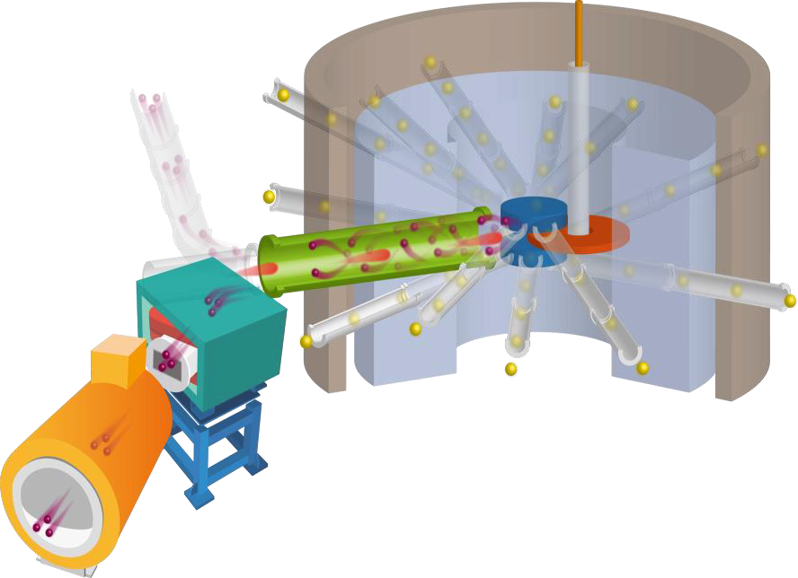
Future in the Accelerator Field
FCC@CERN: 100 TeV
20 T high-field magnet
CERN
Hilumi-LHC: 40 MGy (W-shield)
FCC: >100 MGy?
J-PARC
MLF2 : 130 MGy ?
Conventional Magnet Technology : Challenges
JPARC
NbTi Cable
Ic (< 10 T) cannot achieve the requirement
Organic Material for Insulation
Degradation of the machine strength from 10 MGy
MLF
Development of next-generation radiation resistant high field magnet
Muon
Target
Neutron Target
New Beam Line
MLF 2nd Target Station

Slide 14
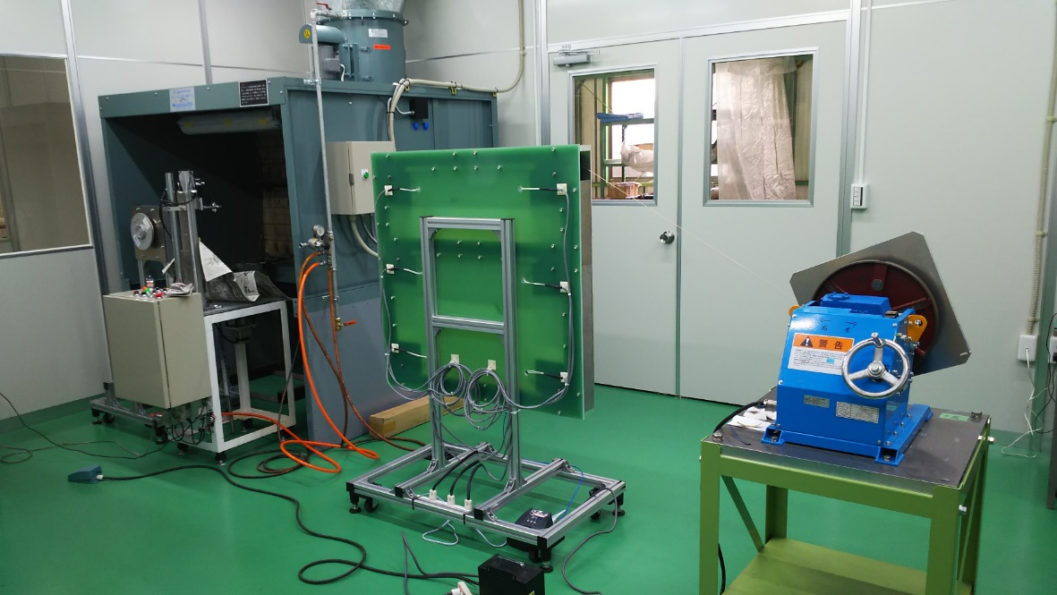
Task 4. KEK Inorganic Insulation of ReBCO tape
Continuous Coating of long ReBCO tape is performed using reel to reel coating machine
Automatic Spray
Coating material: Al₂O₃:SiO₂ = 1:1
Heat treatment: 100º C, 20 min
Withstand Voltage: 2 kV
HTS reel
Heat treatment
section
Successfully achieved
25 ± 4.7 (σ) μm thick ceramic coating.
Total Length : 40 m (Coated both sides)
17
25
24
19
17
16
23
25
27
17
Winding the double pancake racetrack coil for high magnetic field test

Slide 15
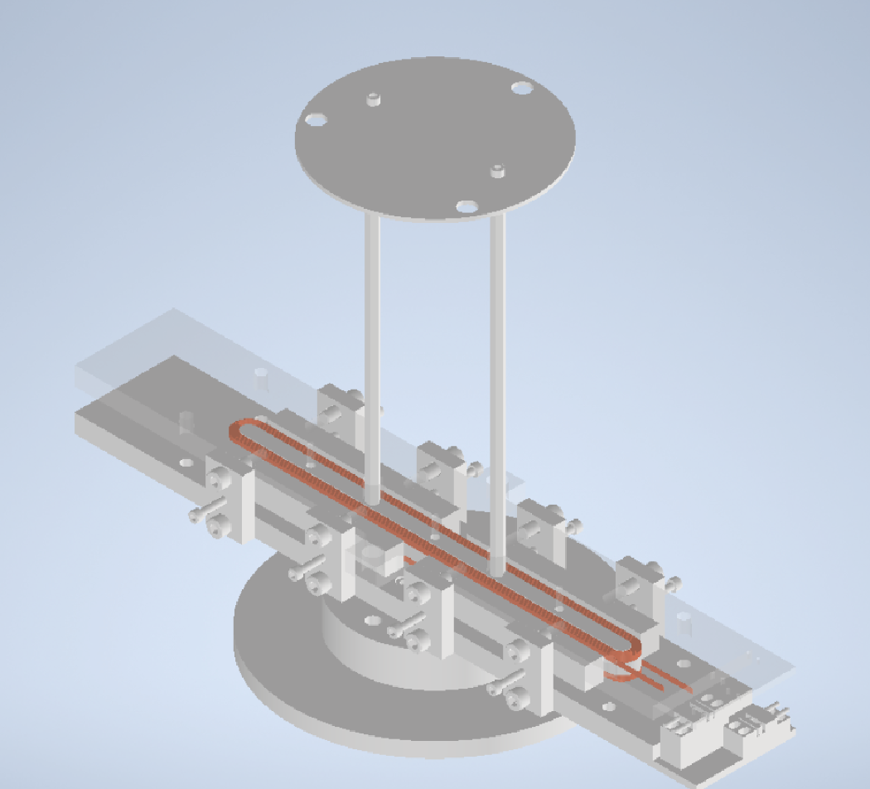
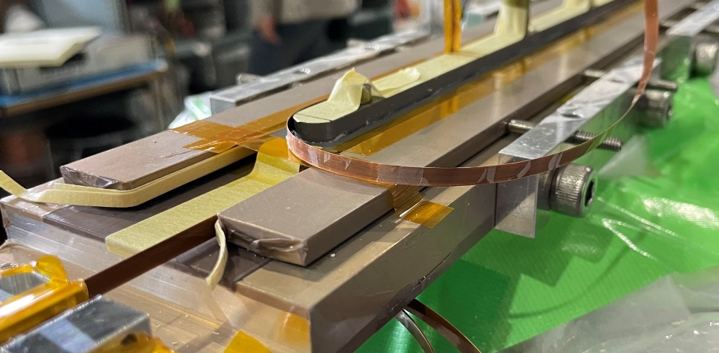
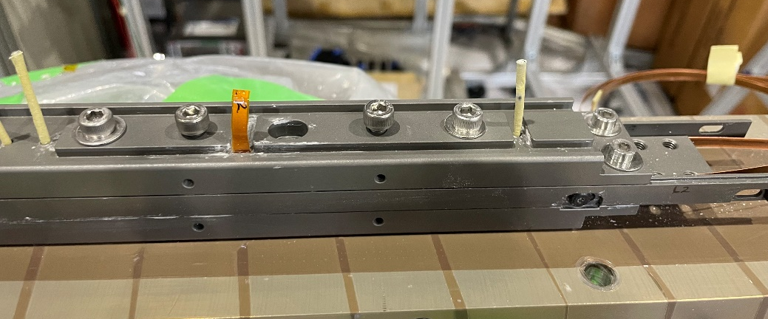
KEK HTS Coil – Winding and Test Status
Winding : Three coil with Coated ReBCO tape (wet winding)
Winding setup for double pancake racetrack coil
The actual conductor thickness: 0.31 mm
(EuBCO: 0.16, coating layer: 0.05, adhesive layer: 0.1)
The number of turns: 20 turns
Winding Completed
Preliminary tests at 77 K are undergoing at KEK
Extension support for HTS lead
Double Pancake HTS Coil
Extension support for HTS lead

Slide 16
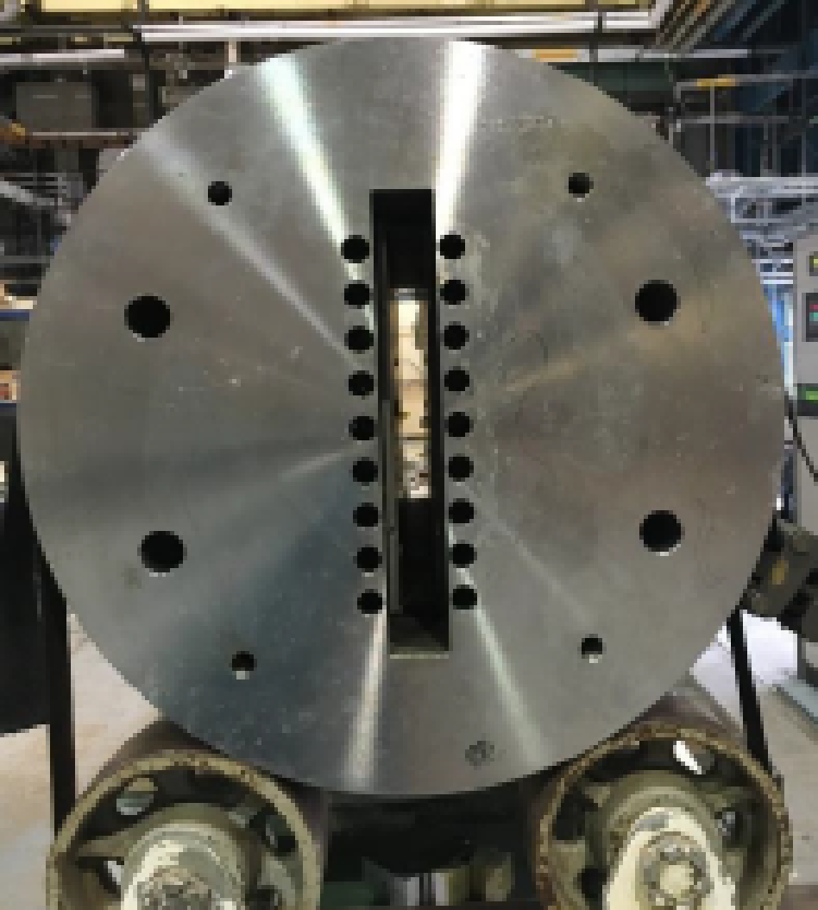
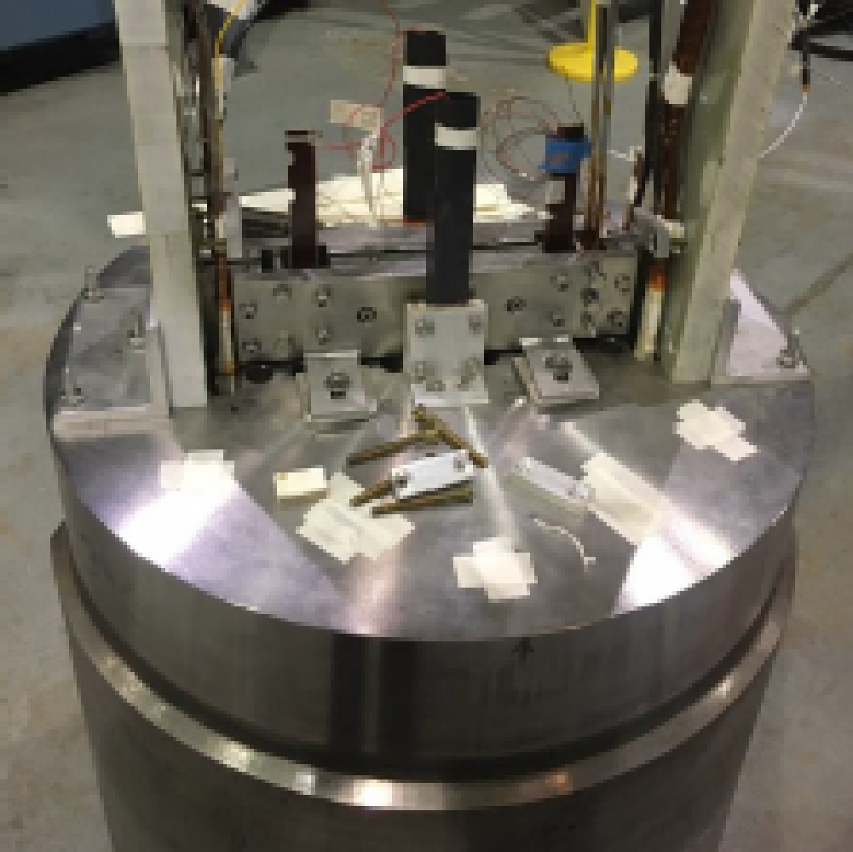
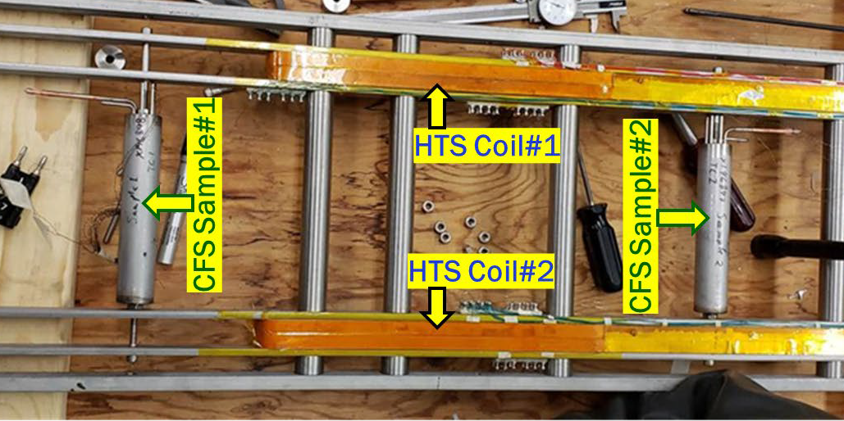
Overview of BNL Nb₃Sn Common Coil Magnet Test Facility
Nb₃Sn, common coil 2-in-1 dipole that allows two insert coils in two aperture
Structure is designed to provide a large open space (~30 mm X 335 mm)
New insert coils can be tested in the background field of up to 10 T (+ self-field)
Facilitates a rapid-turn around, low-cost R&D approach for high field magnets
Insert Coil
Empty
Space
BNL Nb3Sn common coil dipole DCC017 without insert coil
Structure for Test coil insert in Common coil
HTS coils inside Nb₃Sn dipole - early experience of HTS/LTS hybrid dipole

Slide 17
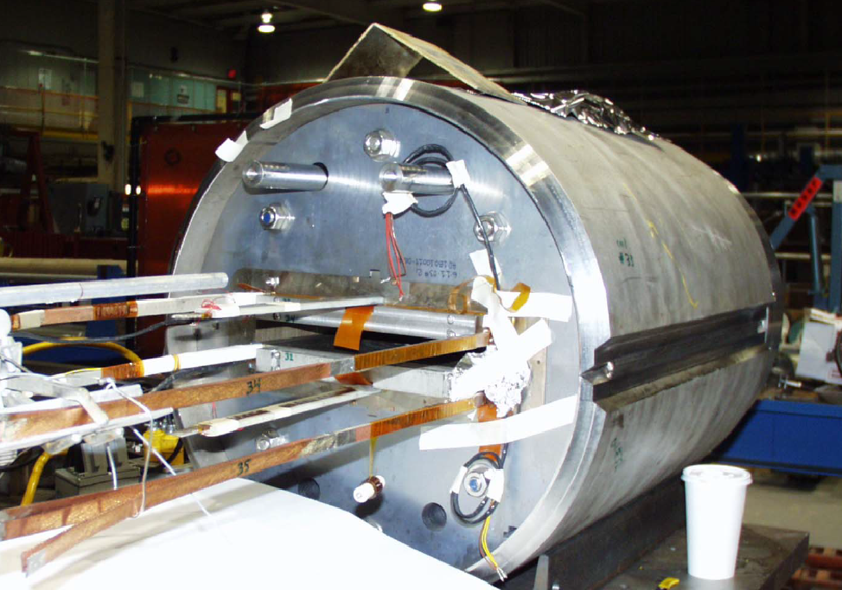
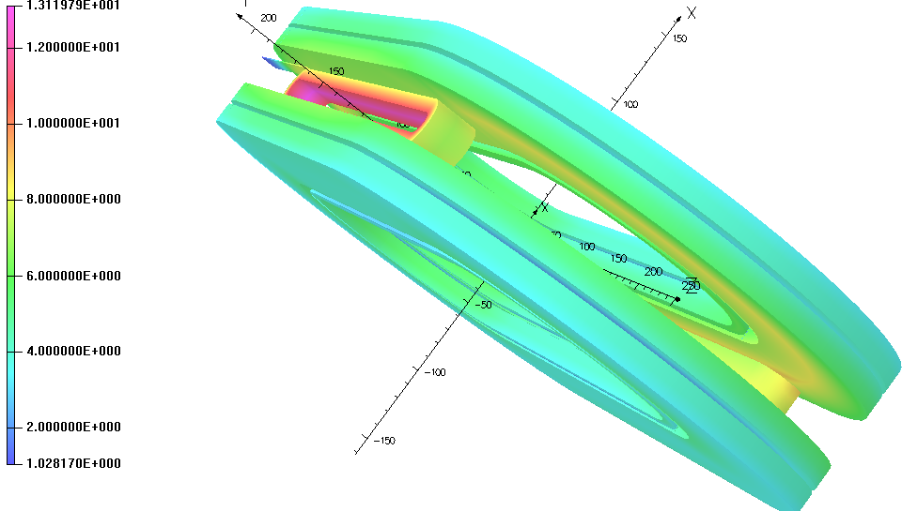
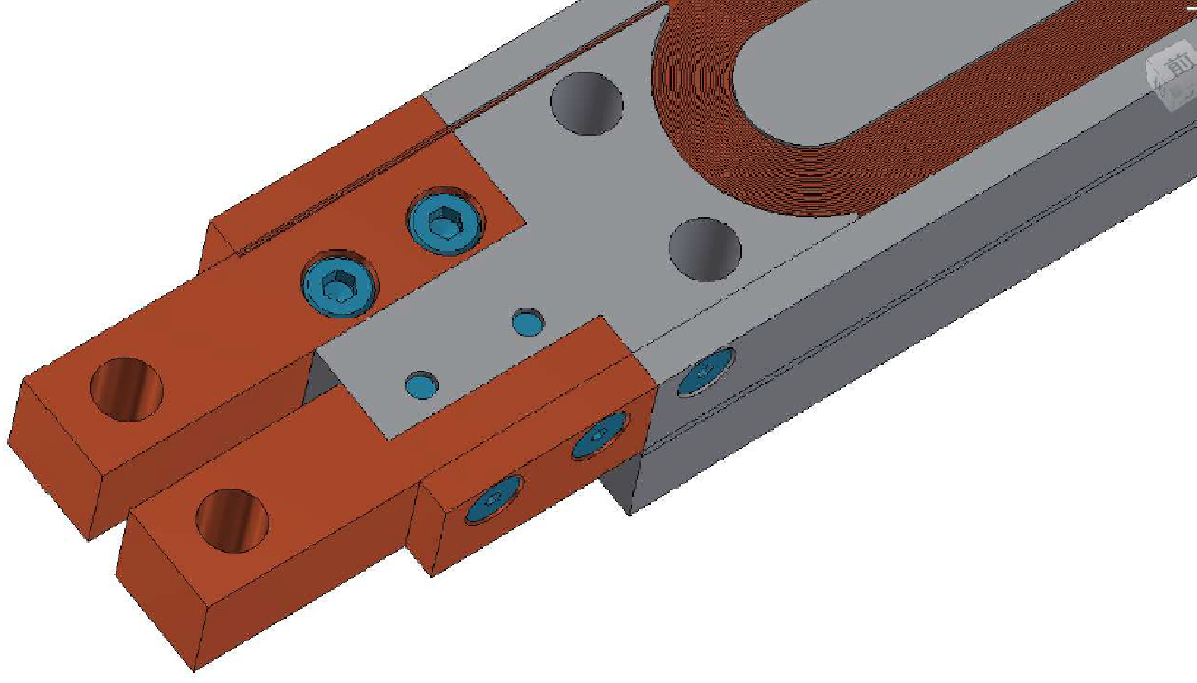
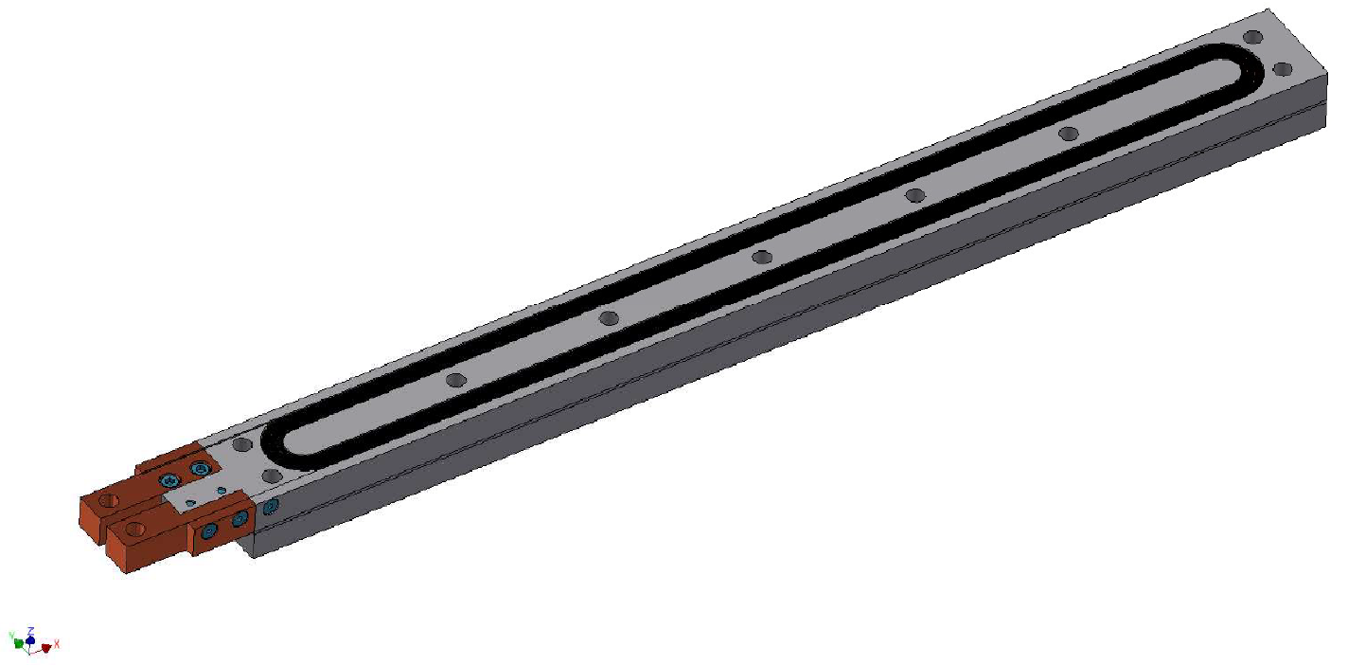
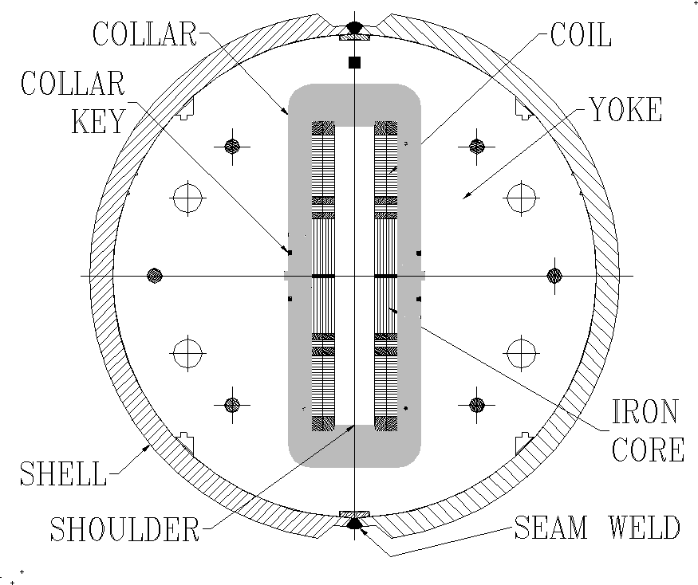
Upcoming Test Plan @ BNL, Upton
Design study in undergoing in parallel
Field Quality studies will be undertaken at BNL
323.2
29
R5.5
31
29
Background
field :~10 T
335
Test Plan in July 2023 @BNL
Two HTS insert coils in two apertures of the common coil dipole:
Upper Bore: field primarily parallel
Lower bore: field primarily perpendicular
7 hall probes will be installed along the length to measure the magnetic field

Slide 18
Summary
Enable four institutions (LBNL, BNL, KEK, and Kyoto University) to team up to address critical issues facing high-temperature superconducting magnet technology for accelerator facilities.
Make possible progress and studies at both fundamental and technological fronts impossible with a single institution alone.
Neutron radiation of REBCO tapes assisted with TEM studies.
Quench protection of HTS magnets with new concepts, uncertain analysis with Monte-Carlo analysis, and quench protection with FPGA at much improved resolutions and margin of safety.
LTS/HTS hybrid magnets.

Slide 19
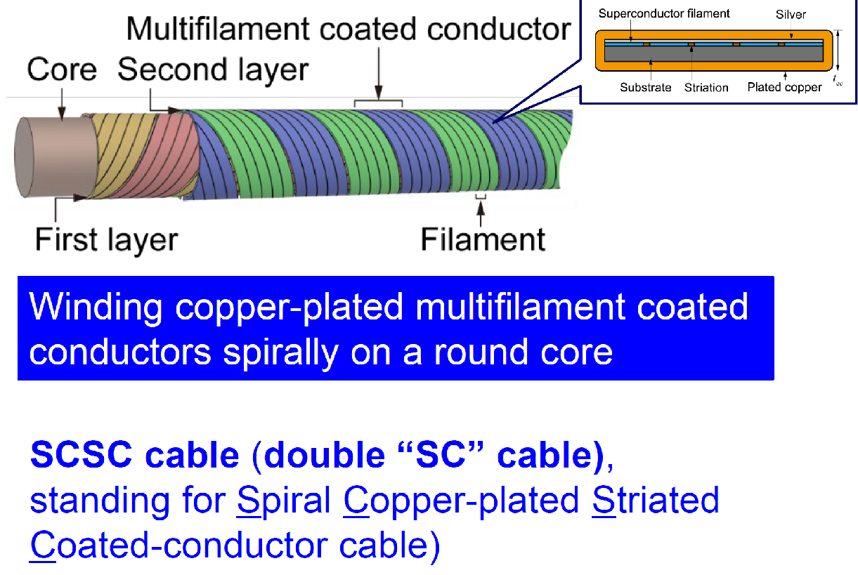
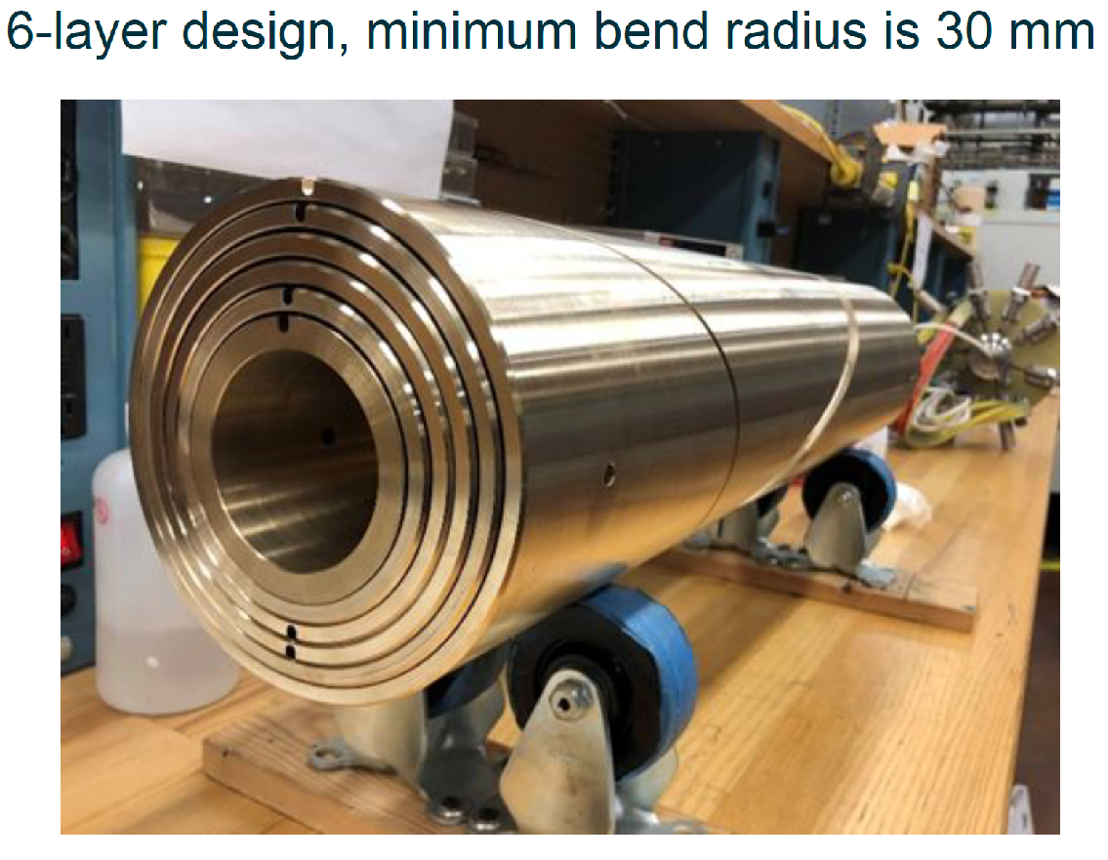
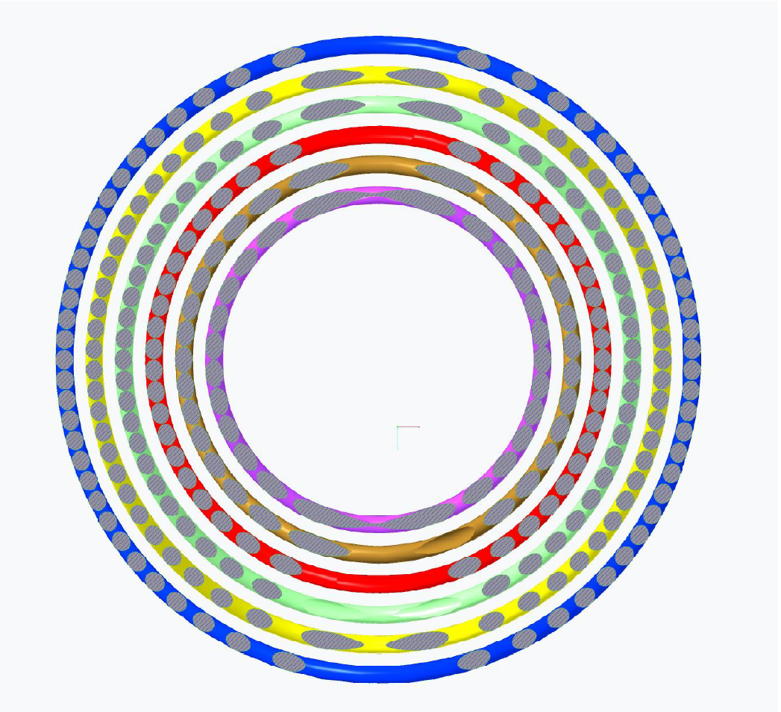
CCT magnet at LBNL and SCSC cable at Kyoto Uni.
LBNL C3 magnet

Slide 20
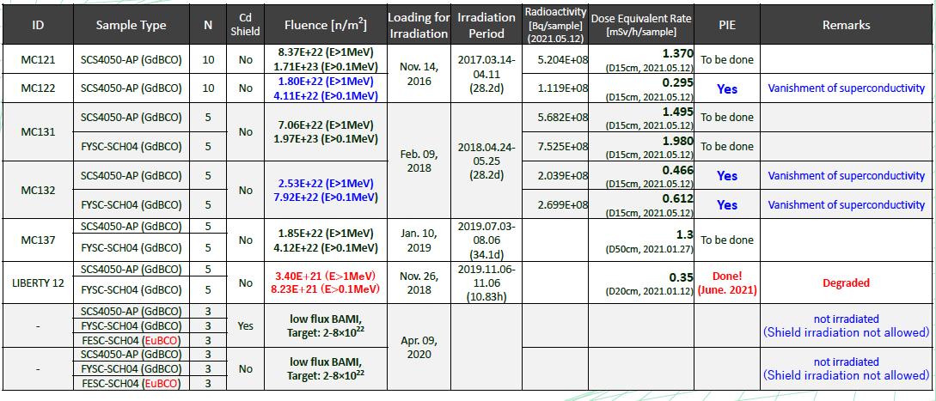
Status of Neutron Irradiation
M. Iio et al., IEEE Trans. Appl. Supercond., vol. 30, no. 4, (2020) 4600505.
Irradiation study of Gd and other rare earth sample is undergoing
MASAMI IIO, KEK

