Slide 1
U.S. High Energy Physics Program
HEPAP View
JoAnne Hewett
May 2023

Slide 2
What is HEPAP’s role?
Objectives and scope of activities
Panel activities include
The High Energy Physics Advisory Panel provides advice and recommendations to the Director, Office of Science (DOE), and the Assistant Director, Mathematical & Physical Sciences Directorate (NSF), on the national high energy physics program, which encompasses the conduct of experimental and theoretical high energy physics research, advanced technology R&D, as well as accelerator stewardship R&D and scientific computing.
Periodic reviews of the program and recommendations of any changes considered desirable on the basis of scientific and technological advances or other factors such as current projected budgets and status of other international high energy physics efforts (2019 assessment)
Advice on competing long-range plans, priorities, and strategies for the national high energy physics program, including relationships of higher energy physics with other fields of science. (2023 P5 subpanel)
Advice on recommended appropriate levels of funding to assure a leadership position and to help maintain appropriate balance among the various elements of the program (2023 international benchmarking subpanel)
Advice on any issues relating to the program as requested by the Director, Office of Science (DOE), and the Assistant Director, Mathematical & Physical Sciences Directorate (NSF).

Slide 3
U.S. HEP Strategic Planning Process
The U.S. High Energy Physics program is guided by the strategic plan laid out in the 2014 P5 report
Community Driven Strategic Process
“Snowmass” 2013: a year-long community-wide study of science opportunities, organized by the Division of Particles and Fields of the American Physical Society
Particle Physics Project Prioritization Panel (P5) 2014: High Energy Physics Advisory Panel (HEPAP) subpanel, prioritized scientific opportunities outlined in the Snowmass study within a budget framework
Dovetailed with
2010 Astronomy & Astrophysics Decadal Survey
2013 European Strategy for Particle Physics
Process defines strategic plan for U.S. HEP for the decade

Slide 4
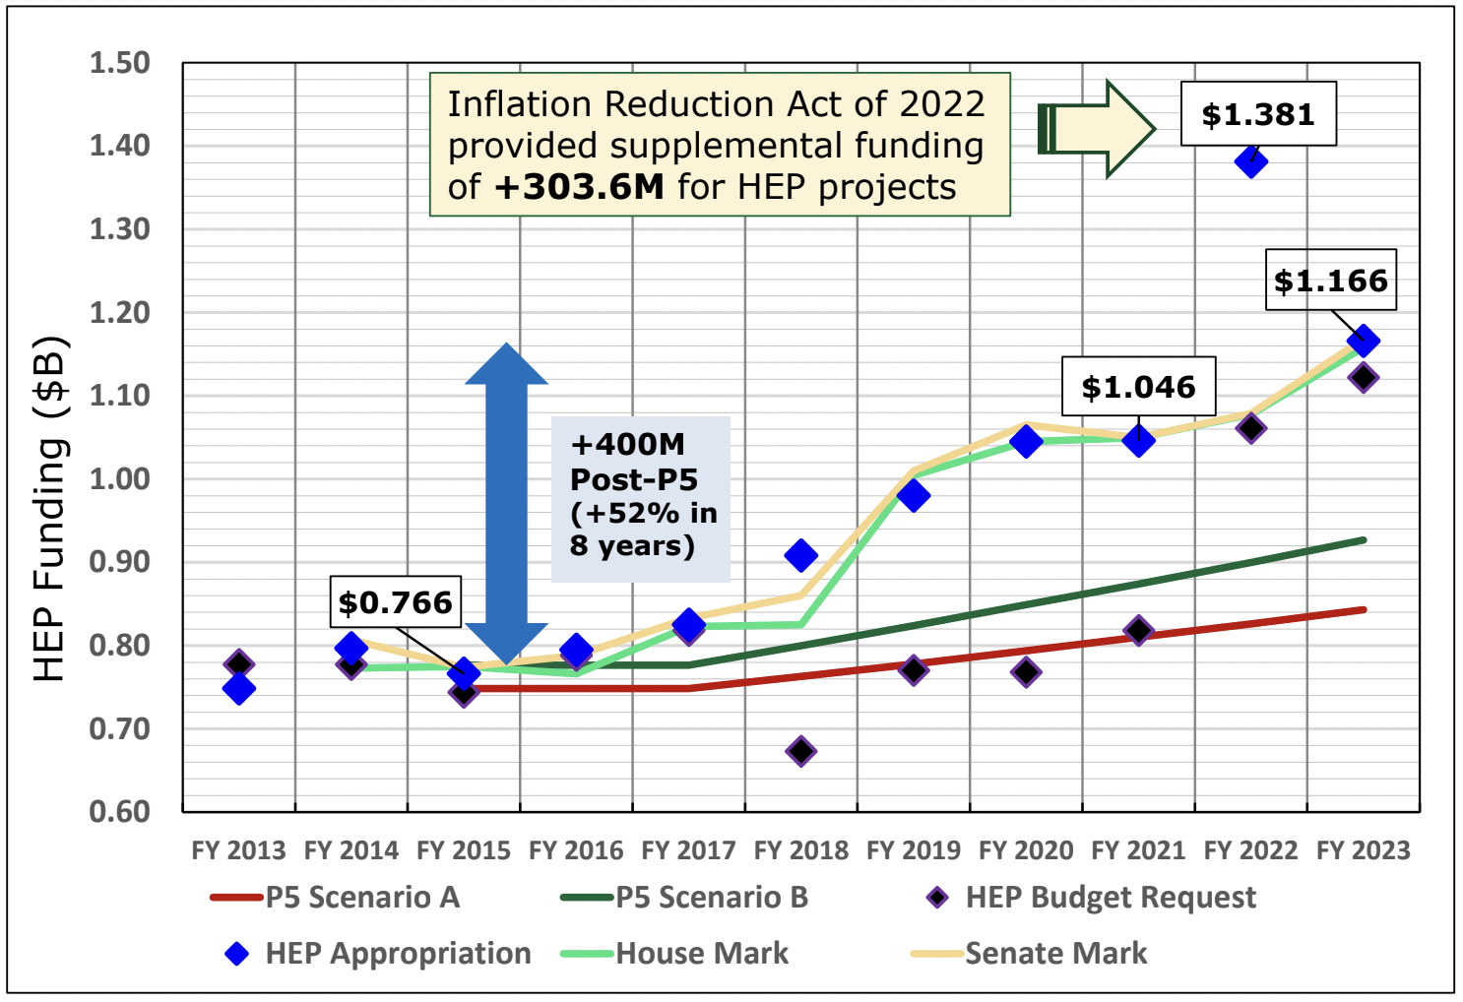
U.S. Administration and Congress have supported the P5 Plan
52% increase in DOE HEP budget in last 8 years
P5 Plan elements
Particle Physics is global
Community made difficult choices
Increase investment in construction

Slide 5
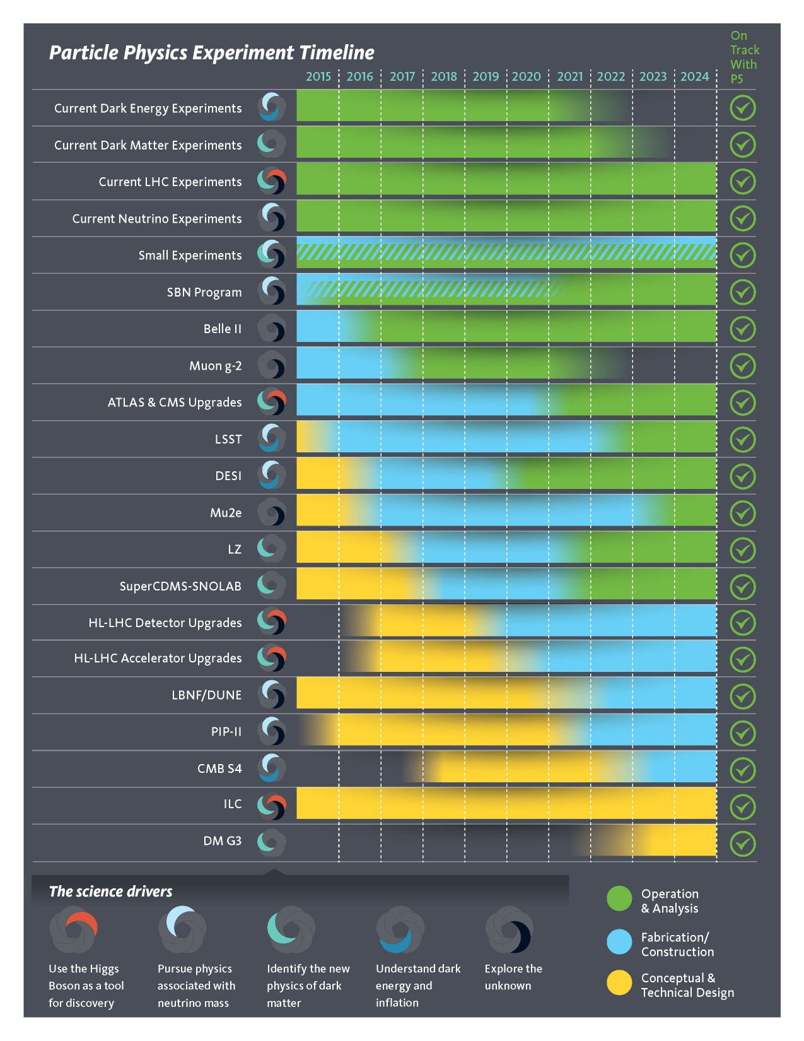
P5 Plan in 2023: 9 years in
P5 projects report card:
9 Projects have been completed (and transitioned to commissioning & operations)
Belle-2, Muon g-2, Phase I ATLAS, Phase I CMS, DESI, LZ, FACET-II, LSSTCamera, sCDMS
5 Projects at CD-2/3 (Baseline/Construction)
HL-AUP, HL-LHC ATLAS, HL-LHC CMS, Mu2e, PIP-II
1 Projects at CD-1 (preparing for baseline)
LBNF/DUNE
2 Projects at CD-0
CMB-S4
Accelerator Control Operations and Research Network at FNAL
Broad portfolio of small projects from R&D phase to operations

Slide 6
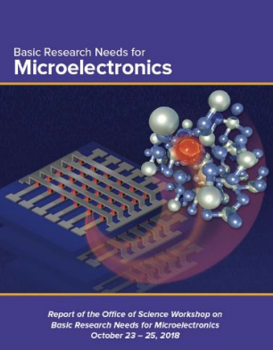
New DOE Programs/Initiatives since P5: Science is Dynamic!
New programs envisioned by small projects portfolio in 2014 P5 report
Quantum Information Science
QuantISED program
5 DOE National QIS Research Centers with strong HEP participation
Artificial Intelligence/Machine Learning
Emergent new program
Dark Matter New Initiatives
R&D Funded for 6 novel small-exp’t concepts
3 Priority Research Directions identified in 2018
There is more to Dark Matter than WIMPS!
Microelectronics
Accelerator Science and Technology
RENEW

Slide 7
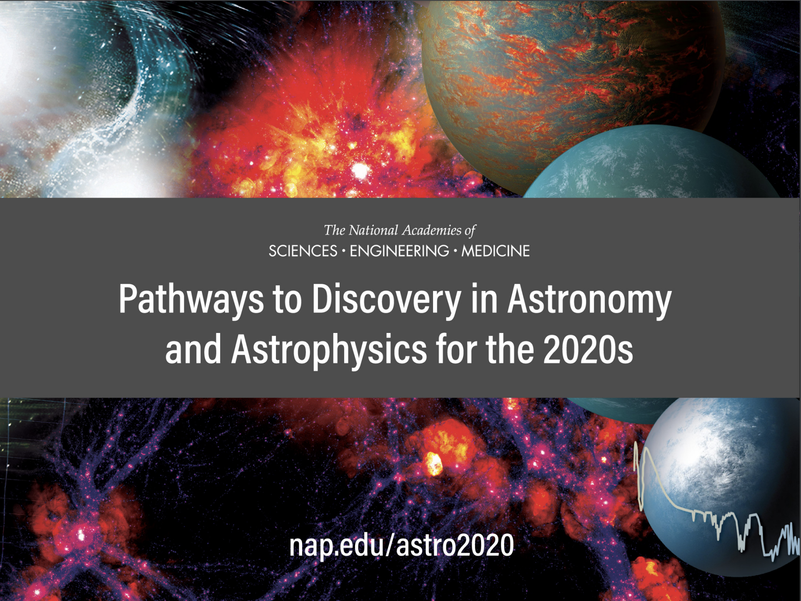
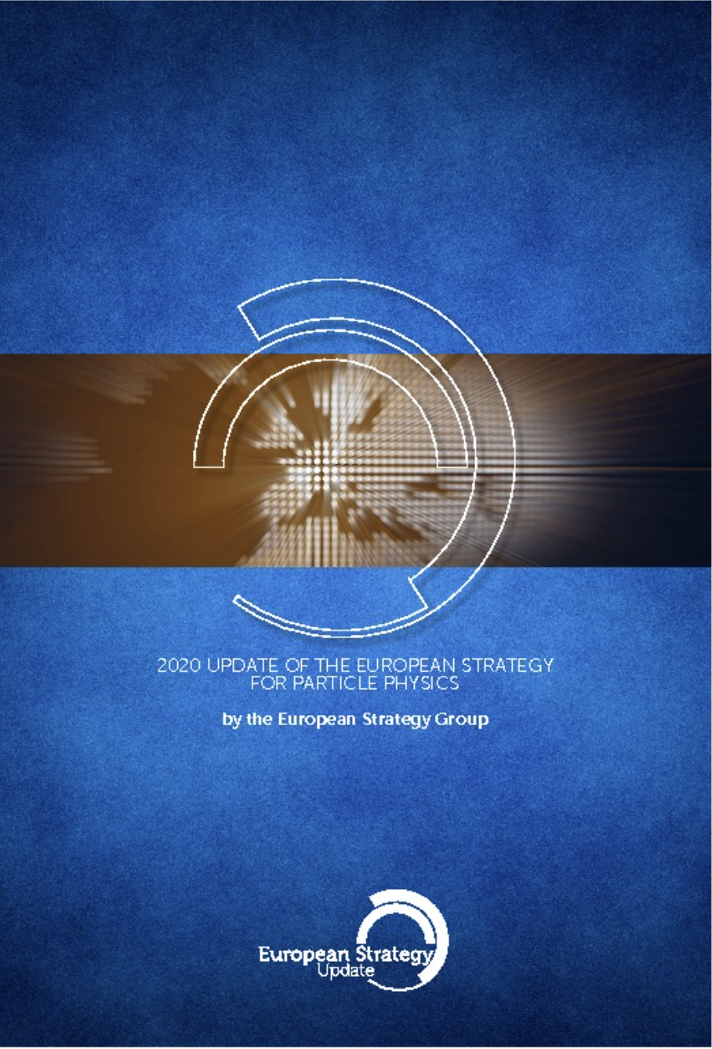
Next U.S. HEP Strategic Planning Process almost complete!
The U.S. High Energy Physics program will be guided by the strategic plan laid out in the 2023 P5 report
Community Driven Strategic Process
“Snowmass” 2020-2022: 2 years-long community-wide study of science opportunities, organized by the Division of Particles and Fields of the American Physical Society
Particle Physics Project Prioritization Panel (P5) 2023: High Energy Physics Advisory Panel (HEPAP) subpanel, prioritized scientific opportunities outlined in the Snowmass study within a budget framework
Dovetailed with
2021 Astronomy & Astrophysics Decadal Survey
2020 European Update on Strategy for Particle Physics

Slide 8
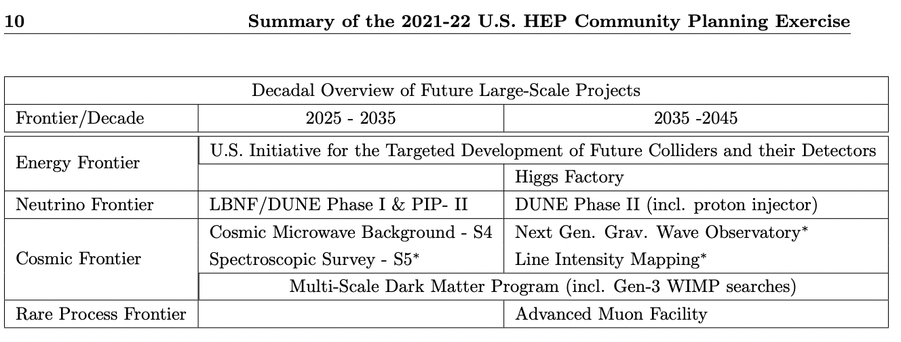
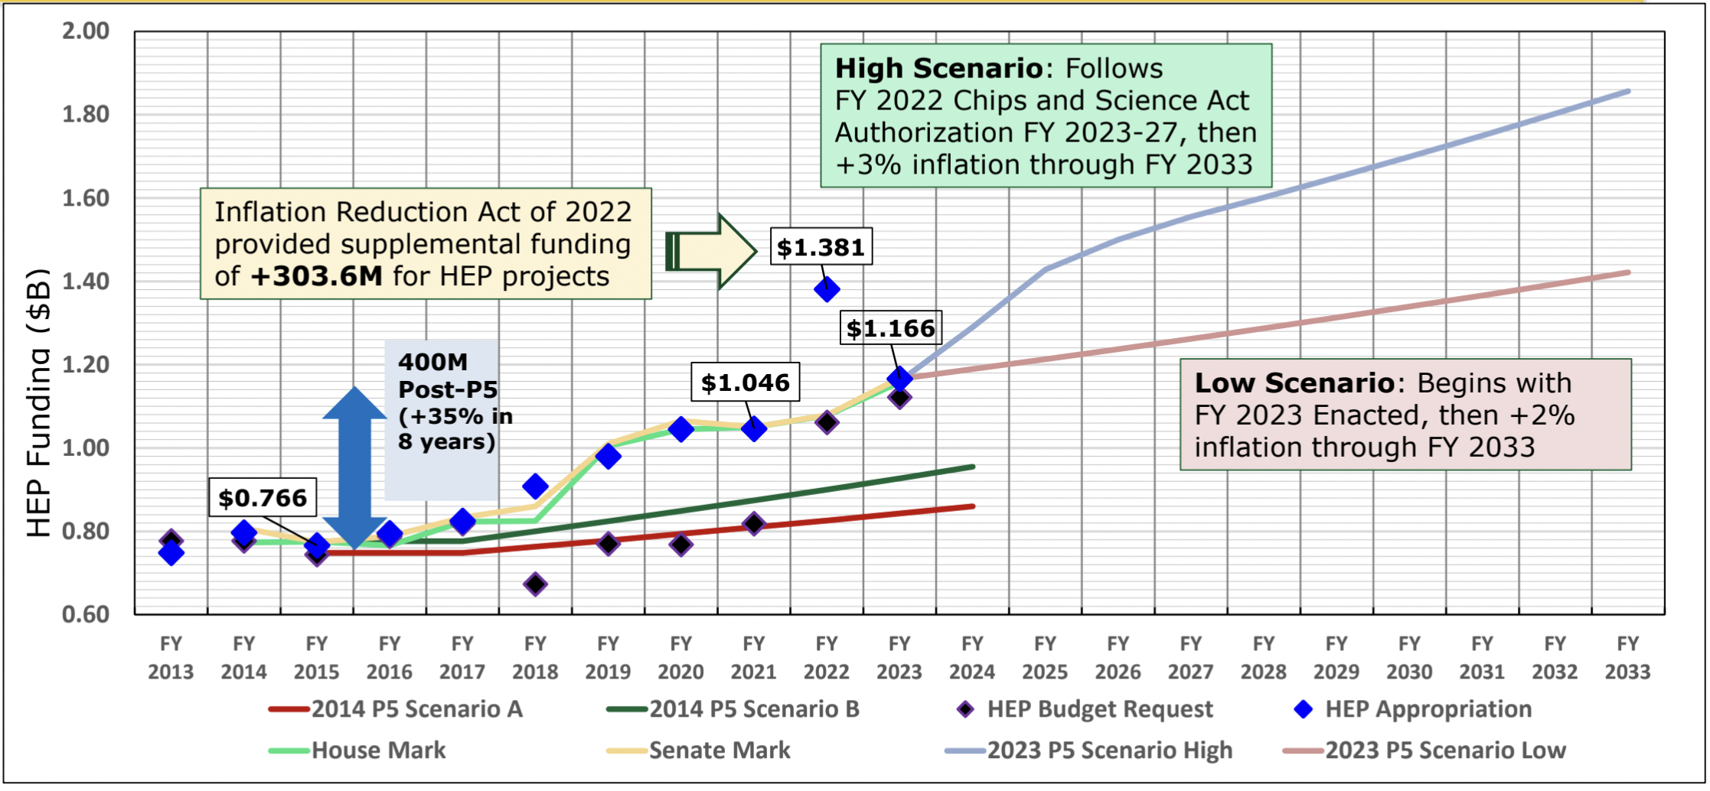
P5 Charge
Merge aspirations of Snowmass Community Study with realistic budget scenarios
Snowmass Summary Report, Butler etal
P5 Budget Scenarios

Slide 9
Reports timeline
P5 report submitted to HEPAP Fall 2023 (by Dec 21, 2023)
Report completed Spring 2024
J. Siegrist, vintage 2022

Slide 10
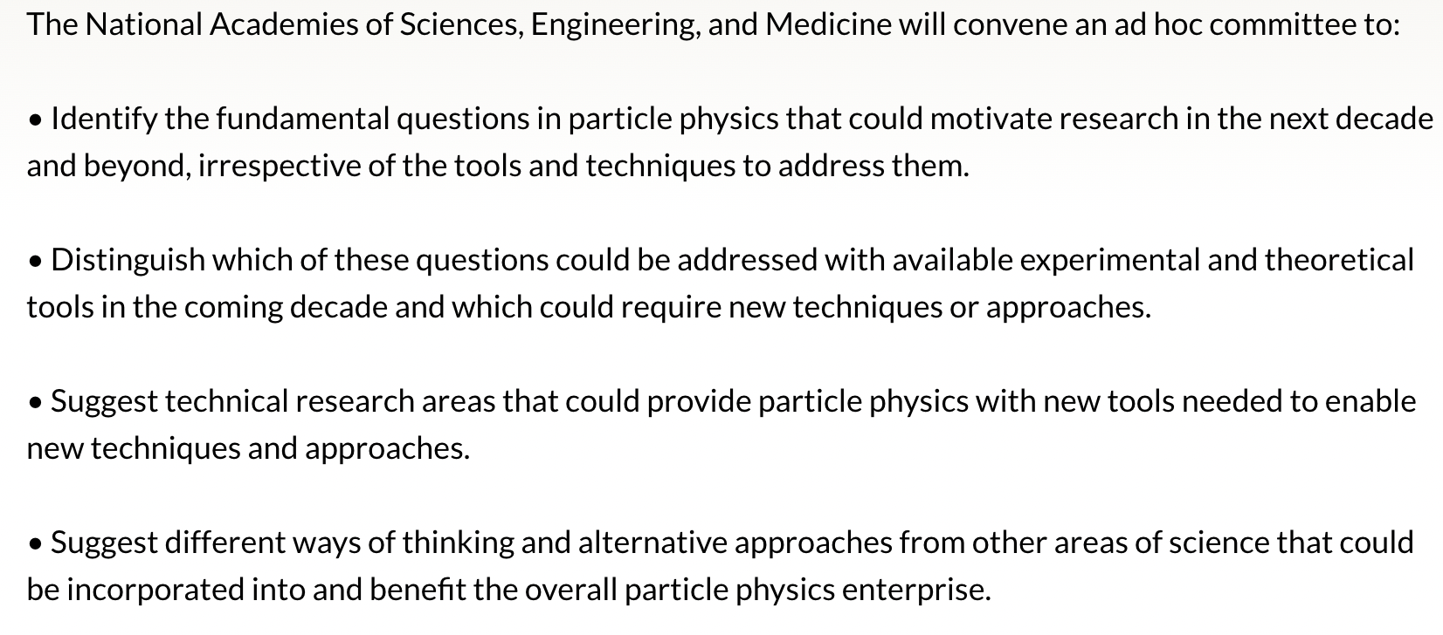
EPP2024: Elementary Particle Physics: Progress and Promise
Take a long-term view without budgetary constraints

Slide 11
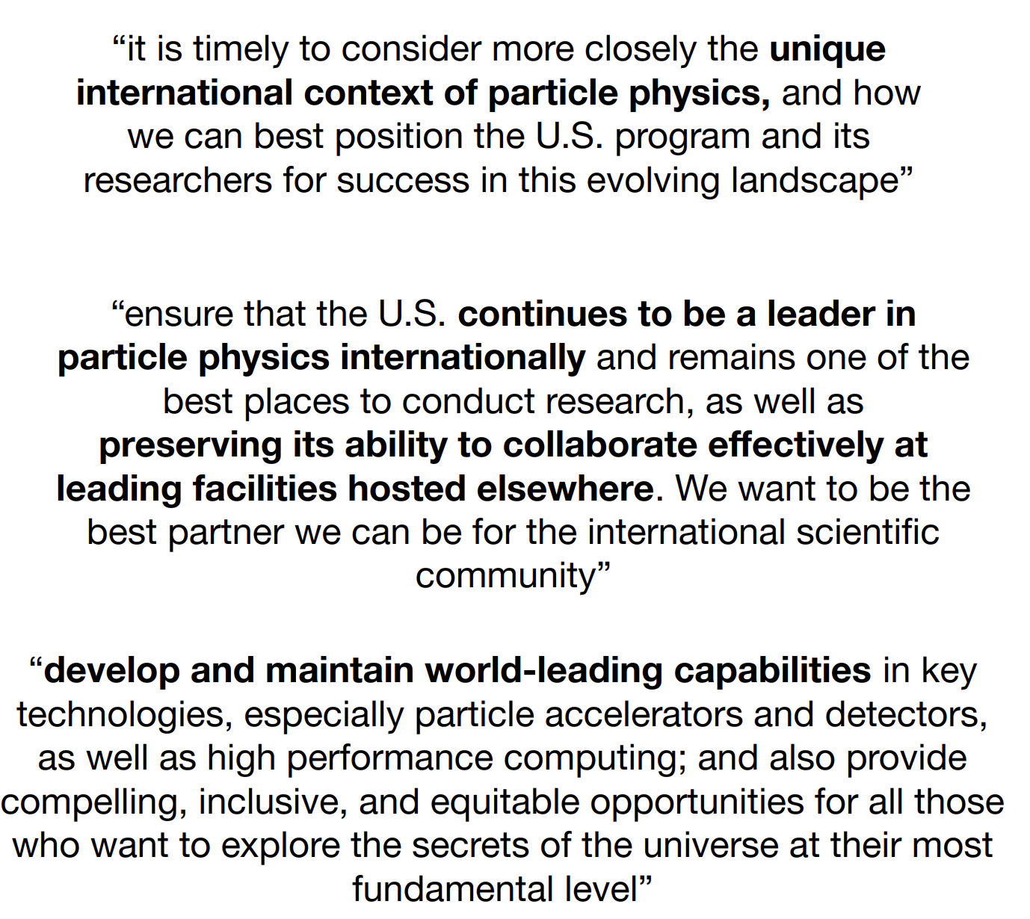
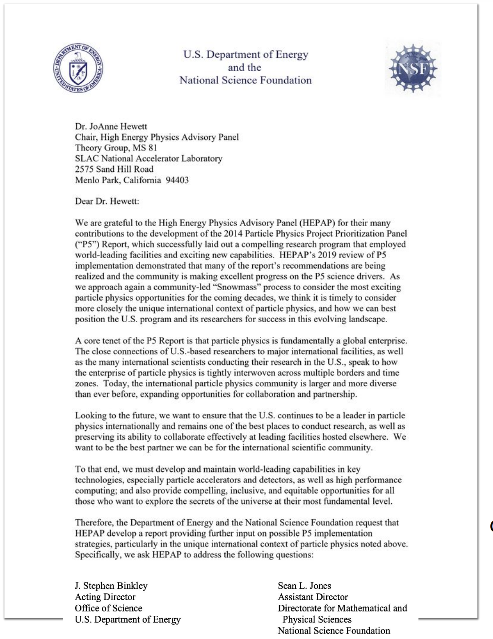
HEPAP Subpanel: International Benchmarking
B. Fleming
2022 HEPAP update
Charge emphasizes that particle physics is global

Slide 12
FESAC also received a similar charge

Slide 13
Benchmarking subpanel organization
Subpanel focus areas
Subpanel members – draw across national and international experience
Charge questions principal points
U.S. as a partner of choice
Identify U.S. leadership areas
Recruit and train the best talent
4 sub-committees
Big experiments
Small experiments
Accelerator program
Workforce
Expertise spans across 2014 P5 science drivers
Co-Chairs: Bonnie Fleming, (FNAL/Uchicago), Patricia McBride (FNAL),
Mei Bai (SLAC, Marcela Carena (FNAL), Scott Dodelson (CMU), Dan Dwyer (LBNL), Tova Holmes (UTK), Tsuyoshi Nakaya (Kyoto), Andy Lankford (UCI), Wim Leemans (DESY), Reina Maruyama (Yale), Sekazi Mtingwa (NRC), Brian Nord (FNAL), Ian Shipsey (Oxford), Stefan Soldner-Rembold (Manchester), Lindley Winslow (MIT)
Ex-officio: JoAnne Hewett (SLAC)

Slide 14
Report to be delivered at next HEPAP meeting
The community is patiently and anxiously waiting!

Slide 15
HEP Community Congressional Annual Visit
Organized by FNAL, LHC, and SLAC users communities
Objectives of the activity

Slide 16
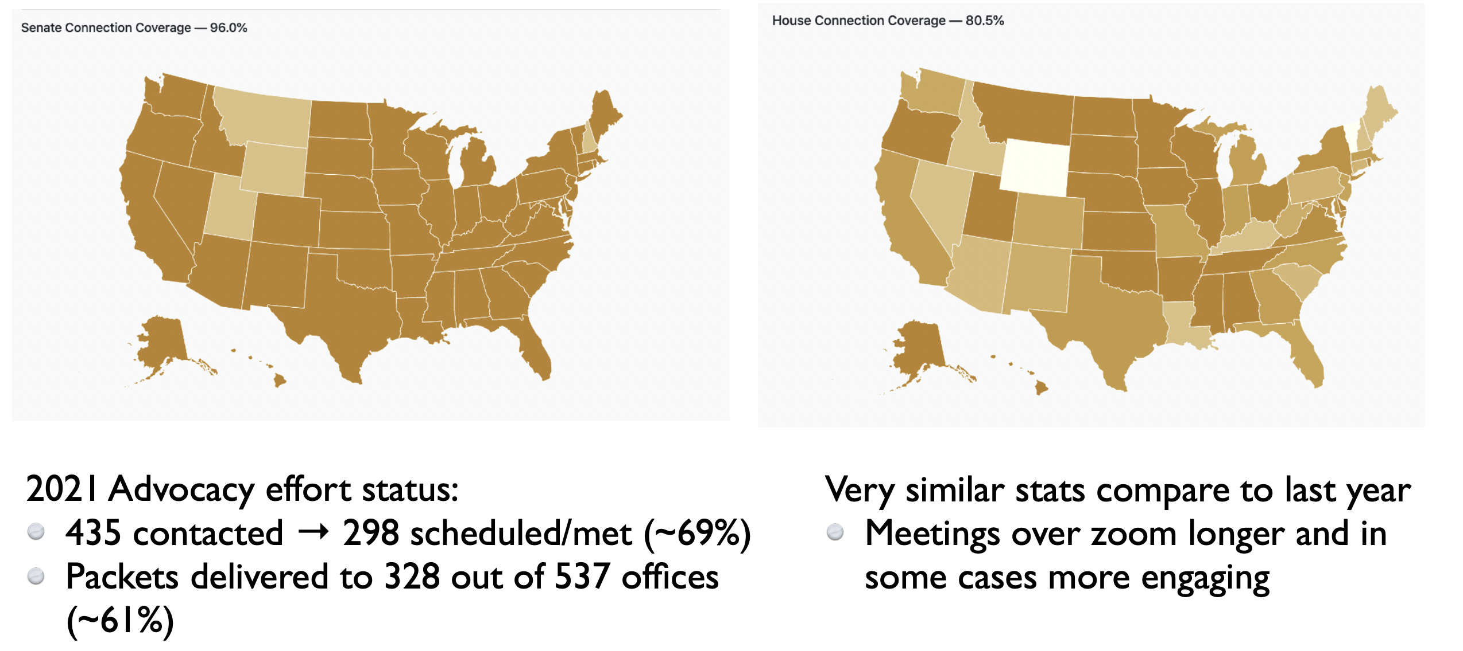
2021 Annual visit congressional office coverage

Slide 17
Summary
Thanks to the community for their tremendous effort in executing the planning process!
Next round of strategic planning is almost complete
Several reports will be completed soon to guide our path forward

Slide 18
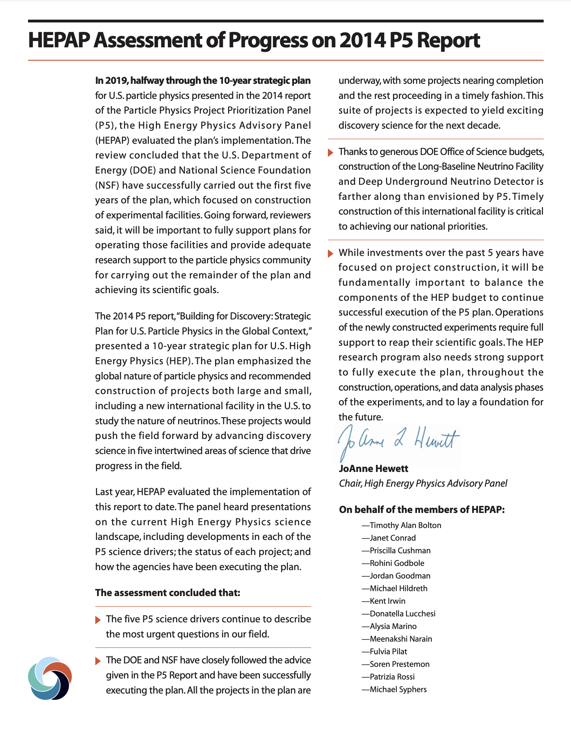
HEPAP 2019 Assessment on P5 Plan Progress
Year-long evaluation of progress, halfway into plan’s decadal horizon
Status of the implementation of the P5 vision
Status of the science drivers in 2019
Checks and balances in carrying out the plan
Criteria for Evaluation
Realization of science impact
Engagement of global partners
Sustained productivity – science results and construction of projects
Balance of project scales
Balance of components: research, operations, & projects
https://science.osti.gov/-/media/hep/hepap/pdf/Reports/HEPAP-Assessment-of-Progress-on-2014-P5-Report-(2020).pdf

Slide 19
HEPAP Assessment Conclusions
Five science drivers continue to describe the most urgent questions in our field
DOE and NSF have closely followed the advice given in the report and have been successfully executing the plan
LBNF/DUNE construction is further along than envisioned by P5 thanks to generous DOE Office of Science budgets. Timely construction is critical to achieving our national priorities
While investments over past 5 yrs have focused on construction, it will be important to balance. The components of the HEP budget to continue successful execution of the plan. Operations of newly constructed experiments require full support to reap their scientific goals and HEP research program needs strong support to fully execute the plan.

