Slide 1
プレゼンテーション表紙サンプル （スライドサイズ 4：3 25.4 x 19.05cm）
OPENING ADDRESS
Tetsuyuki Muramatsu
MEXT, JAPAN
Notes:
Good morning, everybody.

Slide 2
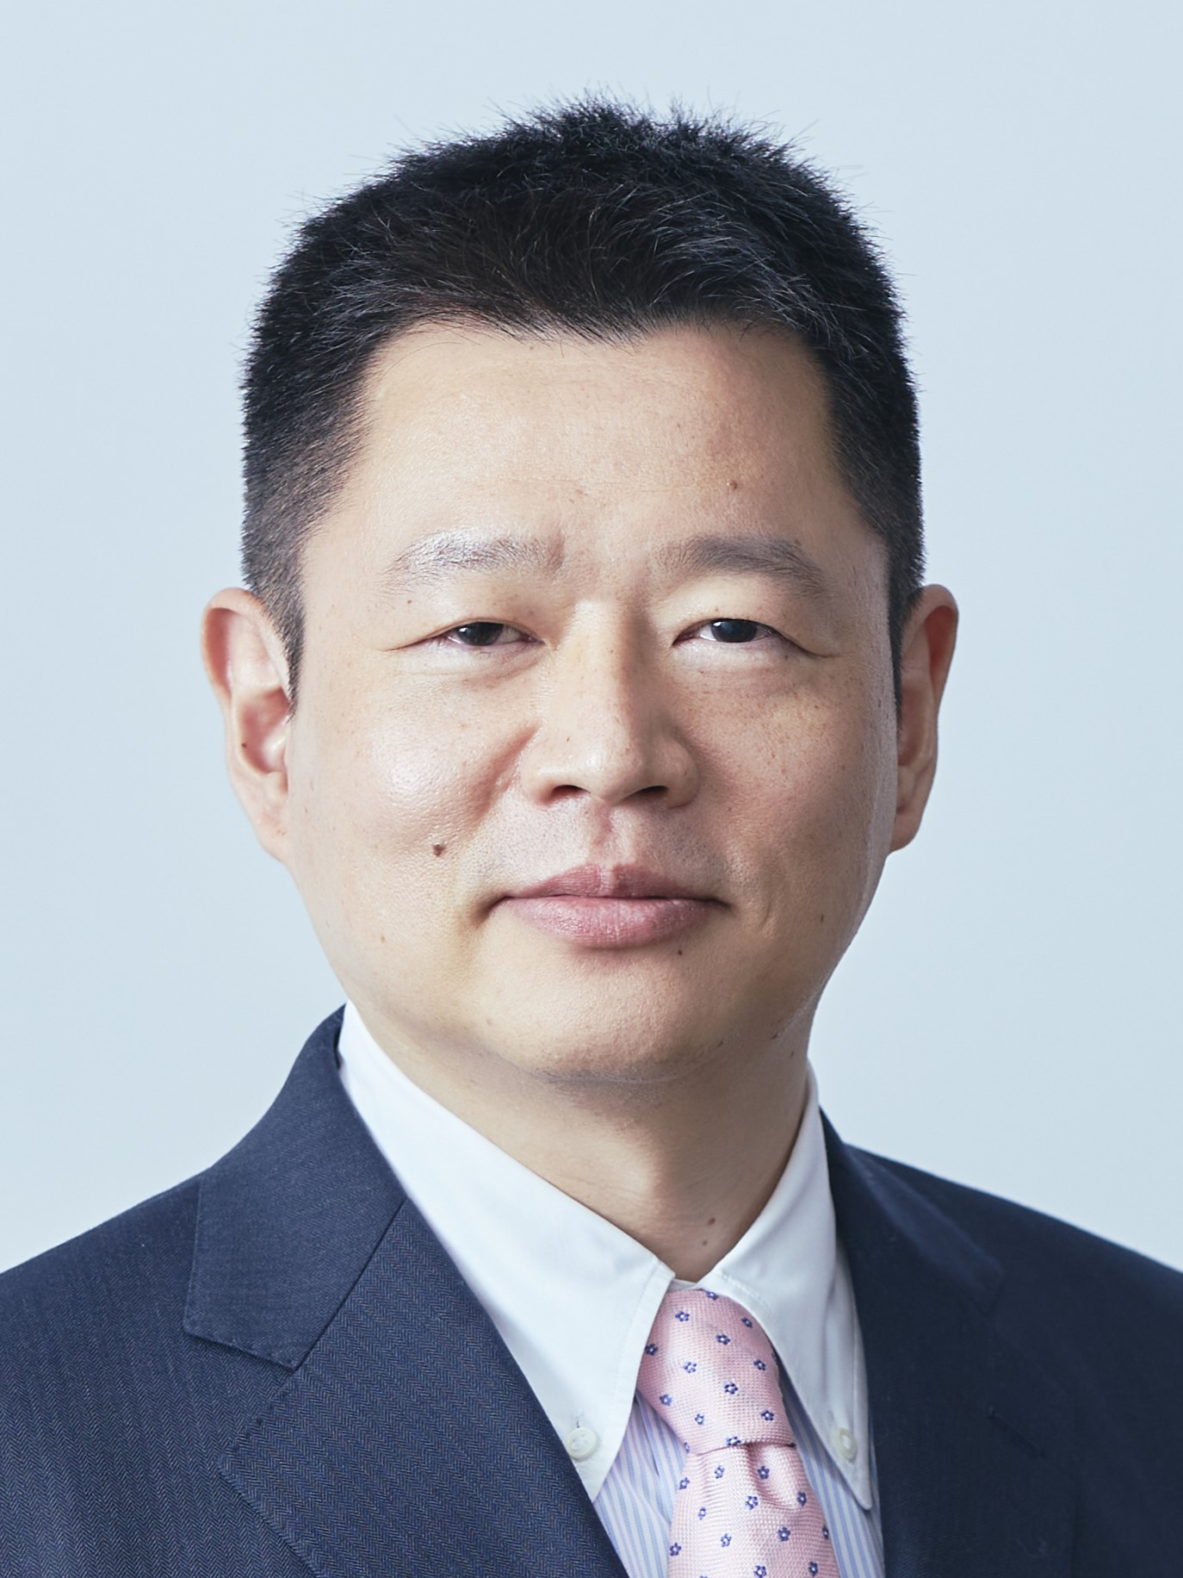
TETSUYUKI MURAMATSU
Director,
Office for Particle and Nuclear Research Promotion,
MEXT(Ministry of Education, Culture, Sports, Science and Technology)
Notes:
I am Tetsuyuki Muramatsu, Director of Office for Particle and Nuclear Research Promotion at MEXT.

Slide 3
Thank you for the efforts of all involved.
Notes:
First of all, I would like to thank the colleagues at the US-DOE, LBNL and KEK for organizing this conference.
I would also like to express my deepest gratitude to Dr. David Lassner, President of the University of Hawaii, and everyone involved for making such a wonderful conference possible here in Hawaii.

Slide 4
The first news of the discovery of the top quark at Fermilab was big news in Japan
Asahi Shimbun, April 23, 1994
Notes:
Let me introduce myself a little.
When I was a freshman at Nagoya University, that was in April 1994, I heard the very first news of the Top Quark discovery at Fermilab.
Until then, I had no interest in elementary particle physics, as I intended to research gravitational theory.

Slide 5
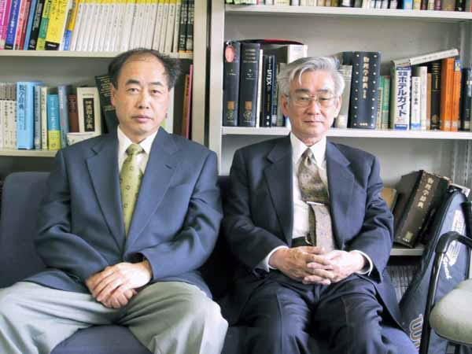
Dr. Kobayashi and Dr. Maskawa are graduates of Nagoya University.
https://www2.kek.jp/ja/newskek/2003/mayjun/photo/km3.jpg
Notes:
However, when I learned that the researchers who predicted the existence of more than six quarks were graduates of Nagoya University, I immediately became interested in particle physics.
Then immediately, I was impressed by the wonderful collaboration of theory and experiment in elementary particle physics.

Slide 6
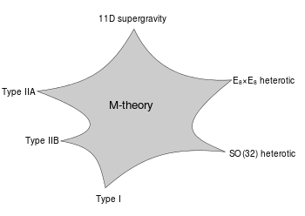
My PhD thesis:
Study of Supersymmetry in Quantum Dynamics of Eleven-dimensional Supergraviton
Notes:
This led me to study the theory of elementary particle physics.
I also had an interest in quantum gravity, so I studied string and M-theory in graduate school.
After a few years as a postdoctoral fellow, I joined the MEXT.
I think I am one of the officials who most understand the importance of particle physics in the Japanese government. So, I am very pleased and honored to have the opportunity to give an opening address at the 45th meeting of the US-Japan Cooperation in High Energy Physics.

Slide 7
Japan and the US have been important long-term partners in high energy physics.
Notes:
Japan and the US have been important long-term partners in high energy physics, and it should be remembered that this friendly and constructive relationship has been established in large part by the US-Japan cooperation program in high-energy physics, which began more than 40 years ago.
In this program, we have supported cooperation in experiments and R&D of accelerators and detectors on both sides.
The program has also played a major role in raining of the scientists, with young Japanese researchers sent to the US under the program becoming leaders in research and education at universities and research institutes.
We would like to pay special tribute to the efforts of all those involved during this period.

Slide 8
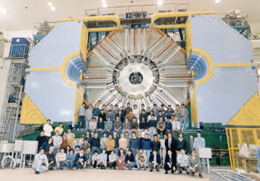
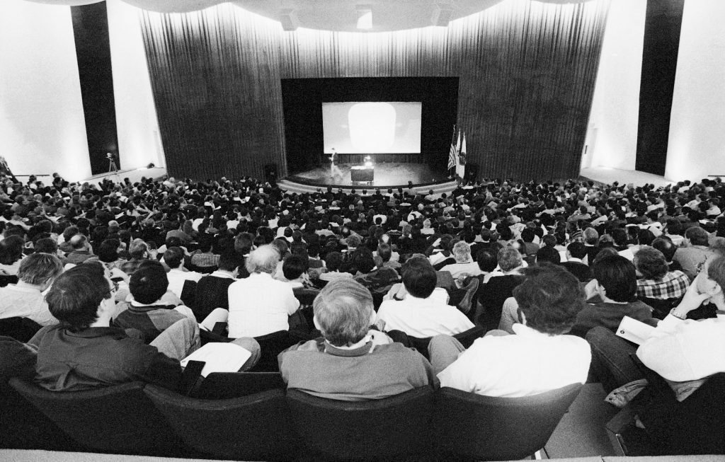
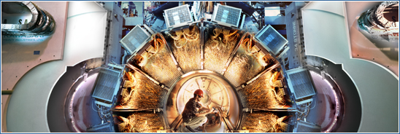
Research collaboration between Japanese and US scientists has contributed to important achievements in high energy physics, which should be highly appreciated.
https://www2.kek.jp/ja/news/nobel/KEKB.html
People pack Fermilab’s Ramsey Auditorium on March 2, 1995, during the announcement of the discovery of the top quark. Photo: Reidar Hahn, Fermilab.
https://news.fnal.gov/2020/03/twenty-fifth-anniversary-of-the-discovery-of-the-top-quark-at-fermilab/
https://www-public.slac.stanford.edu/babar/
Notes:
To date, research collaboration between Japanese and US scientists has contributed to important achievements in high energy physics, which should be highly appreciated. These include the discovery of the top quark at Fermilab, the discovery of CP violation in B meson systems at the B factories built in both countries, and progress in understanding neutrino oscillations in detail, which was also a consequence of the cooperation and competition between the two research groups on both sides.
MEXT respects such a significant history and strongly hopes that such research cooperation will be further developed in the coming years.

Slide 9
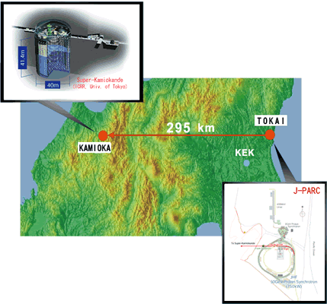
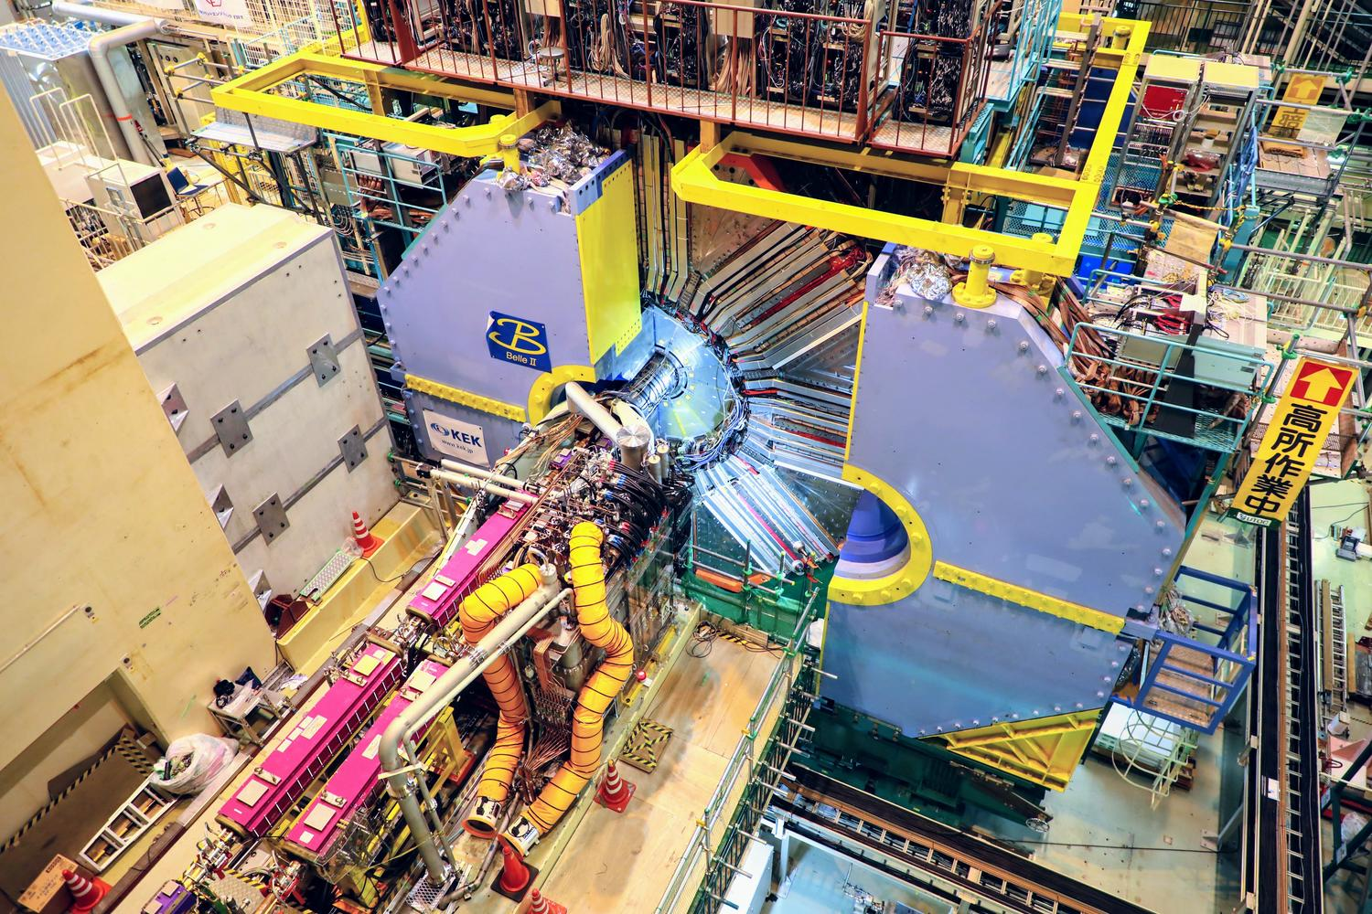
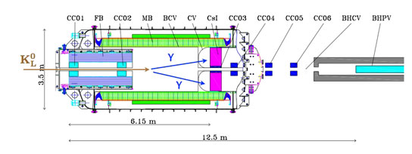
Many US scientists have participated and made essential contributions to the progress of KEK research programs.
https://www.kek.jp/ja/Facility/IPNS/Belle2/
https://t2k-experiment.org/ja/
https://www.kek.jp/ja/Research/IPNS/KL/
Notes:
Research at the B factory, long-baseline neutrino experiment, and rare decay experiment of K mesons continue at KEK, and many US scientists have participated and made essential contributions to the progress of these research programs.
I am grateful for this and deeply appreciate the support of the DOE that makes this possible.
I am watching these studies with great interests to see what results they will produce in the future.
MEXT is well aware of the significance of promoting particle physics research internationally and understands that the activities of physicists to realize the future accelerator such as ILC should be appropriately supported.

Slide 10
US-Japan Meeting 2023
US-Japan Meeting 2023
Notes:
I understand that this symposium will include reports on the progress of research and discussions on future directions. I wish this symposium will be successful for all of you and lead to the development of our field.
We also look forward to continuing discussions with the DOE on ways to make the US and Japan stronger partners in high energy physics.

Slide 11
Thank you for your attention.
Notes:
Thank you very much.

