Slide 1


ASIC needs for future large scale detectors
Veljko Radeka
BNL
Acknowledgements:
H. Chen, A. D’Andragora, G. De Geronimo, S. Li, N. Nambiar, S. Rescia, E. Vernon, B. Yu

Slide 2
Outline
Science motivation
Plans … and dreams …
More modest plans …
The challenge of scaling up detectors: WCD → the need for ASICs?
The challenge of scaling up detectors: LAr TPC → ASICs in LAr
CMOS at low temperature (see the talk Shaorui Li)
ASICs in Two-Phase noble element detectors

Slide 3
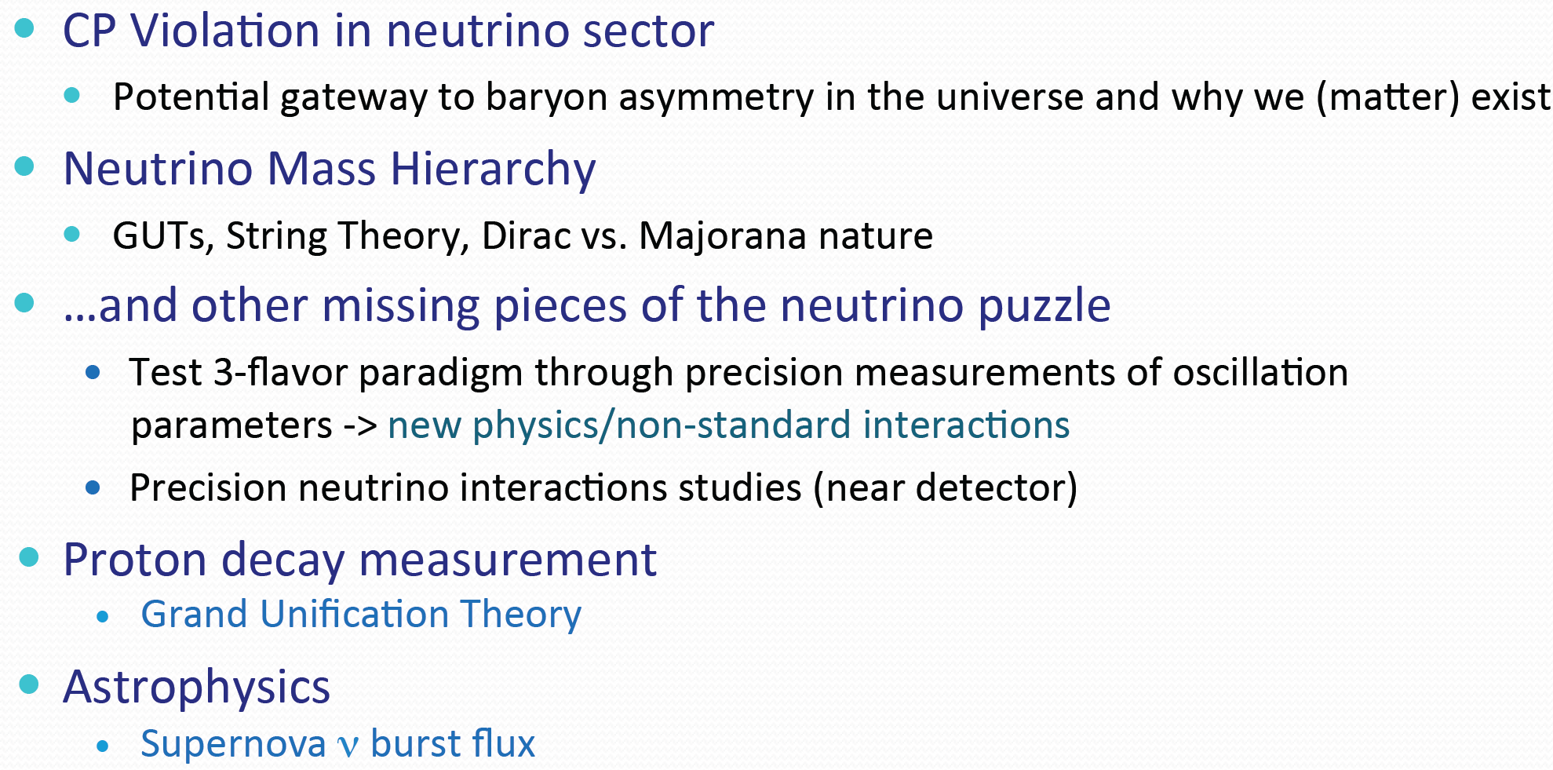
Science Goals for LBNE

Slide 4
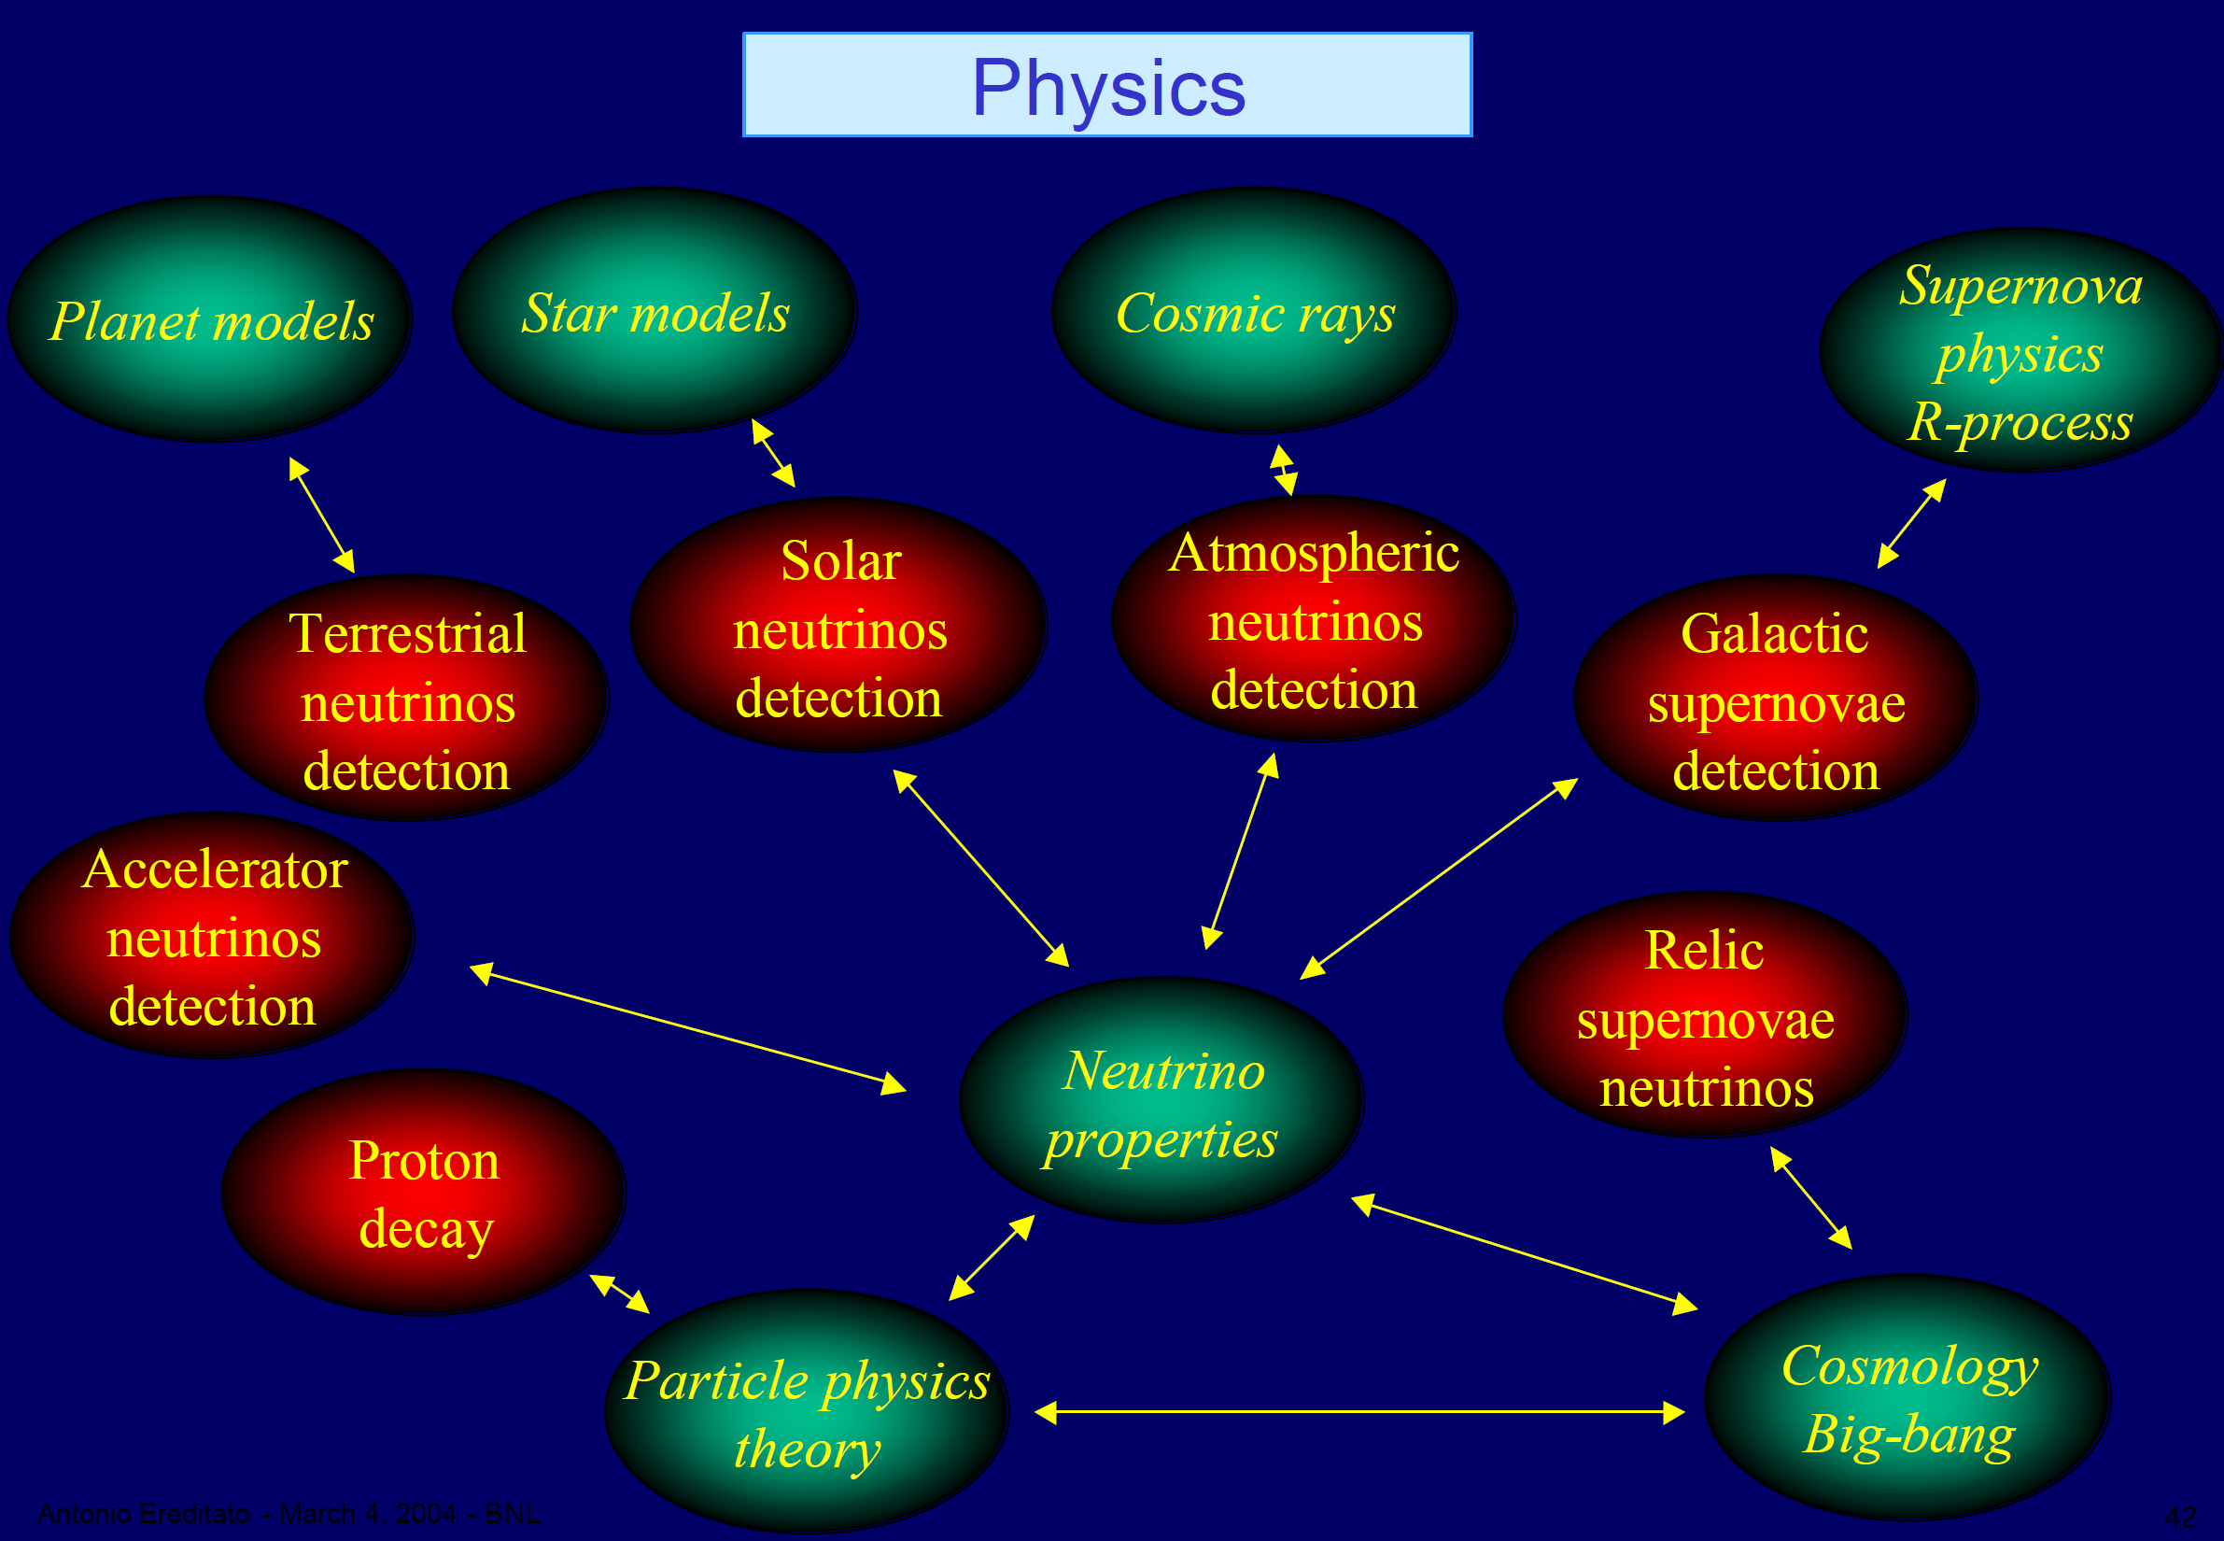

Slide 5
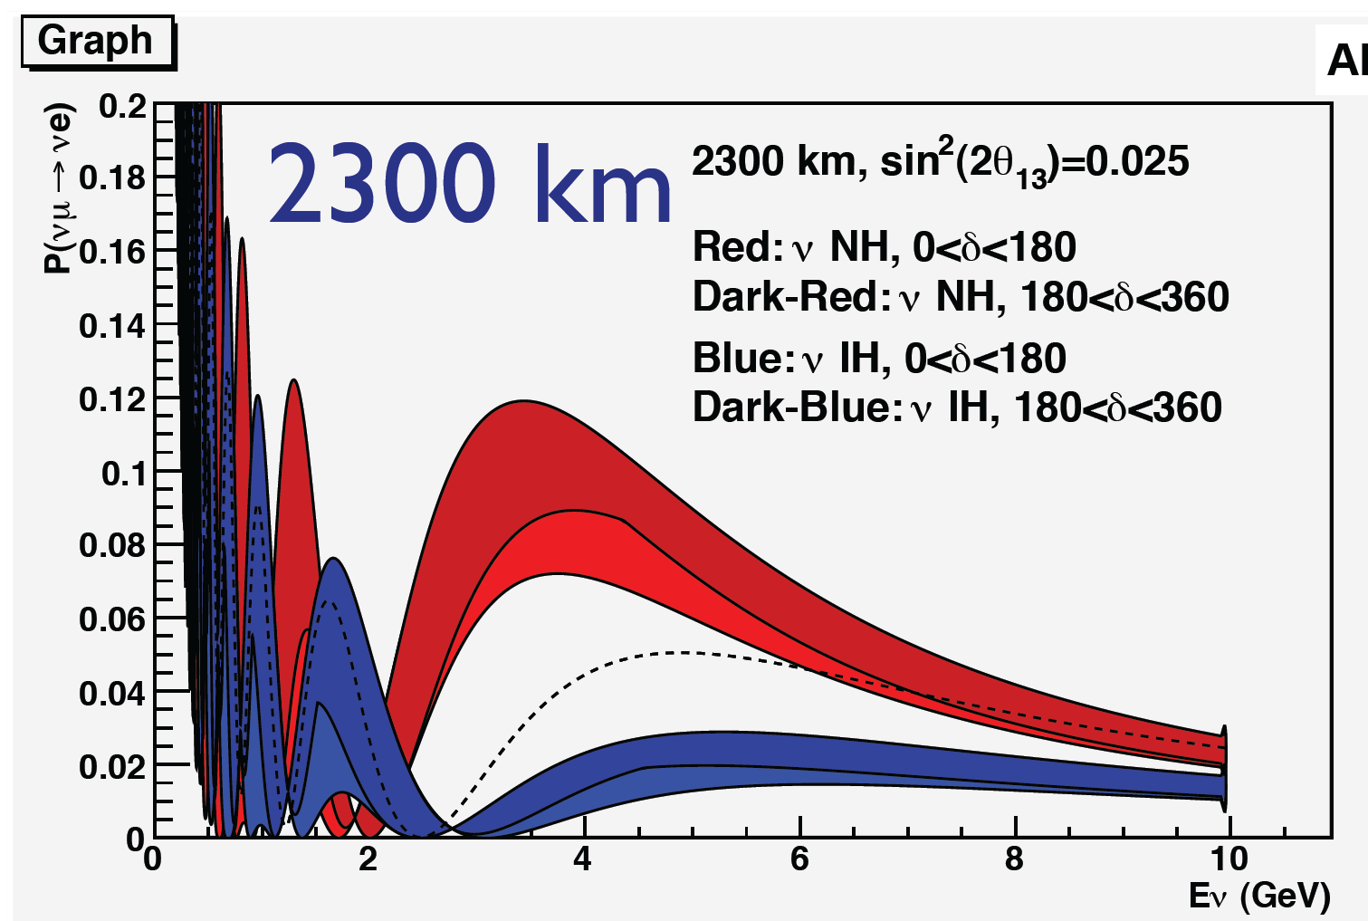
Probability of neutrino oscillations vs neutrino energy
From: A. Rubbia, GLA2011

Slide 6
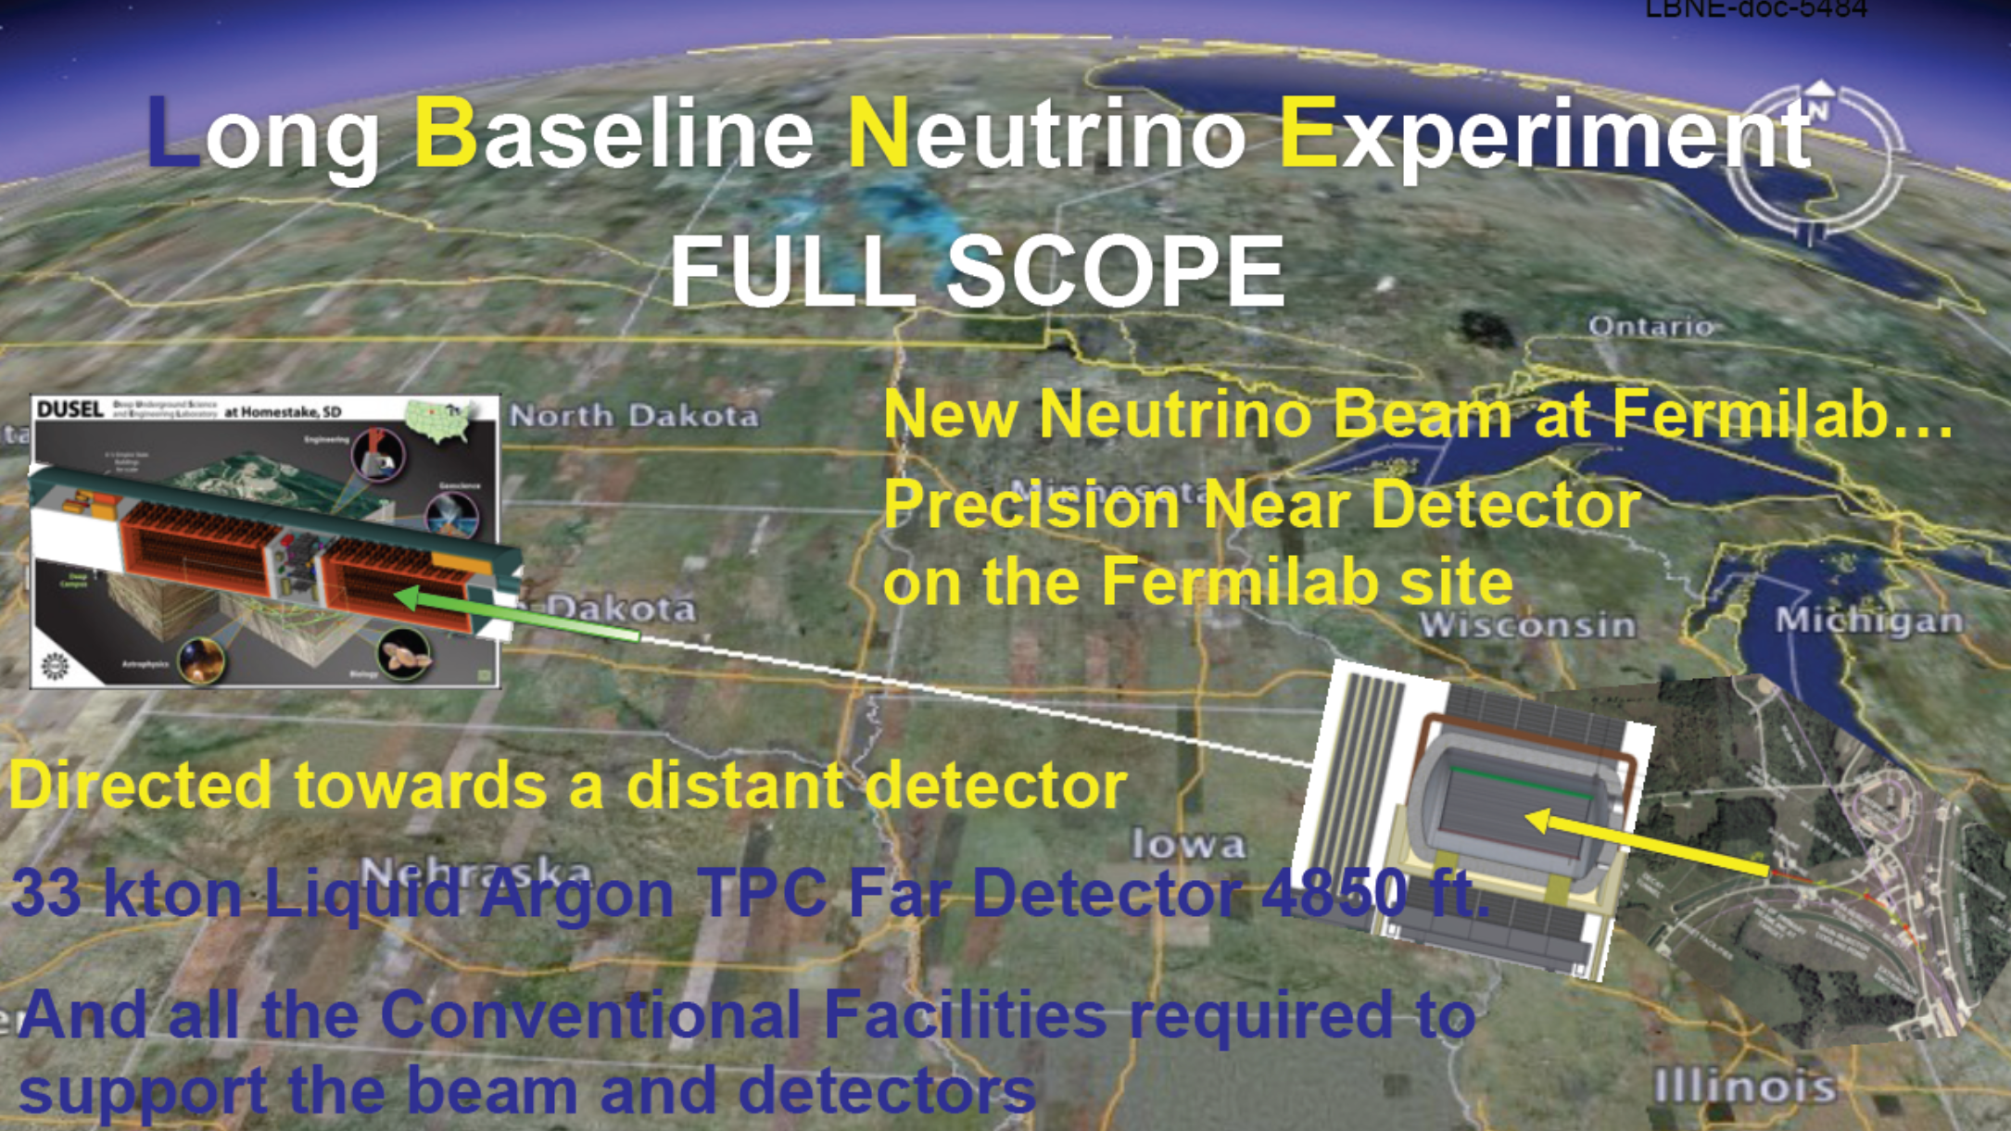
FNAL to Homestake (1300 km)

Slide 7
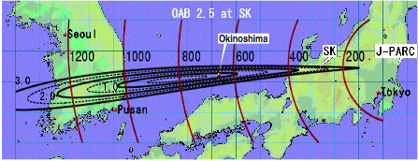
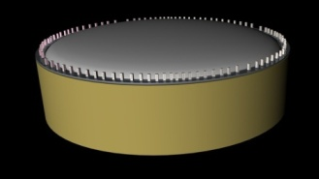
J-PARC to Okinoshima
Distance = 658 km
Off-axis angle = 0.76º (2.5º @ SK)
100 kton liquid Argon
➙ Good coverage of 1st & 2nd oscillation maximum
7

Slide 8
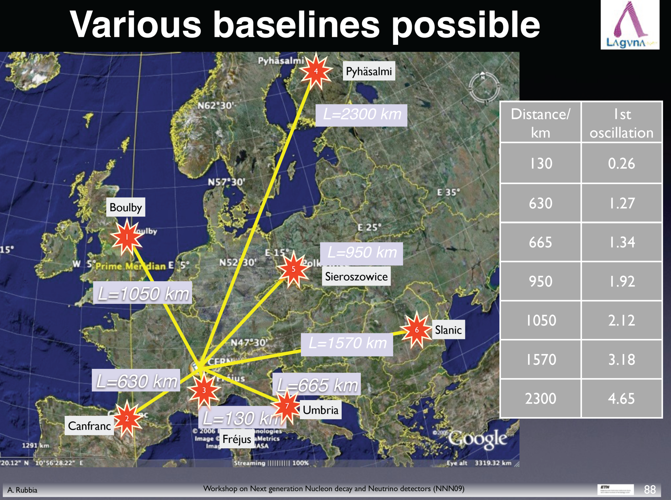

Slide 9
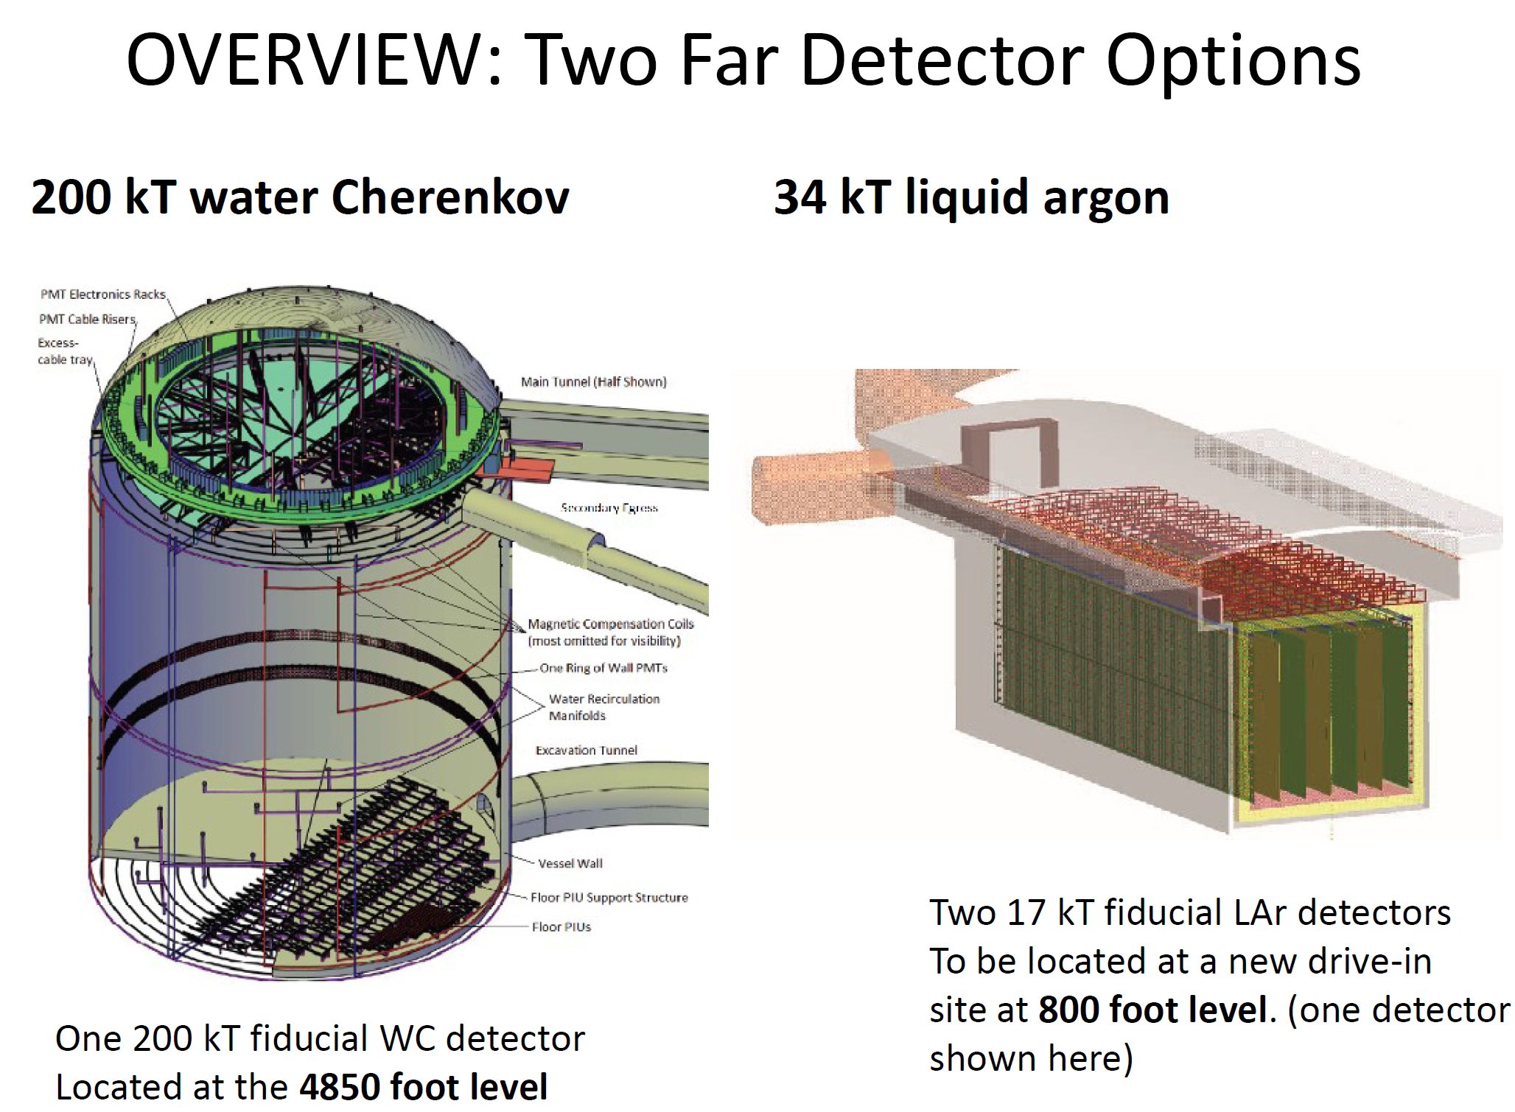
for LBNE

Slide 10
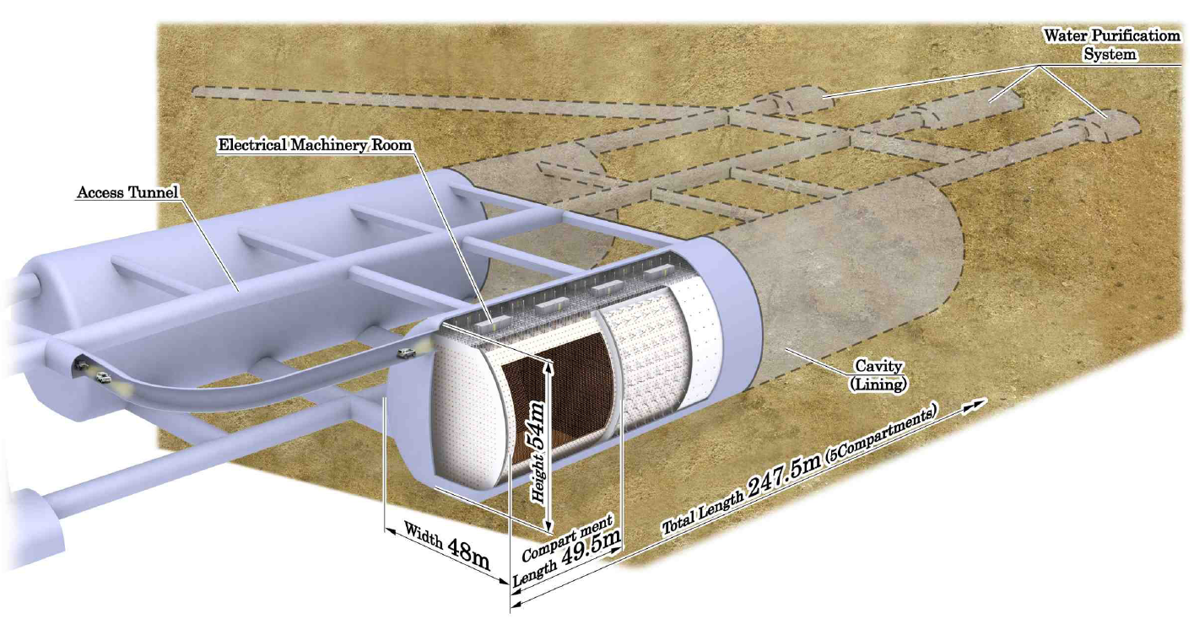
Hyper-K ≈ 20 x S-K
Total (fiducial) vol. ~0.99(0.56) Mton H₂O in 20 modules
From the Letter of Intent, Sept 2011
~99 k 20” + 25 k 8” Photomultipliers

Slide 11
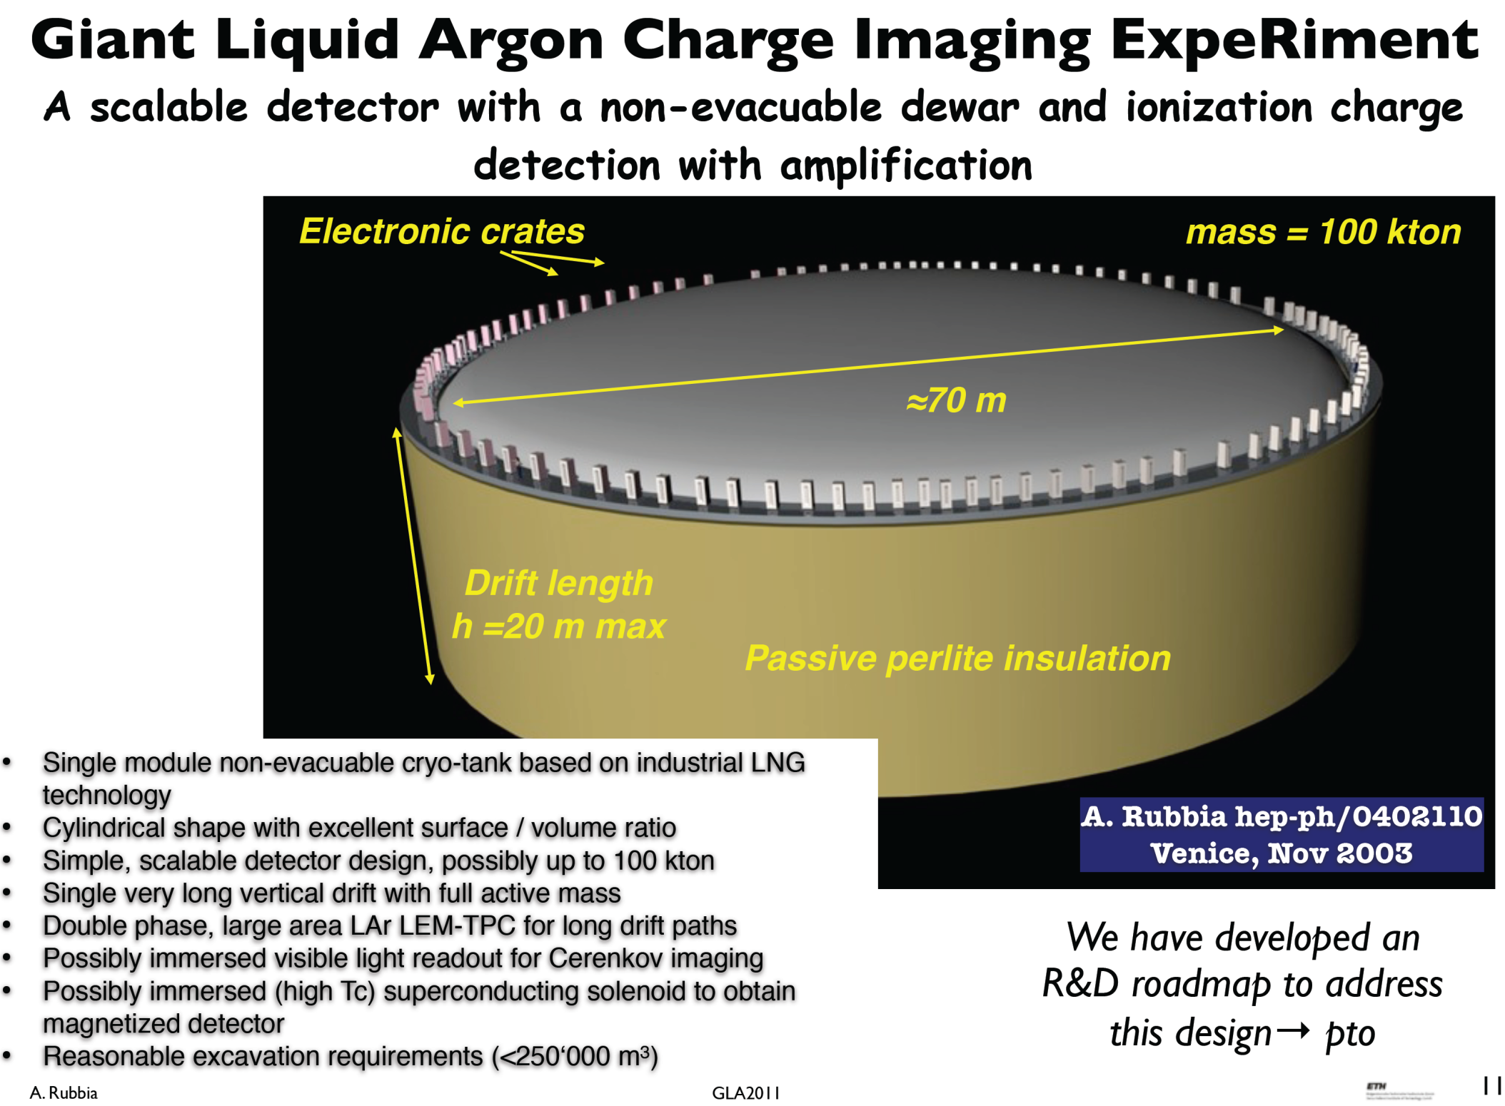

Slide 12
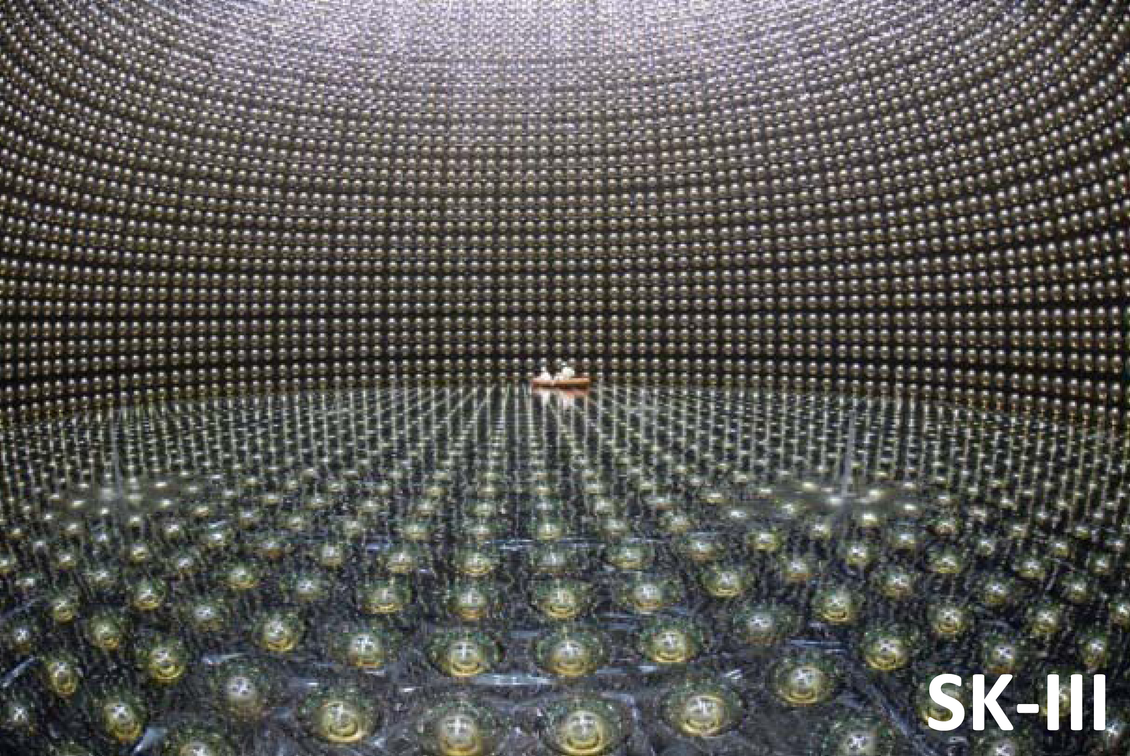
Super-K III: 50kt(22.5kt), 11,446 20” PMs, 40% coverage
From: Y. Suzuki

Slide 13
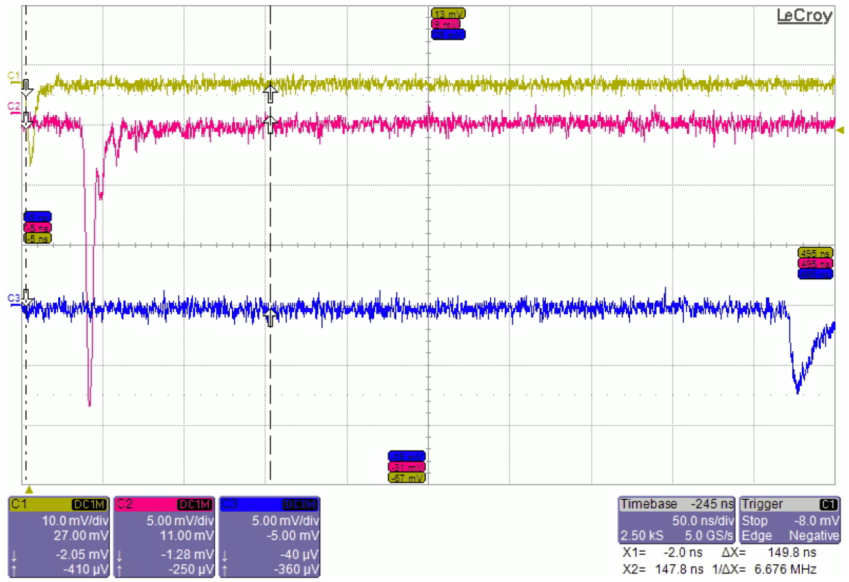
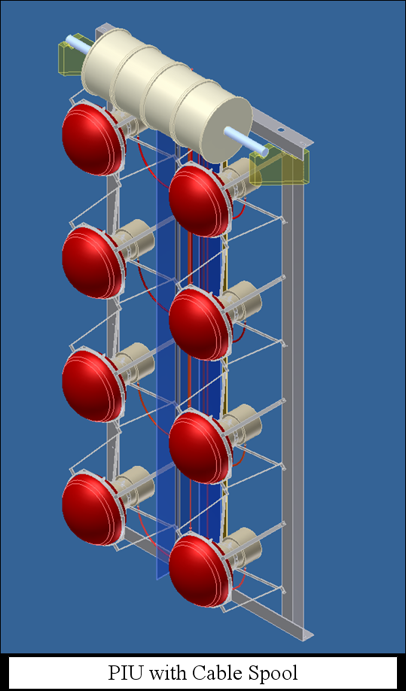
WCD Readout (1): One 100 m cable/PMT
“Fortunately, while the high frequency part of the signal is attenuated by the cable … , the signal from the PMT is quite large (pC) and significant attenuation can be tolerated ….So, … attenuation and signal dispersion over distances of 100 m is not a problem.”
From: LBNE WCD CDR, 2012
From; R. Sharma, PM Concepts, 2010

Slide 14
Readout of WCDs and Liquid Scint. Dets.: Alternatives to “Classical”
1. From Peter Denes (2008):
“Investigate the use of IceCube-like electronics (LBNL) for these detectors …
Multiple PMTs on the same cable
Each PMT is an autonomous, self-contained system
Use of ASIC for complex functionality at low power …”
2. From R&D proposal for Daya Bay II
“… we propose a system that will digitize and group signals close to the PMTs and transport digital information on fiber optics to DAQ.
…. we propose a configuration of clustered digitization electronics, each servicing from 16 to 32 PMTs. Each digitizer unit reports (and receives instructions) via fiber optics to the central digital signal processing and recording in the main data acquisition system.”

Slide 15
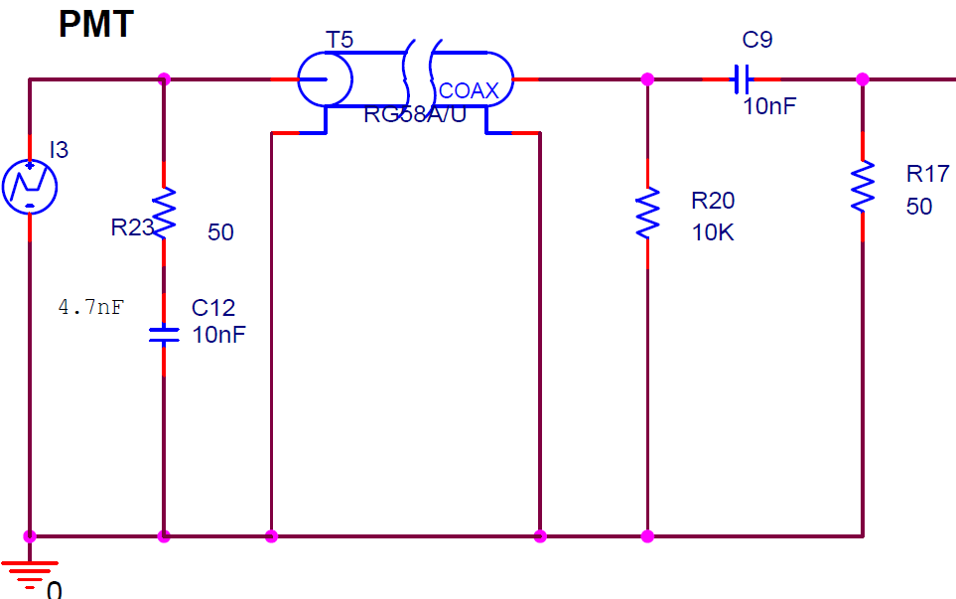
PMT Readout Alternatives
1. and 2. :
One long cable (~100 m/PMT) , electronics outside the vessel; ac coupling (photocathode at 0V), dispersion, terminations, high PMT gain (~10⁷). No ASICs in the vessel, ASICs for analog processing outside.
Clusters of PMTs (~4x4) connected to an ASIC with short cables (~2-4m); ac coupling (photocathode at 0V), dispersion negligible, terminations, lower PMT gain (~10⁶). ASIC/cluster inside.
ASIC at each PMT. Processing in clusters. Photocathode at 0V or at HV. Low PMT gain sufficient.
100 m, or 2-4m
HV
-
+
~20 -30 pF stray C
OV, or HV

Slide 16
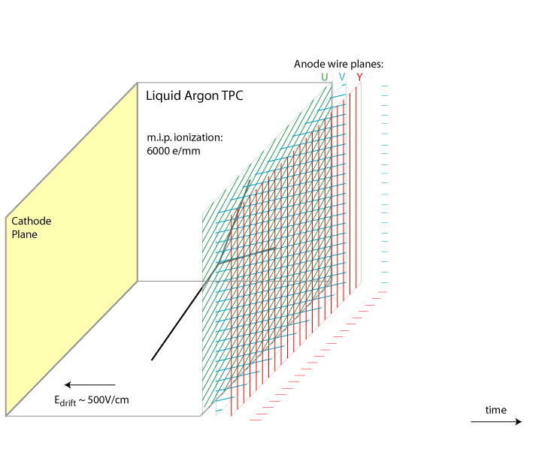
How Does a LArTPC Work
Sense (anode) wires (up to ~ 10m long):
~14-31 kwires/kton
  up to 200 pF/wire
  collecting (Y)
  non-collecting (U,V)
charge sensitivity
  range ~300 fC
  ENC < 1,000 e⁻
sample/buffer events
  ADC 10-12-bit, 1-2 MS/s
  3,000 deep buffer
digital multiplexing
  128:1 to1024:1 two-three stages
  power constraint
  ~ 10 mW /wire
operation in LAr
  > 30 years
dE/dx of 1 MIP: 2.1MeV/cm
First proposed by C. Rubbia, 1977
time

Slide 17
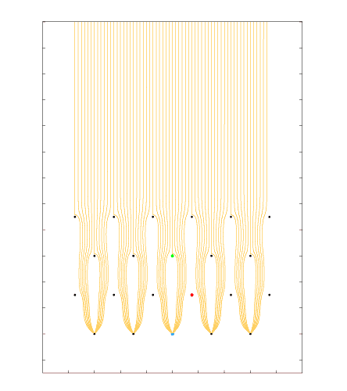
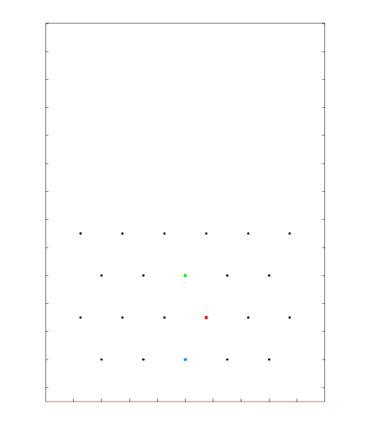
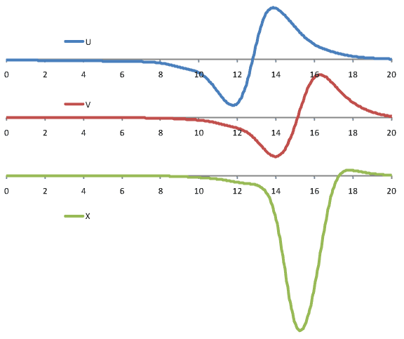
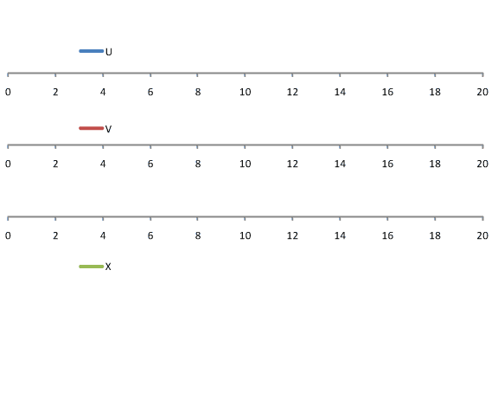
Signal Formation: Induced Signals from a Track Segment
[µs]
LBNE style wire arrangement: 3 instrumented wire planes + 1 grid plane
Raw current waveforms convolved with a 0.5µs gaussian (~1/2 drift length) to mimic diffusion

Slide 18
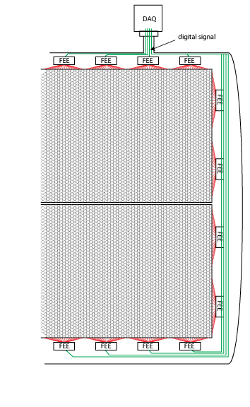
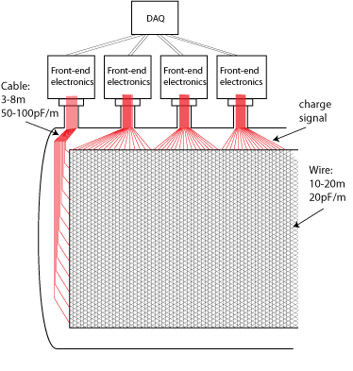
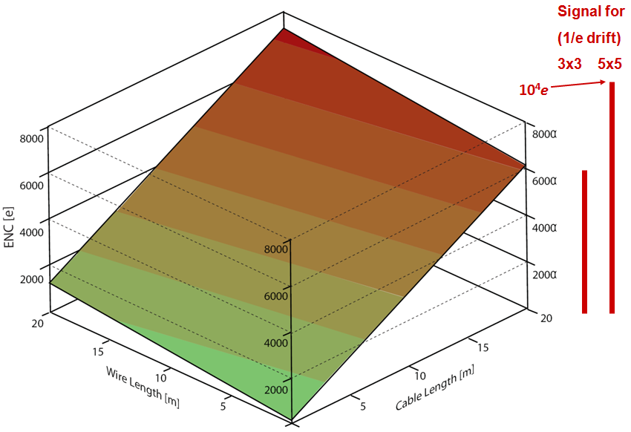
Scaling up LAr TPCs ASICs at the electrodes
A typical readout configuration with warm electronics: long cables connect the sense wires to the FEE, resulting in large electronics noise. To reduce the cable length, one has to implement cold feedthroughs below the liquid level, which increases the cryostat complexity.
Having front-end electronics in the cryostat, close to the wire electrodes yields the best SNR
Highly multiplexed circuits with fewer digital output lines not only greatly reduce the number of cryostat penetrations, but also give the designers of both the TPC and the cryostat the freedom to choose the optimum configurations
Noise (ENC) vs Sense Wire and Signal Cable Length - in relation to MIP Signal for 3x3 and 5x5 mm Wire Spacing
Stacked detectors for large cryostats
18

Slide 19
Anode Plane Assembly (APA) modular TPC in a large cryostat
~5 APAs/kton, ~4.5mm wire pitch, 2.5-3.8m drift , 2560 wires/APA
U, V, Y wires
APAs are structural and electrical units containing all sense wires and readout electronics. They can be tested in LN2 , stored and transported in shipping containers.
7 m
LAr
front-end electronics
~ 2560-3840 channels/APA
2.5 m

Slide 20
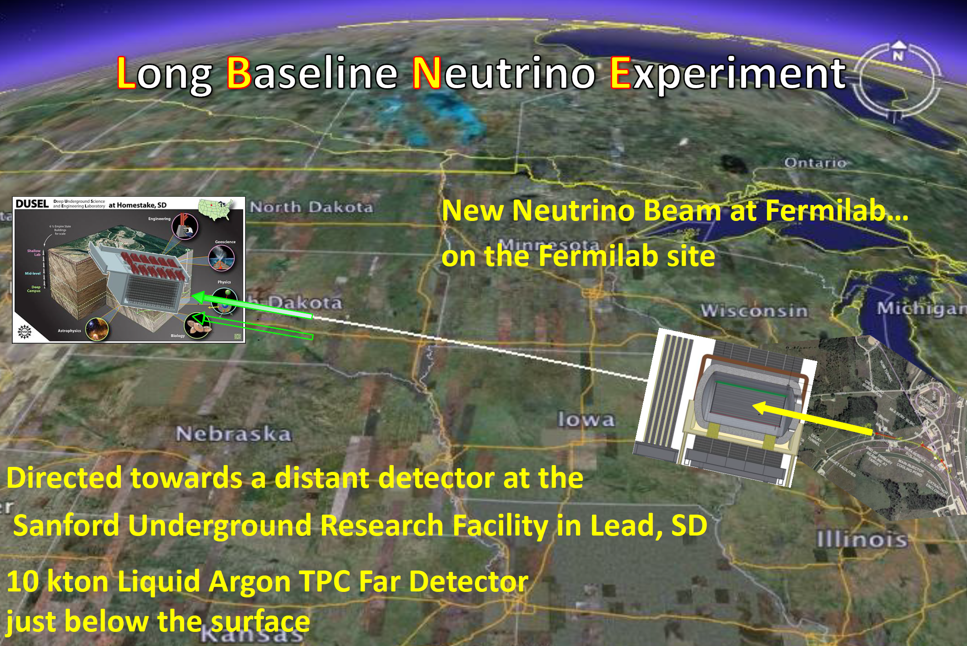
More modest scale: 10 kton Lar TPC
December 2012: CD-1 approval

Slide 21
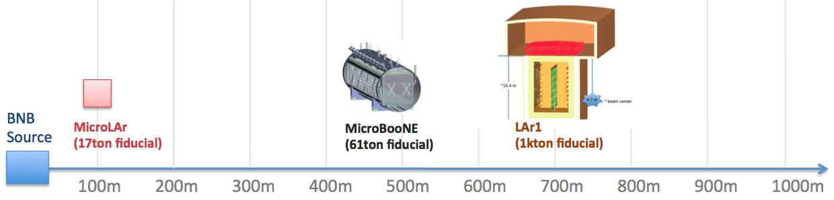
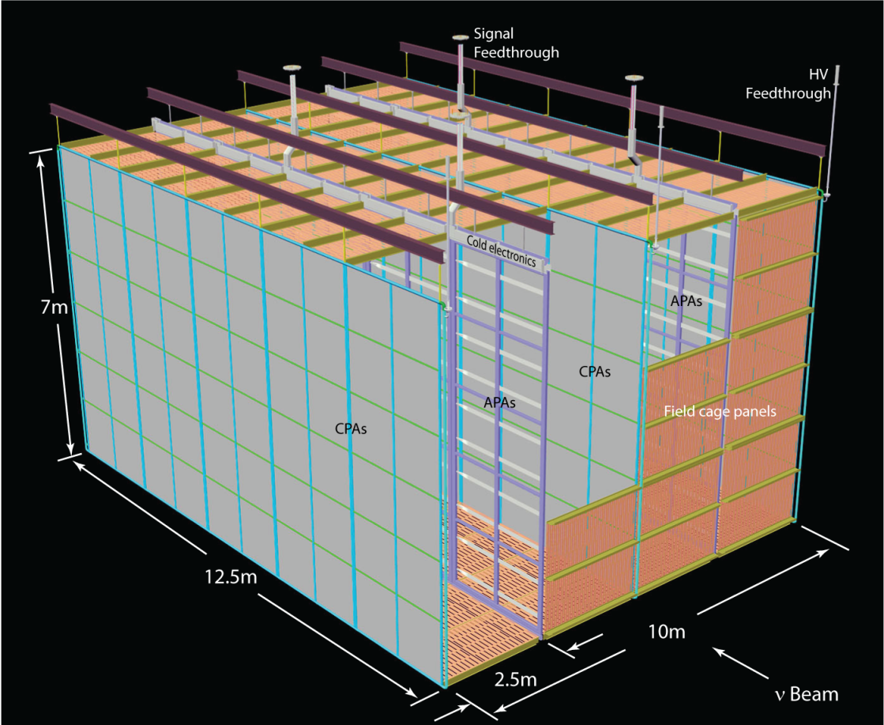
A “really modest” scale: LAr1 (proposal)
LAr1 is a proposal for a neutrino oscillation experiment on the booster neutrino beam
  Multiple LArTPCs to address the anti-neutrino short baseline anomalies and provide development input for very large LArTPC detectors for long baseline oscillation physics
Conceptual design of LAr1-FD TPC inside the cryostat

Slide 22
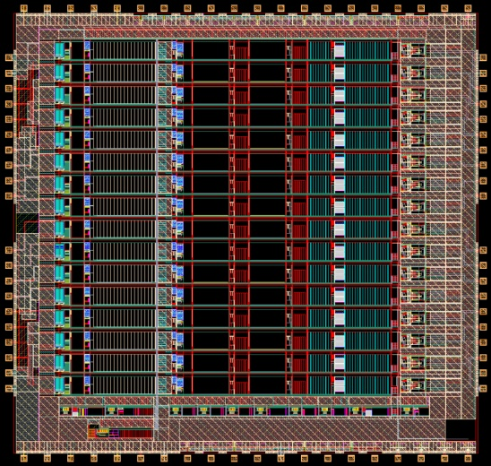
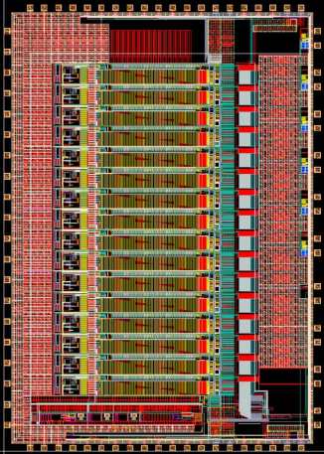
Key Components of Cold Electronics
FE ASIC
ADC ASIC
Cold FPGA
single ended
differential
cs₁ cs₂ ck₁ end sdi sdo ck
16
Waveforms
……..
Lo8
ck 192 MHz
16 wires
……..
FPGA
Hi8
ck 192 MHz
data
ena
JTAG
cs₁ sdi sdo ck
cs₂ sdi sdo
7 additional 16 channel chains
additional multiplexing
(total ≥128:1)
support non-reduction
transparent mode
max output data rate
960Mbit/s or 1.92Gbit/s
timestamp
compression
zero suppression
neighbor triggering
programmable gain, shaping, coupling, …
charge calibration over all chips, channels and temperatures to 1%
ADC 10-12 bit 2MS/s sampling rate
built-in FIFO
serialized outputs
2 x 8:1 multiplexing

Slide 23
CMOS at 77K: Designing for low power = long lifetime
At 77-89K, charge carrier mobility increases, thermal fluctuations decrease with kT/e, resulting in a higher g_{m} /I, higher speed and lower noise.
Life time testing region
Design region (approx.) for low power and long lifetime at 77K (moderate inversion)

Slide 24
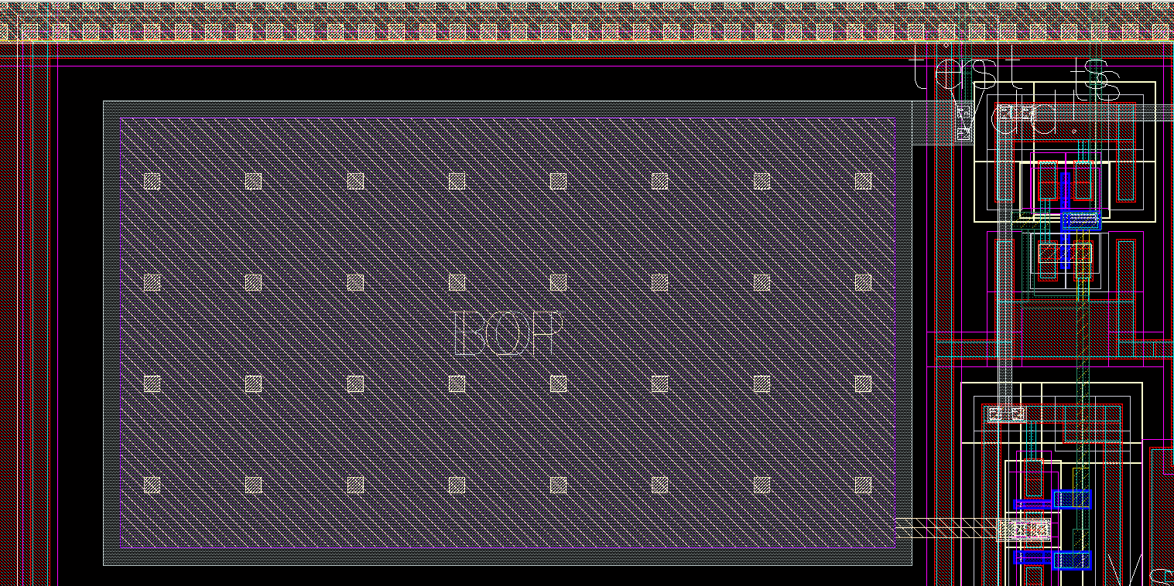
Cold Electronics ASIC - Front-End Detail and Calibration Scheme
N₁ = 20 N₂ = 3, 5, 9, 16
C_{INJ} ≈ 180 fF
Integrated injection capacitance (10 x 18 µm²)
Measured with high-precision external capacitance
Integrated pulse generators on ASICs Charge sensitivity calibration of entire TPC during assembly, cooling and operation

Slide 26
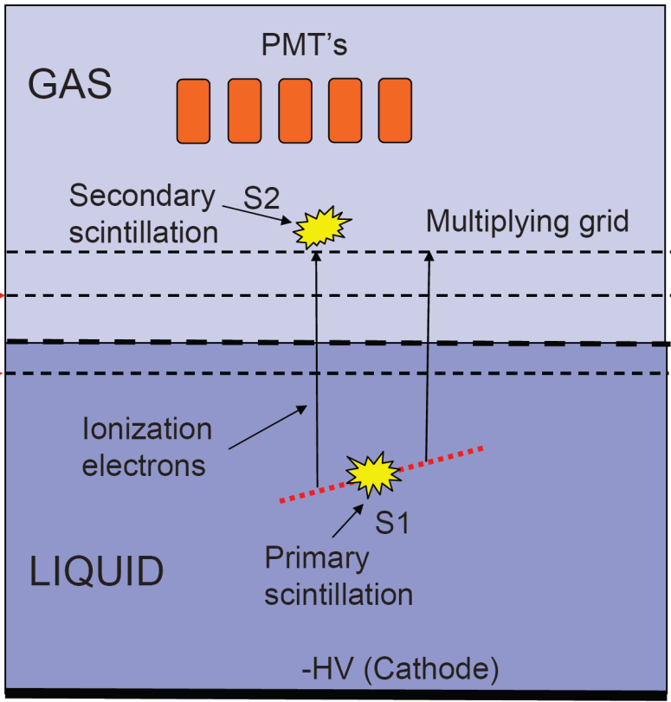
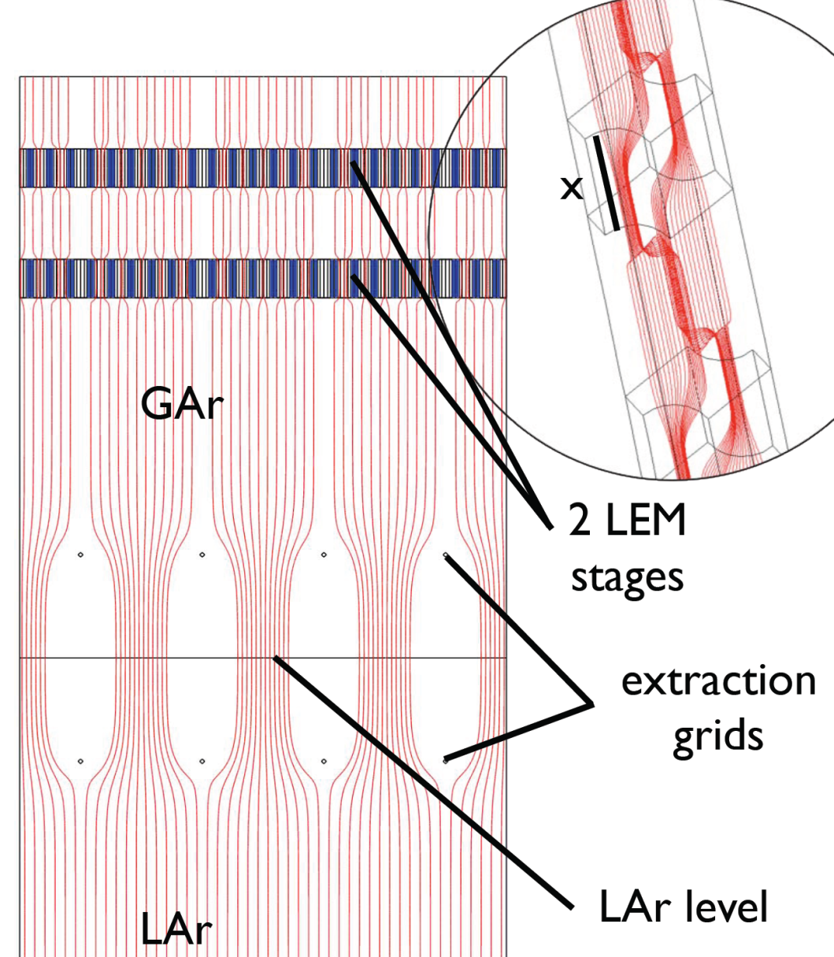
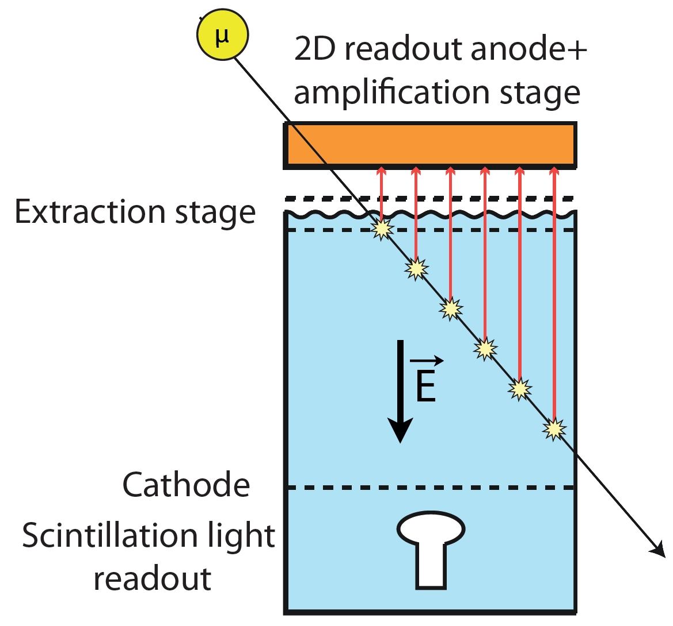
Dual-Phase Noble Liquid-Gas Detectors:
Small (multi-ton) for Dark Matter (WIMP) detection and Large (multi-10 kton) for neutrino studies, proton decay, neutrinos from SN
~1 cm
From: H. Sobel
From: F. Resnati

Slide 27
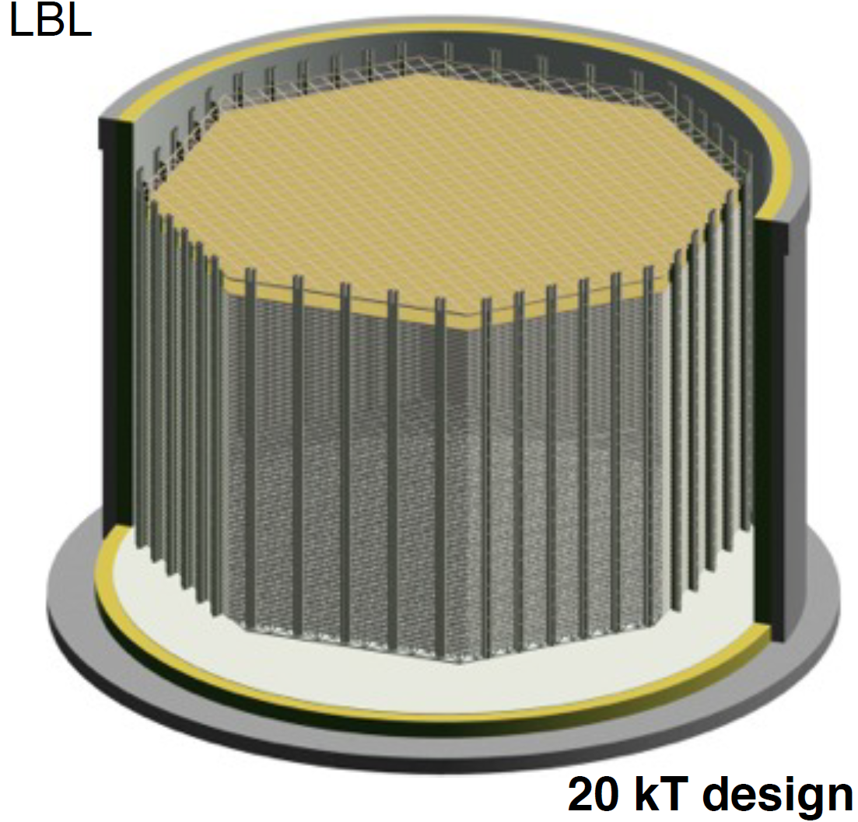
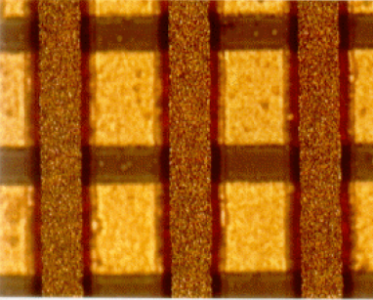
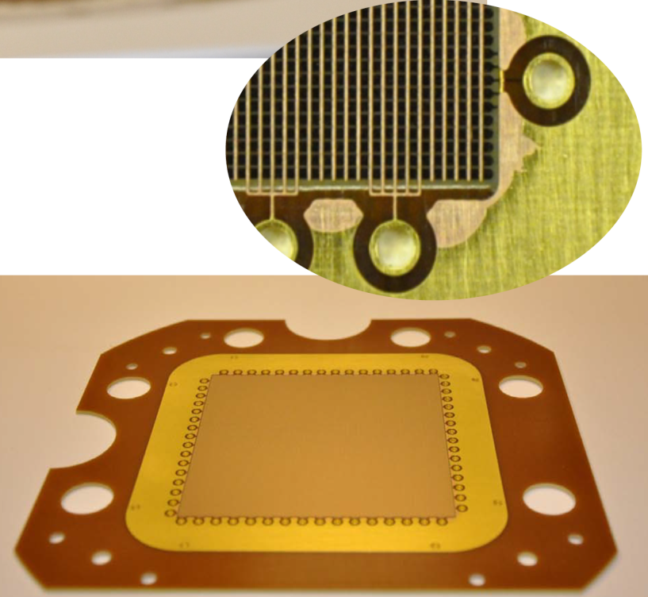
Large Two-Phase LAr TPCs: The Challenge of Scaling up the Readout
Assume
40 m
12 m
10x10 cm²
From: F. Resnati
X-Y strip electrodes have a large capacitance
above ~100-200 pF per strip the S/N is affected
signal channels: ≈ 400/m² → >5x10⁵ for ~ 20 kton (~ 25 strips-channels/ton, nearly the same as for LBNE with 2.5 meter drift distance)
ASICs with multiplexing clearly needed
Electron multiplication leads to loss of easy charge calibration inherent to ion chambers
A scaled down LAGUNA concept
From: A. Rubbia, A. Ereditato
Aiming at ≥ 100 kton

Slide 28
Concluding Remarks:
Water Cherenkov and Liquid Scintillator Detectors – can be built without ASICs in the vessel – BUT SHOULD THEY? ASICs at, or near, PMTs will result in better time response and higher S/N. Significantly lower PM gain will result in better linearity, longer PMT life and reduced afterpulsing. No large detector of this type is likely to be built on a time scale incompatible with the ASIC development time.
LAr TPCs – scaling up all but impossible without ASICs in LAr. Superior performance with ASICs at the TPC electrodes as a part of an integral design.
Two-Phase Noble Liquid-Gas TPCs – scaling up to electrode area larger than ~0.5-1 m² becomes difficult (e.g., electron extraction grids, LEM/GEM electrodes, readout anode). ASICs advantages same as for LAr TPCs. For light readout, ASICs at PMTs.

Slide 29
Additional Material

Slide 30
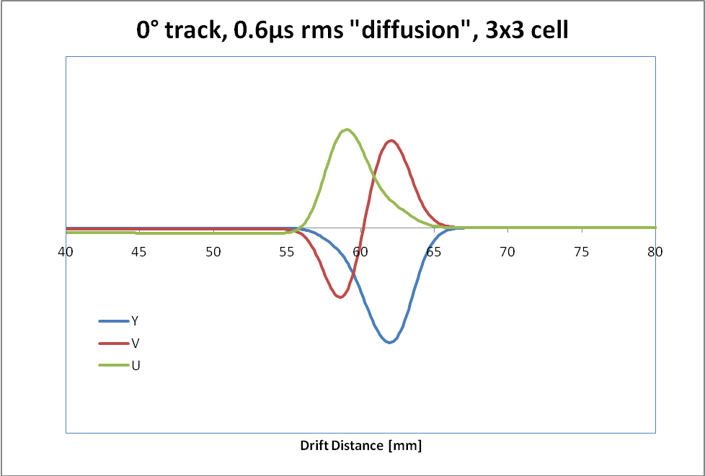
Signals in LAr TPC
Charge signal:
Induced Current Waveforms on 3 Sense Wire Planes:
A 3mm MIP track should create 210keV/mm x 3mm /23.6eV/e = 4.3fC.
After a 1/3 initial recombination loss: ~2.8fC
Assume the drift path to equal the charge life time, reducing the signal to 1/e≈0.368.
The expected signal for 3mm wire spacing is then ≈1fC=6250 e, … and for 5mm, ≈10⁴ e, for the “collection signal”.
The induction signals are smaller
The time scale of TPC signals is determined by the wire plane spacing and electron drift velocity, (~1.5 mm/µs at 500 V/cm).
Sampling rate ≤ 2 Ms/s
30

Slide 31
Noise vs T in CMOS:
Existing ASIC, 0.25 µm (not designed for Lar)
ENC vs. T (Cd=100pF, 0.5µs peaking time)
ENC [e rms]
T [K]
CMOS in LAr has less than half the (white) noise as that at room temperature, higher mobility and higher transconductance/current ratio
Notes:
31
31

Slide 32
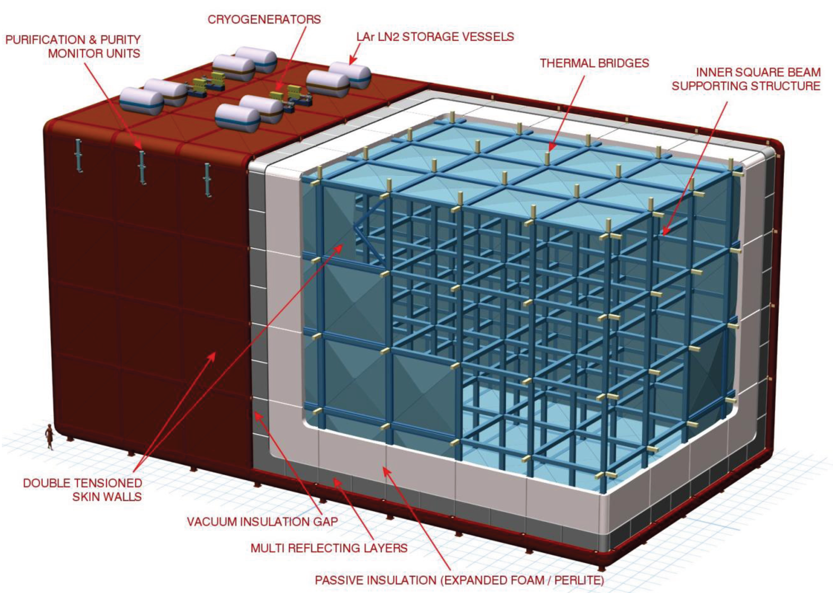
A beautiful Cryo-Mechanical Design of LAr TPC – but the Readout ???

