Slide 1
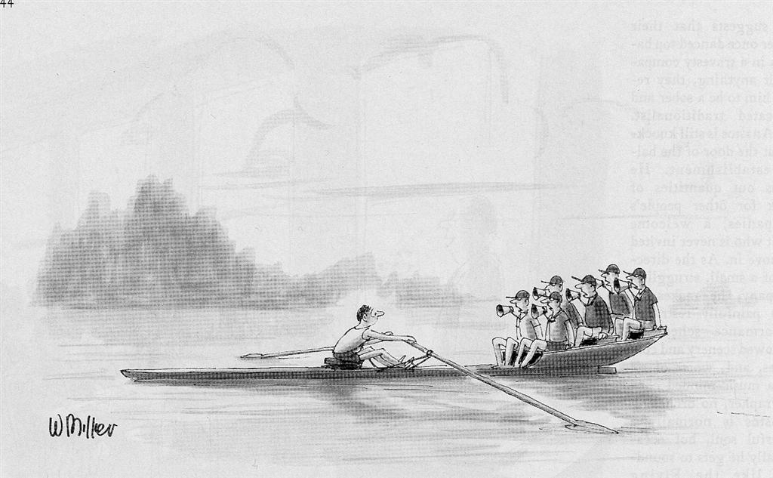
IC Designer in a “Collaboration”

