Slide 1
Machine Learning Applications at SLAC
March 30, 2022
D. Ratner
SLAC National Accelerator Laboratory

Slide 2
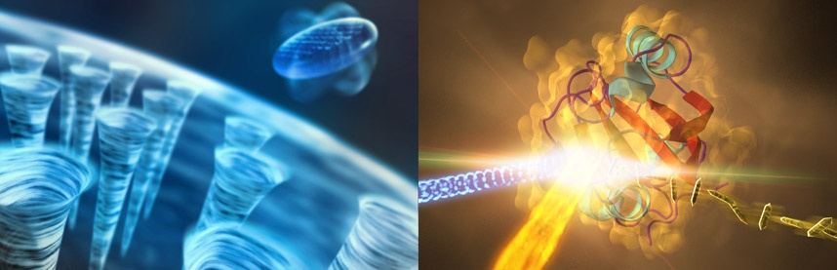
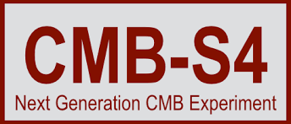






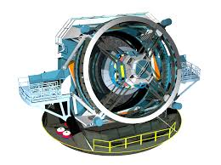
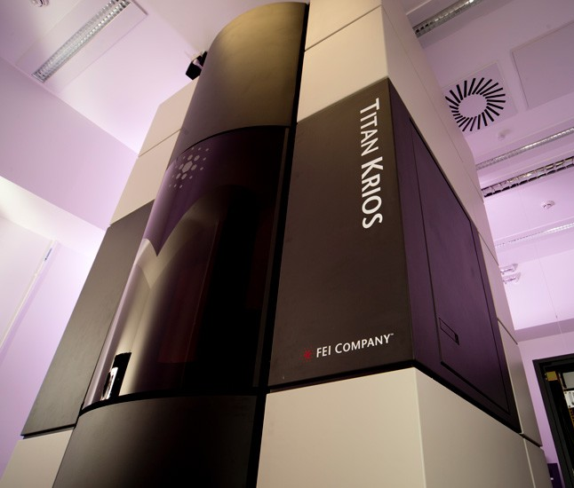
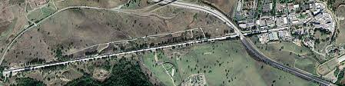
Introduction to SLAC
SLAC’s mission revolves around major scientific facilities
Research projects across biology, chemistry, geology, physics, energy sciences, materials science, and more
LCLS-II
Cryo-EM facilities for COVID research
Vera Rubin Observatory
Particle accelerators for x-ray science

Slide 3
Outline
Online control of x-ray facilities
Ghost imaging
ML for inverse problems
(But there are also many other applications across SLAC)

Slide 4
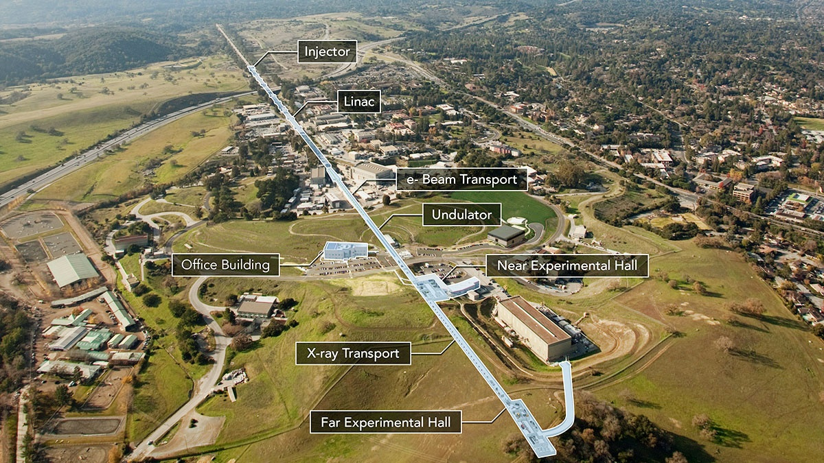
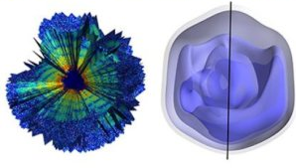
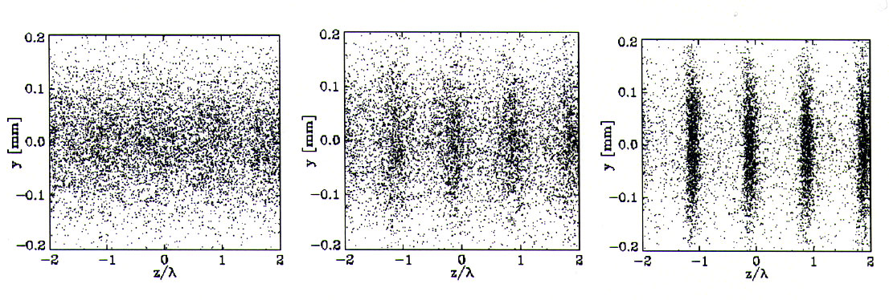
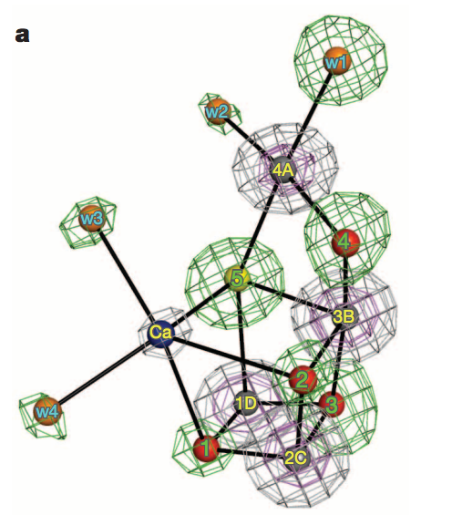
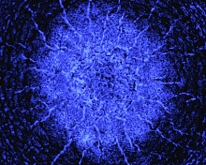
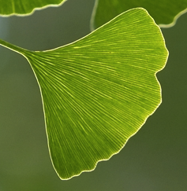
Introduction to X-ray Free-Electron Lasers (XFELs)
X-ray free-electron lasers: Accelerator driven x-ray sources to study ultrafast, ultrasmall scale phenomena
Single particle imaging (Mimivirus)
Ekeberg et al.,
Shock waves in extreme conditions
Photosystem II
Suga et al.
Si
Milathianaki et al.

Slide 5
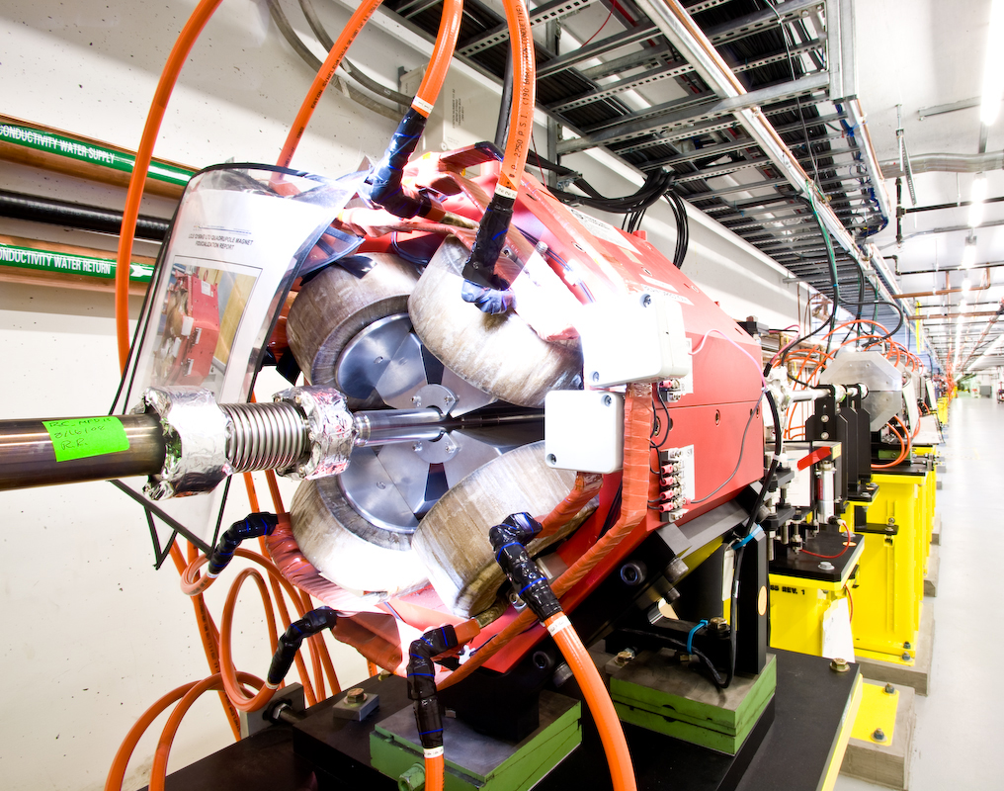
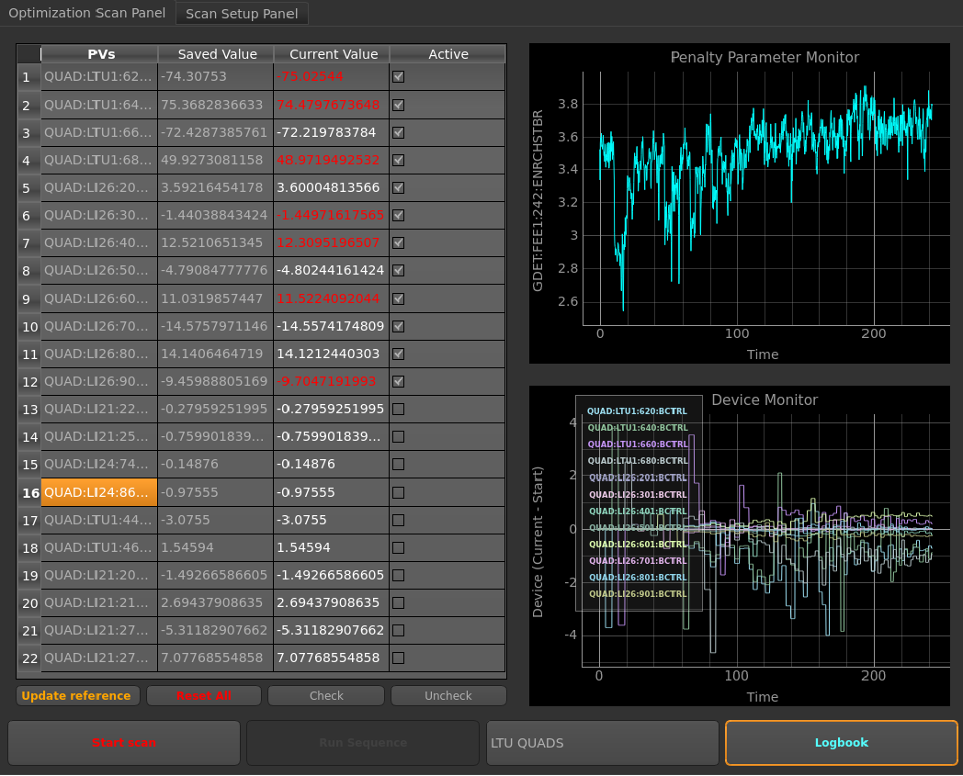
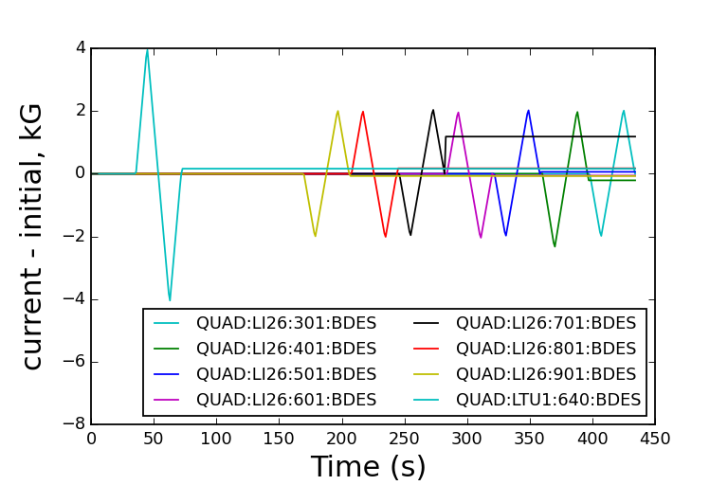
Online optimization
XFEL tuning:
XFELs are instabilities ➔ very sensitive to initial conditions
In total 500 hours/year on single task of quad tuning
Quadrupole magnets
Automate (e.g. simplex)
Badger
optimizer
FEL power

Slide 6
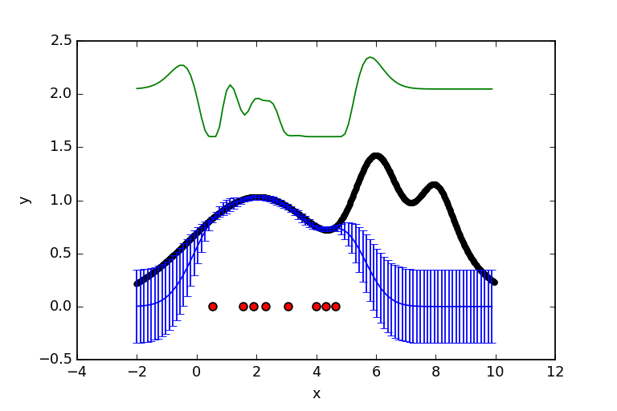
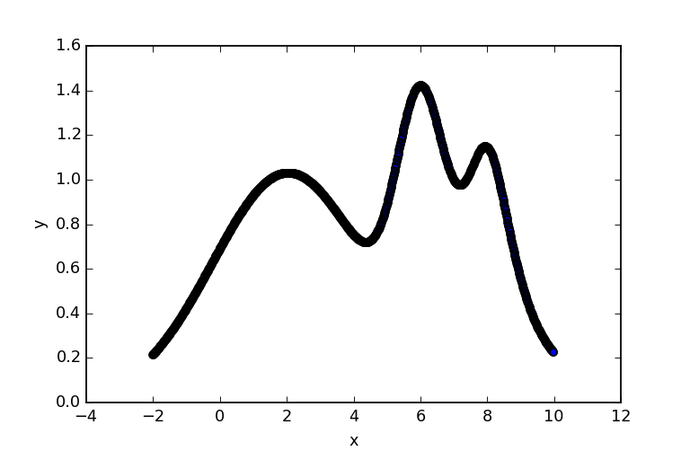
Online optimization
Model-based optimization
Advantage 1: Balance “exploitation vs. exploration”
➔ Find global maximum
Bayesian optimizer
Acquisition point
Gradient optimizer
Acquisition
function
Ground truth
Posterior
Mitch McIntire

Slide 7
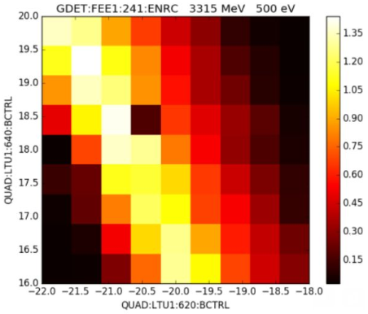
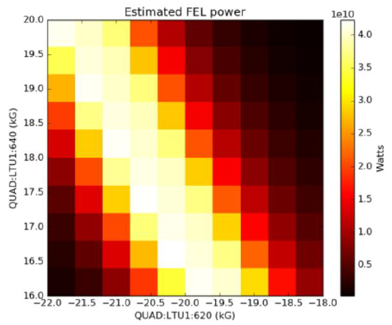
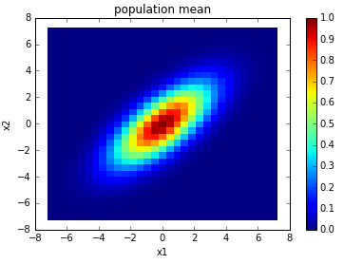
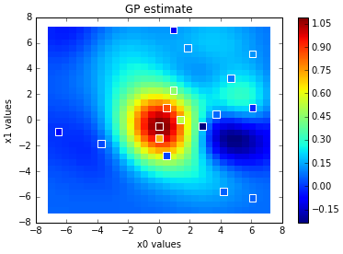
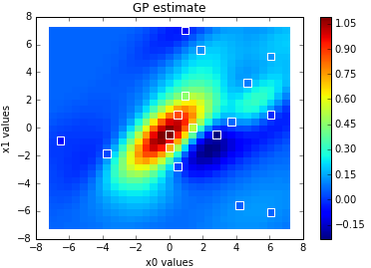
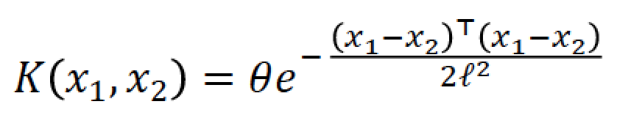
Online optimization
Model-based optimization
Advantage 2: Existence of model enables use of physics, archived data
Measured
Modeled
e.g. learning correlations in data improves modeling
Quad 2
Quad 1
Quad 1
Model,
no correlation
Model,
w/ correlation
Groundtruth
ρ = 0
ρ = 0.7
Bayesian Optimization of a FEL, Duris et al., PRL, 2020

Slide 8
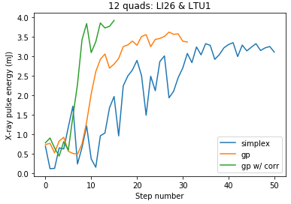
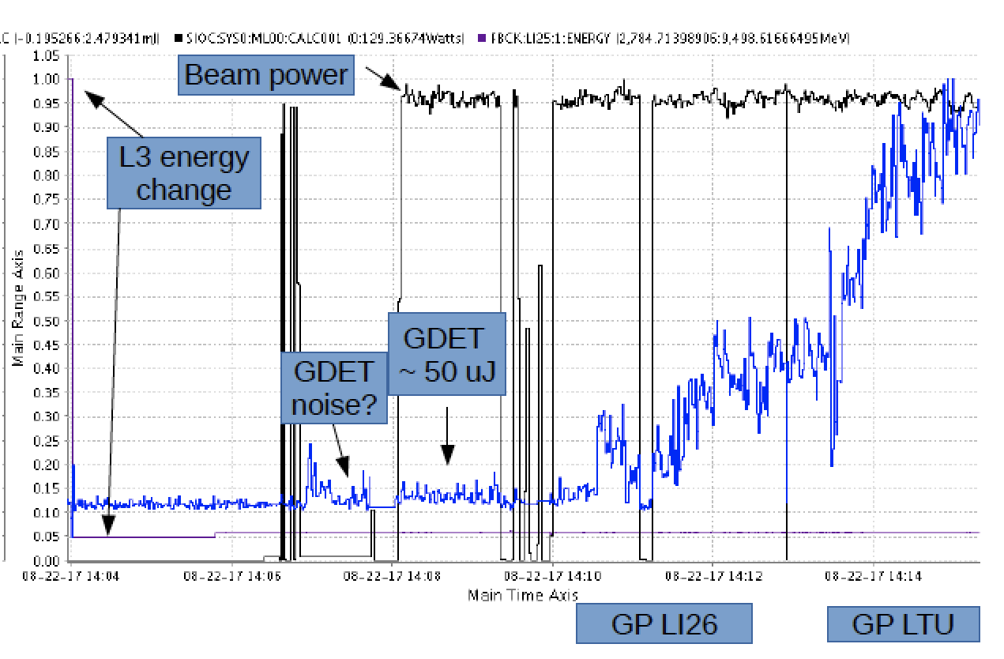
Online optimization
Model-based optimization
Upshot: ➔ Faster tuning (factor of 4 vs. simplex)
➔ More robust tuning (e.g. tune from noise)
Example 1: Fast tuneup in high dimensions
Example 2: tuning quadrupoles from pure noise
4 parameters
Joe Duris, Dylan Kennedy
Bayesian Optimization of a FEL, Duris et al., PRL, 2020

Slide 9
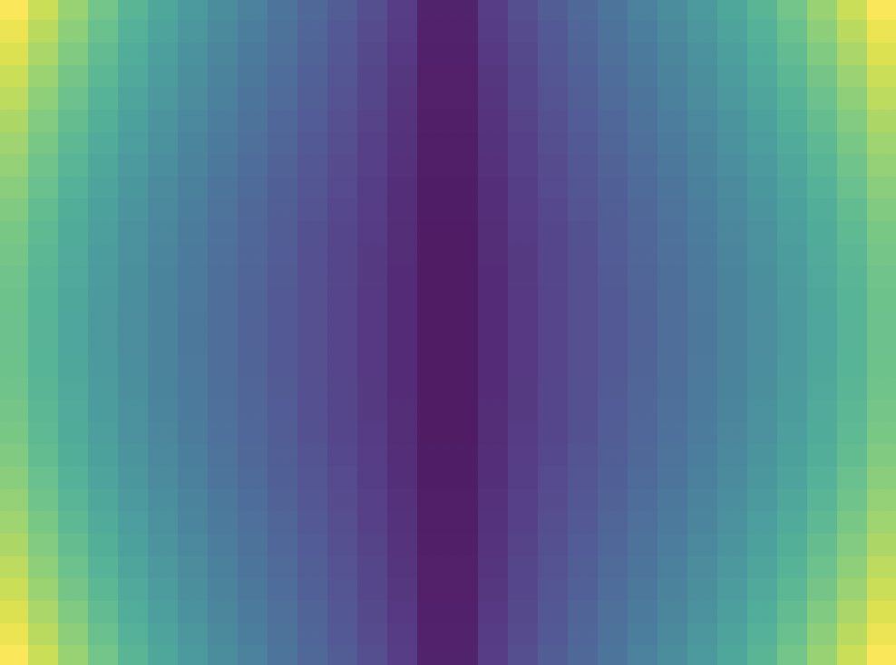
Online optimization
Current focus on complex tasks: multi-objective, hysteresis, etc.
e.g. consider emittance optimization, i.e. beam quality
Beam size measurement
Beam size measurement
Tuning param (e.g. solenoid)
Tuning param (e.g. solenoid)
Measurement parameter
(e.g. matching quadrupole)
Measurement parameter
(e.g. matching quadrupole)
Calculate emittance
➔ InfoBAX: https://willieneis.github.io/bax-website/
W. Neiswanger et al., ICML, 2021
W. Neiswanger, S. Miskovich, A. Edelen

Slide 10
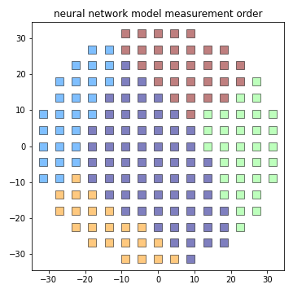
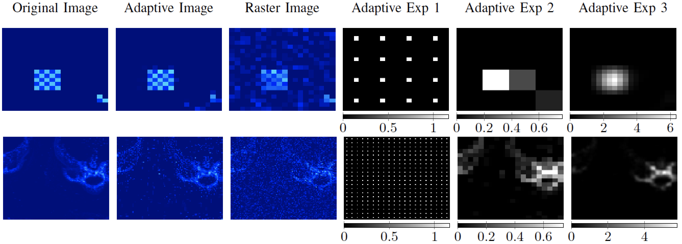
Online optimization
Move optimization target downstream ➔ tuning on user signals
Growing portfolio of anomaly detection…
Phase mapping
Quadrupole magnets
XRF Imaging
FEL power
Hutch detectors
Ground truth
Adaptive
Raster
J. Betterton et al., ICRA, 2020

Slide 11
Outline
Online control of x-ray facilities
Ghost imaging
ML for inverse problems

Slide 12
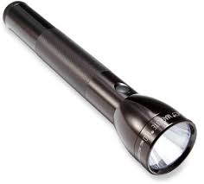
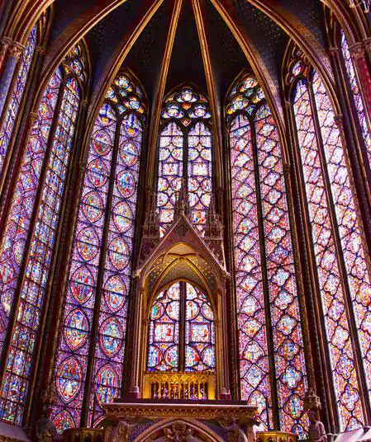
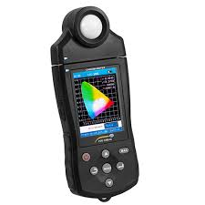
Ghost Imaging
Ghost imaging / Single pixel camera / Compressive Sensing
Riddle: How can I take a picture with a spectrometer?
Answer: Have a friend with a flashlight

Slide 13
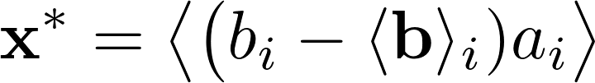
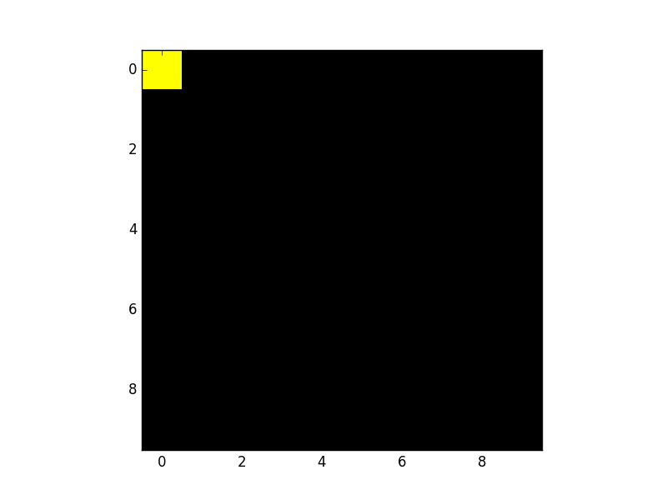
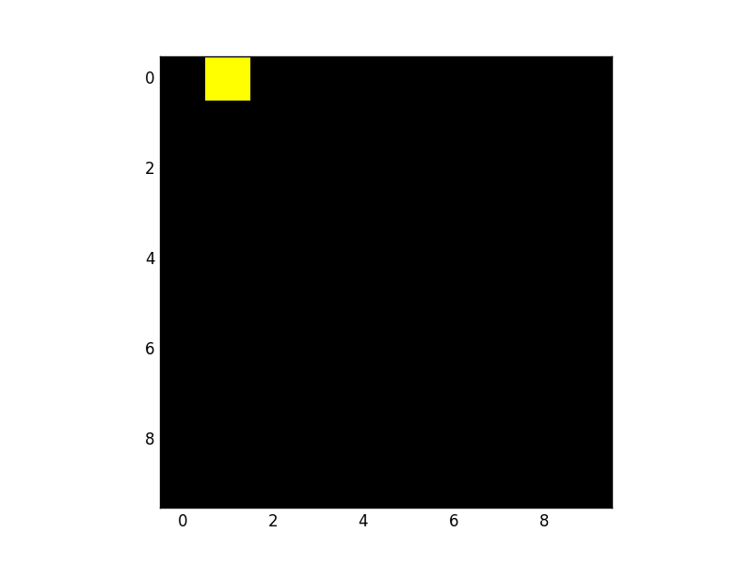
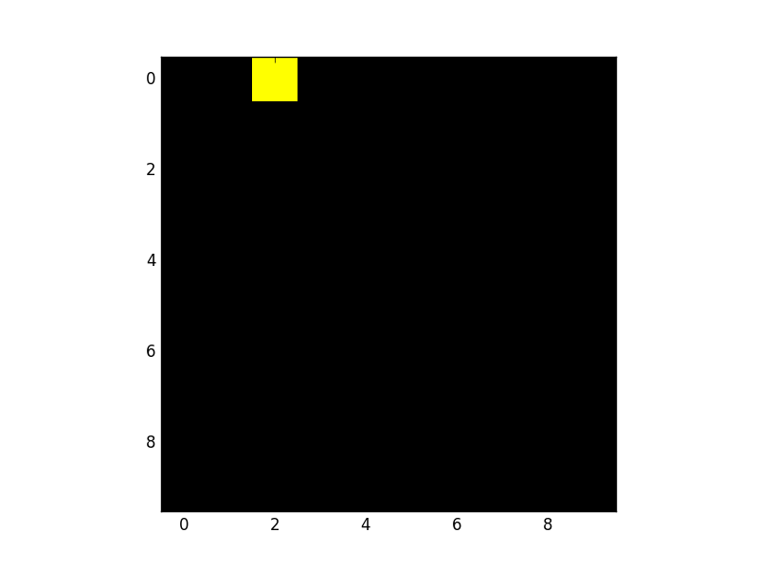
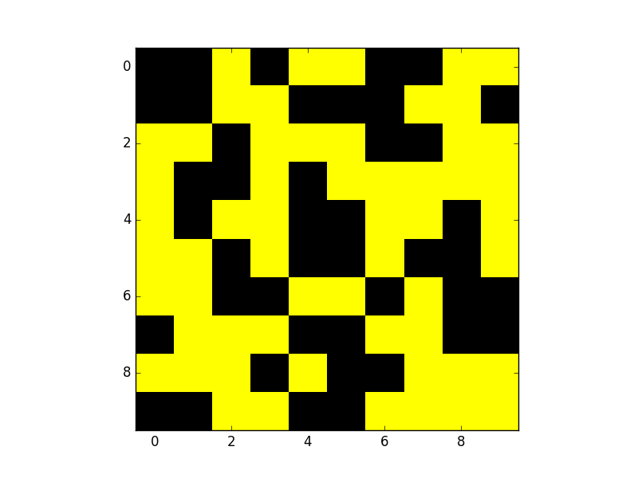
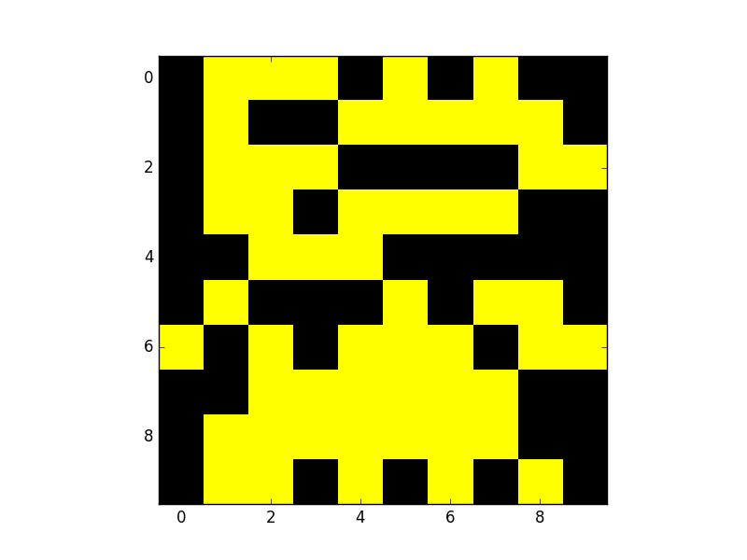
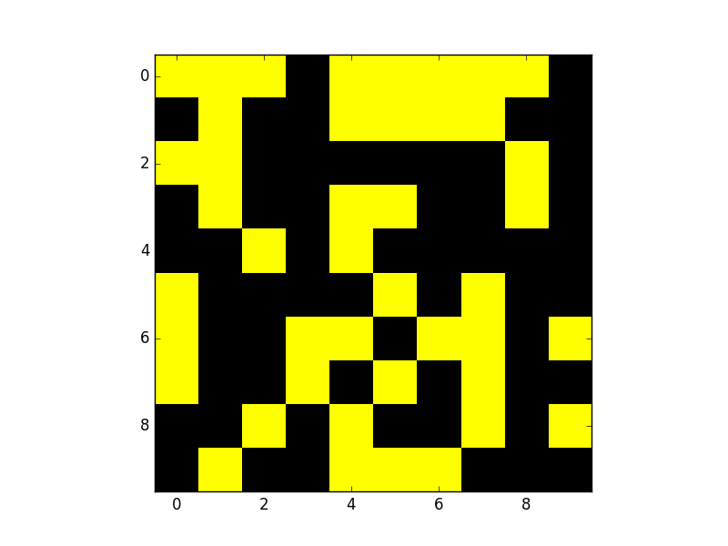
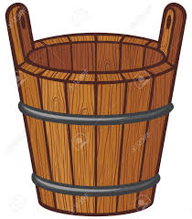
Ghost Imaging
Classic GI formalism:
Raster scan
Ghost imaging
Note: Valid for Gaussian read-out noise but not Poisson noise!
M. Harwit and N. Sloane, “Hadamard Transform Optics, Chapter 4: Noise or When to Multiplex and When to Avoid It,” 1979
1. Fellgett’s/Multiplex advantage
Reconstructed Target, x*
Radiation, a
b = [ 5037,
4783,
4891, … ]
Bucket measures total transmission
Target, x

Slide 14
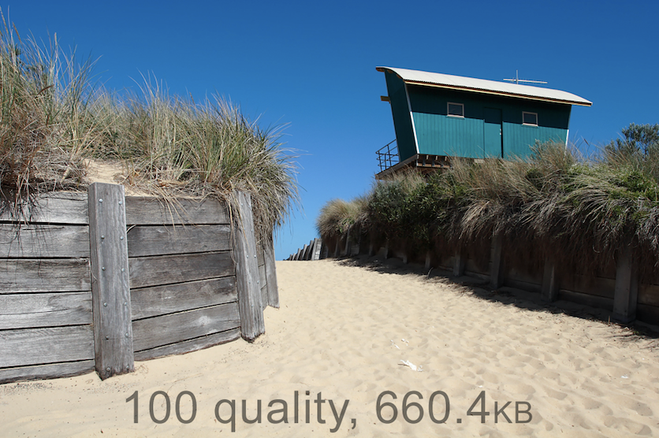
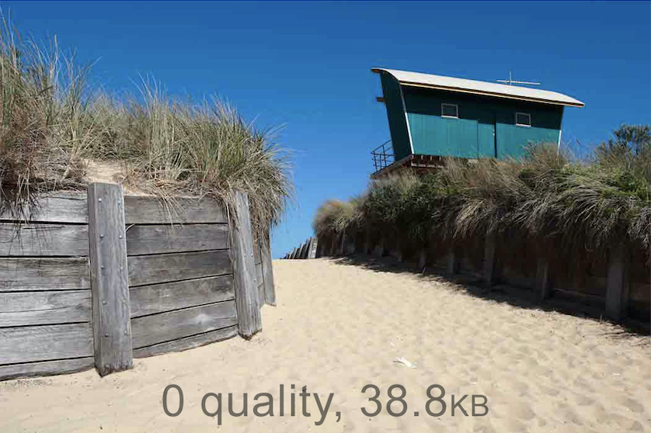
Compressive sensing
Compressive sensing concept:
Why record 660k points if only 39k needed?
Wikimedia
Trick: Use “prior” information to reconstruct the sample
e.g. Sky is uniform blue ➔ minimize “total variation” of image

Slide 15
Ghost Imaging
2. Compressive sensing formalism:
Raster scan
Ghost imaging
Note: Multiplexing can reduce # of samples but not dose!
3. Measurement can be easier/better than control
1. Fellgett’s/Multiplex advantage
b
=
a
x
Reconstructed Target, x*
Radiation, a
b = [ 5037,
4783,
4891, … ]
Bucket measures total transmission
Target, x

Slide 16
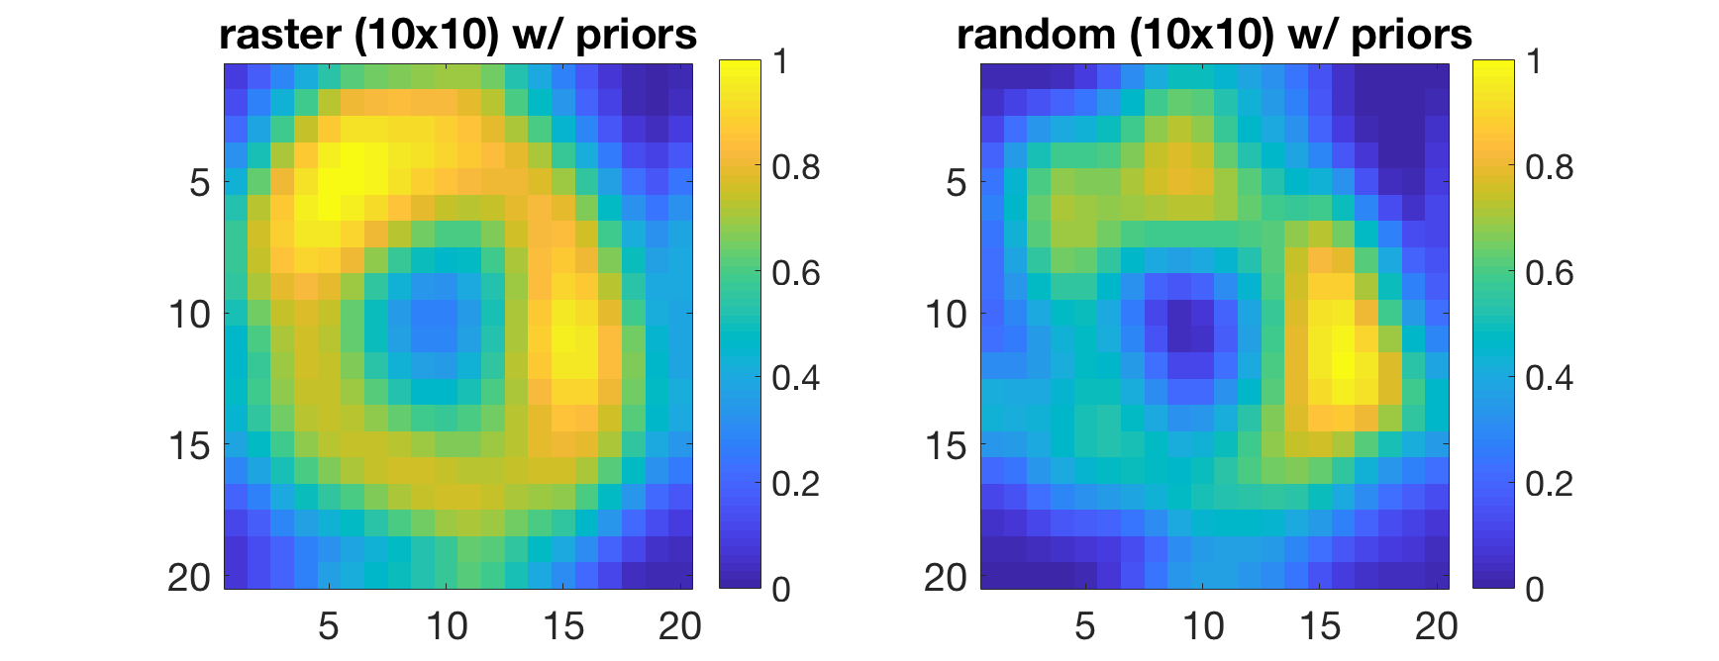
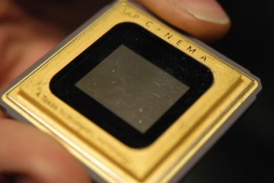
Ghost Imaging
photocathode quantum efficiency
Cathode laser
target
Ground truth
Reconstruction
Cathode
DMD
Pegasus, UCLA
K. Kabra, et al., Phys. Rev. Accel. Beams 23, 022803

Slide 17
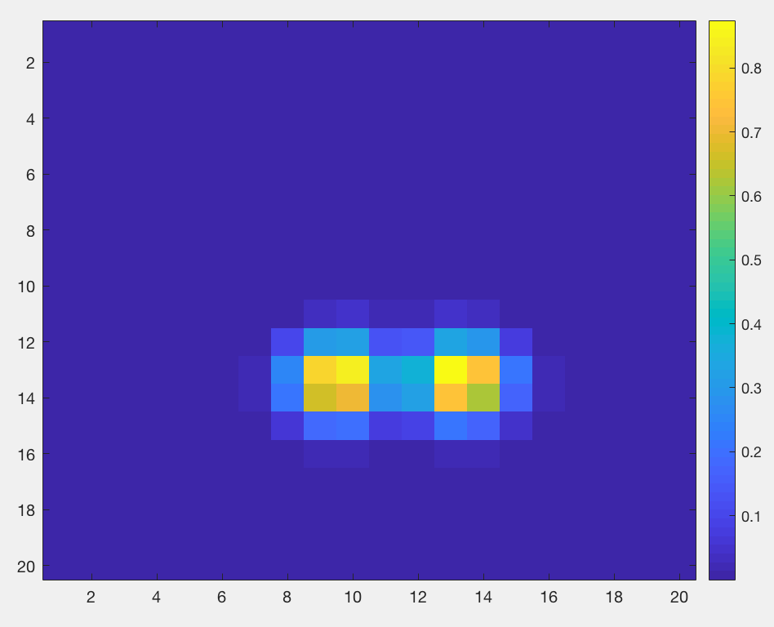
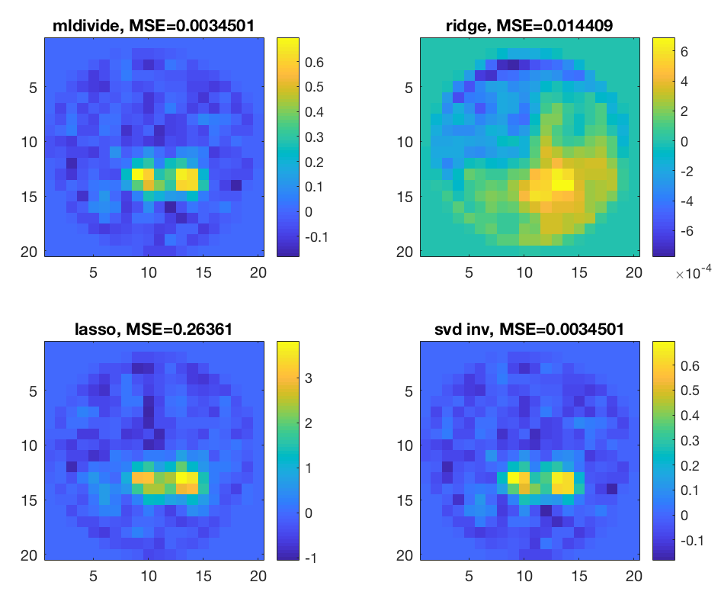
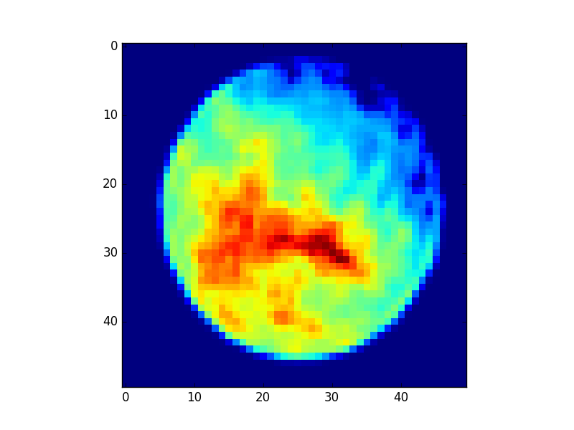

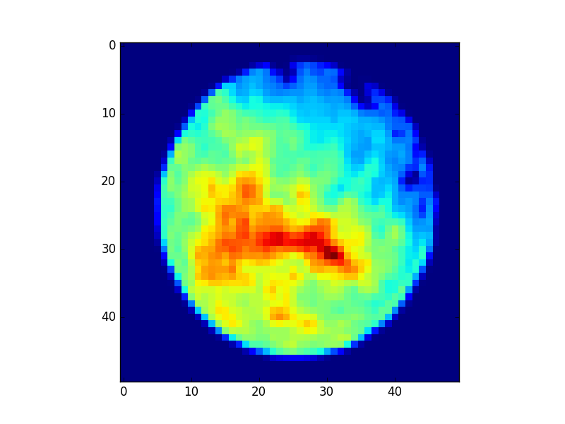
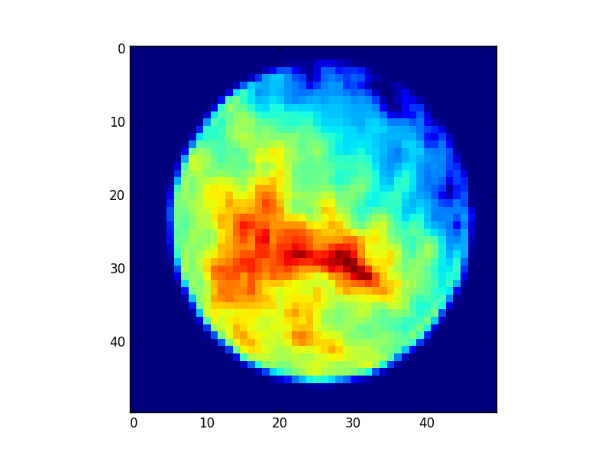
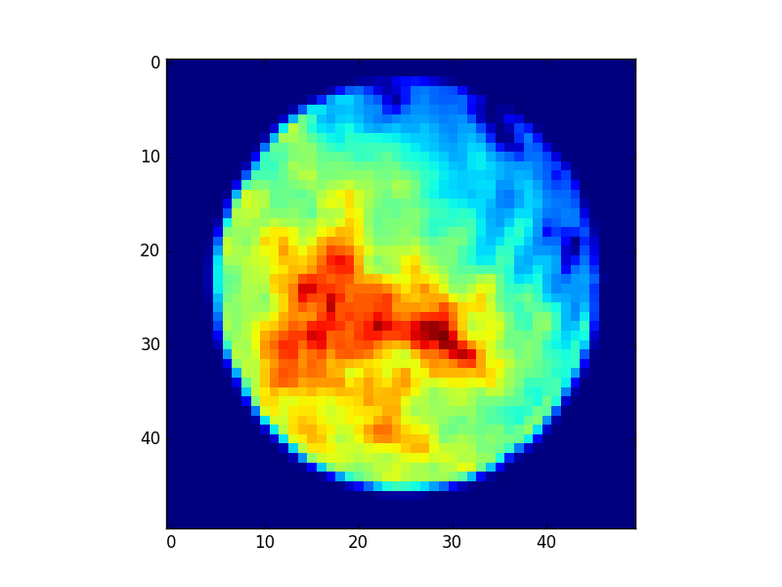
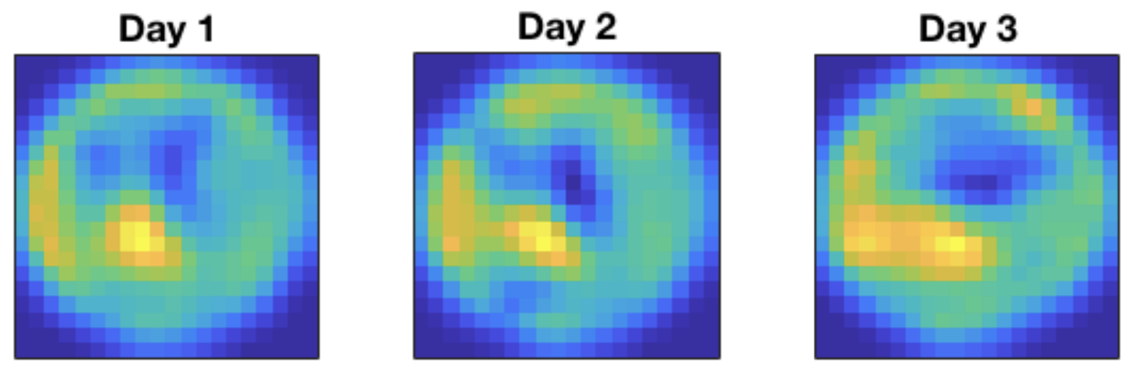
Ghost Imaging
photocathode quantum efficiency
Cathode laser
target
Simulated
Ground truth
Reconstruction
Cathode
DMD
Natural laser jitter
Real data at LCLS
(no ground truth)
Day 1
Day 3
K. Kabra, et al., Phys. Rev. Accel. Beams 23, 022803 (2020)

Slide 18

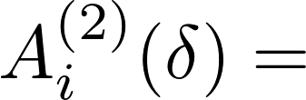

Ghost Imaging
Pump X-ray
δ₃
Sample, CO
δ₂
e-
Probe X-ray
δ₁
δ
“Pump-probe” scan of delay, δ
Signal determined by probability of two photons separated by time δ
b
=
a
x
D. Ratner et al., PRX (2019)
T.J. Lane, D. Ratner Opt. Exp. (2020)
Electron spectra
X-ray autocorrelation
Sample dynamics

Slide 19







Ghost Imaging
Spectral ghost imaging
Note that we never actually need power, only autocorrelation!
Spectral power:
From Wiener-Khinchin theorem:
Time dynamics!
Pump X-ray
Sample, CO
Electron bins
e-
Probe X-ray
X-ray spectra

Slide 20






Ghost Imaging
Biggest XFEL advantage: Measurement vs. control
Spatial domain
Time domain
Spectral domain
Probe: cathode laser jitter
Bucket: total charge (BPM)
Goal: monitor QE passively during operation
Probe: SASE spikes
Bucket: user signal
Goal: Probe short time scales without active beam control
Probe: SASE bandwidth
Bucket: user signal
Goal: Probe narrow bandwidth without active control
τ
“Pump-probe” scan of delay, τ
K. Kabra et al., PRAB (2020)
D. Ratner et al., PRX (2020)
TJ Lane, Opt. Express, 28 (5) 2020

Slide 21
Ghost Imaging
Ghost Imaging Summary
Felgett’s/Multiplex Advantage: Boost signal to noise ratio
Compressive sensing: converge to solution faster using priors
‘Measurement beats control’: Use what nature gives you for easier, faster, higher resolution measurements
Sample dose reduction is NOT an advantage of multiplexing
Felgett’s advantage does NOT work for Poisson detectors
T.J. Lane, D. Ratner, “What are the advantages of ghost imaging? Multiplexing for x-ray and electron imaging,” Opt. Exp., 2020
A. Kingston et al., “Inherent dose-reduction potential of classical ghost imaging,” PRA, 2021

Slide 22
Outline
Online control of x-ray facilities
Ghost imaging
ML for inverse problems

Slide 23





Deep Learning for Inverse problems
Generic inverse problem:
X
Φ
Y
?
Inputs
Target
1. Solve optimization problem:
2. Train a neural network:
x
y
3. Train a cycle-consistent neural network:
x
Y
Caveat: Φ must be differentiable!
Φ

Slide 24




X-ray Pulse Reconstruction
Measure amplitude of power/spectrum: can I recover phase?
Input spectral power points (80meV FWHM resolution)
Spectrum
Input power points
(3fs FWHM resolution)
power
Maxwell, Timothy J., et al. International Society for Optics and Photonics, 2014.

Slide 25
X-ray Pulse Reconstruction
Approach #1: Iterative optimization
Measure Power
Guess
Field
F(t),F(w)
Input spectral power points (80meV FWHM resolution)
Φ
Measure Spectral power
Spectrum
Input power points
(3fs FWHM resolution)
power
Maxwell, Timothy J., et al. International Society for Optics and Photonics, 2014.

Slide 26

X-ray Pulse Reconstruction
Approach #1: Iterative optimization
Measure Power
Pulse #1
Guess
Field
F(t),F(w)
Φ
…
10⁶-10⁹ times
Measure Spectral power
Pulse #n

Slide 27





X-ray Pulse Reconstruction
Approach #2: Train a labeled neural network
Simulated Output
SimulatedInput
field
Labeled loss,
NN Inverse Model
field
power
Predicted Output
Spectrum
Problem: absolute phase is meaningless!
D. Ratner et al., Opt. Exp., 2021

Slide 28



X-ray Pulse Reconstruction
Approach #3: Train a neural network with cycle-consistent loss
“Physics-informed neural network” (PINN)
Advantages: No need for labeled data, train directly on experimental data
Predicted Input
Input
Φ
NN Inverse Model
field
power
Physics forward model, Φ
power
Predicted Output
Spectrum
Spectrum
Unlabeled loss,
D. Ratner et al., Opt. Exp., 2021

Slide 29


X-ray Pulse Reconstruction
Inverse problem: Full beam reconstruction
Advantages: 10⁸ faster, higher accuracy on amplitude and phase compared to iterative method
D. Ratner et al., Opt. Exp., 2021

Slide 30



Cryo-EM Introduction
Youssef Nashed
Frederic Poitevin
Julien Martel
Axel Levy
Harshit Gupta
Geoffrey Woollard
Michael Kagan
Chun Hong Yoon
Daniel Ratner
SLAC/Stanford
    CryoPoseNet: End-to-End Simultaneous Learning of Single-particle Orientation and 3D Map Reconstruction from Cryo-electron Microscopy Data

Slide 31

Cryo-EM Introduction
Youssef Nashed
Frederic Poitevin
Julien Martel
Axel Levy
Harshit Gupta
Geoffrey Woollard
Michael Kagan
Chun Hong Yoon
Daniel Ratner
SLAC/Stanford
    CryoPoseNet: End-to-End Simultaneous Learning of Single-particle Orientation and 3D Map Reconstruction from Cryo-electron Microscopy Data

Slide 32


Deep learning for Cryo-EM Single Particle Imaging
Recast as an inverse problem:
Iteratively solve for pose and densities (e.g. expectation-maximization)
Why use deep learning?
Pose
Φ
Density map

Slide 33
Deep learning for Cryo-EM Single Particle Imaging
Recast as an inverse problem:
Iteratively solve for pose and densities (e.g. expectation-maximization)
Why use deep learning?
Pose
1. Scaling with particle number: classical methods require pose for every particle
Density map
Φ

Slide 34
Deep learning for Cryo-EM Single Particle Imaging
Recast as an inverse problem:
Iteratively solve for pose and densities (e.g. expectation-maximization)
Why use deep learning?
Pose
Density map
1. Scaling with particle number: classical methods require pose for every particle
Φ
2. Solving for conformations: classical methods cannot handle complex, continuous variation

Slide 35





Deep learning for Cryo-EM Single Particle Imaging
Recast as an inverse problem:
Iteratively solve for pose and densities (e.g. expectation-maximization)
Why use deep learning?
CryoDRGN

Slide 36



CryoPoseNet
Our architecture follows auto-encoder architecture:
Decoder network
Forward model
Encoder network
Latent representations
Output
Input
Conformation Space
Microscope Simulation
Orientation Space
Learn network/model parameters by minimizing the difference between input and output images
End-to-end differentiable forward model
The number of learned variables independent of data size
Pose estimation uses single pass through the encoder network
Explicitly decouple conformation and orientation space through the forward model

Slide 37

CryoPoseNet
Our architecture follows auto-encoder architecture:
Synthesized E.coli adenylate kinase cryo-EM datasets
Each with 9000, 128x128 images and different SNRs
Pixel size of 0.8A
Reconstruction performed using Tensorflow in python
Youssef Nashed, Fred Poitevin, et al. ICCV (2021)

Slide 38



CryoPoseNet
Our architecture follows auto-encoder architecture:
Nashed, Youssef SG, et al. arXiv preprint arXiv:2107.02958 (2021)
1. Pose estimation
Euler
Quaternions
S2 x s2
Orientation MAE (degrees)
F. Poitevin
Youssef Nashed, Fred Poitevin, et al. ICCV (2021)

Slide 39


CryoPoseNet
Our architecture follows auto-encoder architecture:
RMSD
Youssef Nashed, Fred Poitevin, et al. ICCV (2021)

Slide 40
Conclusion
Thanks for listening!
Thanks to work by (among others):
F. Christie, E. Cropp, J. Cryan, J. Duris, A. Edelen, C. Emma, K. Kabra, A. Kennedy, T. J. Lane, S. Li, A. Lutman, G. Marcus, P. Musumeci, Y. Nashed, F. Poitevin, G. Stupakov, G. Wetzstein,

