Slide 1
Asmita Patel
Deputy Division Director, Operations Accelerator Technology & Applied Physics Division
Snowmass Community Engagement Session
ATAP IDEA Activities
Date December 10, 2021

Slide 2
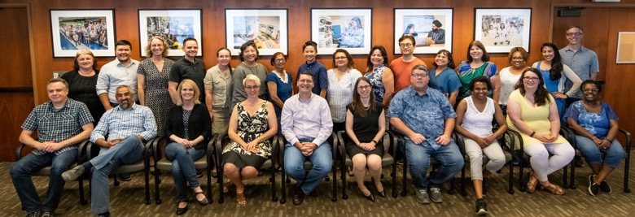
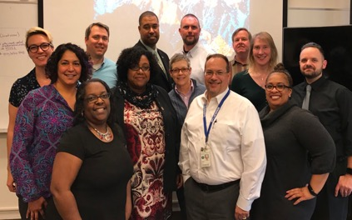
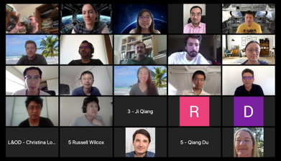
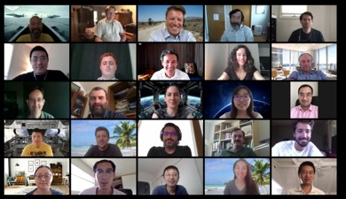
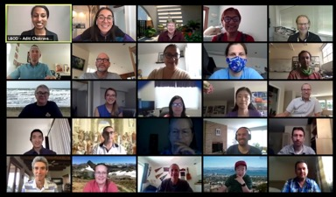
Workforce Development: ATAP Staff Using Diversity, Equity and Inclusion Best Practices
Conversation starter - get increase awareness of IDEA launch (D&I, DEI to IDEA)
Hiring Committees - Leveling the playing field https://womensleadership.stanford.edu/level
Newsletter updates
IDEA related articles discussed at monthly ATAP IDEA meetings. Chosen from Lab’s IDEA website
Micro aggression ppt at ATAP IDEA meeting and all programs within ATAP and Bystander to Upstander - Janie
Survey - worked with HR and IDEA office
ATAP Retreat - Adaptive leadership, IDEA
Video Leaky Pipeline: IDEA mtg, ATAP leadership, APS IDEA
Incorporating IDEA in Safety week
Launch of APS DPP Pride Committee
Ally newsletter
IDEA minute google slides
Increase Awareness
Increase Actions
Divisional IDEA Committee that develops suggestions
People with active membership/leadership roles in Employee Resource Groups (ERGs) share best practices
Steadily increasing diversity hires as seen among our 35 students and 19 postdoctoral scholars, as well as career paths from postdoctoral scholars to research scientists
Several ATAP staff actively involved in Lab-wide and Divisional IDEA efforts
Right: Aditi Chakravarty facilitated Zoom-based virtual retreat with exercises and discussions on exploring and re-enforcing the Lab’s stewardship culture and IDEA Initiative

Slide 3
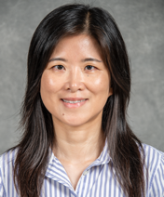
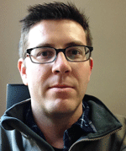
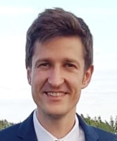
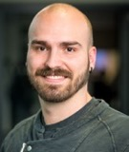
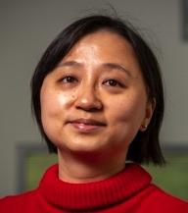
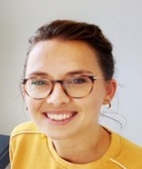
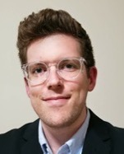
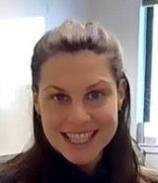
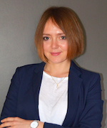
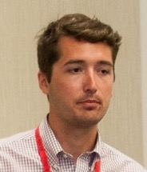
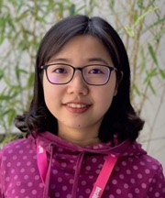
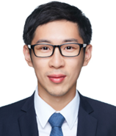
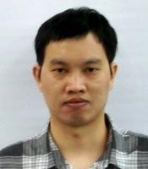
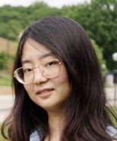
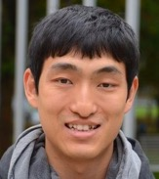
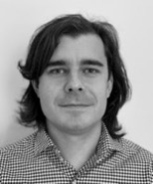
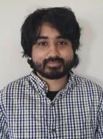
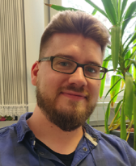
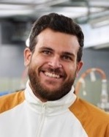
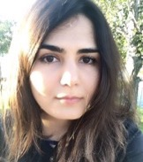
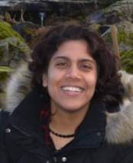
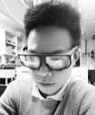
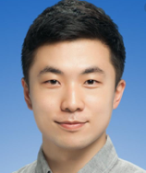
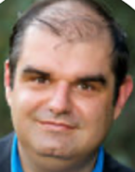
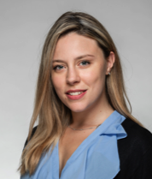
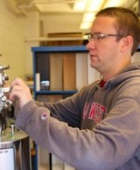
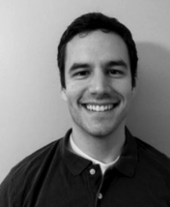
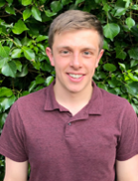
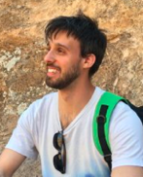
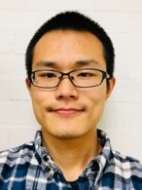
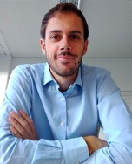
Developing Top-Level, Diverse Young Staff to Drive Accelerator Progress
Career
Staff
Qing Ji
FS-IBT Staff
Scientist
Sam Barber
BELLA Center
Research Scientist
Al Baskys
SMP Research Scientist
Axel Huebl
AMP Research Software Engineer
Tianhuan Luo
BACI Research
Scientist
Lieselotte Obst-Huebl
BELLA Center Research Scientist
Tobi Ostermayr
BELLA Center Research Scientist*
Marlene Turner
BELLA Center
Research Scientist
Olga Shapoval
AMP Project Scientist
Postdoctoral
Scholars
Reed Teyber
SMP Research
Scientist
Dan Wang
BACI Research Scientist
Yilun Xu
BACI Research Scientist
Qiang Chen
BELLA Center
Siyun Chen
BELLA Center
Hao Ding
BELLA Center
Jose Luis Rudeiros
Fernandez
SMP
Neelay Fruitwala
BACI
Marco Garten
AMP
Antonio Gilardi
BACI
Sahel Hakimi
BELLA Center
Kaushalya Jhuria
FS-IBT
Wei Liu
AMP
Geon Lee
SMP
Christian Messe
SMP
Alice Moros
SMP
Cory Myers
SMP
Ryan Sandberg
AMP
Alex Picksley
BELLA Center
Davide Terzani
BELLA Center
Yinjian Zhao
AMP
Edoardo Zoni
AMP
3

Slide 4
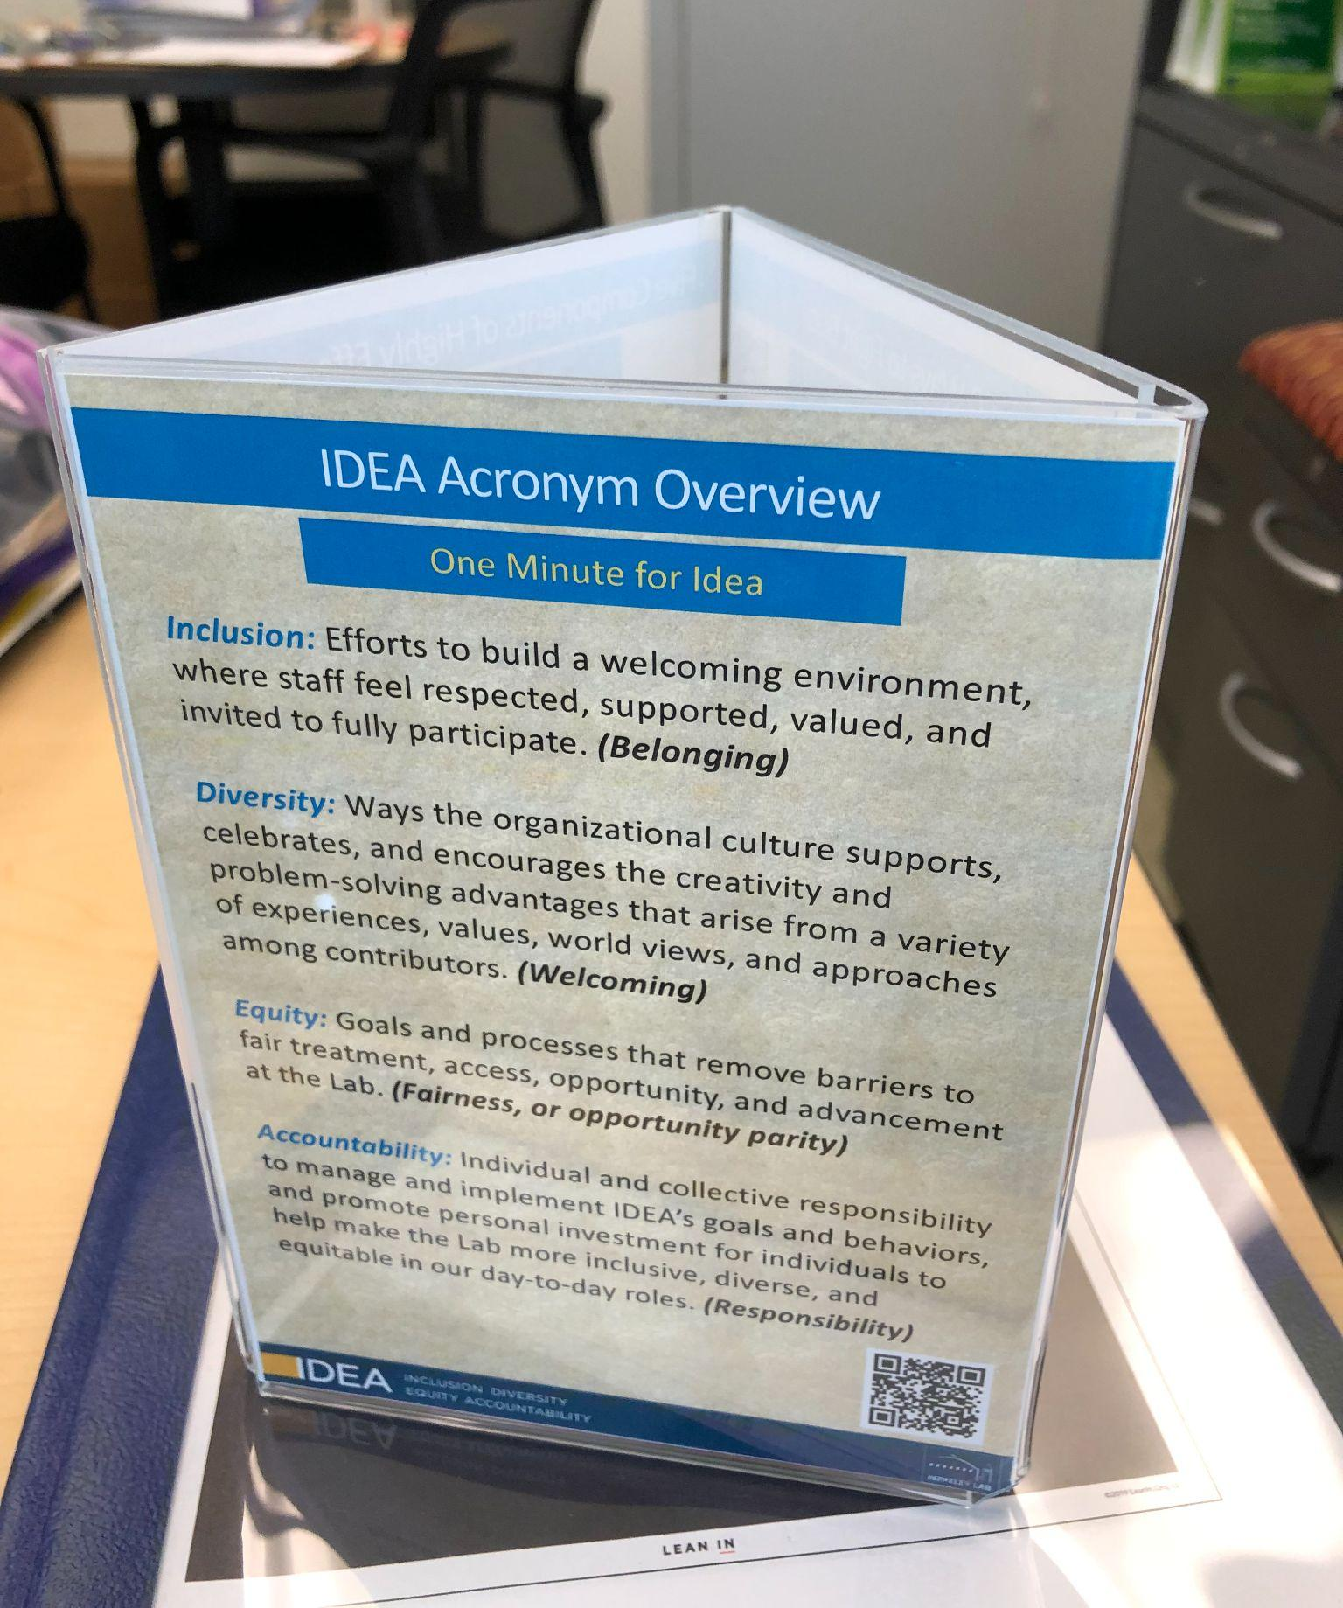
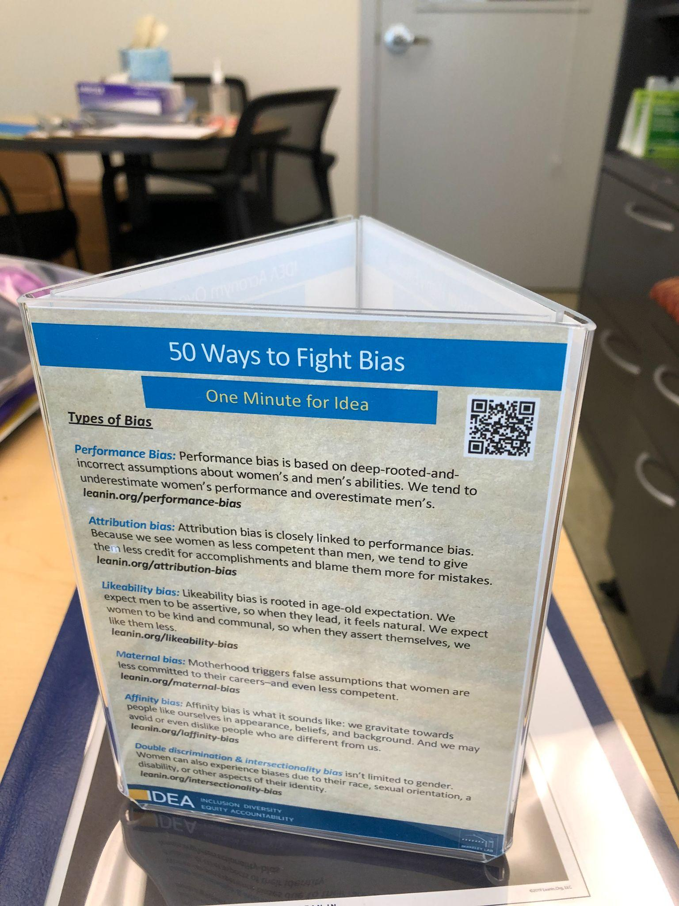
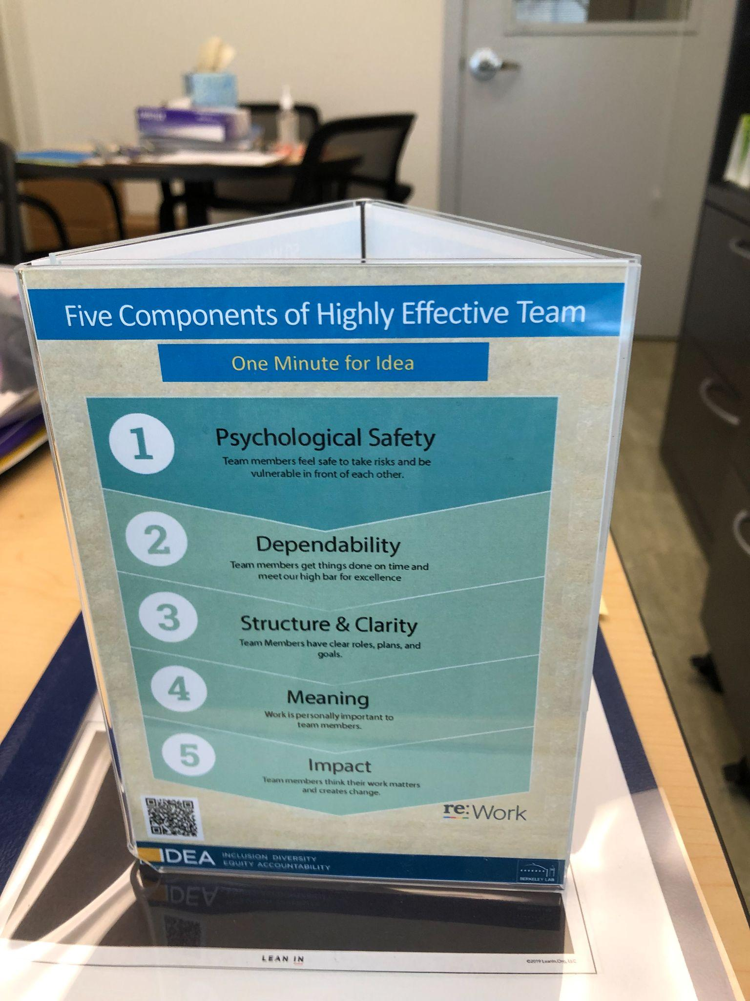
IDEA and Key Actions Items - Conversation Starter
Conversation starter - increase awareness of IDEA launch (D&I, DEI to IDEA)
Trifold
50 ways to fight bias cards and printed slides
Sample for Tammy
All programs within ATAP (for one program we provided the information and followed up via email)

Slide 5
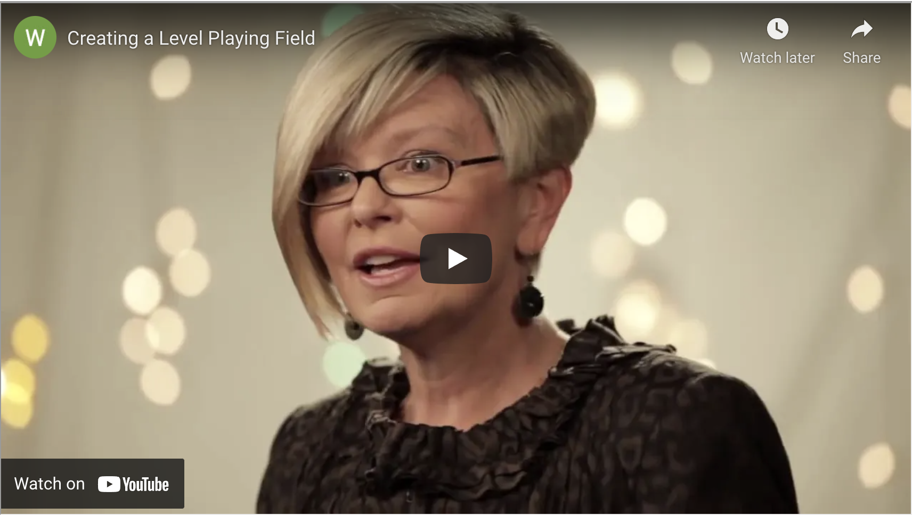
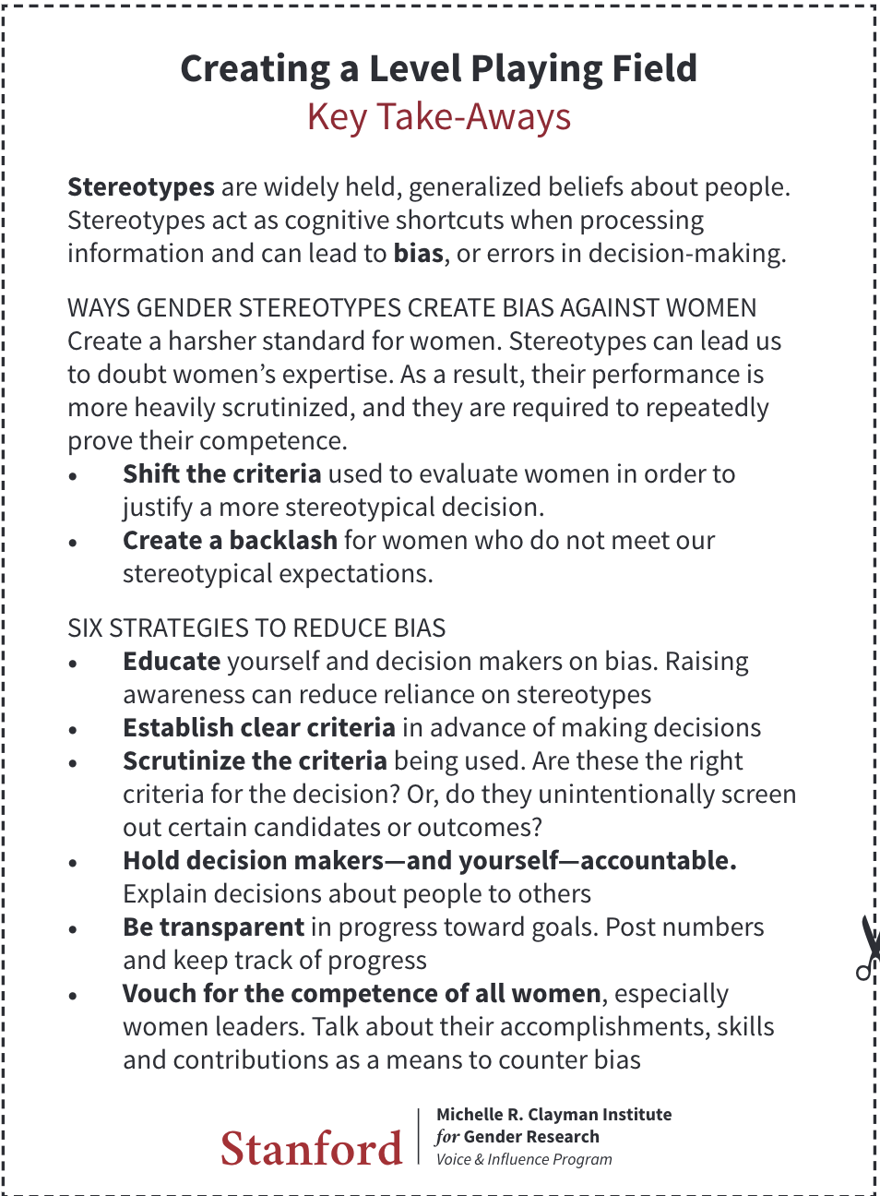
Video - Leveling the Playing Field
Hiring Committees
https://womensleadership.stanford.edu/level
Leveling the playing field
https://womensleadership.stanford.edu/level
All members of search committee for hires review this video
Ina Reichel is invited to kick off meeting
More than 55 people in ATAP have viewed and discussed this video with Ina Reichel

Slide 6
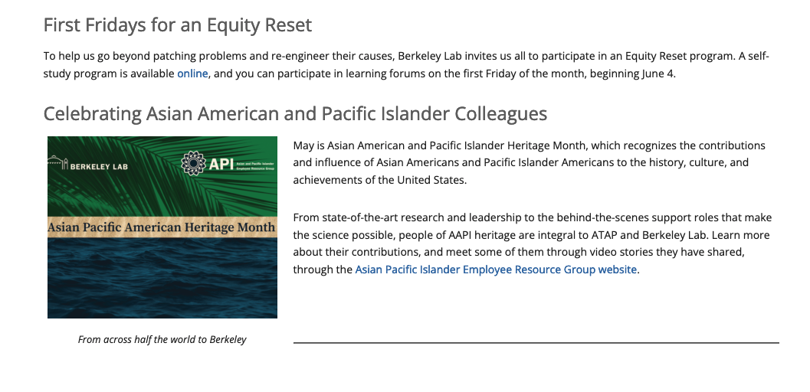
Workplace Life - Section in Bimonthly ATAP Newsletter
https://atap.lbl.gov/news-back-issues/

Slide 7
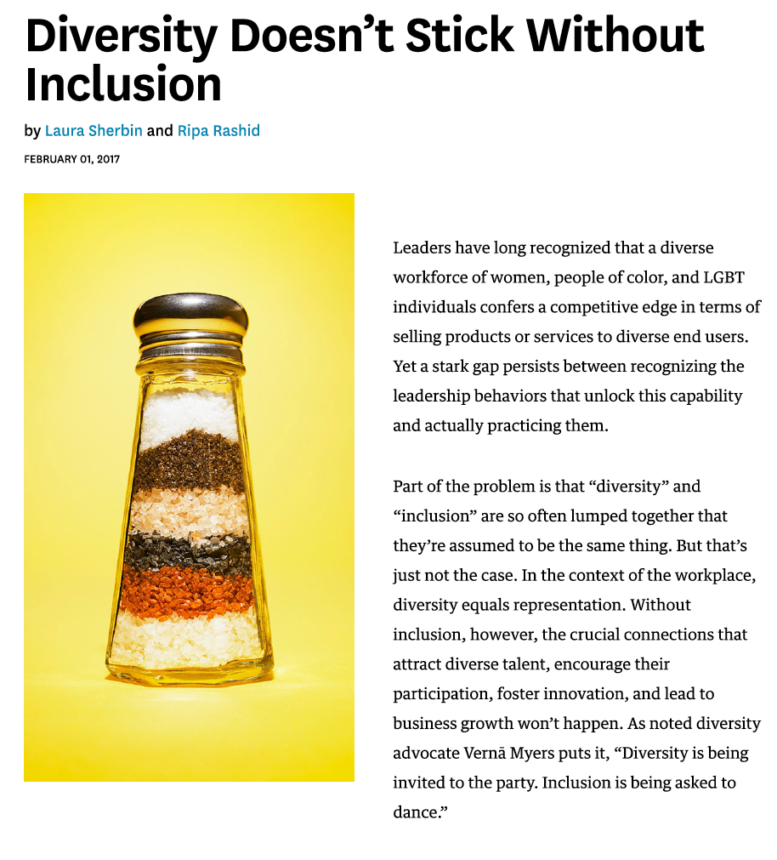
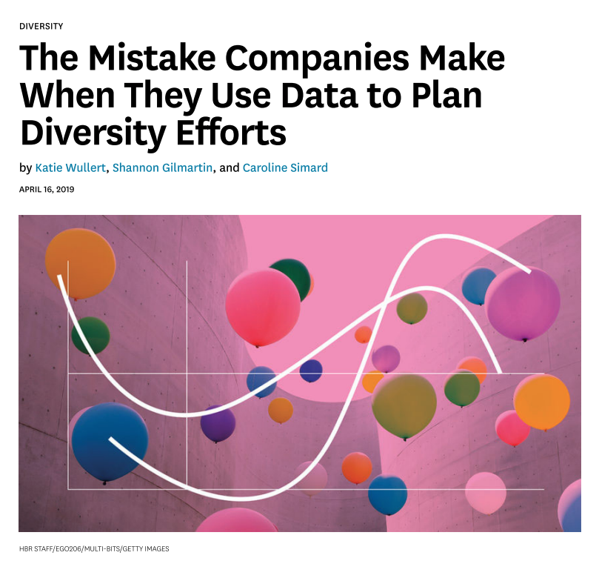
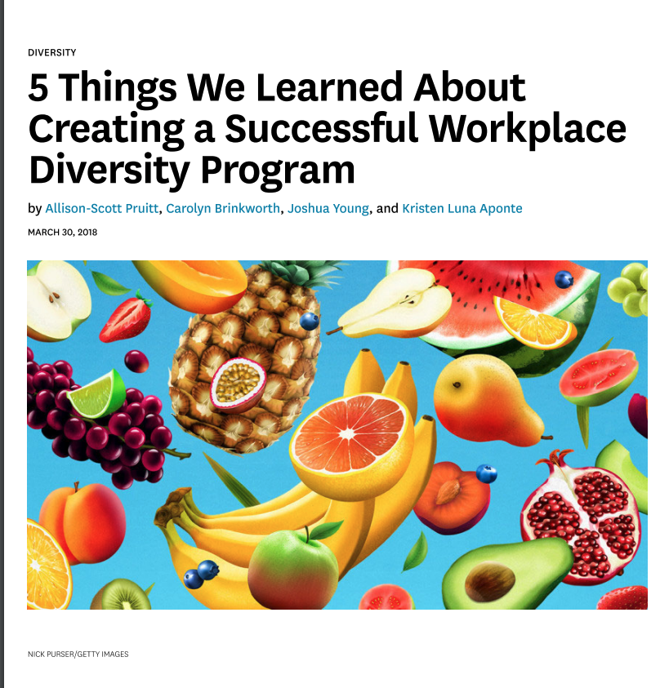
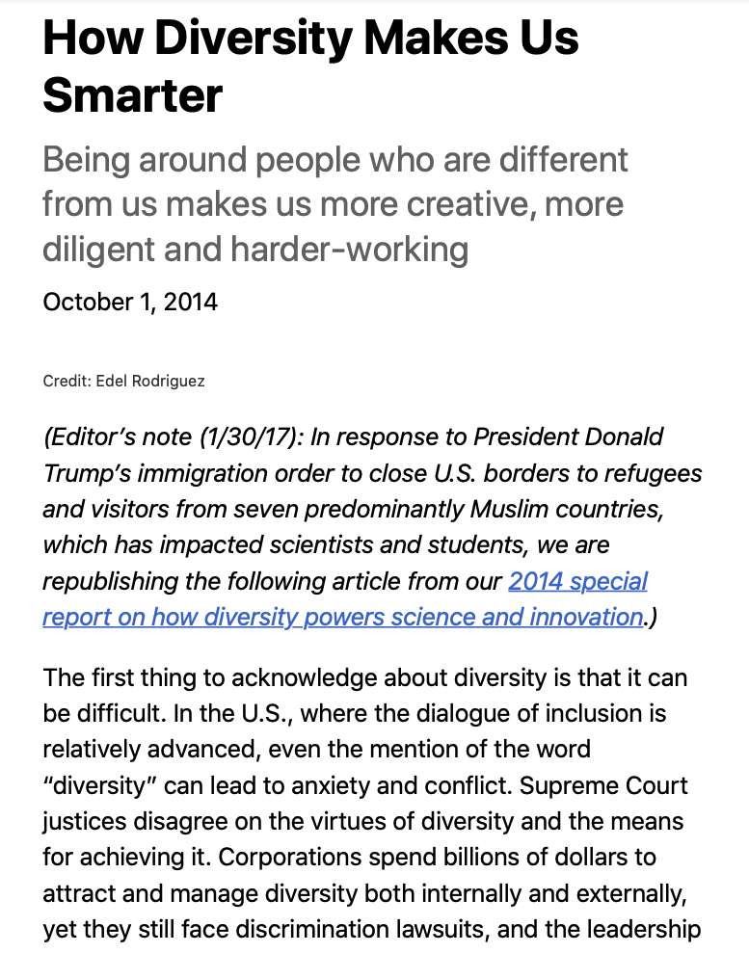
Reviewing and Discussing Papers
Choose papers from IDEA website:
Share with committee
Read and discuss paper and key messages

Slide 8
Microaggression Survey
Going from Bystander to Upstander
Presentation at ATAP IDEA Committee meeting by Ina Reichel
Also organized meeting with each Program in ATAP - presented the Microaggression survey
Invited Janie Pinterits to ATAP IDEA committee meeting for Interactive Presentation and discussion on Going from Bystander to Upstander
The goal was to introduce these topics to everyone - increase awareness

Slide 9
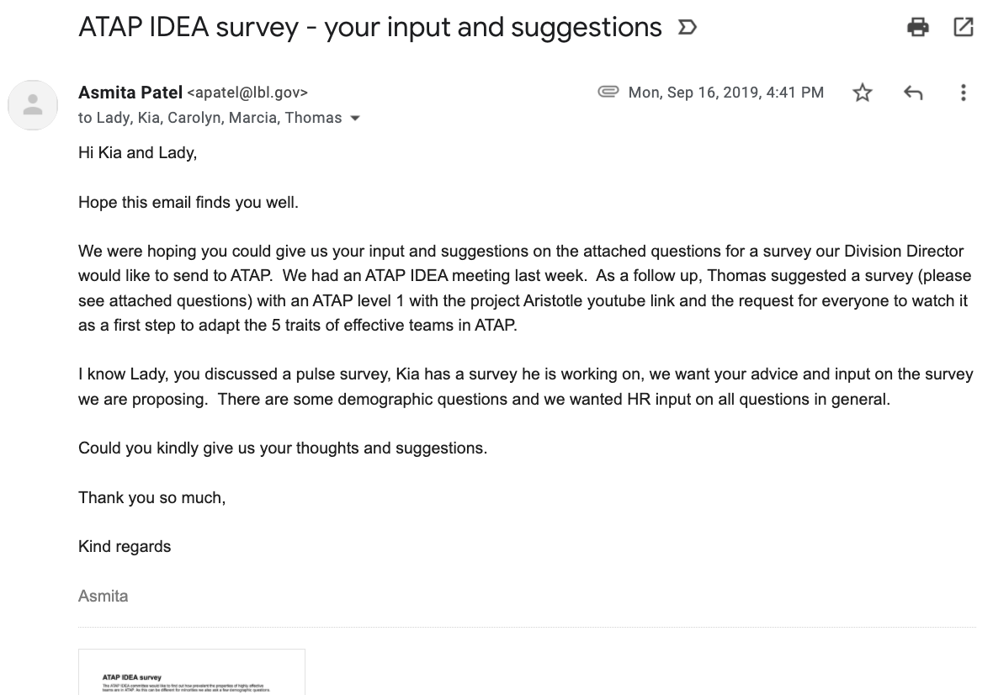
ATAP IDEA survey - Worked with HR
Provided some sample questions
Kia reviewed and worked with Lady
He sent the survey and provided an analysis of the results

Slide 10
ATAP Retreat - Adaptive Leadership, Focusing on IDEA and Team Building

Slide 11
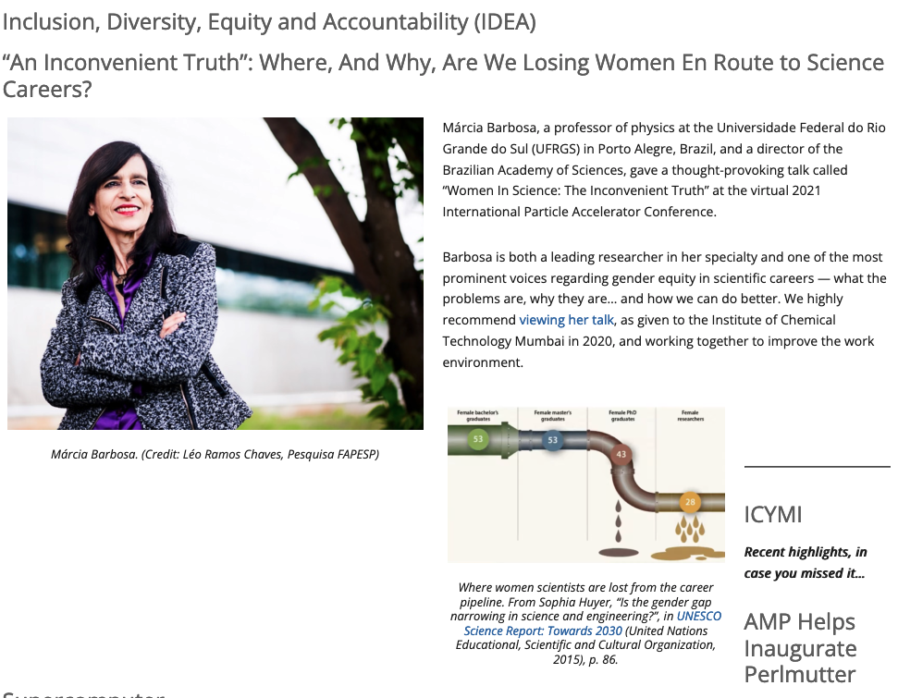
Video - An Inconvenient Truth: Where, Any Why are we Losing Women Enroute to Science Careers?
At the ATAP IDEA committee meeting, one of our staff scientists, ChangChun Sun, informed us about a video on an IDEA topic that was presented at the International Particle Accelerator (iPAC) Meeting in May. The video is available to staff who attended the conference.
We asked ChangChun to present it at one of the monthly ATAP IDEA meetings that are co-chaired by Cameron Geddes, our Division Director, Ina and myself. We had a great discussion about the video and decided to present it at the ATAP Leadership meeting.
It's a 25 minute video that highlights the challenges of what is referred as “An Inconvenient Truth”: Where, And Why, Are We Losing Women En Route to Science Careers?"
https://atap.lbl.gov/atap-news-july-2021/#Barbosa
Changchun attended the ATAP Leadership meeting and also presented the video. Cameron, Ina, Changchun and I led the discussions about information in the video. All ATAP Program Heads were engaged and we had a great discussion on understanding the issues as we work on continuing our IDEA efforts to increase pipeline diversity.
We were able to get a youtube version of the video that is available to everyone so we have highlighted it in the ATAP newsletter.
We also shared this video with APS IDEA committee members and had a discussion about it.

Slide 12
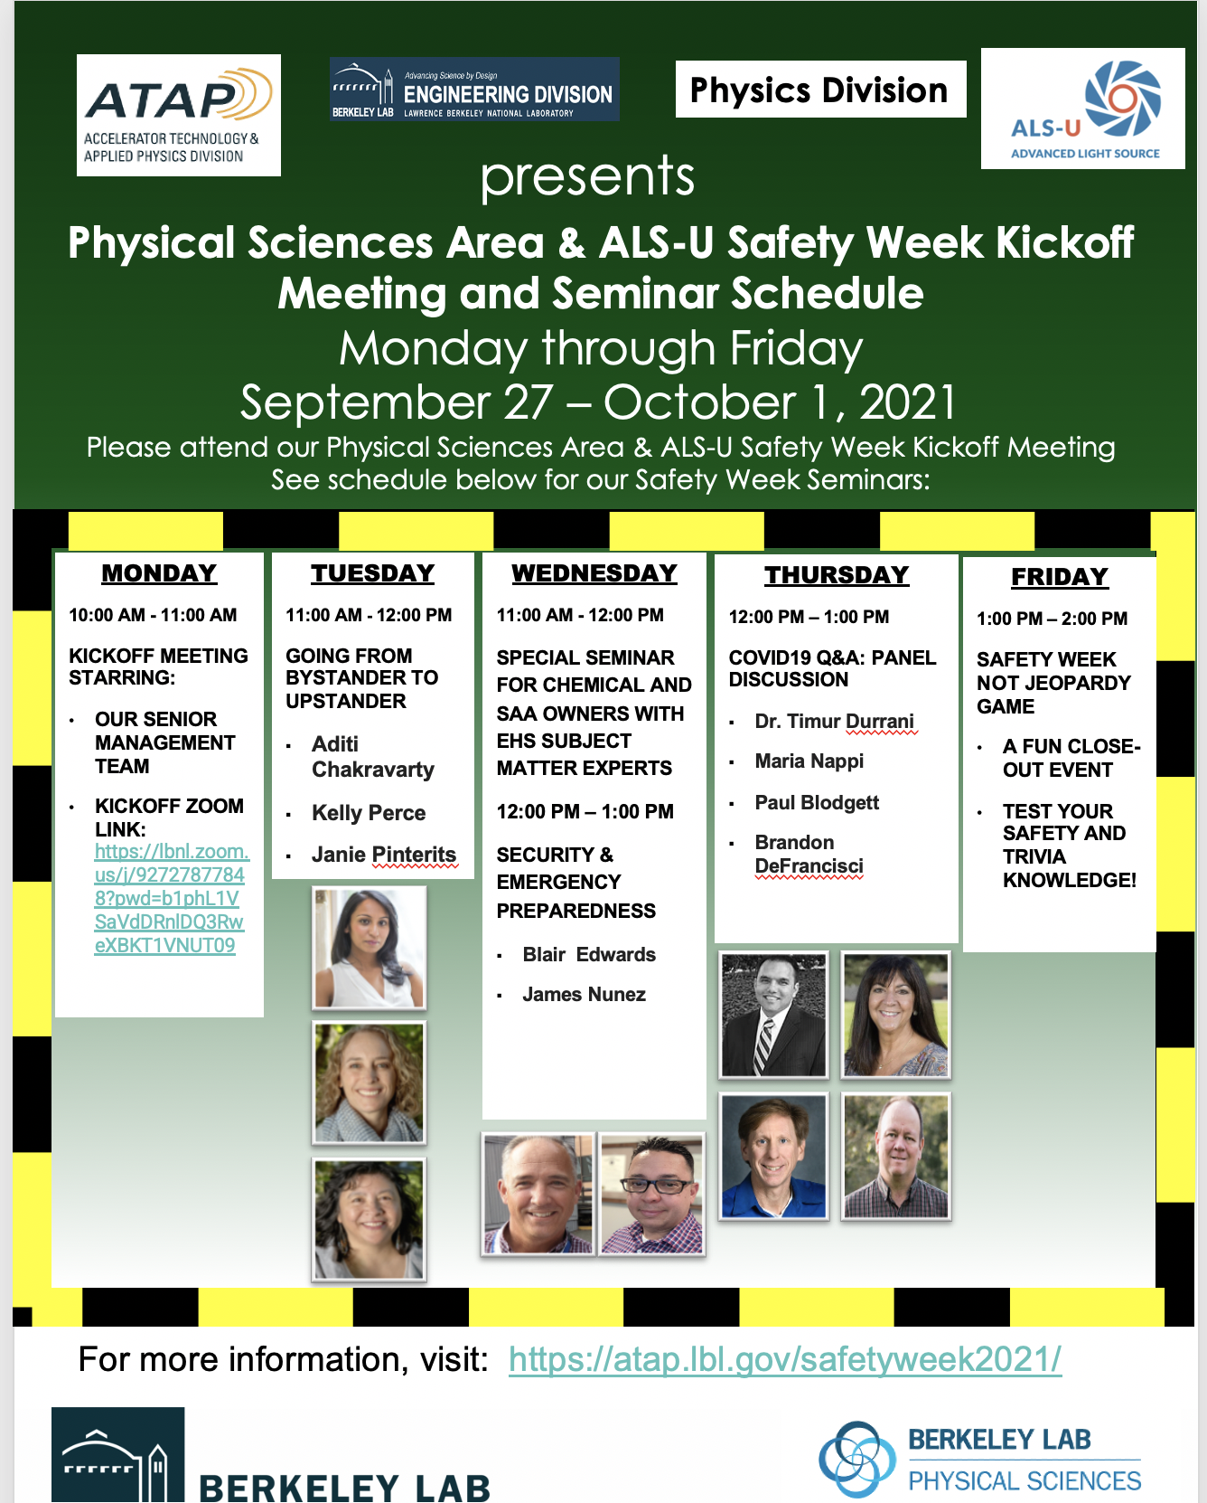
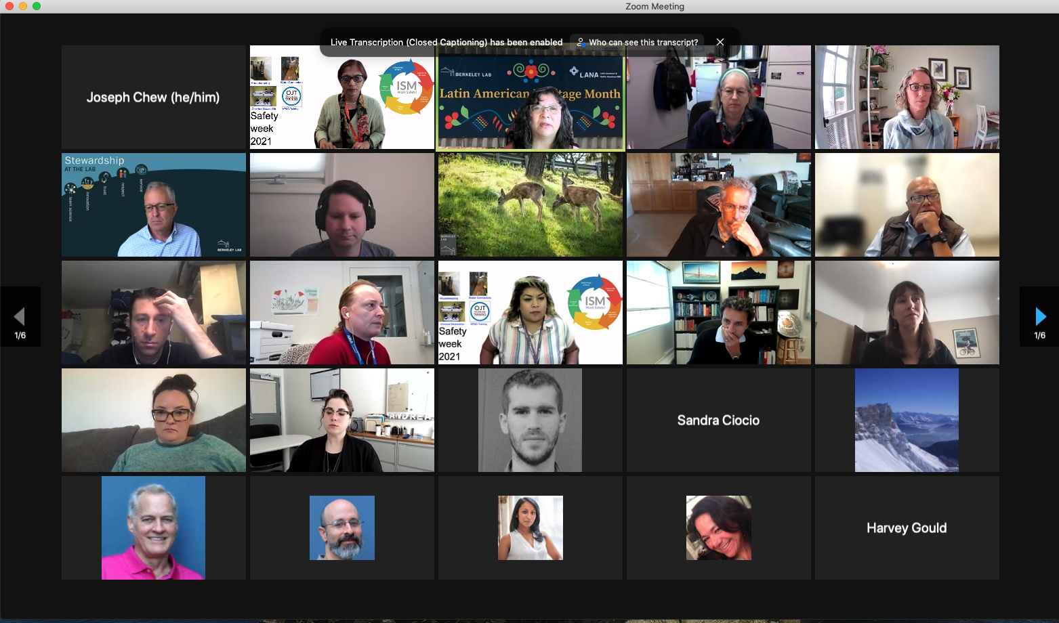
Incorporating IDEA in PS Area and ALS U Safety Week
Attended by 128 employees
Importance of speaking up for someone
Introduction of the topic to wider audience
Stop work - Safety Incidents
Be an Upstander - IDEA

Slide 13
Ally Newsletter
Published every Friday
Great suggestions on being an Ally
Using some of the suggestions for One Minute for IDEA slide deck

Slide 14
Community - IDEA in FESAC Long Range Plan, Aim to Include in Snowmass
Recommendations and section on IDEA/DEI in APS DPP Community Planning (parallel to Snowmass) and FESAC Long Range Plan (parallel to P5)
Strong parallels with HEP and accelerator issues
Aim to foster inclusion of similar content in Snowmass and towards P5
Important to have aligned input from multiple Offices/processes
https://usfusionandplasmas.org

Slide 15
One minute for IDEA slides ATAP IDEA committee
Cameron Geddes
Asmita Patel
Ina Reichel
Changchun Sun
Carl Schroeder
Joe Chew
Michele Pixa
Pat Thomas
Stefano DeSantis
Wes Tabler

Slide 16
One Minute for IDEA - Ask for feedback
Ask for feedback on how to be a better ally
Here’s your somewhat regular reminder to check in with your team and let them know they’re working to become a better ally for underrepresented groups. Ask, “What’s one thing I could be doing differently to support you better or to create a more inclusive workplace?” And then take action.
If you don’t have employees on your team from underrepresented groups, consider joining one of your organization’s employee resource groups (ERGs) as an ally. (After asking if you’d be welcome.) Listen, learn, and, of course, take action.
From: Better Allies newsletter <info@betterallies.com>
5 paragraph-level actionable items per week: subscribe

Slide 17
One Minute for IDEA - Reviewing resumes
Review resumes in the morning
Using data from a large recruitment platform, researchers at ETH Zurich analyzed how recruiters selected candidates. They found that unconscious racial bias was more pronounced by the end of the workday when recruiters were tired or wanted to leave work.
So, in addition to other approaches you may already be taking to combat bias during the recruitment process, consider reviewing resumes in the morning when you and your recruiting team are fresh.
Looking for more ideas to be more inclusive during the hiring process? Check out my second book, The Better Allies Approach to Hiring, listed as one of TeamBuilding’s 16 Best Recruiting Books to Read in 2021.
From: Better Allies newsletter <info@betterallies.com>
5 paragraph-level actionable items per week: subscribe

Slide 18
One Minute for IDEA - Join an Employee Resource Group
What is an Employee Resource Group (ERG)?
ERGs are groups of employees who join together based on shared characteristics or life experiences to provide fellowship, friendship and support, enhance career and personal development. ERGs promote diversity, inclusion, and equity by raising awareness and ensuring that group members have a voice in the organization. At Berkeley Lab, our ERGs also allow employees to participate directly with our ongoing IDEA initiatives.
Membership: Membership is open to all Lab employees.
Be an Ally: Don’t necessarily identify with the group’s characteristics, but still want to be involved? Welcome! You can join to support and participate by being an ally, becoming a member, getting to know people, being curious and open minded, and learning about the issues that are important to the group.
African American (AAERG) - supporting Black/African American talent
All Access - supporting disability inclusion
Asian/Pacific Islander (API ERG) - supporting Asian and Pacific Islander talent
Early Career (ECERG) - supporting colleagues at the start of their careers
gLoBaL - supporting international colleagues
Lambda Alliance - supporting LGBTQ+ talent
Latin American and Native Americans Association (LANA) - supporting Latin American and Native American talent
Veterans (VERG) - supporting veterans and service members
Women Scientists & Engineers Council (WSEC) - supporting women at Berkeley Lab
For more information and to sign up, visit https://berkeleylab-erg.lbl.gov/

Slide 19
One Minute for IDEA - Writing about people
Symmetry style guide: Writing about people with dignity
https://symmetry-mag.github.io/style-guide/

Slide 20
One minute for IDEA - Likeability Bias
Notes:
Video is 10 minutes - longer item

Slide 21
One Minute for IDEA - Meeting dynamics

Slide 22
One Minute for IDEA - Meeting dynamics

Slide 23
One Minute for IDEA - Meeting dynamics

Slide 24
One Minute for IDEA - Everyday interactions

Slide 25
One Minute for IDEA - Everyday interactions

Slide 26
One Minute for IDEA - Everyday interactions

Slide 27
One Minute for IDEA - Stereotype Threat
Stereotypes not only cause their victims to be unfairly assessed, but they can also induce undue pressure affecting performance.
Regardless, being a victim of stereotypes is upsetting and ultimately hinders our ability to achieve successful diverse communities.
https://vimeo.com/606743293

Slide 28
One minute for IDEA- Top 5 microaggressions
The Women Scientists and Engineers Council (WSEC) at the Lab did a survey among its participants. The most common microaggressions experienced and observed were:
Frequent interruptions
He-peating (a woman makes a suggestion which is ignored; shortly thereafter a man makes the same suggestion; everyone thinks his suggestion great)
Mansplaining
“Prove it Again” (women need to prove their competency over and over again)
Jokes about IDEA or work-life balance
Full survey results and a slide deck about the survey and the top 5 are available from Ina Reichel.

Slide 29
One Minute for IDEA - Inclusive Virtual Meetings
How to create an environment that encourages diversity of opinion and participation when participants are not in the same room
Include detailed meeting agenda 24 hours in advance
Make sure list of invitees includes diverse or dissenting points of view
Budget enough time for all invitees to voice their opinions
Identify a co-facilitator
Consider breakout rooms or the poll function in Zoom
Greet each person when they connect to the meeting
Explain the meeting structure
Monitor “airtime” and encourage use of the chat function for quieter participants
Credit the person when a contribution is made
“Clean up as you go” - At the end of each agenda topic, pause to agree on next steps and action items with clear deadlines
For more details see
How to Run Inclusive and Effective Virtual Meetings

Slide 30
Thank you

