Slide 1
Overview of the Main Accelerator R&D Topics and Objectives for Muon Collider
- Based on the US MAP Design Study
Derun Li
Accelerator Technology and Applied Physics Division
Lawrence Berkeley National Laboratory
Berkeley Snowmass Meeting, Friday, December 10, 2021

Slide 2
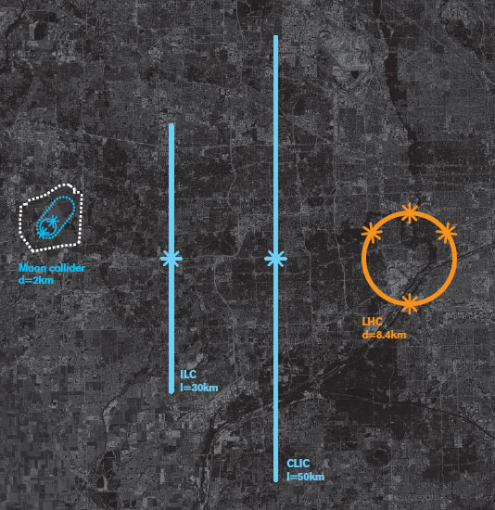
Muon Collider (MC) Has a Smaller Footprint
CLIC
    Accelerator Physics and technology challenges associated with MC:
      Muons are ~ 200 times heavier than electrons
          Allow for circular collider option due to much less synchrotron radiation energy, impossible for e⁻e⁺ circular colliders at TeV scale and therefore smaller footprint.
      Muons decay and are produced with a very large transverse emittance
          Accelerator beam physics challenges;
          Requires fast beam manipulation technologies (target and capture, cooling, high gradient NC and SRF acceleration, SC magnets and etc.)
          Must deal with decay particles and neutrino radiation.
Muon
Collider
ILC
LHC
d=2 km
d=8.4 km
I=30 km
I=50 km
A Muon Collider would offer a precision probe of fundamental interactions, but in a much smaller footprint (may fit Fermilab site) as compared to electron or proton colliders

Slide 3
Studies of High Energy Muon Accelerator Capabilities under MAP
Accelerator physics and technology challenges include:
    Advanced muon beam cooling manipulations and collider design;
    High power target;
    High gradient NCRF in strong magnetic field (cooling);
    SRF for acceleration;
    Superconducting magnets.
Noticeable progresses under MAP in all the above areas
    International MICE cooling demonstration
    ( with major contribution from Berkeley Lab)
Accelerator physics and technology challenges include:
    Advanced muon beam cooling manipulations and collider design (AMP);
    High power target;
    High gradient NCRF in strong magnetic field (cooling) (BACI);
    SRF for acceleration;
    Superconducting magnets (BCMT).
Noticeable progresses under MAP in all the above areas
    International MICE cooling demonstration
    ( with major hardware contribution from Berkeley Lab)

Slide 4
A List of MC Ingredients and Key R&D Challenges
Curtesy of M. Palmer
Issues
Current status
Target
Multi-MW Targets
High Field, Large Bore Capture Solenoid
Ongoing >1 MW target development
Challenging engineering for capture solenoid
Front End
Energy Deposition in Front-End Components
RF in Magnetic Fields (see Cooling)
Current designs handle energy deposition
Cooling
RF in Magnetic Field
High and Very High Field SC Magnets
Overall Ionization Cooling Performance
MAP designs use 20 MV/m → 50 MV/m demo
> 30 T solenoid demonstrated for Final Cooling
Cooling design that achieves most goals
Acceleration
Acceptance
Ramping System
Self-Consistent Design
Designs in place for accel to 125 GeV CoM
Magnet system development for TeV-scale
Self-consistent design for TeV-scale
Collider Ring
Magnet Strengths, Apertures,
and Shielding
High Energy Neutrino Radiation
Self-consistent lattices with magnet conceptual design up to 3 TeV
> ~ 5 TeV – ν radiation solution required
MDI/Detector
Backgrounds from μ Decays
IR Shielding
Further design work required for multi-TeV
Initial multi-TeV promising

Slide 5
Muon Collider Parameters Developed under the US MAP

Slide 6
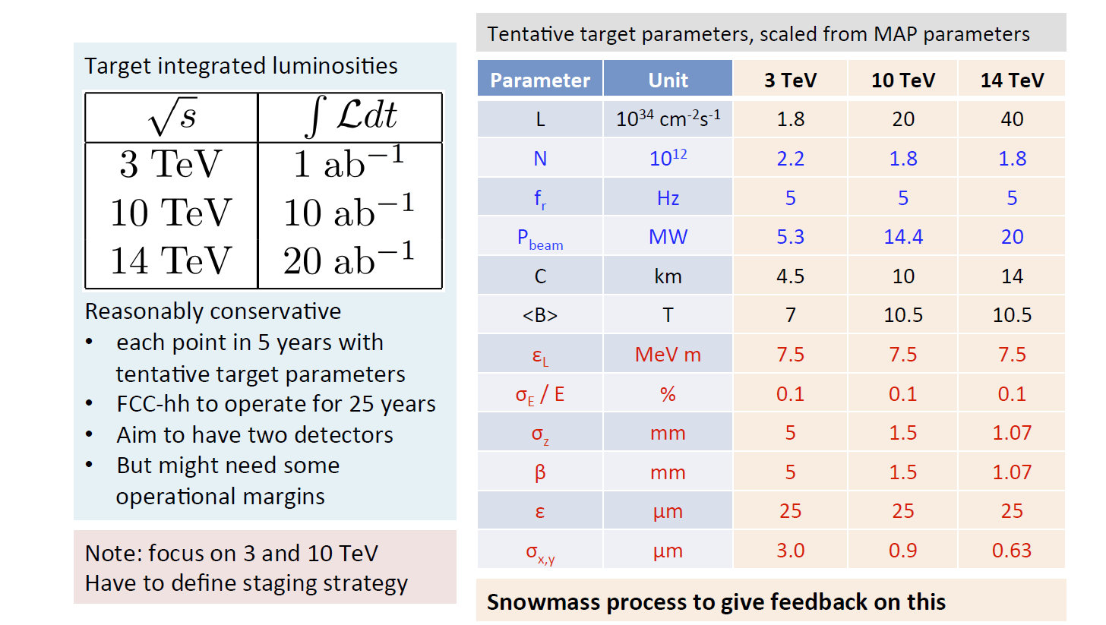
Recent MC Parameters under discussions at MC Forum
Continuing Muon Accelerator R&D requires a strong Physics case on MC
and endorsement from Particle Physics Community;
Close collaboration between Accelerator and Particle Physics communities is essential;
R&D efforts and the US funding possibility likely after next P5.

Slide 7
Superconducting Magnet Technology Challenge for MC
A multi-TeV scale muon collider demands significant advances in superconducting magnet technology including those offered by the HTS.
  Large aperture, high-field arc dipoles (14 cm bore, 20 T for 6 TeV MC)
  Capable of handling large heat load and large magnet stress
  Large aperture, high-field IR quads (15 cm bore, 15 T peak field for 6 TeV MC)
  Driven by large beta values and magnet protection from muon decay products.
Achieving both of above requires to drive Nb₃Sn technology to limit
High field solenoid ( > 30 T) for muon cooling
  Where HTS is an enabling technology.
HTS is also possibly useful for fast cycling magnets needed for acceleration
HTS has seen huge advances in recent years:
  Especially with solenoids. Examples include 32 T all superconducting user solenoid, 28 T commercial NMR magnet, 45.5 T record DC magnetic field.
  Accelerator dipole technologies being pursued at CERN, US MAP with several unique and new concepts. US MDP develops high current density Bi-2212 round wire and stress management canted cosine theta (CCT) magnet.

Slide 8
SRF and NCRF Technology Challenges for MC
SRF technology (for ILC and acceleration of MC)
  17 MV/m (650 MHz for PIP-II)
  31.5 MV/m → 35 MV/m (1.3 GHz ILC)
Future advance
  40 ~ 50 MV/m → 80+ MV/m with Nb₃Sn and at higher temperature?
Pulsed NC RF (for MC, CLIC and new proposed C³ technology)
  ~ 50 MV/m (805 MHz)
  ~ 15 MV/m (201 MHz)
  ~ 100 MV/m (CLIC, 12 GHz) or new materials ?
NCRF in a strong magnetic field (MC)
  50 MV/m at 3 T (805 MHz)
    Demonstrated only at one field = 3 Tesla
  Significant R&D needed for muon cooling application
Muon cooling needs

Slide 9
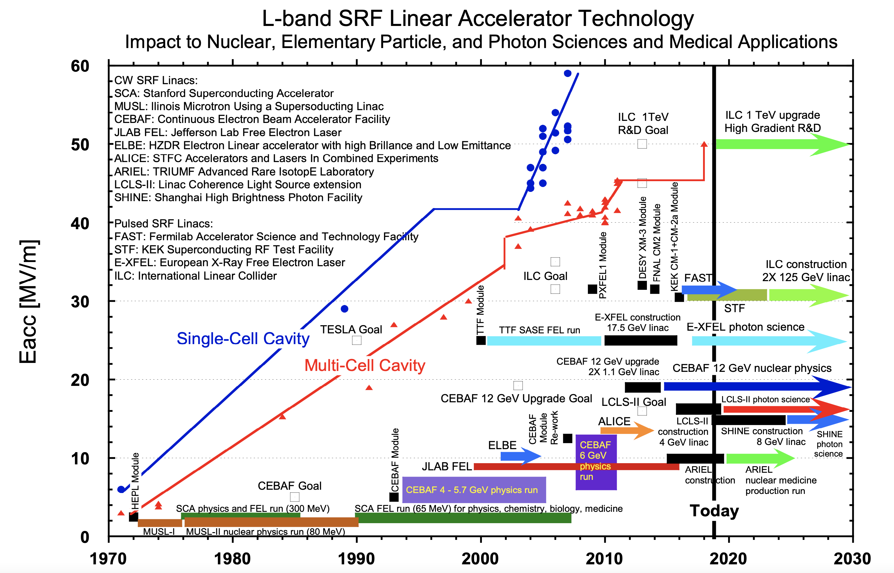
Recent Advance in SRF and NCRF Technology
SRF:
            Demonstrated ILC gradient at 31.5 MV/m (FNAL and KEK);
            Operational XFEL and LCLS-II project at SLAC;
NCRF:
            demonstrated CLIC accelerating gradient at ~ 100 MV/m (CERN)
            High gradient RF breakdown studies:
              RF heating;
              Material stress;
              Pulse width.
            Record high gradient achieved recently at AWA, ANL;
            New distributed coupling structures
            Cryogenic cooled copper
            SLAC’s new C³ proposal
SRF technology decision for ILC made 17 years ago (2004)
More proposed and operational facilities (experience)
(E-XFEL, LCLS-II and LCLS-II HE and PIP-II,…);
Higher Q₀ from nitrogen doping, requires advanced
LLRF controls for pulsed operation;
Advance in RF design tools, geometry, coupling, HOM-damping, …
Steady increase in achievable accelerating gradient, but not
significantly.

Slide 10
Berkeley Lab opportunities for MC
Accelerator and beam physics (Advanced Modeling Program)
  Lattice designs and final cooling using Parametric Resonance Ionization Cooling channel
    Shorter cooling channel designs;
    End-to-end lattice designs for acceleration towards TeV-scale energies;
    Collider ring lattice designs for > 3 TeV Center of Mass.
Magnet technology (Berkeley Center for Magnet Technology)
  High field, multi-Tesla SC magnets for muon production;
  Large bore high-field magnets for cooling, acceleration and collision (dipole, solenoids and quadrupoles);
  HTS material R&D.
RF technology (Berkeley Accelerator Controls and Instrumentation)
  High gradient, robust normal conducting RF cavities for cooling (a world leading role now);
  Advanced RF designs with AI;
  Front-end system for high intensity proton driver (delivered PIP-II RFQ injector in 2015);
  Advanced FPGA-based (could be further enhanced by ML-based fast controls – under development now) low level RF controls for accelerator complex.

Slide 11
Summary
Significant progress and effort for future energy frontier colliders and technology development; valuable experience in operational machines and new machine studies
  ILC, CLIC, FCC-ee, -hh, CEPC, μ-Colliders, C³, laser plasma acceleration, …
  Better positioned for in-depth evaluation of physics and technology readiness;
  Power and costs – technology breakthrough and cost reduction
Higgs Factories Implementation
  A few feasible options on table;
  The choice will define the high-energy future collider path.
Energy Frontier Colliders
  Demand very high electrical power & cost; some options to save;
  Each machine option has its own set of key R&D items for future;
  All colliders option benefit from core acceleration technology R&D
    SC magnets, NCRF/SRF and laser plasma acceleration.
A series of Workshops in each R&D area have been scheduled to define future roadmap before Snowmass-2022, white papers for MC interest under development, including MC International Community (CERN)
A white paper from Muon Collider Forum (with option of site filler in the US) in progress
  A dedicated workshop on accelerator R&D needs for Muon Collider will be held in late January of 2022.

