Slide 1
Magnet options and timeline
P. Ferracin
Lawrence Berkeley National Laboratory
Snowmass at LBNL
LBNL
December 10, 2021

Slide 2
Outline
Superconducting materials
Field levels
  5-9 T 11-13 T 14-16 T Beyond 16 T
Some considerations on timelines

Slide 3
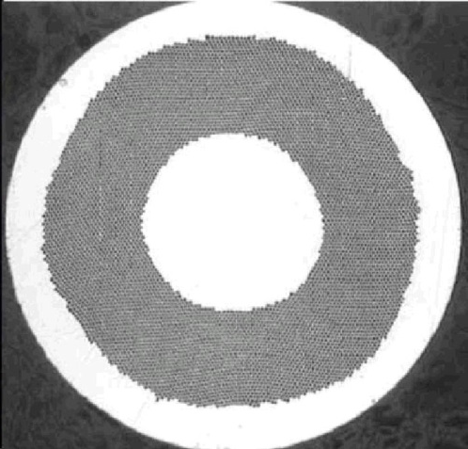
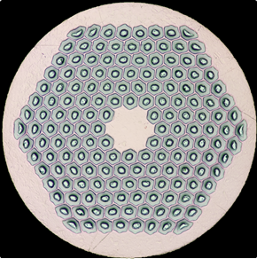
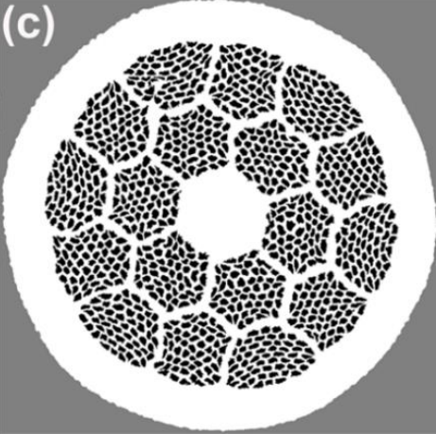
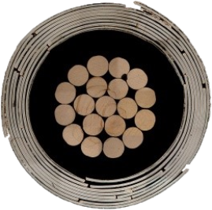
Superconducting materials
Beyond 16 T
Nb-Ti
5 - 9 T
The “workhorse”
Small filaments
Ductile and cheap
Nb₃Sn
11 – 16 T
Strain sensitive and brittle
Reaction to 670 °C
Larger filaments
Bi2212
Round strand -> Rutherford cable
Reaction to 900 °C and 50 bar in O₂
Strain sensitive
REBCO
Tape
No reaction
Strain sensitive
Angle dependence of J_{e}

Slide 4
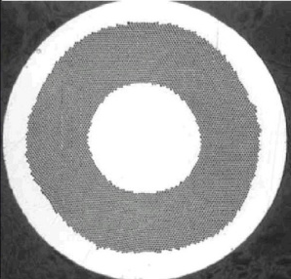
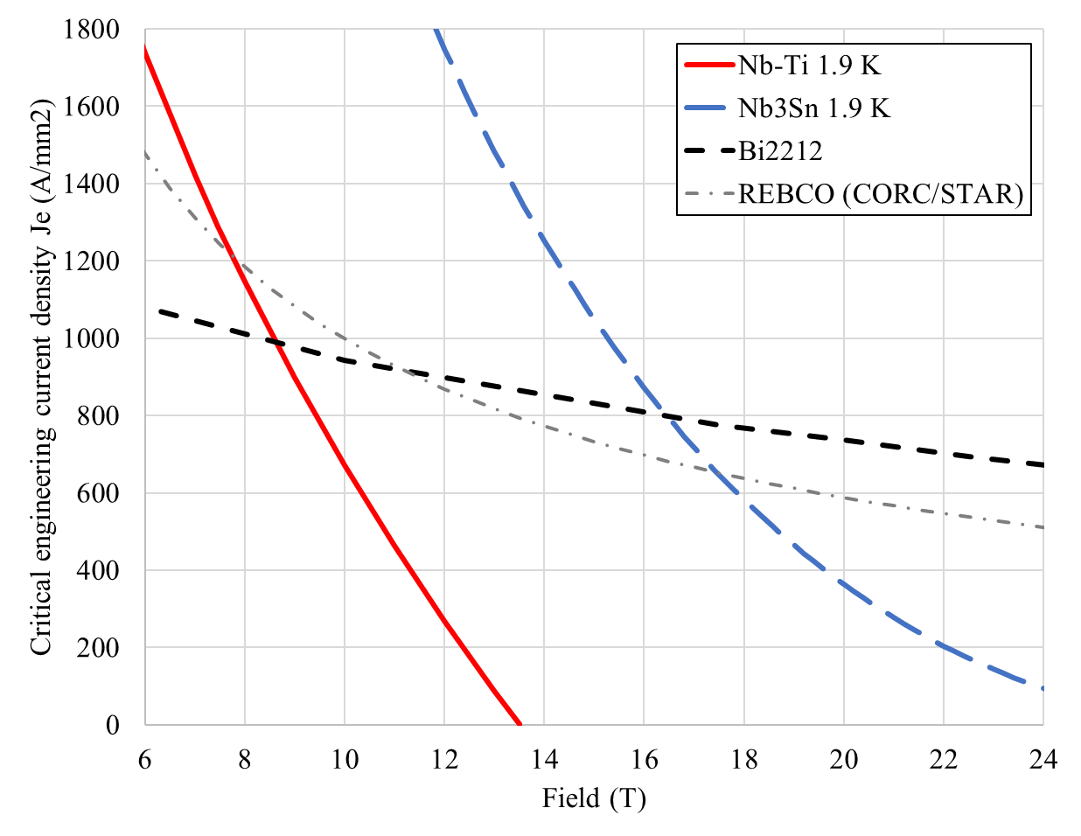
Superconducting materials
J_{e} = Strand current / strand area
Typically magnets operate at 80% of the limits
So,
  Nb-Ti up to 10 T
  Nb₃Sn up to 16 T
Typical J_{e} in accelerator magnets

Slide 5
Outline
Superconducting materials
Field levels
  5-9 T 11-13 T 14-16 T Beyond 16 T
Some considerations on timelines

Slide 6
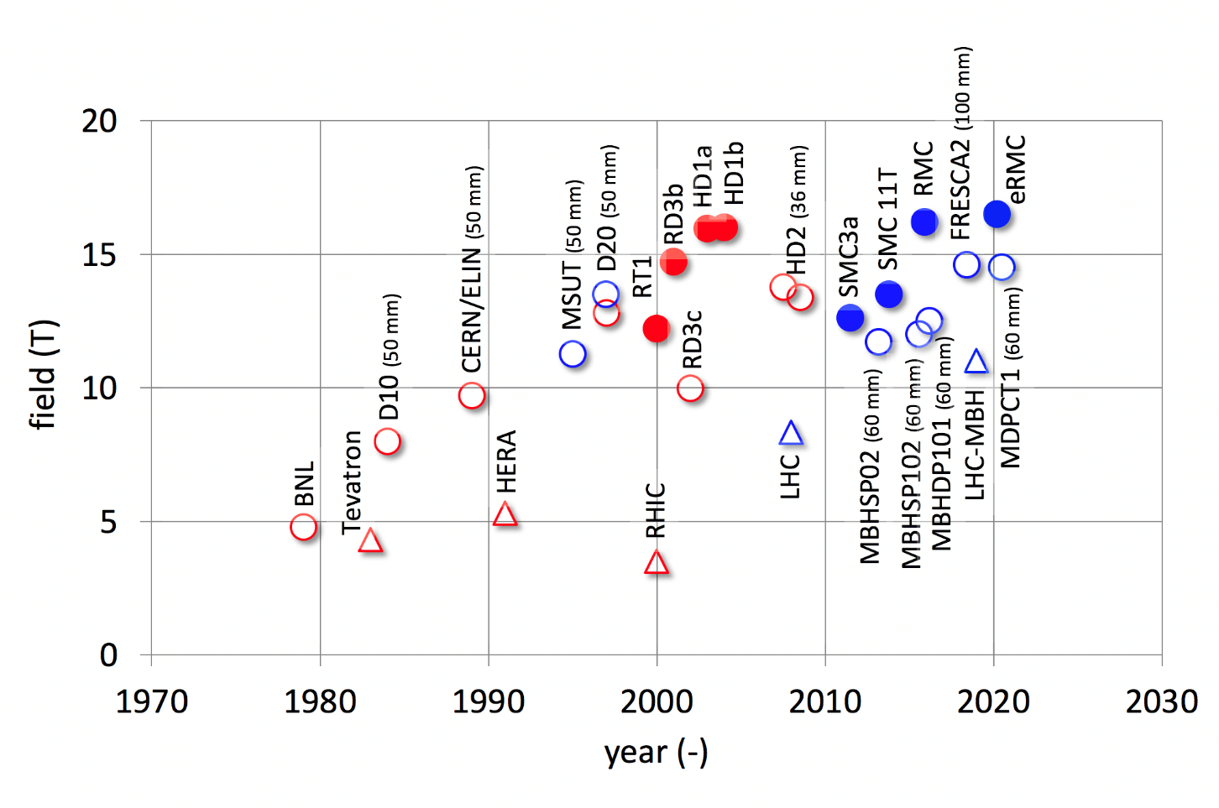
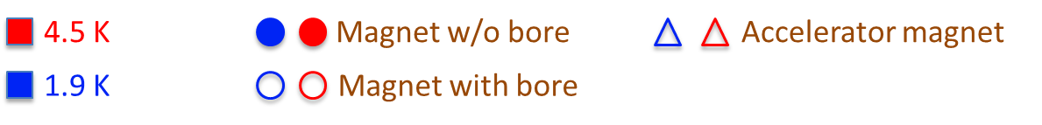
Overview of Nb-Ti and Nb₃Sn dipole magnets
By L. Bottura

Slide 7
The 5-9 T field level (Nb-Ti)
By L. Bottura

Slide 8
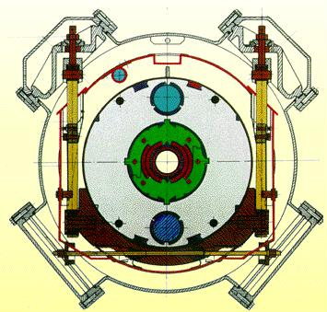
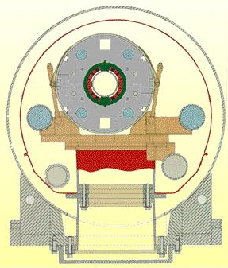
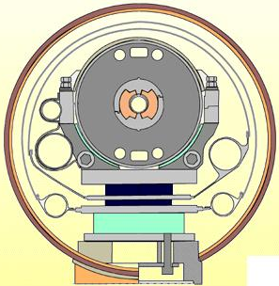
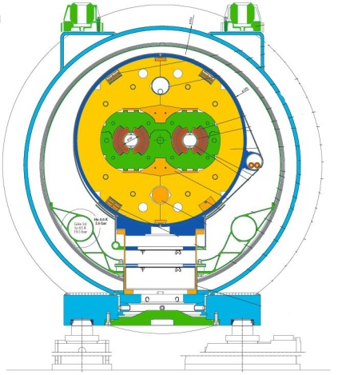
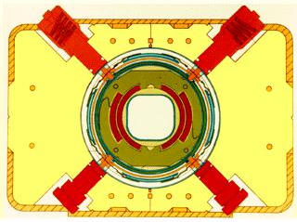
The 5-9 T field level (Nb-Ti)
Accelerator magnets fabricated in large series and installed in particle colliders (except SSC)
From 4.4 T in Tevatron to 8.3 T (9 T ultimate) in LHC
Tevatron
HERA
RHIC
SSC
LHC
Not in scale

Slide 9
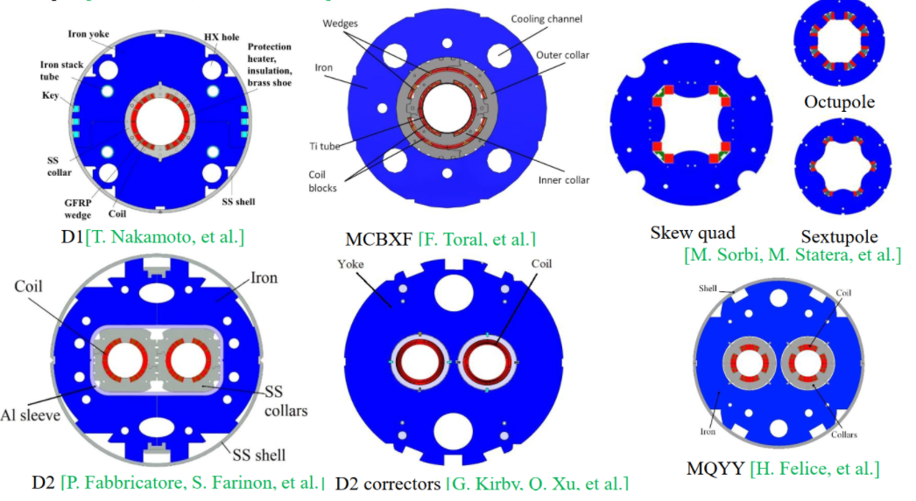
The 5-9 T field level (Nb-Ti)
Nb-Ti magnets for the HL-LHC currently under fabrication: up to 6.6 T

Slide 10
The 11-13 T field level (Nb₃Sn)
By L. Bottura

Slide 11
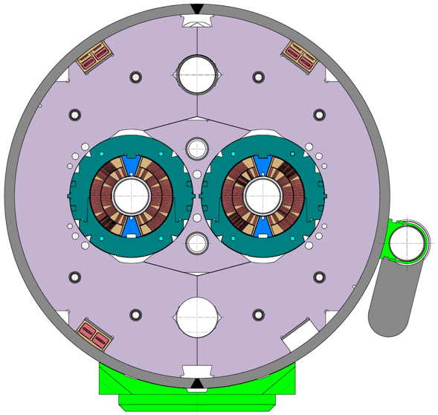
The 11-13 T field level (Nb₃Sn)
IR quadrupole for HL-LHC: MQXF
Arc dipole for HL-LHC: 11T
Accelerator quality magnets
Short model and prototype program completed, series started

Slide 12
The 14-16 T field level (Nb₃Sn)
By L. Bottura

Slide 13
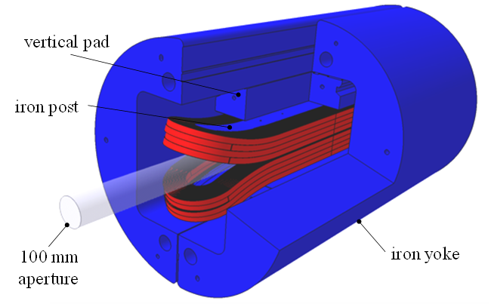
The 14-16 T field level (Nb₃Sn)
FNAL MDPCT: 14.5 T
CERN FRESCA2: 14.6 T
Short models, with aperture, but not yet accelerator quality

Slide 14
The 14-16 T field level (Nb₃Sn)
By L. Bottura

Slide 15
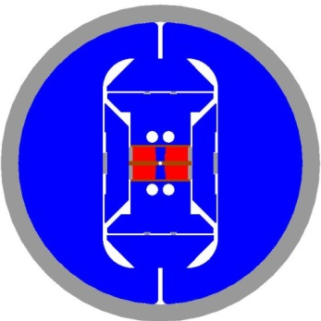
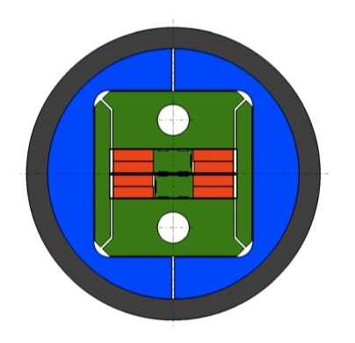
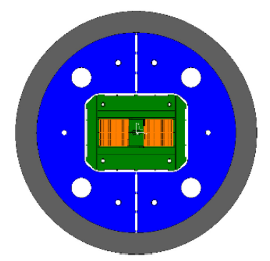
LBNL HD1, CERN RMM and ERMC: all reached (and passed) 16 T
Limit of Nb₃Sn reached so far only in short models with simple coil geometries (no bore, racetrack…)

Slide 16
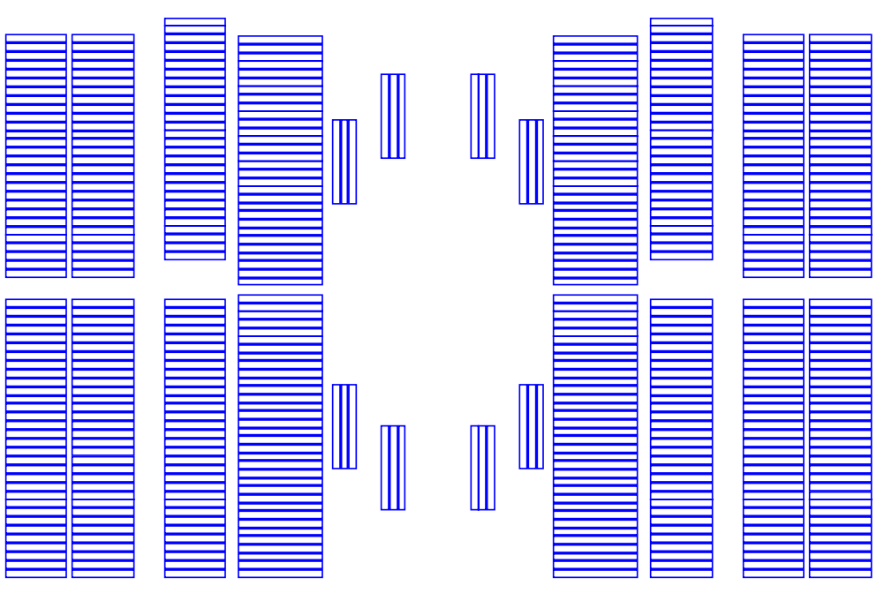
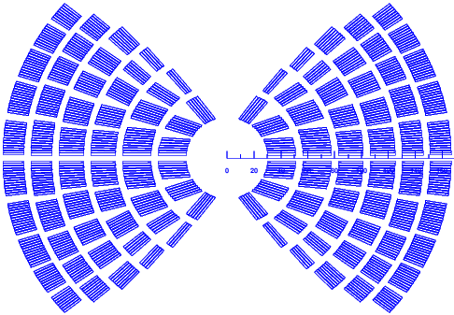
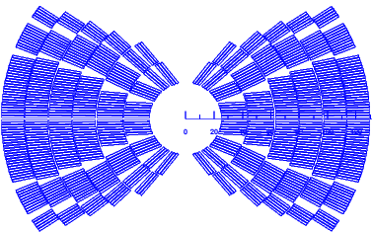
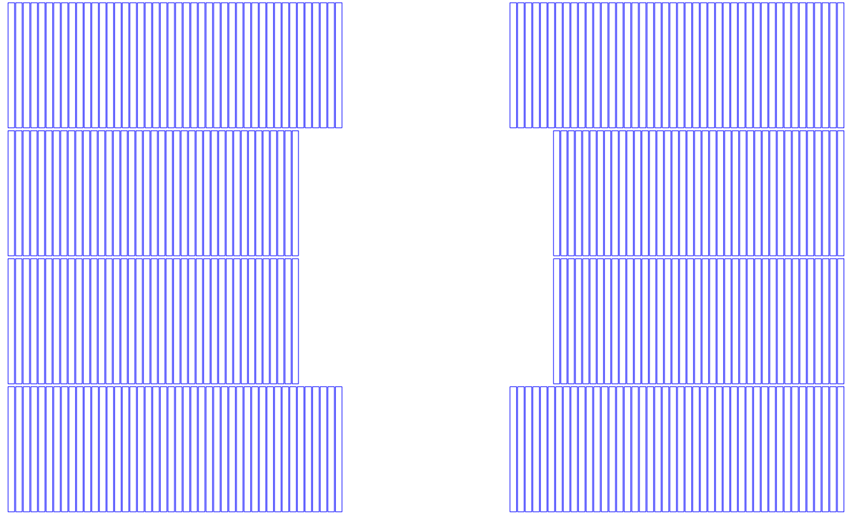
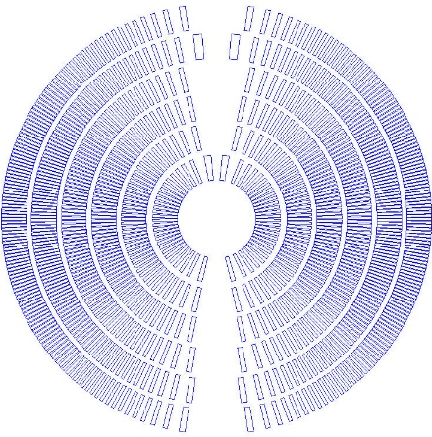
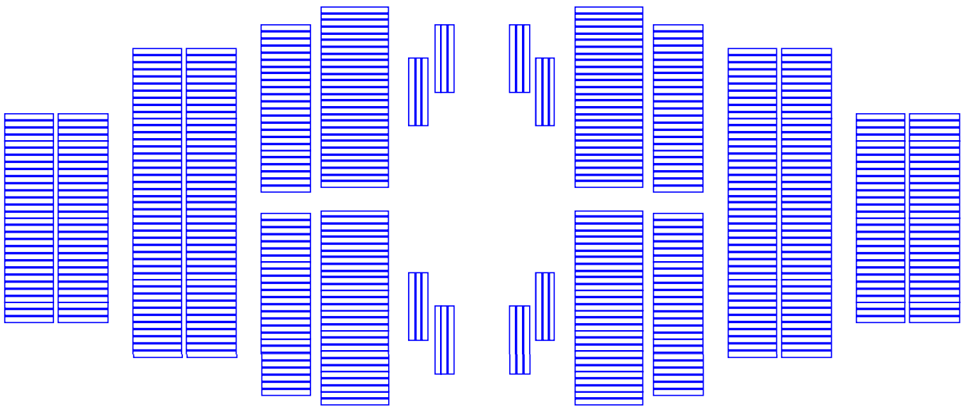
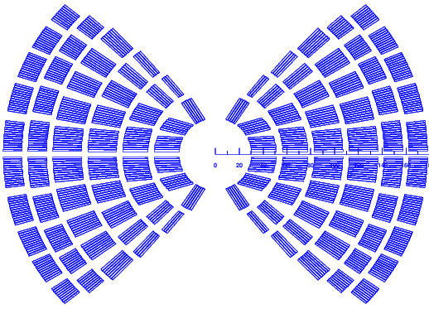
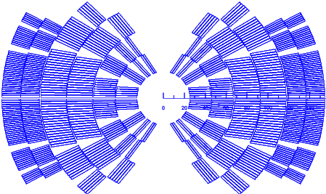
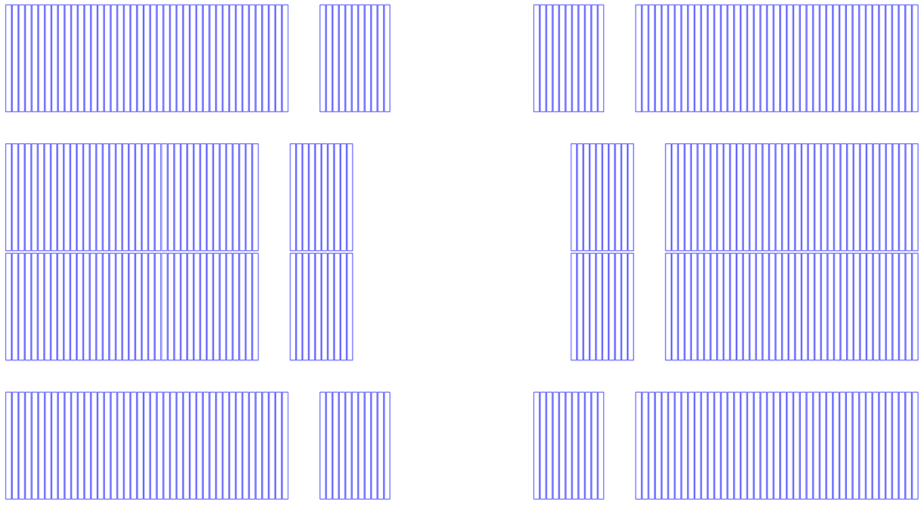
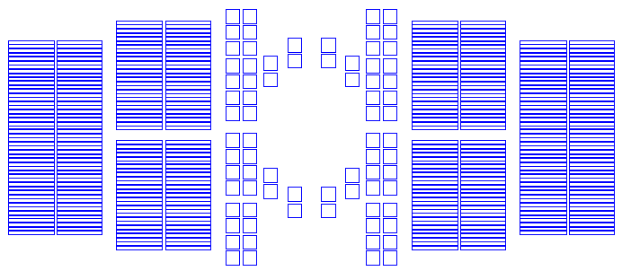
Beyond 16 T
20 T hybrid zoo
Preliminary design studies
  Different HTS and Nb₃Sn coil lay-outs for 20 T hybrid magnets

Slide 17
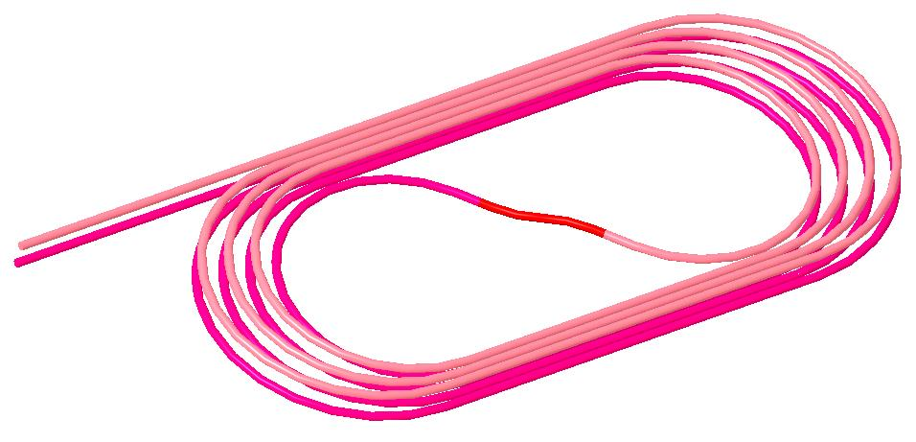
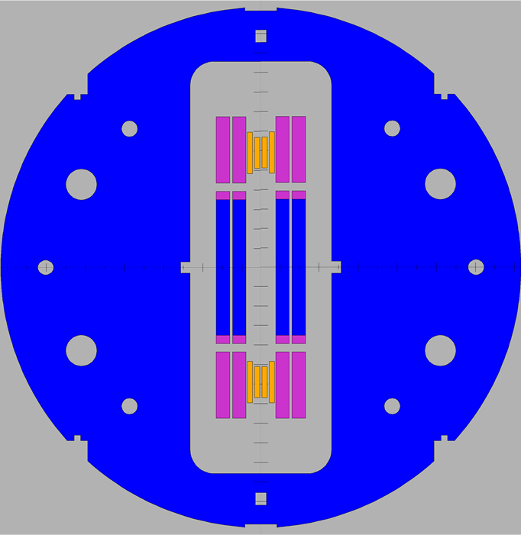
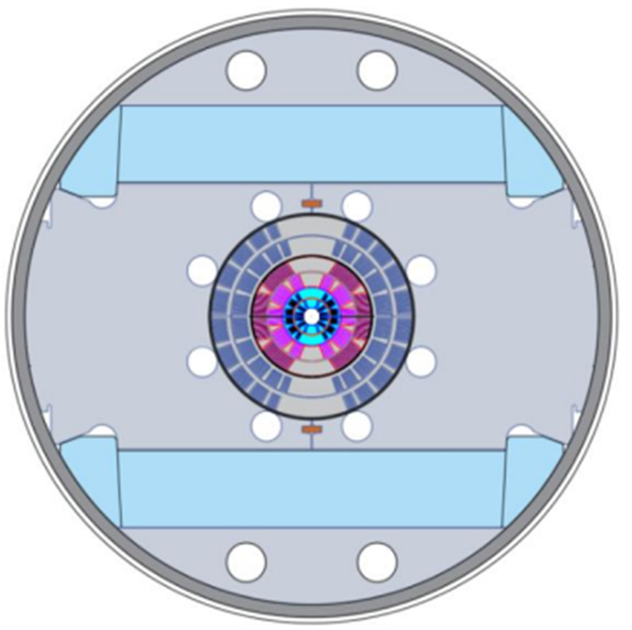
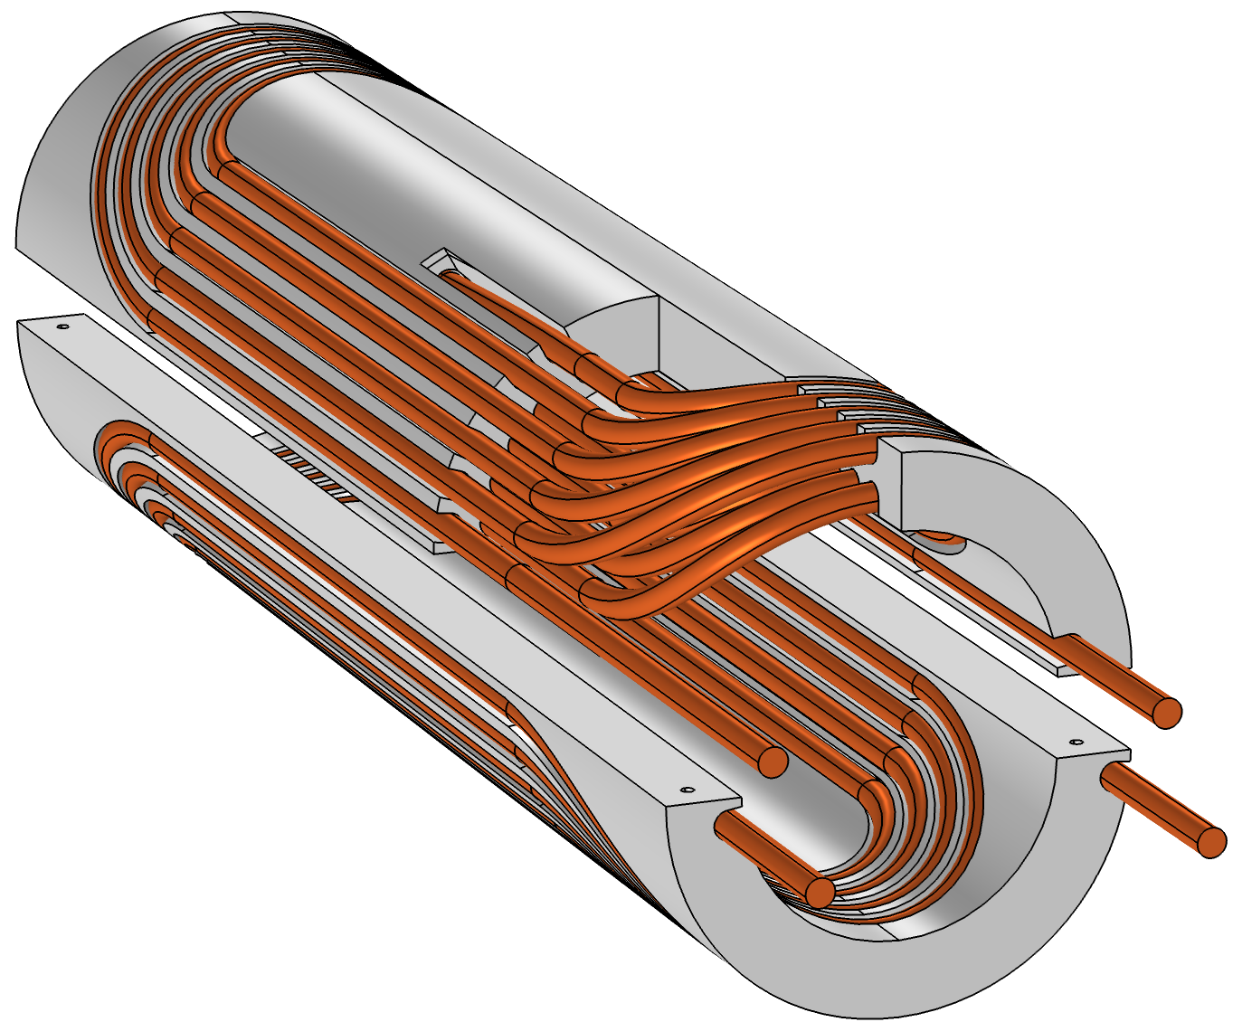
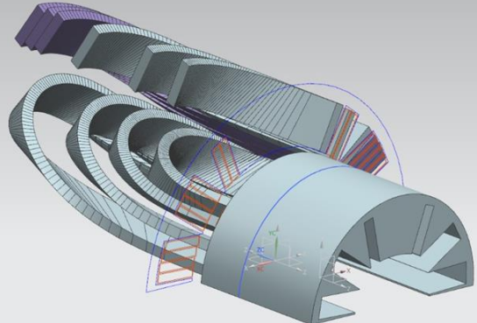
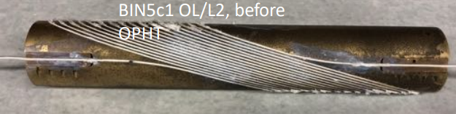
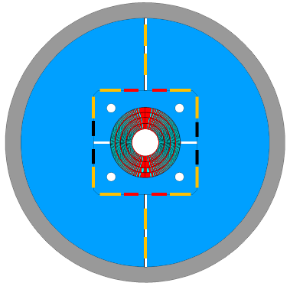
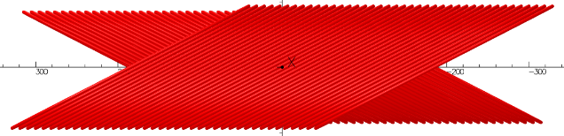
Beyond 16 T
MDP current activities
HTS insert coil (2-5 T) being fabricated at
  BNL
    Racetrack REBCO CORC coils inside common coil
  FNAL
    SMCT inserts in CT and SMCT outserts
  LBNL
    CCT inserts in CCT outserts
Similar activities carried out in Europe

Slide 18
Outline
Superconducting materials
Field levels
  5-9 T 11-13 T 14-16 T Beyond 16 T
Some considerations on timelines

Slide 19
Some considerations on timelines
Project timeline
  10+ years, considering short models, prototype, and series
    Time can change significantly depending on the size of the project (HL-LHC: 1.5 km; FCC: 100 km)
R&D timeline
  Time towards a project
For the Nb-Ti 5-9 T level and the Nb₃Sn 11-13 T level
  Accelerator quality magnets fabricated or being fabricated in series production
    No need of “major” R&D (and a little bit of optimism….)
For the Nb₃Sn 14-16 T level
  We need to fill the gap between R&D (“short”) magnets to accelerator quality (“reasonably long”) magnets
  Possible goal for the next ~10+ years: long accelerator quality Nb₃Sn magnet (a prototype) in the 14-16 T field level
For the ~20 T level
  We are still working on small HTS insert coils, without significant experience in hybrid magnets
  Major R&D effort to be carried out (currently one of the key area of the US MDP program)
  Possible goal for the next ~10+ years: short model with sizable aperture

