Slide 1
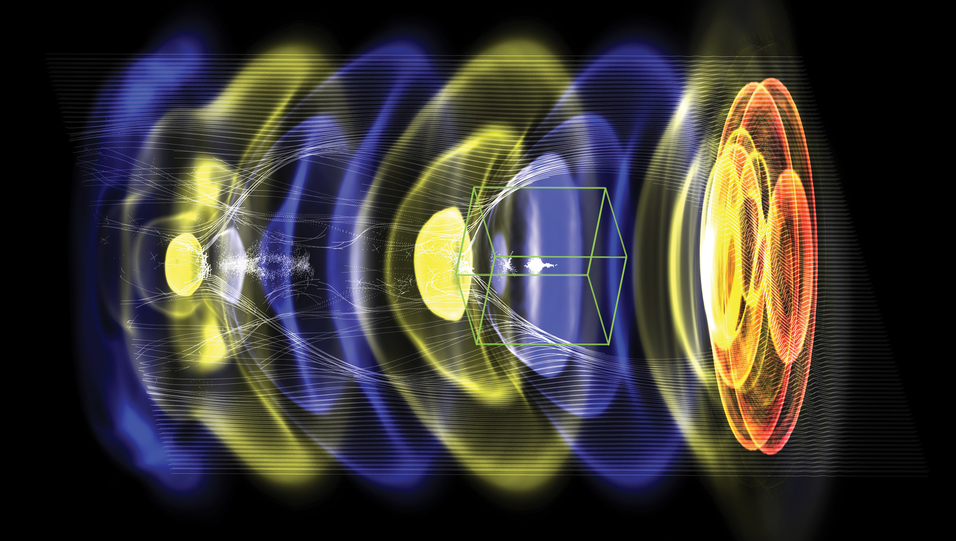


Accelerator design for multi-TeV future colliders based on laser-plasma accelerators
Carl Schroeder
BELLA Center, ATAP
Lawrence Berkeley National Laboratory
WarpX
Snowmass @ LBNL, December 10, 2021
Work supported by the U.S. DOE, Office of Science, Office of High Energy Physics, under Contract No. DE-AC02-05CH11231

Slide 2
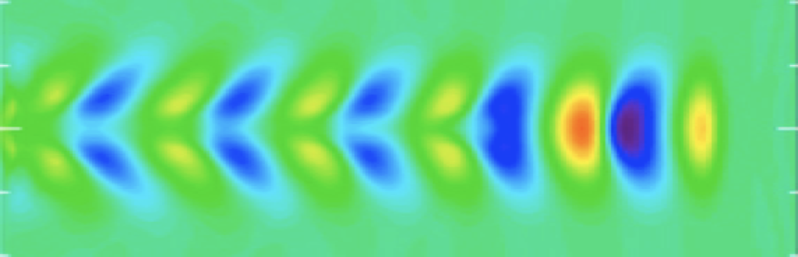
Laser-driven plasma accelerators:
ultra-high accelerating gradients
Wakefield (plasma wave) driven by the ponderomotive force of a resonant laser pulse in plasma
Focusing and acceleration provided by plasma wave
Plasma density n₀~10¹⁷ cm⁻³ yields E~10 GV/m
Wakefield driven by high-power, short duration laser drivers
Compact coupling (< 1 m) of laser drivers using plasma mirrors
Esarey et al., Rev. Mod. Phys. (2009)
electron plasma density
particle beam
laser driver
Laser-driven plasma accelerator
(in quasi-linear regime)
plasma wavelength
Main advantages of laser-plasma accelerator technology for collider applications:
  compact linac footprint (both accelerating plasma cell and drive laser beam)
  ultra-short bunches (few micron) = reduced beamstrahlung = collider power savings
2

Slide 3
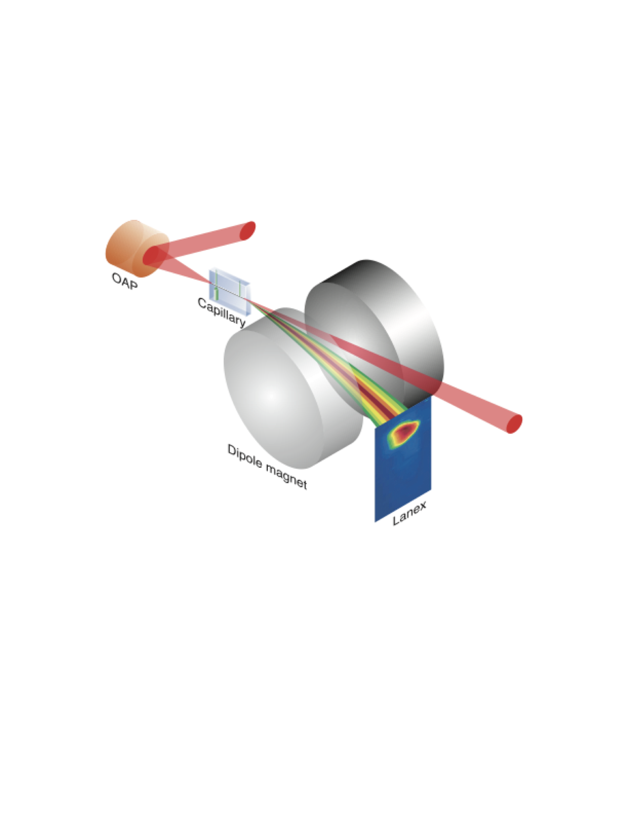
Ultrahigh (GV/cm) gradients experimentally demonstrated
Ti:Sapphire laser:
(0.8 um, 2 J, 40 fs, 10 Hz)
underdense plasma channel
n ~3x10¹⁸ cm⁻³
L~3 cm
Laser-plasma accelerator technology:
  compact accelerator footprint (>10 GV/m)
  ultra-short bunches (few micron bunches, < plasma wavelength)
E-field of plasma wave
laser
Nakamura et al., Phys. Plasmas (2007)
~30 GV/m
1 GeV
2.9%
30 pC
1.7 mrad
PIC (WarpX – J.-L. Vay)
λ_{p}~20 um
3

Slide 4
Basic configuration of a laser-plasma-based linear collider
Linac: staged laser plasma accelerators:
Preliminary/Strawperson designs have been produced to guide R&D
R&D focus has been on developing laser-plasma accelerator
No complete conceptual design is ready (laser technology is developing)
Leemans & Esarey Phys. Today (2009)
Key characteristics of a laser-plasma linear collider:
Design (optimizing operational plasma density, ~10¹⁷ cm⁻³) yields 5 GeV/stage (100 stages/linac for 1 TeV):
    Geometric/average gradient = 2.3 GV/m
Time structure at IP:
    single bunches, separated by ~20 μs (~50 kHz)
Short (8.5 μm rms), shaped current distribution
    beamstrahlung reduction:
    𝞂_{z}< β*
C. Schroeder et al. NIMA (2016)
4

Slide 5
High-level parameters for e+/e- laser-plasma collider
Laser-plasma linear e-/e+ collider |  | 1 TeV | 3 TeV | 15 TeV
Beam energy | TeV | 0.5 | 1.5 | 7.5
Particle number (1E9) |  | 1.2 | 1.2 | 1.2
Beam power | MW | 4.4 | 13 | 65
Luminosity (1E34) | cm-2 s-1 | 1 | 10 | 50
Transverse. beam sizes at IP, x/y | nm | 50 / 1 | 10 / 0.5 | 4 / 0.25
IP beta function, β* | mm | 0.1 | 0.1 | 0.1
RMS bunch length | micron | 8.5 | 8.5 | 8.5
Repetition frequency | kHz | 47 | 47 | 47
Time between collisions | microsec | 21 | 21 | 21
Beamstrahlung photons/e- |  | 0.6 | 1.4 | 1.6
Length (2x main linac tunnel) | km | 0.44 | 1.3 | 6.6
Facility site power (2 linacs) | MW | 105 | 315 | 1100
Notes:
LWFA parameters:
1 um laser wavelength
10¹⁷ cm⁻³ plasma density
Upgrade potential: Same laser systems (linac) for 1, 3, and 15 TeV
5

Slide 6
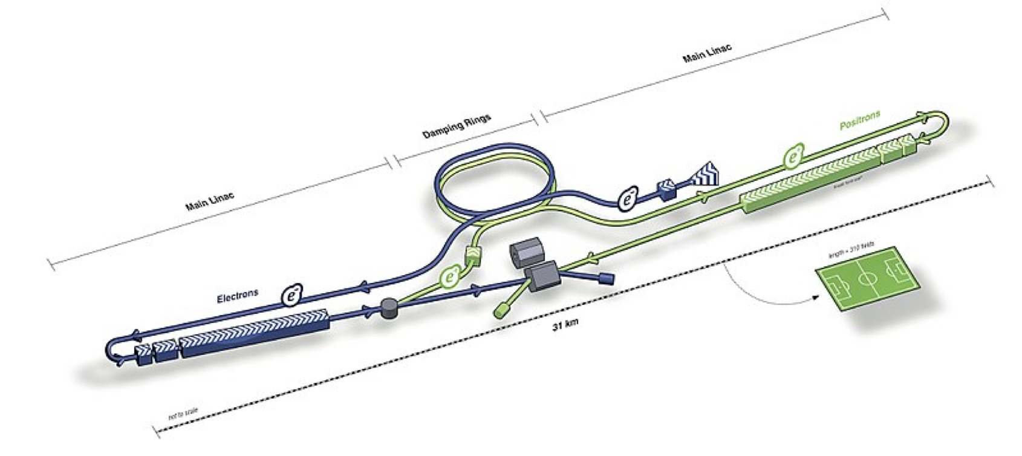
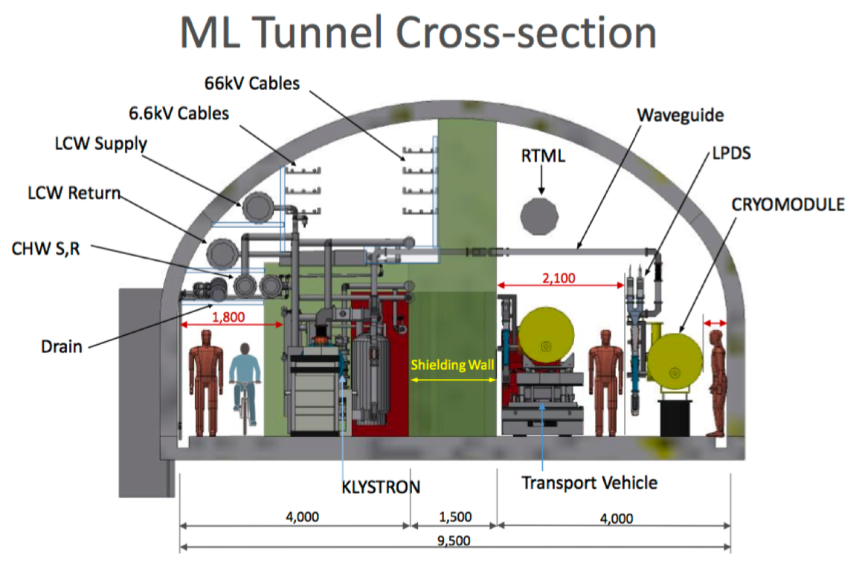
Plasma-based collider using ILC infrastructure
ILC upgrade:
  Replace SCRF with LWFA stages
  Laser drivers (~m²) and plasma cells fits in ILC main linac tunnel
  300 MW site power could support √s = 3 TeV LWFA design
  12 MW beam power for √s = 3 TeV LWFA design (ILC beam dumps rated for 17 MW)
ILC TDR
High energies (1-15 TeV) accessible in conventional accelerator facility footprint
6

Slide 7
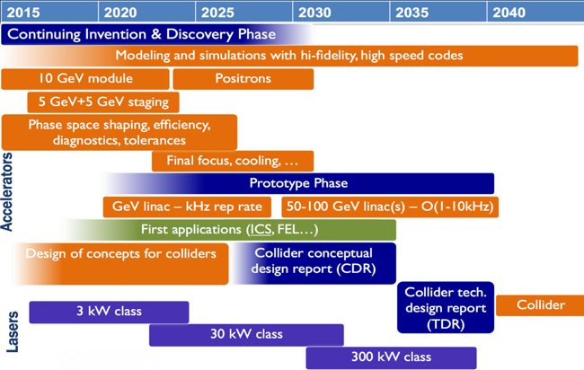
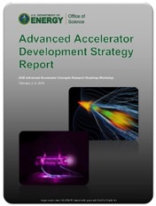
R&D timeline towards a collider
  US AAC community outlined R&D goals in 2016 roadmap
  Progress on all R&D goals
  Roadmap to be updated
DOE HEP AAC Roadmap (2016)
  Technically-limited timeline:
R&D CDR TDR
Construction
5 10 15 20 25 30
years
7

Slide 8

Laser technology requirements for a collider
Laser drivers:
Requires R&D to reach collider parameters:
10 J, 100 fs class, 50 kHz, high wall-to-laser efficiency
Two promising laser architectures:
  Coherent combination of fiber lasers (1 um). R&D at Jena, Michigan, LBNL, LLNL, et al.
      ~60% wall-to-laser efficiency
  Tm:YLF (1.9 micron) – (4x as many LWFA stages). R&D at LLNL
  Peak laser power requirements may be relaxed by excitation using laser pulse trains
High-average power laser drivers
collider
requirement:
50 kHz
> 40% effic.
1 um
10 pulse train
fiber
Tm:YLF
2µm – 4xstages
technically
feasible
today: kHz
average laser power [kW]
kBELLA
fiber
HAPLS (ELI)
existing
laser
systems:
few Hz
J. Cowley et al. PRL (2017)
CoReLS (Korea)
BELLA (LBNL)
Facilities needed to develop high-rep-rate technology (plasma targetry, diagnostics, etc.) and develop collider subsystems
peak laser power [TW]
8

Slide 9
Mid-term collider options for Science and Accelerator R&D
Science
opportunities:
collision
Accelerator:
~10 years
Modest R&D required
e- fixed target / high-intensity laser
10 – 50 GeV; 1 kHz (upgrade 10 kHz)
?
√s = 20 – 100 GeV ; 1 kHz (upgrade 10 kHz)
e-polarized
Lum= 4x10³⁰ cm⁻²s⁻¹ (upgrade 4x10³¹ cm⁻²s⁻¹)
Higher lum. (~10³² cm⁻²s⁻¹) without polarization
e- e-
?
~15 years
√s = 16 – 80 GeV; 1 kHz (upgrade 10 kHz)
Lum~2x10³⁰ cm⁻²s⁻¹ (upgrade ~2x10³¹ cm⁻²s⁻¹)
Requires development of scatter laser source (FEL)
𝛾 e , 𝛾𝛾
?
~20 years
Significant R&D required
√s = 20 – 100 GeV; 1 kHz (upgrade 10 kHz)
e+ plasma acceleration R&D required
Development of e+ source; damping ring
e+ e-
Next talks
e+e- (or 𝛾𝛾)
√s = 1 TeV (upgrade to 3 TeV, 15 TeV)
50 kHz
L = 10³⁴ (upgrade to 10³⁵)
9

Slide 10
Summary
Laser-plasma collider concepts have potential to extend reach of linear lepton colliders to 15 TeV (at 5E35 luminosity)
  High gradients – extend energy reach
  Short beams – reduce beamstrahlung & save power
Community organizing toward integrated design study
  Potential to re-use collider facilities (e.g., ILC) to extend energy reach
Low energy demonstrators required to advance technology
  Science opportunities needed to motivate test facilities
10

Slide 11
Backup slides

Slide 12
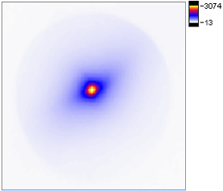
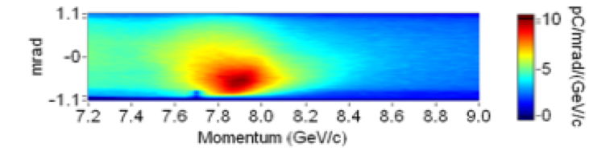
Status of laser-plasma-accelerator experimental R&D
  Single stage achieved multi-GeV acceleration: 8 GeV in 20 cm (40 GV/m)
divergence:
150 mrad
discharge-capillary plasma waveguide
Gonsalves et al. PRL (2019)
2019 (LBNL)
Energy gain (GeV) in LWFA stage
2014 (LBNL)
  1 Hz rep. rate
  Reproducibility limited by laser fluctuations (at ~100 Hz)
2013 (GIST)
2013 (TPW)
  Proof-of-principle staging of plasma accelerators:
2006 (LBNL)
Operational plasma density (x10¹⁸ cm⁻³)
Compact driver coupling using plasma mirrors
Steinke et al. Nature (2016)
Plasma lens focusing of beam
  Proof-of-principle experiment demonstrate 100 MeV energy gain
  Multi-GeV staging experiments are planned / commissioning ongoing
12

