Slide 1
Neutrino Oscillation and LBNL
Dan Dwyer
Snowmass @ LBNL
17 Sep. 2021

Slide 2
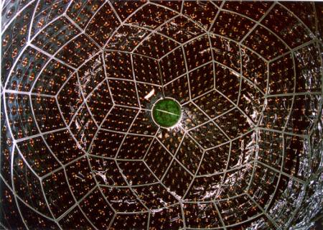
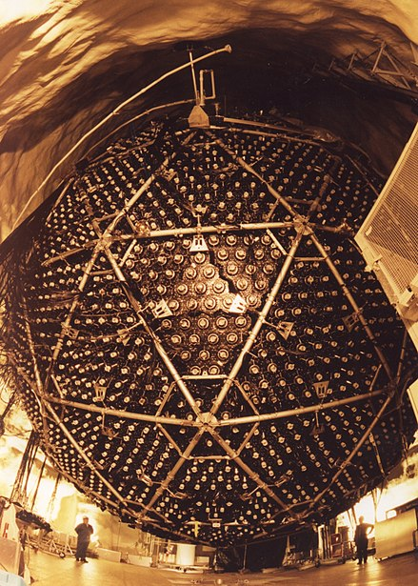
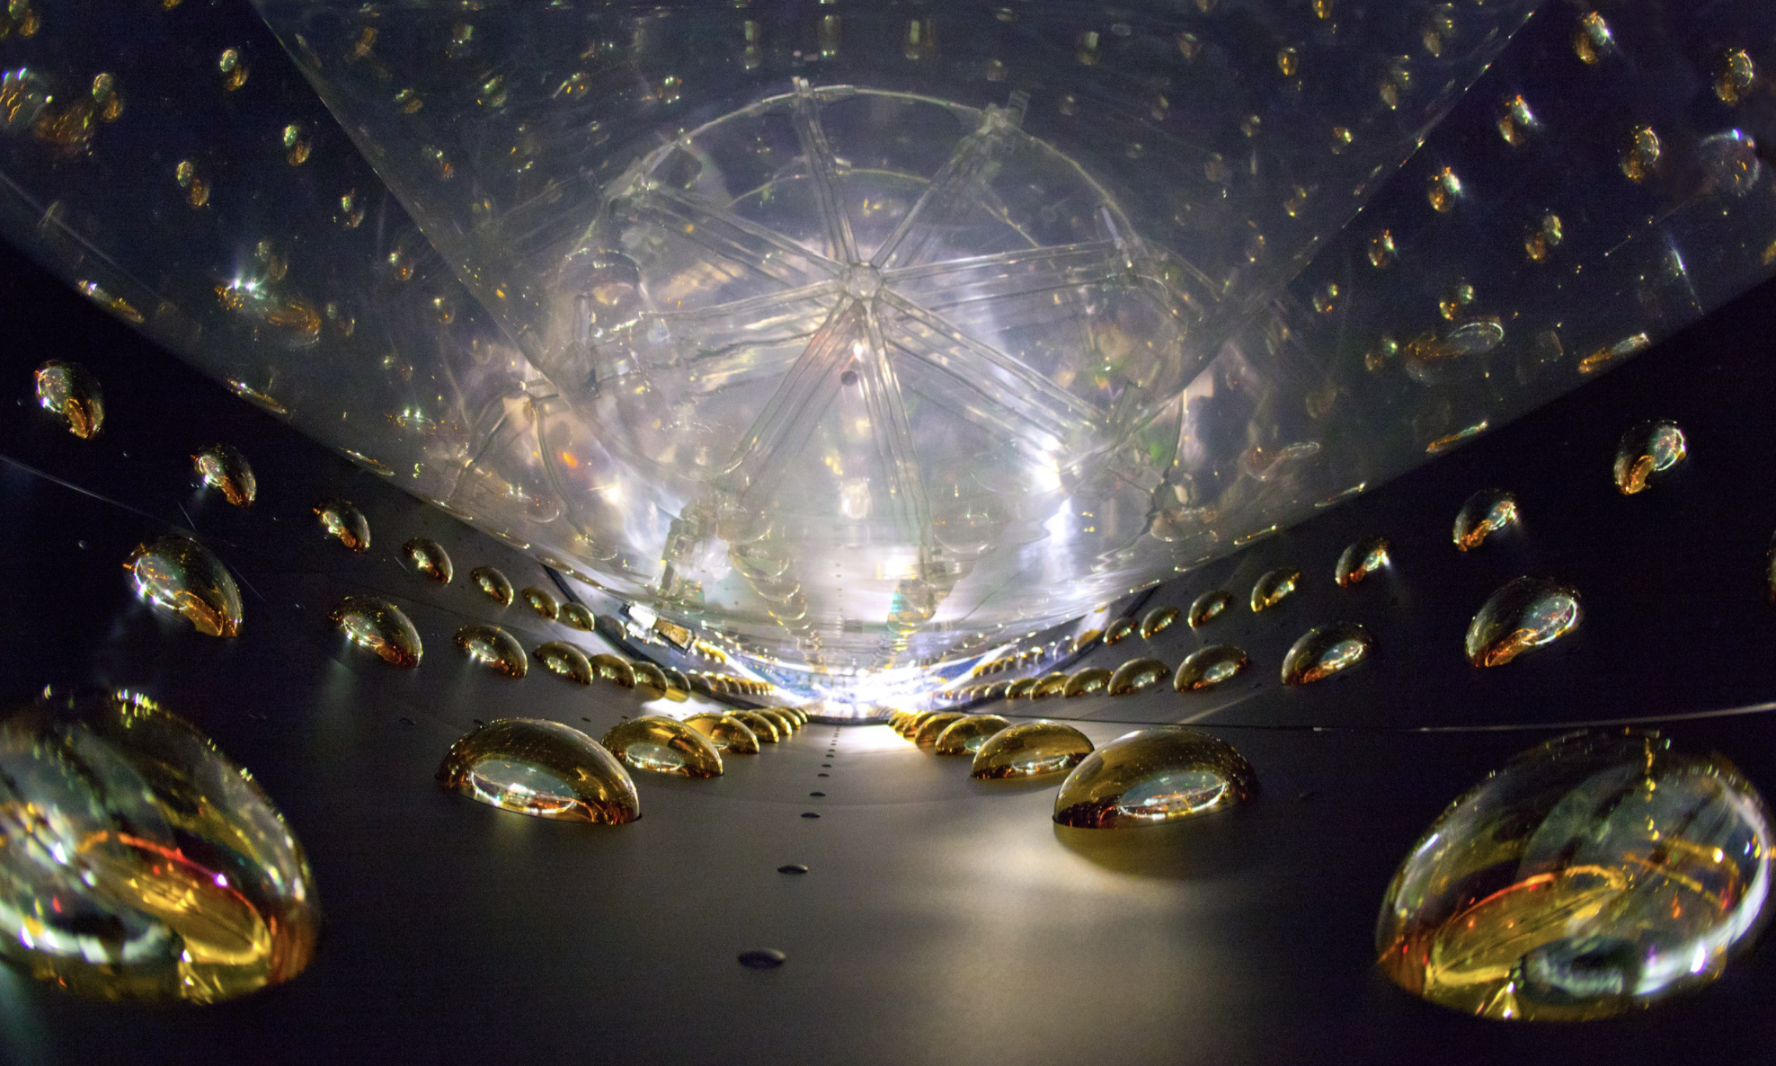
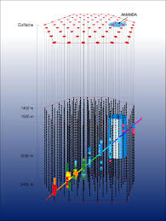
LBNL: Strong Track Record in Neutrino Oscillation Physics (1990-2020)
P.A. Zyla et al. (Particle Data Group),
Prog. Theor. Exp. Phys. 2020, 083C01 (2020) and 2021 update
Leading
Measurements:
SNO, SuperK
KamLAND
T2K, NOvA, IceCUBE
Daya Bay, T2K, NOvA
Daya Bay
T2K, NOvA

Slide 3
Upcoming Neutrino Oscillation Measurements: 2020-2030
P.A. Zyla et al. (Particle Data Group),
Prog. Theor. Exp. Phys. 2020, 083C01 (2020) and 2021 update
Upcoming
Measurements:
Mass Ordering:
T2K, NOvA, JUNO, T2K-II,
IceCUBE upgrade, DUNE
Search for CP-Violation:
T2K, NOvA, T2K-II, DUNE

Slide 4
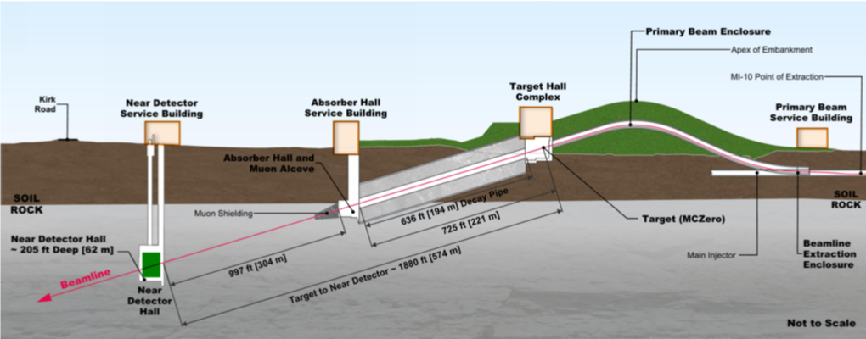
DUNE: Focus of DOE-HEP Neutrino Program for next decade+
DUNE Physics:
Accelerator Neutrinos:
- Search for CP Violation
- Mass Ordering
- Precision Mass and Mixing
Supernova Neutrino Bursts
Baryon Number Violation
BSM Searches
LBNL Leadership:
- Near and Far Detector Electronics
- Near Detector LArTPC Coordination
- Near Site Engineering
Headline
measurements

Slide 5
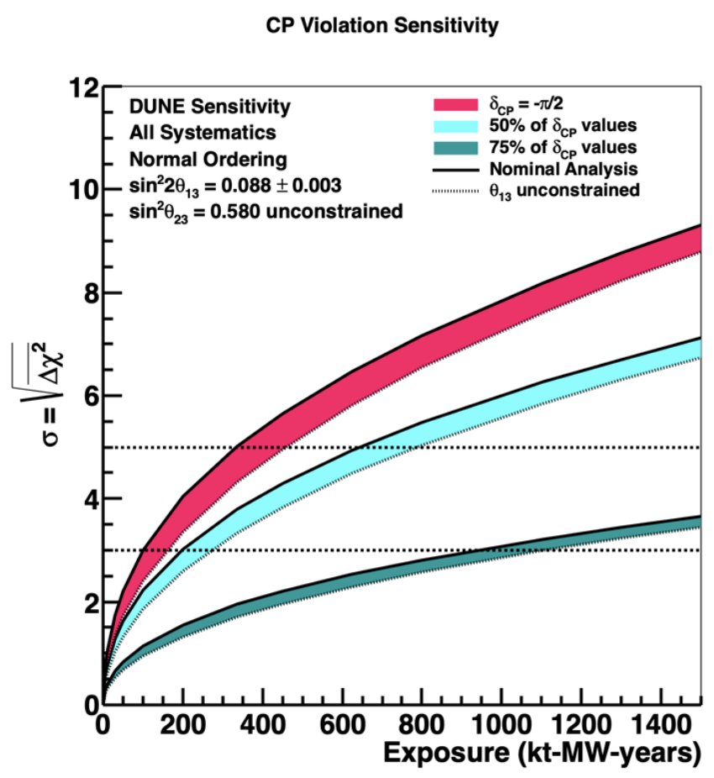
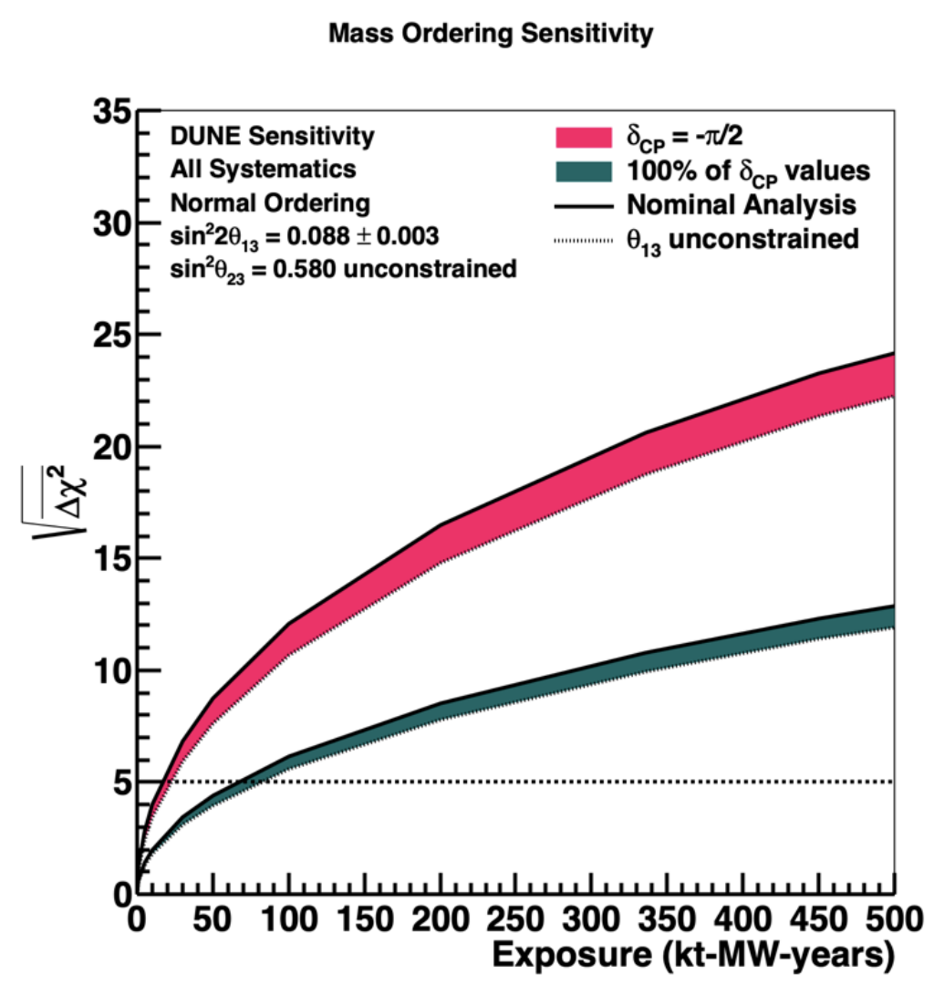
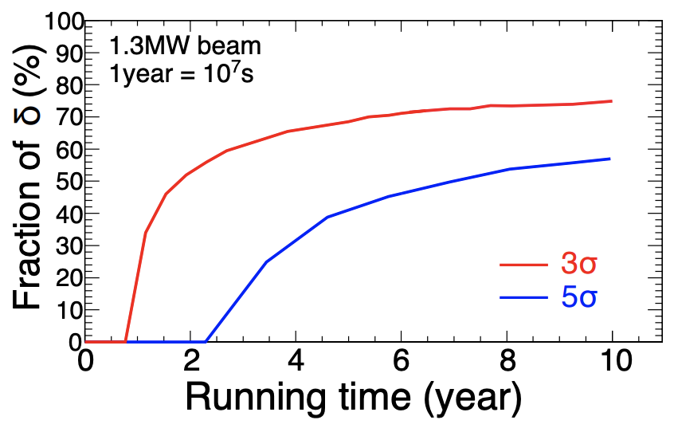
Oscillation Sensitivities: DUNE and Hyper-K
From the DUNE Conceptual Design Report
arXiv:2002.03005
From the HyperKamiokande Design Report
arXiv:1805.04163
and precision oscillation targets:
- Δm²₃₂: ~1%
- θ₂₃: ~1%
- θ₁₃: ~6%
and precision oscillation targets:
- Δm²₃₂: ~1%
- θ₂₃: ~2%

Slide 6
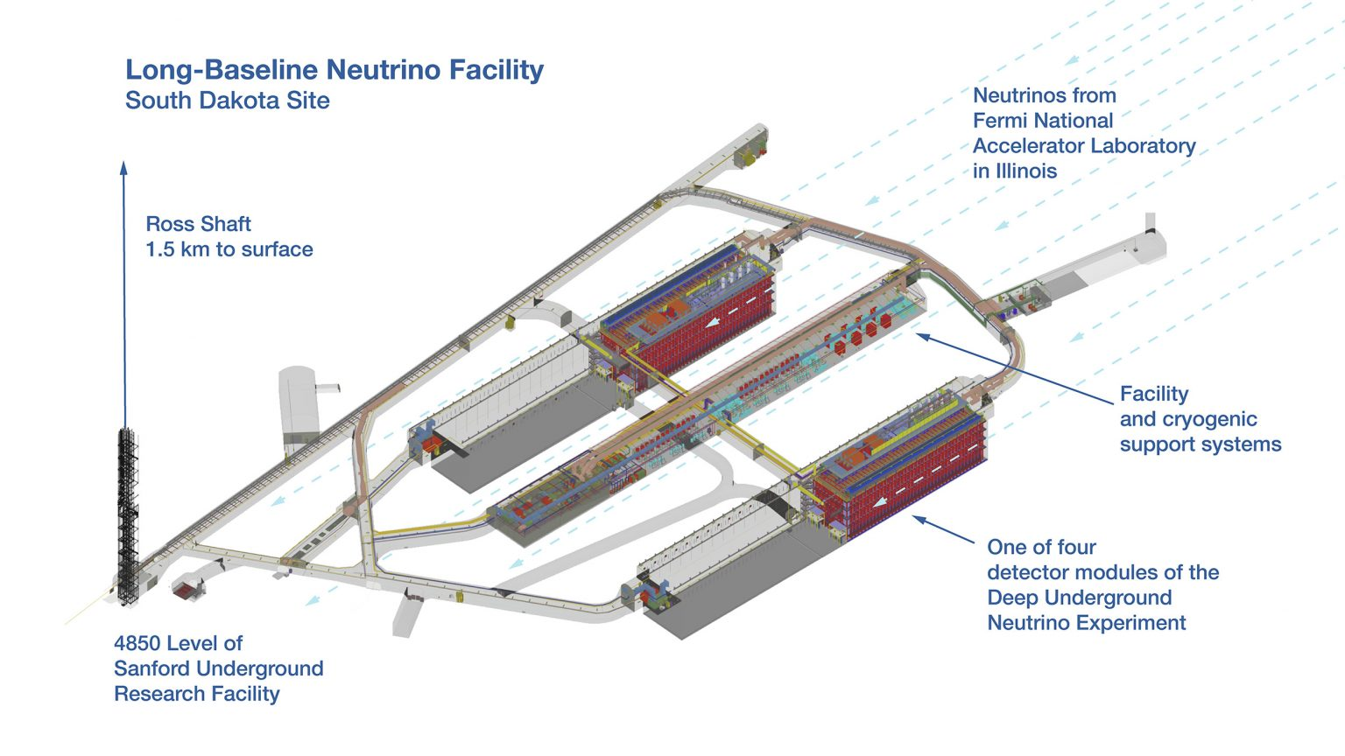
Looking Ahead
Opportunities:
- DUNE project includes
two Far Detectors
- Two additional cavities
(>10k m³ each) will be excavated
- Laying the groundwork to make
use of this valuable underground
detector space.
General Theme:
- Currently pursuing
detector R&D for
novel, scalable,
neutrino detectors.

Slide 7
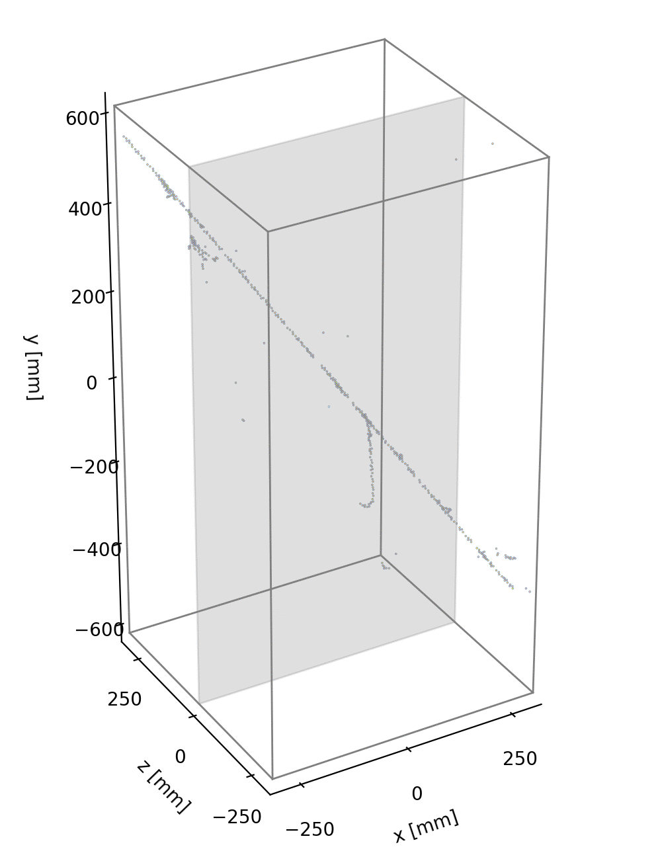
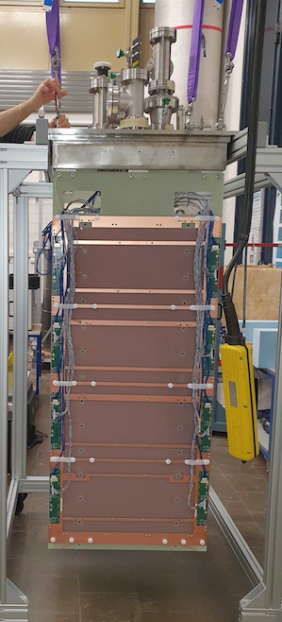
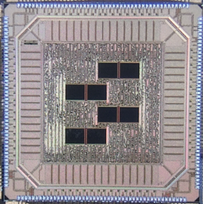
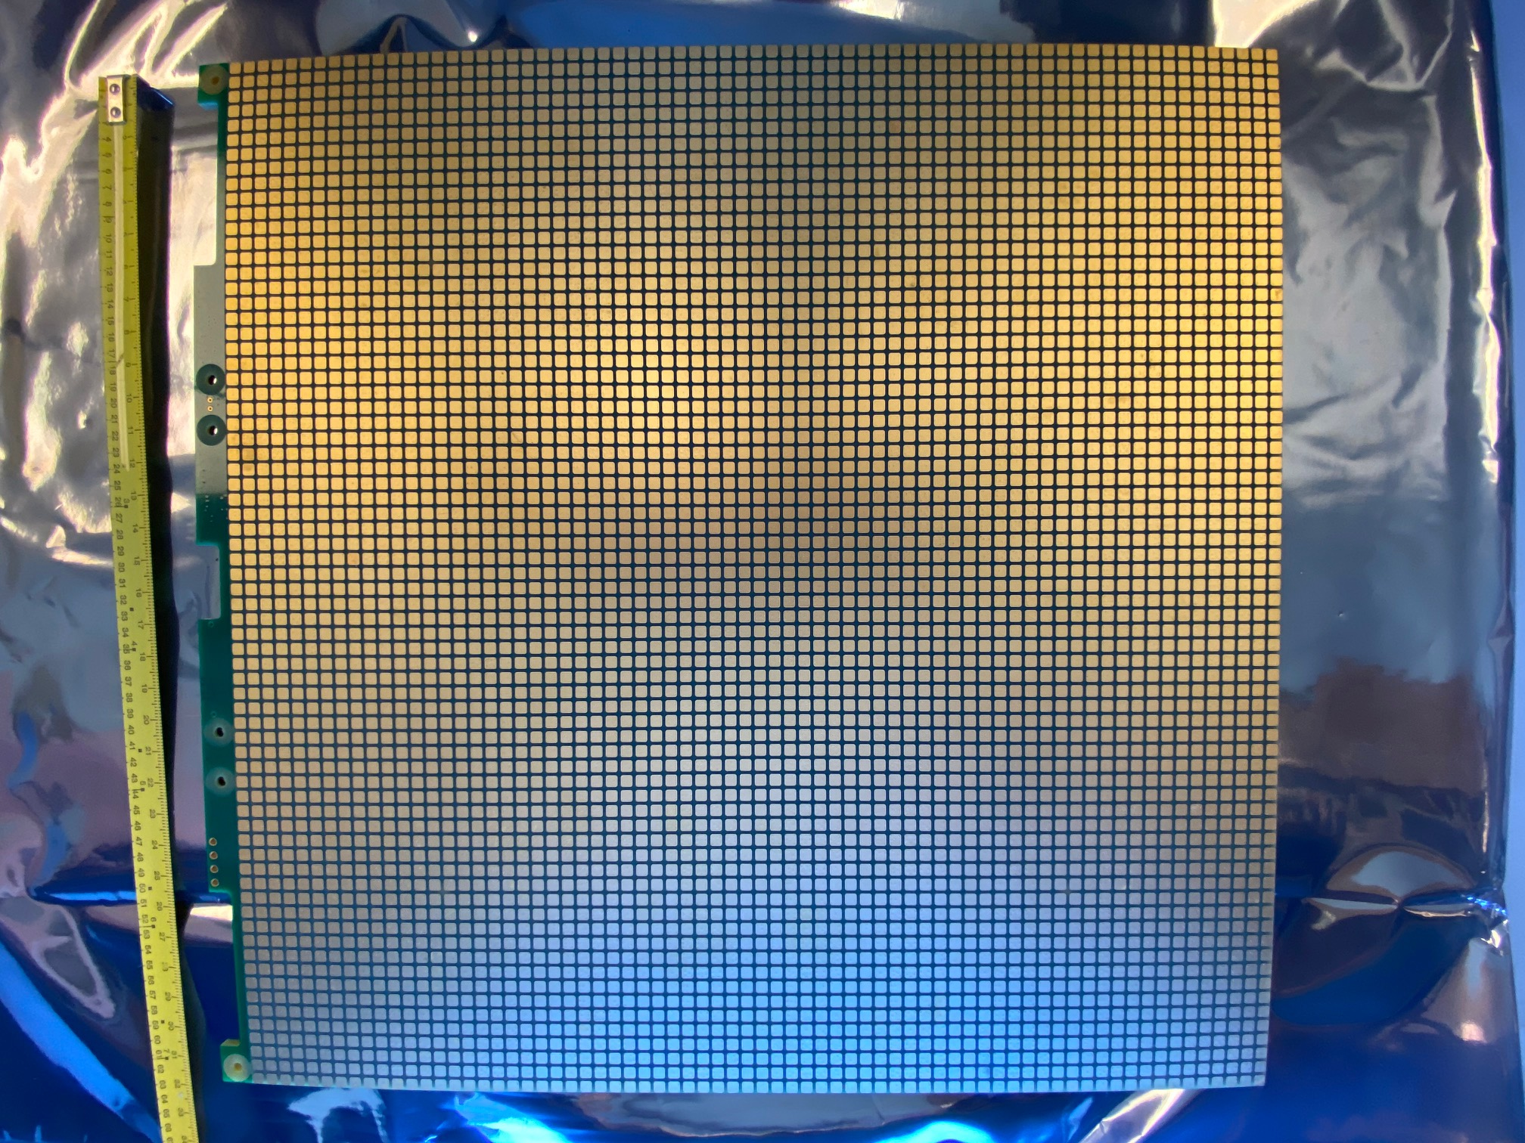
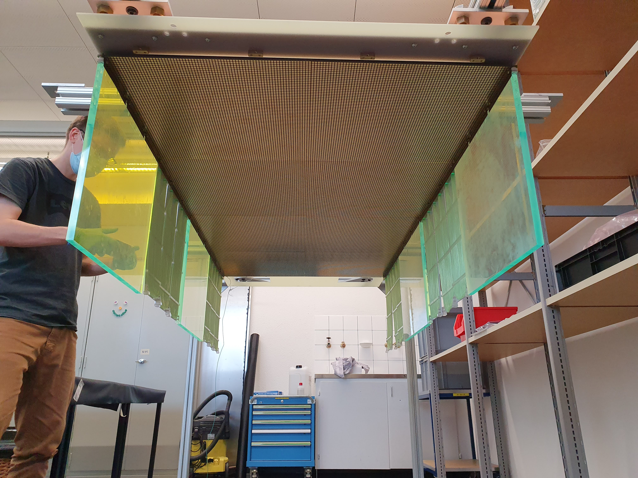
Scalable Pixelated TPCs
Raw 3D cosmic ray images from
Prototype ArgonCube LArTPC module
Prototype LArTPC
LArPix-v2 ASIC
LArPix:
- Scalable pixelated charge readout system for LArTPCs
- Low-noise, ultra-low power, cryogenic compatible
- Leverages commercial partners for scalable production
- Complete detector system: anode tile, pixel chips,
cabling, warm readout, DAQ software
- Conceived, designed, executed at LBNL
Progress:
- Demonstrated commercial production,
scalability to O(100k) channels:
- Provided 4-mm-scale granularity
in a ton-scale LArTPC
- Selected as default technology for
the DUNE Near Detector LArTPC
Future Plans:
- Establish & demonstrate scalability upwards of 10 ktons
- Target deployment in a future DUNE Far Detector cavity
LArPix-v2 Pixel Tile
Prototype pixel anode

Slide 8
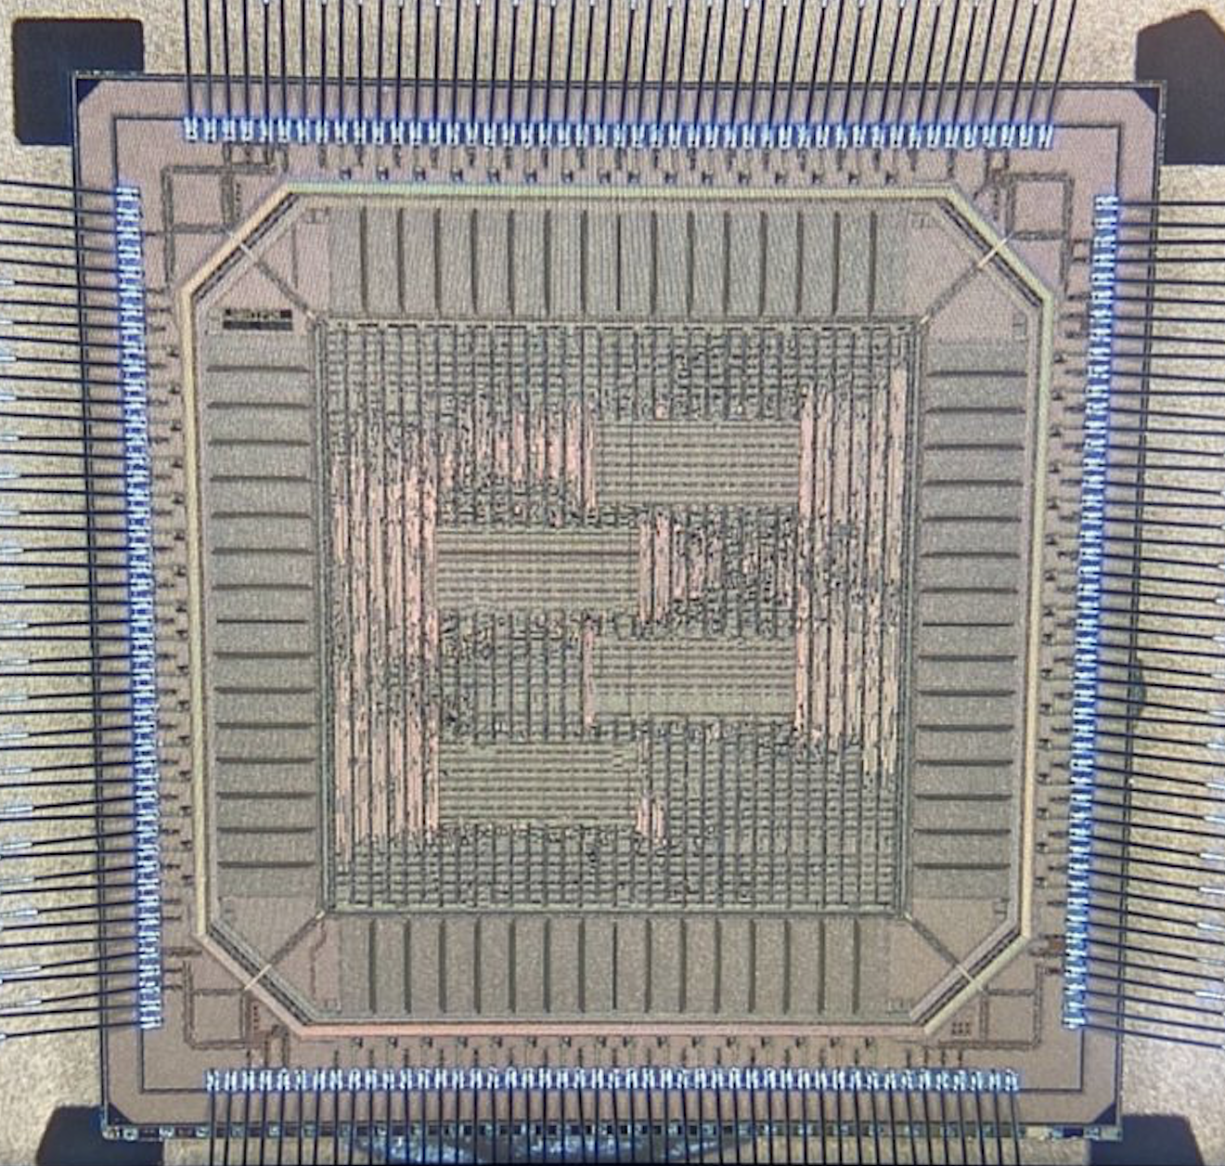
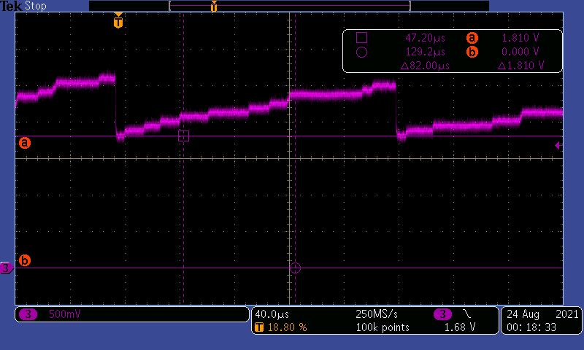
Scalable Photon Detection: LightPix
LightPix Concept:
Replace charge-collecting pixels with SiPMs
to provide highly-granular, scalable photodetector
LightPix:
- Adapt LArPix system to provide scalable readout for many (e.g. >10⁶) Silicon Photomultipliers
- Provide a path for highly-granular photodetection systems for very large detectors
Progress:
- Designed and produced a prototype ASIC, supported by LBNL LDRD
- Demonstrated single photoelectron detection with SiPM test parts
Future Plans:
- Demonstrate LightPix technology, and
pursue application within the DUNE program
- Explore applications for future very large
optical neutrino detectors
Prototype LightPix ASIC
Single photoelectrons observed in bench tests

Slide 9
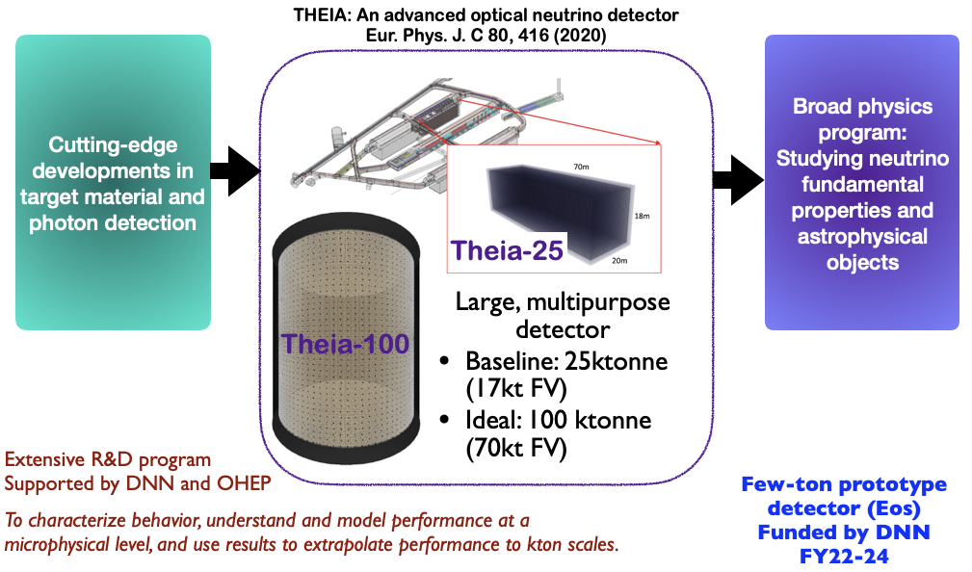
THEIA Concept
G. Orebi-Gann

Slide 10
Physics at THEIA
G. Orebi-Gann

Slide 11
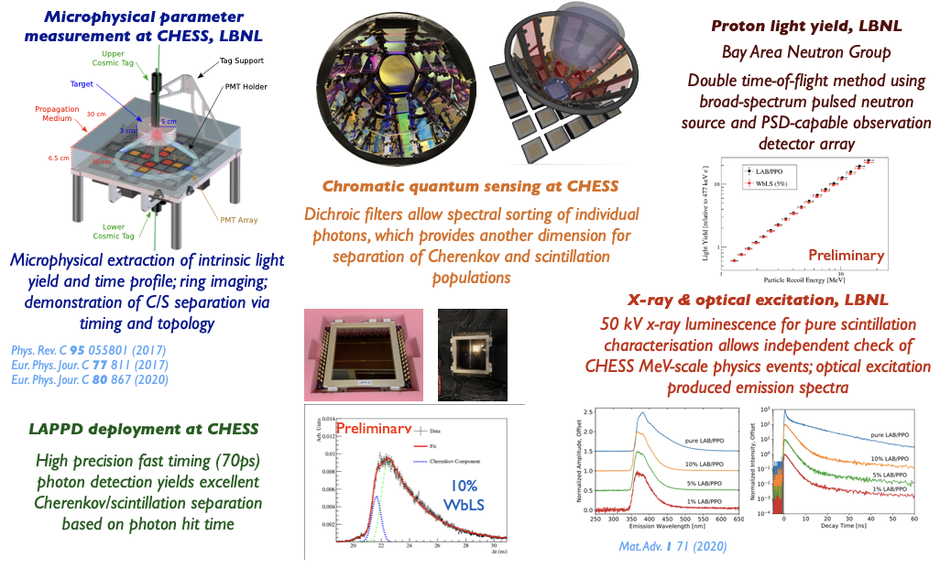
THEIA R&D program at LBNL
G. Orebi-Gann

Slide 12
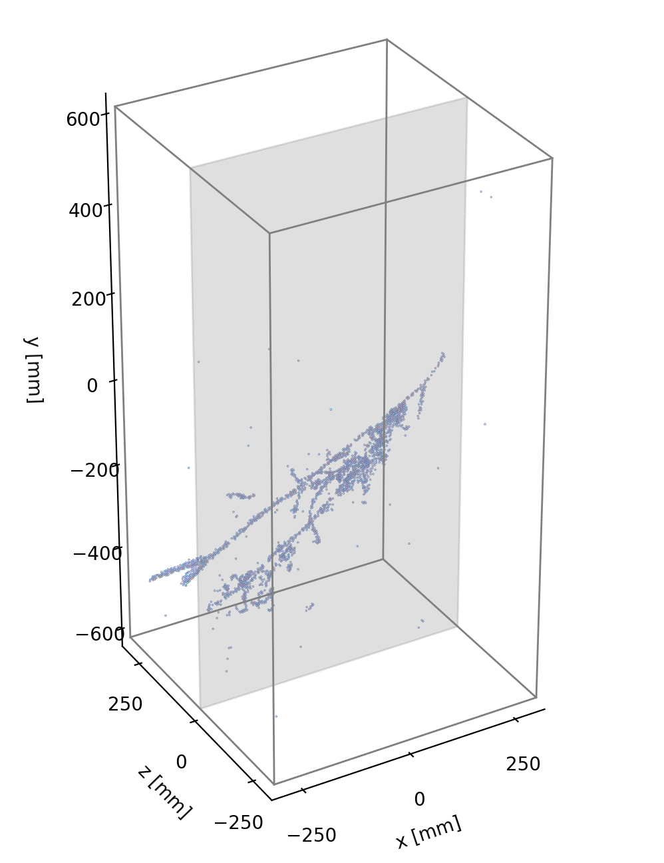
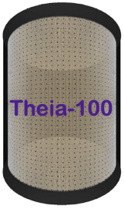
Neutrino Oscillation at LBNL: Summary
Strong track record in Neutrino Oscillation physics
- SNO, KamLAND, IceCUBE, Daya Bay
Near-term picture
- DUNE will be the centerpiece of the DOE-HEP Neutrino
program through at least 2030
- LBNL has significant roles in DUNE electronics
and Near Detector engineering
Looking ahead
- LBNL teams focusing on detector R&D to enable the
next generation of very large neutrino detectors
- Scalable, highly-granular charge and light detector
systems at the >10k m³-scale
- Leveraging novel materials and technologies to expand
the underground neutrino physics program

