Slide 1
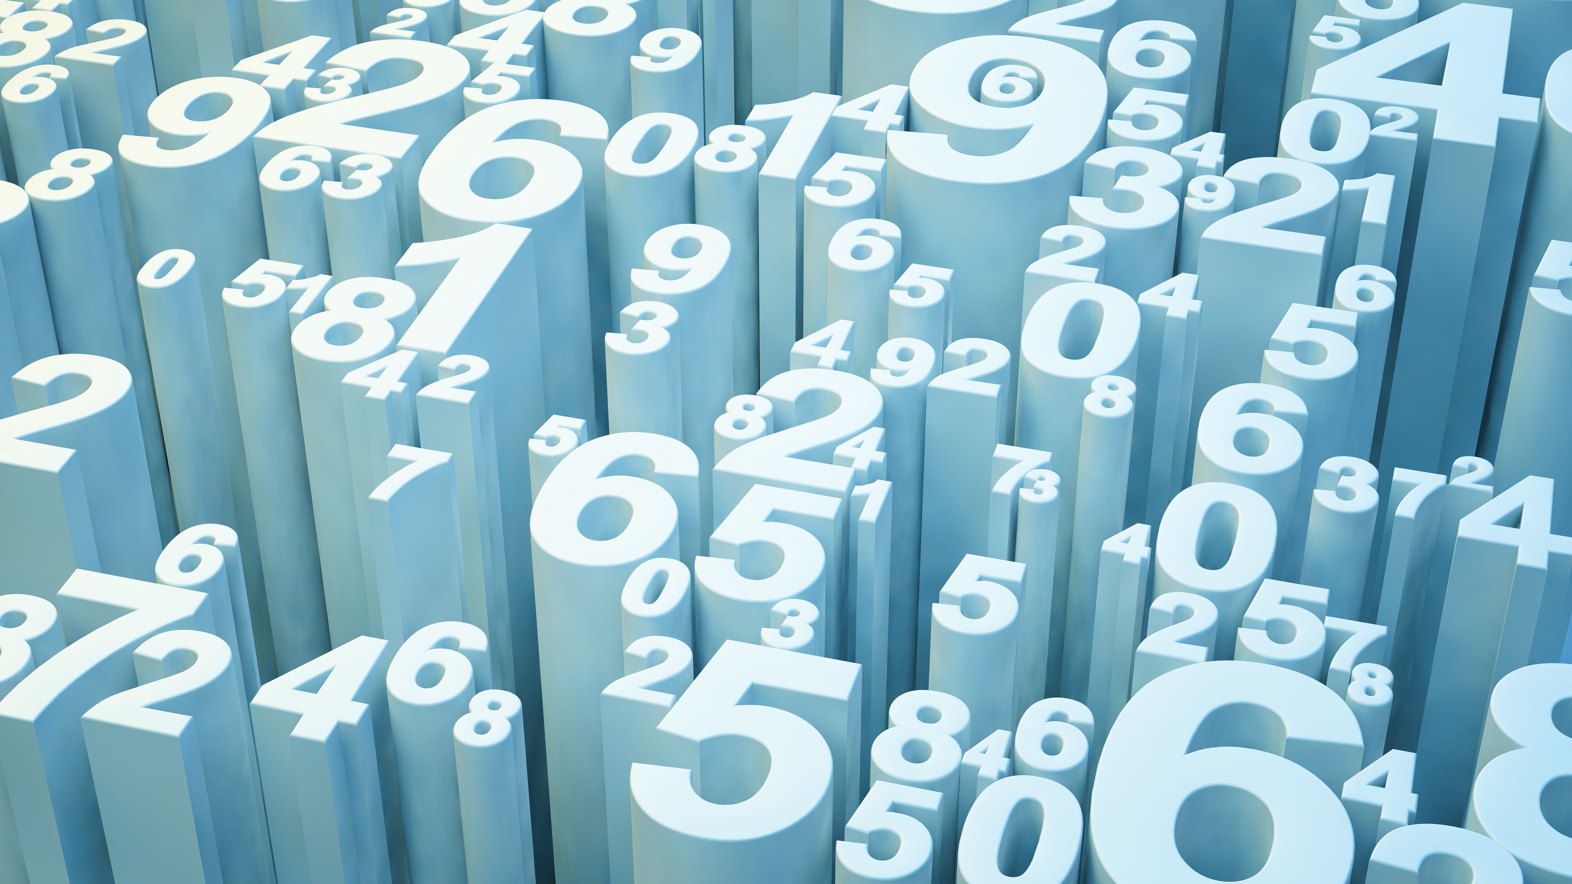
Life & Times of the Fine Structure Constant
Molly Wakeling

Slide 2
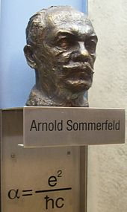
What is $α$?
Characterizes the strength of the EM interaction between elementary charged particles
~1/137 – not related to any mathematical constants!
Slightly larger for higher-energy interactions
“Fine structure” – constant arises in the fine structure corrections to the hydrogen Hamiltonian (relativistic & spin-orbit coupling)
Splitting of spectral lines
(A few) physical appearances:
Ratio of the electron velocity in the lowest state of the Bohr-model atom to the speed of light $α=\frac{e^{2}}{4πε_{0}ℏc}$
Ratio involving three characteristic length scales: classical electron radius, electron Compton wavelength, and Bohr radius $r_{e}=\frac{αλ_{e}}{2π}=α^{2}a_{0}$
Product of the impedance of free space and the conductance quantum: $α=\frac{1}{4}Z_{0}G_{0}={\frac{1}{4}μ}_{0}c∗\frac{2e^{2}}{h}$

Slide 3
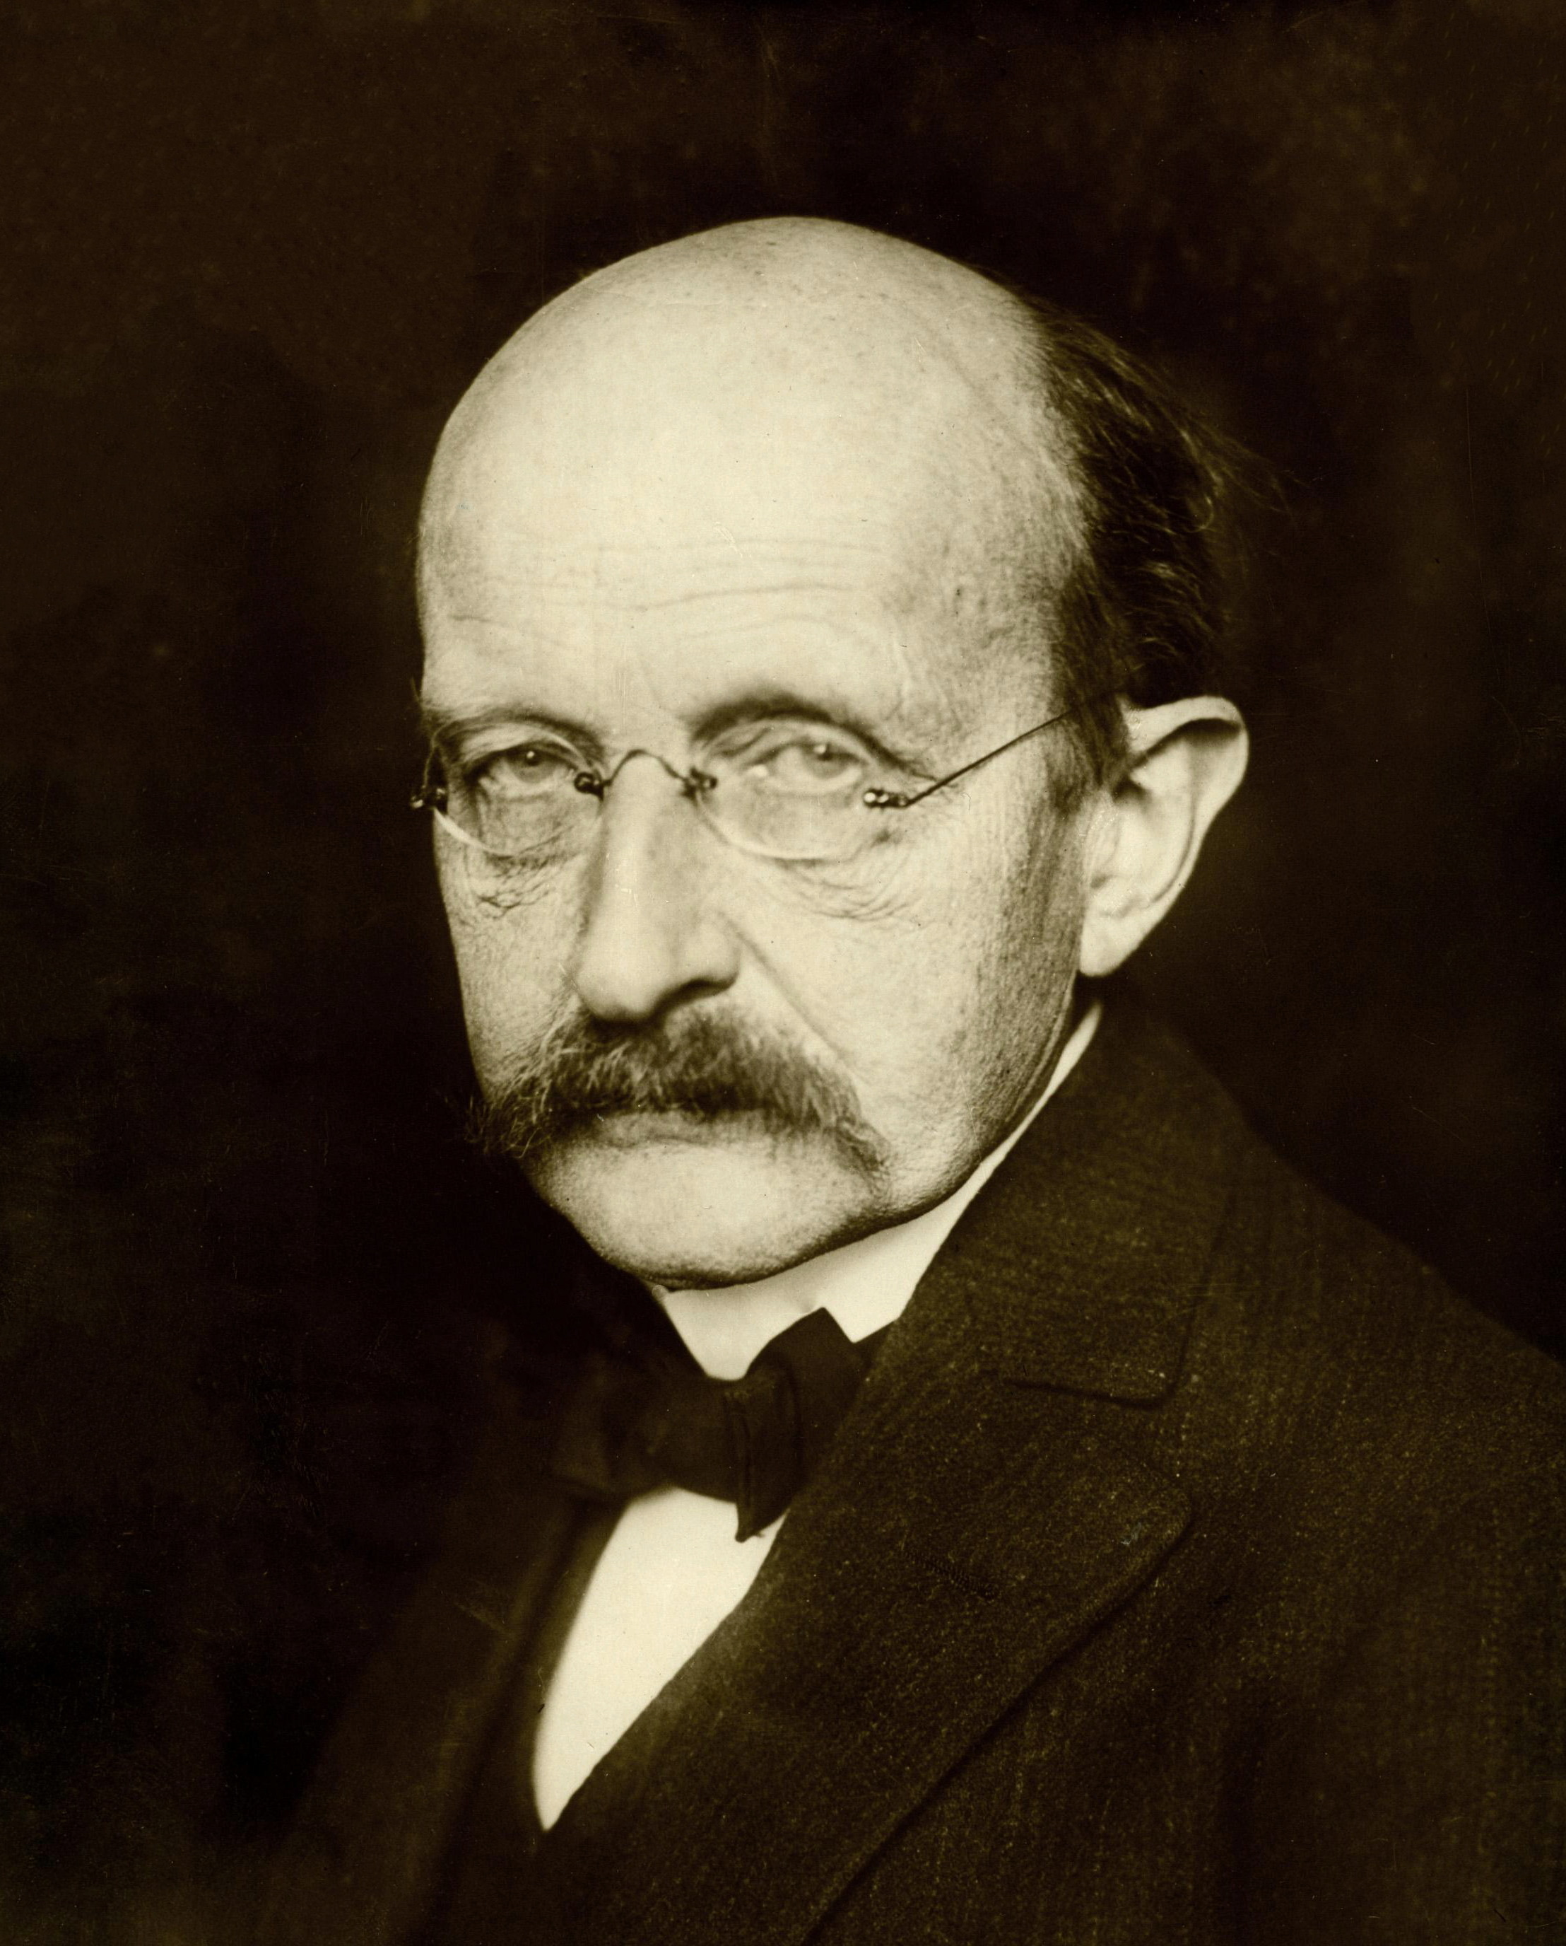
Discovery of $α$
Max Planck noticed that $\frac{e^{2}}{c}$ has the same units as the quantum of action, $h$ (in CGS units) – wondered if the two were identical, and if their relationship could explain the value of the elementary charge
Einstein noted that $\frac{e^{2}}{c}=h$is a good order-of-magnitude estimate, but that “three decimals are missing”
Sommerfeld was the first to call out the constant in 1916
James Jeans speculated that the missing constant might be $1/32π^{3}$; others made similar numerological guesses as well
Max Planck
Notes:
a is radius of the hydrogen atom – at the time, the accepted value was roughly 3x the Bohr radius. If he’d used the Bohr radius instead, C/2pi would have come out to be 164
1/32 pi^3 = 1/992.2

Slide 4
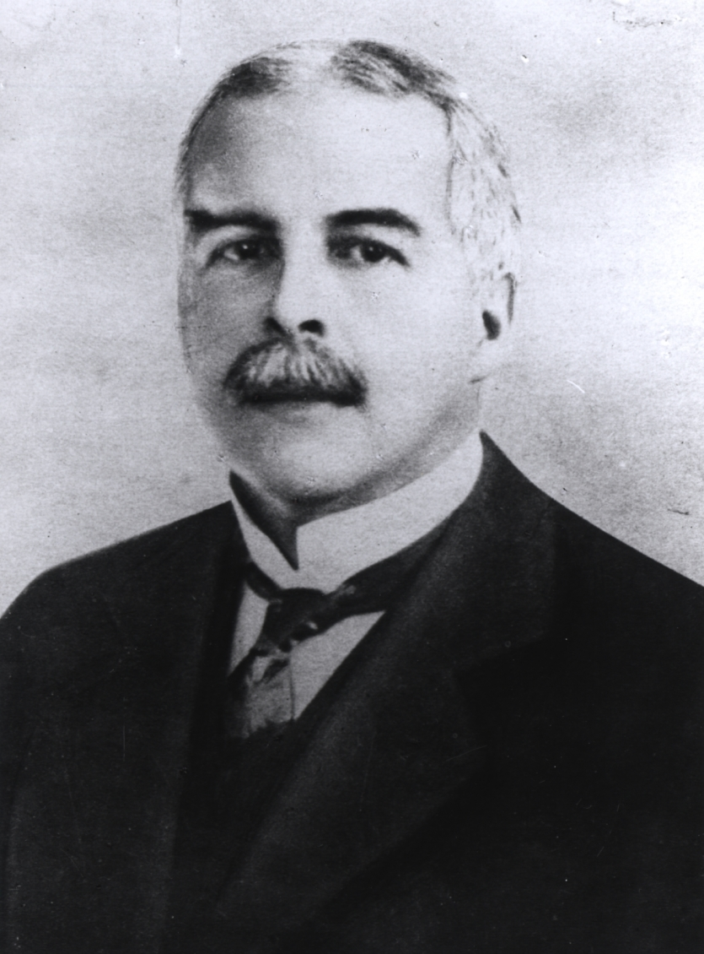
Discovery of $α$
Gilbert Lewis and Elliot Adams, American chemists, 1913:
Developed theory of “ultimate rational units,” positing that all universal constants were pure numbers involving integers and $π$
By way of Stefan’s law and the fundamental charge, they found a value of Planck’s constant: $h=\left(\frac{{\left(4πe\right)}^{2}}{c}\right){\left(\frac{8π^{5}}{15}\right)}^{\frac{1}{3}}$
Rearranged for $\frac{hc}{2πe^{2}}=8π{\left(\frac{8π^{5}}{15}\right)}^{1/3}$ yields a numerical value of 137.348 – within 0.2% of the modern accepted value of $α^{−1}$!
They doubted their value of $h$, however – thought it was too complicated for so fundamental a constant. They also did not accept quantum theory yet.
Gilbert Lewis
Apparently not cool enough to have had his picture taken
Elliot Adams

Slide 5
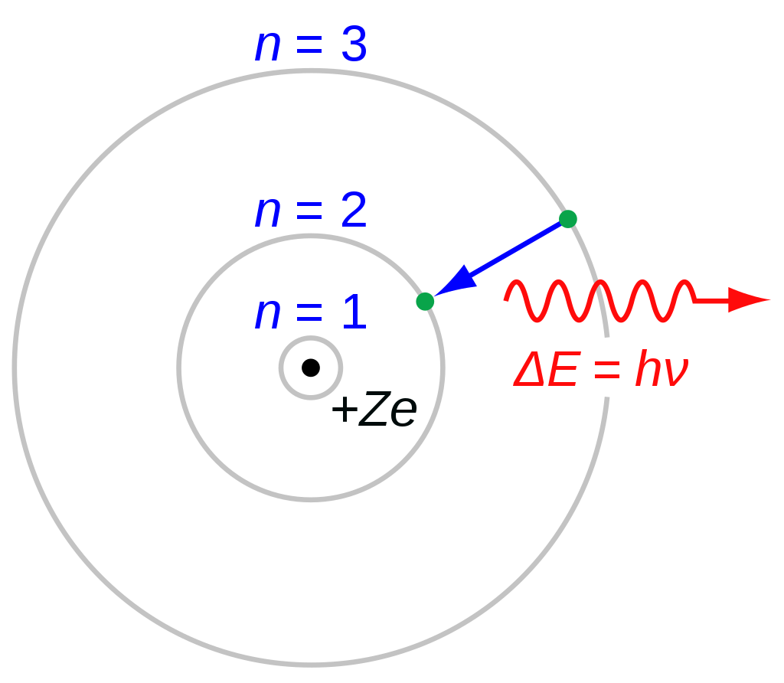
Discovery of $α$
Niels Bohr, 1915:
Ignored special relativity effects and fine structure in a 1913 paper, but realized that his value for hydrogen energy levels could agree better with experiment if he took into account the variation of the electron’s mass with its velocity, as well as using elliptical orbits
Yielded a constant 1/8 of the modern $α$
Arnold Sommerfeld followed Bohr’s efforts closely and by the end of 1915 had improved the fine structure theory with better relativistic effects
Came forth with $\frac{W\left(n,k\right)}{m_{0}c^{2}}={\left\{1+\frac{α^{2}Z^{2}}{{\left[\left(n−k\right)+\sqrt{k^{2}−α^{2}Z^{2}}\right]}^{2}}\right\}}^{−\frac{1}{2}}−1$
$W$ = electron binding energy
$n,k$ = principle & azimuthal quantum numbers
$α$ explicitly called fine structure constant, and defined as $α=\frac{2πe^{2}}{ch}$
Not initially introduced as a spectroscopic quantity, but the ratio between two angular momenta; $\frac{p_{0}}{p_{1}}=\frac{2πe^{2}}{ch}$
$p_{1}$ is angular momentum of $k=1$ electron; $p_{1}=\frac{h}{2π}$
$p_{0}$ is the “limiting momentum,” $p_{0}=\frac{e^{2}}{h}$

Slide 6
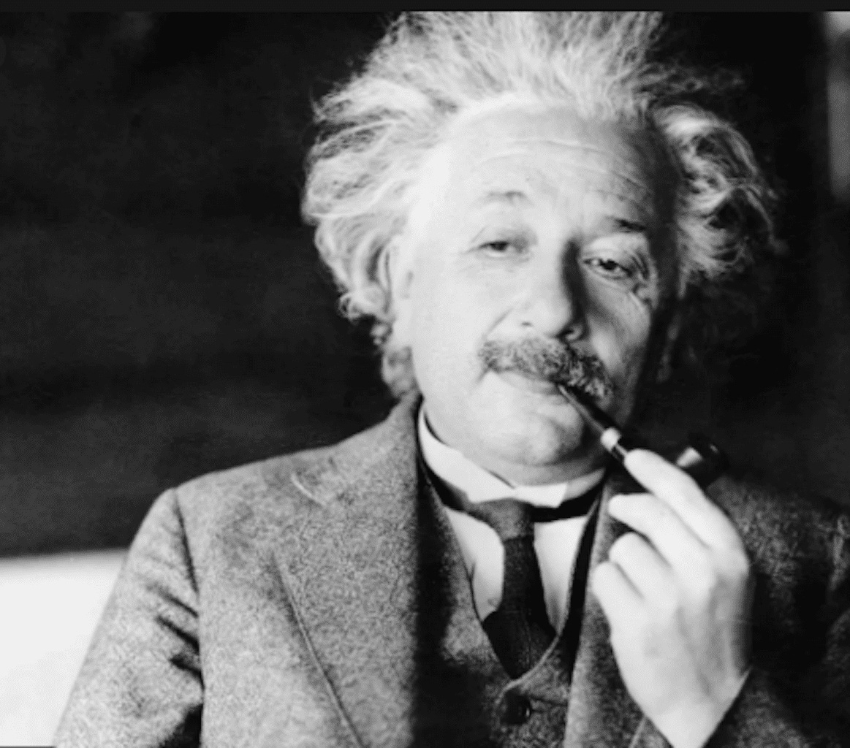
Discovery of $α$
Einstein to Sommerfeld: “Your investigation of the spectra belongs among my most beautiful experiences in physics. Only through it do Bohr’s ideas become completely convincing.”
Sommerfeld then noticed that the fine structure constant fit nicely into the measured H$α$ doublet, and Friedrich Paschen in 1916 measured the numerical value of $α^{−1}$ to be 137.9
Arthur Eddington believed it to be an exact integer, $α^{−1}=137$, and tried to prove it from theoretical deduction
Wound up with 136 as the number of generalized degrees of freedom of a pair of electrons, and added a +1 to make it match experiment, citing indistinguishability
A lot of people didn’t like his theory – including Dirac, Born, Bohr, Hendrik Kramers, Klein, von Neumann, Wigner, and de Broglie
Fought fiercely for his value and believed experimentalists were simply doing things wrong

Slide 7
An Enigma
To Sommerfeld, $α$ had more significance than just a spectroscopic quantity; symbolized a mysterious relationship between electromagnetism ($e$), relativity ($c$), and quantum theory ($h$)
While the value of $α$ was determined with increasing precision, theorists struggled to explain its nature; several looked to connections between cosmological and atomic values
“What we are nowadays hearing in the language of spectra is a true music of the spheres within the atom, chords of integral relationships, an order and harmony that becomes ever more perfect in spite of the manifold variety…All integral laws of spectral lines and of atomic theory spring originally rom the quantum theory. If is the mysterious organon on which Nature plays her music of the spectra, and according to the rhythm of which she regulates the structure of the atoms and nuclei.”
Sommerfeld, Atombau und Spektrallinien
Notes:
- In 1931, in response to Eddington and some others who were getting into numerology, Hans Bethe, Guido Beck and Wolfgang Riezler submitted a spoof paper to Die Naturwissenschaften that pretended to derive absolute zero from Eddington’s theory as T=-(2/a – 1), yielding -273C, in “perfect agreement” with experiment

Slide 8
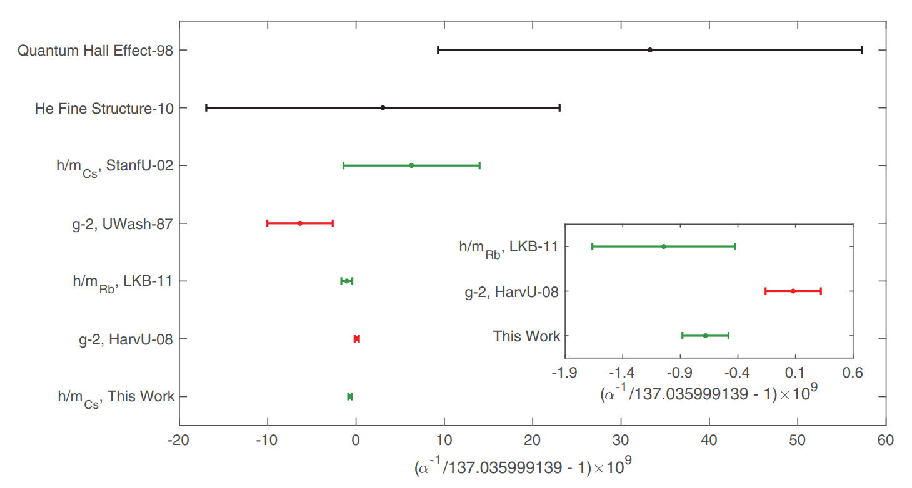
Modern Measurement of $α$
Precise measurement of electron g-factor ($g_{e}−2$)
Quantum Hall effect
Helium fine structure

Slide 9
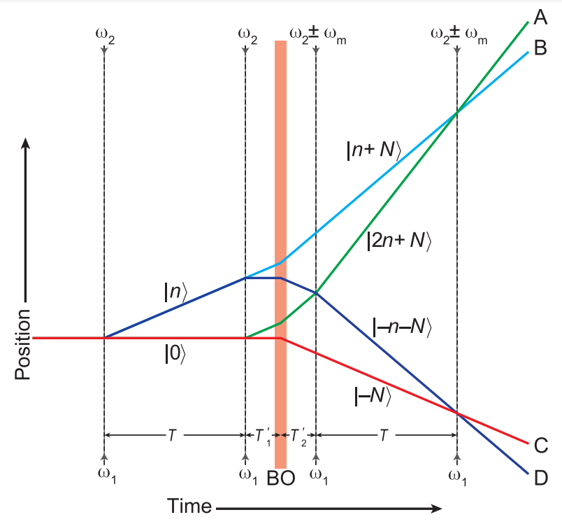
Modern Measurement of $α$
2018 Berkeley measurement: matter-wave interferometer
Laser pulses direct & recombine cesium atom matter-waves; measure the phase difference
Phase difference is proportional to the photon recoil energy, which is used to measure $\frac{ℏ}{m_{\text{Cs}}}$, and then $α$ via $α^{2}=\frac{2R_{∞}}{c}\frac{m_{\text{Cs}}}{m_{e}}\frac{ℏ}{m_{\text{Cs}}}$
$α^{−1}=137.035999046(27)$, 0.20 ppb uncertainty
Interferometer concept

Slide 10
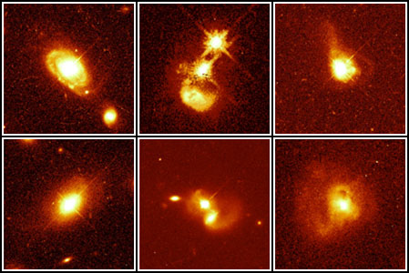
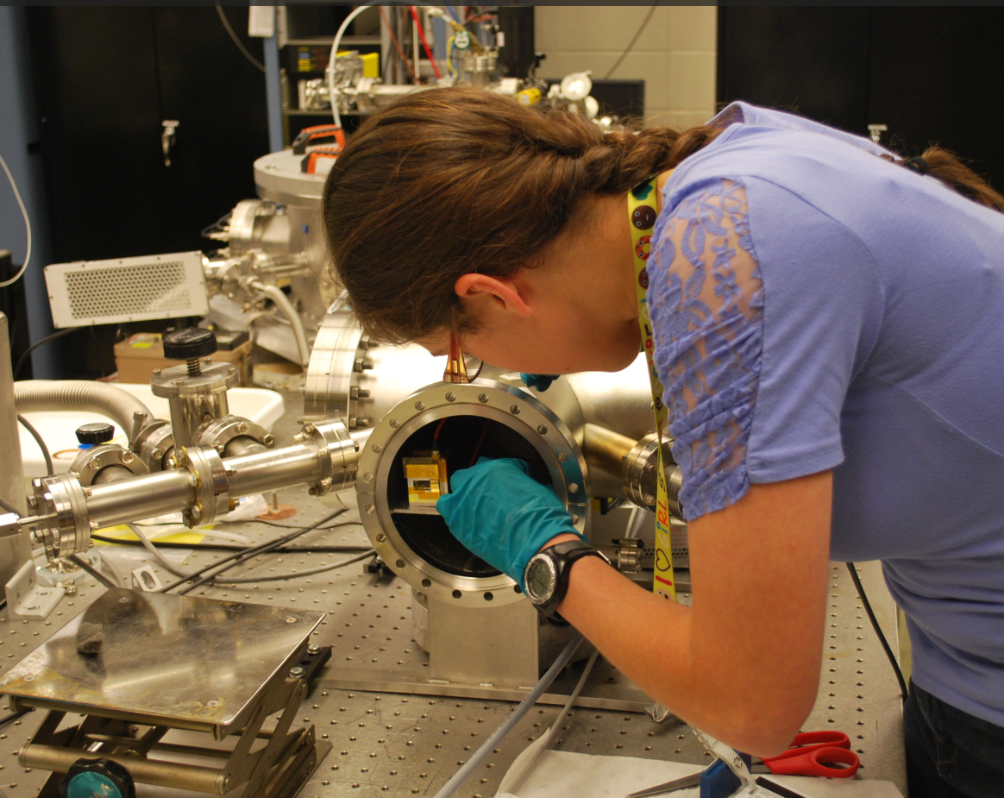
Constant in time?
Quasar spectra
Absorption lines for moderate redshifts (0.5<z<3) show a slight increase of $\frac{Δα}{α}=\left(−5.7±1.0\right)×{10}^{−6}$ over the last 10-12 billion years
Oklo natural fission reactor
Uranium deposit in Africa with self-sustaining fission reaction
$−{45}_{−7}^{+15}×{10}^{−9}$ change in $α$ in last 2 billion years
21 cm line
Would leave imprint on the CMB
To get better measurement than quasars though, need radio array >100 km²
Nuclear vs atomic clock
Could use Th-229m to build nuclear clock & compare to atomic clock, measure variation
Implications
Fundamental charge
Speed of light
Quasars – Hubble Space Telescope
Me, trying to measure Th-229m half-life
Notes:
Error bars on quasar measurement don’t include 0
Oklo mechanism: Sm-149 has a low-energy neutron absorption resonance; excited compound state can decay via gamma emission; resonance energy will change if alpha varies; overlap of resonance with reactor neutron spectrum will alter the ratios of neighboring isotopes

Slide 11
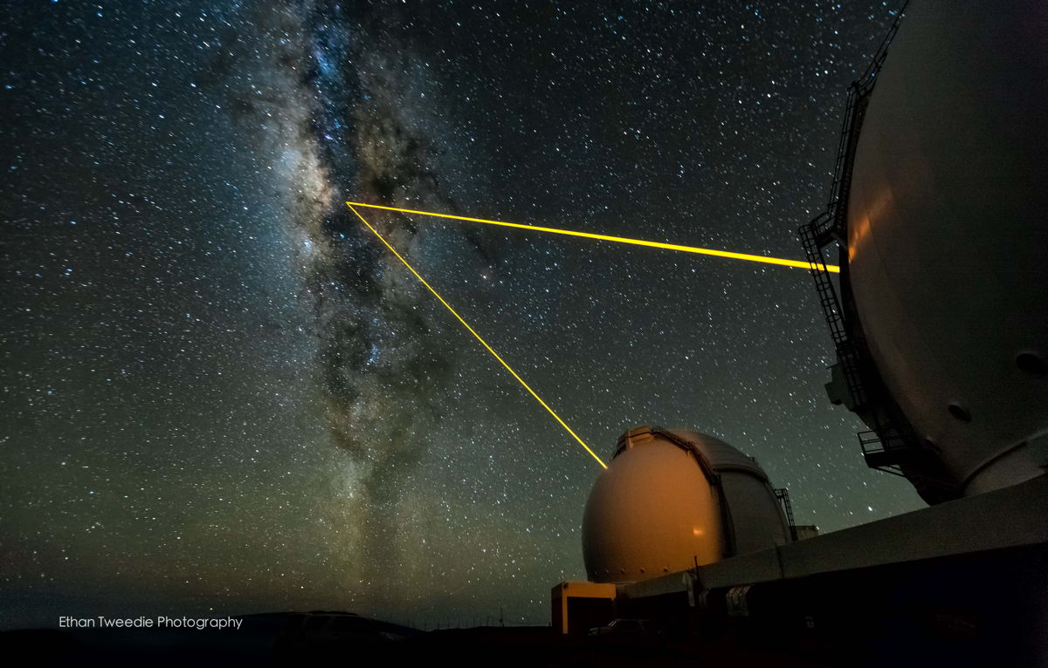
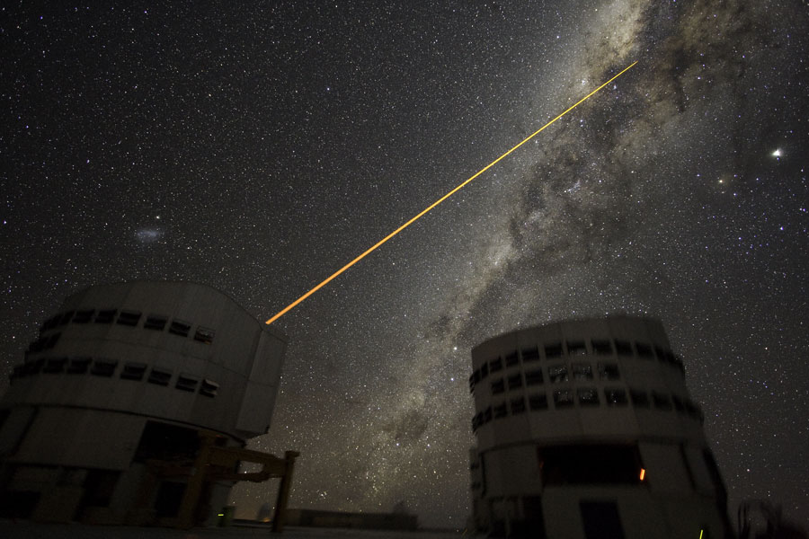
Constant in space?
Quasar data from the Keck telescope and Very Large Telescope
$α$ appears larger by one part in 100,000 southward 10 billion years ago, and smaller by a similar amount northward
2020 verification of those results favored variation over no-variation models by 3.9$σ$
Keck Telescope
Very Large Telescope

Slide 12
Some Fun Numerology…
137
137
137
137 appears frequently in the Torah – lifespan of Ishmael and Levi, age of Abraham when he was prepared to sacrifice Isaac
Using two radii to divide a circle according to the Golden Ratio yields sectors of 137° and 222°
1/137 = 0.00729927007299270072992700... Palindromic, period length of 8
Bohr model: Z=137, electron velocity is just below the speed of light; Z=138 “impossible”
Wolfgang Pauli died in hospital room #137
At the range of 1 fm, the strong force is 137 times as strong as EM force
137
137
137
137
137

Slide 13
Citations
R. Khatri; B. D. Wandelt (2007). "21-cm Radiation: A New Probe of Variation in the Fine-Structure Constant". Physical Review Letters. 98 (11): 111301.
H. Kragh, ”Magic Number: A Partial History of the Fine-Structure Constant,” Arch. Hist. Exact Sci. 57 (2003) 395–431
S. K. Lamoreaux; J.R. Torgerson (2004). "Neutron Moderation in the Oklo Natural Reactor and the Time Variation of Alpha". Physical Review D. 69 (12): 121701.
Parker et al., ”Measurement of the fine-structure constant as a test of the Standard Model” Science 360, 191–195 (2018)
Webb, J. K.; et al. (1999). "Search for Time Variation of the Fine Structure Constant". Physical Review Letters (Submitted manuscript). 82 (5): 884–887
Michael R. Wilczynska, John K. Webb; et al. (2020). "Four direct measurements of the fine-structure constant 13 billion years ago". Science Advances. 6 (17): 9672

Slide 14
Questions?

