Slide 1
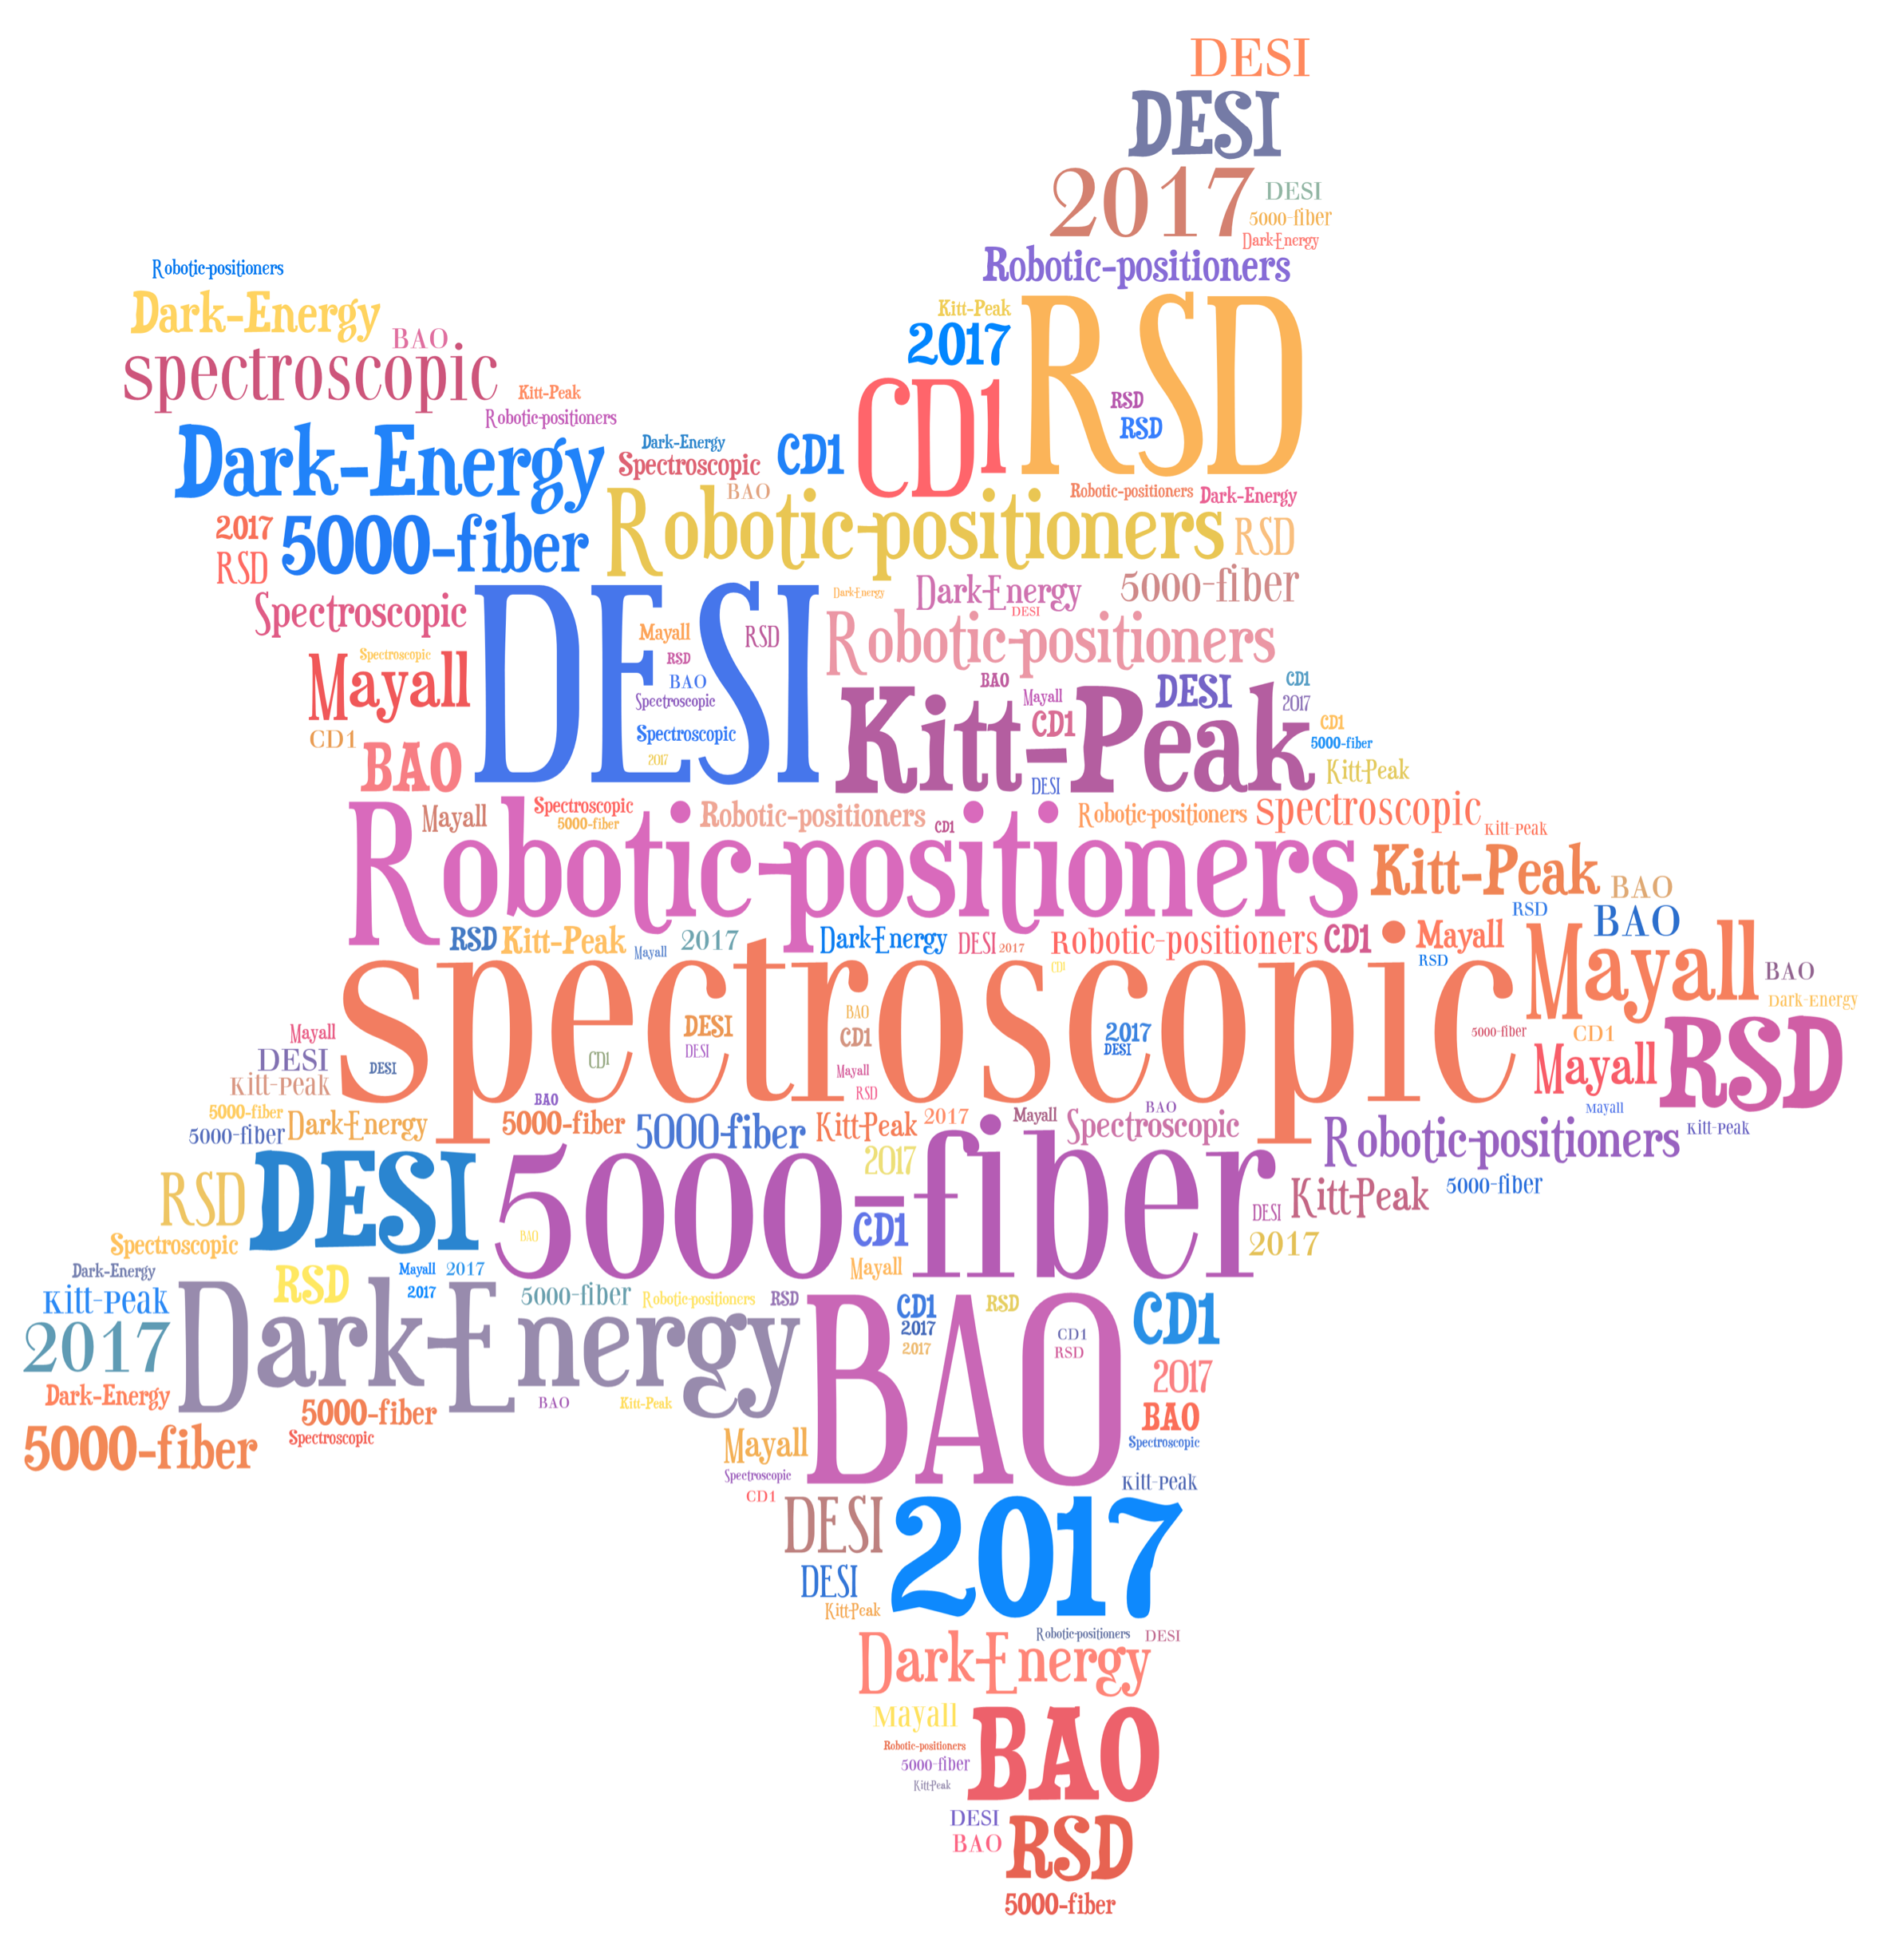
Claire Poppett, LBNL
Lead Fiber scientist, DESI
Notes:
baryon acoustic oscillations (BAO) refers to regular, periodic fluctuations in the density of the visible baryonic matter of the universe. In the same way that supernova experiments provide a "standard candle" for astronomical observations,^{[1]} BAO matter clustering provides a "standard ruler" for length scale in cosmology

Slide 2
Outline
DESI science
Instrument walkthrough
Robotic Fiber Positioners
  The need for robotic fiber positioners
  Fiber positioning technology
  Status of testing

Slide 3
Outline
DESI science
Instrument walkthrough
Robotic Fiber Positioners
  The need for robotic fiber positioners
  Fiber positioning technology
  Status of testing

Slide 4
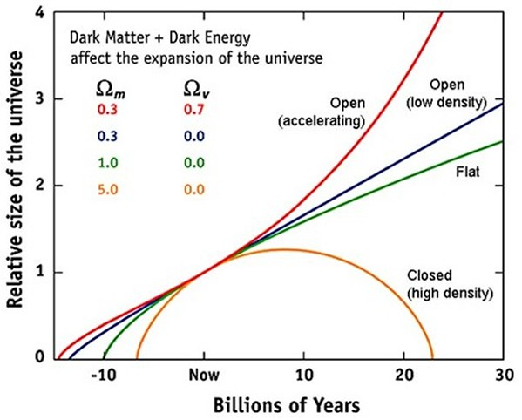
What is the expansion history of the universe?
Notes:
The main question we’re trying to answer, is what kind of universe are we in? And this al depends on the amount of dark energy and dark matter in the universe. More matter than energy = closed, more energy than metter=open, same energy as matter=flat

Slide 5
DESI Will Discriminate Between
Dark Energy Models
CDR Fig. 2.1
Notes:
DE equation of state parameter
omega describes the equation of state of dark energy and is a cosmological constant. If omega<-1/3, then the expansion is accelerating

Slide 6
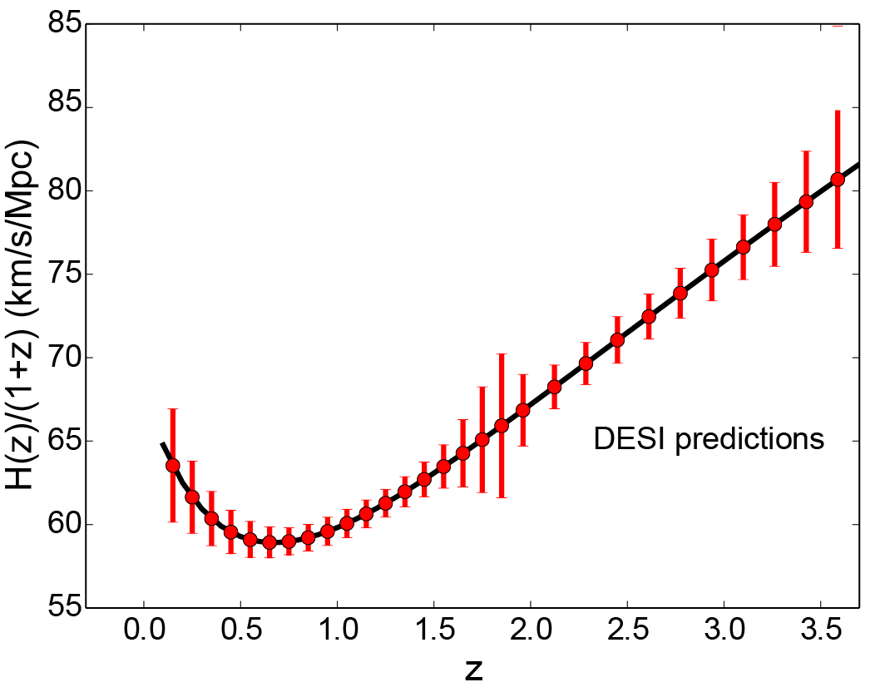
DESI on the Hubble Diagram
Measure wavelengths of target galaxies spectral features as they are redshifted
Δz = 0.0005•(1+z) → Δλ ~ 0.5 Å
Expansion Rate
Notes:
Complicated system, 3 channels, 3 types of object

Slide 7
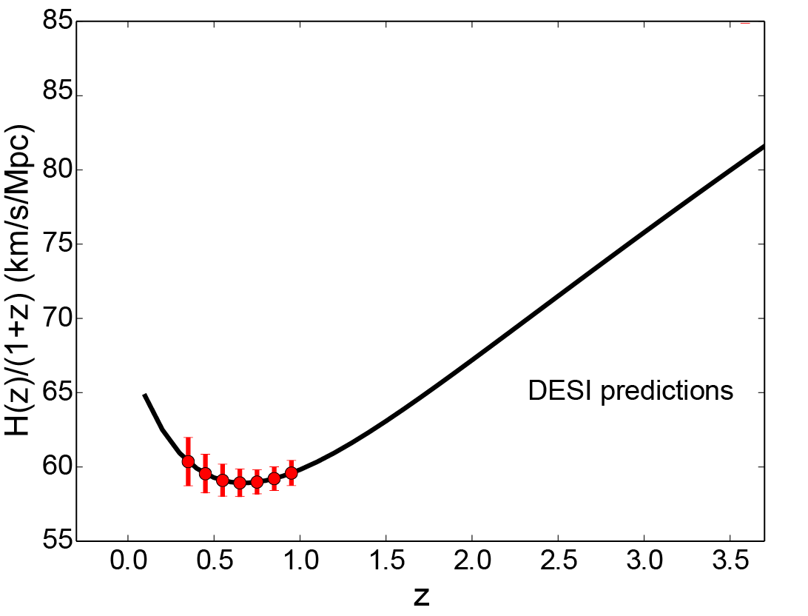
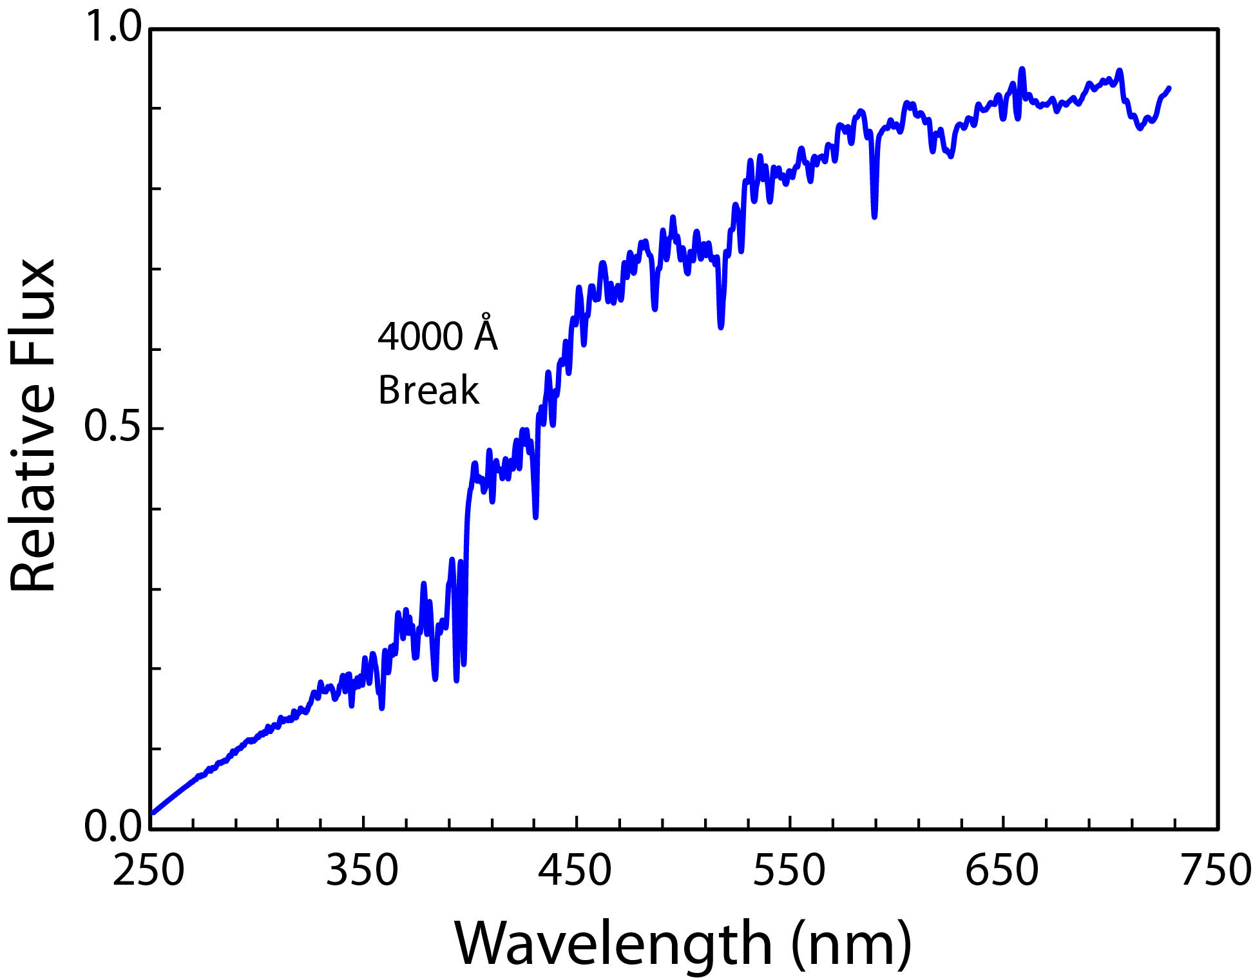
LRG Targets
Luminous Red Galaxies
~4 x 10⁶ goal
0.4 < z < 1.0
Expansion Rate
Notes:
4 million objects – 5000 fibers, 5 years

Slide 8
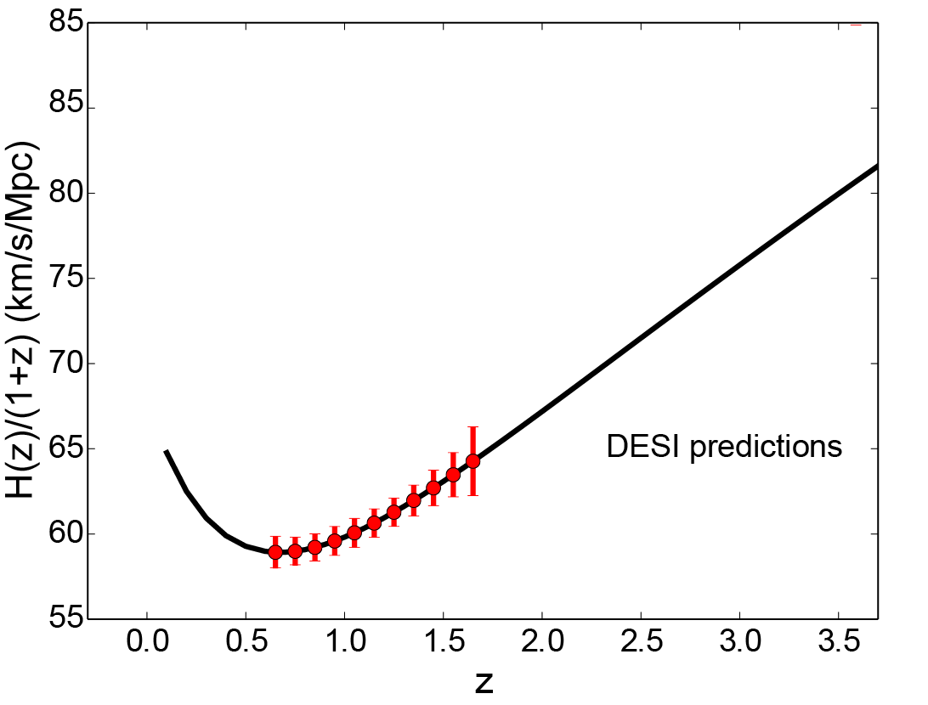
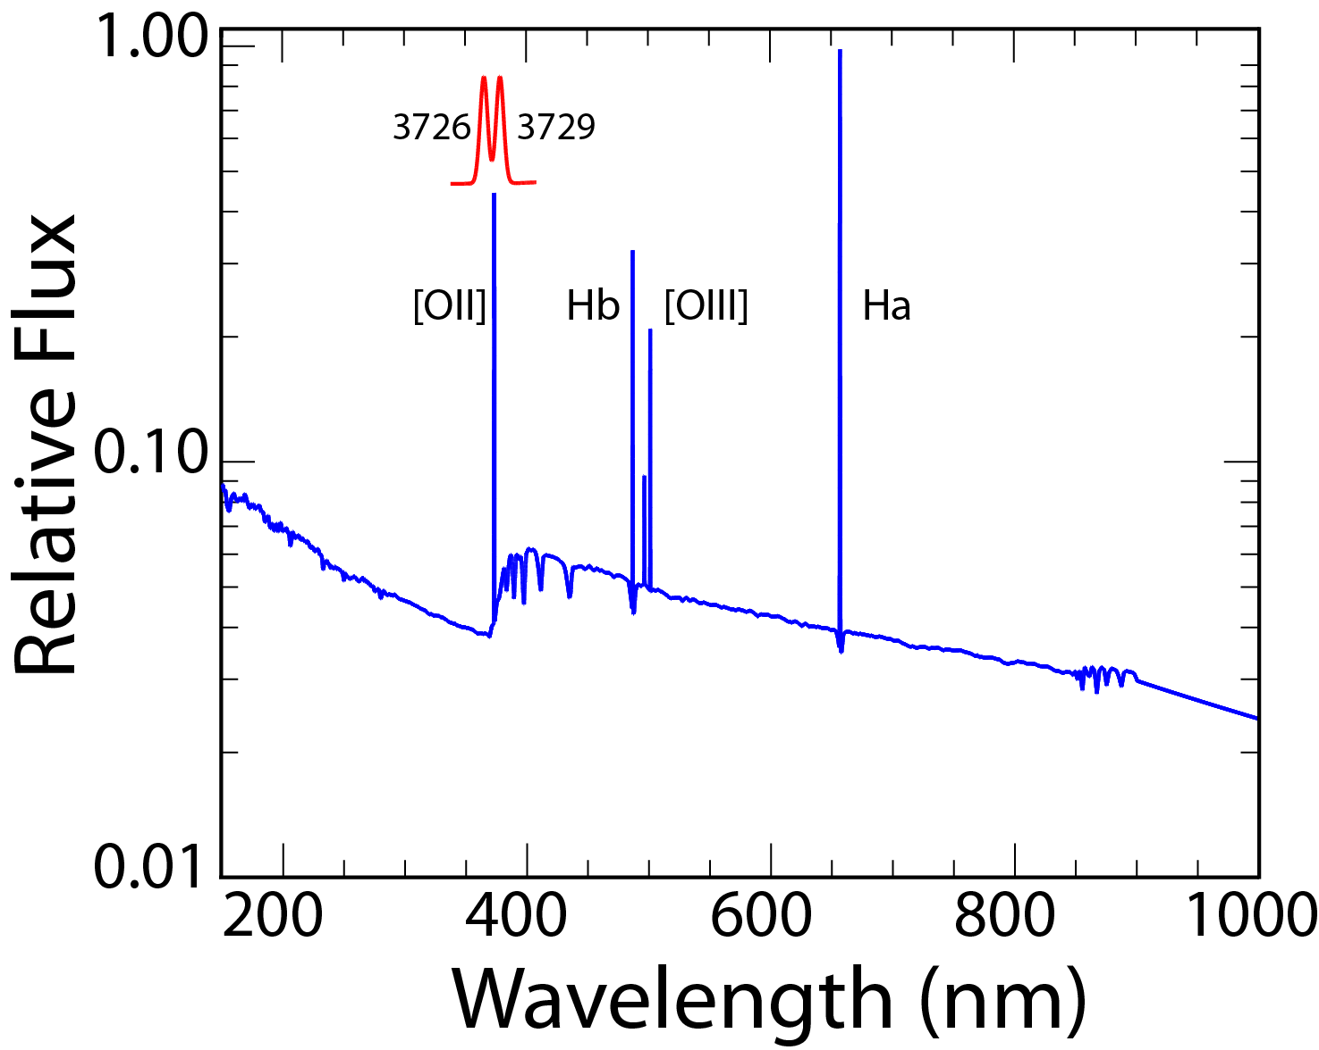
ELG Targets
Emission Line Galaxies
~24 x 10⁶ goal
0.7 < z < 1.6
Expansion Rate
Notes:
Blue band resolution: 1500

Slide 9
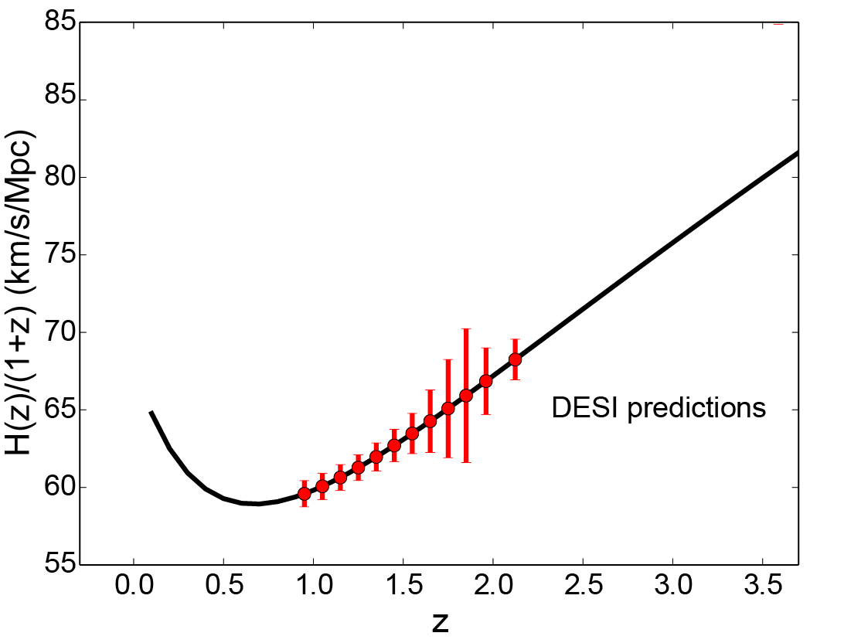
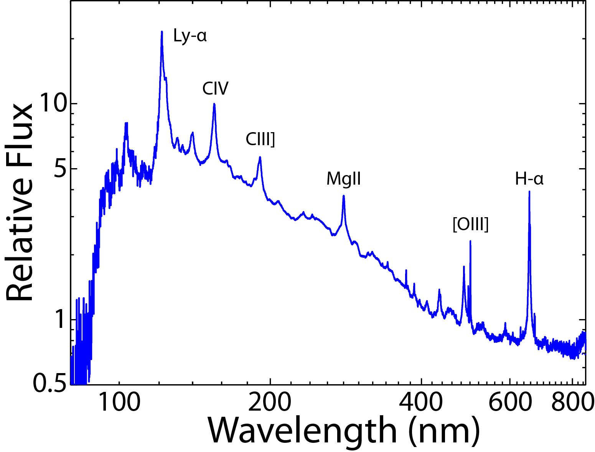
QSO Targets
Quasar Tracers
~1.6 x 10⁶ goal
0.9 < z < 2.2
Expansion Rate
Notes:
NIR band: Resolution 4000
mid band: Resolution > 3000

Slide 10
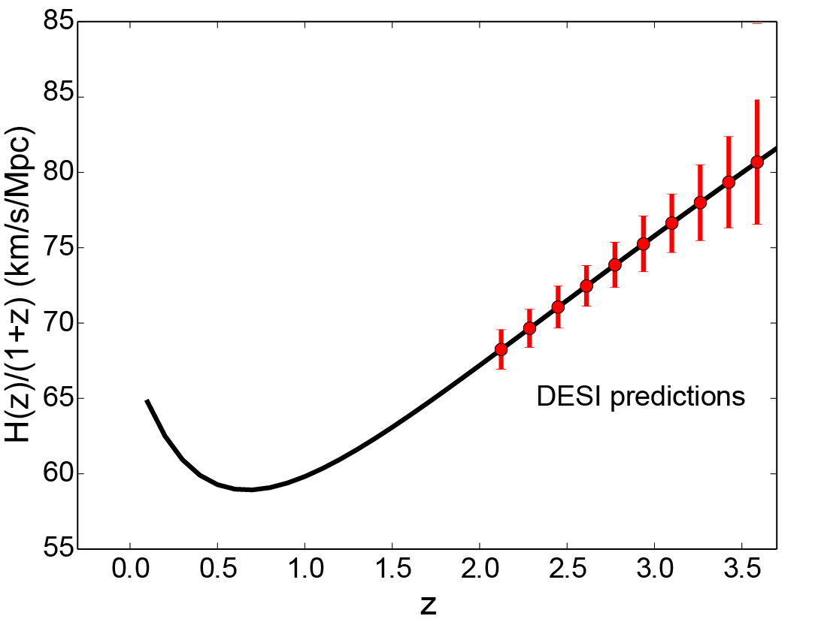
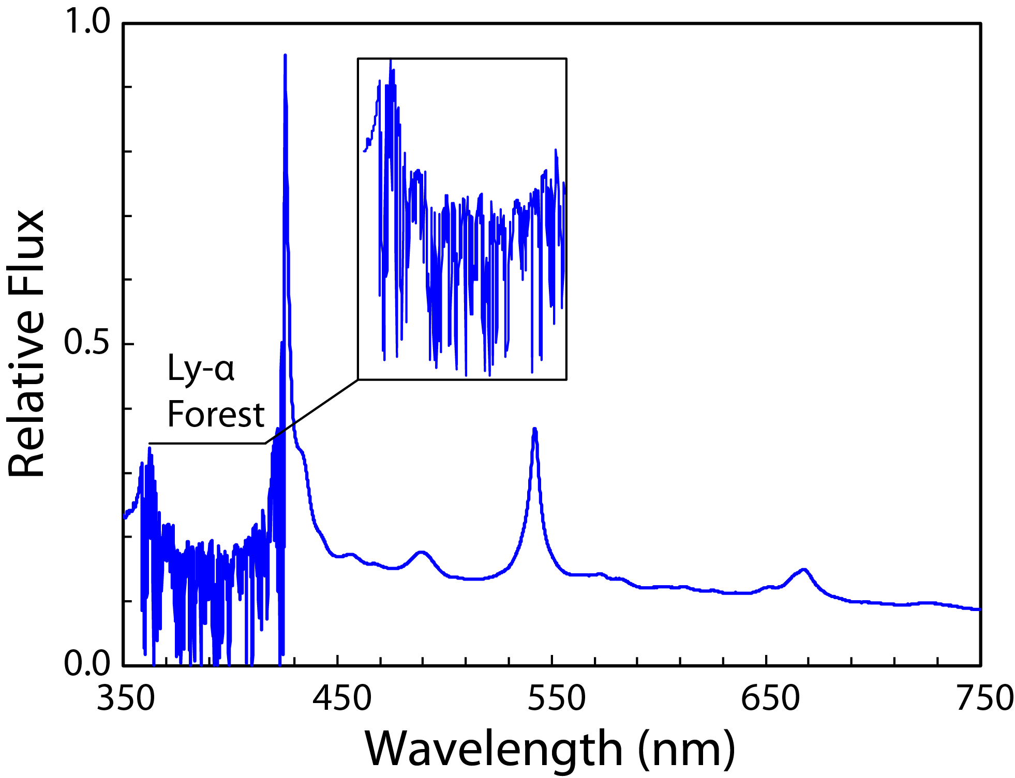
Ly-α Forest Targets
Quasar Ly-α Forest
~0.6 x 10⁶ goal
2.2 < z < 3.5
Expansion Rate
Notes:
Higher redshifts using quasar ly-a forest – it’s why we’re so keen to hang onto the blue despite it being so much more difficult

Slide 11
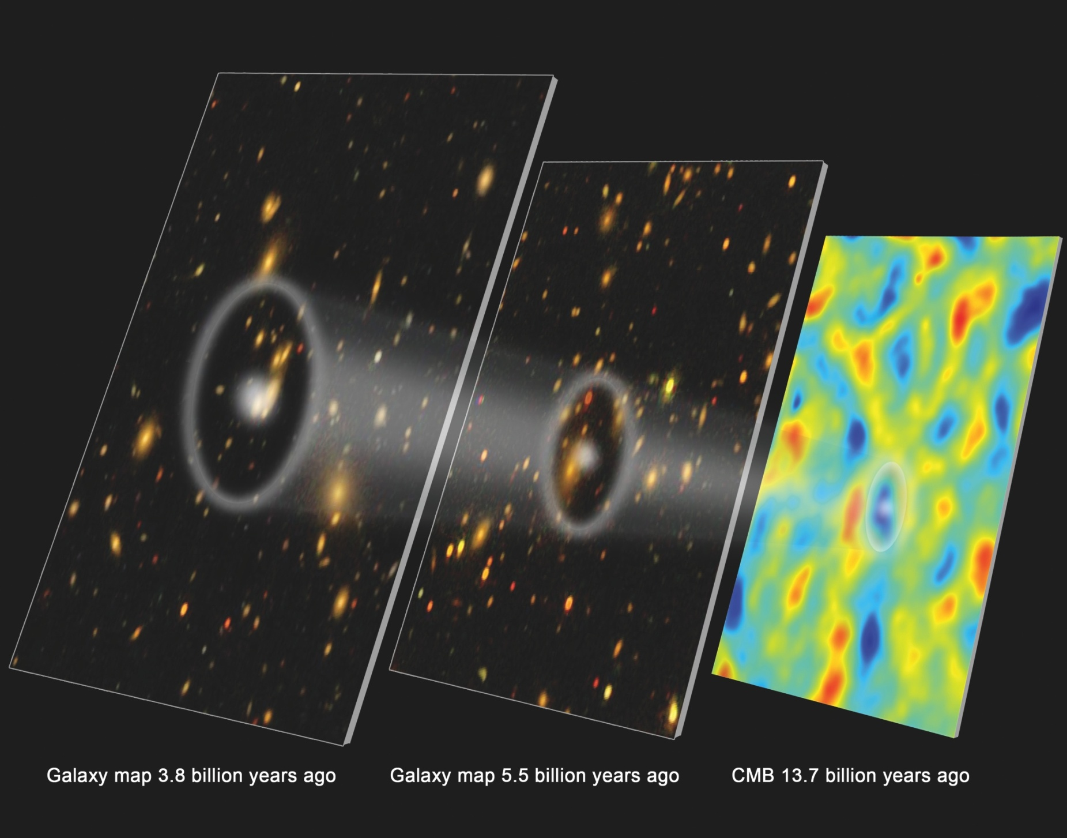
The BAO Distance Ladder
Claire Poppett, LBNL
Notes:
BigBOSS would measure "baryon acoustic oscillations" (BAO) - regular
variations in the density of mass in the universe - which are evident in
the netlike tendrils and voids of visible galaxies and intergalactic gas.
Ordinary matter adds up to only five percent of the mass-energy in the
universe, but its large-scale distribution maps underlying invisible dark
matter, another 20 percent of the total, and echoes the minute temperature
variations of the ancient cosmic microwave background radiation (CMB).
Thus BAO's recurring peaks in density, from the CMB to the present,
represent marks on a standard ruler of the cosmos that can be used to its
measure expansion history from early times until now.

Slide 12
Outline
DESI science
Instrument walkthrough
Robotic Fiber Positioners
  The need for robotic fiber positioners
  Fiber positioning technology
  Status of testing

Slide 13
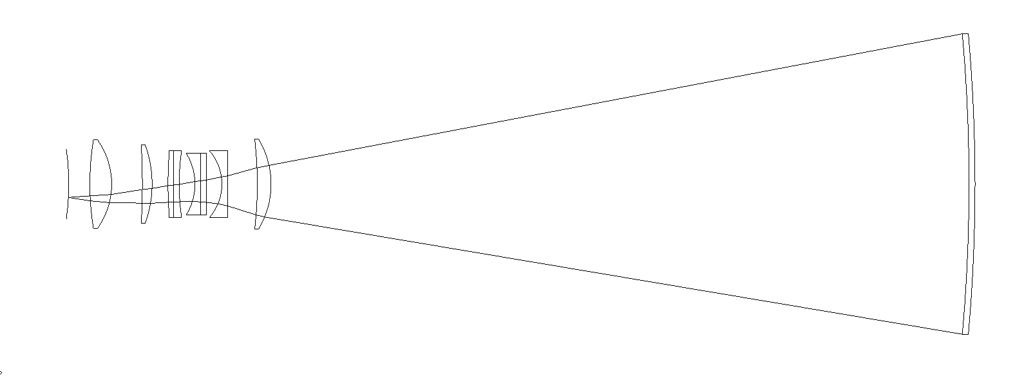
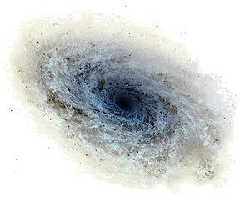
Galaxy image formed at focal surface

Slide 14
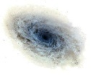
Galaxy image formed at focal surface

Slide 15
Position fiber to capture galaxy

Slide 16
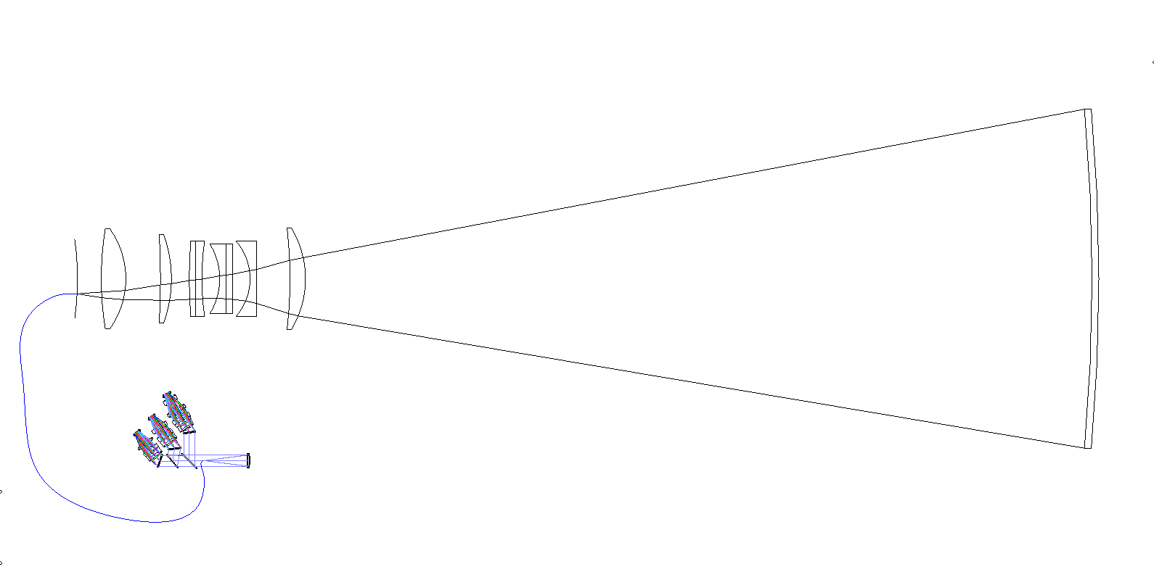
Fiber directs galaxy light to Spectrometer
5000 fibers on focal plate, each with independent positioner
10 three-channel spectrometers, each with 500 fibers

Slide 17
Elements of DESI System

Slide 18
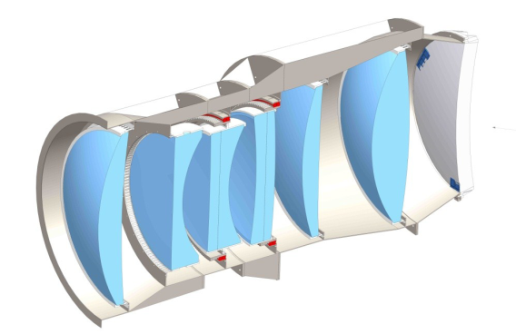
Elements of DESI System
Prime Focus Corrector
Notes:
Primary mirror is f/2.7

Slide 19
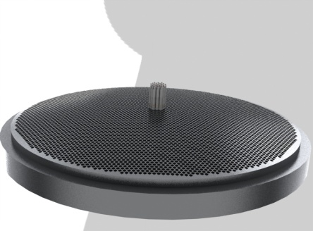
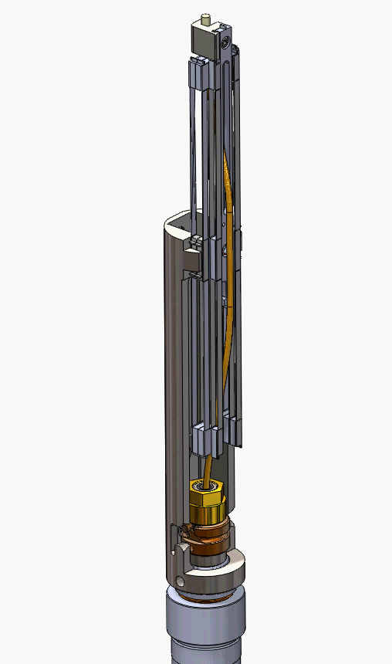
Elements of DESI System
Prime Focus Corrector
Focal Plate

Slide 20
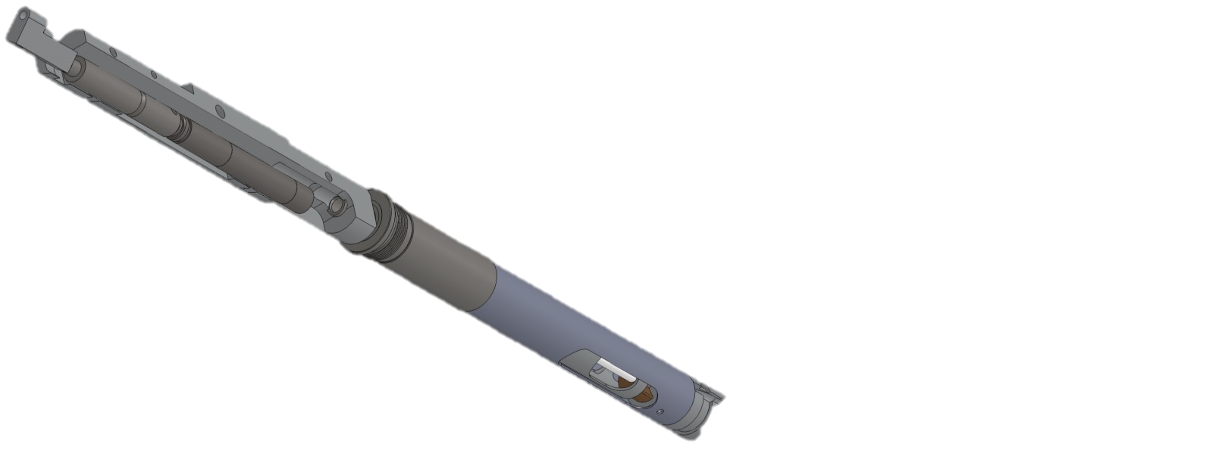
Elements of DESI System
Prime Focus Corrector
Focal Plate
Fiber System
Fiber Positioner

Slide 21
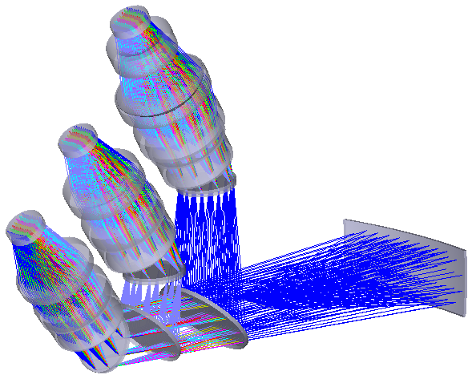
Elements of DESI System
Prime Focus Corrector
Focal Plate
360-660nm
R=1500
620-840nm
R=3000
Spectrometer
Fiber System
800-980nm
R=4000
Fiber Positioner
Dichroic Beamsplitters

Slide 22
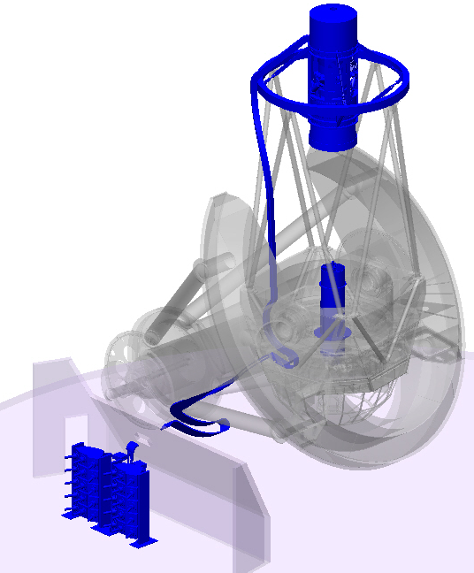
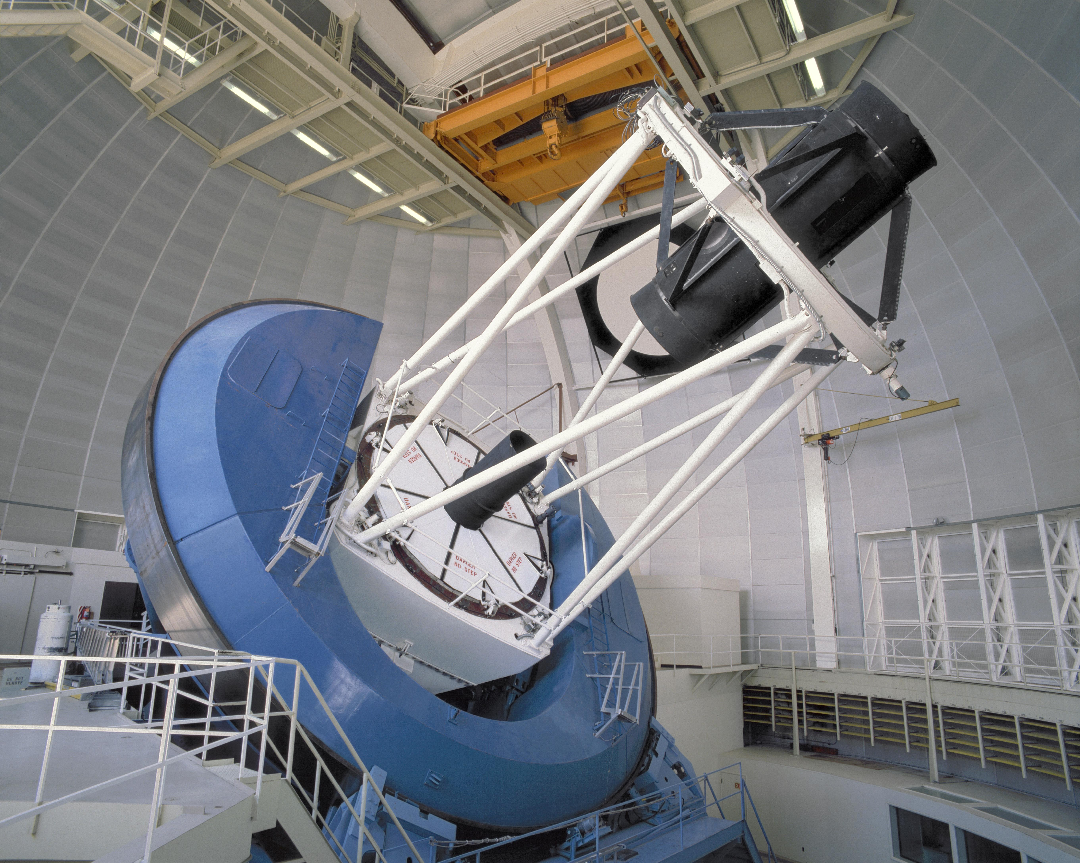
Major DESI Hardware
Corrector, Focal Plane Assembly, Thermal Enclosure
New Upper Ring, Spider, Cage
Fiber Harness
Fiber View Camera & Mount
Ten Spectrographs & Rack/Thermal Enclosure

Slide 23
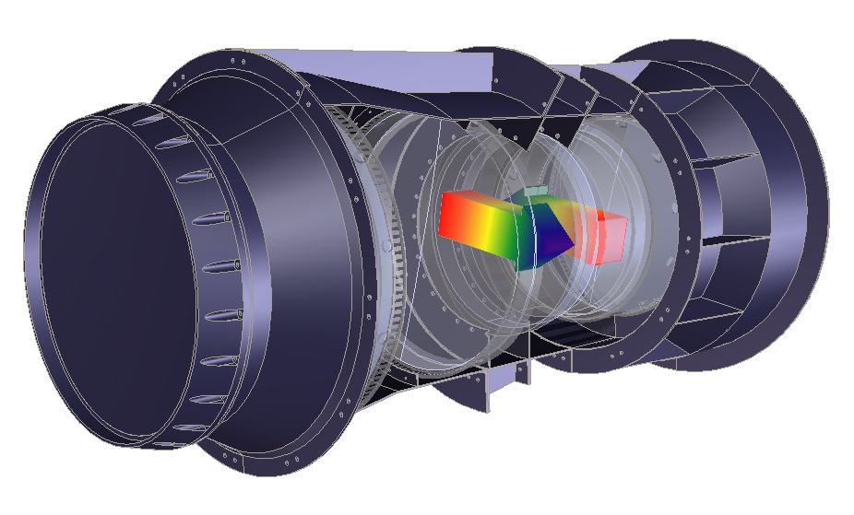
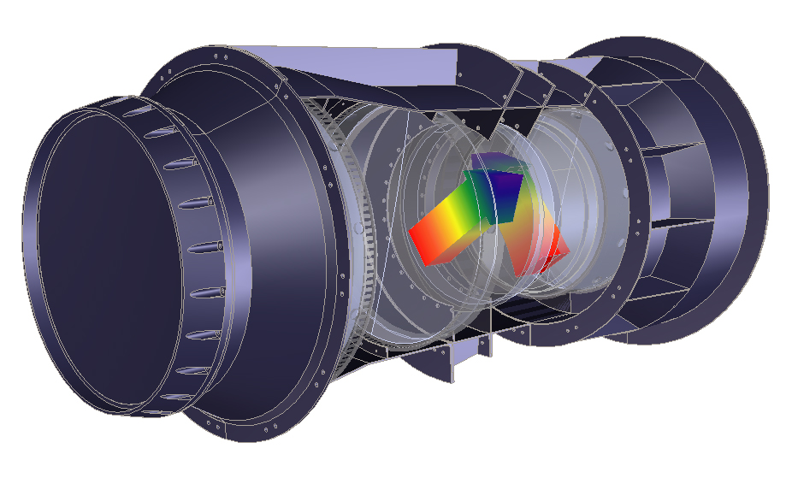
Atmospheric Dispersion Compensator
ADC1
Dispersion
ADC2
Dispersion
ADC1
Dispersion
ADC2
Dispersion
+
=
+
=
Atmospheric
Dispersion
Net ADC
Dispersion
Image
Dispersion
Atmospheric
Dispersion
Net ADC
Dispersion
Image
Dispersion
Notes:
60 degrees off zenith

Slide 24
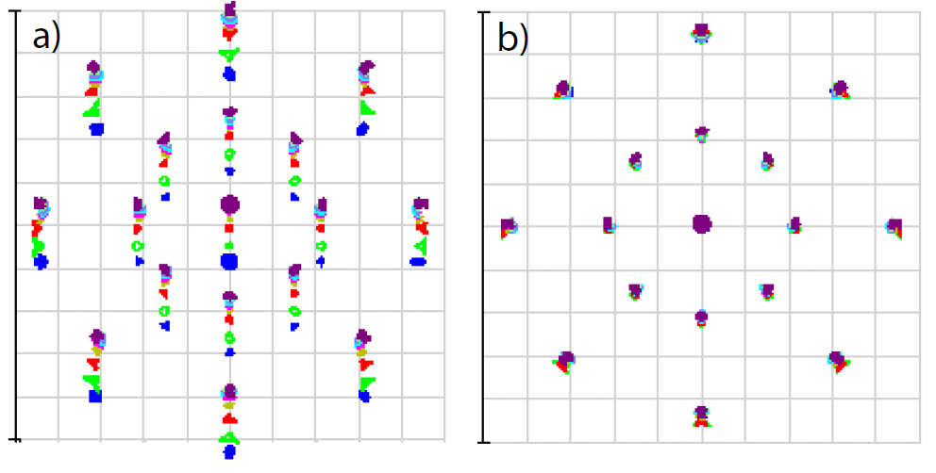
Atmospheric Dispersion Correction
Geometric raytrace shows eects of atmospheric dispersion on telescope point spread function. a) A heavily chromatically aberrated view of the sky 60 from zenith. Overall scale is 1m square, PSF exaggerated by factor of 106. This chromatic aberration is removed by rotating the ADC prisms 85 as shown in b). The dispersion being compensated here is 3 arcsec.

Slide 25
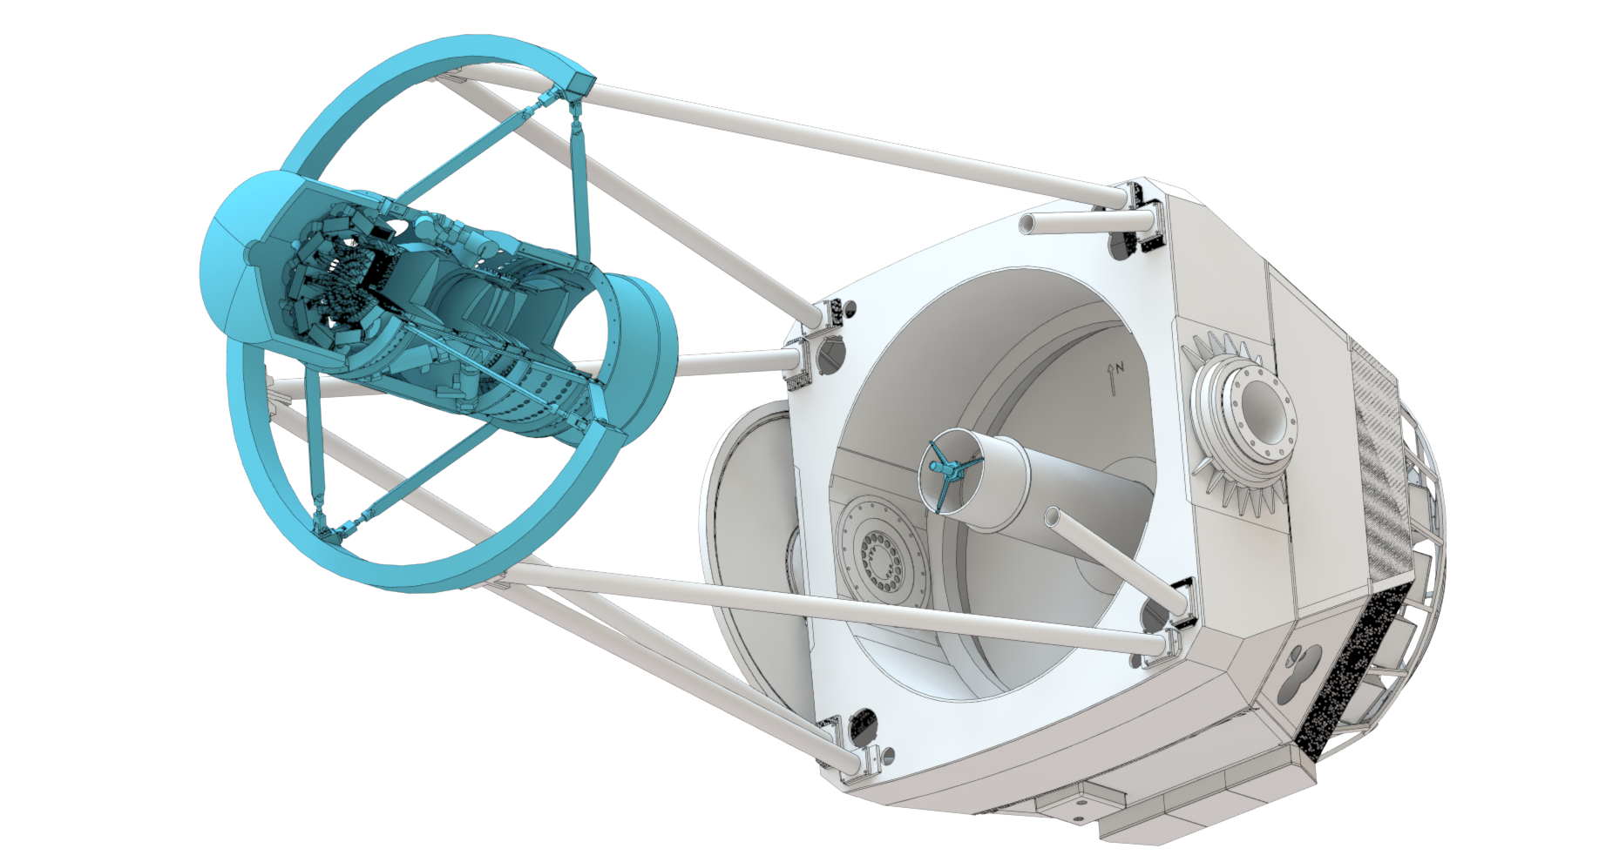
Prime Focus Corrector
Function –
gather broadband galaxy light,
deliver well focused beam …
nearly normal to the focal surface
Requirements
  Field of view: >3˚ linear
  Wavelength band: 360 – 980 nm
  Geometric, manufacturing, and alignment blur <19 μm RMS radius, field-averaged
  Tilt of chief ray: <1˚

Slide 26
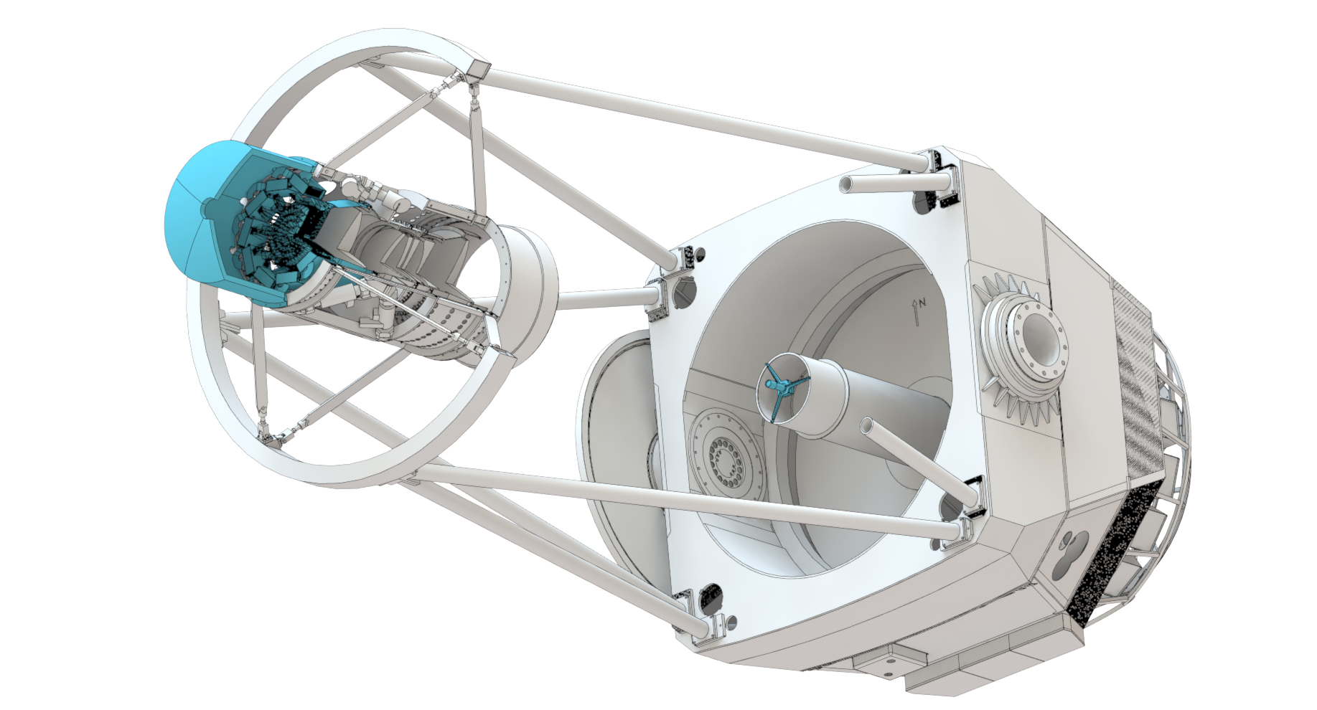
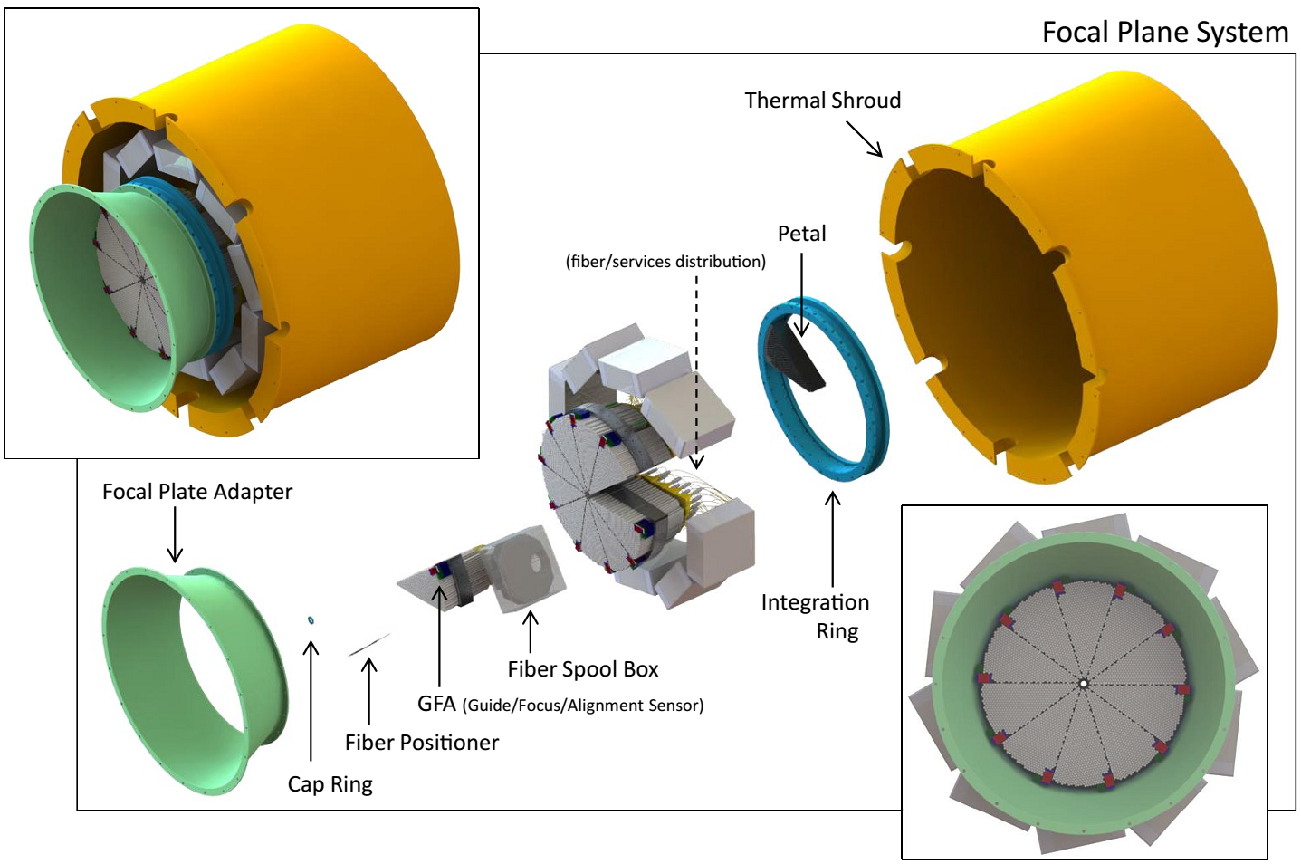
Focal Plate System
Function –
capture galaxy light bundles from
the corrector onto fiber optic tips
Systems
  Focal plate
  Guide sensors
  Focus sensors
  Illuminated fiducials
  Fiber positioners
  Fiber view camera

Slide 27
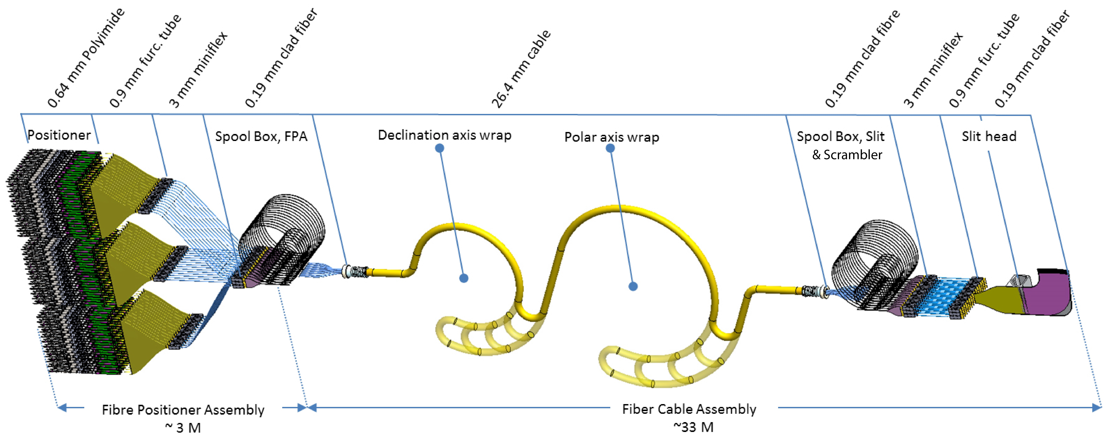
Fiber System
Function –
capture, transport, and deliver the corrector galaxy spots to the spectrographs with as little attenuation and f/# degradation as possible
~3 m
~33 m

Slide 28
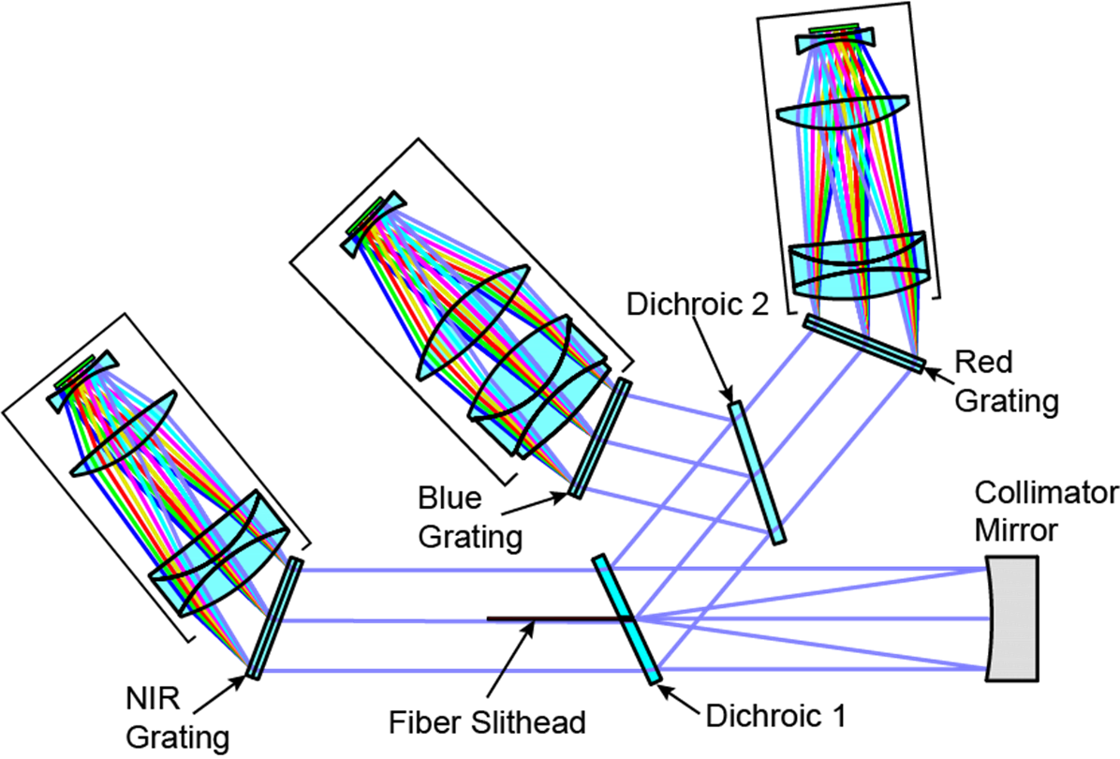
Spectrograph
Function –
capture fiber output beam, disperse, and image with small point spread function to achieve required resolution
Item |  | Requirement
Spectral Requirements
Bandpass |  | 360 – 980 nm
FWHM Resolution (λ/Δλ) | 360nm < λ < 555nm | > 1500
 | 555nm < λ < 656nm | > 3000
 | 656nm < λ < 980nm | > 4000
Optical Requirements
End to End Throughput | λ = 360 nm | > 35%
 | 400nm < λ < 600nm | > 55%
 | 600nm < λ < 900nm | > 60%
 | λ = 980nm | > 50%
FRD Throughput |  | > 90%
Maximum RMS Radius |  | < 12 µm
95% Encircled energy diameter |  | < 110 µm
50% Encircled energy diameter |  | < 50 µm
3 arm design to cover wavelength
range at the required resolution
Optics only
Optics + fiber + detector

Slide 29
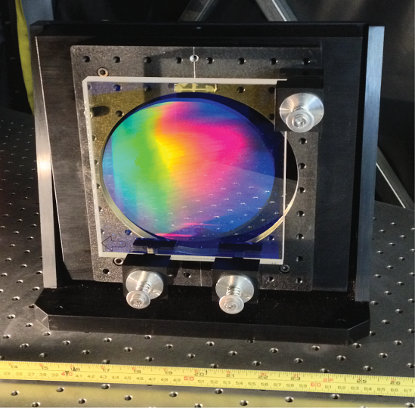
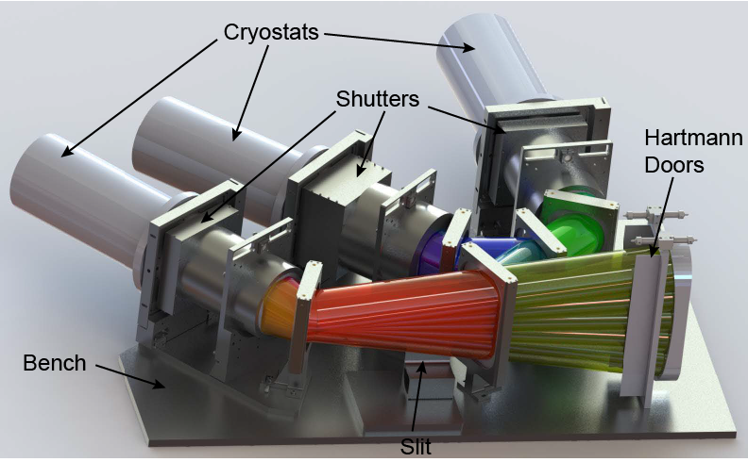
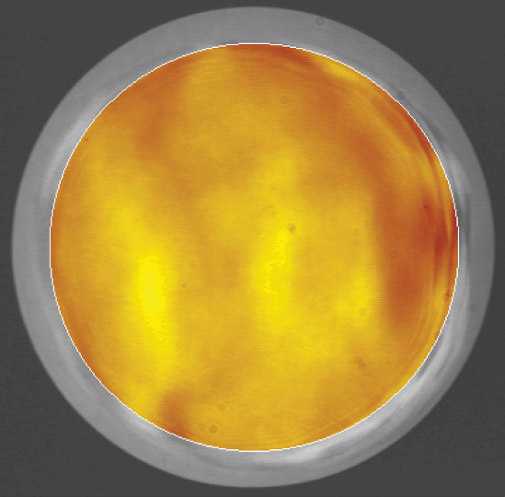
Spectrograph(cont.)
Blue Grating
in test mount
CAD Rendering of Model used to
develop camera interfaces
Measured Wavefront (-1 order)
<1/2 wave P-V

Slide 30
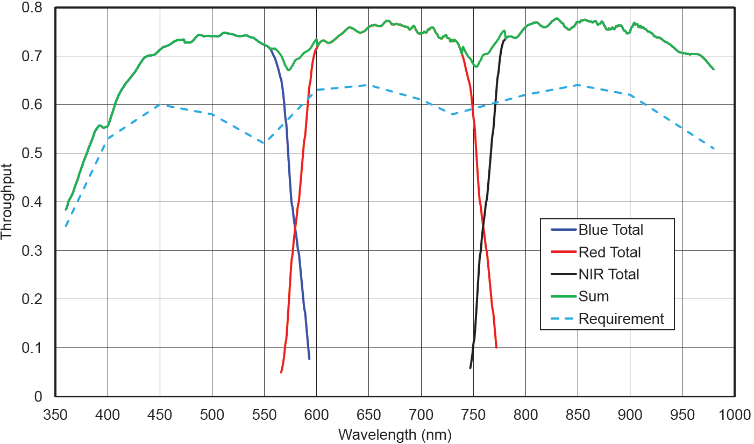
Throughput

Slide 31
Outline
DESI science
Instrument walkthrough
Robotic Fiber Positioners
  The need for robotic fiber positioners
  Fiber positioning technology
  Status of testing

Slide 32
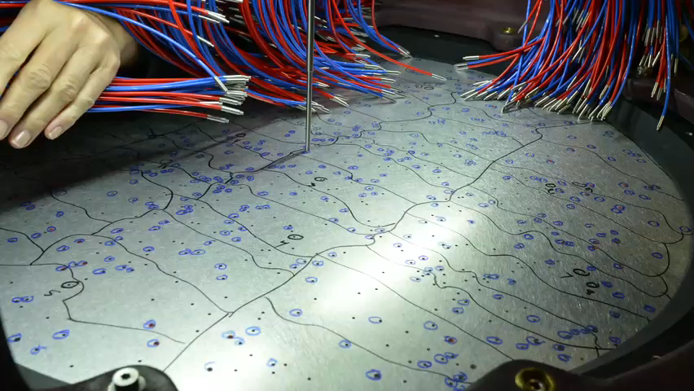
BOSS plus plate
Notes:
MOVIE

Slide 33
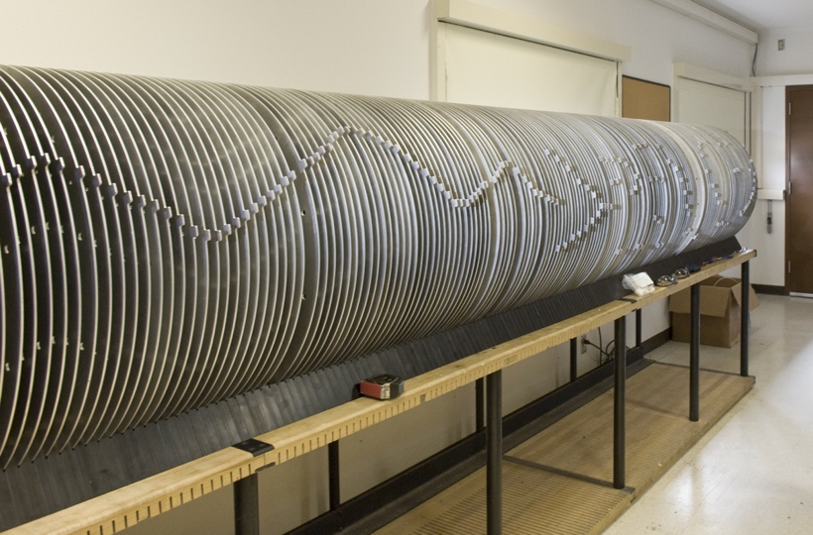
BOSS: 1000 fibres
DESI: 5000 fibres
From BOSS to DESI
Notes:
So that’s what we did with BOSS, but BigBOSS is bigger. Main difference is in the number of fibres

Slide 34
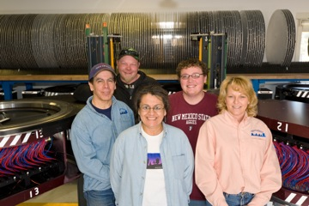
The BOSS fibre plugging team
Notes:
This is the fibre plugging team for BOSS, their first day on the job

Slide 35
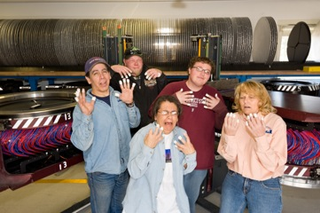
The BOSS fibre plugging team
Notes:
And this is the fibre plugging team now! We can’t make them do a plug plate with 5000 fibres!

Slide 36
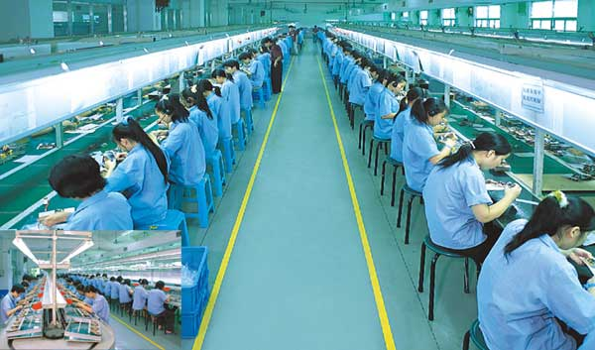

Hire Foxcom?
Notes:
Maybe we could hire FoxCon to do it

Slide 37

Hire Foxcom?
Notes:
They’re kinda busy

Slide 38
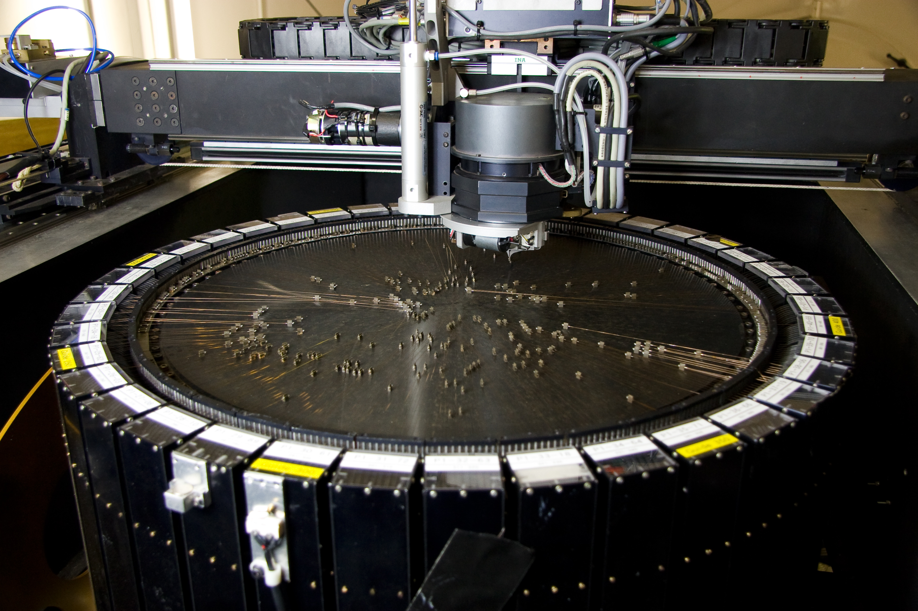
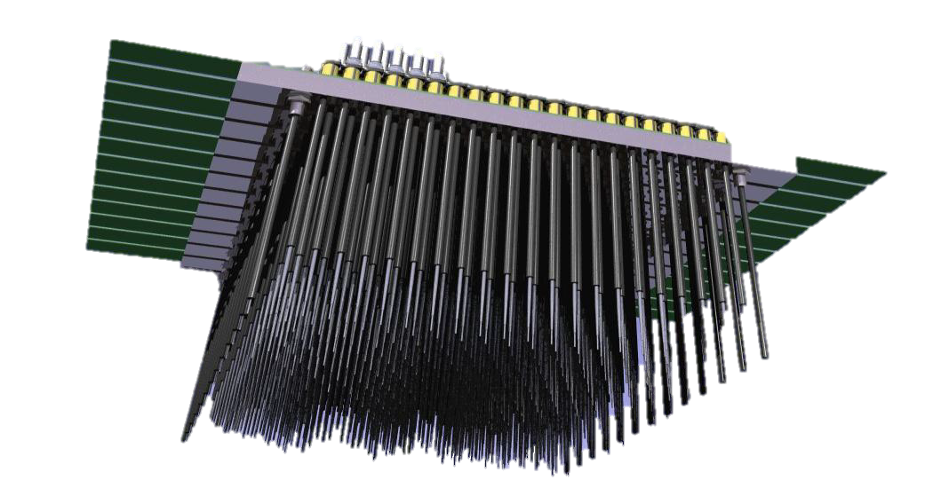
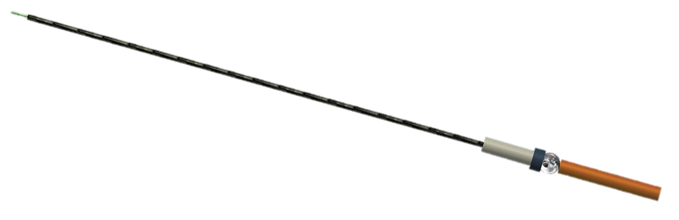
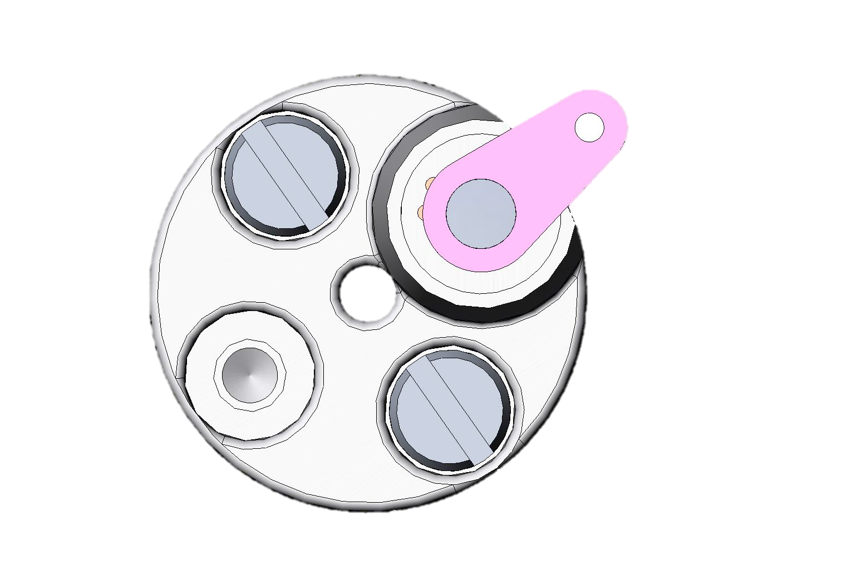
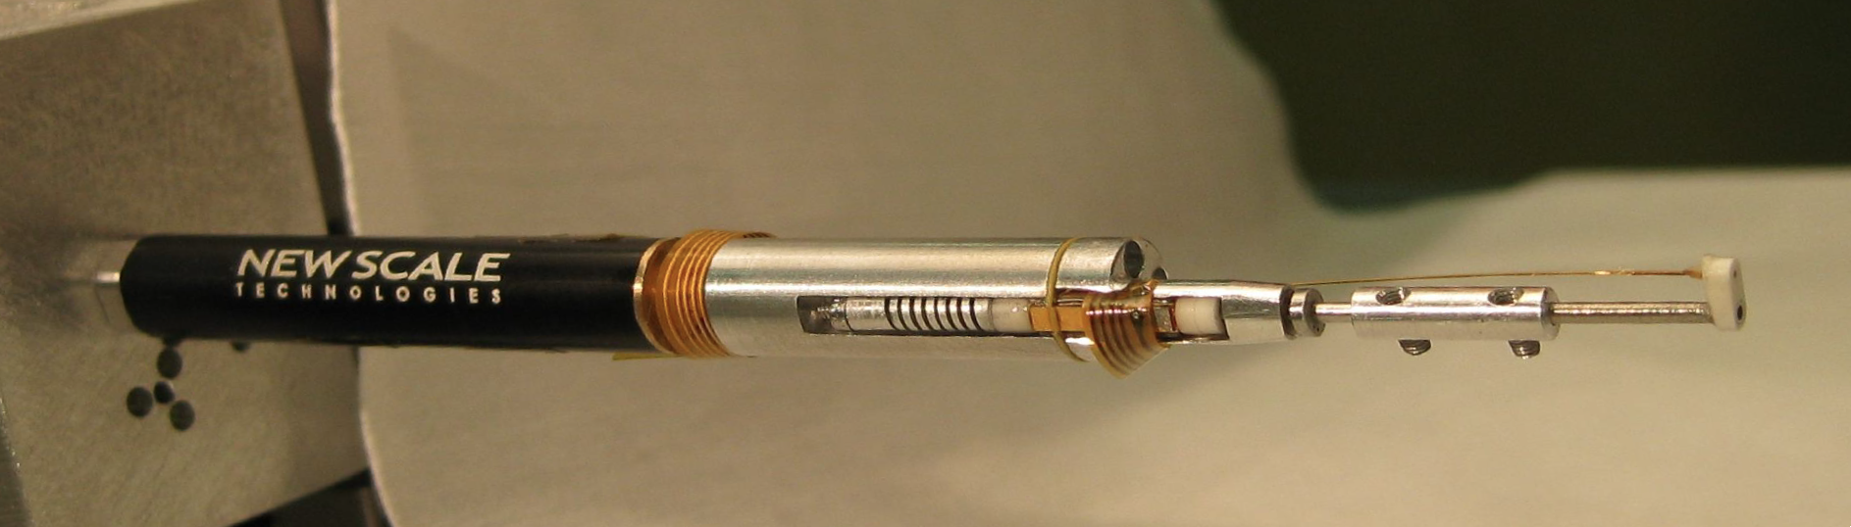
Robotic fiber positioners
Pick and place robots (eg 2df at AAO)
Tilting Spines (eg Echidna on FMOS)
Rotating axis (eg LAMOST at Xinglong Station China)

Slide 39
Desired Positioner Characteristics
Compact: 5000 fibers in 3° diameter FOV on a 815mm diameter focal plate.
Accurate, Fast: Position to within 5µm as quickly as possible with lowest total energy dissipated.
Reliable: Lifetime >250,000 reconfigurations.
Low mass: Minimize gravity sag of focal plate.
Low power: Maintain thermal stability of focal plate.
Fiber-friendly: Maintain fiber min bend radius >50mm.

Slide 40
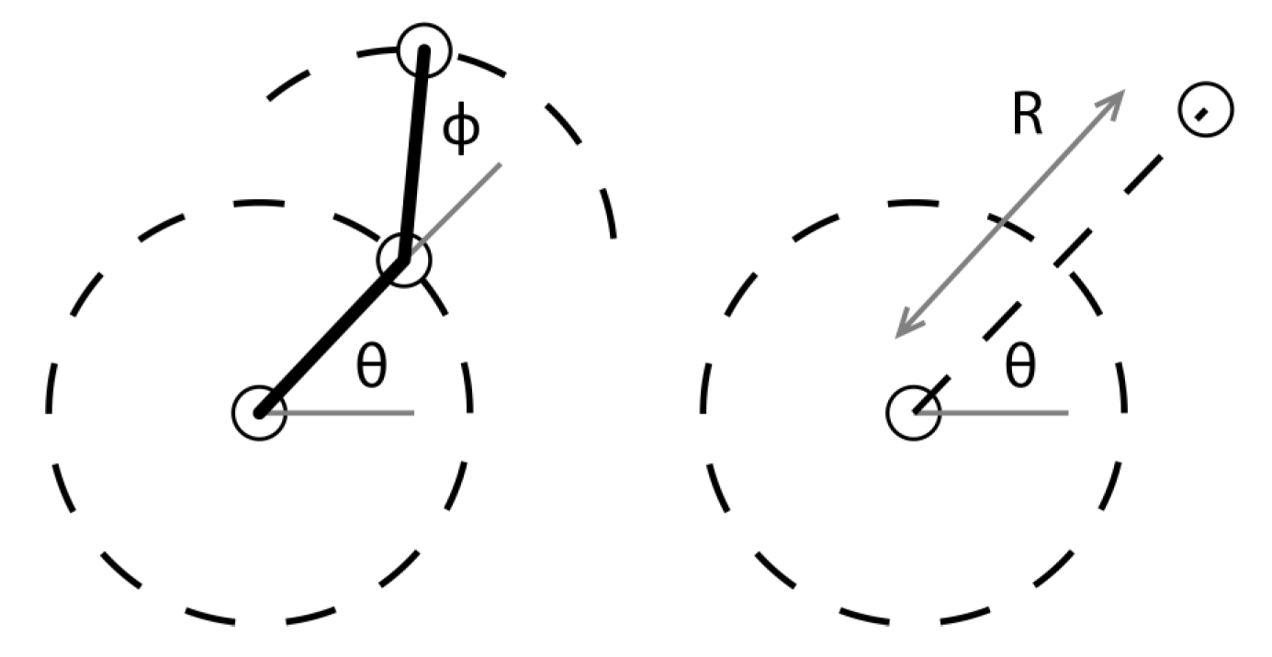
Positioner Kinematics
Yaw
Pitch
In-Plane motion
Spherical motion about a point

Slide 41
Positioner Kinematics
Reference design is theta-phi
Yaw
Pitch
In-Plane motion
Spherical motion about a point

Slide 42
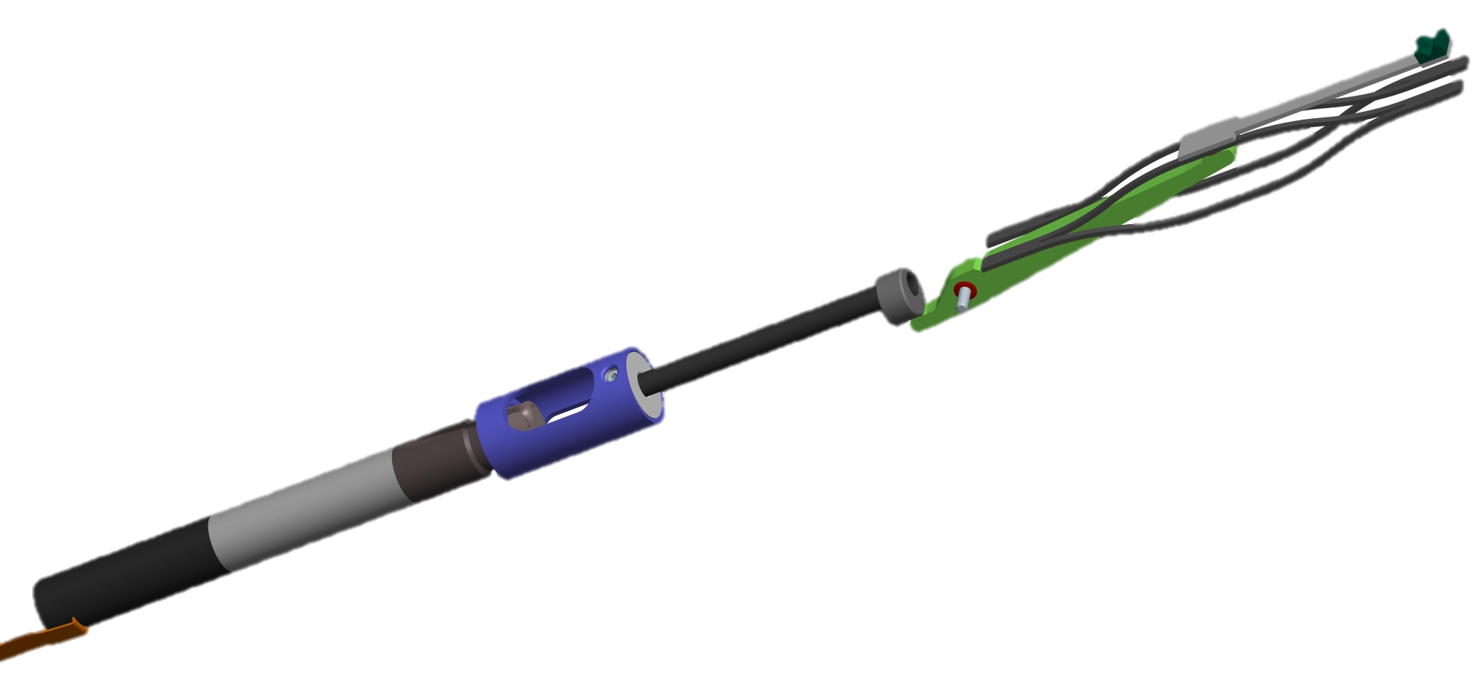
LBNL R-theta actuators
ferrule clamp
support arm
lever
cam
hollow shaft
flexure
(mounted on flexure housing)
Ø6 mm DC-motor
with gearhead
(mounted on Theta-stage
transfer gear)
lever pivot
(supported by flexure housing)
Ø8 mm
transfer gear
R-theta fiber positioner uses brushless DC motors.
Mechanical evolution:
  R-axis driven by cam and lever.
  R-axis driven by cord and spool.
  ‘Production’ version with minor mod’s plus rotation hard stops.
  Analog hall sensor (>60 effective counts/rev), best solution.
Notes:
VIDEO

Slide 43
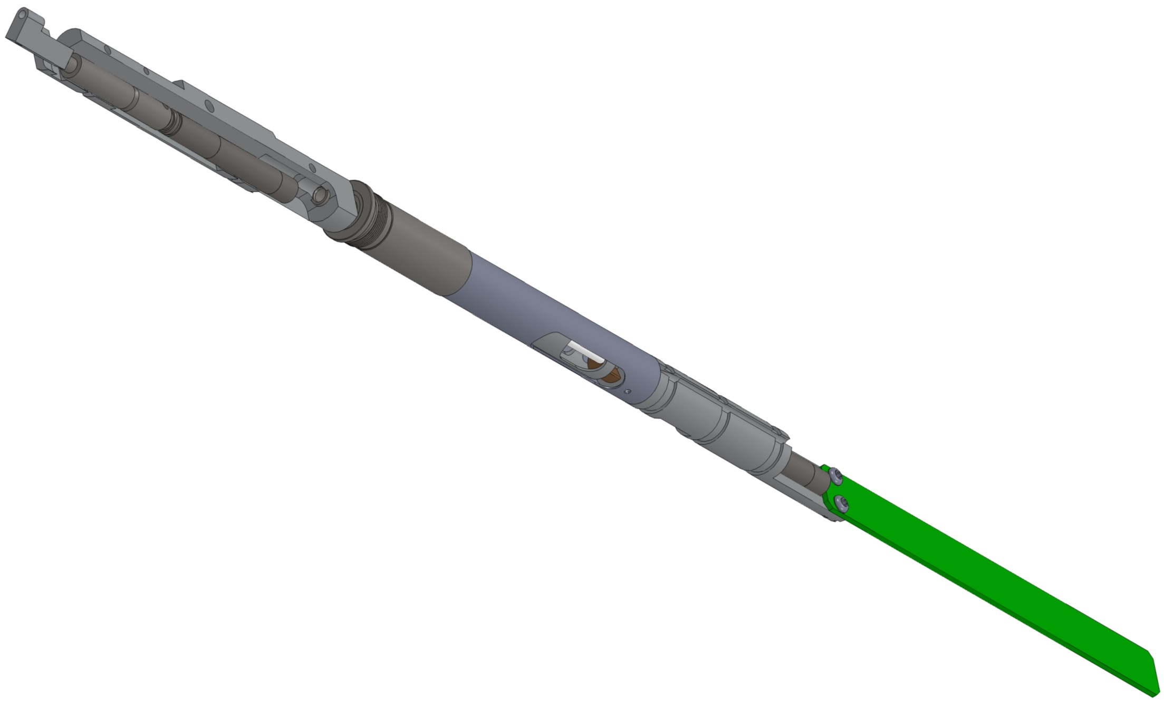
LBNL th-phi: 10.4mm reference design
black anodized, Al ferrule holder (prototype configuration)
Bonded surfaces are masked from black anodizing, as needed.
stainless steel phi bearing cartridge
black anodized, Al upper housing
phi gearmotor
stainless steel theta tube (precision tubing)
stainless steel theta bearing cartridge (threads into focal plate)
openings allow access to thread fiber and phi motor wires through here
Al theta coupler
theta stop
Al aft cap/theta motor mount
back end of theta gearmotor
electronics board (provided by us)

Slide 44


Slide 45
1. LBNL XY performance
Claire Poppett Shanghai Collaboration meeting 45

Slide 46
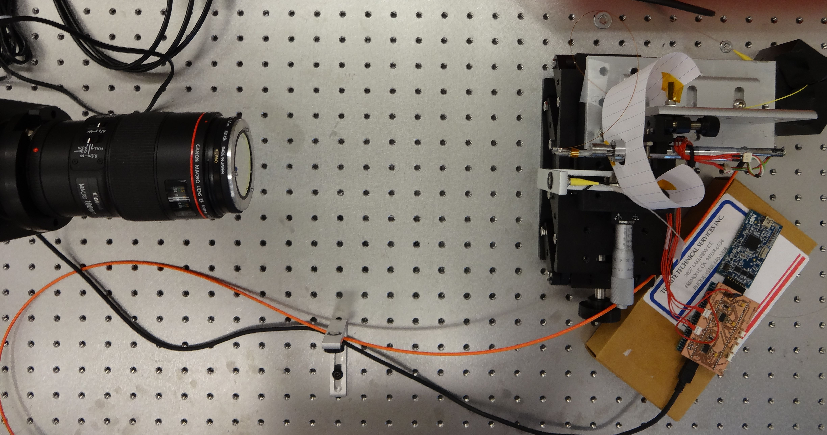
LBNL XY testing procedure
SBIG CCD with macro lens and filter
Test actuator
Integrating sphere
Fibre fed input light from LED
Reference fibre
Actuator electronics

Slide 47
Testing Mohawk positioning accuracy at LBNL
1st move
rms error = 52um

Slide 48
Testing Mohawk positioning accuracy at LBNL
2nd move
rms error = 23um

Slide 49
Testing Mohawk positioning accuracy at LBNL
10th move
rms error = 3um

Slide 50
Comparison of positioning accuracy

Slide 51
2. LBNL FRD testing procedure
Claire Poppett Shanghai Collaboration meeting 51

Slide 52
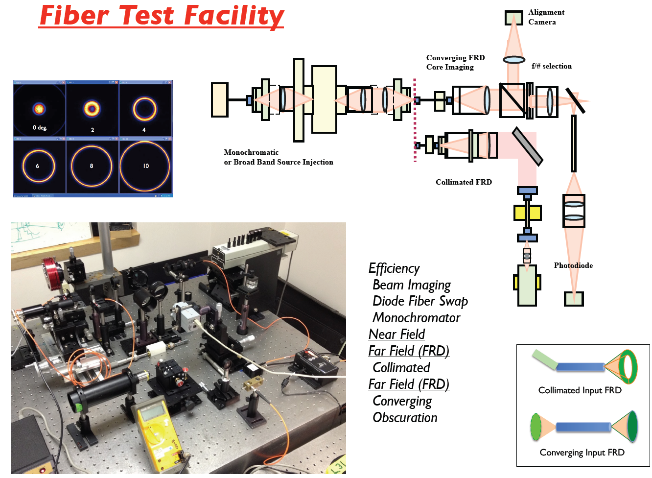
Experimental Characterization

Slide 53


Collimated FRD test
Output light azimuthally scrambled to make donut – radial scrambling is due to FRD so FWHM of donut shows performance
Collimated light at input angle

Slide 54
Full cone FRD test – injection angle effects

Slide 55
Collimated FRD test

Slide 56
FRD over lifetime of th-phi positioner

Slide 57
Status and Conclusions
Corrector Design is fixed and glass is being ordered
Lens manufacture of 1 3-arm spectrograph is underway
  May be used for prototype instrument next year
  Testing of prototype gratings has begun and all gratings meet specifications
Identified different technologies for robotic positioners with very little further testing required
  Selection will be made at the end of May

Slide 58


