Slide 1
PandaX-III, Investigation of possible features for the classification of signal and background with CNN
Shangning XIA, Suizhi HUANG, Xun CHEN and Shaobo WANG
2020-08-06
Shanghai Jiao Tong University, China
On behalf of the PandaX-III collaboration
DANCE Machine Learning Workshop 2020

Slide 2
Outline
Introduction
Data preparation
Signal-Background classification with CNN
Features of the network and physical explanation
Summary

Slide 3
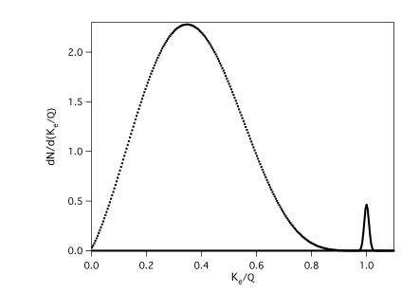
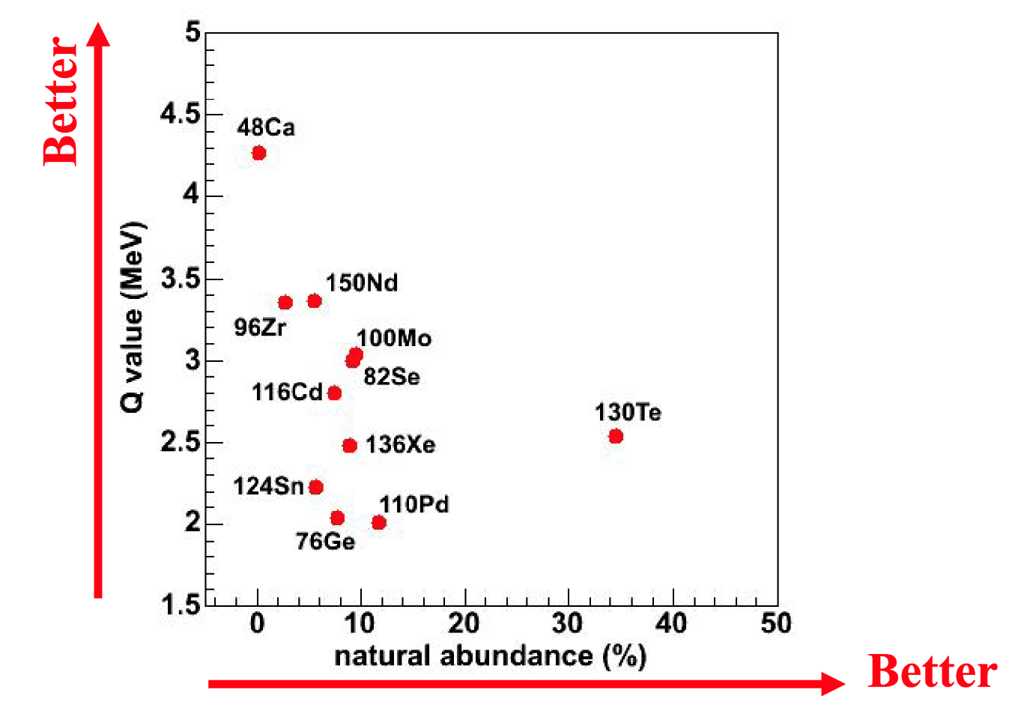
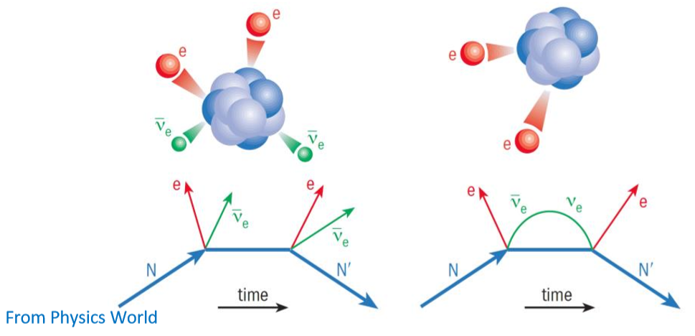
Neutrinoless double beta decay(0νββ) with Xe-136
0νββ: Majorana Neutrino? Lepton number violation?
Q value of ${}_{56}^{136}Xe→{}_{58}^{136}Ba$：
2457.83(37) keV PRL 98, 053003(2007)
2νββ
0νββ

Slide 4
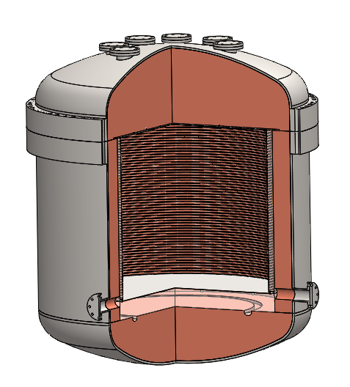
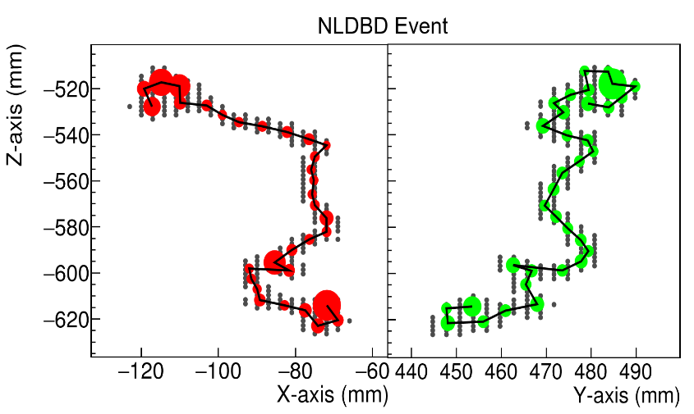
The PandaX-III Experiment
1600mm
readout
PandaX-III：search for 0vbb with 140 kg of 90% Xe-136 enriched gas TPC .
52 Microbulk Micromegas ( 20 ✕ 20 cm), 3mm pitch
Charge readout: 2 series of strips (x, y)
The tracks (length~20cm) : provide informations to distinguish signal and background events, and CNN can effectively exploit this information.
1200
mm
cathode

Slide 5
CNN in PandaX-III

Slide 6
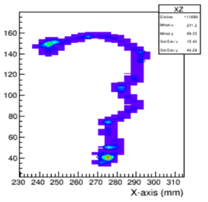
Geant4 based MC simulation
RESTG4 with PandaX-III TPC geometry
Diffusion effects and electronics responses are utilized
Data set:
0νββ Signal : 320,000
Background (Th-232 and U-238): 320,000
Original
Diffusion
Electronic effects

Slide 7
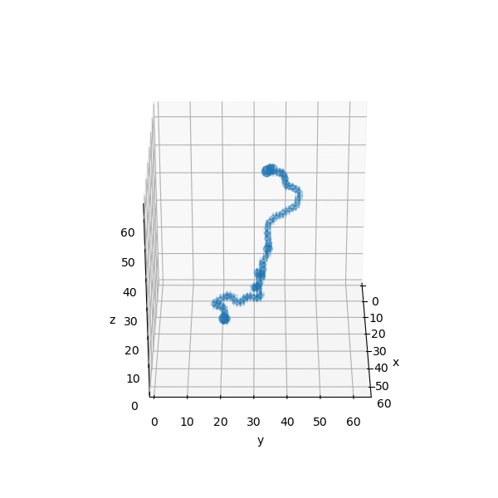
Data preparation for CNN
64 x 64
Calculate the energy center.
The intensity represents the amount of energy.
Data split:
train: validation: test=7:2:1 (640,000 in total)
Data augmentation :
Random shear; Random rotation;
Horizontal flip; Vertical flip.
X or Y
XZ
YZ
Z
Input picture
7

Slide 8
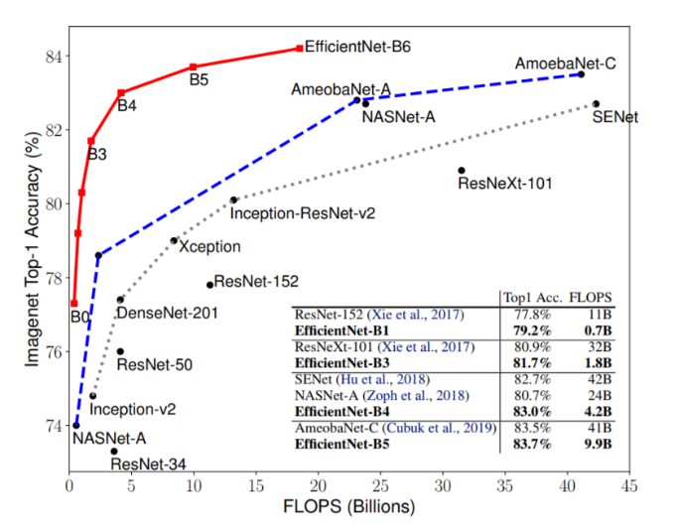
Network selection
We tried different models that are not previously optimized
Network | Overall Accuracy | $ε_{s}$ with 98% background rejection | Significance=$ε_{s}/\sqrt{ε_{b}}$
Resnet50 | 91.12% | 75.93% | 6.80
Densenet169 | 91.81% | 79.96% | 7.92
InceptionV2 | 90.16% | 71.49% | 5.86
Efficientnet | 91.88% | 79.81% | 8.60
Our baseline model
${\text{Sensitivity} \text{Projection} (T}_{1/2})∝η\sqrt{\frac{M×T}{δE}}×\frac{s_{d}}{\sqrt{b_{d}}}∝\frac{ε_{s,cnn}}{\sqrt{ε_{b,cnn}}}$
Signal efficiency of CNN
Background efficiency of CNN
${s_{d} : N}_{signal}$ recorded in detector
${b_{d} : N}_{background}$ recorded in detector
Tan, Mingxing and Quoc V. Le. “EfficientNet: Rethinking Model Scaling for Convolutional Neural Networks.” ICML (2019).
8

Slide 9
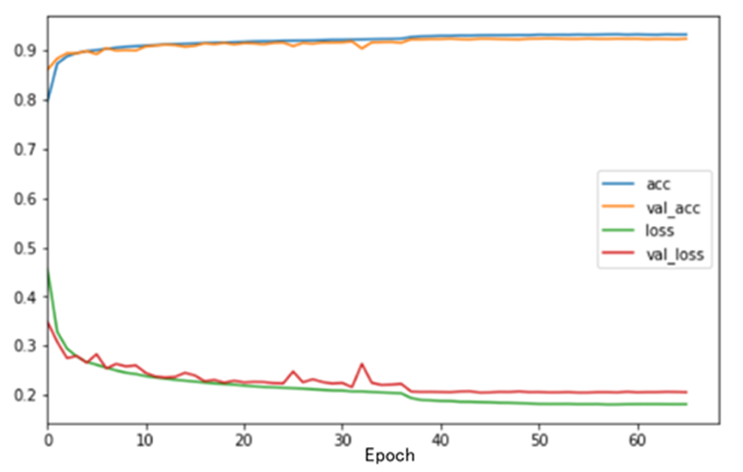
Machine Learning Results
Result: (After tuning the model)
Training set: 93.5%
Validation set: 92.45%
Test set: 92.70%
Altering the configuration and choosing hyperparameters.
Input tensor: 128 ✕ 128
Number of filters in last convolution: 64
Pooling function: Max Pooling
Dropout: None
Learning rate: 1e-3 with reducing learning rate on plateau
Optimizer: Adam
Almost no overfitting
 | $$ε_{s}/\sqrt{ε_{b}}$$ | $$ε_{s}$$ | $$ε_{b}$$
CDR ¹ | 3.816 | 0.645 | 0.0285
Resnet Published ² | 6.264 | 0.475 | 0.0057
$$Efficientnet$$ | 11.09 | 0.265 | 0.0006
[1]
[2]
9

Slide 10
Features Study
10

Slide 11
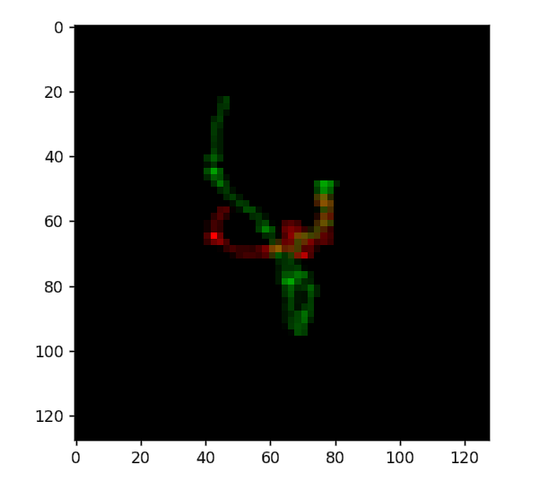
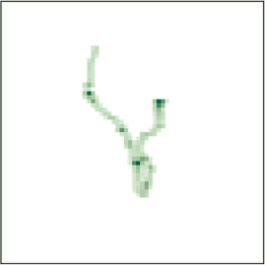
Superficial & Simple Features
Stem_activation (first layer)
Channel detector
XZ plane
Edge detector
Energy detector
=
YZ plane
Both plane
XZ plane
YZ plane
11

Slide 12
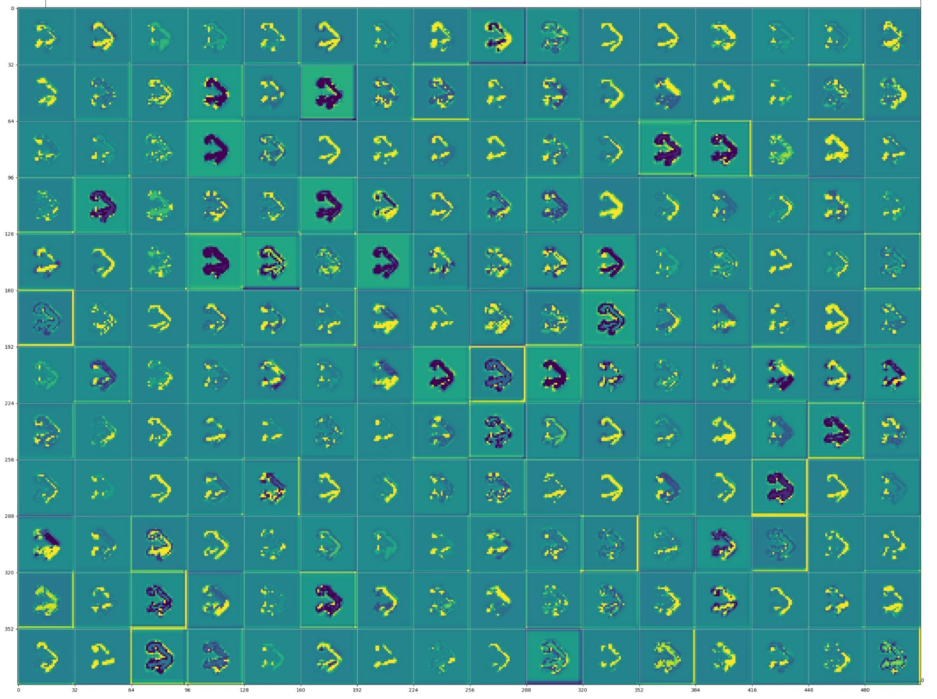
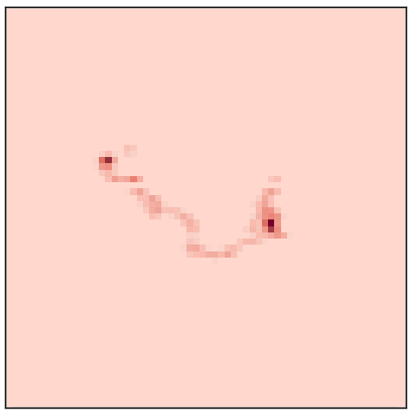
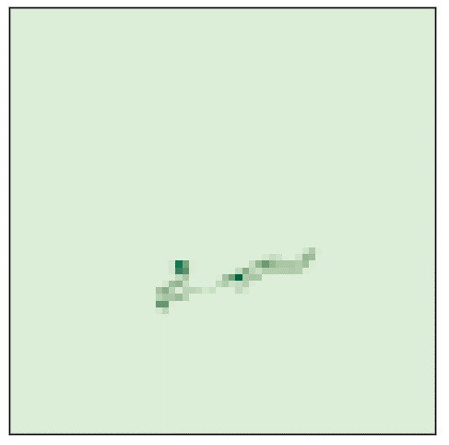
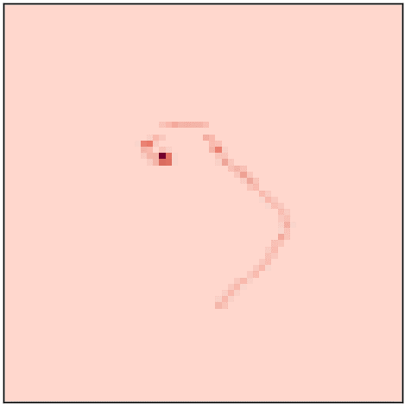
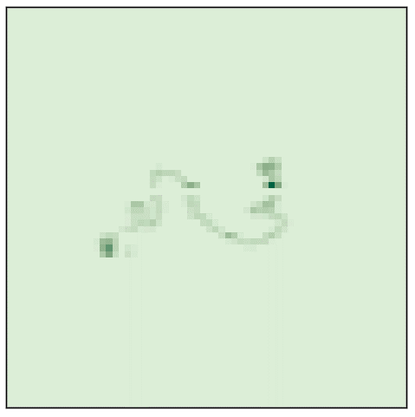
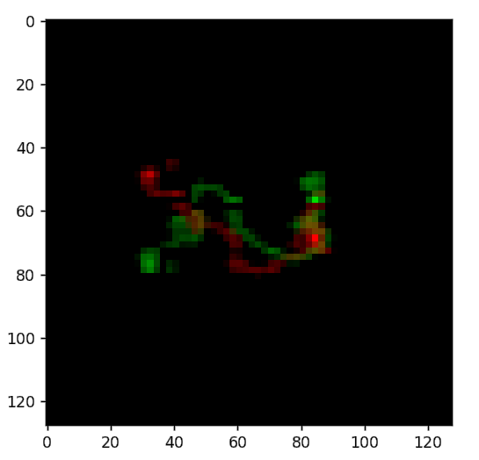
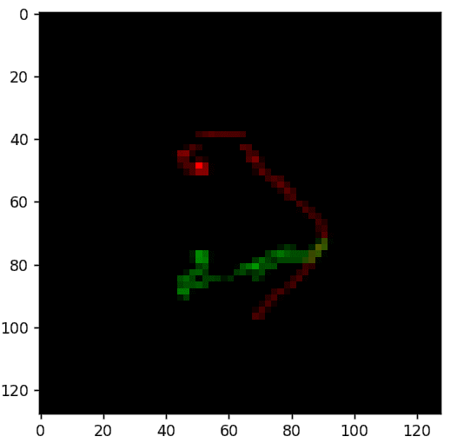
Abstract Physical Concept----Bragg peaks
Middle layer
block3 (the fourth layer)
Bragg peak detector
Edge detector
12

Slide 13
Abstract Patterns for the Events
…
The last convolution layer (64 filters)
The weights
Dominant filters: 3 positive & 4 negative.
Conv
Batch Normalization
Activation
Global Max Pooling
Prediction
13

Slide 14
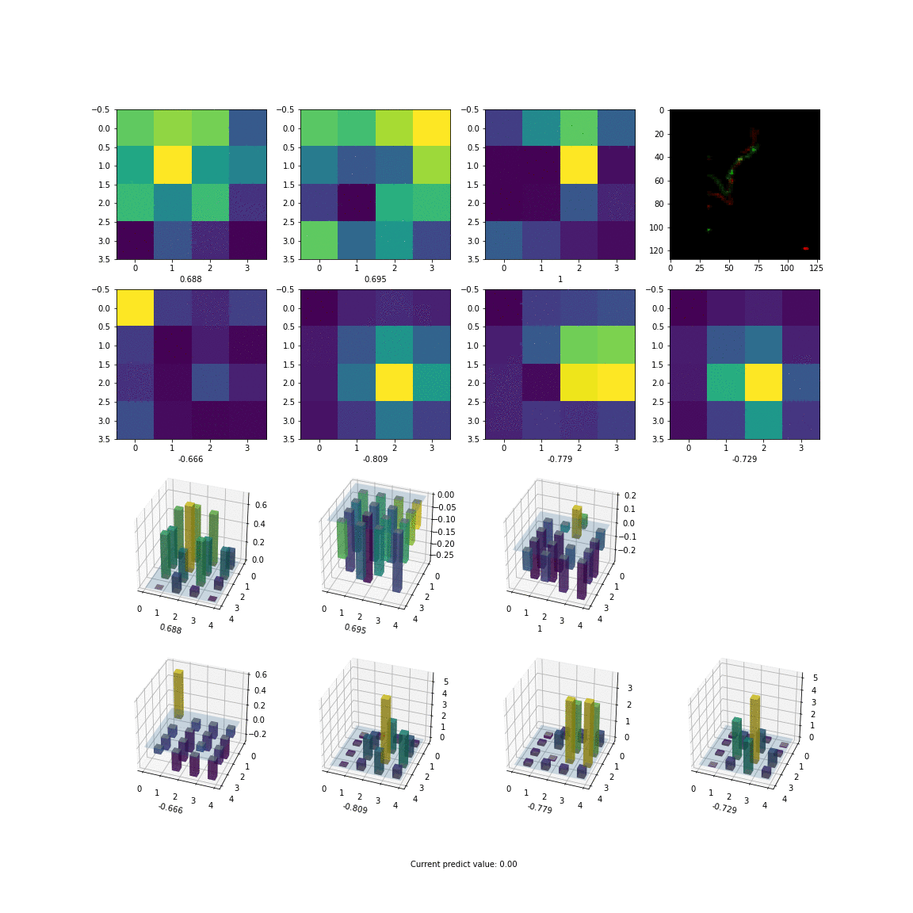
The evolution of the feature maps of the 7 filters according to predicted values.
General findings
Positive filters contribute to 0νββ events
Negative filters contribute to background events
Supplementary filters
Preliminary images
Current predict value:
14

Slide 15
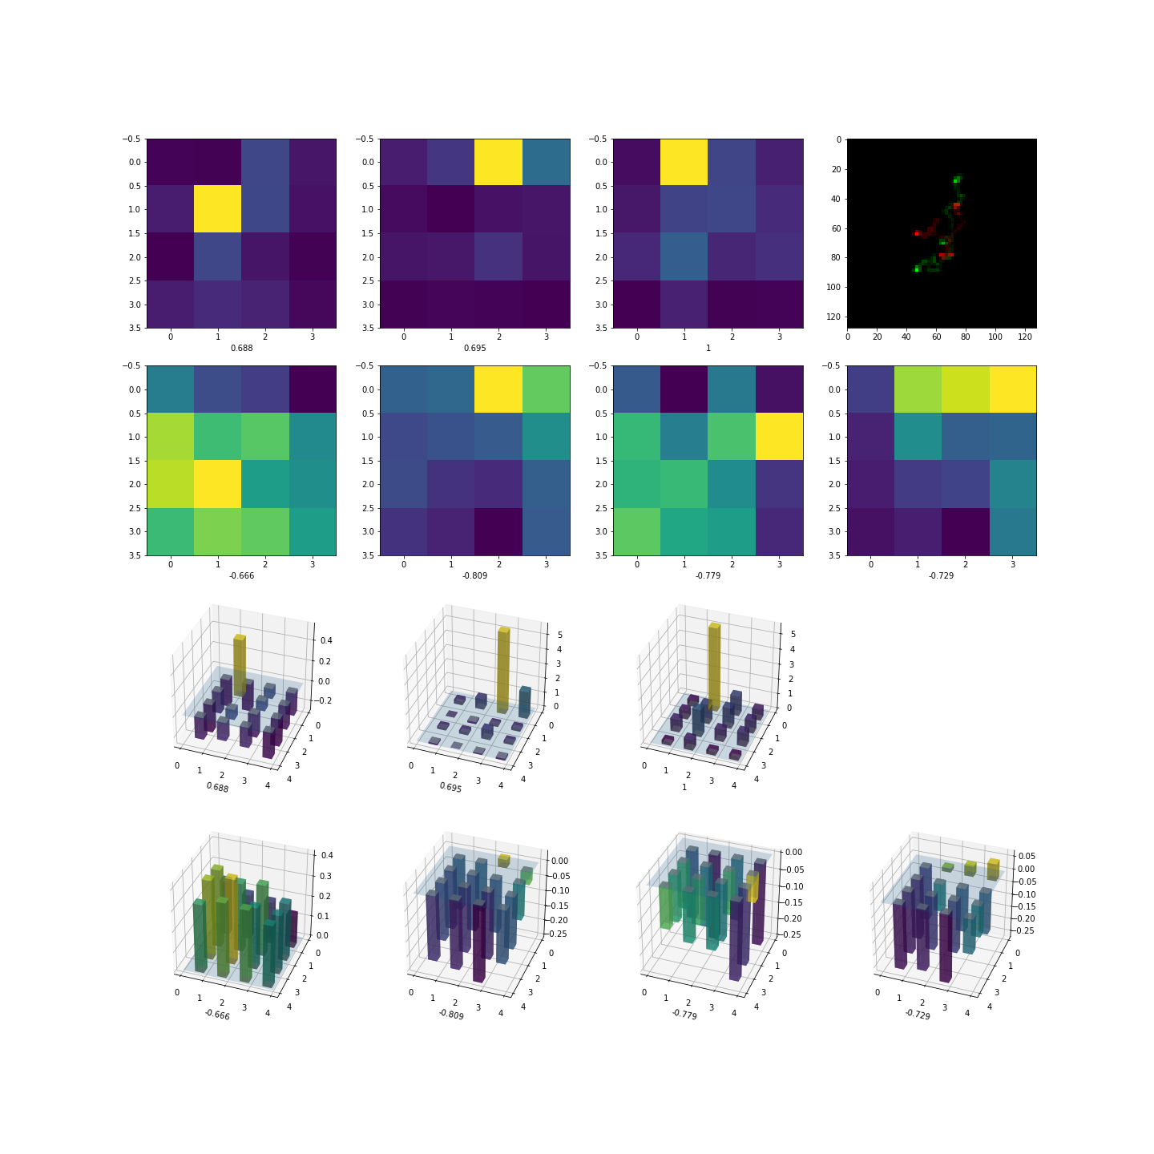
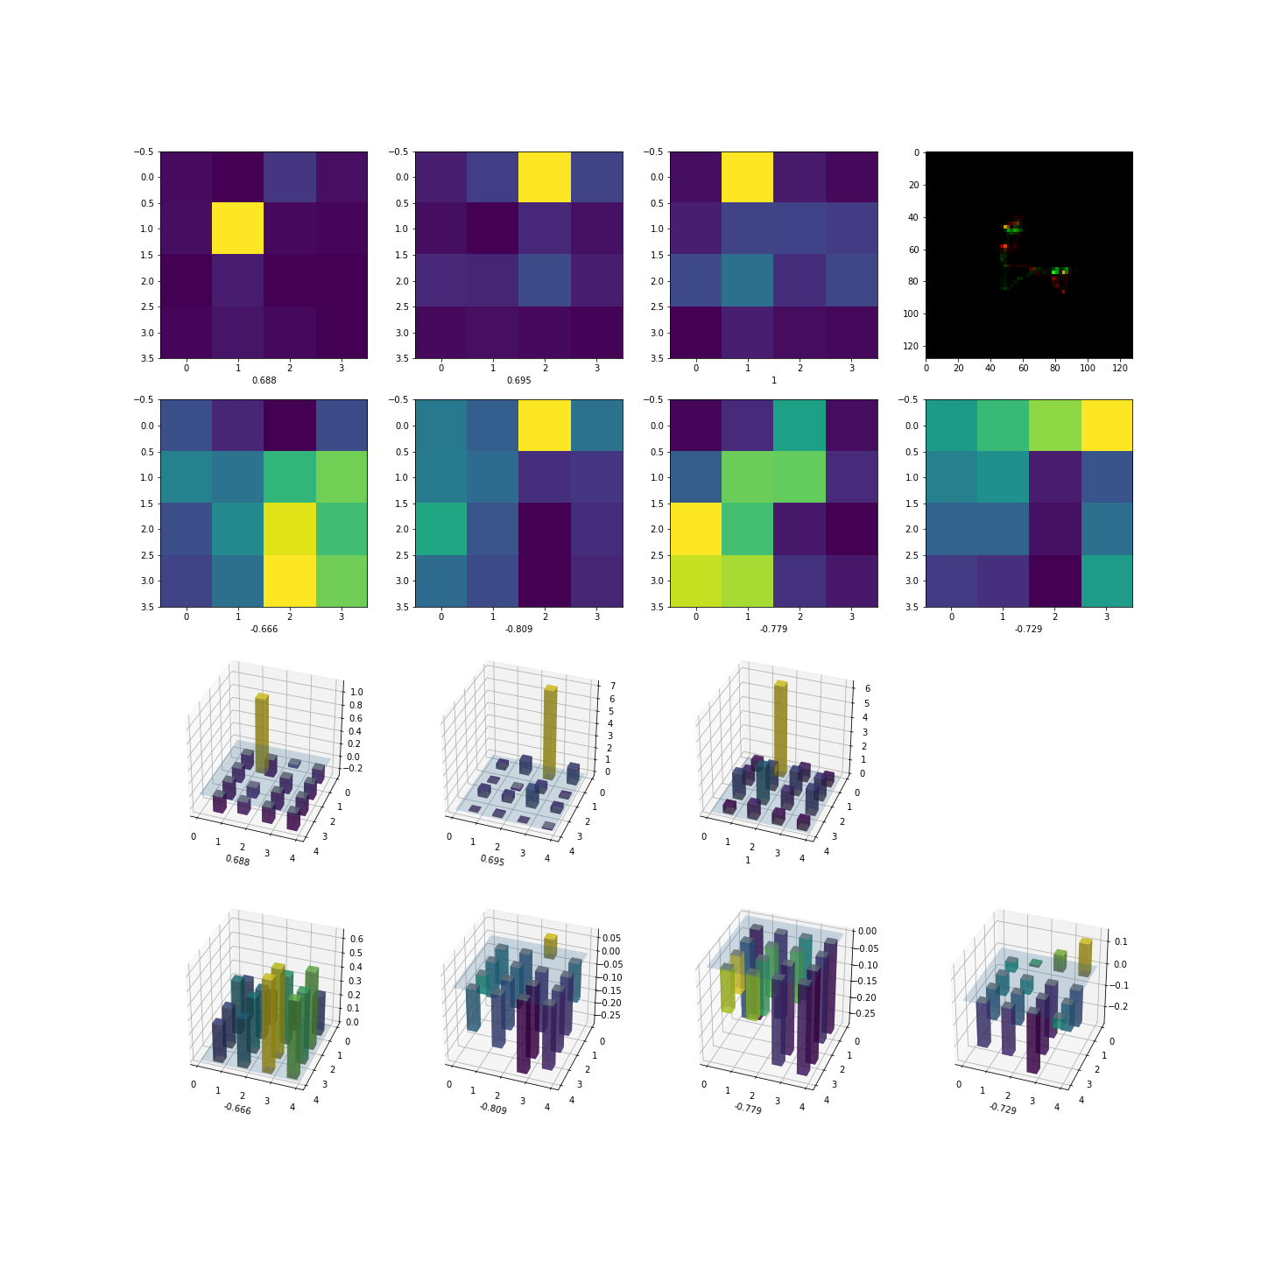
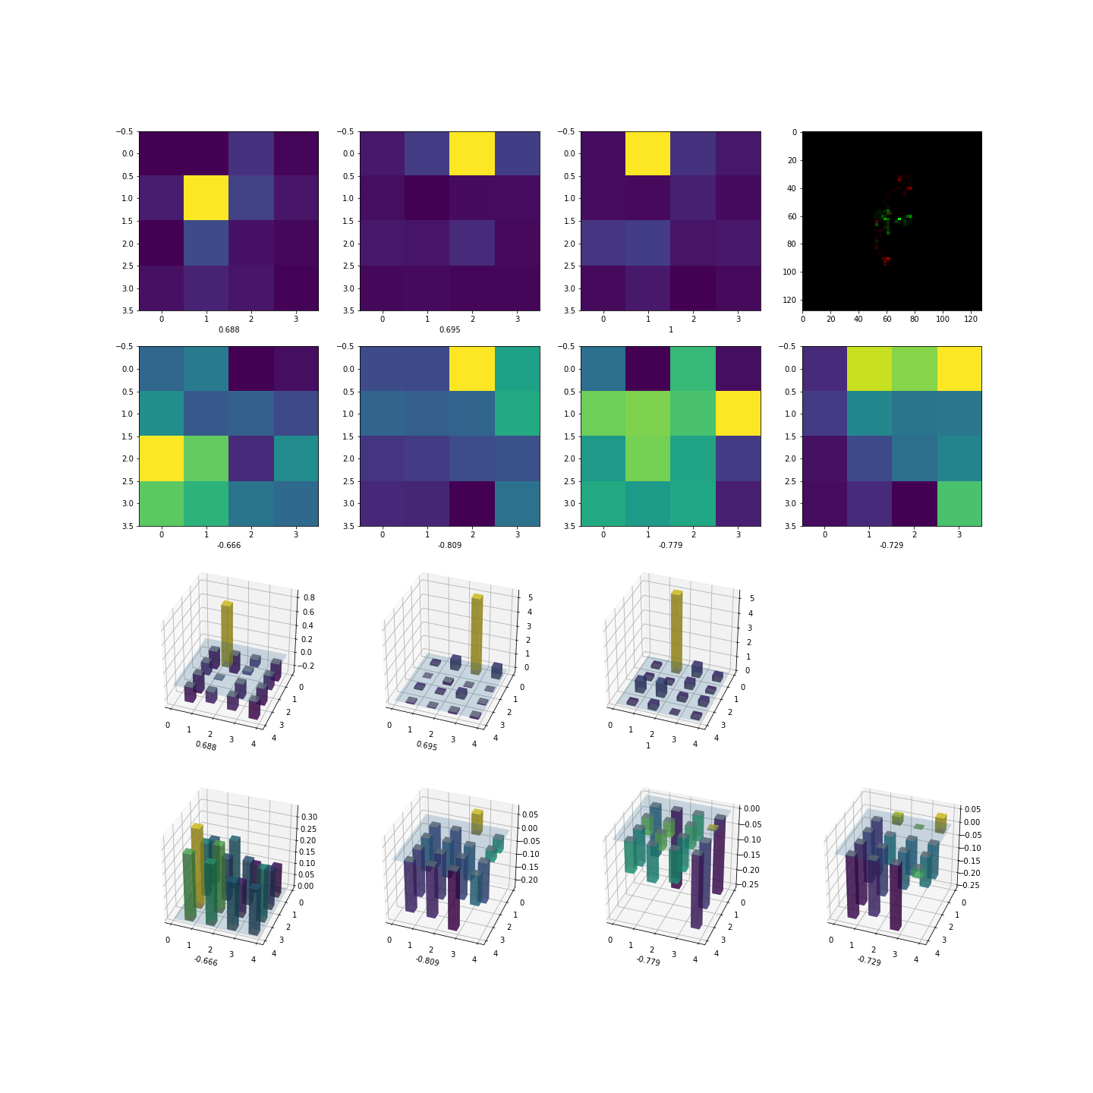
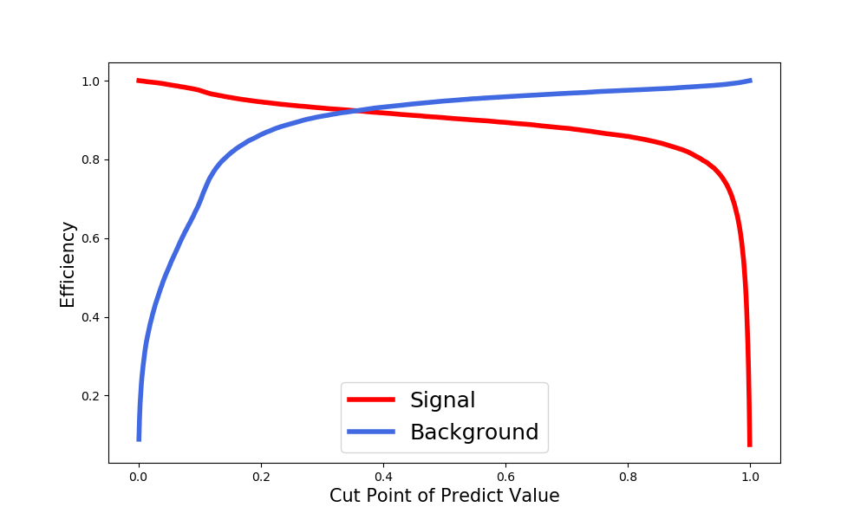
Patterns for 0νββ-like Events
Fixed maximum positions for positive filters.
The absolute values of maximum of negative filters are neglectable.
Predict value:
0.9941
Predict value:
0.998
Predict value:
0.9937
Preliminary images
15

Slide 16
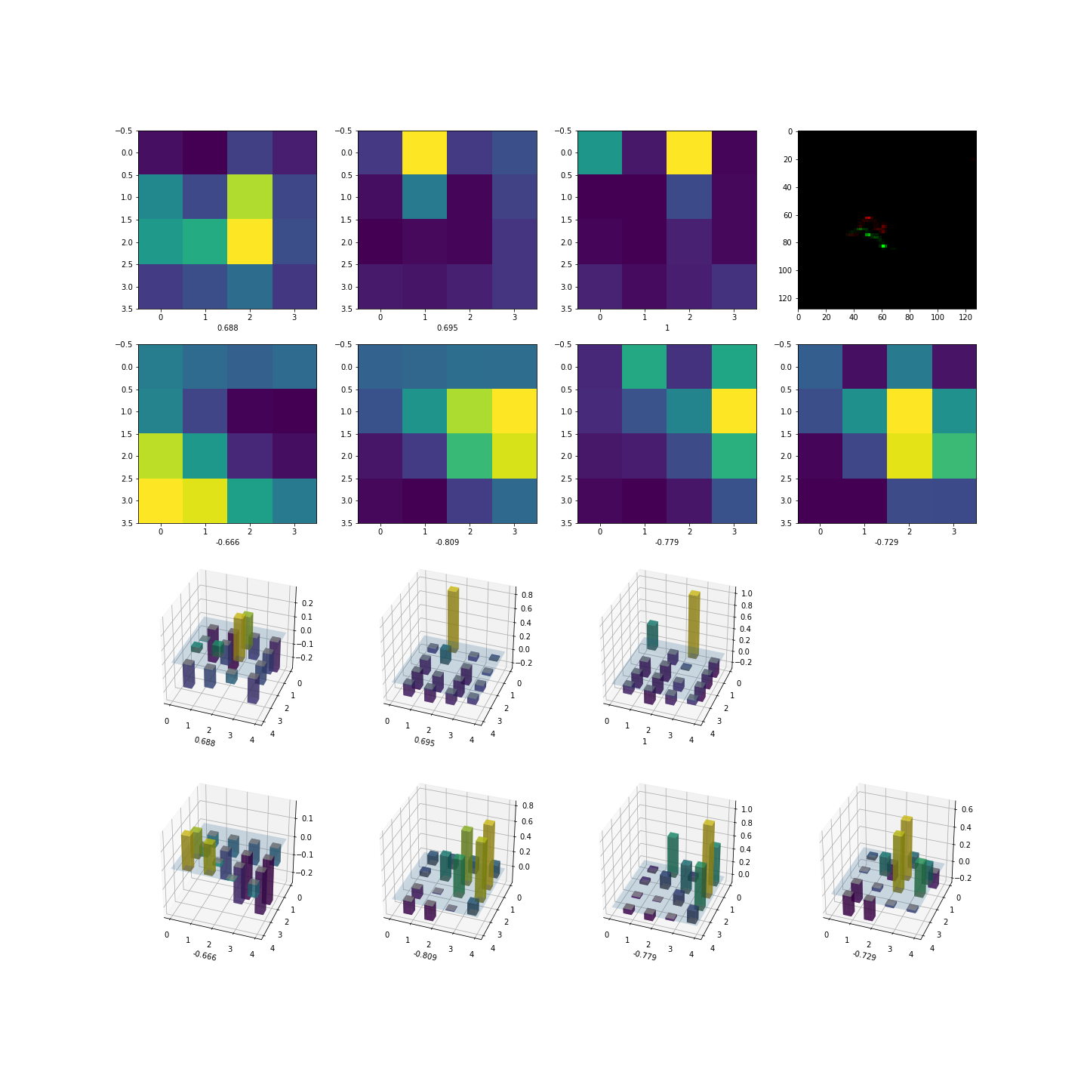
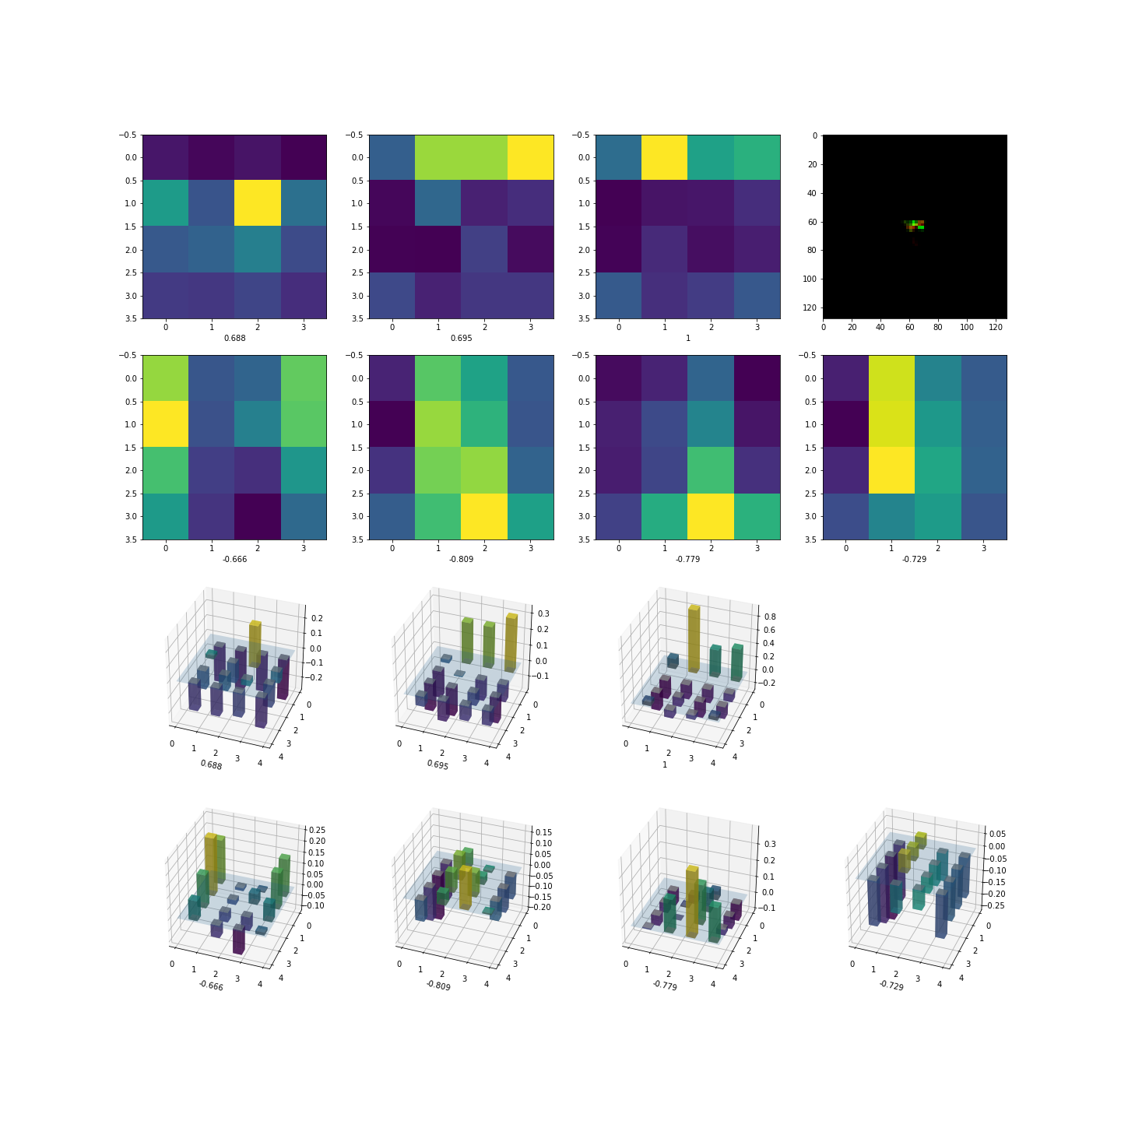
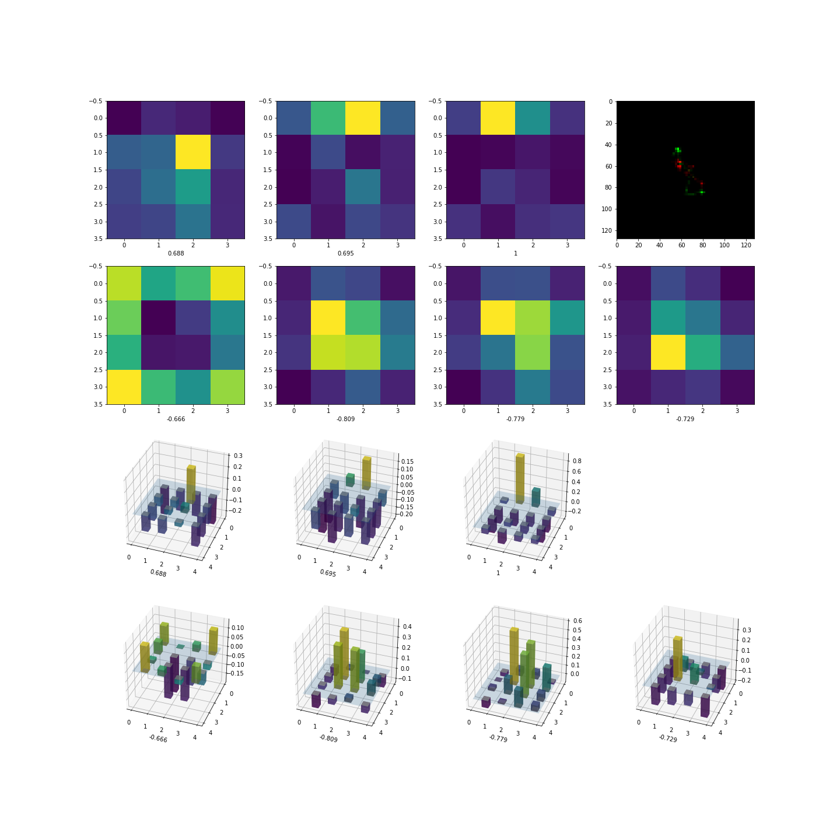
Patterns for Uncertain Events
The maximum positions are no longer fixed for both positive and negative filters.
The absolute values of maximum of positive and negative filters are comparable.
Predict value:
0.4314
Predict value:
0.5797
Predict value:
0.4842
Preliminary images
16

Slide 17
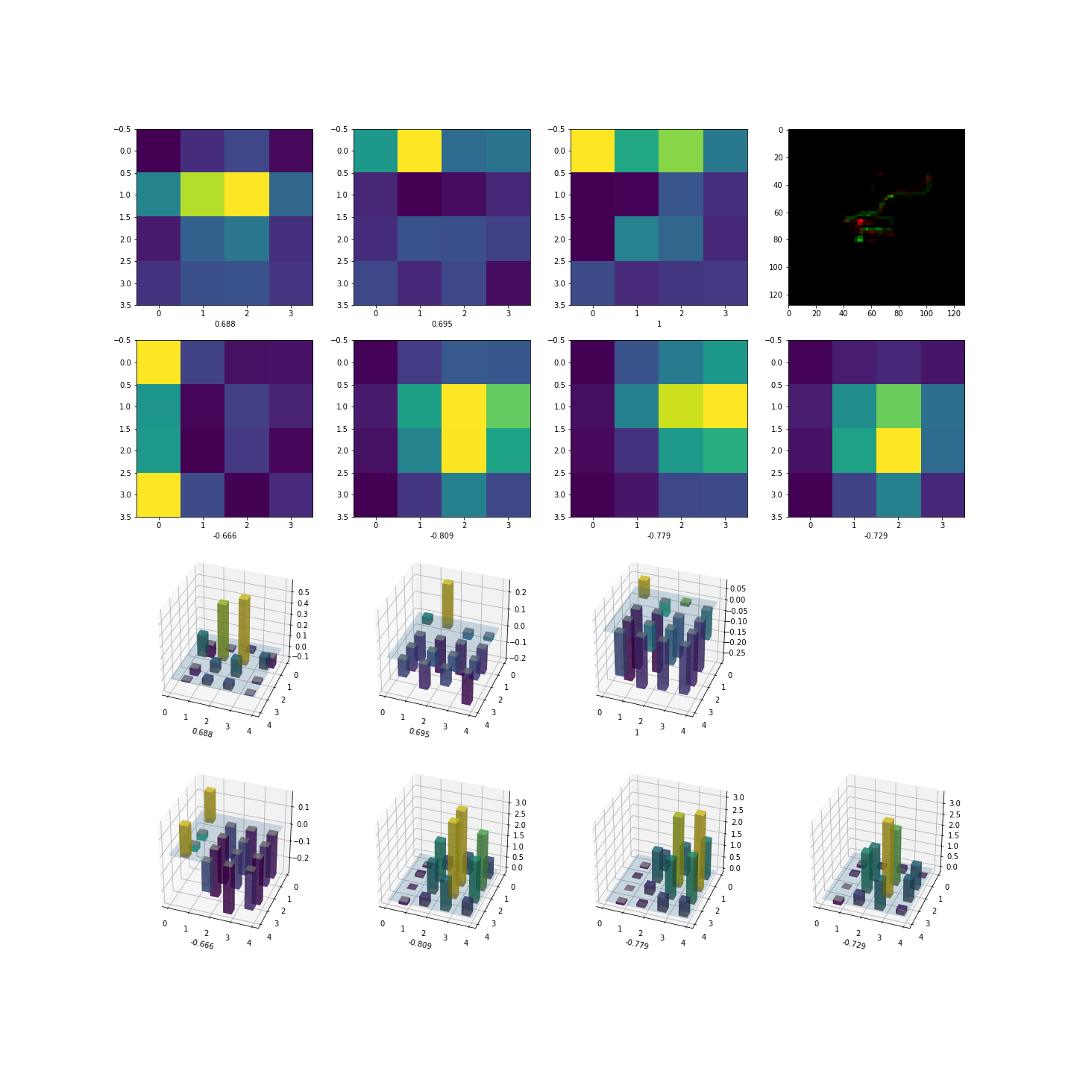
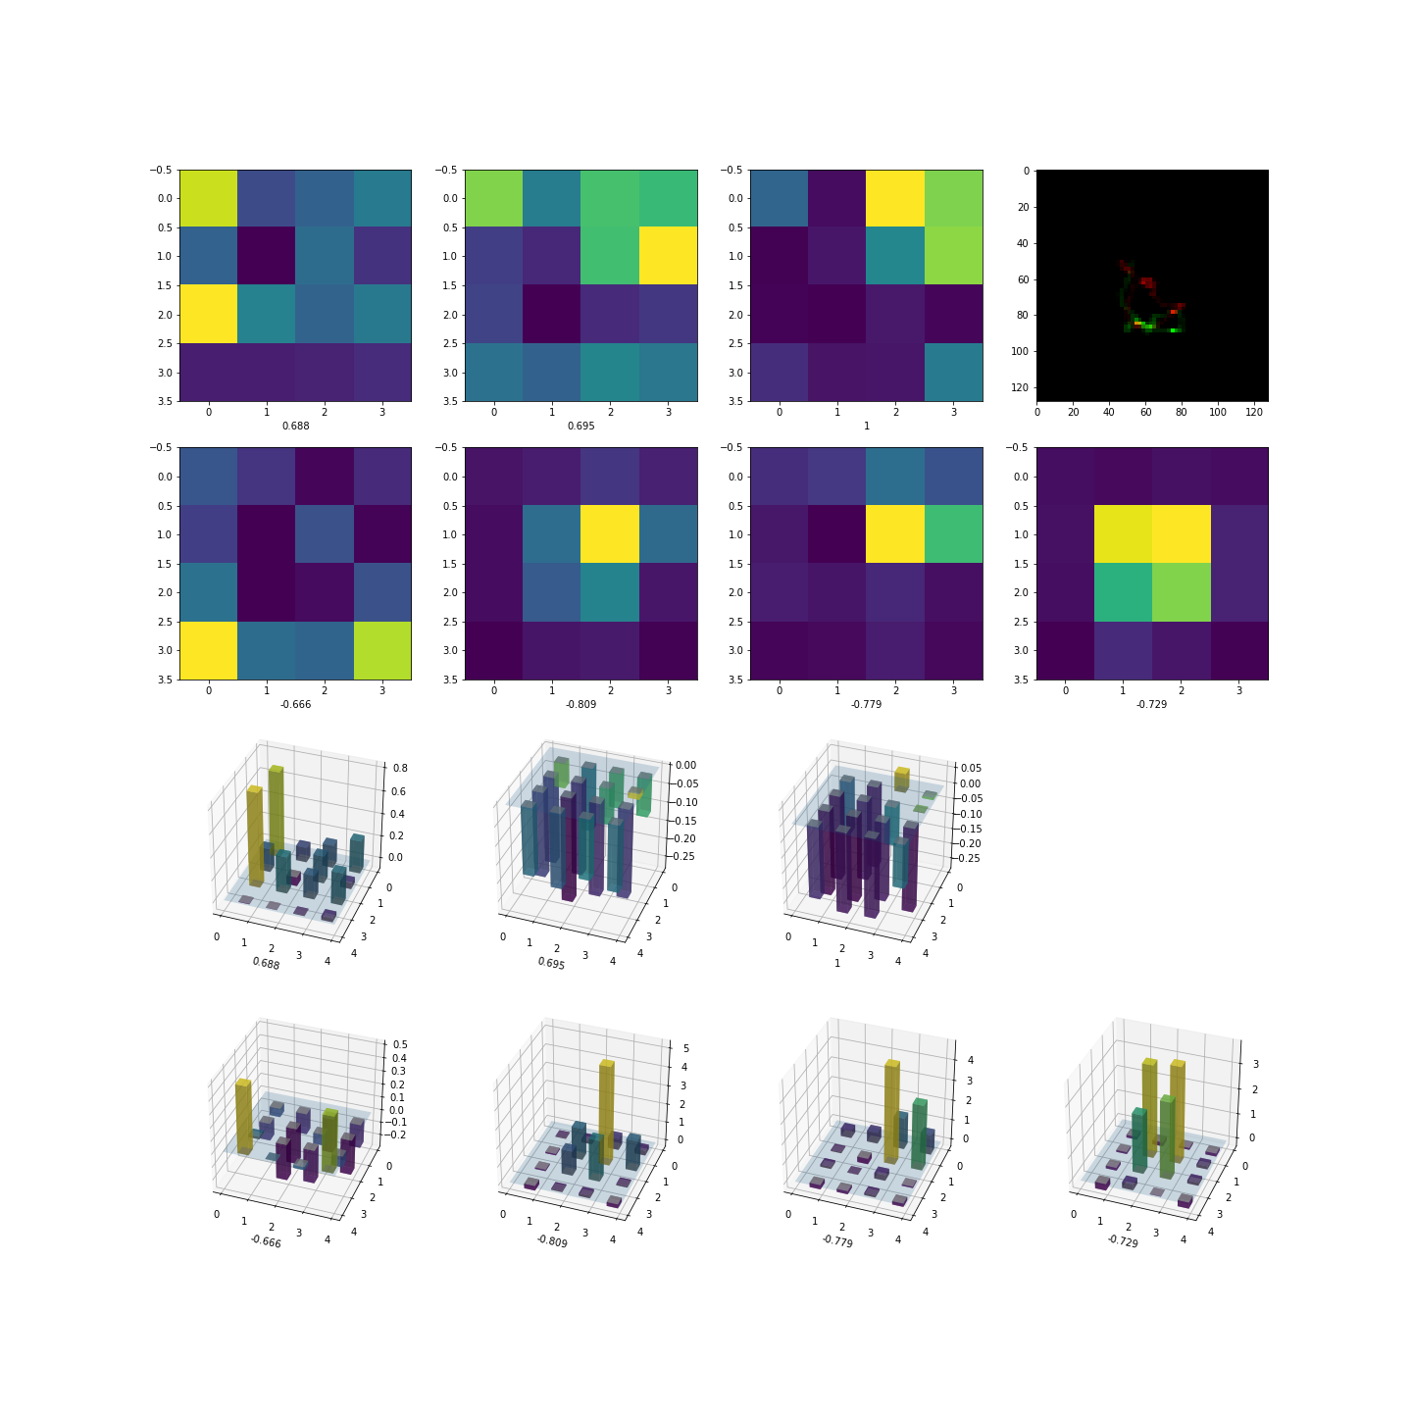
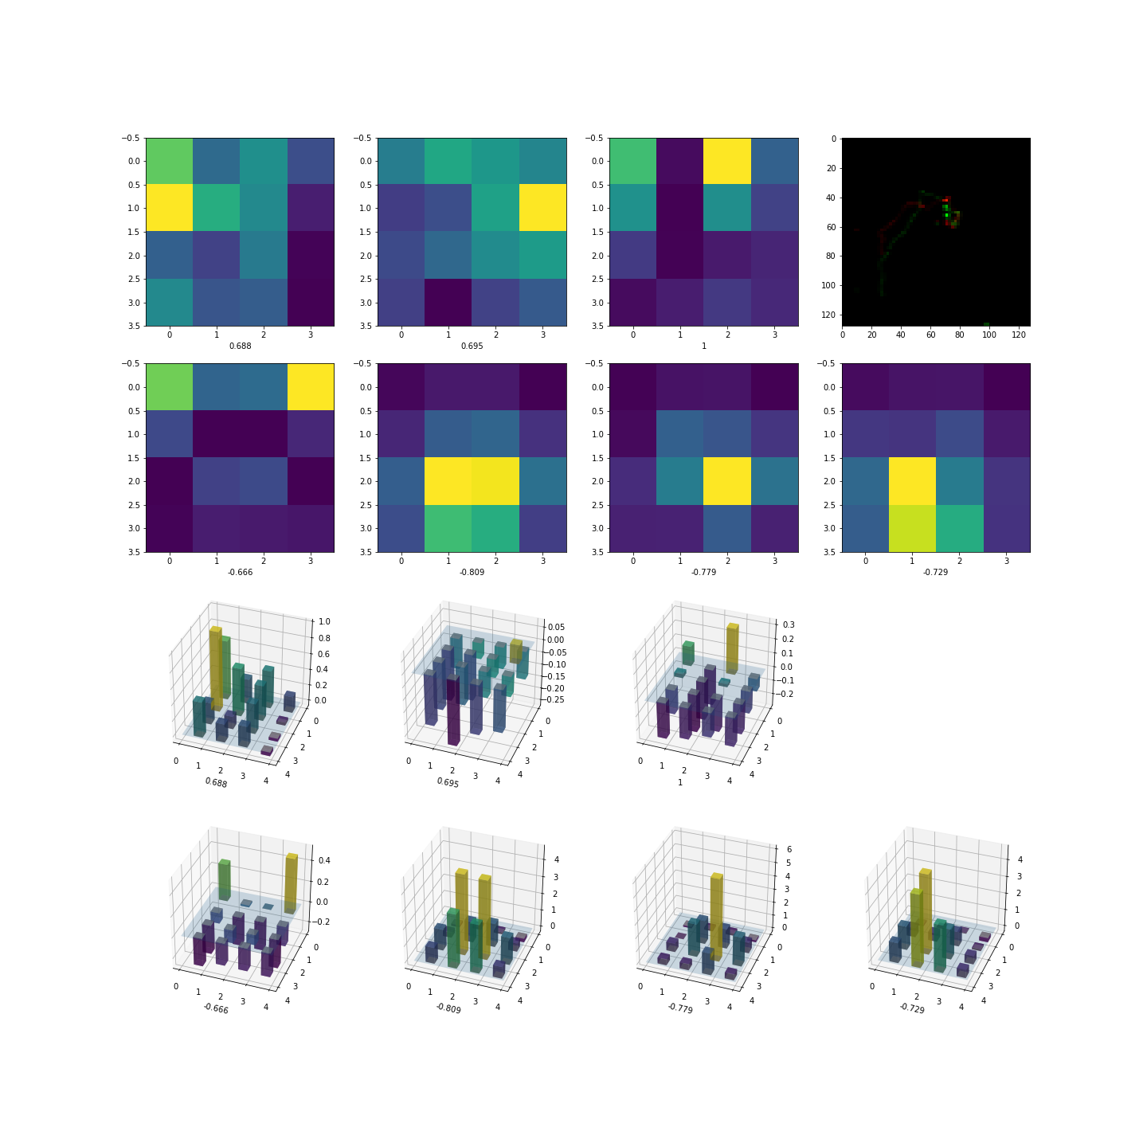
Patterns for Background-like Events
The maximum positions for negative filters are not fixed.
The absolute values of maximum of positive filters are neglectable.
Predict value:
0.013
Predict value:
0.0012
Predict value:
0.0008
Preliminary images
17

Slide 18
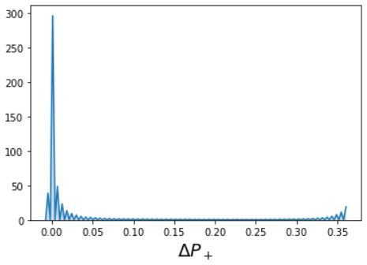
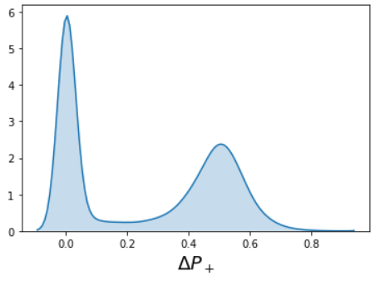
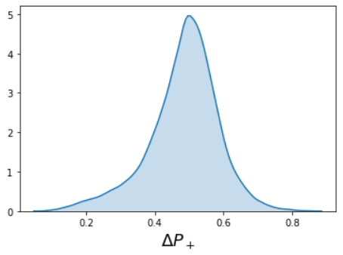
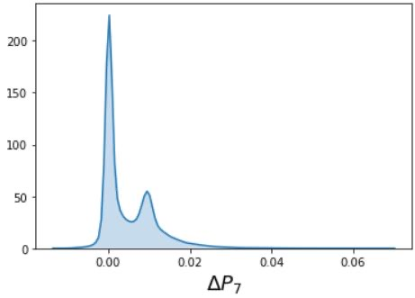
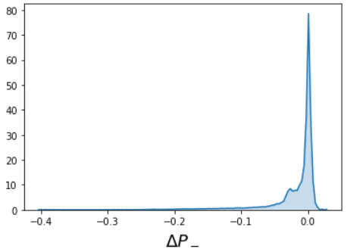
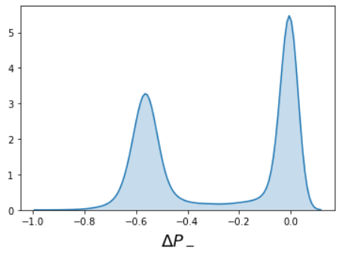
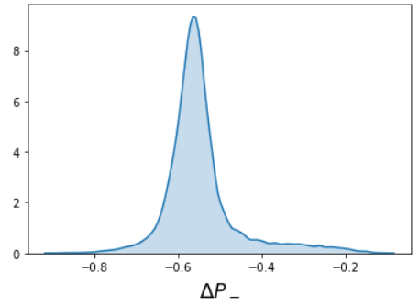
Analyzing of the distribution diagram of the error
Effective for 0νββ
Prediction formula
$predict value=sigmoid(\sum{Max\left(x_{i}\right)∗W_{i})}$
With 3 positive filters
0νββ
With 7 filters
 | $$ε_{s}/\sqrt{ε_{b}}$$ | $$ε_{s}$$ | $$ε_{b}$$
CDR | 3.816 | 0.645 | 0.0285
Resnet Published | 6.264 | 0.475 | 0.0057
$$Efficientnet$$ | 11.09 | 0.265 | 0.0006
Efficientnet with only 7 dominant filters | 10.81 | 0.334 | 0.00095
Background
Effective for background
With 4 negative filters
ΔP: Offset of prediction between selected filters and all 64 filters.
Background
0νββ
18

Slide 19
Summary
Trajectories of particles in PandaX-III play an important role in the classification of signal and background.
Using Efficientnet, we obtained a much better machine learning result comparing with our previous work.
Focusing on the study of features, first several layers extract superficial features while the 7 filters in the last layer indicate abstract features and contribute most to the classification of signal and background.
19

Slide 20
Back up

Slide 21
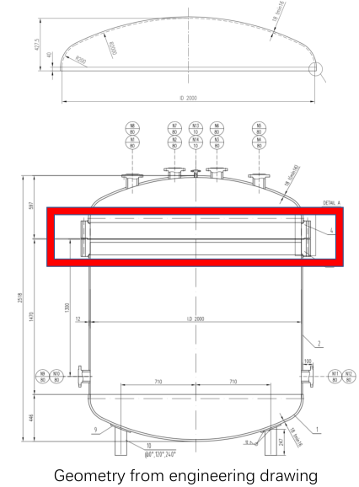
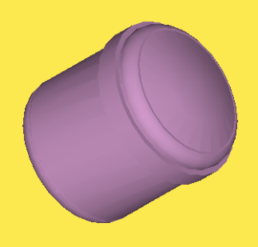
Appendix: Model Construction
Sensitive volume
Engineering design of the container
Representation of the container in Geant4
3D model
21

Slide 22
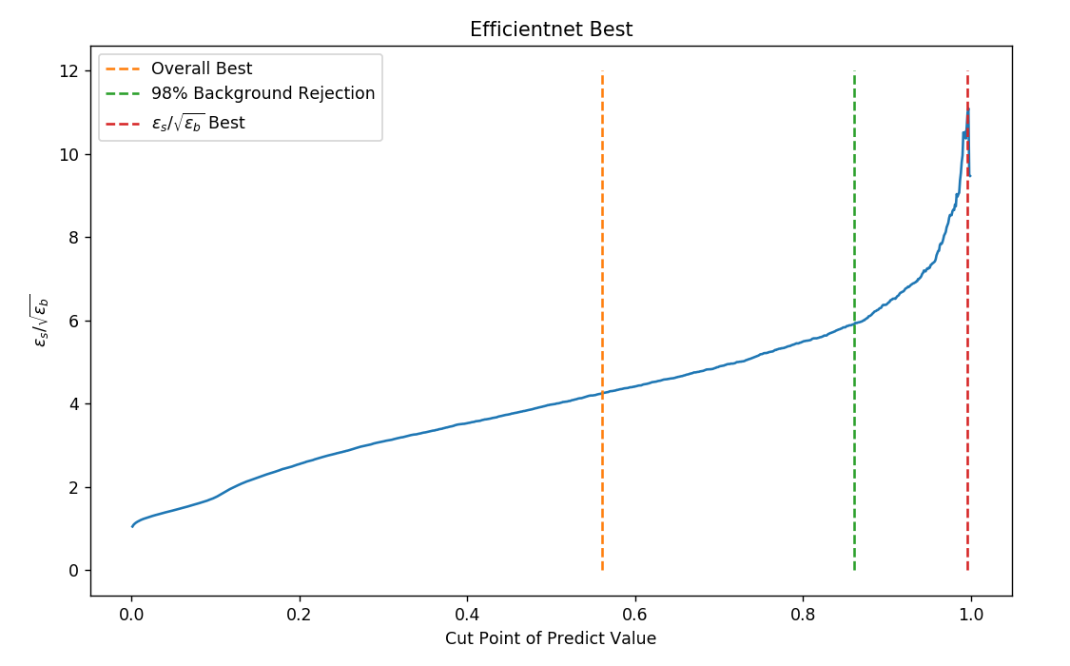
Appendix: Variation of Significance
22

Slide 23
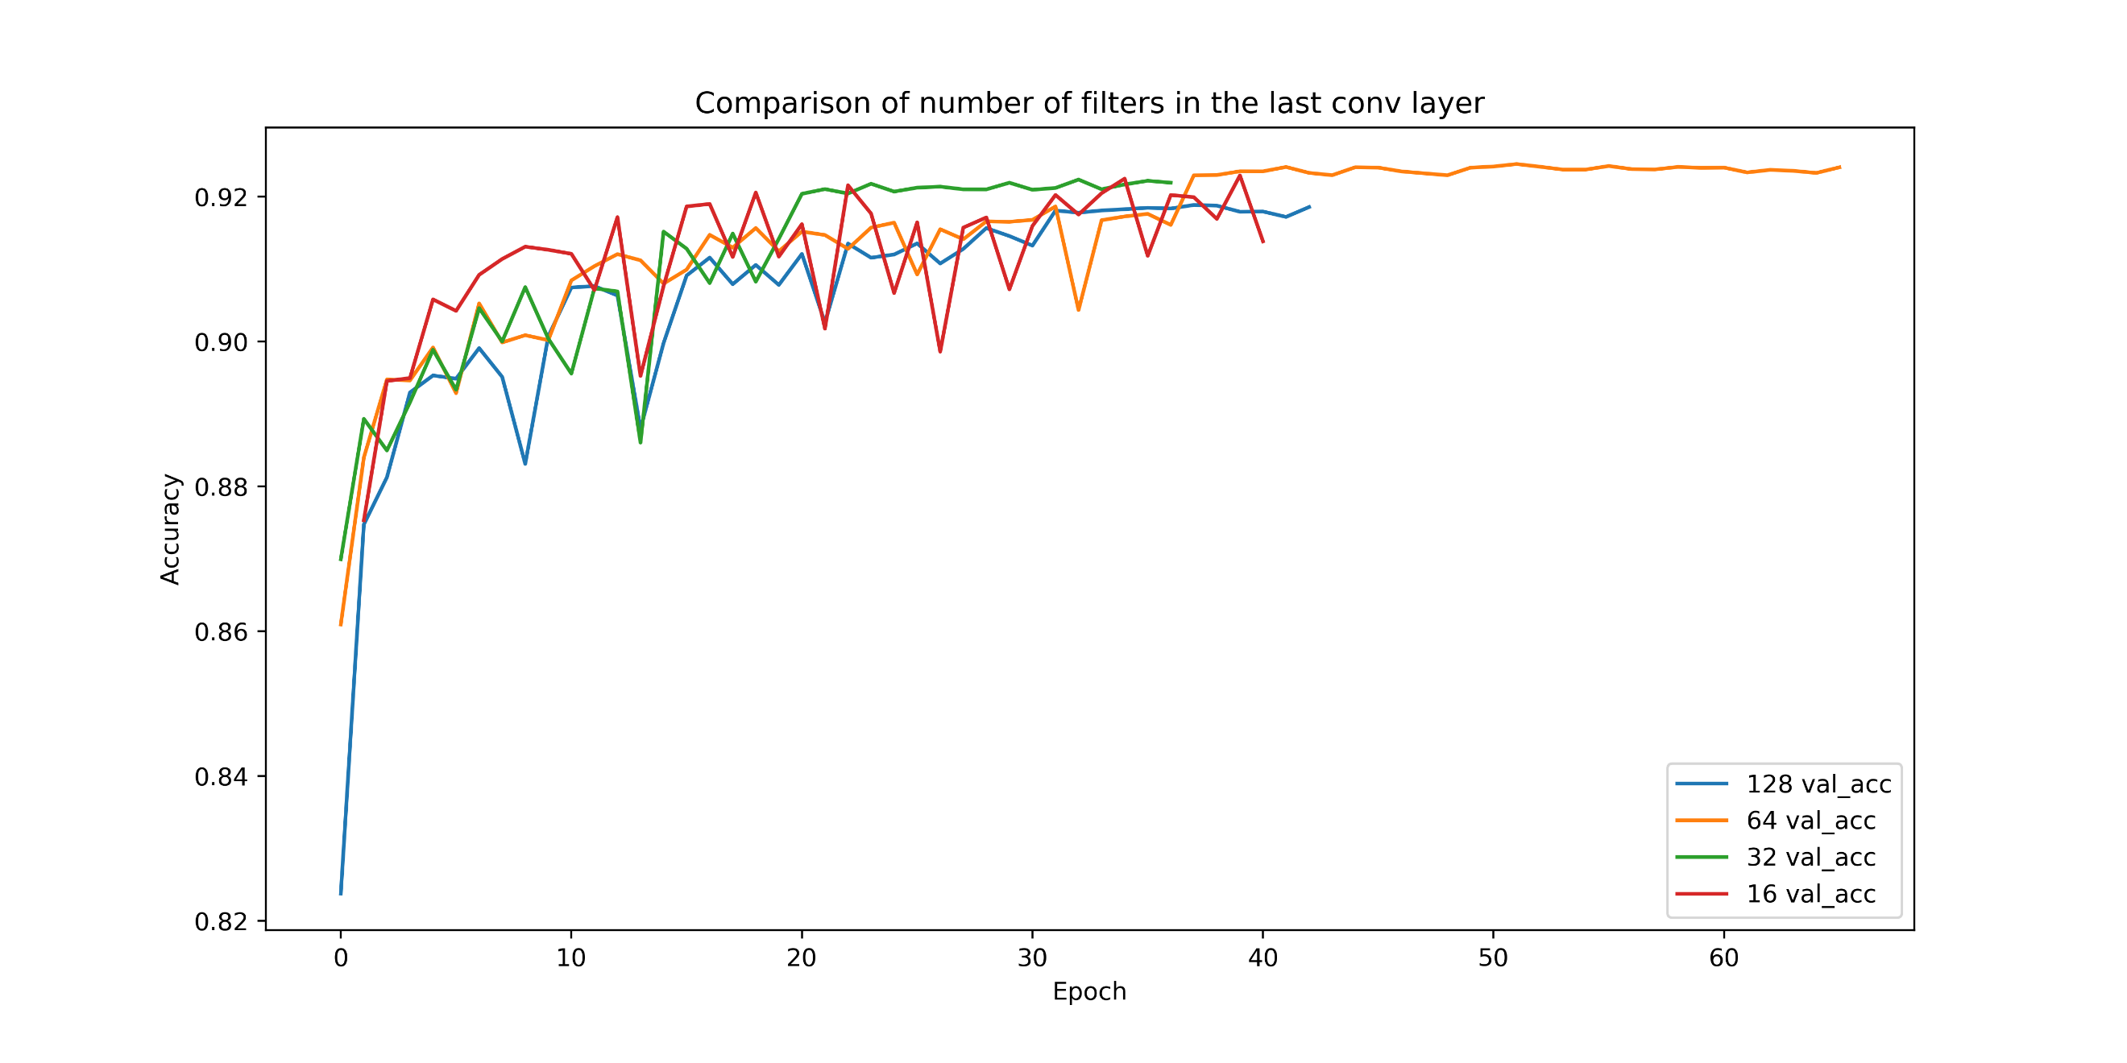
Appendix: Comparison of Performances
23

Slide 24
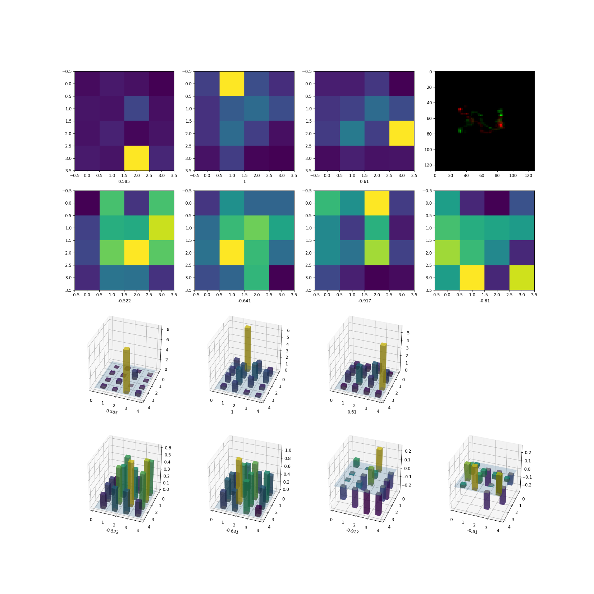
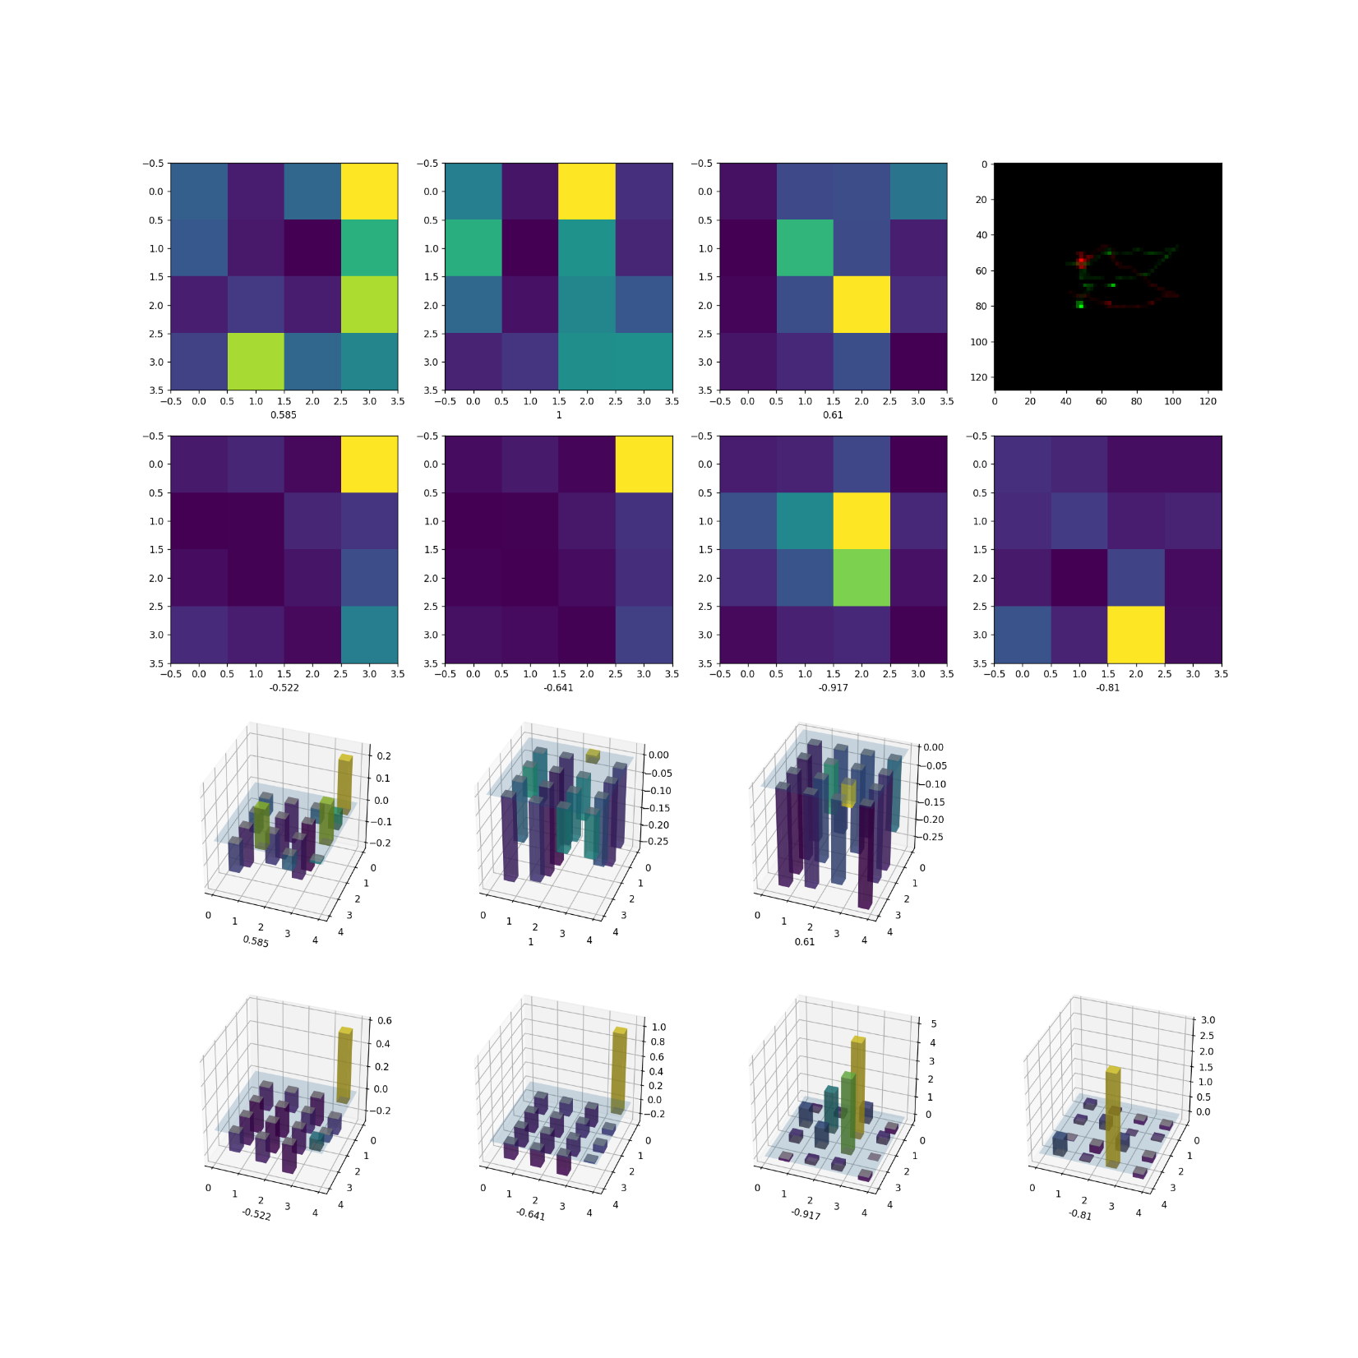
Appendix: Last Conv Layer with 16 Filters
background event
0νββ event
24

Slide 25
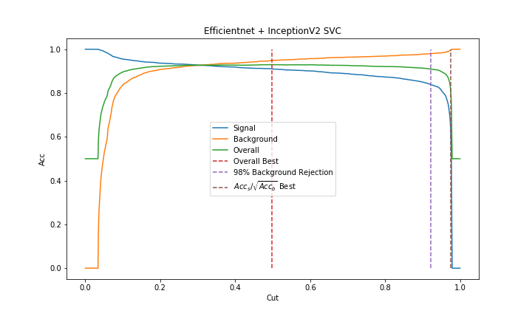
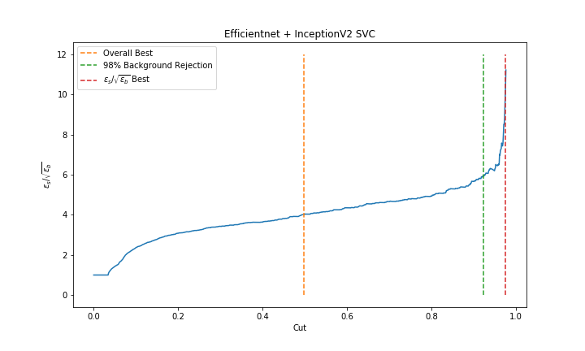
Appendix: Combination of Two networks
 | $$ε_{s}$$ | $$ε_{b}$$ | Accuracy | $$ε_{s}/\sqrt{ε_{b}}$$ | Cut Point
Overall | 89.89%→91.11% | 4.46%→5.08% | 92.71%→93.04% | 4.25→4.04 | 0.561→0.500
98% Background Subjection | 83.75%→83.72% | 2%→2% | 90.88%→90.96% | 5.94→5.96 | 0.861→0.923
$ε_{s}/\sqrt{ε_{b}}$ best | 26.51%→48.64% | 0.06%→0.29% | 62.23%→74.53% | 11.09→11.21 | 0.997→0.976
193.8% higher than CDR，81.7% higher than previous work.
25

